Slide 1



Monday 28th September 2026
28.09.26
Morning Challenge
Solve in your morning challenge books:
347 + 58 = ___
682 + 47 = ___
519 + 86 = ___
234 + 79 = ___
758 + 35 = ___
421 − 68 = ___
603 − 47 = ___
875 − 59 = ___
340 − 82 = ___
726 − 38 = ___
Show your workings using partitioning or column method.

Slide 2
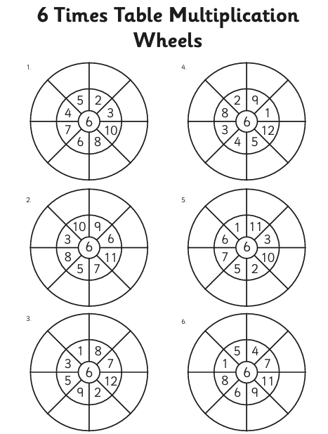
28.09.26​
Times tables

Slide 3
28.09.26
TBAT: tell and write the time on an analogue clock.
3 in 3
3 x 32 =
7 x 6 =
526 + 184 =
Challenge: Half the answer to Question 3.

Slide 4
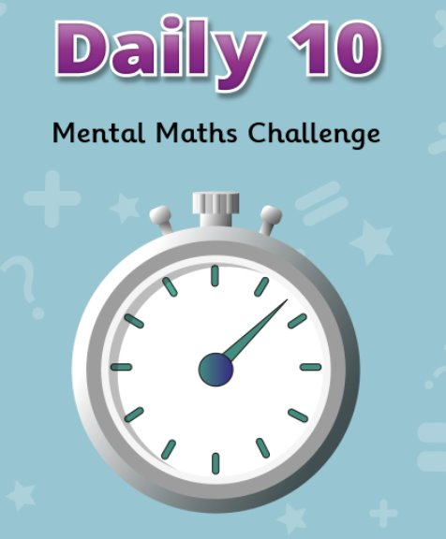
28.09.26
TBAT: tell and write the time on an analogue clock.
Daily 10 - Mental Maths Challenge - Topmarks
Level 4- 6 times tables
Key Vocabulary
analogue
hour
minute
half past
quarter past
quarter to

Slide 5
Partner talk
_____ seconds in a minute
_____ minutes in an hour
_____ hours in a day
_____ days in a year

Slide 6
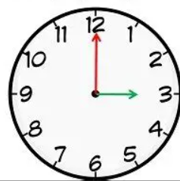
This is an analogue clock
The minute hand
(LONG HAND)
The hour hand
(SHORT HAND)

Slide 7

Minute hand
When the minute hand points to 12,
it means "o'clock"
Hour hand
What is the time on the clock?

Slide 8
Minute hand
When the minute hand points to 12,
it means "o'clock"
Hour hand
What is the time on the clock?

Slide 9
On your clocks, show 4 o'clock

Slide 10
On your clocks, show 11 o'clock
Challenge: How many minutes until Quarter to 12?

Slide 11
Hour hand
When the minute hand points to the 6,
it means "half past"
Minute hand
What is the time on the clock?

Slide 12
On your clocks, show half past 2
Challenge: How many minutes until Quarter past 3?

Slide 13
On your clocks, show half past 6
Challenge: How many minutes until ten past 7?

Slide 14
When the minute hand points to the 3,
it means "quarter past"
Hour hand
Minute hand
What is the time on the clock?

Slide 15
On your clocks, show quarter past 4
Challenge: How many minutes until Quarter to 5?

Slide 16
On your clocks, show quarter past 8
Challenge: How many hours until quarter past 11?

Slide 17
When the minute hand points to the 9,
it means "quarter to"
Minute hand
Hour hand
What is the time on the clock?

Slide 18
On your clocks, show quarter to 8
Challenge: How many minutes until Quarter past 8?

Slide 19
On your clocks, show quarter to 10
Challenge: How many minutes until half past 10?

Slide 20
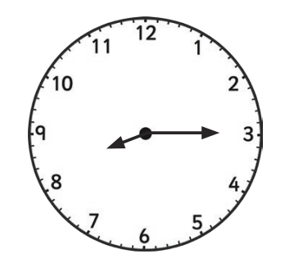
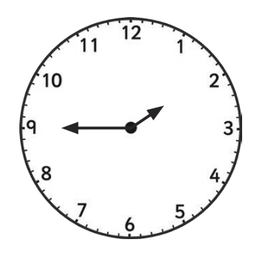
Independent
Answer the following questions in your book.
What time is shown on the clocks?
Blue Green
Challenge- True or false: there are 100 minutes in 2 hours.

Slide 21
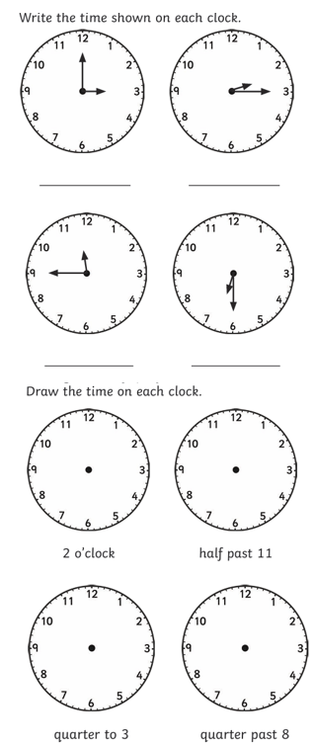
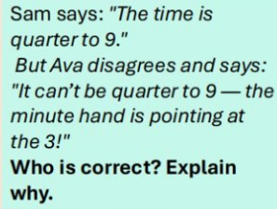
RP: Lena says the shorter hand on the clock tells us the minutes. Is she correct?
Independent
Challenge

Slide 22
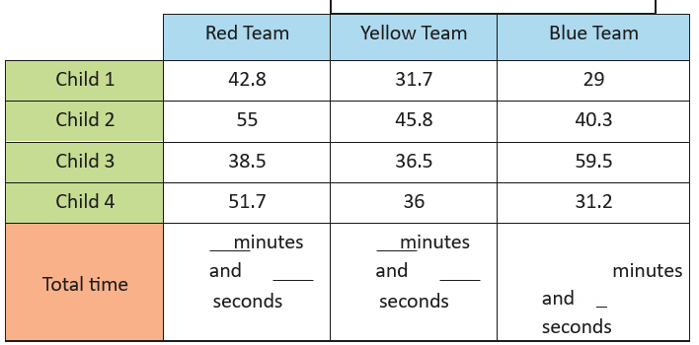
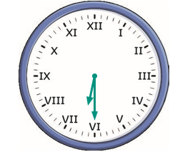
Greater Depth Mastery
Which team ran the fastest relay race?
2) Which team was the slowest?
Mastery Challenge
The party started at the time shown on the clock. It lasted for 1 hour and 45 minutes. What time did it end?

Slide 23
Monday 28th September 2026
Spelling rule
Adding the prefix il- (before a root word staring with ‘l’) &
the prefix ir- (before a root word staring with ‘r’)
A prefix is a group of letters added to the beginning of a word to change its meaning.
For example, the prefix il- and the prefix ir- mean not
legal – illegal (not legal)
regular - irregular (not regular)
Talk partners
Can you think of any words that have the prefix im- at the start?

Slide 24
Word definitions
illegal – not allowed by the law.
illegible – so messy or unclear that it cannot be read.
illogical – not sensible or reasonable.
illiterate – unable to read or write.
illicit – not allowed because it is against the rules or the law.
irregular – not following a usual pattern or rule.
irrelevant – not connected to what is being talked about.
irresponsible – not acting carefully or not taking proper care.
irrational – not sensible or based on clear thinking.

Slide 25
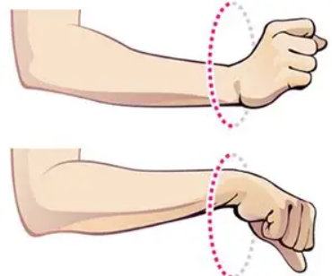
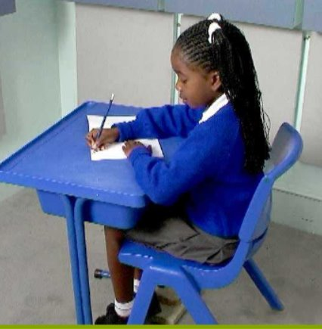
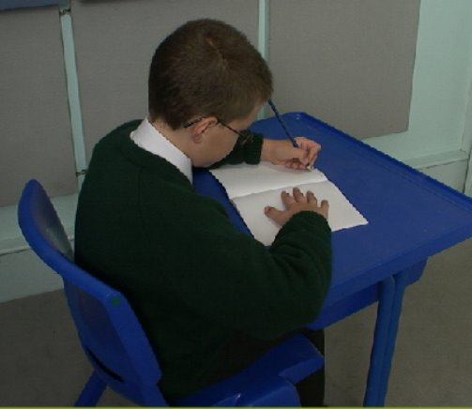
Handwriting​
Warm up – fine warm up – rotating wrists
Posture – are you sitting reading to write?
Write each word twice using joined letters in your handwriting book.
Right-handed posture
Left-handed ​posture

Slide 26

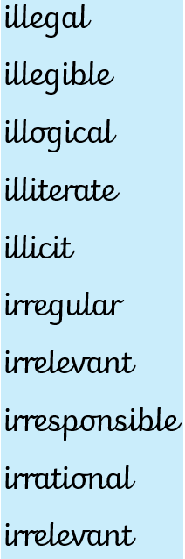

Slide 27
Monday 28th September 2026
TBAT: predict and infer information from a text.
3 in 3
Newspaper Report (with indirect speech)
Jack and Rose’s mother told reporters that she had been searching for the children since early afternoon, after they failed to return from their walk near the old tunnel. She explained that the pair had said they only wanted to explore the area for a few minutes but they never came back. She added that neighbours had mentioned seeing the children step inside the tunnel earlier, which made her even more worried about where they might be now.
What did the mother say the children told her before they left?
2) What had neighbours mentioned they saw?
3)What did the mother say she had been doing since the children didn’t return?
Challenge- Write your own sentence using indirect speech to show what the mother said or explained about Jack and Rose.

Slide 28


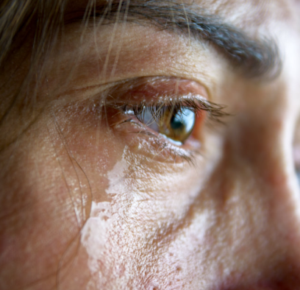
Monday 28th September 2026
TBAT: predict and infer information from a text.
Vocabulary/phrases in the text
'She threw her arms around'- She put her arms around Jack to hug him.
'Setting the table'- Getting the table ready by putting out plates, cups, and cutlery.
'wept'- Cried

Slide 29
Monday 28th September 2026
TBAT: predict and infer information from a text.
Multiple choice
Why was Rose crying?
She missed her mum she feared the tunnel She wanted her brother back
2. The mother said, "You two seem very ______."
happy quiet excited strange
3. Wept is a synonym for
Cried laughed cheered
Read pages 20-end

Slide 30
Independent – Remember to answer in full sentences
Why does Rose hug her brother? (p21) Rose hugs her brother _______________
What time do you think Jack and Rose returned home? (p23) I think Jack and Rose returned at ______________ because the text says '______________'
Why do you think Jack and Rose became closer? I think Jack and Rose became closer because ______________________
4) Predict what would happen if mum found out the truth about where they had been. I predict that if the mum knew where they had gone, _____________________
5) Why do you think Jack and Rose were both quiet when they returned home? I think Jack and Rose were quiet when returning home because ___________
Challenge:
Why might the name 'Rose' be significant to her character?
Summarise the whole story in 30 words or less.

Slide 31
Monday 28th September 2026
Q – What are the changes to the UK's population?
3 in 3
Migration is when people move from one country to another to live. Emigration means leaving your home country, while immigration means arriving in a new country. Many people have migrated to the UK over time for reasons such as work, safety, or to be with family. This has caused the UK population to increase and become more diverse, with people bringing new cultures, skills, and traditions.
What does emigration mean?
Emigration means ________________________
2) What does immigration mean?
Immigration means _____________________
3) Write and finish the sentence: Due to migration, the population has ______________________(increased / decreased)

Slide 32
Monday 28th September 2026​
Q – What are the changes to the UK's population?​
Blue – What is a push factor?
Green – What is a pull factor?
Challenge – Would you like to move to a different country? Yes/no and why.

Slide 33
census
A census is the official collection of data about a whole population.
data
Data is a collection of information that can be analysed to help us answer a question.
inhabitants
Inhabitants are the people who live in a defined area.
population
The population is the total number of people living in a particular area.

Slide 34
How do we find out about the UK's population?
What do you think the population is in the UK?
What about the population in London?
68.75 million
9.09 million

Slide 35
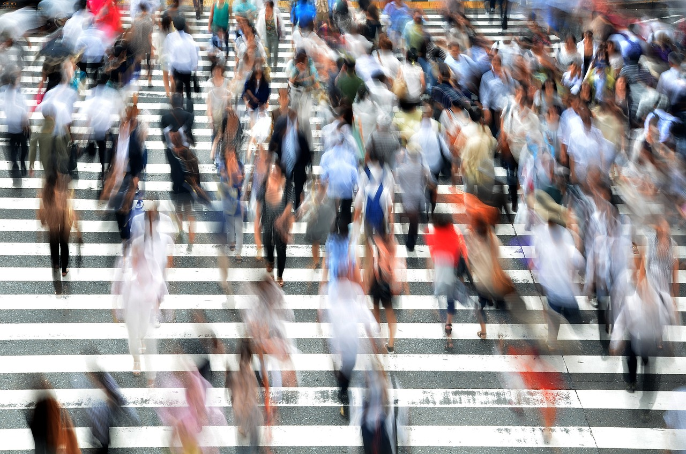
How do we find out about the UK's population?
A census is an official count of the inhabitants of an area.
It is carried out every ten years. The most recent census took place in 2021.
There are quite a lot of questions on the census.
Data is collected from each household.
Everyone in the family has to be added, and it is against the law to lie on the form.

Slide 36

How do we find out about the UK's population?
The census is carried out on a particular date.
Everyone has to say where they lived on that date.
The census in 2021 took place on the 21st March 2021.
This would have been the first time you appeared on a census if you were born after 2011.

Slide 37
How do we find out about the UK's population?
It usually collects information such as:
how many people live in the country
people’s age
where people live
people’s jobs
languages spoken
country of birth
household information (who lives together)

Slide 38
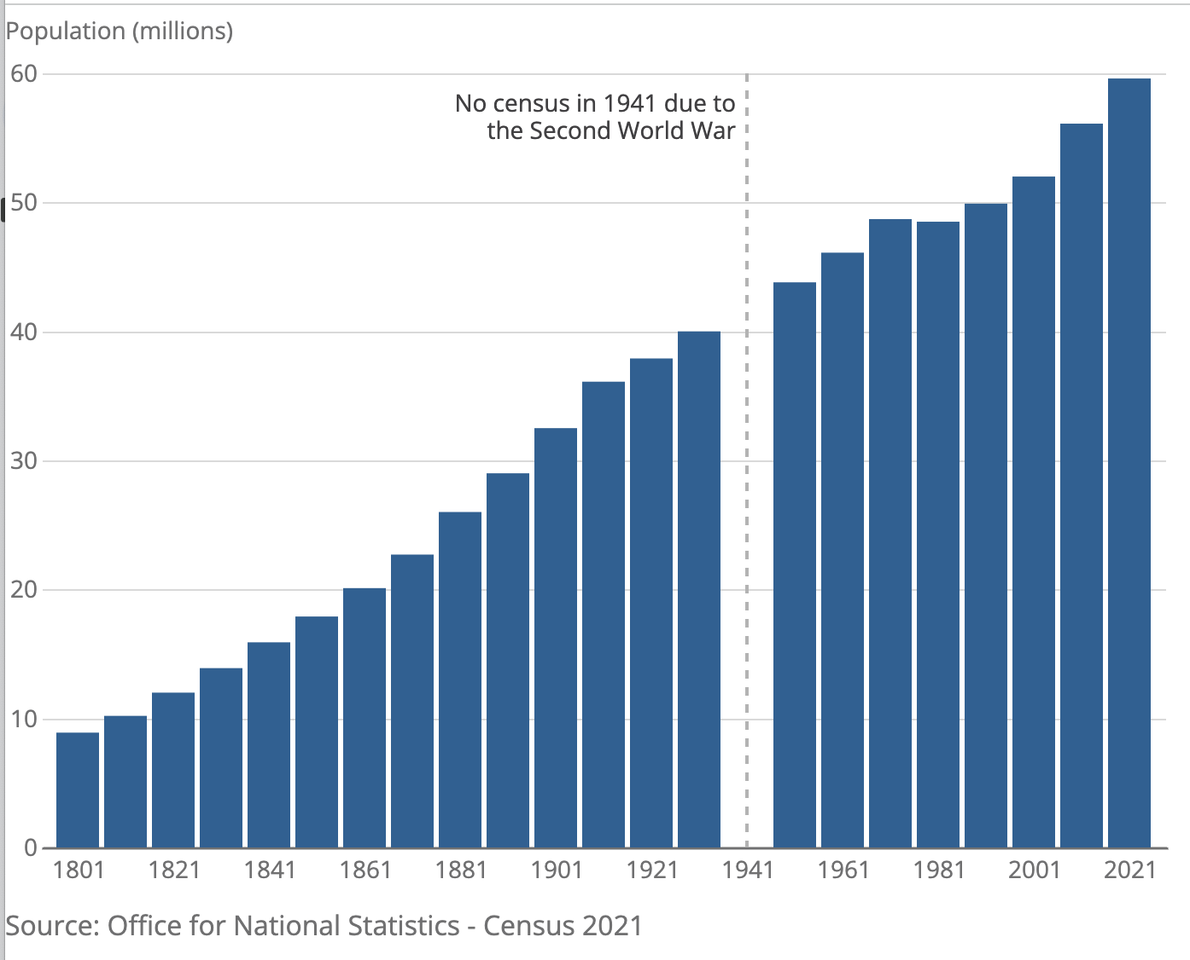
How do we find out about the UK's population?
The census tells us how the population is changing.
The graph shows how the population of the UK has increased since 1801. This is using data from each census.
Office for National Statistics – Census 2021, licensed under the Open Government Licence v3.0

Slide 39
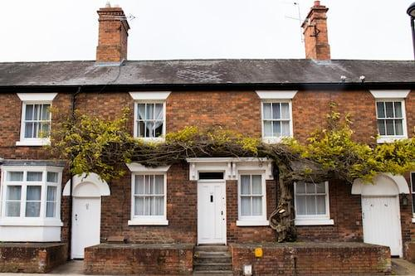
How do we find out about the UK's population?
Over ten years, we might expect some changes to the population:
The number of inhabitants will have risen.
There are likely to be more older people in the population.
Some people will have moved house: some into the countryside and others will have moved into cities.

Slide 40
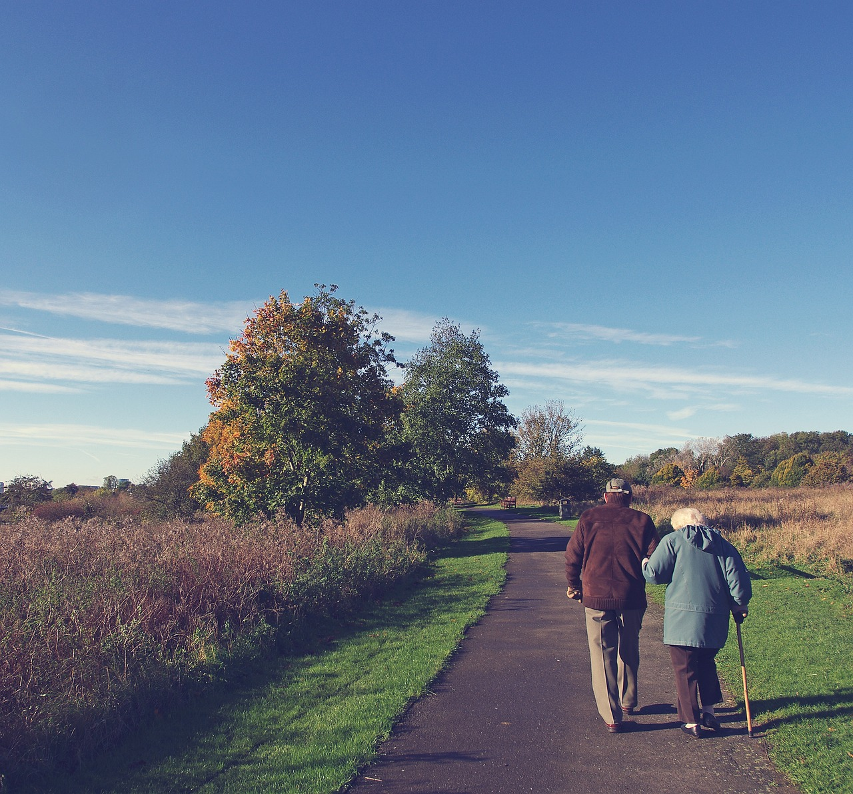
How do we find out about the UK's population?
What other changes might we see?
Some people will have left school and started a job.
Some people will have finished working and retired.
Some people will have started work in a new location or now work from home.
Some people’s health will have changed.

Slide 41
How do we find out about the UK’s population?
Task: Can you explain what type of information the census collects and what it will tell us?
A census is ______________________
It collects information such as _____________
WAGOLL- A census is an official count of people in a country. It collects information such as how many people there are, where they live, and sometimes details like age or jobs.

Slide 42
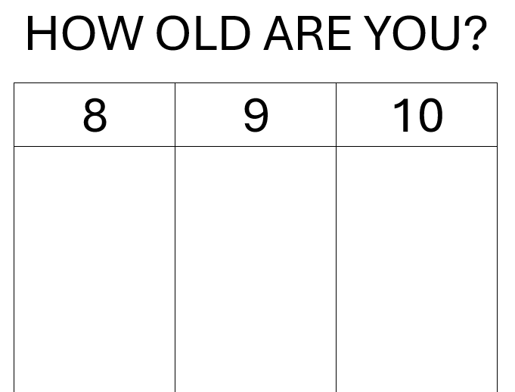
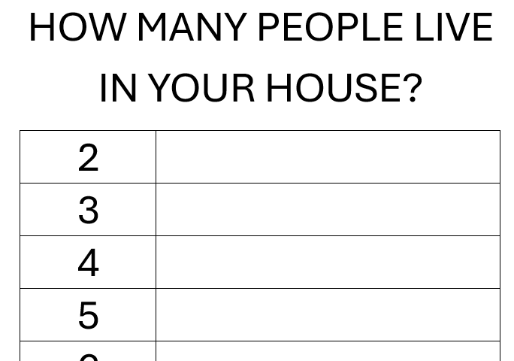
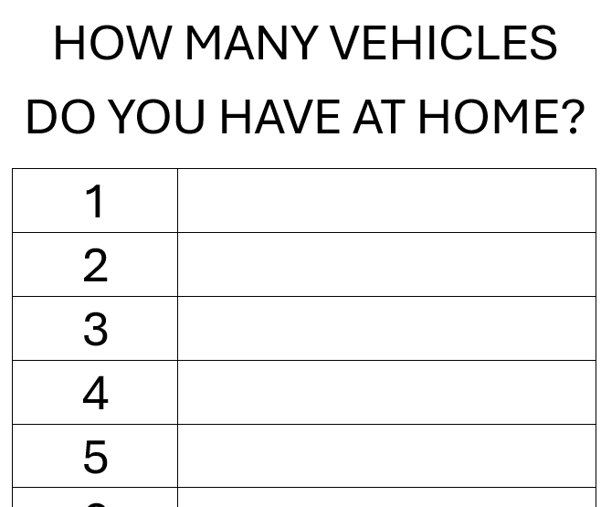
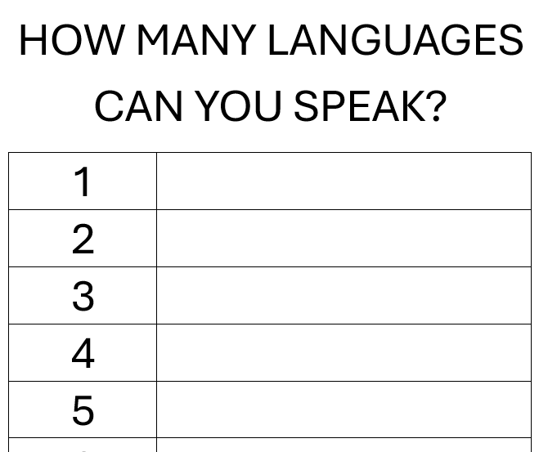
How do we find out about the UK’s population?
Around the classroom, there are 4 sheets of paper with questions. They include:
How old are you?
How many people live in your house?
How many vehicles do you have at home (cars, vans etc)?
How many languages can you speak?
You will go round the room and write your answer on the sheet in the tally.

Slide 43
How do we find out about the UK’s population?
Each group (rows) will now take one of the questions and analyse the data.
You will need to write the question in your book, draw the tally and complete it using the data.
Example:
How old are you?
8 | 9 | 10
//// | // | ///

Slide 44
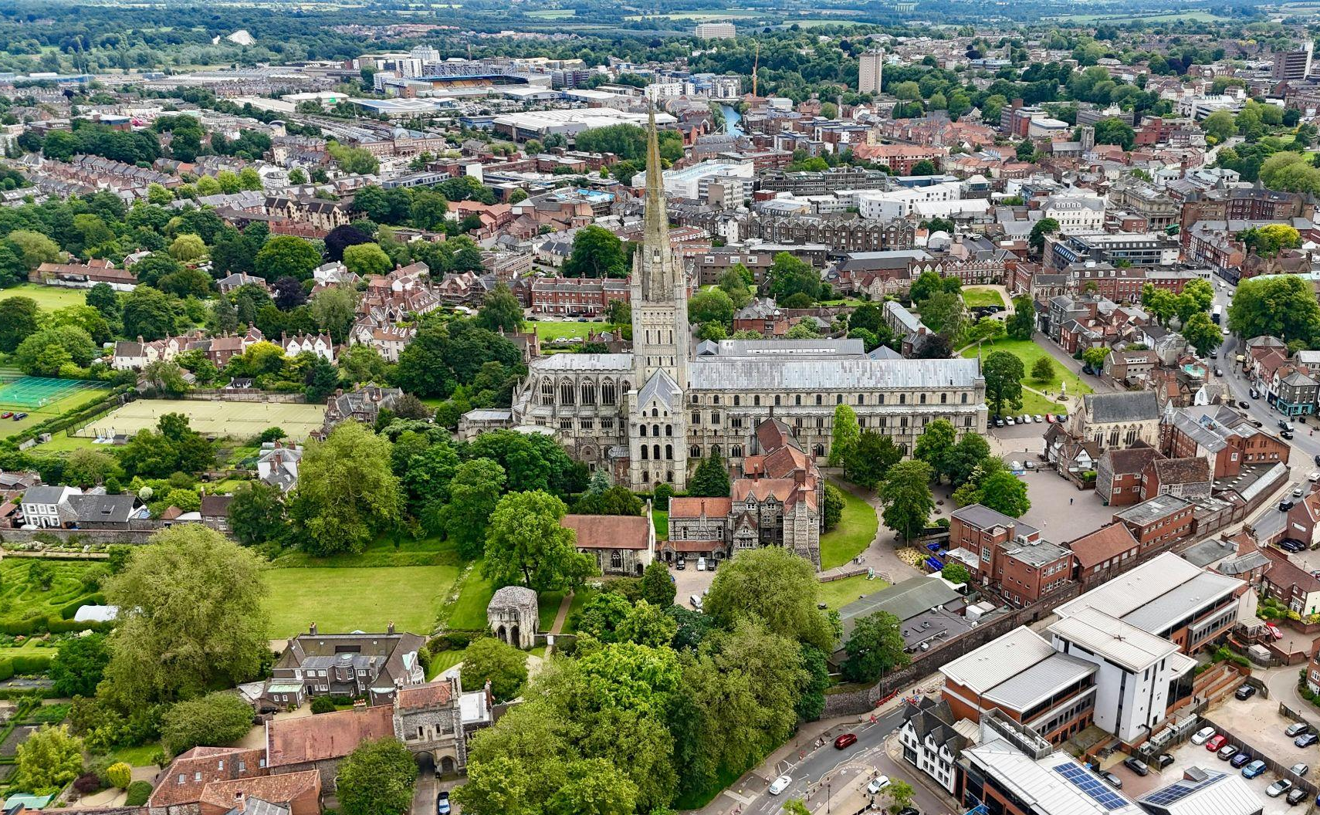
Looking at some of the changes migration causes
Migration has led to changes in cities.
Migrants tend to live in cities because this is where there are more jobs available.
Migrants to cities tend to be adults of working age.

Slide 45
Looking at some of the changes migration causes
Migration has led to changes in cities.
Migrants tend to live in cities because this is where there are more jobs available.
Migrants to cities tend to be adults of working age.

Slide 46
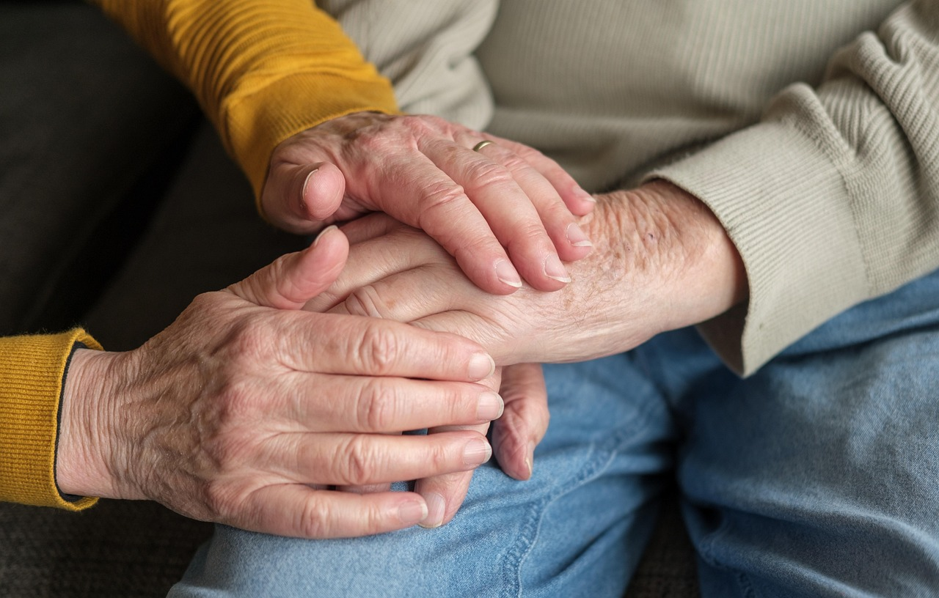
Looking at some of the changes migration causes
An ageing population needs looking after. Older people are more likely to need medical care, so there are lots of people needed to look after them.
Many immigrants find work in the care and health sectors.

Slide 47
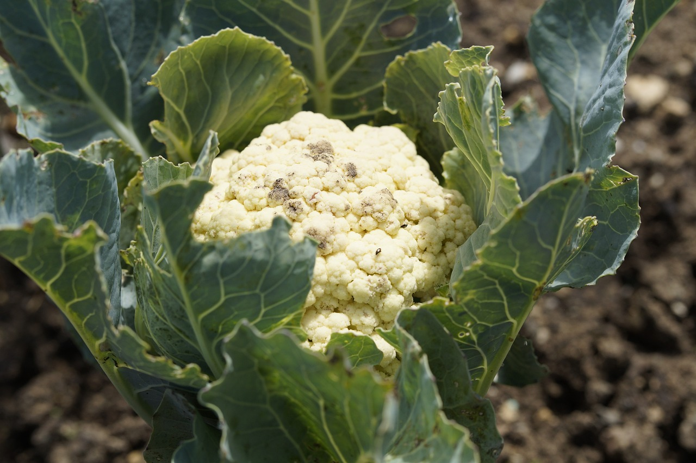
Looking at some of the changes migration causes
Migration has also brought changes to rural areas.
Although there is a lot of machinery used in farming, some crops still have to be picked and processed by hand.
This is often done by migrant workers from the EU and elsewhere.

Slide 48
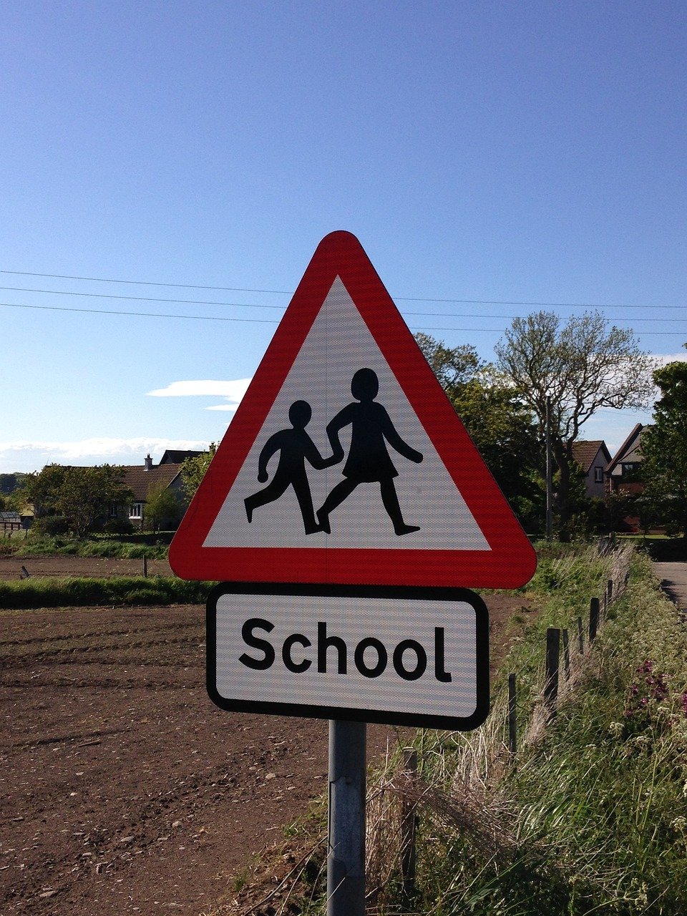
Looking at some of the changes migration causes
Migration has brought a need for more school places for the children of immigrants.
New schools take a lot of time to build, so some schools have seen more pupils joining, which may mean larger class sizes.

Slide 49

Looking at some of the changes migration causes
There are also changes in the creative industries, as music, poetry and other arts attract young people from different backgrounds and the culture they bring influences UK culture.
For example, Caribbean musicians introduced styles such as ska and reggae into UK culture.
Exit task: Tell your partner what migration means.

Slide 50
Movement break​
🍄 Mario Galaxy Run ⭐ Fitness Run | Brain Break | Exercise | GoNoodle Inspired

Slide 51

lundi 28 septembre
TBAT: say how old I am.
Turn and talk:
How do you say number '16 ' In French?
How do you say number '14' in French?
Language angels: languageangels.com/resource/1/5/27/129

Slide 52
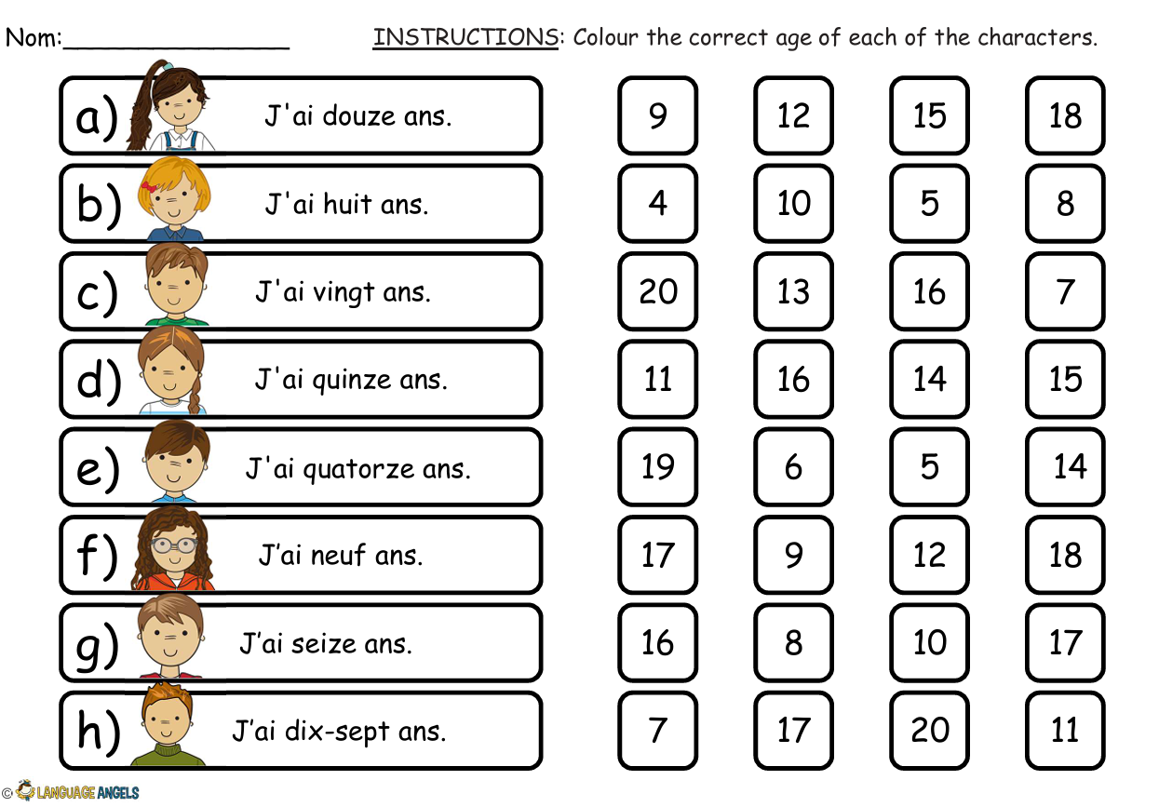
lundi 28 septembre
TBAT: say how old I am.

Slide 53
