Slide 1
Thursday 4th June 2026

Slide 2
TBAT: recap words with a schwa
Speedy sounds
Digital Flashcards - Teach Your Monster to Read

Slide 3
TBAT: recap words with a schwa
doctor
celebrate
brother
zebra
about
banana
sofa
pencil

Slide 4
TBAT: recap words with a schwa
animal
elephant
family
Chocolate
camera
different

Slide 5


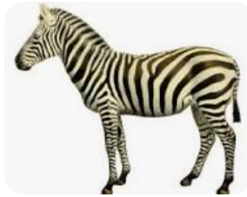
TBAT: recap words containing split digraphs
Label the images
__________________ _________________ _________________
Notes:
Animals, celebrate, zebra

Slide 6
TBAT: recap words with a schwa
Read this sentence
The elephant has a banana on the sofa.

Slide 7

TBAT: recap words with a schwa
…......................................................................
…......................................................................
….......................................................................
…........................................................................
Notes:
He plays the flute by the gate in space.

Slide 8
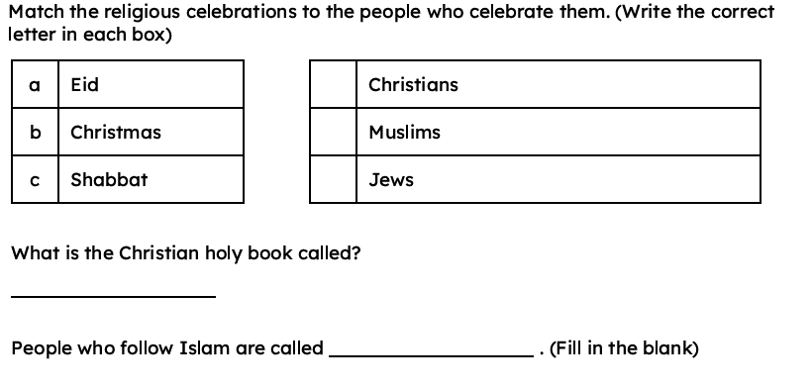
KQ: Can I describe how some Christians might belong to a church.
3 in 3:

Slide 9
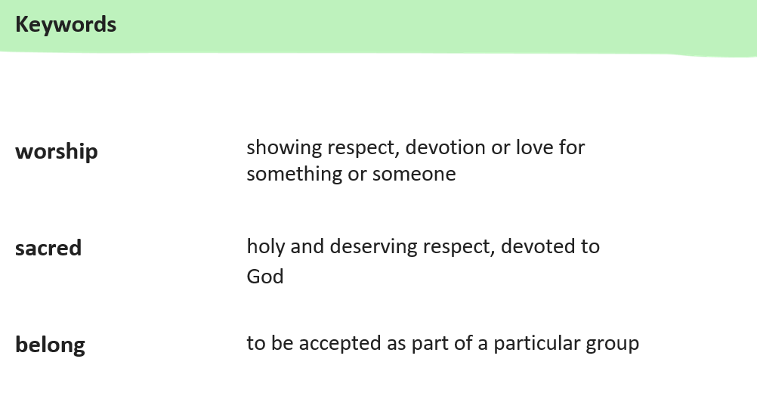
KQ: Can I describe how some Christians might belong to a church.

Slide 10
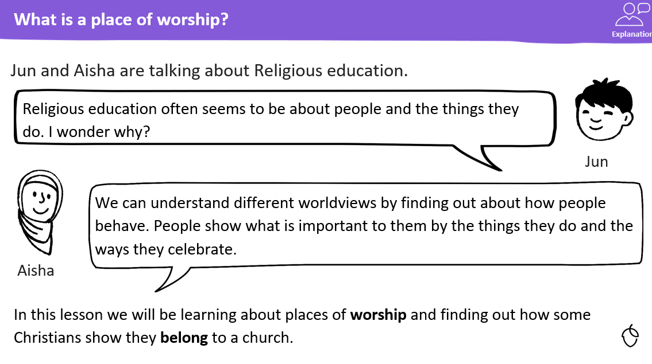
KQ: Can I describe how some Christians might belong to a church.

Slide 11
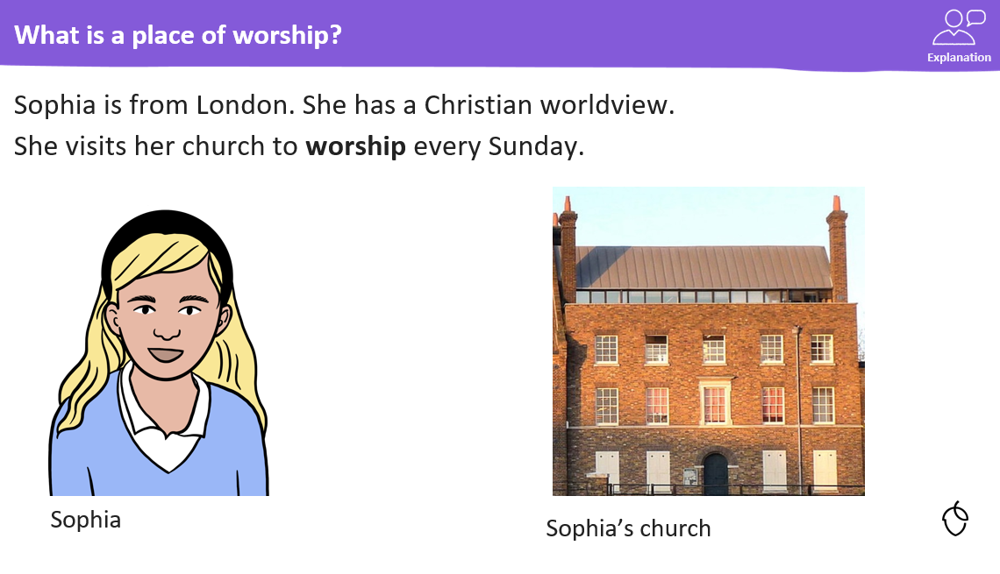
KQ: Can I describe how some Christians might belong to a church.

Slide 12
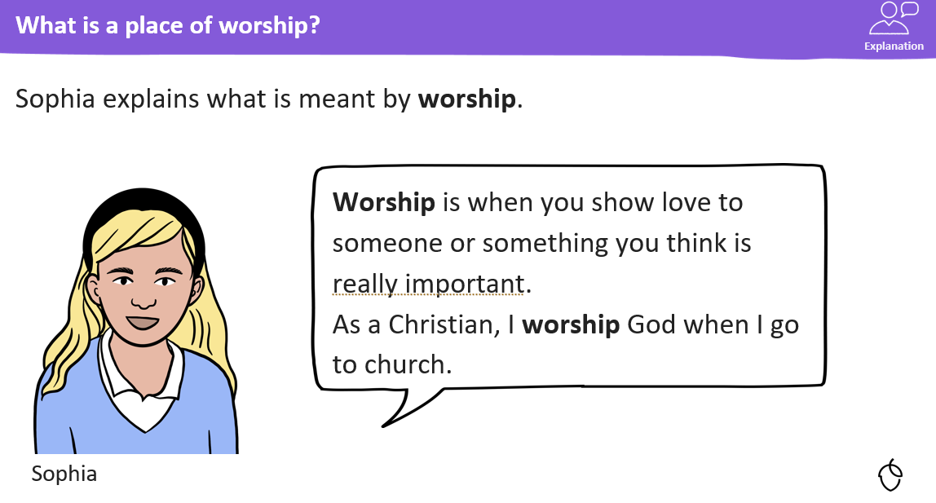
KQ: Can I describe how some Christians might belong to a church.

Slide 13
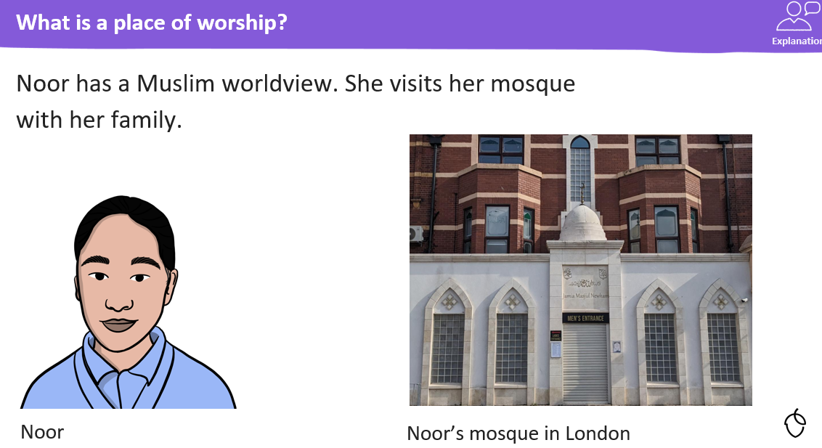
KQ: Can I describe how some Christians might belong to a church.

Slide 14
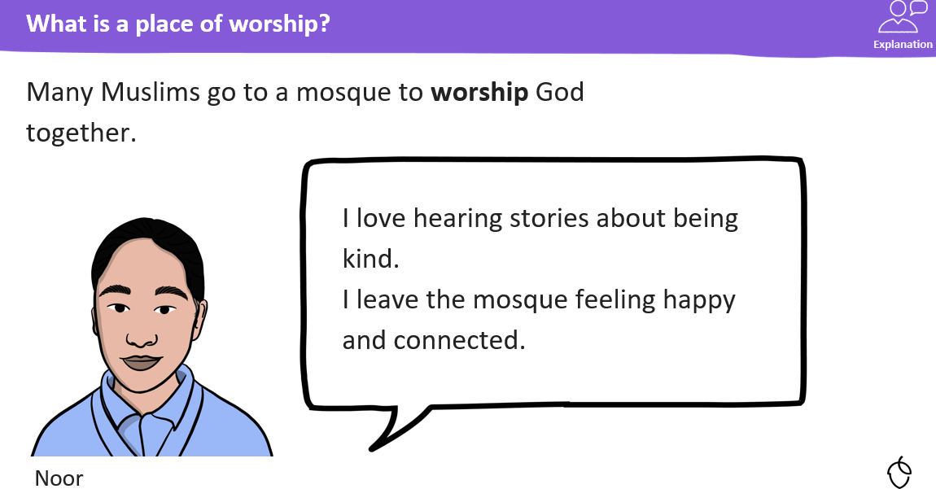
KQ: Can I describe how some Christians might belong to a church.

Slide 15
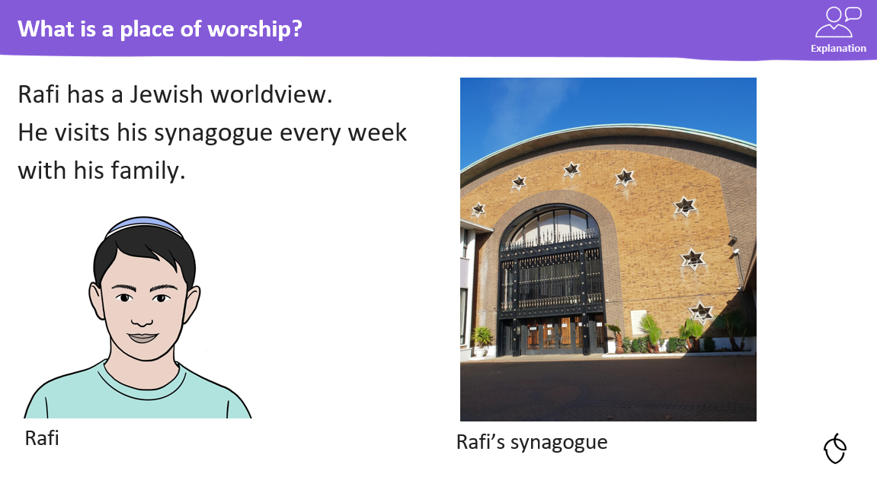
KQ: Can I describe how some Christians might belong to a church.

Slide 16
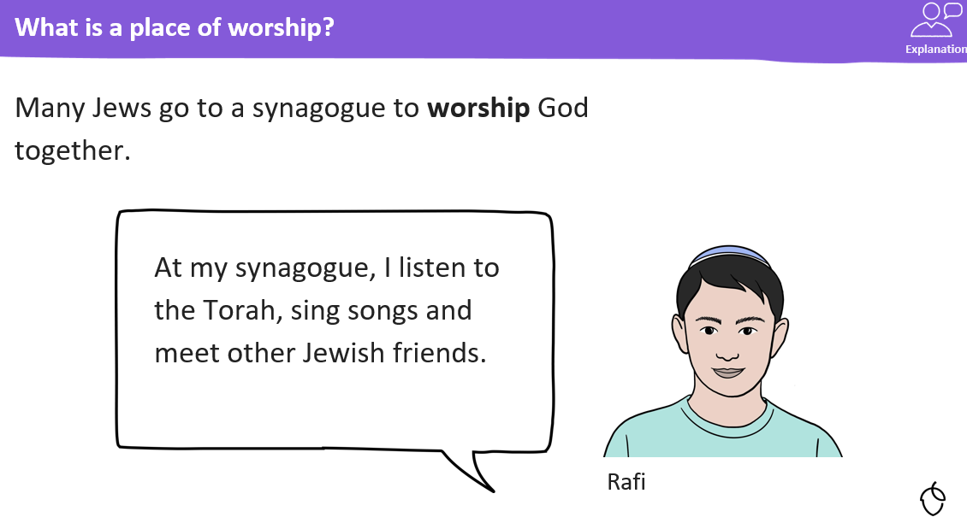
KQ: Can I describe how some Christians might belong to a church.

Slide 17

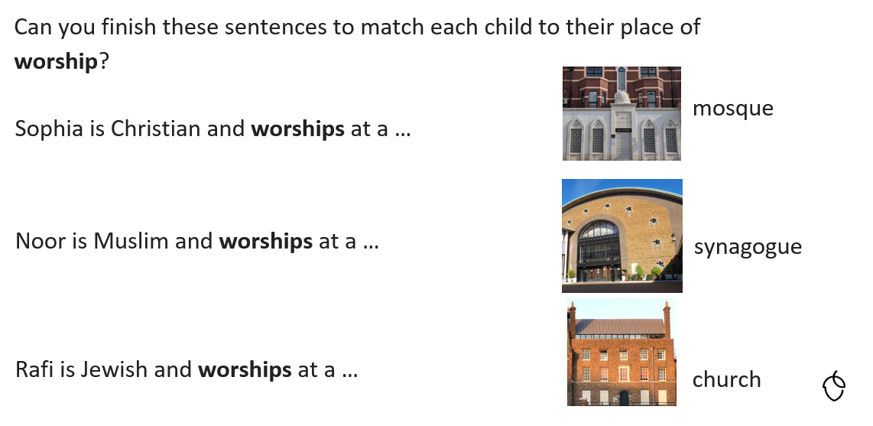
KQ: Can I describe how some Christians might belong to a church.
Blue/ Green- Discuss with your partner.

Slide 18
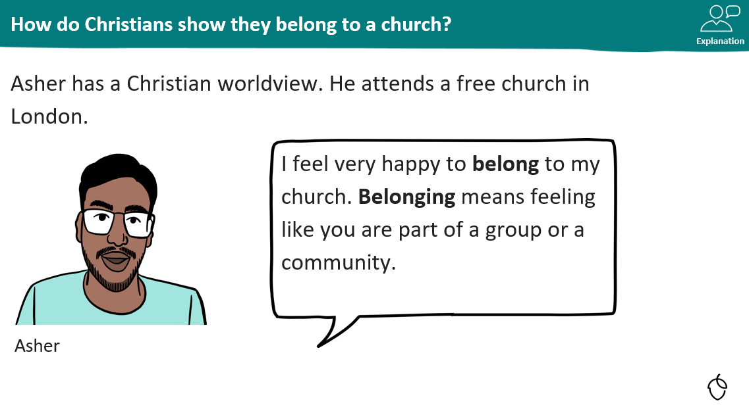
KQ: Can I describe how some Christians might belong to a church.

Slide 19

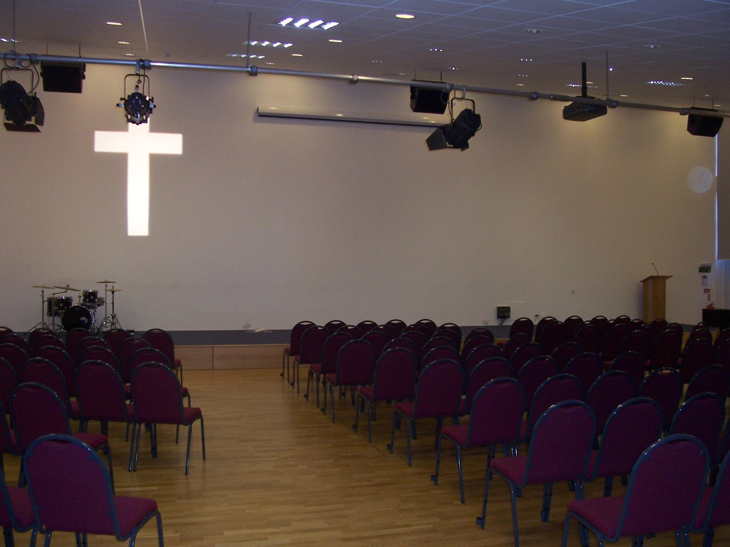

How do Christians show they belong to a church?
Listen to Asher explaining what belonging to a church means to him.
Asher
inside Asher’s church

Slide 20
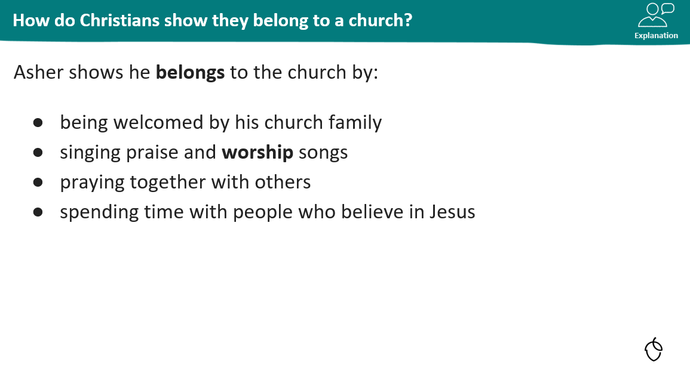
KQ: Can I describe how some Christians might belong to a church.

Slide 21
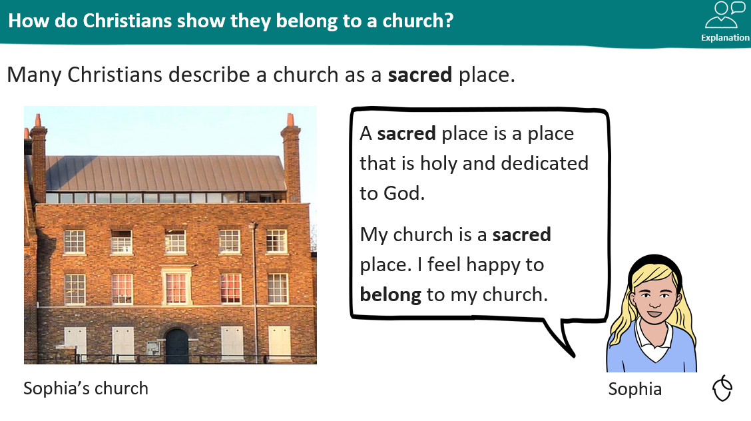
KQ: Can I describe how some Christians might belong to a church.

Slide 22


How do Christians show they belong to a church?
Listen to Sophia as she explains why her church is such a sacred place.
Sophia

Slide 23
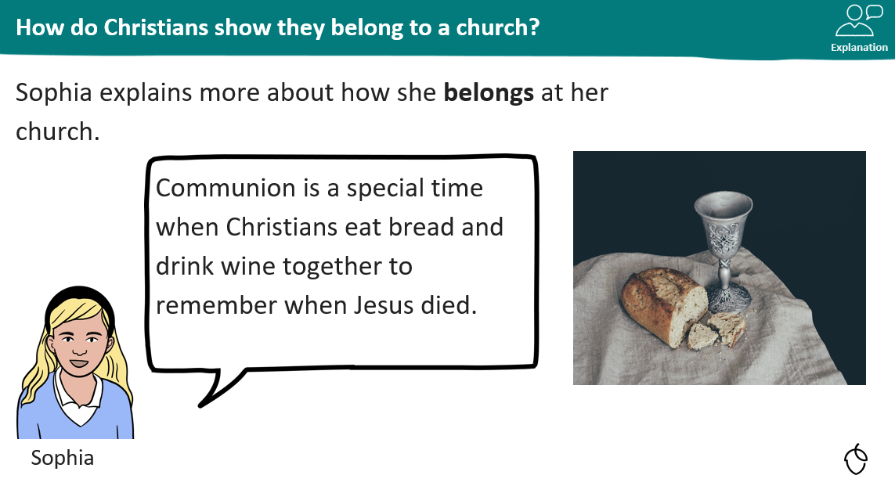
KQ: Can I describe how some Christians might belong to a church.

Slide 24
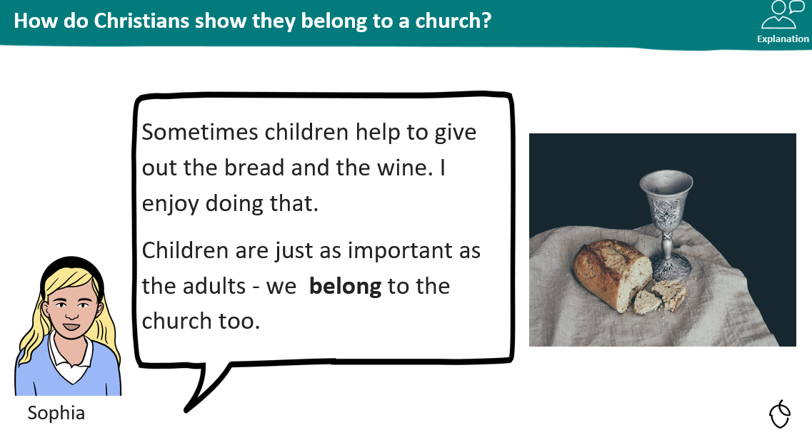
KQ: Can I describe how some Christians might belong to a church.

Slide 25
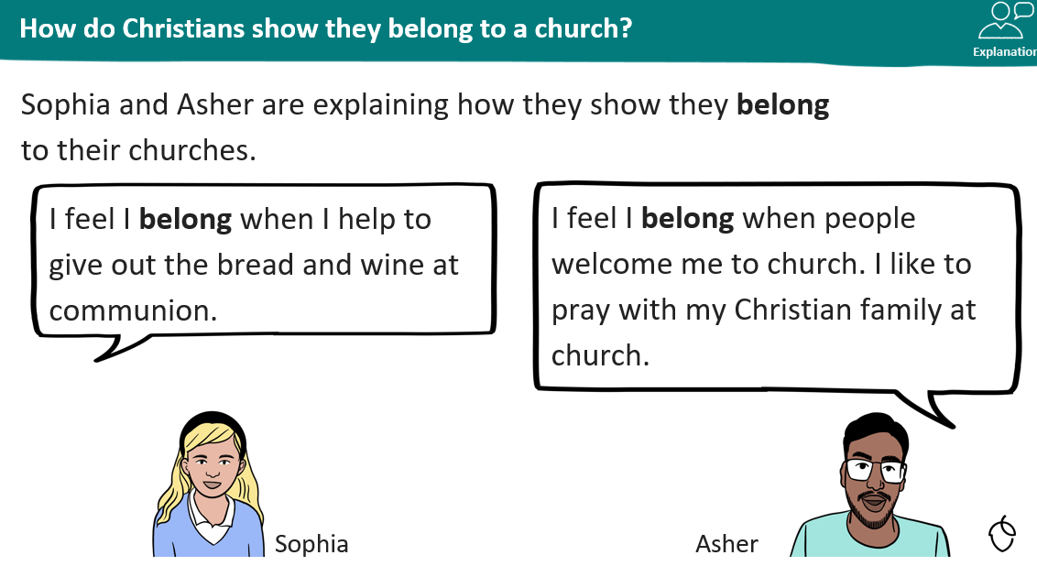
KQ: Can I describe how some Christians might belong to a church.

Slide 26
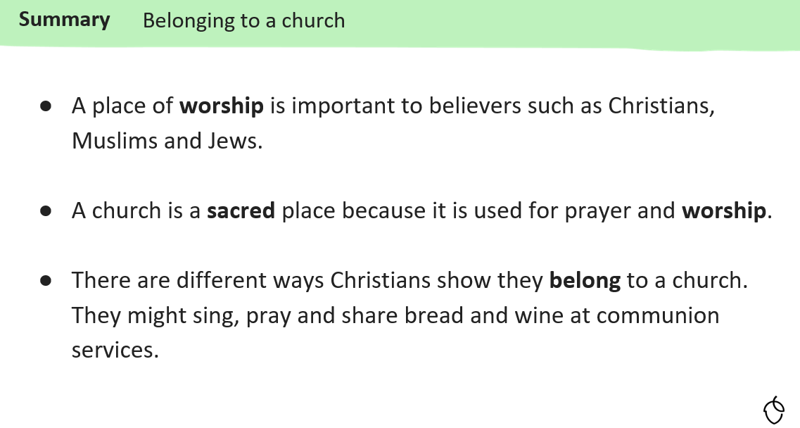
KQ: Can I describe how some Christians might belong to a church.

Slide 27
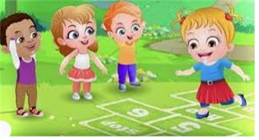
Break

Slide 28
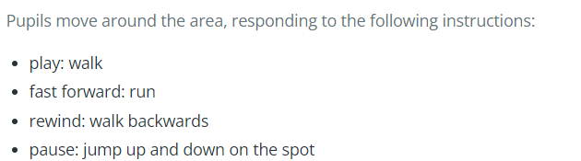
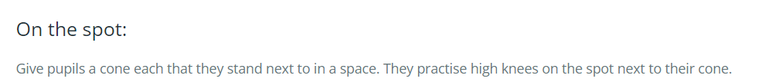
Warm-up
READY
TBAT – move at different speeds over distances

Slide 29
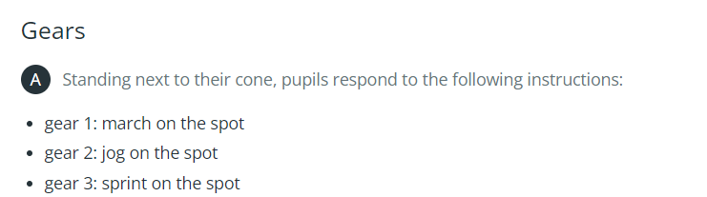
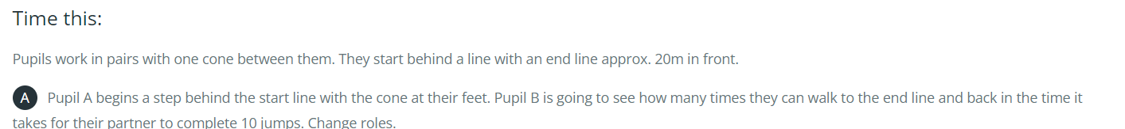
TBAT – move at different speeds over distances
Skill development
In p

Slide 30
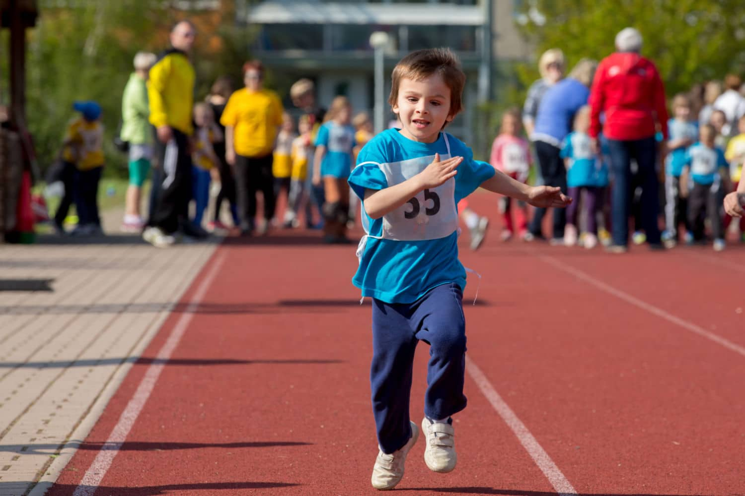

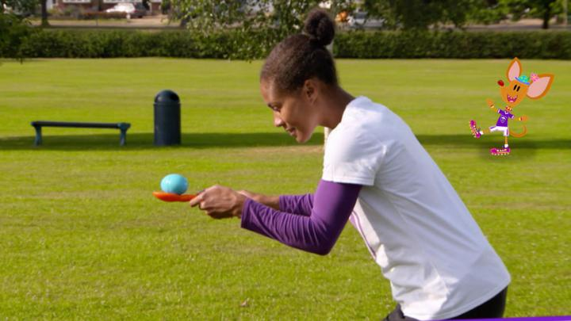
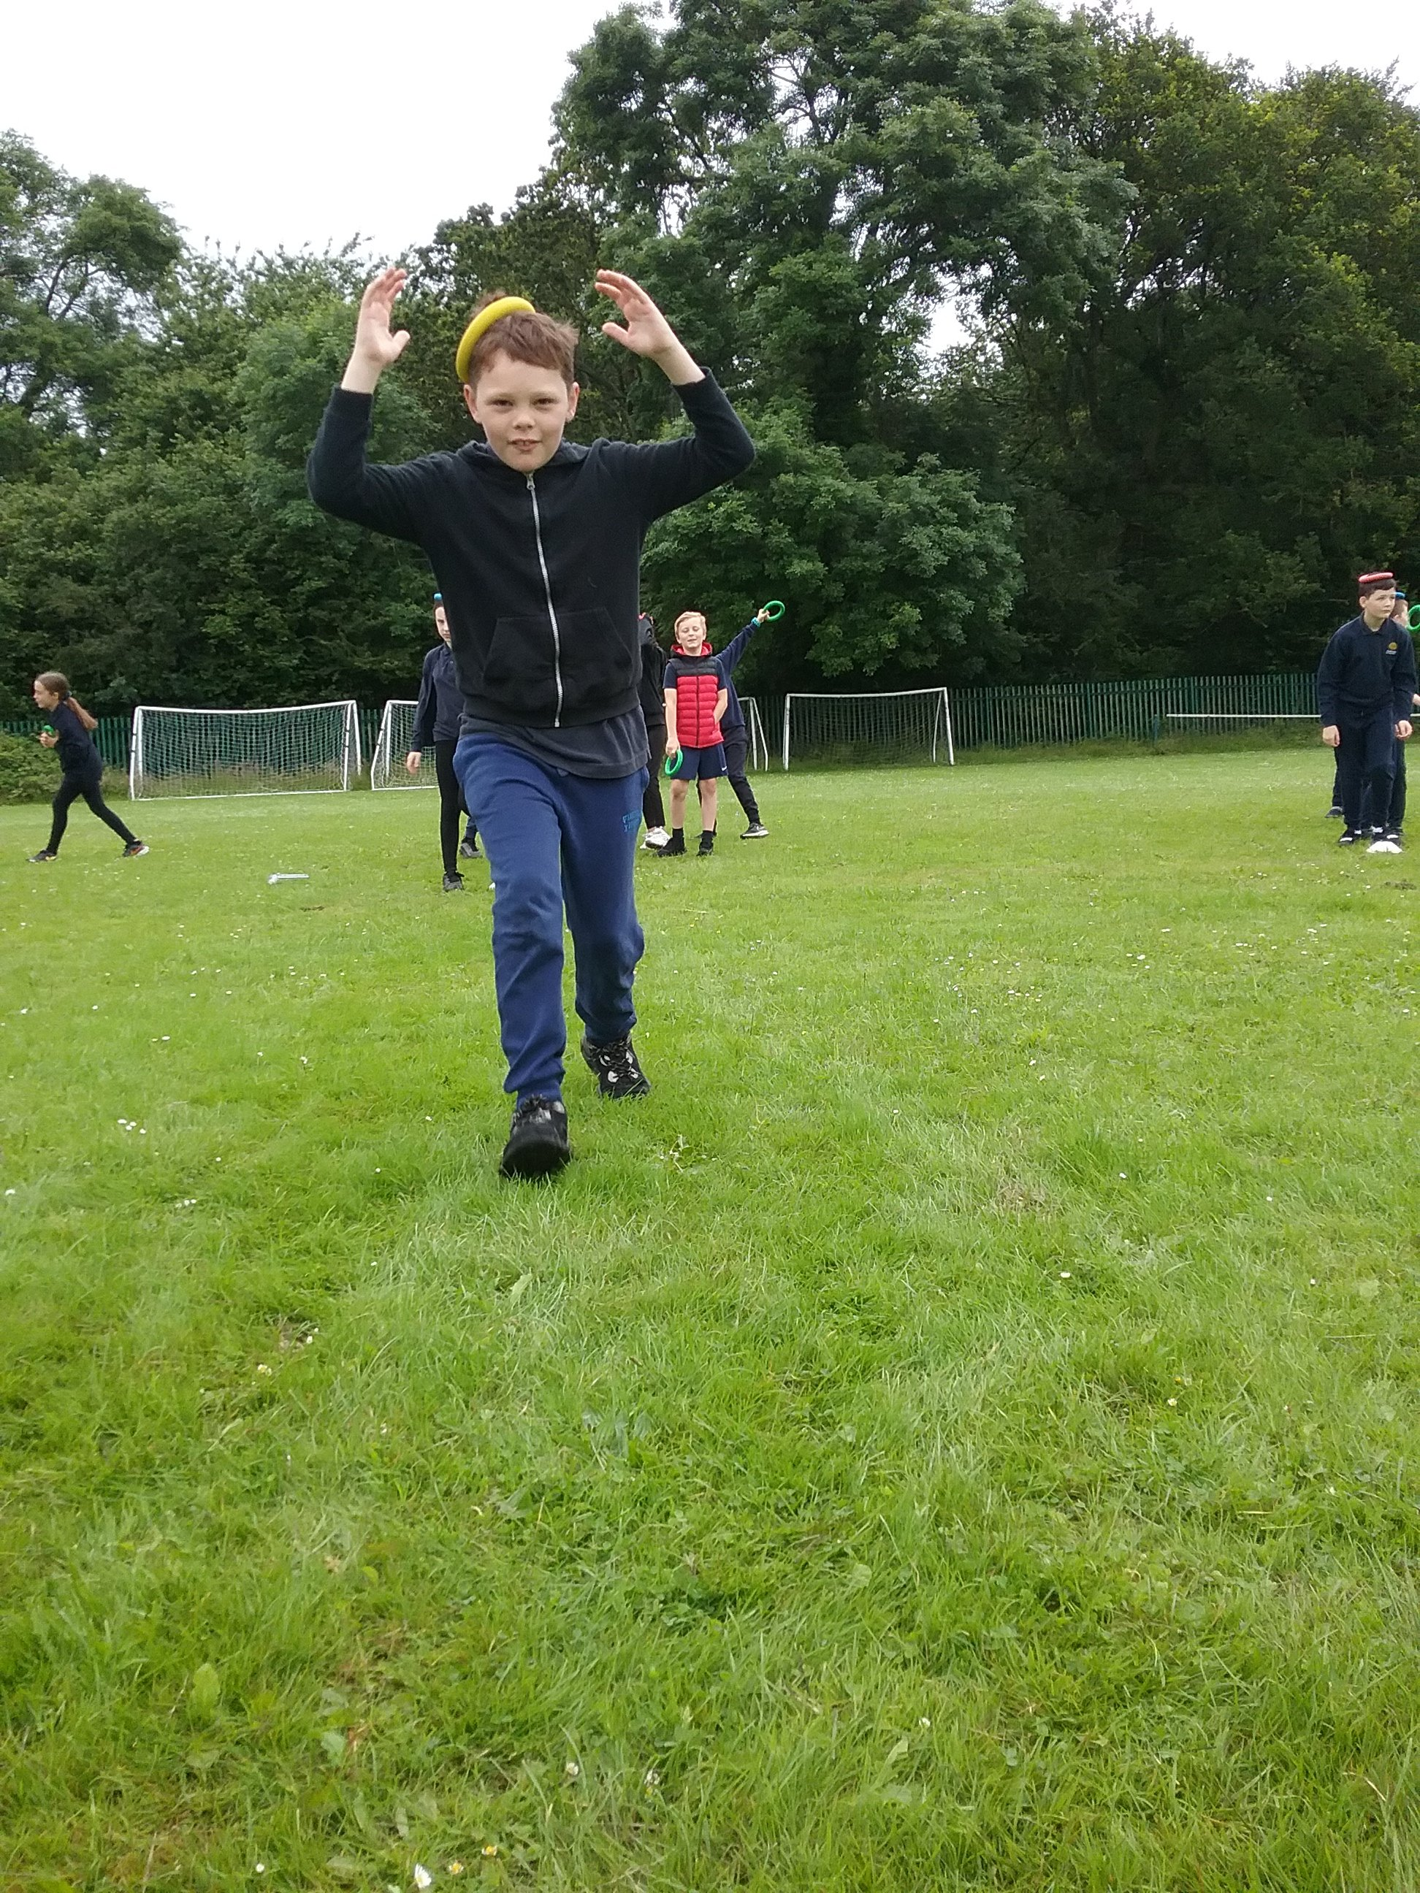
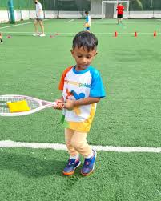
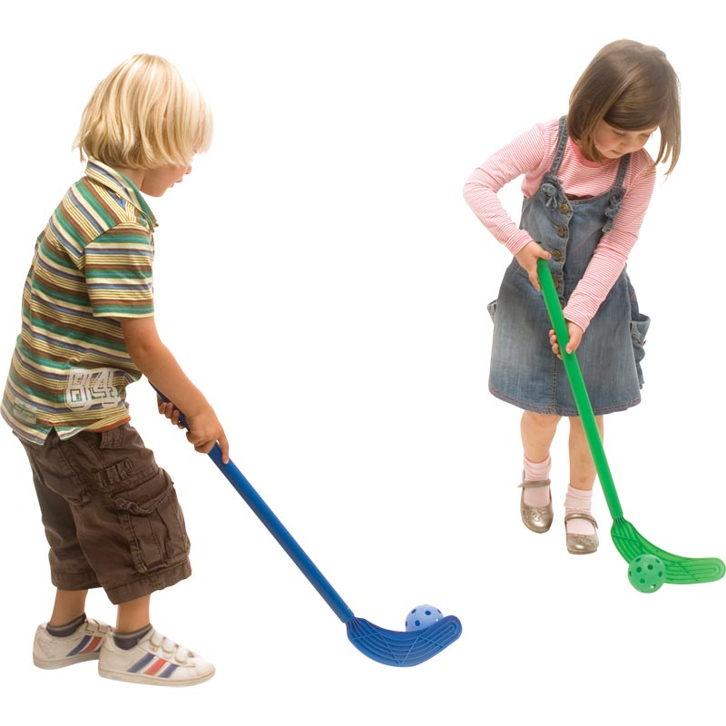
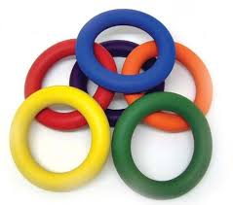
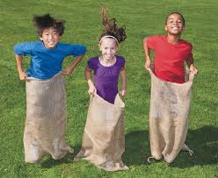
Sports Day
Race 1 Race 2 Race 3
Sprint race Hoop over the head Egg and spoon
Race 4 Race 5 Race 6
Quoit on head Bean bag on racket Hockey stick and ball
Race 7
Sack race

Slide 31
TBAT –
Sports Day practice
X
X
X
X
X
X
X
X
X
X
X
X
X
X
X
X
You will
Be put into teams
Sit in your team
Run one way and then branch off to the side
Give equipment to your next team mate

Slide 32

Lunch

Slide 33
Odd one out
3 in 3
Notes:
Do Now:

Slide 34
To share equally between a given number of groups
equal
share
fair
equally
groups
divide
whole

Slide 35
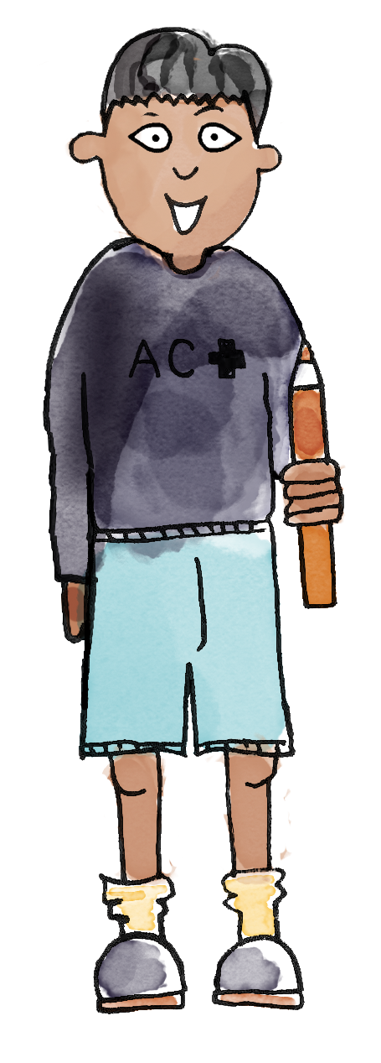
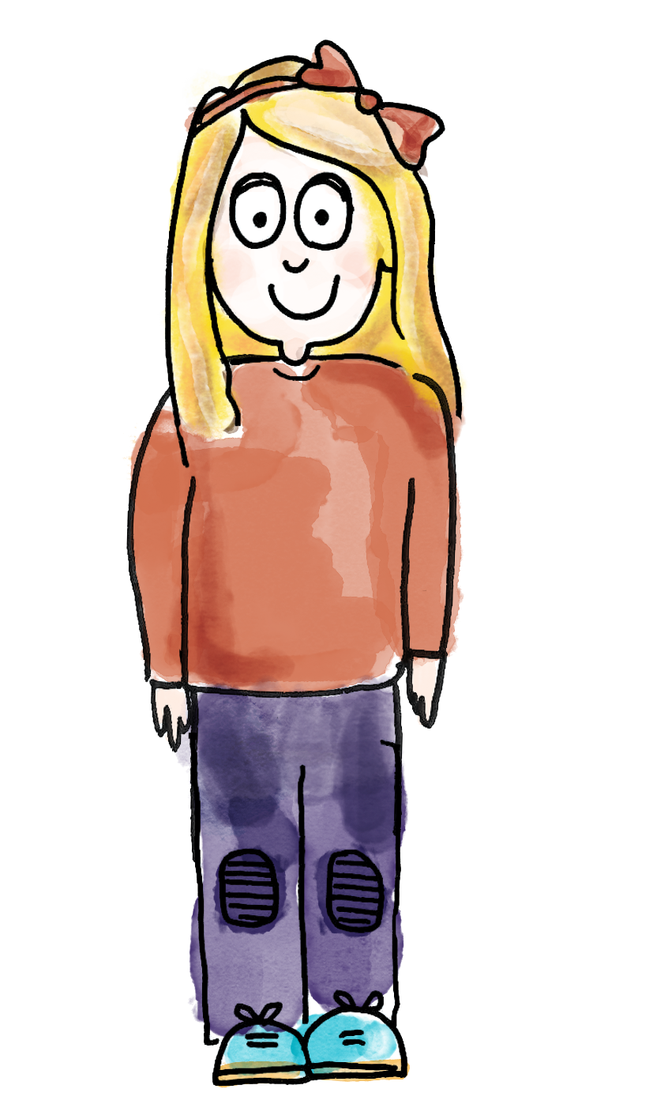
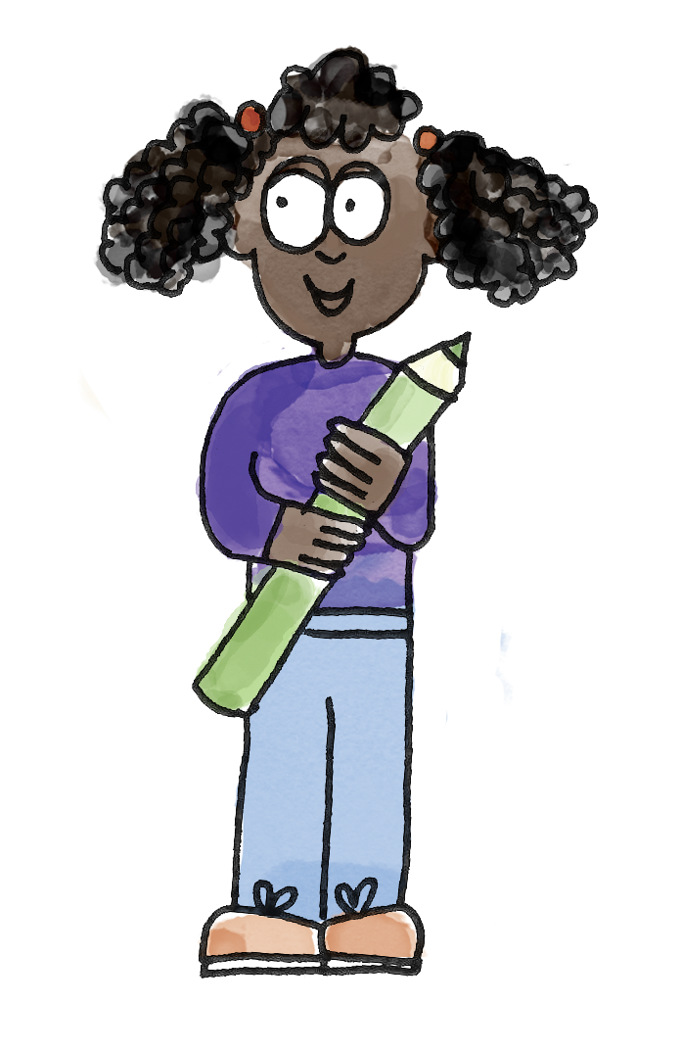



Let’s share six bananas between three children
DYNAMIC REPRESENTATION
Build up your own representation, ‘live’ in the lesson
Notes:
New Learning: Introducing sharing
Invite three pupils to the front of the class and explain that you have six bananas to give them. First share the bananas unequally (e.g. three, two, one).
Have I shared the bananas fairly? Why/why not?
Then share them unequally in a different way (e.g. four, one, one) and repeat the question. Have pupils explain why both of these options are unfair and suggest how to make it fair. Establish that ‘fair’ means that everyone has the same number; they are equal. Model sharing the bananas by distributing them one at a time to each pupil and then again until all bananas have been shared.
Describe the situation in terms of total items shared/groups shared between/items per group, using sentences such as:
Six bananas shared between three children. Each child gets two bananas.
Repeat with another example, e.g. sharing eight apples between four baskets, or nine pencils between three pots. Each time, model distributing the items one at a time until all have been shared, and then checking that each group has an equal number by counting.

Slide 36
Is this fair? Why/why not?
How can we make it fair?
Notes:
New Learning: Introducing sharing
Invite three pupils to the front of the class and explain that you have six bananas to give them. First share the bananas unequally (e.g. three, two, one).
Have I shared the bananas fairly? Why/why not?
Then share them unequally in a different way (e.g. four, one, one) and repeat the question. Have pupils explain why both of these options are unfair and suggest how to make it fair. Establish that ‘fair’ means that everyone has the same number; they are equal. Model sharing the bananas by distributing them one at a time to each pupil and then again until all bananas have been shared.
Describe the situation in terms of total items shared/groups shared between/items per group, using sentences such as:
Six bananas shared between three children. Each child gets two bananas.
Repeat with another example, e.g. sharing eight apples between four baskets, or nine pencils between three pots. Each time, model distributing the items one at a time until all have been shared, and then checking that each group has an equal number by counting.

Slide 37
I’ve chosen ‘ten apples shared into two groups’.
Here are ten counters, and two plates.
There are two groups. I am placing the counters into each group, one at a time.
B/G
There are five counters in each group.
equal share equally groups fair
Notes:
Talk Task: Sharing equally between groups
Each pair of pupils has 15 counters/cubes, four plates/cake cases and a cut-out copy of the Task Sheet. Pupil A selects a card, counts out the correct number of counters and sets out the correct number of plates. Pupil B shares the counters, one at a time, between the plates. Pupil A states how many counters are on each plate. Pupils swap roles and repeat.

Slide 38

I need to divide 8 pens into two pots
The whole is ______.
There are ____ equal groups.
Notes:
Develop Learning: Sharing equally between groups
Introduce the word ‘division’ to describe sharing into equal groups. Model another example, such as eight pens divided between two pots, sharing them one at a time.
We have divided/shared the eight pens into two groups. Each group has four pens. Eight divided into two groups is equal to four.
Model using a part-whole model to show the same process, starting with eight ‘pens’ in the whole and sharing them one at a time between two parts.

Slide 39
The whole is ______.
There are ____ equal groups.
Each group has ____pens.
Notes:
Model using a part-whole model to show the same process, starting with eight ‘pens’ in the whole and sharing them one at a time between two parts.
What is known and unknown?
I know the whole is eight, I know that we need to share into two equal groups. I do not know the amount in each group.
The whole is eight pens. We have divided them into two equal parts. Each part has four pens. Eight divided into two equal parts is equal to four.
Repeat with further examples, each time modelling creating groups and then representing on a part-whole model. Establish that the number of ‘parts’ is the number of groups we want to make.
Discuss how this representation is similar and differ to the array explored in previous lessons.

Slide 40
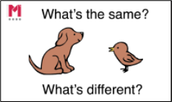
Ms Sharma needs to share 8 pens into four pots
What’s the same? What’s different?
How would our part whole model change?
Notes:
Repeat with a second example with a different amount of parts. Ask pupils to identify what’s the same and what’s different, model drawing a part whole model with four parts and then sharing.

Slide 41
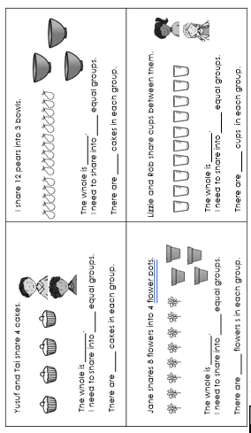
TBAT: share a total equally between a given number of groups
Find the whole and represent it with counters.
Find how many equal groups there are and select the correct part whole model.
Share your counters on the part whole model to find out how many in each group.
Notes:
Independent Task: Exploring sharing equally between groups
Pupils have the Task Sheet and their counters/cubes and plates/cake cases from the Talk Task. For each question, they count out manipulatives and share them between the given number of groups. They draw a pictorial representation of this. They complete the sentences.
Possible adaptations:
Pupils could represent each problem on a part-whole model.
Pupils could be provided with two options for each question, one shared equally and one shared unequally. They choose the correct one, make a concrete representation, and record how many are in each group.

Slide 42
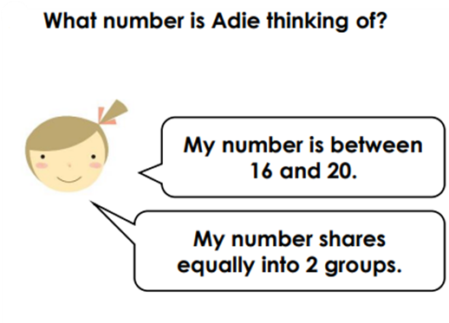
TBAT: share a total equally between a given number of groups
RP:
Notes:
Independent Task: Exploring sharing equally between groups
Pupils have the Task Sheet and their counters/cubes and plates/cake cases from the Talk Task. For each question, they count out manipulatives and share them between the given number of groups. They draw a pictorial representation of this. They complete the sentences.
Possible adaptations:
Pupils could represent each problem on a part-whole model.
Pupils could be provided with two options for each question, one shared equally and one shared unequally. They choose the correct one, make a concrete representation, and record how many are in each group.

Slide 43
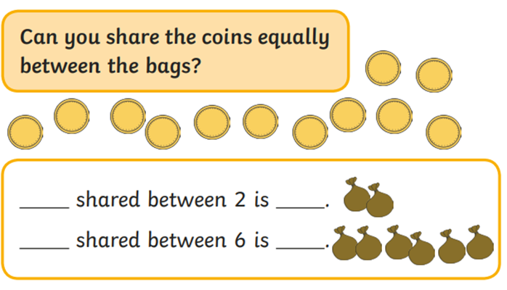
TBAT: share a total equally between a given number of groups
Challenge:
Notes:
Independent Task: Exploring sharing equally between groups
Pupils have the Task Sheet and their counters/cubes and plates/cake cases from the Talk Task. For each question, they count out manipulatives and share them between the given number of groups. They draw a pictorial representation of this. They complete the sentences.
Possible adaptations:
Pupils could represent each problem on a part-whole model.
Pupils could be provided with two options for each question, one shared equally and one shared unequally. They choose the correct one, make a concrete representation, and record how many are in each group.

Slide 44
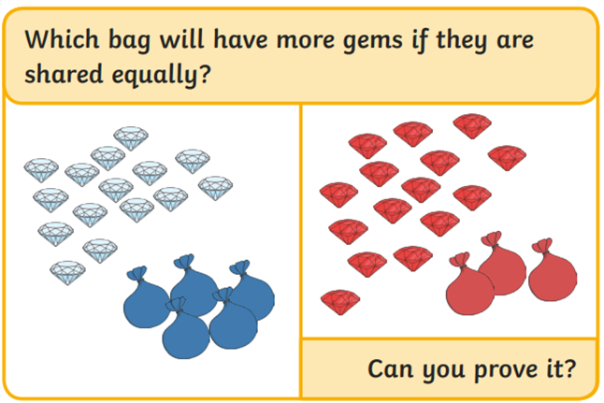
TBAT: share a total equally between a given number of groups
Mastery:
Notes:
Independent Task: Exploring sharing equally between groups
Pupils have the Task Sheet and their counters/cubes and plates/cake cases from the Talk Task. For each question, they count out manipulatives and share them between the given number of groups. They draw a pictorial representation of this. They complete the sentences.
Possible adaptations:
Pupils could represent each problem on a part-whole model.
Pupils could be provided with two options for each question, one shared equally and one shared unequally. They choose the correct one, make a concrete representation, and record how many are in each group.

Slide 45
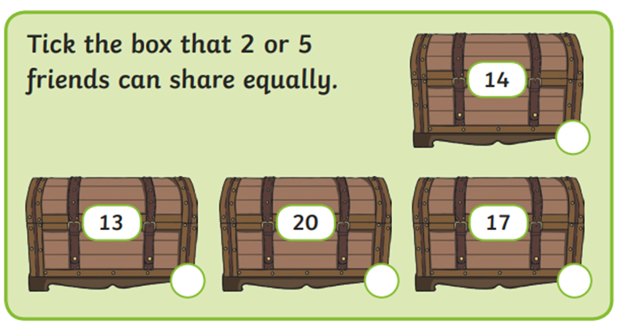
TBAT: share a total equally between a given number of groups
Mastery with greater depth:
Notes:
Independent Task: Exploring sharing equally between groups
Pupils have the Task Sheet and their counters/cubes and plates/cake cases from the Talk Task. For each question, they count out manipulatives and share them between the given number of groups. They draw a pictorial representation of this. They complete the sentences.
Possible adaptations:
Pupils could represent each problem on a part-whole model.
Pupils could be provided with two options for each question, one shared equally and one shared unequally. They choose the correct one, make a concrete representation, and record how many are in each group.

Slide 46
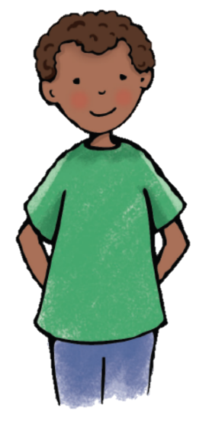
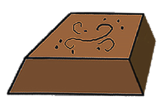
Do you agree?
I have divided my chocolate fairly into four groups.
Each group has three pieces of chocolate.
Notes:
Plenary: Tackling a misconception
Show pupils the slide and read the child’s statement.
Do you agree with what the child is saying? Why/why not?
Give pupils a chance to look and discuss. They should identify that the chocolate has been divided equally but there are three groups with four pieces of chocolate in each group (rather than four groups with three pieces each).

Slide 47
TBAT: use discussion to gain a deeper understanding of a character
3 in 3
Which suffix needs to be added to these words? –ed, -ing or -er
Julian enjoy___ dressing as a mermaid.
The mermaid was a great perform___.
Julian’s Nana was walk___ beside him.

Slide 48
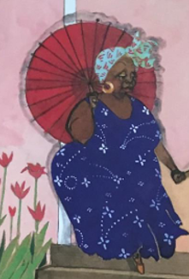
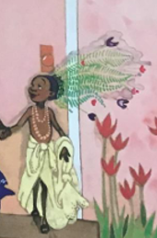
Blue / Green
TBAT: use discussion to gain a deeper understanding of a character
Think of some words to describe your character. Describe what they look like and their personality.

Slide 49
TBAT: use discussion to gain a deeper understanding of a character
We will read the book again and have a think about what we learn about Julian at each part. We will discuss his feelings and words to describe what he looks like.

Slide 50
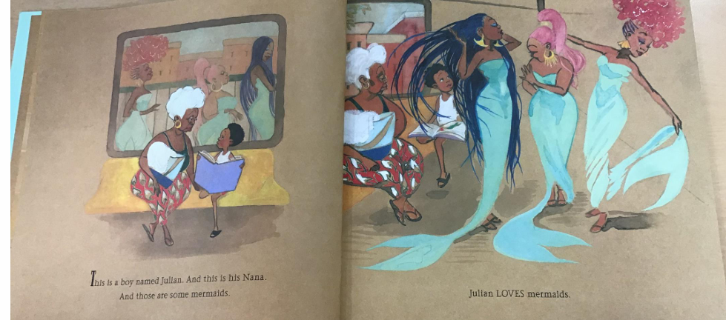
TBAT: use discussion to gain a deeper understanding of a character

Slide 51
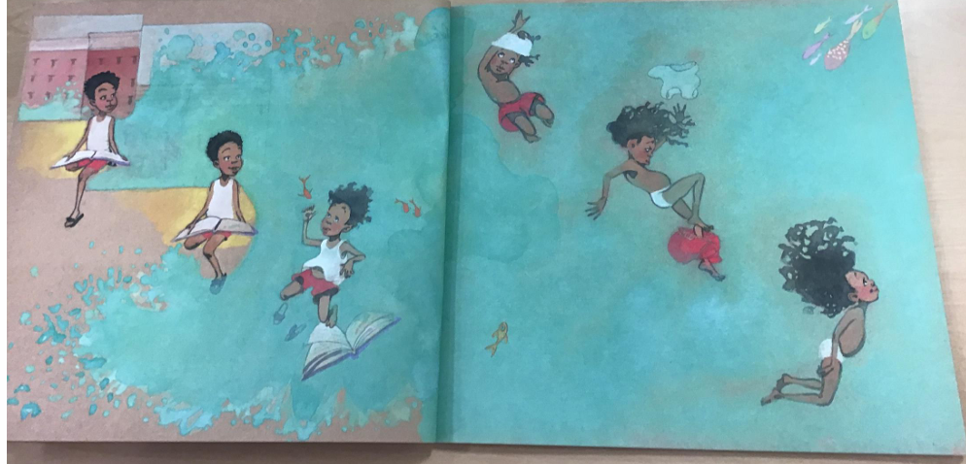
TBAT: use discussion to gain a deeper understanding of a character

Slide 52
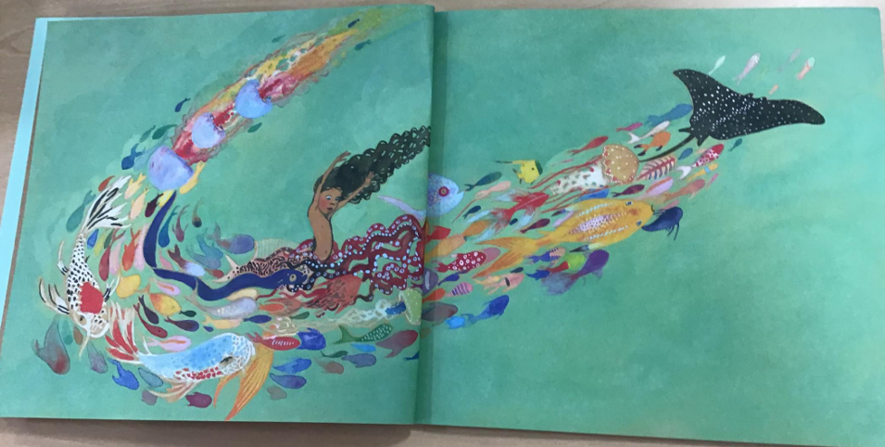
TBAT: use discussion to gain a deeper understanding of a character

Slide 53
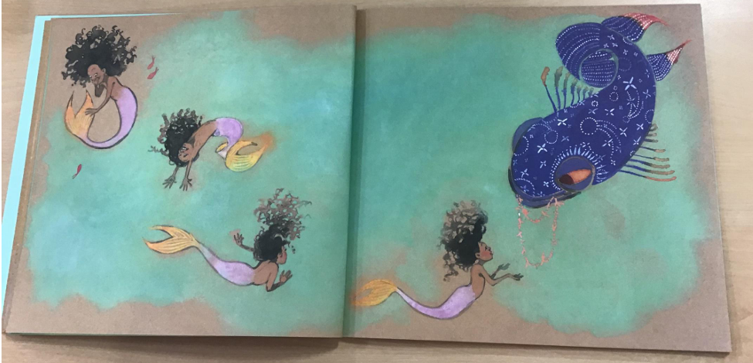
TBAT: use discussion to gain a deeper understanding of a character

Slide 54
TBAT: use discussion to gain a deeper understanding of a character
Blue / Green
What do we know about Julian from this part of the story?
What is he like? What words can we think of to describe him?
Let’s add these to our role on the wall

Slide 55
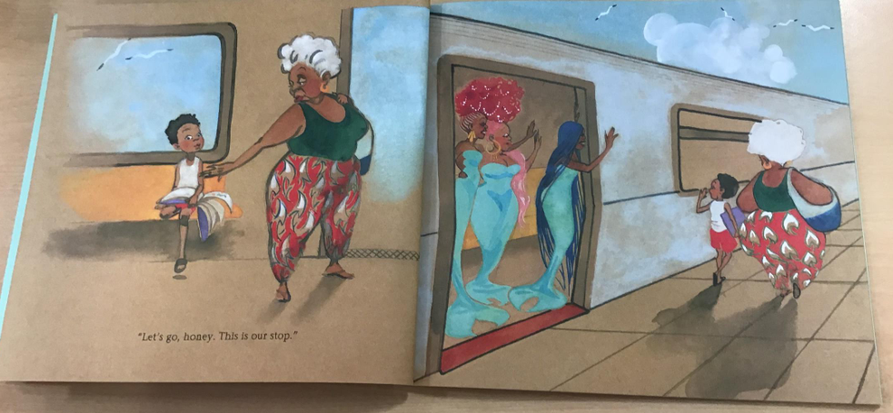
TBAT: use discussion to gain a deeper understanding of a character

Slide 56
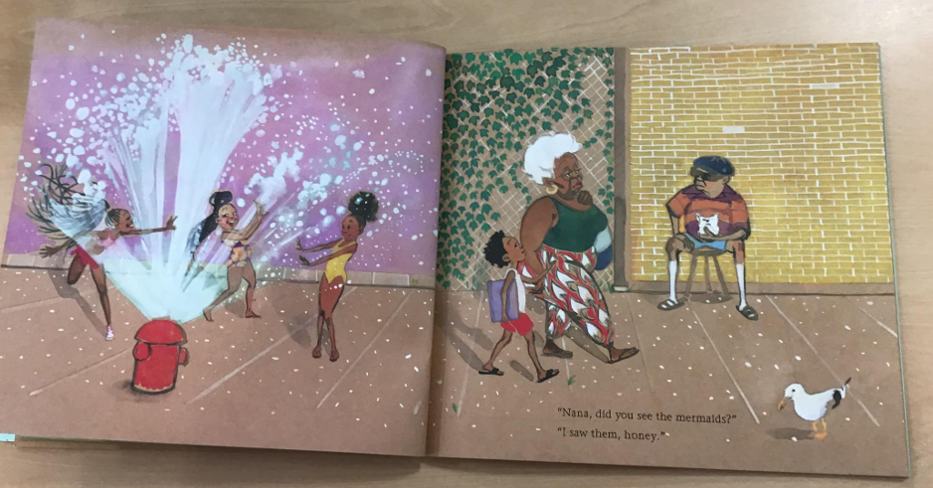
TBAT: use discussion to gain a deeper understanding of a character

Slide 57

TBAT: use discussion to gain a deeper understanding of a character

Slide 58

TBAT: use discussion to gain a deeper understanding of a character

Slide 59

TBAT: use discussion to gain a deeper understanding of a character

Slide 60
TBAT: use discussion to gain a deeper understanding of a character
Blue / Green
Can we still describe him in the same way or are there some other things we can now add?
What is he feeling now?
Let’s add these to our role on the wall

Slide 61

TBAT: use discussion to gain a deeper understanding of a character

Slide 62

TBAT: use discussion to gain a deeper understanding of a character

Slide 63

TBAT: use discussion to gain a deeper understanding of a character

Slide 64

TBAT: use discussion to gain a deeper understanding of a character

Slide 65

TBAT: use discussion to gain a deeper understanding of a character

Slide 66

TBAT: use discussion to gain a deeper understanding of a character

Slide 67

TBAT: use discussion to gain a deeper understanding of a character

Slide 68

TBAT: use discussion to gain a deeper understanding of a character

Slide 69
TBAT: use discussion to gain a deeper understanding of a character.
Blue / Green
Is there any other ways we can describe Julian now?
Would you have gone to the parade if you were him? Why? Why not?
Let’s add these to our role on the wall

Slide 70
Blue / Green
TBAT: use discussion to gain a deeper understanding of a character.
Do you like Julian? Why?
Does he have any qualities that you admire?

Slide 71
TBAT: use discussion to gain a deeper understanding of a character.
Challenge:
Write a sentence about what you think about Julian. Do you like him? Why? What qualities does he have that you admire?

