Slide 1
Monday 1st June 2026

Slide 2
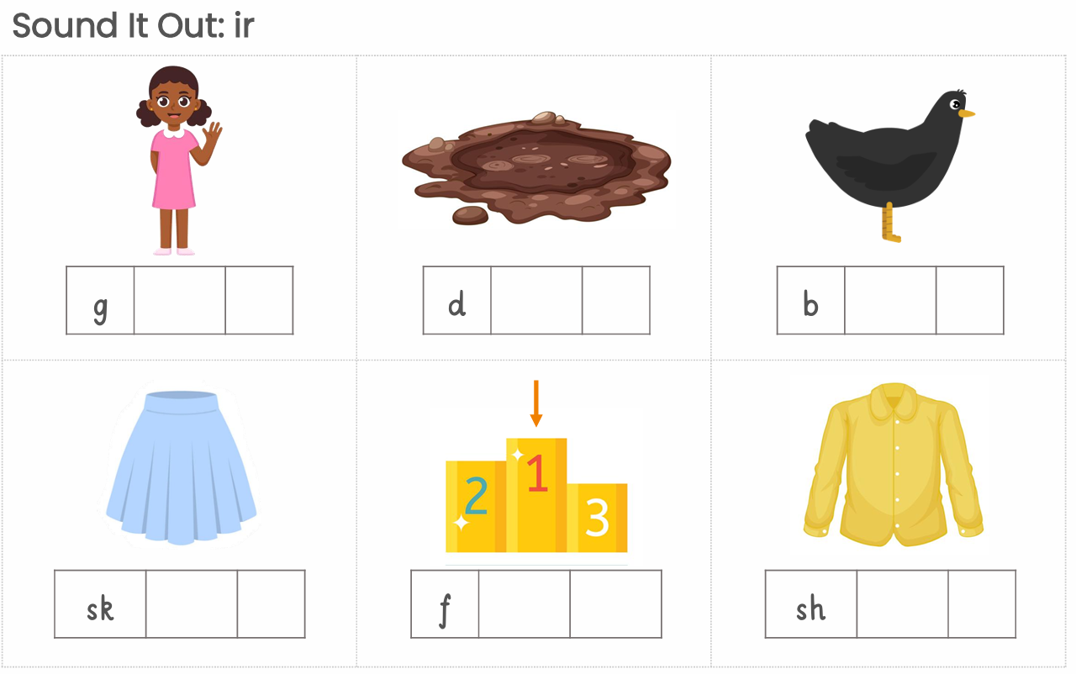
Morning Challenge
Write a sentence using each word.

Slide 3
TBAT: read and write words which include consonant blends.
Speedy sounds
Digital Flashcards - Teach Your Monster to Read

Slide 4

TBAT: read and write words which include consonant blends.
thrust thrigs
thrift thrang
thrash throgs

Slide 5
TBAT: read and write words which include consonant blends.
stripe streg
screws scring
screw scrift
strap sphall

Slide 6



TBAT: read and write words which include consonant blends.
Label the images
__________________ _________________ _________________
Notes:
Strong, shrink, splat

Slide 7



TBAT: read and write words which include consonant blends.
Label the images
__________________ _________________ _________________
Notes:
Shrimp, splash, stripes

Slide 8
TBAT: read and write words which include consonant blends.
Read this sentence
The dog will sprint and do the splits.

Slide 9

TBAT: read and write words which include consonant blends.
…......................................................................
…......................................................................
….......................................................................
…........................................................................

Slide 10
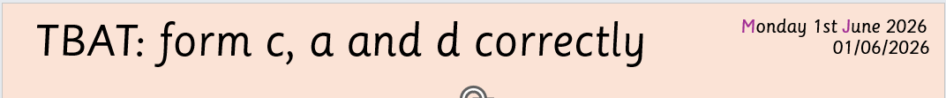
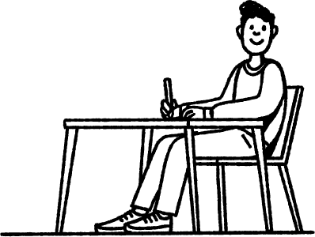

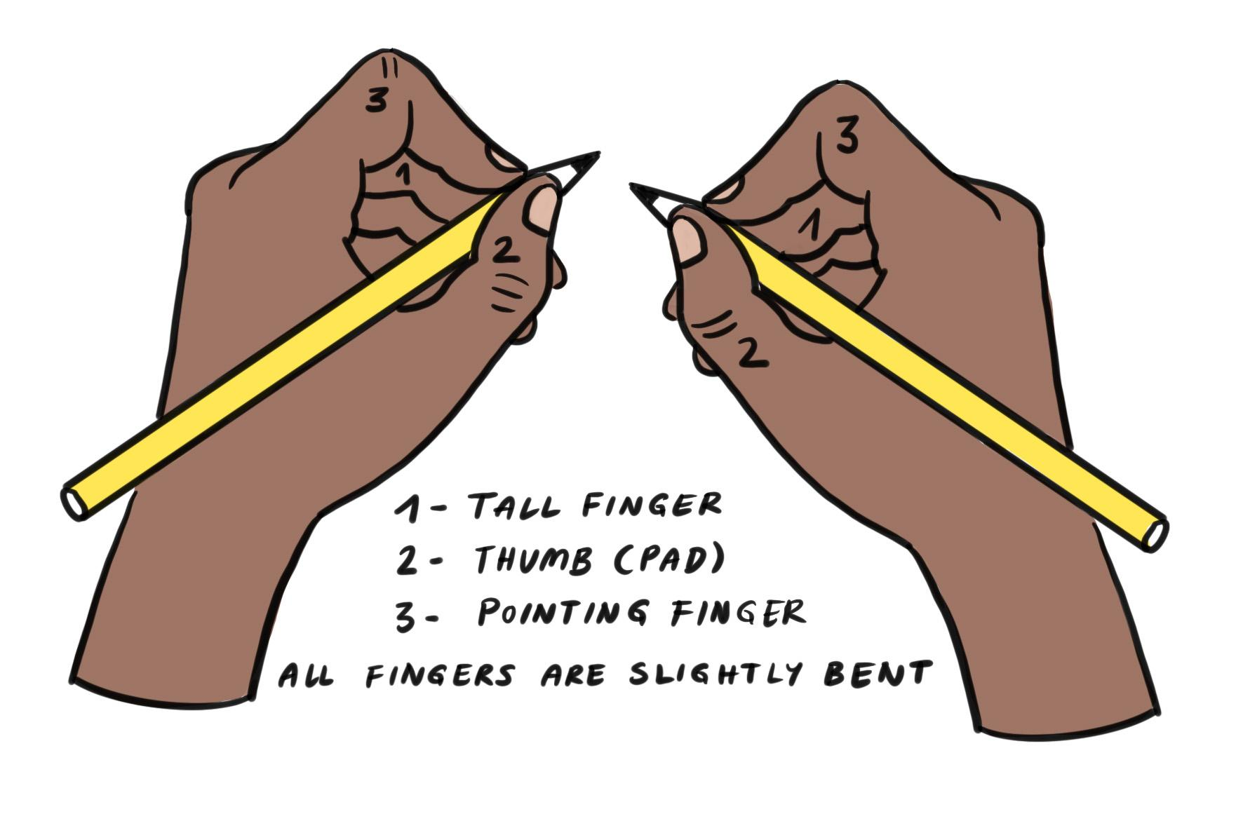
Before we start, what are these pictures reminding you to do?
sit on a chair at a table
feet flat on the floor
back against the chair
angle your paper correctly
non-writing hand supports
hold your pencil in the tripod grip

Slide 11
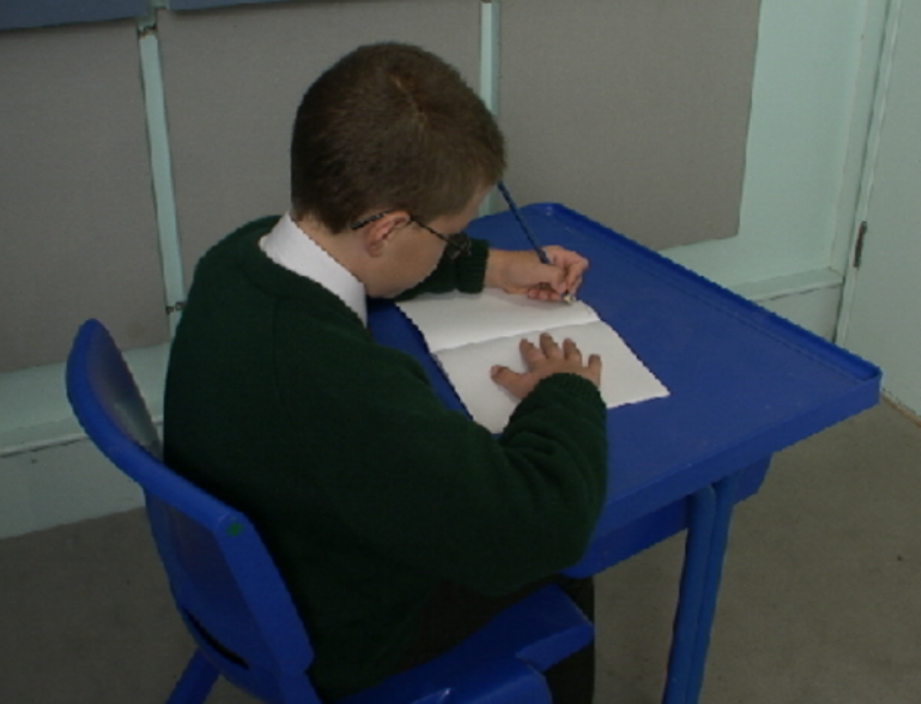
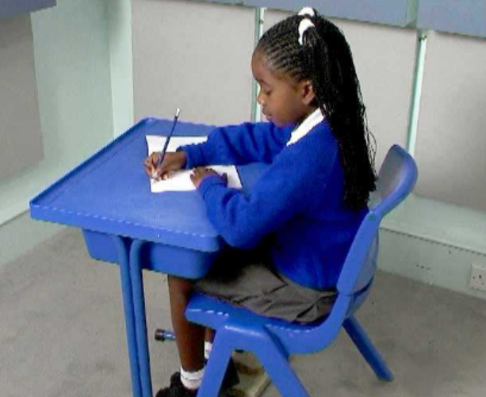
Right handed Left handed

Slide 12
Handwriting warm-up
I do the finger tap warm up and the clapping position warm up.
You do the finger tap warm up and the clapping position warm up.

Slide 13
Handwriting warm-up
I do the handwriting pattern in the air with my finger and elbow.
You do the handwriting pattern in the air with your finger and elbow.

Slide 14
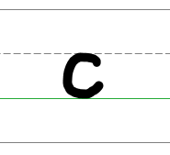
Forming the lower case letter c in print
The letter c is an x-height letter.
The letter c is a small letter.
It does not have an ascender.
It does not have a descender.
The letter c is curved.

Slide 15
Forming the lower case letter c in print
I will form the letter c in the air with my finger and form the letter c in the air with my nose.
You will form the letter c in the air with your finger and form the letter c in the air with your nose.
anti-clockwise

Slide 16
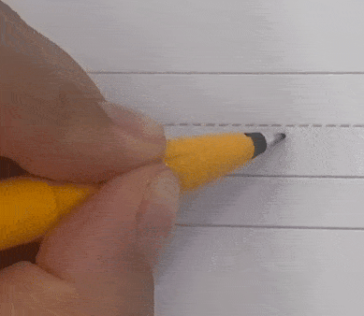
Forming the lower case letter c in print
Let’s write the letter c.
Sit comfortably and hold your pencil.
Start just below the x-height line.
Go round in an anti-clockwise direction and finish just above the baseline.
Remember do not lift your pencil when forming the letter c.

Slide 17
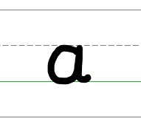
Forming the lower case letter a in print
The letter a is an x-height letter.
The letter a finishes with a flick.
The letters a and c are formed in a similar way.
anti-clockwise
They both start just below the x-height line, go round in an anti-clockwise direction.
They belong to the same letter family.

Slide 18
Forming the lower case letter a in print
I will form the letter a in the air with my finger and form the letter a in the air with my fist.
You will form the letter a in the air with your finger and form the letter a in the air with your fist.
anti-clockwise

Slide 19
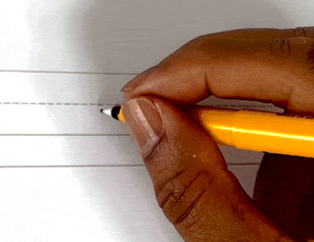
Forming the lower case letter a in print
Let’s write the letter a.
Sit comfortably and hold your pencil.
Start just below the x-height line.
Go round in an anti-clockwise direction, back up to the x-height line and down to the baseline.
Finish with a flick.
Remember do not lift your pencil when forming the letter a.

Slide 20
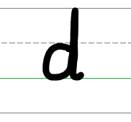
Forming the lower case letter d in print
The letter d has an ascender.
The letter d is formed in a similar way to the letters c and a.
anti-clockwise
They all start just below the x-height line and go round in an anti-clockwise direction.
They belong to the same letter family.

Slide 21
Forming the lower case letter d in print
I will form the letter d in the air with my finger and form the letter d in the air with my elbow.
You will form the letter d in the air with your finger and form the letter d in the air with your elbow.
anti-clockwise

Slide 22
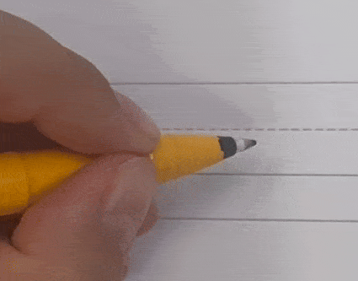
Forming the lower case letter d in print
Let’s write the letter d.
Sit comfortably and hold your pencil.
Start just below the x-height line.
Go round in an anti-clockwise direction, back up to the ascender line and down to the baseline.
Finish with a flick.
Take your pencil off the page.

Slide 23
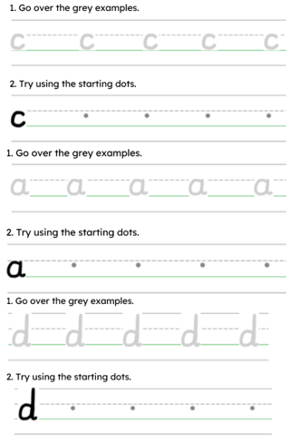
dad
cod
day
Handwriting Repeater

Slide 24
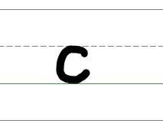
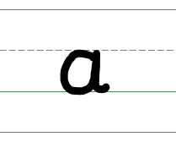
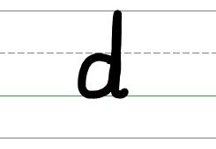
Formation of c, a and d
the letters c and a are x-height letters
the letter d has an ascender
letters c, a and d start just below the x-height line and go round in an anti-clockwise direction
letters a and d finish with a flick
letters c, a and d are in the same letter family

Slide 25
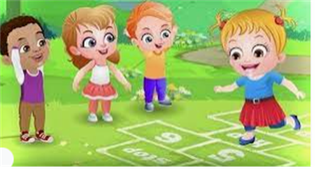
Break

Slide 26
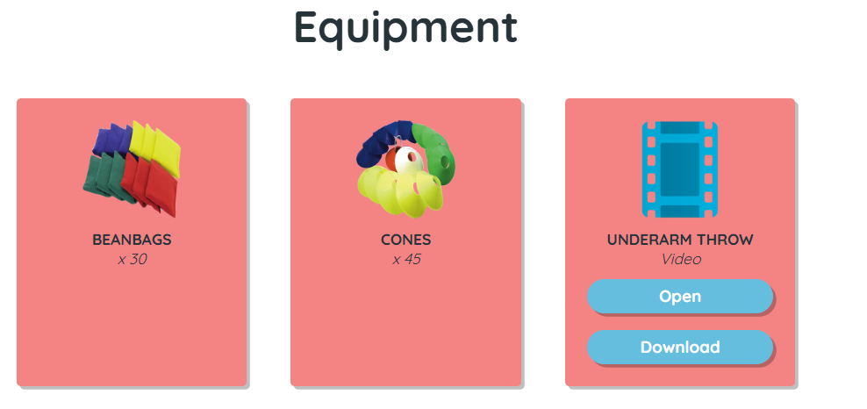
TBAT: develop underarm throwing towards a target.
Tuesday 3rd June 2025

Slide 27
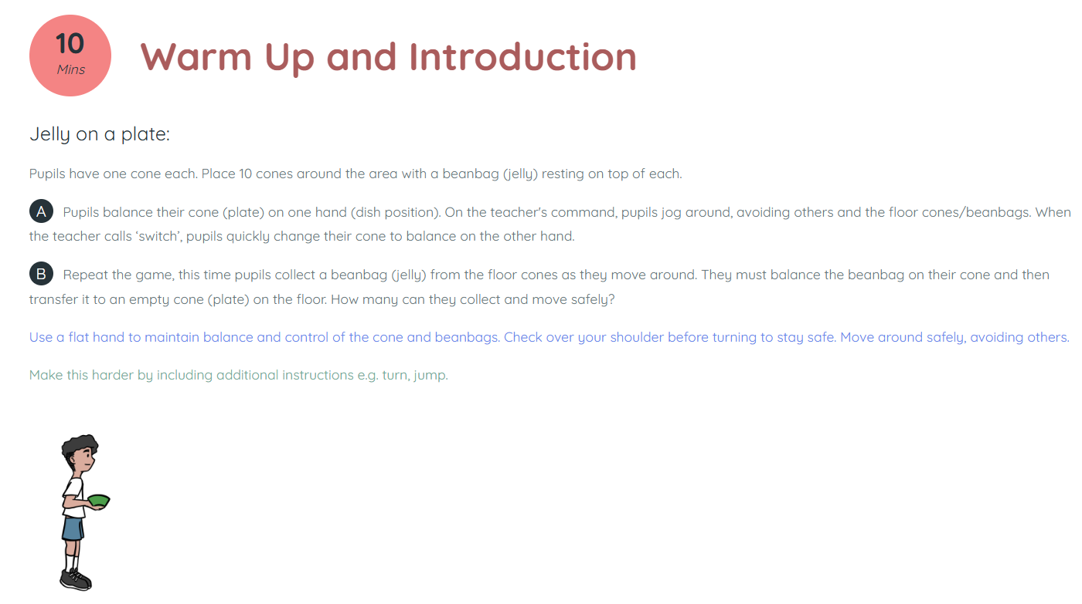
TBAT: develop underarm throwing towards a target.
Tuesday 3rd June 2025

Slide 28
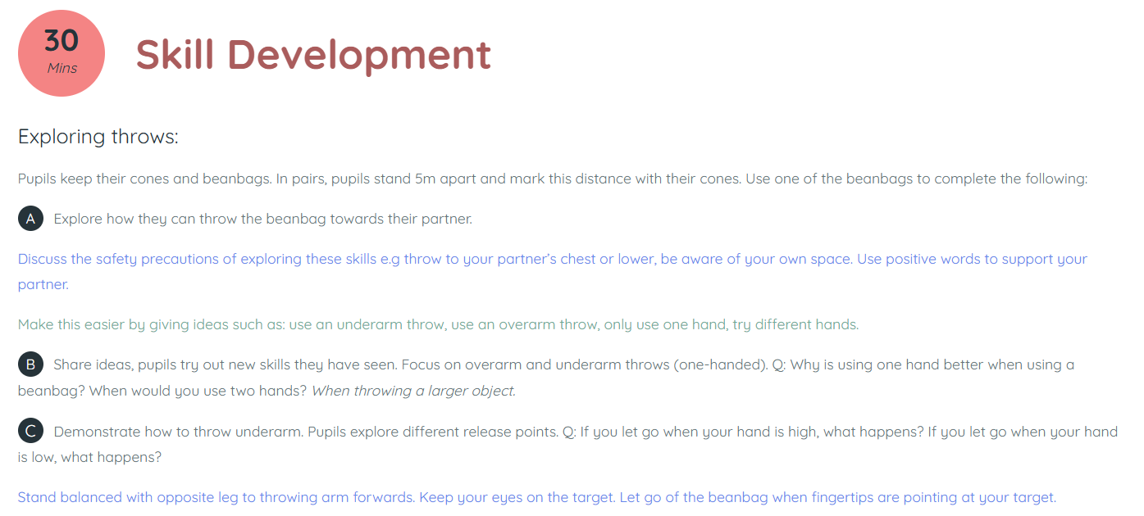
TBAT: develop underarm throwing towards a target.
Tuesday 3rd June 2025

Slide 29
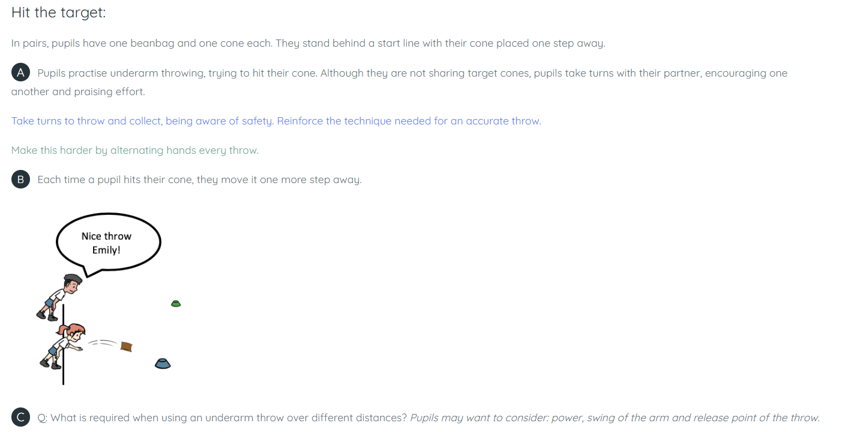
TBAT: develop underarm throwing towards a target.
Tuesday 3rd June 2025

Slide 30
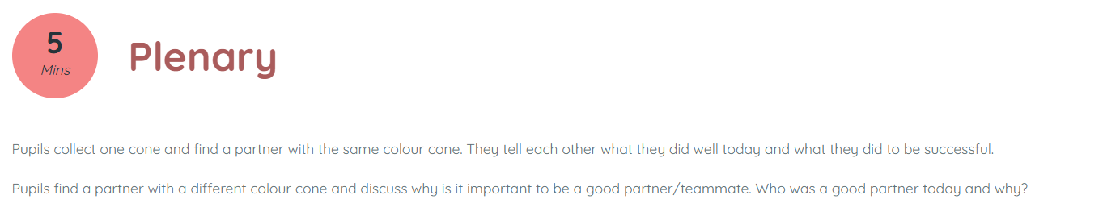
TBAT: develop underarm throwing towards a target.
Tuesday 3rd June 2025

Slide 31

Lunch

Slide 32

Today's Alien language is.......

Slide 33
What are the missing numbers?
What's the same in each pair?
What's different?
3 in 3
1
+
1
=
2
2
+
2
=
4
3
+
3
=
6
10
+
10
=
20
20
+
20
=
40
30
+
=
60
4
+
=
5
+
5
=
10
40
+
40
=
80
+
=
100
Notes:
Do Now: Number patterns
Show pupils the slide. They read the equations out loud with a partner and complete the gaps.
What’s the same and what’s different in each pair?
Can you continue the pattern of equations?

Slide 34
TBAT: describe arrays
array
equal groups
groups
altogether

Slide 35
What do you see?
How do you see it?
Notes:
New Learning: Exploring arrays
Display an array using the slide or an arrangement of counters under a visualiser.
What do you see? How do you see it?
I can see a group of three and a group of two.
How many (dots) are there altogether? How do you know?
There are five dots altogether. I used my number bonds three add two is equal to five.

Slide 36
What do you see?
How do you see it?
Notes:
Show a second array with an additional group of two and again ask pupils to discuss what they see before asking them how many there are altogether.
There are seven dots altogether. I know because I counted one group of two then added another group of two, 2,4. Then I added three.
I could also count them all.
Model one to one correspondence to check, crossing off each one as you count.

Slide 37
What do you see? How do you see it?
B/G
array groups equal groups altogether
Notes:
Talk Task: Describing arrays
Pupils take it in turns to describe different shaped arrays including some that are and some that are not rectangular.
I can see two threes
I can see a one, a two and a three.

Slide 38
How many equal groups?
Notes:
Develop Learning: Describing equal groups
Show the five by one array. Draw a box around it, explaining how the array could be described as rectangular, recapping the properties of a rectangle as needed. Explain that we are going to refine our descriptions by talking about equal groups. Model describing the array as ‘one group of five.’

Slide 39
How many equal groups?
Notes:
Display the next slide with the two by five array.
I can see two groups of five. The groups are equal. I can see two equal groups of five.

Slide 40
How many equal groups?
Notes:
Repeat with three groups of five. At this stage pupils are not expected to understanding commutativity but you may also want to show that we can also see five groups of two and five groups of three. This may also be away to extend thinking for some learners who are secure with the language.

Slide 41

Spot the mistake:
I can see 4 equal groups of 4.
There are 8 altogether.
Notes:
A further example is included with a purposeful mistake, ask pupils to spot what’s wrong to check for understanding before starting the Independent task.

Slide 42
TBAT: describe arrays
Rectangular arrays
Describe each array using the star words and full sentences.
I can see three equal groups of two. Two, Four, Six. There are 6 altogether.
Notes:
Independent Task: Rectangular arrays
Pupils describe each array. You may want to begin this task verbally, similar to the talk task and use your judgment as to whether pupils progress to a written description using the included task sheets and sentence scaffolds.
Possible adaptations:
Pupils create arrays using counters and use one to one correspondence to count how many altogether.
Pupils could be provided with sentence stems to support them with the language
Pupils could create their own rectangular array to describe.
Pupil could explore different ways to see equal groups on the same array e.g. three equal groups of two and two equal groups of three moving towards the generalisation that three lots of 2 is the same as two lots of three.

Slide 43
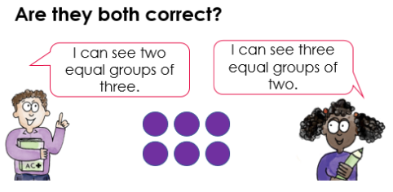
TBAT: describe arrays
RP:
Notes:
Independent Task: Rectangular arrays
Pupils describe each array. You may want to begin this task verbally, similar to the talk task and use your judgment as to whether pupils progress to a written description using the included task sheets and sentence scaffolds.
Possible adaptations:
Pupils create arrays using counters and use one to one correspondence to count how many altogether.
Pupils could be provided with sentence stems to support them with the language
Pupils could create their own rectangular array to describe.
Pupil could explore different ways to see equal groups on the same array e.g. three equal groups of two and two equal groups of three moving towards the generalisation that three lots of 2 is the same as two lots of three.

Slide 44
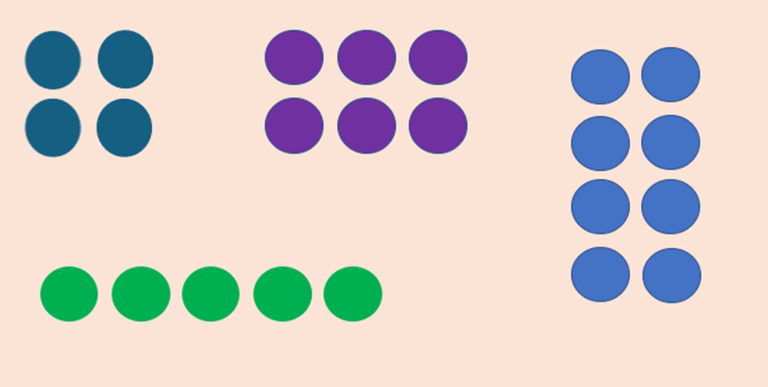
TBAT: describe arrays
Challenge: Which array is the odd one out?
Notes:
Independent Task: Rectangular arrays
Pupils describe each array. You may want to begin this task verbally, similar to the talk task and use your judgment as to whether pupils progress to a written description using the included task sheets and sentence scaffolds.
Possible adaptations:
Pupils create arrays using counters and use one to one correspondence to count how many altogether.
Pupils could be provided with sentence stems to support them with the language
Pupils could create their own rectangular array to describe.
Pupil could explore different ways to see equal groups on the same array e.g. three equal groups of two and two equal groups of three moving towards the generalisation that three lots of 2 is the same as two lots of three.

Slide 45
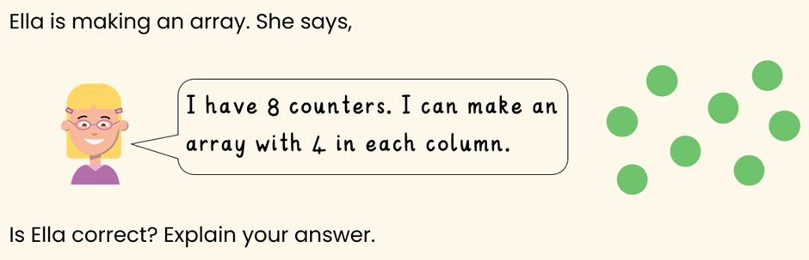
TBAT: describe arrays
Mastery:
Notes:
Independent Task: Rectangular arrays
Pupils describe each array. You may want to begin this task verbally, similar to the talk task and use your judgment as to whether pupils progress to a written description using the included task sheets and sentence scaffolds.
Possible adaptations:
Pupils create arrays using counters and use one to one correspondence to count how many altogether.
Pupils could be provided with sentence stems to support them with the language
Pupils could create their own rectangular array to describe.
Pupil could explore different ways to see equal groups on the same array e.g. three equal groups of two and two equal groups of three moving towards the generalisation that three lots of 2 is the same as two lots of three.

Slide 46
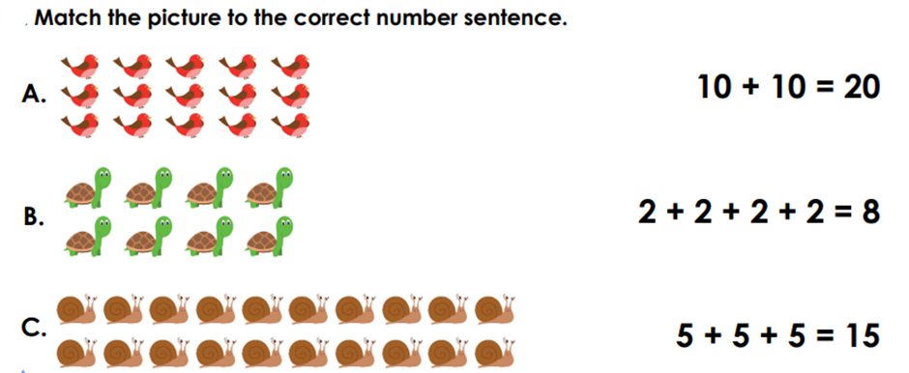
TBAT: describe arrays
Mastery with greater depth:
Notes:
Independent Task: Rectangular arrays
Pupils describe each array. You may want to begin this task verbally, similar to the talk task and use your judgment as to whether pupils progress to a written description using the included task sheets and sentence scaffolds.
Possible adaptations:
Pupils create arrays using counters and use one to one correspondence to count how many altogether.
Pupils could be provided with sentence stems to support them with the language
Pupils could create their own rectangular array to describe.
Pupil could explore different ways to see equal groups on the same array e.g. three equal groups of two and two equal groups of three moving towards the generalisation that three lots of 2 is the same as two lots of three.

Slide 47

Little Wandle Guided Reading

