Slide 1

Monday 11th May 2026
TBAT: Use joins consistently.
nearby
everywhere
nowhere
inside
downstairs
outside
upstairs
underneath
behind
somewhere
Are there any words you are unsure of?
Use a dictionary to look them up and then use them in a sentence.

Slide 2
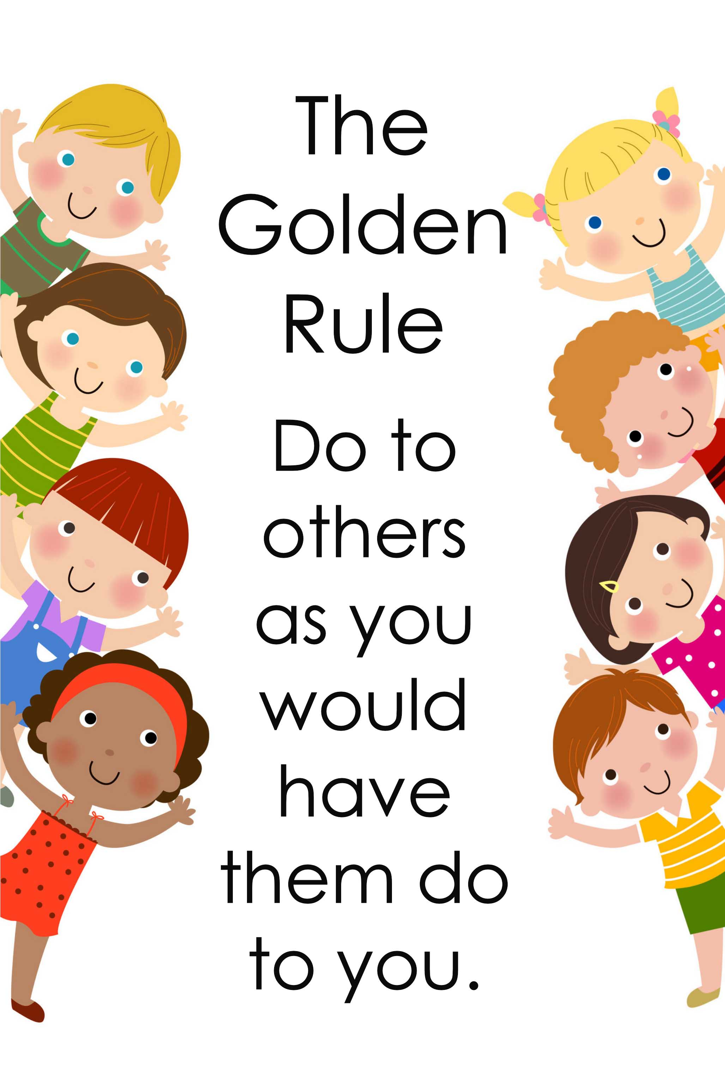
Monday 11th May
Morning challenge
SATs Week for Year 6
Golden rules:
- If you are going to the toilet,
you walk silently
Wait for the message to
tell you it is breaktime
Be kind to Year 6
Remember: it will be you next year!

Slide 3
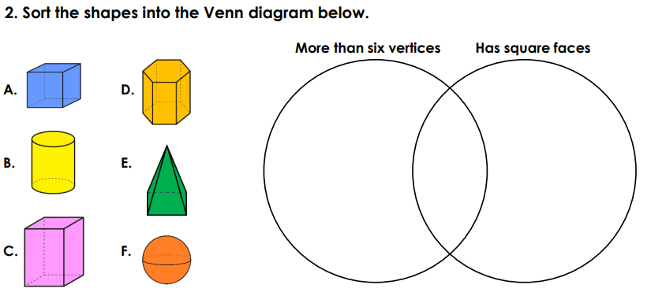
11.05.26
TBAT- identify 3D nets using 2D representations.
3 in 3
1) 34, 827 + ? = 50, 000 3) 60 x 4 =
Challenge:
What am I?
I have two square faces and four rectangular faces.

Slide 4
Daily 10
Daily 10 - Mental Maths Challenge - Topmarks

Slide 5
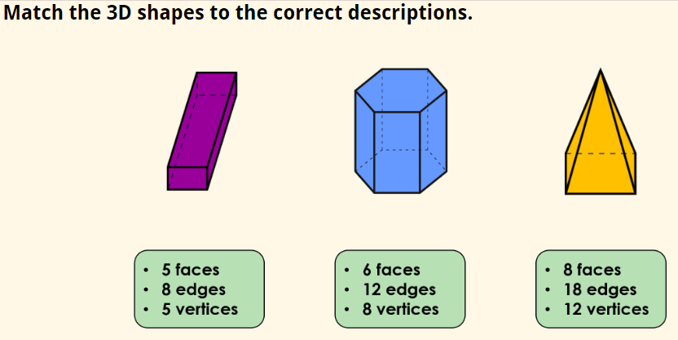
Talk partners:

Slide 6
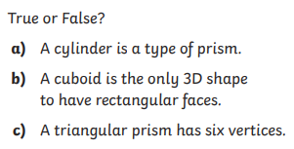
Whiteboard work:

Slide 7
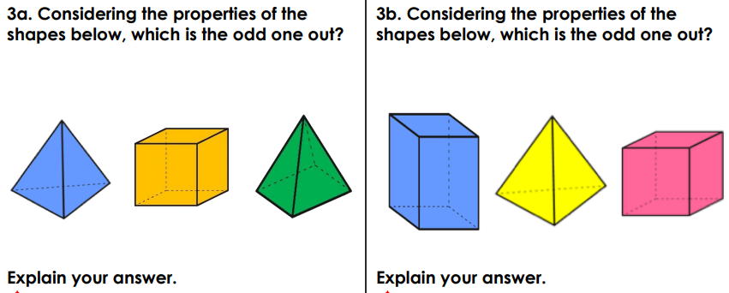
Blue Green

Slide 8
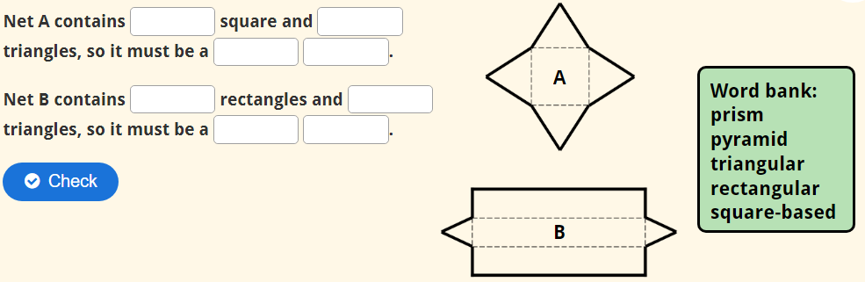
Complete in books:

Slide 9
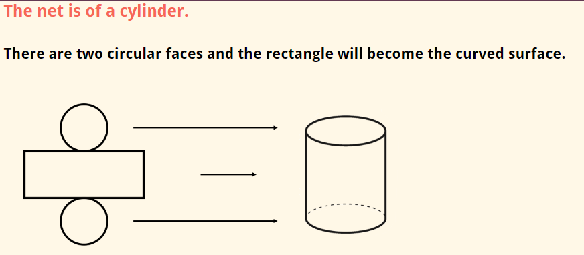

Slide 10
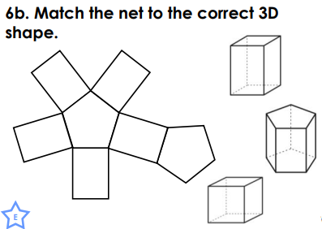
Talk partners:

Slide 11
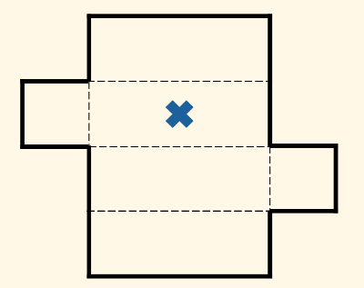
Which 3D shape will this net make?
Whiteboard work:

Slide 12
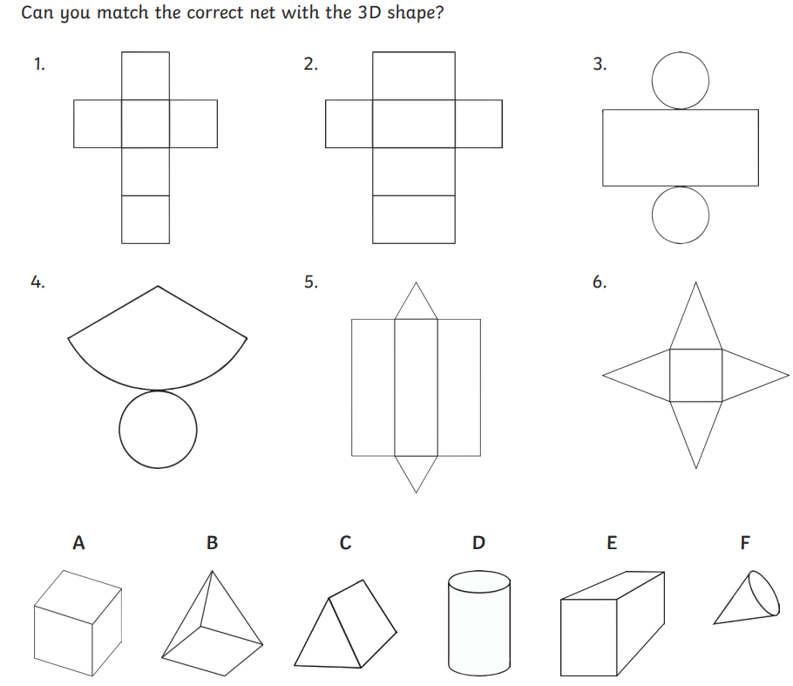

Check point question
1=
2=
3=
4=
5=
6=

Slide 13
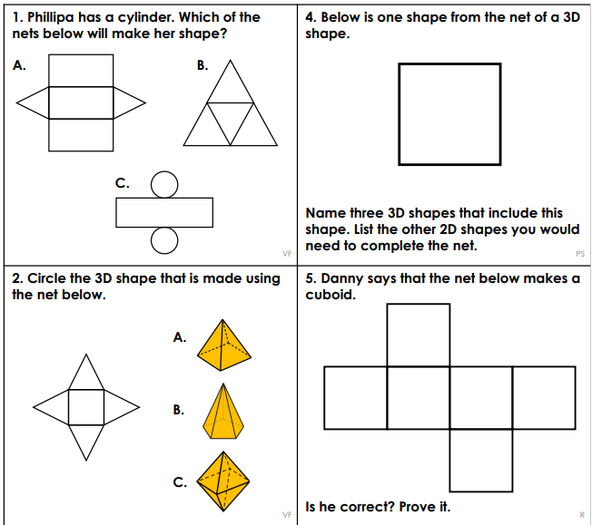
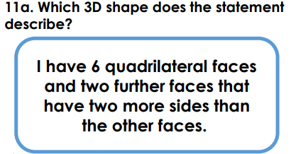
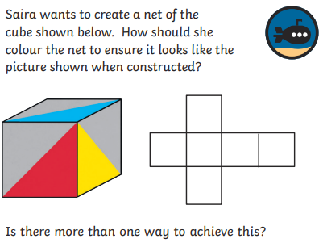
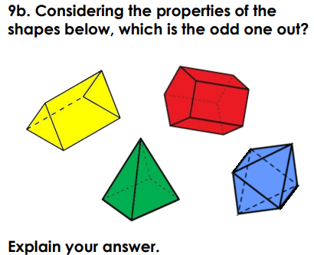
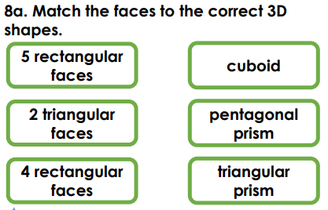
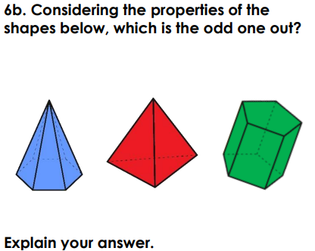
Challenge:
Mastery: Mastery with GDS:

Slide 14
Monday 11th May
TBAT: retrieve information from a text
3 in 3
When Lucy pushed aside the thick curtain of ivy at the back of the garden, she gasped in wonder. Hidden behind it was a secret garden filled with bright flowers that danced in the breeze and tall trees whispering softly overhead. The air smelled sweet, like honey and fresh rain, and a small stone path twisted through the grass as if inviting her to explore. She felt as though she had stepped into a magical place that had been waiting just for her.
What did Lucy push aside to discover the garden?
What could Lucy smell in the secret garden?
What kind of path was inside the garden?

Slide 15
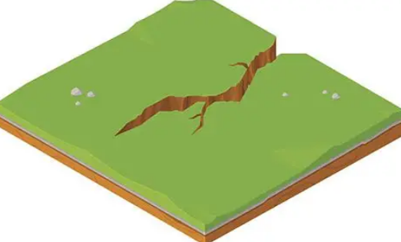
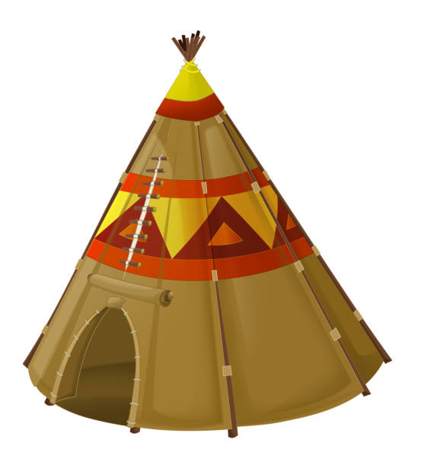
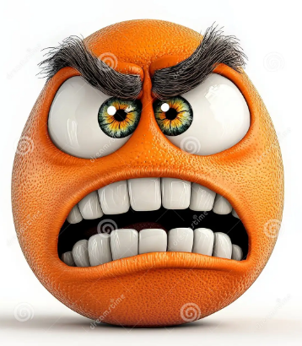
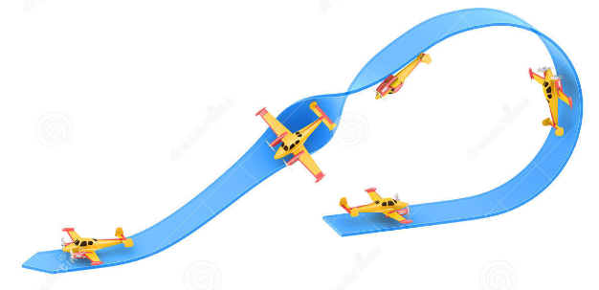
Monday 11th May ​
TBAT: retrieve information from a text
Crevice - a small, narrow crack or space, especially in the surface of rock
Wigwam - a rounded structure made from a frame of poles covered with materials such as grass, cloth, or animal skins
Grimace - to make an expression of pain, strong dislike
Manoeuvred - a movement or set of movements needing skill and care

Slide 16
Monday 11th May ​
TBAT: retrieve information from a text
Multiple choice questions
Who was the letter to that Hatty wrote?
Father Christmas Fairies Easter Bunny
2. What did they find among the tools and seed-boxes?
Feathers grass cuttings eggs
3. What was the book at the topmost of the pile?
The Secret Garden Tom's Midnight Garden Bible

Slide 17
Monday 11th May ​
TBAT: retrieve information from a text
Why did Hatty break off some of the yew tree?
Find and copy two of Hatty’s hiding places.
What did Hatty unlatch?
What could you see through each colour of the pane?
What was the name of the tree that Tom had climbed?
Why was one tree called the tricksy?
What was sad about Abel?
Why did Tom recognise the story about Abel?

Slide 18
Monday 11th May ​
TBAT: retrieve information from a text
Challenge
How do the games and stories that Tom and Hatty share in Chapter 10 help us understand their friendship? Use at least two examples from the chapter to explain your answer, and describe how their friendship changes or grows.

Slide 19
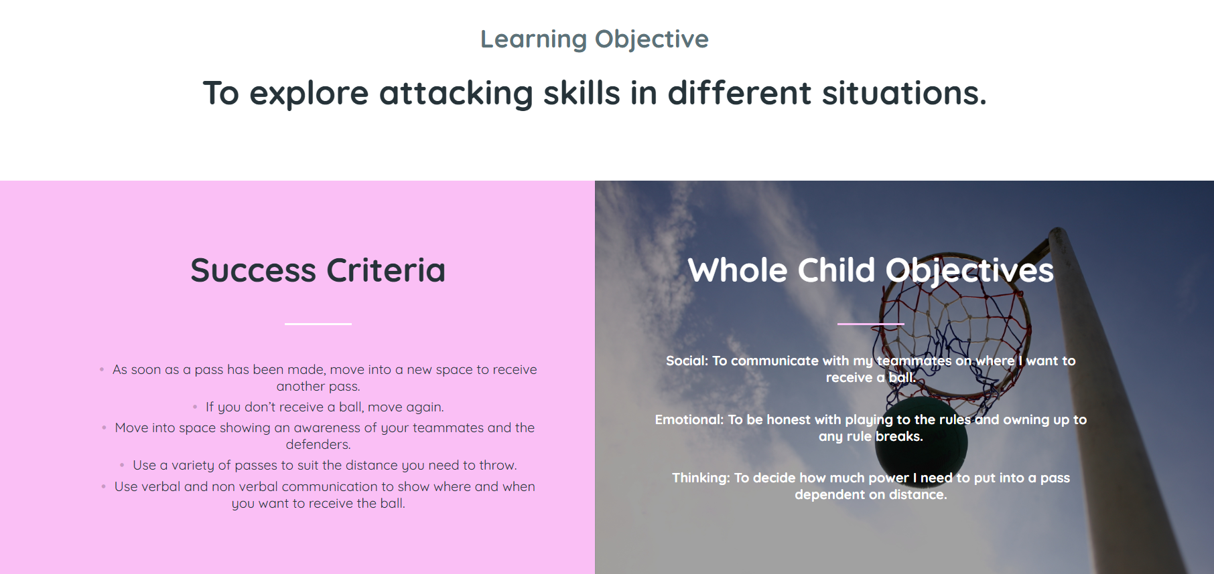

Slide 20
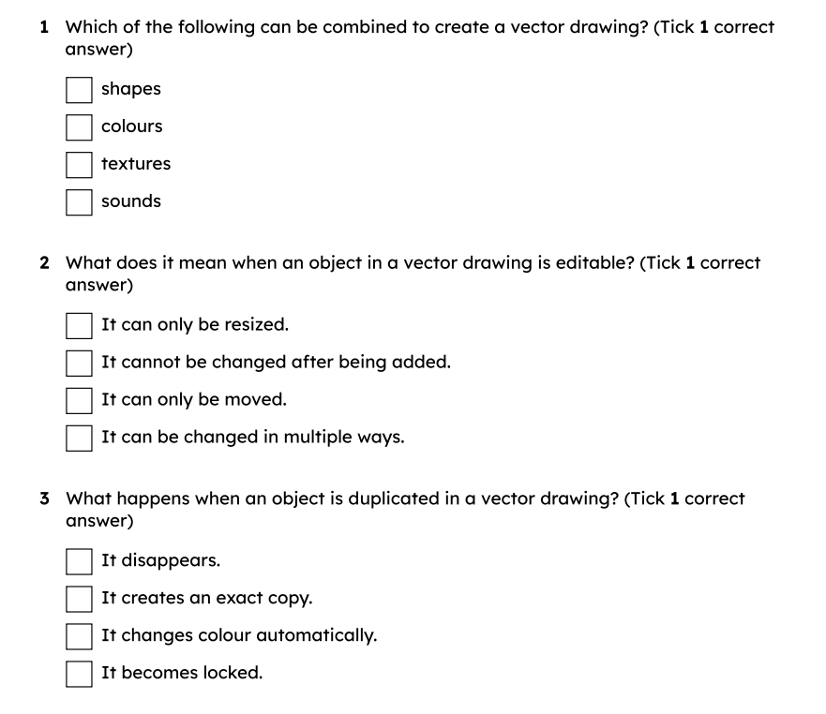
Monday 11th May
TBAT: use software tools to adapt a vector drawing.
Complete on
whiteboards:
Challenge:
How can you manipulate an image on paint?

Slide 21

Monday 11th May
TBAT: use software tools to adapt a vector drawing.
Use Year 4 chrome books – and access paint (NOT google draw)
Children need to have chrome books throughout the lesson to access each task.

Slide 22
zoom
to make the view closer or further away without changing the size of the objects
align
to line up objects neatly, either side by side or on top of each other
border
the line around the outside of a shape, which you can change the colour, thickness or style of

Slide 23
Use the zoom tool to view and edit details
Which two penguins are the same?
1.
2.
3.
4.
5.
6.
7.
8.

Slide 24
Use the zoom tool to view and edit details
Which two penguins are the same?
1.
2.
3.
4.
5.
6.
7.
8.

Slide 25
Use the zoom tool to view and edit details
Here are some of the differences.
1.
2.
3.
4.
5.
6.
7.
8.

Slide 26


Use the zoom tool to view and edit details
Why is using zoom useful?
Alex
When objects are small, they can be hard to click on to move and resize.
To get a better view, you can use the zoom tool.
The zoom tool does not change the size of the object — it just helps you view the image more closely.

Slide 27

Use the zoom tool to view and edit details
Using the zoom tool changes the actual size of the shapes.
Why?
The zoom tool does not change the size of the object — it just helps you view the image more closely.

Slide 28
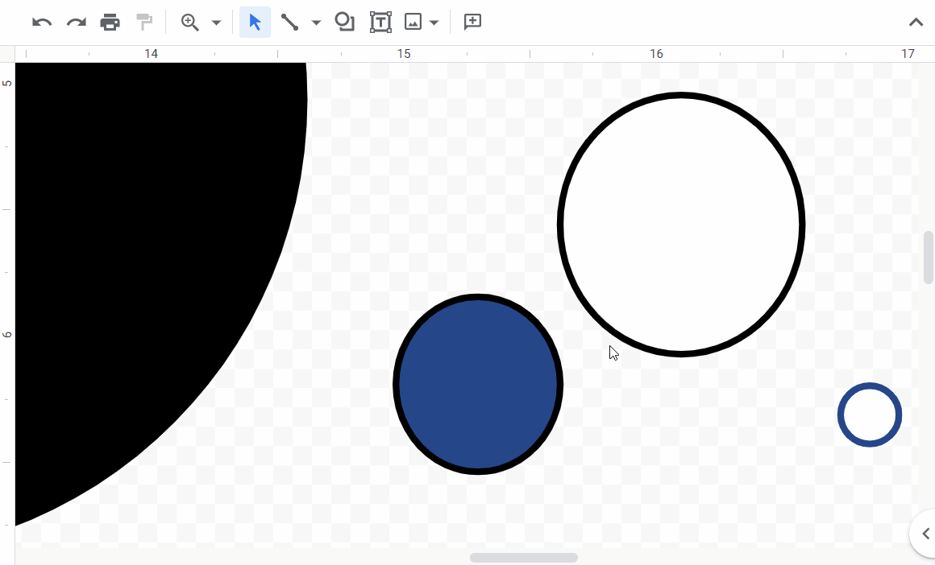
Use the zoom tool to view and edit details
When you have zoomed enough, use the Select button to make changes.
You may need to scroll the screen to see other parts of your image when you are zoomed in.
Click the arrow next to the Zoom button and select Fit when you want to see the whole page again.
Google Drawings is a trademark of Google LLC and this content is not endorsed by or affiliated with Google in any way.

Slide 29

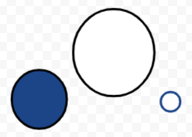
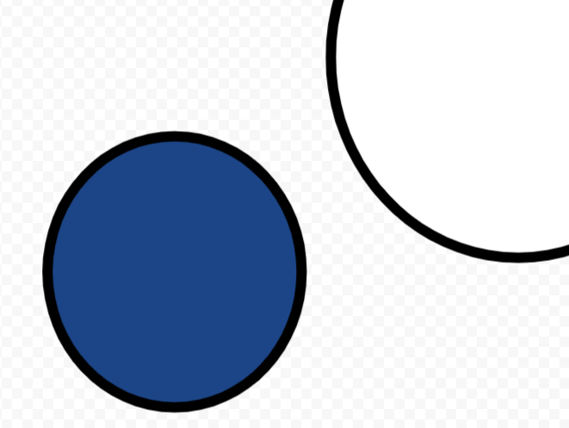
Use the zoom tool to view and edit details
The zoom tool does not change the size of the object.
Click the zoom button and then click on the area you want to see more clearly.
zoom
Google Drawings is a trademark of Google LLC and this content is not endorsed by or affiliated with Google in any way.

Slide 30
Use the zoom tool to view and edit details
What does the zoom tool do?
It makes the shapes bigger permanently .
It helps you see parts of your drawing more clearly.
It changes the colour of your shapes.
It moves your shapes.

Slide 31
Use the zoom tool to view and edit details
Use the zoom tool to build the penguin’s head.
Once you have placed the eye and beak, reset your zoom to Fit.
Stop once you have completed the head.
Google Drawings is a trademark of Google LLC and this content is not endorsed by or affiliated with Google in any way.

Slide 32
Use the zoom tool to view and edit details

Slide 33
Use alignment and resizing to improve consistency
What are the red lines that appear when I move shapes?
Alex
When you move shapes, red lines may appear. These are alignment guides — they help you to centre or line up objects with others.

Slide 34
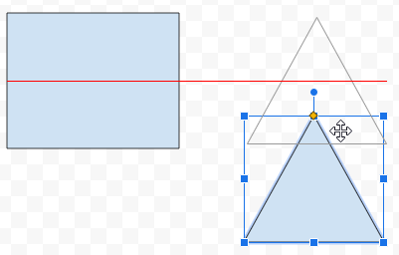
Use alignment and resizing to improve consistency
The red lines are used for alignment:
You can align an object with the centre of another object.
You can align an object with the edge of another object.
Google Drawings is a trademark of Google LLC and this content is not endorsed by or affiliated with Google in any way.

Slide 35
Use alignment and resizing to improve consistency
What do alignment guides help you do?
rotate a shape
make your drawing colourful
line up your shapes neatly
delete shapes

Slide 36
Use alignment and resizing to improve consistency
What are the blue lines that appear when I resize shapes?
Alex
When resizing shapes, blue lines help you match the size with other shapes.
You can use this to keep shapes the same width or height.

Slide 37
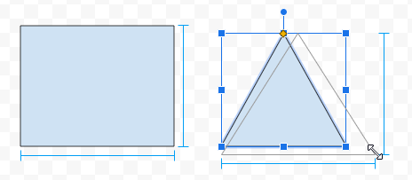
Use alignment and resizing to improve consistency
These blue lines are used as a size guide.
As you resize objects, you can use these lines to match them with other objects on the canvas.
You can match the width and/or height with another object.
Google Drawings is a trademark of Google LLC and this content is not endorsed by or affiliated with Google in any way.

Slide 38
Use alignment and resizing to improve consistency
Blue lines help you match colour with another object.
Why?
They help you match the size.

Slide 39
Use alignment and resizing to improve consistency
Use the alignment and resize guides to
match the model penguin.
Google Drawings is a trademark of Google LLC and this content is not endorsed by or affiliated with Google in any way.

Slide 40
Use alignment and resizing to improve consistency
Use the resize lines to make sure the feet pieces are the same size, before overlapping them.
Google Drawings is a trademark of Google LLC and this content is not endorsed by or affiliated with Google in any way.

Slide 41
Use alignment and resizing to improve consistency
Share your penguins with your class.

Slide 42
Modify objects to create a new image
How have circles B, C and D changed from circle A?
A
B
C
D

Slide 43
Modify objects to create a new image
What has changed from circle A?
A
B
C
D
B has a bold border.
C has a dotted border.
D has a coloured border.

Slide 44

Modify objects to create a new image
Border tools can be used to adjust the appearance of each outline (border).
border colour
border weight
border dash
B
C
D
Google Drawings is a trademark of Google LLC and this content is not endorsed by or affiliated with Google in any way.

Slide 45
Modify objects to create a new image
border weight – changes the thickness of the line
border colour – changes the colour of the line
border dash – changes the style of the line
Google Drawings is a trademark of Google LLC and this content is not endorsed by or affiliated with Google in any way.

Slide 46
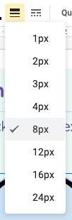
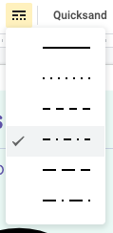
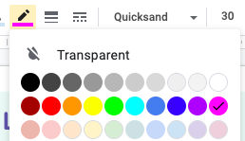
Modify objects to create a new image
border weight
border dash
border colour
B
C
D
Google Drawings is a trademark of Google LLC and this content is not endorsed by or affiliated with Google in any way.

Slide 47
Modify objects to create a new image
Which tool would you use to make a shape outline thicker?
border colour
border weight
fill colour
resize handle

Slide 48
Modify objects to create a new image
Can you spot any differences between the penguin and the parrot?
Have any shapes been added?
Have any changes been made to the shapes?
Have any shapes been deleted?

Slide 49
Modify objects to create a new image
Have any shapes been added?

Slide 50
Modify objects to create a new image
Have any changes been made to the shapes?

Slide 51
Modify objects to create a new image
Have any shapes been deleted?

Slide 52
Modify objects to create a new image
To change an object’s shape or colour, you must delete it and draw a new one.
Why?
You can make changes to an object rather than deleting it and starting again.

Slide 53
Modify objects to create a new image
Use the following tools to turn your penguin into a parrot:
shape (add new shapes)
rotate and resize
alignment and size guides
fill (change the colour)
border weight, border dash and border colour
zoom

Slide 54
Modify objects to create a new image
Share your parrots with your class.

