Slide 1
Monday 18th May 2026

Slide 2
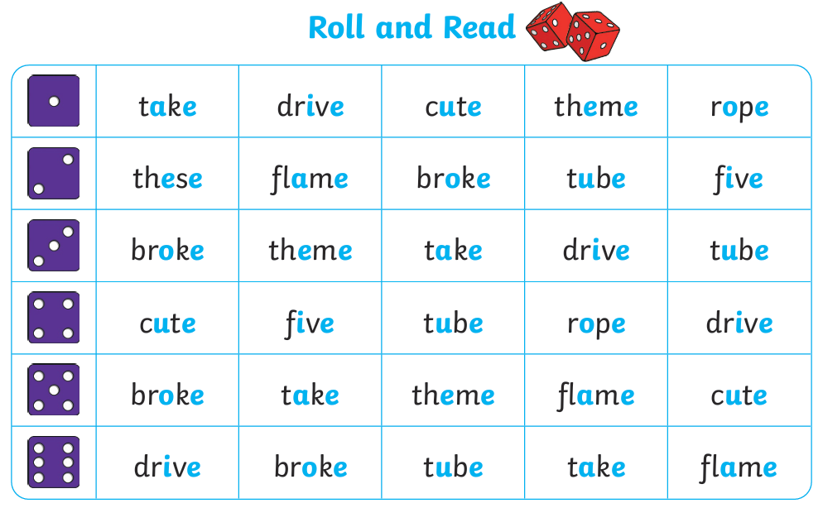
Early Morning work: Take turns to roll a dice and read the word for the number you roll.

Slide 3
TBAT: read and write words which include consonant blends.
Speedy sounds
Digital Flashcards - Teach Your Monster to Read

Slide 4
TBAT: read and write words which include consonant blends.
s-t-r-o-ng

Slide 5
TBAT: read and write words which include consonant blends.
sh-r-i-mp

Slide 6
TBAT: read and write words which include consonant blends.
s-c-r-i-p-t

Slide 7

TBAT: read and write words which include consonant blends.
s-p-l-o-g

Slide 8

TBAT: read and write words which include consonant blends.
s-t-r-i-b

Slide 9

TBAT: read and write words which include consonant blends.
sh-r-u-t

Slide 10

TBAT: read and write words which include consonant blends.
s-p-r-o-d

Slide 11

TBAT: read and write words which include consonant blends.
th-r-i-p

Slide 12
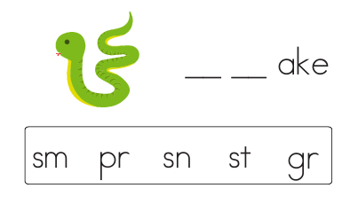
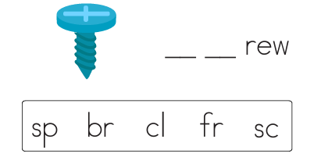
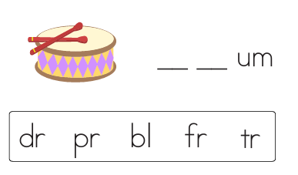
TBAT: read and write words which include consonant blends.

Slide 13
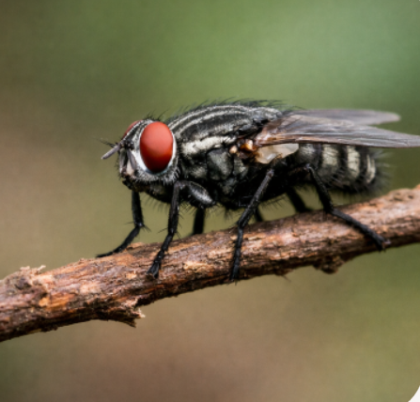
TBAT: read and write words which include consonant blends.
…......................................................................
…......................................................................
….......................................................................
…........................................................................
Notes:
The fly landed in the twig

Slide 14
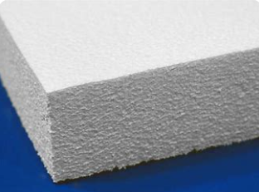

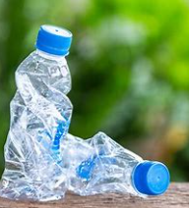
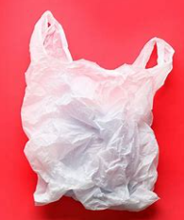

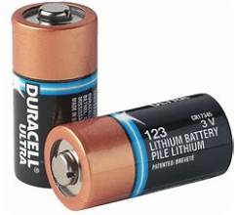
Key Question- How can we make a difference by recycling?
Monday 28th April 2025
3 in 3- Sort the materials into the table
Can be recycled | Cannot be recycled

Slide 15
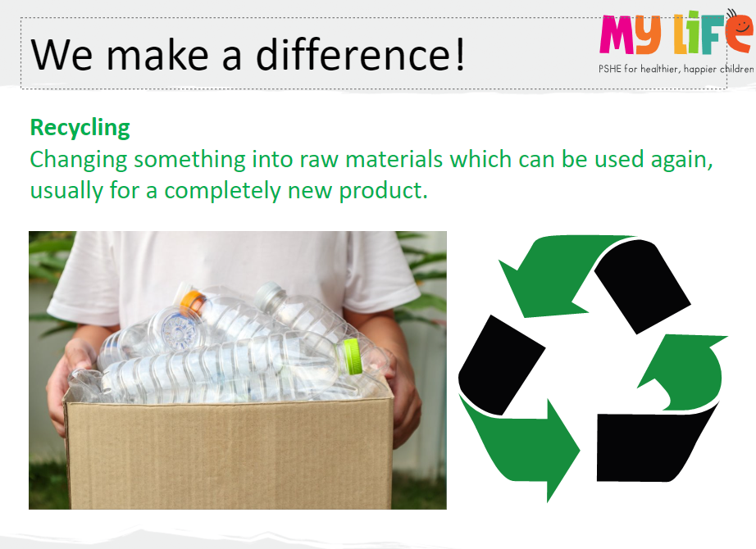
Key Question- How can we make a difference by recycling?
Monday 28th April 2025

Slide 16
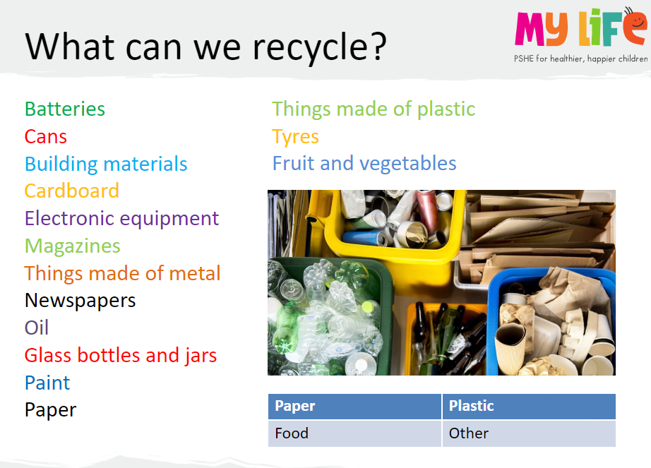
Key Question- How can we make a difference by recycling?
Monday 28th April 2025

Slide 17

Key Question- How can we make a difference by recycling?
Monday 28th April 2025
Recycle - Online Game (mrnussbaum.com)

Slide 18
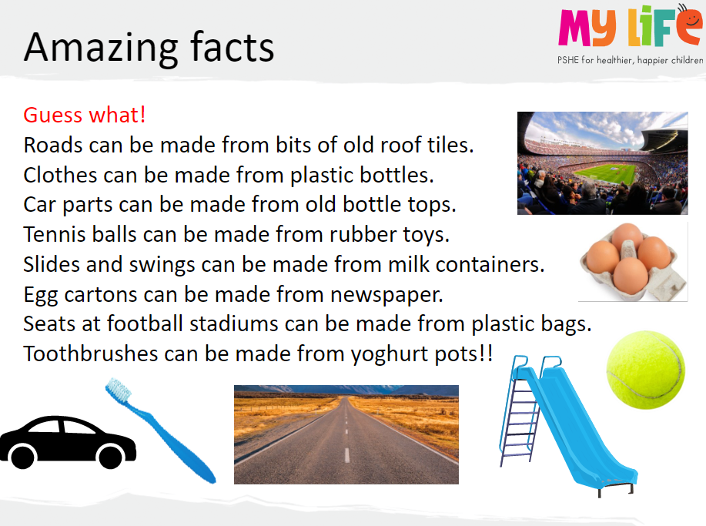
Key Question- How can we make a difference by recycling?
Monday 28th April 2025

Slide 19

Assembly

Slide 20
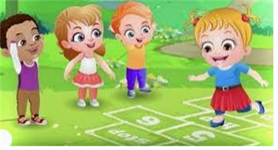
Break

Slide 21
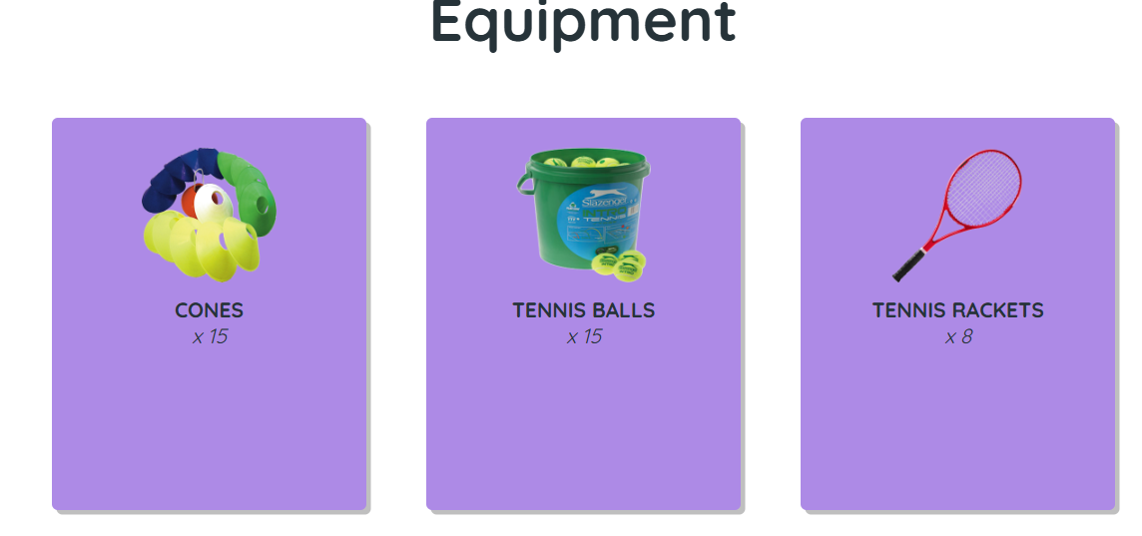
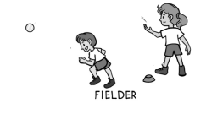
TBAT: Know how to get the batter out Warm up and Introduction Q: Can you name any of the players we have learnt about so far in striking and fielding games? Q: What is the job of each of these players? Bowler, bowls the ball to the batter. Fielders collect the ball quickly to stop the batter scoring. A batter hits the ball and moves to score points

Slide 22
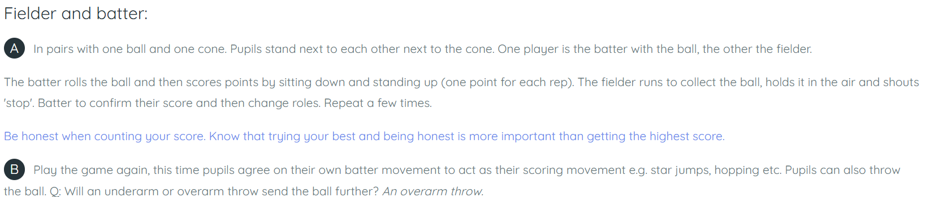
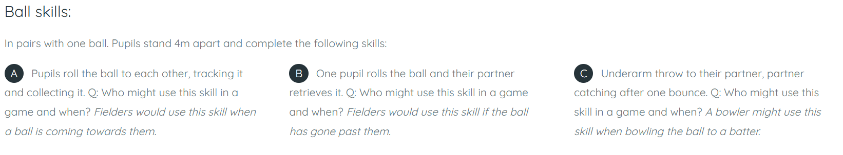
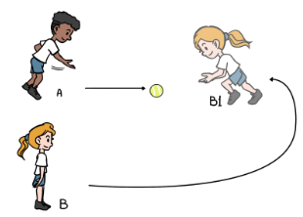

Slide 23
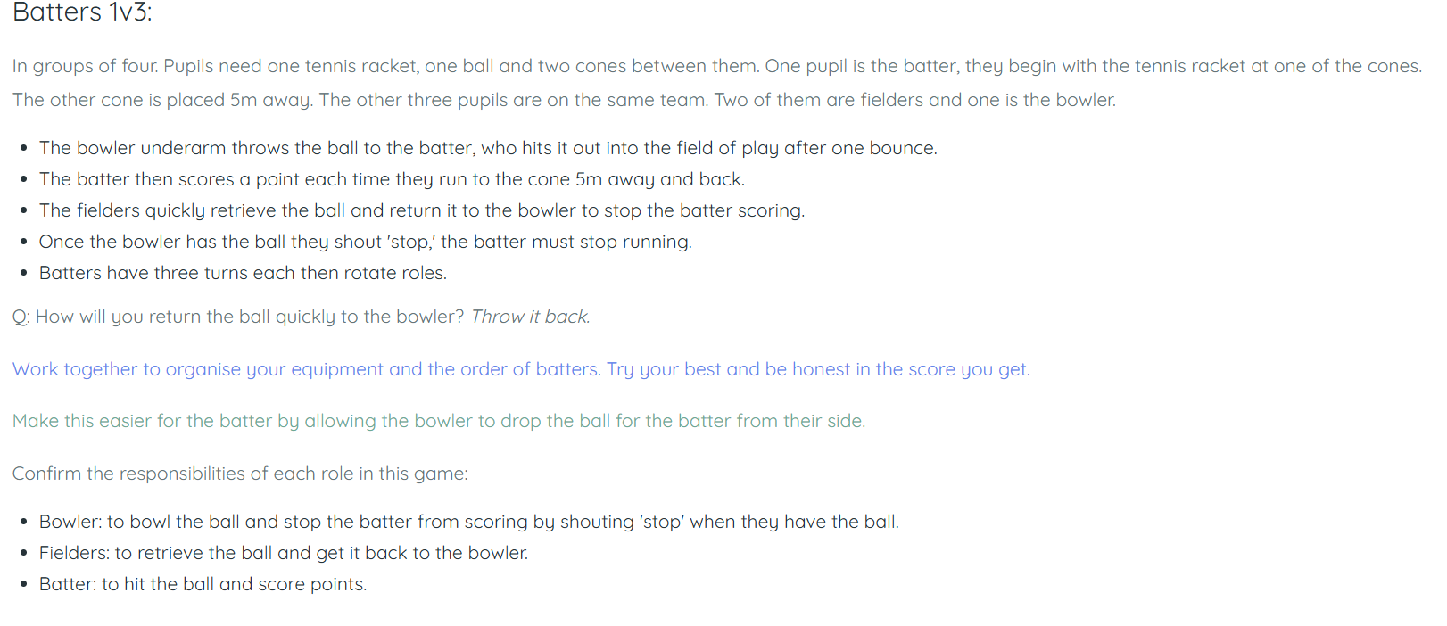

Slide 24
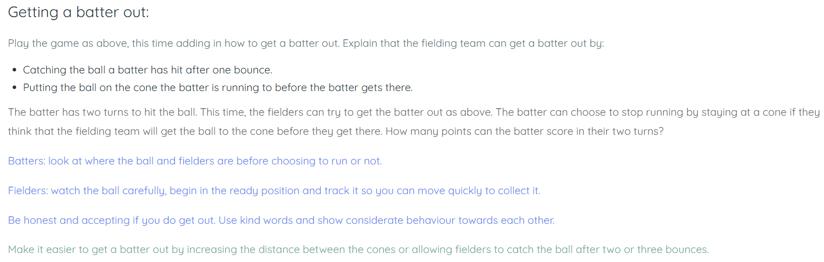

Slide 25
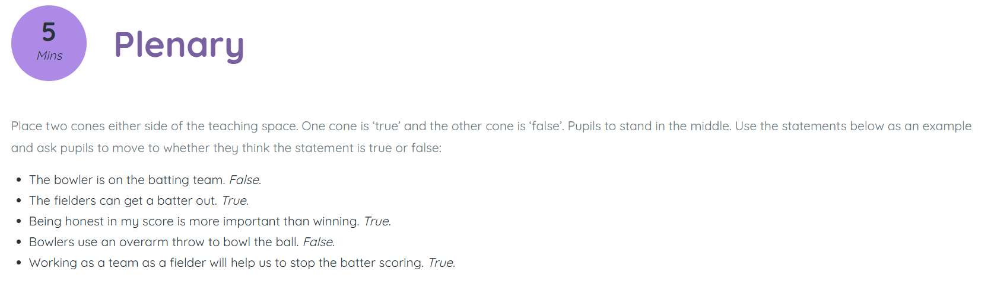

Slide 26

Lunch

Slide 27

Today's Alien language is.......

Slide 28
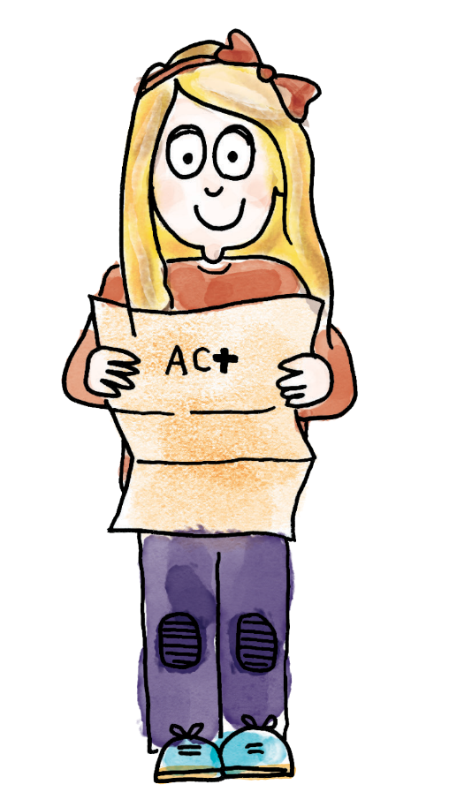
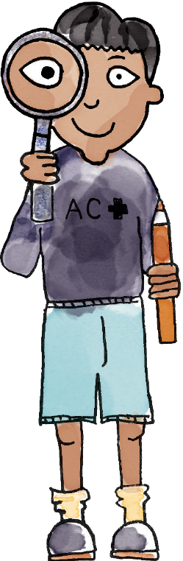
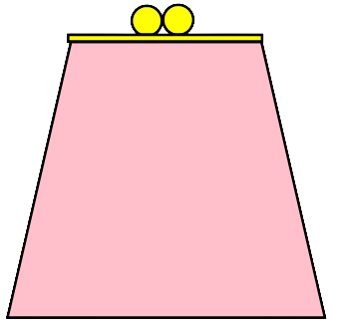



How much does Charlie need to have the same amount as Jenny?
TBAT: use addition and subtraction in the context of money
What coins would Charlie need? Can you prove it?
3 in 3
This is my purse.
I want the same amount as Jenny.
Jenny
Charlie
Notes:
Do Now: Problem solving
Show pupils the problem on the Do Now slide, which presents a simple difference problem. They represent the problem using manipulatives and discuss their answers.

Slide 29
TBAT: use addition and subtraction in the context of money
value column
add row
subtract

Slide 30

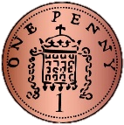


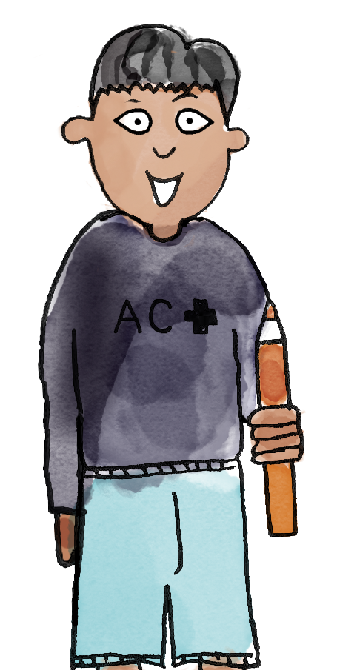
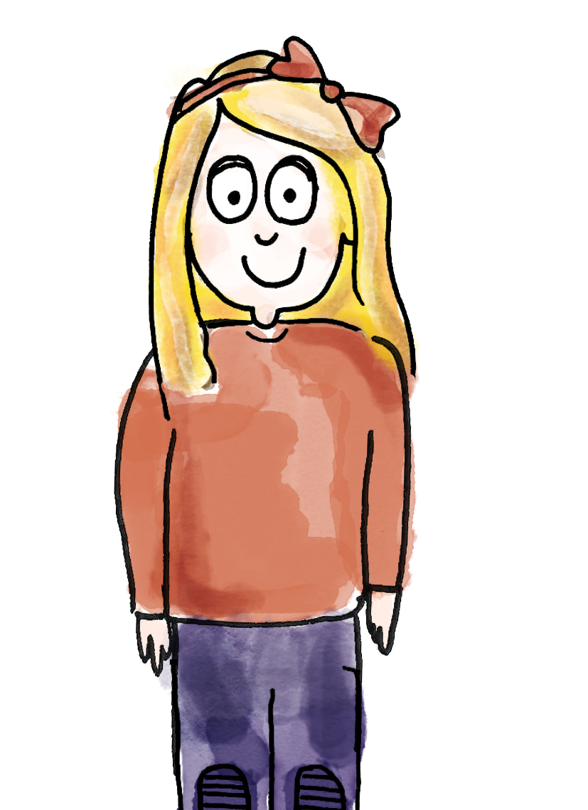
TBAT: use addition and subtraction in the context of money
What is the value of the coins? Which box has the highest value?
B/G
I know the _____ has the highest value because___
value add equal
Notes:
Talk Task: Exchanging penny coins
Each pair has ten pennies as well as a 2 p, 5 p and 10 p coin. They have a cut-out copy of the Talk Task Sheet, cards placed face down. Pupil A picks a coin value card and matches the corresponding coin. Pupil B counts out the number of pennies equal to the value on the card. Pupil A and B exchange their coins (e.g. a 5 p coin for five pennies). Pupils swap roles.

Slide 31
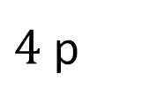
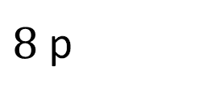
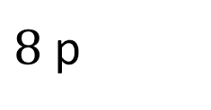
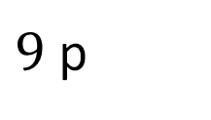
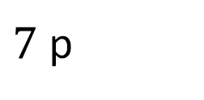

Coin puzzle
TBAT: use addition and subtraction in the context of money
$8$ p
$6$ p
$7$ p
$9$ p
$8$ p
$4$ p
Notes:
New Learning: Introducing the puzzle
Show pupils the puzzle board on the New Learning slide. Explain that the amount at the top of each column is the total value of that column and the amount at the side of each row is the total value of that row.
How could you find out what the missing coins are?
Where would you start? Why?
How does addition help you solve this problem? How does subtraction help you solve this problem?
Pupils’ responses will indicate how much support you need to provide in solving the puzzle. Using pupils’ responses as a springboard, model starting with a column or row with only one missing value, making connections to the part-whole model.
The whole in this column is eight pence. There is already two pence and five pence, which makes seven pence. Seven pence is one part so the other part is one pence. Eight pence subtract seven pence is one pence.
Encourage pupils to use their known number bonds within 10 to find the necessary values.

Slide 32

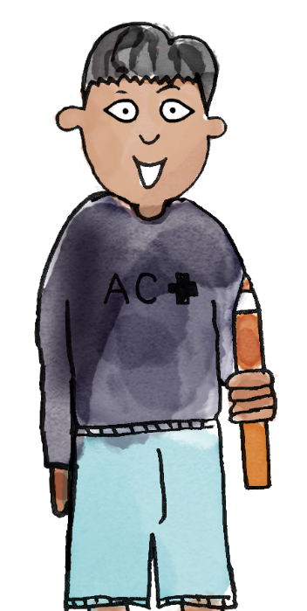
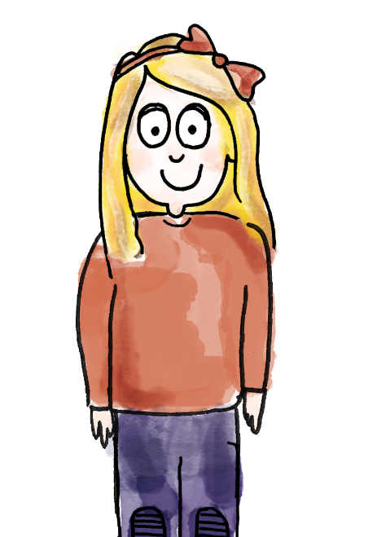

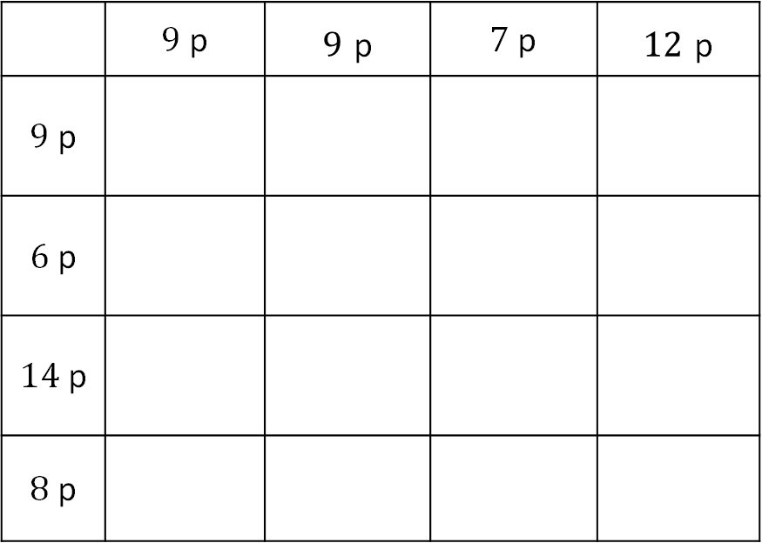
Coin puzzle
TBAT: use addition and subtraction in the context of money
The whole row is 9 p. 7 plus 2 is equal to 9. The missing coin is 2 p
The first row only has one gap, so let's start there! I can see 7 p in total.
 | $9$ p | $9$ p | $7$ p | $12$ p
$9$ p
$6$ p
$14$ p
$8$ p
value column add row subtract
Notes:
Talk Task: Exploring the money puzzle
Pupils have a copy of the Talk Task Sheet and some 1 p, 2 p, 5 p and 10 p coins. They use addition and subtraction to calculate the missing values. They place coins into the squares to solve the problem.
The puzzle could be adapted to provide more information if necessary.

Slide 33
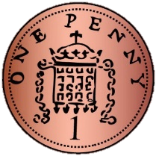
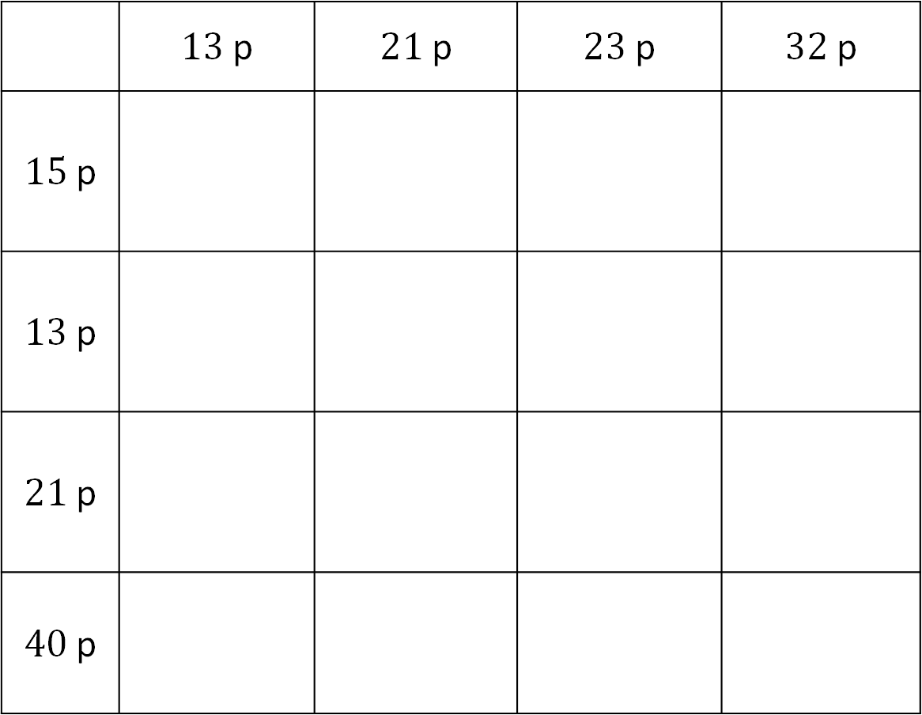
Finding the missing coins
TBAT: use addition and subtraction in the context of money
 | $13$ p | $21$ p | $23$ p | $32$ p
$15$ p
$13$ p
$21$ p
$40$ p
Which coin should we calculate first?
How can we work out the missing coin?
Notes:
Develop Learning: Developing a strategy
Share pupils’ solutions to the Talk Task puzzle and discuss the strategies they used.
Did anyone find a way to work out the missing coins when there were two coins missing in the row or column?
Take suggestions and then look at an example of this on a new puzzle, which will be the Independent Task. Look at the row which sums to 40 p.
What could the missing coins be? Is there more than one possibility?
Give pupils chance to think, represent and discuss and then take feedback. The coins must be 10 p and 20 p (as the row sums to 40 p, there is 10 p there already and there are two spaces left).
How can you work out which way round to place the two coins?
(The above is just one example of how you might provide pupils with an opportunity to share their reasoning and strategies.)

Slide 34
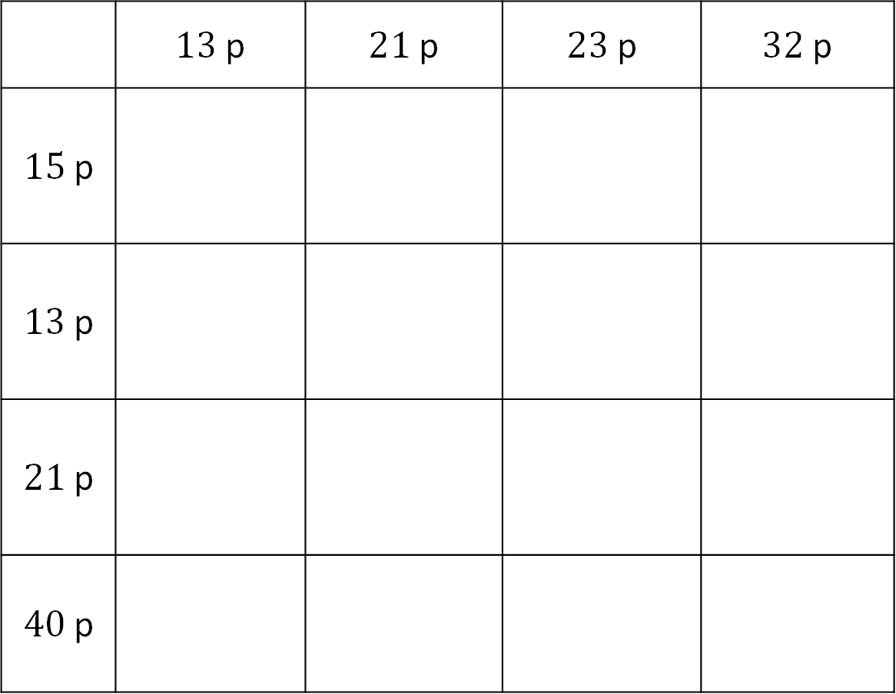
TBAT: use addition and subtraction in the context of money
 | $13$ p | $21$ p | $23$ p | $32$ p
$15$ p
$13$ p
$21$ p
$40$ p
Notes:
Independent Task: Applying a strategy to solve the puzzle
Pupils have a copy of the Task Sheet and some 1 p, 2 p, 5 p, 10 p and 20 p coins. They work together to solve the puzzle. Pupils use bead strings or other manipulatives to support their calculations (though should be encouraged to use known facts where possible). The task is meant to be challenging; it presents an opportunity for lots of addition and subtraction practise, as well as to discuss strategies and the importance of resilience in problem solving.
Possible adaptations:
Scaffold this task by adding more coins onto the grid (though beware of reducing the challenge too much).
Pupils could create their own similar money problem for a friend to solve.

Slide 35
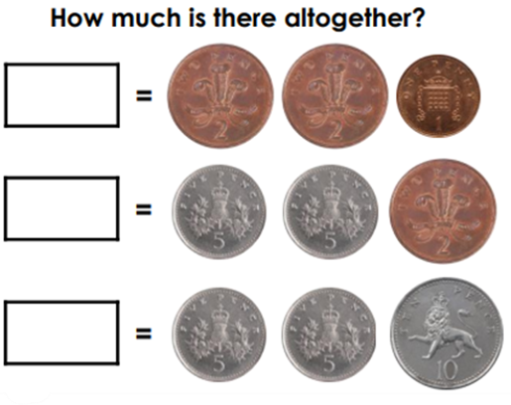
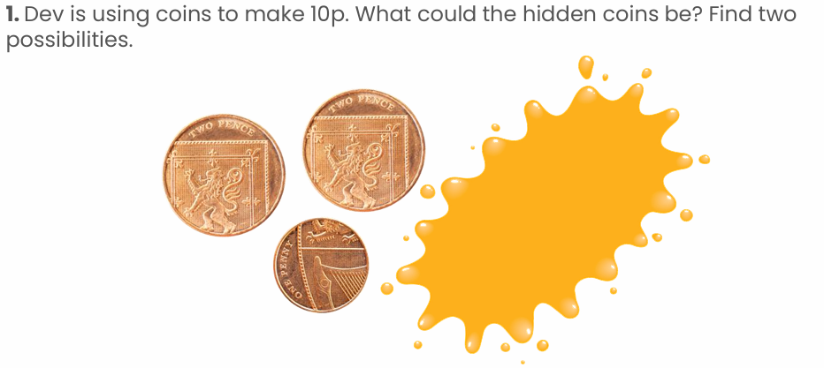
TBAT: use addition and subtraction in the context of money
RP: Challenge:
Notes:
Independent Task: Applying a strategy to solve the puzzle
Pupils have a copy of the Task Sheet and some 1 p, 2 p, 5 p, 10 p and 20 p coins. They work together to solve the puzzle. Pupils use bead strings or other manipulatives to support their calculations (though should be encouraged to use known facts where possible). The task is meant to be challenging; it presents an opportunity for lots of addition and subtraction practise, as well as to discuss strategies and the importance of resilience in problem solving.
Possible adaptations:
Scaffold this task by adding more coins onto the grid (though beware of reducing the challenge too much).
Pupils could create their own similar money problem for a friend to solve.

Slide 36
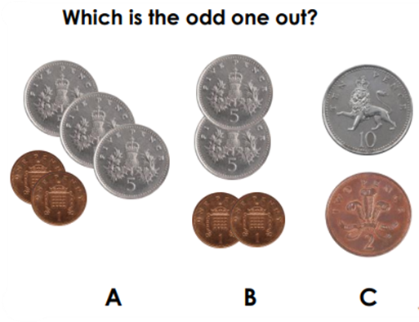
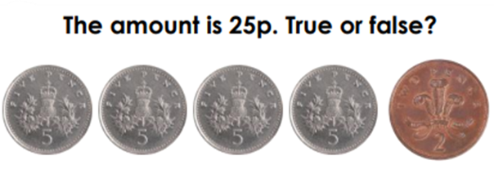
TBAT: use addition and subtraction in the context of money
Mastery: Mastery with greater depth:
Notes:
Independent Task: Applying a strategy to solve the puzzle
Pupils have a copy of the Task Sheet and some 1 p, 2 p, 5 p, 10 p and 20 p coins. They work together to solve the puzzle. Pupils use bead strings or other manipulatives to support their calculations (though should be encouraged to use known facts where possible). The task is meant to be challenging; it presents an opportunity for lots of addition and subtraction practise, as well as to discuss strategies and the importance of resilience in problem solving.
Possible adaptations:
Scaffold this task by adding more coins onto the grid (though beware of reducing the challenge too much).
Pupils could create their own similar money problem for a friend to solve.

Slide 37
Exploring solutions
How did you work out the missing coins?
Did anyone try a different way?
Notes:
Plenary: Exploring solutions
Share pupils’ solutions to the money puzzle and the strategies they used to find the answers. Encourage pupils to ‘make their reasoning visible’ by using concrete manipulatives when explaining to others.

Slide 38
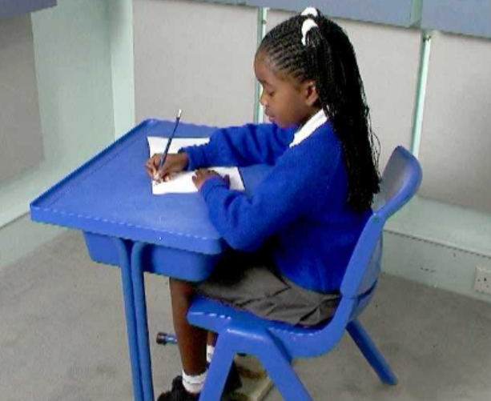
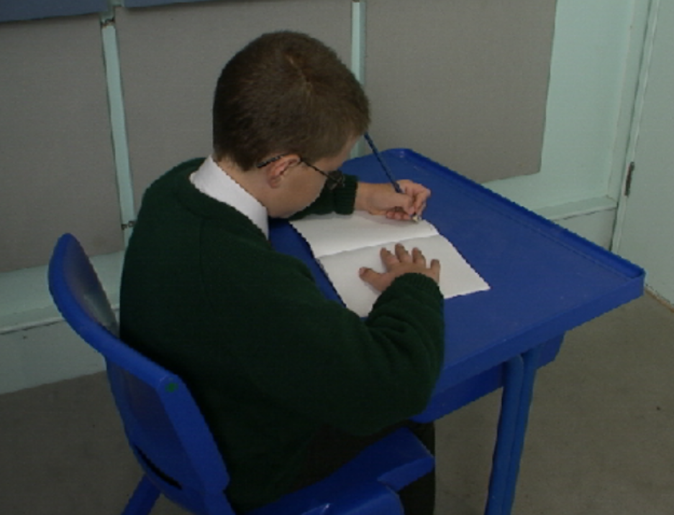
TBAT: correctly form the letters b and p.
Right handed Left handed

Slide 39
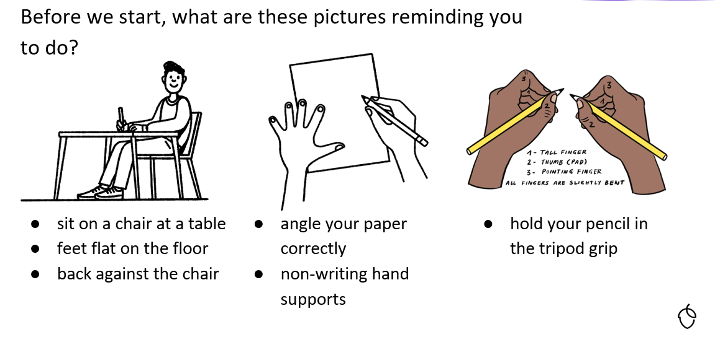
TBAT: correctly form the letters b and p.

Slide 40
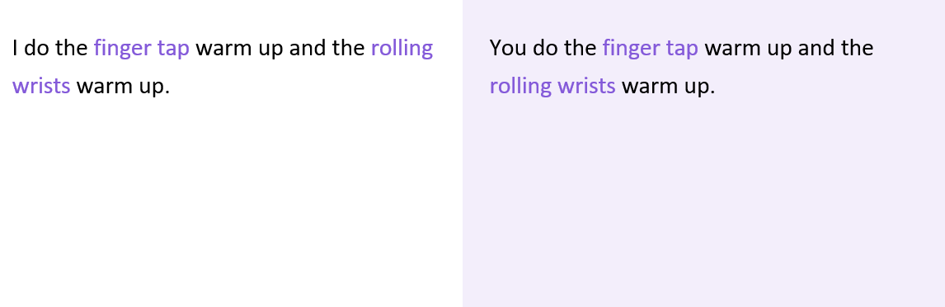
TBAT: correctly form the letters b and p.

Slide 41
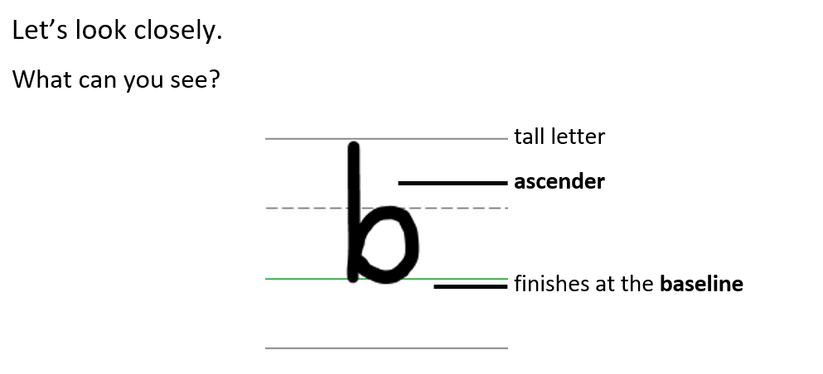
TBAT: correctly form the letters b and p

Slide 42
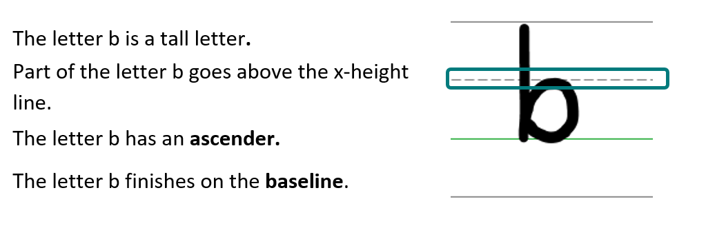
TBAT: correctly form the letters b and p.

Slide 43
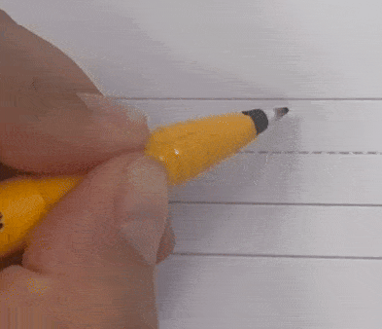
Forming the lower case letter b in print
Let’s write the letter b.
Sit comfortably and hold your pencil.
Start on the ascender line.
Go down to the baseline, back up, go over and curl around and back down to the baseline.
Finish at the baseline with the two lines joining together.
Take your pencil off the page.

Slide 44

TBAT: correctly form the letters b and p.

Slide 45

TBAT: correctly form the letters b and p.

Slide 46

TBAT: correctly form the letters b and p.

Slide 47

Forming the lower case letter p in print
Let’s write the letter p.
Sit comfortably and hold your pencil.
Start on the x-height line.
Go down to the descender line, back up, go over and curl around back to the baseline.
Finish at the baseline with the two lines joining together.

Slide 48

TBAT: correctly form the letters b and p.
bus
blip
pop
Handwriting Repeater

Slide 49

Little Wandle Guided Reading

