Slide 1
Monday 11th May 2026

Slide 2
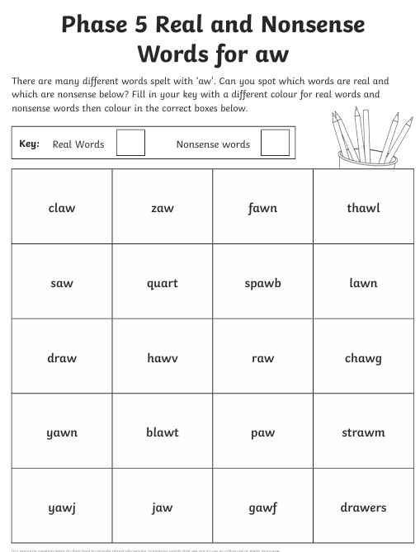
Early morning work:

Slide 3
TBAT: read and write words which include the /ar/ digraph
Speedy sounds
Digital Flashcards - Teach Your Monster to Read

Slide 4
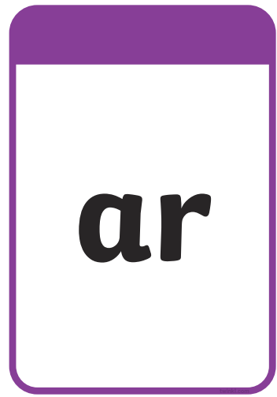
TBAT: read and write words which include the /ar/ digraph.

Slide 5
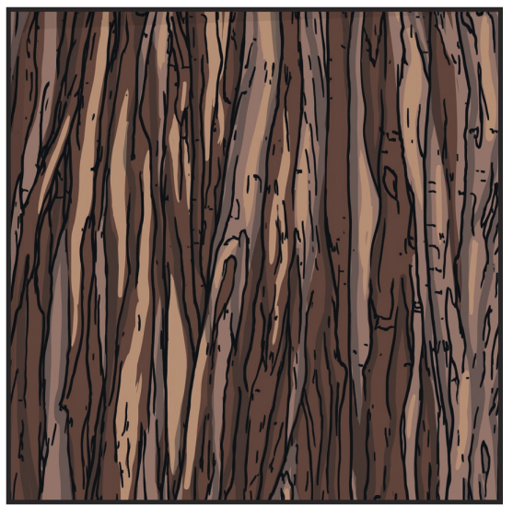
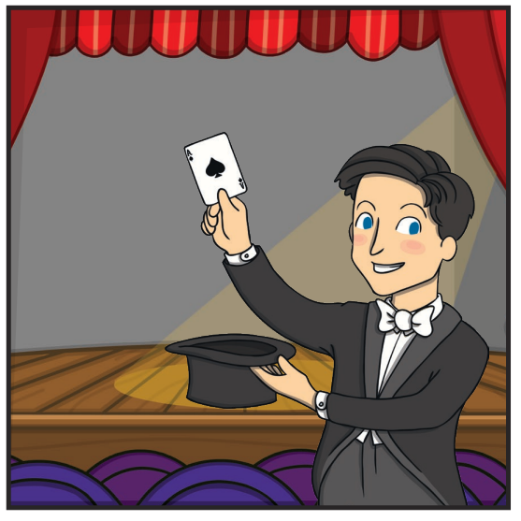
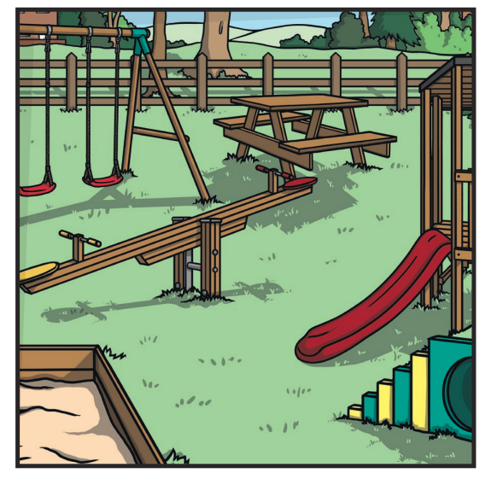
TBAT: read and write words which include the /ar/ digraph.
Label the pictures.

Slide 6
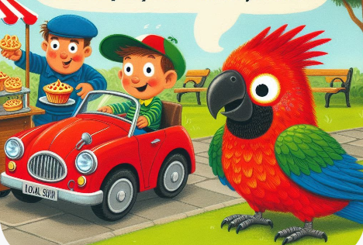
TBAT: read and write words which include the /ar/ digraph.
Mark and his smart little parrot, Sparky, went to the park. They saw a big red car zoom past and stopped by a cart selling tarts. Mark gave Sparky a tart, but the cheeky bird wanted to start a party! He flapped his wings and made a sharp sound—so loud that everyone stared!

Slide 7
TBAT: read and write words which include the /ar/ digraph.
Underline the /ar/ graphemes in the sentence.
My friend is so smart at art.

Slide 8

TBAT: read and write words which include the /ar/ digraph.
…......................................................................
…......................................................................
….......................................................................
…........................................................................

Slide 9
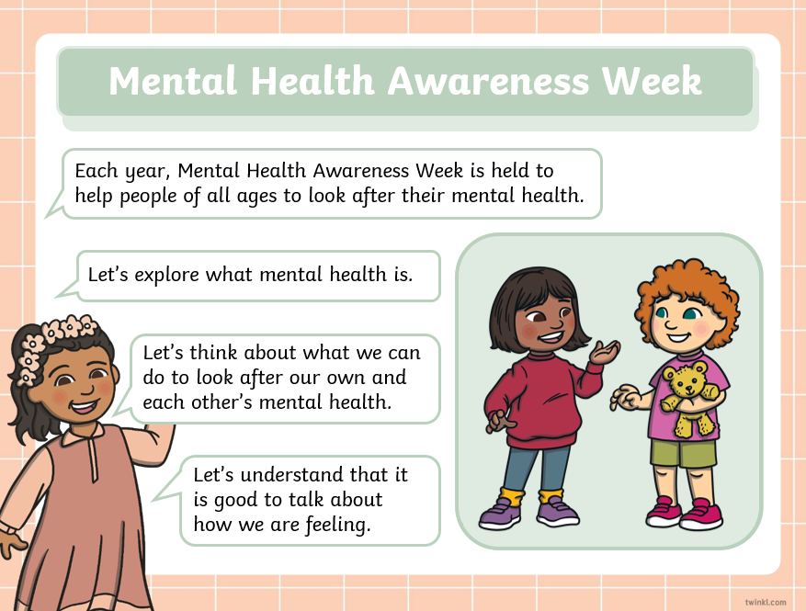
TBAT: explore what mental health is, why it is important to look after our mental health and how we can do this.

Slide 10
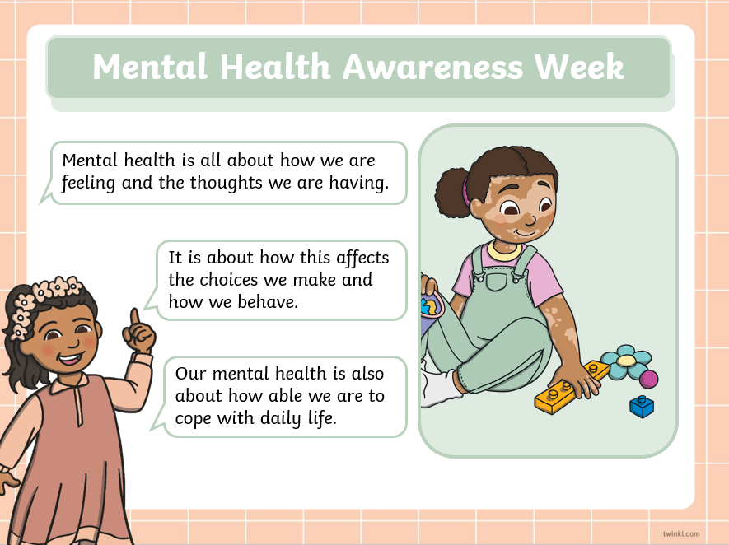
TBAT: explore what mental health is, why it is important to look after our mental health and how we can do this.

Slide 11

TBAT: explore what mental health is, why it is important to look after our mental health and how we can do this.

Slide 12
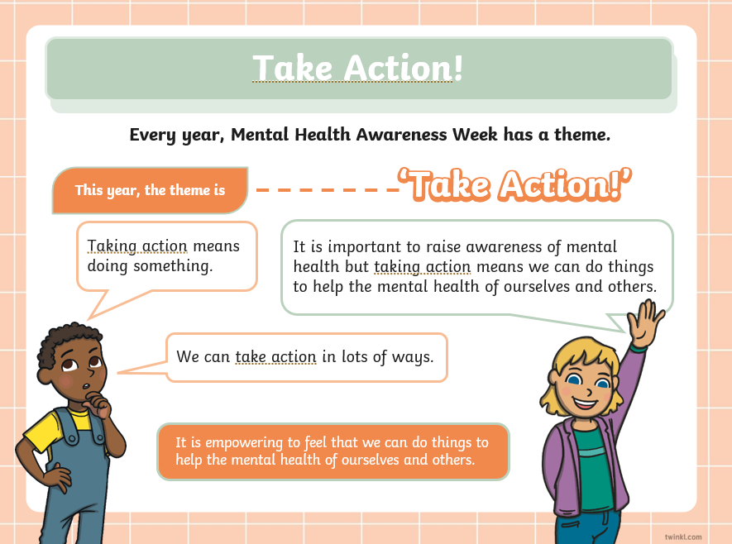
TBAT: explore what mental health is, why it is important to look after our mental health and how we can do this.

Slide 13

TBAT: explore what mental health is, why it is important to look after our mental health and how we can do this.

Slide 14

TBAT: explore what mental health is, why it is important to look after our mental health and how we can do this.

Slide 15

TBAT: explore what mental health is, why it is important to look after our mental health and how we can do this.

Slide 16
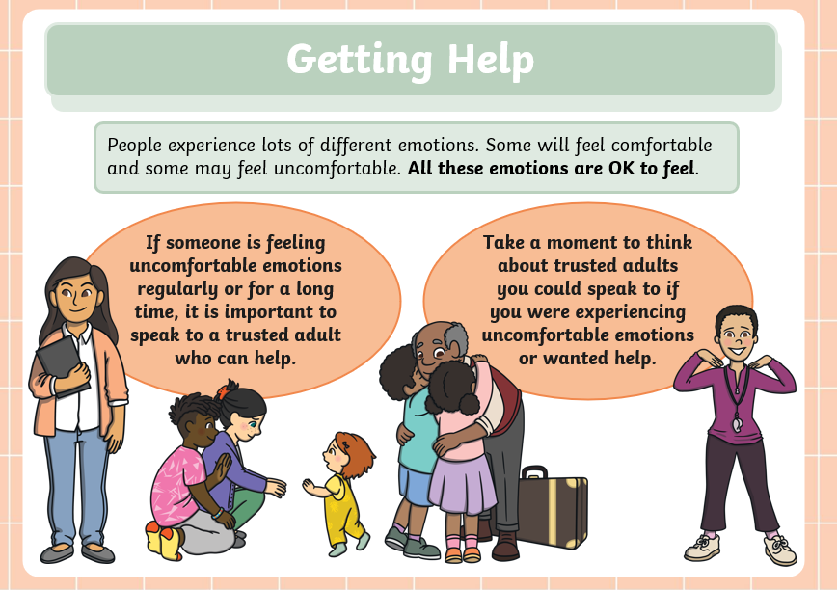
TBAT: explore what mental health is, why it is important to look after our mental health and how we can do this.

Slide 17

Assembly

Slide 18
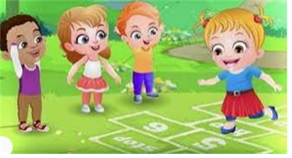
Break

Slide 19
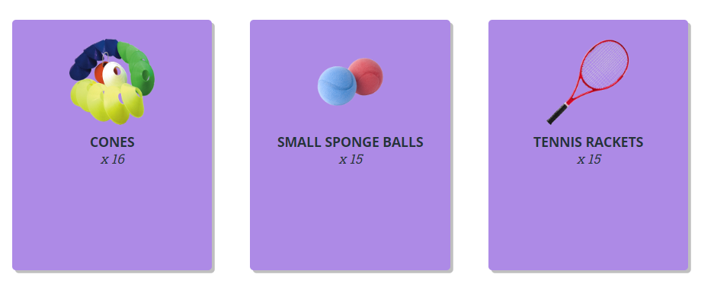
TBAT – develop hitting a ball
2 in 2
Name 1 way of throwing
How can we warm up our body?

Slide 20
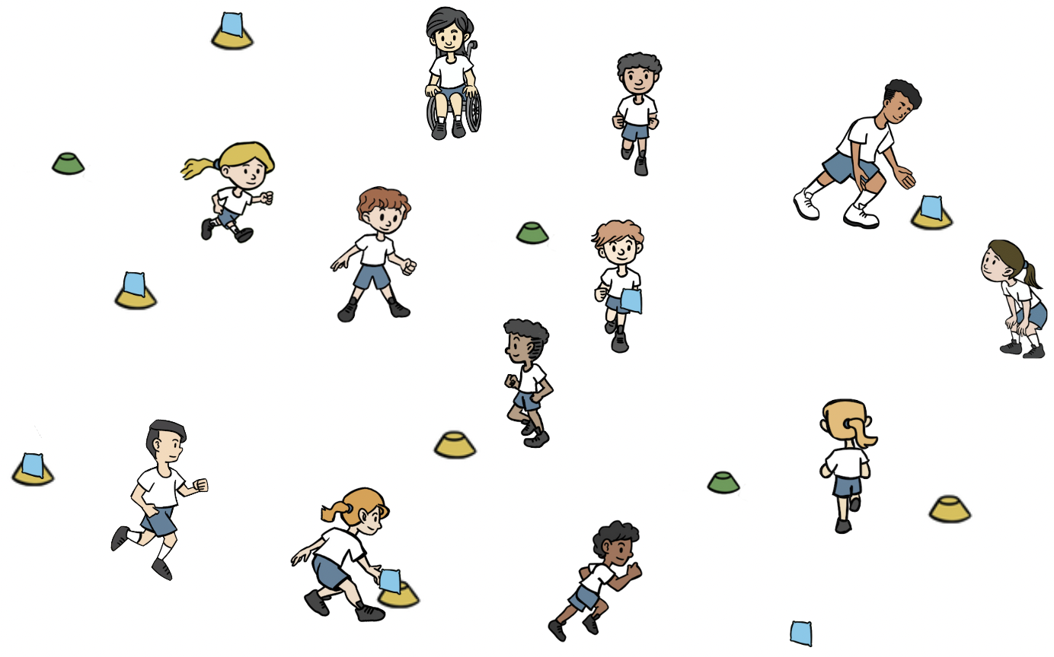
TBAT – develop hitting a ball
Warm-up
Split the class into two teams, a 'batting' and a 'fielding' team. Batting team have a cone and beanbag that they place in space (beanbag on top of cone).
Batters move from cone to cone, throwing the beanbags off the cones.
Fielders retrieve the beanbags and place them back on the cones.
Use underarm and overarm throwing.

Slide 21
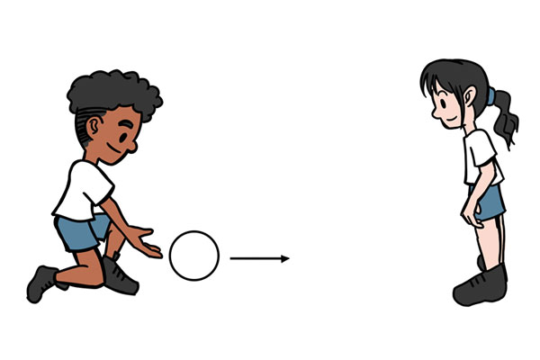
TBAT – develop hitting a ball
Skill development
Striking the ball
In pairs with one ball. Pupils begin standing opposite each other. They take turns to hit the ball to their partner.
Standing opposite each other. One pupil underarm throws the ball to their partner so that it bounces once. After one bounce, the other pupil tries to hit it with their hand.

Slide 22
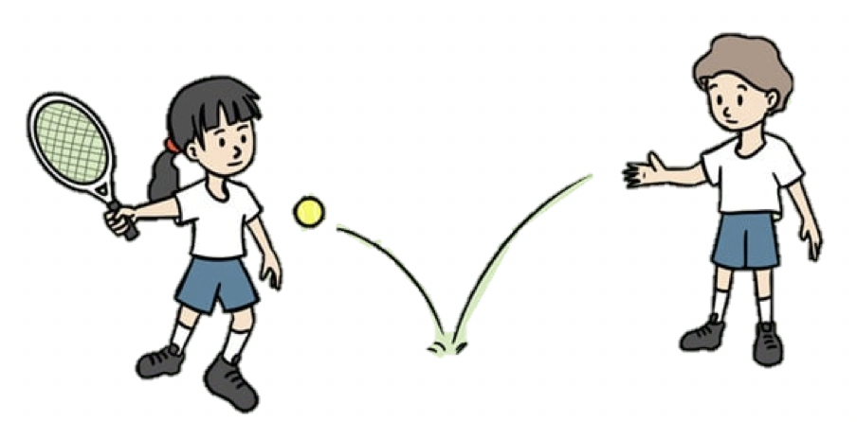
TBAT – develop hitting a ball
Skill development
Using a racket
In pairs with one racket and a sponge ball between them. Pupil A begins with the racket and ball. They drop the ball on the floor and hit it after one bounce. Pupils B runs to collect and return it. Have four turns then change over.
Watch the ball and let it bounce once. Hit the ball using the centre of the racket. Hold the racket towards the bottom of the handle.
This time, pupil A underarm throws the ball for pupil B to hit. Pupil A collects the ball and they change roles.
Stand sideways on to your partner. Watch the ball as it comes towards you. Hit after one bounce.

Slide 23
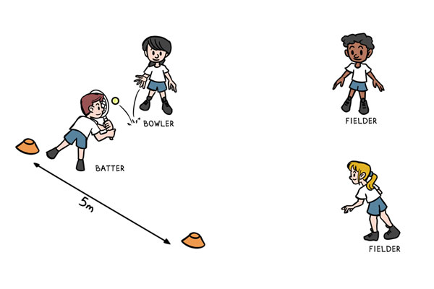
TBAT – develop hitting a ball
Skill development
Strike and field
Groups of four you need one tennis racket, one ball and two cones.
One pupil is the batter, they begin with the tennis racket, at one of the cones.
The other cone is placed 5m away.
The other three pupils are on the same team. Two of them are fielders and the other pupil is the bowler.
The bowler underarm throws the ball to the batter, who attempts to hit it with the racket.
The batter then runs between the two cones, scoring a point each time they reach a cone.
The fielders must collect the ball and return it to the bowler, who shouts 'stop' to stop the batter scoring.

Slide 24
TBAT – develop hitting a ball
Plenary
When batting, I should hit towards the fielders.
The bowler is on the fielding team.
Hitting the ball softly will make it go further.
Watching the ball as it comes towards me will help me to hit it.
My job as a fielder is to stop the batter scoring.

Slide 25

Lunch

Slide 26

Today's Alien language is.......

Slide 27
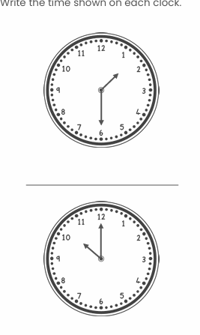
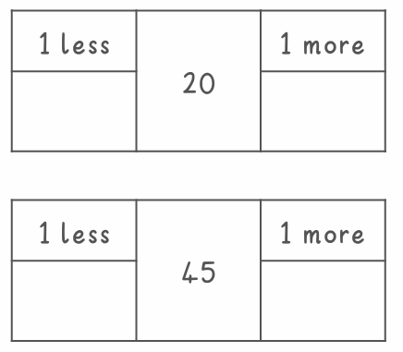

Slide 28
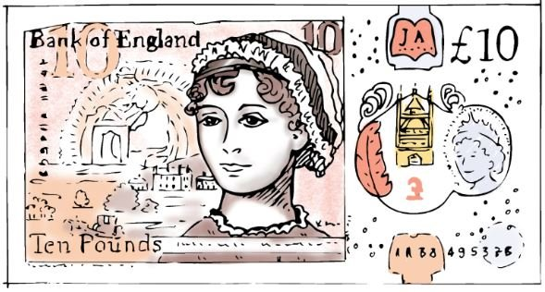
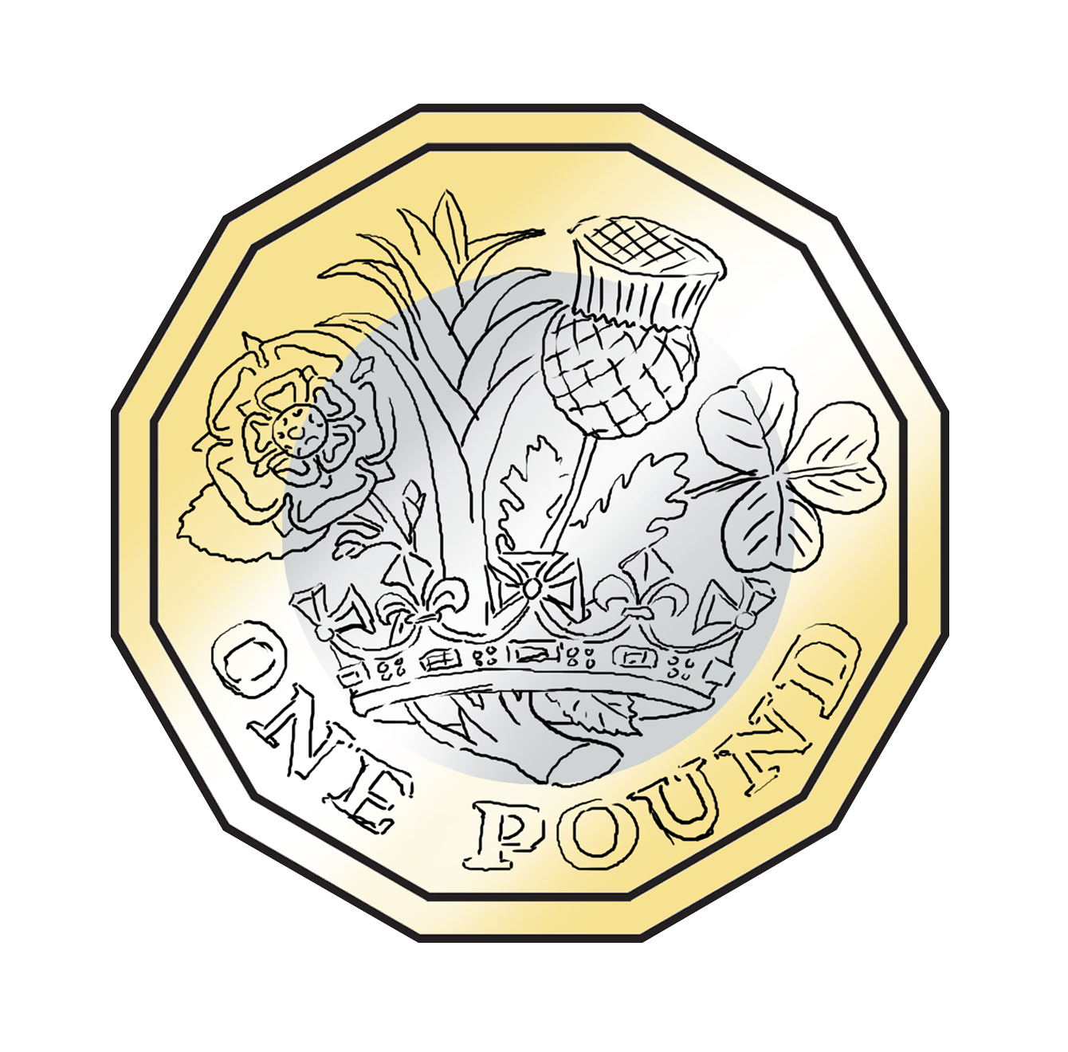

TBAT: identify the physical properties of coins
Which of these can you use to buy things with?
Do you know what they are called?
3 in 3

Slide 29
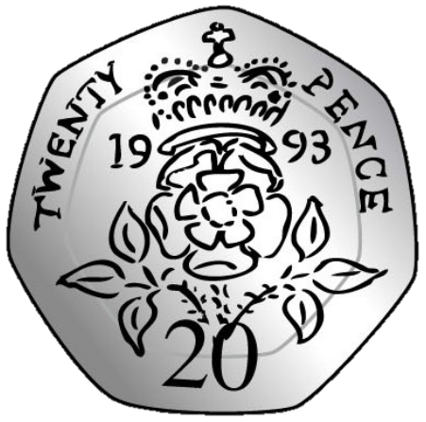
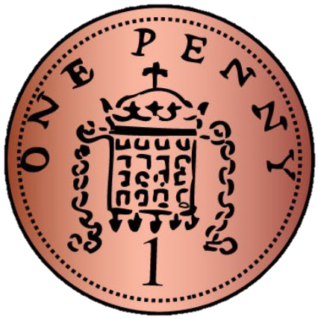
TBAT: identify the physical properties of coins
coin gold
round silver
heptagonal copper

Slide 30
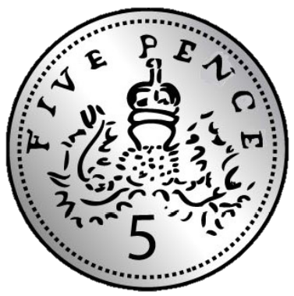
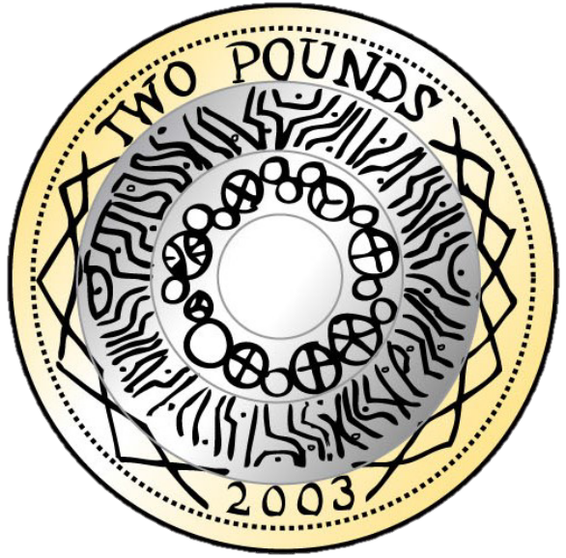
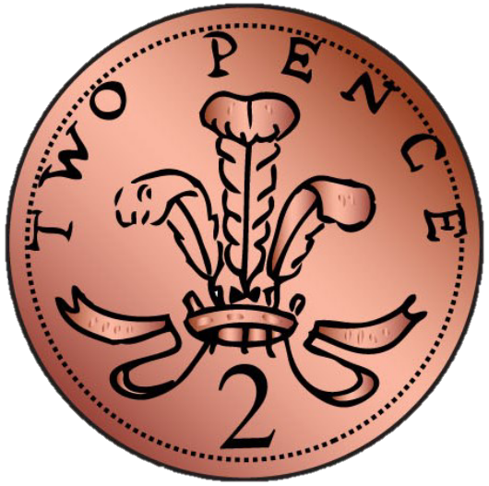
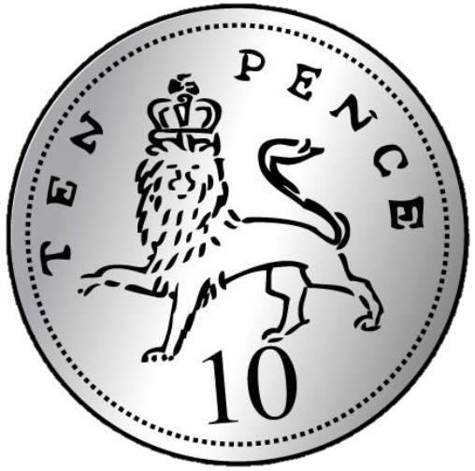
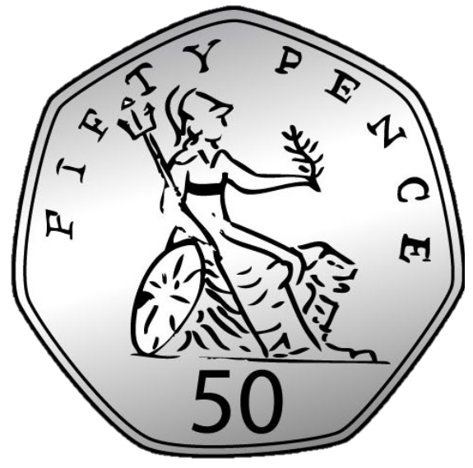
Introducing coins
TBAT: identify the physical properties of coins
one penny
five pence
twenty pence
one pound
two pence
ten pence
fifty pence
two pounds
Notes:
New Learning: Introducing coins
Note: this lesson focuses on the physical appearance of the coins and their names; their values are introduced in subsequent lessons.
Show pupils each of the eight coins used in the UK. Pass around real or plastic versions of the coins, asking pupils to pay attention to their appearance.
What’s the same and what’s different between the coins?
Give pupils chance to discuss, then take feedback. Introduce the relevant colour vocabulary (copper, silver and gold). Link this to gold, silver and bronze medals and explain that the gold (and silver) coins have the greatest value, followed by the silver, then the copper (or bronze). Draw attention to the fact they all have the King or Queen’s head on one side and that they all have different images on the other side.
Then show pupils some different groupings of coins, e.g. a set of all the silver coins and a set of the copper coins; a set of the round coins and a set of the heptagonal coins.
How have the coins been grouped? Can you group them in a different way?
Take feedback, then teach the vocabulary ‘heptagonal’ (seven-sided) and say that 20 pence and 50 pence coins have heptagonal faces. Draw attention to the circular faced coins, and engage pupils in discussion around the pound coin (12-sided).

Slide 31

Is the statement true or false? How do you know?
TBAT: identify the physical properties of coins
B/G
All coins are round.
All coins
are the same size.
This statement is true/false because.....
Notes:
New Learning: Introducing coins
Note: this lesson focuses on the physical appearance of the coins and their names; their values are introduced in subsequent lessons.
Show pupils each of the eight coins used in the UK. Pass around real or plastic versions of the coins, asking pupils to pay attention to their appearance.
What’s the same and what’s different between the coins?
Give pupils chance to discuss, then take feedback. Introduce the relevant colour vocabulary (copper, silver and gold). Link this to gold, silver and bronze medals and explain that the gold (and silver) coins have the greatest value, followed by the silver, then the copper (or bronze). Draw attention to the fact they all have the King or Queen’s head on one side and that they all have different images on the other side.
Then show pupils some different groupings of coins, e.g. a set of all the silver coins and a set of the copper coins; a set of the round coins and a set of the heptagonal coins.
How have the coins been grouped? Can you group them in a different way?
Take feedback, then teach the vocabulary ‘heptagonal’ (seven-sided) and say that 20 pence and 50 pence coins have heptagonal faces. Draw attention to the circular faced coins, and engage pupils in discussion around the pound coin (12-sided).

Slide 32
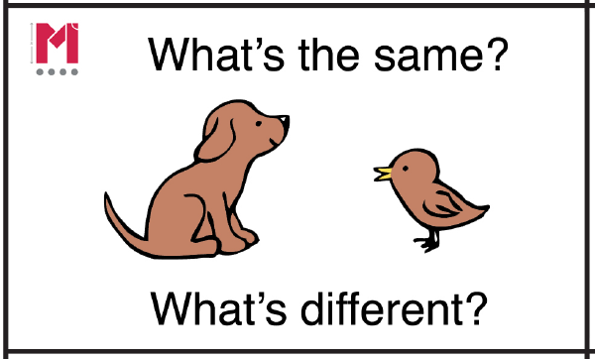
What’s the same? What’s different?
TBAT: identify the physical properties of coins
Notes:
New Learning: Introducing coins
Note: this lesson focuses on the physical appearance of the coins and their names; their values are introduced in subsequent lessons.
Show pupils each of the eight coins used in the UK. Pass around real or plastic versions of the coins, asking pupils to pay attention to their appearance.
What’s the same and what’s different between the coins?
Give pupils chance to discuss, then take feedback. Introduce the relevant colour vocabulary (copper, silver and gold). Link this to gold, silver and bronze medals and explain that the gold (and silver) coins have the greatest value, followed by the silver, then the copper (or bronze). Draw attention to the fact they all have the King or Queen’s head on one side and that they all have different images on the other side.
Then show pupils some different groupings of coins, e.g. a set of all the silver coins and a set of the copper coins; a set of the round coins and a set of the heptagonal coins.
How have the coins been grouped? Can you group them in a different way?
Take feedback, then teach the vocabulary ‘heptagonal’ (seven-sided) and say that 20 pence and 50 pence coins have heptagonal faces. Draw attention to the circular faced coins, and engage pupils in discussion around the pound coin (12-sided).

Slide 33
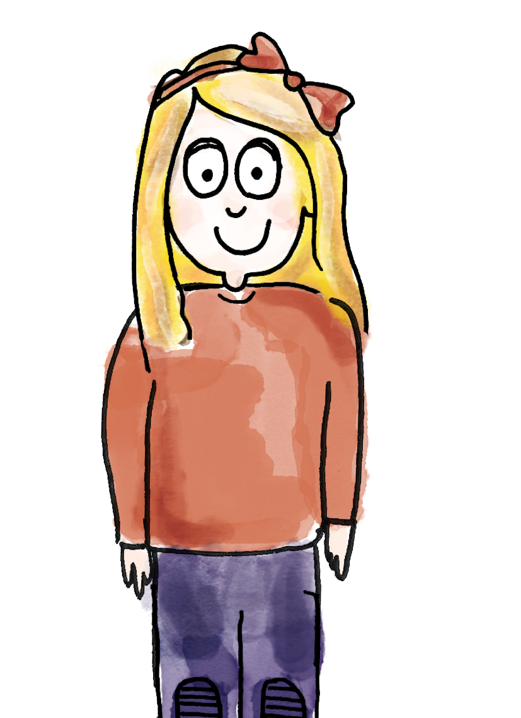
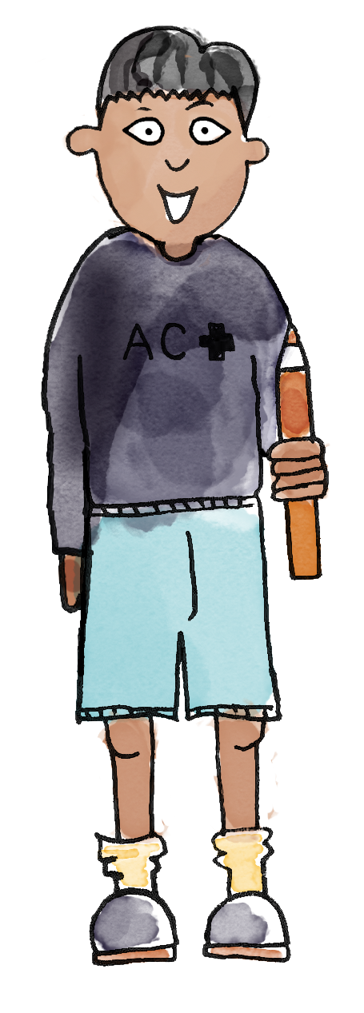
Sorting coins
TBAT: identify the physical properties of coins
I am putting this coin in this cup because it is heptagonal.
I am putting this coin in this cup because it is round.
heptagons
round
coin gold round silver heptagonal copper
Notes:
Talk Task: Sorting coins according to their physical properties
Each pair has a set of the eight unique coins and two cups. Explain that one cup is for heptagonal coins and the other is for round coins. Pupils take it in turns to pick up a coin and place it in the correct cup, explaining their reason to each other to practise key vocabulary. Once most pupils have completed the task, check with the class for consensus on which coins belong in which cup. Then relabel the cups as ‘copper’ and ‘silver or gold’ and repeat.

Slide 34
Sorting coins
TBAT: identify the physical properties of coins
The coin is silver and gold so it belongs here.
This coin belongs in the copper cup.
silver or gold
copper
coin gold round silver heptagonal copper
Notes:
Talk Task: Sorting coins according to their physical properties
Each pair has a set of the eight unique coins and two cups. Explain that one cup is for heptagonal coins and the other is for round coins. Pupils take it in turns to pick up a coin and place it in the correct cup, explaining their reason to each other to practise key vocabulary. Once most pupils have completed the task, check with the class for consensus on which coins belong in which cup. Then relabel the cups as ‘copper’ and ‘silver or gold’ and repeat.

Slide 35
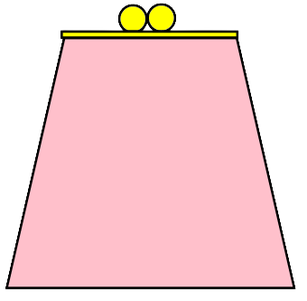
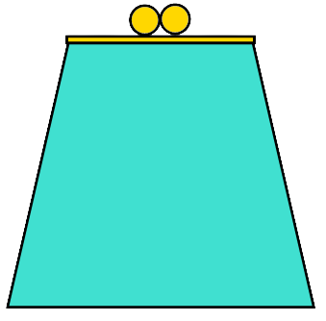
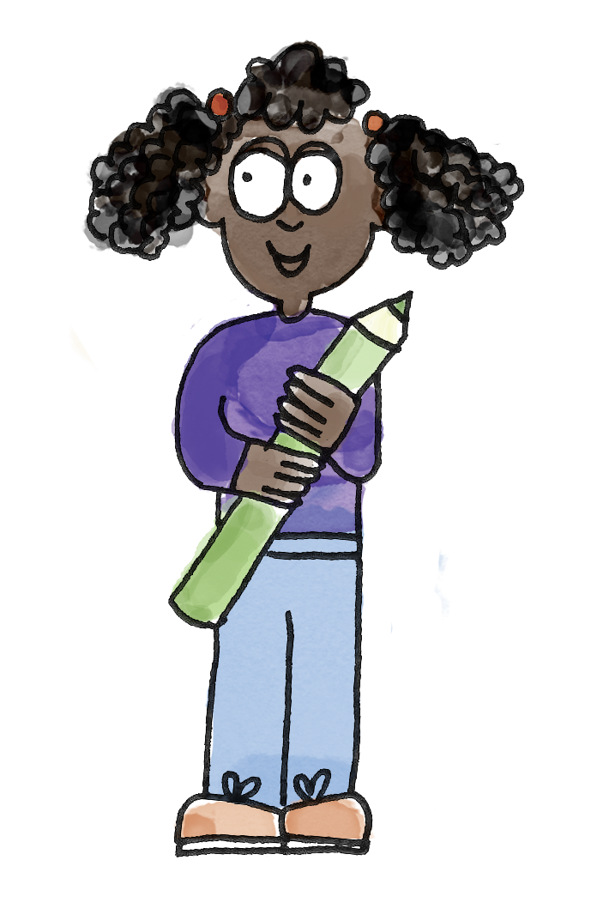
Halima sorted her coins into two purses
TBAT: identify the physical properties of coins
How has she sorted them?
Why are some coins not in a purse?
Notes:
Develop Learning: Apply knowledge of properties of coins
Recap the names of coins if necessary. There are two Develop Learning slides, each showing how someone has organised the coins into purses according to some criteria.
Halima has organised her coins into two purses. How has she organised them? Why do you think some coins are not in a purse?
Use this opportunity to discuss what happens when an item does not belong in any set (that it is left out).
One purse contains copper coins and the other has silver coins. The other coins are not copper or silver, so she has left them out.
If there is time, play ‘guess the coin’. Share specific properties and ask pupils which coin you could be thinking of.
I’m thinking of a coin. It is silver. What could it be?

Slide 36
Charlie sorted his coins in a different way
TBAT: identify the physical properties of coins
How has he sorted them?
How do you know?
Notes:
Develop Learning: Apply knowledge of properties of coins
Recap the names of coins if necessary. There are two Develop Learning slides, each showing how someone has organised the coins into purses according to some criteria.
Halima has organised her coins into two purses. How has she organised them? Why do you think some coins are not in a purse?
Use this opportunity to discuss what happens when an item does not belong in any set (that it is left out).
One purse contains copper coins and the other has silver coins. The other coins are not copper or silver, so she has left them out.
If there is time, play ‘guess the coin’. Share specific properties and ask pupils which coin you could be thinking of.
I’m thinking of a coin. It is silver. What could it be?

Slide 37

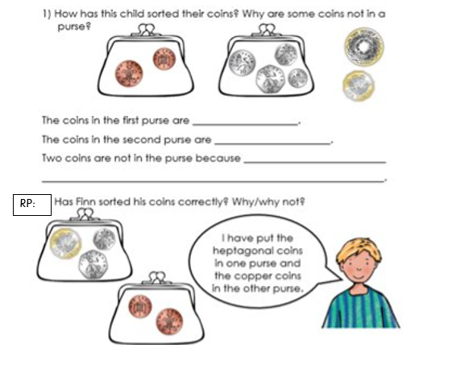
TBAT: identify the physical properties of coins
Notes:
Independent Task: Applying knowledge of the properties of coins
Pupils have a copy of the Task Sheet. They identify how the coins have been sorted, correct the errors in how coins have been sorted and suggest possibilities for the coins each child could be thinking of. Pupils could then experiment with different ways of sorting the coins. Can their partner work out how they have sorted the coins?
Possible adaptations:
Give pupils coins sorted in a variety of ways with mistakes for them to identify. With some explanation, this could include Carroll diagrams.
The Task Sheet could be adapted to make it multiple choice.

Slide 38
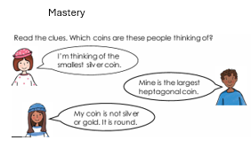
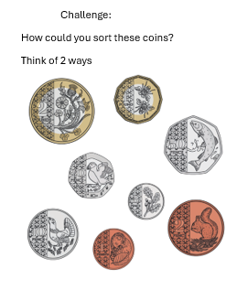
TBAT: identify the physical properties of coins.
Challenge:
Mastery:
Notes:
Independent Task: Applying knowledge of the properties of coins
Pupils have a copy of the Task Sheet. They identify how the coins have been sorted, correct the errors in how coins have been sorted and suggest possibilities for the coins each child could be thinking of. Pupils could then experiment with different ways of sorting the coins. Can their partner work out how they have sorted the coins?
Possible adaptations:
Give pupils coins sorted in a variety of ways with mistakes for them to identify. With some explanation, this could include Carroll diagrams.
The Task Sheet could be adapted to make it multiple choice.

Slide 39
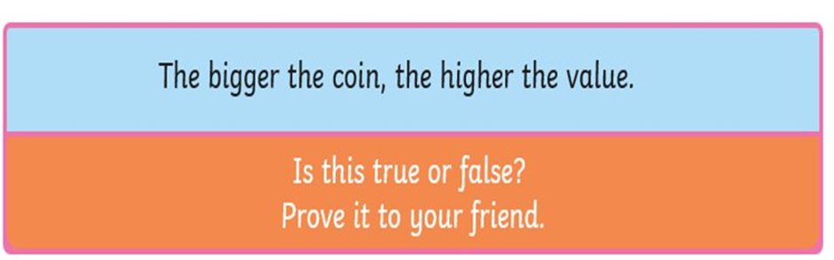
TBAT: identify the physical properties of coins.
Mastery with greater depth:
Notes:
Independent Task: Applying knowledge of the properties of coins
Pupils have a copy of the Task Sheet. They identify how the coins have been sorted, correct the errors in how coins have been sorted and suggest possibilities for the coins each child could be thinking of. Pupils could then experiment with different ways of sorting the coins. Can their partner work out how they have sorted the coins?
Possible adaptations:
Give pupils coins sorted in a variety of ways with mistakes for them to identify. With some explanation, this could include Carroll diagrams.
The Task Sheet could be adapted to make it multiple choice.

Slide 40
The one pound coin is dodecagonal
A dodecagon is a 12-sided shape.
Can you count the 12 edges?
Notes:
Plenary: The dodecagonal one pound coin
Show pupils the image of the one pound coin. Have pupils practise saying ‘dodecagonal’ and explaining to a partner what it means.
Can you count the 12 edges on the front face of your one pound coin?

Slide 41
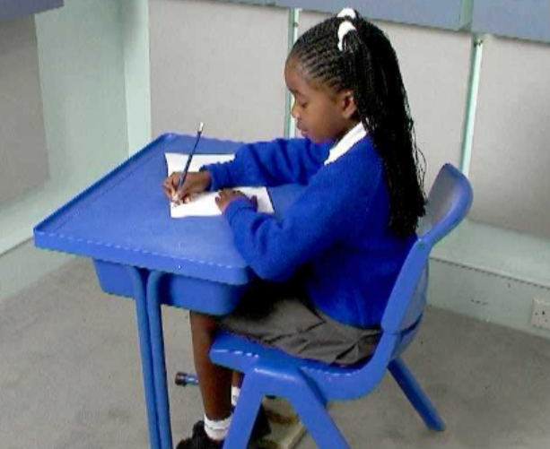
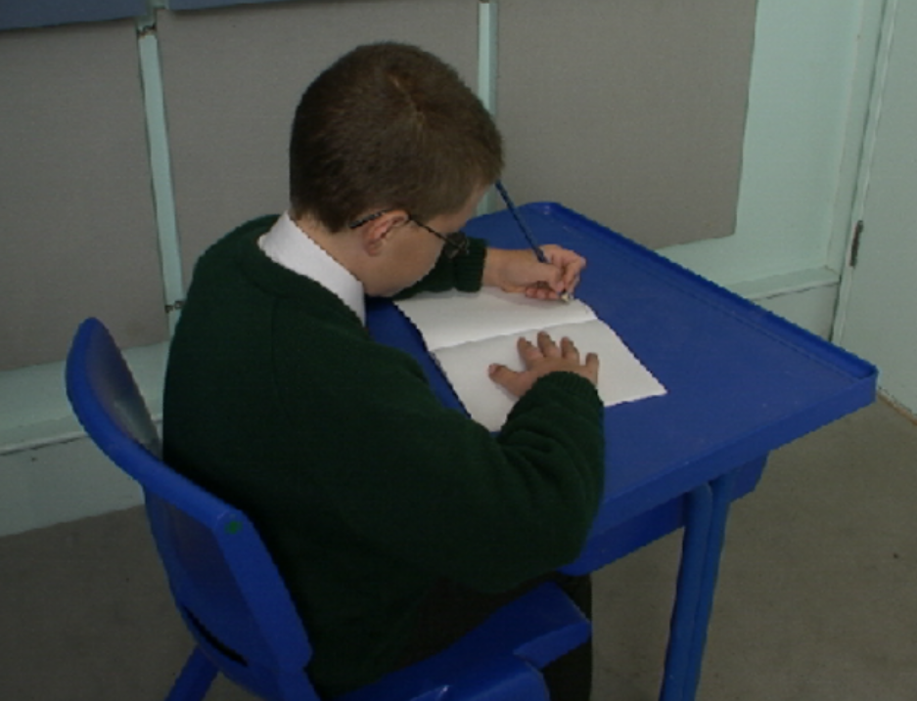
Correct posture
TBAT: correctly form the letters h and k.
Right handed Left handed

Slide 42
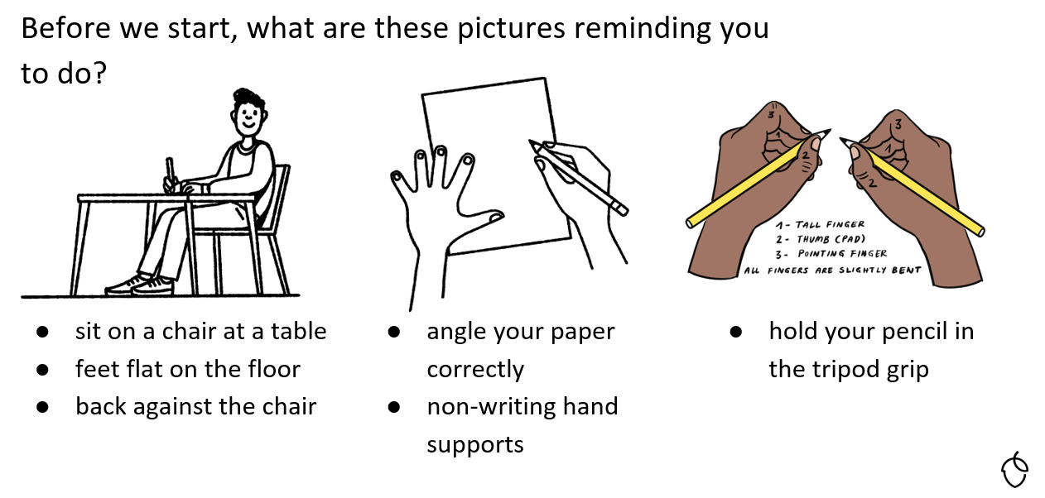
TBAT: correctly form the letters h and k.

Slide 43
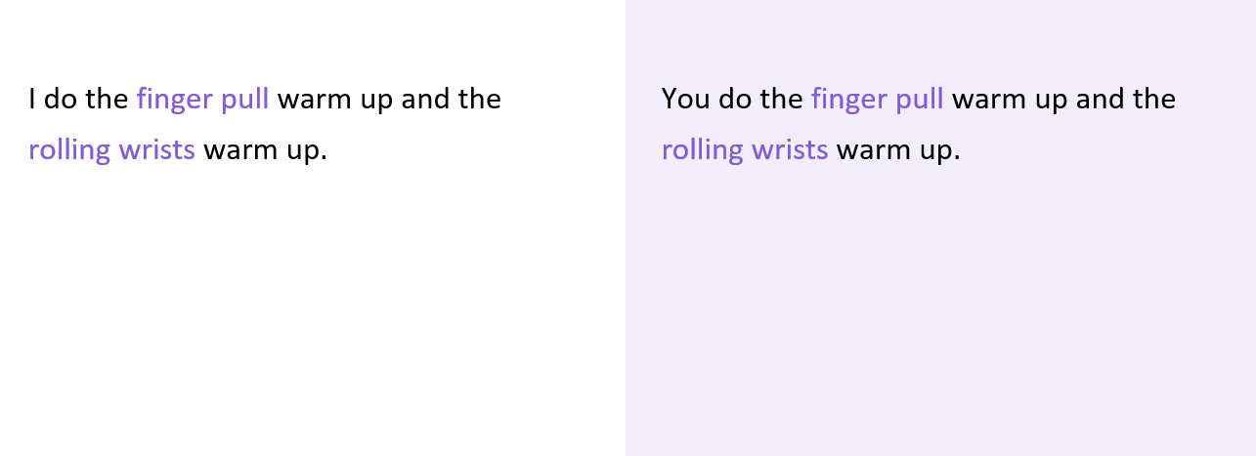
TBAT: correctly form the letters h and k.

Slide 44
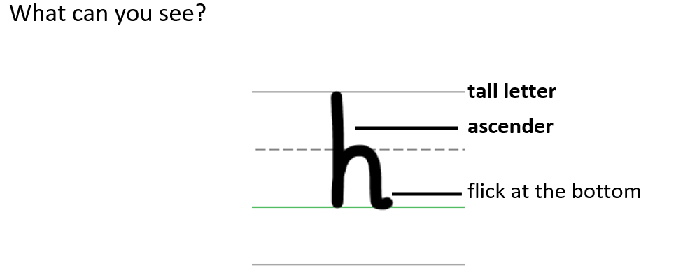
TBAT: correctly form the letters h and k.

Slide 45
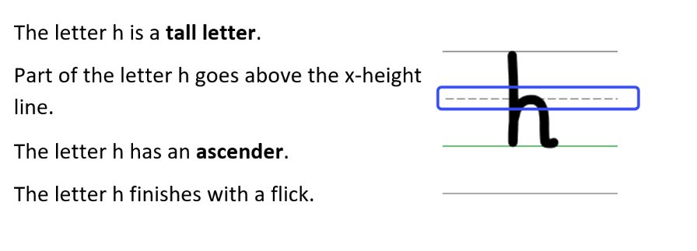
TBAT: correctly form the letters h and k.

Slide 46
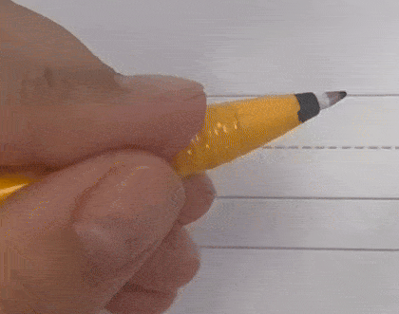
Forming the lower case letter h in print
Let’s write the letter h.
Sit comfortably and hold your pencil.
Start on the ascender line.
Go down to the baseline, back up to the x-height line, go over and down.
Finish at the baseline with a flick.
Take your pencil off the page.

Slide 47
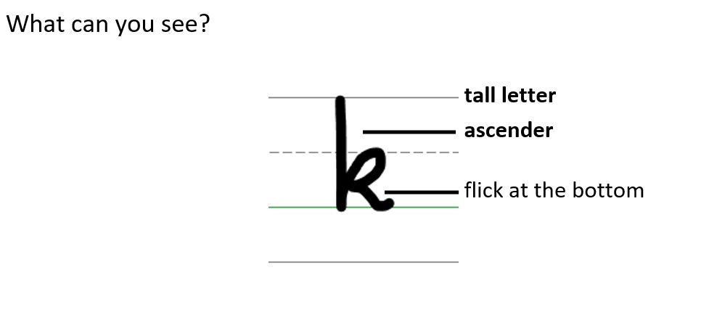
TBAT: correctly form the letters h and k.

Slide 48
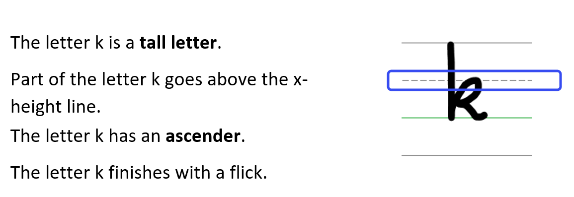
TBAT: correctly form the letters h and k.

Slide 49
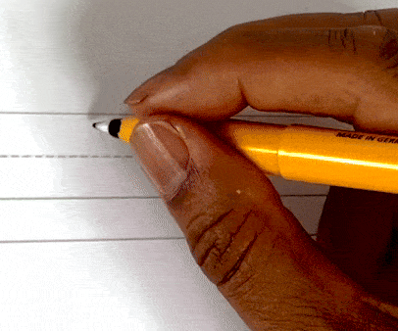
Forming the lower case letter k in print
Let’s write the letter k.
Sit comfortably and hold your pencil.
Start on the ascender line.
Go down to the baseline, back up and over to make a loop that touches the x-height line.
Make a small line down to the baseline and finish with a flick.

Slide 50
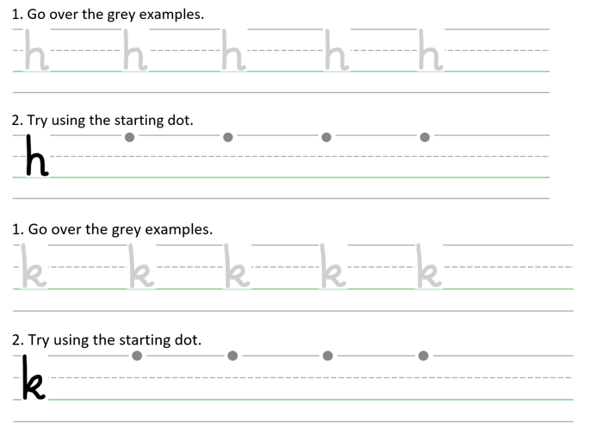
TBAT: correctly form the letters h and k.
hike
help
kite
Handwriting Repeater

Slide 51

Little Wandle Guided Reading

