Slide 1
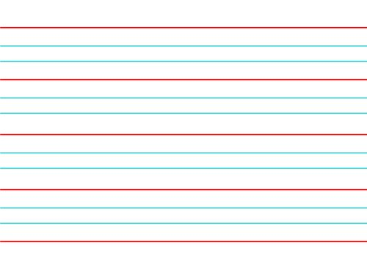
Monday 27th April
TBAT: Use joins consistently.
plough
bough
drought
brought
bought
wrought
thought
ought
borough
thorough Are there any words you are unsure of? Use a dictionary to look them up and then use them in a sentence.

Slide 2
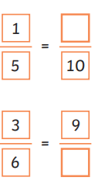
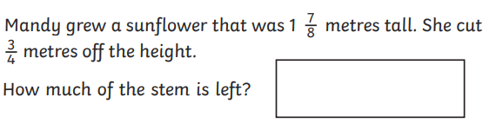
27.4.26 TBAT- find fractions of amounts. 3 in 3
1)
2) 2 x 4 = 3) 6 - ½ =
3 10
Challenge:

Slide 3
Daily 10 Daily 10 - Mental Maths Challenge - Topmarks

Slide 4
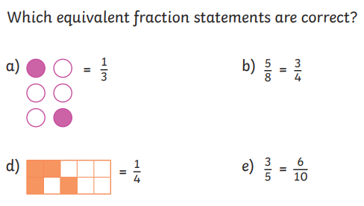
Talk partners:

Slide 5
Green Blue 135 divided by 5 = 148 divided by 4 = 27 x 3 = 37 x 3 = Challenge: How does the above link to fractions of amounts?

Slide 6
Talk partners: How would we solve the following problem?
1/5 of 45 =

Slide 7
Talk partners: Using the previous answer, solve the next two problems. 1/5 of 45 = 9
2/5 of 45 =
3/5 of 45 =

Slide 8
Whiteboard work: 2/3 of 360 = 2/7 of 420 =
Challenge:
Draw a bar model to represent your calculation.

Slide 9
Joe has £120 in his piggy bank. He spends 2/5 of it on a game. How much has he spent? How much does he have left?
Class work:

Slide 10

Checkpoint question: Joe has a 180g bag of sweets. If he eats 1/3 of it on day 1, how much is left? a) 60g b) 120g c) 30g

Slide 11
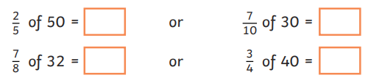
Blue Green
In books:
Challenge:
Draw a bar model to represent your calculations.

Slide 12



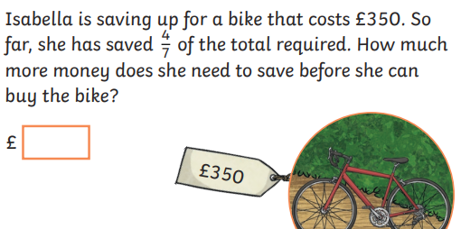
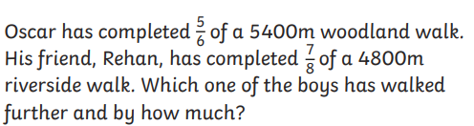
I:
2)

Slide 13
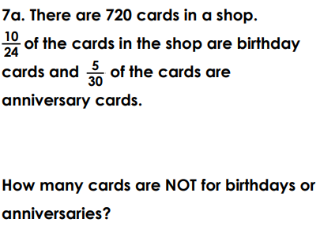
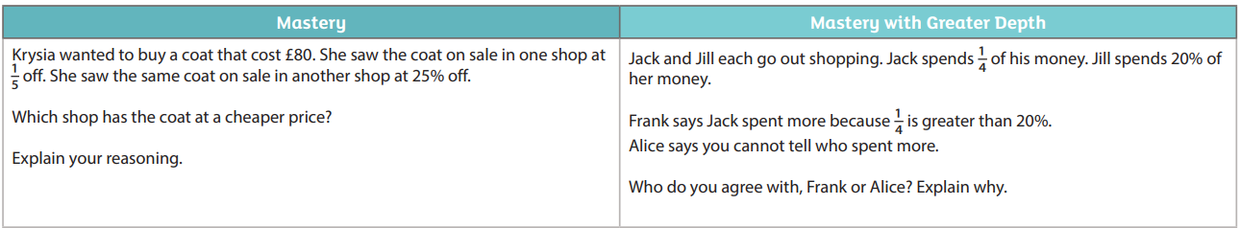
Challenge:

Slide 14
Monday 27th April
TBAT: explain and justify inferences with evidence from the text.
3 in 3
When Mia opened the school library early one morning, she noticed something strange. A muddy footprint led from the door straight to the history shelf, where an old book lay open on the floor. Tucked inside the pages was a crumpled note with only three words written on it: “Too late now.” Mia’s heart began to race as she wondered who had been there—and why.
What did Mia notice on the floor when she opened the library?
2. What does the note “Too late now” suggest about what might have happened?
3. What do you think Mia will do next? Use evidence from the text to explain your answer.

Slide 15
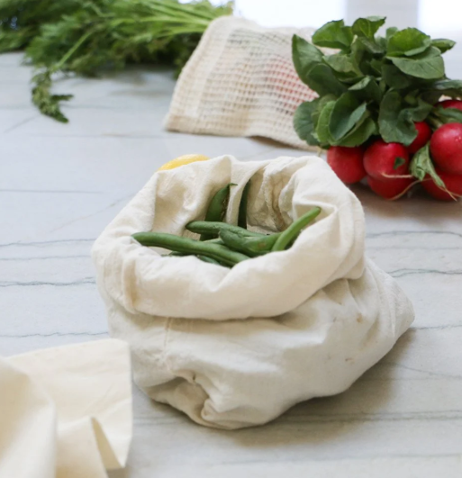
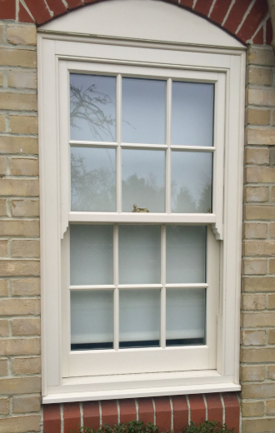
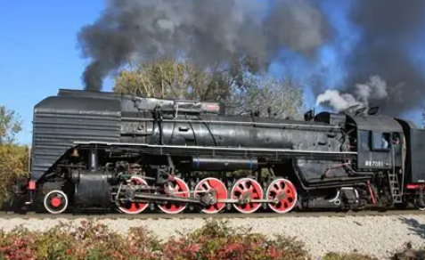
Monday 27th April
TBAT: explain and justify inferences with evidence from the text.
Muslin bags -
Bough -A bough is a large, primary limb of a tree that extends from the trunk and serves as a main structural support for smaller branches and foliage.
Sash -
Locomotive engine -
Foliage - the leaves of a plant or tree

Slide 16
Monday 27th April
TBAT: explain and justify inferences with evidence from the text.
Multiple choice questions
What is an ‘orchard’?
A type of flower, a piece of land with fruit trees, a building
2. What was the gardener eating?
Bacon and bread sandwich, cheese sandwich, tuna sandwich
3. Why did Tom jump in the wheelbarrow?
He was tired, he wanted to get muddy, he wanted to go through the gate

Slide 17
Monday 27th April
TBAT: explain and justify inferences with evidence from the text.
Why does Tom feel both excited and nervous as he steps through the door in the garden?
2. How can we tell that Tom believes the garden is real and not a dream?
3. How does Tom’s behaviour change from the beginning to the end of the chapter, and what does this suggest about his confidence?
4. How do you think Tom felt when the gardener looked straight through him?
5. How do you think the storm changed Tom’s opinion of the garden?
6. What do you think troubled Tom the most about the storm?
7. Explain why the author named the chapter ‘Through A Door’

Slide 18
Monday 27th April
TBAT: explain and justify inferences with evidence from the text.
Challenge
Summarise what happened during the storm in no more than two sentences.

Slide 19
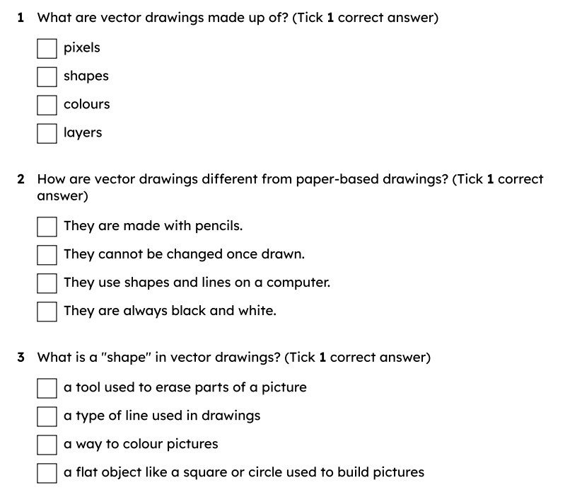
Monday 27th April
TBAT: create a vector drawing by combining shapes.
3 in 3 (orally)
Challenge: Talk through how you would create an image of a house on a drawing programme.

Slide 20
Monday 27th April
TBAT: create a vector drawing by combining shapes.
Name a tool you can use to create a vector drawing.
How do you add colour to a vector drawing? Name some different ways you can manipulate a shape.

Slide 21
move
to change where an object is placed on the canvas
resize
to make an object bigger or smaller
rotate
to turn an object around a point
handle
a small square or circle on the edge of a shape that you can click and drag to resize or rotate the shape

Slide 22
Identify the shapes used to make a vector drawing
To start making bigger and better vector drawings, you need to think about:
What shapes are there?
How many shapes can you see?

Slide 23
Identify the shapes used to make a vector drawing
Look at the individual shapes.
What shapes are there?
How many shapes do you see?

Slide 24
Identify the shapes used to make a vector drawing
Which object would you need to draw first?

Slide 25

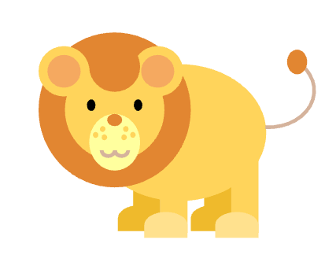


Identify the shapes used to make a vector drawing
Which image is created by shapes and lines?

Slide 26
Identify the shapes used to make a vector drawing
What shapes have been used?
Which shapes are in front of others?
Which shapes are at the back?
Rectangles and circles are used.
Circles for the wheels and rectangles for the windows are at the front and the big red rectangle is at the back.

Slide 27
Identify the shapes used to make a vector drawing
What shapes have been used?
Which shapes are in front of others?
Which shapes are at the back?
Rectangles and circles are used.
The small details like the rectangle eyes and circle buttons are at the front and the head and body rectangles are at the back.

Slide 28
Identify the shapes used to make a vector drawing
What shapes have been used?
Which shapes are in front of others?
Which shapes are at the back?
Circles and ovals are used.
The circles for nostrils and eyes are at the front. The body is at the back.

Slide 29
Identify the shapes used to make a vector drawing
Why do we draw the back shapes first?

Slide 30
Identify the shapes used to make a vector drawing
Why do we draw the back shapes first?
As you add shapes they are layered. The back shapes are added first, so that the last shapes are shown at the front.

Slide 31
Identify the shapes used to make a vector drawing
The order you draw the shapes can change how the picture looks.
Why? In vector drawings, shapes are layered. This means the order you draw them affects what is visible at the front.

Slide 32
Identify the shapes used to make a vector drawing
Look at the image and answer the following questions:
What shapes are used?
What order would you draw them in?
Which shapes appear more than once?

Slide 33
Explain that drawing elements are objects
Each shape or line in a vector drawing is called an object. Objects can be clicked on, moved, resized or rotated.

Slide 34
Explain that drawing elements are objects
This snowman looks like one drawing, but it’s made up of separate objects.
What objects can you spot?

Slide 35
Explain that drawing elements are objects
When you click on an object in a vector drawing, you can:
move it
resize it
rotate it
change its colour

Slide 36
Explain that drawing elements are objects
Which of these is true about objects in a vector drawing?
You cannot move them.
Each shape or line is an object.
You must draw all objects at the same time.

Slide 37
Explain that drawing elements are objects
Objects only stick together if they have been grouped or selected at the same time. Even if they touch or overlap, they can still move separately.

Slide 38
Explain that drawing elements are objects
Once you add shapes to a vector drawing they are stuck together forever.
Why?
They remain separate unless grouped.

Slide 39



Move, resize and rotate objects
How can I get more than one of an object?
Sam
Making more than one of an object is called duplicating. We need to copy and paste.
Alex

Slide 40
Move, resize and rotate objects
How do I copy and paste?
Sam
There are two ways to copy and paste:
Click on your shape.
Click edit at the top.
Click duplicate.

Slide 41
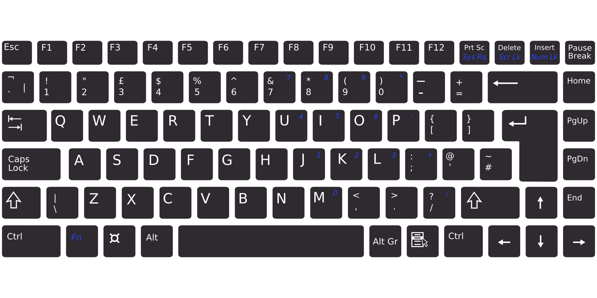
Move, resize and rotate objects
How do I copy and paste?
Sam
There are two ways to copy and paste:
Use ctrl + c on your keyboard to copy.
Use ctrl + v on your keyboard to paste.
copy
paste

Slide 42
Move, resize and rotate objects
Create your own vector drawing using shapes.
Try to:
add different shapes to your drawing
move the shapes to the right places
resize shapes to make them bigger or smaller
rotate some shapes
copy and paste a shape instead of making a new one each time

Slide 43


