Slide 1
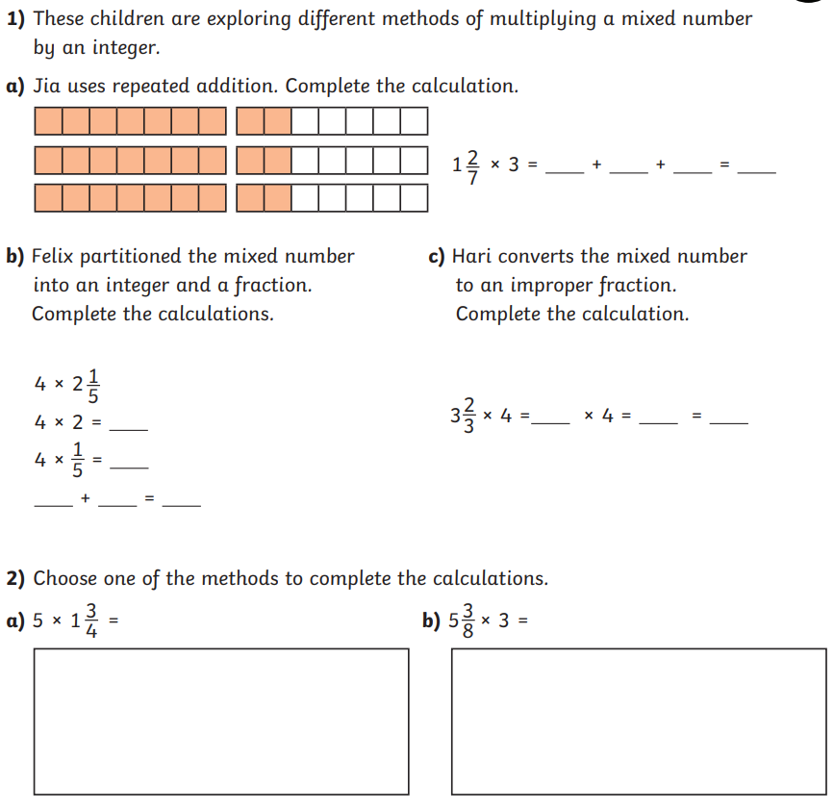
Morning challenge

Slide 2


How can we repair damaged friendships?
Voyagers
Read the scenario and decide three things that need to happen for this friendship to be repaired.
Jun and Izzy are playing football. Izzy tries to score a goal, but the ball misses the net. Jun shouts: “That was an easy shot! I can’t believe you missed!” Izzy shouts back: “Well, at least I tried to score! You’ve not even got the ball close to the net!” Jun feels angry and walks off the pitch. Izzy feels angry too and decides to take some time out to calm down.
Jun
Izzy

Slide 3
How can we repair damaged friendships?
Read this scenario and decide three things that need to happen for this friendship to be repaired. You might have said:
To repair this friendship, Jun should apologise to Izzy, admit fault for making unkind comments to her, and take responsibility for his actions.
Izzy should also apologise and take responsibility for how she reacted to Jun’s comments as this was also unkind.
They might want to get some space from each other, talk about how they felt in the situation, or talk to a trusted adult for help repairing the friendship.
Jun
Izzy

Slide 4
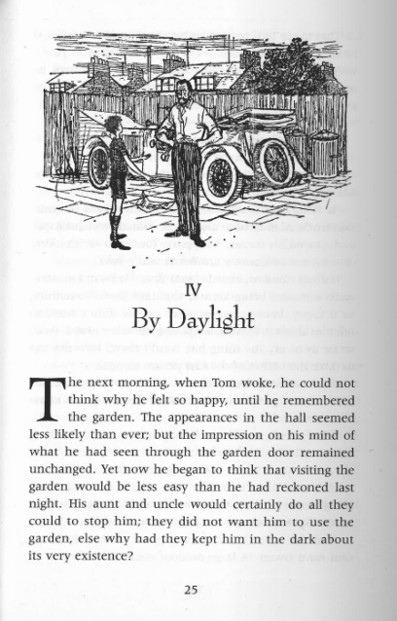
Wednesday 22nd April
Extended Reading
Chapter 4
What has happened so far in the story?
What do you think will happen next?

Slide 5
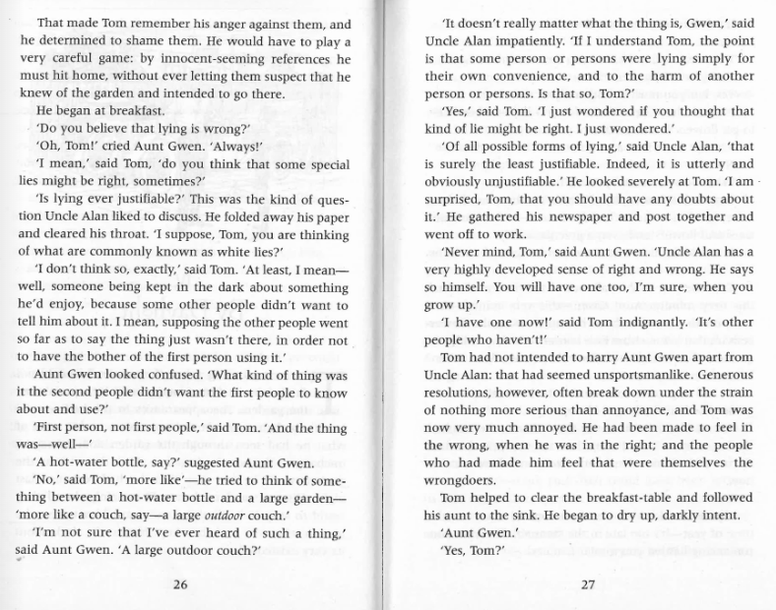
What are ‘white lies’?
Why did Tom and Uncle Alan have a long conversation about whether it was right or not to lie?

Slide 6
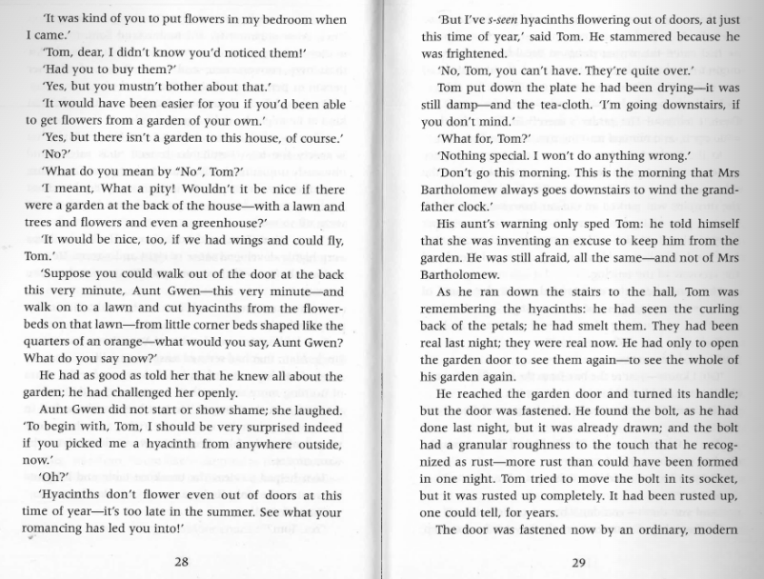
What was Tom afraid of, if not Mrs Bartholomew?
Why would Aunt Gwen be surprised if Tom picked a hyacinth?

Slide 7
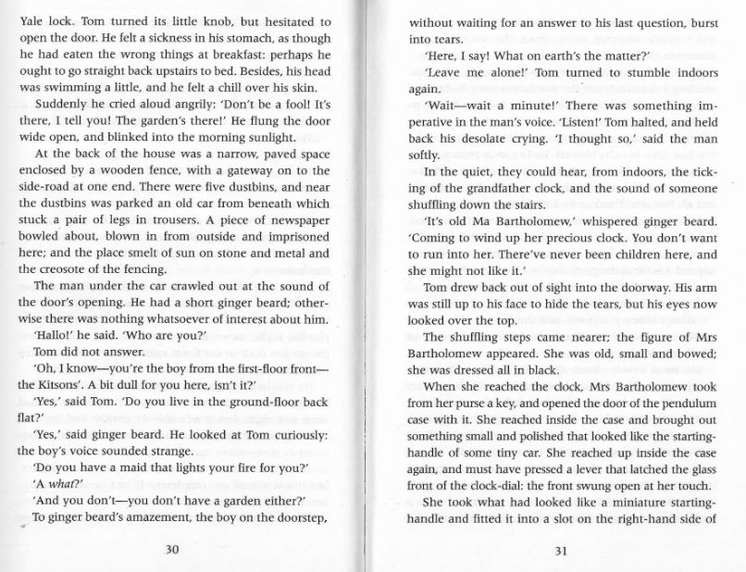
How is the garden different at night compared to how it looks during the day?
What does Tom’s behaviour show about his personality?

Slide 8
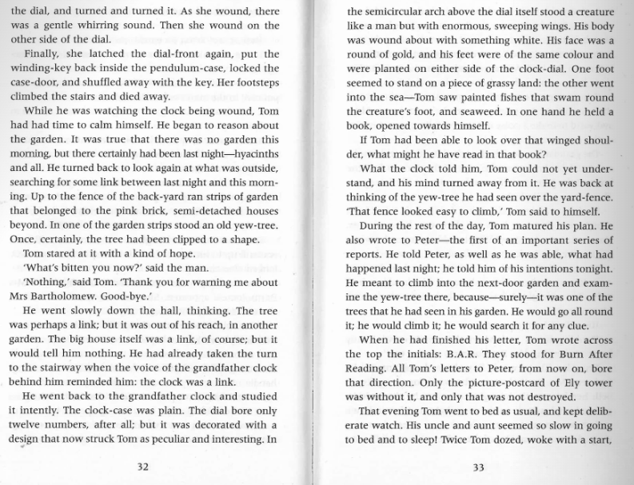
Why was Tom searching for a link between last night and this morning?
What does it mean if you ‘mature your plan’?

Slide 9
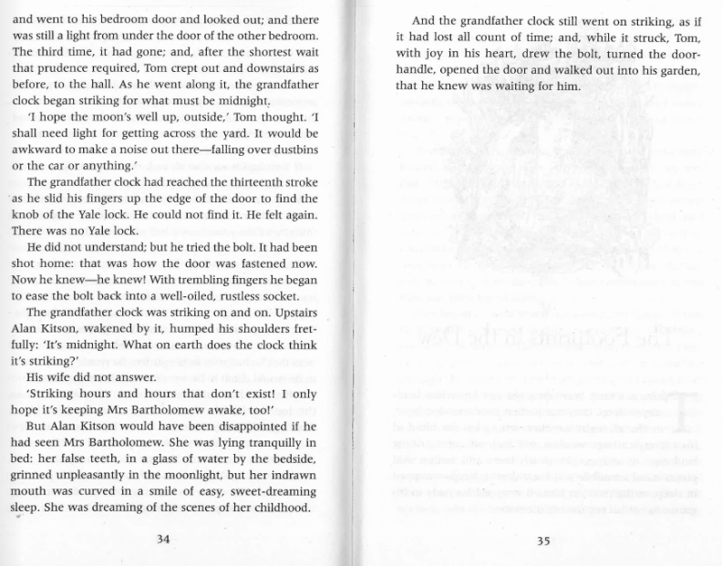
How does Chapter 4 change Tom’s attitude towards staying with his aunt and uncle?
What do you think Tom will do the next time the clock strikes thirteen?

Slide 10
22.4.26
TBAT: multiply mixed number fractions by integers.
3 in 3
60 x 7 =
850 divided by 5 =
Convert this mixed number to an improper fraction: 4 3/5 =
Challenge:
20% of 450 =

Slide 11

22.4.26
TBAT: multiply mixed number fractions by integers.
Daily 10 - Mental Maths Challenge - Topmarks

Slide 12
Blue Green
Convert this mixed number to an improper fraction:
3 2/3 =
Convert this mixed number to an improper fraction:
2 4/5 =
Challenge: What is my missing denominator?
2 ?/4 = 10/4

Slide 13
Talk partners:
How would you solve:
2 2/5 x 5 = step 1: step 2: step 3:

Slide 14
Whiteboard work:
3 2/3 x 4 =
4 ½ x 5 = step 1: convert the mixed number into an improper fraction. step 2: multiply the numerator to the improper fraction by the integer. step 3: keep the denominator the same.

Slide 15

Checkpoint question:
2 1/3 x 4 = a) 7/4 b) 7/3 c) 6/3

Slide 16
Blue Green
2 ¾ x 4 = 3 ½ x 3 =
Challenge:
A gardener plants 2 ½ metres of flowers along one side of a garden.
He plants the same length of flowers along 4 sides of the garden.
How many metres of flowers does the gardener plant altogether?

Slide 17
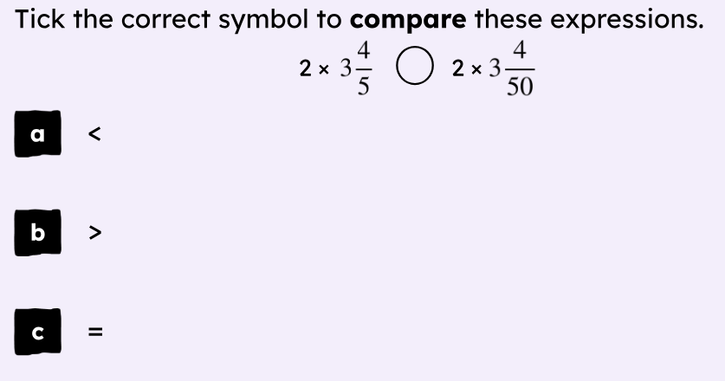
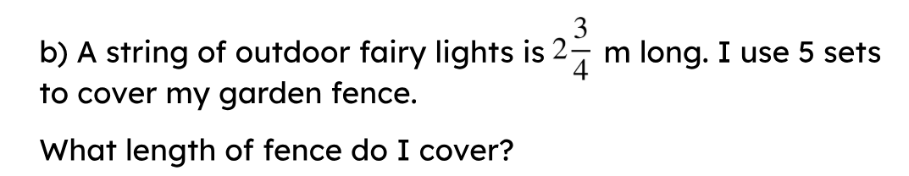
Independent
1 ¾ x 5 =
2 1/6 x 4 =
3 ½ x 6 =
4 3/5 x 3 =
What is the missing numerator?
2 ?/3 = 8/3

Slide 18
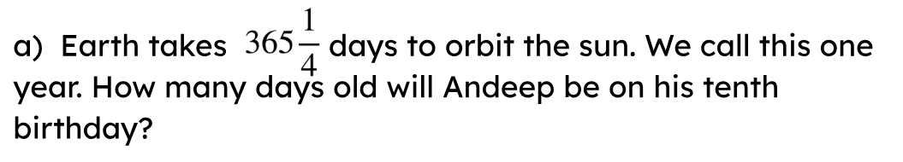
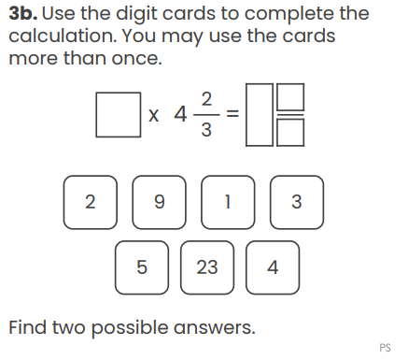
Challenge:
Mastery:

Slide 19
Wednesday 22nd April
TBAT: plan a journalist report
3 in 3
Yesterday, Riverside Park reopened to excited families after a month‑long makeover. The council added new play equipment, brighter paths, and more picnic benches. Many visitors said the park now feels safer and more welcoming. A small celebration was held, and children were the first to try the new climbing frame.
What new features were added to Riverside Park?
How do you think the visitors felt about the changes? Give a reason for your answer.
What does the word makeover mean in this paragraph?

Slide 20
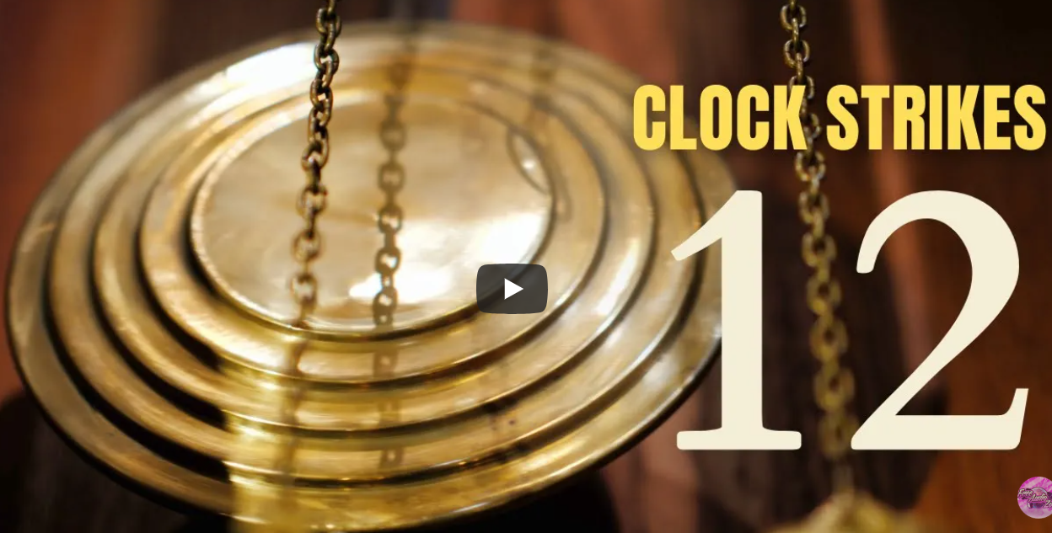

Wednesday 22nd April
TBAT: plan a journalist report
Sound Effect Grandfather Clock Strikes Twelve
Why might this be strange?
What might a journalist do if they heard about this?

Slide 21
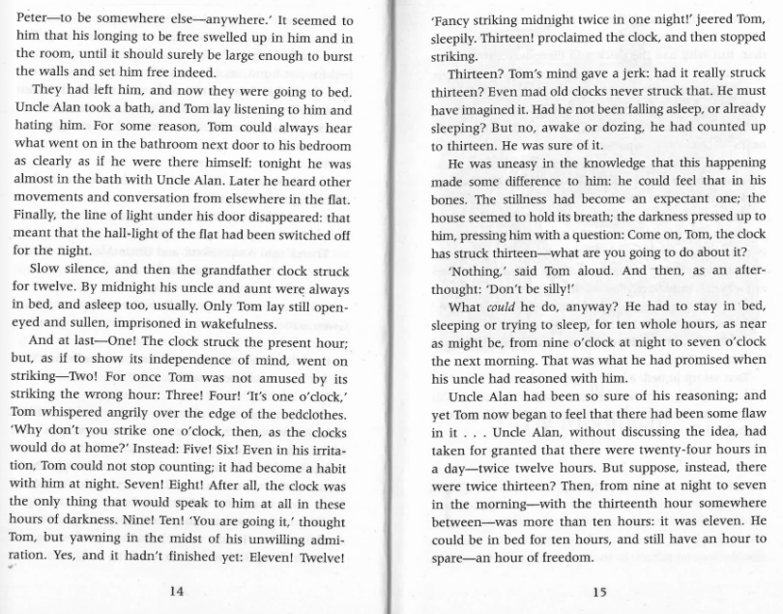
Wednesday 22nd April
TBAT: plan a journalist report
Re-read pages 14 and 15.

Slide 22
Wednesday 22nd April
TBAT: plan a journalist report
Shortly after midnight, residents were left baffled when a local clock chimed thirteen times (an impossible event, according to experts). Tom Long, who was staying with his aunt and uncle, claimed that he “couldn’t believe his ears” and later explained that he had checked the clock twice to be sure.
Can you find:
Journalistic language
Fronted adverbials
Relative clauses
Parenthesis
Indirect speech

Slide 23
Wednesday 22nd April
TBAT: plan a journalist report
Planning-
Headline
Use punchy, dramatic headlines:
“Unexplained Thirteenth Chime Alarms Household”
“Boy Reports Impossible Midnight Event”

Slide 24
Wednesday 22nd April
TBAT: plan a journalist report
Planning-
Opening – from Friday 17th April
(5 Ws)
Who: Tom Long, Aunt Gwen, Uncle Alan
What: Clock struck thirteen
When: Just after midnight
Where: The hallway of the house
Why: Unknown – possible malfunction or something mysterious

Slide 25
Wednesday 22nd April
TBAT: plan a journalist report
Planning-
Witness statements (indirect speech) - from Tuesday 21st April
Plan at least two:
Tom said that he had counted thirteen chimes.
Aunt Gwen explained that the clock had “never behaved strangely before”.

Slide 26
Vocabulary Bank
incident
investigation
according to witnesses
sources reported
experts suggested
unusual occurrence
mysterious event
Fronted adverbial: In the early hours of the morning,
Relative clause: The clock, which usually kept perfect time,
Parenthesis: (much to Tom’s confusion)
Indirect speech: Uncle Alan suggested that the boy might have been mistaken.
Wednesday 22nd April
TBAT: plan a journalist report
Paragraph 2 – What Tom Heard/Saw
Paragraph 3 – Reactions & Witness Statements
Paragraph 4 – Conclusion
What might happen next?
Will the clock be inspected?
Is there a mystery to solve?
Challenge: add a quote from an expert (invented), such as a clockmaker or historian, using indirect speech.

Slide 27
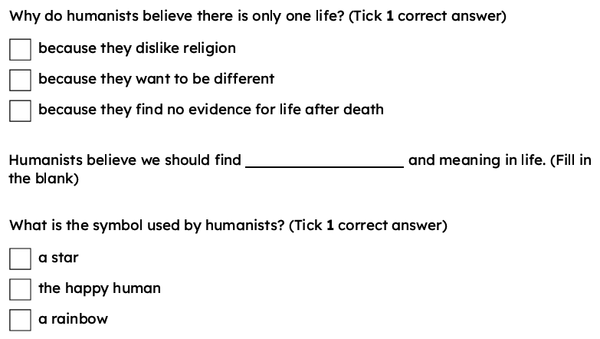
Wednesday 22nd April
TBAT: explain how humanists describe the origins of the world.

Slide 28
evidence
proof supporting a claim
reason
use of logic and facts to make sense of the world
empathy
understanding and sharing the feelings, thoughts and experiences of another person
connection
the responsibility and care a person might feel towards something or someone

Slide 29




How do humanists explain our origins?
Lucas and Aisha are discussing ultimate questions.
Some questions are big questions. ‘What shall I do when I grow up?’ is a big question! But what is an ultimate question?
An ultimate question is a really big and important question that people ask when they want to understand life or the world better. It’s the kind of question that doesn’t always have a simple answer. Sometimes, no one really knows the answer for sure!
Lucas
Aisha

Slide 30

How do humanists explain our origins?
Here are some examples of ultimate questions:
Why are we here?
What happens when we die?
Is there a God?
Can you think of any ultimate questions?

Slide 31
How do humanists explain our origins?
Lucas and Aisha are thinking of a particular ultimate question.
I have been wondering, ‘how did humans come to be on this planet?’
I think the answer depends on your religion or worldview. Some people might say that we were created by god. I wonder how a humanist might answer this question?
Lucas
Aisha

Slide 32

How do humanists explain our origins?
Lucas meets with Nell. She has a humanist worldview.
Nell, how would a humanist go about trying to answer the question ‘how did humans come to be on this planet?’.
Lucas
To answer ultimate questions, humanists think you should question your beliefs carefully and look for evidence. We call this using our reason.
Nell

Slide 33
How do humanists explain our origins?
As a humanist, I don’t think you should believe something if it does not make sense, or is not reasonable. Look at these statements; which of them can you answer using reason?
Nell
I believe my Gran’s car is red because I saw it.
I believe aliens exist because my friends do.
I believe it will snow tomorrow because I dreamed it would.

Slide 34
How do humanists explain our origins?
I believe my Gran’s car is red because I saw it.
I think this statement makes sense because the person used reason and the evidence from their eyes.
Lucas
Yes! We can find out if Gran’s car is red by going and finding it.
So we can find evidence for this statement.
Nell

Slide 35
How do humanists explain our origins?
I believe it will snow tomorrow because I dreamed it would.
I believe aliens exist because my friends do.
I don’t think these statements make sense because they are not based on evidence.
Lucas
Exactly! Dreaming something will happen does not mean it will.
We need to question what people say and see if they are using reason or just hoping it is true.
Nell

Slide 36

How do humanists explain our origins?
Which of the following statements is not based on evidence or reason?
I believe plants need water because I did an experiment to test it.
I believe all cats are cuddly because I want them to be.
I believe dogs are carnivores because my dog is and my vet tells me they all are.

Slide 37
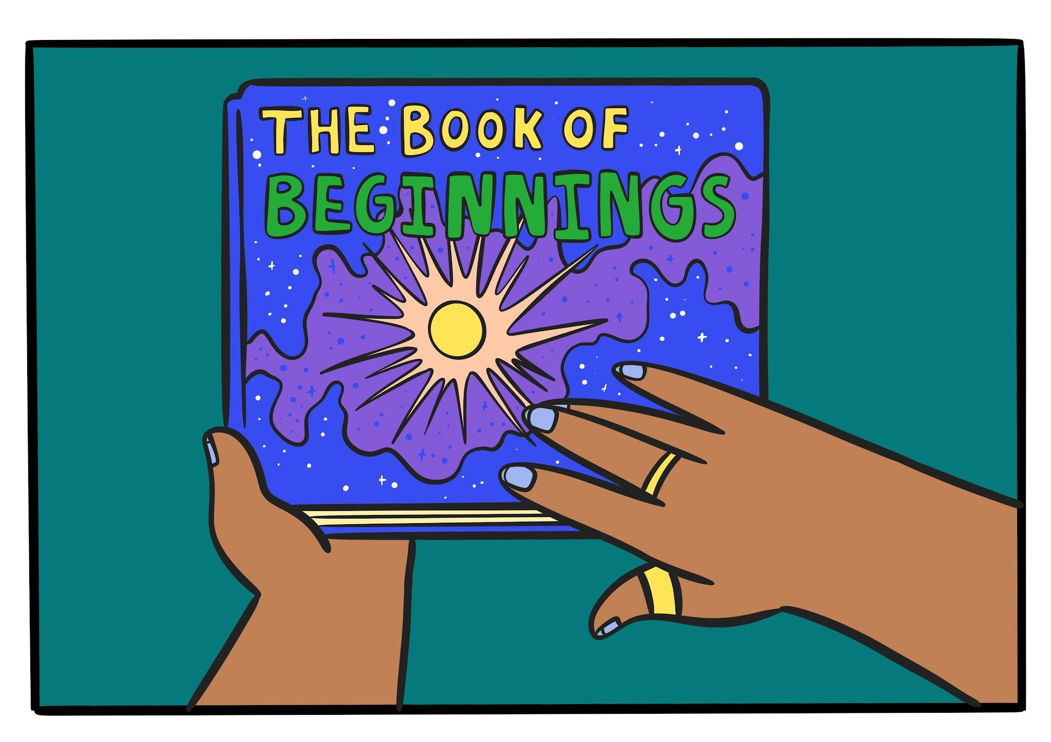
How do humanists explain our origins?
When I was younger, my Mum read me this book.
It answers the question ‘how did human beings come to be on this earth?’.
It uses evidence from science and scientists use this evidence and their reason to come up with the best theory.
Would you like to look inside?
Nell

Slide 38
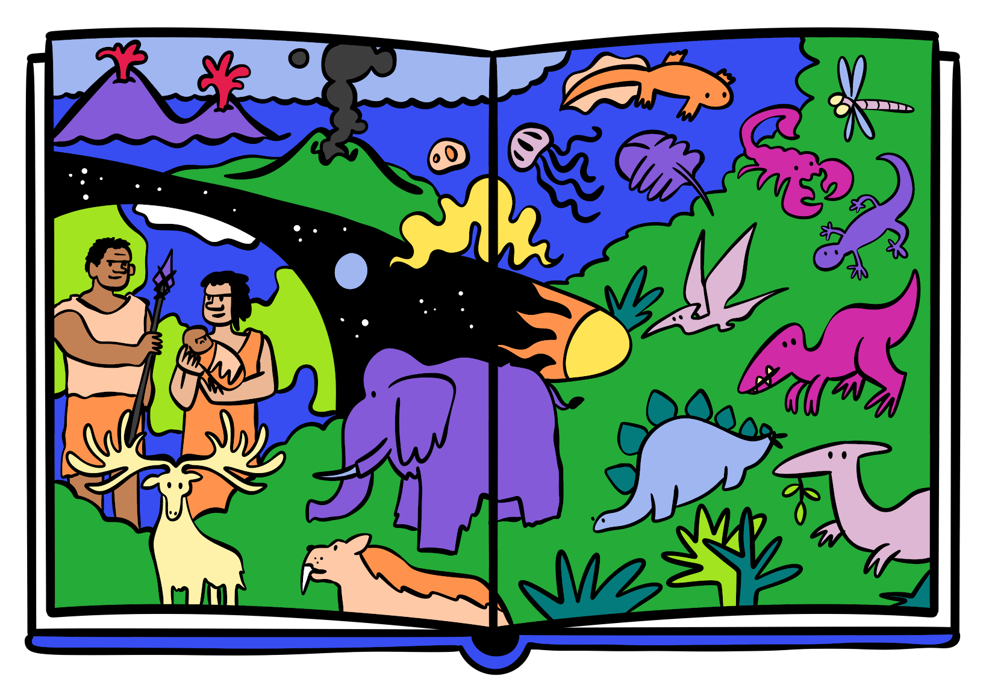
How do humanists explain our origins?
What can you see in this picture?
How might a humanist use this to explain human origins?
What evidence might help them think this?

Slide 39
How do humanists explain our origins?
As a humanist, I think that everything in the universe, the stars, the planets and even life itself came about naturally.
Humanists talk about the Big Bang to explain where human life came from, a huge explosion that created space, time and everything we see around us.
Nell

Slide 40
How do humanists explain our origins?
Who hasn’t understood Nell correctly?
A humanist might use reason, including evidence from science such as the Big Bang, to conclude that humans have evolved from animals.
A humanist might use reason such as evidence from the supernatural world such as god, the stars and the planets to explain where humans have come from.
Lucas
Aisha

Slide 41

How do humanists explain our origins?
So how might a humanist prove that humans have evolved naturally?
Lucas
Have you ever looked at the fossil record? A humanist might use this as evidence to support the claim that humans have evolved over millions of years.
Nell

Slide 42
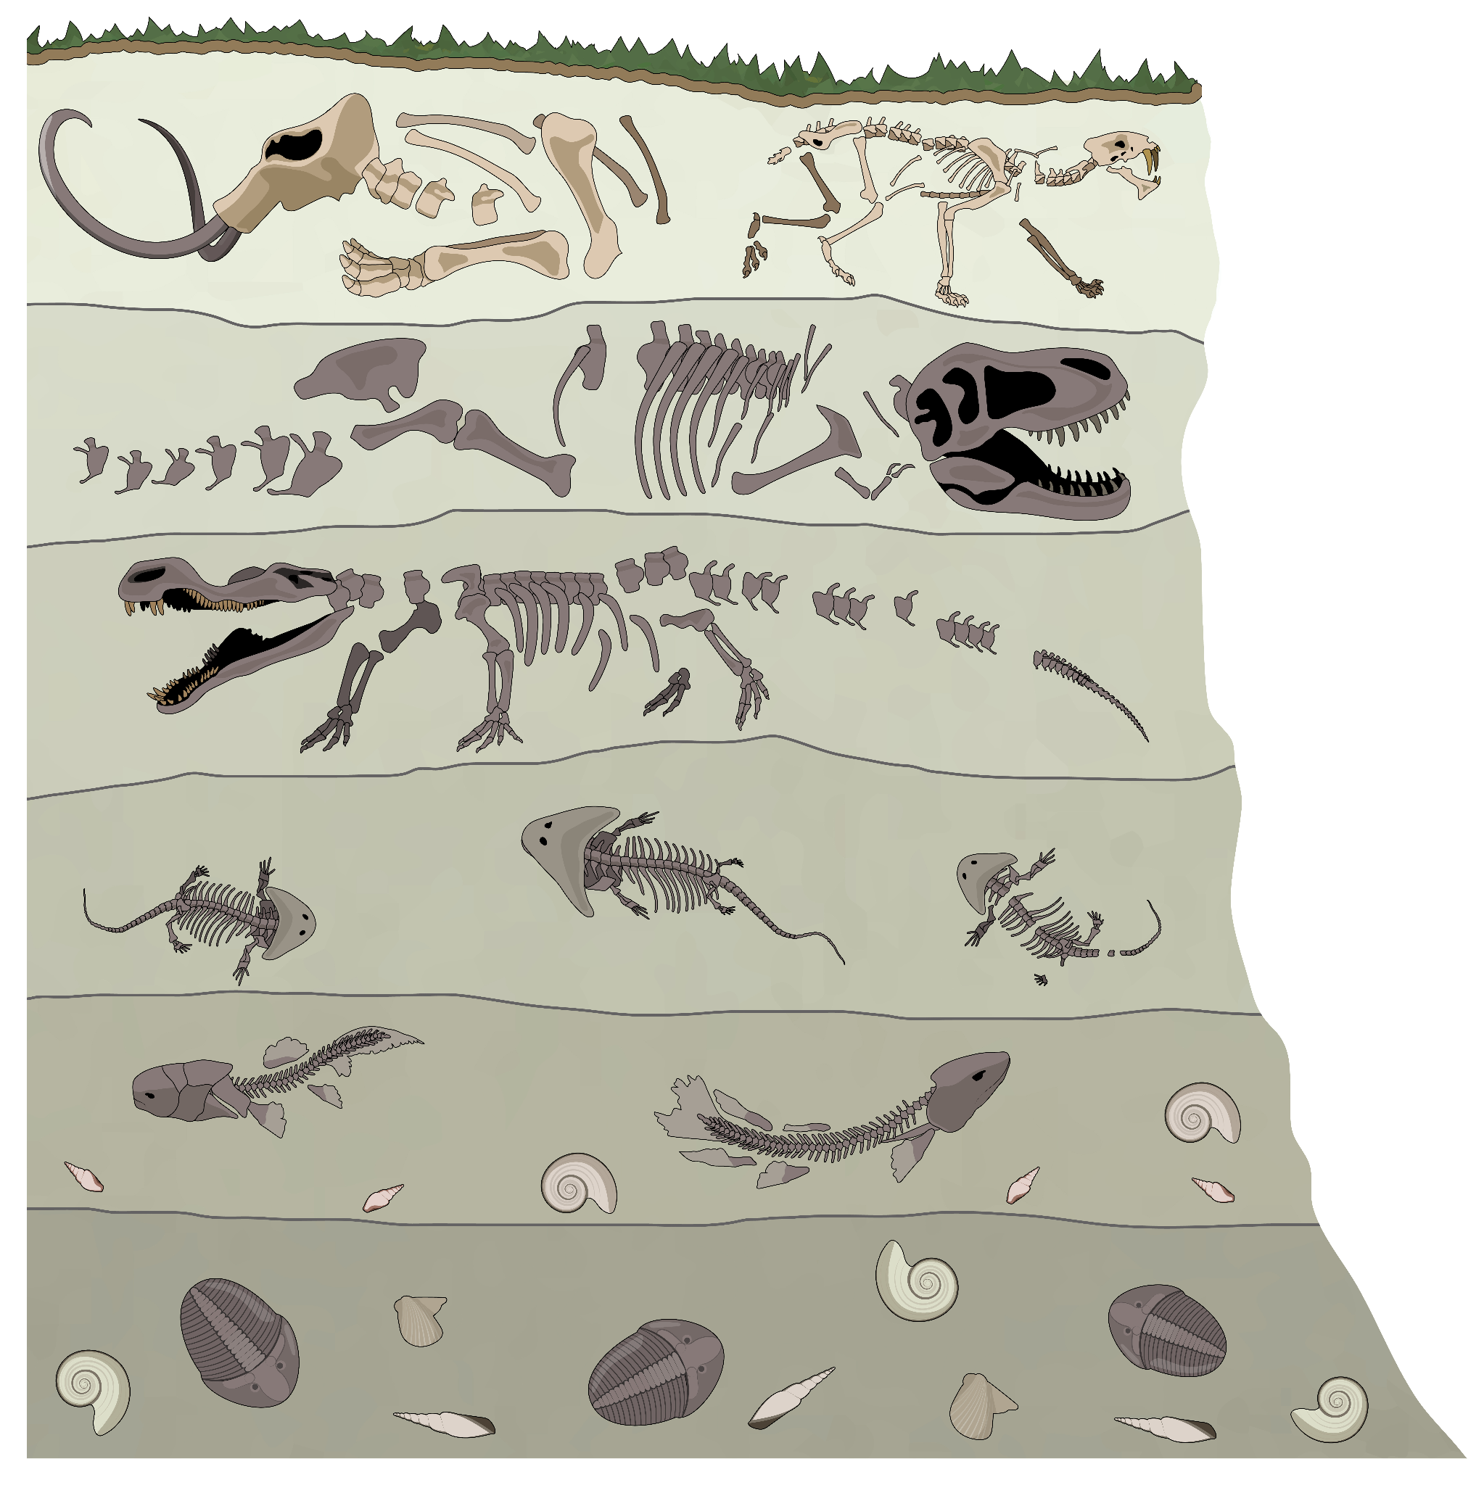
How do humanists explain our origins?
Can you see how the fossils are different in each layer of rock?
A humanist might reason that fossils at the bottom layers of rock are older and more simple than those closer to the surface.
This can explain our origins, showing that life has evolved over time.
Nell
cross-section of a cliff diagram

Slide 43
How do humanists explain our origins?
Complete the sentence with the correct keyword.
The use of logic and facts to make sense of the world is known as .
reason

Slide 44
How do humanists explain our origins?
Explain how a humanist might respond to the question ‘where do humans come from?’.
Use the image of the fossil record to support your answer.
Include the words reason and evidence in your response.

Slide 45
Is humanism just about humans?
Lucas and Aisha reflect on the idea of natural origins.
I wonder how believing in the Big Bang theory and evolution makes a difference to how humanists think about the world?
I wonder if humanists think that humans are special or unique?
Lucas
Aisha

Slide 46
Is humanism just about humans?
How does believing in the Big Bang and evolution affect a humanist, Nell?
Aisha
Knowing that humans have evolved from simple life forms helps me understand that we humans are very much part of nature. We have evolved as part of nature. We are not special or different from the rest of it.
Nell

Slide 47
Is humanism just about humans?
Does that mean that there is more to humanism than just humans?
Aisha
As a humanist, I definitely care about humans. However, there is definitely more to humanism than just humans!
We depend on nature; we need soil, air, water to grow food and survive. We need to look after all of this planet.
Nell

Slide 48
Is humanism just about humans?
Which statement below is not correct?
Humanists care about humans.
Humanists only care about humans.
There is more to humanism than humans.

Slide 49
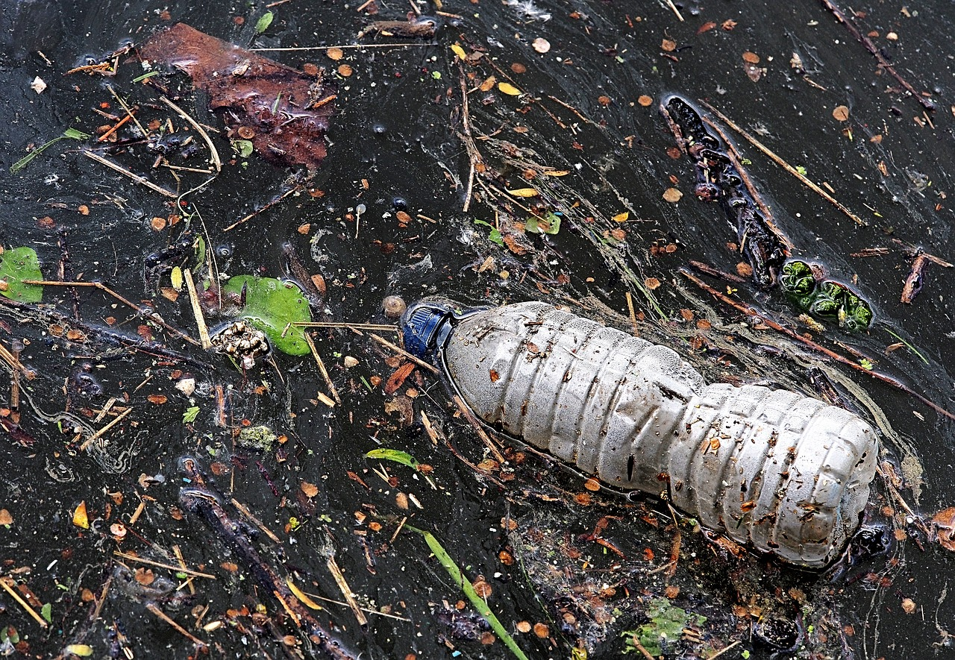
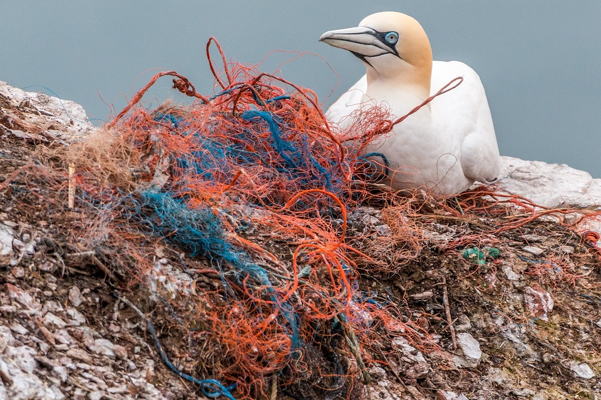
Is humanism just about humans?
What can you see in these photographs?
What connection can you make to nature?
a polluted river
plastic nets on a beach
What might a humanist think when they see these?

Slide 50

Is humanism just about humans?
Aisha meets with Elijah. He also has a humanist worldview and lives in Devon.
Elijah, how do you think about the planet?
Aisha
When I see the mess in our rivers and seas, I feel sad. I think of birds or sea creatures losing their habitat or getting tangled in plastic. This feeling is called empathy. I feel a connection with these animals.
Elijah

Slide 51
Is humanism just about humans?
We humans are part of nature.
I don’t believe in God, but I do think we humans have a special responsibility.
Empathy means we can think about how other people feel. Empathy tells me the planet is hurting.
I also listen to scientists who use reason to explain that if we don’t care for our planet, it will become a difficult place for all life.
Elijah

Slide 52
Is humanism just about humans?
What does empathy mean to Elijah?
thinking how others might feel
using reason to make an argument
caring about the planet

Slide 53

Is humanism just about humans?
What might be happening here? Why?
I live near to the sea. Each weekend, a friend and I take a bag and remove some plastic from along the beach.
As a humanist, I asked, ‘how can I stop the animals in the sea suffering?’
I then decided to take action.
Elijah and his friend

Slide 54
Is humanism just about humans?
Because I believe in our connection with nature and that we should care about animals and the environment, I decided to become vegetarian.
How did you reach that decision, Nell? What kind of questions did you ask?
Nell
Aisha

Slide 55
Is humanism just about humans?
I asked questions such as; will eating meat cause animals to suffer, and do I want to be part of that?
What do scientists say about how meat affects the environment?
Is being vegetarian one way I can live kindly and fairly toward other living things?
Nell

Slide 56
Is humanism just about humans?
Asking these questions helped me to conclude that I should be vegetarian to avoid causing harm or suffering to animals and the environment.
Not all humanists will be vegetarian. My mum tries to be meat free twice a week and only eats meat that comes from places where animals are treated well.
Nell

Slide 57
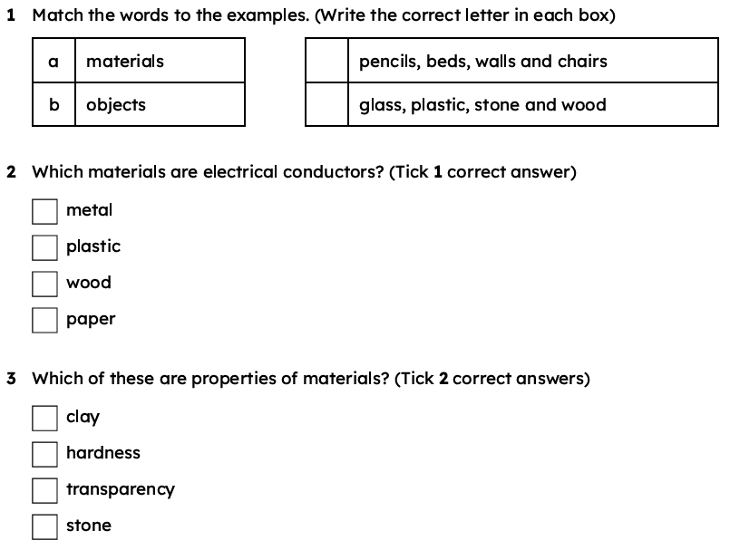
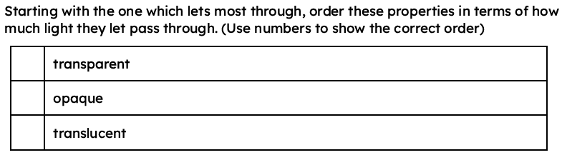
Wednesday 22nd April
Q: What are the uses of everyday materials?

Slide 58
physical properties
The physical properties of a material are the features that can be observed or measured.
material
A material is the substance that objects are made from such as wood, metal or plastic.
results
The result of a test or enquiry is what happened or what was found out.
suitable
If something or someone is suitable, it has properties which are right or acceptable for it.

Slide 59


Knowing the properties of materials
Sam and Alex have been investigating the physical properties of materials.
Explain to a partner what physical properties are.
They grouped the materials depending on their different physical properties.
Sam
Alex
conducts electricity | does not conduct electricity
metal (steel paper clip) | plastic (cling film)
metal (aluminium foil) | glass (cup)
 | wood (toy)
Which properties have you tested?
Sam and Alex grouped the results for all properties into one table.

Slide 60


Knowing the properties of materials
material | rigid | transparent | conducts electricity | magnetic
metal (aluminium foil)
metal (steel paper clip)
plastic (cling film)
glass (cup)
wood (toy)
But why is it useful to know the properties of materials?
Do you know?
Alex

Slide 61
Knowing the properties of materials
The features of a material that can be observed or measured are called its .
properties
abilities
behaviours
properties

Slide 62
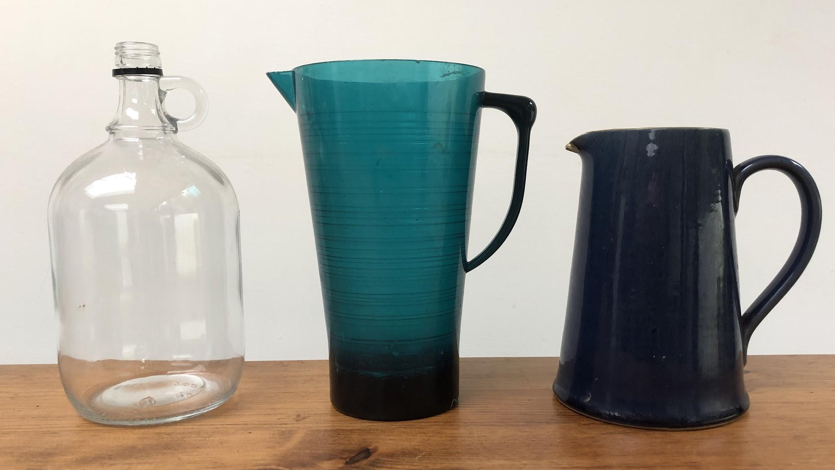
Knowing the properties of materials
The properties of materials can make them suitable for some uses and unsuitable for other uses.
The results of scientific investigations allow us to explain why materials are suited to particular uses.
When engineers design objects, they must think about what they need those objects to be able to do.
water containers made from different materials

Slide 63
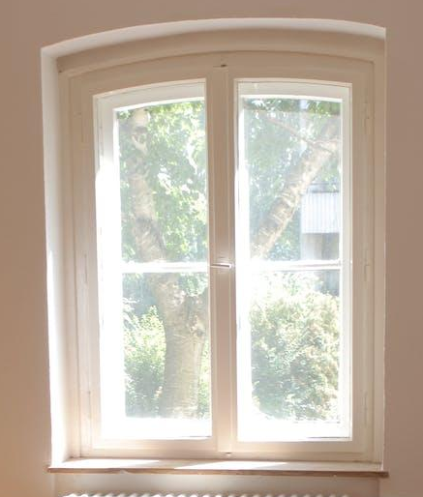
Knowing the properties of materials
Engineers can then choose materials with suitable properties that allow the object to function in the best way possible.
What properties does the material suitable for a window need?
A window needs to be transparent and hard.
a window
Sam

Slide 64
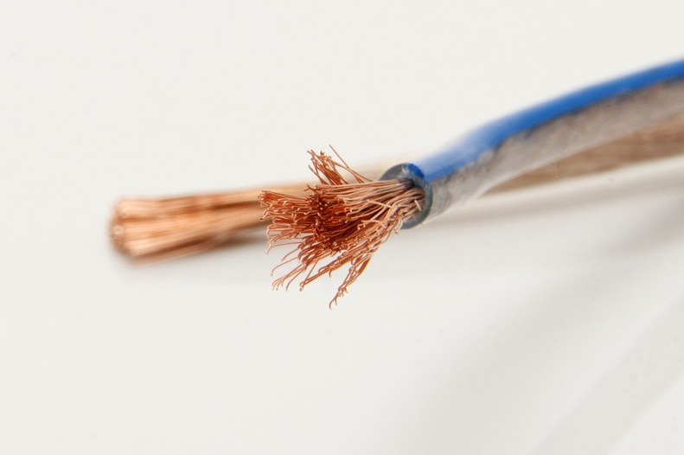
Knowing the properties of materials
What properties does the material suitable for a wire in an electric circuit need?
Wires needs to be flexible and an electrical conductor.
Alex
electrical wires

Slide 65

Knowing the properties of materials
What properties does the material suitable for a jumper need?
The material for a jumper needs to be soft and flexible.
Sam
jumper

Slide 66
Knowing the properties of materials
Which of these is the most likely way that scientists find out whether particular materials are suitable for particular uses?
reading newspapers
carrying out investigations
designing products

Slide 67
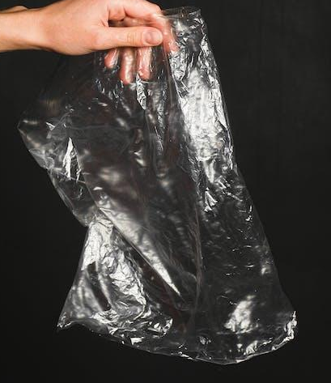

Choosing materials based on their properties
Sam has observed something a bit confusing.
This plastic is flexible and transparent …
but this plastic is rigid and opaque.
Sam
plastic bag
plastic bin
Some materials come in different types which have different properties.
Can you think of any other examples of this?

Slide 68
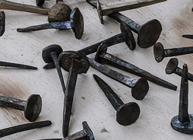
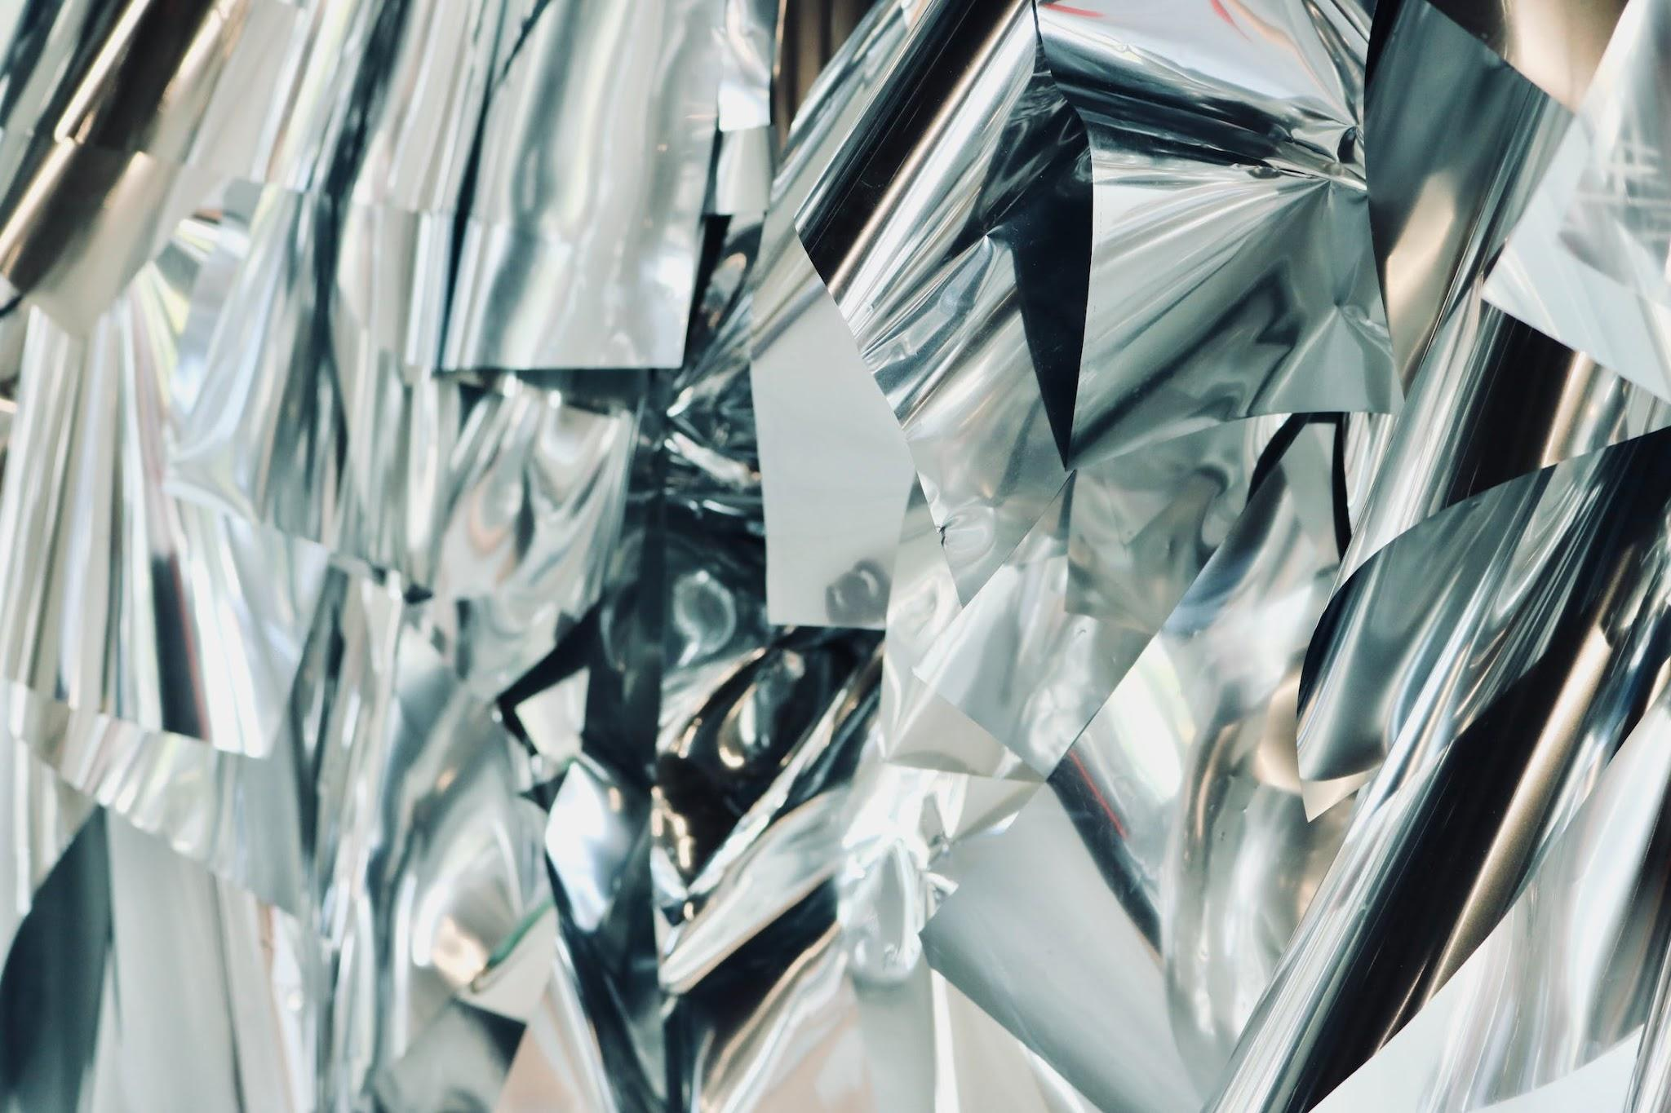
Choosing materials based on their properties
There are lots of different types of metals and they do not all have the same properties.
For example, can you remember which metals are attracted to magnets?
Iron is attracted to magnets, but aluminium is not.
iron
aluminium
What other materials have different types?

Slide 69
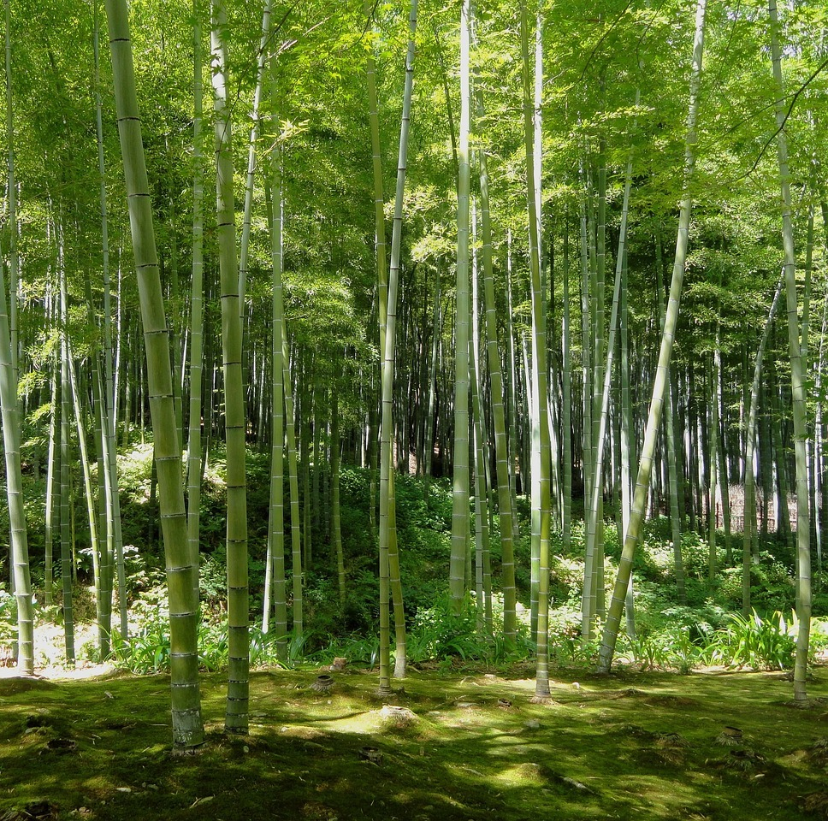
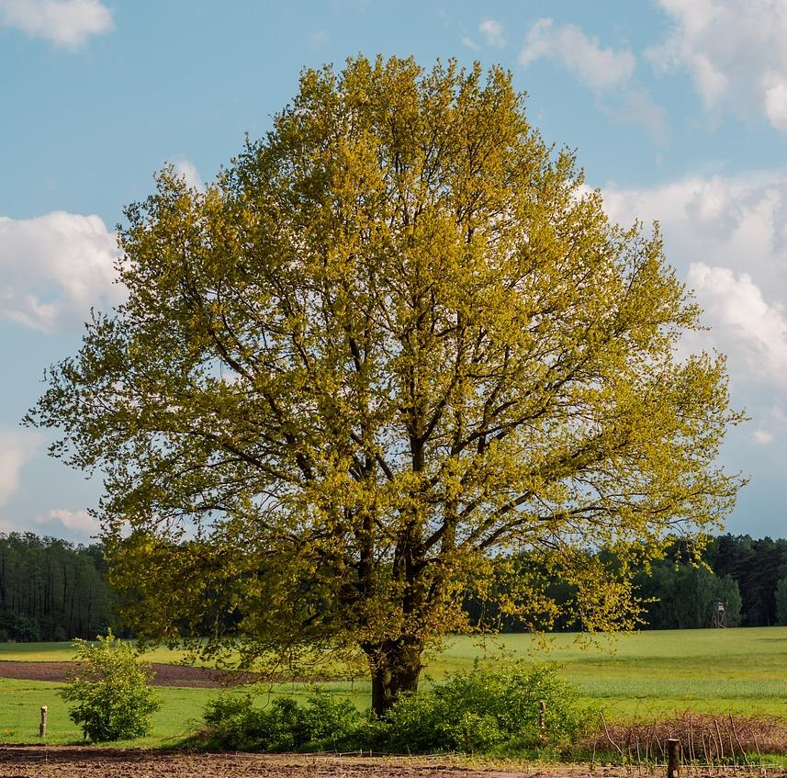
Choosing materials based on their properties
There are lots of different types of wood. Each one has different properties which makes them suitable for different uses.
Bamboo is flexible, lightweight and biodegradable.
Oak is rigid, strong and biodegradable.
bamboo plant
oak tree

Slide 70
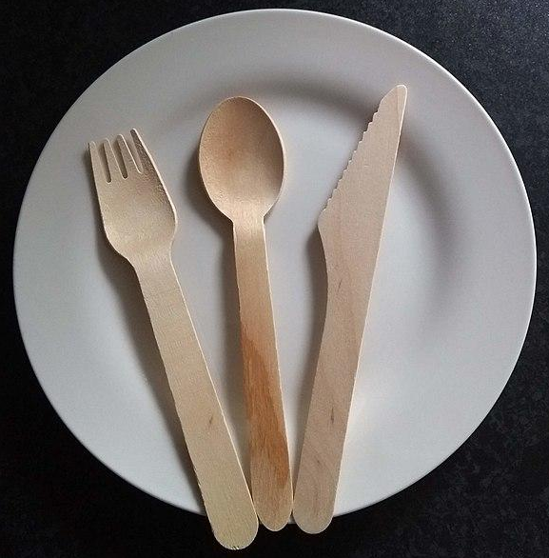
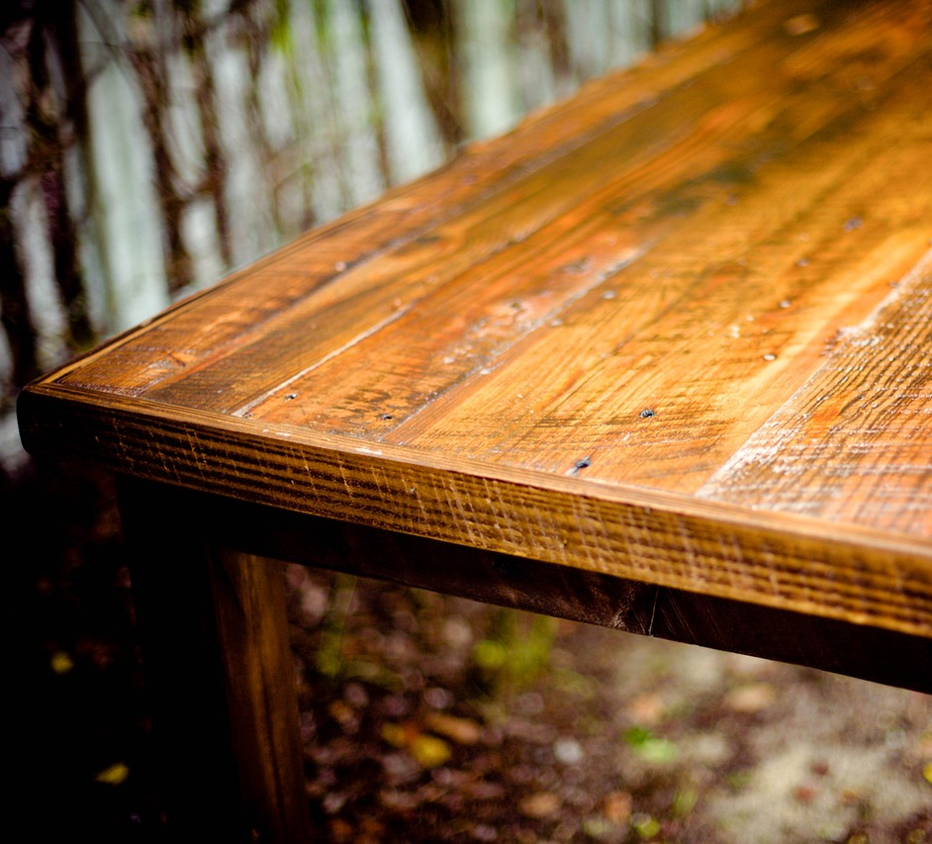
Choosing materials based on their properties
Would you use oak or bamboo to make disposable cutlery? Why?
Would you use oak or bamboo to make a table? Why?
Bamboo is flexible, lightweight and biodegradable.
Oak is rigid, strong and biodegradable.
bamboo cutlery
oak table

Slide 71
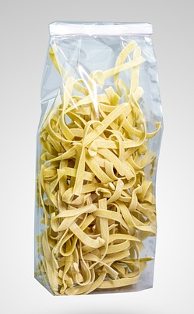
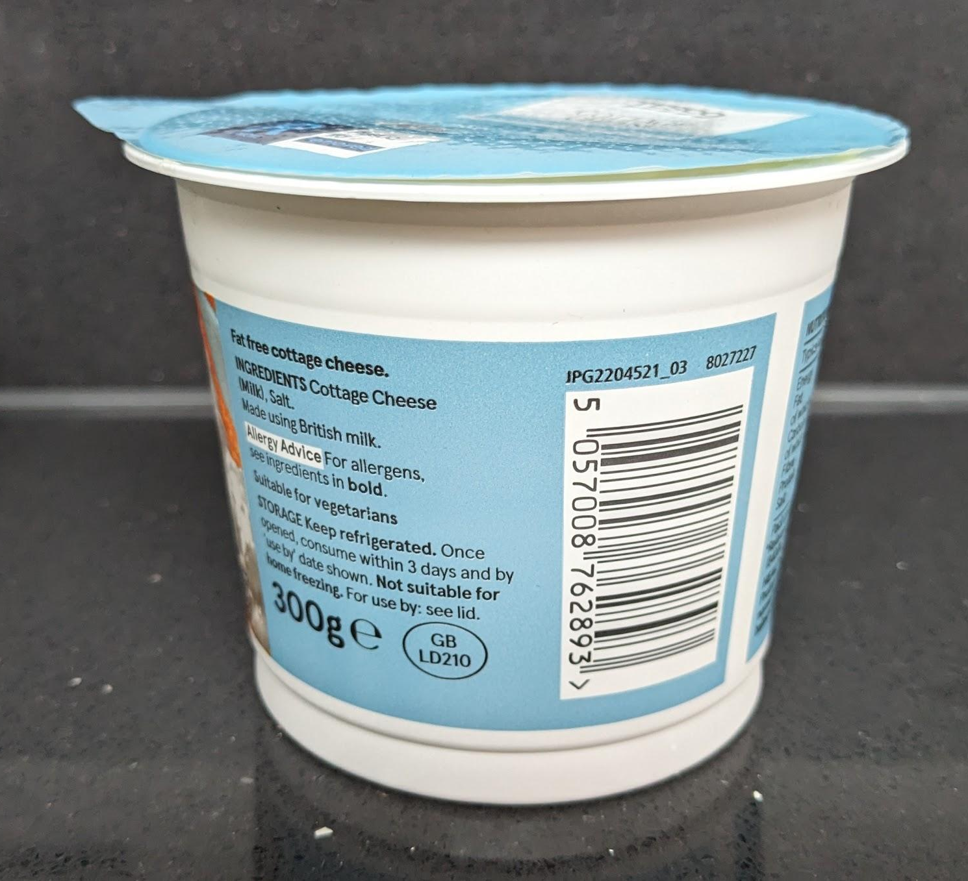
Choosing materials based on their properties
Scientists and engineers choose materials for different uses based on their physical properties.
Plastic is often used to make packaging for food.
What properties of plastic make it suitable for this?
Plastic is lightweight and waterproof and can be made in different shapes and forms.
food in plastic packaging

Slide 72
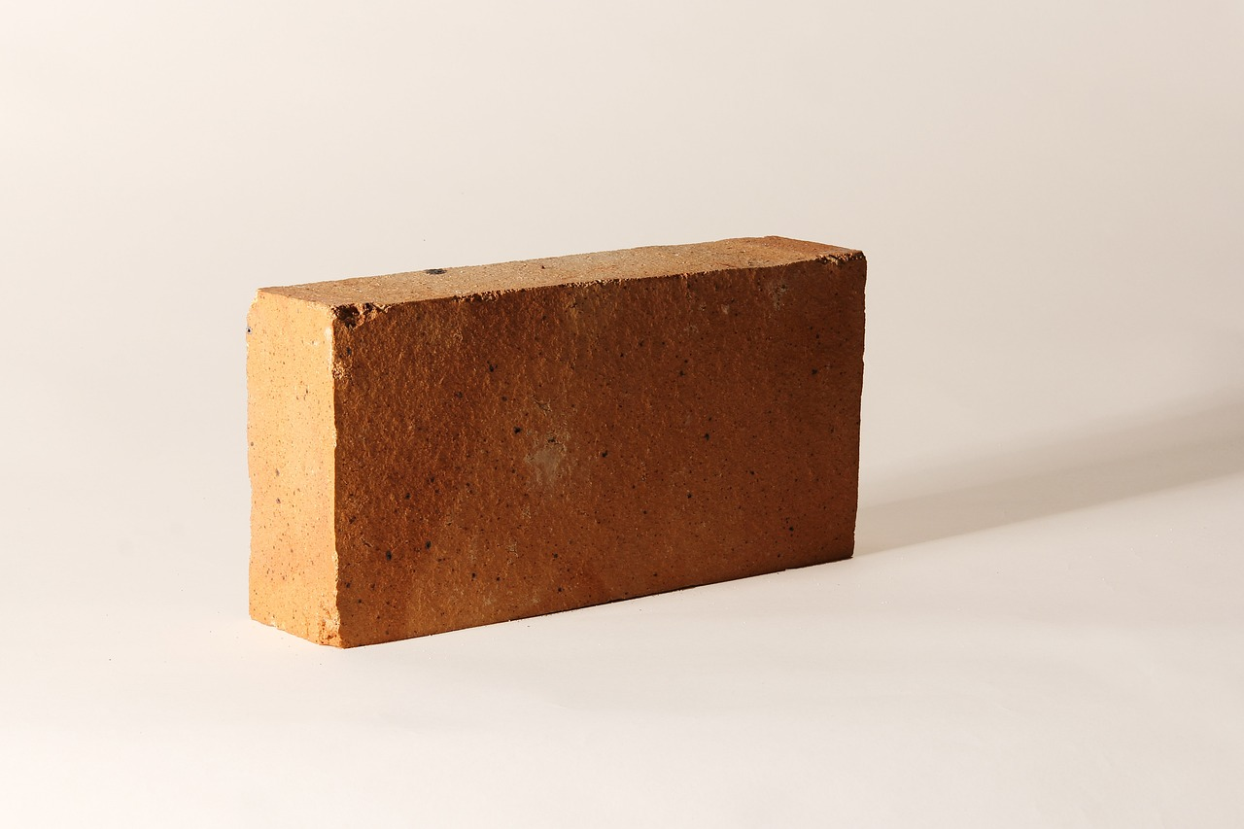
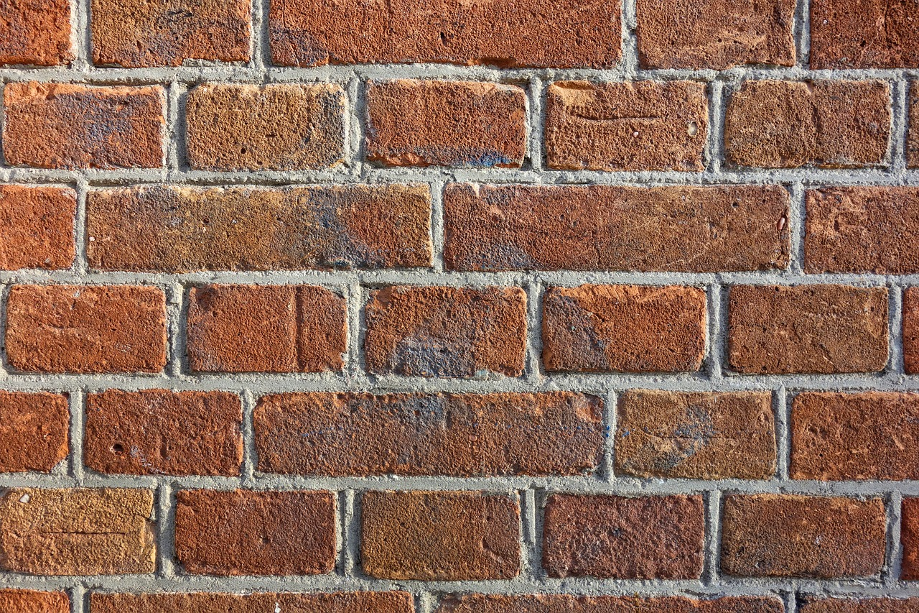
Choosing materials based on their properties
Why do you think brick has suitable properties for construction?
a brick
brick wall
Brick is hard, rigid and strong and can be formed into different sizes and shapes.

Slide 73
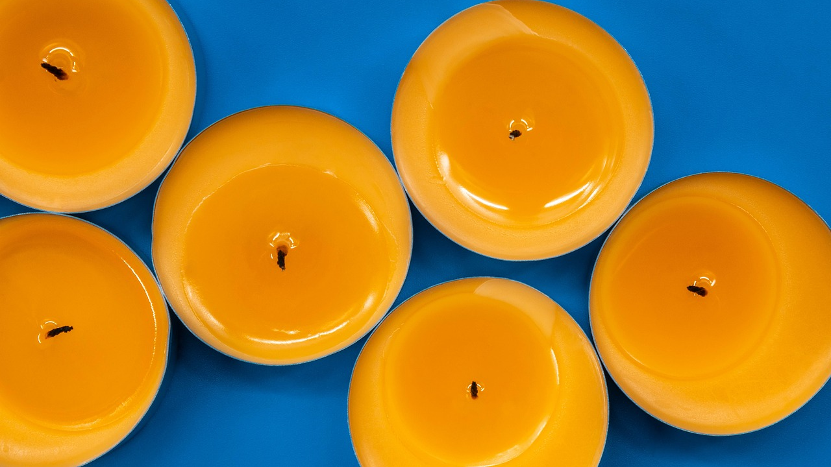
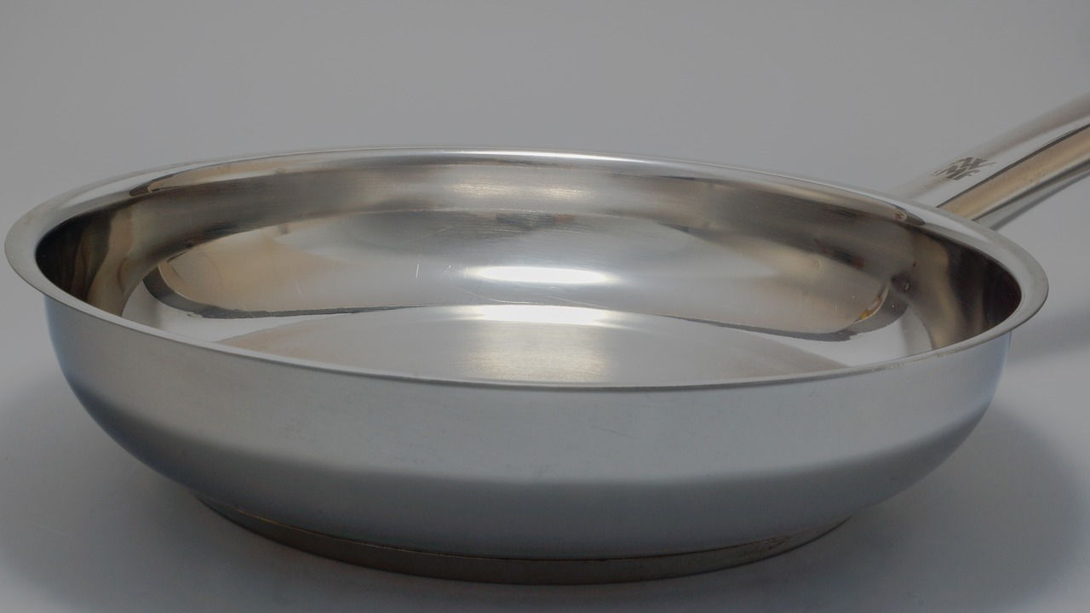
Choosing materials based on their properties
Understanding the properties of materials also helps engineers choose which materials are unsuitable for particular tasks.
Why wouldn’t you use wax to make a saucepan?
wax candles
metal saucepan
Wax melts at low temperatures, so a saucepan made of wax would melt when it was heated on a cooker.
Alex

Slide 74
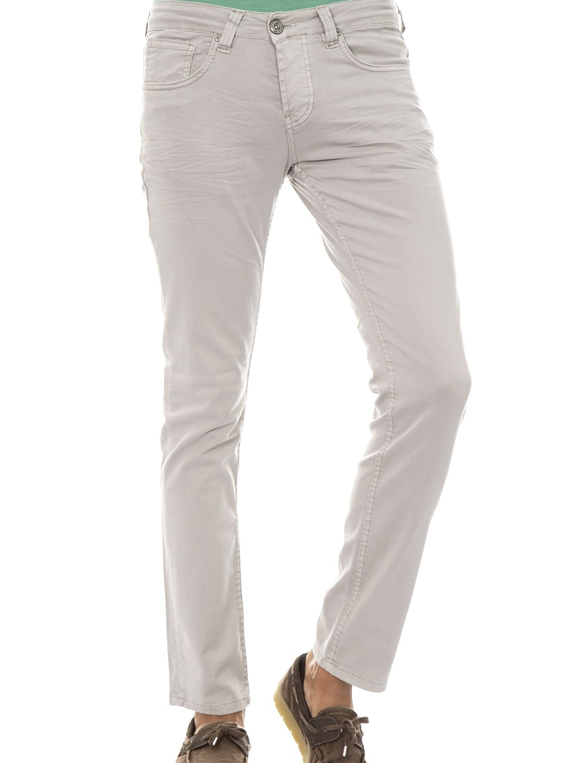
Choosing materials based on their properties
Which materials would not have suitable properties for making a pair of trousers?
I think glass is not suitable for making trousers because it is rigid, transparent and could shatter.
Sam
Do you have other ideas?
pair of trousers

Slide 75
Choosing materials based on their properties
Scientists and engineers choose for different uses based on their physical properties.
materials
companies
materials
designers

Slide 76
Choosing materials based on their properties
If you know the properties of one type of metal, then you will know the properties of all metals.
Some materials, like metal, come in different types which have different properties.
Some materials come in different types and their properties change from day to day.

Slide 77
Choosing materials based on their properties
Choose which materials would be most suitable and least suitable for these objects and explain why.
Record your results in a table like this:
object | material
 | suitable | not suitable
window
device to keep fridge door closed
the wires in an electrical circuit
a table top
You could use your own test results to support your explanations.

Slide 78
Choosing materials based on their properties
Items:
a window
a device to keep a fridge door closed
a winter hat
the wires in a electrical circuit
a tale top
Choose which materials would be most suitable and least suitable for these objects and explain why.
object | material
 | suitable | not suitable
window | glass - rigid and transparent | wood - opaque
device to keep fridge door closed | steel on the door and a magnet on the other side - steel is magnetic so the door would stay shut. | aluminium - not magnetic so would not be attracted to the magnet to keep the door closed.

Slide 79
Choosing materials based on their properties
Items:
a window
a device to keep a fridge door closed
a winter hat
the wires in a electrical circuit
a table top
Choose which materials would be most suitable and least suitable for these objects and explain why.
object | material
 | suitable | not suitable
wires in electrical circuit | any metal - they are electrical conductors | any plastic - not electrical conductors
table top | wood - rigid | plastic used in cling film - soft and flexible

Slide 80
Wednesday 22nd April
Q: What are the uses of everyday materials?
EXIT QUESTIONS
The physical properties of a material are the features that can be observed or __________.
Some materials come in different types which have different ________.
Scientists and engineers choose materials for different uses based on their _________ ___________.
properties, measured, physical

Slide 81
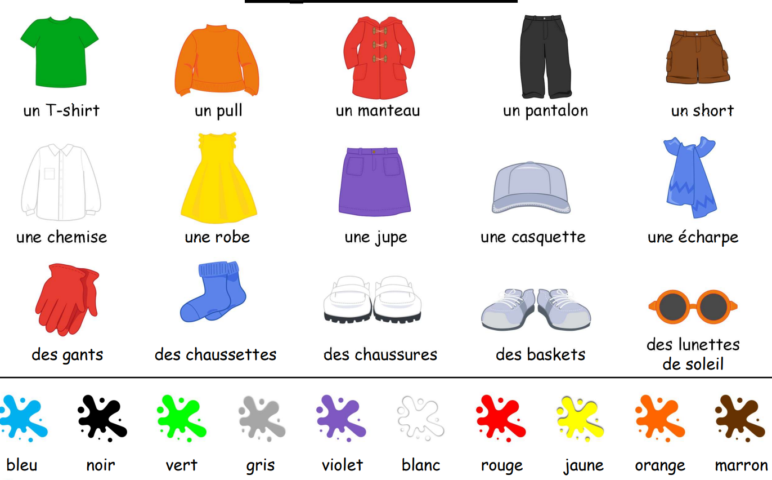
mercredi 22 avril
TBAT: Learn 5 more items of clothing.
3 in 3
Using the information,
write the following
in French:
Remember the adjective
comes after the noun.
1. Red jumper
2. Yellow hat
3. Black dress

Slide 82
mercredi 22 avril
TBAT: Learn 5 more items of clothing.
languageangels.com/resource/1/5/53/215
Lesson 2
Go through slides, stop at slide 20 to complete the first task and slide 27 to complete the independent learning.

Slide 83
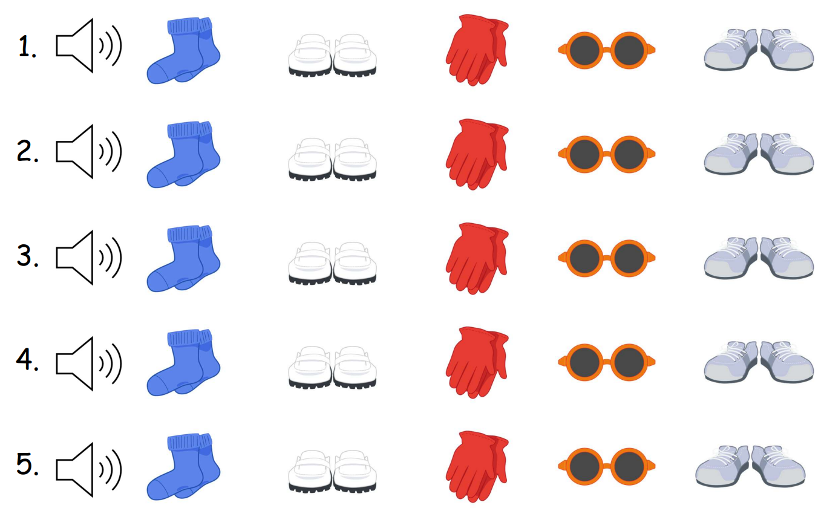
French
Slide 20

Slide 84
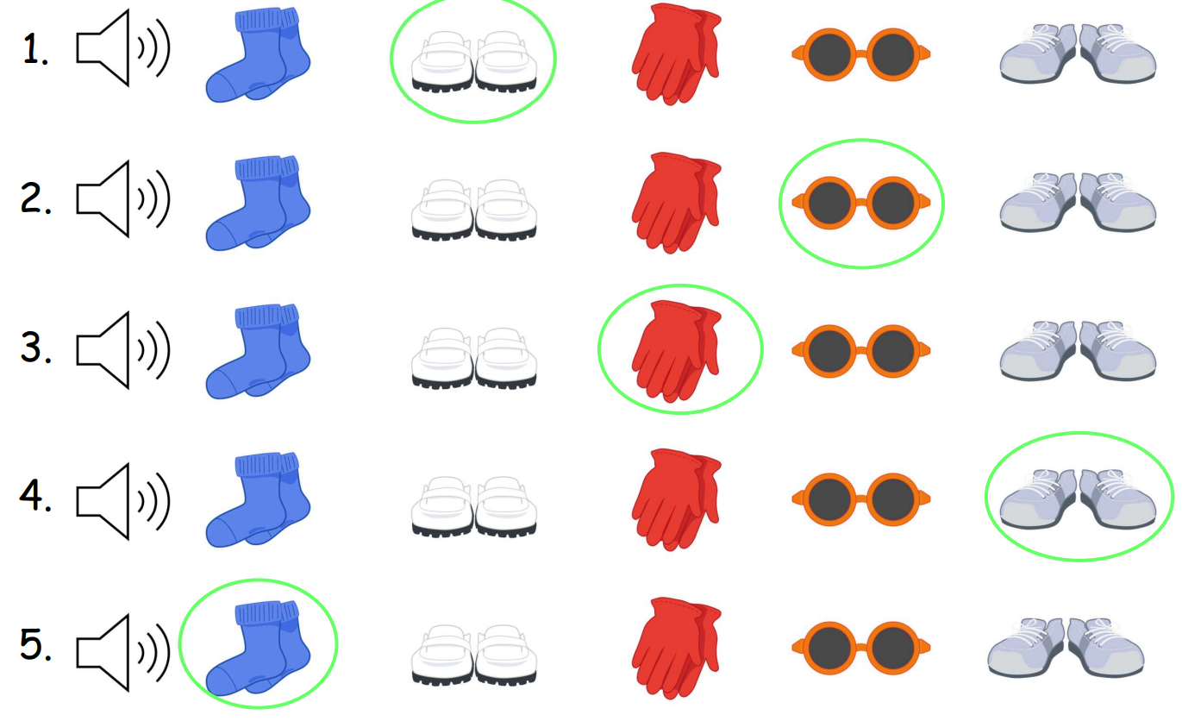
French
Slide 20

Slide 85
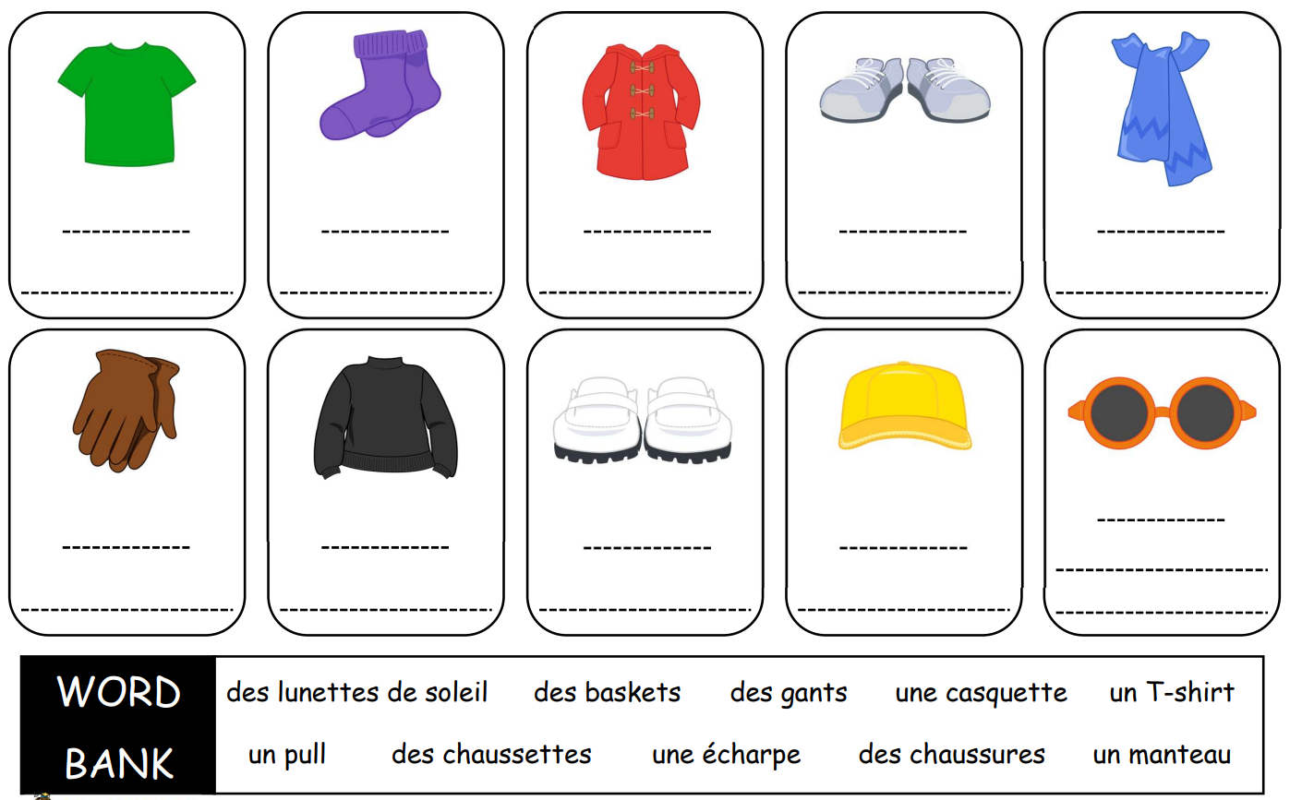
French
Independent

