Slide 1
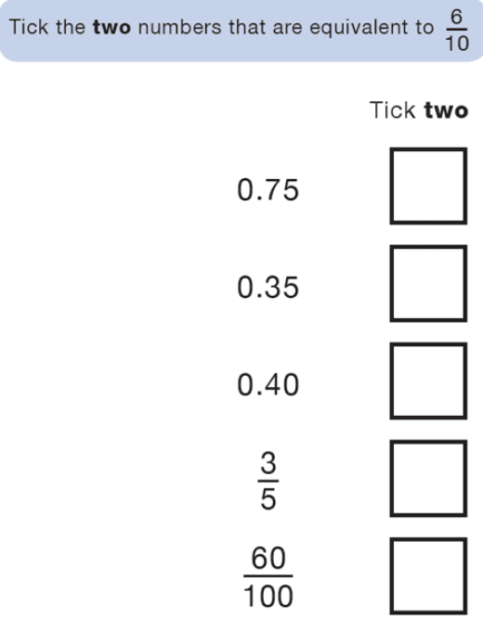
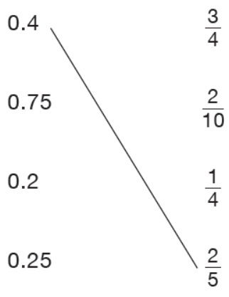
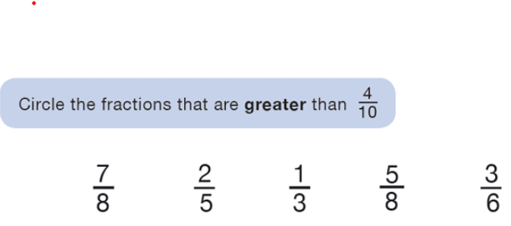
Morning Challenge:

Slide 2
21.4.26
TBAT: multiply mixed number fractions by integers.
3 in 3
40 x 7 =
350 divided by 5 =
23/ 5 =
Challenge:
20% of 350 =

Slide 3
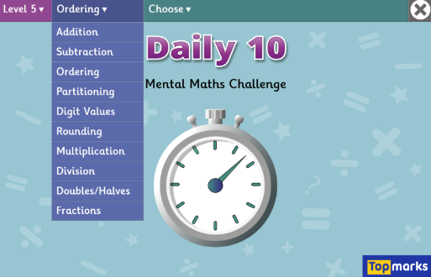
21.4.26
TBAT: multiply mixed number fractions by integers.
Daily 10 - Mental Maths Challenge - Topmarks

Slide 4
Blue Green
1/7 + 1/7 + 1/7 + 1/7 =
1/5 + 1/5 + 1/5 + 1/5 =
Challenge: Write your number sentence as a multiplication problem.

Slide 5
Talk partners: 1 ½ 2 ¾ What is a mixed number? How would I convert these into improper fractions?

Slide 6
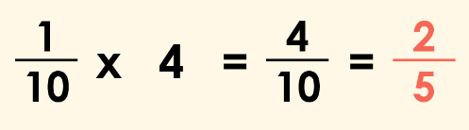
We can simplify four tenths to two fifths. True or false?

Slide 7
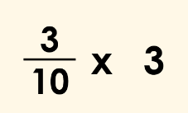
Here is a multiplication involving a non-unit fraction and an integer.
We can also write this multiplication using repeated addition.

Slide 8
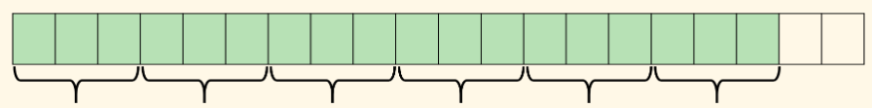
Talk partners: What is represented on this bar model?

Slide 9
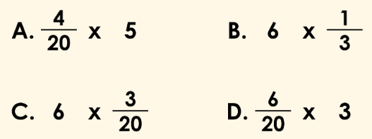
Talk partners: Which calculation does the bar model represent?

Slide 10
Whiteboard work: 3/4 x 6 = ½ x 12 = 11 x ¾ =

Slide 11
Talk partners: What is the missing integer? ¾ x ? = 15/4 = 3 ¾

Slide 12
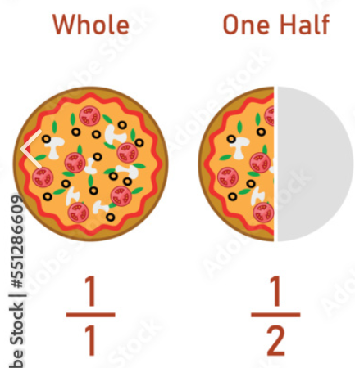
Step by step: 2 x 1 ½ -Convert to an improper fraction: 3/2 -Multiply: 2 x 3/2 = 6/2 Can we simplify 6/2?

Slide 13
Talk partners: How would we solve the following problem? 5 2/5 x 5 =

Slide 14

Checkpoint question: 3 1/3 x 4 = a) 40/4 b) 40/3 c) 10/4

Slide 15
TBAT: multiply proper fractions by integers.
6/7 X 4 =
4 ½ x 7 =
4/9 X 6 =
3 4/5 x 2 =
Challenge: 2 6/8 x 2 = 4 12/8
What mistake has been made?

Slide 16
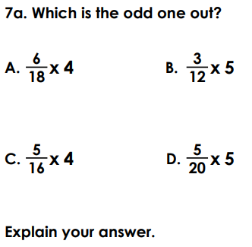
Independent
1 whole and 4/8 X 5 =
1 whole and 5/7 X 3 =
2 wholes and 1/2 X 8 =
2 wholes and ¾ X 7 =
2/7 x 6 = 12/ 42 T or F?
Explain the mistake that has been made.
6. 4/5 x ? = 12/ 5

Slide 17
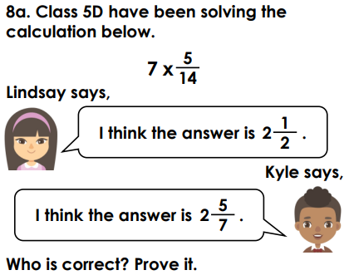
Challenge: The answer is 2 ¾. Write a correct multiplication
Mastery:

