Slide 1
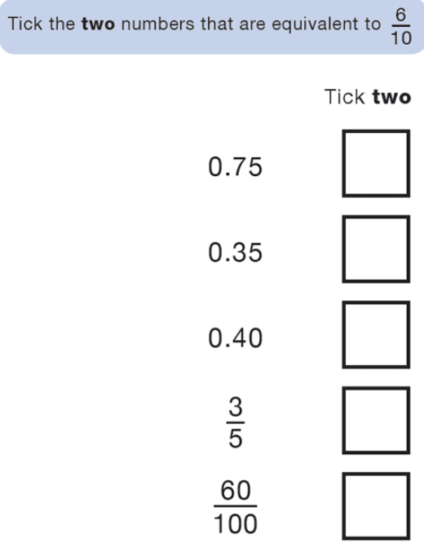
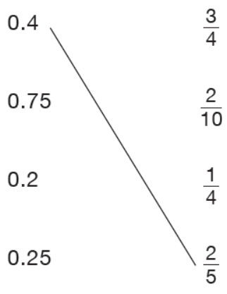
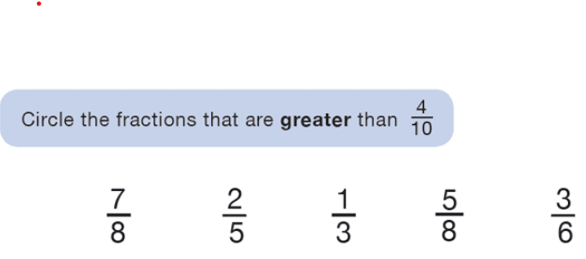
Morning Challenge:

Slide 2

Tuesday 21st April
Close Reading
TBAT: understand words in context.
It was evening when a camp counsellor led a group of youngsters on a narrow trail through the woods. Laughing and chatting, they did not suspect that they were being watched as they made their way to a campground by a stream. From high above, in the trees’ leafy canopy, a pair of dark brown eyes observed the humans. Even if the campers had scanned the treetops with binoculars, they might have missed their observer. The creature sat still, perfectly concealed by his streaks and bands of brown, grey, and white feathers. The creature had sharp eyesight. His eyes could capture light even on dark nights. Although his eyes could not move, he had no problem tracking the campers below. His neck was so flexible, he could almost turn his head in a complete circle. Even after the campers had disappeared from sight, the creature knew where they were. His eyesight was excellent, but his hearing was phenomenal. His larger right earhole was positioned slightly differently from his left earhole. That meant each ear received sound waves in different ways. The creature’s brain used the information from both ears to pinpoint the source of a sound. If a tiny animal scurried under a layer of leaves far below, the creature knew exactly where it was. The creature stirred on his branch. It was time to hunt. He called loudly to announce himself to others of his kind. All the campers heard the eight hoots floating through the trees. But they weren’t familiar with woodland sounds. “That might be a hound barking,” the counsellor guessed. The creature flew towards the stream. His fringed wing feathers muffled all sound. Silently, he landed on a tree branch. The campers were roasting marshmallows below. The creature focused his attention on shrubs behind the campfire. A faint squeak came from under a shrub. He launched himself at the spot. “Did you see that?” asked a camper. “Something just flew right by us.” But nobody else had seen the owl make his sudden landing. In the darkness, nobody saw him lift himself into the air with a mouse held tightly in his talons.

Slide 3
Tuesday 21st April
Close Reading
TBAT: understand words in context.
In the sentence “The creature sat still, perfectly concealed by his streaks and bands of brown, grey, and white feathers,” what does the word concealed mean? A) Covered or hidden B) Feeling scared C) Moving quickly D) Sitting loudly
The text says “His eyesight was excellent, but his hearing was phenomenal.” What does phenomenal suggest about his hearing? A) It was very poor B) It was average C) It was extremely good D) It was confusing
In the sentence “The creature’s brain used the information from both ears to pinpoint the source of a sound,” what does pinpoint most nearly mean? A) Guess roughly B) Find the exact location C) Ignore completely D) Move away from

Slide 4
21.4.26
TBAT: multiply mixed number fractions by integers.
3 in 3
40 x 7 =
350 divided by 5 =
23/ 5 =
Challenge:
20% of 350 =

Slide 5
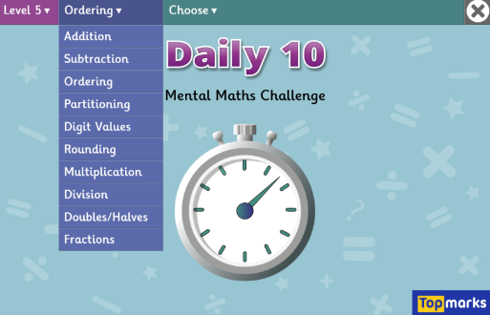
21.4.26
TBAT: multiply mixed number fractions by integers.
Daily 10 - Mental Maths Challenge - Topmarks

Slide 6
Blue Green
1/7 + 1/7 + 1/7 + 1/7 =
1/5 + 1/5 + 1/5 + 1/5 =
Challenge: Write your number sentence as a multiplication problem.

Slide 7
Talk partners: 1 ½ 2 ¾ What is a mixed number? How would I convert these into improper fractions?

Slide 8
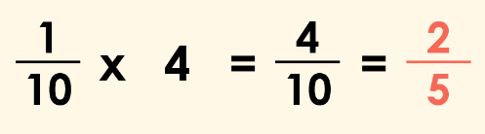
We can simplify four tenths to two fifths. True or false?

Slide 9
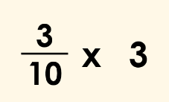
Here is a multiplication involving a non-unit fraction and an integer.
We can also write this multiplication using repeated addition.

Slide 10
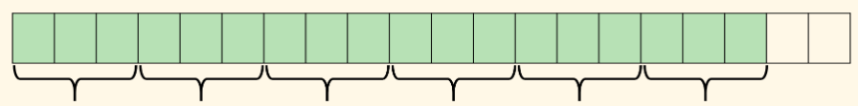
Talk partners: What is represented on this bar model?

Slide 11
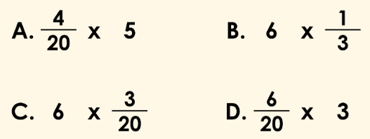
Talk partners: Which calculation does the bar model represent?

Slide 12
Whiteboard work: 3/4 x 6 = ½ x 12 = 11 x ¾ =

Slide 13
Talk partners: What is the missing integer? ¾ x ? = 15/4 = 3 ¾

Slide 14
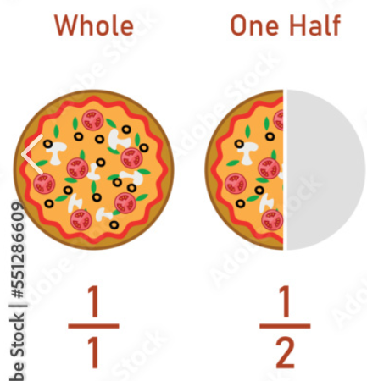
Step by step: 2 x 1 ½ -Convert to an improper fraction: 3/2 -Multiply: 2 x 3/2 = 6/2 Can we simplify 6/2?

Slide 15
Talk partners: How would we solve the following problem? 5 2/5 x 5 =

Slide 16

Checkpoint question: 3 1/3 x 4 = a) 40/4 b) 40/3 c) 10/4

Slide 17
TBAT: multiply proper fractions by integers.
6/7 X 4 =
4 ½ x 7 =
4/9 X 6 =
3 4/5 x 2 =
Challenge: 2 6/8 x 2 = 4 12/8
What mistake has been made?

Slide 18
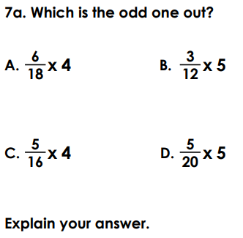
Independent
1 whole and 4/8 X 5 =
1 whole and 5/7 X 3 =
2 wholes and 1/2 X 8 =
2 wholes and ¾ X 7 =
2/7 x 6 = 12/ 42 T or F?
Explain the mistake that has been made.
6. 4/5 x ? = 12/ 5

Slide 19
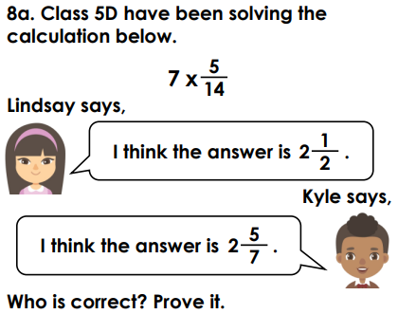
Challenge: The answer is 2 ¾. Write a correct multiplication
Mastery:

Slide 20
Tuesday 21st April
TBAT: Use direct and indirect speech in a journalistic review
3 in 3
Last Friday, Year 5 pupils watched the new stage performance The Secret of the Lost Forest, and many agreed it was exciting and well‑acted. The show used colourful costumes and clear voices, which helped the audience follow the story easily. While some scenes felt a little long, the message about teamwork and caring for nature was strong and memorable. Overall, the performance was enjoyable and left pupils talking about it long after it ended.
What did the audience enjoy about the performance?
Why does the reviewer think the message of the show was important?
How does the reviewer show a balanced opinion in the paragraph?

Slide 21
Tuesday 21st April
TBAT: Use direct and indirect speech in a journalistic review
What features are found in a journalistic review?
What technique can be used to make the healine eye-catching?
What is the difference between direct and indirect speech?

Slide 22
Tuesday 21st April
TBAT: Use direct and indirect speech in a journalistic review
“An Exciting Adventure That Keeps You Hooked!”
“I couldn’t put this book down,” said one reader.
One reader said that they couldn’t put the book down.
What do you notice about these sentences?
How are they similar?
How are they different?
Which one sounds more “newspaper-like”?
Sentence 1 = Direct Speech
Sentence 2 = Indirect (Reported) Speech

Slide 23
Tuesday 21st April
TBAT: Use direct and indirect speech in a journalistic review
Direct Speech
“The film was hilarious,” said Sam.
Indirect Speech
Sam said that the film was hilarious.
No quotation marks
Tense often shifts (is → was)
Pronouns change (I → he/she/they)
Reporting verbs are used (said, thought, believed)

Slide 24
Tuesday 21st April
TBAT: Use direct and indirect speech in a journalistic review
In a journalistic review, writers often include:
Audience reactions
Expert opinions
General responses
But instead of quoting everyone directly, journalists often report what people thought.
Example:
Critics said the film was beautifully filmed but a little too long.

Slide 25
Tuesday 21st April
TBAT: Use direct and indirect speech in a journalistic review
I do
Change this direct speech to indirect speech.
“The ending was shocking,” said the reviewer.
No quotation marks
Tense often shifts (is → was)
Pronouns change (I → he/she/they)
Reporting verbs are used (said, thought, believed)

Slide 26
Tuesday 21st April
TBAT: Use direct and indirect speech in a journalistic review
We do
Change this direct speech to indirect speech.
“I loved the main character,” said Mia.
“It was too scary for younger readers,” said Tom.
No quotation marks
Tense often shifts (is → was)
Pronouns change (I → he/she/they)
Reporting verbs are used (said, thought, believed)

Slide 27
Tuesday 21st April
TBAT: Use direct and indirect speech in a journalistic review
You do
Write 2 direct speech sentences and 2 indirect speech sentences you would include in a journalistic review about Tom's Midnight Garden.
Sentence starters :
One reader said that …
The reviewer explained that …
“This story kept me guessing,” said …
Many people felt that …

Slide 28
Tuesday 21st April
TBAT: Use direct and indirect speech in a journalistic review
Challenge
When writing a review, why might indirect speech be useful?

Slide 29
Tuesday 21st April 2026 TBAT: understand music narrative and interpret notation. Collins Connect Lesson1 – At the movies – sound effects
Warm up – Physical warm up – rubber chicken.
Activity 1 - Watch the 1920s movie The carpenter. Discuss the role of the music. Compare this with an excerpt from the1930s cartoon On the farm. Discuss how the use of the music is different. Watch 'On the farm' again to follow the music. In which bits of the movie did the children feel the music captured the action most effectively?
Activity 2 - Look at the graphic representations of the musical sound effects, then listen to them. Invite volunteers to demonstrate making each sound effect using any available classroom percussion or other sound makers. Which of your instruments are capable of playing all the sound effects and which can only play one or two?
Activity 3 - Look at the Cartoon storyboard sequence. Discuss the action sequence and invite volunteers to demonstrate sound effects for each action using tuned and untuned instruments. Divide the class into small groups with a selection of tuned and untuned instruments and a copy of the blank storyboard grid. Each group creates their own storyboard sequence, drawing simple actions and inventing sound effects for each.

Slide 30
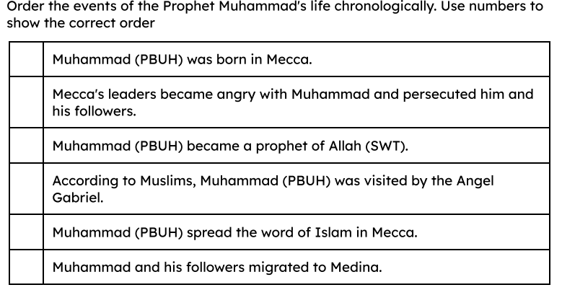
Tuesday 21st April Q) What were the reasons for the early success of Islam in the mid 7th century? 3 in 3 1) What does PBUH stand for? 2) Who was the Prophet Muhammed (PBUH) and why was he important to the rise of the religion of Islam? 3)

Slide 31
Medina
Medina is a city in Saudi Arabia and the second holiest city to Muslims after Mecca.
Arabian
Arabic-speaking people, who lived on the Arabian peninsula, were known as Arabian.
truce
A truce is an agreement between enemies to stop fighting for a certain time.
pilgrimage
A pilgrimage is a journey to a holy place.

Slide 32

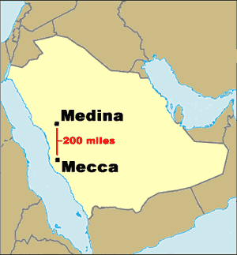
The Constitution of Medina
The Prophet Muhammad (PBUH) and his followers decided to migrate from Mecca to Medina in 622 CE. This journey is known as the Hijra.
A
The Prophet Muhammad (PBUH) was welcomed into the city of Medina because he brought hope of peace.
Map of the Arabian Peninsula

Slide 33

The Constitution of Medina
Muhammad (PBUH) and his followers migrated from Mecca to which city in 622 CE?
Baghdad
Medina
Jeddah

Slide 34
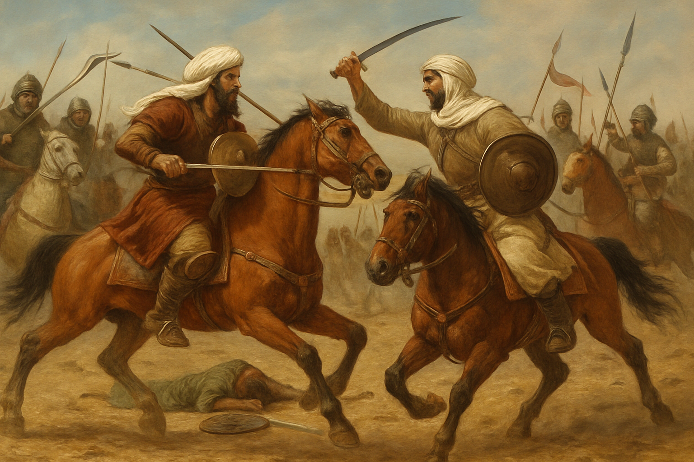
The Constitution of Medina
A
For more than a century, the southern Arabian tribes of Medina had been at war with each other.
Illustration of warring tribes of Southern Arabia

Slide 35
The Constitution of Medina
A
The Arabian tribes wanted to end the fighting and so they asked Muhammad (PBUH) to help them find a fair way to put an end to the violence.
Illustration of warring tribes of Southern Arabia

Slide 36
The Constitution of Medina
A
To do this, Muhammad (PBUH) created the Constitution of Medina.
It united the Arabian tribes through the religion of Islam so they could live together peacefully under the leadership of the Muslims.

Slide 37
The Constitution of Medina TALK PARTNERS
Which two of the following statements about the Constitution of Medina are true?
It was created by Muhammad (PBUH).
It brought peace to Mecca.
It stopped the Arabian tribes in Medina fighting.
It created a war between the Arabian tribes.

Slide 38


The Constitution of Medina IN BOOKS
Read Aisha’s statement below. Do you agree with it?
Early Islamic civilisation started in Medina.
Write one or two sentences to explain your reasoning.
A good explanation would include the following:
the Hijra
the Constitution of Medina
Early Islamic civilisation did/did not start in Medina. I think this because...

Slide 39
The Constitution of Medina
Your answer might have included:
Early Islamic civilisation started in Medina.
I agree with Aisha. Muhammad (PBUH) and his followers migrated from Mecca to Medina (a journey known as the Hijra), where he helped the warring southern Arabian tribes make peace with each other. He created the Constitution of Medina, which tried to unite the tribes through the religion of Islam, creating an early Islamic civilisation.

Slide 40
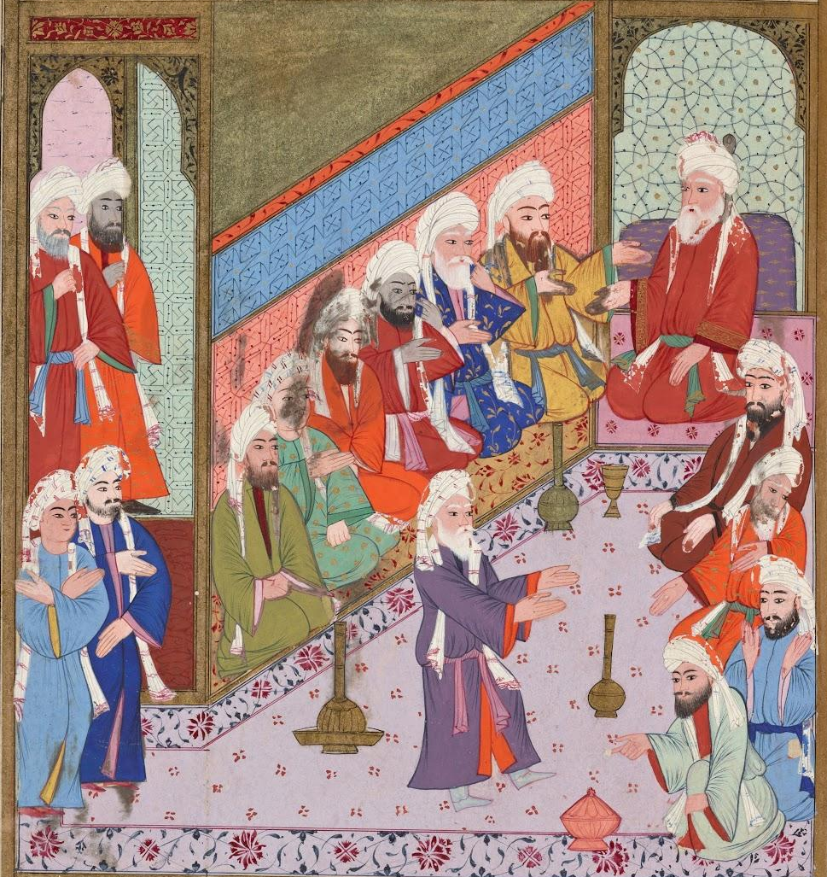
Muhammad (PBUH) returns to Mecca
B
The city leaders of Mecca did not agree with the message of Islam, which led to fighting between them and the Muslims.
Illustration of a meeting of the Meccan leaders

Slide 41
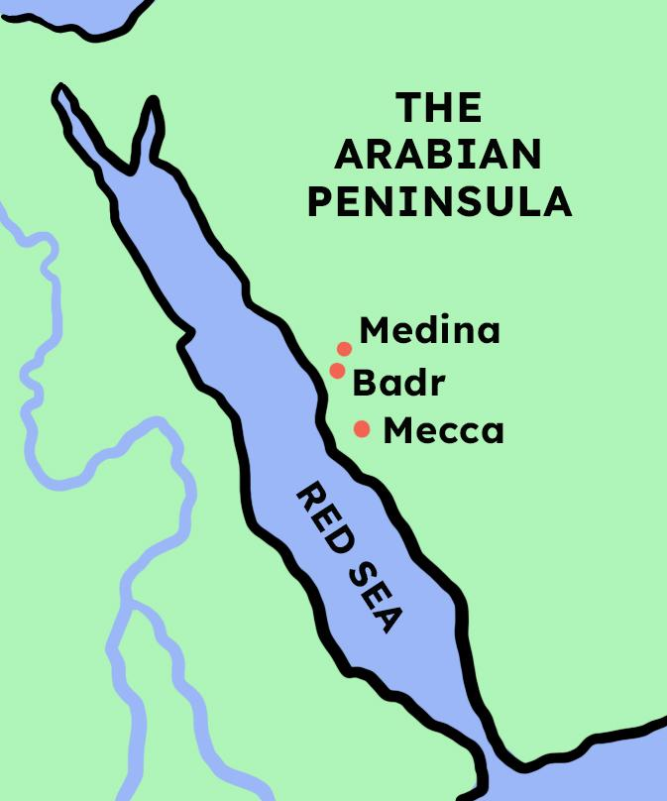
Muhammad (PBUH) returns to Mecca
B
At Badr in 624 CE, the Muslims of Medina won a battle against the army of Mecca. They believed that it was because Allah (SWT) was with them.
Map of the Arabian peninsula

Slide 42
Muhammad (PBUH) returns to Mecca
The victory at the battle of Badr helped spread Islam in Arabia.
It was seen as a sign that Allah (SWT) was on the side of the Muslim army.

Slide 43
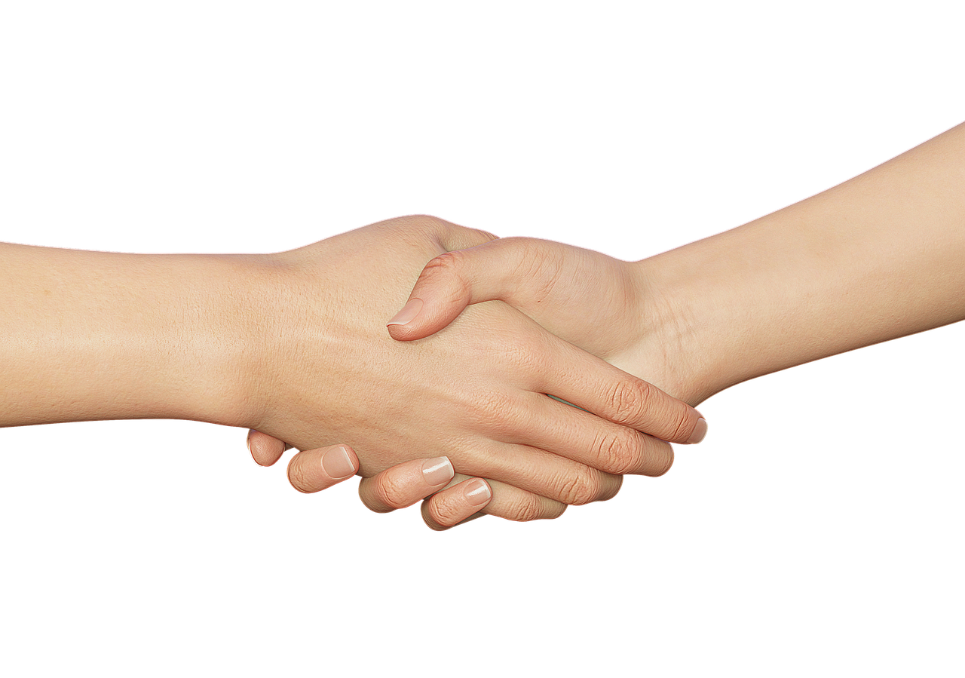
Muhammad (PBUH) returns to Mecca
B
In 628 CE, a ten-year-long truce was agreed between the leaders of Mecca and Muhammad (PBUH).
Photo of a truce handshake

Slide 44
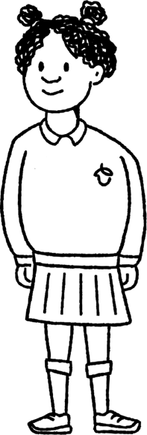

Muhammad (PBUH) returns to Mecca
Help Izzy to complete her sentence.
An agreement between enemies to stop fighting for a certain time is known as a …
truce.

Slide 45
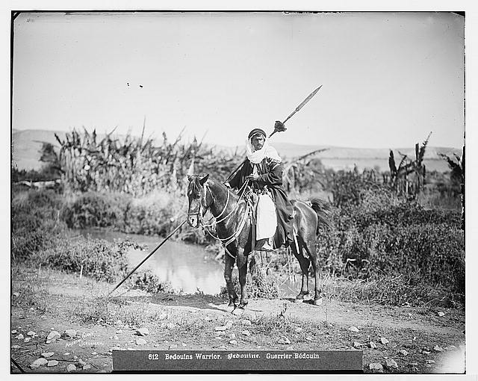
Muhammad (PBUH) returns to Mecca
B
The truce was broken when soldiers from Mecca attacked a Muslim camp.
Photo of an Arabian soldier
Library of Congress, Prints & Photographs Division, [reproduction number LC-DIG-matpc-06823]

Slide 46
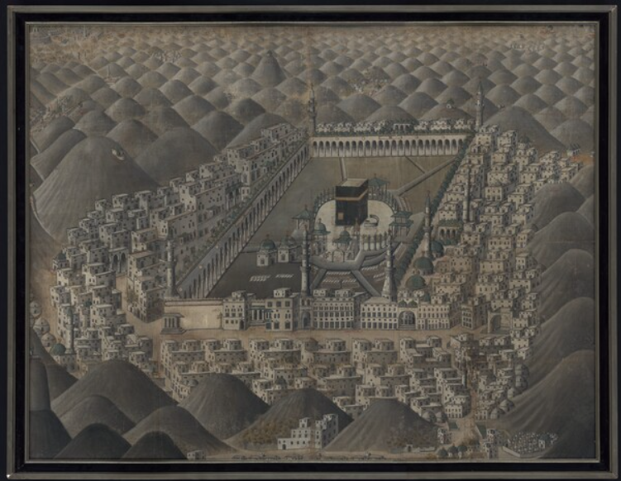
Muhammad (PBUH) returns to Mecca
B
Muhammad (PBUH) and the Medina Muslims took control of Mecca peacefully.
Illustration of the city of Mecca

Slide 47
Muhammad (PBUH) returns to Mecca
The truce between the leaders of Mecca and the Medina Muslims ended.
Soldiers from Mecca attacked a Muslim camp.

Slide 48
Muhammad (PBUH) returns to Mecca
Answer the following questions about how Muhammad (PBUH) peacefully took control of Mecca.
The leaders of which city did not agree with the teachings of Islam? _________________________________________________________
Why did the Muslim army believe they had won the battle of Badr against the Meccans? ___________________________________________________________________________
How was the truce between the Meccans and the Muslims of Medina broken? _______________________________________________________________

Slide 49
Muhammad (PBUH) returns to Mecca
Answer the following questions about how Muhammad (PBUH) peacefully took control of Mecca.
Your answers might look something like this:
The leaders of Mecca did not agree with the teachings of Islam.
The Muslim army believed that Allah (SWT) was on their side to win the battle of Badr.
The truce between the Meccans and the Muslims of Medina was broken when soldiers from Mecca attacked a Muslim camp.

Slide 50
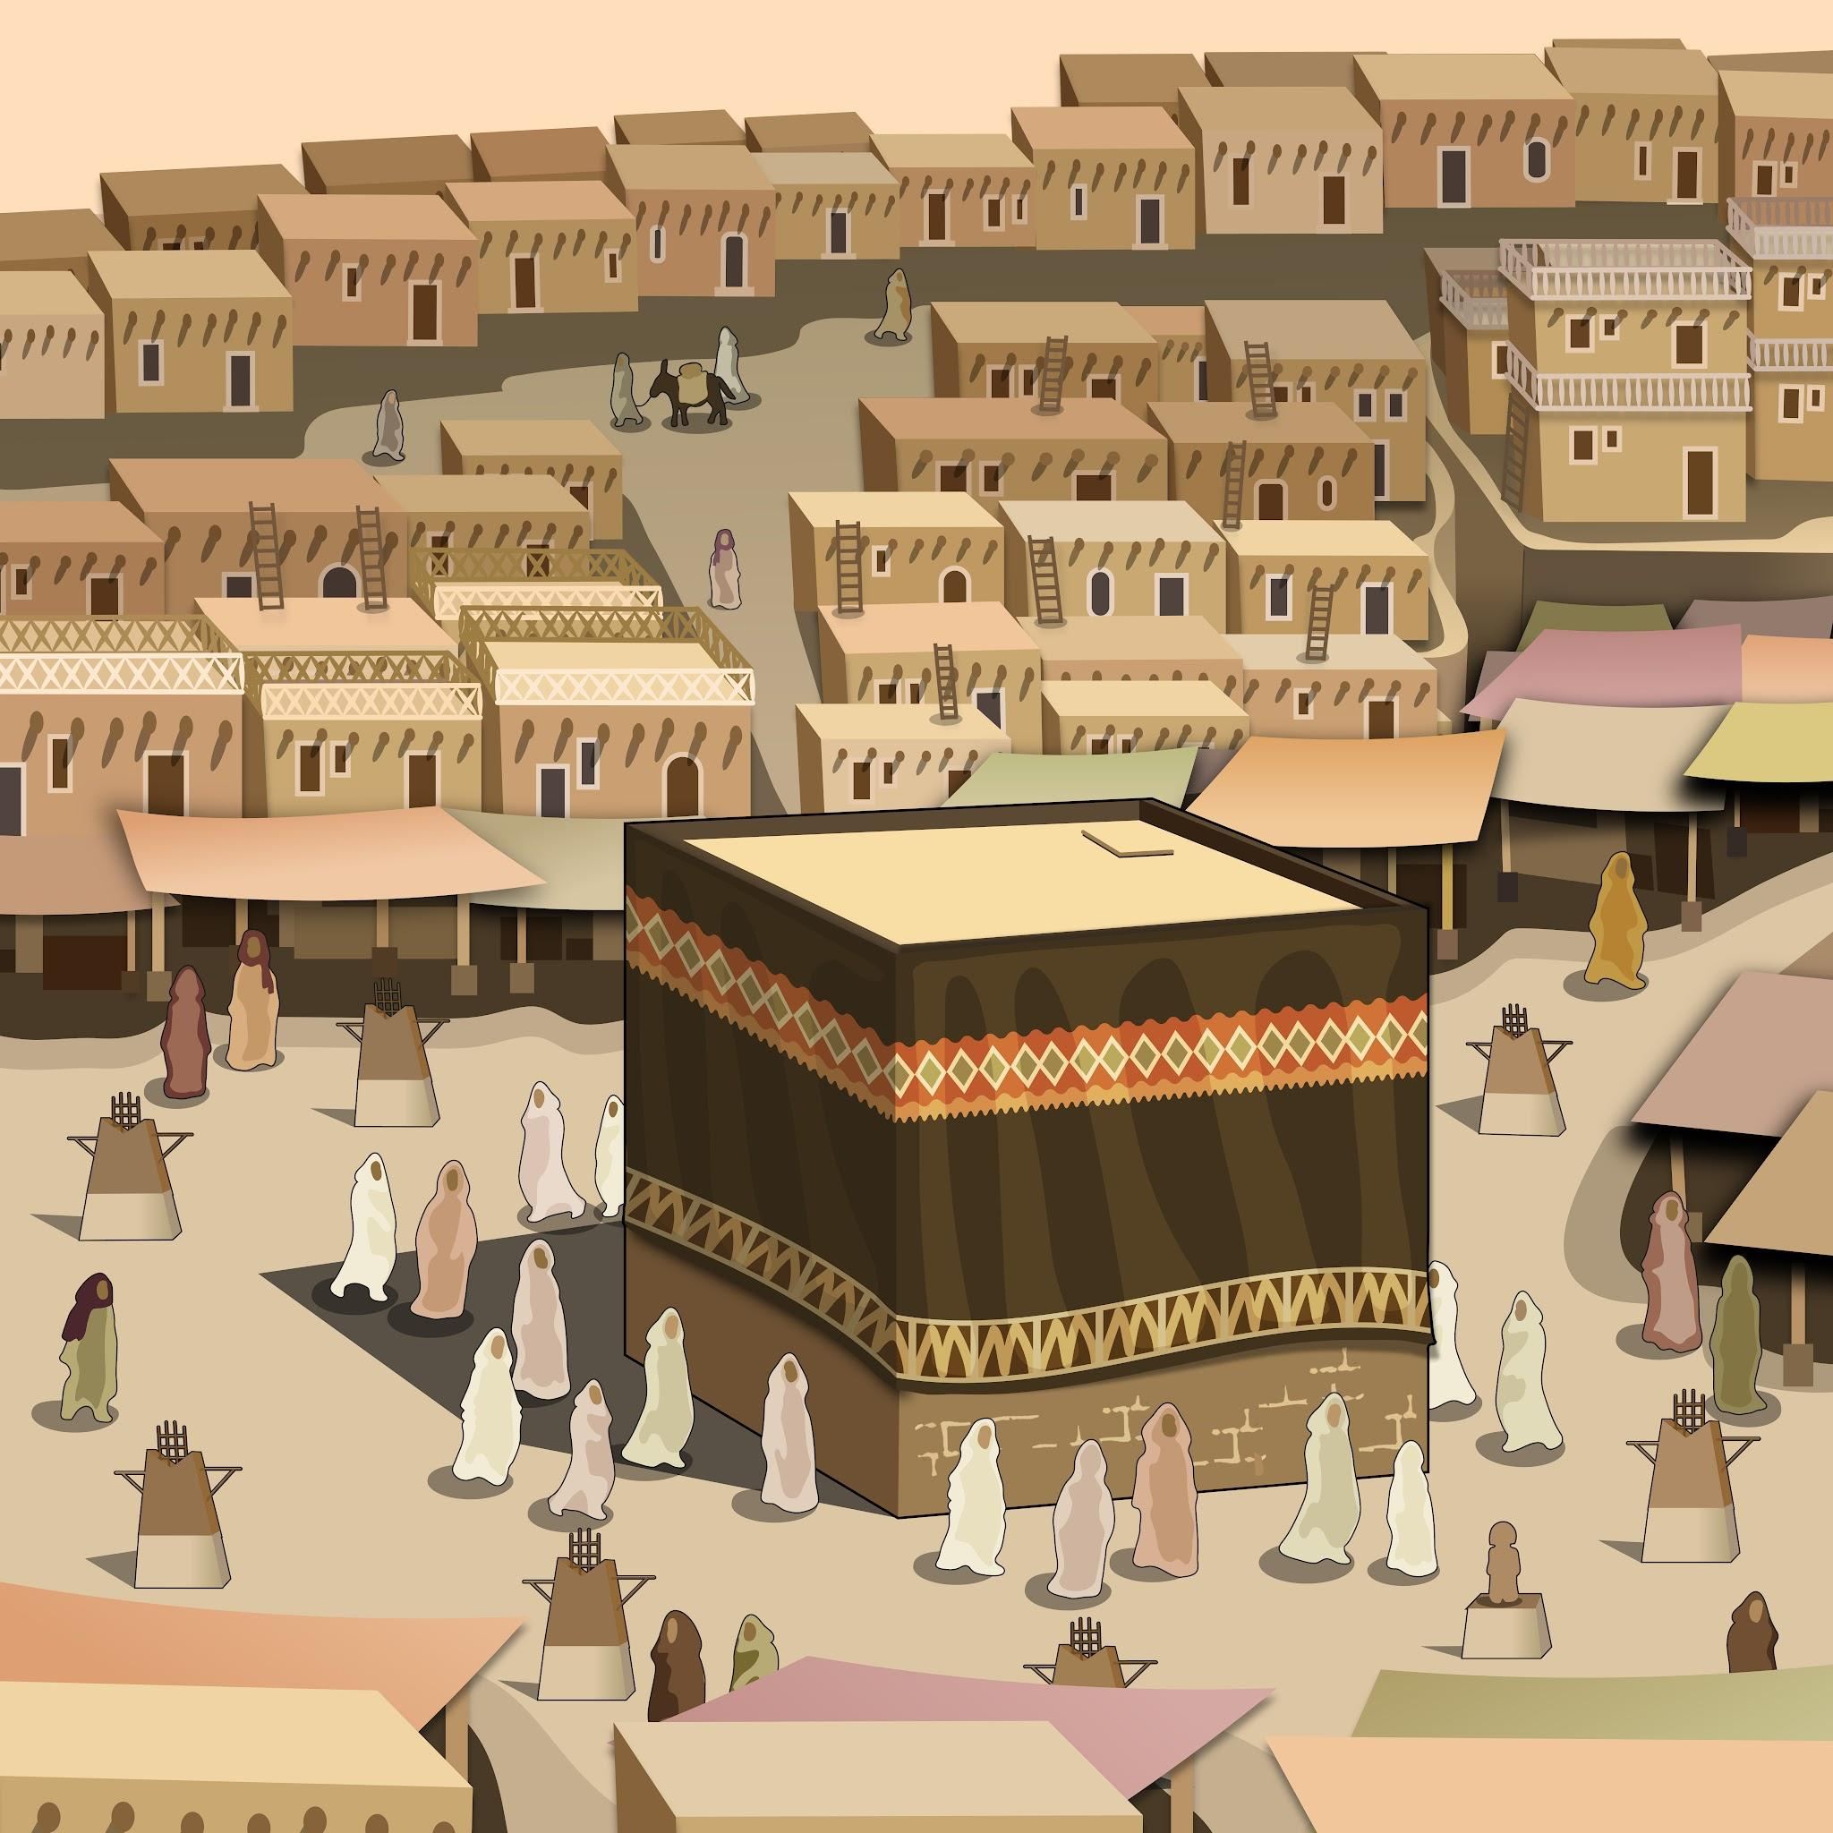
Mecca and the Ka’ba
C
The Ka’ba is a cube-shaped building in Mecca.
Illustration of the Ka’ba in Mecca

Slide 51
Mecca and the Ka’ba
C
Muslims believe that it was built by the Prophet Abraham and his son Ishmael for the worship of Allah (SWT).
Illustration of the Ka’ba in Mecca

Slide 52
Mecca and the Ka’ba
Where is the Ka’ba?
Medina
Baghdad
Mecca

Slide 53
Mecca and the Ka’ba
C
Muhammad (PBUH) declared the Ka’ba the most sacred site in Islam and a place of Muslim pilgrimage.
Illustration of the Ka’ba in Mecca

Slide 54
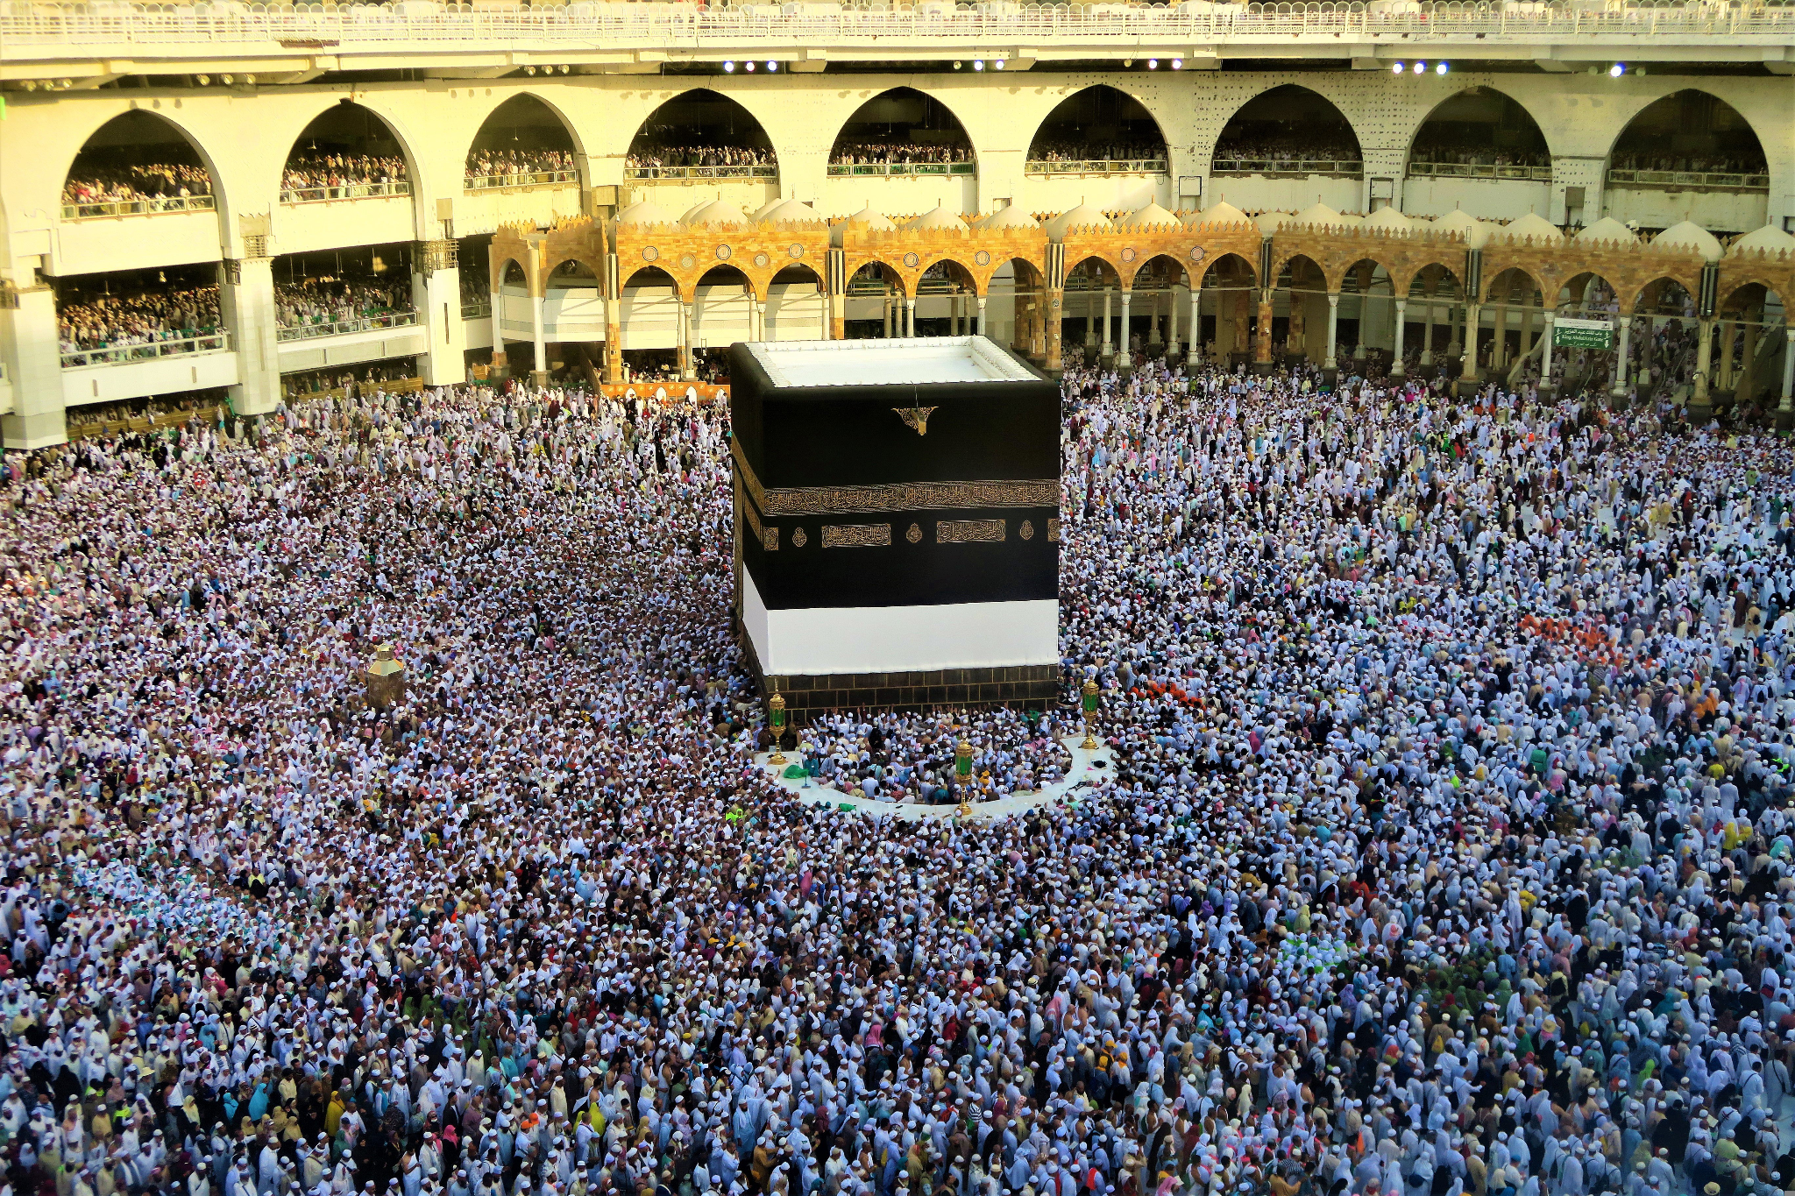
Mecca and the Ka’ba
C
All Muslims are expected to make a pilgrimage to Mecca at least once in their lifetimes.
Photo of the Ka’ba in Mecca

Slide 55
Mecca and the Ka’ba
Which two statements about the Ka’ba are true?
It is the most sacred site in Islam.
It is in Medina.
It is a pilgrimage site for Muslims.
It is not a sacred place for Muslims.

Slide 56
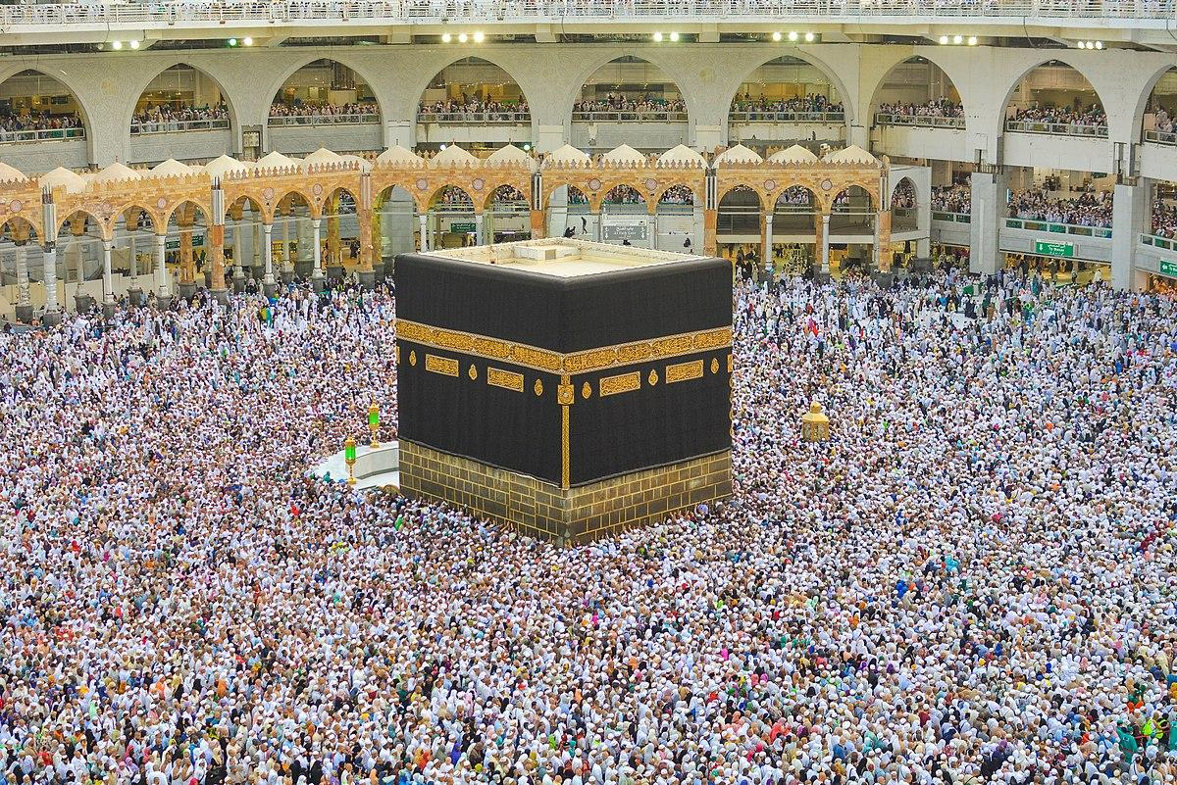
Mecca and the Ka’ba
Add labels to the photo about the Ka’ba.
You could include details about:
the shape
the city
pilgrimages
Photo of the Ka’ba in Mecca
The Kaaba during Hajj, Adli Wahid, 2013, licensed under CC BY-SA 4.0

Slide 57
Mecca and the Ka’ba
Add labels to the photo about the Ka’ba.
Your answers might have included:
The Ka’ba is in the city of Mecca in Saudi Arabia.
The Ka’ba is the most sacred site in Islam and a place for Muslim pilgrimages.
The Ka’ba is a cube shaped building.
Photo of the Ka’ba in Mecca
The Kaaba during Hajj, Adli Wahid, 2013, licensed under CC BY-SA 4.0

Slide 58
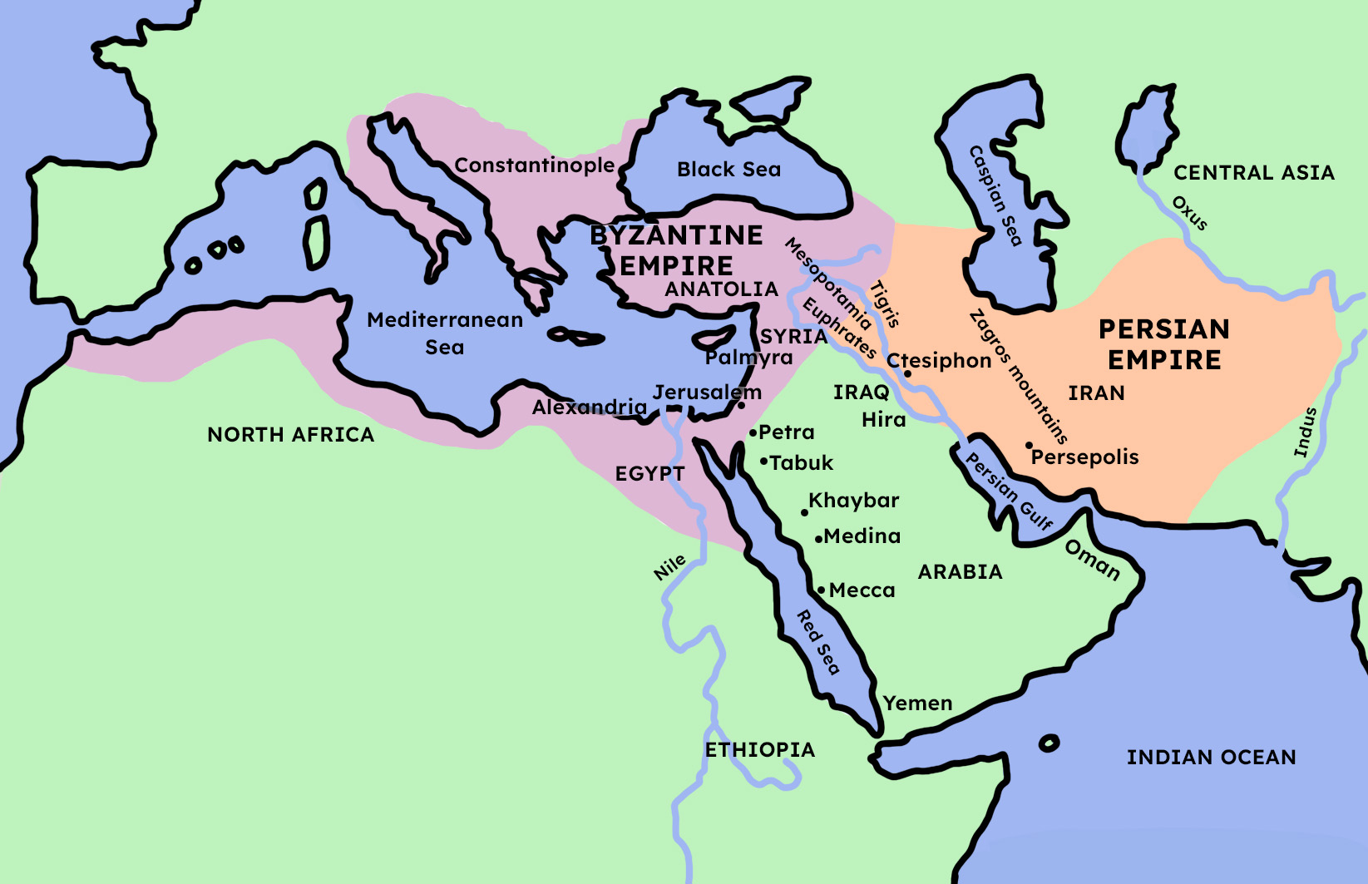
Islam spreads to the Byzantine and Persian Empires
The Byzantine and Persian Empires were north east and north west of the Arabian peninsula.
D
Arabian peninsula
Map showing the Byzantine and Persian Empires

Slide 59
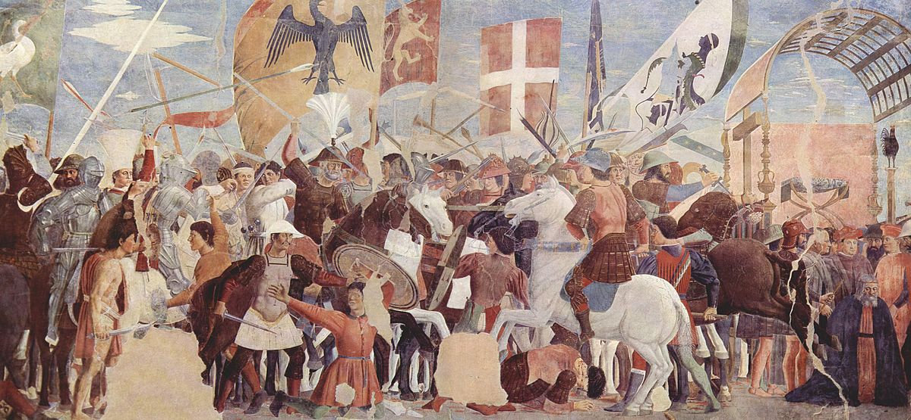
Islam spreads to the Byzantine and Persian Empires
D
The Byzantine and Persian Empires had been at war with each other for a long time. This had made their armies weak.
Illustration of the Byzantine-Persian War of 602–628

Slide 60
Islam spreads to the Byzantine and Persian Empires
The armies of the Byzantine and Persian Empires were strong.
Their armies had been weakened by decades of fighting.

Slide 61
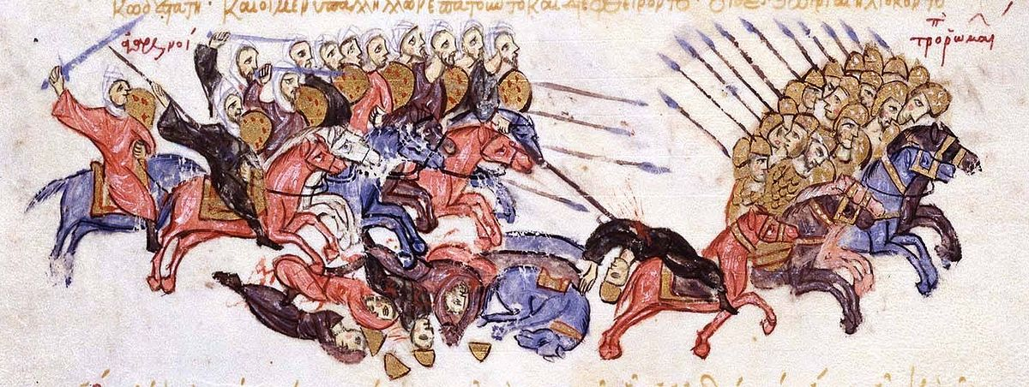
Islam spreads to the Byzantine and Persian Empires
Muhammad (PBUH) sent Muslim armies to take control of the Byzantine and Persian Empires.
D
Illustration of a Muslim army pursuing fleeing Byzantines

Slide 62
Islam spreads to the Byzantine and Persian Empires
The Arab Muslim armies quickly took over areas in which two empires?
Ancient Roman Empire
Byzantine Empire
Persian Empire

Slide 63
Islam spreads to the Byzantine and Persian Empires
Write one or two sentences for each of the following events to explain how it contributed to the early success of Islam.
The Constitution of Medina
The conquest of Mecca
War against the Byzantine and Persian Empires

Slide 64
Islam spreads to the Byzantine and Persian Empires
Write one or two sentences for each of the following events to explain how it contributed to the early success of Islam.
Your answer may have included:
The Constitution of Medina
The Constitution of Medina attempted to unite the warring Arabian tribes under the banner of Islam. This put the leadership of the city in the hands of the Muslims.

Slide 65
Islam spreads to the Byzantine and Persian Empires
Write one or two sentences for each of the following events to explain how it contributed to the early success of Islam.
Your answer may have included:
The conquest of Mecca
After Muhammad (PBUH) conquered Mecca, he declared it a place of Muslim pilgrimage, which means that all Muslims are expected to journey to Mecca at least once in their lifetimes. Here, Muslims from around the world recognise the early success of Muhammad and Islam. The Ka’ba is located in Mecca and is the most sacred site in Islam.

Slide 66
Islam spreads to the Byzantine and Persian Empires
Write one or two sentences for each of the following events to explain how it contributed to the early success of Islam.
Your answer may have included:
War against the Byzantine and Persian Empires
Muhammad (PBUH) knew that the Byzantine and Persian Empires had been at war with each other for decades, which had weakened both of them. He sent Muslim armies to take over land in these empires that once belonged to the Byzantines and Persians.

Slide 67
Exit questions: 1. What is a truce? 2. Why did the truce between the Arabian tribes help Islam to grow?

Slide 68
The early success of Islam
From Medina, Muhammad (PBUH) tried to unite the southern Arabian tribes through the religion of Islam.
Following successful attacks against his enemies from Mecca, a ten year truce was called and the forces of Islam grew.
Mecca was established as the religious centre of Islam; the Ka’ba becoming a focus for pilgrimage and prayer.
Muhammad (PBUH) sent Muslim armies to exploit the Byzantine and Persian Empires, weakened by fighting one another.

Slide 69
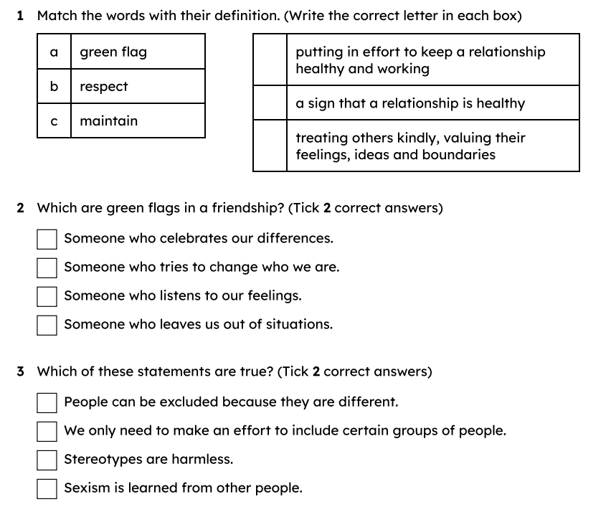
Tuesday 21st April TBAT: Explain how to repair damaged friendships. 3 in 3

Slide 70
damaged
in this context, a friendship which has been hurt
responsibility
to accept blame for something
repair
to fix something
compromise
an agreement where all people are happy
red flag
a sign that a relationship is unhealthy

Slide 71

What could damage a friendship?
Most of the time, a good friendship will make us feel:
happy
cared for
respected
safe
loved.
However, sometimes, a friendship can be damaged and this can affect how we feel.

Slide 72

What could damage a friendship?
A friendship could be damaged if, within the friendship, someone feels:
hurt
angry
betrayed
upset.
This can happen when someone does or says something that hurts the other person’s feelings.

Slide 73


What could damage a friendship?
A friendship can be damaged by accident.
Sometimes, what we say can be misunderstood by a friend.
Or, we might feel hurt by something a friend has done, even if they didn’t mean to hurt our feelings.
Even if a friend didn’t mean to hurt our feelings, we can still feel upset. A good friend will take responsibility for their actions.
Sam

Slide 74

What could damage a friendship?
Who is correct?
A friendship can only be damaged on purpose. If a friend didn’t mean to hurt you, you shouldn’t get upset.
Jacob
A friendship can be damaged by accident. Even if a friend didn’t mean to hurt you, it’s okay to feel upset.
Aisha

Slide 75


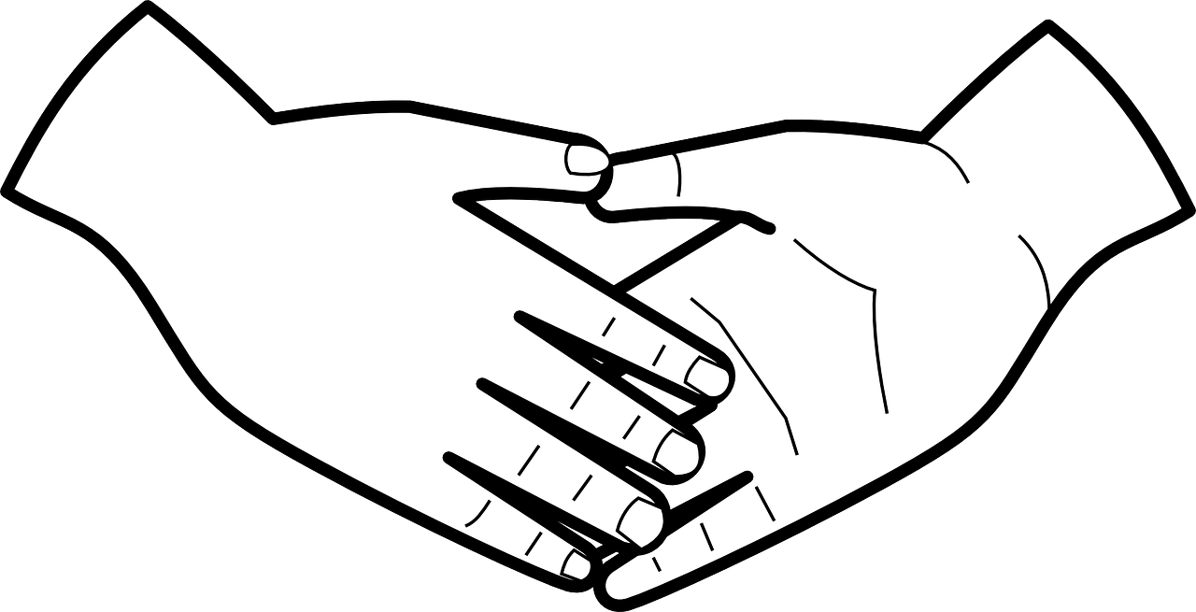
What could damage a friendship?
A friendship could be damaged by lots of different things, such as:
a misunderstanding
unkind words
broken trust

Slide 76


What could damage a friendship?
A misunderstanding can happen when people don’t communicate with each other, or don’t communicate clearly.
Other times, someone might have just got something wrong.
I was upset when I heard Aisha talking about sitting next to Jacob on the coach for the school trip, as I thought we’d agreed that we would sit together. After talking to her, it turns out that she was talking about sitting next to Jacob on the way back, not the way there!
Jun

Slide 77
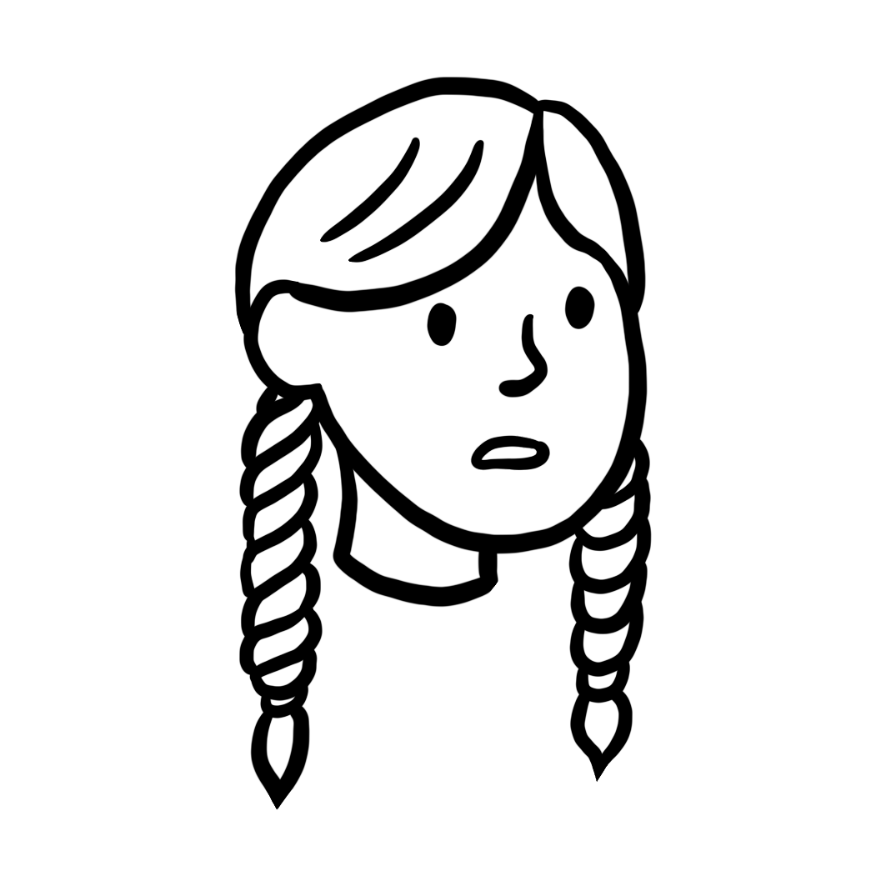
What could damage a friendship?
Sometimes, a friend might say something unkind to us, either on purpose or by accident.
It’s never okay to be unkind to someone on purpose, but sometimes we can say things we don’t mean, especially if we feel upset or angry.
One time, my friend was angry and called me unkind names. They hadn’t done this before, so I felt worried. I told my teacher and he spoke to my friend. My friend apologised and explained that they were tired and hadn’t slept much the night before.
Laura

Slide 78
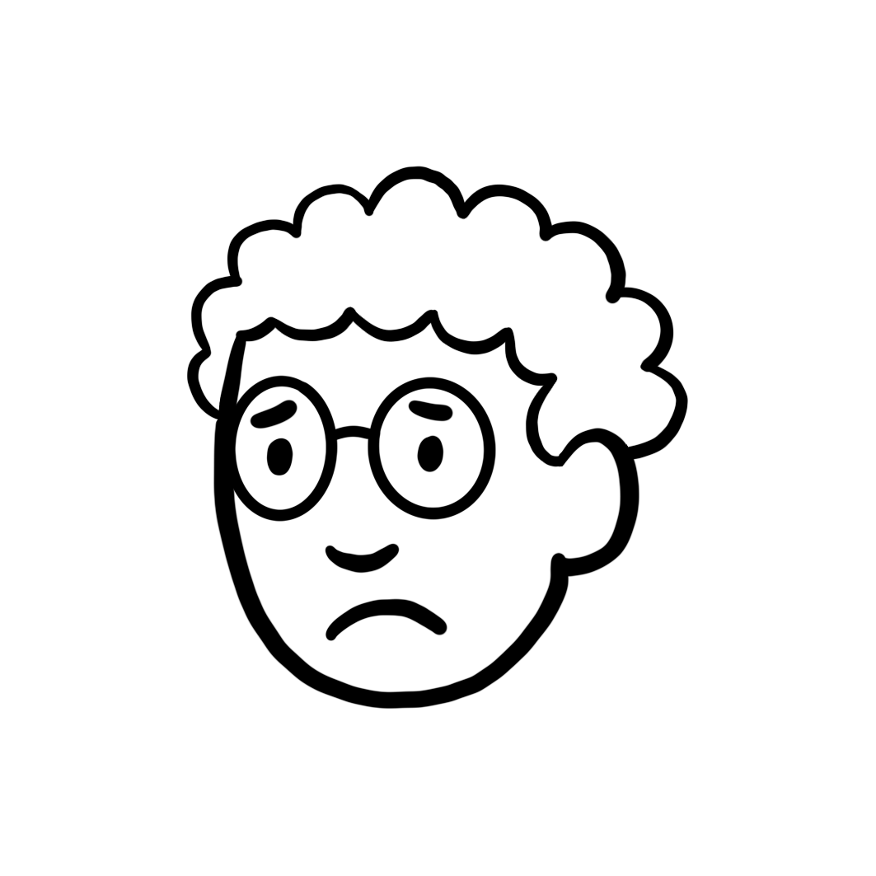
What could damage a friendship?
A good friendship is usually built on trust.
This means that both people trust each other to be kind, to show respect, and to not try to hurt the other person in some way.
If one person does something to break this trust, the friendship could be damaged.
I shared a secret with a friend and they told other people. I trusted them to keep what I said private and they broke my trust. After that, I struggled to trust them again.
Alex

Slide 79

What could damage a friendship?
Which of these interactions could damage a friendship?
Wow, I did so much better than you in that test! I guess you just didn’t work as hard as me.
a
Great job on your test results! I know you worked really hard on it.
b

Slide 80
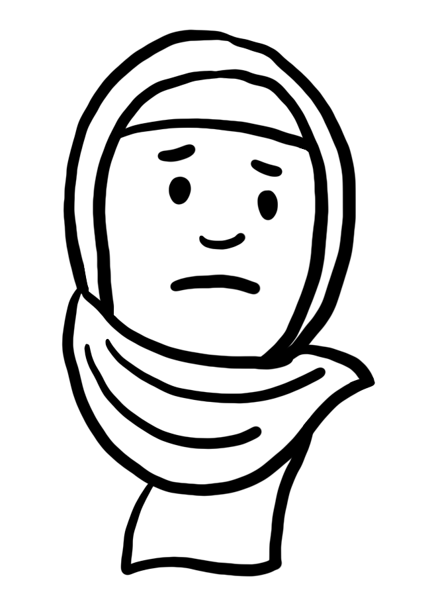

What could damage a friendship?
Read the scenario and identify what caused the friendship to become damaged.
Aisha and Sofia are working together on an art project, and Aisha suggests drawing a lake. Sofia disagrees and says they should draw a forest. Aisha says: “I thought we agreed earlier that we would draw a lake?” Sofia says: “No, I said we could draw something in nature!” They now don’t want to draw anything and Aisha feels upset.
Aisha
Sofia

Slide 81
What could damage a friendship?
Read the scenario and identify what caused the friendship to become damaged. You might have said:
Aisha and Sofia had a misunderstanding which caused damage to their friendship. Aisha had misunderstood what Sofia had said about what they were going to draw, so she had become upset. Sofia might not have communicated clearly about drawing something from nature, or Aisha might have misunderstood what she was saying.
Aisha
Sofia

Slide 82


How can we repair damaged friendships?
To repair friendships, we might need to admit fault and apologise, even when we didn’t mean to hurt our friend’s feelings.
When we admit fault, we take responsibility for how our actions have affected others and we show that repairing the friendship is important to us.
Sorry for the misunderstanding Aisha. I might not have communicated clearly.
Sofia
Aisha

Slide 83
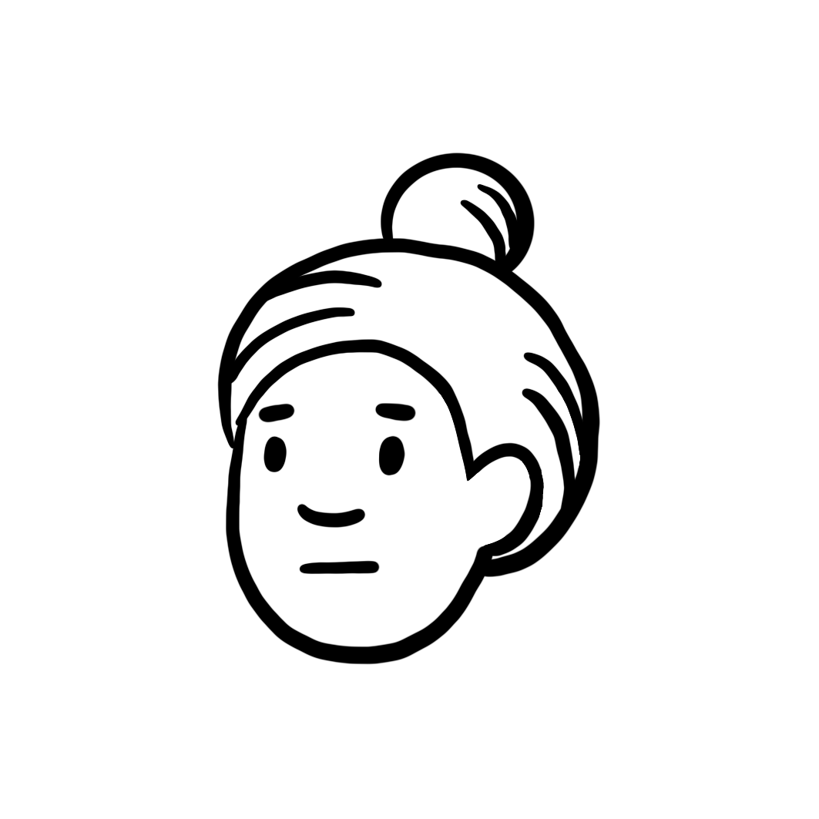
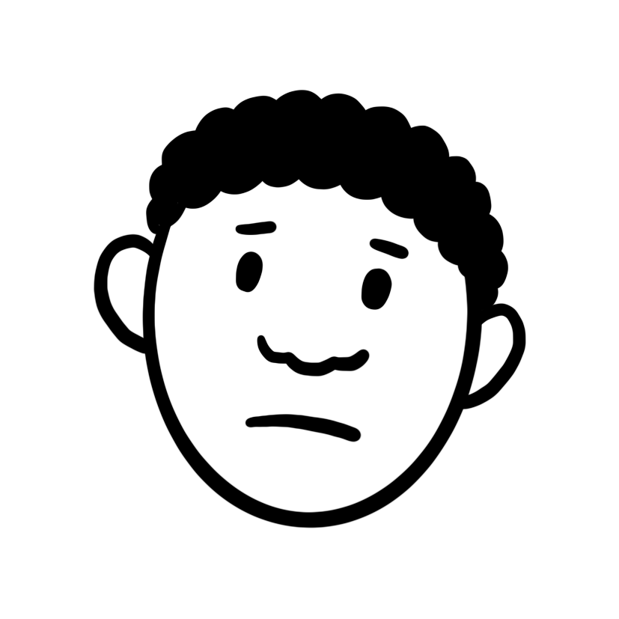
How can we repair damaged friendships?
When we apologise, we need to understand why we are apologising and why it’s important.
We also need to commit to trying not to behave in a hurtful way again.
I’m really sorry for breaking your trust, Andeep. I shouldn’t have made plans to see the film with someone else after I had already said we would go together. I won’t do it again.
Andeep
Lucas

Slide 84
How can we repair damaged friendships?
To repair a friendship, we need to listen to our friend, see things from their point of view and we may need to compromise.
When we listen to our friend, we show them that we care about how they feel and that we want to make things better.
When Andeep explained how he felt, I realised that I had broken his trust. I knew if I was him, I’d feel upset and disappointed too. Andeep is a great friend, and I don’t want to hurt him in that way again.
Lucas

Slide 85
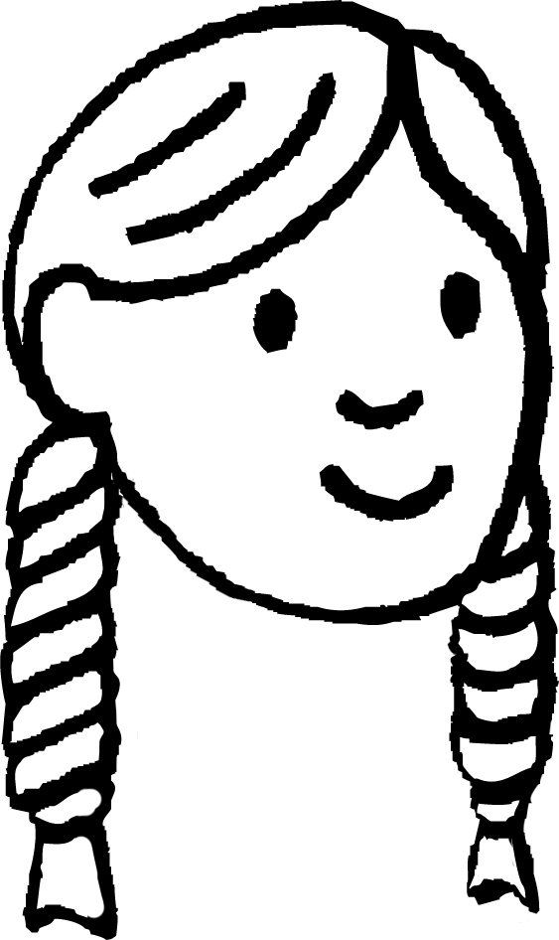

How can we repair damaged friendships?
Coming to a compromise can be helpful when two people want to do different things.
In a healthy friendship, people take it in turns to do what they want, and they compromise so that both people are happy.
Do you want to play the game we played yesterday? I thought it was so much fun!
No, but how about we play football? We both love that!
Sounds fun! Let’s do it!
Sam
Laura

Slide 86

How can we repair damaged friendships?
Does this conversation show a compromise?
Do you want to go the park tomorrow?
No, we did that last week. Why don’t we play some board games instead?
No, that’s boring. Either come to the park with me, or we won’t do anything!
Fine, I guess we’ll go the park.
Why?
This isn’t a compromise because both people haven’t come to an agreement they’re happy with. The second person doesn’t want to go to the park.

Slide 87
How can we repair damaged friendships?
An important part of repairing a friendship is taking responsibility for our actions and our words.
When we take responsibility, we accept that what we’ve said or done has hurt someone else, and we make an effort to try not to do it again.
It can be hard to take responsibility, but it’s an important part of repairing a damaged friendship. Taking responsibility can mean explaining why we did something, and accepting that we’ve hurt our friend’s feelings. Sometimes, both people in a disagreement need to accept responsibility.
Sofia

Slide 88
How can we repair damaged friendships?
What do you think about what Laura says?
It’s not my fault if I get angry sometimes! When I’m angry, I know I can say unkind things to people, but I can’t help it. I can’t take responsibility for my actions.
Laura
Laura is incorrect. Everyone can take responsibility for their actions in different ways. If Laura struggles with feeling angry, she can talk to a trusted adult about how she feels.

Slide 89
How can we repair damaged friendships?
Sometimes, we might try to repair a damaged friendship, and our friend might still feel hurt.
Apologising and taking responsibility is an important step to take, but it may not change how our friend feels straight away.
When Lucas apologised, I still felt upset and hurt. I was glad that he had taken responsibility, but it took me some time to trust him again. Just because someone apologises, it doesn’t change what they did. After some time and talking with my trusted adults, I was able to be friends with Lucas again.
Andeep

Slide 90
How can we repair damaged friendships?
Which of these shows someone taking responsibility?
I’m sorry if I hurt your feelings, but I didn’t mean to. I got angry and you know I can’t control what I do when I feel angry. Can we just forget about it now?
a
I’m sorry I hurt your feelings. It was an accident, but I should have thought about how my actions would affect you. I was feeling angry, and I can see now that what I said was unkind. If you need some space, that’s okay.
b

Slide 91
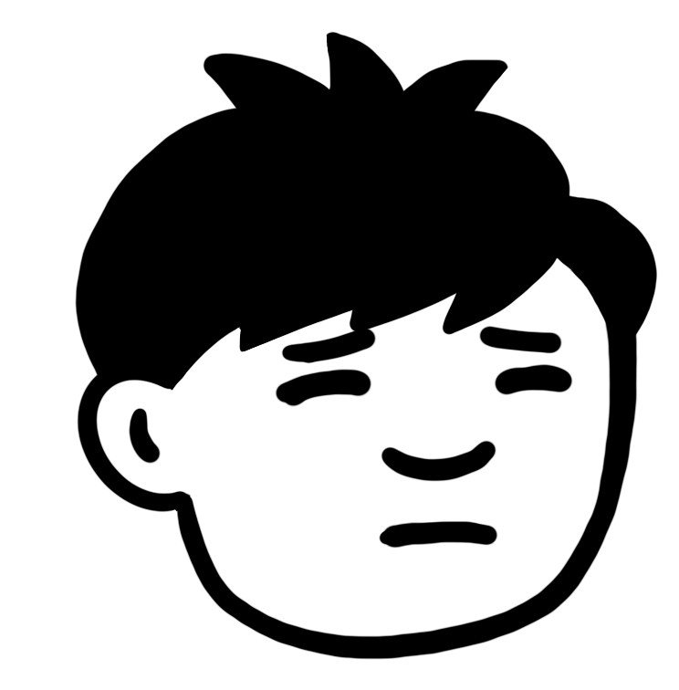
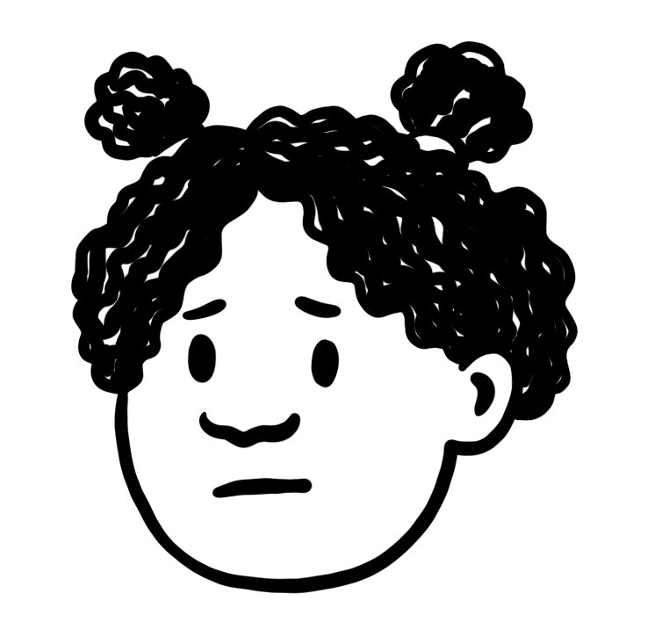
How can we repair damaged friendships?
Read the scenario and decide three things that need to happen for this friendship to be repaired.
Jun and Izzy are playing football. Izzy tries to score a goal, but the ball misses the net. Jun shouts: “That was an easy shot! I can’t believe you missed!” Izzy shouts back: “Well, at least I tried to score! You’ve not even got the ball close to the net!” Jun feels angry and walks off the pitch. Izzy feels angry too and decides to take some time out to calm down.
Jun
Izzy

Slide 92
How can we repair damaged friendships?
Read this scenario and decide three things that need to happen for this friendship to be repaired. You might have said:
To repair this friendship, Jun should apologise to Izzy, admit fault for making unkind comments to her, and take responsibility for his actions.
Izzy should also apologise and take responsibility for how she reacted to Jun’s comments as this was also unkind.
They might want to get some space from each other, talk about how they felt in the situation, or talk to a trusted adult for help repairing the friendship.
Jun
Izzy

