Slide 1
Tuesday 21st April 2026

Slide 2
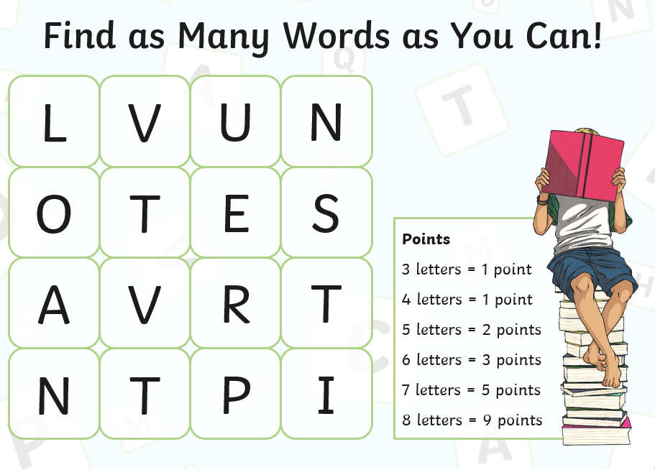
Early morning work

Slide 3
TBAT: read and write words which include the /ee/, /ea/ and /ey/ digraphs.
Speedy sounds
Digital Flashcards - Teach Your Monster to Read

Slide 4
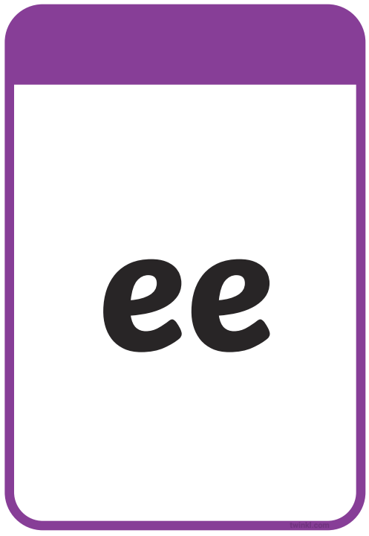
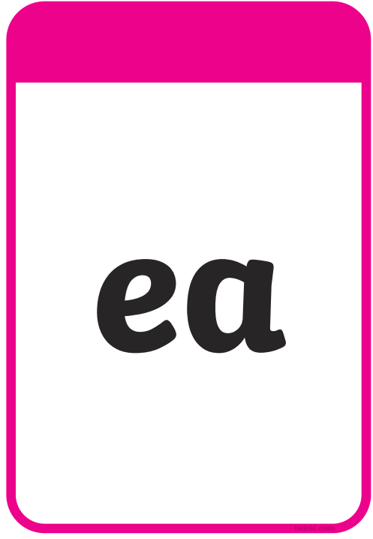

TBAT: read and write words which include the /ee/, /ea/ and /ey/ digraphs.

Slide 5



TBAT: read and write words which include the /ee/, /ea/ and /ey/ digraphs.
donkee
donkey
donkea
seyt
seet
seat
bee
bea
bey

Slide 6



TBAT: read and write words which include the /ee/, /ea/ and /ey/ digraphs.
feyt
feet
feat
leef
leaf
leyf
turkea
turkey
turkee

Slide 7



TBAT: read and write words which include the /ee/, /ea/ and /ey/ digraphs.

Slide 8
TBAT: read and write words which include the /ee/, /ea/ and /ey/ digraphs.
Underline the /ee/, /ea/ and /ey/ graphemes in the sentence.
The donkey was set free and she went to the beach.

Slide 9
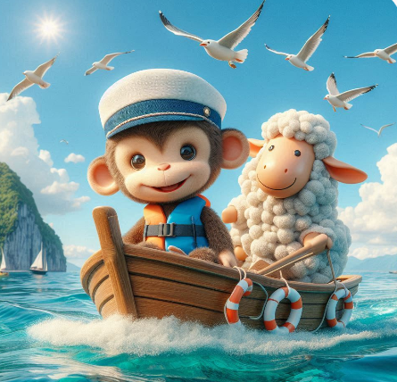
TBAT: read and write words which include the /ee/, /ea/ and /ey/ digraphs.
…......................................................................
…......................................................................
….......................................................................
…........................................................................

Slide 10
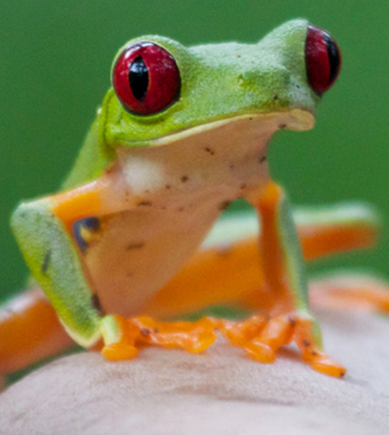
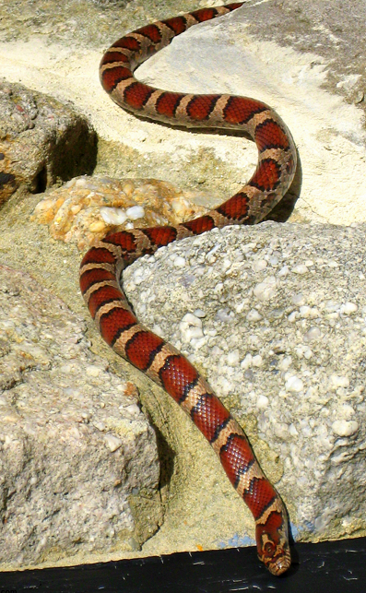
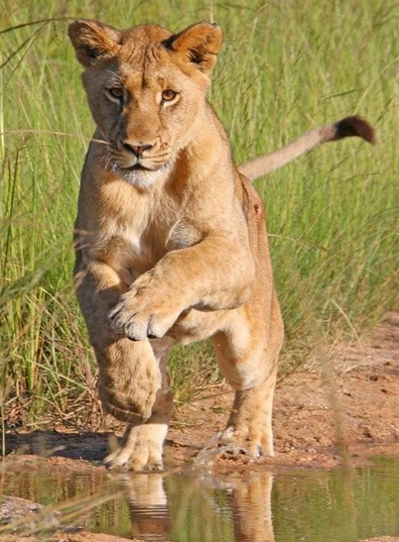
TBAT: explore interesting vocabulary
3 in 3- How many words can you think of to complete these sentences?
The frog has …..eyes.
The snake is .......
The lion is …....... over the puddle.

Slide 11
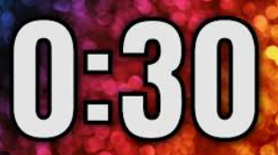
TBAT: explore interesting vocabulary
Blue/ Green- Which sentence do you think is better? Explain why.
The playful dog leaped off the wooden table and chased rapidly after the worried cat.
The dog ran after the cat.
The …..... sentence is better because …................

Slide 12
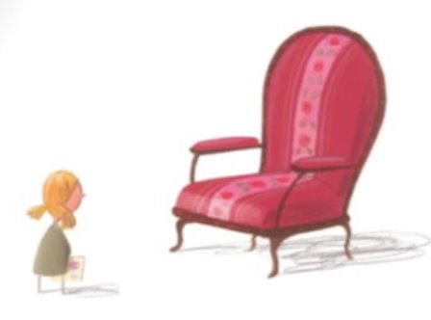
TBAT: explore interesting vocabulary
The girl is sad.

Slide 13
TBAT: explore interesting vocabulary
What words can you think of that mean sad?
sad

Slide 14

TBAT: explore interesting vocabulary
Improve the sentence.
The girl felt ...........

Slide 15
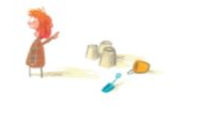
TBAT: explore interesting vocabulary
The girl is happy.

Slide 16
TBAT: explore interesting vocabulary
What words can you think of that mean happy?
happy

Slide 17
TBAT: explore interesting vocabulary
The girl is..............

Slide 18
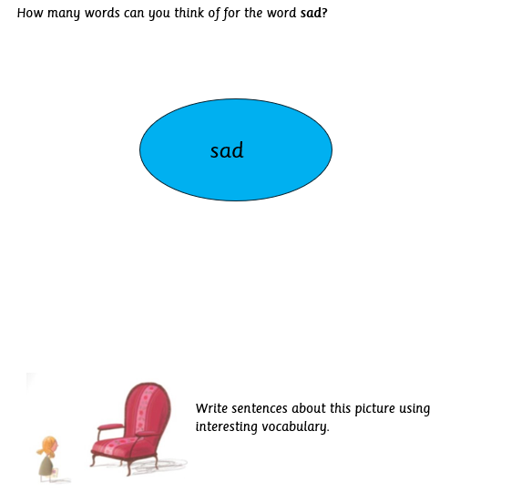
TBAT: explore interesting vocabulary
Independent:
Challenge:
Explain why interesting vocabulary is needed when reading and writing.

Slide 19
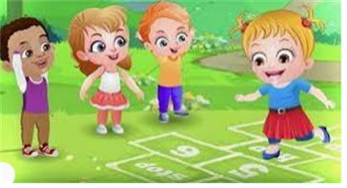
Break

Slide 20
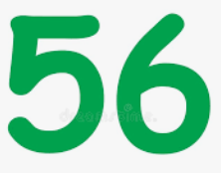

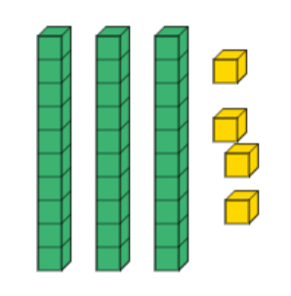
TBAT: compare numbers within 100 on a number line
3 in 3
Find 10 more and 10 less

Slide 21
Blue/ Green Which numbers are hidden behind the shapes?
TBAT: compare numbers within 100 on a number line
51
52
53
54
55
What can you say about the two numbers under the blue circles?
What can you say about the two numbers under the green squares?
56
57
58
59
60
61
62
63
64
65
66
67
68
69
70
71
72
73
74
75
Notes:
Do Now: Revising one/ten more/fewer
Pupils identify the numbers hidden beneath the shapes on the slide.
What can you say about the two numbers under the blue circles?
What about the two numbers under the green squares?
(They have a ten more/ten fewer relationship.)

Slide 22
TBAT: compare numbers within 100 on a number line
greater than
most
less than
least
equal to
compare
value
number line

Slide 23
Count in tens on the number line
TBAT: compare numbers within 100 on a number line
0
10
20
30
40
50
60
70
80
90
100
Notes:
New Learning: Using a number line to compare numbers
Use this part of the lesson to establish that numbers further ‘along’ the number line have a greater value and numbers closer to zero have a lesser value.
Begin by skip counting in tens on a 0–100 number line.
When we count in tens along the number line, is each number ten greater or ten less?
Repeat, counting backwards in tens and emphasising that each value is ten less.
Then skip count in tens beginning at five, to demonstrate that counting in tens does not mean the numbers must be multiples of ten.
Use the next slide to model using a number line to compare values, e.g. 14 and 41. Have pupils mark each number on the number line and reason about how they know which number is greater.
41 is greater than 14 because it is further from zero on the number line. The numbers increase in value along the number line.
Represent the same numbers on two bead strings and line them up to compare.
Repeat with further examples, giving all pupils the opportunity to reason about which number has a greater/lesser value. Ensure pupils formulate full sentences to describe the relationships.

Slide 24
Use the number line to compare …
TBAT: compare numbers within 100 on a number line
41 and 14
62 and 69
83 and 23
0
10
20
30
40
50
60
70
80
90
100
Notes:
New Learning: Using a number line to compare numbers
Use this part of the lesson to establish that numbers further ‘along’ the number line have a greater value and numbers closer to zero have a lesser value.
Begin by skip counting in tens on a 0–100 number line.
When we count in tens along the number line, is each number ten greater or ten less?
Repeat, counting backwards in tens and emphasising that each value is ten less.
Then skip count in tens beginning at five, to demonstrate that counting in tens does not mean the numbers must be multiples of ten.
Use the next slide to model using a number line to compare values, e.g. 14 and 41. Have pupils mark each number on the number line and reason about how they know which number is greater.
41 is greater than 14 because it is further from zero on the number line. The numbers increase in value along the number line.
Represent the same numbers on two bead strings and line them up to compare.
Repeat with further examples, giving all pupils the opportunity to reason about which number has a greater/lesser value. Ensure pupils formulate full sentences to describe the relationships.

Slide 25
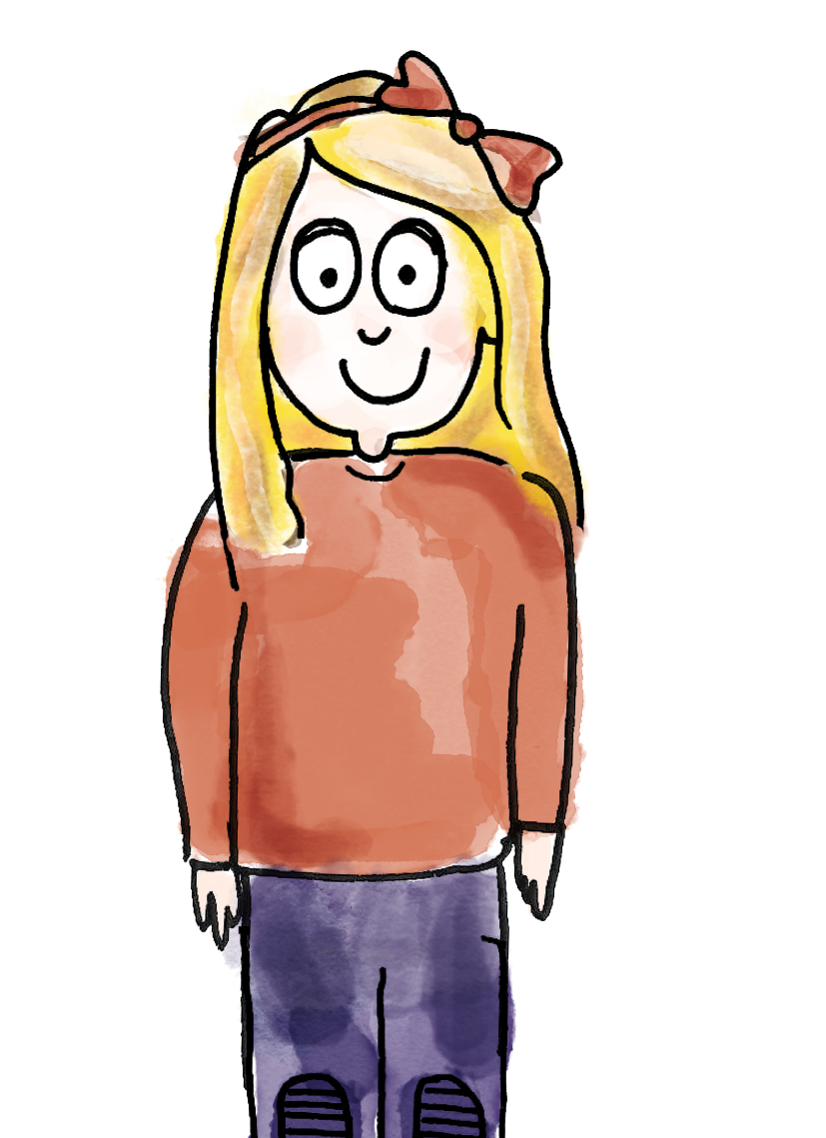
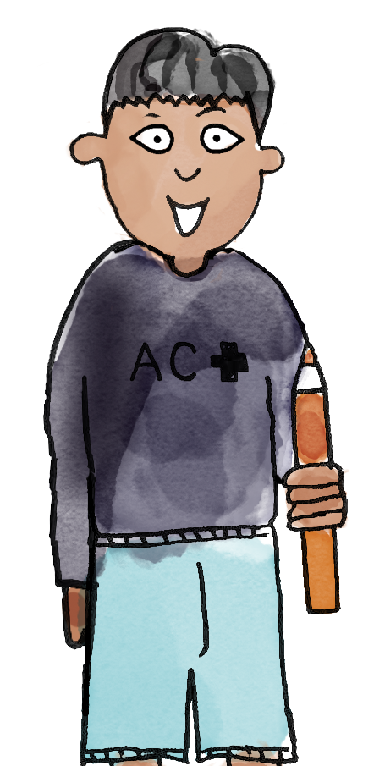


TBAT: compare numbers within 100 on a number line
53 is greater than 43.
53 beads is further from one than 43 beads.
43 is less than 53.
43 has four tens and 53 has five tens, and four has less value than five.
greater than less than equal to value most least compare number line
Notes:
Talk Task: Practise comparing 2-digit numbers
Pupils have a bead string each and the Task Sheet. Pupils A and B each make the given number on their bead string. Pupil A says which number is greater, and explains how they know. Pupil B says which number is less, and explains how they know.

Slide 26
Who has the most money? Who has the least?
TBAT: compare numbers within 100 on a number line
Amir, Bella and Carlos empty their money boxes.
Amir has 49 pence.
Bella has 72 pence.
Carlos has 27 pence.
0
10
20
30
40
50
60
70
80
90
100
Challenge:
How much more money does Bella have than the other two?
Notes:
Develop Learning: Comparing three 2-digit numbers on a number line
Give pupils a problem such as that on the slide, which requires comparison of three 2-digit numbers.
How could we compare Amir’s, Bella’s and Carlos’s money?
Follow pupils’ suggestions, which may include using a number line, bead string or other manipulative. Model sentences to compare the amounts:
Bella has the most money because 72 is the furthest along the number line. Amir has less money than Bella but more than Carlos because 49 is less than 72 but more than 27. Carlos has the least money.
Repeat with an example in a different context such as the following slide, which includes two equal quantities.
The number of sticks is equal to the number of bricks.

Slide 27
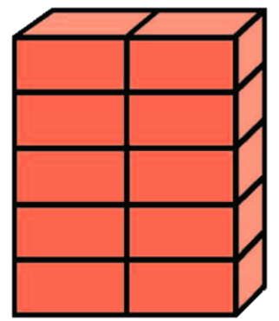
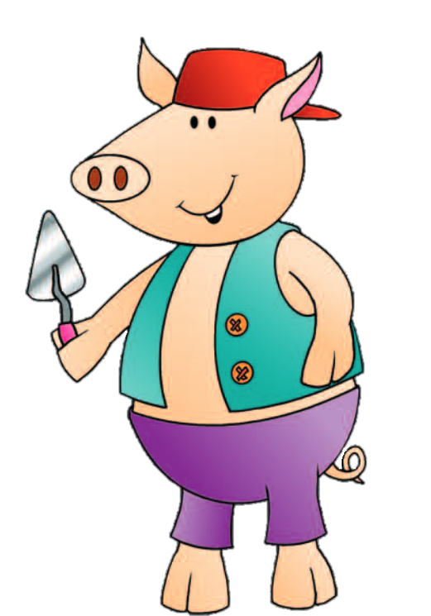
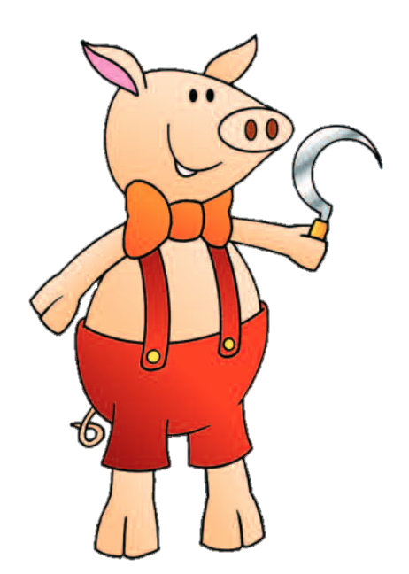

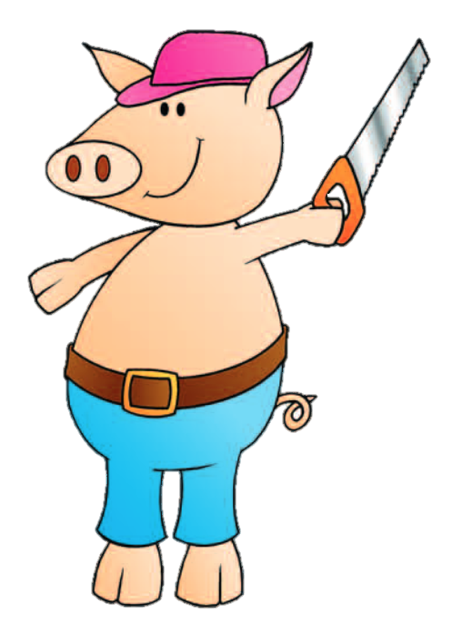
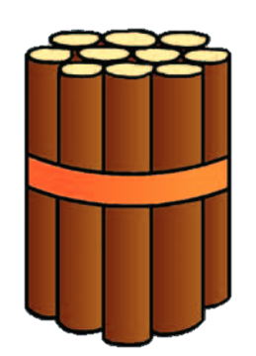
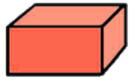
Who has the most sticks or bricks?
TBAT: compare numbers within 100 on a number line
Who has the least?
What other sentences can you make?
0
10
20
30
40
50
60
70
80
90
100
Challenge: How much more does the first pig have than the second pig?
Notes:
Develop Learning: Comparing three 2-digit numbers on a number line
Give pupils a problem such as that on the slide, which requires comparison of three 2-digit numbers.
How could we compare Amir’s, Bella’s and Carlos’s money?
Follow pupils’ suggestions, which may include using a number line, bead string or other manipulative. Model sentences to compare the amounts:
Bella has the most money because 72 is the furthest along the number line. Amir has less money than Bella but more than Carlos because 49 is less than 72 but more than 27. Carlos has the least money.
Repeat with an example in a different context such as the following slide, which includes two equal quantities.
The number of sticks is equal to the number of bricks.

Slide 28
Knowledge check:
TBAT: compare numbers within 100 on a number line
Who has the least?
Who has the most?
1.
2.
3.
0
10
20
30
40
50
60
70
80
90
100
Challenge: How much more does the pig with the most have than the pig with the least?
Notes:
Develop Learning: Comparing three 2-digit numbers on a number line
Give pupils a problem such as that on the slide, which requires comparison of three 2-digit numbers.
How could we compare Amir’s, Bella’s and Carlos’s money?
Follow pupils’ suggestions, which may include using a number line, bead string or other manipulative. Model sentences to compare the amounts:
Bella has the most money because 72 is the furthest along the number line. Amir has less money than Bella but more than Carlos because 49 is less than 72 but more than 27. Carlos has the least money.
Repeat with an example in a different context such as the following slide, which includes two equal quantities.
The number of sticks is equal to the number of bricks.

Slide 29
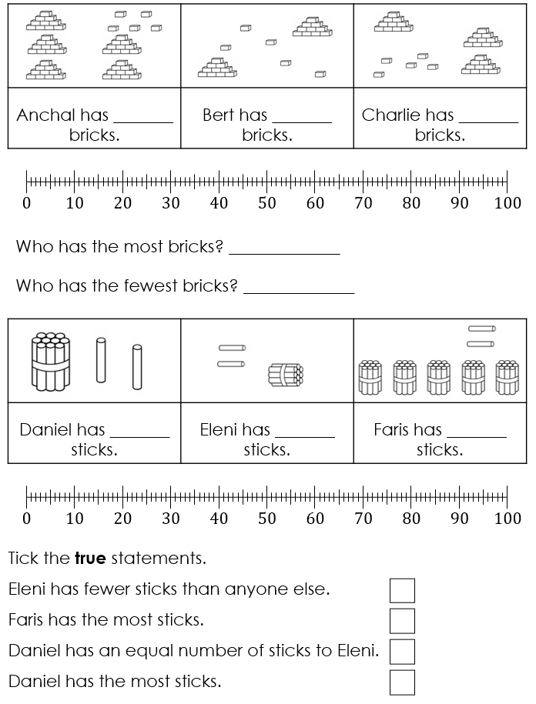
TBAT: compare numbers within 100 on a number line
Solve the problems by marking the numbers on the number line.
You could make the numbers on a bead string to check.
Notes:
Independent Task: Comparing three 2-digit numbers on a number line
Pupils have the Task Sheet. They mark each set of three numbers on the number line and use this to compare and complete the missing information.
Possible adaptations:
Pupils could instead have a set of number cards 0–100 from the resource bank, place them face down and then choose sets of three or more to compare.
Pupils could make each value on a bead string to compare/check their answers.

Slide 30
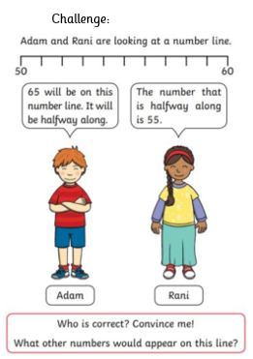
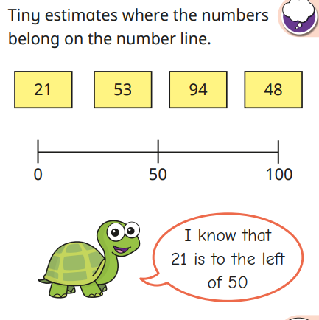
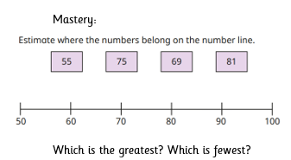
RP:
Is he right? How do you know?

Slide 31
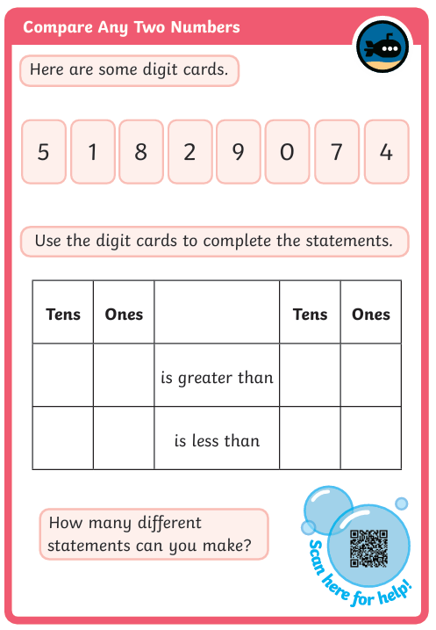
Mastery with greater depth

Slide 32

Lunch

Slide 33

Today's Alien language is.......

Slide 34
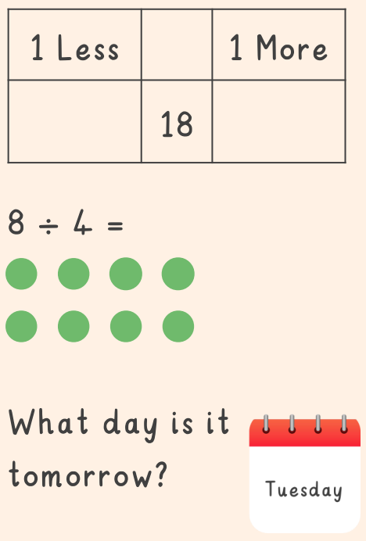
One quarter of 8 is

Slide 35

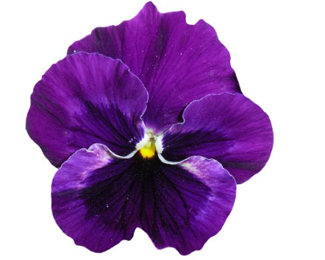
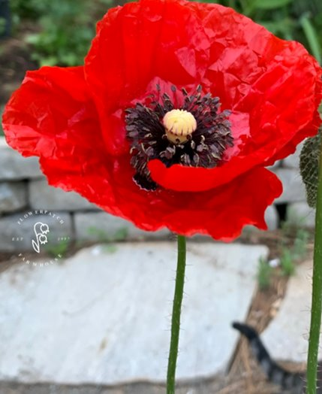
TBAT: use a range of textures to create clay flower tiles.
3 in 3
What can you observe on these 3 flowers?

Slide 36
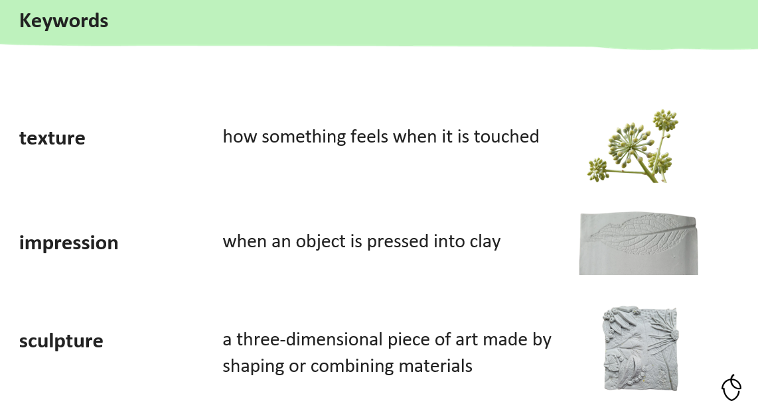
TBAT: use a range of textures to create clay flower tiles.

Slide 37
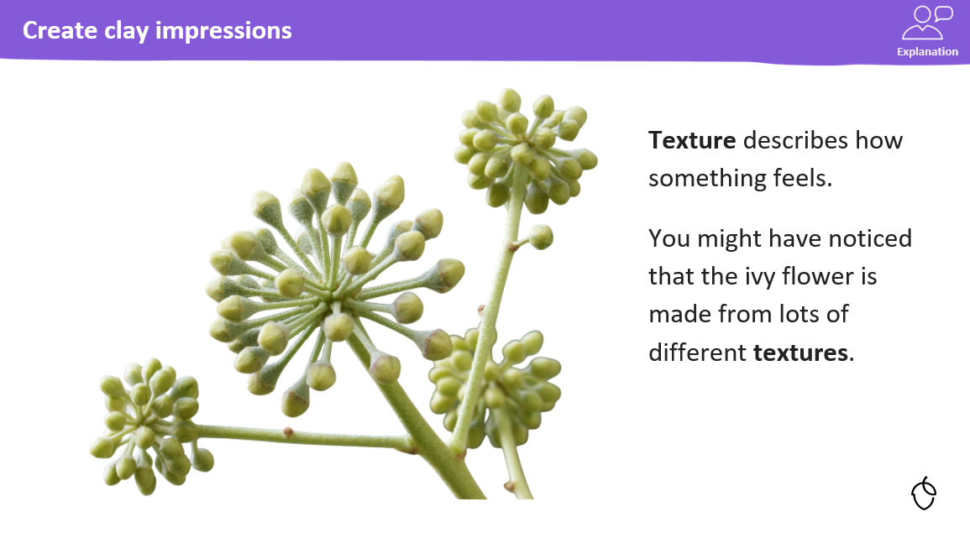
TBAT: use a range of textures to create clay flower tiles.

Slide 38
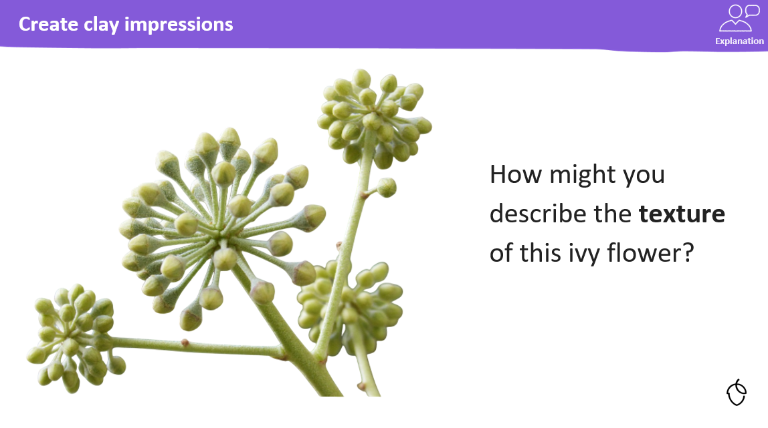

TBAT: use a range of textures to create clay flower tiles.
Blue/ Green
bumpy
smooth
rough

Slide 39
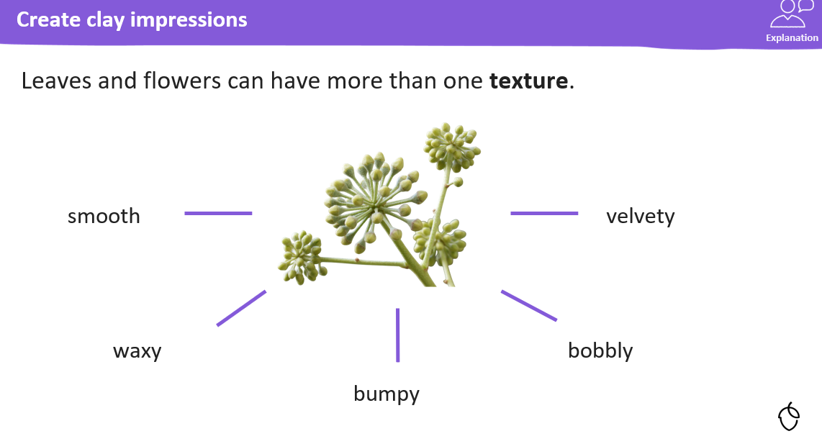
TBAT: use a range of textures to create clay flower tiles.

Slide 40
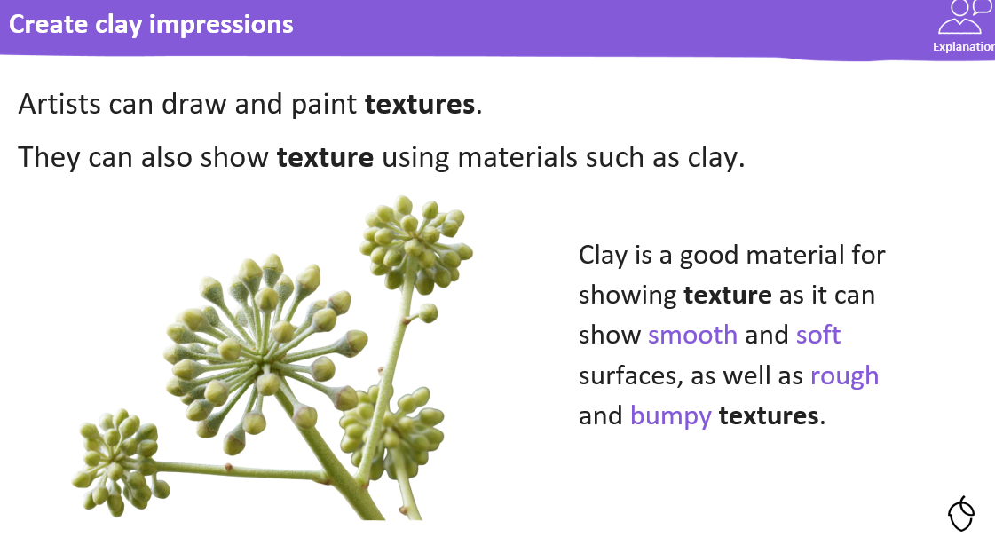
TBAT: use a range of textures to create clay flower tiles.

Slide 41
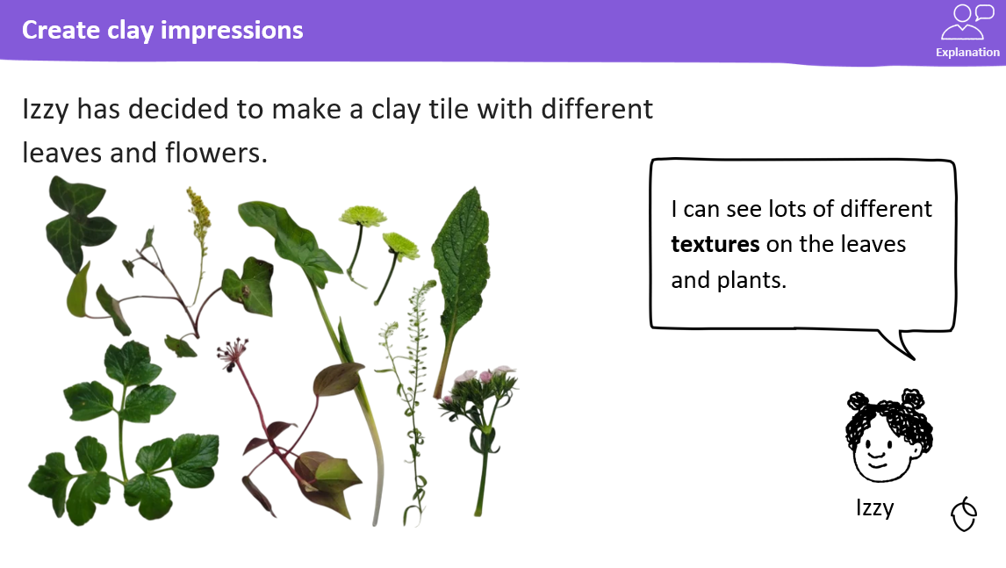
TBAT: use a range of textures to create clay flower tiles.

Slide 42
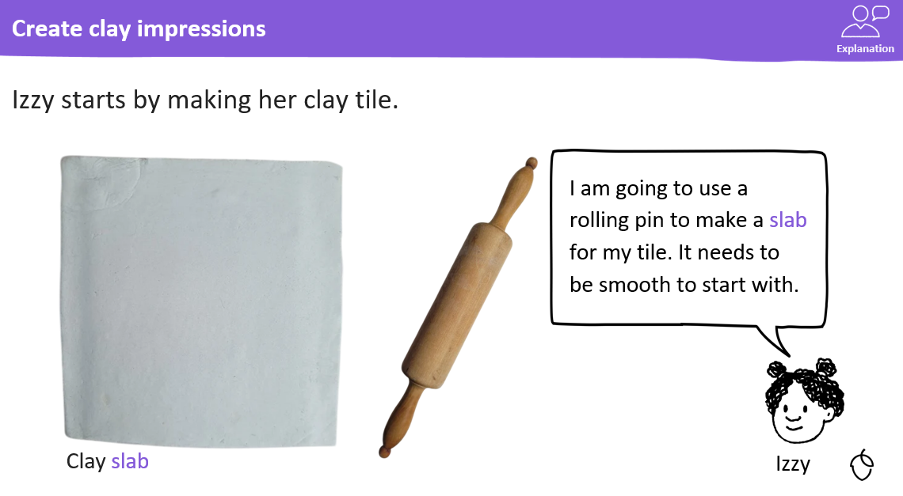
TBAT: use a range of textures to create clay flower tiles.

Slide 43
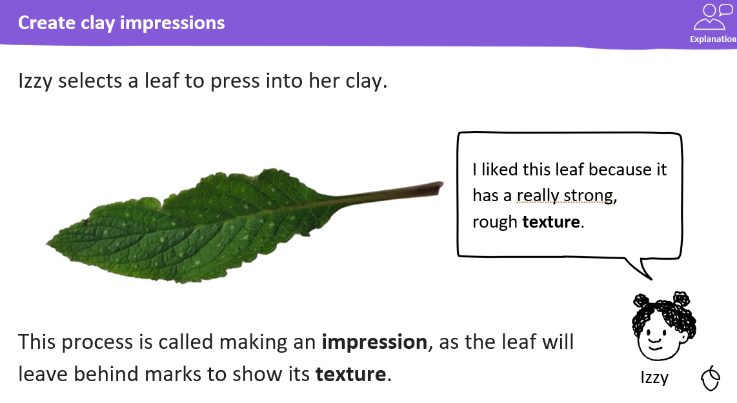
TBAT: use a range of textures to create clay flower tiles.

Slide 44
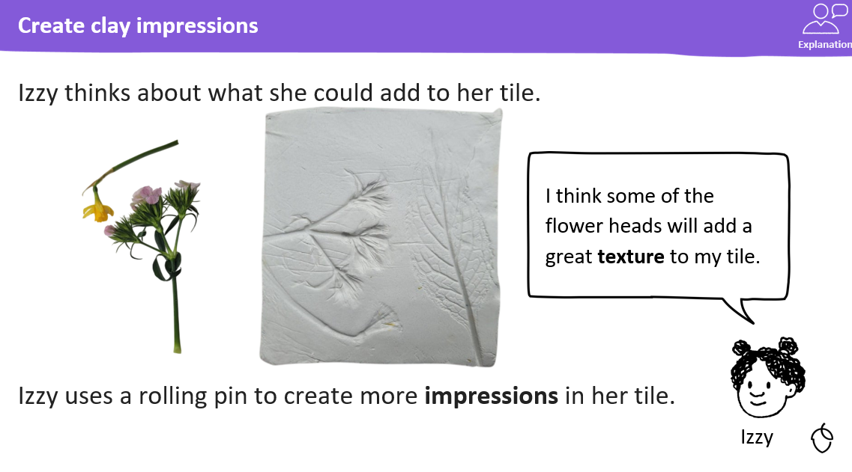
TBAT: use a range of textures to create clay flower tiles.

Slide 45
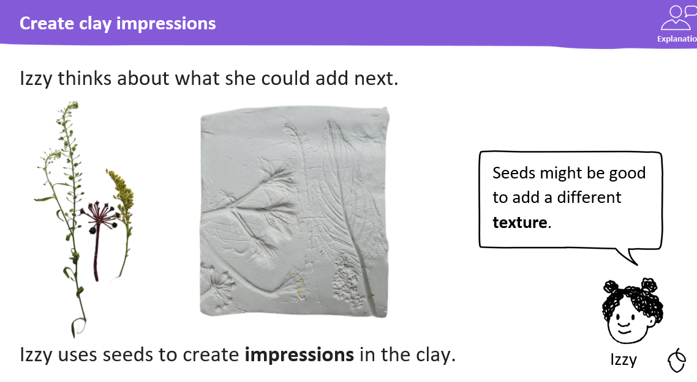
TBAT: use a range of textures to create clay flower tiles.

Slide 46
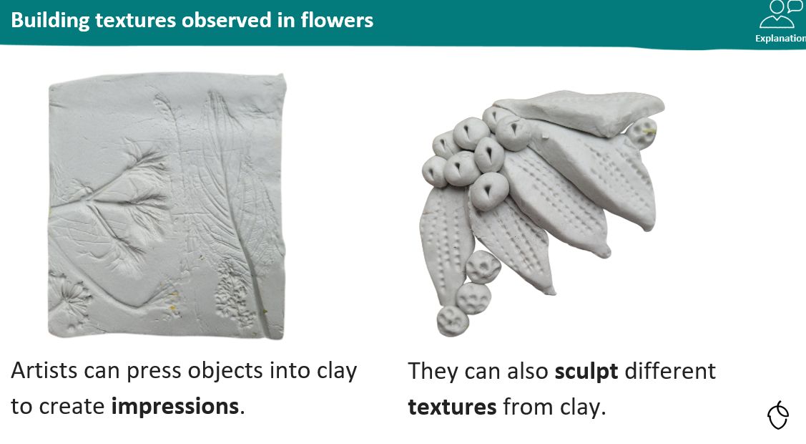
TBAT: use a range of textures to create clay flower tiles.

Slide 47
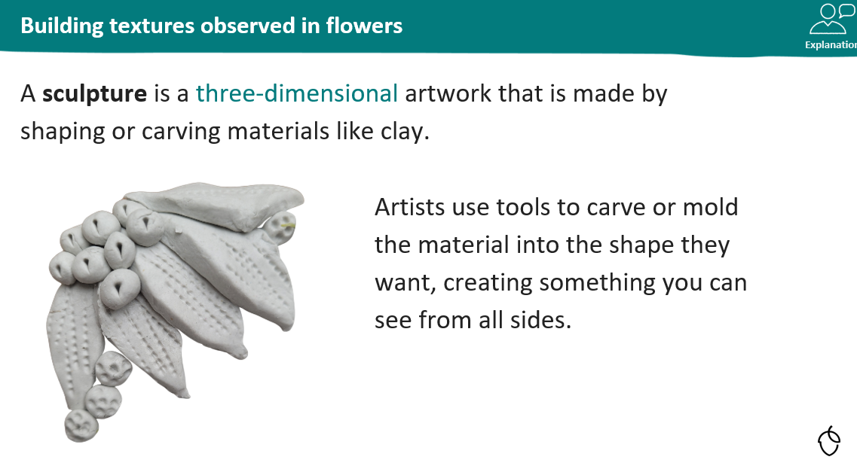
TBAT: use a range of textures to create clay flower tiles.

Slide 48
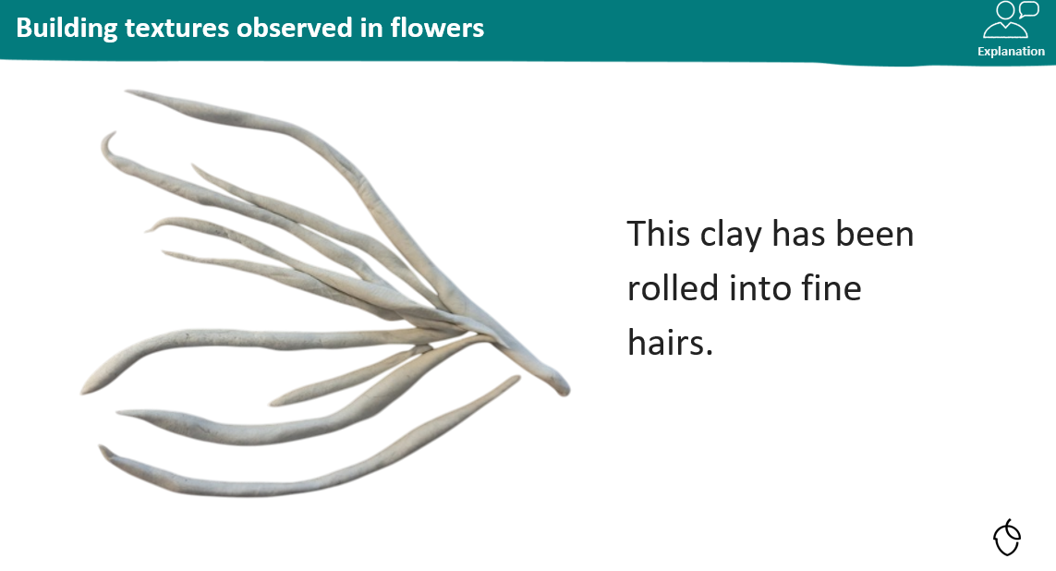
TBAT: use a range of textures to create clay flower tiles.

Slide 49
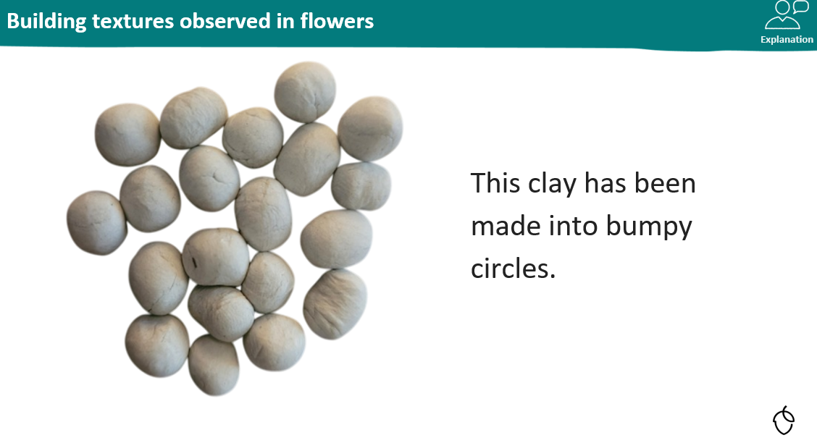
TBAT: use a range of textures to create clay flower tiles.

Slide 50
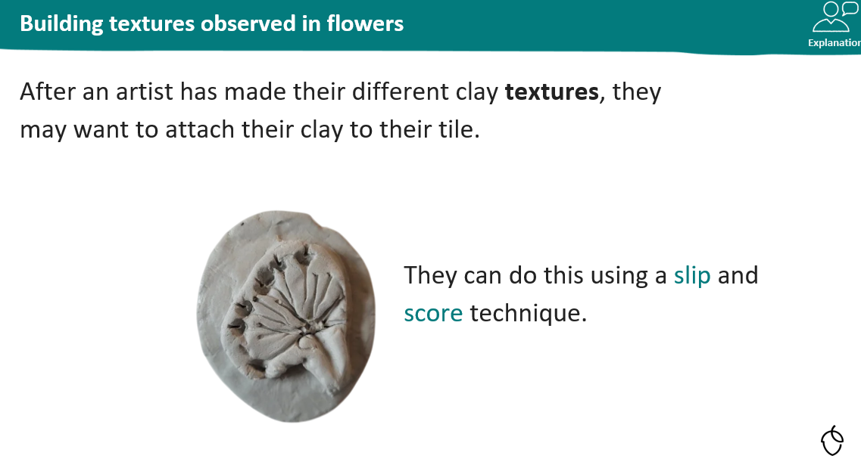
TBAT: use a range of textures to create clay flower tiles.

Slide 51
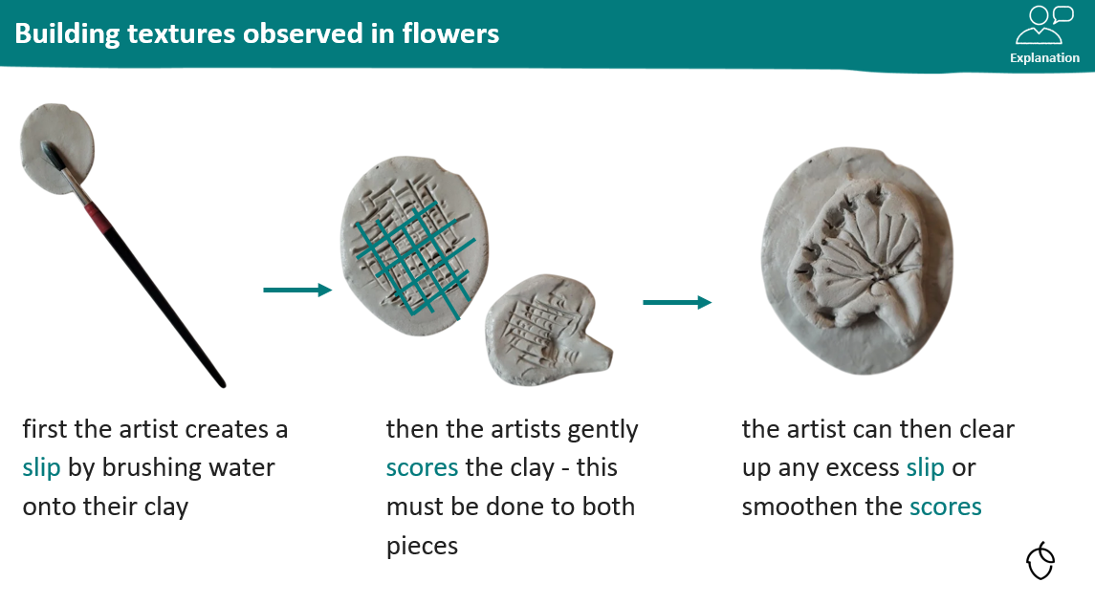
TBAT: use a range of textures to create clay flower tiles.

Slide 52
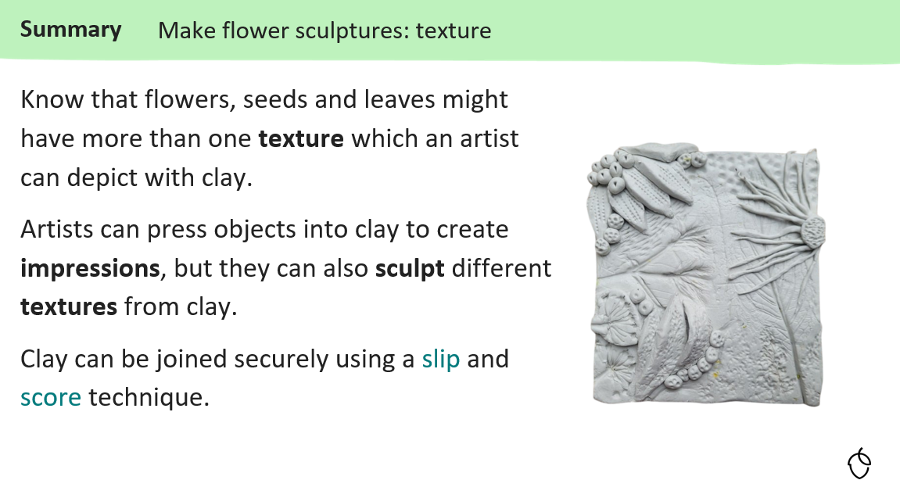
TBAT: use a range of textures to create clay flower tiles.

Slide 53
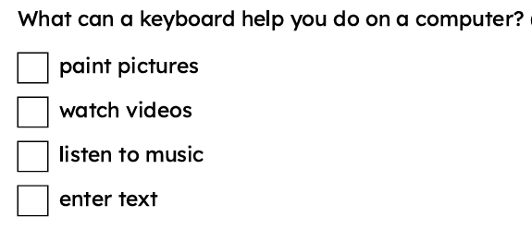
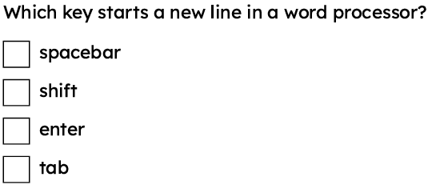
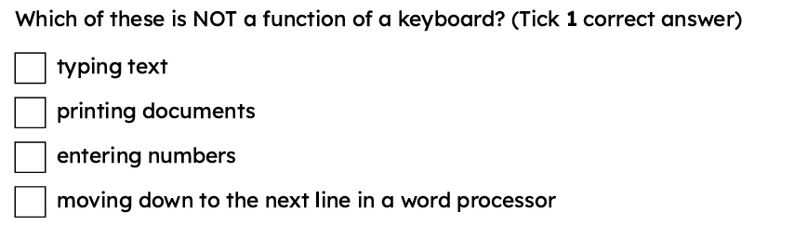
3 in 3
TBAT: add and remove text using a keyboard

Slide 54
cursor
in a word processor, the blinking line where text will appear
spacebar
the key that makes a space in between words
enter
the key that starts a new line
backspace
the key that removes the last letter or space

Slide 55



Control the cursor
We use letter keys to type letters.

Slide 56
Control the cursor
We use number keys to type numbers.

Slide 57





Control the cursor
I use a mouse to point and click on my computer.
Laura
I tap on the touchscreen to use my tablet.
Andeep

Slide 58

Control the cursor
The blinking line on the screen is called the cursor. It shows us where the next letter or number will go when we type.
cursor

Slide 59

Control the cursor
In a document, when you click with the mouse or tap on the touch screen, it moves the cursor.
Google Docs is a trademark of Google LLC and this content is not endorsed by or affiliated with Google in any way

Slide 60

Control the cursor
Some keyboards have arrow keys. You can use the arrow keys to move the cursor.
Google Docs is a trademark of Google LLC and this content is not endorsed by or affiliated with Google in any way

Slide 61

Control the cursor
When you press a key on the keyboard, the letter appears where the cursor is blinking.
Google Docs is a trademark of Google LLC and this content is not endorsed by or affiliated with Google in any way

Slide 62

Control the cursor
The cursor moves forward as we type a letter.
Google Docs is a trademark of Google LLC and this content is not endorsed by or affiliated with Google in any way

Slide 63
Add space in text
How would you write these words on a computer?
cat dog

Slide 64



Add space in text
I pressed the keys catdog.
Jacob
Is this how you would write this word on paper?
What has Jacob missed out?
cat dog

Slide 65
Add space in text
This is the spacebar on a computer keyboard.

Slide 66
Add space in text
How would you start writing on a new line on a computer?
You need to press the enter key.

Slide 67

Add space in text
What does the enter key do?
adds a space between words
starts a new line
removes a letter

Slide 68
Remove text
This is the backspace key. It helps fix mistakes by taking away letters we don't want.

Slide 69

Remove text
Spelling mistakes can have a coloured line underneath them.
Laura
Google Docs is a trademark of Google LLC and this content is not endorsed by or affiliated with Google in any way

Slide 70

Remove text
You can fix mistakes using the backspace key.
Jacob
Google Docs is a trademark of Google LLC and this content is not endorsed by or affiliated with Google in any way

Slide 71

Remove text
Download Task C. Some of the sentences have some mistakes.
Fix your sentences to match the correct ones.
You should:
move the cursor
add spaces
fix spelling mistakes

Slide 72

Remove text

Slide 73
Adding and removing text
The blinking line on the screen is called the cursor.
The cursor can be moved with the mouse or the arrow keys on the keyboard. The spacebar adds a space between words on the computer. The enter key starts a new line on the computer. The backspace key removes letters on the computer.

Slide 74
TBAT: Sing a song with high and low melodies and accompany a piece with high and low sounds
3 in 3
Listen to the rhythm and clap it back
Make a high pitched sound
Make a low pitched sound
Now do both by sirening

Slide 75
TBAT: Sing a song with high and low melodies and accompany a piece with high and low sounds
Vocabulary:
pitch (high/low)
verse – a part of a song
Accompaniment – playing along with music

Slide 76

TBAT: Sing a song with high and low melodies and accompany a piece with high and low sounds
Listen to the song.
How do the animals move?
What is the difference in pitch in the two verses?
Can you sing along? Use your high pitched voice and low pitched voice.

Slide 77

TBAT: Sing a song with high and low melodies and accompany a piece with high and low sounds
What instruments can you hear?
How does the music represent the creatures?
Which instrument is for the egret and which is for the crab?

Slide 78

TBAT: Sing a song with high and low melodies and accompany a piece with high and low sounds
Choose an instrument.
Think about which animal it represents. Is it high or low pitched?
Practise playing your instrument at the right time.
Perform!

