Slide 1
Monday 27th April 2026

Slide 2
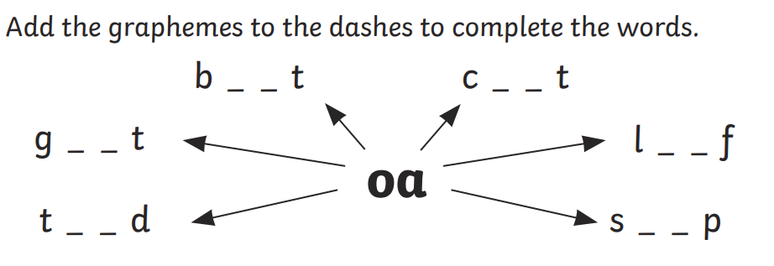
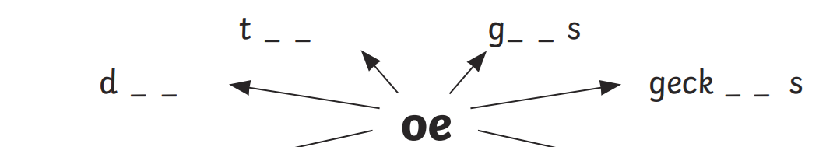
Early morning work

Slide 3
TBAT: read and write words which include the /or/, /au/ and /aw/ digraphs.
Speedy sounds
Digital Flashcards - Teach Your Monster to Read

Slide 4



TBAT: read and write words which include the /or/, /au/ and /aw/ digraphs.

Slide 5


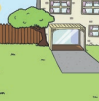
TBAT: read and write words which include the /or/, /au/ and /aw/ digraphs.
Match the label to the picture- where is the /or/ sound?
cork
lawn
astronaut

Slide 6



TBAT: read and write words which include the /or/, /au/ and /aw/ digraphs.
Label the picture- Which /or/ sound will you use?

Slide 7
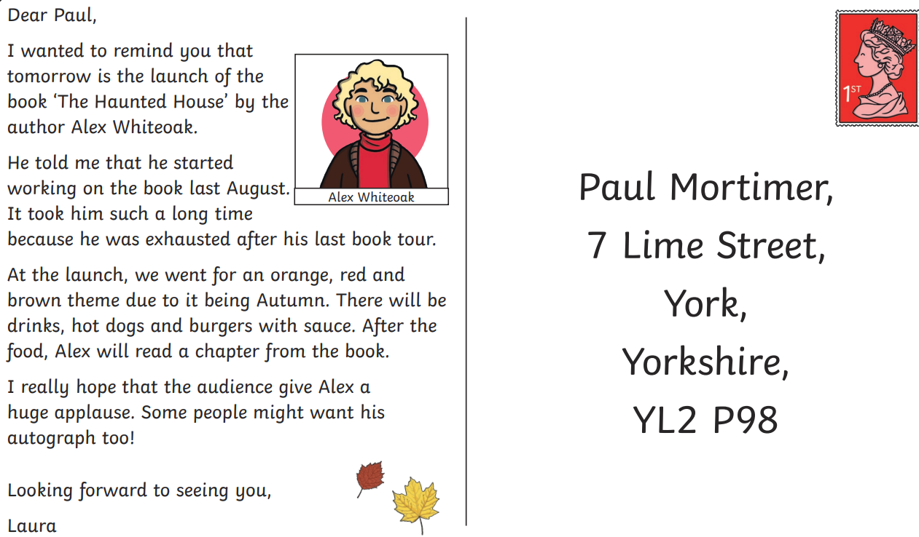
TBAT: read and write words which include the /or/, /au/ and /aw/ digraphs.
How many /or, /au/ or /aw/ graphemes can you spot?

Slide 8
TBAT: read and write words which include the /or/, /au/ and /aw/ digraphs.
Underline the /or/, /au/ and /aw/ graphemes in the sentence.
The astronaut was awesome at sport.

Slide 9
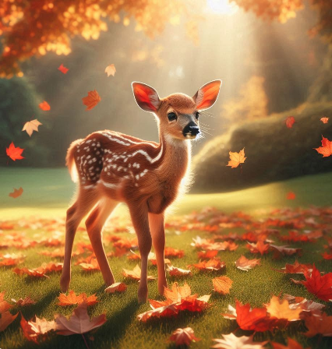
TBAT: read and write words which include the /or/, /au/ and /aw/ digraphs.
…......................................................................
…......................................................................
….......................................................................
…........................................................................

Slide 10
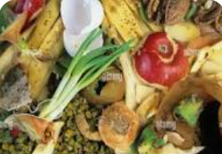
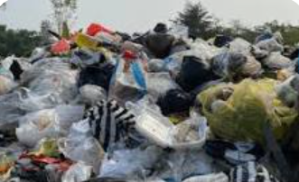
KQ: How can we reduce what we use to help the planet?
3 in 3
What does it mean if something is biodegradable?
Which are biodegradable?
What did we decide we should do with our rubbish?

Slide 11

Reducing for the planet
Reduce means ‘to make something smaller so there is less of it’.
Notes:
Explain to pupils that there are three ways we can all help to have less rubbish in our world and they are reducing, reusing and recycling. Ask pupils if they have heard of these words and what they mean. Explain that reusing and recycling are about using things again instead of throwing them away – maybe using them in a different way. Tell pupils that if you reduce something you make it smaller or less, and reducing rubbish is making less rubbish.

Slide 12


Reducing for the planet
I reduce packaging by buying loose fruit and vegetables at the supermarket.
I reduce plastic bags by bringing my own shopping bags to the supermarket.
Notes:
Tell pupils that Mr and Mrs Patel try to reduce their rubbish. Here, they are describing the things that they do. Explain that taking your own reusable shopping bag means that you are not using a plastic bag which is not biodegradable. Talk with pupils about the packaging of fruits and vegetables and how wasteful it is, as it just gets thrown away. Help pupils to see that it can be reduced.

Slide 13
Reducing for the planet
I reduce plastic by using a refillable water bottle.
I reduce waste by repairing old clothes and by donating them to charity instead of throwing them away.
Notes:
Remind pupils that plastic bottles are not biodegradable and take hundreds of years to begin to break up. Even though clothes are biodegradable, some materials take longer to rot. Explain that Mr Patel repairs clothes by sewing up holes and sewing on new buttons and zips. If he really doesn’t want clothes any more, he gives them to charity so they are not thrown away. Explain that even torn, faded clothing which is beyond repair can be taken to charity shops. It can be sold on as rags to be used as furniture filling.

Slide 14
Reducing for the planet
I reduce plastic by packing my lunch in a reusable container.
I reduce paper by reading the news on my laptop.
Notes:
Explain that many sandwiches bought in a supermarket have a lot of packaging which gets thrown away. Mrs Patel doesn’t waste the plastic and cardboard because she makes her own sandwiches and stores them in her reusable sandwich box. Mr Patel doesn’t waste paper because he reads the newspaper on his laptop.

Slide 15

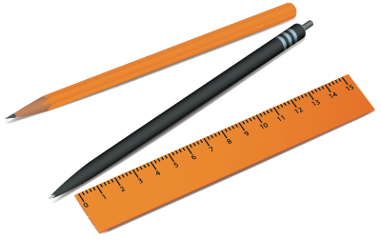
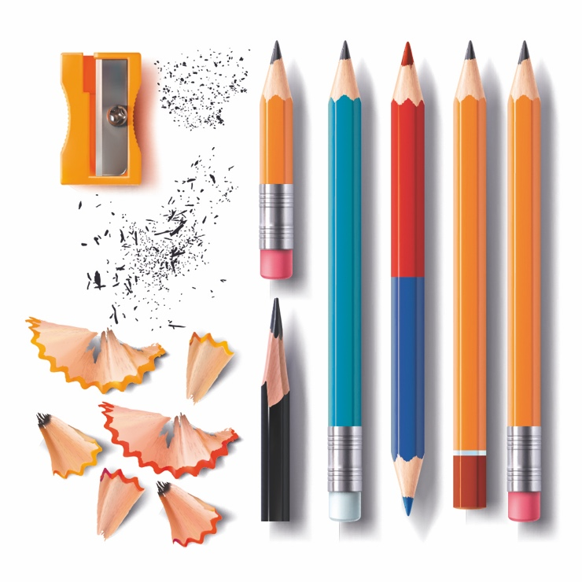

Reducing for the planet
Blue / green
How can we reduce waste in our classroom?
Come up with two ideas each.
Blue share your ideas first.
Notes:
Tell pupils that the classroom cleaner has said that every day she has to throw away lots of school resources. She says that children waste a lot of paper and that there are often pencils, rubbers, sharpeners and other stationery on the floor and in the bins. Lots of pens have missing tops and pencils are thrown away because they are blunt. She says that there are plastic sandwich bags and carrier bags in the bin. She adds that it makes her very sad.
Ask pupils if they can think of any ways that the class can stop wasting things and reduce rubbish. Here are some ideas:
Using the front and the back of paper
Not scribbling on paper or wasting it
Putting lids on pens and felt tips so that they don’t dry out
Naming stationery so that it can be returned to its owner
Having a pencil case or box and packing things away carefully at the end of the lesson
Not sharpening pencils too much
Having a place for rulers and scissors and putting them away
Reusing boxes for parts of their lunch so they don’t waste plastic and packaging

Slide 16

Assembly

Slide 17
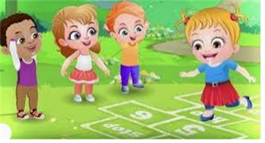
Break

Slide 18
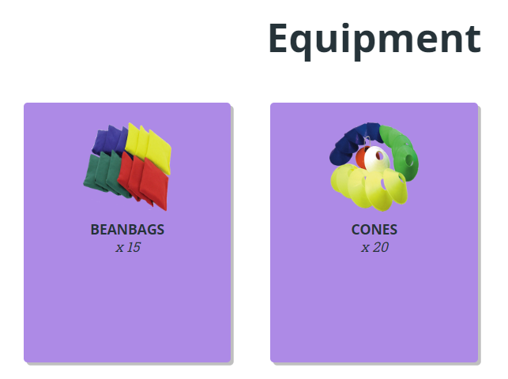
TBAT – develop overarm throwing
2 in 2
What is the job of a fielder?
What Is the job of a batter?

Slide 19
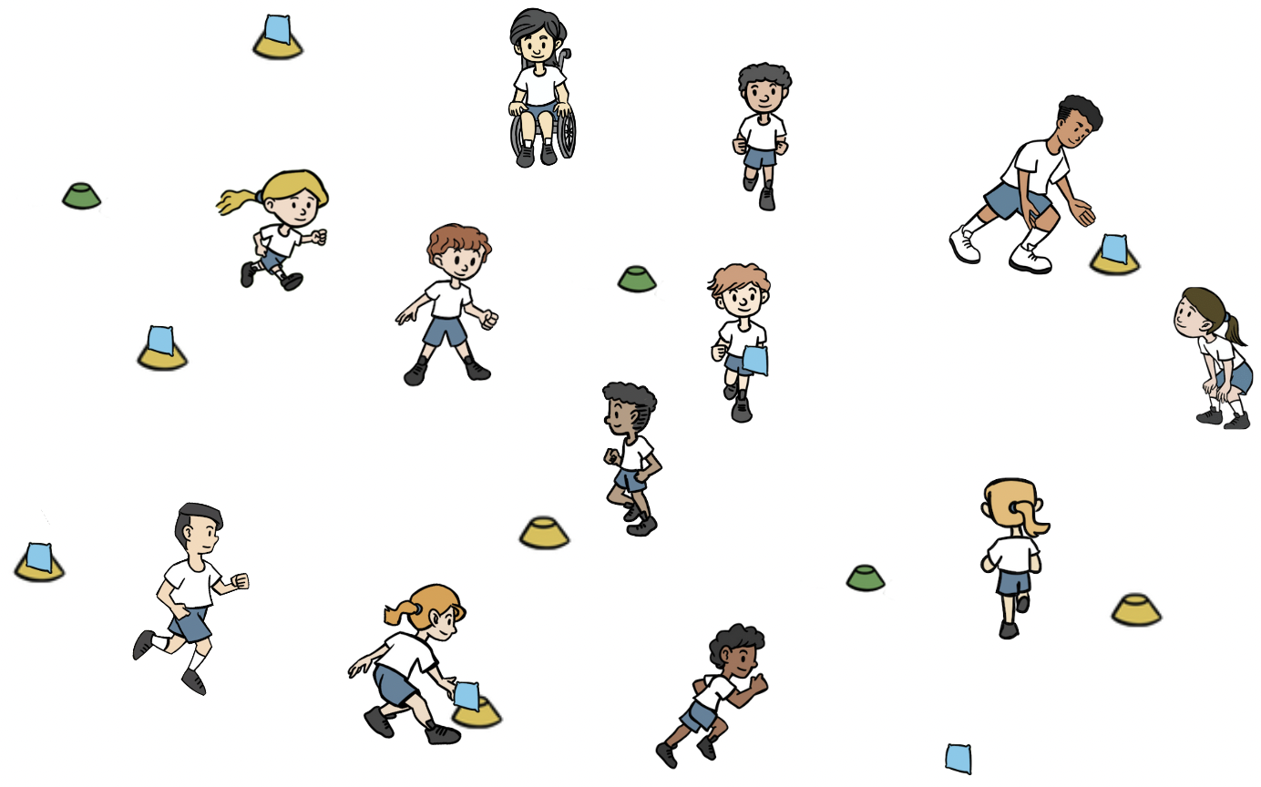
TBAT – develop overarm throwing
Warm-up
Whole class split into two teams, a 'batting' and a 'fielding team'.
Batting team have a cone and beanbag that they place in space (beanbag on top of cone).
Batters move from cone to cone, throwing the beanbags off the cones.
Fielders collect the beanbags and place them back on the cones.

Slide 20
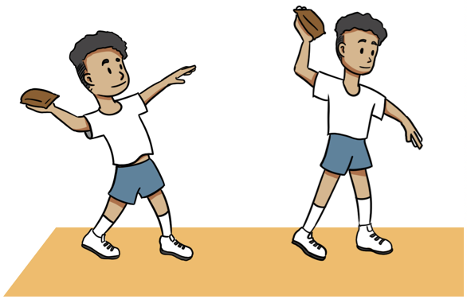
TBAT – develop overarm throwing
Skill development
Overarm
In pairs, with one beanbag. Pupils stand approx. 3m away. Practise overarm throwing. When confident to throw over 3m, take a step back.
Step forwards with the opposite foot to your throwing arm. Have your throwing elbow in line with your shoulder. Point your hand towards your target. To catch, track the ball by looking at it and moving your feet if needed.

Slide 21
TBAT – develop overarm throwing
Skill development
Fielders and batters
In pairs name one a fielder and one a batter to make two teams. Batting team have a cone and beanbag that they place in space (beanbag on top of cone). Play the game from the warm-up, this time batters can use an overarm throw.
Batters move from cone to cone, throwing the beanbags off the cones.
Fielders collect the beanbags and place them back on the cones.
Q: Why would an overarm throw help the batters to score?

Slide 22
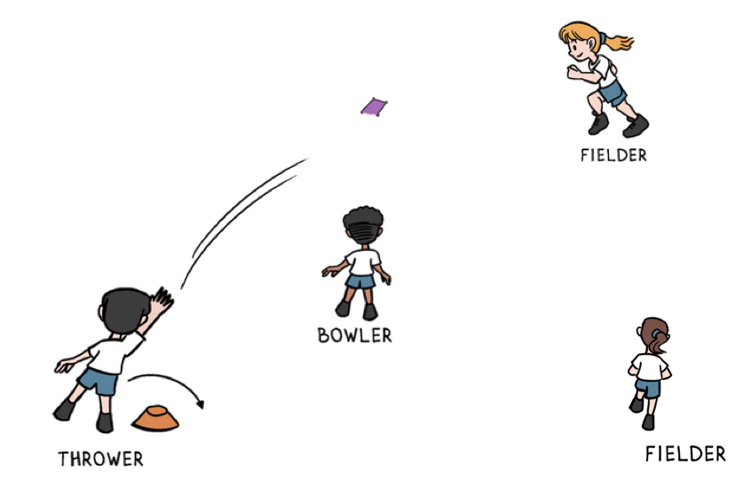
TBAT – develop overarm throwing
Skill development
Strike and field
Groups of four. You need one cone and one beanbag in each group. One pupil is the bowler, one pupil is a batter who begins at the cone and the other two pupils are fielders.
Remember
A bowler is on the fielding team.
They bowl the ball for the batter to hit or in this case throw.
The bowler underarm throws the beanbag to the batter, who catches it.
The batter then throws the beanbag out into the space using an overarm throw.
The fielders collect the beanbag quickly and get it back to the bowler.
The batter counts how many times they can jump over their cone before the fielders get the beanbag back to the bowler.
Have three turns each and swap over.

Slide 23
TBAT – develop overarm throwing
Plenary
When batting, I should throw into space away from the fielders
.
Some teaching points are the same for underarm and overarm throwing.
If I want to throw further, I use an underarm throw.
When I throw, I step forward with the opposite foot to my throwing hand
My job as a fielder is to stop the batter scoring
The bowler is on the batting team

Slide 24

Lunch

Slide 25

Today's Alien language is.......

Slide 26
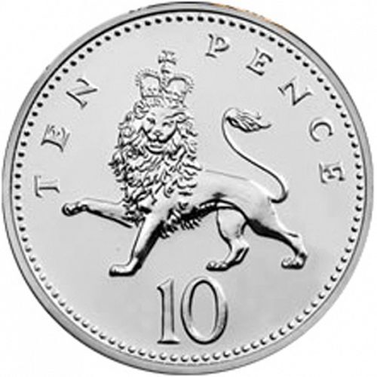
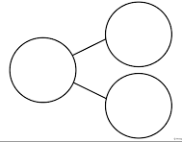
John has five ten pence coins. He spends ten pence on sweets. How much does he have left?
Partition into tens and ones
What is 10 more and 10 less than 34?

Slide 27
TBAT: apply knowledge of number bonds within 20
3 in 3
___ + 8 = 10 so ___ + 8 = 20
5 + 3 = ___ so 15 + 3 = ___
9 + __ = 10 so 19 + __ = 20

Slide 28
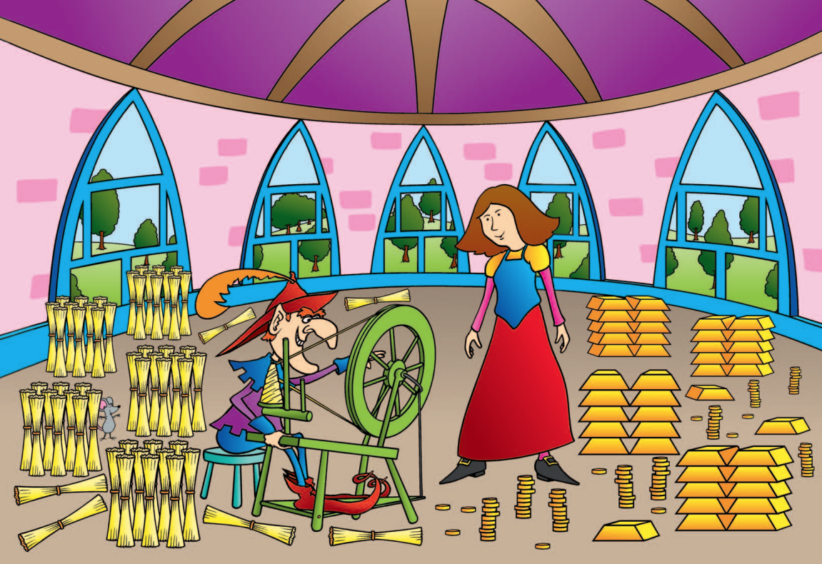
TBAT: apply knowledge of number bonds within 20
Blue / Green
How many gold bars are there?
How many bundles of wool?
Are there more gold bars or bundles of wool?
How do you know?

Slide 29
TBAT: apply knowledge of number bonds within 20
add
part
subtract
whole

Slide 30
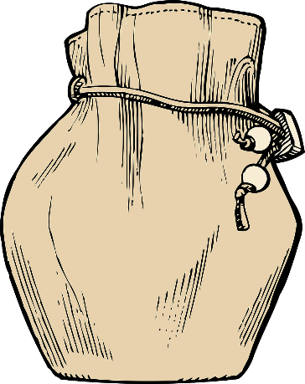
Rumpelstiltskin has 20 gold coins
TBAT: apply knowledge of number bonds within 20
He has put them into two money bags.
How many coins could be in each bag?
Notes:
New Learning: Investigating number bonds within 20
Introduce the problem – Rumpelstiltskin has 20 gold coins and he splits them between two bags. Show pupils two opaque bags.
How many gold coins could be in each money bag?
Give pupils a chance to discuss and take feedback.
Use two hoops to represent the two bags and 20 large counters or cubes to represent the coins. Share the ‘coins’ between the two hoops using a pupil’s suggestion, e.g. ten coins in each hoop. Record this on a part-whole model. Have pupils repeat key sentences:
The whole is 20. One part is ten and the other part is ten. Ten plus ten is equal to twenty. Twenty subtract ten is equal to ten.
Write the corresponding equation.
Now move one coin from one hoop to the other. Without counting the coins again, can pupils say how many coins are in each bag? Record on a part-whole model. Model the sentences:
This part has decreased by one; it now has nine coins. This part has increased by one; it now has 11 coins. The whole has stayed the same; the whole is 20. Nine plus 11 is equal to 20. 20 subtract nine is equal to 11.
Write the corresponding equation.
Continue modelling working systematically, moving one coin at a time, to find other possibilities, with pupils describing the part-whole relationship each time.

Slide 31

How many coins could be in each bag?
TBAT: apply knowledge of number bonds within 20
20
One part is ____.
The other part is ____.
The whole is 20.
Notes:
New Learning: Investigating number bonds within 20
Introduce the problem – Rumpelstiltskin has 20 gold coins and he splits them between two bags. Show pupils two opaque bags.
How many gold coins could be in each money bag?
Give pupils a chance to discuss and take feedback.
Use two hoops to represent the two bags and 20 large counters or cubes to represent the coins. Share the ‘coins’ between the two hoops using a pupil’s suggestion, e.g. ten coins in each hoop. Record this on a part-whole model. Have pupils repeat key sentences:
The whole is 20. One part is ten and the other part is ten. Ten plus ten is equal to twenty. Twenty subtract ten is equal to ten.
Write the corresponding equation.
Now move one coin from one hoop to the other. Without counting the coins again, can pupils say how many coins are in each bag? Record on a part-whole model. Model the sentences:
This part has decreased by one; it now has nine coins. This part has increased by one; it now has 11 coins. The whole has stayed the same; the whole is 20. Nine plus 11 is equal to 20. 20 subtract nine is equal to 11.
Write the corresponding equation.
Continue modelling working systematically, moving one coin at a time, to find other possibilities, with pupils describing the part-whole relationship each time.

Slide 32
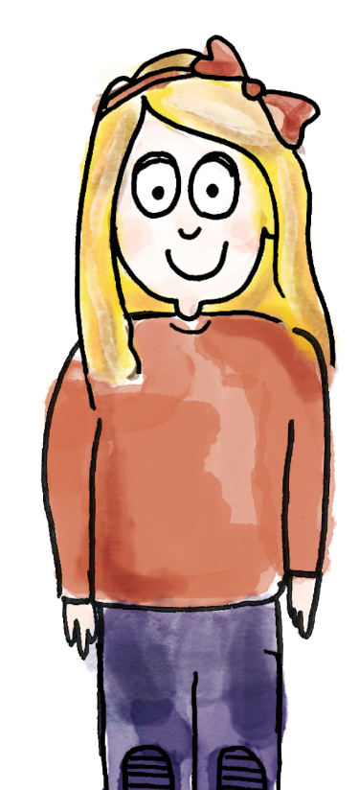
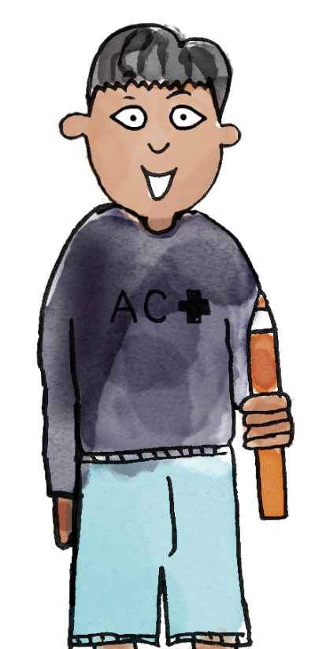
Rumpelstiltskin has split 15 coins into two bags
TBAT: apply knowledge of number bonds within 20
The whole is 15.
The parts are 0 and 15.
Zero plus 15 is equal to 15. 15 subtract zero is 15.
15
add subtract part whole
Notes:
Talk Task: Investigating number bonds to 15
Each pair of pupils has the Task Sheet and 15 counters or cubes. Explain that now Rumpelstiltskin has split 15 coins between two bags. How many coins might be in each bag?
Pupil A partitions the 15 counters into two parts, placing them on the part-whole model on the Task Sheet. They say what the whole and the parts are. Pupil B states two corresponding equations: one addition and one subtraction. Pupils swap roles and repeat, finding as many different ways of partitioning 15 coins as possible.

Slide 33
How many coins could be in each bag?
TBAT: apply knowledge of number bonds within 20
15
Challenge: There are half the amount of coins in one bag than the other. How many in each?
One part is ____.
The other part is ____.
The whole is 20.
Notes:
New Learning: Investigating number bonds within 20
Introduce the problem – Rumpelstiltskin has 20 gold coins and he splits them between two bags. Show pupils two opaque bags.
How many gold coins could be in each money bag?
Give pupils a chance to discuss and take feedback.
Use two hoops to represent the two bags and 20 large counters or cubes to represent the coins. Share the ‘coins’ between the two hoops using a pupil’s suggestion, e.g. ten coins in each hoop. Record this on a part-whole model. Have pupils repeat key sentences:
The whole is 20. One part is ten and the other part is ten. Ten plus ten is equal to twenty. Twenty subtract ten is equal to ten.
Write the corresponding equation.
Now move one coin from one hoop to the other. Without counting the coins again, can pupils say how many coins are in each bag? Record on a part-whole model. Model the sentences:
This part has decreased by one; it now has nine coins. This part has increased by one; it now has 11 coins. The whole has stayed the same; the whole is 20. Nine plus 11 is equal to 20. 20 subtract nine is equal to 11.
Write the corresponding equation.
Continue modelling working systematically, moving one coin at a time, to find other possibilities, with pupils describing the part-whole relationship each time.

Slide 34

The bag contains 12 gold and silver coins
TBAT: apply knowledge of number bonds within 20
How many could be gold?
How many silver?
gold
12
silver
Challenge: There are half the amount of gold coins than silver. How many in each?
Notes:
Develop Learning: Addition and subtraction within 20
Show pupils an opaque bag and explain that it contains 12 gold and silver coins.
How many gold coins could be in the bag? How many silver coins could be in the bag?
Allow pupils time for discussion then take feedback.
Then tell pupils that we now know there are nine gold coins. Write ‘9’ in one part of the part-whole model on the slide.
There are 12 coins altogether. Nine are gold. How many are silver?
Discuss the two ways of thinking about this – either as 12 subtract nine, or as ‘what do I add to nine to make 12?’
Then use the next slide to prepare pupils for the Independent Task, where they must select from given numbers of gold and silver coins to make a total.

Slide 35
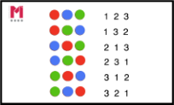
Find combinations that make 12
TBAT: apply knowledge of number bonds within 20
Choose from the possibilities shown here.
Is there more than one answer?
gold
gold
7
11
9
1
12
silver
silver
6
3
2
5
Notes:
Develop Learning: Addition and subtraction within 20
Show pupils an opaque bag and explain that it contains 12 gold and silver coins.
How many gold coins could be in the bag? How many silver coins could be in the bag?
Allow pupils time for discussion then take feedback.
Then tell pupils that we now know there are nine gold coins. Write ‘9’ in one part of the part-whole model on the slide.
There are 12 coins altogether. Nine are gold. How many are silver?
Discuss the two ways of thinking about this – either as 12 subtract nine, or as ‘what do I add to nine to make 12?’
Then use the next slide to prepare pupils for the Independent Task, where they must select from given numbers of gold and silver coins to make a total.

Slide 36

TBAT: apply knowledge of number bonds within 20
For each bag, find combinations that make the total.
Choose from the possibilities shown.
gold coins
silver coins
10
4
5
15
18
20
11
13
7
9
11
10
8
3
Notes:
Independent Task: Addition and subtraction within 20
Pupils have the Task Sheet, a large part-whole model and 20 counters or cubes to represent coins. For each bag, they explore which combinations of the given gold and silver coin quantities could make the total. Is there more than one possibility for each?
Possible adaptations:
Pupils could be given additional clues, e.g. in one bag there are eight gold coins.
Pupils could be challenged to convince you that they have found all the possibilities.

Slide 37
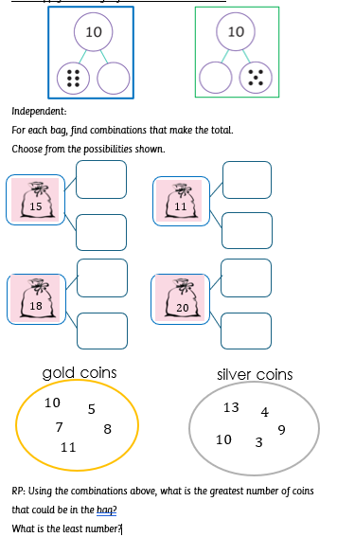

Slide 38
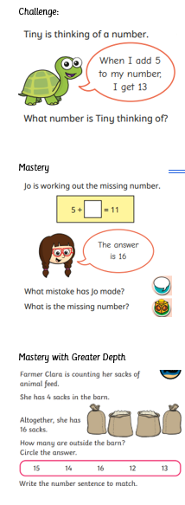

Slide 39
Feedback on the Independent Task
How did you work out what the combinations could be?
What was tricky?
What was easy?
gold coins
silver coins
10
4
5
15
18
20
11
13
7
9
11
10
8
3
Notes:
Plenary: Feedback on the Independent Task
Take feedback on pupils’ solutions to the Independent Task problem.
How did you work out what the combinations could be?
What was tricky? What was easy?

Slide 40
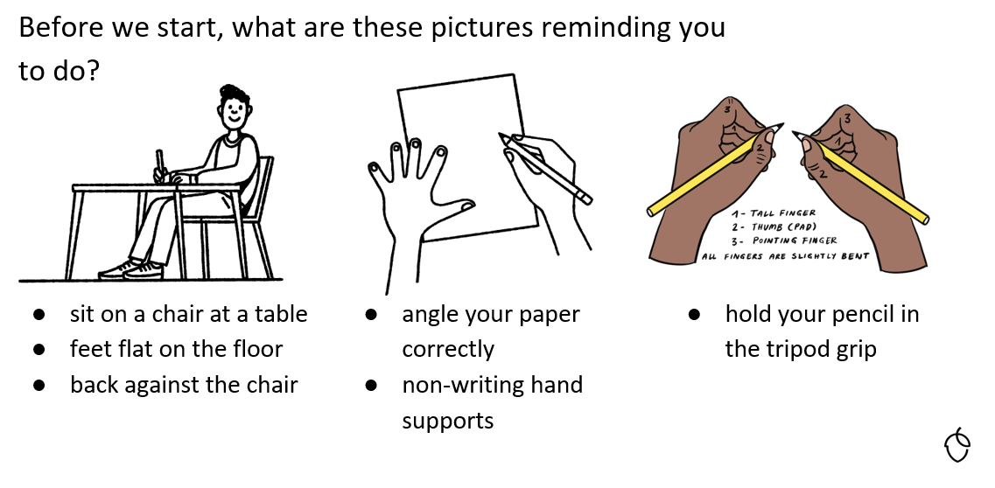
TBAT; correctly form letters m, n and r

Slide 41
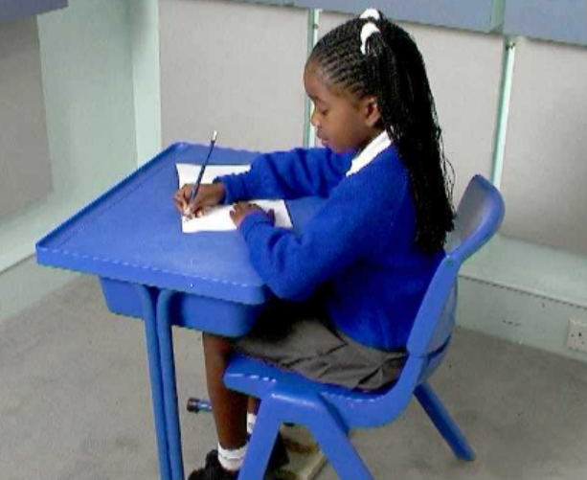
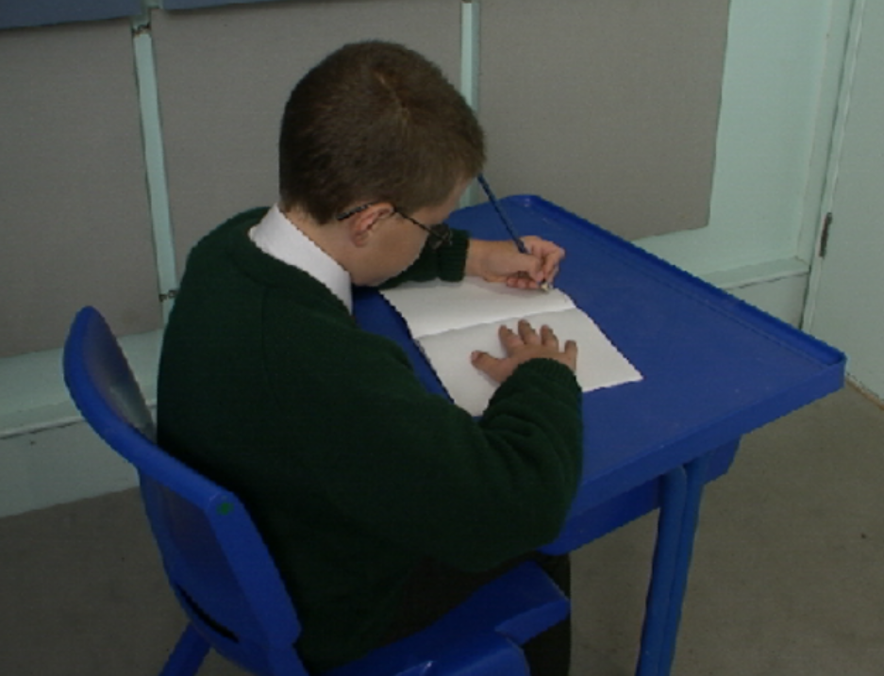
Correct posture
TBAT; correctly form letters m, n and r
Right handed Left handed

Slide 42
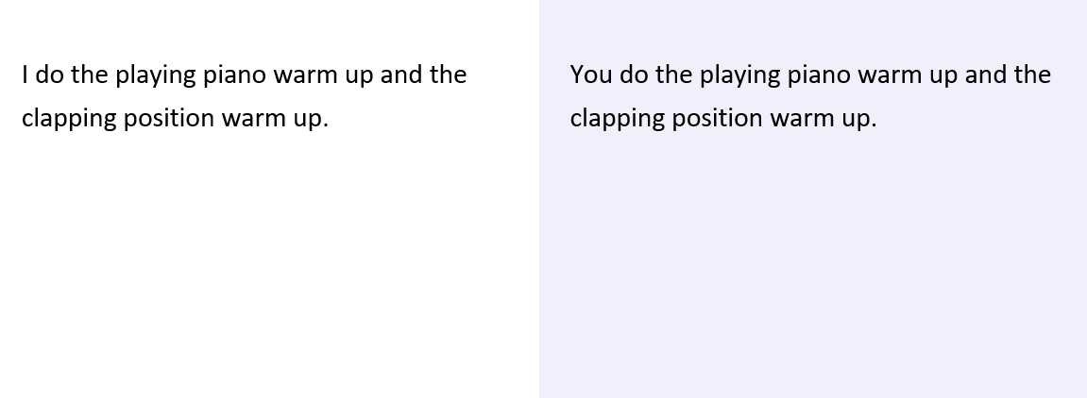
TBAT; correctly form letters m, n and r

Slide 43
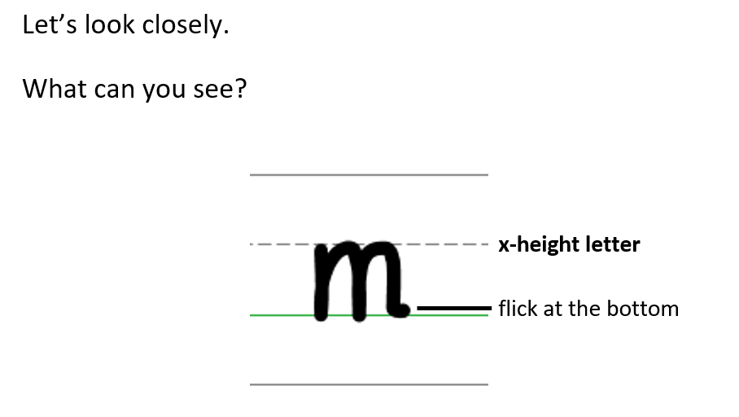
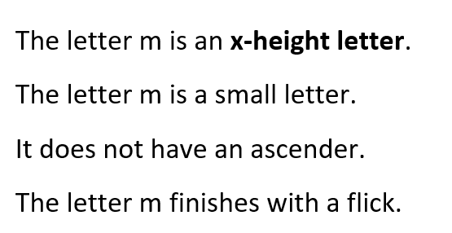
TBAT; correctly form letters m, n and r

Slide 44
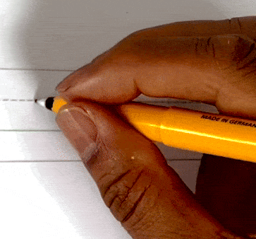
Forming the lower case letter m in print
Let’s write the letter m.
Sit comfortably and hold your pencil.
Start on the x-height line.
Go down to the baseline, go back up to the x-height line, go over and down, back up, go over and down.
Finish with a flick.
Remember do not lift your pencil when forming the letter m.

Slide 45
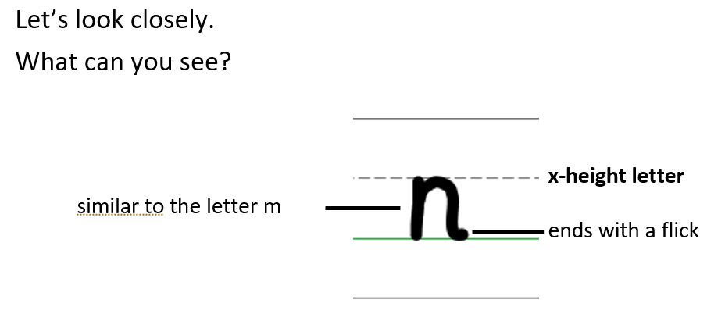
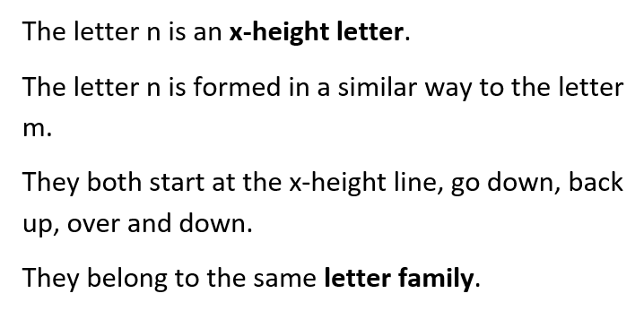
TBAT; correctly form letters m, n and r

Slide 46
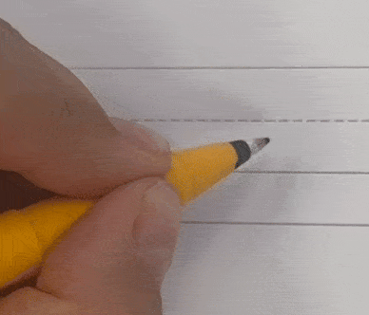
Forming the lower case letter n in print
Let’s write the letter n.
Sit comfortably and hold your pencil.
Start on the x-height line.
Go down to the baseline, go back up to the x-height line, go over and down to the baseline.
Finish with a flick.
Remember do not lift your pencil when forming the letter n.

Slide 47
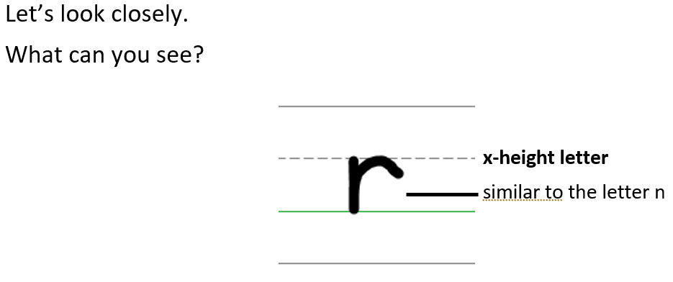
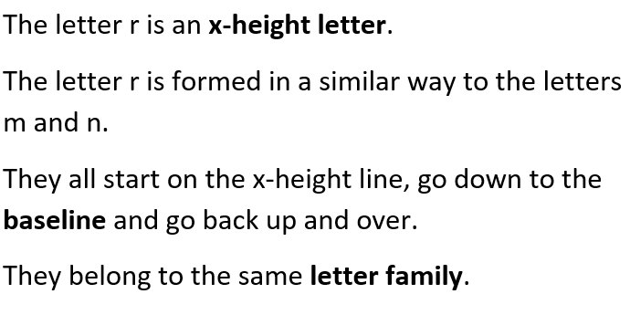
TBAT; correctly form letters m, n and r

Slide 48
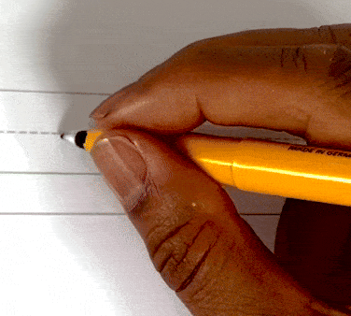
Forming the lower case letter r in print
Let’s write the letter r.
Sit comfortably and hold your pencil.
Start on the x-height line.
Go down to the baseline, go back up to the x-height line and go over.
Take your pencil off the page.

Slide 49
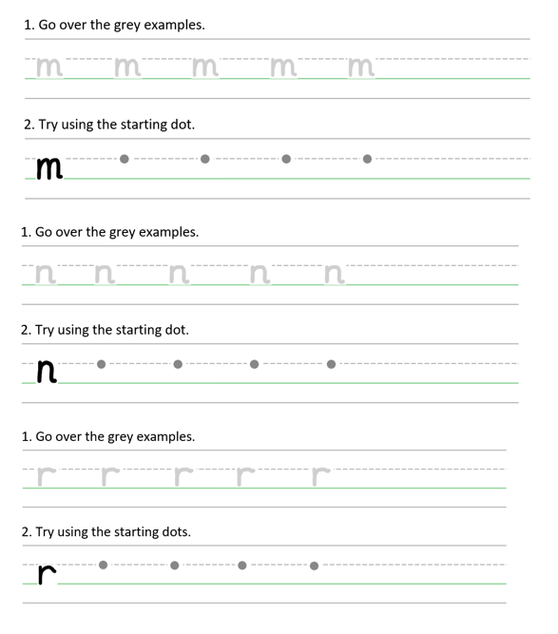
TBAT; correctly form letters m, n and r
mum
nip
run
Handwriting Repeater

Slide 50

Little Wandle Guided Reading

