Slide 1
Monday 20th April 2026

Slide 2
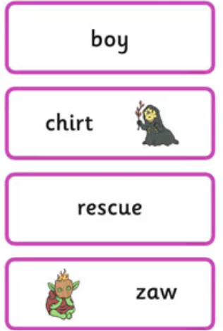
Early morning work
Choose a word card and read it. Swap it with a partner.

Slide 3
TBAT: read and write words which include the // and // digraphs.
Speedy sounds
Digital Flashcards - Teach Your Monster to Read

Slide 4


TBAT: read and write words which include the /ai/ and /ay/ digraphs.

Slide 5
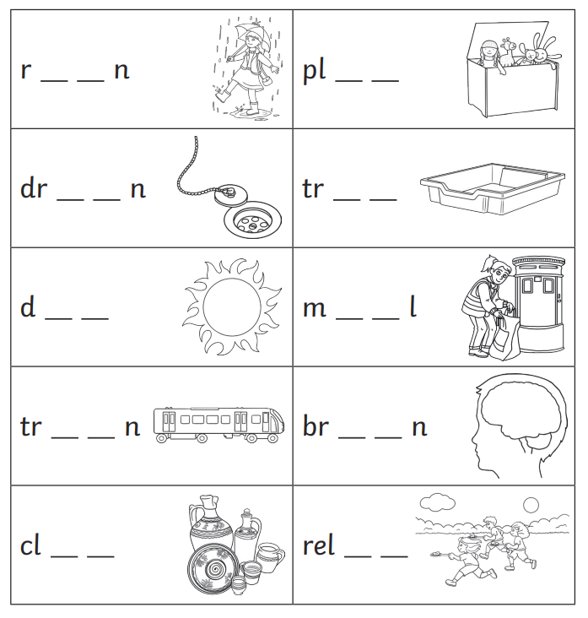
TBAT: read and write words which include the /ai/ and /ay/ digraphs.
Complete these words using the /ai/ and /ay/ graphemes.

Slide 6
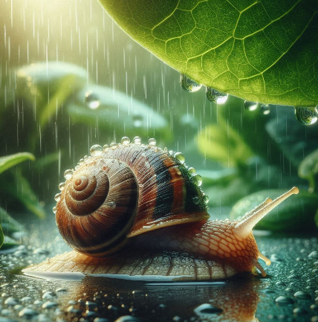
TBAT: read and write words which include the /ai/ and /ay/ digraphs.
Best Bet- which grapheme is most likely to be missing? Why?
The sn....l got wet in the r.....n.

Slide 7
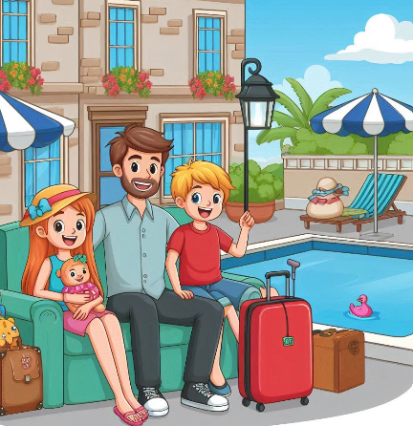
TBAT: read and write words which include the /ai/ and /ay/ digraphs.
Best Bet- which grapheme is most likely to be missing? Why?
On my holid....... I went to st...... in a hotel.

Slide 8
TBAT: read and write words which include the /ai/ and /ay/ digraphs.
Underline the /ai/ and /ay/ graphemes in the sentence.
You might hurt yourself if you play with nails.

Slide 9
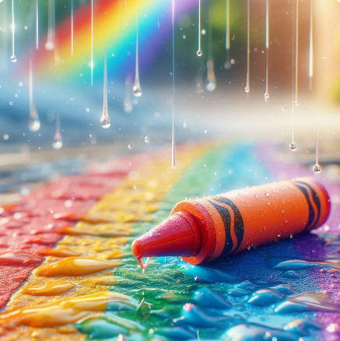
TBAT: read and write words which include the /ai/ and /ay/ digraphs.
…......................................................................
…......................................................................
….......................................................................
…........................................................................

Slide 10
3 in 3- Match the words to their definition.
Key Question: How do I feel about 'our beautiful world'?
beach
an area with fields, farms and open spaces.
woods
an area with sand and a sea
countryside
an area with lots of trees

Slide 11
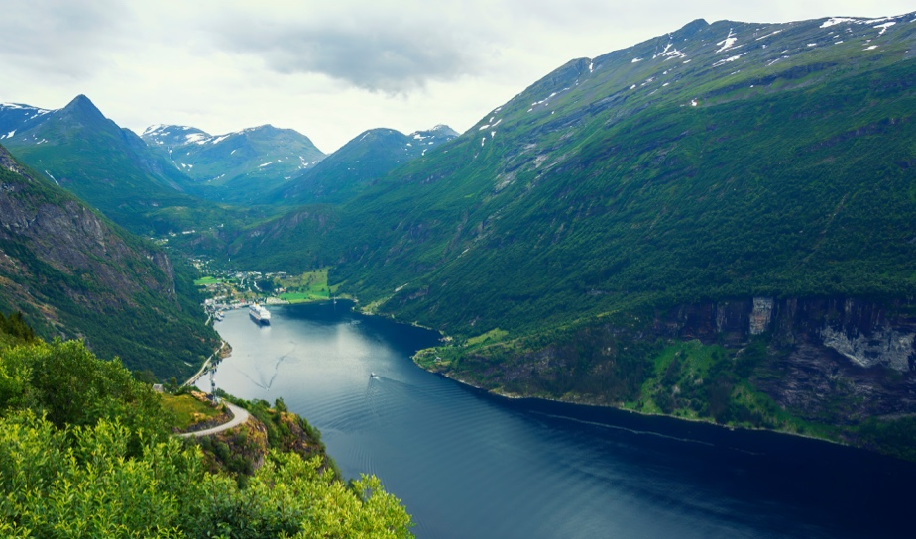
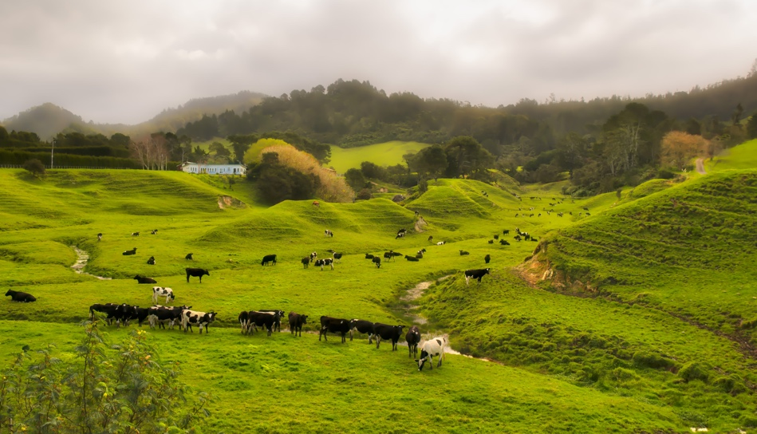
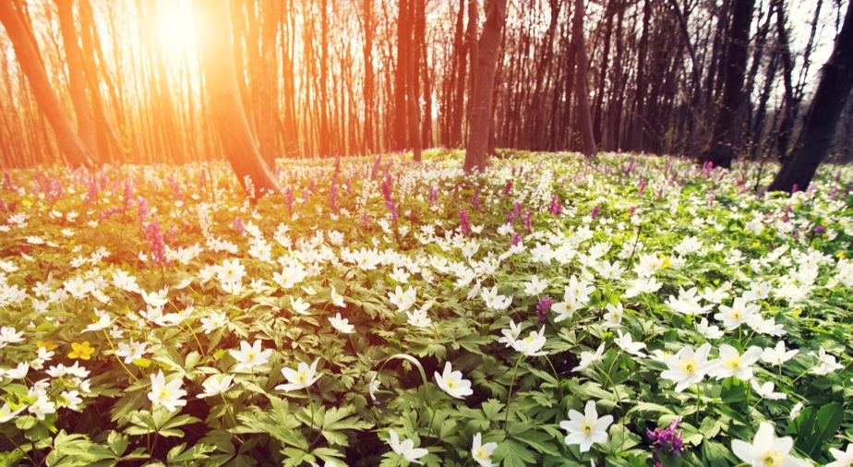
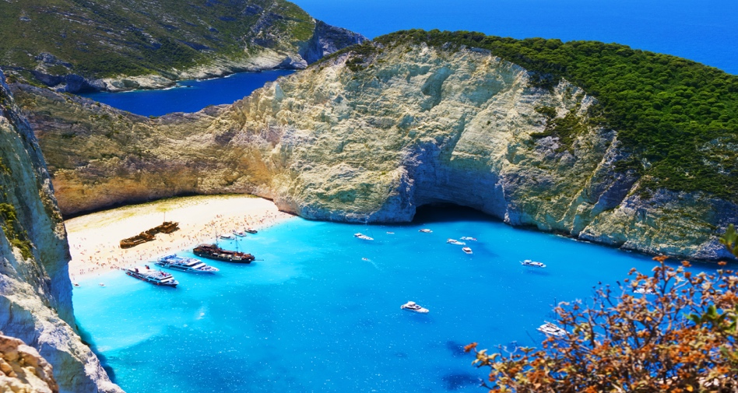
Key Question: How do I feel about 'our beautiful world'?
Our beautiful world
Notes:
Tell pupils that all these pictures are from different places on Planet Earth. Explain that our planet has very diverse climates and lots of different plants and creatures living in them. You may like to write words such as forest, rivers, mountains, deserts, oceans, cliffs, waterfalls on the board. Ask pupils to describe the pictures and their features.
The pictures show:
1. Rivers and mountains in Finland
2 and 3. English fields and woodlands
4. A beach on a Greek island.
Some pupils will have been to places like this; others won’t. Tell pupils that when they are older they could travel to beautiful and fascinating places in the world. Tell them about some jobs which involve travelling to such places, like environmental scientist, zoologist, botanist, oceanographer or conservation scientist. All these jobs involve studying the landscapes and wildlife in different environments.

Slide 12
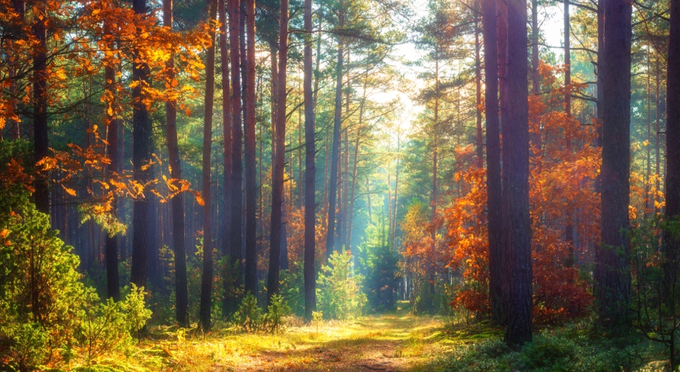


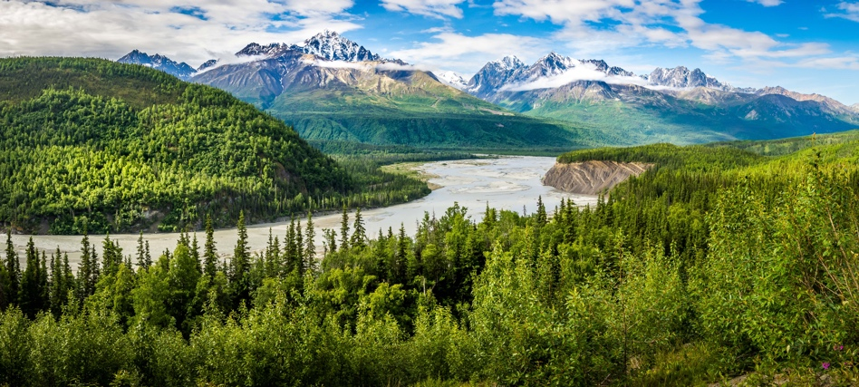
Key Question: How do I feel about 'our beautiful world'?
Our beautiful world
sri lanka beach - Google Maps
Krka Waterfall - Google Maps
Google Earth
Planet Earth II: Official Extended Trailer | BBC Earth
Notes:
These photos show a wood in autumn in England, a beach in Sri Lanka, waterfalls in Croatia and mountains in Alaska. Use an atlas or maps on the board to show where these places are in the world.

Slide 13
Blue/green
Which is your favourite scene?
How would you feel if someone dumped lots of rubbish on it?

Slide 14
Key Question: How do I feel about 'our beautiful world'?
Biodegradable - can be broken down and become part of nature.
Decay – To rot and break down.

Slide 15
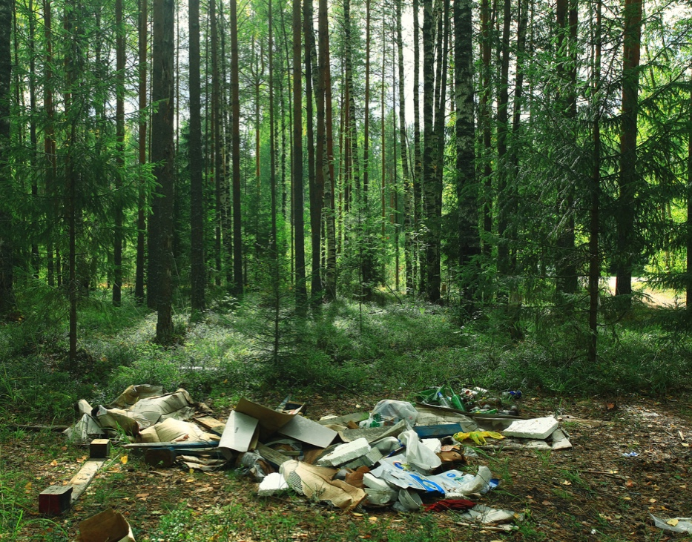
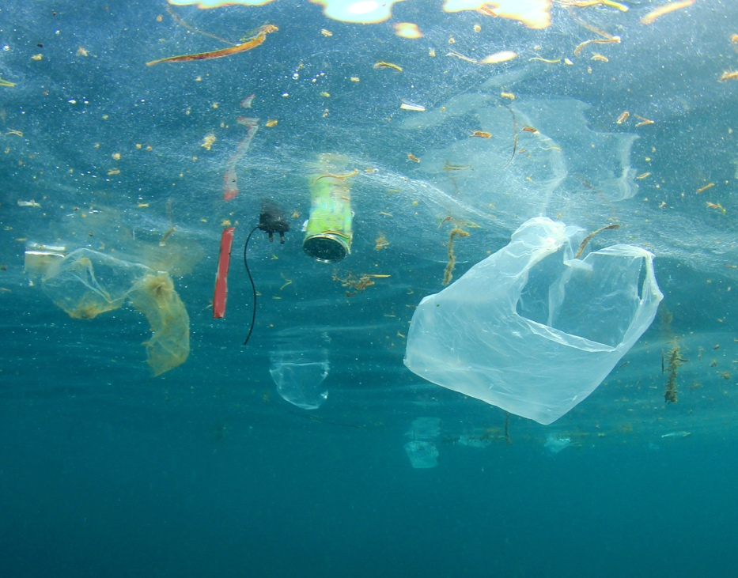
Key Question: How do I feel about 'our beautiful world'?
Not so beautiful …
Blue/ Green How long do you think it takes for a plastic bag to break down and disappear?
Notes:
Explain that consequences are things that happen because of something else. For example, when we throw a pebble into a puddle, as a consequence there are ripples, or when I eat too much chocolate, as a consequence I feel sick! Talk with pupils about the consequences of dropping and dumping rubbish. Help them to understand that these things won’t rot away, that rubbish hurts the environment and can kill plants and wildlife. Animals can get trapped inside containers – especially plastic bags – and die.
You could also begin to explain how plastic and other rubbish can get into the food chain, when smaller creatures eat the rubbish and are then eaten by others. Rubbish is washed into our seas and if dangerous chemicals are dumped, they can get into the water cycle, causing acid rain. Rubbish can cause accidents, like cuts from glass or metal or people being tripped up. The rubbish can become smelly and become a breeding ground for germs. It also attracts rats, which spread disease.

Slide 16
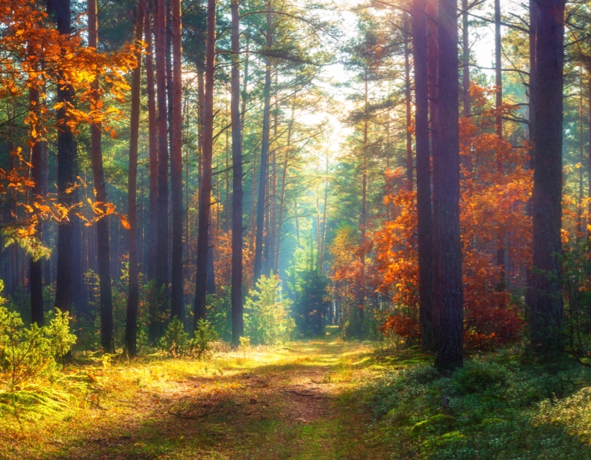
Key Question: How do I feel about 'our beautiful world'?
How long does it take?
How long does it take to break down?
Glass bottle 1 million years
Plastic fishing line 600 years
Plastic bottle 450 years
Disposable nappy 450 years
Aluminium can 80–200 years
Plastic cup 50 years
Tin can 50 years
Plastic bag 10–20 years
Cigarette butt 1–5 years
Woollen sock 1–5 years
Milk carton 3 months
Apple core 2 months
Newspaper 6 weeks
Orange or
banana peel 2–5 weeks
Paper towel 2–4 weeks

Slide 17
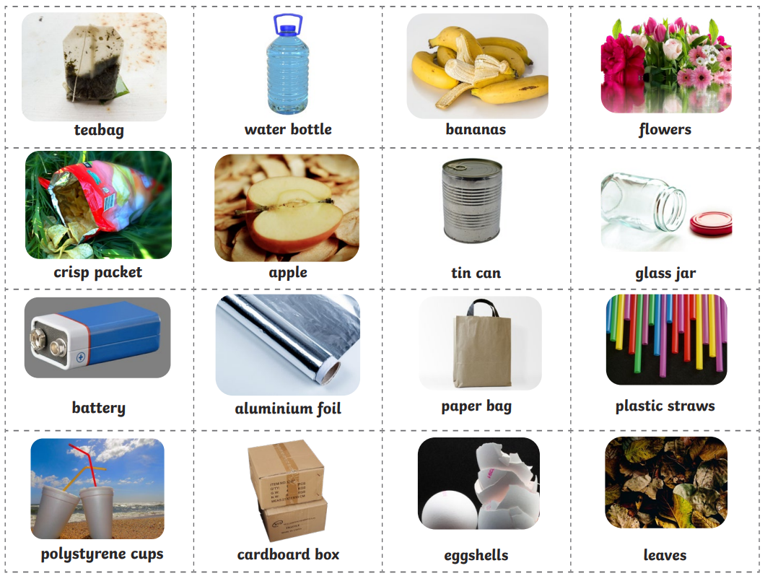
Key Question: How do I feel about 'our beautiful world'?
Biodegradable or not?
Notes:
Pupils may find these photos distressing. Explain that these are pictures of the consequences of lots of rubbish being thrown away. In the photo on the left, which was taken in India, rubbish is washed up onto a beach. The photo on the right shows a landfill site where household rubbish is taken in the UK. Explain that all the risks and consequences from Slide 3 are magnified here!

Slide 18
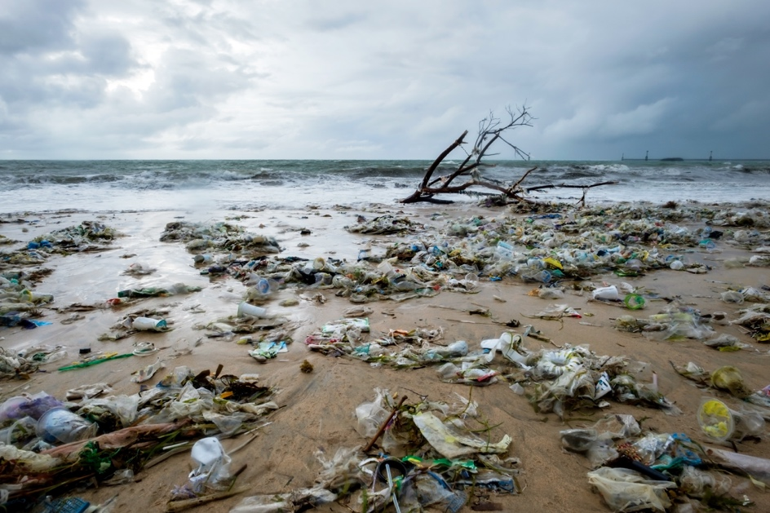
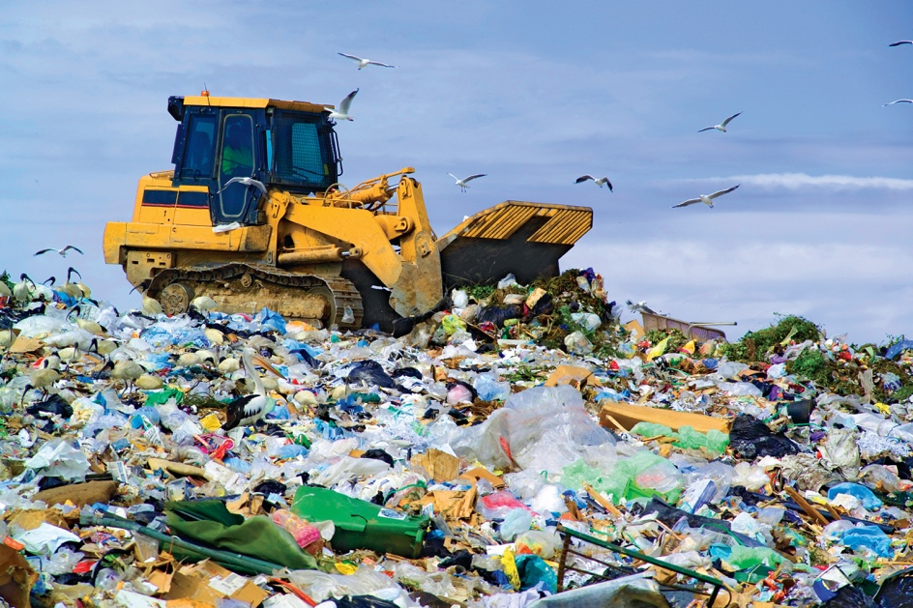
Key Question: How do I feel about 'our beautiful world'?
It’s all rubbish
Notes:
Pupils may find these photos distressing. Explain that these are pictures of the consequences of lots of rubbish being thrown away. In the photo on the left, which was taken in India, rubbish is washed up onto a beach. The photo on the right shows a landfill site where household rubbish is taken in the UK. Explain that all the risks and consequences from Slide 3 are magnified here!

Slide 19

Assembly

Slide 20
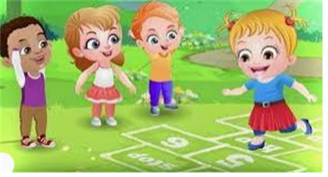
Break

Slide 21
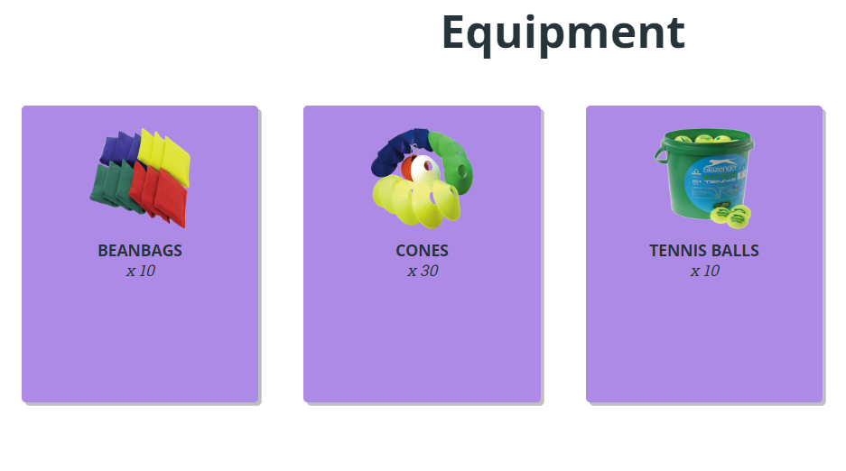
TBAT – develop underarm throwing and catching
2 in 2
What 2 parts of the body do we use to throw/catch a ball?
Name 2 sports that we throw or catch a ball

Slide 22
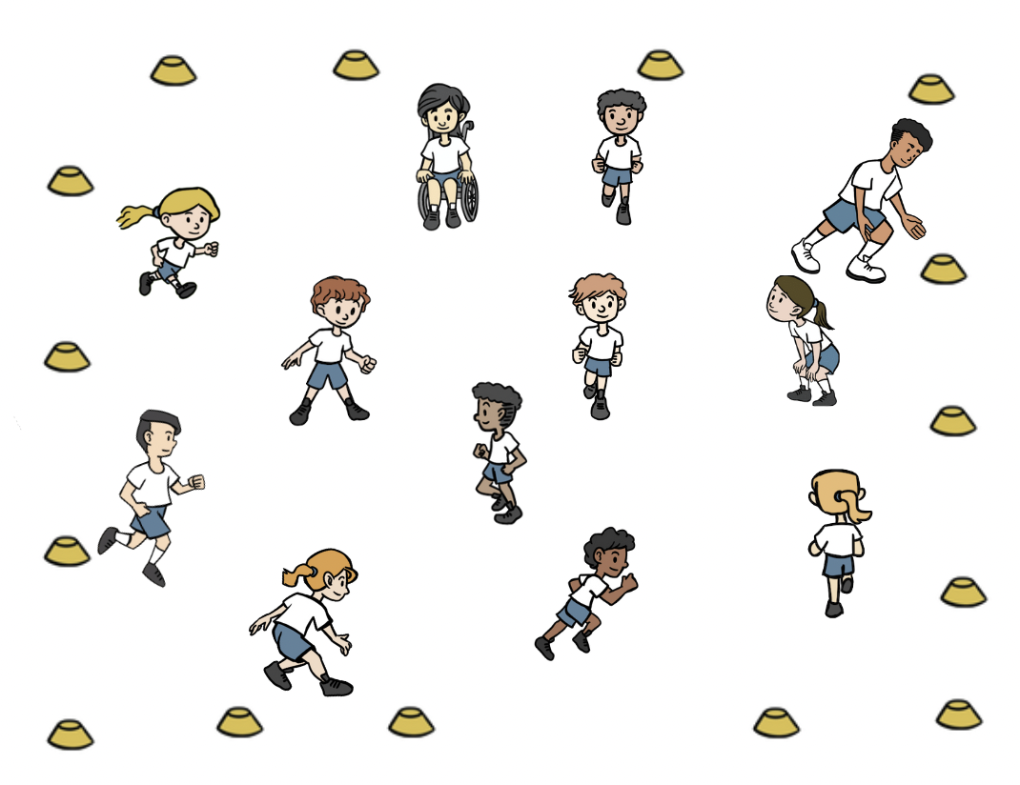
TBAT – develop underarm throwing and catching
Warm-up
Everyone has a cone that they place around the outside of the teaching space.
Jog around inside the cones.
When a number is called pupils run to touch that number of cones before continuing to travel again.

Slide 23
TBAT – develop underarm throwing and catching
Skill development
Throwing
Get into groups of 3 – have a bean bag each
With a straight arm swing the bean bag backwards and then forwards letting go. Take turns.
Step with the opposite foot to throwing hand. Finish with your hand pointing at your target.
Catching
Throw and catch whilst counting in tens out loud. How many tens can they get to? Repeat.
Call your partner's name if they are not looking at you. Track the beanbag by watching it and moving your feet if needed.

Slide 24
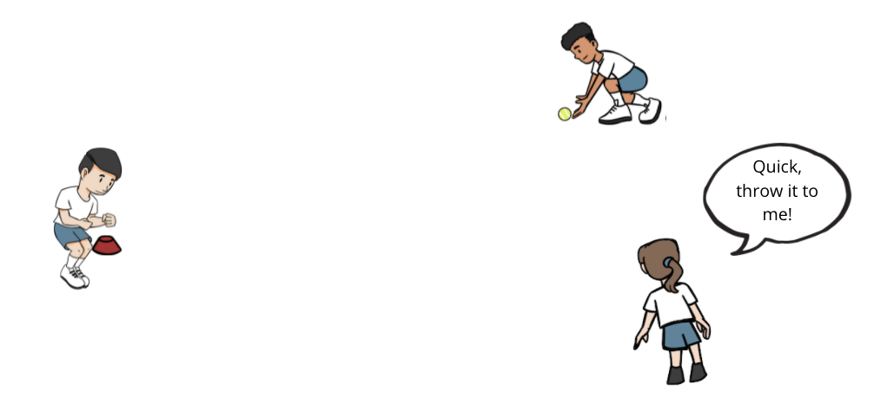
TBAT – develop underarm throwing and catching
Skill development
One of you is the batter with the ball by a cone.
The other two pupils are the fielders.
The batter throws the ball out in to the space and then starts to jump side to side over their cone, scoring one point for every jump.
The fielders collect the ball as quickly as possible and complete ten passes before shouting ‘stop’.
Communicate with your teammate to decide who will collect the ball. Move towards the ball as soon as it is thrown and as quickly as possible. Make sure your teammate is looking at you before you throw.

Slide 25
Plenary
My job as a batter is to score points
If I want the ball to go to my partner, I finish with my hand pointing at the sky.
To do an underarm throw, I use two hands.
When I throw, I step forward with the opposite foot to my throwing hand.

Slide 26

Lunch

Slide 27

Today's Alien language is.......

Slide 28
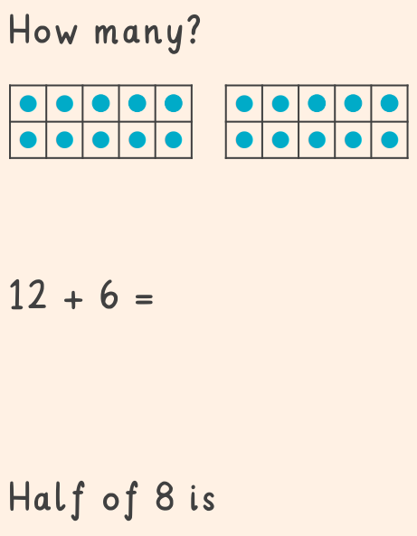

Slide 29
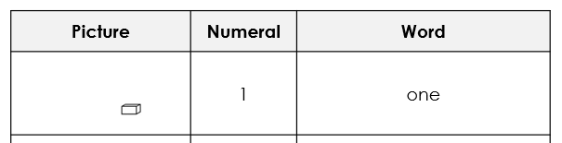
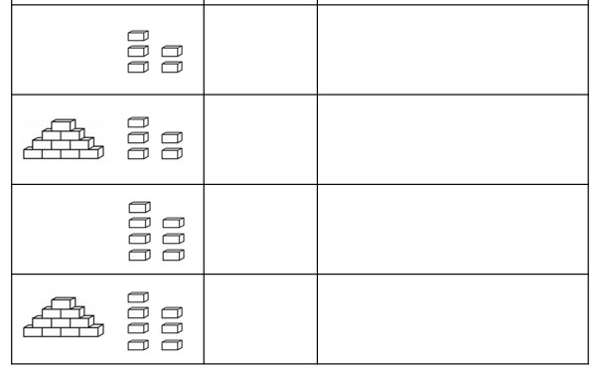
3 in 3
TBAT: recognise one more and one fewer and ten more and ten fewer
Write the numerals and words to
match each set of bricks. ​

Slide 30
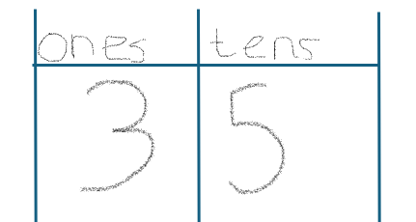
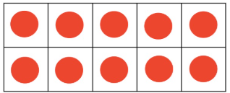

Blue / Green
TBAT: recognise one more and one fewer and ten more and ten fewer
Jenny has written her tens and ones in a place value grid. Can you spot her mistake?
What number is shown? What number should it be?​

Slide 31
TBAT: recognise one more and one fewer and ten more and ten fewer
one more
ten more
ten less
one less
ten fewer
one fewer

Slide 32
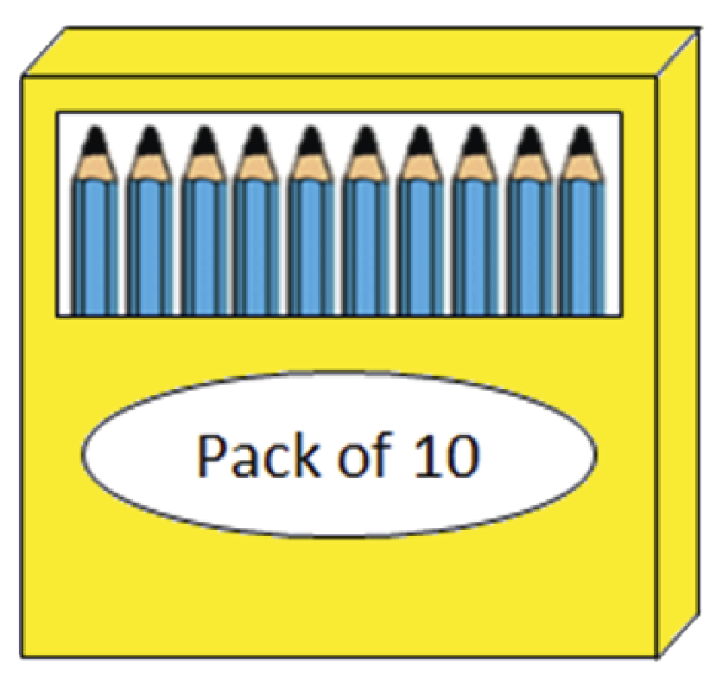

One more and one less/fewer
TBAT: recognise one more and one fewer and ten more and ten fewer
13 pencils add one more pencil is _____ pencils.
_____ is one more than 13.
13 is one fewer than _____.
Notes:
New Learning: One more and one less / fewer within 100
Show pupils a concrete representation of a teens number other than 19, e.g. 13 pencils, grouped into one group of ten and three ones.
How many pencils do I have here? How do you know?
Add one more pencil to the group.
How many pencils now? How do you know? What changed? What stayed the same?
Model this with the same numbers (e.g. 13 add one) on a bead string and with Dienes.
I have made the number 13. Can you show me one more using your bead string/Dienes?
13 pencils add one more is 14 pencils.
14 is one more than 13. 13 is one fewer than 14.
(Note: when we talk about a countable quantity, e.g. pencils, we say ‘fewer’ and when we talk about uncountable abstract numbers we say ‘less’.).
Next, model a teens number subtract one. Check pupils are confident in explaining how they know what one more and one less/fewer is within teens numbers, then move on to other numbers within 100 where adding and subtracting one only results in a change in the ones. Encourage pupils to see that the tens are staying the same, but the ones are changing.
Depending on pupils’ confidence, you may wish to look at some examples where the tens change, e.g. 29 + 1 and 40 – 1.
What happens when we add one to a number with nine ones? What happens when we subtract one from a number with no ones?
If you do move onto this, avoid spending time talking about regrouping, as pupils’ grasp of this will be in its infancy. The bead string/number line representations avoid this.

Slide 33


One more and one less/fewer
TBAT: recognise one more and one fewer and ten more and ten fewer
0
1
2
3
4
5
6
7
8
9
10
11
12
13
14
15
16
17
18
19
20
One more than 13 is 14.
One less than 14 is 13.
Notes:
New Learning: One more and one less / fewer within 100
Show pupils a concrete representation of a teens number other than 19, e.g. 13 pencils, grouped into one group of ten and three ones.
How many pencils do I have here? How do you know?
Add one more pencil to the group.
How many pencils now? How do you know? What changed? What stayed the same?
Model this with the same numbers (e.g. 13 add one) on a bead string and with Dienes.
I have made the number 13. Can you show me one more using your bead string/Dienes?
13 pencils add one more is 14 pencils.
14 is one more than 13. 13 is one fewer than 14.
(Note: when we talk about a countable quantity, e.g. pencils, we say ‘fewer’ and when we talk about uncountable abstract numbers we say ‘less’.).
Next, model a teens number subtract one. Check pupils are confident in explaining how they know what one more and one less/fewer is within teens numbers, then move on to other numbers within 100 where adding and subtracting one only results in a change in the ones. Encourage pupils to see that the tens are staying the same, but the ones are changing.
Depending on pupils’ confidence, you may wish to look at some examples where the tens change, e.g. 29 + 1 and 40 – 1.
What happens when we add one to a number with nine ones? What happens when we subtract one from a number with no ones?
If you do move onto this, avoid spending time talking about regrouping, as pupils’ grasp of this will be in its infancy. The bead string/number line representations avoid this.

Slide 34
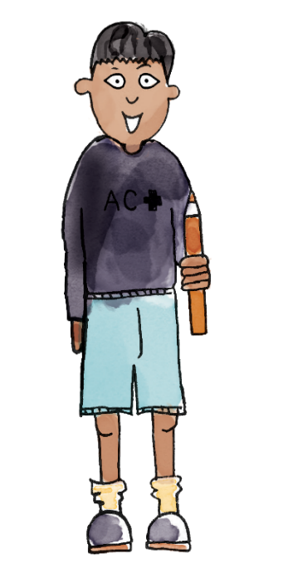
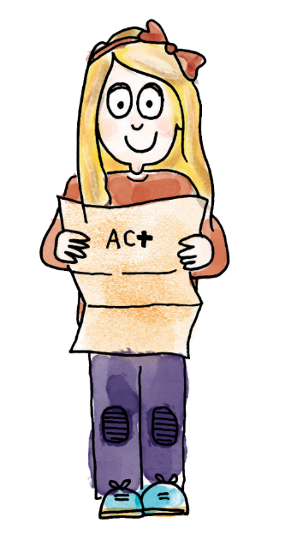
One more and one less/fewer
TBAT: recognise one more and one fewer and ten more and ten fewer
52 is five tens and two ones. One less than 52 is 51.
I have counted 52 beads. One fewer than 52 beads is 51 beads.
51
52
53
54
55
56
57
58
59
60
61
62
63
64
65
66
67
68
69
70
one more one less one fewer
ten more ten less ten fewer
Notes:
Talk Task: One more and one less / fewer within 100
Pupils have the Task Sheet and a bead string/Dienes. Pupil A picks a star on the number grid and says which number it is hiding, saying a full sentence such as ‘51 is one less than 52’. Pupil B represents the same relationship using concrete manipulatives and says a sentence to describe it, e.g. ‘I have counted 52 beads. One fewer bead leaves 51 beads.’

Slide 35
One more and one less/fewer
TBAT: recognise one more and one fewer and ten more and ten fewer
What is hidden under the stars? How do you know?
Blue / Green​
51
52
53
54
55
56
57
58
59
60
61
62
63
64
65
66
67
68
69
70
one more one less one fewer
ten more ten less ten fewer
Notes:
Talk Task: One more and one less / fewer within 100
Pupils have the Task Sheet and a bead string/Dienes. Pupil A picks a star on the number grid and says which number it is hiding, saying a full sentence such as ‘51 is one less than 52’. Pupil B represents the same relationship using concrete manipulatives and says a sentence to describe it, e.g. ‘I have counted 52 beads. One fewer bead leaves 51 beads.’

Slide 36
How many pencils are there?
TBAT: recognise one more and one fewer and ten more and ten fewer
There are 36 pencils.
Three groups of ten pencils and six single pencils.
Notes:
Develop Learning: Ten more and ten less / fewer within 100
Now show pupils a concrete representation of, for example, 36 pencils grouped into three tens and six loose ones. This time add another group of ten.
What did I change? How many pencils do I have now?
You added a group of ten. There were three groups of ten and six ones. Now there are four groups of ten and six ones. There are 46 pencils now. Ten more than 36 is 46.
Have pupils represent this in different ways, e.g. using other objects grouped into tens and ones and using Dienes. Repeat with further examples, adding and subtracting ten.

Slide 37
What has changed? How many pencils now?
TBAT: recognise one more and one fewer and ten more and ten fewer
36 pencils add ten more is _____ pencils.
_____ is ten more than 36.
36 is ten fewer than _____.
Notes:
Develop Learning: Ten more and ten less / fewer within 100
Now show pupils a concrete representation of, for example, 36 pencils grouped into three tens and six loose ones. This time add another group of ten.
What did I change? How many pencils do I have now?
You added a group of ten. There were three groups of ten and six ones. Now there are four groups of ten and six ones. There are 46 pencils now. Ten more than 36 is 46.
Have pupils represent this in different ways, e.g. using other objects grouped into tens and ones and using Dienes. Repeat with further examples, adding and subtracting ten.

Slide 38

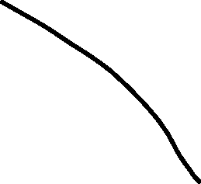
What if I took away a pack of pencils?
TBAT: recognise one more and one fewer and ten more and ten fewer
There are 36 pencils.
Three groups of ten pencils and six single pencils.
Notes:
Develop Learning: Ten more and ten less / fewer within 100
Now show pupils a concrete representation of, for example, 36 pencils grouped into three tens and six loose ones. This time add another group of ten.
What did I change? How many pencils do I have now?
You added a group of ten. There were three groups of ten and six ones. Now there are four groups of ten and six ones. There are 46 pencils now. Ten more than 36 is 46.
Have pupils represent this in different ways, e.g. using other objects grouped into tens and ones and using Dienes. Repeat with further examples, adding and subtracting ten.

Slide 39
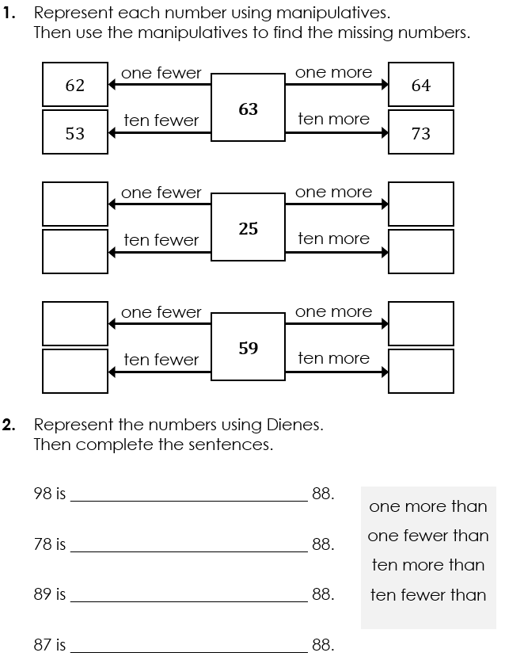
TBAT: recognise one more and one fewer and ten more and ten fewer
Complete the missing information.
Notes:
Independent Task: Finding one more, one fewer, ten more and ten fewer
Pupils have the Task Sheet and a bead string/Dienes. They represent each number with Dienes or on a bead string and find one/ten more/fewer, then complete the sentences.
Possible adaptations:
Pupils could choose their own numbers for part one (greater than nine and less than 90!).
Pupils could draw representations of one/ten more/fewer.

Slide 40
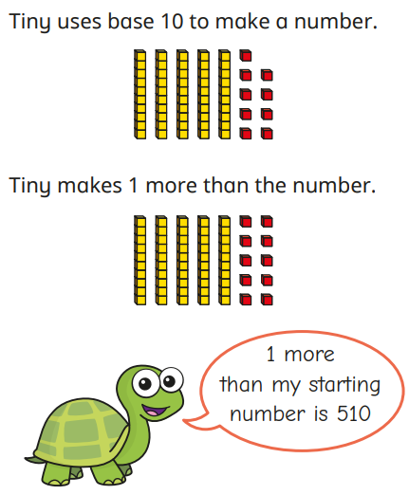
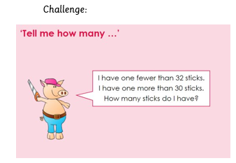
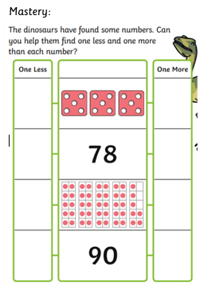
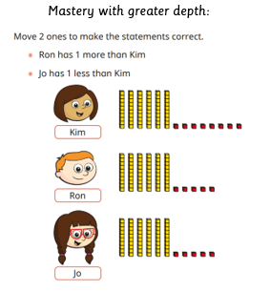

Slide 41
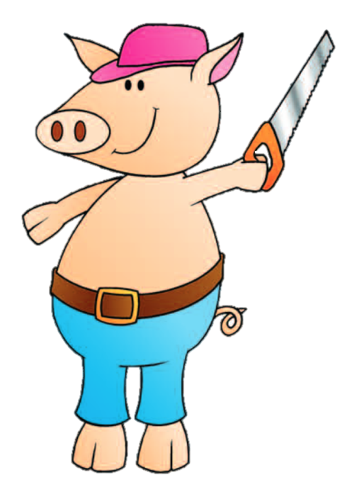
‘Tell me how many …’
I have one fewer than 32 sticks.
I have one more than 30 sticks.
How many sticks do I have?
Notes:
Plenary: ‘Tell me how many …’
Choose a mystery number of objects and give pupils clues like those on the slide.
Then invite pupils to give clues for their own chosen number. Select some pupils to share their clues and have the class work out the mystery number.

Slide 42
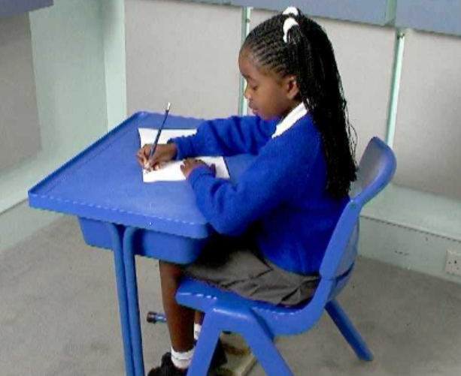
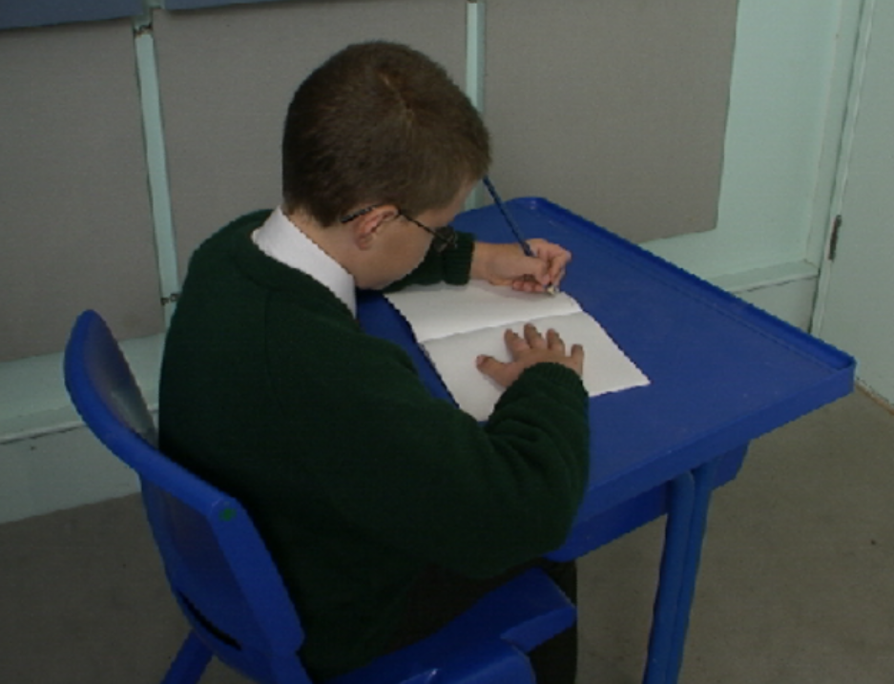
Correct posture
TBAT: correctly form the letters u, y and j.
Right handed Left handed

Slide 43
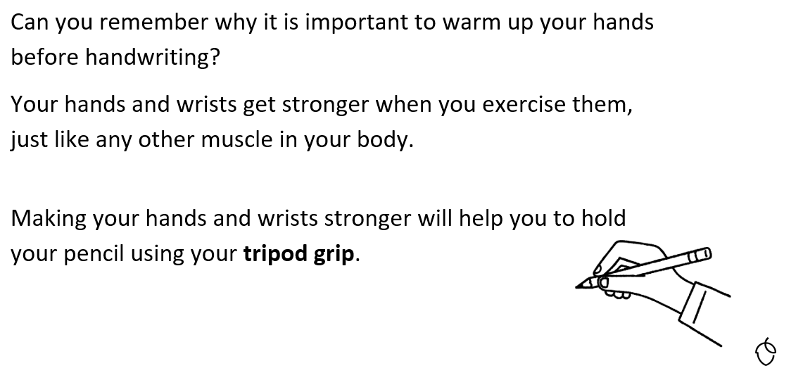
TBAT: correctly form the letters u, y and j.

Slide 44
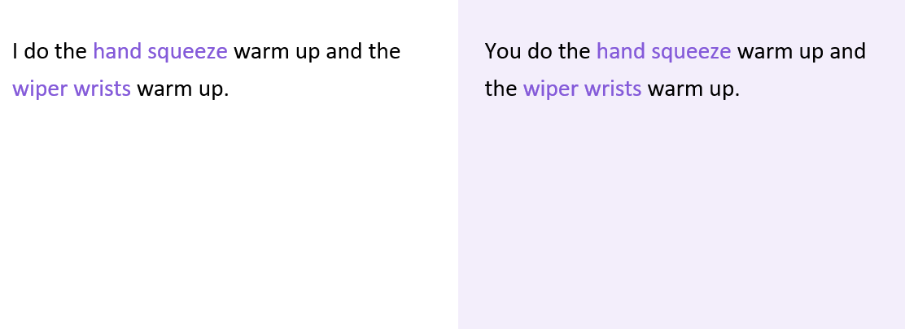
TBAT: correctly form the letters u, y and j.

Slide 45
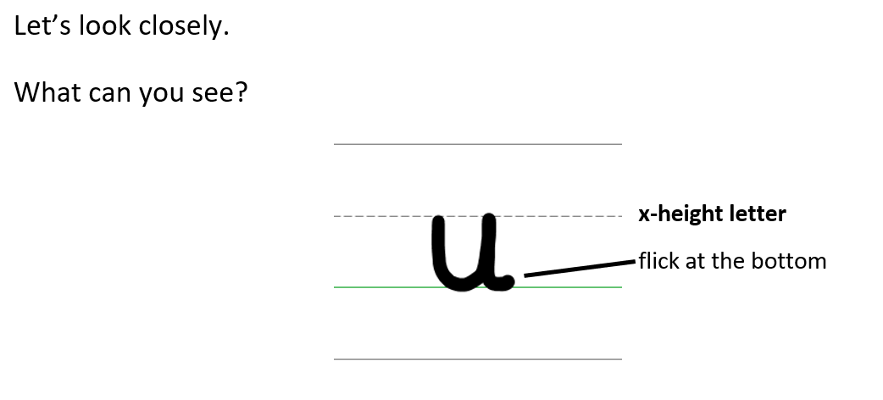
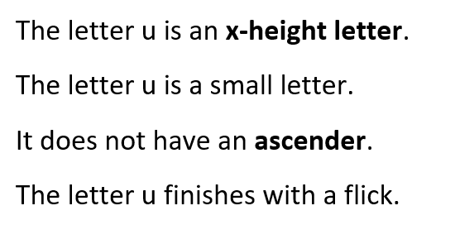
TBAT: correctly form the letters u, y and j.

Slide 46
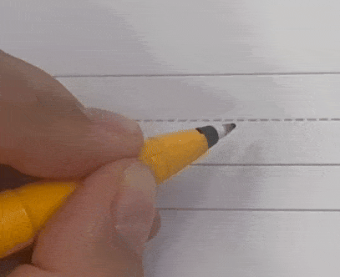
Forming the lower case letter u in print
Let’s write the letter u.
Sit comfortably and hold your pencil.
Start on the x-height line.
Go down to the baseline, go across, back up to the x-height line and down.
Finish with a flick.
Remember, do not lift your pencil when forming the letter u.

Slide 47
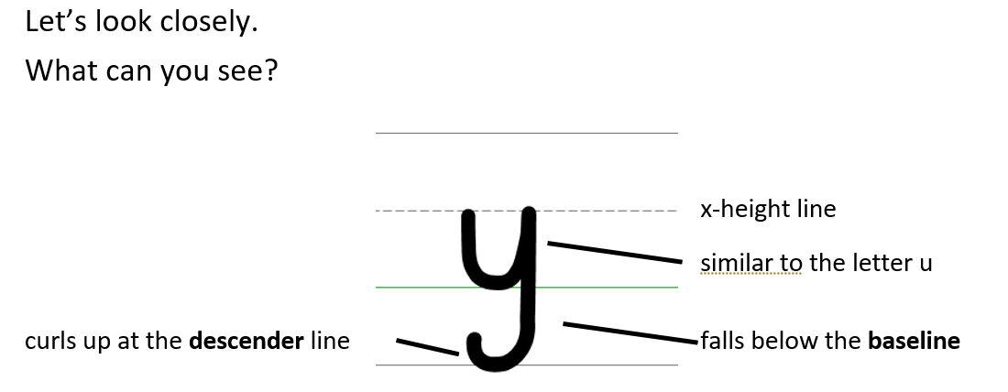
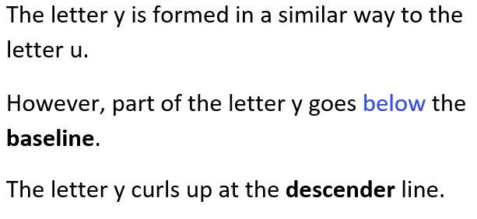
TBAT: correctly form the letters u, y and j.

Slide 48
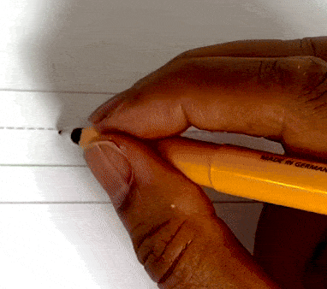
Forming the lower case letter y in print
Let’s write the letter y.
Sit comfortably and hold your pencil.
Start on the x-height line.
Go down to the baseline, go across, back up to the x-height line, down to the descender line.
Finish with a curl up.
Remember, do not lift your pencil when forming the letter y.

Slide 49
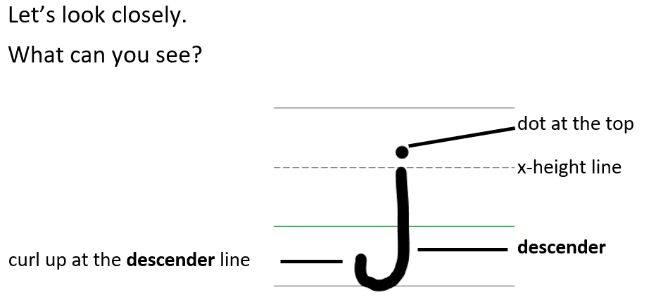
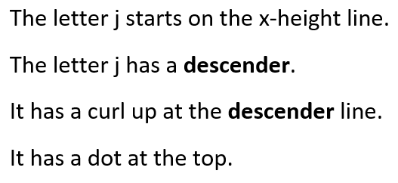
TBAT: correctly form the letters u, y and j.

Slide 50
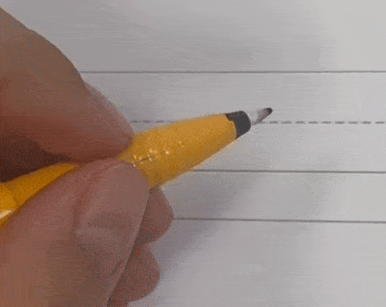
Forming the lower case letter j in print
Let’s write the letter j.
Sit comfortably and hold your pencil.
Start on the x-height line.
Go down to the descender line and curl up.
Take your pencil off the page.
Add a dot at the top.

Slide 51
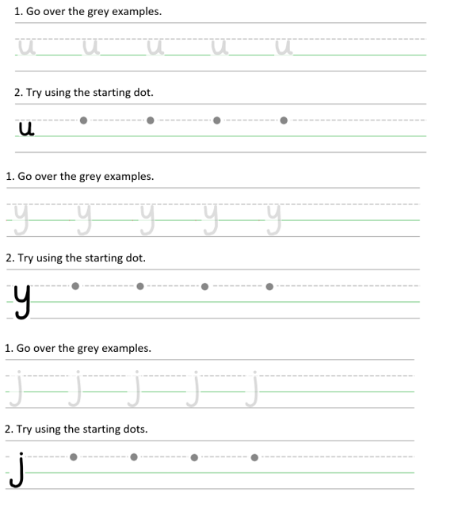
TBAT: correctly form the letters u, y and j.
cup
yes
jump
Handwriting Repeater

Slide 52

Little Wandle Guided Reading

