Slide 1
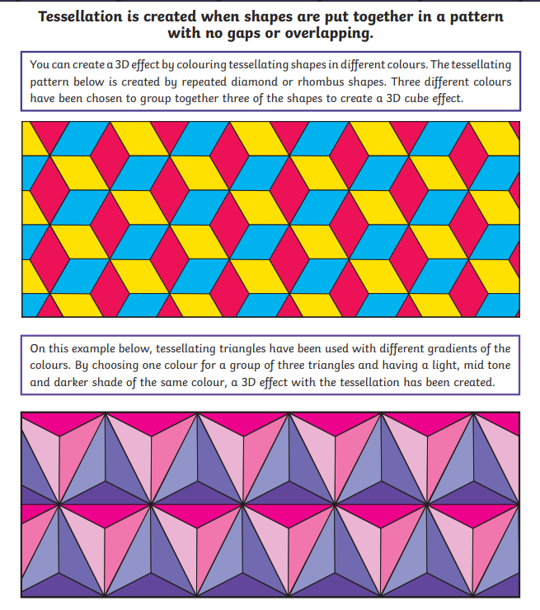
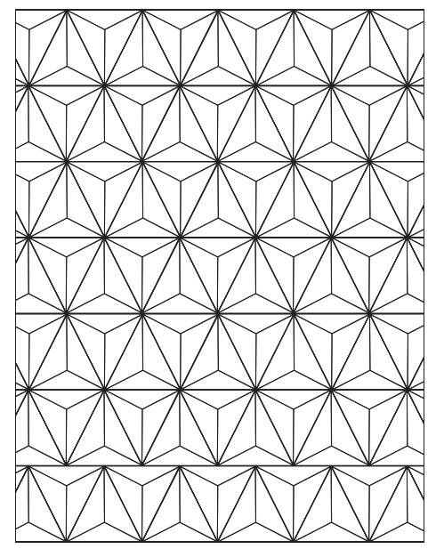
Morning challenge

Slide 2

TTRS – BATTLE OF THE BANDS
Final morning

Slide 3
Choose any 3-digit number with digits the same Add up the digits Divide the original number by the sum of the digits Your answer will be 37
Maths Challenge 1

Slide 4
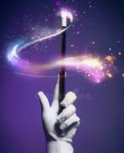
Magic Subtraction
Maths Challenge 2

Slide 5
Magical Subtraction Write a 5-digit number. Rearrange the 5-digits and subtract it from your initial number. Circle one of the digits from your answer. Add the remaining digits together. Share the total of the digits. Your circled number is….

Slide 6
TBAT- understand that an unknown can be represented by a letter. 1) 67 + ? = 200 2) 16 x 5 = 3) 0.08 x 1000=

Slide 7
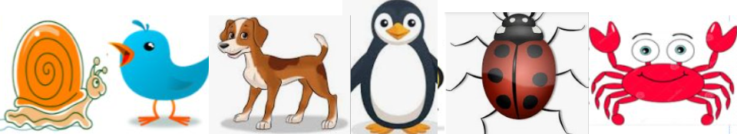
b + l = 8
What does b equal?
What does l equal?
Talk partners:

Slide 8
s=
b =
d=
p=
l=
c=
Instead of writing the number of legs, we are going to represent it with the first letter of the animal.

Slide 9
c + d = ?

Slide 10

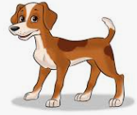
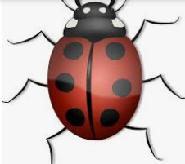
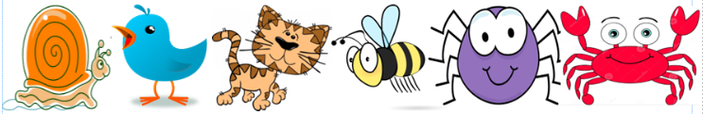
l - p = ?

Slide 11
b + l + s = p + b + c =

Slide 12
Paired whiteboard work:
Write calculations that total 10.

Slide 13
d2 = 16
Talk partners: How?

Slide 14
Work systematically to write as many calculations as you can using algebra.
Can you make it harder for yourself by using multiplication?
b4 + s = 13

Slide 15
Work systematically to write as many calculations as you can using algebra.

Slide 16
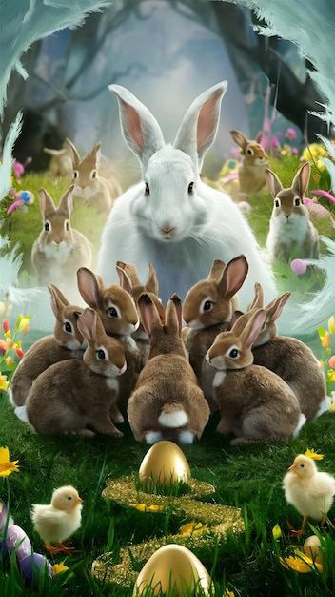
Free write Friday
You have free range to write about whatever subject you choose. You could use the picture below as a prompt:
You must include: - fronted adverbials - inverted commas - subordinate clauses - parenthesis
Sentence starters:
Early one bright spring morning, the Easter Bunny hopped into…
Deep inside the mysterious garden, something unusual was happening…
The baby bunnies scampered behind the Easter Bunny as he whispered…
No one knew what lay beyond the twisted, ivy‑covered gate…

