Slide 1
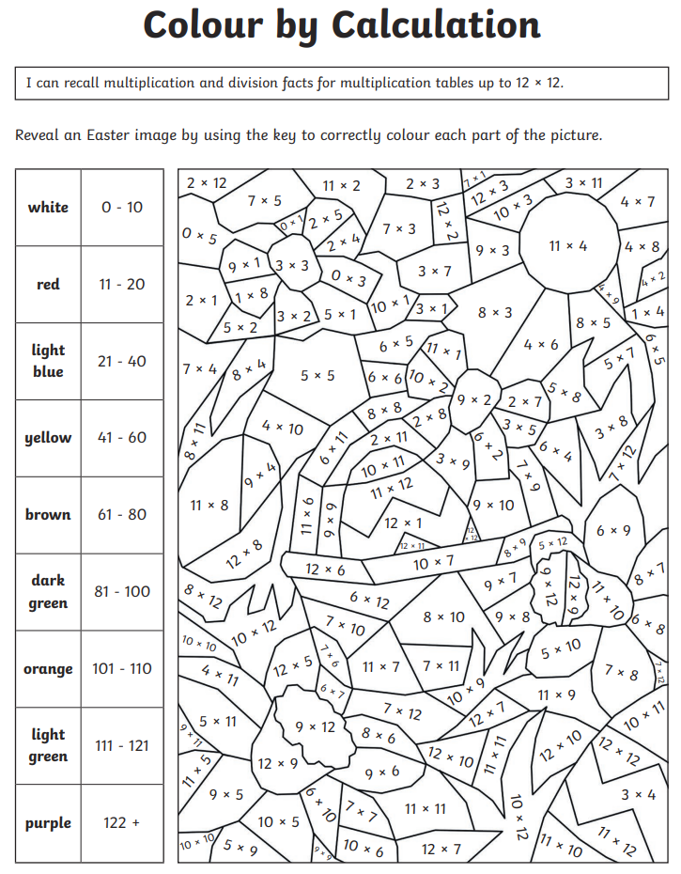
Thursday 26th March
Morning Challenge

Slide 2
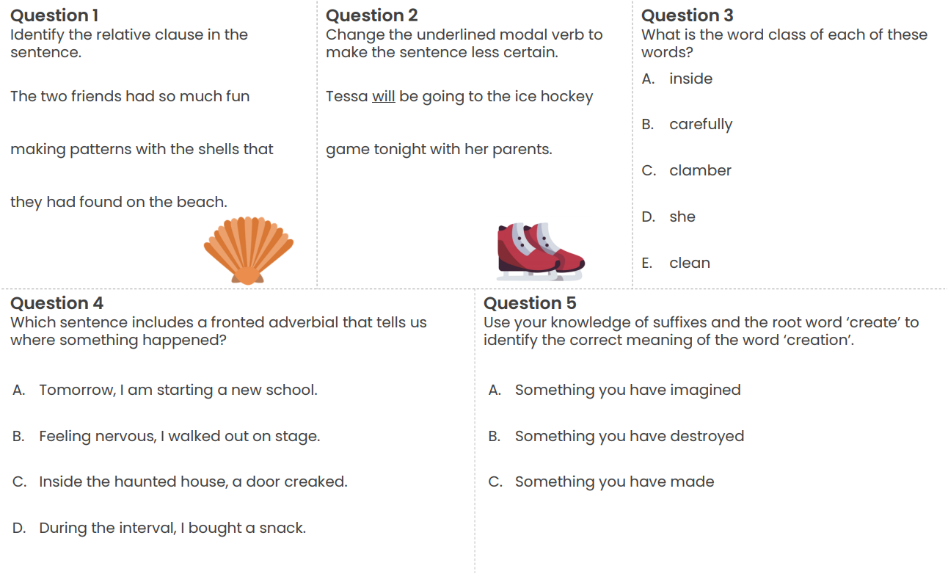
Word work (on sheet)

Slide 3
26.3.26
TBAT- calculate the area of compound shapes.
1) 5.43 + 12.9 =
2) 1292 ÷ 7 =
3) A grocer has 60kg of potatoes. In one day, he sells 50% of the potatoes. What mass of potatoes does he sell?

Slide 4
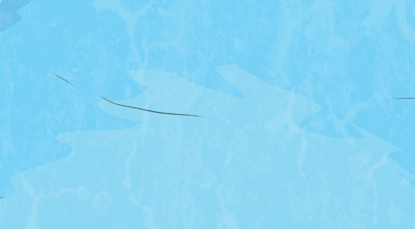

Remember It
Find the answers to the following calculations.
8m × 3m =
7cm × 8cm =
3m × 12m =
Order the shapes from smallest to largest area.
2m
7m
D
C
7m
8m
2m
A
13m
6m
3m
B
2m
2m
E
A rectangular swimming pool has a length
measuring 8m and a width of 400cm.
What is the area of this swimming pool?
What is its perimeter?
400cm
Remember to convert units!
8m

Slide 5
Remember It
Find the answers to the following calculations.
8m × 3m =
7cm × 8cm =
3m × 12m =
24m²
56cm²
36m²
Order the shapes from smallest to largest area.
2m
D
7m
7m
C
2m
8m
A
13m
6m
E
<
<
3m
<
B
<
2m
2m
A rectangular swimming pool has a length
measuring 8m and a width of 400cm.
What is the area of this swimming pool?
What is its perimeter?
400cm = 4m
Area: 8m × 4m = 32m²
Perimeter: 8m + 4m + 8m + 4m = 24m
400cm
8m

Slide 6
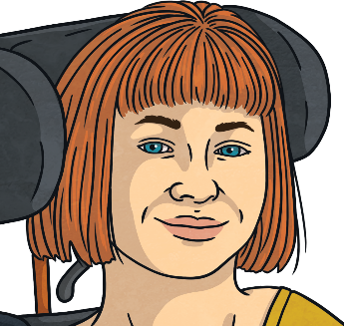
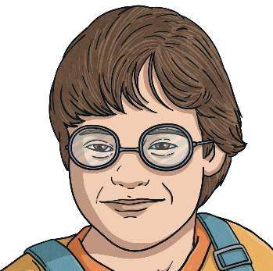
What Is a Compound Shape?
Ellie-Mae
What is a compound shape?
A compound shape is a shape which is made up of at least two shapes.
Charlie
A compound shape is also known as a composite shape. Both composite and compound mean the same thing: a shape which is made up of at least two shapes.
Like this:
A
A
B
B

Slide 7
Talk Task: Area of Compound Shapes
1cm
How could we find the area of this compound shape?
1
2
1cm
3
4
Ellie-Mae
5
6
7
8
9
10
11
12
13
14
15
16
In the previous lesson, we learned to find the area by counting centimetre squares.
We can find the area of compound shapes by counting squares, too.
There are squares inside the compound shape so
the area of the compound shape must be
centimetre squares (cm²).
16
16
Area =
16cm²

Slide 8
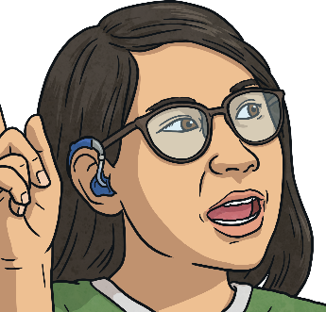
Shapes within Shapes
Ruby
1cm
How can we split this compound shape into two shapes?
1cm
We have two options.
Shape
1
Shape
2
Shape
2
Shape
1

Slide 9
Area of Compound Shapes – Counting Squares
Ruby
Let’s focus on the compound shape made up of these two shapes:
1cm
1cm
We can count the squares within each shape and add the totals together.
Shape
1
1
2
Area of Shape 1 = 6cm²
3
4
Area of Shape 2 = 10cm²
5
6
Shape
2
1
2
3
4
5
6
7
8
9
10
Compound Area = Area of Shape 1 + Area of Shape 2
= 6cm² + 10cm²
= 16cm²

Slide 10
Finding the Area of Compound Shapes by Multiplying
How could we find the area of this compound shape?
7m
Shape 1
Shape
2
2m
5m
3m
What is the first thing we must do?
Decide where to split the shapes.

Slide 11
Finding the Area of Compound Shapes by Multiplying
How could we find the area of this compound shape?
4m
7m
Shape 1
Shape
2
2m
5m
3m
Find the missing measurements.
Area of Shape 1 = 5m × 4m = 20m²
5m × 4m = 20m²
Total Area of Compound Shape
Area of Shape 2 = 3m × 2m = 6m²
3m × 2m = 6m²
Total Area of Compound Shape = 20m² + 6m² =
26m²

Slide 12
Finding the Area of Compound Shapes – 3 Shapes
Find the area of this compound shape.
Rectangle A
9cm × 3cm = 27cm²
Rectangle B
4cm × 3cm = 12cm²
3cm
Rectangle C
5cm × 2cm = 10cm²
2cm
9cm
A
2cm
27cm² + 12cm² + 10cm² = 49cm²
4cm
C
5cm
Charlie
B

Slide 13
Adjusting Area
1cm
1cm
5cm
5cm
We can also find the area of this compound shape by treating it as a complete rectangle and then adjusting the answer.
Ruby
If you look at the yellow outline, you can see we are missing several squares.

Slide 14
Adjusting Area
1cm
1cm
5cm
5cm
Ruby
Area = length × width
So 5cm × 5cm = 25cm²
Now we must calculate the area of the white space:
3cm × 3cm = 9cm²

Slide 15
Adjusting Area
1cm
1cm
5cm
5cm
Ruby
The area of the compound shape is:
25cm² − 9cm² = 16cm²

Slide 16
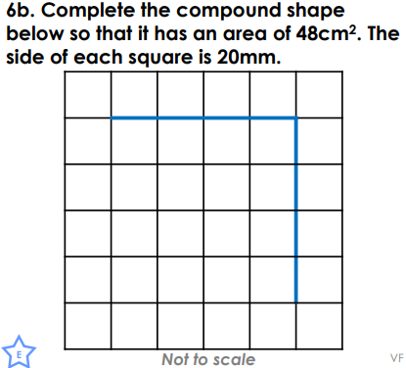
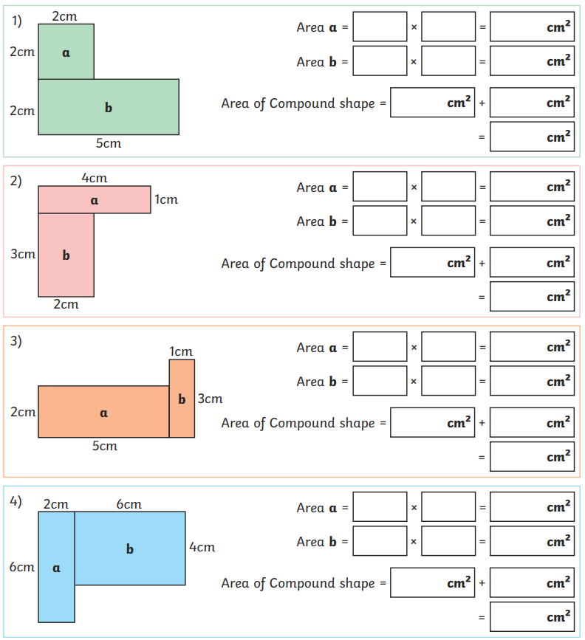
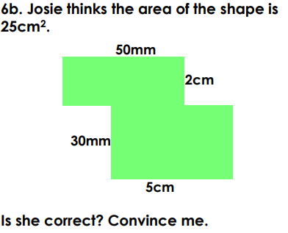
26.3.26
TBAT- calculate the area of compound shapes.
Independent
Challenge
Mastery

Slide 17
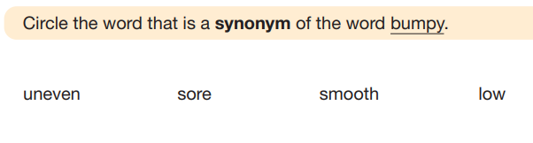
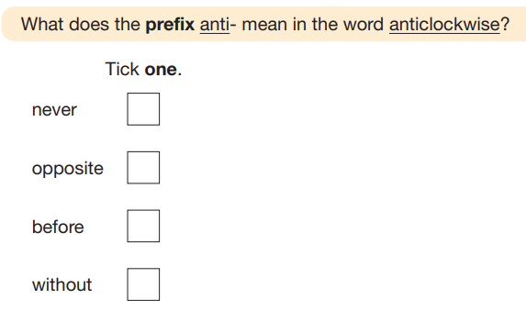
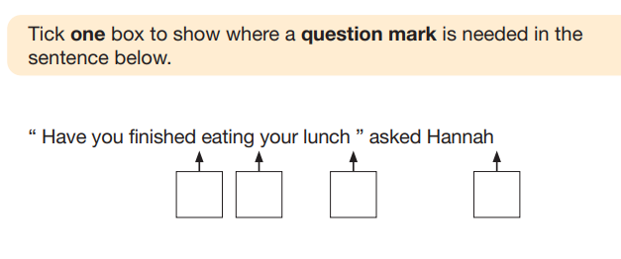
Venturers: (not in books)
Thursday 26th March
TBAT: use fronted adverbials.
3 in 3

Slide 18
Thursday 26th March
TBAT: use fronted adverbials.
What is the difference between a clause and a phrase?
What is a fronted adverbial?
Describe what adverbs can be used for in a sentence?

Slide 19
A fronted adverbial is a sentence starter followed by a comma.
A comma is a punctuation mark that is used after any fronted adverbial.
A phrase is a group of words with no verb.
A clause is a group of words that contains a verb.
An adverbial clause is a type of subordinate clause that starts with a subordinating conjunction.

Slide 20
Identifying different fronted adverbials
Sentences can start in different ways.
Desperately, she searched for the ancient ruins.
Full of excitement, she searched for the ancient ruins.
When she reached the island, she searched for the ancient ruins.
word
a single word
phrase
a group of words with no verb
desperately
clause
a group of words with a verb
full of excitement
when she reached the island

Slide 21
Identifying different fronted adverbials
Fronted adverbials are words, phrases or clauses that act as sentence starters.
She searched for the ancient ruins.
Desperately, she searched for the ancient ruins.
Full of excitement, she searched for the ancient ruins.
When she reached the island, she searched for the ancient ruins.
These are all fronted adverbials.
The fronted adverbial gives us more information about the action in the sentence that follows it. It is always followed by a comma.

Slide 22


Identifying different fronted adverbials
Which of these are true for fronted adverbials?
PARTNER TALK:
They are sentence starters.
They can be words, phrases or clauses.
They are followed by a comma.
They always contain a verb.

Slide 23
Identifying different fronted adverbials
We can tell a fronted adverbial is a sentence starter because if it is removed, the sentence still makes sense.
Embarrassed, I walked up to the stage with my face in my hands.
I walked up to the stage with my face in my hands.
The fronted adverbial is followed by a comma. The section after the comma is a complete sentence.
On Wednesday evening, I went shopping for bargains.
I went shopping for bargains.

Slide 24
Identifying different fronted adverbials
Single words and phrases can be fronted adverbials.
fronted adverbial single words
fronted adverbial phrases
Now, take the temperature of the mixture.
Here, you will be able to develop your skills in peace.
Cautiously, I examined the system of pipes and tubes.
Before long, you will be more than just an amateur player.
In the dark sky, lightning flashed like a warning.
Full of mischief, she tiptoed down the creaking stairs.
Each time, the fronted adverbial is followed by a comma.
It could be removed and the sentence would still make sense.

Slide 25
Identifying different fronted adverbials WHITEBOARD WORK
The sentence ‘When the competition was over, the results were announced.’ begins with a fronted adverbial phrase.
Fronted adverbial phrases do not contain a verb and the word ‘when’ is a verb.
Fronted adverbial phrases do not contain a verb and the word ‘was’ is a verb.

Slide 26
Identifying different fronted adverbials
An adverbial clause can also be used as a fronted adverbial.
An adverbial clause is a group of words that…
contains a verb.
is a type of subordinate clause so doesn’t make sense on its own.
begins with a subordinating conjunction.
while we watched
before we were ready
after it had finished
When an adverbial clause starts a sentence, it is a type of fronted adverbial - a fronted adverbial clause.
While we watched, the soldier approached rapidly.
Before we were ready, the competition had begun.

Slide 27
Identifying different fronted adverbials
We must identify the fronted adverbial in a sentence in order to place the comma.
,
Because we have produced pollution we’ve damaged the environment.
fronted adverbial clause
makes complete sense
main clause
,
Later in the race the slower runners became a hindrance.
fronted adverbial phrase
makes complete sense
main clause

Slide 28
Identifying different fronted adverbials PARTNER TALK
Where should the commas be placed to show the fronted adverbials?
,
Soon I began to appreciate how hard Mum worked.
,
Within weeks Parliament had made its decision.
,
As the sun rose we trudged to the back of the queue.
,
After we had searched for hours we found some accommodation.

Slide 29
Identifying different fronted adverbials
Some words can start both fronted adverbial phrases and fronted adverbial clauses.
no verb
fronted adverbial phrases
Before sunrise, we joined the long queue to get in.
As a treat, Mrs Begum let us have extra story time.
Before the sun had risen, we were in the queue.
verb
fronted adverbial clauses
As we listened carefully, Mrs Begum began her explanation.

Slide 30
Identifying different fronted adverbials WHITEBOARD WORK
The sentence ‘After a long wait, the results were announced.’ begins with a fronted adverbial clause.
Fronted adverbial clauses start with a subordinating conjunction.
‘After a long wait,’ is a phrase because it does not contain a verb.

Slide 31
Identifying different fronted adverbials PARTNER TALK
Do these sentences start with a fronted adverbial phrase or a fronted adverbial clause?
clause
After we had eaten, we boarded the yacht.
phrase
After dinner, we boarded the yacht.
phrase
Before sunset, I will know his identity.
Before he strikes again, I will find out his identity.
clause

Slide 32
Identifying different fronted adverbials
Decide if each sentence begins with a fronted adverbial clause, fronted adverbial phrase or fronted adverbial single word and add a comma in the appropriate place.
Before night had fallen we were in a foreign country.
All night long the rhythm of the music could be heard.
Soon you will see how all this is relevant to you.
After it ended we discussed the movie thoroughly.
After the twelfth of December you can hang your decorations.
Embarrassed I looked up at the familiar faces.

Slide 33
Identifying different fronted adverbials
Decide if each sentence begins with a fronted adverbial clause, fronted adverbial phrase or fronted adverbial single word and add a comma in the appropriate place.
Before night had fallen, we were in a foreign country.
All night long, the rhythm of the music could be heard.
Soon, you will see how all this is relevant to you.
After it ended, we discussed the movie thoroughly.
After the twelfth of December, you can hang your decorations.
Embarrassed, I looked up at the familiar faces.
clause
phrase
word
clause
phrase
word

Slide 34
Using fronted adverbial words, phrases & clauses
Fronted adverbial words and phrases can have different purposes. They all tell us more about the action after the comma.
Fronted adverbials of time
Soon,
In an instant,
Just after playtime,
Now,
These show us when something happened.
Fronted adverbials of place
In the woods,
On the bridge,
There,
At the edge of the forest,
These show us where something happened.
Fronted adverbials of manner
Full of misery,
Embarrassed,
With a smile,
Without a backward glance,
These show us how something happened.

Slide 35
Using fronted adverbial words, phrases & clauses PARTNER TALK
Decide whether each fronted adverbial is showing time, place or manner.
Full of anger, the soldier left the site of the disastrous battle.
manner
With a tear in my eye, I thought about the sacrifices we had made to get there.
manner
At the entrance to the cemetery, a flock of ravens sat on the iron fence.
place
At that very moment, I recognised her.
time

Slide 36
Using fronted adverbial words, phrases & clauses
We can learn several useful ways of creating fronted adverbials of manner.
The person experiencing the feeling in the fronted adverbial must come after the comma:
Horrified, the door creaked open.
Horrified, I watched as the door creaked open.
Full of…
Full of sadness,
Full of fear,
Full of desperation,
Full of anger,
-ed words
Exhausted,
Devastated,
Horrified,
Disgusted,
With a…/Without a…
With a sigh,
With a tear in my eye,
Without a thought,
Without looking back,
-ly words
Cautiously,
Sadly,
Angrily,
Hopefully,

Slide 37
Using fronted adverbial words, phrases & clauses WHITEBOARD WORK
Tick all the sentences that use a fronted adverbial of manner correctly.
Disgusted, she watched the lumpy custard drop slowly from her spoon.
Disgusted, the lumpy custard dropped slowly from her spoon.
Full of fear, we tiptoed into the creaking old house.
Full of fear, the old house creaked.

Slide 38
Using fronted adverbial words, phrases & clauses
Most fronted adverbial clauses are used to give more detail about when the action after the comma happened.
I felt my stomach rumble.
When I saw the mountain of party food, I felt my stomach rumble.
As I sat in assembly, I felt my stomach rumble.
While I waited for Dad to make tea, I felt my stomach rumble.
Before Maths had even started, I felt my stomach rumble.
Each fronted adverbial clause of time tells us more about when my stomach was rumbling!

Slide 39
Using fronted adverbial words, phrases & clauses PARTNER TALK
Match the fronted adverbial clauses of time to the most appropriate sentences.
As Mrs Begum blew the whistle, we rushed to find an available spot in the line.
Before I could argue,
Before I could argue, Mr McIntyre made me clap the rhythm to the whole class.
While we waited to be called,
While we waited to be called, we took the opportunity to chat amongst ourselves.
As Mrs Begum blew the whistle,

Slide 40
Using fronted adverbial words, phrases & clauses
Use the list of subordinating conjunctions to think of different fronted adverbial clauses of time that could come before this main clause.
The queue moved forwards.
When the shop opened, the queue moved forwards.
As my feet began to ache, the queue moved forwards.
Before I could grumble any more, the queue moved forwards.
While we chatted happily, the queue moved forwards.
After we had waited for hours, the queue moved forwards.
When
As
Before
While
After

Slide 41
Using fronted adverbial words, phrases & clauses
We can use a variety of fronted adverbials to add interest to our writing.
Full of fear, we tiptoed into the dark cave. As our hearts pounded in our chests, we glanced at each other anxiously. Just then, a loud noise came from the depths of the cave. Instantly, we froze. While we held our breath, the noise came again.
In the darkness, something was lurking…
fronted adverbial phrases
fronted adverbials of manner
fronted adverbial clauses
fronted adverbials of time
fronted adverbial single words
fronted adverbials of place

Slide 42
Using fronted adverbial words, phrases & clauses
Identify the different types of fronted adverbial used in this passage.
Without a backward glance, we dashed from the cave. As I ran, I felt the cold stone scratch my arms. In the distance, I could see the dim light of the cave entrance. Desperately, I pushed on towards it. In my chest, my heart was racing.
fronted adverbial phrases
fronted adverbial clauses
fronted adverbial single words

Slide 43
Using fronted adverbial words, phrases & clauses
How many fronted adverbials can you think of to add more detail in front of this main clause?
We dashed from the cave.
Fronted adverbials of time
Instantly,
Immediately
When…, As…, While…,
Instantly, we dashed from the cave.
Full of fear, we dashed from the cave.
Horrified, we dashed from the cave.
With a scream, we dashed from the cave.
When we heard it, we dashed from the cave.
As we screamed, we dashed from the cave.
Fronted adverbials of manner
Full of terror,
Without looking back,
Desperately,
Terrified,

Slide 44
Using fronted adverbial words, phrases & clauses
Rewrite the passage below, using appropriate fronted adverbials to add interest and detail for your reader.
Fronted adverbials of time
Instantly,
Immediately
When…, As…, While…,
We stepped through the dark forest. Our pulses were racing. I thought I saw dark shapes moving. My foot caught on a branch. I tried to free myself. I heard a loud growl…
Fronted adverbials of manner
Full of terror,
Without looking back,
Desperately, Terrified,
Fronted adverbials of place
In the distance,
There, In the sky above,

Slide 45
Using fronted adverbial words, phrases & clauses
Here is an example passage using a range of fronted adverbials.
Cautiously, we stepped through the dark forest. As we walked, our pulses were racing. Among the dark trees, I thought I saw dark shapes moving. All of a sudden, my foot caught on a branch. Desperately, I tried to free myself. Just then, I heard a loud growl…
fronted adverbials of manner
fronted adverbials of time
fronted adverbials of place

Slide 46
VOYAGERS Thursday 26th March
TBAT: write a narrative non-fiction.
3 in 3
Over thousands of years, the pebble was shaped again and again by the powerful forces of nature. Stormy winds scoured its surface, and heavy rain hammered down, washing it across muddy ground and rocky slopes. When winter arrived, freezing ice squeezed into cracks around it, forcing the rock to split further until the small pebble broke completely free. The river swept it into its fast‑moving current, spinning and bumping it against other stones. Each collision knocked away tiny fragments, slowly smoothing its edges as it travelled through ever‑changing landscapes.
1. Which three natural forces helped shape the pebble over thousands of years?
2. What does the word “scoured” suggest about how the wind affected the pebble?
3. Why do you think the pebble’s edges became smoother over time as it travelled?

Slide 47
Thursday 26th March
TBAT: write a narrative non-fiction.
Partner work:
In pairs, edit and improve the following sentences:
Look at punctuation. Can you add any words or phrases?
1) on a hot sunny day Emma a kind-hearted girl was exploring a forest.
2) Emma whispered Where did you come?" from
3) the volcan exploded and thick runny lava trickled down the volcano and cooled and turned into solid rock.

Slide 48
Thursday 26th March
TBAT: write a narrative non-fiction.
Whiteboard work:
Write your opening sentence to paragraph 4 on a whiteboard:
-Start with a fronted adverbial.
Over thousands of years,
- Describe part of your pebble's journey.
Over thousands of years, the pebble ______________

Slide 49
Thursday 26th March
TBAT: write a narrative non-fiction.
Partner work
Using your opening sentence to paragraph 4, work with your partner to upskill the sentence.
Over thousands of years, the pebble ______________
Could you add: a relative clause, a subordinating conjunction?

Slide 50
Thursday 26th March
TBAT: write a narrative non-fiction.
Teacher model (visualiser)
Paragraph 4:
- How did the rock become the pebble?
Wind scratched the rock and made cracks bigger.
Rainwater seeped into small gaps.
Ice froze and pushed the rock apart.
Waves rolled the rock, smoothing it.
Rivers bumped the pebble against other stones.
Over thousands of years, the pebble was shaped again and again by the powerful forces of nature. Stormy winds scraped its surface, and heavy rain washed it across rocky ground. When winter crept across the land, freezing ice pushed into tiny cracks around it, causing the surrounding rock to split and crumble. Eventually, the newly‑formed pebble slipped free and tumbled into a rushing river. The fast‑moving water spun it, bumped it into other stones, and smoothed its edges as it drifted through ever‑changing landscapes.

Slide 51
Thursday 26th March
TBAT: write a narrative non-fiction.
Teacher model (visualiser)
Paragraph 5:
- Where did the pebble end up?
On a quiet riverbank
On a sandy beach
In a shallow stream
On the edge of a cliff or valley
On top of newly formed ground after the ice melted
In a calm rock pool
Finally, after travelling through roaring rivers, deep oceans and shifting layers of Earth, the pebble came to rest on the soft bed of a quiet stream. As the water grew calmer, the pebble settled into the muddy bank, hidden among reeds and drifting leaves. For the first time in thousands of years, it lay still, no longer pushed or pulled by wild waves, fierce winds, or freezing ice. Here it waited—buried, uncovered, and moved by gentle currents—until the day Emma walked past.

Slide 52
Thursday 26th March
TBAT: write a narrative non-fiction.
Teacher model (visualiser)
Paragraph 6:
- The present day – your character holds the pebble in amazement.
Character realises how long the pebble has existed.
They imagine volcanoes, mountains, rivers and ice.
They feel amazed, shocked, or fascinated.
They speak quietly to the pebble.
They hold it gently, knowing its journey was extraordinary.
Back in the present, Emma held the pebble gently in her hands, her eyes widening with amazement. “You’ve travelled across the whole world,” she breathed, imagining the volcano that created it, the river that carried it, and the oceans that polished it smooth. The pebble, warm in the sunlight, felt ancient and important. Emma smiled to herself, realising she was holding a tiny piece of Earth’s incredible history.

Slide 53
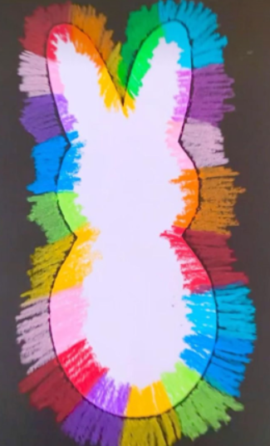
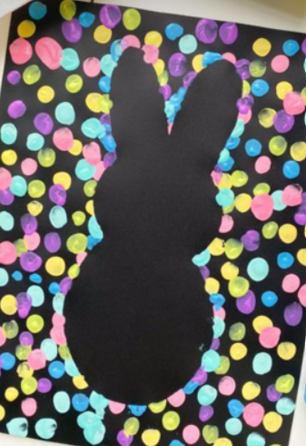
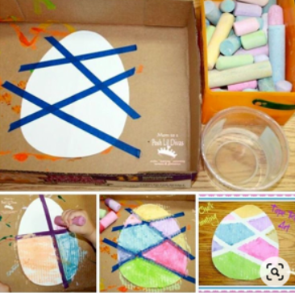
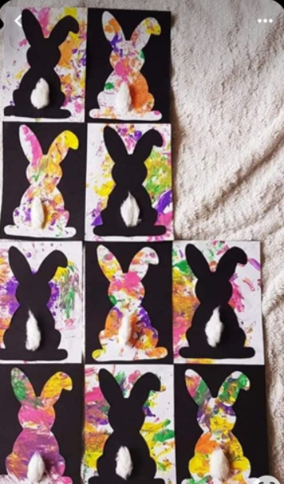
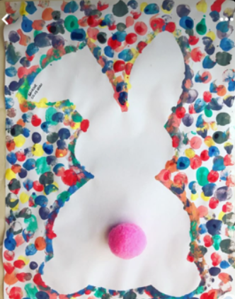


Easter crafts

Slide 54
Year 5 dodgeball battle (downstairs hall)

