Slide 1
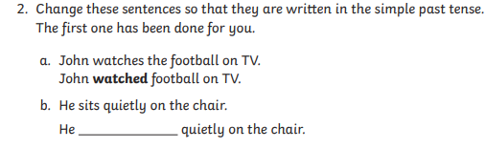
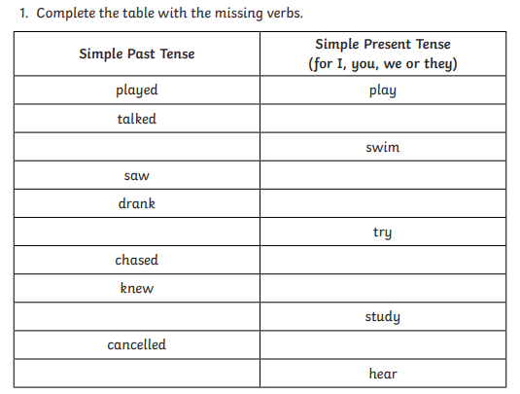
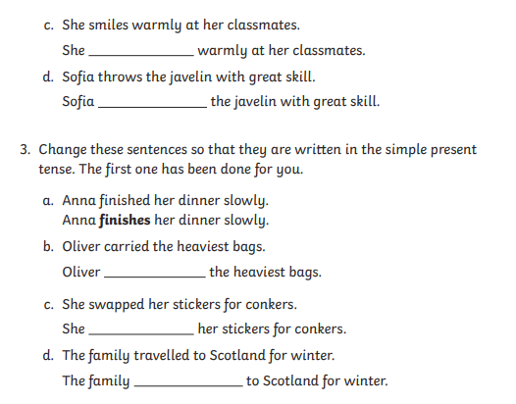
Morning challenge

Slide 2
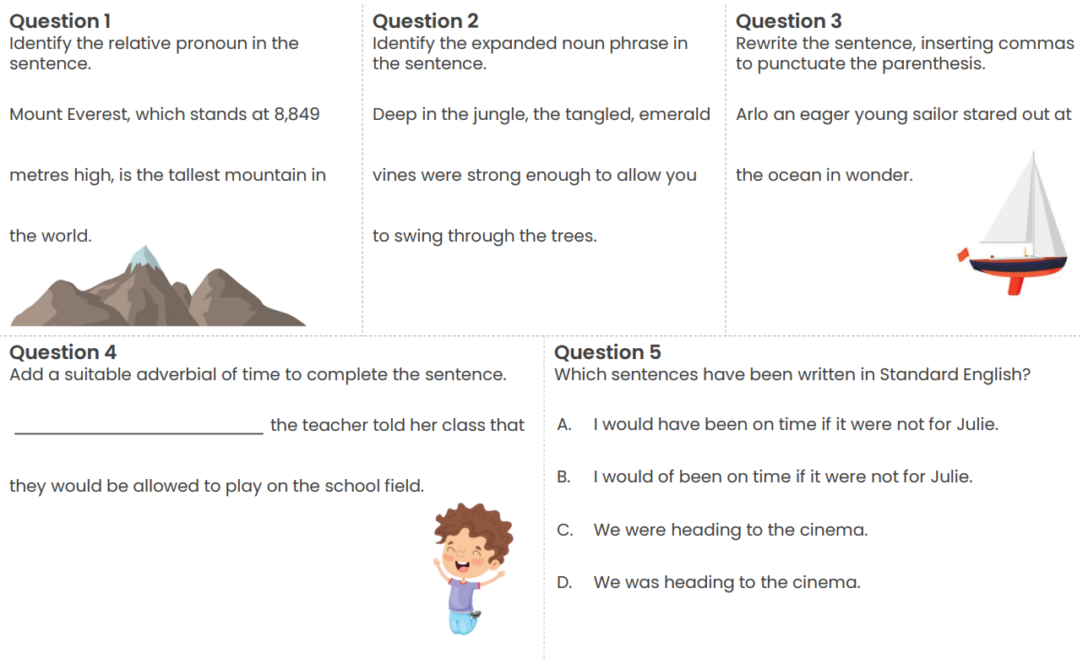
Word work: (on whiteboards)

Slide 3
24.4.26
TBAT- read, write and plot coordinates.
1) 5.907 x 1000 =
2) 5/6 x 3 =
3) 2, 453
Nearest 10= Nearest 100 = Nearest 1, 000=

Slide 4
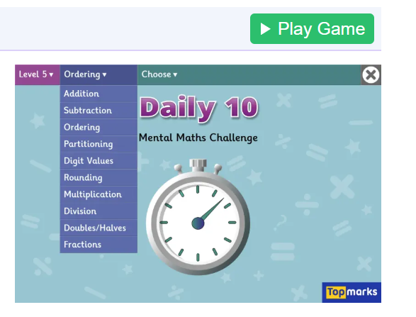
Daily 10
Daily 10 - Mental Maths Challenge - Topmarks

Slide 5
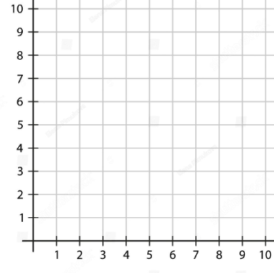
Talk partners: Which axis is 'x' and which is 'y'?

Slide 6
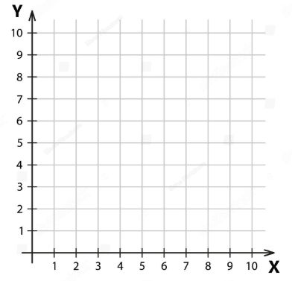
Talk partners: Which axis do you read or plot first?

Slide 7

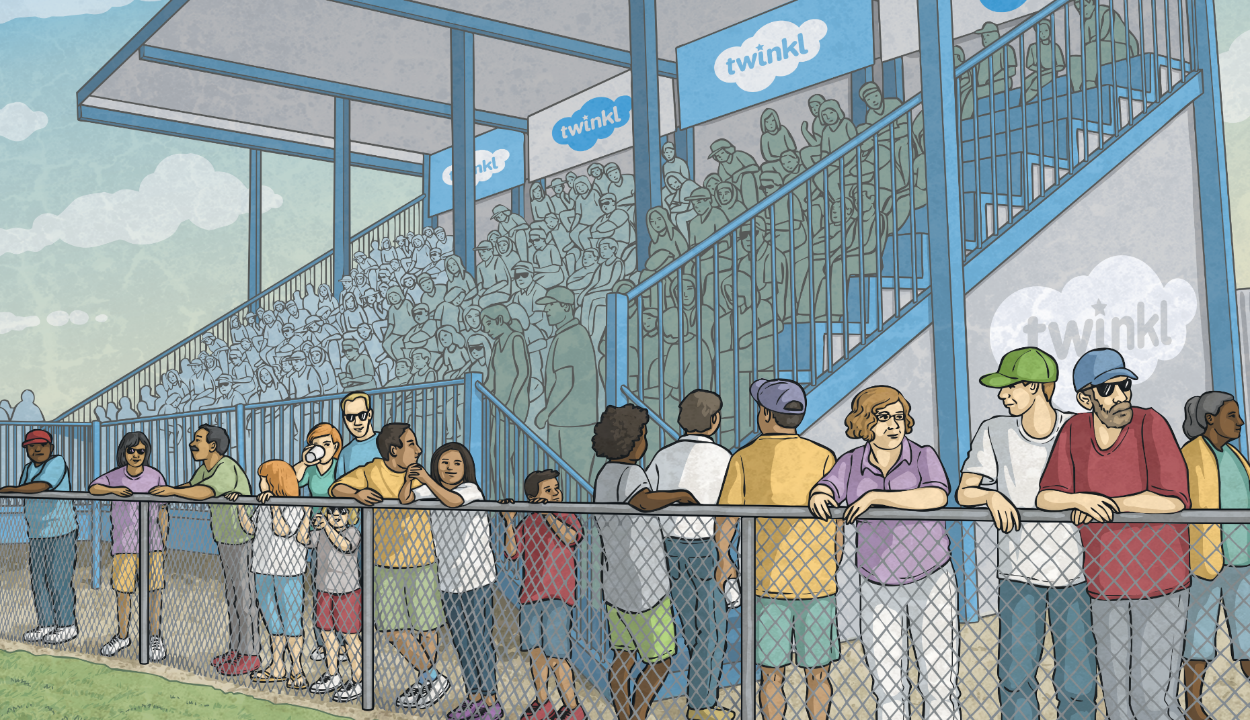
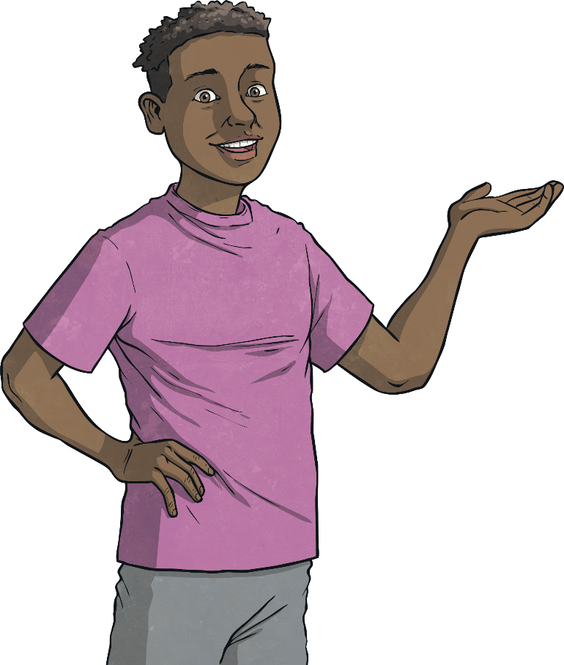
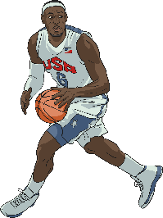
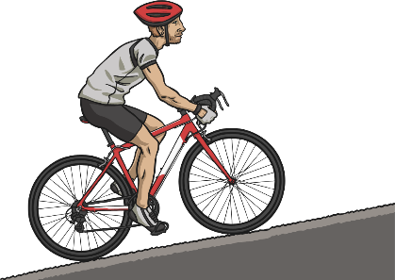
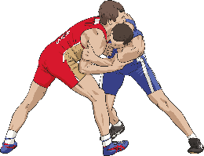
Olympic Sports Coordinates
6
My favourite sports to watch are (5,3), (2,5) and (0,1).
?
?
?
?
?
?
?
5
?
?
?
?
?
?
?
4
?
?
?
?
?
?
?
3
?
?
?
?
?
?
?
2
?
?
?
?
?
?
?
1
?
?
?
?
?
?
?
?
?
?
?
?
?
?
0
?
?
?
1
2
3
4
5
6
Click the correct coordinates to
find Joe’s favourite Olympic sports:

Slide 8
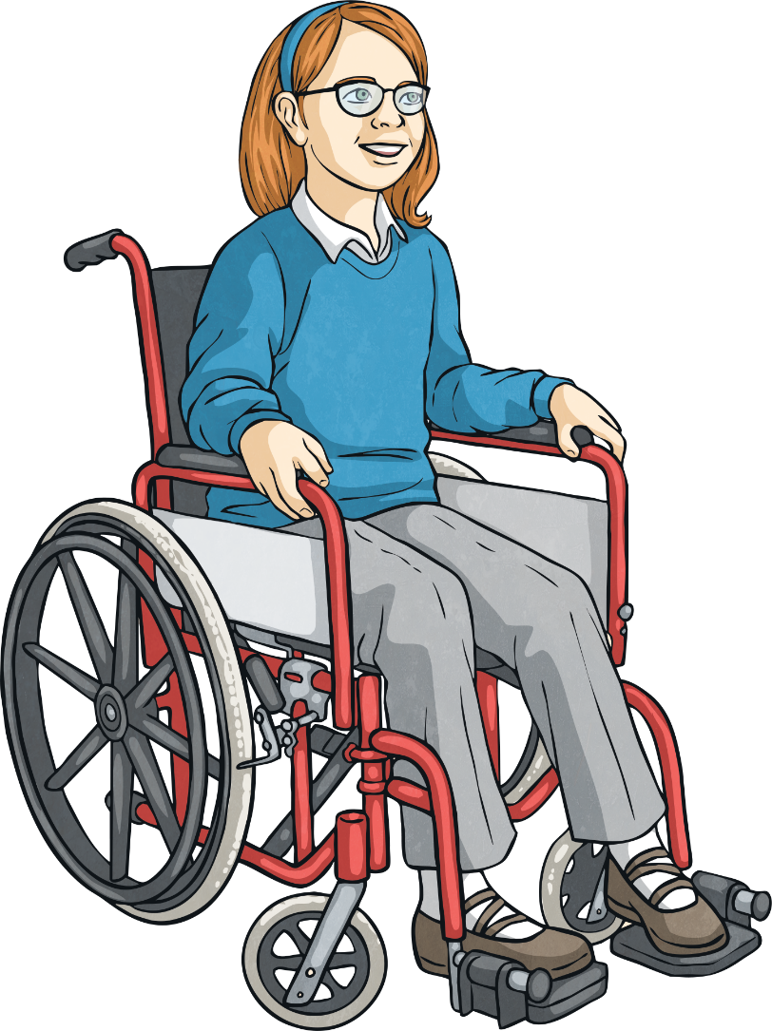
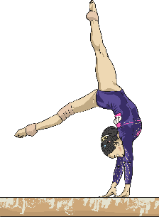
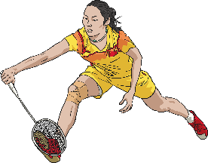

Olympic Sports Coordinates
6
My favourite sports to watch are (6,2), (1,6) and (3,3).
?
?
?
?
?
?
?
5
?
?
?
?
?
?
?
4
?
?
?
?
?
?
?
3
?
?
?
?
?
?
?
2
?
?
?
?
?
?
?
1
?
?
?
?
?
?
?
?
?
?
?
?
?
?
0
?
?
?
1
2
3
4
5
6
Click the correct coordinates to find
Anika’s favourite Olympic sports:

Slide 9


The Four Quadrants
6
In the first activity, you were identifying coordinates in the first quadrant, using the horizontal x-axis and vertical y-axis.
5
4
second
quadrant
3
first
quadrant
2
The point where the horizontal and vertical axes intersect is at (0,0). This is called the origin.
1
-6
-5
-4
-3
-2
-1
0
1
2
3
4
5
6
-1
When the x-axis and y-axis number lines are extended beyond the origin, into negative numbers, a much larger coordinate grid is created, made of four areas called quadrants.
-2
third
quadrant
-3
fourth
quadrant
-4
-5
-6

Slide 10





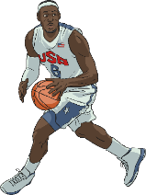
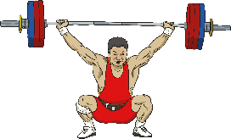




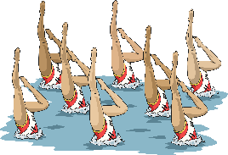
The Four Quadrants
6
5
Which quadrant should each Olympic sport be positioned in?
4
3
(-1,6)
first quadrant
(-3,4)
2
second quadrant
1
third quadrant
-6
-5
-4
-3
-2
-1
0
1
2
3
4
5
6
(5,-2)
-1
(6,1)
fourth quadrant
-2
-3
(-4,-1)
-4
(2,-2)
-5
-6

Slide 11





Missing Coordinates
6
5
Identify the missing coordinate for each Olympic sport:
4
3
(-2,-4)
?
2
(4,5)
1
?
-6
-5
-4
-3
-2
-1
0
1
2
3
4
5
6
(-3,-2)
-1
?
-2
(2,-4)
?
-3
-4
(-5,4)
?
-5
-6

Slide 12
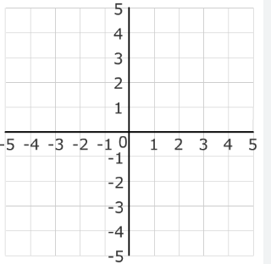
Read coordinates and translate.

Slide 13
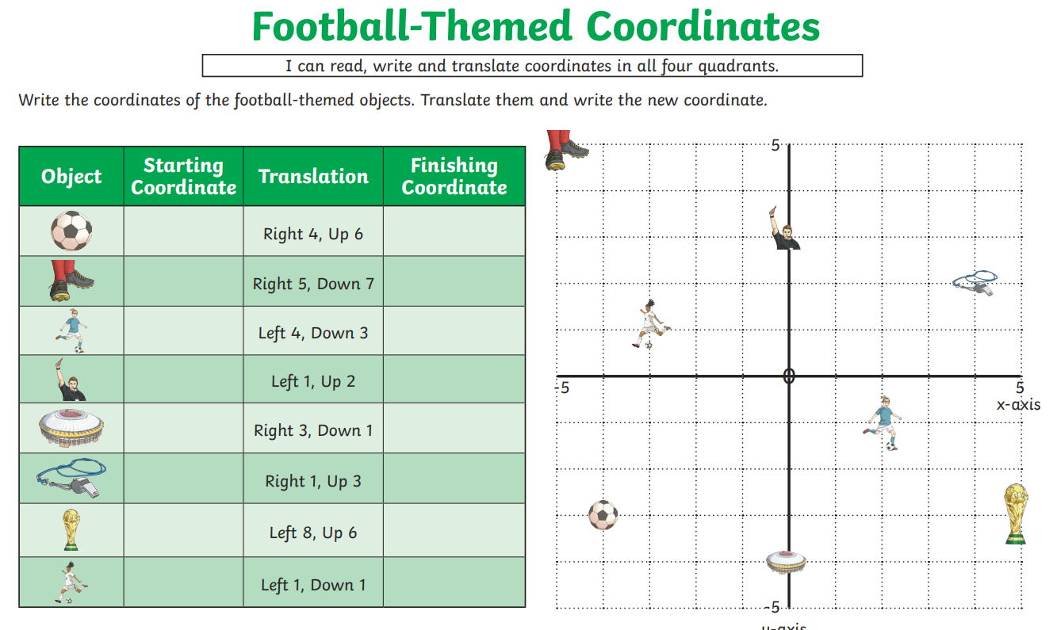
Independent:

Slide 14
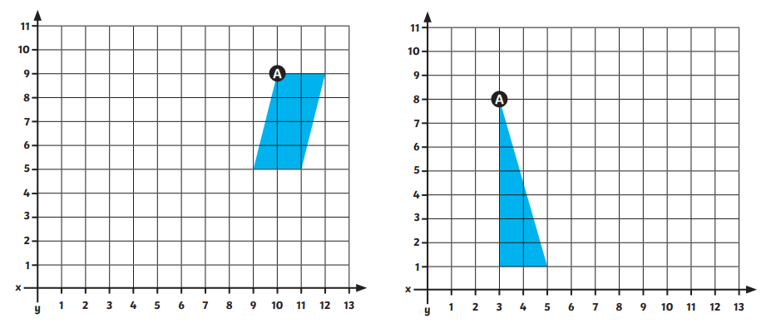
Translate shape A 5 left and 3 down. Translate shape A 2 up and 6 right.

Slide 15
Tuesday 24th March
TBAT: write a narrative non-fiction.
3 in 3
As Elias wandered along the winding riverbank, his eyes were drawn to a small, silver‑grey pebble shimmering gently in the afternoon light. Kneeling down, he lifted it carefully between his fingers and examined its smooth surface. “What ancient journey have you been on?” he murmured, curiosity flickering across his face. The pebble felt cool, polished and strangely important, as though it carried a secret from the distant past.
Millions of years earlier, deep beneath the Earth’s crust, blistering magma swirled and heaved like a fiery ocean. Without warning, a colossal volcano erupted, hurling molten lava down its sides in glowing streams. As the lava cooled, it solidified into hard, obsidian‑dark rock. Trapped within this rock was a tiny fragment — the very beginning of the pebble that would, one day, rest in Elias’s hand.
Over countless centuries, the mighty forces of nature reshaped the rock. Harsh winds carved scratches across its surface, relentless rainwater seeped into tiny cracks, and freezing ice expanded until the rock finally shattered. The new pebble tumbled into a rushing river, colliding with other stones as it was carried downstream. Over time, rolling waves swept it across sandy shores and powerful tides polished it smoother and smoother. The pebble changed again and again as it travelled through rivers, seas and shifting landscapes for thousands upon thousands of years.
1. What does the word obsidian‑dark suggest about the appearance of the rock?
2. Name two natural forces that helped break the original rock apart.
3. Why might Elias believe the pebble “carried a secret from the distant past”?

Slide 16
Tuesday 24th March
TBAT: write a narrative non-fiction.
Whiteboard work:
Write your opening sentence on a whiteboard:
-Start with a fronted adverbial.
-Introduce your character.
One sunny day, ________ was walking along the riverbank when__________

Slide 17
Tuesday 24th March
TBAT: write a narrative non-fiction.
Partner work
Using your opening sentence, work with your partner to upskill the sentence.
One sunny day, ________ was walking along the riverbank when__________
Could you add: a relative clause, a subordinating conjunction?

Slide 18
Tuesday 24th March
TBAT: write a narrative non-fiction.
Teacher model (visualiser)
Paragraph 1:
- Introduce your character
- Where are they?
- What do they say?
As Emma walked along the riverbank, she spotted a small, grey stone glistening in the sunlight. Bending down, she picked it up and turned it over in her hand. “Where have you come from?” she whispered, smiling softly to herself. The pebble felt cool and smooth, and she had a strange feeling that it had a long story to tell.

Slide 19
Tuesday 24th March
TBAT: write a narrative non-fiction.
Teacher model (visualiser)
Paragraph 2:
- Where did your pebble begin?
Include: fronted adverbials
subordinating conjunction
relative clause
Millions of years ago, deep beneath the Earth’s surface, scorching hot magma bubbled and churned. Suddenly, a powerful volcano erupted, sending glowing lava streaming down its sides. As the lava slowly cooled, it hardened into dark, solid rock. Hidden inside that rock was the tiny fragment that would one day become Emma’s pebble.

Slide 20
Tuesday 24th March
TBAT: write a narrative non-fiction.
Teacher model (visualiser)
Paragraph 3:
- The pebble's journey
Include: fronted adverbials
subordinating conjunction
relative clause
As centuries passed, wind scratched the rock, rain soaked into its cracks, and ice expanded inside it until the rock finally split apart. The small pebble tumbled in to a fast‑flowing river, bumping against other stones as it travelled. Over time, waves pushed it across sandy beaches and rolling tides polished its surface. The pebble changed shape again and again as it journeyed through rivers and oceans for thousands of years.

Slide 21
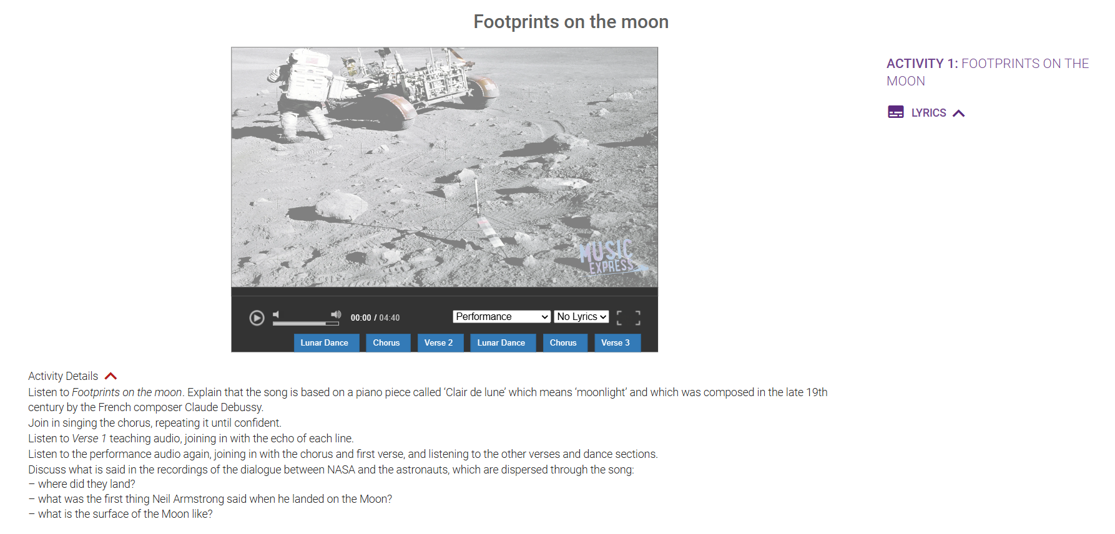
Tuesday 24th March
TBAT: sing confidently.
The Collins Hub Educator > Library

Slide 22
Humanities
Quiz Time!!!

Slide 23
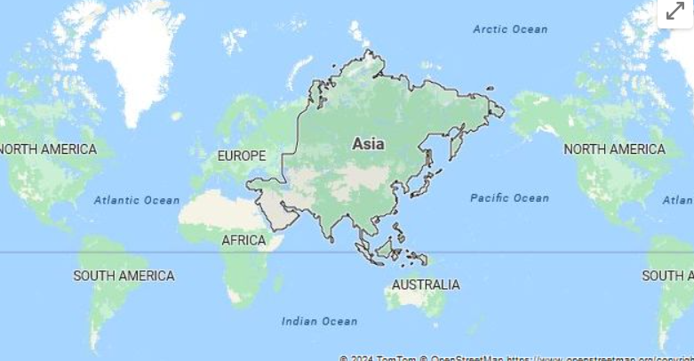
Asia

Slide 24
How many countries are there in Asia?
56 40 48 9

Slide 25
Which ocean is a natural border to Asia?
Pacific Atlantic Artic

Slide 26
Which country has the largest population?
China Maldives India

Slide 27
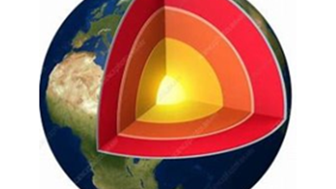
The hottest part of the Earth structure is... mantle crust inner core

Slide 28
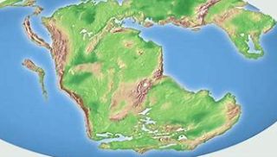
The name of the supercontinent is called...
Asia continental drift Pangaea

Slide 29
Mountains

Slide 30
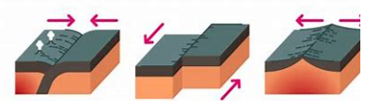
Mountains are formed when tectonic plates...
1) 2) 3)

Slide 31
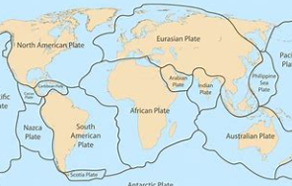
Tectonic plates are like jigsaw pieces on the Earth's.... mantle crust outer core

Slide 32
Volcanoes

Slide 33
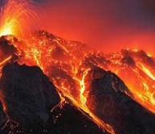
Magma escapes through only the main vent.
True False

Slide 34
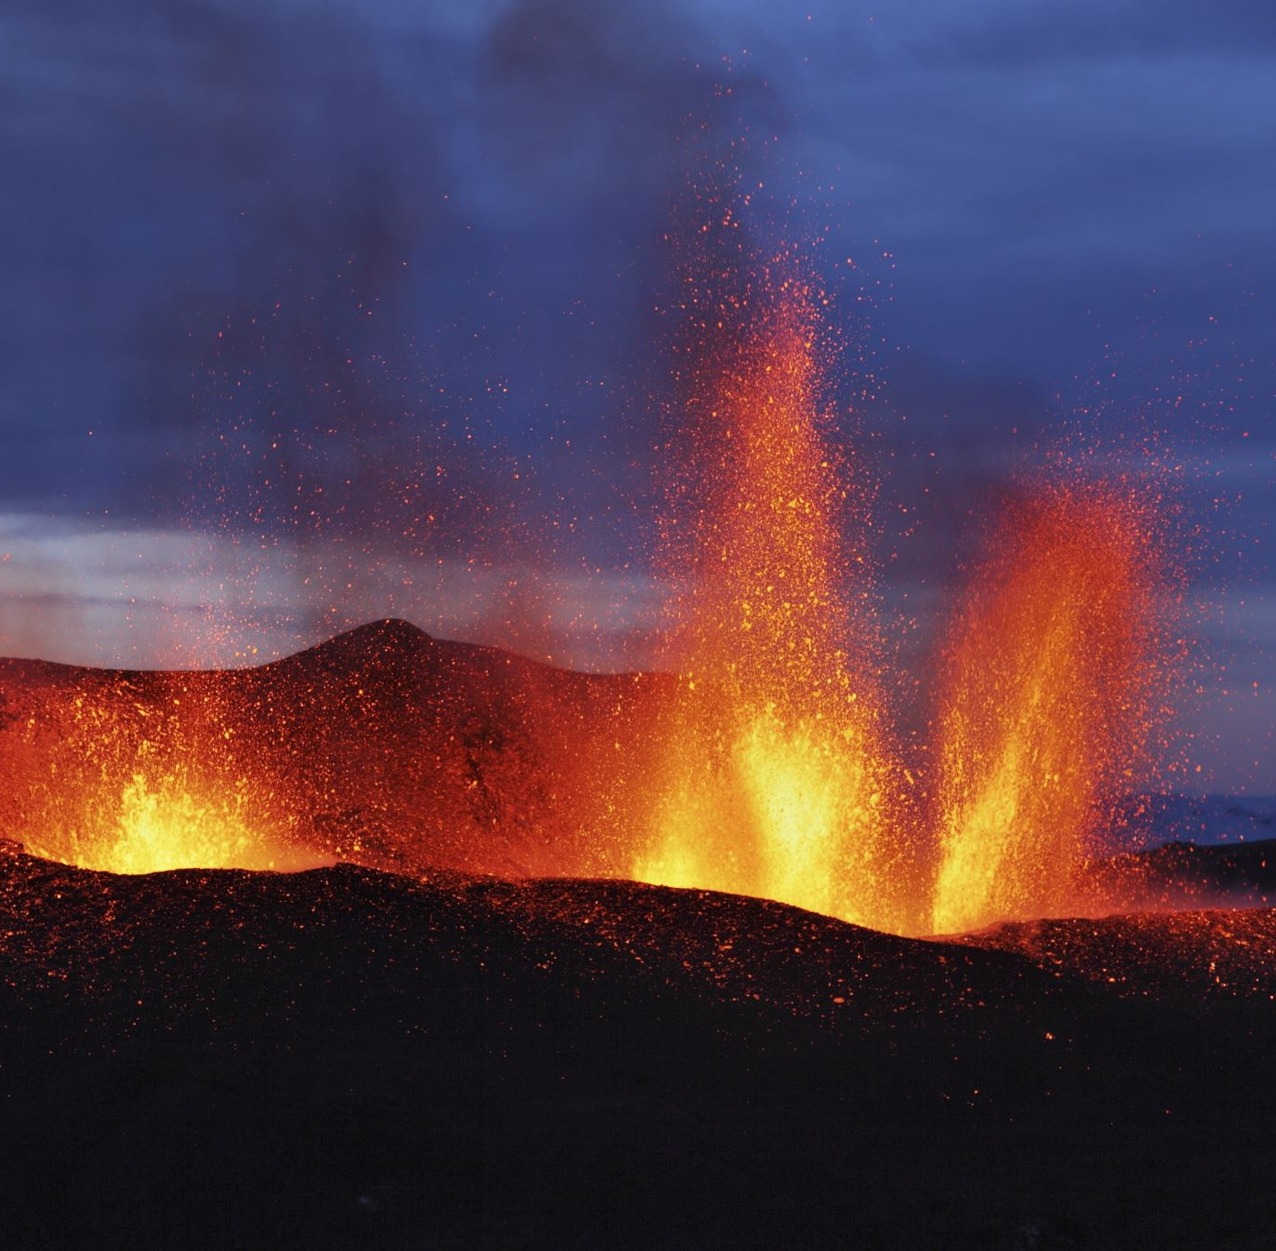
What are the three types of volcanoes?
When magma reaches the surface it is called?

Slide 35
Earthquakes

Slide 36
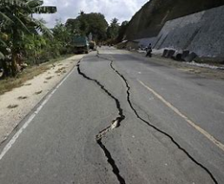
An earthquake happens when tectonic plates get stuck and then there is a sudden movement.
It creates _________ lines in the ground.

Slide 37
Seismic waves are felt more strongly at the epicentre of the earthquake.
True False

Slide 38
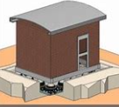
Buildings in Asia are made to absorb seismic energy.
True False
The engineers use shock ________________

Slide 39
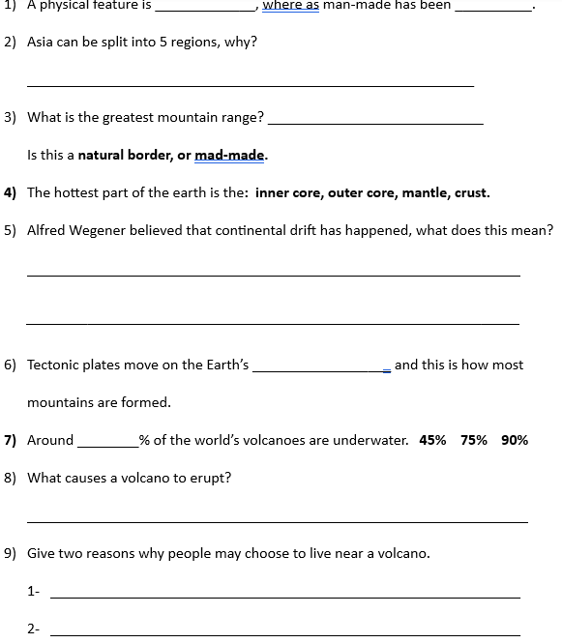
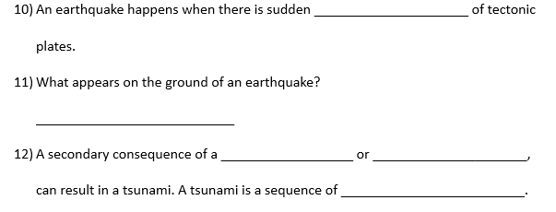
Complete both parts of the quiz- show off what you have learnt.

Slide 40
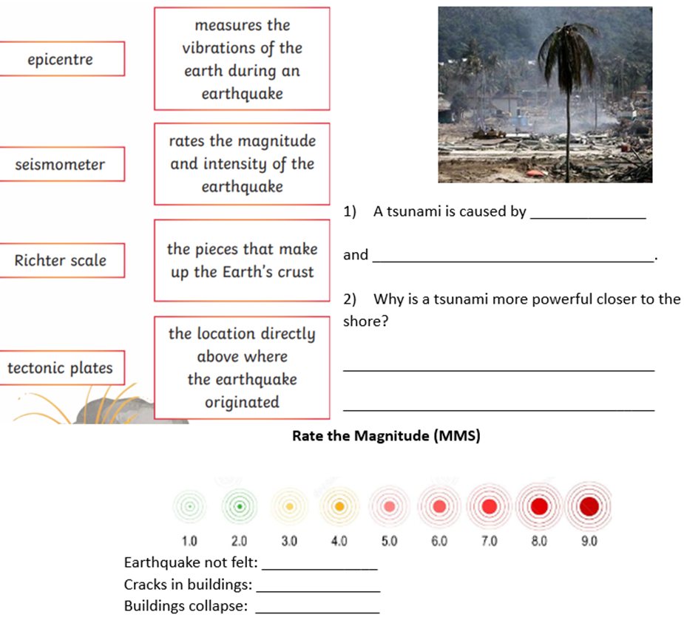
Complete both parts of the quiz- show off what you have learnt.
Part 2
Part 1- fill in the missing words.

Slide 41

Easter Fayre

