Slide 1

Monday 23rd March
TBAT: Use joins consistently.
amplify
solidify
signify
falsify
glorify
classify
notify
testify
purify
intensify
Are there any words you are unsure of? Use a dictionary to look them up and then use them in a sentence.

Slide 2
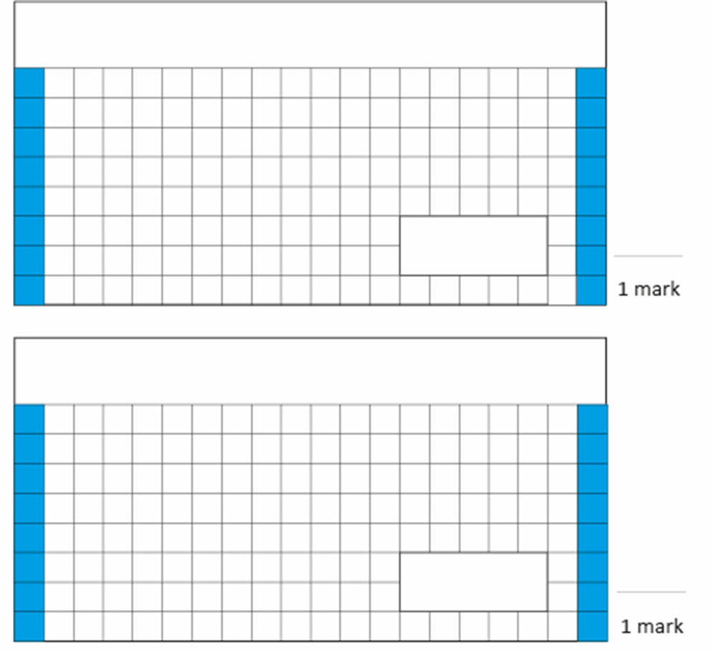
23.3.26
TBAT: order and compare decimals.
1 3/5 X 7 =
3. A curtain maker wants some material for a new order. Each curtain needs 175cm of material and he needs 4 curtains. The material costs £20 per metre. How much will he have to spend?
2. 1265 X 46 =
Challenge:
3/5 of 200 =

Slide 3
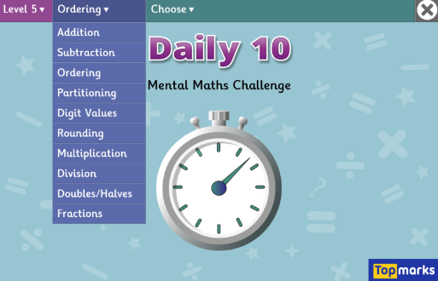
TBAT: order and compare decimals. x 7 tables
Daily 10 - Mental Maths Challenge - Topmarks

Slide 4
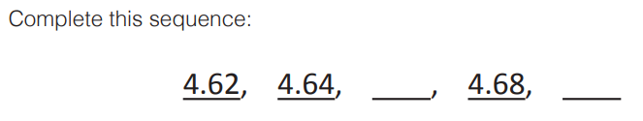
Talk Partners:

Slide 5
3.4 , 3.7, 4, 4.3 , 4.6 , ____ 5.11 , 5.13, _____, 5.17, 5. 19
Challenge: - 4.59 , - 4.55, -4. 51 , _______

Slide 6
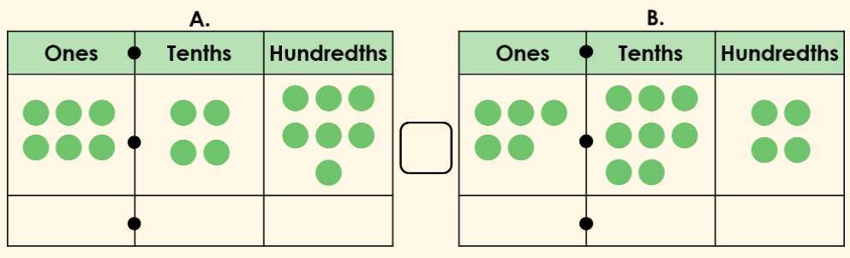
Talk partners: Which number is greater and how do you know?
Use a comparison symbol to compare the charts below.

Slide 7

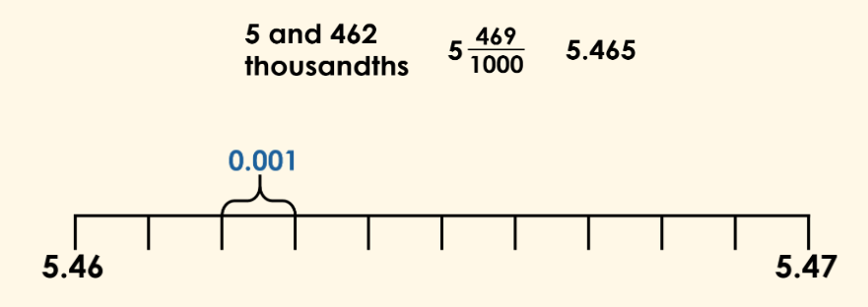
TBAT: order and compare decimals.
We can use a number line to help us order decimal numbers.
Whiteboard work:

Slide 8

TBAT: order and compare decimals.
We can order decimal numbers using our existing knowledge of place value.
We consider the digits in turn from the highest to lowest place value column.
Whiteboard work:

Slide 9

TBAT: order and compare decimals.
We can also order decimals with different numbers of decimal places.
Here we have numbers made up of 1, 2 and 3 decimal places.

Slide 10
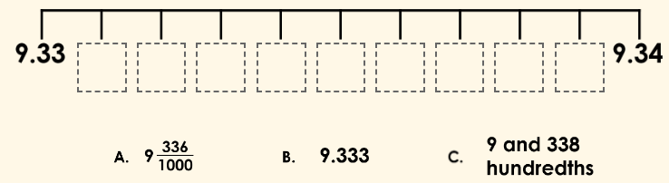
TBAT: order and compare decimals.
Task: Use the number line to arrange the values.

Slide 11

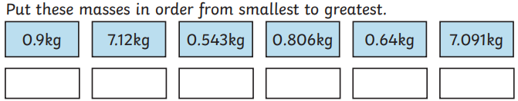
TBAT: order and compare decimals.
Checkpoint Question

Slide 12
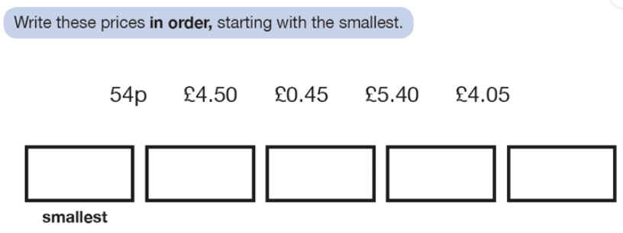
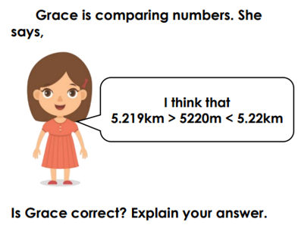
Independent- write the questions and answers in your books
Write these numbers in descending order:
0.92, 0.82, 0.4, 0.07, 0.01
Write these numbers in ascending order:
2) 5.3, 5.94, 5.19, 5.66, 5.04, 5.4, 5.52
Complete the missing numbers in the sequence:
3) 5.12, 5.22, _____, 5.42, _____
4) 2.62, 2.42, 2.22, _____, _____
Write < or > between each pair of lengths.
5) 4.5m 4, 050km
6) 3.2kg 2, 900g

Slide 13
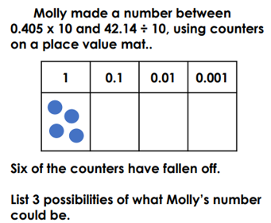
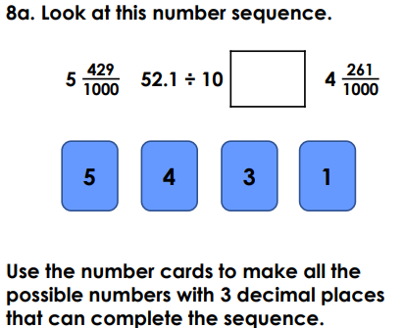
Challenge
Mastery

Slide 14
Monday 23rd March TBAT: Summarise a text and plan a narrative non-fiction.
3 in 3

Slide 15
Monday 23rd March TBAT: Summarise a text and plan a narrative non-fiction.
Multiple choice questions 1. What happens first in the pebble’s journey? The pebble reaches the sea. Dinosaurs trample on rocks. Lava erupts and cools to form rock. A cliff collapses and rock shatters.
2. What causes new rocks to form at the bottom of the sea? Glacier movement Layers of dead creatures Dinosaurs trampling on the cliffs Pebbles sliding into rivers
3. What does the word fragments most closely mean in the statement “the rock shatters into fragments”? Smooth pebbles Large mountains Tiny broken pieces Dust and sand

Slide 16
Sequencing and summarising the key events
Look at the summary of "Pebble in my pocket" (next two slides)
Lava erupts from a volcano and then cools to form rock.
The earth’s surface rises, rocks push together forming mountains.
A cliff falls and the rock shatters into fragments.
volcano
mountains
cliff
They slide into the river and travels in it for “thousands of years”.
The rock is now a pebble. It reaches the sea and is washed onto shore.
Layers of “creatures” that have died form new rock at the bottom of the sea.
river
beach
seabed
Notes:
You may wish to replace the text with images from the book.

Slide 17
Sequencing and summarising the key events
The Earth rises and the rocks form new mountains above water.
The cliffs erode and rocks break away. Dinosaurs trample on them.
Glaciers form and freezes the pebble for many, many years.
new mountains
dinosaurs
glacier
The weather warms, the ice melts. The pebble is trampled on by animals and humans.
The ice returns and melts, until the pebble emerges on the side of a “valley”.
Since then, the pebble has moved little. Today, it “lies” on top of the earth.
river bank
valley
today
Notes:
You may wish to replace the text with images from the book.

Slide 18
Monday 23rd March TBAT: Summarise a text and plan a narrative non-fiction.
Summary questions: 1. Number these events from 1 to 4 to show the correct order: ☐ The Earth rises and new mountains form. ☐ Lava erupts from a volcano and cools to form rock. ☐ Glaciers freeze the pebble for many years. ☐ A cliff falls and rock shatters into fragments.
2. Write a one‑sentence summary of the pebble’s journey.

Slide 19
Monday 23rd March TBAT: Summarise a text and plan a narrative non-fiction.
Planning – Pebble in my pocket Box 4: Over thousands of years…
(How did the rock become the pebble?)
Sentence Starters:
Over thousands of years, wind and rain slowly…
Bit by bit, the rock began to…
As ice got into tiny cracks, it…
The pebble finally broke free when…
Ideas to help you plan:
Wind scratched the rock and made cracks bigger.
Rainwater seeped into small gaps.
Ice froze and pushed the rock apart.
Waves rolled the rock, smoothing it.
Rivers bumped the pebble against other stones.
The rock became smaller → rounder → smoother.
Natural Forces:
wind • rain • ice • river • waves • erosion • weathering • pressure • melting • freezing
Describing Words:
smooth • tiny • ancient • rounded • cracked • powerful • gentle • steady • glistening
Journey Words:
bumped • rolled • washed • travelled • polished • buried • uncovered • carried • formed • settled
Character Reaction Words:
amazed • astonished • curious • fascinated • whispering • gasped • wondered

Slide 20
Monday 23rd March TBAT: Summarise a text and plan a narrative non-fiction.
Planning – Pebble in my pocket Box 5: Finally…
(Where did the pebble end up?)
Sentence Starters:
Finally, the pebble came to rest…
After travelling for so long, it settled…
At last, the river washed it onto…
After thousands of years of moving, the pebble lay…
Ideas to help you plan:
On a quiet riverbank
On a sandy beach
In a shallow stream
On the edge of a cliff or valley
On top of newly formed ground after the ice melted
In a calm rock pool
Natural Forces:
wind • rain • ice • river • waves • erosion • weathering • pressure • melting • freezing
Describing Words:
smooth • tiny • ancient • rounded • cracked • powerful • gentle • steady • glistening
Journey Words:
bumped • rolled • washed • travelled • polished • buried • uncovered • carried • formed • settled
Character Reaction Words:
amazed • astonished • curious • fascinated • whispering • gasped • wondered

Slide 21
Monday 23rd March TBAT: Summarise a text and plan a narrative non-fiction.
Planning – Pebble in my pocket Box 6: Your character holds the stone in amazement.
(Return to the character in the present)
Sentence Starters:
Back in the present, ______ picked up the pebble and gasped…
Holding the tiny stone tightly, ______ whispered…
“I can’t believe how old you are!” ______ said softly.
As the pebble lay in their hand, they imagined…
Ideas to include:
Character realises how long the pebble has existed.
They imagine volcanoes, mountains, rivers and ice.
They feel amazed, shocked, or fascinated.
They speak quietly to the pebble.
They hold it gently, knowing its journey was extraordinary.
Natural Forces:
wind • rain • ice • river • waves • erosion • weathering • pressure • melting • freezing
Describing Words:
smooth • tiny • ancient • rounded • cracked • powerful • gentle • steady • glistening
Journey Words:
bumped • rolled • washed • travelled • polished • buried • uncovered • carried • formed • settled
Character Reaction Words:
amazed • astonished • curious • fascinated • whispering • gasped • wondered

Slide 22
Lesson 4: Computer databases
Objectives
TBAT- explain that tools can be used to select specific data
I can choose which field and value are required to answer a given question
I can outline how ‘AND’ and ‘OR’ can be used to refine data selection
I can choose multiple criteria to answer a given question

Slide 23
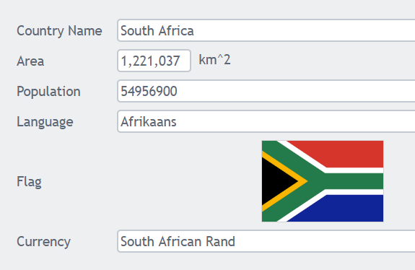
Parts of a record
Introduction
Talk partners: identify the fields in this record.
Fields can contain different types of data. For example ‘text’ is a data type.
What data types can you see in the fields?
Notes:
Ask learners which data types they can see here (text, numeric, and image). Label the values in the record, e.g. South Africa is the value in the ‘Country name’ field.
Screenshot: https://www.j2e.com/data/examples/countries

Slide 24
Parts of a record
Introduction
Fields
Values
Data type
text
numeric
numeric
text
image
text
Notes:
Click to see fields, values, and data types on the slide.
Screenshot: https://www.j2e.com/data/examples/countries

Slide 25

Meeting given criteria.
Activity 1
Listen carefully to the statements read out and stand up if they apply to you. Sit down again after each statement:
Stand up if your hair is tied back
Stand up if you're left-handed
Stand up if you have brown eyes
Stand up if you ate toast for breakfast
Notes:
Whistle: https://pixabay.com/vectors/whistle-black-blow-referee-game-33271/

Slide 26
Searching a database
Activity 1
You can search a database for records which meet a specific criteria.
Age = 16
Alfons
Age:
16
Mary
Age:
16
Youssef
Age:
16
Argene
Age:
24
Hudson
Age:
30
Alfons
Age:
16
You can work with just the records the search returned.

Slide 27
ncce.io/dat5-4-a1-r

Slide 28
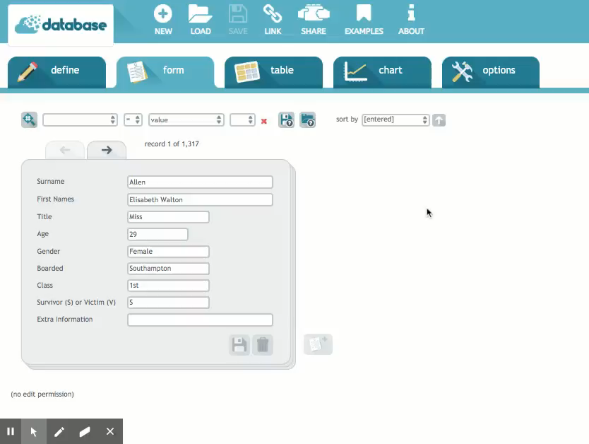
ncce.io/dat5-4-a1-r
Activity 1
Talk partners: How many records does this database include?
How could I answer the question: How many 16-year-olds were on board the Titanic?
This is similar to the simple database searches from Lesson 3, where all the records meeting one criteria were found by the database, e.g. ‘which countries speak German?’
To find out you need to search the Titanic database for Age = 16
Notes:
Use the video or demonstrate live from the link: https://www.j2e.com/data/examples/Titanic+Passenger+List

Slide 29
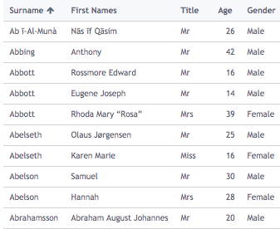
Meeting given criteria
Activity 1
Now use the database to answer these questions:
How many people were in third class on board?
How many people survived?
Challenge: This type of question allows us to find information based on one criteria. True or false?
Notes:
Screenshot: https://www.j2e.com/data/examples/Titanic+Passenger+List

Slide 30
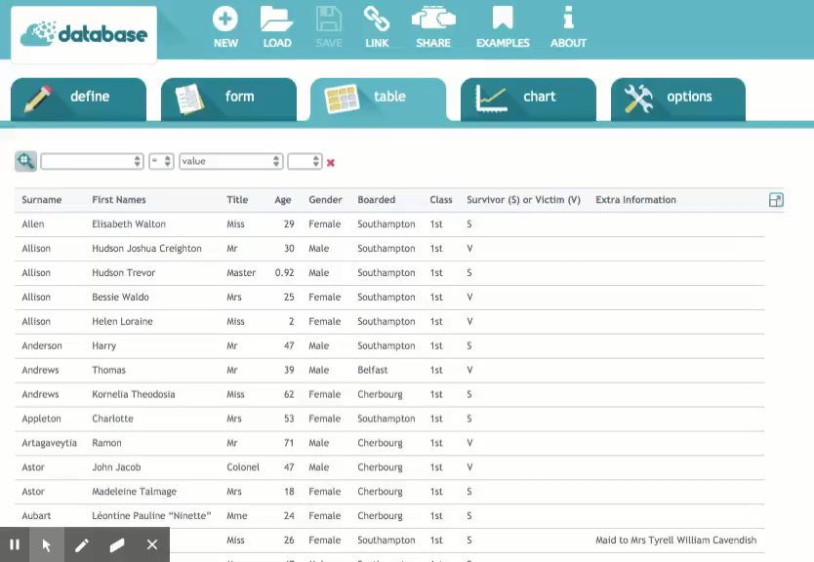
A computer database can be searched in the same way, using two fields to find all the records matching both criteria. How many 16-year-olds boarded the Titanic in Southampton?
Activity 2
Talk partners: What is the two criteria in this search?
You need to search for Age = 16 AND boarded = Southampton
Notes:
Use the video or demonstrate live to show how to use the ‘AND’ tool within a search to answer the question, ‘How many 16-year-olds boarded the Titanic in Southampton?’ Scroll through the records found and point out the ‘age’ and ‘boarded’ fields on each record showing ‘16’ and ‘Southampton’.
Video: https://www.j2e.com/data/examples/Titanic+Passenger+List

Slide 31
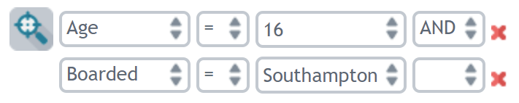
Narrowing your searches using ‘AND’
Activity 2
Record your answers on your assignment.
Use the ‘AND’ tool in your search to answer these questions on your sheet:
How many males were in first class?
How many females died?
How many females boarded in Belfast?
How many males under ten years old were on board?
Notes:
Screenshot: https://www.j2e.com/data/examples/Titanic+Passenger+List

Slide 32
Searches using ‘OR’
Activity 3
Stand up if one or the other parts of the statement apply to you. Sit down again after each statement:
Stand up if you're a left-handed OR you have brown hair
Stand up if you have brown eyes OR you ate toast for breakfast
Stand up if your hair is tied back OR you have a jumper on
Stand up if you have laces on your shoes OR blue eyes
Talk partners: How do the results differ?
Notes:
Carry out the unplugged ‘OR’ questions before searching the database.
Whistle: https://pixabay.com/vectors/whistle-black-blow-referee-game-33271/ .

Slide 33
The result numbers may increase if searches are looking for more than one attribute.

Slide 34
Searches using ‘OR’
Activity 3
Let’s use the ‘OR’ tool in the search to answer this question:
How many people were in first or second class?
Before you search, do you think the answer will be more or less than the number of people in first class only? Why?
Was it more or less? Why?
Notes:
Use the video (next slide) or demonstrate live how to use the ‘OR’ tool in the computer database to answer the question, ‘How many people were in fIrst or second class?’ Before searching, ask learners if they think the answer to this question will be more or less than the number of people in first class only? (324) Carry out the search, scroll through the records found, and point out the ‘Class’ field on each record showing only first or second. Discuss the number of records found (628) and ask learners to explain why it is more than the 324 in first class only. Remind learners that results from any search can also be ordered using ‘sort by’ as covered in Lesson 3.

Slide 35
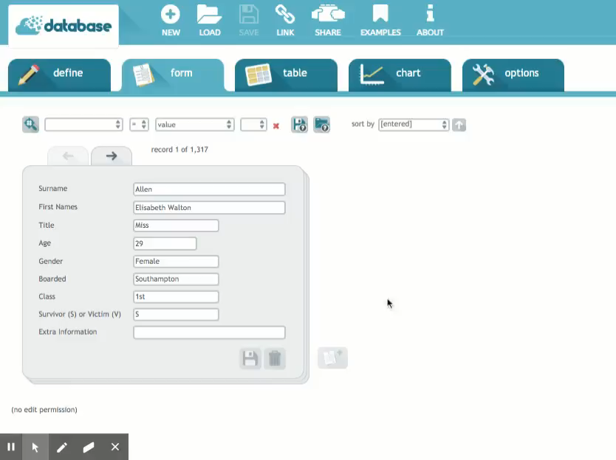
How many people were in first or second class?
Activity 3
Remember you can use 'sort by'. We did this in lesson 3.
You need to search for Class = 1st OR Class = 2nd
Notes:
Use the video or demonstrate live how to use the ‘OR’ tool in the computer database to answer the question ‘How many people were in first or second class?’. Before searching, ask learners if they think the answer to this question will be more or less than the number of people in first class only? (324) Carry out the search, scroll through the records found, and point out the ‘Class’ field on each record showing only first or second. Discuss the number of records found (628) and ask learners to explain why it is more than the 324 in First class only. Remind pupils that the results from any search can also be ordered using ‘sort by’, as covered in Lesson 3.
Video: https://www.j2e.com/data/examples/Titanic+Passenger+List

Slide 36
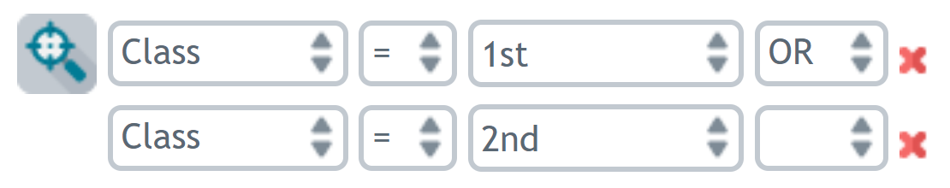
Searches using ‘OR’
Activity 3
Use the ‘OR’ tool in your search to answer these questions:
Blue
How many people boarded at Belfast or Queenstown?
How many of the passengers were under 18 or over 70?
Green
Who was the oldest person in first or second class?
Who was the oldest person out of people who boarded at Southampton or Cherbourg?
Notes:
Screenshot: https://www.j2e.com/data/examples/Titanic+Passenger+List

Slide 37

Lesson 4: Using search tools
Plenary
Using AND and OR in real life
With a partner, discuss which fields a TV-streaming service might include in a database of all their shows.
These might include:
Show name, e.g. ‘Batman’
Show length, e.g. 30 minutes
Show type, e.g. comedy
Age range, e.g. children under five
Notes:
Click to show suggestions of fields.
Image source: https://pixabay.com/illustrations/video-netflix-online-media-player-3410270/

Slide 38
Lesson 4: Using search tools
Plenary
Using AND and OR in real life
Can you think of an ‘AND’ or ‘OR’ search you might carry out?
For example, ‘Which shows are suitable for children under five AND less than 30 minutes long?’
Notes:
Image source: https://pixabay.com/illustrations/video-netflix-online-media-player-3410270/

Slide 39
