Slide 1
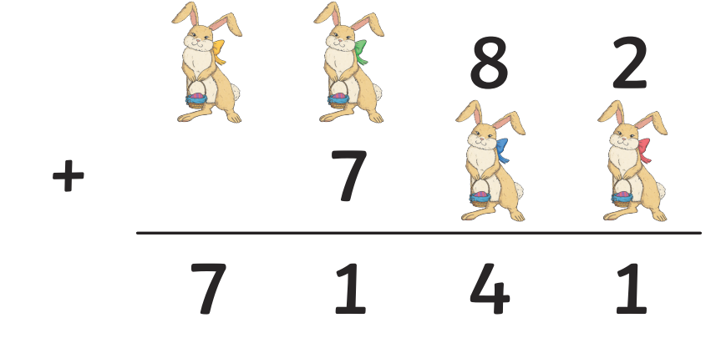
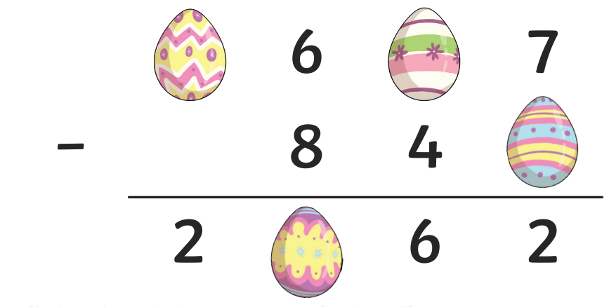
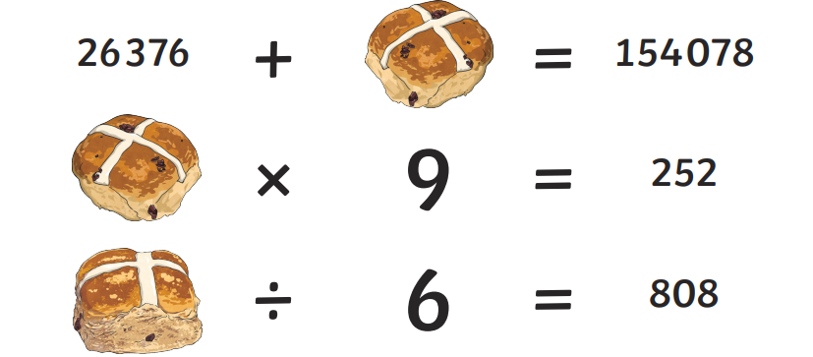
Friday 20th March
Morning Challenge

Slide 2
Address GPS misconceptions

Slide 3
20.3.26 - Whiteboards
1) 653 x 14 =
2) 4/8 x 5 =
3) 23 x ½ =
Challenge:
A stadium holds 8365 people.
3765 are seated and 1572 are standing.
How many more people can fit in the stadium?

Slide 4

Daily 10 - Mental Maths Challenge - Topmarks

Slide 5
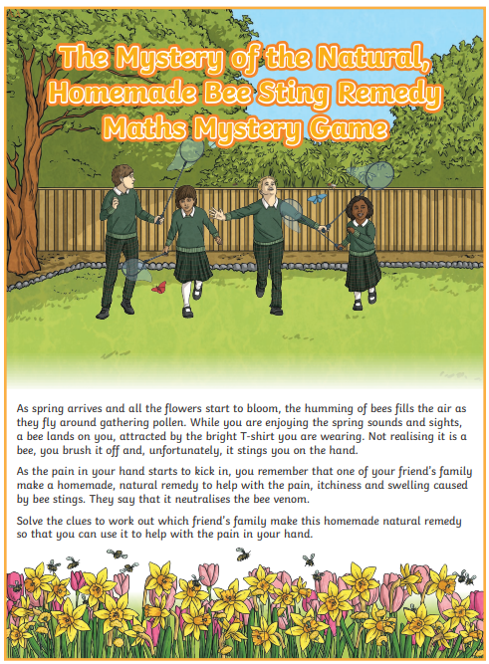
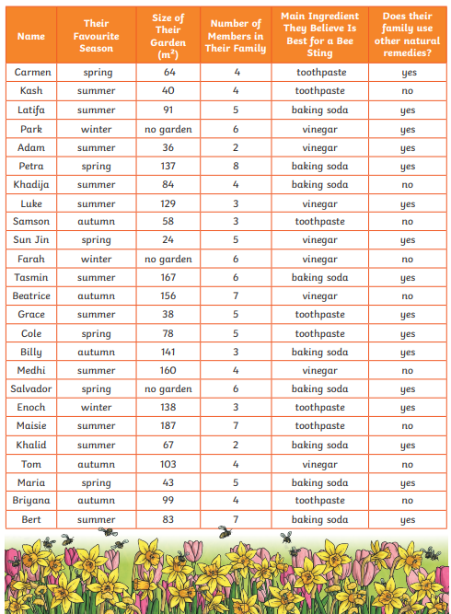

Slide 6
Friday 20th March
TBAT: Plan a narrative non-fiction.
3 in 3
Luke walked slowly along the quiet riverbank after school, listening to the soft rush of water beside him. As he crouched to tie his shoelace, something smooth and grey caught his eye. He picked up a tiny pebble and held it carefully in his hand. “Where did you come from?” he whispered. It looked ordinary, but Luke had a feeling that this little stone had lived a very long, extraordinary life—one that began millions of years before he was born.
What did Luke find on the riverbank?
2. What does the word “ordinary” mean in this paragraph?
A. very special
B. not unusual
C. too heavy
3. Why do you think Luke whispered to the pebble instead of speaking loudly?

Slide 7
Friday 20th March
TBAT: Plan a narrative non-fiction.
Talk partners:
Tell your partner about your character.
What is their name?
What is their personality like?
What do they look like?

Slide 8
Friday 20th March
TBAT: Plan a narrative non-fiction.
Look back at the reading lesson from last week.
What is the order of the pebble's journey?
Can you draw this in your book?

Slide 9
Friday 20th March
TBAT: Plan a narrative non-fiction.
Box 1: Your character finds the stone (Include speech)
Questions to help you plan:
Who is your character?
Where are they when they find the stone?
How do they feel when they discover it?
What do they say out loud?
Model together
What are the rules of speech?
Sentence Starters:
As ______ walked along the riverbank, she/he noticed…
“What are you doing here?” _____ whispered to the stone.
Bending down slowly, ______ picked up the tiny, smooth pebble.
The stone felt cool in _____’s hand as they murmured, “…”
Example Ideas:
A curious girl exploring the woods
A boy on the beach collecting shells
A child on a school trip discovering a strange stone
A young explorer who loves nature

Slide 10
Friday 20th March
TBAT: Plan a narrative non-fiction.
Box 2: Millions of years ago… (The beginning of the pebble)
Questions to help you plan:
How did the pebble begin?
Was there a volcano?
Did the rock melt, cool, or break?
What natural forces were involved?
Sentence Starters:
Millions of years ago, deep beneath the Earth’s surface…
Hot, melted rock burst out of a volcano…
As the lava cooled, it slowly hardened into solid rock.
Inside the rock, a tiny piece waited for its long journey to begin.
Example Ideas:
A powerful volcanic eruption
Lava cooling into hard, dark rock
A tiny fragment trapped inside a huge boulder
Heat, pressure, and molten rock

Slide 11
Friday 20th March
TBAT: Plan a narrative non-fiction.
Box 3: As centuries passed… (What journey has the pebble been on?)
Questions to help you plan:
How did the rock break apart?
What natural forces shaped the pebble?
Where did it travel?
How did it change?
Sentence Starters:
As centuries passed, wind and rain slowly shaped the rock…
Over time, the rock cracked and the pebble broke free.
Carried by rushing rivers, the pebble bumped against other stones…
Sometimes waves tossed it across the shore, smoothing its edges.
Example Ideas:
Weathering: wind, rain, ice
River journey: bumping, rolling, smoothing
Ocean waves polishing it
Being buried in sand and uncovered again
Travelling across beaches, riverbeds, cliffs, or oceans

Slide 12
Example:
As Clarissa walked along the riverbank, she spotted a small, grey stone glistening in the sunlight. Bending down, she picked it up and turned it over in her hand. “Where have you come from?” she whispered, smiling softly to herself. The pebble felt cool and smooth, and she had a strange feeling that it had a long story to tell.
Millions of years ago, deep beneath the Earth’s surface, scorching hot magma bubbled and churned. Suddenly, a powerful volcano erupted, sending glowing lava streaming down its sides. As the lava slowly cooled, it hardened into dark, solid rock. Hidden inside that rock was the tiny fragment that would one day become Clarissa’s pebble.
As centuries passed, wind scratched the rock, rain soaked into its cracks, and ice expanded inside it until the rock finally split apart. The small pebble tumbled into a fast‑flowing river, bumping against other stones as it travelled. Over time, waves pushed it across sandy beaches and rolling tides polished its surface. The pebble changed shape again and again as it journeyed through rivers and oceans for thousands of years.

Slide 13
Address Maths misconceptions

