Slide 1
A book cost £7.50. A pencil cost £0.89.
A) How much would it cost for 1 book and two pencils?
B) How much change would you get from £10.00?
2) A cake was cut into 10 slices. 3 slices were eaten at 2pm and a further 2 at 4pm. How many slices are left? Write the amount as a fraction, decimal and percentage.
3) How many days in total are in the months September, October and December?
4) A bag of flour weighs 1kg. A cake mix needs 345g. How much flour is needed for 2 cakes? Write your answer in g and kg.
5) There were 17 pencils in a box. If I had 6 boxes, how many pencils are there in total?
A box costs the school £3.49, how much do 6 boxes cost?

Slide 2
Maths Warm Up
1. 4³ –3² =
2. Write 27/100 as a decimal
3. Round 167 to the nearest 10 and nearest 100.
4. Convert 0.75Kg into grams
5. A rectangle measures 2cm x 6cm. What is its perimeter?

Slide 3
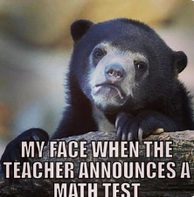
Maths Paper 3
9:20-10:00

Slide 4
Spellings – use the words below to recall the spelling patterns that we have practised this year accommodate receive knight / science / lamb usually / finally rough / plough / through great / grate infectious/ conscious infection
Think of another word for each of the spelling rules.

Slide 5
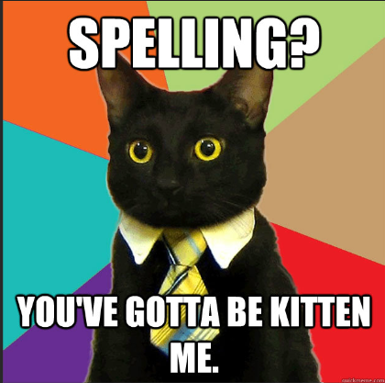
Spelling Paper

Slide 6

Complete Reading paper

Slide 7
Wednesday 18th March
Q: What is air resistance?
2 in 2
Friction occurs when objects move through water or air.
Air resistance is a type of friction between air and another material.
For example, when an aeroplane flies through the air, air particles hit the aeroplane making it more difficult for it to move through the air.
It's the same for an object moving through water. If you go swimming, there is friction between your skin and the water particles. This is known as water resistance.
1. What is air resistance?
2. What makes it difficult for an aeroplane moving through the air?

Slide 8
Wednesday 18th March
Q: What is air resistance?
Vocabulary match
Friction A force that opposes or slows down another force
Resistance The total amount of matter in an object. It's different from weight,
which is the force of gravity on an object.
Mass The force that pulls objects towards the center of a planet or other
body.
Gravity The force that occurs when two surfaces slide or rub against each other,
slowing down the movement of the object.

Slide 9


Thinking Time
1
Talk partners
What do we mean by the
word force?
Can you name different types of forces?

Slide 10
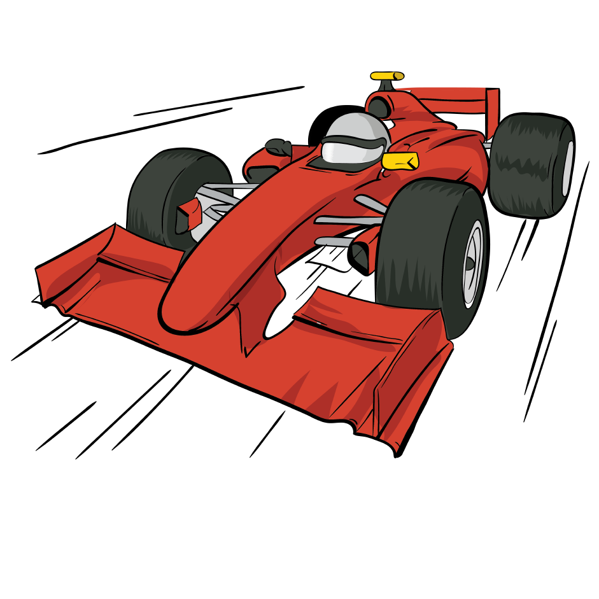
Force
2
We can't see forces, but they are an important part of our everyday lives.
Forces are acting on us all the time! Forces affect us when we drive to school or fly on holiday.
Because human beings have a good knowledge of forces, we can build houses that don’t fall down
and chairs that don’t collapse. It enables us to launch satellites into orbit that can beam television signals around the world and map the planet from space!
Simple forces are pushes and pulls.

Slide 11


Thinking Time
3
Why does everything fall to the ground?
What are water and air resistance? - BBC Bitesize

Slide 12
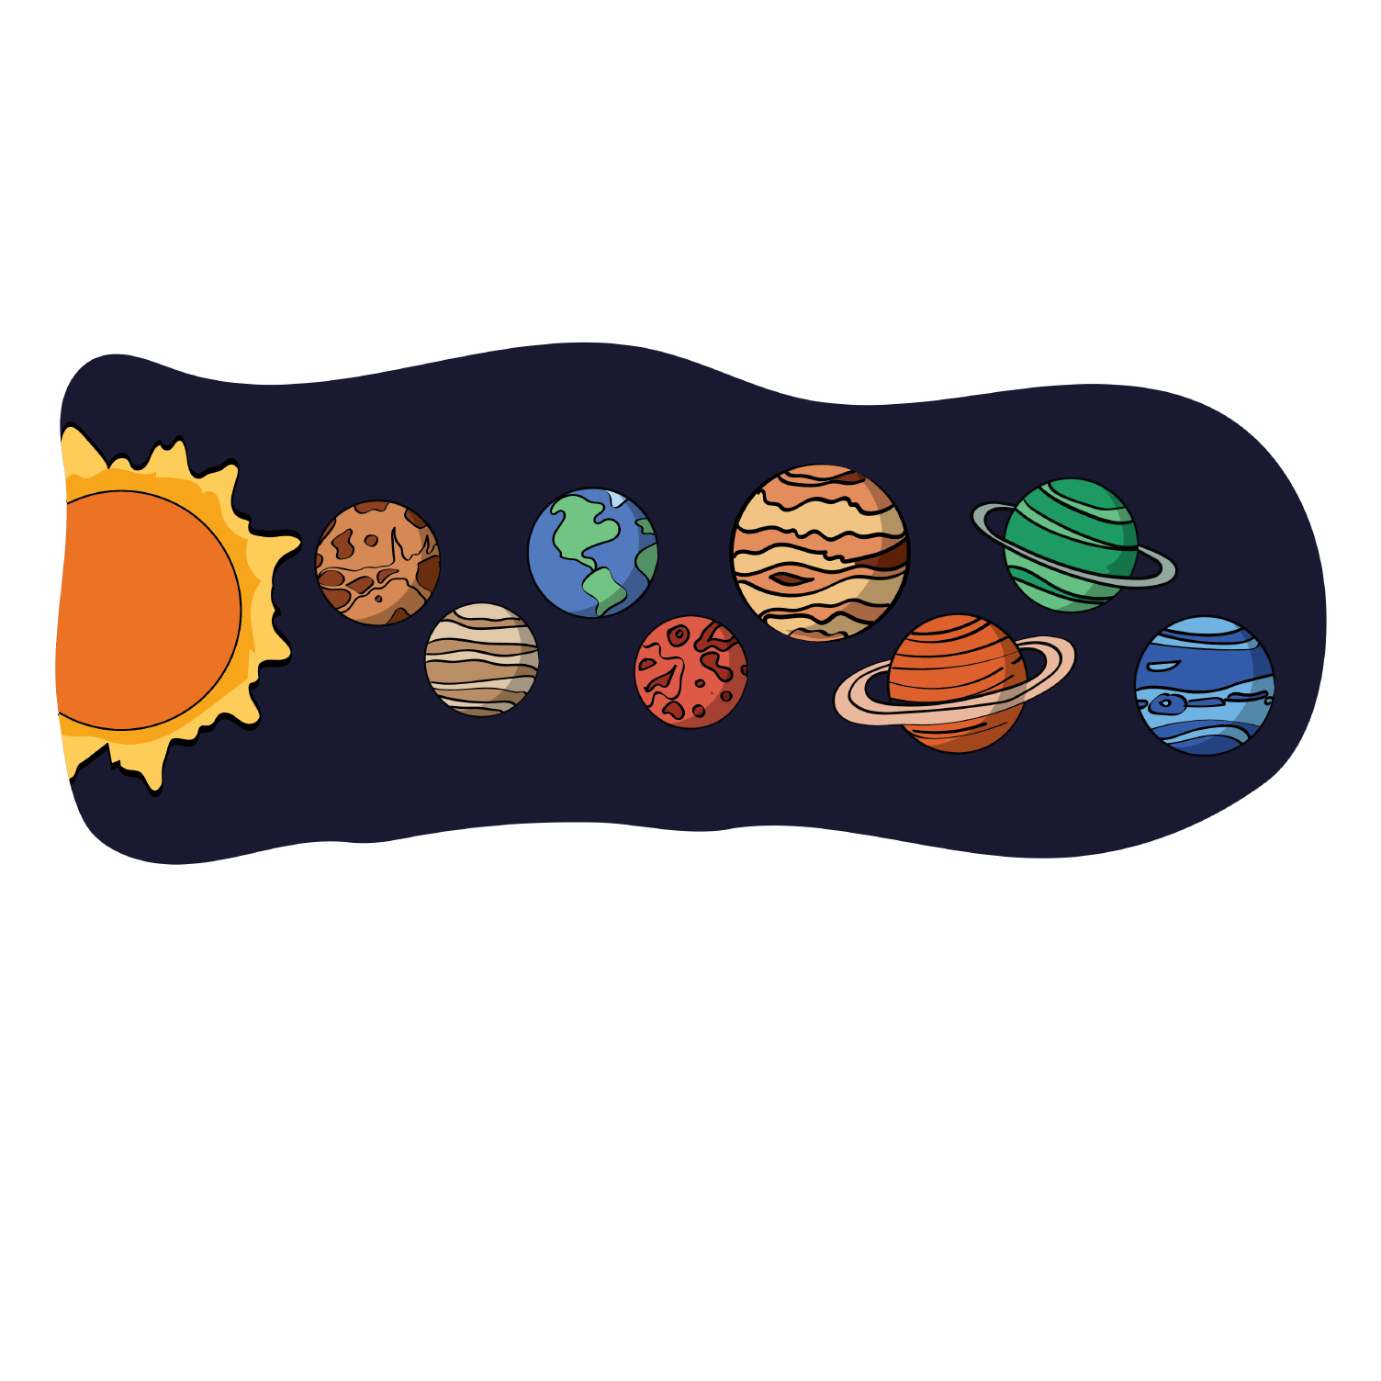
Gravity
4
Gravity is a force which acts at a distance. It is a pull force that pulls objects towards the centre of the Earth.
The planets and the Sun do not touch, yet the planets stay in orbit around the Sun due to the force of gravity.

Slide 13
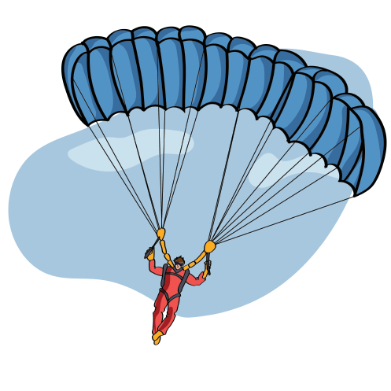
Air Resistance
5
Air resistance is a force that acts in the opposite direction to gravity. It acts between a moving object and the air molecules around it, slowing the object down.
Air resistance is a type of friction. Parachutes are used to increase air resistance and slow down the parachutist, so they can land safely.
Modern cars and planes are streamlined in design to reduce air resistance, allowing them to move faster.
New Word Alert
Streamlined - designing an object in a particular way so that the amount of air/water resistance is reduced. Streamlined shapes push air or water around them, so they can travel faster.

Slide 14
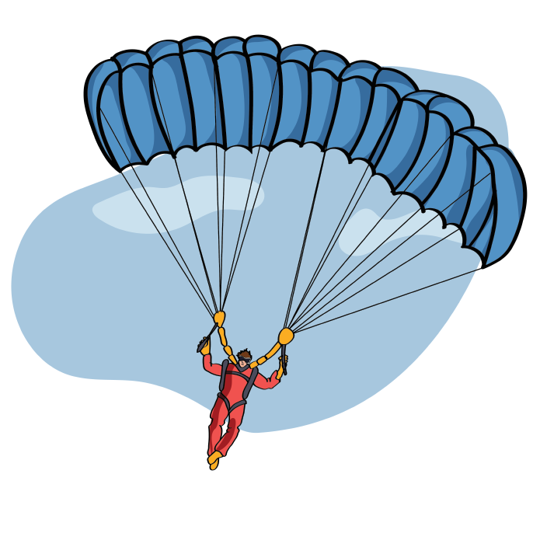
Air Resistance in action!
6
F1 cars have to be streamlined in order to go faster. However, they also need big wheels in order to increase the grip between the tyres and the track.
Which force are F1 cars increasing by increasing the grip?
Talk to your partner!
How does a parachute use air resistance?

Slide 15

Air Resistance in action!
7
What forces are acting on this person?

Slide 16
Air Resistance in action!
8
Air resistance
Gravity
What forces are acting on this person?

Slide 17
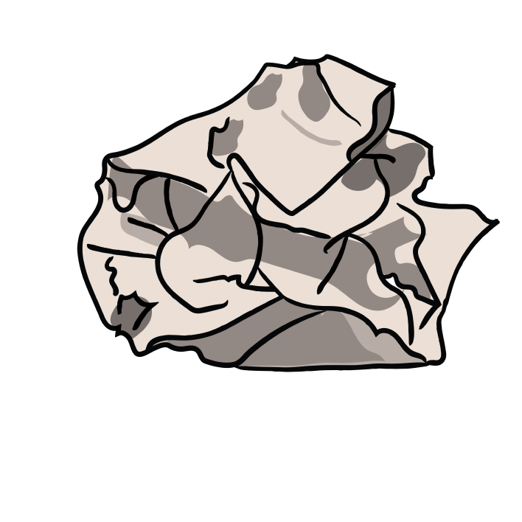

Group Activity
9
Each group has 2 pieces of (scrap) paper.
Scrunch one up into a ball and leave the other one as a flat piece of paper.
Drop each one from the same height.
What happens? Explain using the words gravity and air resistance.

Slide 18
Group Activity
9
What happens? Explain using the words gravity and air resistance.
When I dropped the two pieces of paper,
the ________ piece fell quicker. This was because …..

Slide 19


Investigation Time
10
Today, you have a challenge to design
the best paper aeroplane.
In groups of 4, you will make an aeroplane and then take it to the hall to test.
-How will we know which plane is the best?
-How will we make it fair?
-What will we measure?
-What do you predict about this investigation?

Slide 20
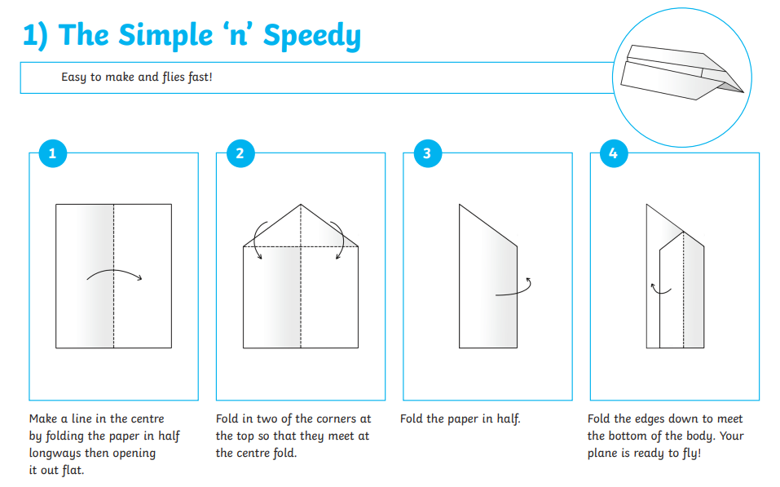
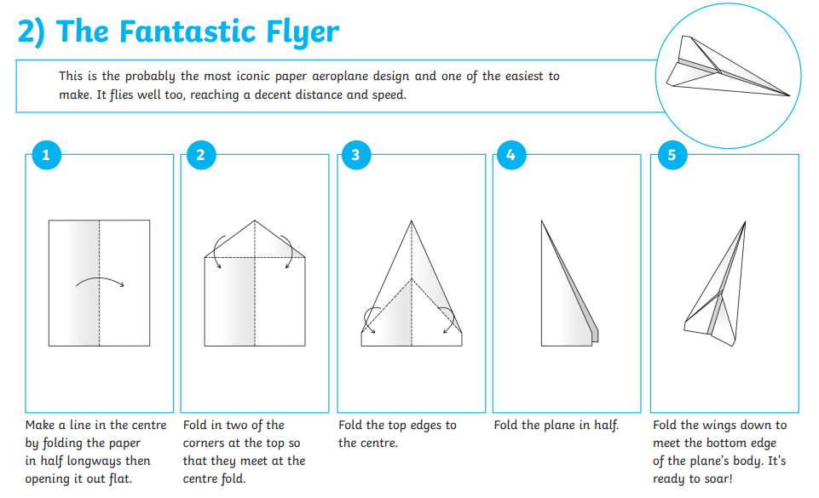
10
Some design ideas:

Slide 21
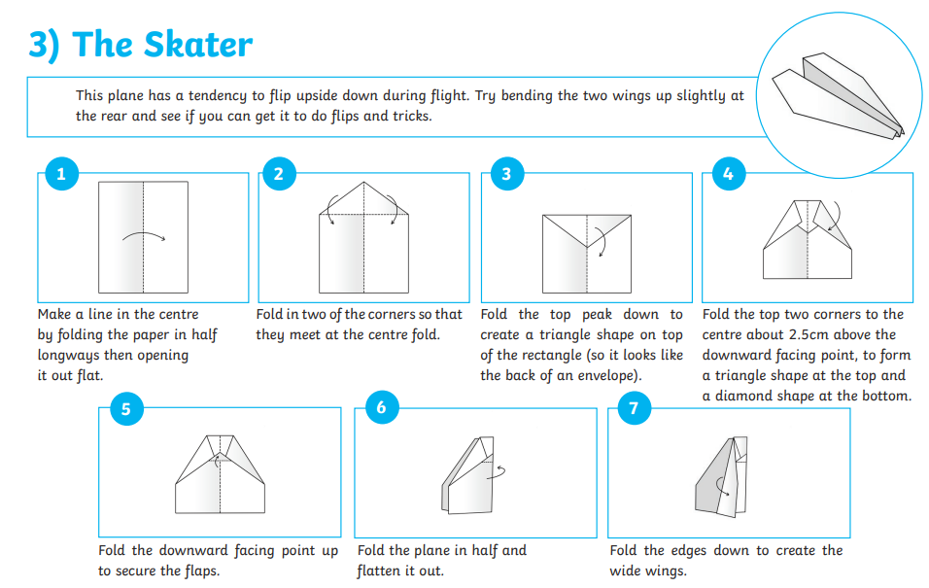
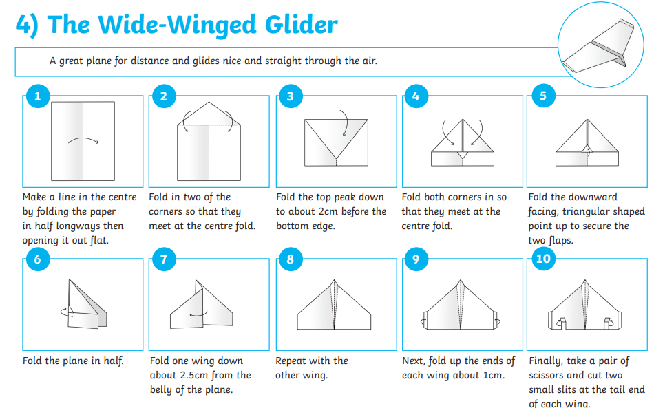
10
Some design ideas:

Slide 22
Investigation Time
11
How will we know which plane is the best? The one that flies the furthest.
What will we measure? Distance travelled.

Slide 23
What did we find out?
12
We investigated __________ ____________.
To make our test a fair test, we
___________________________________.
I predicted that: ______________.
Our paper aeroplane travelled __________.
I found out that __________________.
This happened because
__________________________________.

Slide 24
We investigated...
In groups we designed.... to test the level of ______________.
We found that ____ air resistance airplane greater slowed surface area air particles

Slide 25
What did we find out?
12
Today we have learnt about friction which is a type of force.
Blue– Explain what air resistance is to your partner without using the words 'air resistance'.
Green – Explain what streamlined means to your partner without saying the word 'streamlined'.

Slide 26
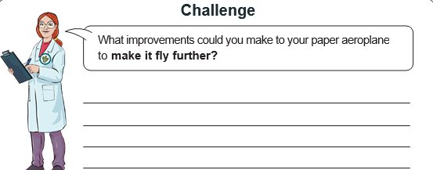
12
Vocabulary to include: Air resistance, friction, streamlined

Slide 27



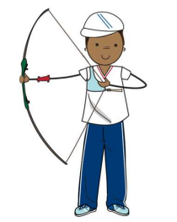
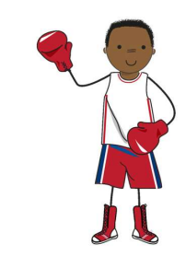
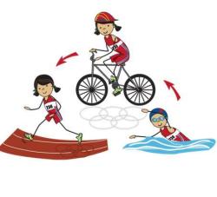
mercredi 18 mars
TBAT: consolidate the 10 Olympic sports in French and use them in full sentences.
3 in 3 languageangels.com/resource/1/5/54/223 - Lesson 4

Slide 28
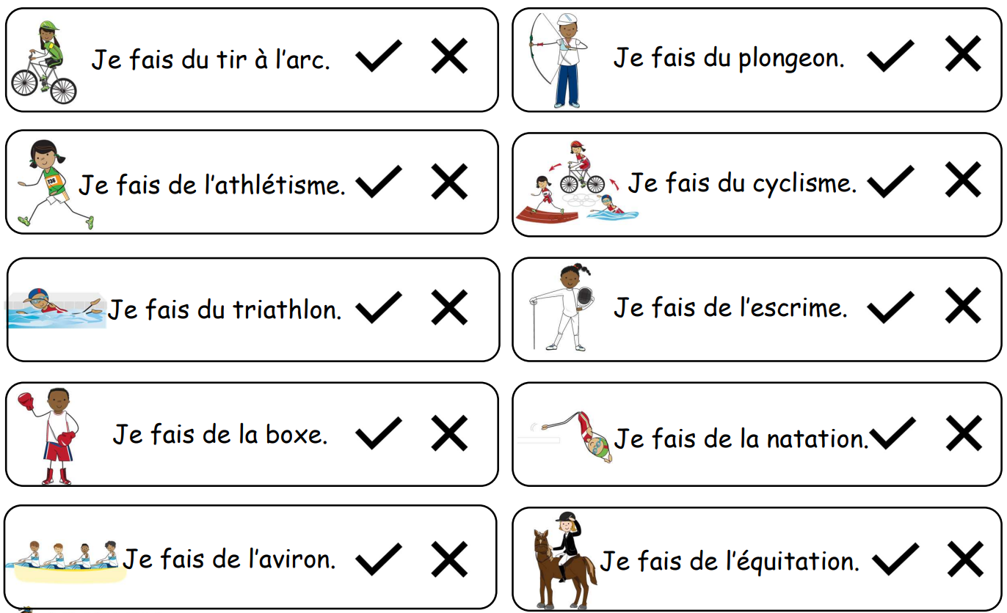

Slide 29
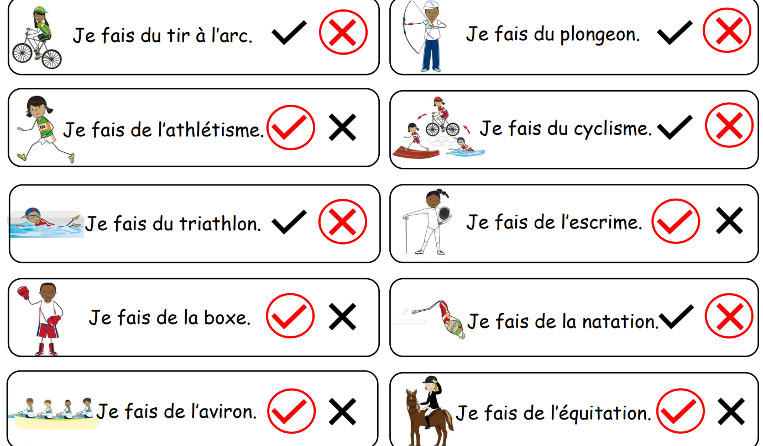

Slide 30
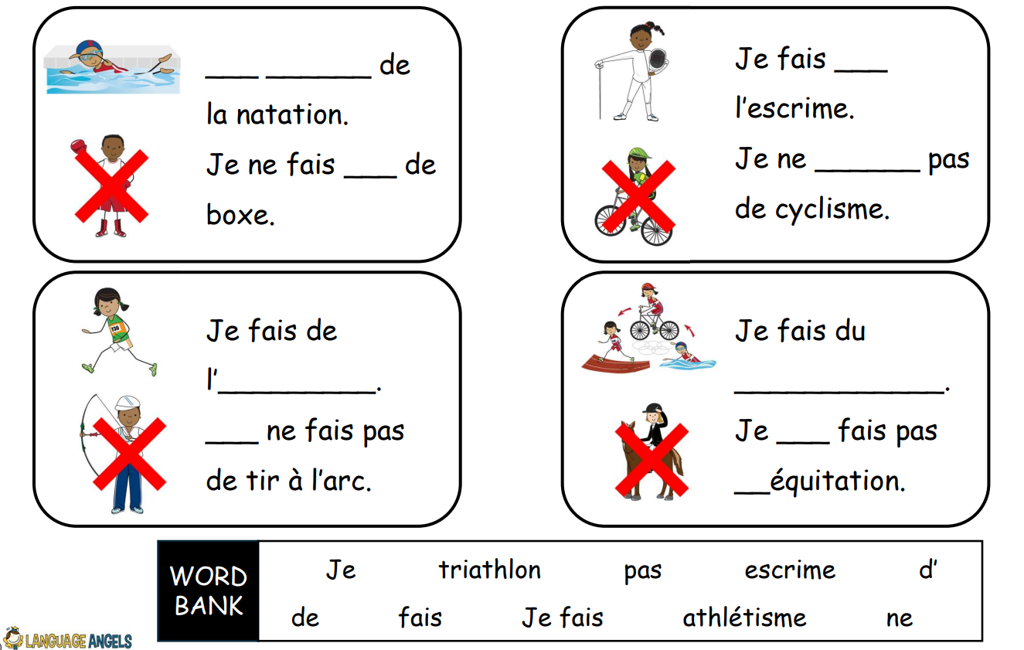

Slide 31
