Slide 1
308 - 10 =
456 + 1, 927 =
35.7 + 23.51 =
5, 706 – 1, 001 =
24, 456 – 6,785 =
444 x 7 =
123 x 23 =
612 divided by 6 =
420 divided by 7 =
4.5 x 100=
61 divided by 10=

Slide 2
2 ¾ x 6 =

Slide 3
¾ + 3/5 = 5/6 + 2/3 = 5/8 - ¼ =

Slide 4

9:40 - 10:10 Arithmetic Paper 1

Slide 5
Athlete Assembly

Slide 6
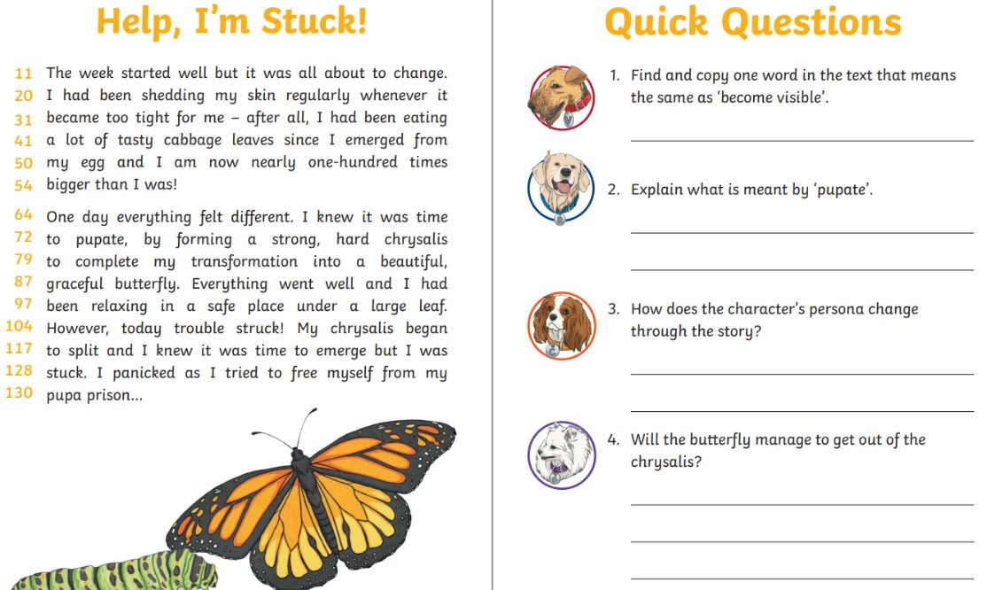

Slide 7

Reading paper 11am - 12pm

Slide 8
Lesson 3: Using a database
Objectives
To outline how you can answer questions by grouping and then sorting data
I can explain that data can be grouped using chosen values
I can group information using a database
I can combine grouping and sorting to answer specific questions

Slide 9
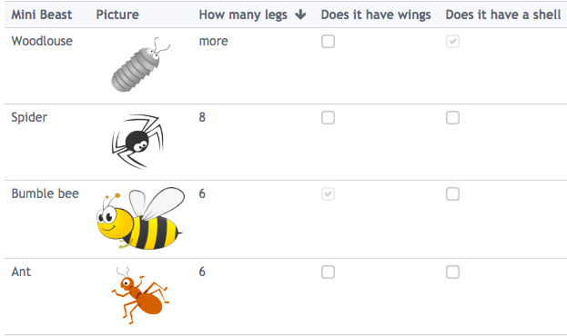
Why do we use computer databases?
Introduction
Give three reasons why we might use computer databases.
Think, write, pair, and share.
Notes:
Answers might include:
To keep our data secure
To keep a large amount of data organised easily
To allow us to search our data more quickly
To sort our data easily
To prevent manual errors being made
Screenshot: https://www.j2e.com/data/examples/minibeasts

Slide 10
To keep our data secure
To keep a large amount of data organised easily
To allow us to search our data more quickly
To sort our data easily
To prevent manual errors being made
Why do we use computer databases?

Slide 11
Grouping the paper records
Grouping the paper records
Activity 1
You are going to make some changes to your card database so that you can pull out records which meet specific criteria.
The cards you pull out will be a group of records which have something in common.
Can fly
Has six legs
Name: elephant
Lives in large groups
Is more than one colour
✓

Slide 12
Grouping the paper records
Activity 1
Cut off the corners of your record cards that don’t have ticks.
Can fly
Has six legs
Name: elephant
Lives in large groups
Is more than one colour
✓

Slide 13
Grouping the paper records
Grouping the paper records
Activity 1
When you hold a corner and carefully shake your cards you will be left with a group of records. Find out:
How many animals in your database have six legs?
How many animals in your database can fly?
How many animals are more than one colour?
Can fly
Has six legs
Name: elephant
Lives in large groups
Is more than one colour
✓
Notes:
Reflect on grouping cards using the corner cutting method, considering the questions above.

Slide 14
Grouping the paper records
Grouping the paper records
Activity 1
How reliable do you think this method is?
How does this method compare with the manual grouping you carried out in Lesson 1?
Which method do you think is better and why?
How well would this method work if you had 2,000 records in your database?
Can fly
Has six legs
Name: elephant
Lives in large groups
Is more than one colour
✓
Notes:
Reflect on grouping cards using the corner cutting method, considering the questions above.

Slide 15
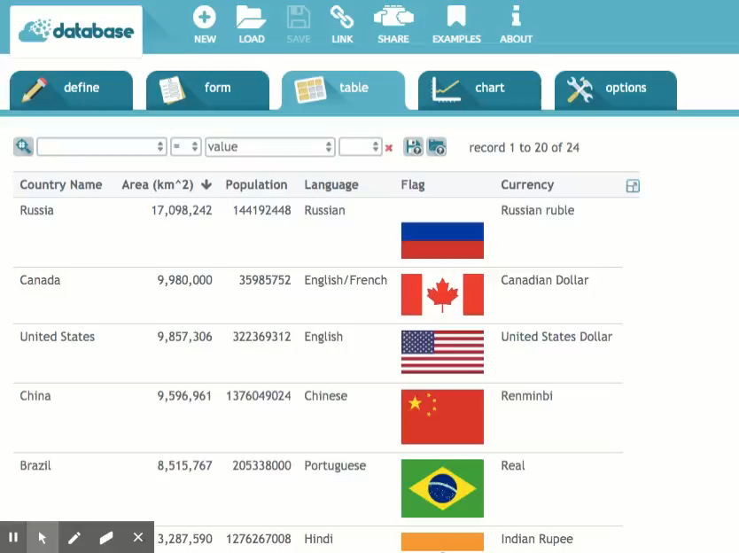
Searching the database
Activity 2
How would we find out which countries in the database are German-speaking?
Notes:
Use the video or live demonstration of a search to find out which countries in the database are German-speaking. To find the answer to this question, search for ‘Language = German’.

Slide 16
Searching the database
Activity 2
How can we find out which countries in a database are German-speaking?
To find the answer to this question, search for ‘Language = German’. (see next slide)
Switzerland
The search puts the matching records into a group.
In this case, the group contains Germany, Austria, and Switzerland.
Austria
Germany
Notes:
Use the video or live demonstration of a search to find out which countries in the database are German-speaking. To find the answer to this question, search for ‘Language = German’.

Slide 17
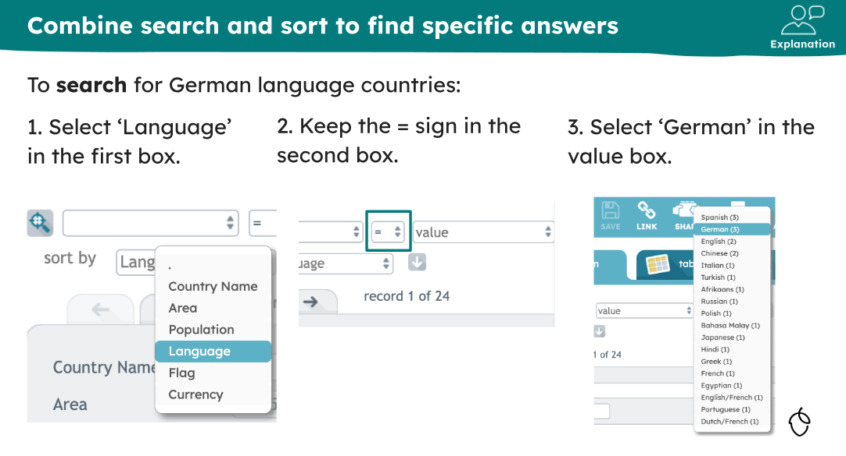

Slide 18
Searching the database countries
Activity 2
Language=German
Notes:
Use the video or live demonstration of a search to find out which countries in the database are German-speaking. To find the answer to this question, search for ‘Language = German’.

Slide 19
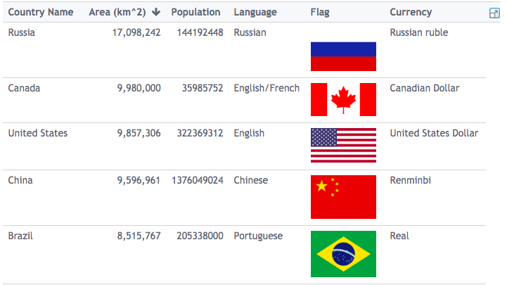
Grouping records in a computer database - ncce.io/dat5-3-a2-r
Activity 2
Task: Use the search function to answer the questions below:
Which countries in the database use the Euro as currency?
Which two countries are Chinese-speaking?
Which country has a population of 8,800,000?
Which countries have a population of over 100,000,000?
Notes:
Screenshot: https://www.j2e.com/data/examples/countries

Slide 20
Grouping and sorting
Activity 2
If you wanted to find the German-speaking country with the smallest population you would:
1. Search the database for language = German. This will create a group.
Germany
Population
81,459,000
Switzerland
Population
8,211,700
Austria
Population
8,800,000
Austria
Population
8,800,000
Switzerland
Population
8,211,700
2. Sort the group by population.
Germany
Population
81,459,000

Slide 21
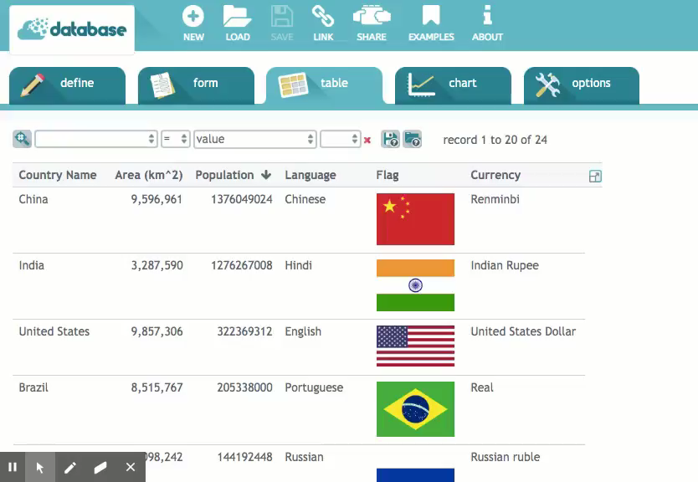
Grouping and sorting the database
Activity 3
What do the following terms mean in computing?
sorting
grouping
Notes:
Use the video or live demonstration to show that once you have searched the database, you can then sort the results, allowing you to further organise the group. Ask learners what sorting means in a computing context? (Putting data values in order.)

Slide 22
Grouping and sorting
Activity 3
Using the database
Using the ‘search’ and ‘sort by’ tools in the ‘Countries’ database, answer the following questions:
Which Spanish-speaking country has the largest population?
Which Chinese-speaking country has the smallest population?
Which country using the Euro currency has the smallest area?
Which country using the Euro currency has the smallest population?
Out of all the countries with a population of over 100,000,000, which has the largest area?
Answer the questions on the ‘Using the database’ activity sheet by grouping and then sorting the records.

Slide 23
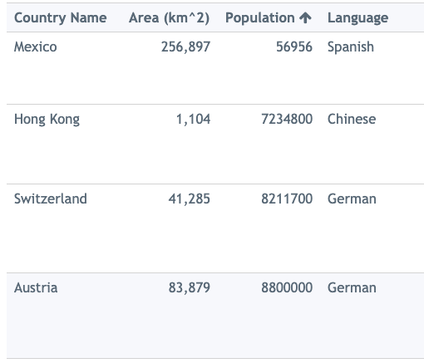
Data accuracy
Plenary
This is data from the ‘Countries’ database. The population of Mexico is more than ten times smaller than the population of all the other countries. This is a mistake. The data is wrong.
Talk partners: explain why this might have happened.
Notes:
As a class, discuss findings from the ‘Combining grouping and sorting’ activity and clarify the functions of ‘grouping’, ‘searching’, and ‘sorting’ if needed.
Screenshot: https://www.j2e.com/data/examples/countries

Slide 24
Next lesson
Summary
In this lesson, you…
Grouped records in a paper database and a computer database
Combined ‘search’ and ‘sort’ to answer questions
Next lesson, you will…
Use database tools to select data to answer questions

Slide 25
