Slide 1
Monday 23rd March 2026

Slide 2
Phonics
TBAT
Read words with a ch /c/ /sh/

Slide 3

Revisit and review
Today's Grapheme
ch

Slide 4
recap
c sh

Slide 5
Revisit and review
What are the digraphs?
shriek
shaking
chasing
chapter
children
crocodile
Segment these
words and read them
Blend and say words

Slide 6
Focus words
s-ch-oo-l
e-ch-o
ch-e-f
Sounds out these
words and read them

Slide 7
Focus words
school
echo
chef
Sounds out these
words and read them

Slide 8
school
chemist
echo
chef
stomach
Parachute
Christmas
Focus words
Read, sound talk and blend
And again... FASTER!

Slide 9
Revisit and review
GROW THE CODE
Sort the words depending on their grapheme
CHALLENGE – Can you think of any more words?
/c/ch /sh/ch
chemist echo chef Christmas parachute stomach

Slide 10
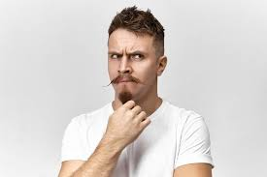
Revisit and review
because
laugh
tricky words
Read the tricky words
eye

Slide 11

Now let's read this sentence!​
What digraphs can you see?
What tricky words can you see?

Slide 12
Let's spell!
How many sounds? Write it.
tricky words
school echo laugh
Listen to the sentence, say it, write it and read it!
Challenge
Extend the sentence using 'and’ or ‘or’.

Slide 13

Today’s big question
What job would I like to do when I grow up?
Notes:
Encourage pupils to think of as many ideas as they can. They call these out and you see how many you can write down as they go!
Examples: business people, builders, architects, shop workers, scientists, hairdressers, beauty therapists, fashion designers, hospital workers, doctors, nurses, drivers, chefs, police, public transport workers, teachers, electricians, plumbers, carpenters, farmers, labourers, grooms (riding stables), vets, shop workers, army personnel, fishermen, ferry and tunnel workers, life guards, water police, marine conservation workers, pilots, air maintenance crew, cabin crew, air traffic control, artists, dancers, actors, writers, set designers, costume departments, lighting and sound engineers.

Slide 14
KQ: What job would I like to do when I grow up?
3 in 3- Circle three ways that an adult can earn money.
volunteering
full-time working
part-time working
swimming
benefits and grants
archery
Notes:
Encourage pupils to think of as many ideas as they can. They call these out and you see how many you can write down as they go!
Examples: business people, builders, architects, shop workers, scientists, hairdressers, beauty therapists, fashion designers, hospital workers, doctors, nurses, drivers, chefs, police, public transport workers, teachers, electricians, plumbers, carpenters, farmers, labourers, grooms (riding stables), vets, shop workers, army personnel, fishermen, ferry and tunnel workers, life guards, water police, marine conservation workers, pilots, air maintenance crew, cabin crew, air traffic control, artists, dancers, actors, writers, set designers, costume departments, lighting and sound engineers.

Slide 15

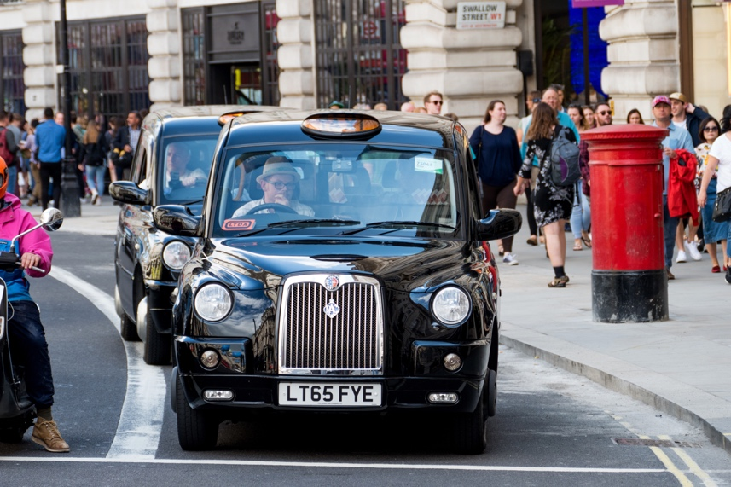

KQ: What job would I like to do when I grow up?
Would you like a job in the city?
Notes:
Include business people, builders, architects, shop workers, scientists, hairdressers, beauty therapists, fashion designers, hospital workers, doctors, nurses, drivers, chefs, police, public transport workers, teachers, electricians, plumbers, carpenters, etc.
Use these according to your pupils’ needs/understanding. Note: The main focus is to open their minds to the huge variety of jobs that are available to them when they grow up.

Slide 16
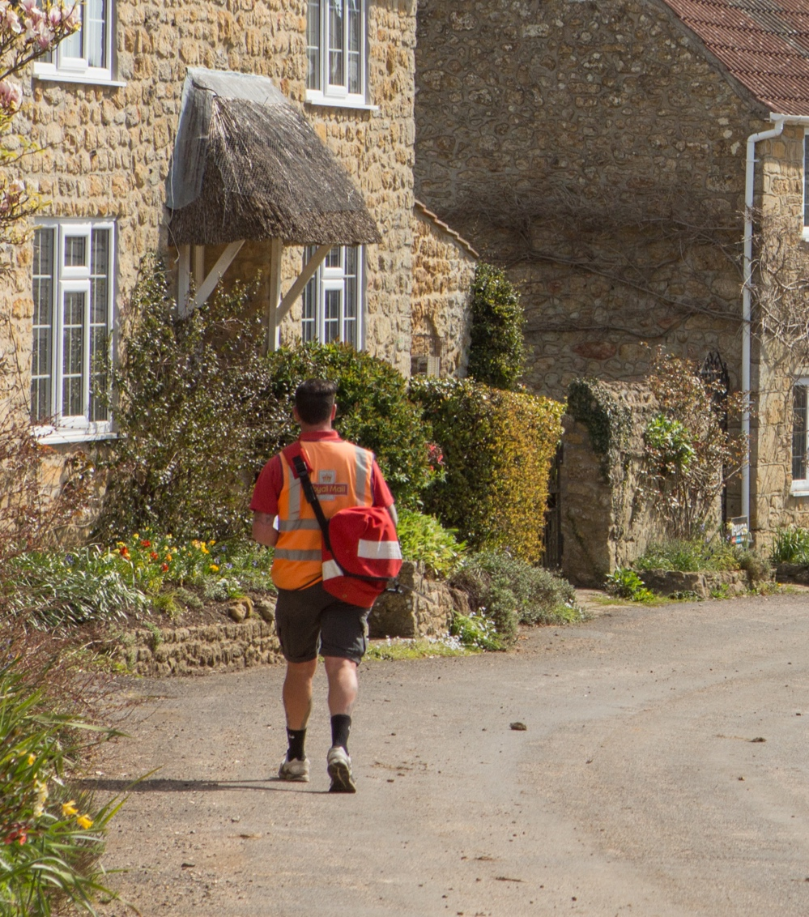
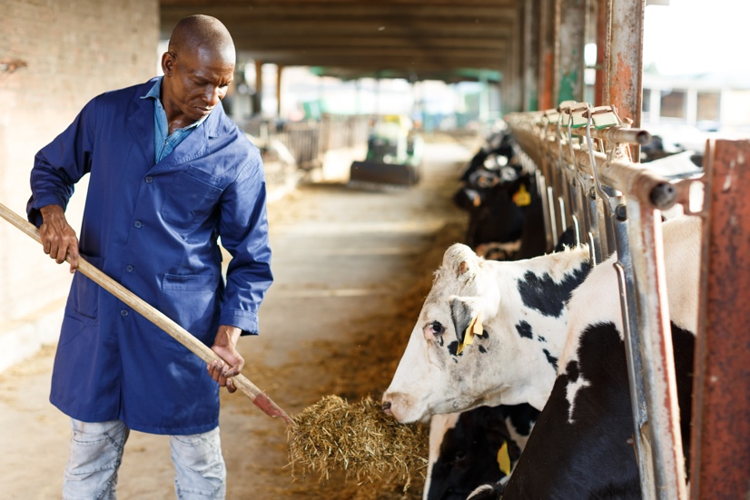
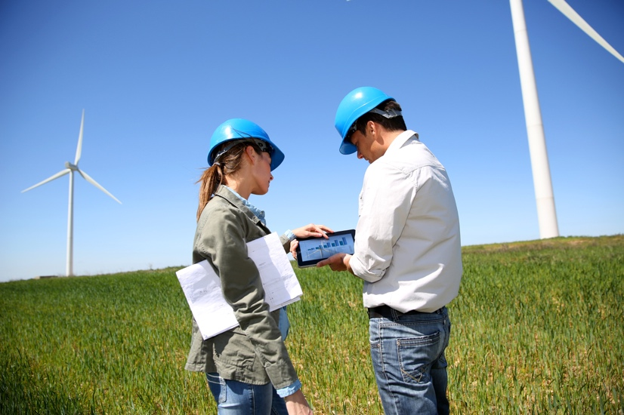
KQ: What job would I like to do when I grow up?
Would you like a job in the countryside?
Notes:
Include farmers, labourers, grooms (riding stables), vets, shop workers, army personnel, business people, builders, architects, shop workers, hairdressers, beauty therapists, hospital workers, doctors, nurses, drivers, chefs, public transport workers, teachers, electricians, plumbers, carpenters, etc. (Many of these overlap with city work – it’s good to discuss this so they understand some work can be in either cities or the countryside.)
Use these according to your pupils’ needs/understanding. Note: The main focus is to open their minds to the huge variety of jobs that are available to them when they grow up.

Slide 17
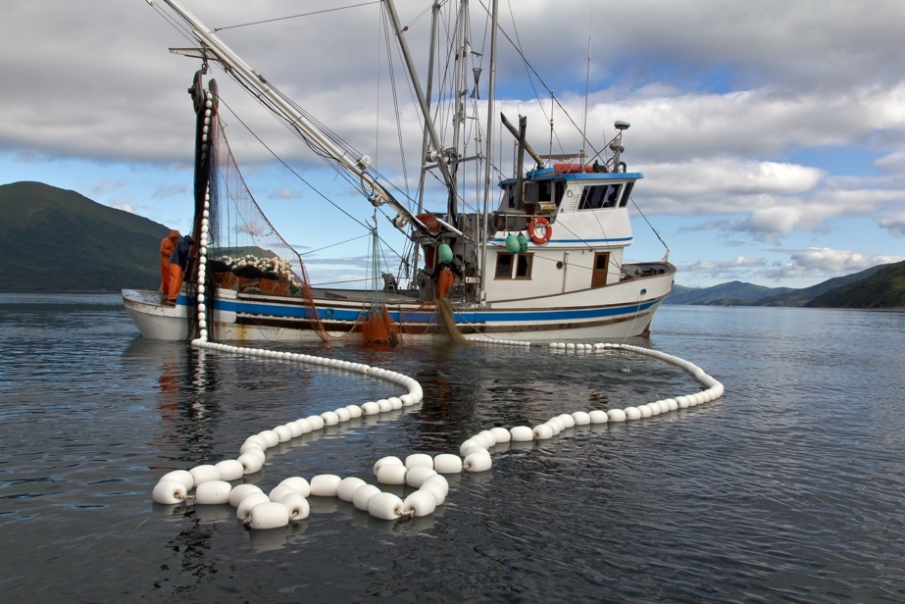
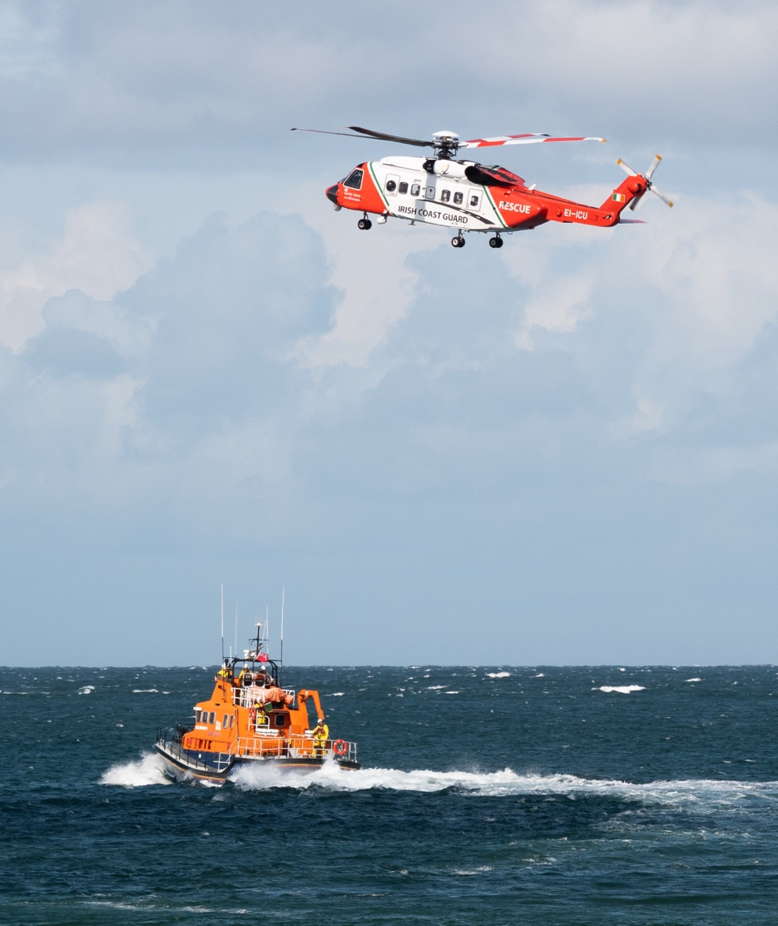
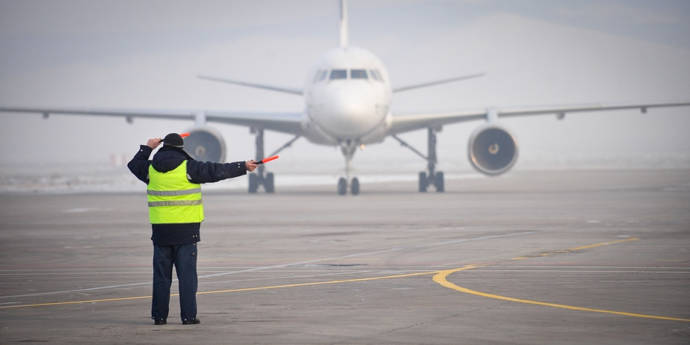
KQ: What job would I like to do when I grow up?
Would you like a job in or near water or in the air?
Notes:
Include fishermen, ferry and tunnel workers, life guards, water police, marine conservation workers and scientists. Also pilots, air maintenance crew, cabin crew, air traffic control, etc.
Use these according to your pupils’ needs/understanding. Note: The main focus is to open their minds to the huge variety of jobs that are available to them when they grow up.

Slide 18
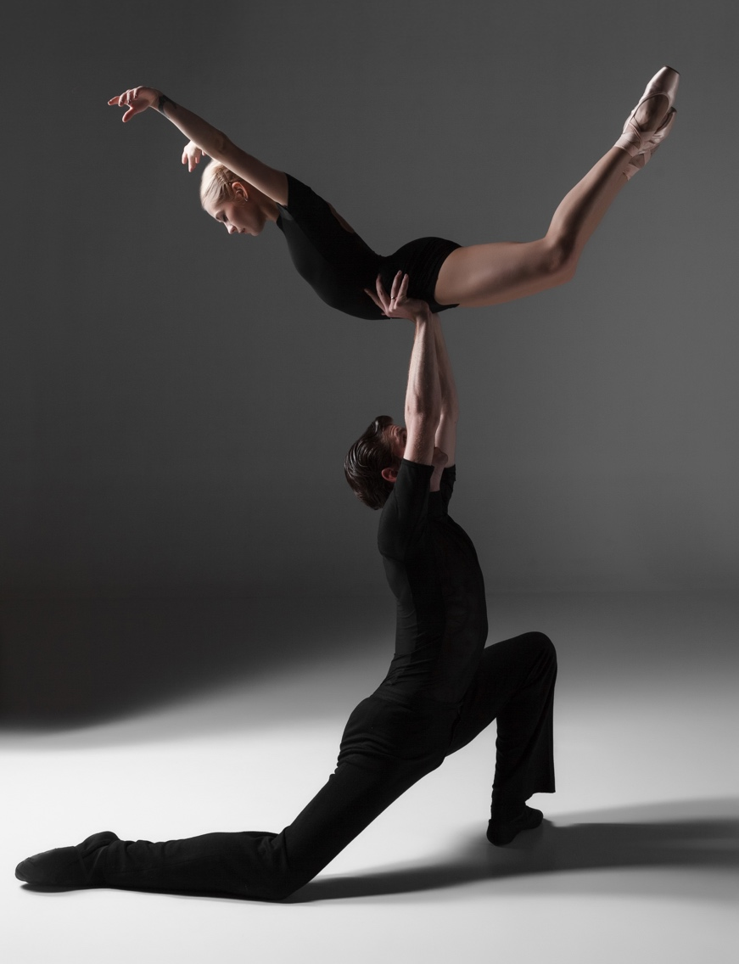

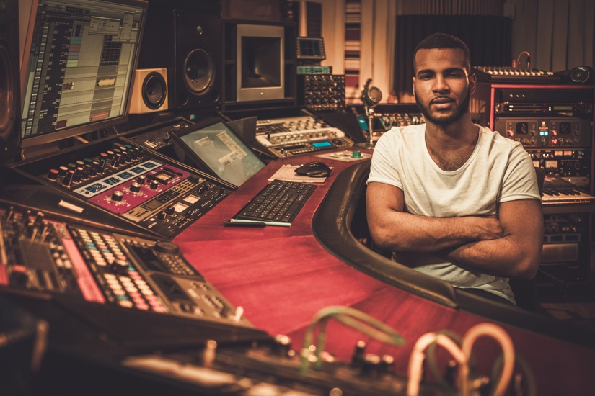
KQ: What job would I like to do when I grow up?
Would you like a creative job?
Notes:
Include artists, dancers, actors and writers, plus set designers, costume department workers, lighting and sound engineers, etc. Use these according to your pupils’ needs/understanding.
Note: The main focus is to open their minds to the huge variety of jobs that are available to them when they grow up.

Slide 19
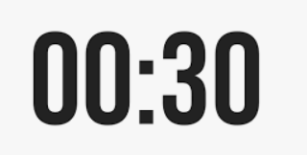
KQ: What job would I like to do when I grow up?
Blue/ Green- What job would you like to do when you grow up?
When I grow up, I would like to be a.........
Challenge: What skills would you need to achieve this goal?
Notes:
Include artists, dancers, actors and writers, plus set designers, costume department workers, lighting and sound engineers, etc. Use these according to your pupils’ needs/understanding.
Note: The main focus is to open their minds to the huge variety of jobs that are available to them when they grow up.

Slide 20

Assembly

Slide 21
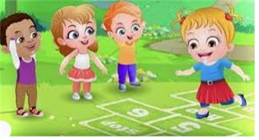
Break

Slide 22
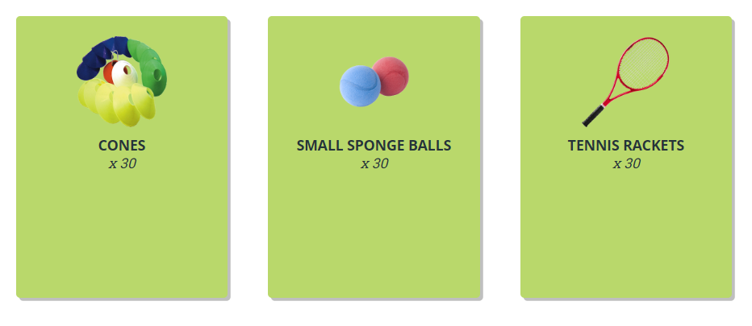
Warm-up :
Get a cone each and stand next to it in a space. Jog around the area touching the cones with your hands as you move.
Get a ball and carry it to a cone and place it on top then move to a new cone to collect a ball and repeat. How many balls can you move? Now pick up a ball and complete three throws and catches on the spot before moving to a new cone
TBAT – develop sending a ball using a racket
2 in 2
Where on a racket should you keep the ball?
Name the three parts of a racket

Slide 23
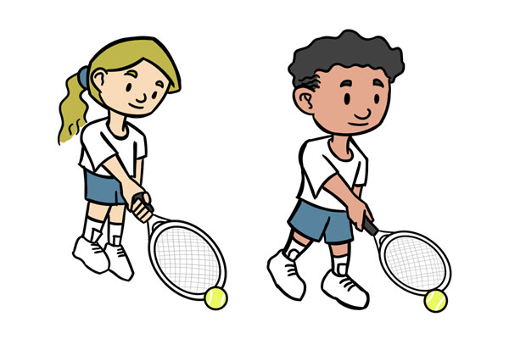
TBAT – develop sending a ball using a racket
Skill development
Racket and ball familiarization
A
Get a racket and stand next to a cone and ball.
Roll the ball from side to side on the floor using the racket.
B
Push the ball around the cone using the racket
C
Push the ball around the area using the racket, travelling around each cone that you get to.

Slide 24
TBAT – develop sending a ball using a racket
ON THE MOVE
Practise the following skills whilst keeping the ball controlled on the racket.
What part of the racket should you keep the ball for good control?
Walk around the teaching area and now try;
side stepping
walking backwards

Slide 25
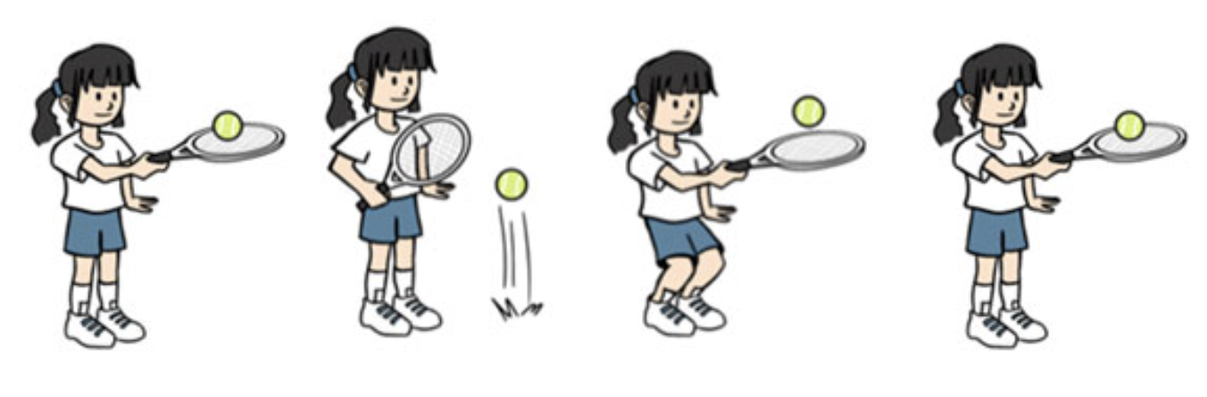
TBAT – develop sending a ball using a racket
RACKET AND BALL SKILLS
A
Place the racket on the floor next to the cone.
Drop the ball from two hands onto the racket face and catch with two hands.
B
Begin with the ball on the racket face. Tip the ball from the racket face and bend your knees to scoop it back up after one bounce.
C
Tap the ball up, let it bounce on the floor and then catch it on the racket.

Slide 26
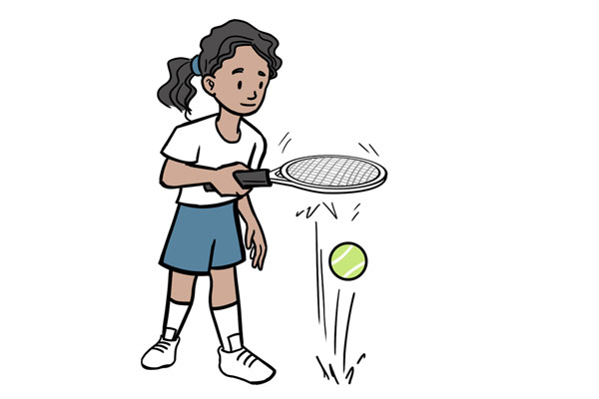
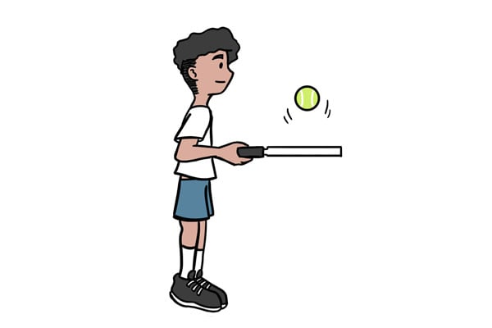
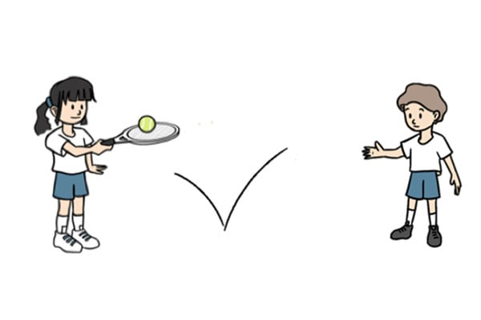
TBAT – develop sending a ball using a racket
D
Tap the ball up, let it bounce on the floor and then catch it on the racket.
E
Tap the ball up continuously with the racket
In pairs use one racket. One will throw the ball so that it bounces on the floor and the other will catch the ball in the centre of their racket. After a few turns, change over.

Slide 27
TBAT – develop sending a ball using a racket
Plenary
What helps you to control the ball?
Where on the racket should you hit the ball?
Did you find any of the skills difficult?
How does it make you feel when you find things difficult?
What did you do if you found things difficult?

Slide 28

Lunch

Slide 29

Today's Alien language is.......

Slide 30
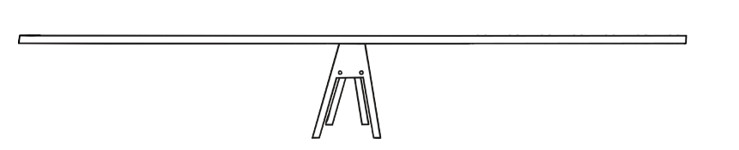

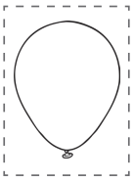
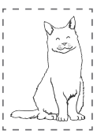
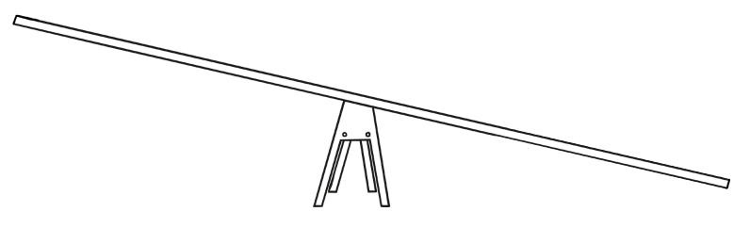
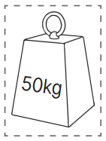
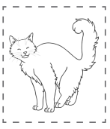
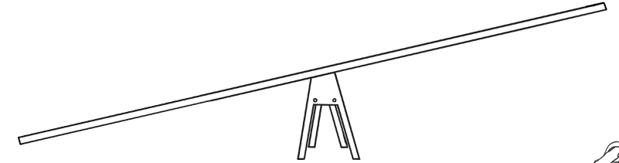
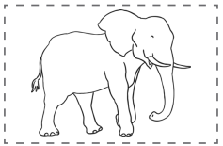
TBAT: compare the masses of more than two objects
3 in 3 – Place the objects correctly onto the balance scales.

Slide 31
TBAT: compare the masses of more than two objects
balance
balances
level
estimate
heavier
heaviest
lighter
lightest

Slide 32
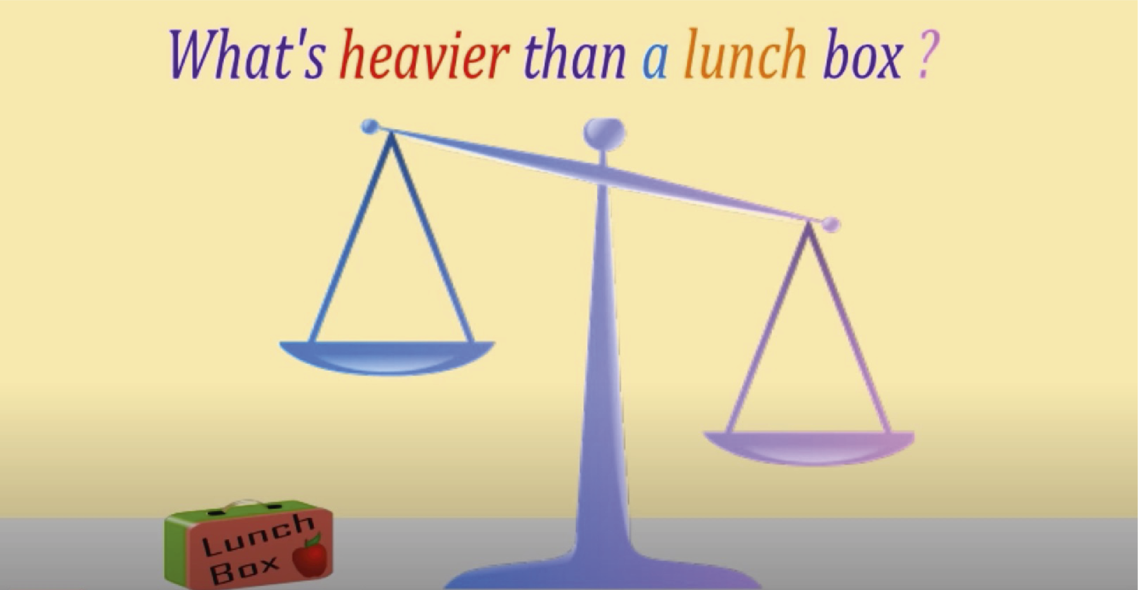
Let's learn a song about mass!

Slide 33
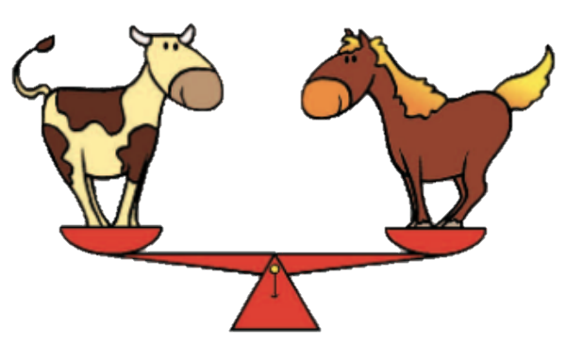
The cow and the horse have the same mass
How do we know this is true?
I am as heavy as the cow.

Slide 34

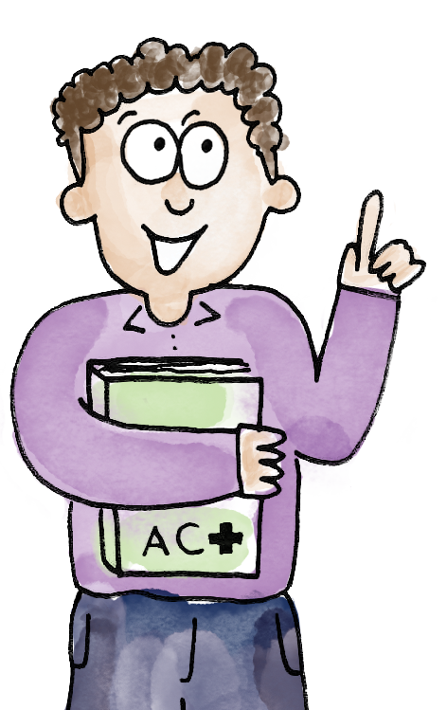
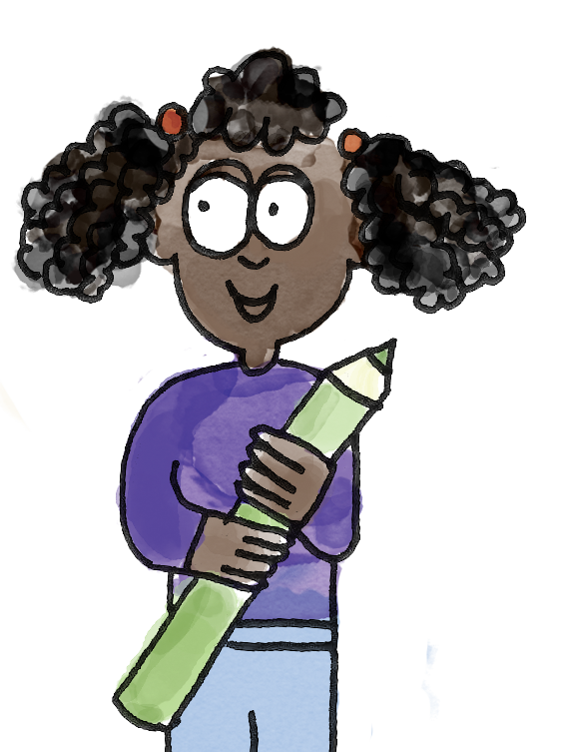



I choose the book. I think it will be heavier than the marble.
I’ve swapped the book for the marble. And now I’ve made the balance level again.
The book is heavier than the marble.
I know it is heavier because you had to add more playdough.
balance balances level estimate heavier heaviest lighter lightest

Slide 35


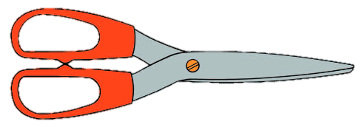

Which object do you think is the heaviest?
Which do you think is the lightest?

Slide 36
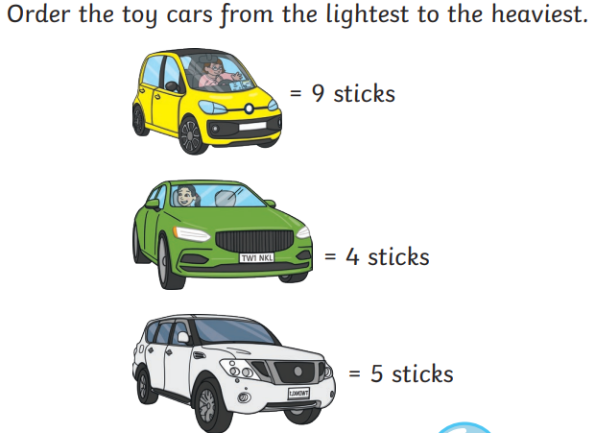
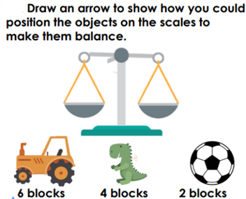
To compare the masses of more than two objects
RP:
Independent:
Sort your three items of ‘post’ from heaviest to lightest.
Challenge:

Slide 37
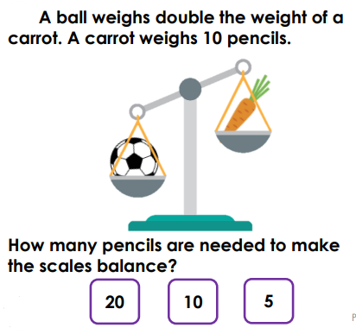
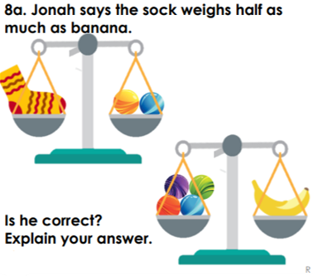
TBAT: compare the masses of more than two objects.
Mastery:
Mastery with greater depth:

Slide 38
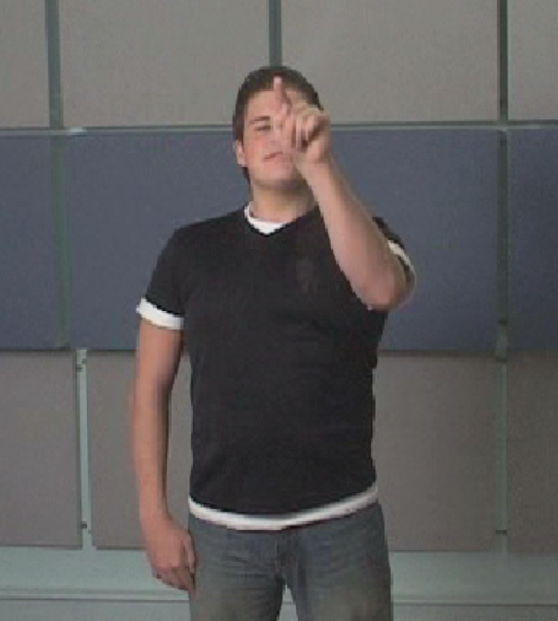
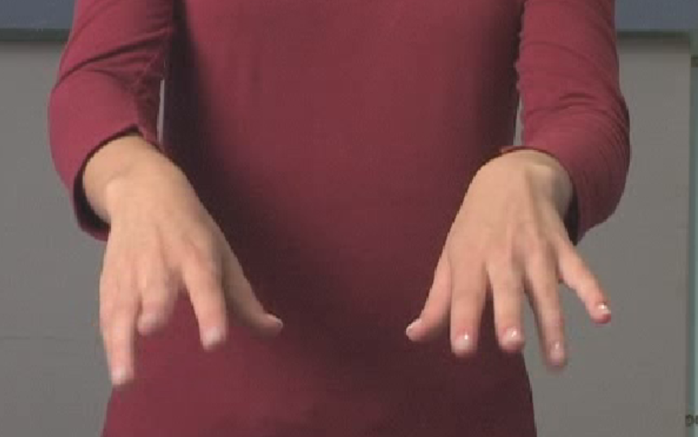
TBAT: recap the long letter family
Warm up:
Draw a face Knuckles, wrists, palms

Slide 39
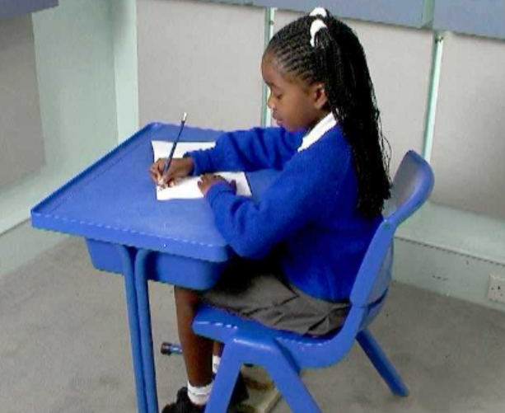
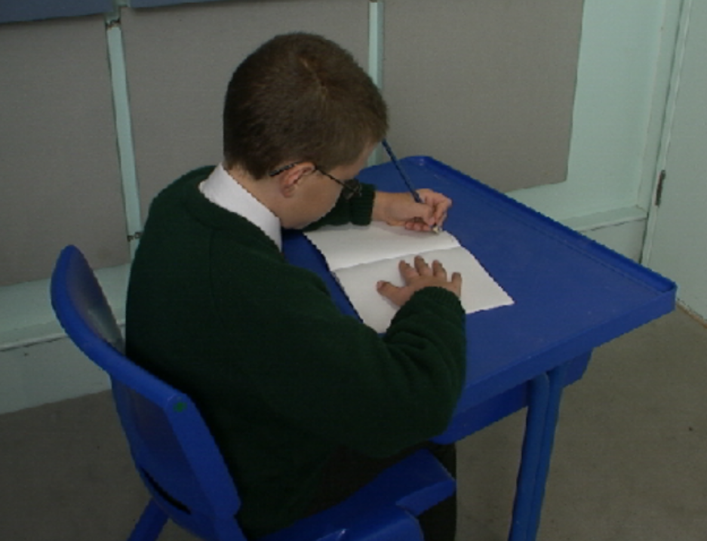
Correct posture
Right handed Left handed

Slide 40

Look at the heights of the letters. Can you see the ascenders and descenders?
let jet tell

Slide 41
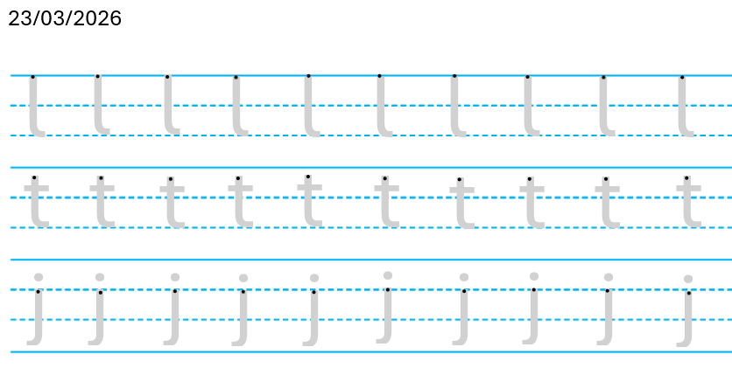

Slide 42
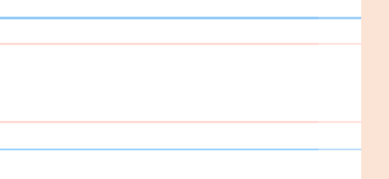

let
jet
tell

Slide 43

Little Wandle Guided Reading

