Slide 1
Monday 16th March 2026

Slide 2


Morning Challenges:
Name writing
Write sentences to describe the picture. Use adjectives.

Slide 3
Phonics
Revisit and review
Lesson focus:
Read words with the /ur/ear grapheme

Slide 4

Revisit and review
Today's Grapheme
ear

Slide 5
Recap:
ur ir or air ear are ere y al

Slide 6
Revisit and review
What are the digraphs?
whispering
salt
wasp
watch
there
wear
Segment these
words and read them
Blend and say words

Slide 7
Focus words
l-ear-n
s-ear-ch
r-e-h-ear-s-al
Sounds out these
words and read them

Slide 8
Focus words
learn
search
rehearsal
Sounds out these
words and read them

Slide 9
Focus words
learn
early
earth
search
heard
rehearsal
Read, sound talk and blend
And again... FASTER!

Slide 10
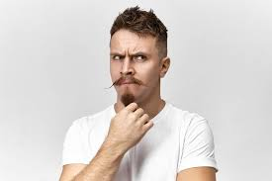
Revisit and review
any
many
tricky words
friend
Read the tricky words

Slide 11
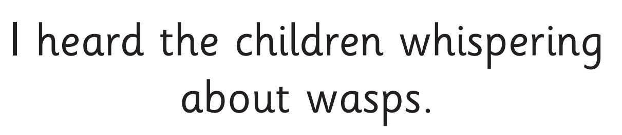
Now let's read this sentence!​
What digraphs can you see?
What tricky words can you see?

Slide 12
Let's spell!
How many sounds? Write it.
tricky words
learn early any
Listen to the sentence, say it, write it and read it!
Challenge
Extend the sentence using ‘and’ or ‘or’.

Slide 13

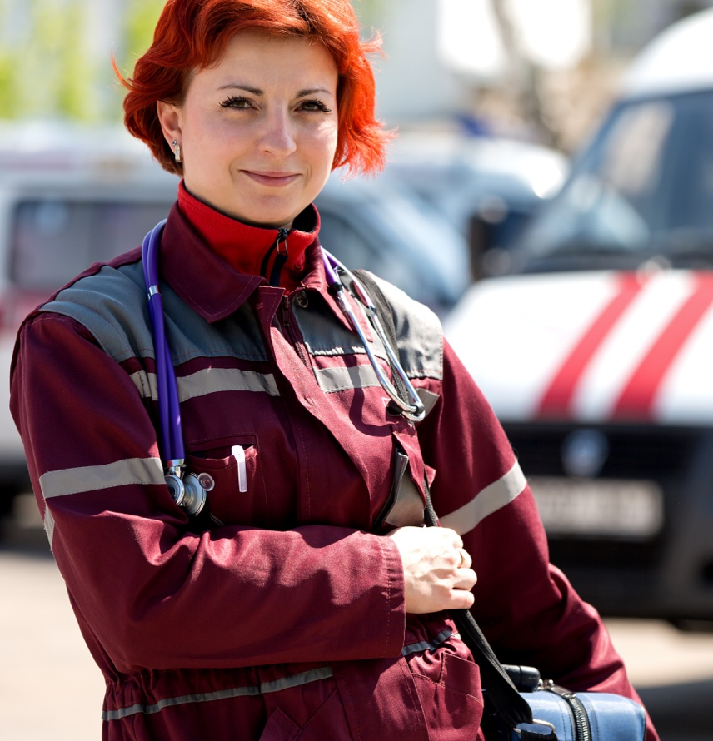
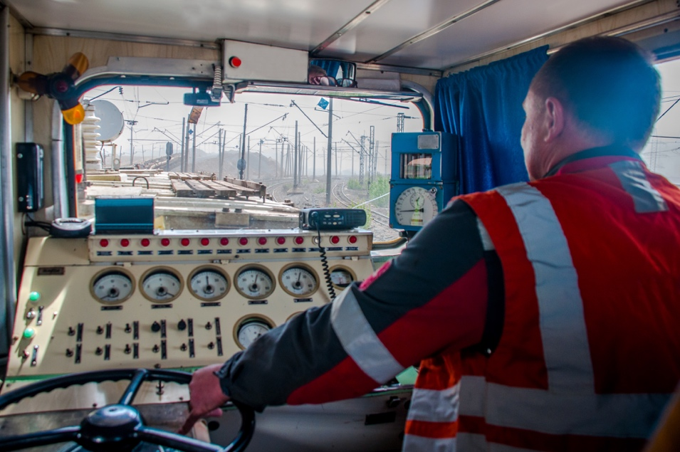
Today’s big question
Where do adults get their money?
Notes:
Encourage pupils to think of as many ideas as they can; they call these out and you can see how many you can write down as they go! Deduce that some people work and some, who are ill and cannot work due to being ill, or for other reasons, get benefits and social help. Others may be students or may work as volunteers (explain that this is unpaid work, normally for a good cause/charity).

Slide 14
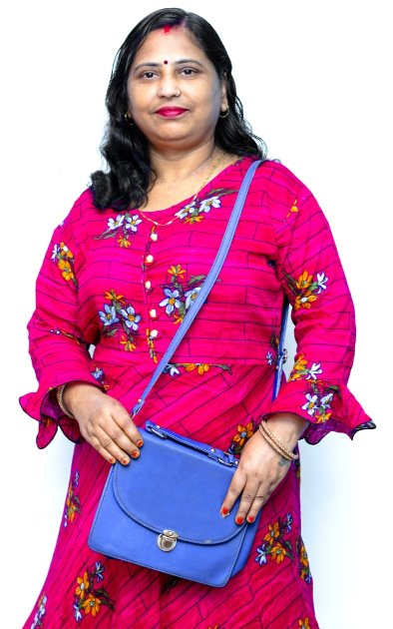

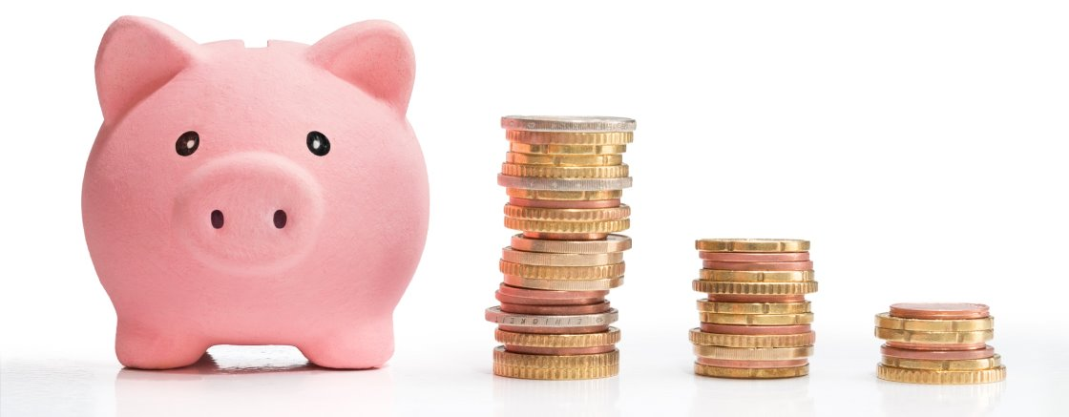
KQ: Where do adults get their money?
3 in 3: List three places you could keep your money to keep to it safe.
Challenge: Which is the safest and least safe option? Why?

Slide 15

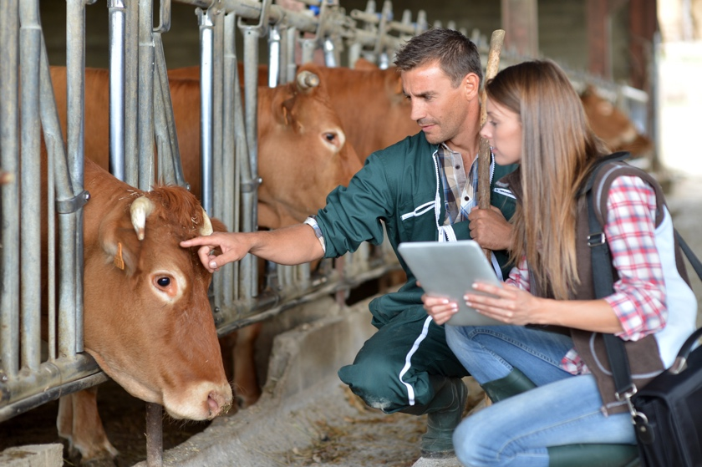
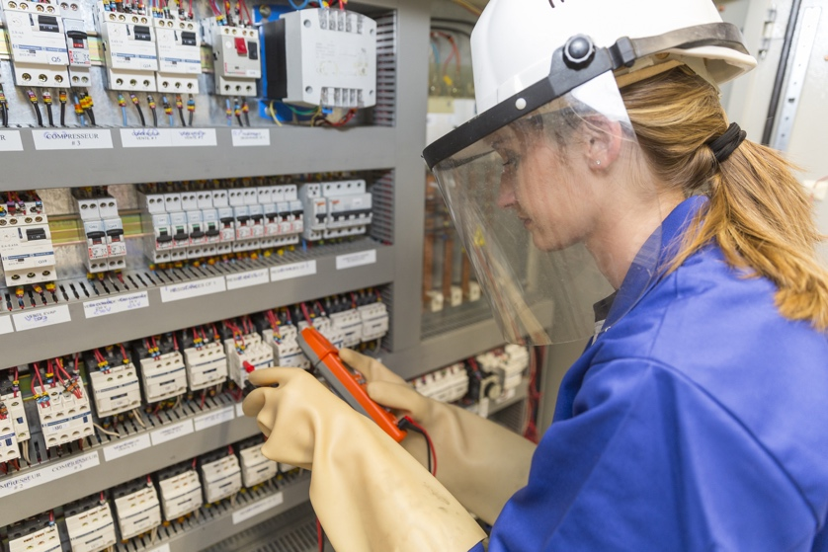
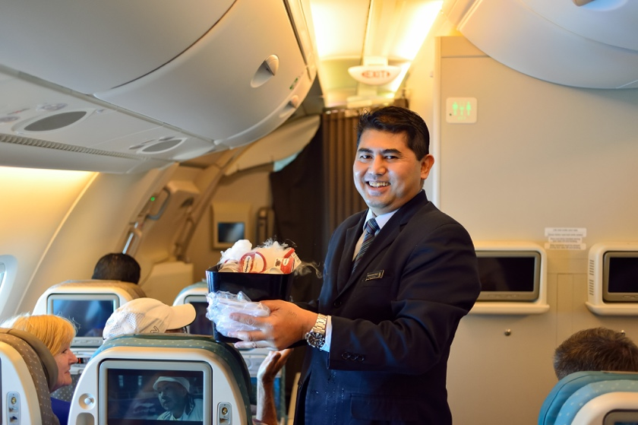
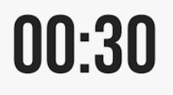
KQ: Where do adults get their money?
Jobs
Blue/ Green
What job would you like to do when you grow up?
When I grow up I would like to be.......
Challenge: What skills would you need for that job?
Notes:
This slide should be used as a stimulus for ideas about different jobs. Before you send the pupils off to talk together, spend a little time looking at and discussing the images and the different jobs. Why are they wearing these clothes? What might they do all day? Do they work inside or outside? Do they travel? What skills might they need?

Slide 16
KQ: Where do adults get their money?
Other ways people get money to live
What about people who are ill, or have to look after children, or are studying?
Working is the best way to make money but sometimes this isn’t possible.
The Government can help people who are unable to work or who only earn a little bit by supporting them with some money.
They do this through benefits, credits, pensions, loans or grants.
Notes:
These can be given to people who only earn a small amount of money or don’t earn anything, and so need help.
Examples include: Working Tax Credit – helps low income families; State Pension – helps older people who have retired; Sick Pay – people who are ill; Student Loans – the Government lends money to people who want to study; Jobseekers Allowance – those people who are looking for work or only work a few hours each week (16 hours); Housing Benefit – helps people pay rent; Disability Allowances – people of all ages who need help because of a disability.

Slide 17
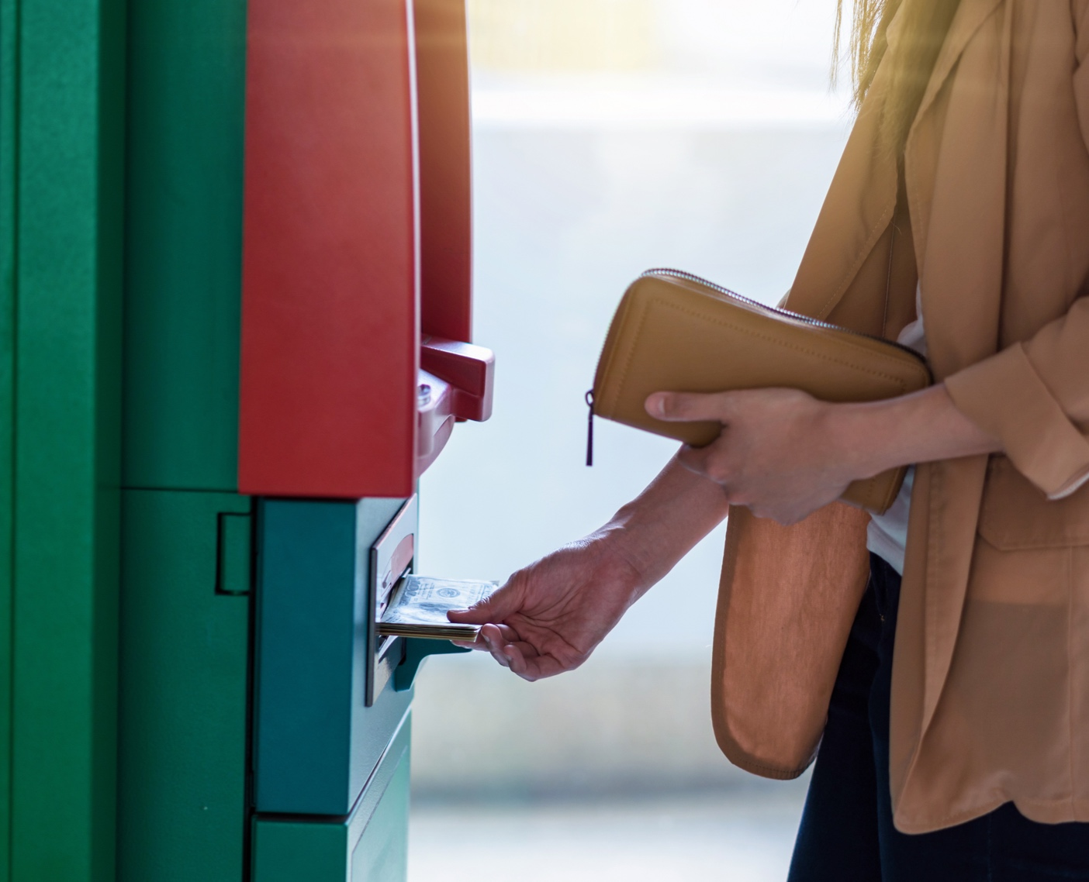
KQ: Where do adults get their money?
What have we learnt?
Today’s big question:
Where do adults get their money?
Notes:
Pupils should now have a much clearer idea about the reality of how people get their money.
Remind pupils that they have learned that some jobs are paid (some more than others) and some are voluntary, while other people have to rely on social support. Use this big question to evaluate their understanding and, if necessary, spend time clarifying any misconceptions or answering any questions.

Slide 18
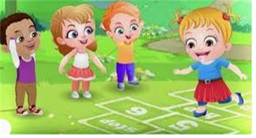
Break

Slide 19
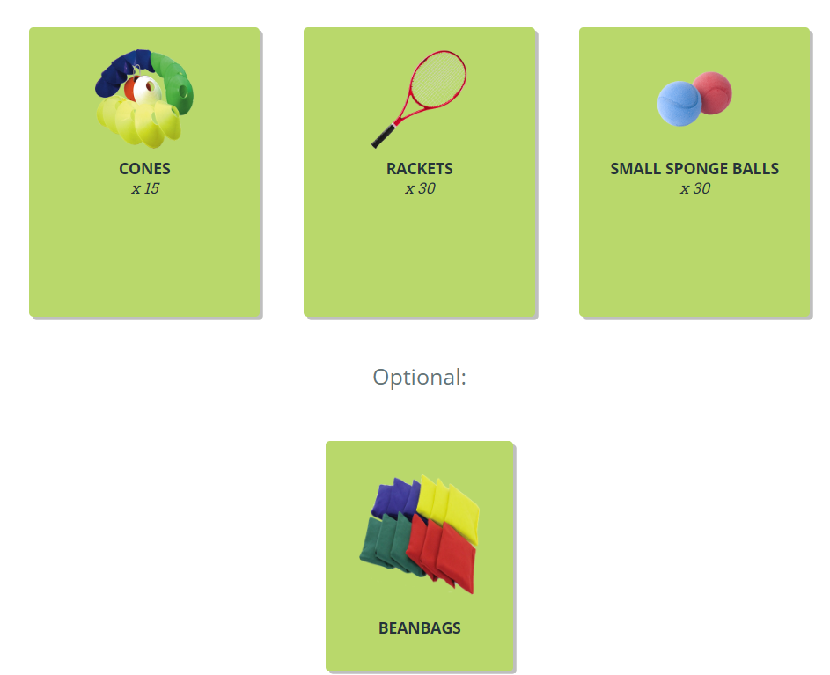
Warm-up
Runner bean: fast running on the spot
Baked bean: hopping around the teaching space
Jumping bean: two footed jumps
Broad bean: complete star jumps
What changes have happened to your body? Why?
TBAT – explore hitting with a racket
2 in 2

Slide 20
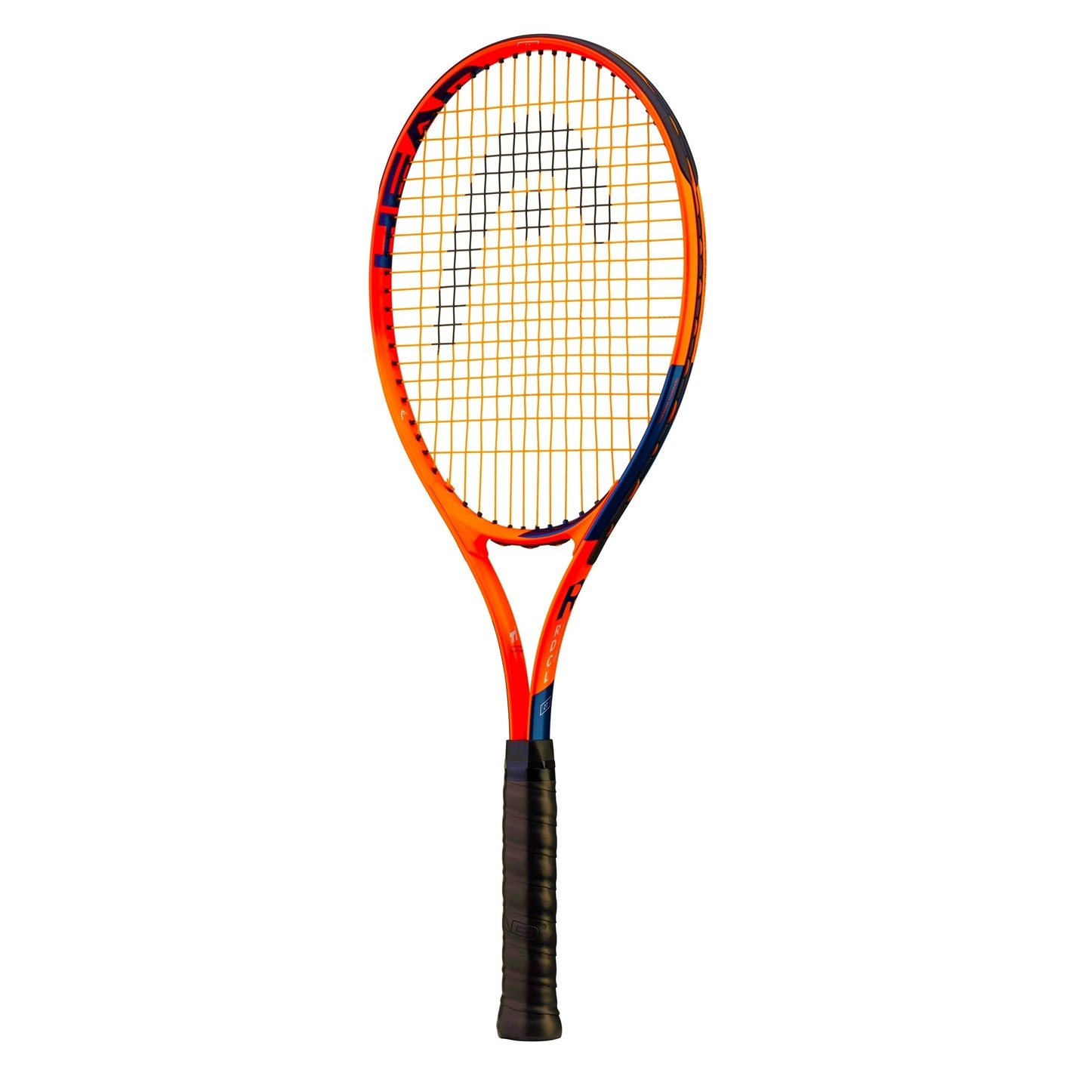
TBAT – explore hitting with a racket
Skill development
Touch the handle
Touch the head of the racket
Touch the face (strings)
Practice moving the racket
Hand to hand
around your body
around one leg and around both legs
in a figure of eight through the legs

Slide 21
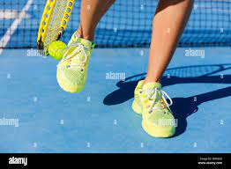
TBAT – explore hitting with a racket
PICK-UP
Pick up a racket and one sponge ball.
Start with a ball on the floor.
Can you find a way of getting the ball up onto your racket without using your hands?

Slide 22
TBAT – explore hitting with a racket
BAD WEATHER
Walk around the hall with a ball on your racket and when you hear.....
FLOOD: lift the racket above your head, keeping the ball on the racket.
HURRICANE: turn 360°, keeping the ball on the racket.
WIND: drag the ball from side to side on the floor.

Slide 23
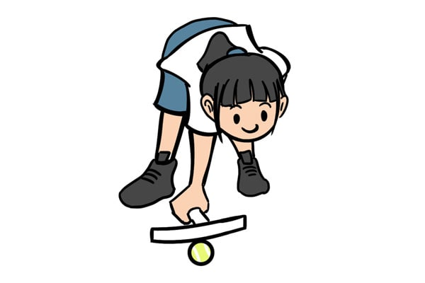
TBAT – explore hitting with a racket
FLOOR RALLY
In teams of four, stand in a square formation.
Place the ball on the floor and practice pushing the ball so that it rolls along the floor to a partner
Try and trap the ball placing a racket on top of it.

Slide 24
TBAT – defend space using the ready position
Plenary
Where on the racket should you keep the ball? Why?
How many hands should you hold the racket with?
Who was a supportive teammate? Why?
Which challenges did you find difficult?

Slide 25

Lunch

Slide 26

Today's Alien language is.......

Slide 27


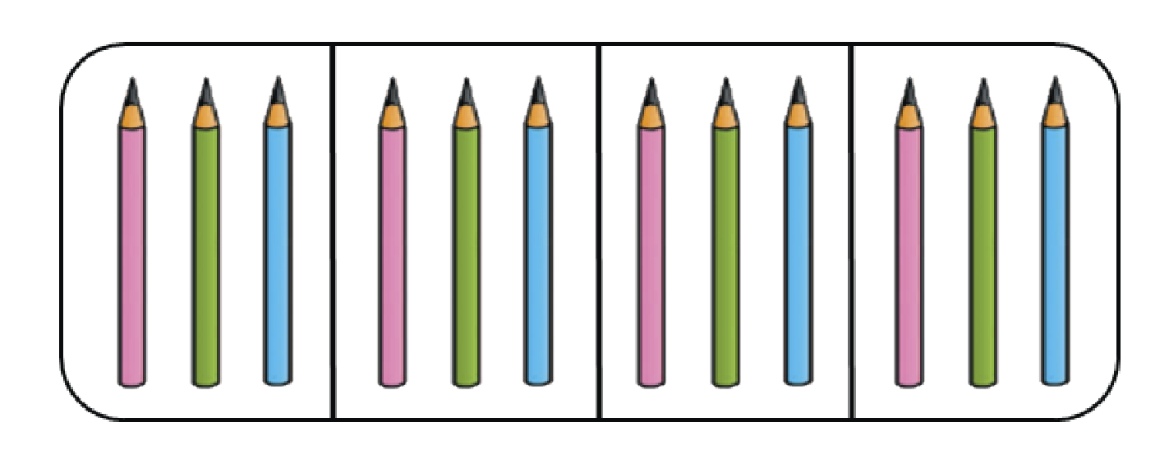
Which of these show halves?
3 in 3
Challenge: If they are not halved, why not?

Slide 28
TBAT: compare the lengths and heights of two or more objects
long
longer
longest
short
shorter
shortest
tall
taller
tallest
higher
lower
length
height

Slide 29
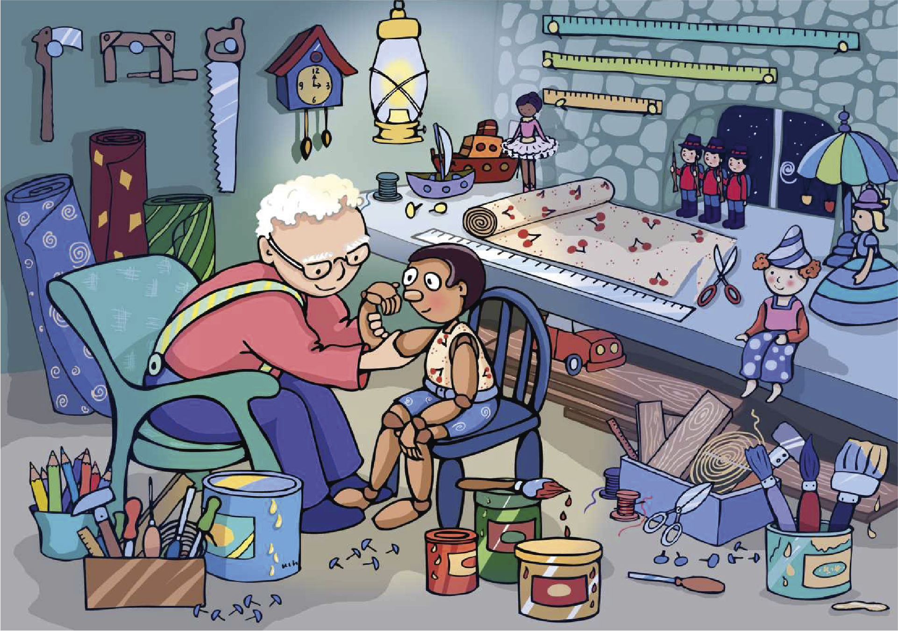
Length and height
The material is long.
The chair is tall.

Slide 30
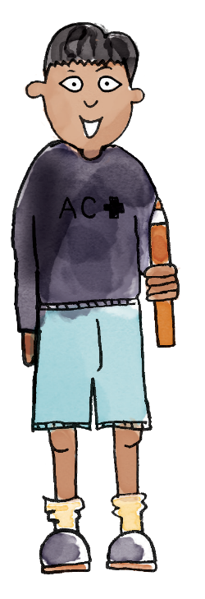
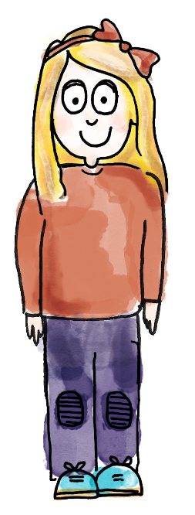
Length and height
The boy is taller than the girl.
The girl is shorter than the boy.
I am taller than ______.
I am shorter than ______.

Slide 31
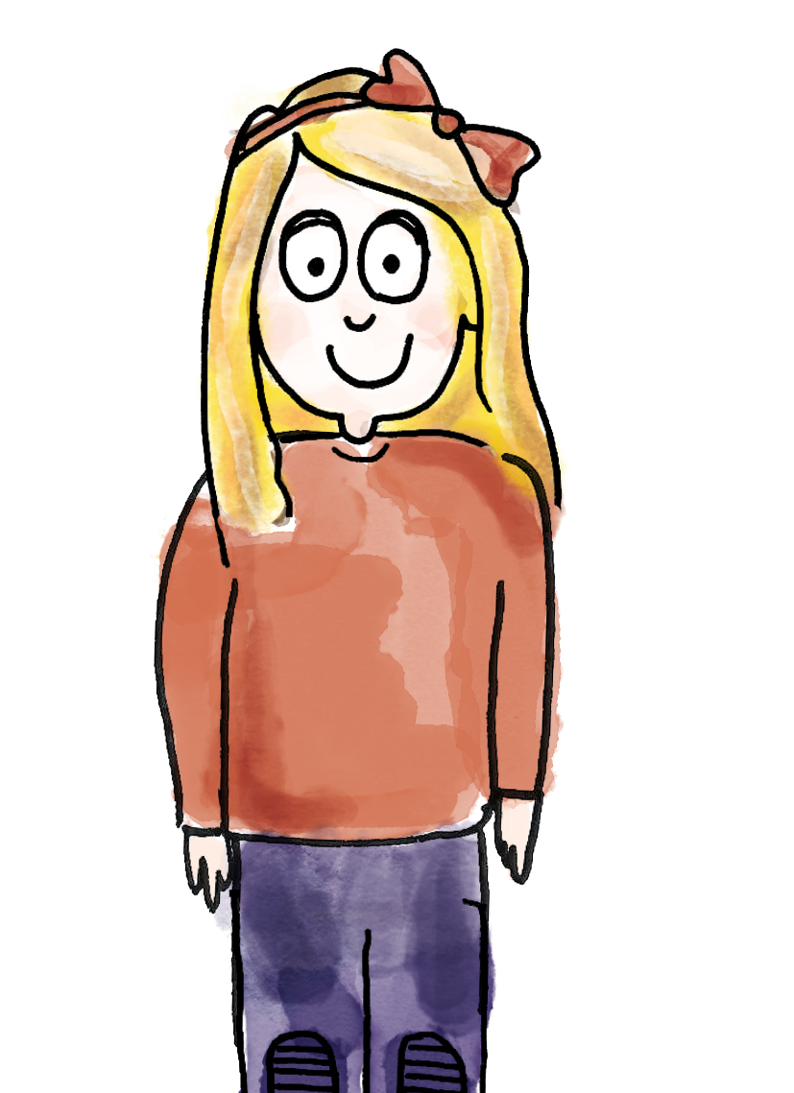
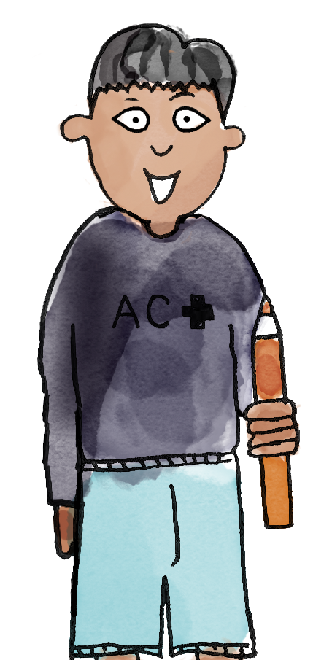
Comparing lengths
My train is six cubes long.
My train is four cubes long.
My train is longer than yours.
My train is shorter than yours.
length height long longer longest short shorter shortest tall taller tallest higher lower

Slide 33
Knowledge check: How could you describe the arrows?
longest
shortest
tallest
shortest

Slide 34
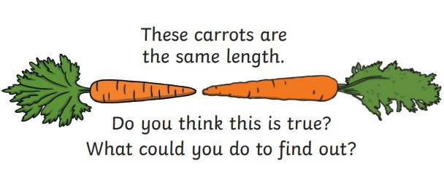
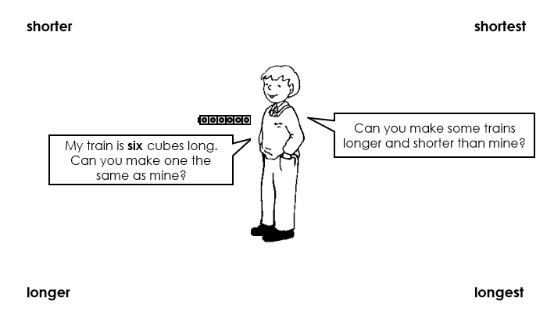
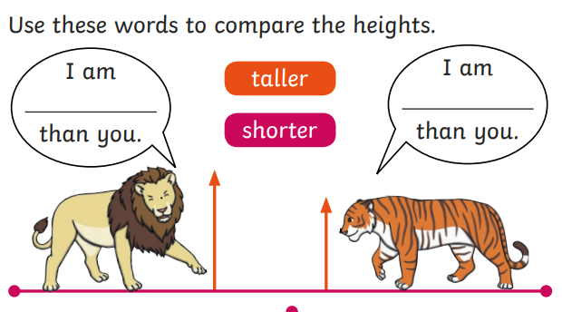
TBAT: compare the lengths and heights of two or more objects
Independent:
RP:
Challenge:

Slide 35
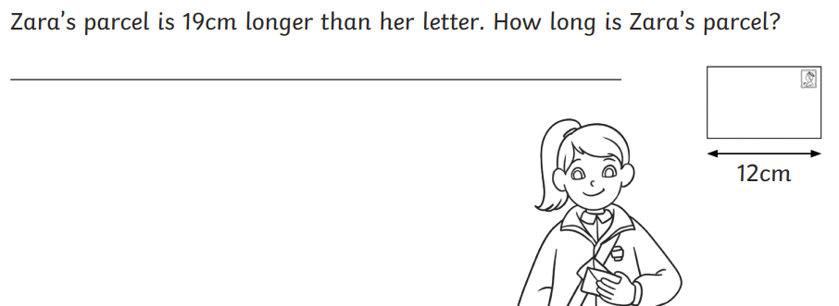
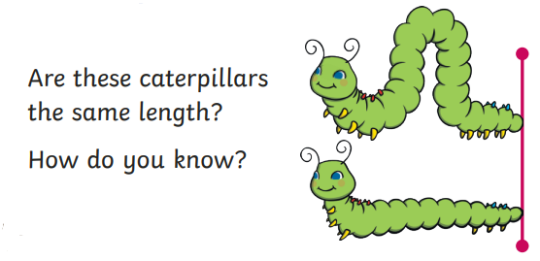
TBAT: compare the lengths and heights of two or more objects
Mastery:
Mastery with greater depth:

Slide 36
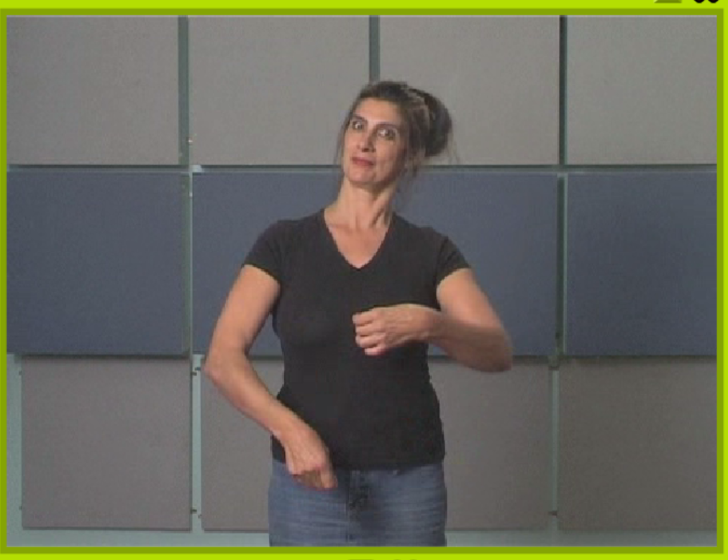
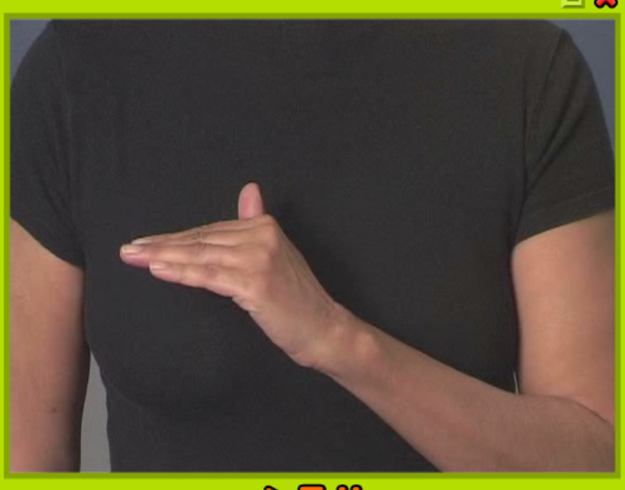
TBAT: correctly write the letter e warm up:
Musical instruments
Hand bend

Slide 37
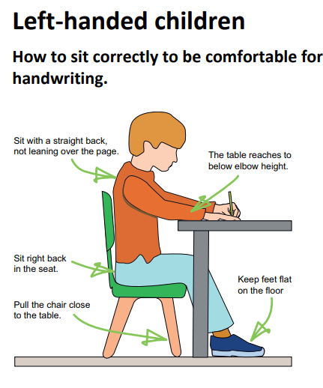
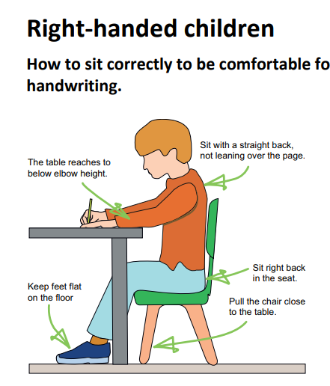

Slide 38
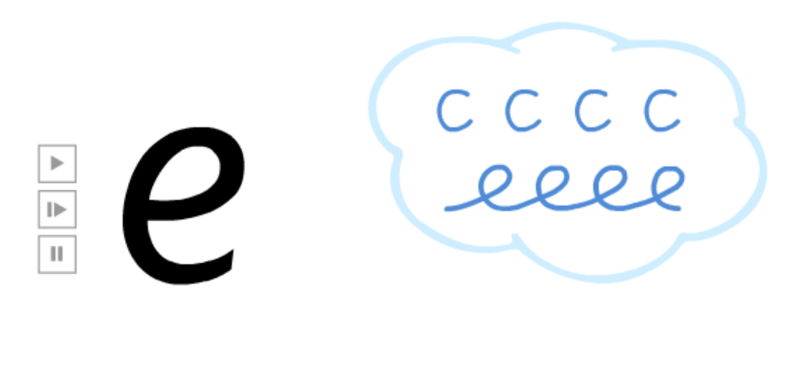
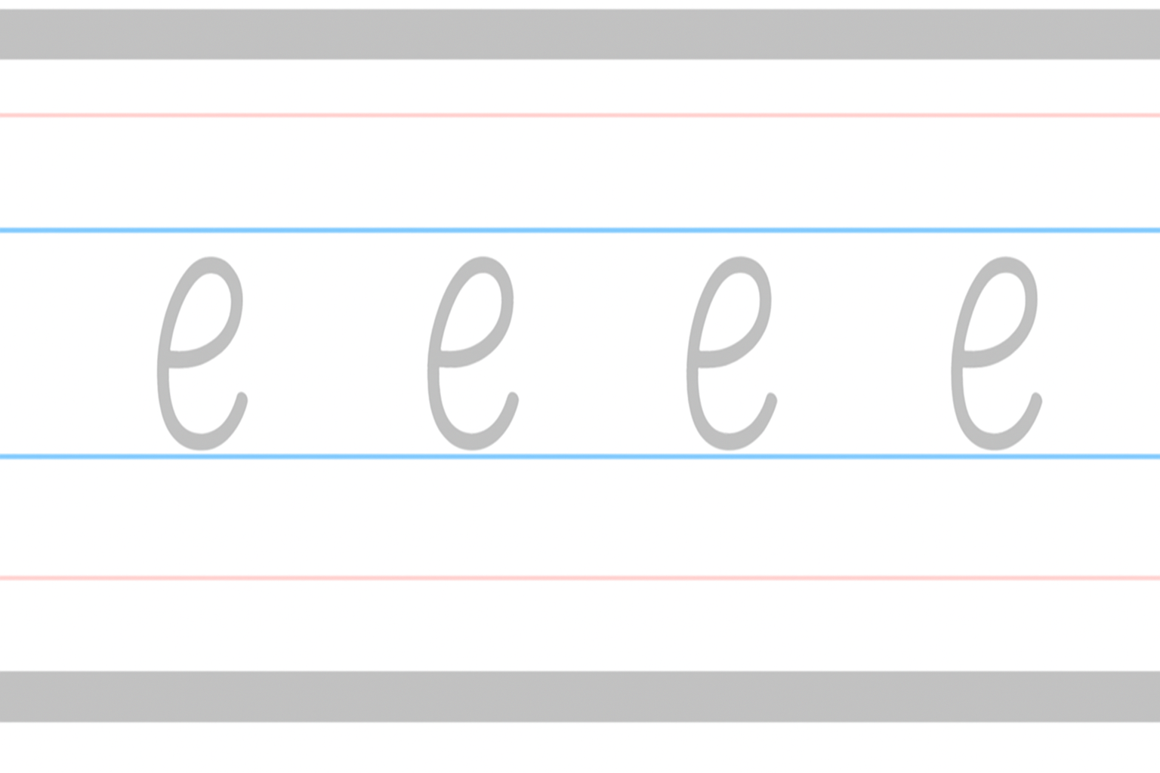

Slide 39





Slide 40

Little Wandle Guided Reading

