Slide 1

Monday 9th February
TBAT: Use joins consistently.
alter
altar
ascent
assent
bridal
bridle
cereal
serial
compliment
complement Are there any words you are unsure of? Use a dictionary to look them up and then use them in a sentence.

Slide 2
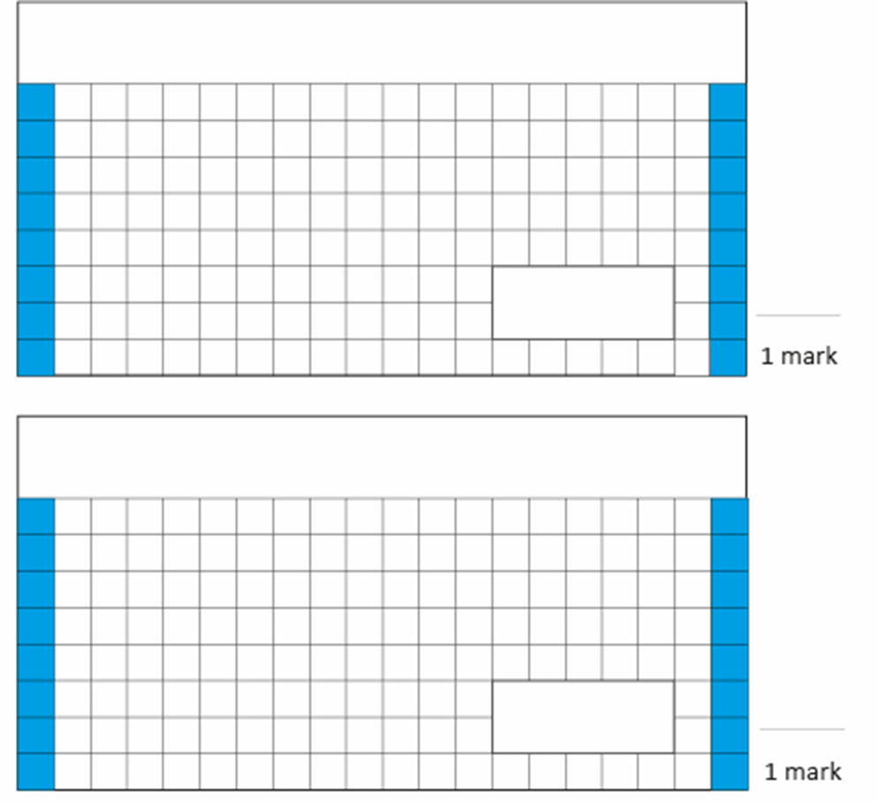
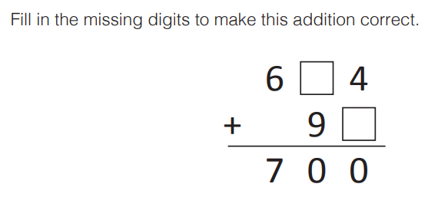
09.02.26
TBAT: Use a written method to multiply pairs of 2-digit numbers.
1. 721 X 3 =
3.
2. 0.0103 X 100 =
Challenge:
A show began at 13:05 and finished at 13: 54. How long did it last?

Slide 3

TBAT: Use a written method to multiply pairs of 2-digit numbers.
Daily 10 - Mental Maths Challenge - Topmarks

Slide 4
In books:
60 x 4 =
70 x 40 =
30 x 3 =
40 x 50 =
Challenge: 50 x ? = 4, 500

Slide 5
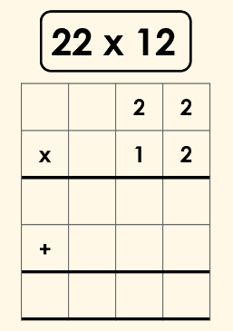
To multiply 2-digit numbers, we can also use a formal written method.
The digits in the second row are known as multipliers and are multiplied with the top number in turn.

Slide 6
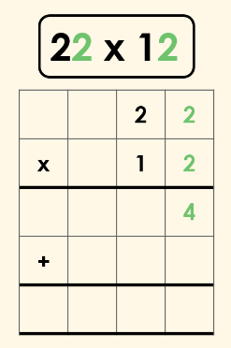
First, we multiply the ones in the top number by the ones in the multiplier.

Slide 7
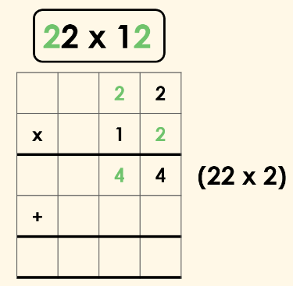
TBAT: Use a written method to multiply pairs of 2-digit numbers.
Next, we multiply the tens in the top number by the ones in the multiplier.

Slide 8
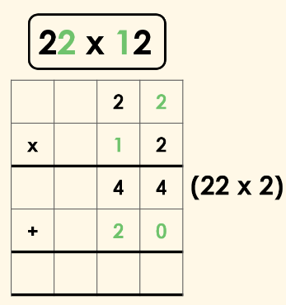
TBAT: Use a written method to multiply pairs of 2-digit numbers.
As we have multiplied both digits by the ones of the multiplier, we move on to multiplying both digits by the tens of the multiplier.

Slide 9
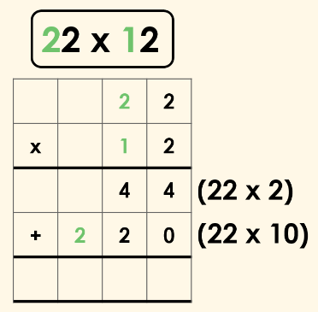
TBAT: Use a written method to multiply pairs of 2-digit numbers.
We then move onto multiplying the tens in the top number by the tens in the multiplier.

Slide 10
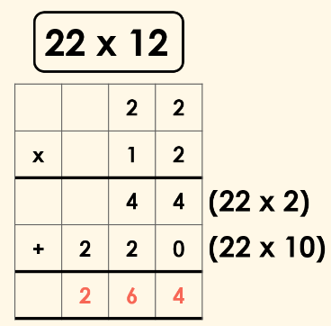
TBAT: Use a written method to multiply pairs of 2-digit numbers.
Finally, we add the two calculations together.
The product of 22 x 12 is 264.

Slide 11
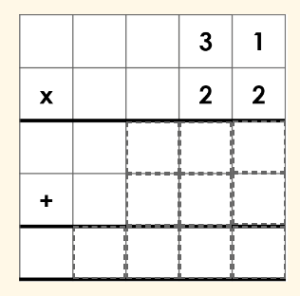
TBAT: Use a written method to multiply pairs of 2-digit numbers.
Whiteboard work: .

Slide 12
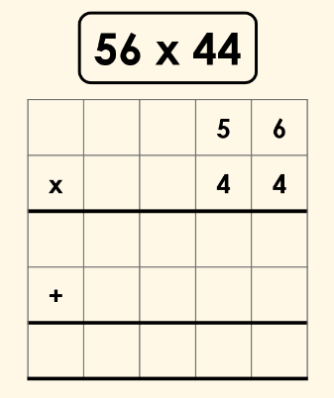
TBAT: Use a written method to multiply pairs of 2-digit numbers.
Whiteboard work:

Slide 13
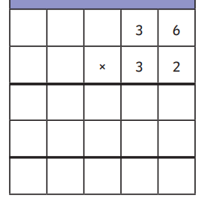
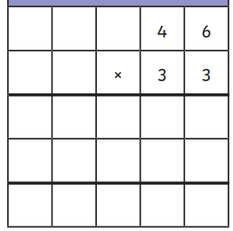
TBAT: Use a written method to multiply pairs of 2-digit numbers.

Slide 14
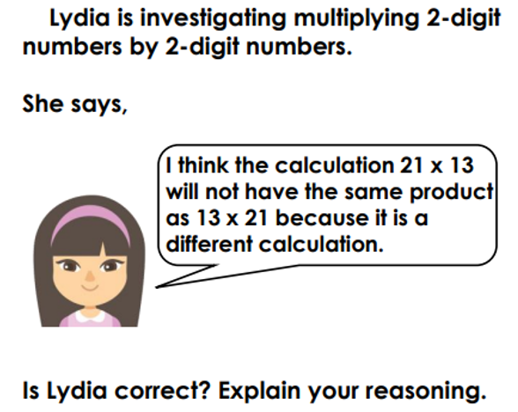
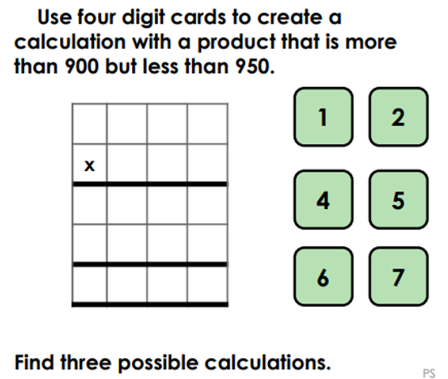
TBAT: Use a written method to multiply pairs of 2-digit numbers.
Challenge
Independent
1. 32 X 14=
2. 28 X 16 =
3. 44 X 23=
4. 49 X 31=
5. 124 X 14=
RP – a) A man travels from London to Oxford; the trip is 52 miles. He does this trip 13 times, how many miles does he travel altogether?
b) T/F Evie says multiplying 120 x 5 is the same as multiplying 12 x 50.
Mastery

Slide 15
Monday 9th February TBAT: Use words in context and discuss the author's choice of words.
3 in 3 Leo’s fingers trembled as he tightened his grip on the envelope, its crisp edges digging into his sweaty palms. His chest rose and fell rapidly, as though he had just run a race. The world around him faded—the chatter of his friends became distant hums, and even the teacher’s voice was a blur. His eyes darted from the thick red seal to the gold lettering on the front. A bead of sweat tickled his temple, but he didn’t dare wipe it away. He swallowed hard, his throat dry as sandpaper, knowing that whatever lay inside would change everything.
1. How do we know Leo is nervous without the author directly saying it?
2. What does the phrase "his throat dry as sandpaper" suggest about how Leo feels? 3. What effect does the description of Leo gripping the envelope tightly have on the reader? CH: Create your own sentence to add to this paragraph where you show not tell how Leo is feeling.

Slide 16
Monday 9th February TBAT: Use words in context and discuss the author's choice of words.
Words/Phrases we will find in the text Legacy - .the long-lasting impact of particular events, actions, etc. that took place in the past, or of a person’s life.
Strewn - untidily scattered. Prodigy - a young person with exceptional qualities or abilities. Undeniable - something is certainly true and cannot be denied. Innovative - having or producing new and creative ideas.

Slide 17
Monday 9th February TBAT: Use words in context and discuss the author's choice of words.
Shades of meaning activity Order the synonyms for the following words – be prepared to justify why you have ordered them in this way: Buzzed: hummed murmured drummed
Hesitated: faltered doubted dithered

Slide 18
Monday 9th February TBAT: Use words in context and discuss the author's choice of words.
Multiple choice questions:
1. What was required for entrants to participate in the LEGO competition?
a) Visit LEGO HQ and present their ideas
b) Build a LEGO design, write a story about it, and share it on Twitter
c) Write a letter to Leah LEGO asking for a spot in the competition
d) Create a sculpture using only red bricks
2. Why was Leo angry when Max Carter was announced as one of the winners? a) Max’s creation wasn’t very impressive b) Max was known for being kind but lazy c) Max was suspected of stealing someone else's design d) Max had already won a similar competition
3. What does the phrase "Leo's heart thumped against his ribs" suggest about how he was feeling? a) He was cold b) He was nervous and excited c) He was confident and calm d) He was angry

Slide 19
Monday 9th February TBAT: Use words in context and discuss the author's choice of words.
Words in context questions: 1. What does the phrase "Leo’s mind buzzed with thoughts of the competition" suggest about how Leo is feeling at the start of the day?
2. Find and copy a phrase that shows Isabella Fernandez is shy during the news announcement.
3. What does the description "taking credit for other people's ideas and trampling anyone in his way" suggest about Max Carter's personality?
4. Why do you think the author describes Leo’s heart as "thumping against his ribs" during the final announcement? What does this tell us about his emotions? 5. The reporter describes Mia's design as having "captured the judges' hearts." What does this metaphor imply about the judges' reaction to her creation?

Slide 20
Monday 9th February TBAT: Use words in context and discuss the author's choice of words.
Challenge Think about the phrase show not tell in writing. Give an example of how the author has used this in the story and explain what they are trying to convey to the reader.

Slide 22
Safer Internet Day 2026
What is AI? What could be a benefit of AI? What could be a negative of using AI?

Slide 23
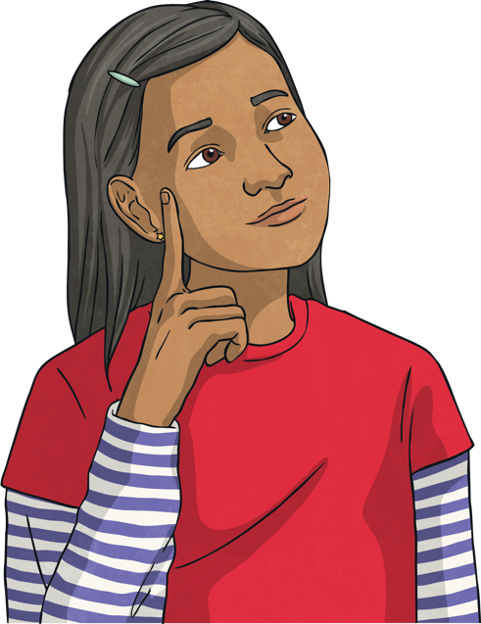

What is artificial intelligence?
Artificial intelligence (AI) refers to computer-based systems designed to:
process data;
recognise patterns;
complete specific tasks automatically.
These systems follow programmed instructions and use data to improve accuracy over time.
AI technologies are part of our everyday lives, even if we don’t realise it.
Click me!
AI technologies refer to any system, tool, model or machine that uses neural networks or machine learning to simulate human intelligence.

Slide 24

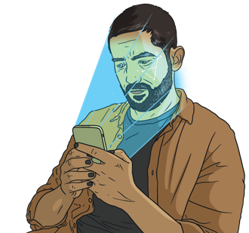


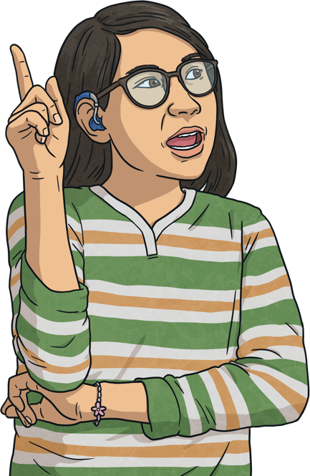

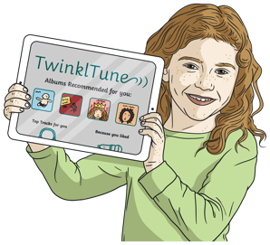
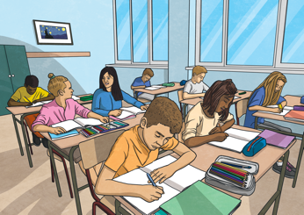
AI technologies are used in:
Why do people use AI technologies?
devices using facial recognition
Internet search engines
healthcare services
AI technologies can:
increase efficiency and productivity;
enhance customer experience;
improve accuracy and decision-making.
traffic control systems
apps using personal recommendations
education
and many more!

Slide 25
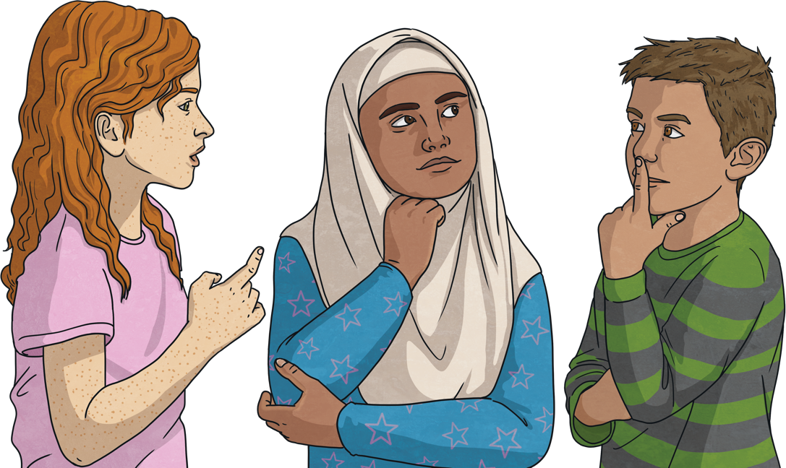
Can you think of any benefits and potential risks of using AI technologies?

Slide 26
Did you think of any of these?
Benefits
Potential Risks
AI technologies can make everyday tasks easier and more convenient.
AI technologies can do many tasks but they don’t always generate accurate information.
AI technologies can operate 24 hours a day, seven days a week, without needing breaks.
If we rely too much on AI tools, we might stop thinking for ourselves and become less creative.
AI technologies can be used to monitor data that can help researchers better understand the impacts of climate change and ways to combat it.
AI technologies do not understand what content is suitable for children. They might generate material that is harmful or upsetting.
AI technologies can analyse your past purchases, browsing history and recently watched TV shows to recommend things tailored to your interests.
Some people fear that AI technologies could take job opportunities away from them.

Slide 27


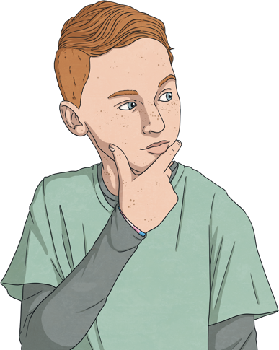

AI bias happens when an AI system generates unfair or wrong decisions because the data it was trained on is incomplete or unfair. This means an AI system might treat some people or situations differently without a good reason.
As good digital citizens, it is important that we check facts and information when using AI technologies.
AI systems generate content based on the data they have been trained on. If this training data contains incorrect or biased information, it could lead to:
inaccurate or biased content being generated;
the spreading of misinformation;
the encouragement of stereotypes.
Think
Does it look or sound real or fair?
As we have seen, AI technologies can do many tasks but they don’t always generate accurate information.
Ask
If you’re not sure, talk to a trusted adult.
Click me!
Check
Can you find the same information from trusted sources?
A stereotype is an idea many people have about a particular type of person or group that is often untrue.
Click me!

Slide 28
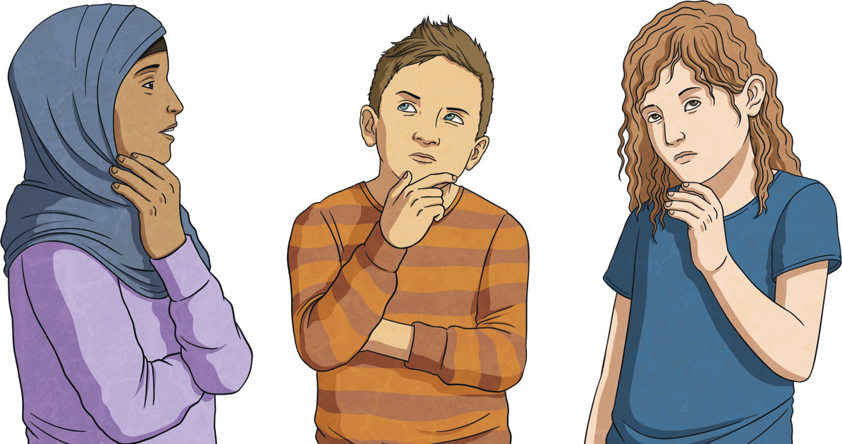
Is This Safe?
Read the following scenarios and decide if you think they are safe or unsafe uses of AI technology.

Slide 29
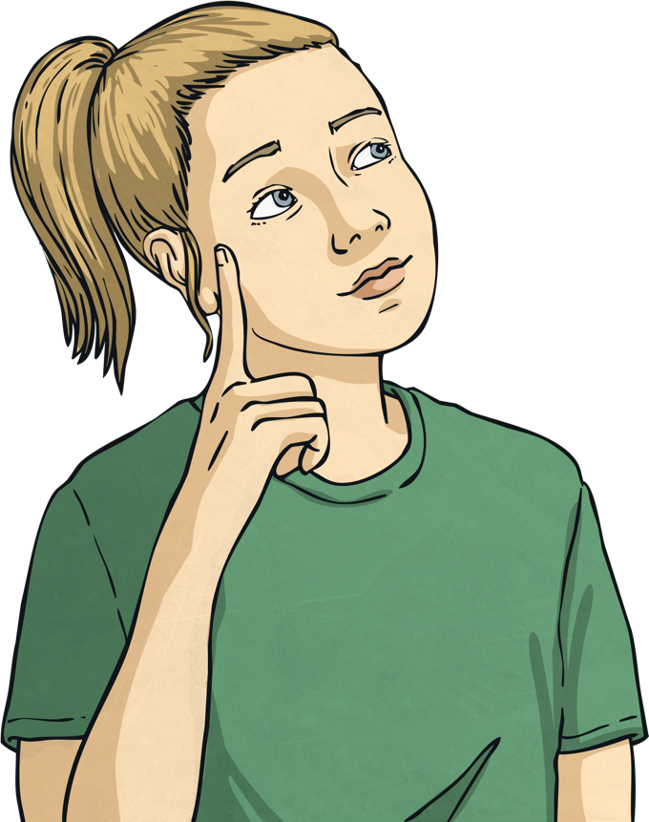
Neve uses an AI technology to ask what a word means so she can complete her science homework. Is this safe?
Yes, AI technology can be used for this.
Remember, AI technology does not always generate accurate information so it’s always worth double-checking the information with another source.

Slide 30
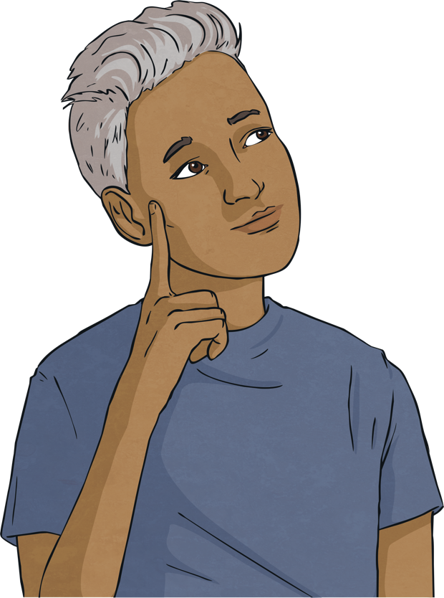
Thomas uses an AI technology to help write a scary story about his friends at school. Is this safe?
No, you should never share personal information such as friends’ names or the name of your school with AI technologies.
It is also worth remembering that most AI technologies are designed to be used by people aged 13 or over. AI technologies do not understand what is safe and appropriate for children and could generate a story that is extremely scary or upsetting.
Always speak to a trusted adult first before using AI technology.

Slide 31
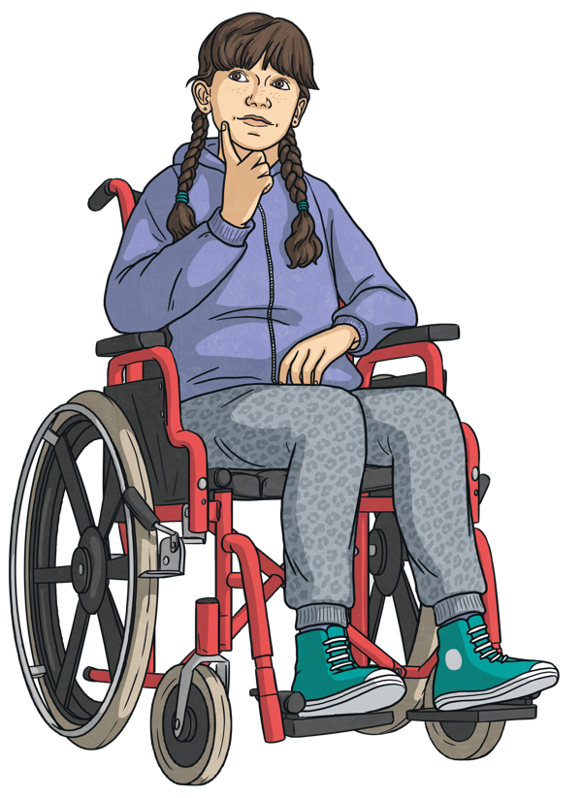
Sophie asks an AI tool to generate a funny photo of her friends. It asks her to upload some photos of them. Is this safe?
No, Sophie shouldn’t share photos online without people’s permission. Anything shared online could be used as training data for AI technology.
It is also worth thinking about whether this is a kind thing to do, as AI technology cannot recognise whether the content it generates may be hurtful.

Slide 32
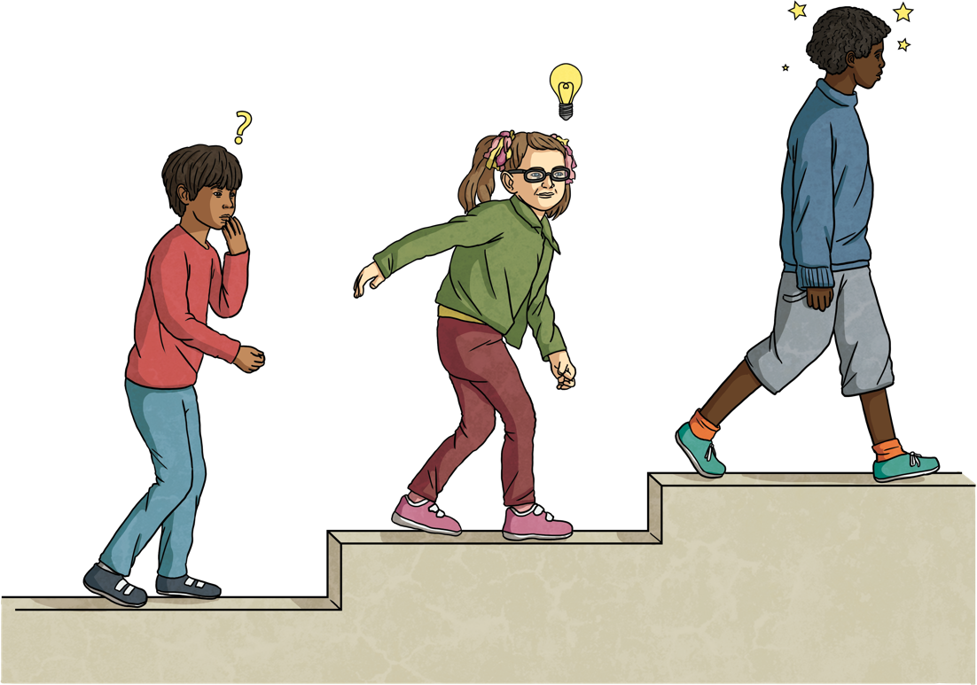
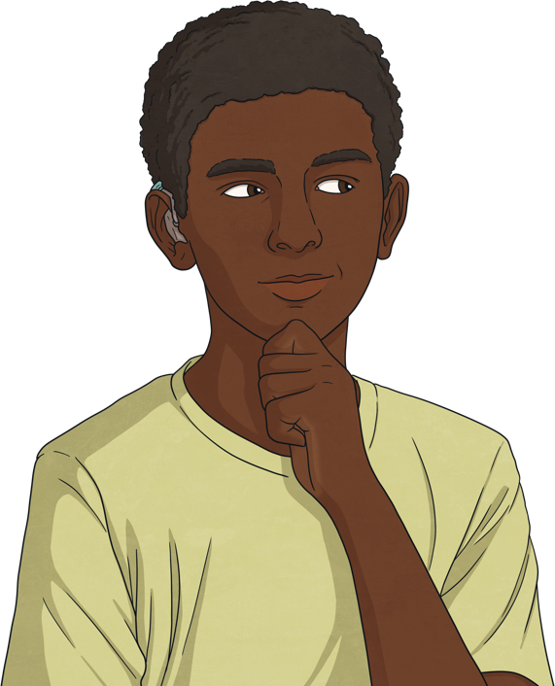
While AI technologies can make completing tasks simpler and easier, it is important not to become overreliant.
Humans have thoughts and feelings. Our brains can imagine, create and solve problems in ways that AI technologies cannot.
Is AI technology always the right tool for the job?
Before using any AI technologies, ask yourself:
Is this the right tool for the job?
Could I complete this task myself?
Remember to make time to go outside, take part in screen-free activities and be creative without relying on AI technologies.

Slide 33

Key Learning
Only use AI technology that a trusted adult has given you permission to use.
Do not share personal information with AI technologies.
AI technologies are not perfect and can get things wrong. Always double-check information you receive from them.
If you ever feel unsure, uncomfortable or upset when using AI technology, always speak to a trusted adult.

Slide 34
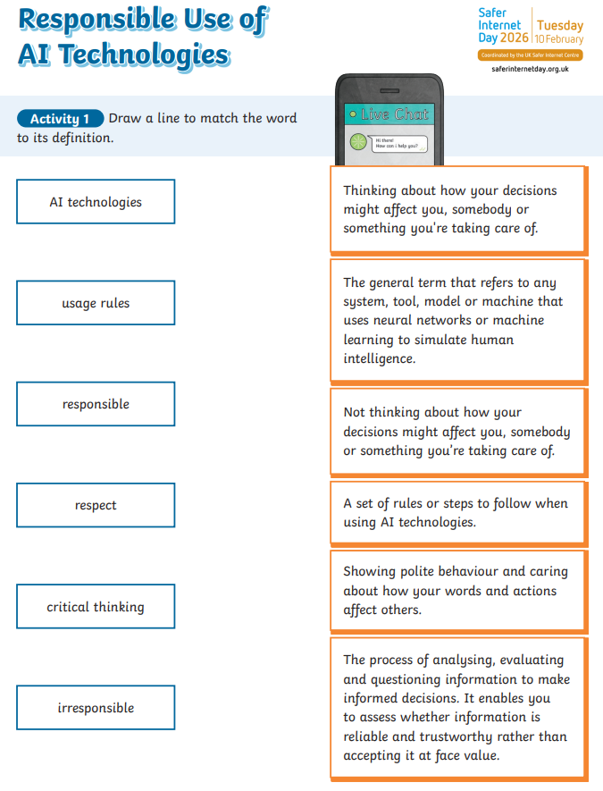

Slide 35






Introducing the light sensor
Notes:
This YouTube video explains
The micro:bit’s LEDs, as well as acting as an output, also can work as an input, sensing how dark or light it is
We can use this to make projects that react when it gets dark or light.

Slide 36





TBAT: successfully make a code that uses sensors and logic.
I can explain that sensors are inputs that sense things in the real world, such as movement and light.
I can explain that logic is how computers make decisions in code based on whether things are true or false.
Notes:
Explain that Sensors are inputs that measure things outside a computer, like light, or movement. Logic is a key idea in computing. It helps machines to make decisions, like turning a light on if it’s dark.
Optional: play Nightlight introduction video which also explains that the micro:bit light sensor works in a range from 0 (very dark) to 255 (the brightest it can go).

Slide 37




Think: night light introduction video
Optionally play video: https://youtu.be/6nWwnq8aYh8

Slide 38

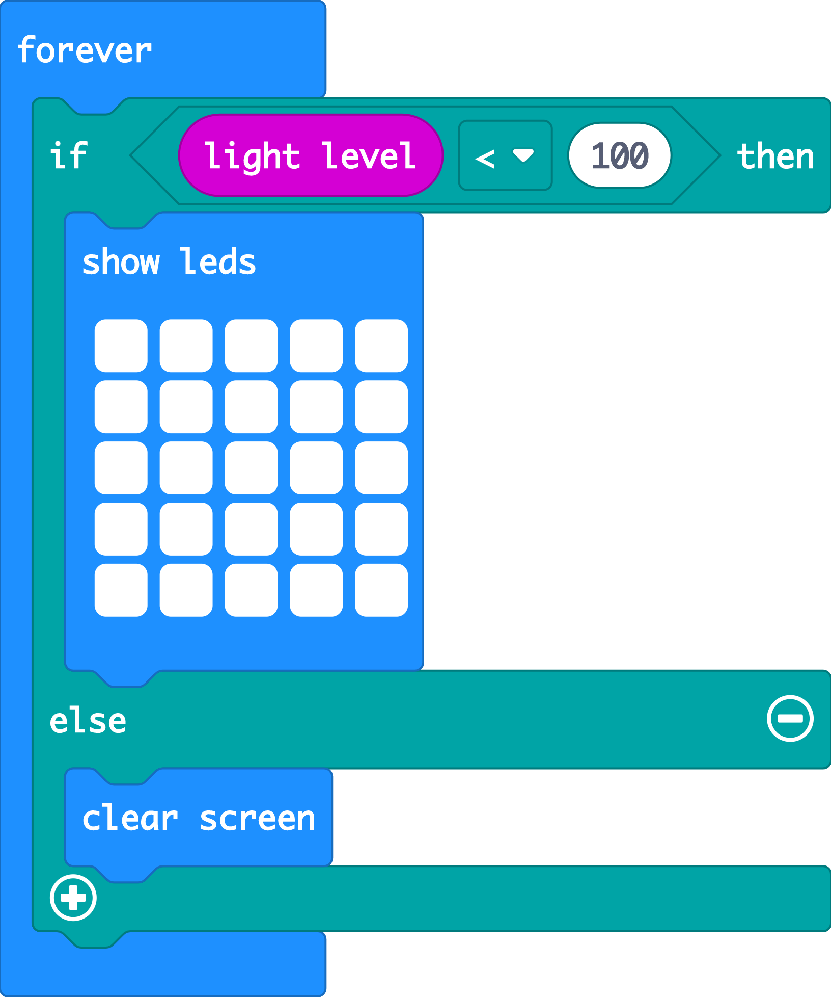

Create: examine the code
The ‘forever’ loop keeps the micro:bit checking the light level.
The logic ‘if… then’ block checks if the light level is low, less than (<) 100.
When the accelerometer input senses a shake, the ‘change’ block adds 1 to the number stored in the ‘steps’ variable.
Else (otherwise) the light level must be 100 or more. It must be light, so it turns the LEDs off with ‘clear screen’.
Teacher: open the completed code in the editor
Notes:
You can follow the link to open the completed code in the editor. Model testing it in the simulator by dragging the yellow line in the circle up and down on the micro:bit in the simulator.

Slide 39


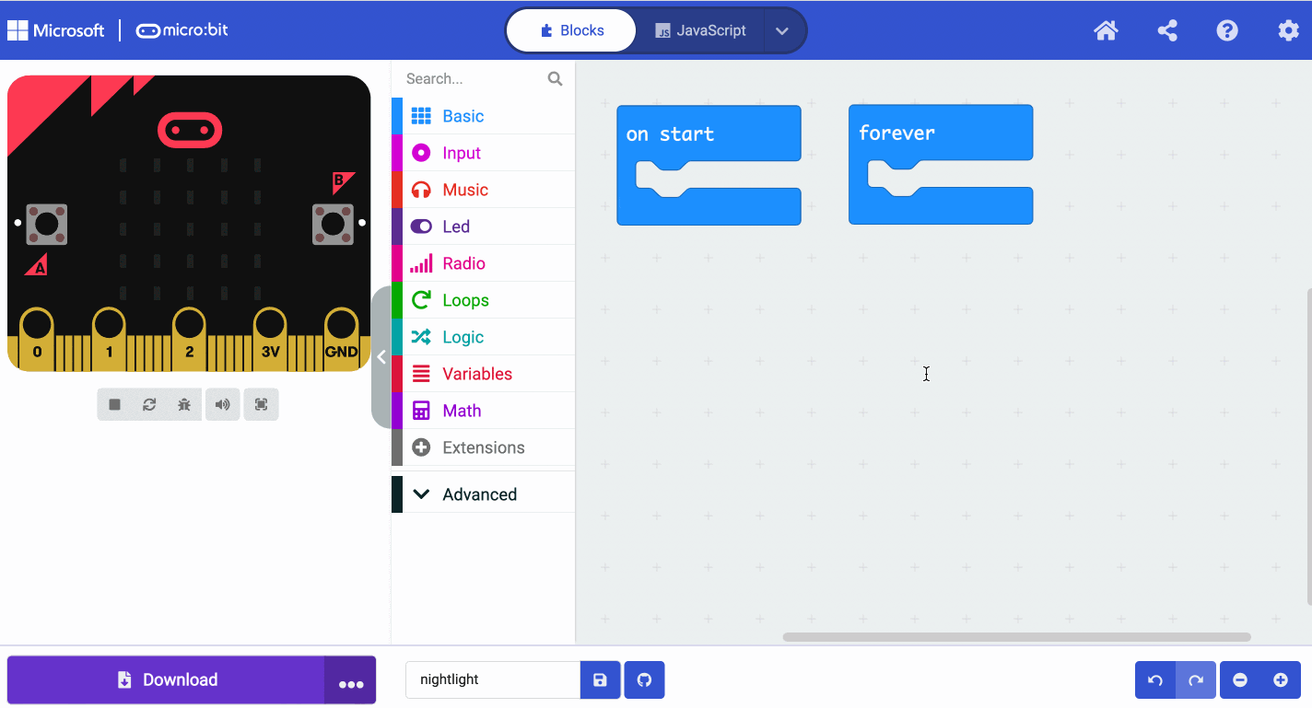
Create: coding animation
Notes:
Animated GIF of building the code you can share with your students, if YouTube is blocked in your school.

Slide 40
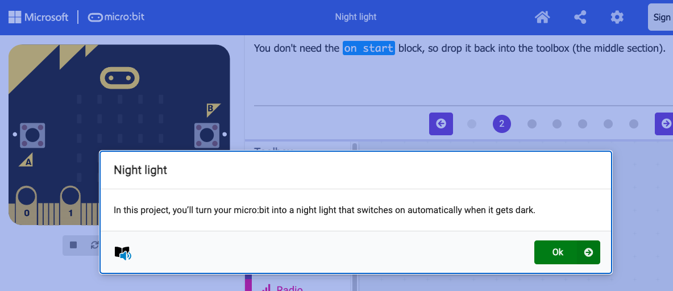
Create: step-by-step online tutorial
https://mbit.io/tutorial-night-light
Notes:
You can optionally share this online step-by-step tutorial with your students to follow individually.

Slide 41


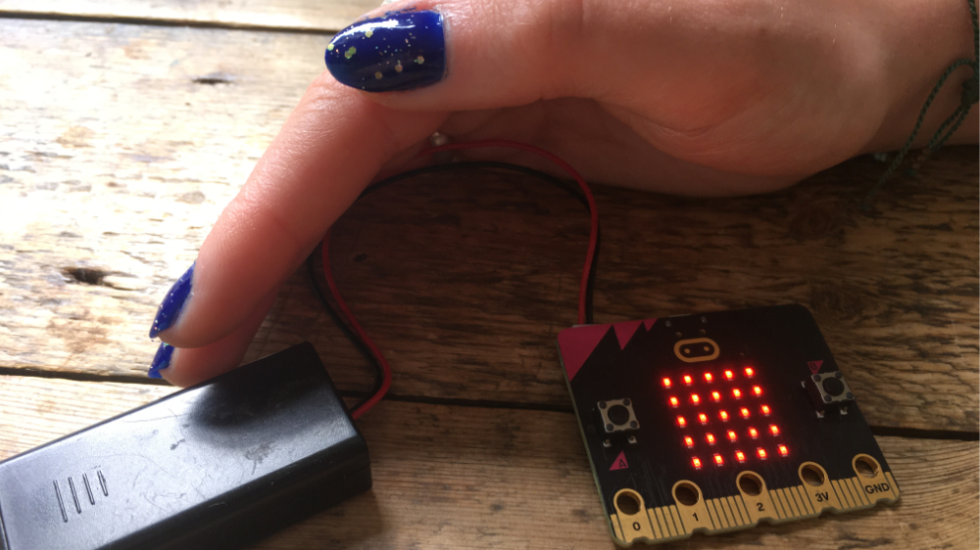

Evaluate
Download your code to a micro:bit
Does it work as you expect? Use smaller numbers if the LEDs switch on too easily, or larger numbers if it’s hard to make the lights switch on.
How good is the project?
Could it have other uses?
How does it work?
Notes:
How good is the project?
Would you recommend it to a friend?
How could you improve it?
How does it work?
Encourage students to think about how it works when holding it in their hands.

Slide 42

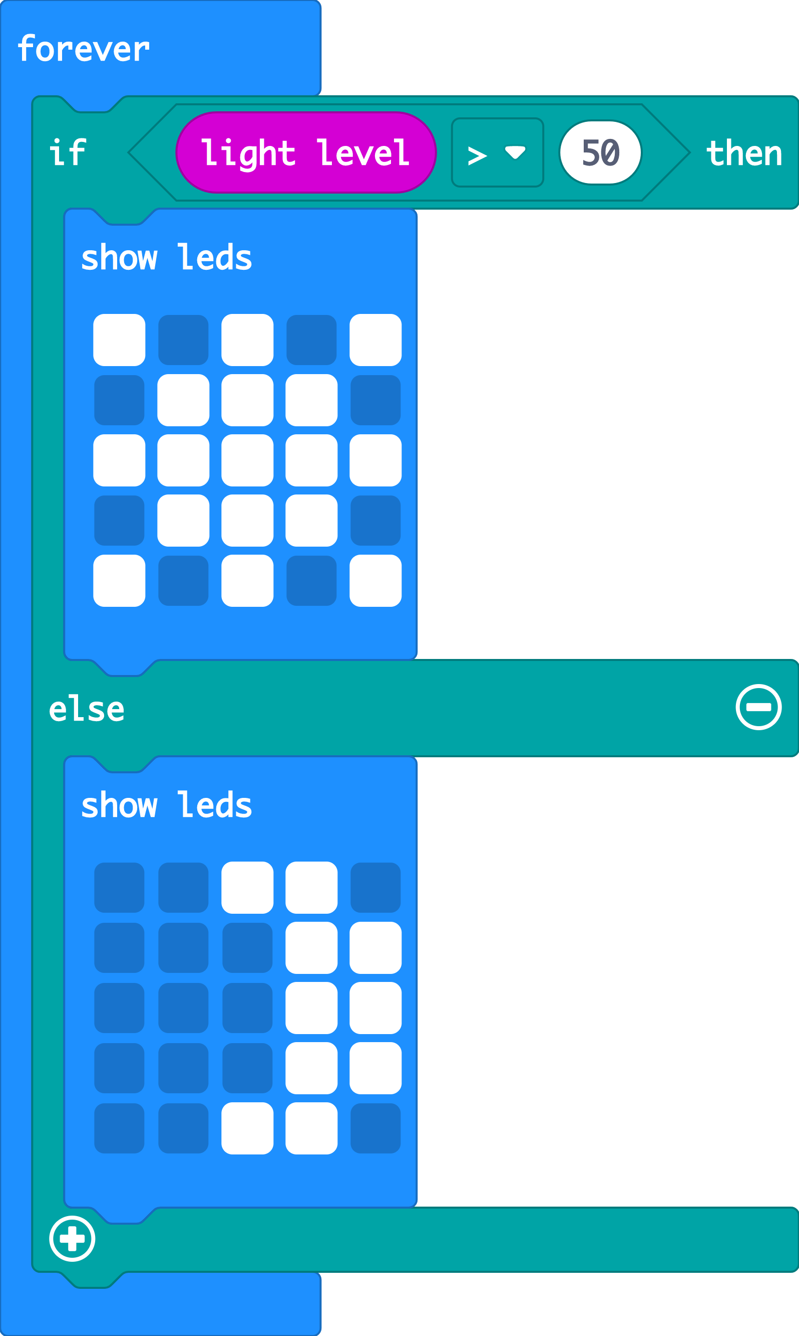


Extend
Make different pictures appear if it’s bright or dark.
You could experiment by changing the logic comparison block from less than < to greater than >
Notes:
Opportunity to reinforce mathematics learning about less than < and greater than > symbols.

Slide 43

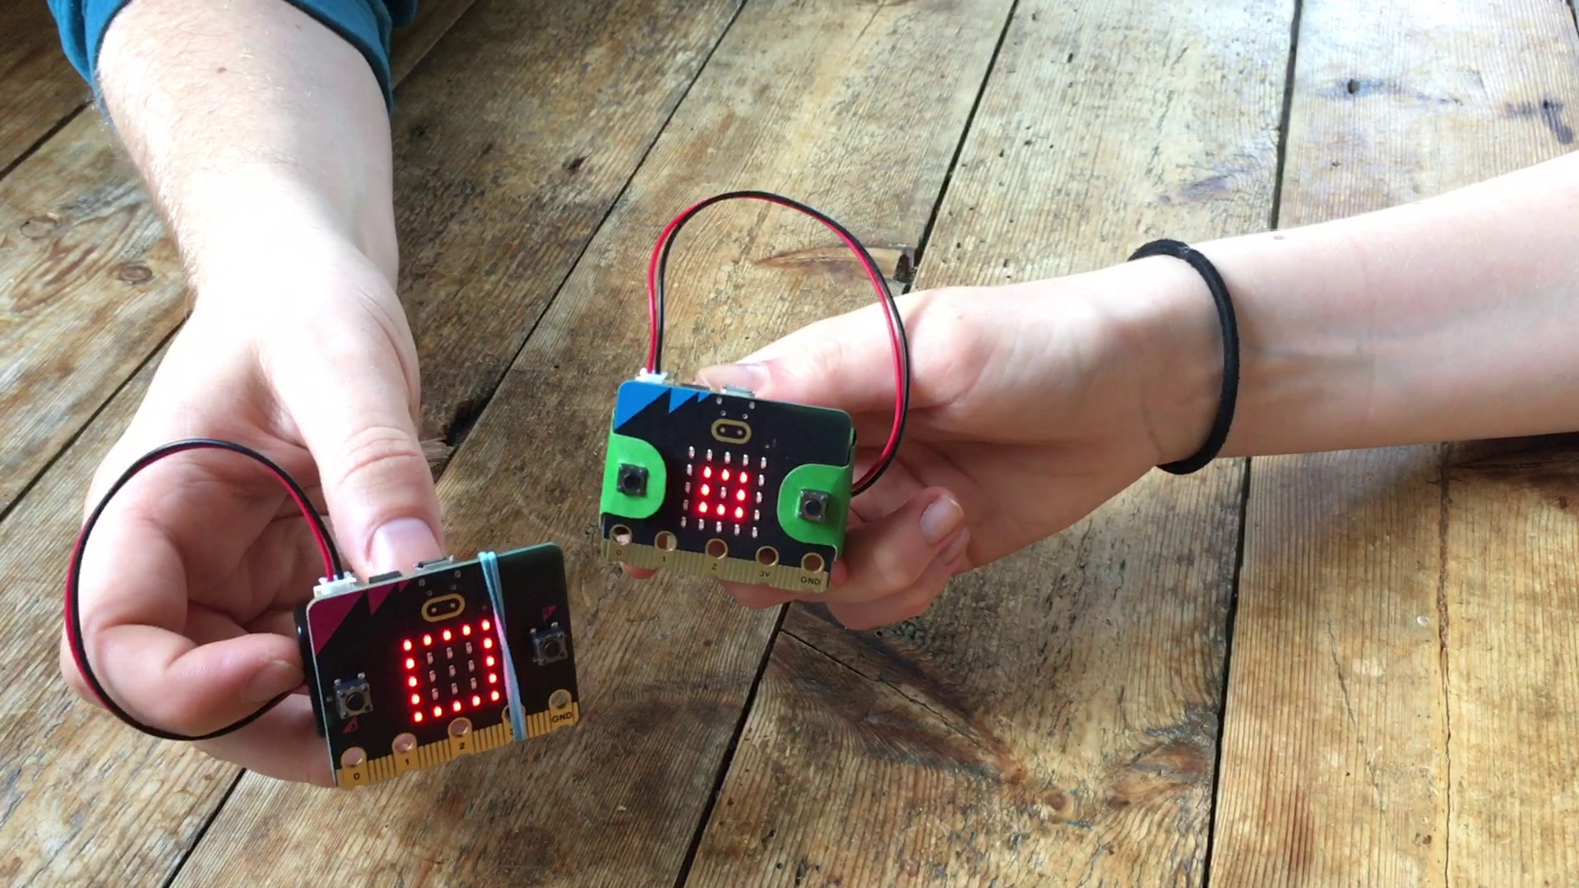
Next steps
Today we used the micro:bit light sensor and logic to turn LED lights on automatically when it gets dark.
Next time, we’ll use micro:bit sensors and logic to make a classic game of chance.

Slide 44
