Slide 1

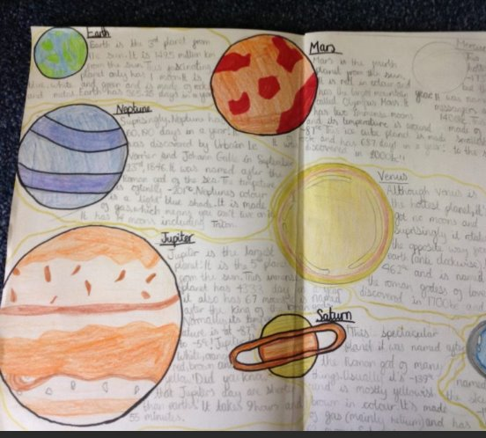
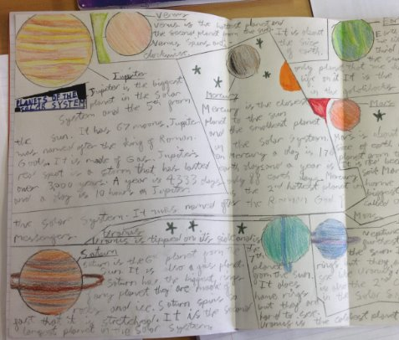
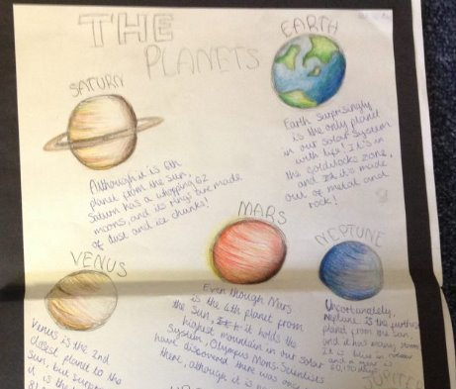
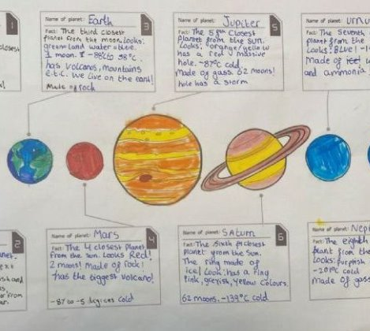
Morning Challenge
Finish Science work

Slide 2
Athlete assembly 9am

Slide 3
Thursday 5th February
Word work:
TBAT: Upskill my vocabulary
Read through your plan in your literacy books.
Circle 5 words which you could up skill.
Share these words with your partner.

Slide 4
Thursday 5th February
Word work:
TBAT: Upskill my vocabulary
Can your partner think of a better word for your circled word?
Use a thesaurus to upskill your word.
Can you upskill the sentence which your word is in?
Fronted adverbial subordinate clause relative clause

Slide 5
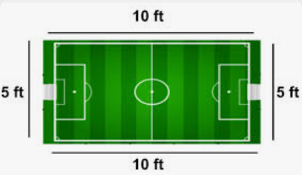
05.02.26
TBAT- solve addition and subtraction problems.
3 in 3
1) Perimeter: Area:
2) 0.87 + 12.7 =
3) 60% = ______ = 0. ___
Challenge:
1/3 + ¾ =

Slide 6
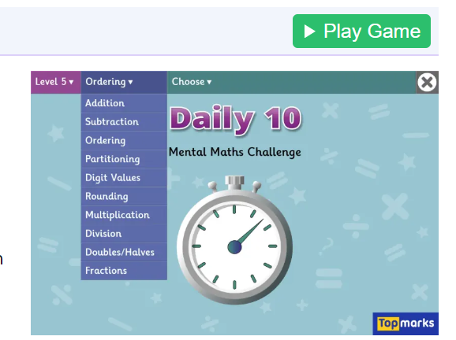
Daily 10 - Mental Maths Challenge - Topmarks x8

Slide 7
In books:
623 – 99=
7, 283– 5, 719=
5, 001 - 200=
9, 294 – 7, 815=
Challenge: If there were 369 pupils in the primary school, 56 in the nursery and 864 in the high school, how many pupils are there altogether?

Slide 8
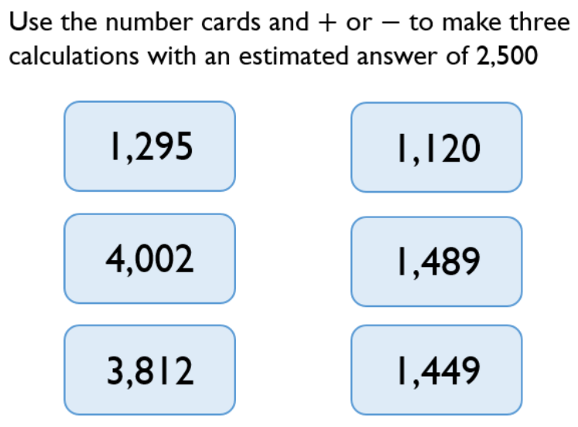
Paired work:

Slide 9
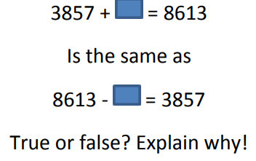
Talk partners:

Slide 10
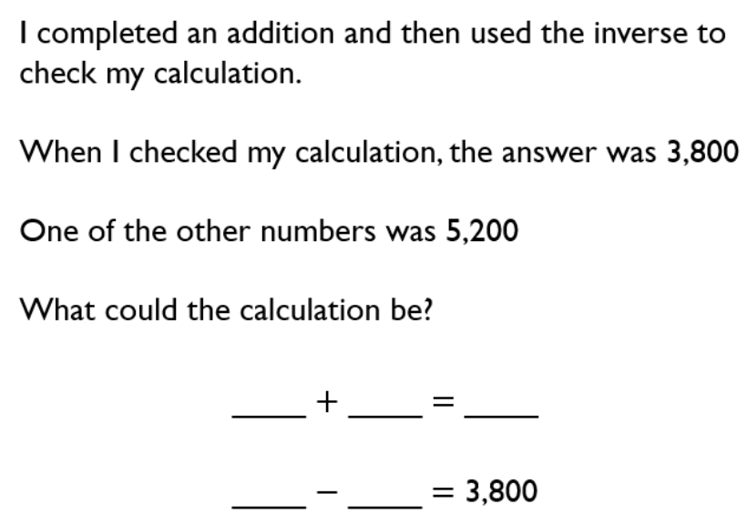

Slide 11
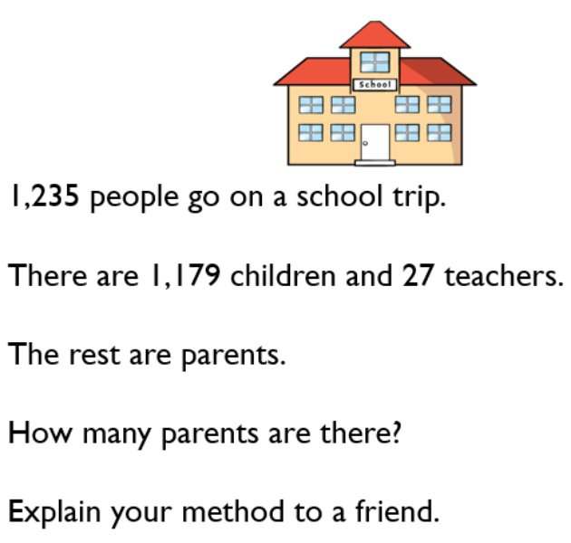
Paired work:
R- read the problem.
N- note/underline the key information.
C- decide on the calculation.
A- answer the problem.

Slide 12
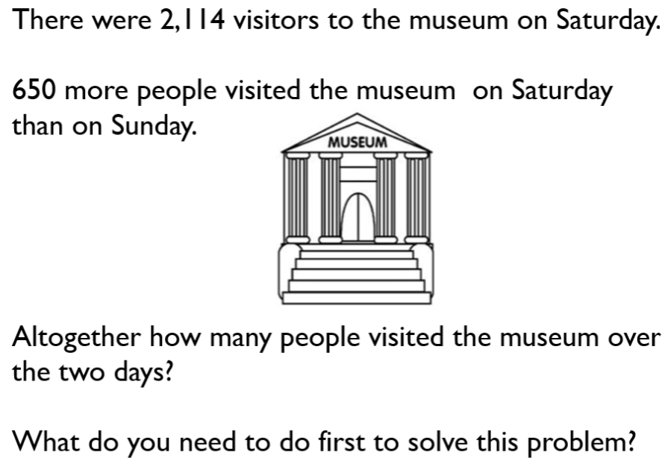
Checkpoint question:
A) 1464
B) 2114
C) 3578

Slide 13
In books:
567 + ______= 1, 426
6, 728 – ______= 2, 500
374 + _____= 1, 500
9, 294 – ______= 3, 648
Challenge: What is the best method to solve the problem below:
5, 267 + _______ = 1, 276 + 8000

Slide 14
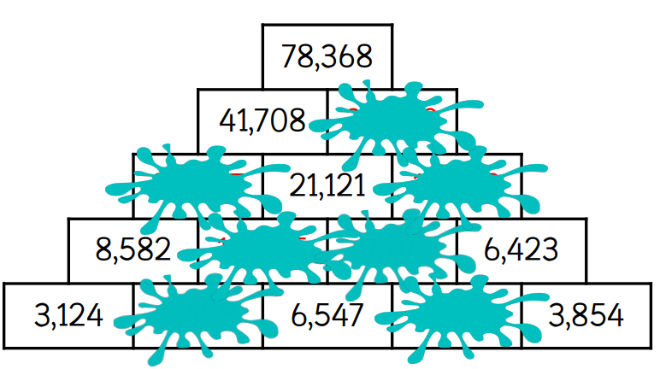
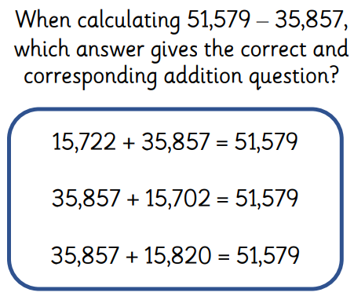
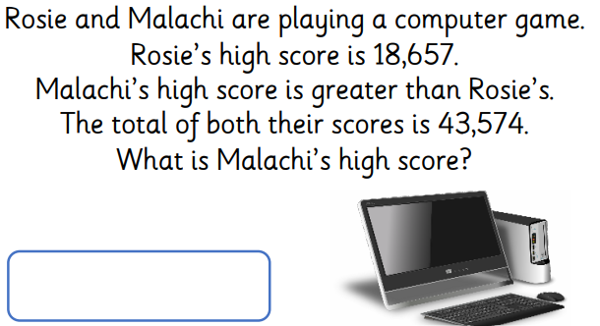
Independent:

Slide 15
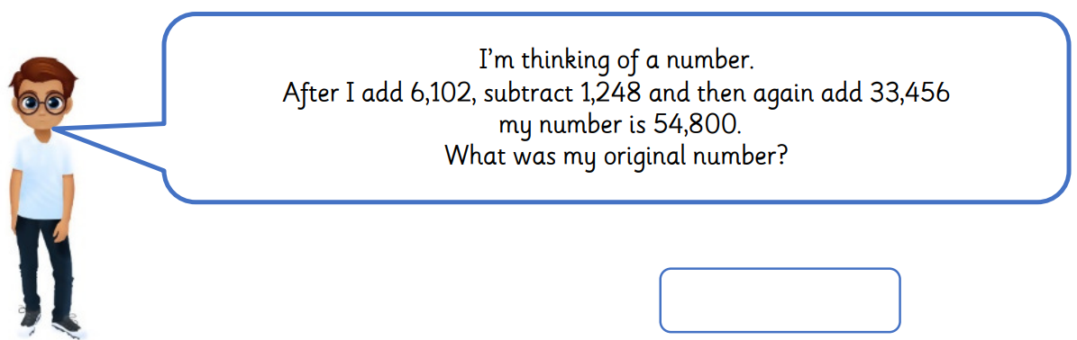
Challenge:
Mastery:
Sam has £26 more than Tom and Amy has £17.10 which is £11.05 less than Tom. How much do they have altogether?

Slide 16
Police assembly 10am
Year 5 and 6

Slide 17
Thursday 5th February
TBAT: plan a narrative
3 in 3
Leo’s heart thumped wildly, each beat louder than the last, as he sat frozen on the edge of the sofa. The news anchor’s voice filled the room, sharp with suspense. "And now," she declared dramatically, "the announcement you’ve all been waiting for — the final winner of the LEGO Junior Master Inventor competition." Leo’s breath came in shallow gasps, nerves twisting in his stomach. Was his creation imaginative enough? Had his futuristic city design impressed the judges? He wiped his sweaty palms on his jeans, trying to steady himself. The air was thick with anticipation when suddenly, his phone vibrated against his leg. His pulse quickened as he stared at the glowing screen. Slowly, he lifted it, eyes widening as he read the first few words...
1. Find and copy a word which means reporter.
2. "He wiped his sweaty palms on his jeans, trying to steady himself." How is Leo feeling in this sentence?
3. How has the author left the reader wanting to read on?

Slide 18
Thursday 5th February
TBAT: plan a narrative
Talk partners:
Summarise your plan to your partner.
What happens in your story? Who are your characters? What are your character's traits?
How will your story end?

Slide 19
Literacy
Planning for paragraph 6
Ellie’s heart thumped loudly in her chest as she waited for the final announcement. “Only one spot remains,” the reporter teased, “and the judges have made their decision.” Ellie swallowed hard. Could it be her? She had poured her heart into her submission. Her palms grew sweaty as she stared at her phone, willing it to buzz. Suddenly, it vibrated in her hand. A notification popped up on the screen. Ellie’s breath caught in her throat as she read the first few words—
What do you like about this paragraph?
What features have been used?

Slide 20
Task: Write your main characters final thoughts on the competition – there is one space left.
How is your main character feeling physically?
Sick? Can you uplevel this word?
How is your main character feeling emotionally?
Hopeful, anxious? Can you uplevel these words?

Slide 21

Task: Write your main characters final thoughts on the competition – there is one space left. (Box 6)
P6 include:
-Figurative language to show main
character's physical feelings.
-an announcement/tweet from Lego
to say the final spot remains
-rhetorical question
-description of how the character is feeling.

Slide 22
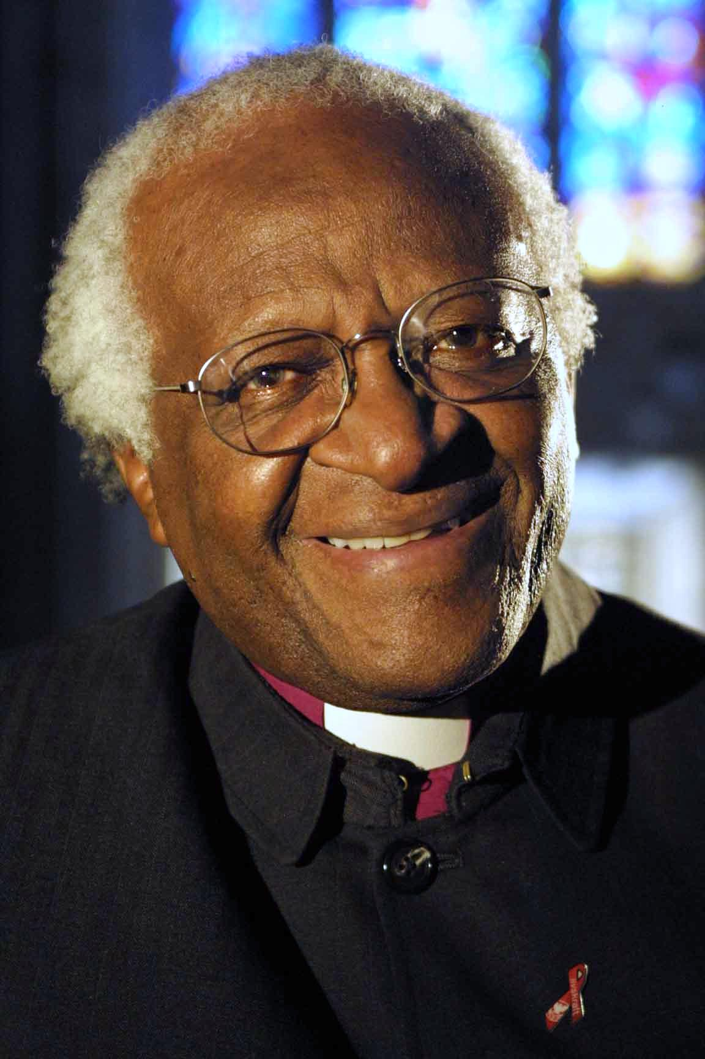
How did Christian teaching influence Desmond Tutu?
This photograph of Desmond Tutu shows him dressed as a Bishop in the Anglican church.
Desmond Tutu had a Christian worldview.
His life was influenced by Jesus' teachings on love, justice, peace and forgiveness.
He famously said:
“Without forgiveness, there is no future.”
What do you think he meant?

Slide 23

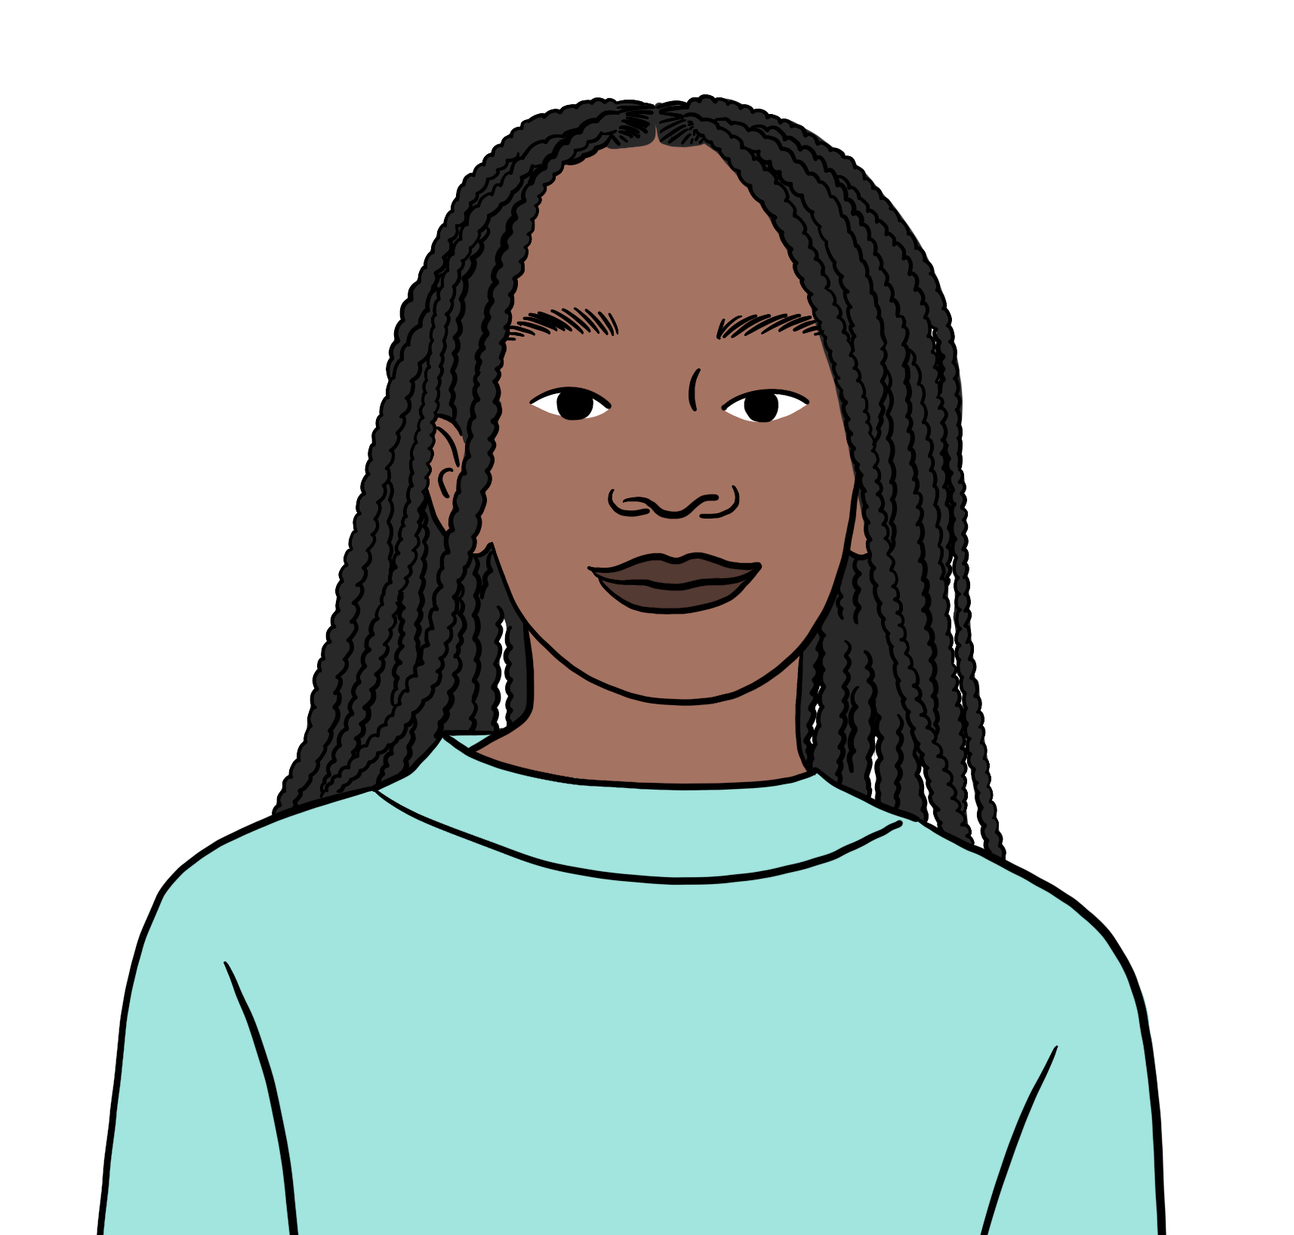
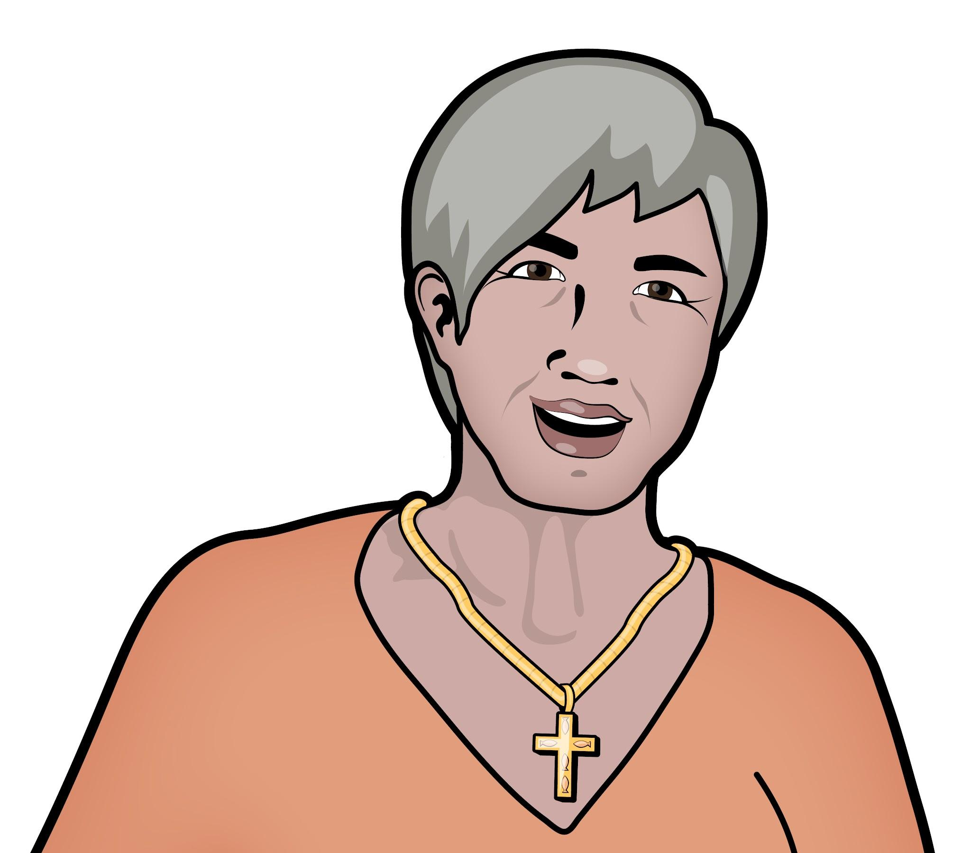
How did Christian teaching influence Desmond Tutu?
Grace and Fiona have Christian worldviews. Desmond Tutu’s life is important to both of them.
I protested against apartheid in the 1980s. Desmond Tutu shows me how forgiveness and reconciliation is the best way.
My parents talked about Desmond Tutu a lot growing up. They were inspired by how he put the teachings of Jesus into practice.
Grace
Fiona

Slide 24
How did Christian teaching influence Desmond Tutu?
Desmond Tutu lived out Jesus' teachings by fighting for justice against oppression.
Jesus stood up for the poor, the oppressed, and those treated unfairly.
He spent time with those society ignored.
Desmond Tutu spoke out against apartheid, fighting for the rights of Black South Africans who were oppressed by unfair laws.
Grace

Slide 25
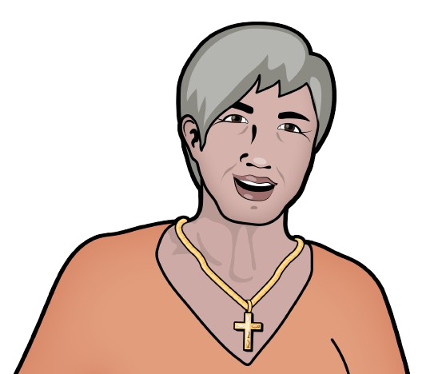
How did Christian teaching influence Desmond Tutu?
Desmond Tutu lived out Jesus' teachings by choosing peace over violence.
Desmond Tutu followed this teaching by rejecting violence and encouraging non-violent protests against apartheid.
I joined in the protests. It is hard to choose peace when you are angry!
Jesus said, “Blessed are the peacemakers, for they will be called children of God.”
I interpret this to mean that peace is more powerful than fighting.
Fiona

Slide 26
How did Christian teaching influence Desmond Tutu?
Desmond Tutu lived out Jesus' teachings by encouraging forgiveness to heal his country.
Jesus taught limitless forgiveness. He said,
“Forgive not just seven times, but seventy times seven.”
After apartheid ended, Desmond Tutu led the Truth and Reconciliation Commission, where victims and wrongdoers could seek truth and forgiveness instead of revenge.
Grace

Slide 27

How did Christian teaching influence Desmond Tutu?
After the fall of apartheid, Desmond Tutu called South Africa a “Rainbow Nation”.
Why do you think Desmond Tutu called South Africa a “Rainbow Nation”?
What might the rainbow symbolise?

Slide 28
How did Christian teaching influence Desmond Tutu?
Grace and Fiona are interpreting how Desmond Tutu’s Christian worldview led to him choosing a rainbow.
In the Bible, God sent a rainbow after the flood as a promise of a new beginning and hope.
I think Desmond Tutu meant that South Africa’s new start after apartheid was a promise of a better, fairer future for everyone.
Fiona

Slide 29
How did Christian teaching influence Desmond Tutu?
Grace and Fiona are interpreting how Desmond Tutu’s Christian worldview led to him choosing a rainbow.
Jesus taught that all people are equal in God’s eyes. I think Desmond Tutu meant that the rainbow has many colours and South Africa has many people, languages, and cultures that are all equally special!
Grace

Slide 30
Wednesday 4th February
Q: How did Desmond Tutu promote reconciliation in South Africa?
What did Desmond Tutu mean when he said: “Without forgiveness, there is no future”?
How did Desmond Tutu live out Jesus’ teaching of "Blessed are the peacemakers"?
Why did Desmond Tutu call South Africa a “Rainbow Nation”?

Slide 31



How did Christian teaching influence Desmond Tutu?
Jacob and Laura reflect on Desmond Tutu and reconciliation.
Forgiveness is really hard. It would have been easy for Desmond Tutu to carry on being angry at the people who had treated Black South Africans like him so badly.
Jacob
Desmond Tutu said, ‘Without forgiveness there is no future.’ I think he meant if we don’t forgive people then everyone will be hurt. We have to move forward.
Laura
What do you think about what Desmond Tutu said about forgiveness? Do you think it is important? Why do you have that opinion?

Slide 32
Art Workshop
Bottles

Slide 33
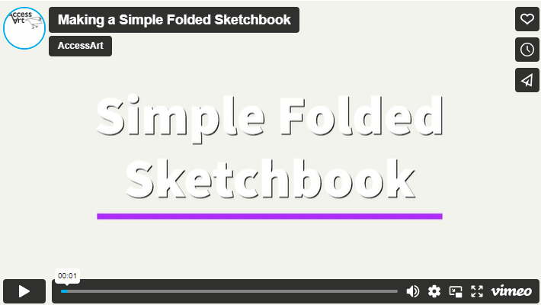
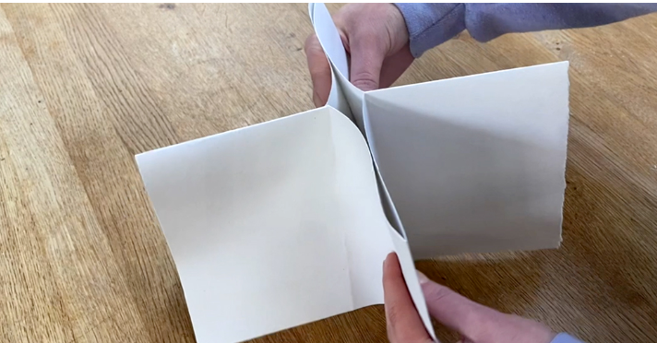
Thursday 5th February
TBAT: continue to create a visual poetry zine.
Making a Simple Folded Sketchbook (accessart.org.uk)
Making a small “booklet” sketchbook out of a single piece of paper is a handy trick to have up your sleeve! These versatile sketchbooks can be made in a variety of sizes and used for drawing exercises, specific projects or even to accompany pupils on school trips.

Slide 34
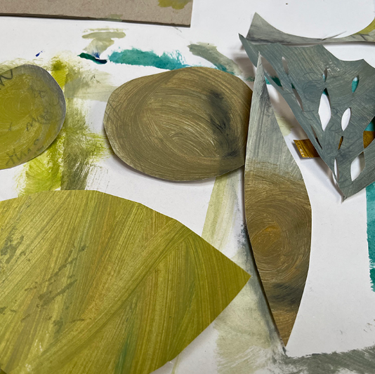
Use scissors to cut out some shapes.
Don’t draw the shapes first, instead just cut into the coloured paper. In terms of the shapes you cut, again listen to the poem and let the content of the poem guide the imagery.
In this case – Ghost in the Garden made us think of leaf shapes, grass shapes, cobwebs etc.

Slide 35
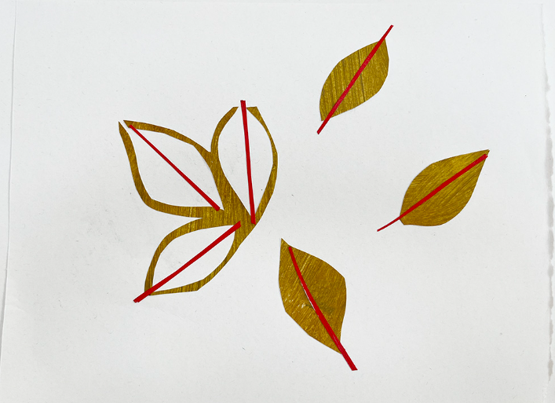
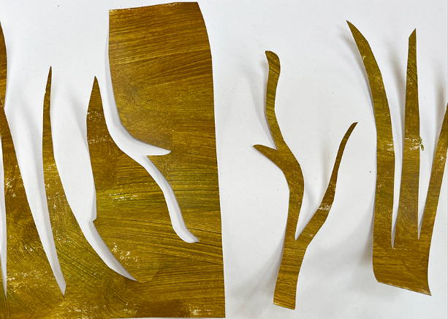
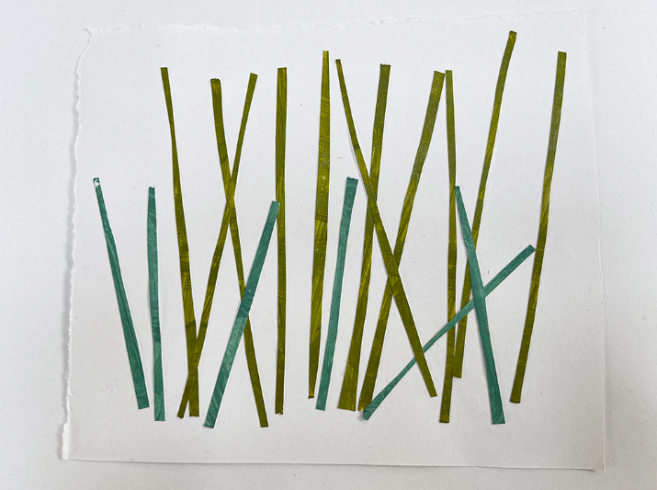
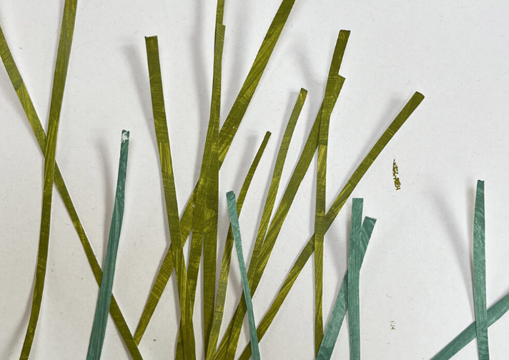
Experiment with how you would like to use the shapes to collage backgrounds on the pages of the blank zine. Play around with the pieces of painted card before you finally stick them down.

Slide 36
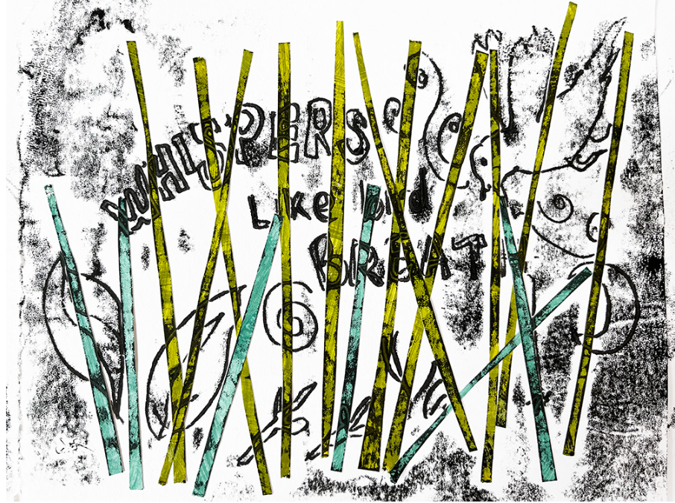
Time to print:
Using monotones
Watch 1.20 - 3.50
How to Make a Monotype Print - Tutorial #1 Trace Monotype Print with Pastel (without a press)
We will be using paper and pencils -
teacher to demonstrate.
Listen to Ghost in the Garden for inspiration
Ghost in the Garden - The Children’s Poetry Archive

