Slide 1
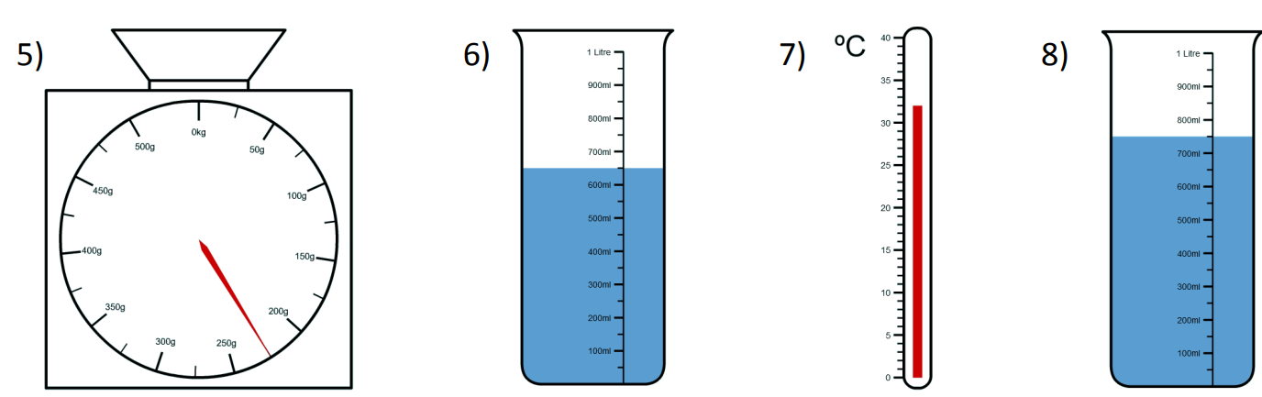
4L = ________________ml 3.2kg = ______________g
2, 000 m = ____________km 200ml = ____________L
What do each of these units of measurements have in common?

Slide 2
03/02/26 Word work: TBAT- select vocabulary to show, not tell. As each winner is announced, how is the main character in the story feeling? resentful cross Share your words with your partner, are you going to magpie any? Now use a thesaurus to find more words.

Slide 3

Shades of Meaning
Calmest feeling
Sort your words. This should reflect the progression of feelings.
Most overwhelming feeling

Slide 4
Talk partners: Which would be best used in a narrative and why? Showing: As his mother switched off the light and left the room, Michael tensed. He huddled under the covers, gripped the sheets, and held his breath as the wind brushed past the curtain.
Telling: Michael was terribly afraid of the dark.

Slide 5
Decide if your example is showing or telling the reader? Blue The dry orange leaves crunched under my feet as I pulled the collar up on my coat. Green I walked through the forest. It was already Fall and I was getting cold.

Slide 6
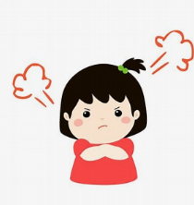
The second winner has been announced, Ellie was feeling cross. Instead of saying how she was feeling, how can you show the reader? What might she have been doing? Write your idea down.

Slide 7
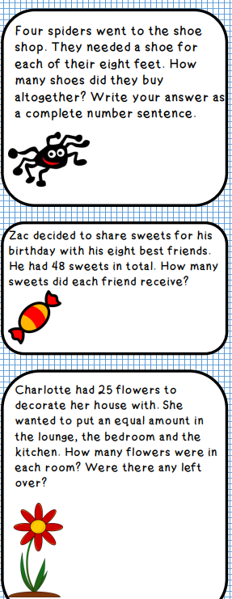
2 x 8 =
4 x 8 =
8 x 8 =
3 x 8 =
6 x 8 =

Slide 8
3.2.26
TBAT- use column method to subtract.
3 in 3
Challenge:
3/5 + 1/3 =
420 divided by 6 =
35% = 0. ________ = _____
6.7kg = ________ g
570g = ________kg

Slide 9
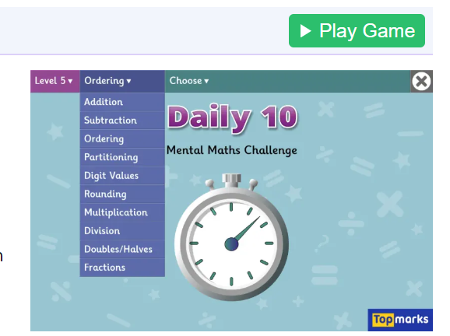
Daily 10 - Mental Maths Challenge - Topmarks x8

Slide 10
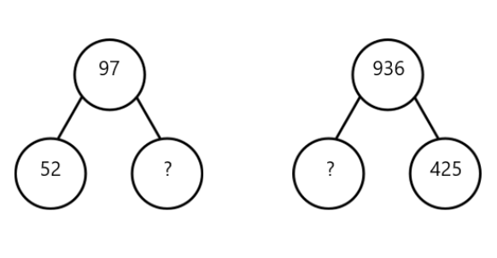
Which method would you use to calculate the missing number? Blue Green
Challenge: Write the inverse operation to check your answer.

Slide 11
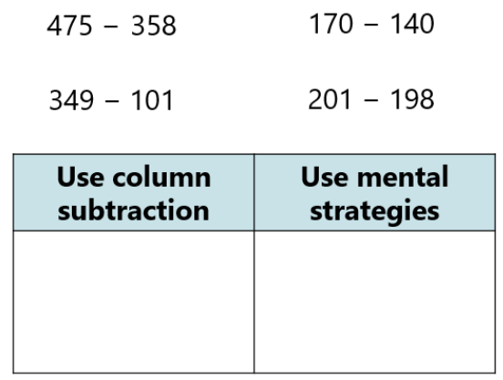
Create a table on your whiteboard and sort the calculations:

Slide 12
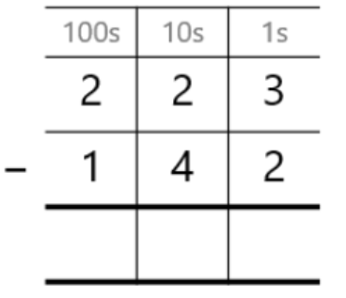

Slide 13
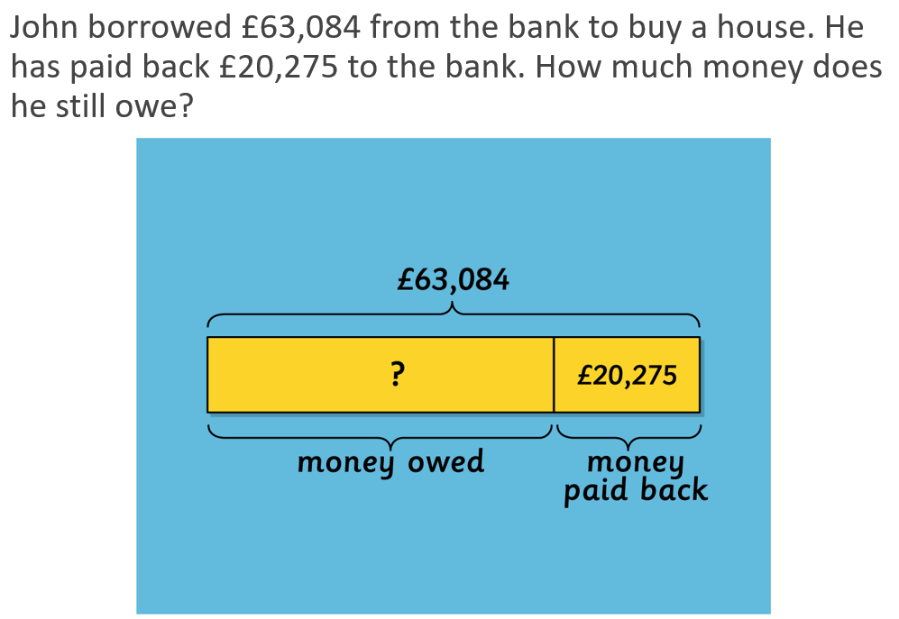

Slide 14
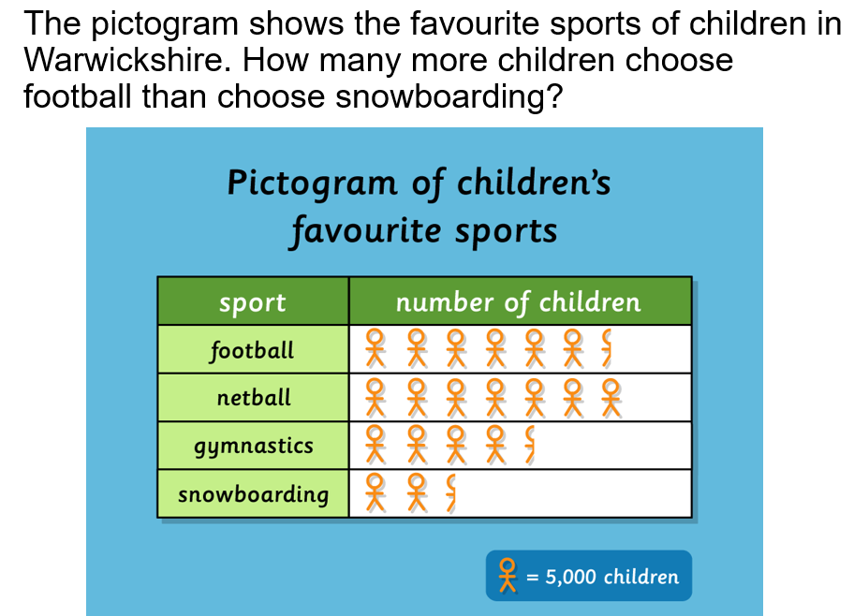

Slide 15
Whiteboard work: Complete the calculations.

Slide 16
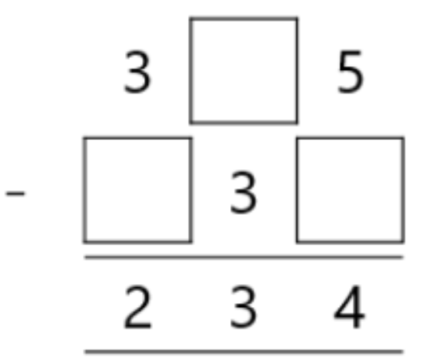
Paired work:

Slide 17
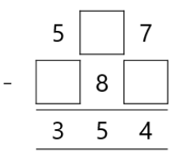

Checkpoint Question:
A) 567 - 281 B) 537 - 183 C) 517 - 282

Slide 18
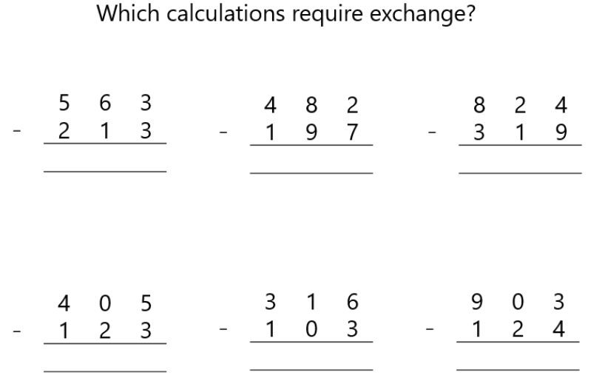
Talk partners:

Slide 19
Independent:

Slide 20
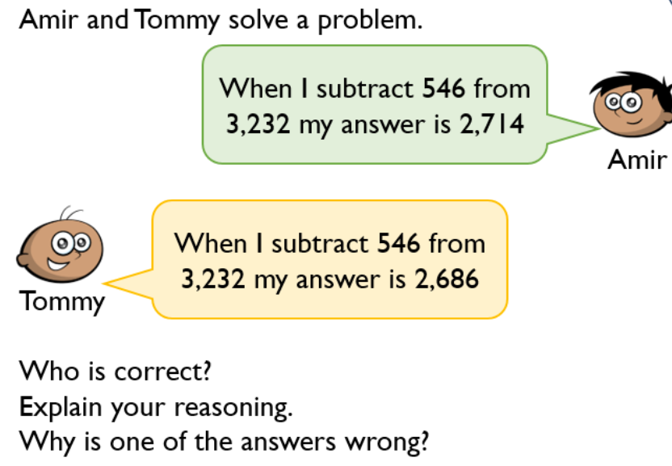
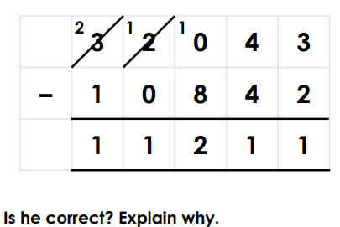
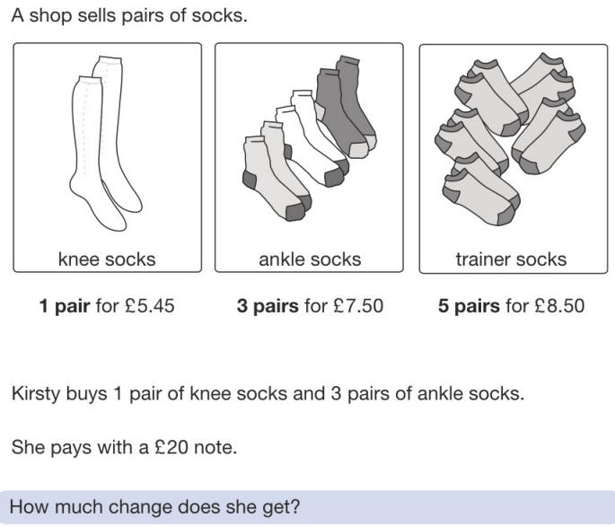
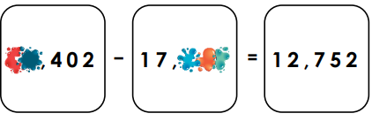
Mastery:
Challenge:

Slide 21
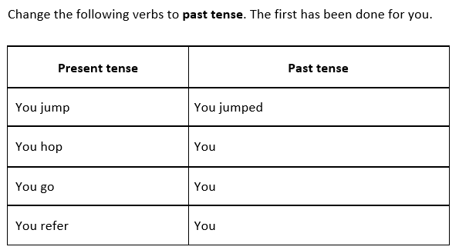
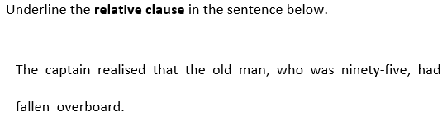
Tuesday 3rd February TBAT- plan a narrative.

Slide 22

Read the competition announcement. (P1) What needs to be included? Breaking news from LEGO HQ! Are you bursting with creativity? Do you love building worlds with bricks of endless possibility? If you’ve ever dreamed of seeing your wild ideas come to life, now’s your chance! The legendary Leah Lego, owner of the iconic LEGO company, has announced that she is retiring after years of building joy and adventure for children across the globe. She is searching for the next Junior Master Inventor to take her place as the honorary owner of LEGO for an entire year! The winner will work alongside top designers to create exciting new sets for kids everywhere.
Think you've got what it takes? Here's how to enter:
1: Build your most imaginative LEGO creation.
2: Write a short story explaining your amazing design.
3: Share your entry on Twitter using #LegoCompetition and tag @IamLegoInventor.
Don't miss your chance to turn your imagination into reality and become part of LEGO history!

Slide 23

Task: Write the Competition Announcement (box 1) Opening statement Rhetorical question. The announcement. How to enter: Bullet point three instructions
Write this straight onto the planning sheet.

Slide 24
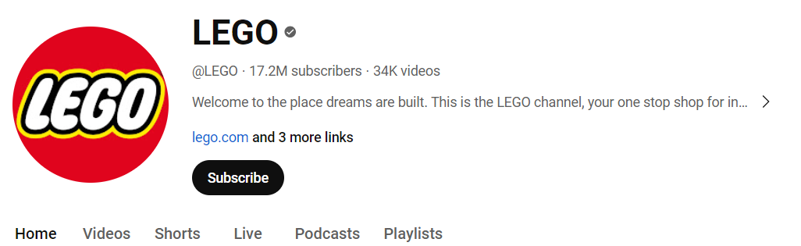
The winning announcements are made on the LEGO YouTube channel.
These will be clips of the winner and their family in their own home- viewed by the main character.

Slide 25
In pairs discuss what the purpose of each part is-
Before long, that dreaded notification of a winner was announced:
“Hey, LEGO enthusiasts! We've got an exciting update from the LEGO Product Design Competition. After sifting through an incredible array of entries, we're thrilled to announce our first winner! Meet Miranda Fayn, the Master Builder of the Miniature House!”
The camera scanned the room, displaying the twenty photo frames that stood with pride showing a picturesque family.
“We're here with Miranda, whose outstanding LEGO creation has secured her a spot as one of the winners in our competition. She built a breathtaking miniature house that captured our hearts and showcased her incredible skills as a LEGO architect. How does it feel to be one of the first winners in the LEGO Product Design Competition?”
“Oh, wow! I can't believe it!” she said skipping merrily towards her house. “I'm absolutely over the moon right now. Being chosen as a winner is a dream come true. LEGO has been my passion since I was a kid, and to have my creation recognized in this way is just incredible.”
Of course she won thought Giana, a nice pretty girl from what looks like a perfect little family.

Slide 26
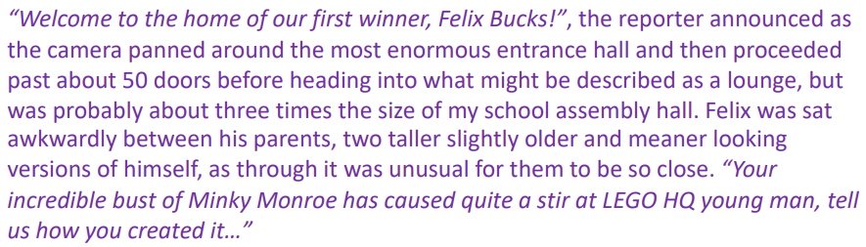
Class Work: Read the text. Identify what is happening at each stage of the paragraph.
Presenter dialogue
Introducing the winner, give a clue about their personality

Slide 27
Independent: write a short paragraph for announcement 1. Write in full sentences, just use the template below as guidance for structure.
Presenter- introduce character 1 | Dialogue – inverted commas and reported clause
The camera moves- what does it see? Describe the house of the winner | Camera moved in the room. What room are they in? What does it show?
Introduce the winner | What was the character doing as the cameramen were in the room? Playing a game, reading a book, watching tele?
Presenter dialogue- discuss what was made by the winner | Introduce the winning piece- include the info from Wednesday's plan

Slide 28
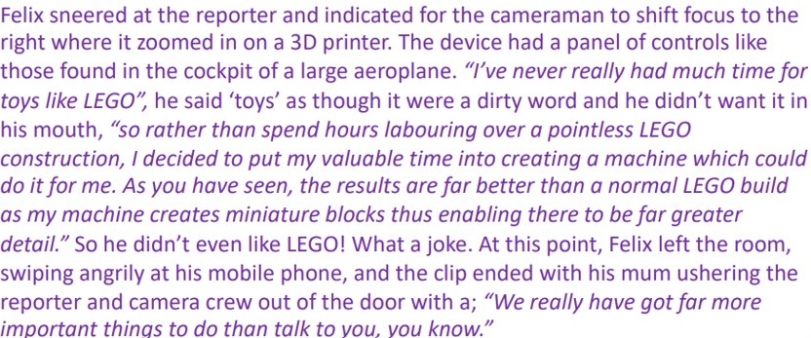

Slide 29
Class Work: Read the text. Identify what is happening at each stage of the paragraph.
Character's actions
Quote from the winner

Slide 30
Independent: write a short paragraph for announcement 1. Write in full sentences, just use the template below as guidance for structure.
Character going towards the LEGO | How does he travel towards it? What is his body language like?
Quote from the winner | Use Wednesday's plan- quote from the winner
Main character's thoughts | What is the main character thinking watching this? What would they say to themselves?

Slide 31
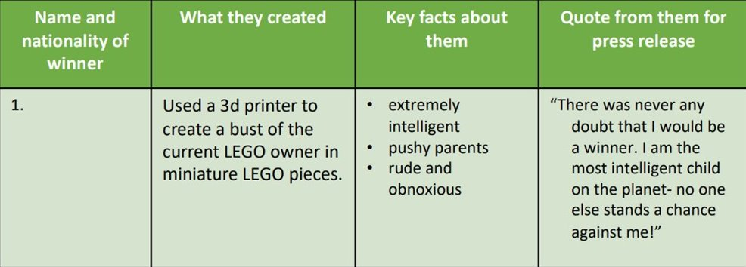
Recap the character: Who they are, what they are like and a quote they will say.

Slide 32
Ellie clenched her fists. “That’s not fair!” she exclaimed to no one in particular. Her cheeks burned with frustration. Jeremy was infamous for his sneaky behaviour and terrible attitude. Ellie had heard countless stories of his cheating in school competitions and mocking others who lost. “How could they let him win?” she fumed. “It’s so wrong.”
What do we like about this paragraph?

Slide 33
Task: Write your announcement which matches to the unworthy character. Make it clear about what your character was doing and how they are feeling. Make sure it is written in third person. Challenge: Use a semi-colon in one of your sentences to show your characters thought.

Slide 34
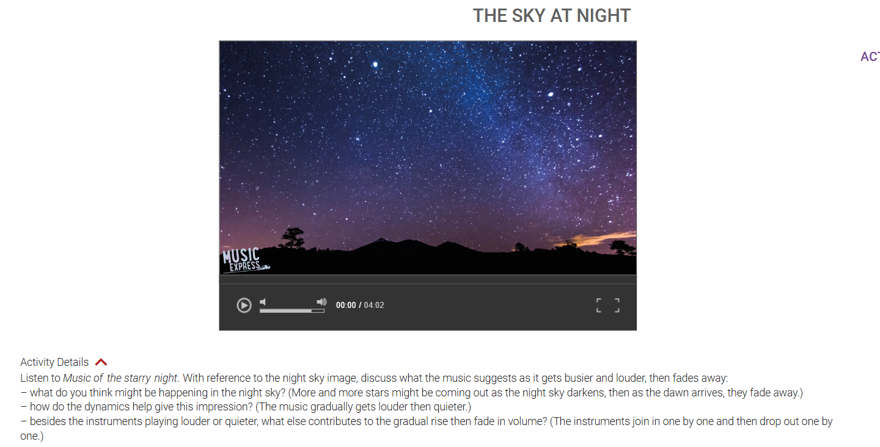
Music TBAT: Listen to music and evaluate. The Collins Hub Educator > Library - Year 5 – Solar system – The sky at night.

Slide 35
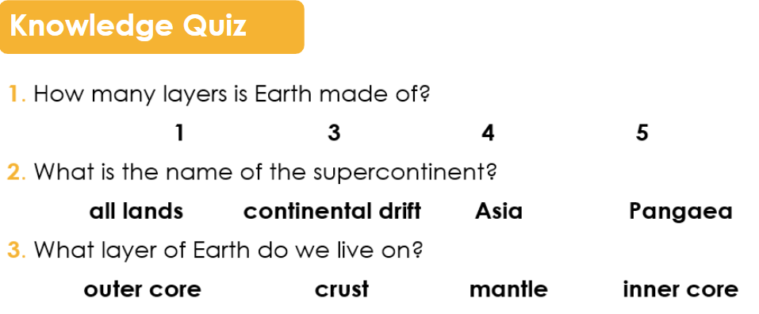
Tuesday 3rd February Q: How are mountains formed?

Slide 36
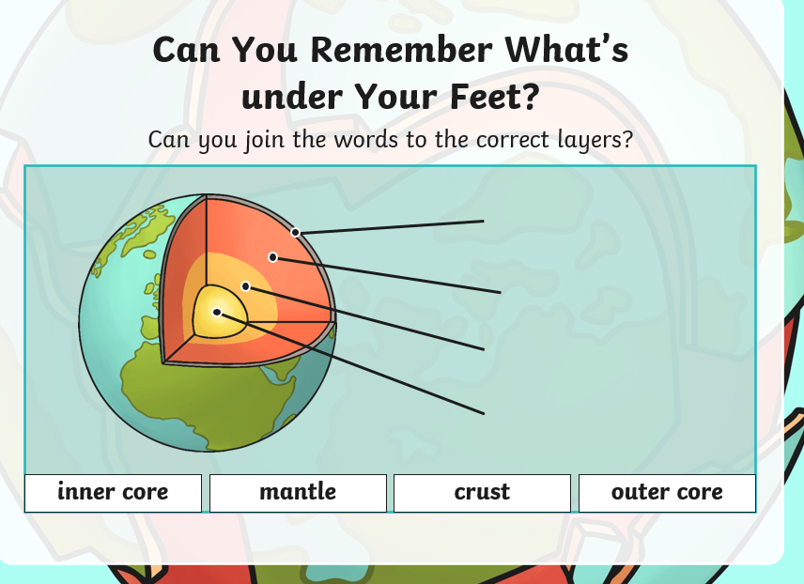
Recap:

Slide 37
Entry Questions: Blue Earth's mantle is made up of large pieces called ___________ pl______. Green Tectonic plates move and when they meet, they: ___________, _______apart or ________ against each other.

Slide 38

What are the key physical features of Asia?
What are tectonic plates?
1
4
Learning journey
What are the key human features of Asia?
How are mountains formed?
2
5
What are Asia’s natural borders?
How are volcanoes formed?
3
6
Copyright © ArkCurriculum+ 2022
Notes:
Share the Learning journey.

Slide 39
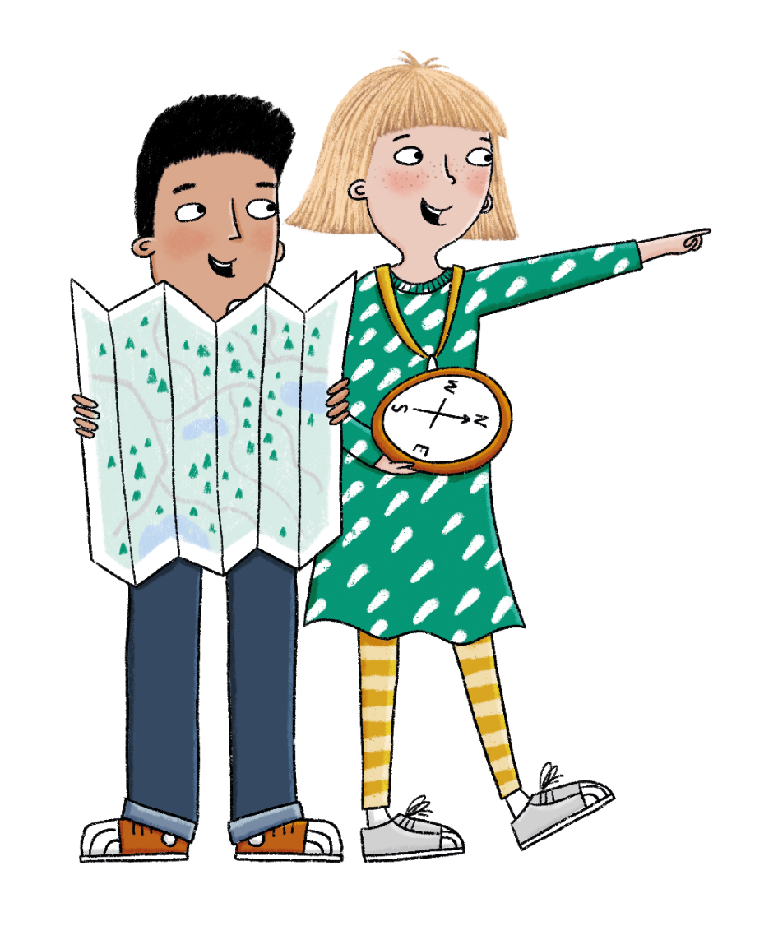
In this lesson, you will learn to use maps to locate and describe the topographical features of mountains.
Lesson 5: Lesson statement
Copyright © ArkCurriculum+ 2022
Notes:
Share the specific lesson statement. In this lesson, pupils are learning to use maps to locate and describe the topographical features of mountains. Mountains were previously studied in Year 3 UK settlements and land use, where pupils learned the features of hills and mountains and the differences between the two.

Slide 40
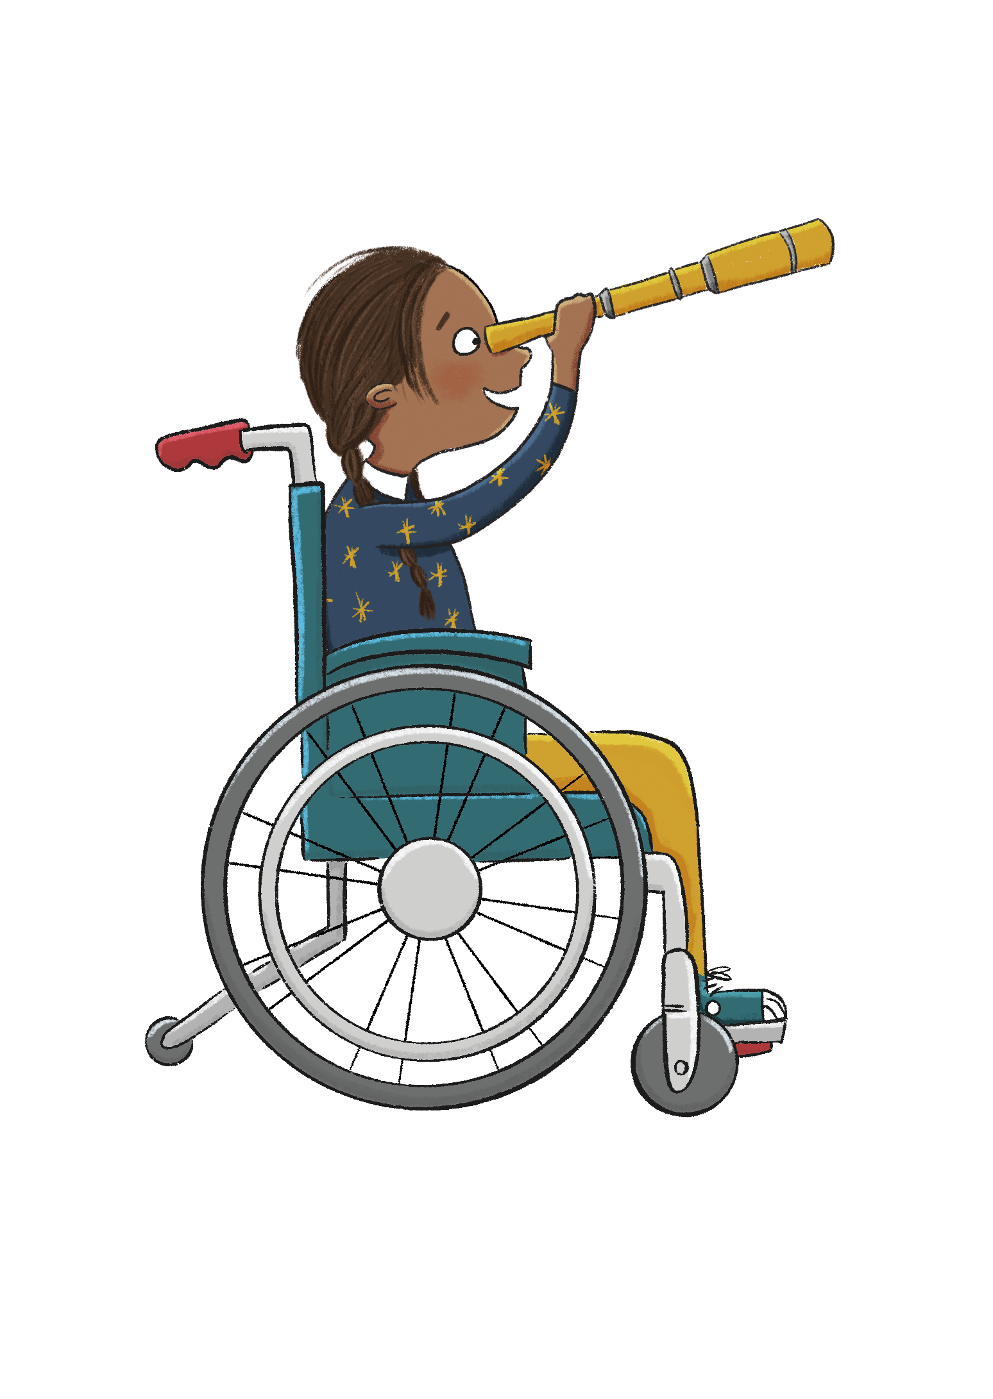
The key term in this lesson is landform.
A landform is a natural feature of Earth's surface.
Lesson 5: Key term
Copyright © ArkCurriculum+ 2022
Notes:
Key term: A landform is a natural feature of Earth’s surface. Discuss this key term. Break down the word to think about it being a form that is on the land (so, a natural/physical feature of the Earth’s surface).

Slide 41
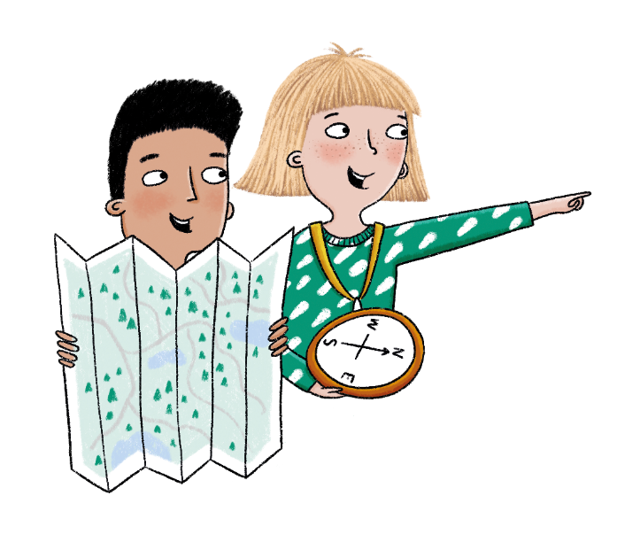

How are mountains formed?
Key knowledge
Most geologists classify a mountain as a landform that rises at least 1,000 feet (300 metres) or more above its surrounding area.
Around 20 per cent of Earth’s surface is covered with mountains.
Mountains are most often formed by movement of the tectonic plates in Earth’s crust.
The Himalayas are the tallest mountains in the world.
Key vocabulary
plateau
slope
summit
valley
Lesson 5: Key knowledge
Copyright © ArkCurriculum+ 2022
Notes:
Share the key knowledge and vocabulary. Discuss any key words that have been learned before. Pupils will have seen the words ‘slope’ and ‘summit’ if they have previously studied mountains in the UK. People can use their Knowledge organisers to help.

Slide 42
Talk partners: What are the different ways that we can measure lengths? What unit do you think is used for a mountain?

Slide 43

Measuring in feet and metres
‘Feet’ and ‘metres’ are both units of measurement that we use to measure distance.
‘Feet’ are known as imperial units of length, and we don’t commonly use them anymore. Most people now use metres.
There are approximately 30 centimetres in 1 foot. There are approximately 3.3 feet in 1 metre.
Group Work: Use a metre rule to measure the length of the object. Measure it in metres and then convert the measurement to feet. We can then complete the table together.
Lesson 5: Investigation
Object | Length in feet | Length in metres
Copyright © ArkCurriculum+ 2022
Notes:
Investigation: Explain to the class that we have different units to measure things like length. Ask: ‘Does anyone know of any?’ (centimetres, feet, inches, metres). Share the slide about measuring in feet and metres with the class and read it together. Ask pupils to paraphrase it in pairs to check their understanding, particularly of converting between metres and feet. Hand out metre rules and ask pupils to measure three objects from the classroom in both feet and metres. Discuss what is mostly used now (metres) and what was mostly used in the past (feet). Discuss what the difference is between metres and feet (metres are broken down into centimetres and feet into inches).

Slide 44
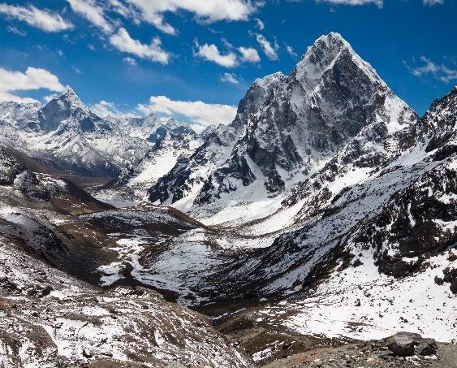

What is a mountain?
A mountain is a natural landform that rises above the surrounding land. Most geologists classify a mountain as a landform that rises at least 1,000 feet (300 metres) or more above its surrounding area.
A mountain range is a series or chain of mountains that are close together.
Around 20 per cent of Earth’s surface is covered with mountains. There are mountains and mountain ranges in the ocean. Many islands are the tops of mountains, with their base on the ocean floor.
Lesson 5: Read
Copyright © ArkCurriculum+ 2022
Notes:
Read: Section titled—What is a mountain? Revise previous learning if necessary and focus on new vocabulary here.

Slide 45
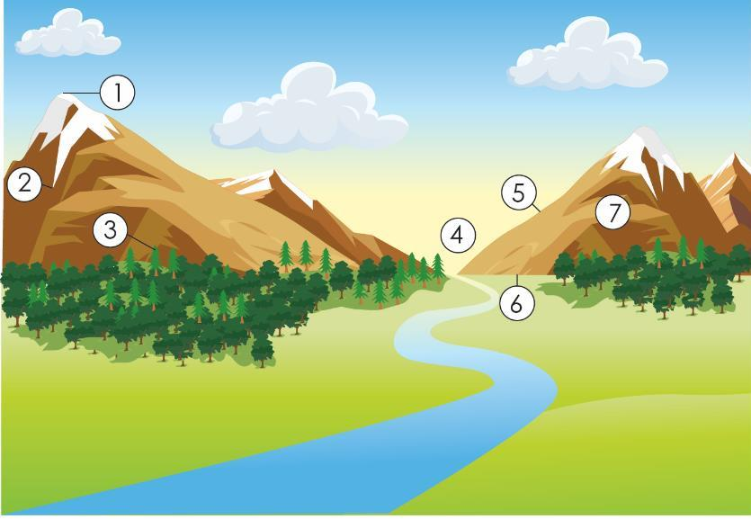

What are the features of a mountain?
Write the number next to the correct definition.
A summit or peak is the top of the mountain.
A slope is an area of ground increasing in height.
A foot is the bottom of the mountain.
A valley is an area of low land between mountains.
A treeline is the highest point forests are found.
A face is the ‘side’ of a mountain.
A snow line is where ice and snow cover the mountain all year.
Lesson 5: Write
Copyright © ArkCurriculum+ 2022
Notes:
Write: Pupils use the definitions to locate the features of a mountain on the diagram. Pupils write the numbers from the diagram beside the definitions below the diagram. Check answers against those on the slide and address any misconceptions.

Slide 46
What are the features of a mountain?
Write the number next to the correct definition.
1
A summit or peak is the top of the mountain.
A slope is an area of ground increasing in height.
A foot is the bottom of the mountain.
A valley is an area of low land between mountains.
A treeline is the highest point forests are found.
A face is the ‘side’ of a mountain.
A snow line is where ice and snow cover the mountain all year.
Lesson 5: Write
5
6
4
3
7
2
Copyright © ArkCurriculum+ 2022

Slide 47
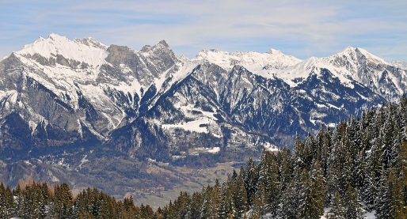
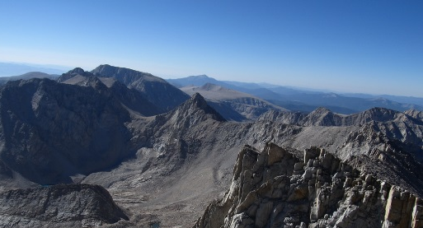
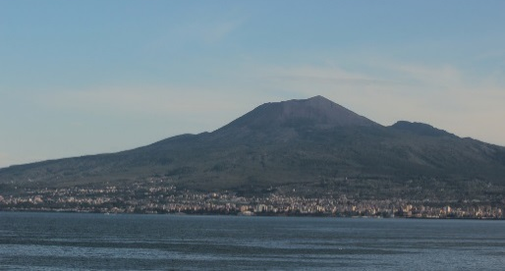
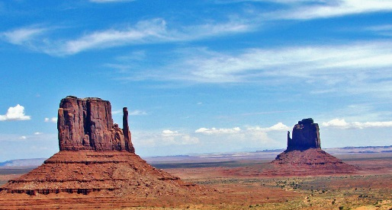
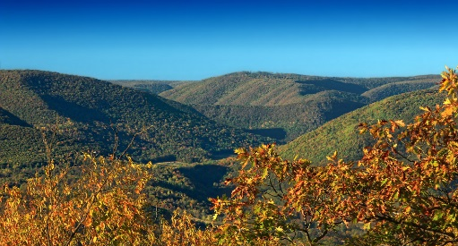
How Mountains are Made
There are 5 main types of mountains:
fold mountains
fault-block mountains
volcanic mountains
dome mountains
plateau mountains
Each one is formed differently.
Photo courtesy of Tambako the Jaguar, Ken Lund, DragonGhost19, inkknife_2000 and Nicholas_T @flickr.com) - granted under creative commons licence – attribution

Slide 48
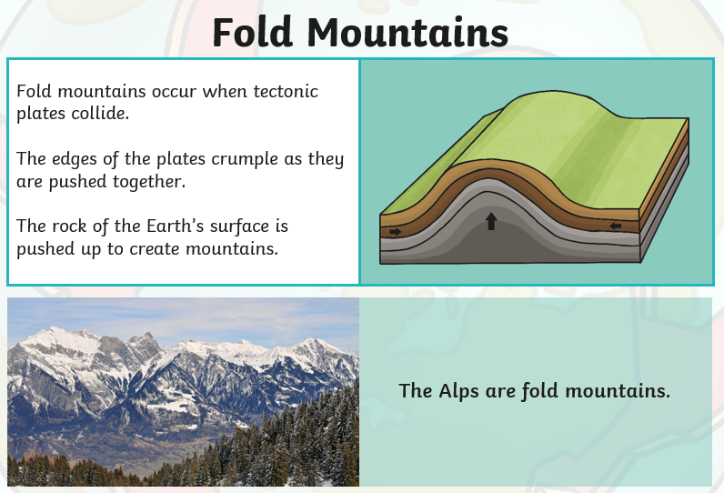

Slide 49
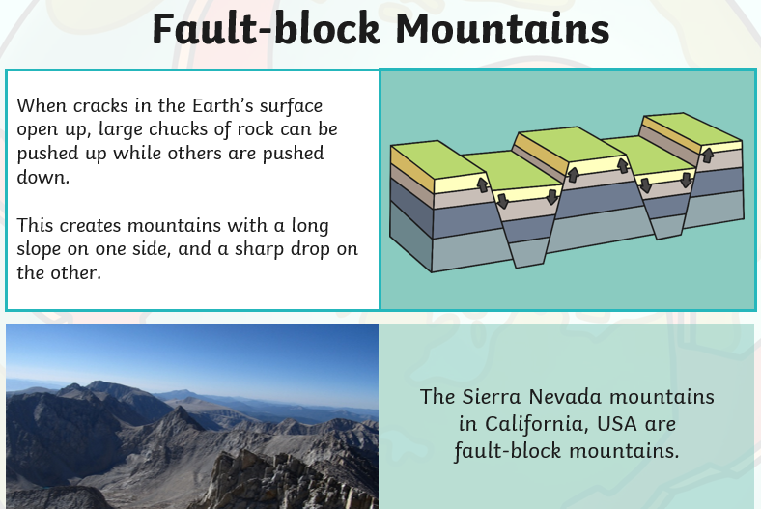

Slide 50
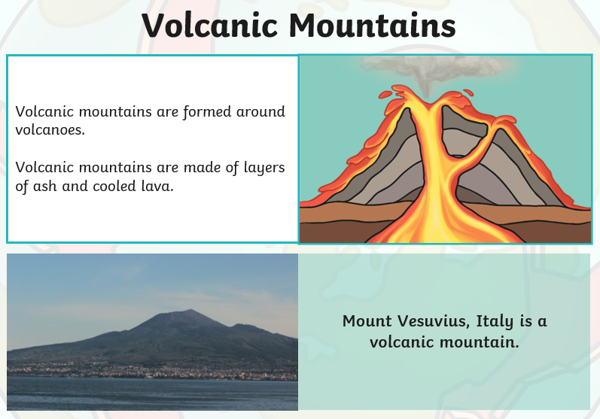

Slide 51
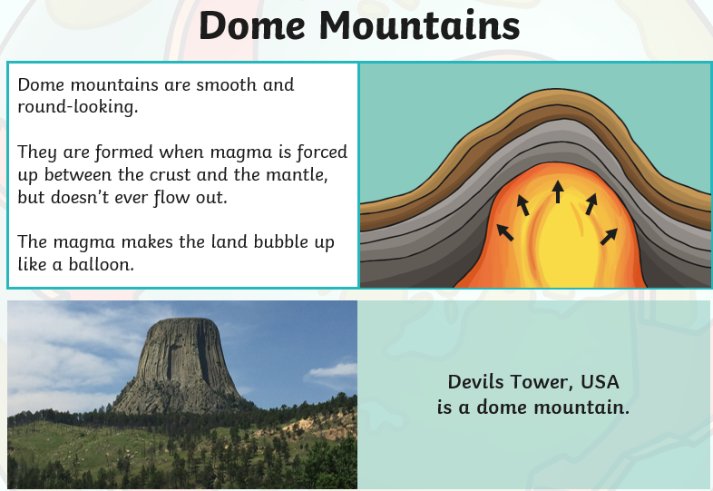

Slide 52
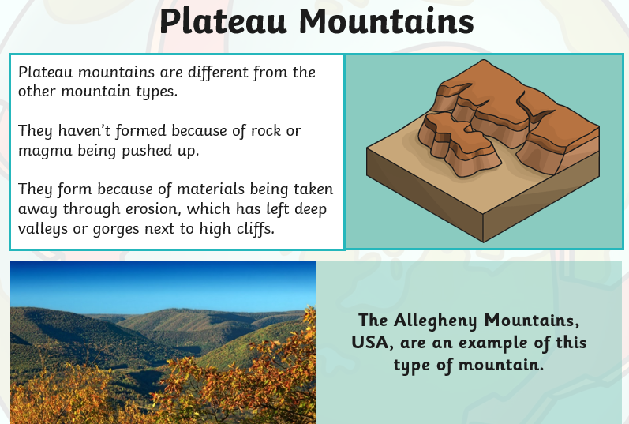

Slide 53
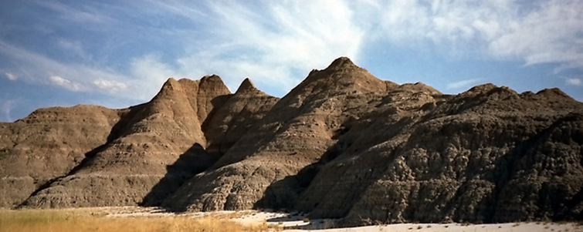
What type of mountain is it?
Dome Plateau Fault-block

Slide 54
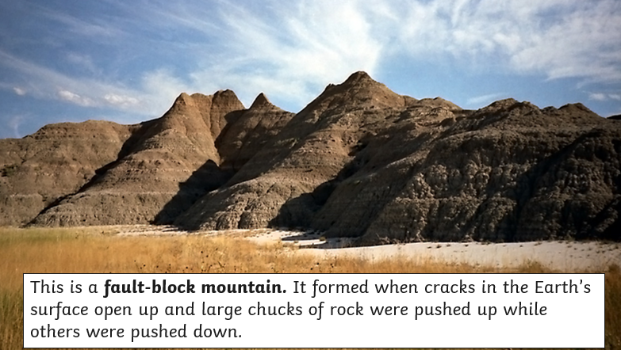

Slide 55
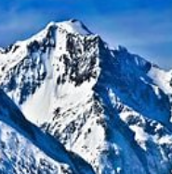
Partner Work: How are mountains formed? Verbally share your understanding using the key words below. Think it, say it, like it, write it.
Tectonic plates
movement
collide
tear apart
slide against
Plateau Mountain​
Dome Mountain ​
Volcanic Mountain ​
Fault-block Mountain ​
Fold Mountain

Slide 56
Partner Work: How are mountains formed? Write your sentences. Think it, say it, like it, write it.
Tectonic plates
movement
collide
tear apart
slide against
Plateau Mountain​
Dome Mountain ​
Volcanic Mountain ​
Fault-block Mountain ​
Fold Mountain

Slide 57
Plateau Mountain​
Dome Mountain ​
Volcanic Mountain ​
Fault-block Mountain ​
Fold Mountain

Slide 58
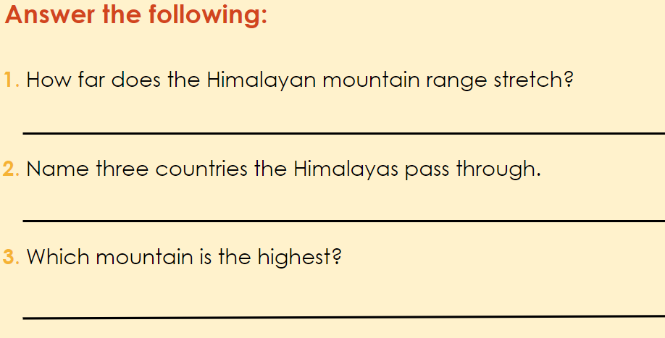
Read the Himalayas text and answer the questions in full sentences.

Slide 59
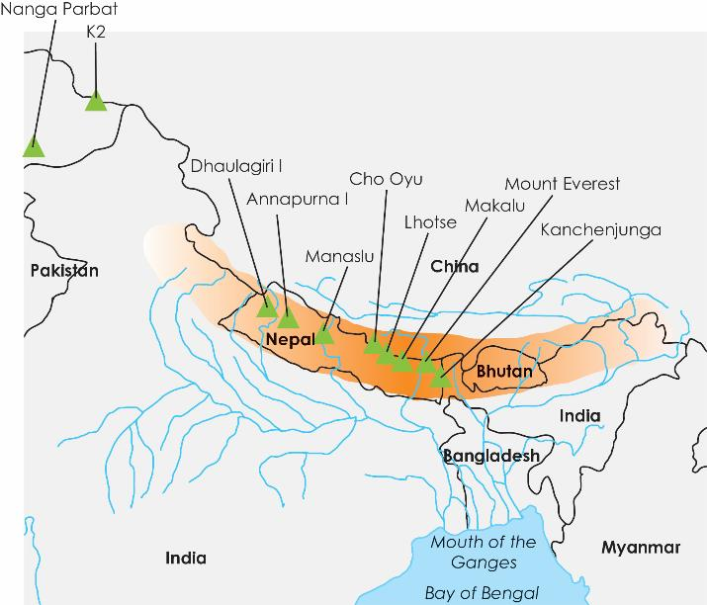
Case study—The Himalayas
The Himalayas are a mountain range in South Asia. The word ‘Himalaya’ means ‘house of snow’. The Himalayas are the tallest mountains in the world, and stretch 1,500 miles from east to west, across Bhutan, Nepal, India, China, Pakistan, and Afghanistan.
Lesson 5: Read
Copyright © ArkCurriculum+ 2022
Notes:
Read: Section titled—Case study—The Himalayas. Make time to define any unknown vocabulary. Ensure understanding by asking questions as you read if necessary.

Slide 60
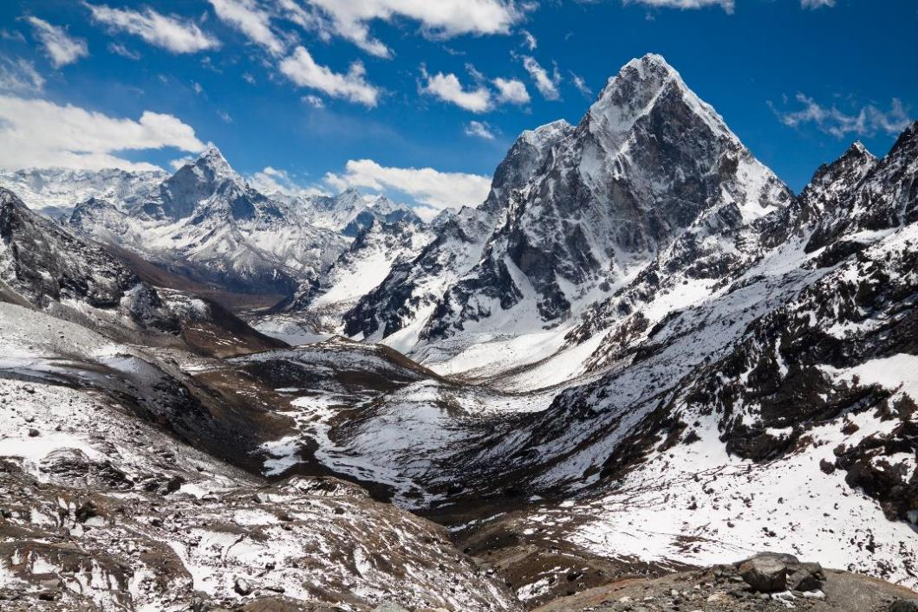
Case study—The Himalayas
The 15 highest mountains in the world are in the Himalayas. They include Mount Everest, Annapurna, and Nanga Parbat. Mount Everest is the highest mountain on Earth at over 29,000 feet (about 8,850 metres) tall.
Lesson 5: Read

Slide 61

Case study—The Himalayas
The Himalayas shape the climate of the surrounding countries. They block the clouds and when moist air moves north from the Indian Ocean, the clouds rise and cool. This causes rain to fall on the south side of the mountains. North of the Himalayas is the Tibetan Plateau, which is called ‘the roof of the world’ as it stands over three miles above sea level. It is very dry because the mountains block the rain.
Lesson 5: Read
Copyright © ArkCurriculum+ 2022

Slide 62

Case study—The Himalayas
The highest mountain ranges are created by tectonic plates pushing together and forcing the ground up where they meet. This is how the mountains of the Himalayas in Asia were formed.
Lesson 5: Read
Copyright © ArkCurriculum+ 2022

Slide 63

1. How far does the Himalayan mountain range stretch?
2. Name three countries the Himalayas pass through.
3. Which mountain is the highest?
Answer the following:
1,500 miles from east to west
Lesson 5: Retrieval
Any three of: Bhutan, Nepal, India, China, Pakistan, and Afghanistan.
Mount Everest
Copyright © ArkCurriculum+ 2022

Slide 64
How are mountains formed?
Key knowledge
Most geologists classify a mountain as a landform that rises at least 1,000 feet (300 metres) or more above its surrounding area.
Around 20 per cent of Earth’s surface is covered with mountains.
Mountains are most often formed by movement of the tectonic plates in Earth’s crust.
The Himalayas are the tallest mountains in the world.
Key vocabulary
plateau
slope
summit
valley
Lesson 5: Key knowledge
Copyright © ArkCurriculum+ 2022

Slide 65
Exit Questions: Mountains are most often formed by the ____________ of _________ _______. To be classed as a mountain, it needs to measure ______________ or above. Which mountain range is the highest?

Slide 66
TBAT- know how to communicate safely online. 2 in 2 Why is communication important? List two features of a good friend.
PSHE
3.2.26

Slide 67
Recap Talk partners What is a bystander? How can you be a safe bystander?

Slide 68
Blue What does cyber-bullying mean? Green What is the difference between being bullied and someone being mean? Challenge: Give two reasons why someone may bully.

Slide 69
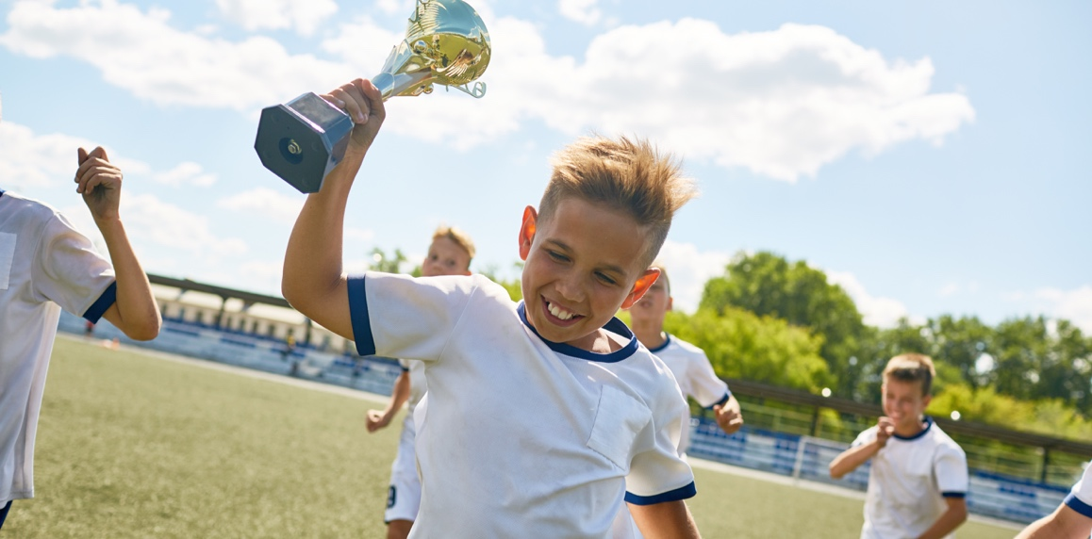
Jack’s story
How might Jack be feeling after seeing these comments?
Well done, that’s amazing!
He’s so ugly, who cares about his trophy anyway.
Ha ha, it’s probably fake anyway!
Well done, you should be proud of yourself.
Notes:
Ask the pupils to view the post and read the comments. How might Jack be feeling after seeing this? His emotions might include embarrassment, disappointment, shock, anger, pride, sadness.

Slide 70
A troll is disagreeing with someone's view or opinion.
True or false?
What is a troll?
What is an internet troll and what do they do?
Watch up to 2 minutes
Trolling and Online Bullying Explained ft. Marc Zapanta | Voice Box | Childline (youtube.com)
Notes:
An internet troll is someone who writes nasty comments on posts and websites and tries to create arguments online. Their main aims are to get people to react to their comments and cause upset.
Ask pupils if they’ve ever experienced this. It’s good to clarify that simply disagreeing with someone’s view or opinion doesn’t make them a troll!

Slide 71
In lesson one you thought of words associated with friendship: loyal kind nice caring kind-hearted good communicator
What words would you associate with a friendship online?

Slide 72
Is it the same online?
Talk partners:
Discuss the following statement:
‘It doesn’t matter what you say online, as no one knows who you are.’
Notes:
Allow pupils to research safe rules or tips for communicating online. They should present these in the form of an acrostic-style factsheet spelling out FRIENDSHIP.
Use websites such as www.childnet.com, www.saferinternet.org.uk and www.kidsmart.org.uk to help research ideas for the factsheet.

Slide 73
Talk partners: What are the rules which could be applied to communication online and being a friend online?

Slide 74
What are the rules which could be applied to communication online and being a friend online?
Together let's explore these websites and find rules for communicating safely online.
Use the following websites to research safe rules or tips for communicating online.
www.childnet.com
www.saferinternet.org.uk
www.kidsmart.org.uk

Slide 75
Write 10 rules as an acrostic of FRIENDSHIP. F- R- I- E- N- D- S H- I- P-
What are the rules which could be applied to communication online and being a friend online?

Slide 76
What are the rules which could be applied to communication online and being a friend online? Use the following websites to research safe rules or tips for communicating online.
Write 10 rules as an acrostic of FRIENDSHIP.
www.childnet.com, www.saferinternet.org.uk and www.kidsmart.org.uk

Slide 77
Remember Jack?
Task:
Knowing what you know now, how would you advise Jack to deal with this situation?
Well done, that’s amazing!
He’s so ugly, who cares about his trophy anyway.
Ha ha, it’s probably fake anyway!
Well done, you should be proud of yourself.

