Slide 1
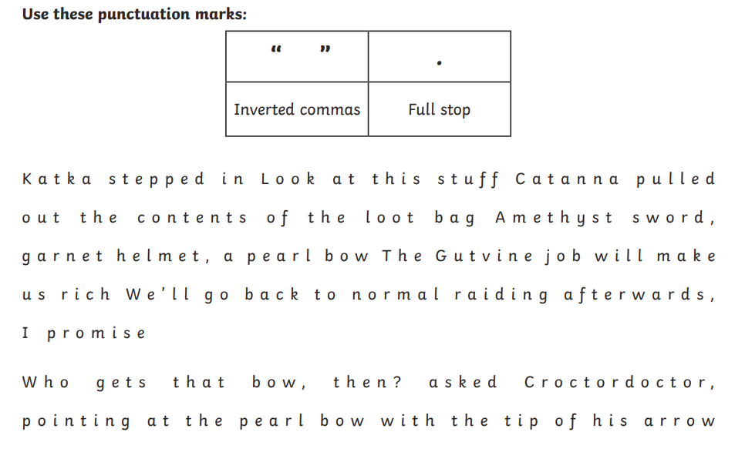
Friday 27th February
Morning Challenge

Slide 2
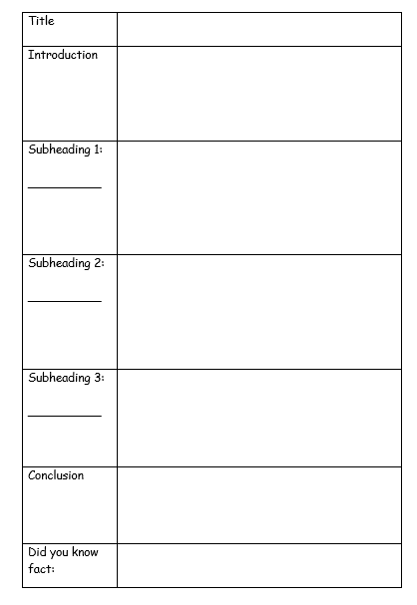
Write your draft introduction on your planning sheet. Remember to include: - What you will have in your sections (subheadings) - Fronted adverbials - Ambitious vocabulary - Technical language - Adverbs of possibility

Slide 3
Friday 27th February Dictation
The enormous elephant walked slowly across the dry, dusty field.
Please put these books into the correct category on the shelf.
The tornado spun quickly through the town and lifted cars into the air.
According to the weather forecast, it will rain later this afternoon.
She was given the opportunity to sing in front of the whole school.

Slide 4
27.02.26 TBAT- identify lines of symmetry.
673 + 502 =
576 x 22 =
6257 divided by 3 =
Challenge:
2/3 + ½ =

Slide 5
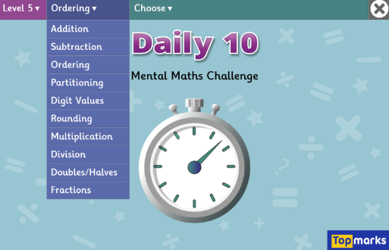
TBAT- identify lines of symmetry. x7 tables.
Daily 10 - Mental Maths Challenge - Topmarks

Slide 6
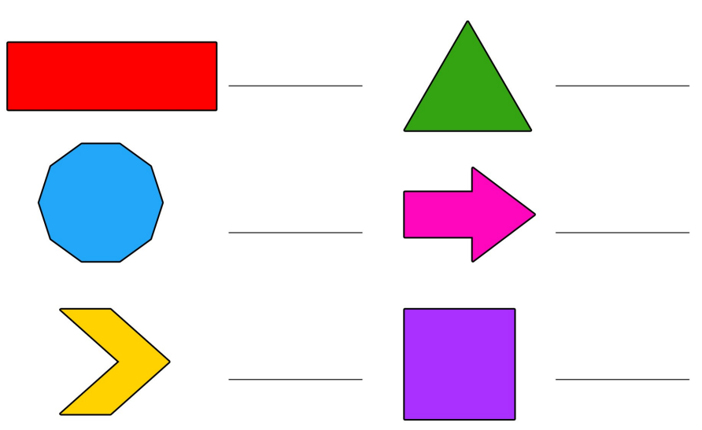
Write the name of your shape and identify if it is regular or irregular. Blue Green

Slide 7

A 2D shape is symmetrical if a line can be drawn through it and either side is a reflection of the other. You would call this the line of symmetry.

Slide 8

Talk partners: There is also a horizontal line of symmetry in this shape. True or false?

Slide 9
Lines of symmetry - Maths - Learning with BBC Bitesize

Slide 10
A 2D ______ is symmetrical if a line can be drawn through it and either side is a ________ of the other. You would call this the line of __________.
symmetry
reflection
shape
drawn

Slide 11
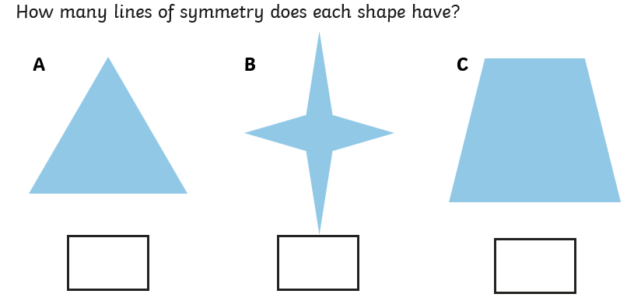
Whiteboard work:

Slide 12
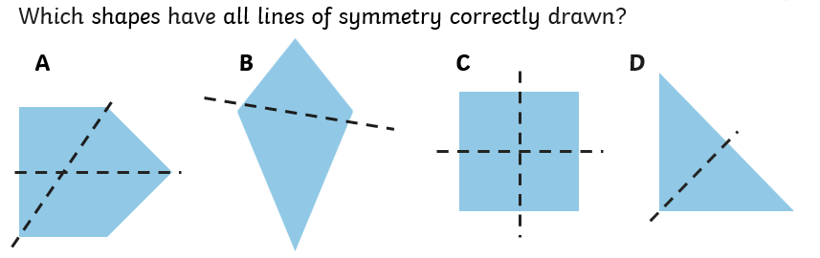
Whiteboard work:

Slide 13
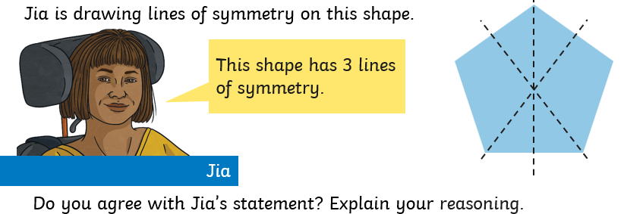
Talk partners:

Slide 14
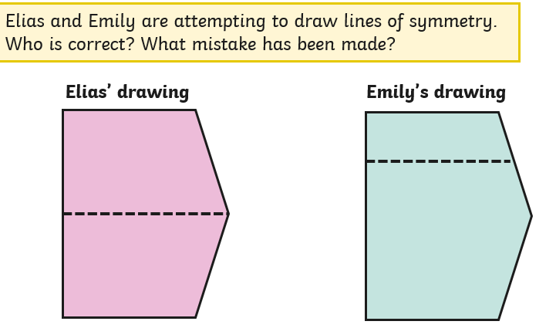
Talk partners:

Slide 15
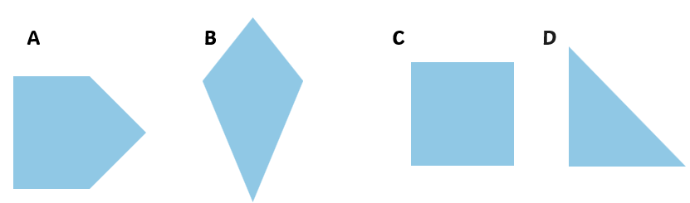
Draw the lines of symmetry on the shapes.
Green Blue
Challenge: What does a line of symmetry mean?

Slide 16
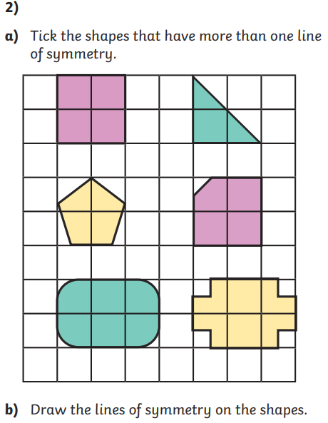
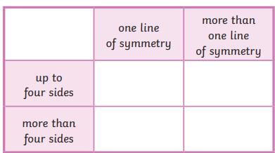
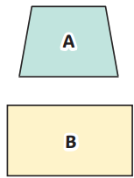
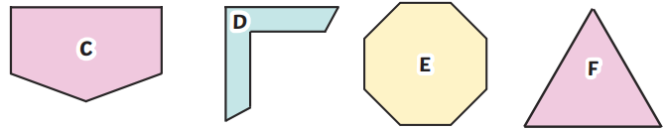
Independent:

Slide 17
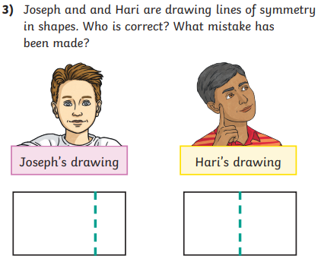
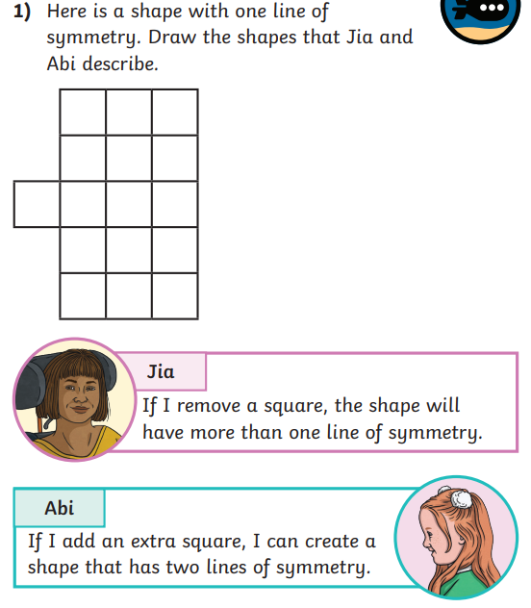
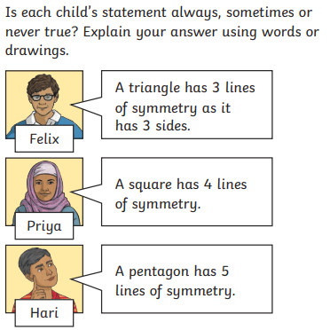
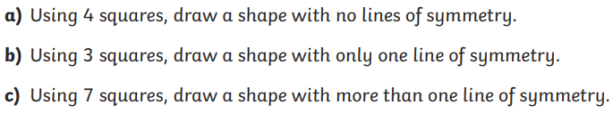
Challenge:
Mastery:

Slide 18
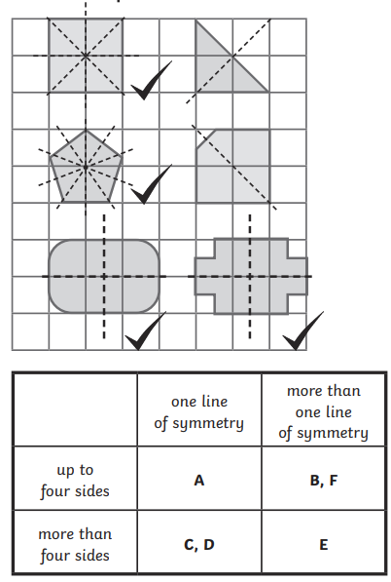
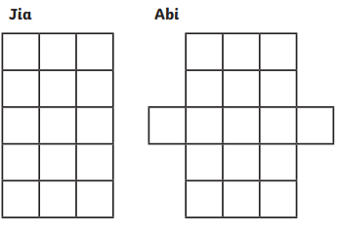
Challenge:

Slide 19
Friday 27th February TBAT: Use subject specific vocabulary.
3 in 3 Far below our feet, an enormous ocean of molten rock churns and swirls. Because the Earth is extremely hot inside, solid rock can melt into glowing magma, which waits beneath the crust. Gradually, as gases build up and pressure increases, the magma may force its way through weak spots in the ground. Meanwhile, when tectonic plates slide past each other or slowly pull apart, cracks can appear (sometimes stretching for many kilometres). Without warning, the trapped magma erupts violently into the air and thick, blazing lava spills across the land. Over time, these fierce eruptions pile up cooled lava and ash, creating a towering volcano. In some regions of the world, volcanoes are more likely to form due to constant plate movement, so new ones could still appear in the future.
Find and copy an adverbial which means slowly.
True or false: parenthesis has been used in the text.
Look at the final sentence, "In some regions of the world...", what could be the sub-heading for the next paragraph, linking to this sentence?
Challenge: Write a sentence about volcano formation including parenthesis.

Slide 20
Friday 27th February TBAT: Use subject specific vocabulary.
Talk partners: Orally rehearse your introduction from yesterday.
Has your partner included: -Fronted adverbials - Adverbs of possibility
Subject specific vocabulary
Can you offer any suggestions to your partner to improve their work?

Slide 21
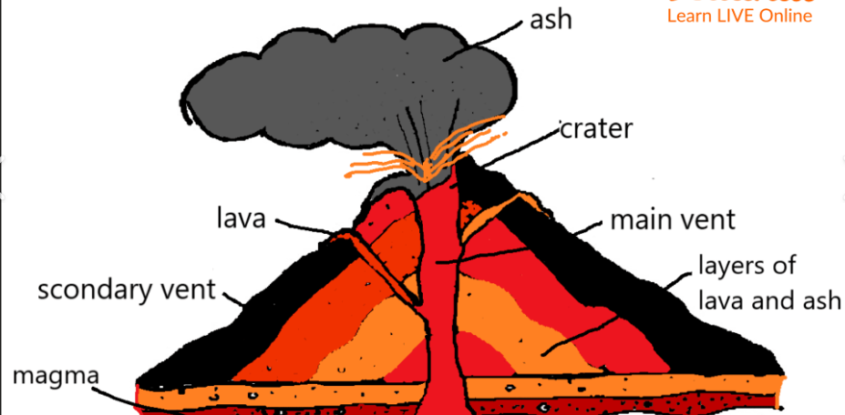
Friday 27th February TBAT: Use subject specific vocabulary.
Talk partners: List as many subject specific words as you can on your whiteboards – linking to volcanoes.

Slide 22
Friday 27th February TBAT: Use subject specific vocabulary.
Think about what your three sub-headings will be.
In your books, draw a table with your three sub-headings and write the subject specific vocabulary which will link to each sub-heading.
How are volcanoes formed? | What happens during an eruption? | Where are Volcanoes found?
Tectonic plates Boundaries | Pressure Magma | Asia Ring of Fire Ocean

Slide 23
Friday 27th February TBAT: Use subject specific vocabulary. How are volcanoes formed?
Deep beneath the Earth’s crust, powerful forces are constantly at work. Over millions of years, heat from the planet’s core melts solid rock into a fiery liquid called magma. Suddenly, when pressure builds up, this scorching magma pushes upwards through cracks in the crust. In some places, tectonic plates (huge pieces of the Earth’s surface) move apart or crash together, and as a result, gaps are created where magma can escape. Eventually, the bubbling magma bursts through the surface and becomes lava. As the lava cools and hardens, it slowly builds up layer upon layer, forming a steep, rocky mountain. In certain areas, volcanoes are more likely to form because the Earth’s crust is thinner, so eruptions may happen more often.
What features of a non-chronological report can you spot?
How are volcanoes formed? | What happens during an eruption? | Where are Volcanoes found?
Tectonic plates Boundaries | Pressure Magma | Asia Ring of Fire Ocean

Slide 24

Friday 27th February TBAT: Use subject specific vocabulary.
Check point question
Which sentence is best suited to a non-chronological report? A) Formed at tectonic plate boundaries, volcanoes develop when pressurised magma rises through fissures in the Earth’s crust and solidifies after repeated eruptions.
B) Volcanoes kinda just happen when super-hot rock pushes up through cracks in the ground and explodes everywhere.

Slide 25
Friday 27th February TBAT: Use subject specific vocabulary.
Take your first sub-heading.
Think about what you want to say. (Teacher model using word bank/WAGOLL)
Think it, say it (to your partner), like it, write it (on a whiteboard)
When you are happy, write it on your plan.
Remember: -Subject specific vocabulary
-Fronted adverbials
-Powerful adjectives
How are volcanoes formed? | What happens during an eruption? | Where are Volcanoes found?
Tectonic plates Boundaries | Pressure Magma | Asia Ring of Fire Ocean

Slide 26
Friday 27th February
TBAT: understand Islam in the UK, including how it is represented and how it has grown.
Why did many Muslims move to the UK?
True or False
Muslims arrived in the UK in the 20th century.
True or False
The Muslim population makes up 6.5% of the total UKpopulation.

Slide 27
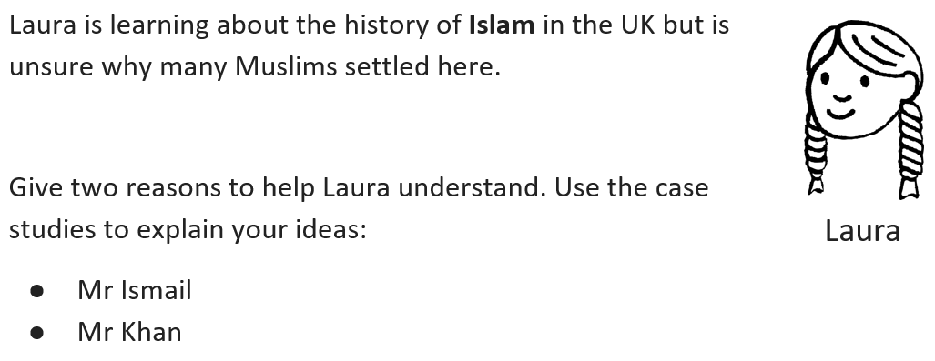
Friday 27th February
TBAT: understand Islam in the UK, including how it is represented and how it has grown.
Link to:
Work – factories, transport and other industries.
Rebuild after the war – hospitals, transport and factories.
Could find better work than in their home countries.
They took jobs in factories, trains and hospitals.
Families joined them.

