Slide 1
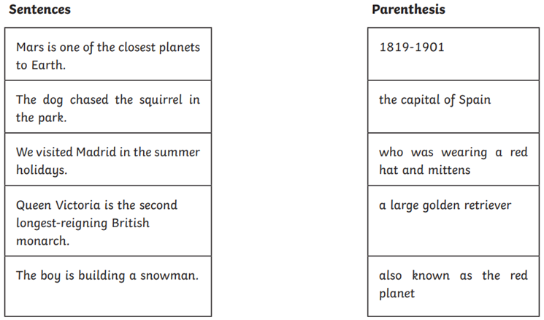
Morning Challenge: Use a ruler to connect the sentence and parenthesis. Write the sentence in your books using dashes or brackets.

Slide 2
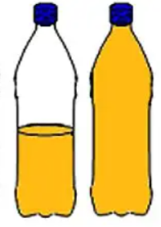
Venturers: Write about the experiment we completed in Science yesterday using the two water bottles of the same shape with different amounts of water. Remember to include: -What you thought would happen. -What happened. -Why this happened.
Key words: Galileo Mass Shape Height

Slide 3
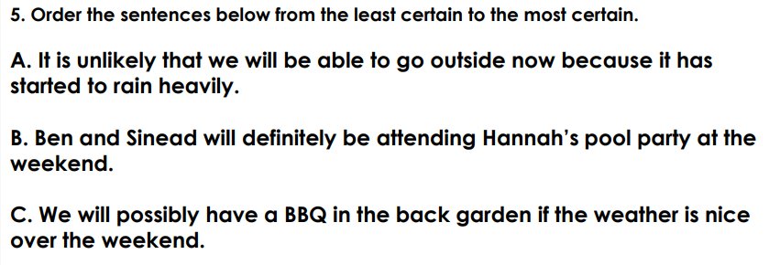
Thursday 26th February
TBAT: Use adverbs of possibility.
Talk partners:

Slide 4
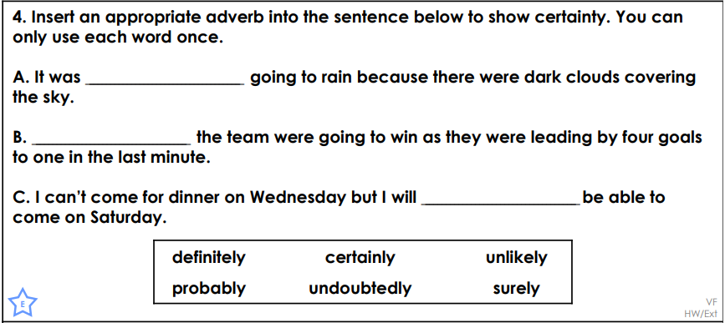
Thursday 26th February
TBAT: Use adverbs of possibility.

Slide 5
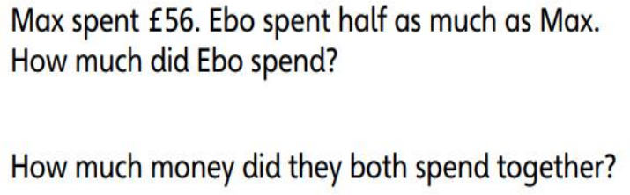
26.2.26 TBAT- identify and draw perpendicular lines.
45.8 + 111 =
7206 divided by 100 =
Challenge:
76 % = 0. = ____

Slide 6

Daily 10 x7
Daily 10 - Mental Maths Challenge - Topmarks

Slide 7
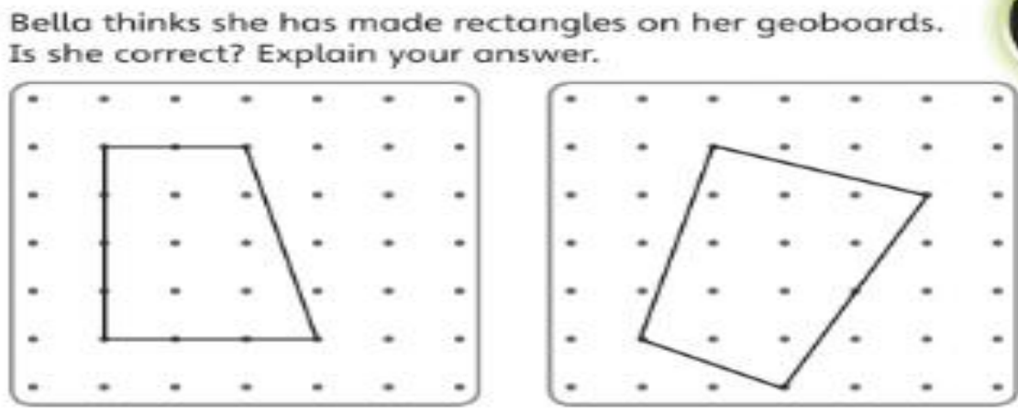
Blue
Green
Challenge: List two properties of a rectangle.

Slide 8
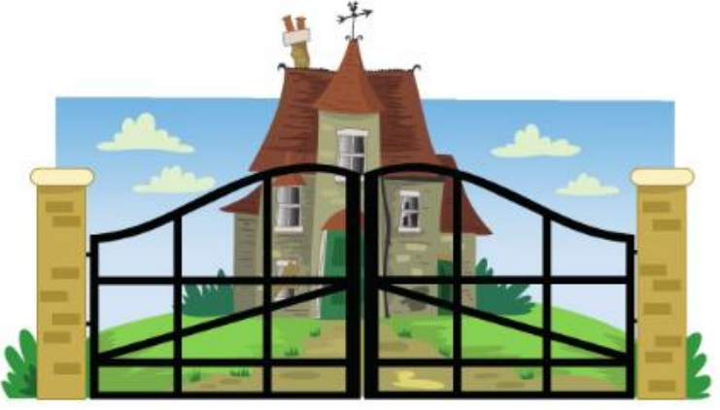
Identify the parallel and perpendicular lines on the gates.

Slide 9
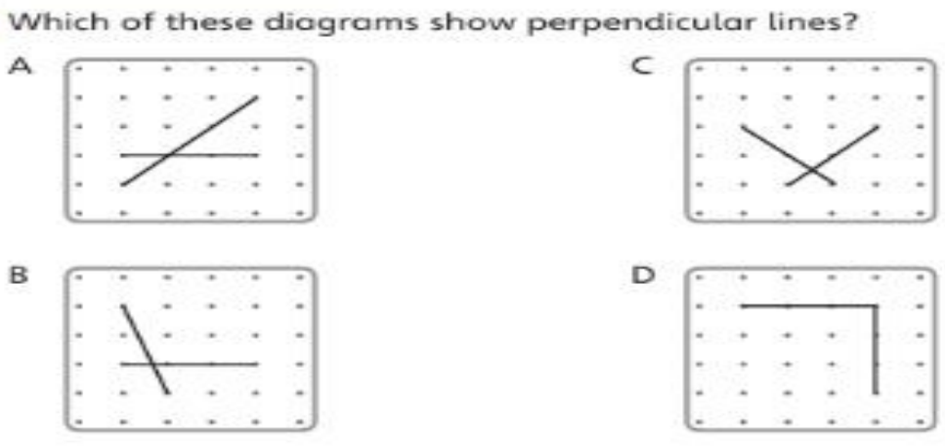
Talk partners:

Slide 10
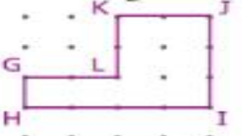
How many right angles are in this shape? How many perpendicular lines are there in this shape?

Slide 11
Class work: KJ is perpendicular to ______

Slide 12
Whiteboard work: HG is perpendicular to ______
Challenge: write a sentence . _______ is perpendicular to ________

Slide 13
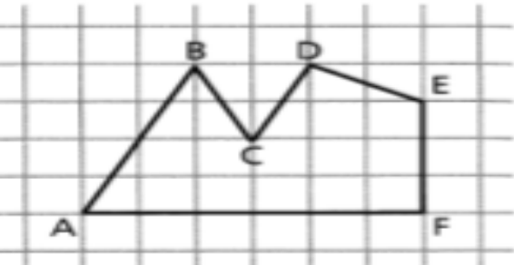
Talk partners: Which statement is correct? How do you know?
AB is perpendicular to BC.
AF is perpendicular to AB.
EF are perpendicular to FA.

Slide 14

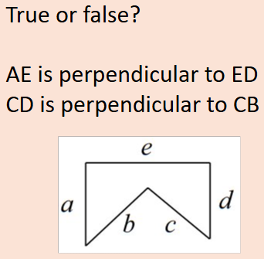
Check point Question

Slide 15


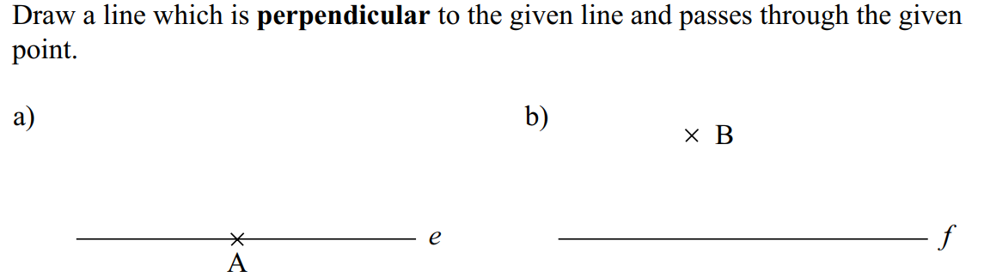
Independent: Identify the perpendicular lines.

Slide 16

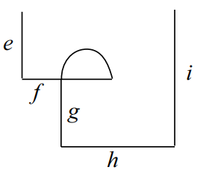
Draw two lines to complete each rectangle below.
Challenge:
Write mathematical sentences to support this diagram.
___is perpendicular to ____

Slide 17
Thursday 26th February
TBAT: orally rehearse an informative introductory paragraph.
3 in 3 For millions of years, volcanoes have shaped our planet in powerful and unpredictable ways. Formed deep beneath the Earth’s crust, these extraordinary natural features are created when molten rock, known as magma, is forced upwards under immense pressure. Eventually, it may erupt through weak points in the Earth’s surface, where it is released as lava, ash and gases. Across the globe, volcanoes can be found towering over landscapes or hidden beneath the oceans, quietly reminding us of the restless forces below.
Find and copy a word which means likely to change suddenly and without reason.
Give an example of a fronted adverbial.
Give an example of technical language used in the text.
Challenge: Create your own opening sentence for an introductory paragraph about volcanoes including a fronted adverbial and technical vocabulary.

Slide 18
Thursday 26th February
TBAT: orally rehearse an informative introductory paragraph.
Name a feature of a non-chronological report. What is the purpose of a non-chronological report. Select the best adverb of possibility to complete the sentence below: Volcanoes close to plate boundaries ____________ have a higher chance of erupting than those located further away from the boundary.
Maybe definitely possibly

Slide 19
Thursday 26th February
TBAT: orally rehearse an informative introductory paragraph.
Today we are going to become presenters for a geographical channel. We are going to inform our audiences about volcanoes.
Watch these introductions:
Planet Earth III - Narrated by Kids - BBC iPlayer Watch to 1.50
Earth's Hidden Volcanos | A Perfect Planet | BBC Earth watch to 1.05 What's the same? What's different?

Slide 20
Thursday 26th February
TBAT: orally rehearse an informative introductory paragraph.
Deep beneath the Earth’s surface, powerful forces are constantly at work. For millions of years, volcanoes have been formed as tectonic plates slowly move and pressure is built up within the Earth’s crust. When this molten rock, known as magma, is forced upwards, it may erupt through a vent and be released as lava, ash and gases. Across vast landscapes, towering cones can be seen rising dramatically against the skyline. During an eruption, ash could be blasted high into the atmosphere and rivers of lava might pour down the mountainside. Although volcanoes are often destructive and unpredictable, new land is sometimes created when the lava cools and hardens. These awe-inspiring natural features continue to shape our world in extraordinary ways.
What do you like about this introduction?
What features can you spot of a non-chronological report?

Slide 21
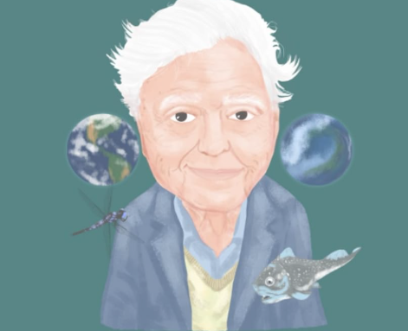
Thursday 26th February
TBAT: orally rehearse an informative introductory paragraph.
LIFE ON OUR PLANET – VOLCANOES Today, you are going to narrate a new David Attenborough documentary all about volcanoes. In your pairs, rehearse what you would like to say: Think it, say it, like it, write it (on a whiteboard)
Look at your word banks to help you.

Slide 22
Thursday 26th February
TBAT: orally rehearse an informative introductory paragraph. Remember to include: - What you will have in your sections (subheadings) - Fronted adverbials - Ambitious vocabulary - Technical language - Adverbs of possibility

Slide 23
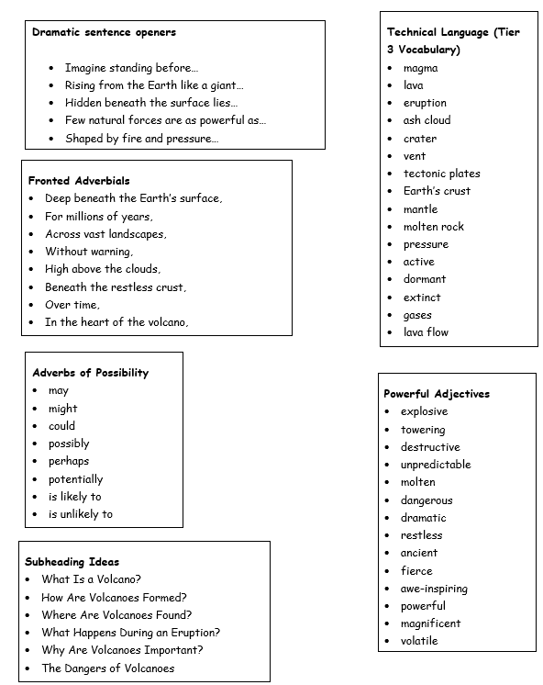

Slide 24
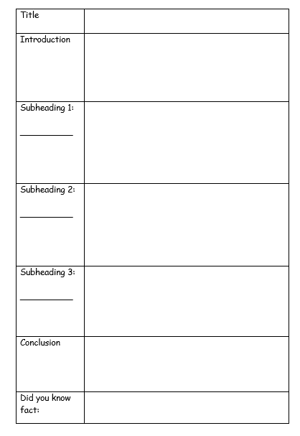
Thursday 26th February
TBAT: orally rehearse an informative introductory paragraph.
Write your draft introduction on your planning sheet. Remember to include: - What you will have in your sections (subheadings) - Fronted adverbials - Ambitious vocabulary - Technical language - Adverbs of possibility

Slide 25
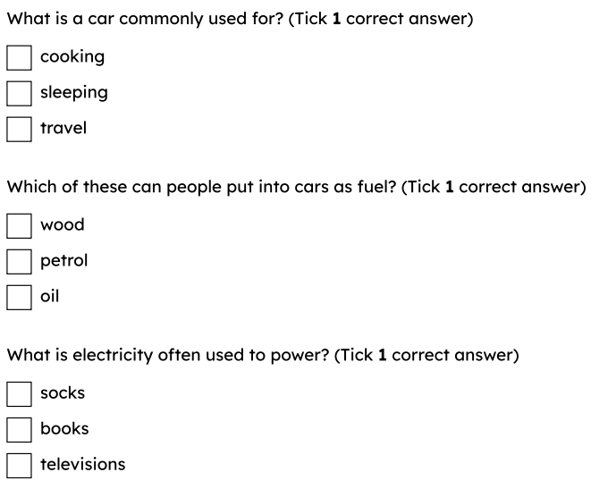
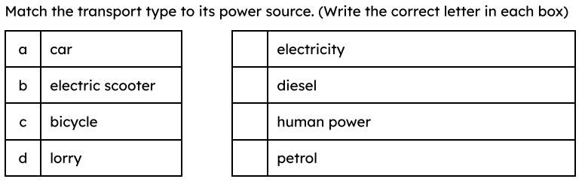
Thursday 26th February
TBAT: describe Dorothée Pullinger’s contributions to car engineering

Slide 26
car engineer
someone who designs and builds cars
sustainable
using what we need, while protecting the environment so there is enough for the future

Slide 27
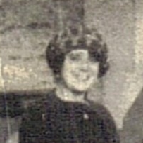
Dorothée Pullinger – car engineer
Dorothée Pullinger
Dorothée Pullinger was a pioneering car engineer and businesswoman.
She was one of the first people to recognise that cars should be designed differently for female drivers.
She is best known for producing the Galloway car – a car built entirely by women in Scotland.
Dorothée Pullinger
Go Industrial, 2021, licensed under CC-BY-NC 3.0

Slide 28
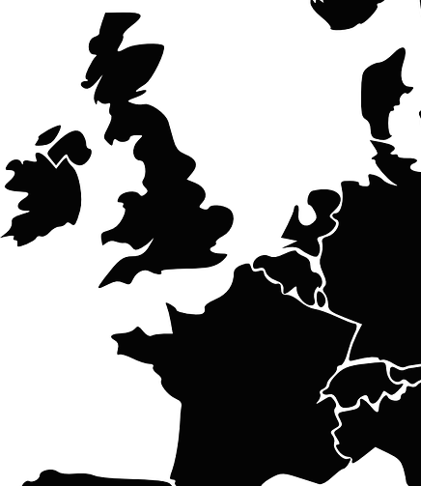
Dorothée Pullinger – car engineer
Dorothée’s childhood
Dorothée was born on 13th January 1894 in Normandy, France.
She was the eldest daughter of Thomas Pullinger, a well-known car designer, and his French wife, Aurélie Bérénice.
UK
France
In 1902, when Dorothée was eight years old, the family moved to England.
Normandy, France

Slide 29
Dorothée Pullinger – car engineer
Dorothée’s early work
After completing her studies at Loughborough Grammar School, 16-year-old Dorothée joined her father at the Arrol-Johnston car factory as a draughtswoman.
She used her skills to draw technical designs and plans for the cars made in the factory.

Slide 30
Dorothée Pullinger – car engineer
World War I
During the First World War, Dorothée was employed to supervise over 7000 female workers to make ammunition for the war effort.
Being able to speak both English and French meant she could communicate clearly with all the workers, many of whom were French and Belgian refugees.

Slide 31
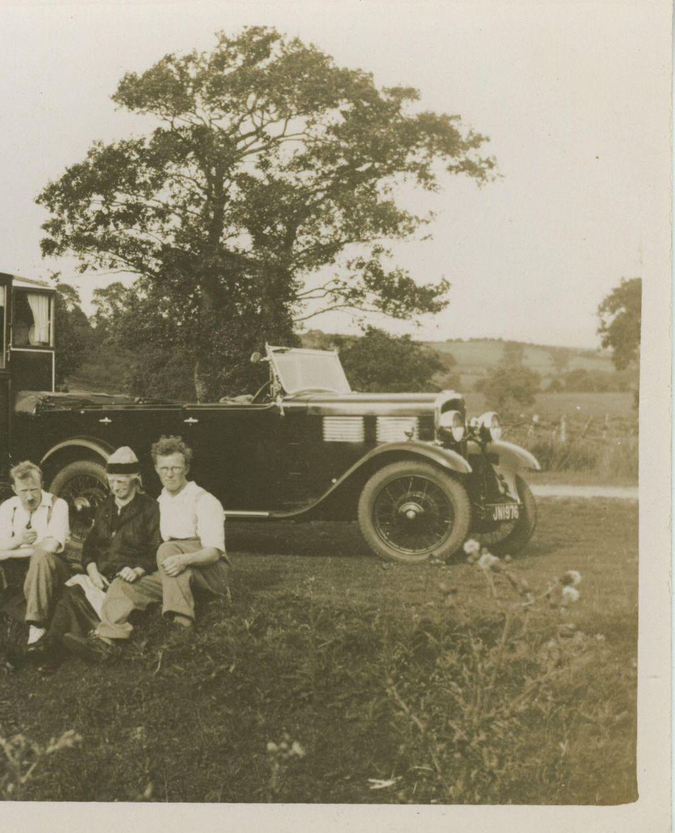
Dorothée Pullinger – car engineer
Designing the Galloway
After the war, Dorothée recognised that there was a new market for women who could drive.
Most cars at the time were large and difficult to handle.
Dorothée designed and built a car that was smaller, lighter and easier to drive.
the Galloway
Chronicle, 2020, Alamy Stock Photo

Slide 32
Dorothée Pullinger – car engineer
Supporting female engineers
It was difficult for woman to be accepted as engineers at this time, as many people thought it was a job only suitable for men.
Inspired by Dorothée’s determination, her father opened an engineering college and apprenticeship programme just for women.
When she became the director of Galloway Motors Ltd, Dorothée employed mostly women to build her car.

Slide 33
Dorothée Pullinger – car engineer
Further success
Dorothée continued to prove herself when she became the first female member of the Institute of Automobile Engineers in 1921.
In 1924, she became a racing driver, driving the Galloway car and winning the cup in the Scottish six-day car trials.
In 1944, she was the only woman asked to help write a report on helping rebuild British industry after the Second World War.

Slide 34
Dorothée Pullinger – car engineer
Dorothée Pullinger timeline
Joins the Institute of Automobile Engineers
Family move to England
Begins career as a draughtswoman
Designs the Galloway car
Born
Died
1894
1902
1910
1918
1921
1986

Slide 35
Dorothée Pullinger – car engineer
Women in engineering
Throughout history, women have been involved in engineering, but before the First and Second World Wars, it was uncommon for them to gain qualifications or hold official positions.
Women were able to prove their value to the engineering industry during the wars, when they were called upon to take over manufacturing.
Since then, women have continued to make valuable contributions in all areas of engineering, as well as science, technology and maths!

Slide 36
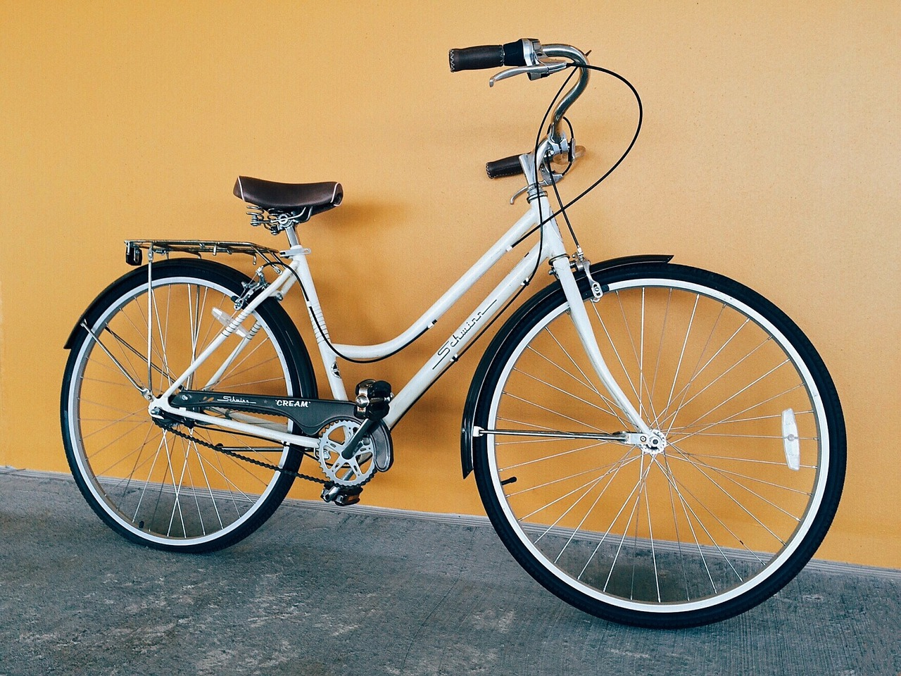
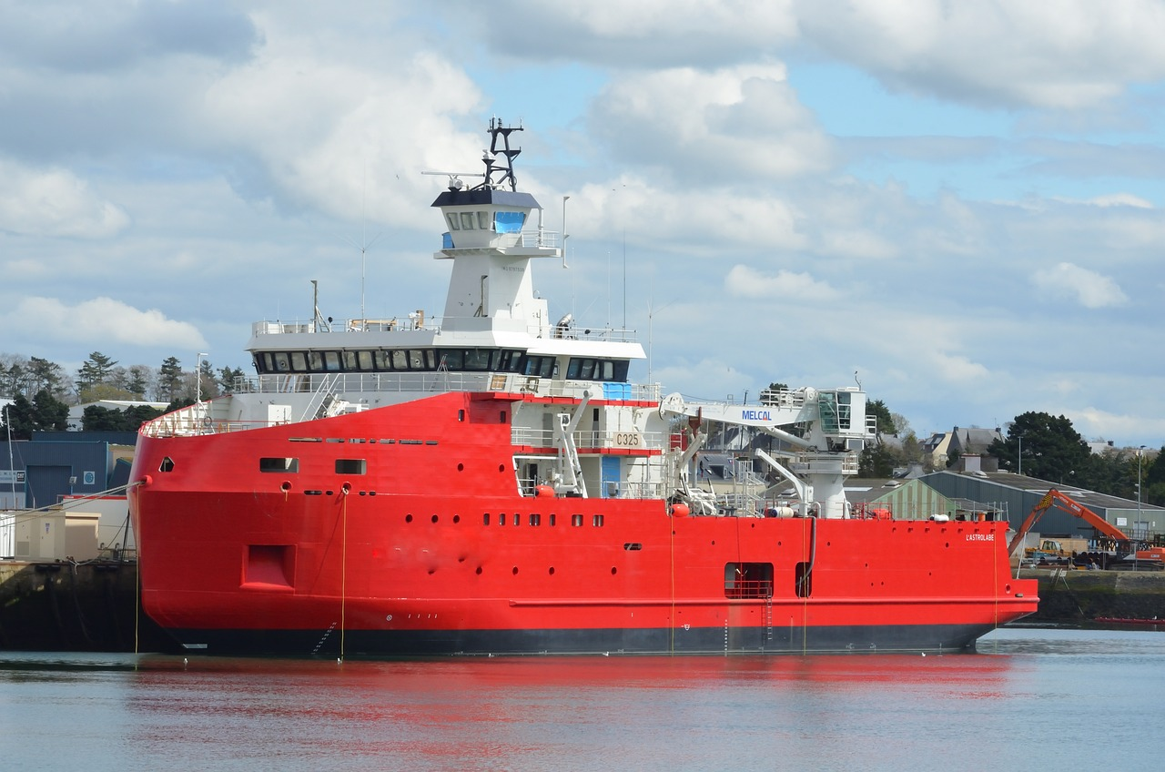
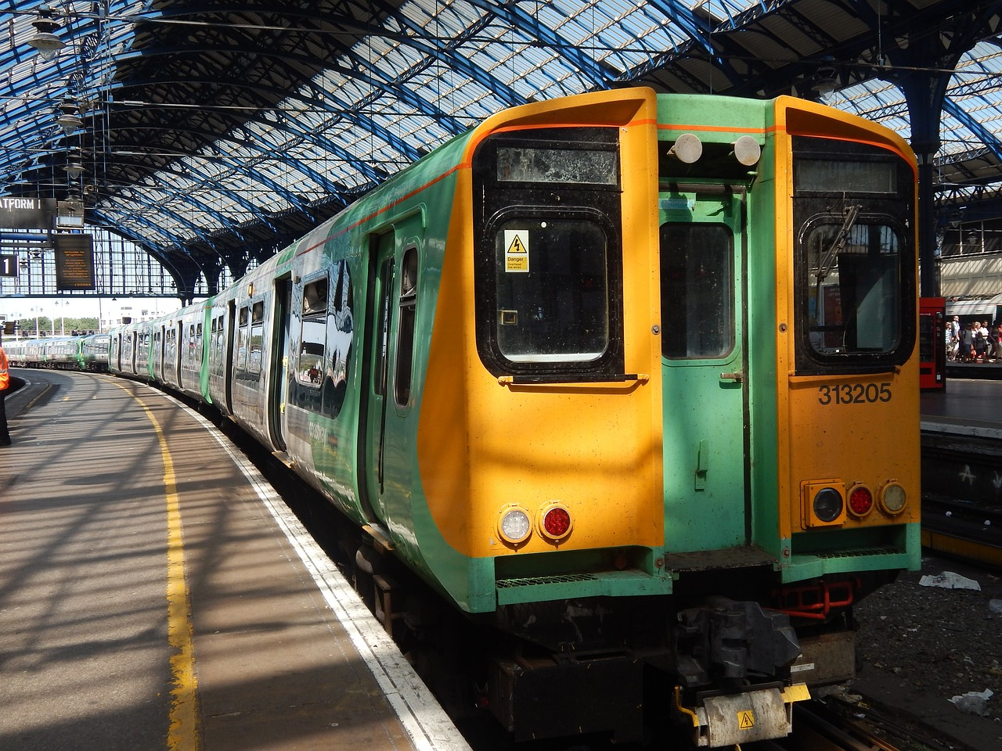
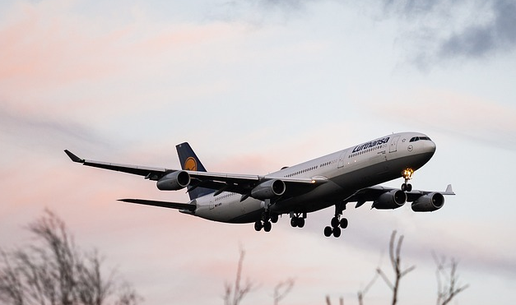
Sustainable travel
Humans have always needed to travel and move from place to place.
Over time, we have invented many ways to make it easier to travel longer distances.
What other things do we use to help us get around?

Slide 37
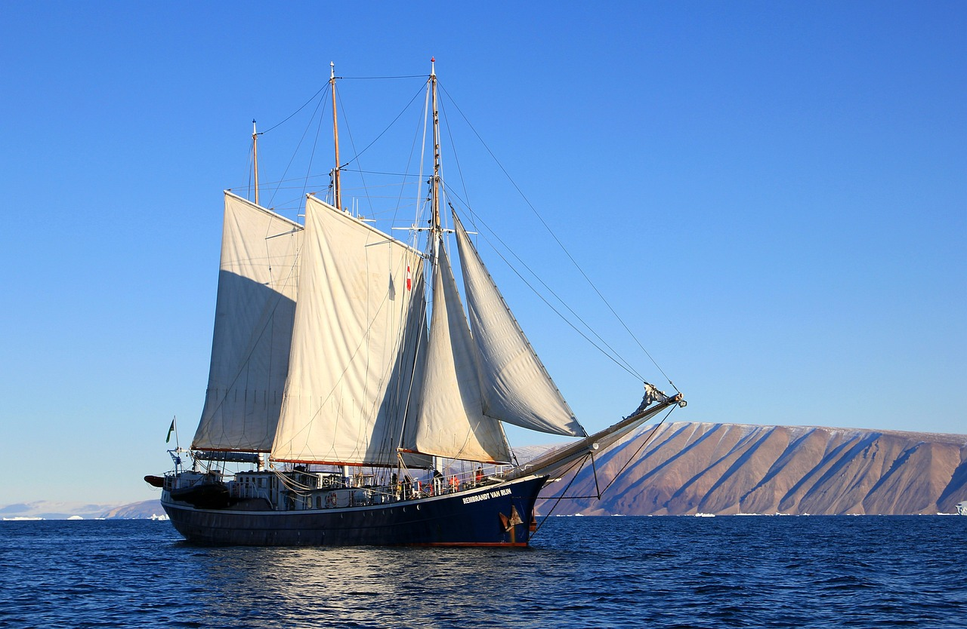
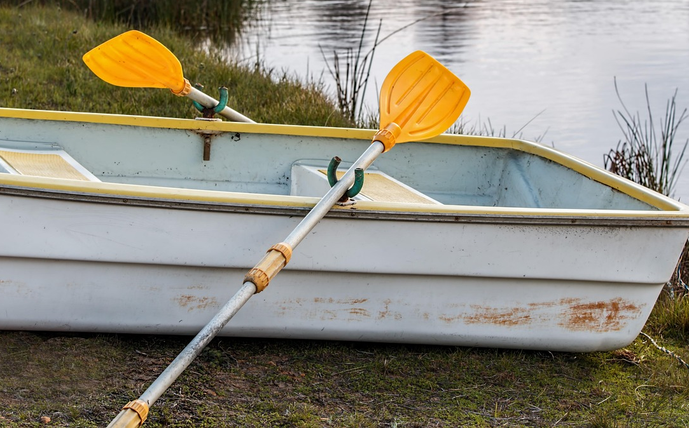
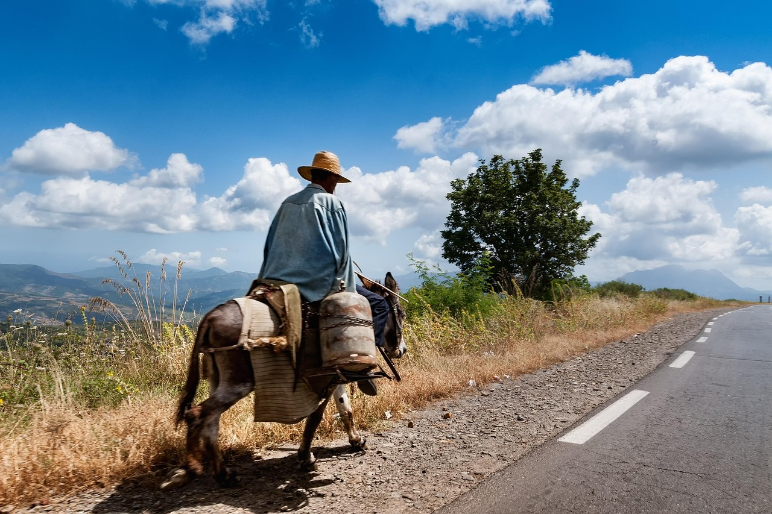
Sustainable travel
In the earliest days of travel, most methods relied on the power of nature, or the strength of humans and animals.
These methods did not cause damage to the environment.

Slide 38
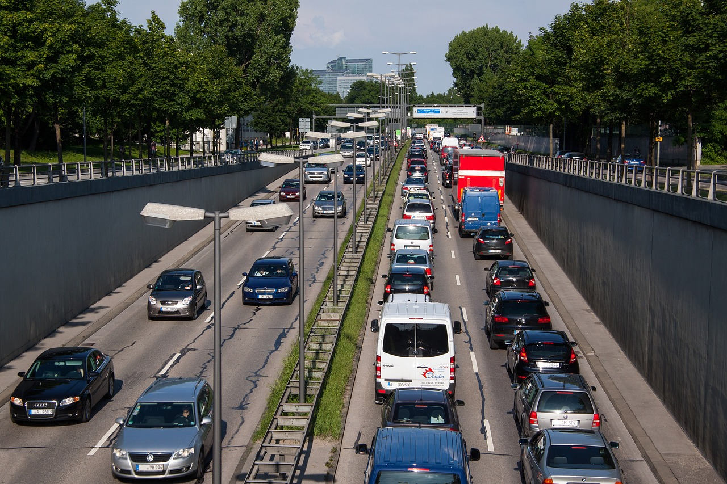
Sustainable travel
With the wider use of the combustion engine, travel has become quicker and easier.
However, these engines burn fuel, which releases harmful gases into the air and causes pollution.

Slide 39
Sustainable travel
As we become more aware of the impact our travel has on the planet, car engineers are developing cleaner, more sustainable solutions for the future.
To be sustainable, vehicles should:
be manufactured (made) in a sustainable way
use sustainable materials
use clean fuel or power sources
be easier to dispose of or recycle

Slide 40
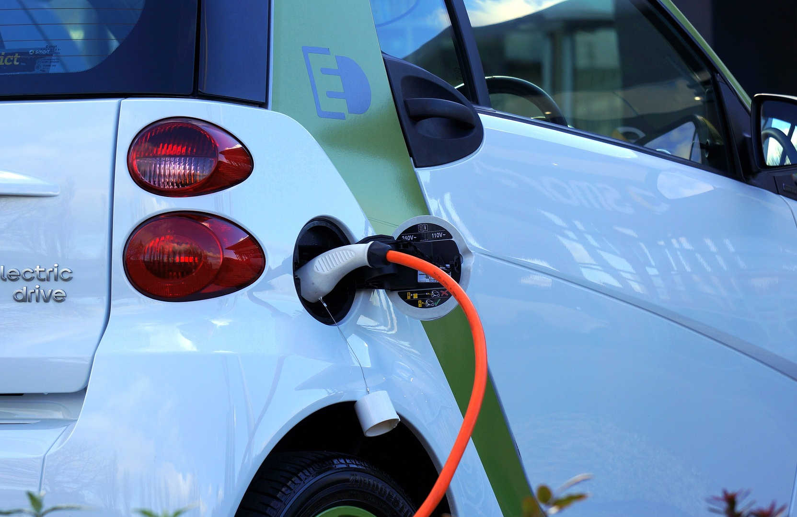
Sustainable travel
Electric and hybrid-electric cars have become more common in recent years.
Electric cars are powered by batteries that are charged using electricity.
Hybrid-electric cars have both an electric battery and a combustion engine.
This helps to reduce pollution, compared to cars that only use fuel.
electric car charging

Slide 41
Sustainable travel
Other forms of transport, such as trains and buses, have also been redesigned to use electricity.
Whilst these methods cause less air pollution than vehicles with combustion engines, they still impact the environment.
Environmental impact includes:
manufacturing (making): uses natural resources and can cause pollution
disposal (getting rid of): not all parts can be recycled

Slide 42


Sustainable travel
Calling all future engineers!
Imagine how people might travel in the future.
Use your creativity to design a new method of transport that is both futuristic and sustainable.
Your design could be based on an existing vehicle.
How will it be powered?
What will it be made from?
What will it look like?
Andeep

Slide 43



Sustainable travel
Present your idea to a group or partner.
Explain how your design will be more sustainable than current vehicles.
My design is more sustainable because…
Do they agree that your design is sustainable? Why or why not?

Slide 44
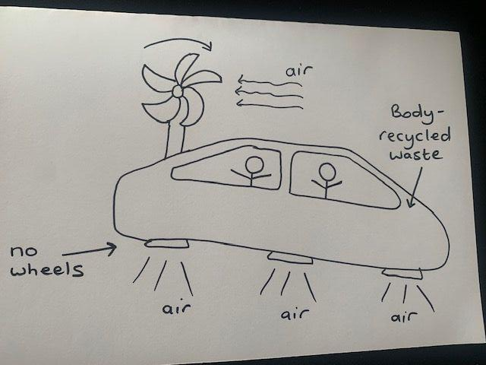
Sustainable travel
Andeep has imagined what a sustainable vehicle of the future might be like.
We might use air to power vehicles, so they would not cause pollution. The air could also make the car fly, meaning we would not need rubber tyres! The car would also drive itself.
Andeep’s design idea

Slide 45
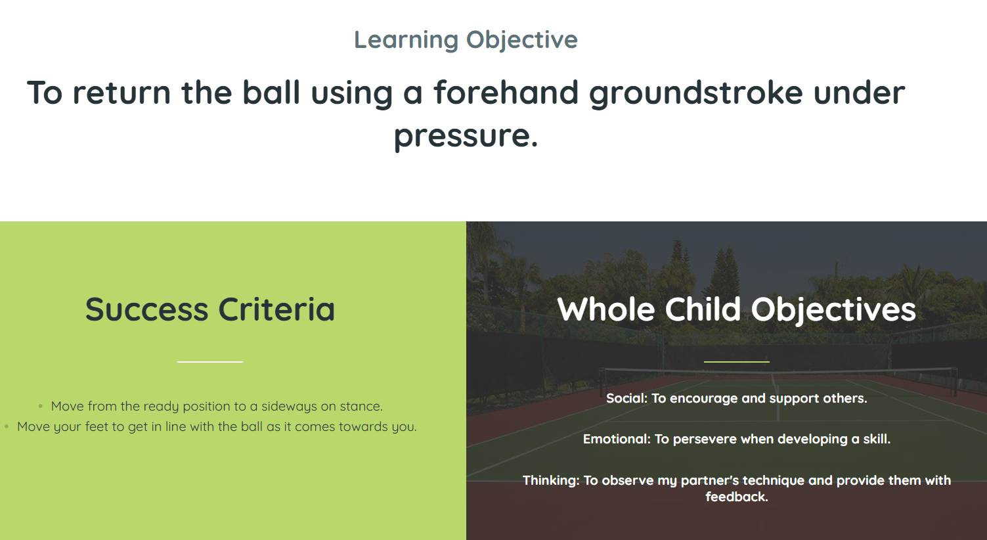
Thursday 26th February

