Slide 1

Tuesday 24th February 24.2.26
TBAT: Use joins consistently.
forty
scorch
absorb
decorate
afford
enormous
category
tornado
according
opportunity
Are there any words you are unsure of?
Use a dictionary to look them up and then use them in a sentence.

Slide 2
Tuesday 25th February 25.2.25
Word work
Mark my work:
Half term had flown by in the blink of an eye, and as Mia and Jake walked to school, they eagerly shared their adventures.
I can’t believe half term is over already! It went by so fast. What did you do, Jake" Mia asked", her eyes shining with excitement.
Jake grinned. It was amazing! We went to the seaside for a few days—there was so much to do: swimming in the sea building sandcastles and eating the biggest ice cream ever. It had three scoops and sprinkles on top

Slide 3
Tuesday 25th February 25.2.25
Word work
Partner talk:
Tell your partner something you enjoyed about your half term.
Write yours on a whiteboard using inverted commas.

Slide 4
Tuesday 25th February 25.2.25
Word work
Write the conversation between you and your partner in your books.
Remember: NEW SPEAKER, NEW LINE!
Add a sentence before the speech to tell us what you and your partner are doing:
Example -
As we sat back in our seats after half term, I was excited to see my partner, Ruby. "How was your half term?" I asked.

Slide 5


24.2.26
TBAT: identify regular and irregular polygons.
1. 578 X 9 =
3. Computers are packed in boxes of 8. A factory packs 5,887 computers. How many full boxes will there be?
2. 54.02 X 100 =
Challenge:
Write the decimal equivalent of these fractions.

Slide 6
Blue
Green
What is the name of your shape?
How many sides does your shape have?

Slide 7
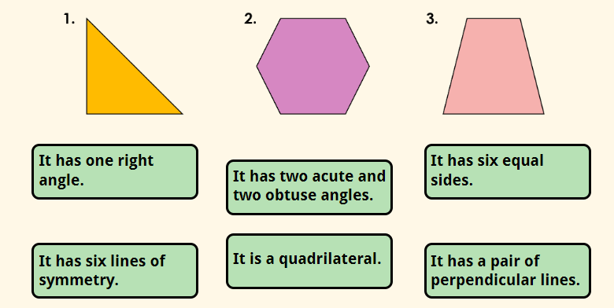
Activity in books: Match the properties below to each shape.

Slide 8

TBAT: identify regular and irregular polygons.
Talk partners: Here is a selection of 2D shapes. What do they all have in common?

Slide 9
They are all polygons.
A polygon is a 2D shape which has been formed with straight lines.
These shapes are all regular polygons.
A regular polygon has equal sides and equal angles.

Slide 10

TBAT: identify regular and irregular polygons.
Activity in books
Here is a circle.
Is a circle a polygon?

Slide 11
TBAT: identify regular and irregular polygons.
A circle cannot be a polygon as it has one curved edge and no straight lines.
Other examples of 2D shapes that are not polygons are semi-circles and ovals.

Slide 12
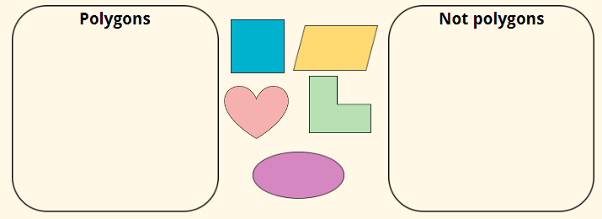
Whiteboard work: Sort the shapes below into those that are polygons and those that are not.

Slide 13
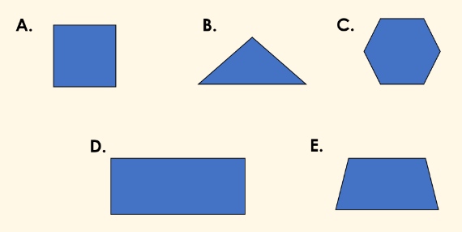
Whiteboard work:
Which of the shapes below are irregular polygons?
Write your answers alphabetically.

Slide 14
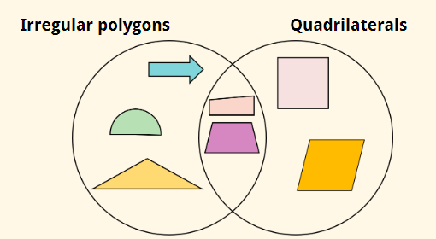
Gemma has sorted the shapes below into the Venn diagram.
Find and explain her mistakes.

Slide 15
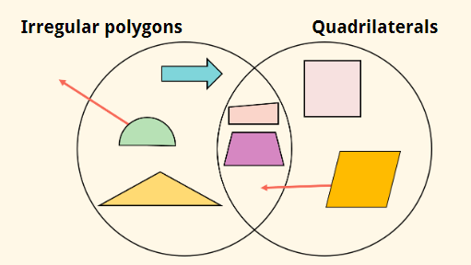
TBAT: identify regular and irregular polygons.
Gemma has sorted the shapes below into the Venn diagram.

Slide 16

TBAT: identify regular and irregular polygons.
Look at the shape below.
What shape is this?
What do you notice about it?

Slide 17
This is a pentagon because it has five sides.
However, not all of the sides and angles are equal.
This is an irregular pentagon.

Slide 18
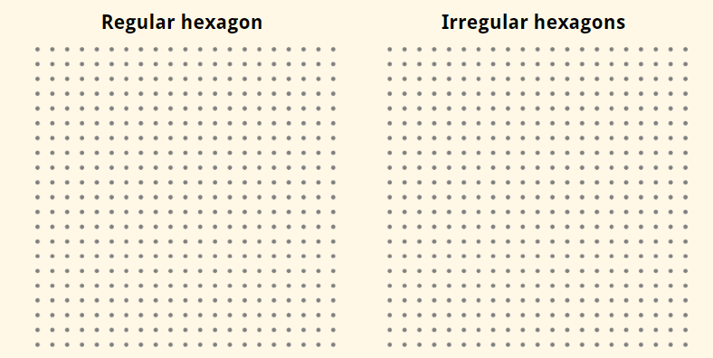
We can draw regular and irregular hexagons on the grids below.

Slide 19
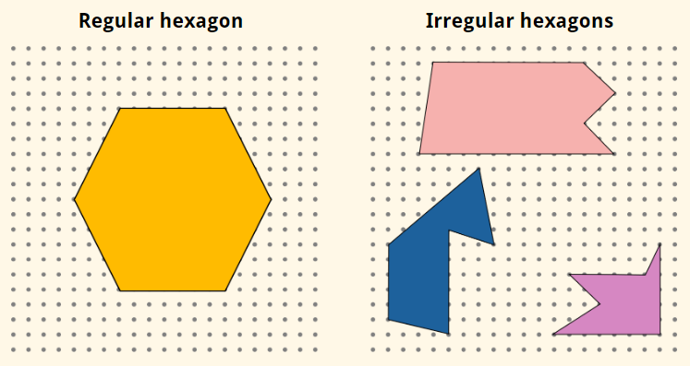
TBAT: identify regular and irregular polygons.
All hexagons have six sides.

Slide 20


TBAT: identify regular and irregular polygons.
Check point Question
Is this shape regular or irregular?
Can you name the shape?

Slide 21
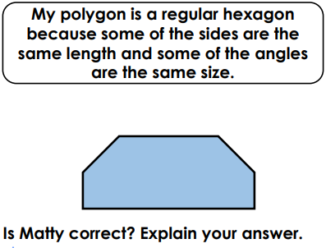
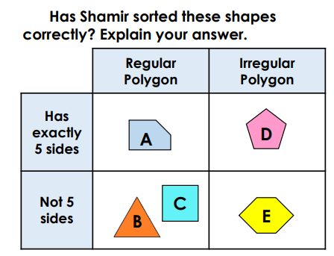
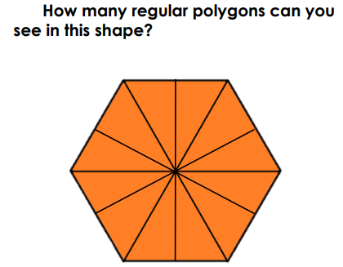
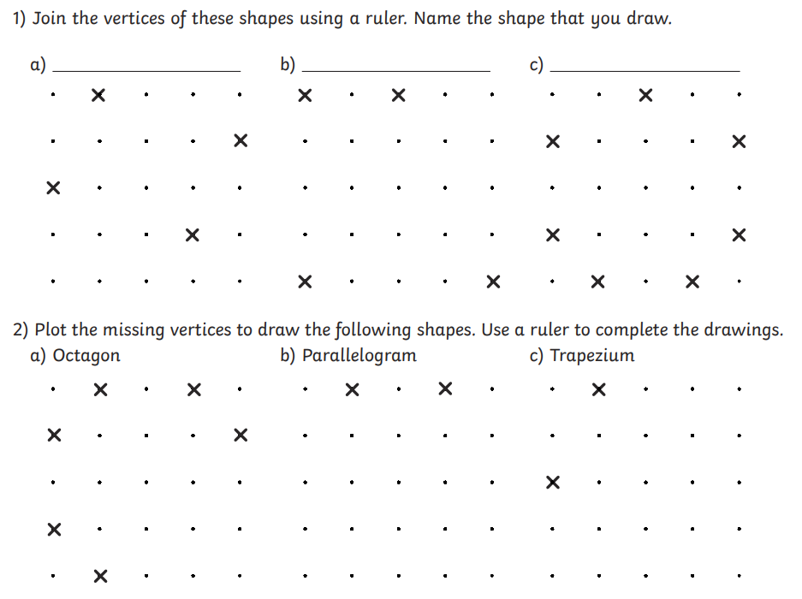
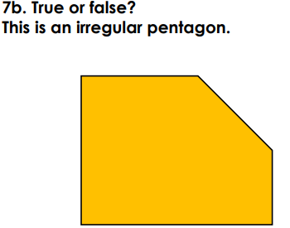
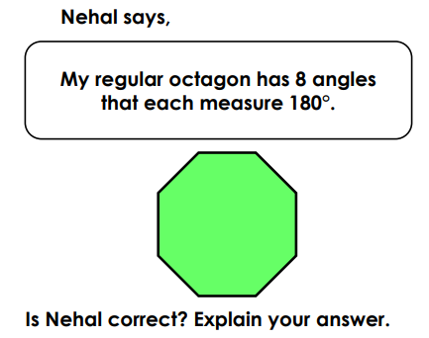
TBAT: identify regular and irregular polygons.
Independent
RP
Challenge
Mastery
Notes:
Chaklkllenge 7
Mastery incorrect

Slide 22
Tuesday 24th February
TBAT: Identify the main idea of "Pebble in my Pocket".
3 in 3
Features of a Non-Chronological Report
A non-chronological report is a type of information text that gives facts about a subject without describing events in time order.
Key Features
Title
Clearly tells the reader what the report is about.
Introduction
A short opening paragraph that explains what the subject is and what the report will cover.
Subheadings
Break the text into sections (for example: Habitat, Diet, Appearance).
Paragraphs
Each paragraph focuses on one main idea or topic.
Formal, factual language
Uses facts, not opinions or personal feelings.
Present tense
Written mainly in the present tense (e.g. lives, eats, has).
Technical or subject-specific vocabulary
Includes words related to the topic being explained.
Third person
Written using it, they, or the name of the subject, not I or we.
Pictures, diagrams or captions (optional)
Help the reader understand the information more clearly.
What is the main purpose of a non-chronological report?
(To explain, inform, or entertain?)
Why are subheadings important in a non-chronological report?
Explain your answer.
Which tense is usually used in a non-chronological report and why?

Slide 23
Narrative non-fiction is a true story told in the style of a narrative.
History is the study of past events.
A narrator is the person telling the story.
Chronological means in the order of time.

Slide 24
Introduction to the genre and text
narrative non-fiction
A narrative non-fiction text is a true story told in the style of a narrative.
‘The Pebble in my Pocket’ tells the story of how a tiny pebble is formed over the course of millions of years.
It teaches us about history, geography and science along the way.

Slide 25

Introduction to the genre and text
A narrative non-fiction is a made up story.
A narrative non-fiction is any true story.
A narrative non-fiction is a true story that is told in the style of a narrative.

Slide 26
Introduction to the genre and text
How will the following subjects help us learn about where a pebble comes from?
history
the study of past events
geography
the study of the earth (landscape and climate)
science
the study of the natural world (rock formation)

Slide 27
Introduction to the genre and text
‘The Pebble in my Pocket’ begins with a girl as the narrator.
She finds a pebble in the present day.
narrator: the person telling the story
Notes:
You may wish to add the relevant image from the book

Slide 28
Introduction to the genre and text
The story then jumps back 480 million years ago to where the pebble began its journey, in a volcano.
The narrator changes at this point in the story.
Notes:
You may wish to add the relevant image from the book

Slide 29
Introduction to the genre and text
What is the definition of ‘narrator’?
where a story is set
the person telling the story
the characters in the story

Slide 30
Introduction to the genre and text
When the history of something is told, it is presented in chronological order.
chronological (adjective)
relating to time

Slide 31
Introduction to the genre and text
History is told in chronological order.
A story is always told in chronological order.
It is important to understand history in the order that it happened.

Slide 32
Introduction to the genre and text
Match the vocabulary with the correct definition.
Vocabulary
history
narrator
chronological
Definition
the person telling the story
the study of past events
order of time

Slide 33
Introduction to the genre and text
Match the vocabulary with the correct definition.
Vocabulary
history
narrator
chronological
Definition
the person telling the story
the study of past events
order of time

Slide 34
Reading ‘The Pebble in my Pocket’
What do we know about ‘The Pebble in my Pocket’?
it is a narrative non-fiction text
it has two narrators: the girl who finds the pebble in the current day, and a narrator who tells the story of the pebble’s journey through time
the history of the pebble is told in chronological order

Slide 35


Reading ‘The Pebble in my Pocket’
Read the book up until the end of page four, which explains how mountains are formed.
PowerPoint Presentation
What can you see in the images?
Which narrator is telling the story? Is it one or both?
Notes:
You may wish to add the relevant images from the book

Slide 36
Reading ‘The Pebble in my Pocket’
Where did the pebble’s journey begin?
in the girl’s pocket
at the top of a mountain
as liquid rock inside a volcano
Notes:
You may wish to add the relevant image from the book

Slide 37
Reading ‘The Pebble in my Pocket’
As the rock rises and pushes together, what is formed?
mountains
valleys
rivers
Notes:
You may wish to add the relevant image from the book

Slide 38
Reading ‘The Pebble in my Pocket’
Let’s hear a summary of the story of the pebble.
390 million years ago
375 million years ago
340 million years ago
A cliff falls and the rock shatters into fragments.
The rock slides into the river and travels through it for thousands of years.
The rock is now a pebble which reaches the sea and is washed onto the shore.
Notes:
You may wish to add the relevant images from the book

Slide 39
Reading ‘The Pebble in my Pocket’
Let’s hear a summary of the story of the pebble.
300 million years ago
155 million years ago
65 million years ago
Layers of dead creatures at the bottom of the sea press down forming more rock.
Over millions of years, the Earth rises and the rocks form mountains above water.
The cliffs erode, rocks break away. Dinosaurs trample on them, breaking them down.
Notes:
You may wish to add the relevant images from the book

Slide 40
Reading ‘The Pebble in my Pocket’
Let’s hear a summary of the story of the pebble.
15 million years ago
200,000 years ago
12,000 years ago
A glacier picks up the pebble and freezes it for thousands of years.
The weather warms. The pebble is on a river bank, trampled on by animals.
The ice returns and melts, returns and melts, until the pebble emerges on the side of a valley.
Notes:
You may wish to add the relevant images from the book

Slide 41
Reading ‘The Pebble in my Pocket’
The pebble has existed through different landscapes and climates.
It has been in a volcano, mountain, ocean and glacier.
It has travelled for a very long time.

Slide 42
Reading ‘The Pebble in my Pocket’
Read the book up to the end of the story, with the image of the girl lying on her front on the grass playing with the pebble.
PowerPoint Presentation
At what point does the narrator change?
What do you notice about how the earth changes by looking at the illustrations?
Notes:
You may wish to add the relevant images from the book

Slide 43
Reading ‘The Pebble in my Pocket’
Select all of the statements you agree with:
“By the time the girl found the pebble, it had…”
existed in many different forms
only just been created
been on a journey for 480 million years

Slide 44

Reading ‘The Pebble in my Pocket’
Discuss: Reflect on what we have read and understood so far.
Answer these questions with your partner.
Likes: What caught your attention?
Dislikes: Was there anything that put you off reading this text?
Puzzles: Was there anything you found strange or surprising?

Slide 45
Reading ‘The Pebble in my Pocket’
Answer these questions in your book:
Likes: What caught your attention?
I liked finding out that rocks can exist in liquid form inside a volcano.
I am excited to read a story that teaches us about geography as well.
Dislikes: Was there anything that put you off reading this text?
I found it uncomfortable to think of huge cliffs falling down.
I found it difficult to understand all of the history.
Puzzles: Was there anything you found strange or surprising?
I don’t understand how dead animals can form rock at the bottom of the sea.
I am surprised that a non-fiction text can also be a story.

Slide 46
Summarise
In your book, summarise the text in 5 sentences.
Word bank:
Non-fiction narrative
Narrator
Chronological
History

Slide 47
Identifying the main idea of ‘The Pebble in my Pocket’
‘The Pebble in my Pocket’ is a non-fiction narrative that tells the story of a pebble’s journey through time
the story has two narrators: the girl who finds the pebble today and the narrator who tells the journey
the history of the pebble begins 480 million years ago and is told in chronological order
everything that exists has a story to tell and helps us to build our understanding of the world

Slide 48

Understanding the main idea of the story
Order the descriptions in chronological order from 1 - 4, to show the pebble’s journey in time.
New mountains form, and rocks break away. A glacier freezes the pebble until the weather warms.
a
The girl finds the pebble in the present day. It has travelled huge distances over long periods of time.
b
c
A volcano erupts lava, which cools and turns to rock.
Thousands of years later, a pebble reaches the shore which then forms new rock at the bottom of the seabed.
d
Notes:
You may wish to add the relevant images from the book

Slide 49
Understanding the main idea of the story
Order the descriptions in chronological order from 1 - 4, to show the pebble’s journey in time.
New mountains form, and rocks break away. A glacier freezes the pebble until the weather warms.
3
a
4
The girl finds the pebble in the present day. It has travelled huge distances over long periods of time.
b
1
c
A volcano erupts lava, which cools and turns to rock.
Thousands of years later, a pebble reaches the shore which then forms new rock at the bottom of the seabed.
2
d
Notes:
You may wish to add the relevant images from the book

Slide 50
Music
TBAT: Develop techniques of performing rap using texture and rhythm.
Class work:
Match the vocabulary to the definition:
Texture describes the quality of a sound.
Tone how the layers of sound are combined to create a piece's overall quality.
Dynamics the loudness or softness of a piece of music.

Slide 51
TBAT: Develop techniques of performing rap using texture and rhythm.
Class work:
Match the vocabulary to the definition:
Texture describes the quality of a sound.
Tone how the layers of sound are combined to create a piece's overall quality.
Dynamics the loudness or softness of a piece of music.

Slide 52
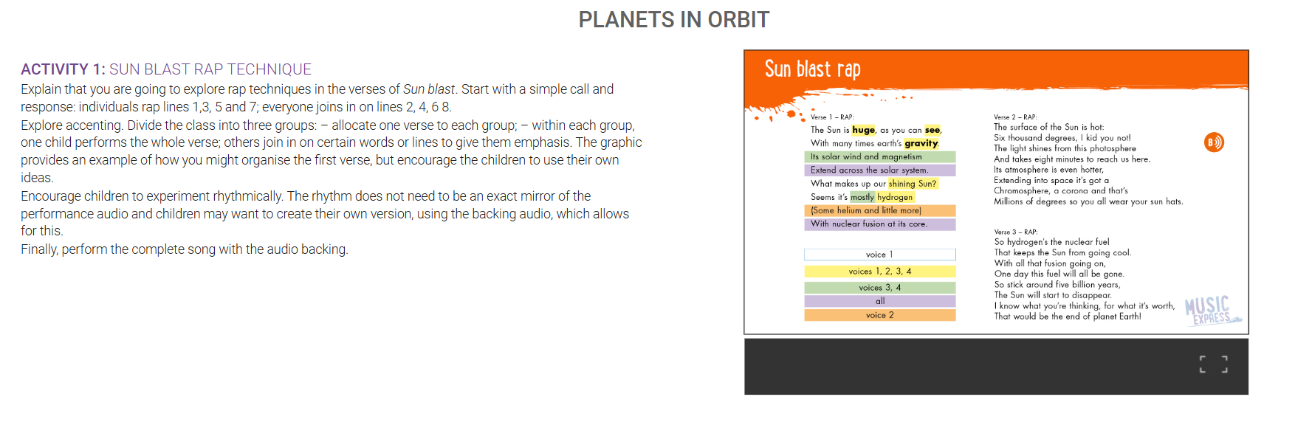
TBAT: Develop techniques of performing rap using texture and rhythm.
The Collins Hub Educator > Library
Solar System: Lesson 3 – Planets in Orbit

Slide 53
Tuesday 24th February
Q: What happens when a volcano erupts?
Blue-
Volcanoes are formed when tectonic plates _____________.
Green-
There are three types of volcanoes: active, dormant and extinct. Which one will never erupt again?

Slide 54

Knowledge quiz 5 in 5
1. Which part of the volcano does the magma mainly escape from?
secondary vent magma chamber main vent crater
2. What does magma become when it reaches Earth’s surface?
rock lava ash
3. If a volcano has not erupted in a long time but still could, what is
it called?
dormant active extinct
4. How many of the world’s active volcanoes are underwater?
10% 50% 75% 80%
5. What is the Ring of Fire?
where volcanoes erupt where all volcanoes are
where many volcanoes are found
Lesson 7: Knowledge quiz
Copyright © ArkCurriculum+ 2022
Notes:
Knowledge quiz: Pupils complete the quiz in their pupil workbooks to assess knowledge from the previous lesson. They write their score on the Knowledge quiz scores page at the front of the pupil workbook.

Slide 55

What are the key physical features of Asia?
What are tectonic plates?
1
4
Learning journey
What are the key human features of Asia?
How are
mountains formed?
2
5
What are Asia’s natural borders?
  How are
  volcanoes formed?
3
6
Copyright © ArkCurriculum+ 2022
Notes:
Share the Learning journey.

Slide 56
  What happens when a volcano erupts?
  What happens when an earthquake strikes?
7
9
Learning journey
  What is an earthquake?
  What are the secondary consequences of a volcanic eruption or an earthquake?
8
10
Copyright © ArkCurriculum+ 2022

Slide 57
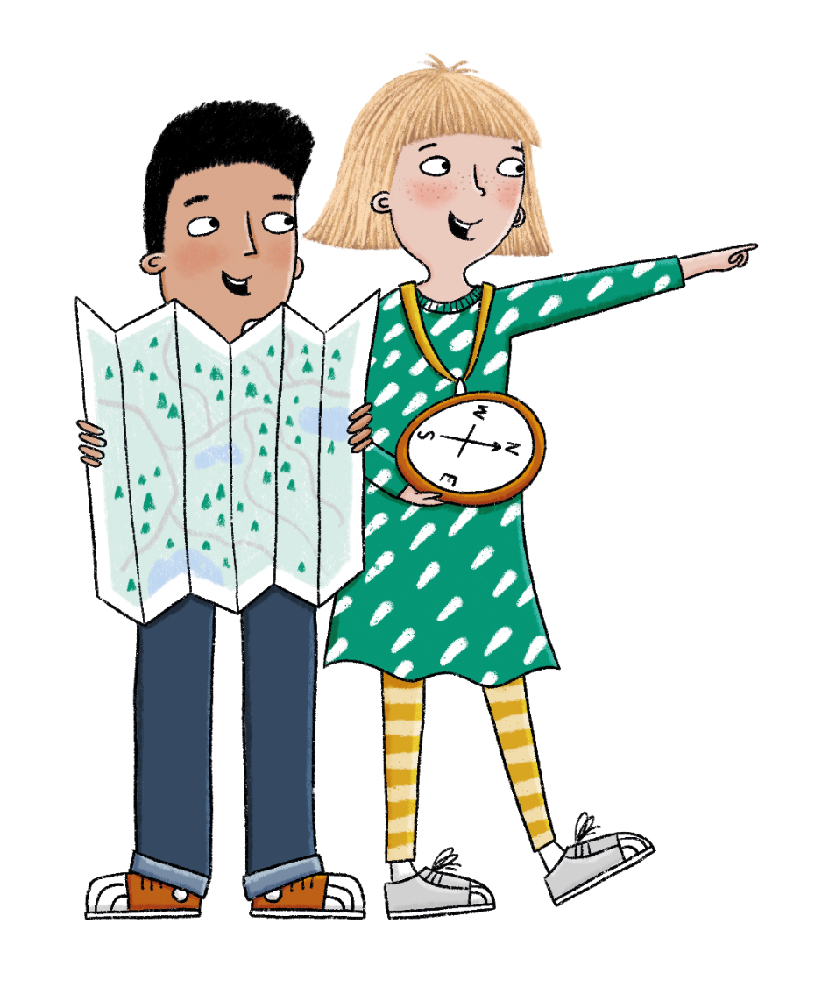
In this lesson, you will learn about the impact that volcanic eruptions can have on human life.
Lesson 7: Lesson statement
Copyright © ArkCurriculum+ 2022
Notes:
Share the specific lesson statement. In this lesson, pupils are learning about the impact volcanic eruptions can have on human life.

Slide 58
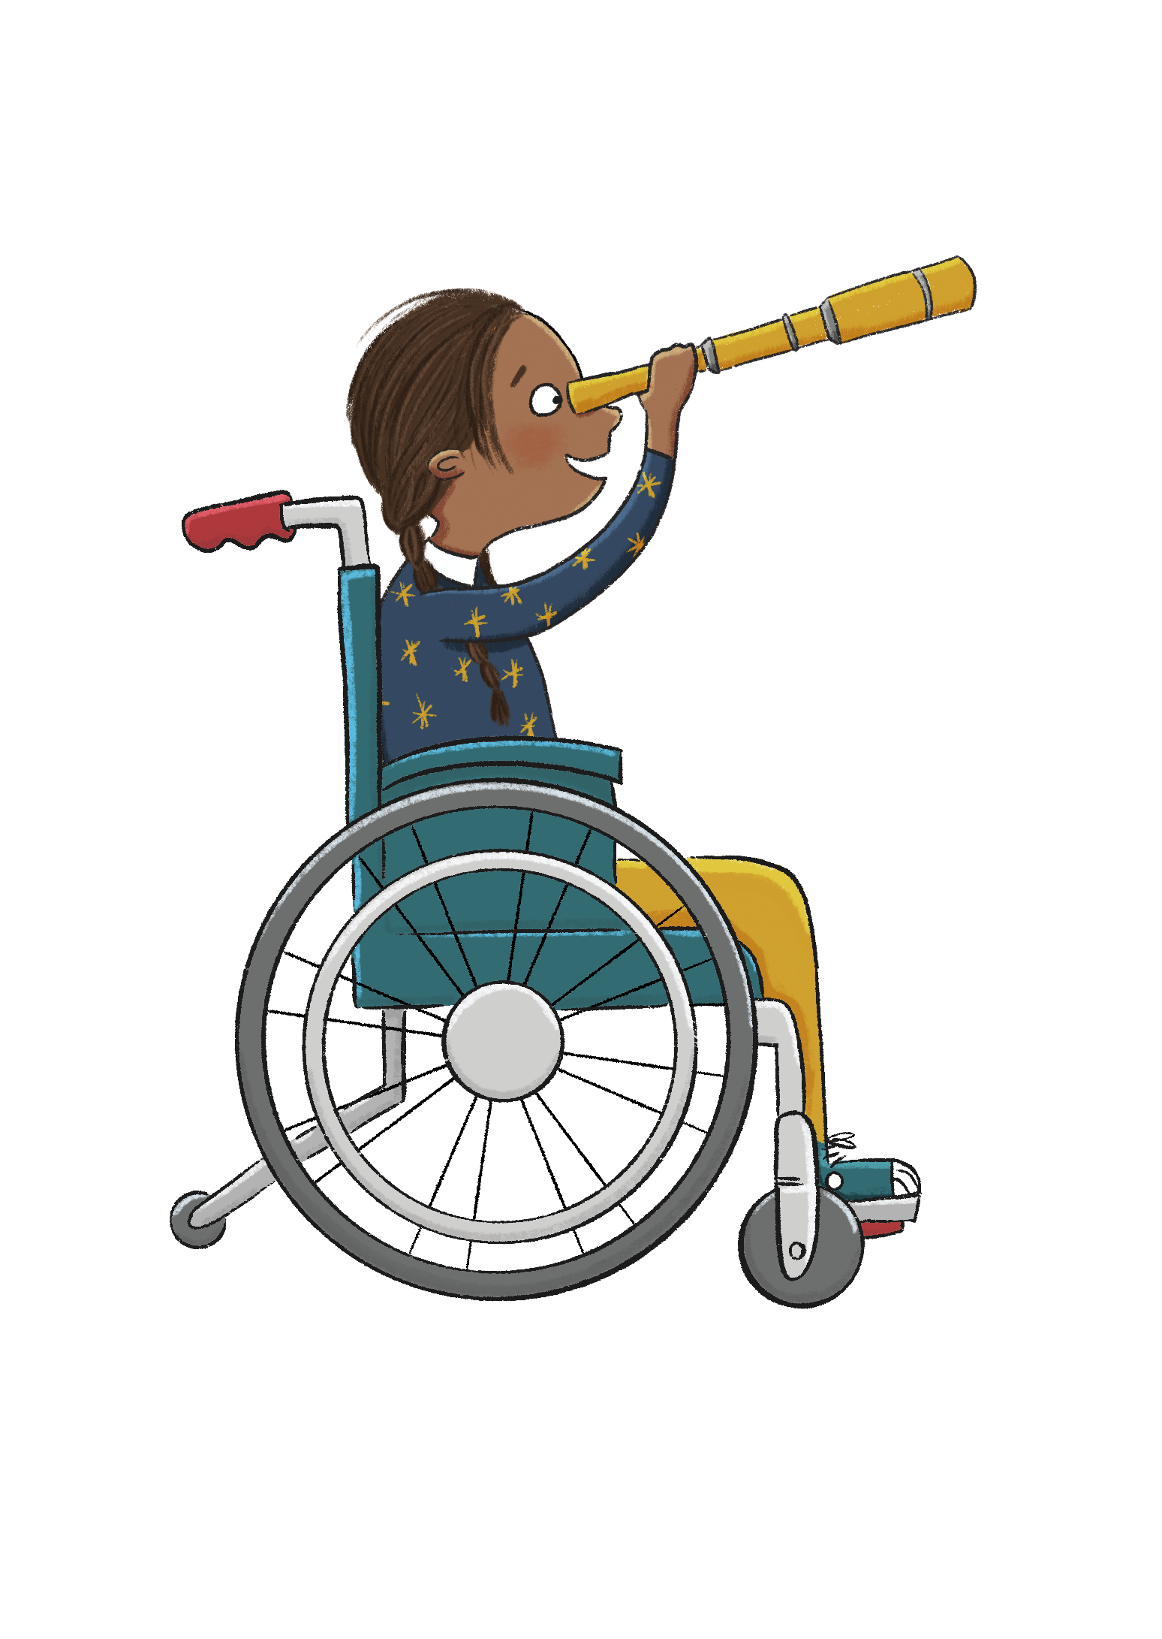
The key term in this lesson is volcanic eruption.
A volcanic eruption is when lava and gas are released from a volcano—
sometimes explosively.
Lesson 7: Key term
Copyright © ArkCurriculum+ 2022
Notes:
Key term: A volcanic eruption is when lava and gas are released from a volcano—sometimes explosively.

Slide 59


What happens when a volcano erupts?
Key knowledge
Volcanic eruptions vary depending on the type of volcano and the different types of plate boundary they sit on.
Eruptions can be catastrophic, damaging towns and farmland, and even taking lives.
Volcanic eruptions can benefit the surrounding area as they create fertile ground.
Key vocabulary
dormant
erupt
geothermal energy
volcanic ash
Lesson 7: Key knowledge
Copyright © ArkCurriculum+ 2022
Notes:
Share the key knowledge, and vocabulary. Discuss any key words that the pupils already know and the definitions of any new words. Pupils can use their Knowledge organisers to help.

Slide 60
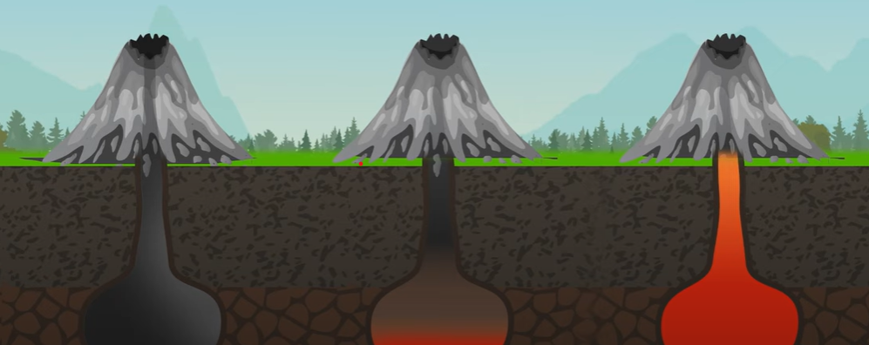
Recap Task: in pairs, state the volcano type :
active extinct dormant

Slide 61
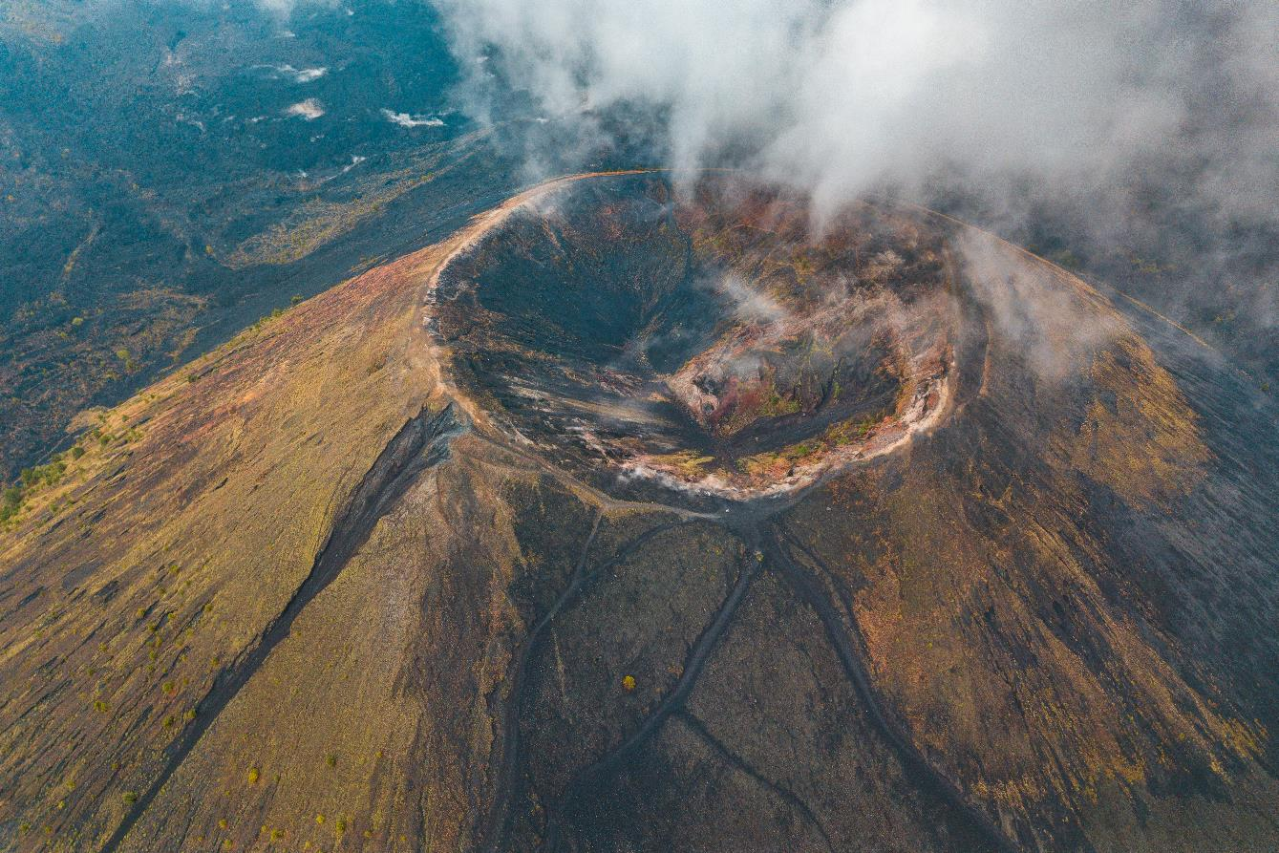
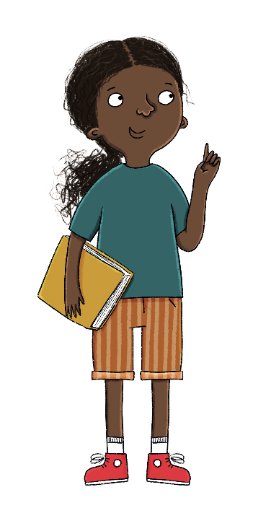

What happens when tectonic plates collide and cause weaknesses in Earth’s crust? What is formed?
Lesson 7: Talk task
Copyright © ArkCurriculum+ 2022
Notes:
Talk task: What happens when tectonic plates collide and cause weaknesses in Earth’s crust? Pupils should recall learning from the previous lesson about volcanoes forming.

Slide 62
Talk partners: What is the process of a volcanic eruption?
Key vocabulary: pressure secondary vents magma chamber gasses erupt tectonic plates

Slide 63
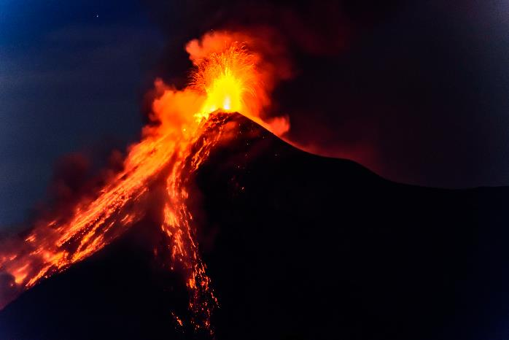

What happens during an eruption?
Volcanic eruptions are different depending on the type of volcano and the types of lava that they release.
Volcanoes that release thick lava are often very explosive when they erupt. Gas bubbles that are trapped in the magma chamber find it hard to escape through the rock. They can also spurt lots of hot ash and rocks into the air, making them extremely dangerous.
Lesson 7: Read
Copyright © ArkCurriculum+ 2022
Notes:
Read: Section titled—What happens during an eruption?

Slide 64
What happens during an eruption?
Volcanoes that release very thin, runny lava when they erupt are often less explosive, although the lava released is extremely fast, and can cover large areas very quickly.
Lesson 7: Read
Copyright © ArkCurriculum+ 2022

Slide 65
Task: Think it, say it..
Thick lava is more dangerous than thin lava.
Do you agree? Explain why.
Like it, write it...

Slide 66
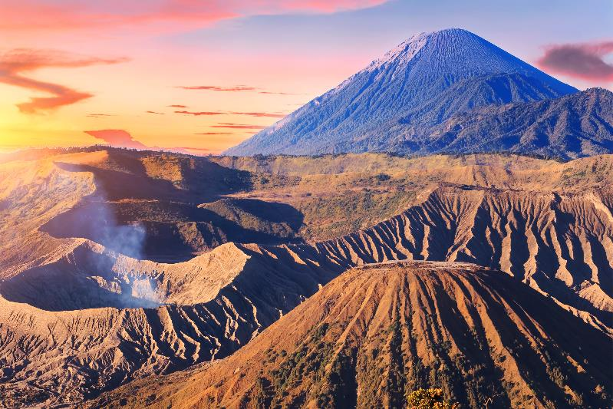
How does a volcanic eruption affect the local area?
Negative Impact
Volcanic eruptions can be catastrophic. The area surrounding the volcano is usually evacuated quickly to keep people safe. Extremely hot lava can cause lots of damage, burning through towns and farmland. Natural habitats can be affected badly, and animals and plants can be destroyed. The ash from a volcano can also cause breathing problems.
Lesson 7: Read
Task: Which do you think is the most negative impact and why?
Copyright © ArkCurriculum+ 2022
Notes:
Read: Section titled—How does a volcanic eruption affect the local area? Highlight the positives and the negatives.

Slide 67
How does a volcanic eruption affect the local area?
However, a volcanic eruption can sometimes be good for its surroundings. For example, the volcanic ash can break down to create very fertile farmland, which makes the surrounding areas good places for people to grow crops. Volcanic areas can also generate geothermal energy, which can be used as renewable energy. Volcanoes, both active and dormant, are also tourist attractions that bring money for the local communities.
Lesson 7: Read
Task: Which do you think is the most positive impact and why?
Copyright © ArkCurriculum+ 2022

Slide 68
Discussion task:
Justify your answer to your partner. Will either of you change your mind?
Discussion point 2:
Based on this, why do you think some people would choose to live near a volcano?

Slide 69
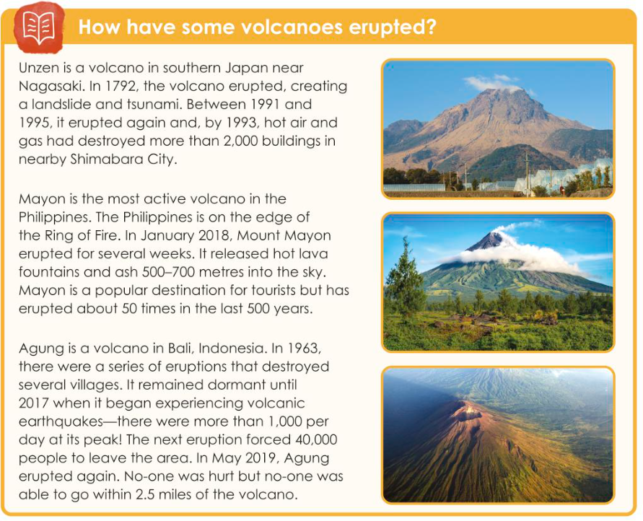

Slide 70

Read the text and answer the following:
1. Which volcanic eruption created a landslide and tsunami?
2. Which volcanic eruption caused the most damage to property?
3. Which volcano erupted for several weeks?
4. Why do you think no one was able to go within 2.5 miles of
Agung after it erupted?
Lesson 7: Retrieval
Copyright © ArkCurriculum+ 2022
Notes:
Retrieval: Pupils answer questions about the Asian volcanoes.

Slide 71
Answer the following:
1. Which volcanic eruption caused the most deaths?
Unzen, in Japan
2. Which volcanic eruption caused the most damage to property?
Unzen, in Japan
3. Which volcano erupted for several weeks?
Mayon, in the Philippines
4. Why do you think no one was able to go within 2.5 miles of
Agung after it erupted?
Because it was still dangerous.
Lesson 7: Retrieval
Copyright © ArkCurriculum+ 2022

Slide 72
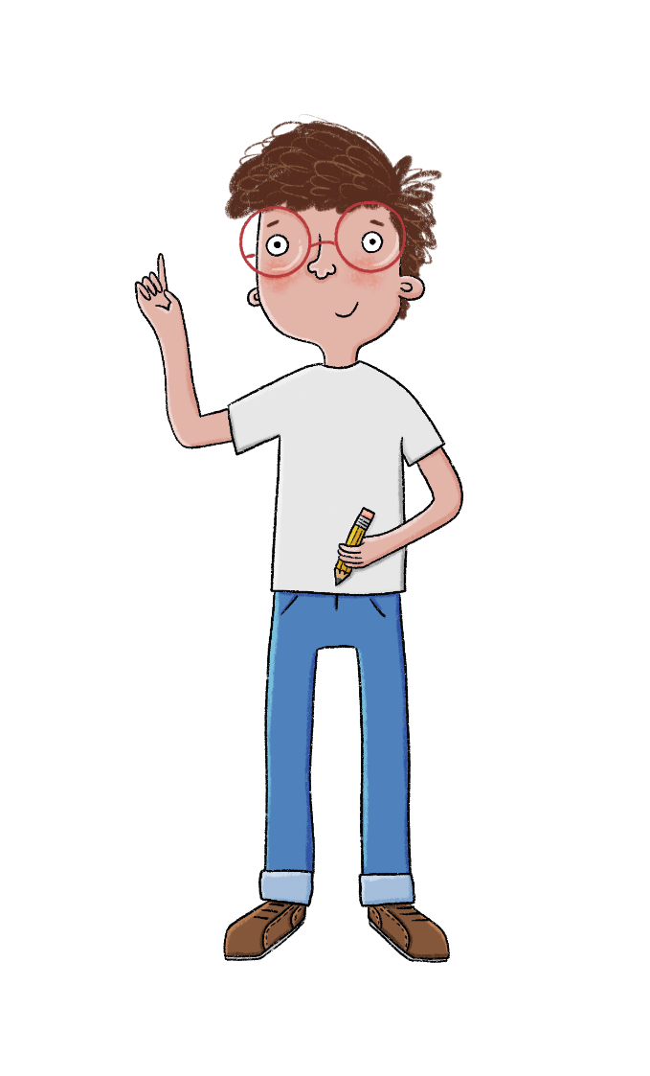
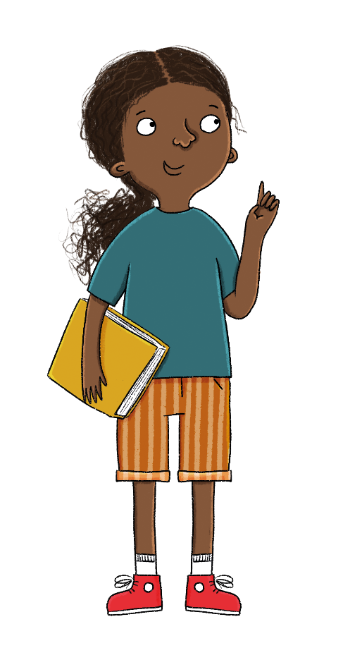

Research another volcano in Asia.
Where is it?
When did it last erupt?
Lesson 7: Investigation
Challenge: What impact did this eruption have on the area and people?
Copyright © ArkCurriculum+ 2022
Notes:
Investigation: Pupils research another volcano in Asia. They might describe where it is and when it last erupted.

Slide 73
What happens when a volcano erupts?
Key knowledge
Volcanic eruptions vary depending on the type of volcano and the different types of plate boundary they sit on.
Eruptions can be catastrophic, damaging towns and farmland, and even taking lives.
Volcanic eruptions can benefit the surrounding area as they create fertile ground.
Key vocabulary
dormant
erupt
geothermal energy
volcanic ash
Lesson 7: Key knowledge
Copyright © ArkCurriculum+ 2022

Slide 74
Talk partners:
Why do some people choose to live near a volcano?
What happens when a volcano erupts?

Slide 75
Exit Question:
Are all eruptions the same?
Negative impact.
Positive impact.
Key vocabulary
dormant
erupt
geothermal energy
volcanic ash
eruption
fertile

Slide 76
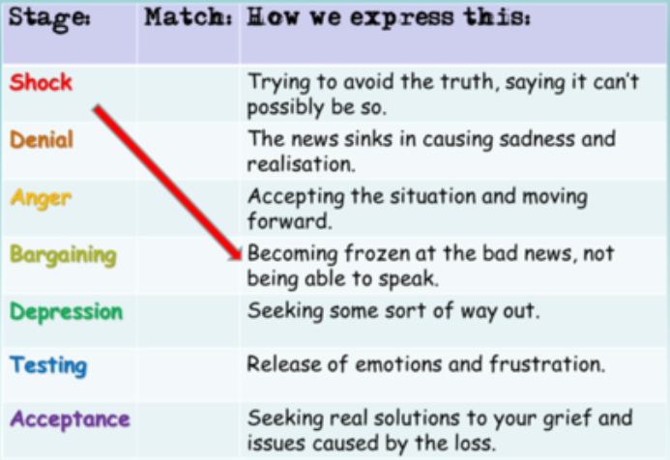
24.2.26
TBAT- know how to support someone who is grieving.
1 in 1

Slide 77
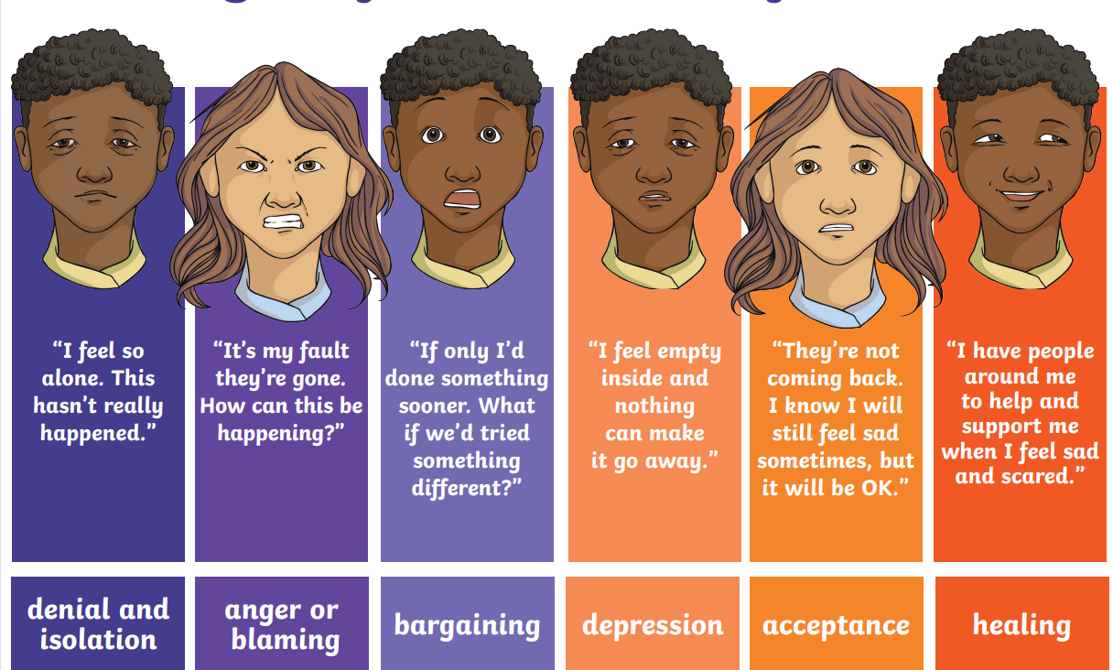

Slide 78


Who do you love?
How do you enjoy sharing time with people you love?
How do you feel when you have to leave them?
Notes:
Discuss with pupils how they like to spend time with their loved ones and highlight how lucky we are to have special people in our lives who love us and share their time with us.

Slide 79
Sarah’s story –Listen to the story
Hi, I’m Sarah and I lost my grandma. I don’t know why we say that, we didn’t actually lose her.
She died. Why do we have so many different phrases for death? We say passed away, passed on,
gone to a better place, but what we actually mean is she died.
I came home from school one day to find my mum crying and saying that she had some bad news and needed to talk to Josh and me. Josh is my brother. She could barely speak she was crying so much. She told us that Grandma Jean had died. Just like that. How could she have died? I saw her last week and she was fine. She said ”Goodbye and I’ll see you next week”. She lied. How could she do that? I didn’t believe my mum and shouted at her that it wasn’t true. I rushed out of the room and went straight to my bedroom crying. My mum came up a bit later to speak to me but I just shouted at her to leave
me alone.
I don’t want to speak to anyone. I found my memory box and looked at all the cards Grandma Jean has send me over the past 9 years. She never ever forgets my birthday. I’ve just realised she won’t be here for my birthday this year.
I go downstairs to get a drink and see Josh playing in the garden. How can he actually play when we’ve just found out that Grandma Jean has gone. Doesn’t he even love her? He’s so selfish I hate him.
I’m Sarah and I lost my grandma.
Groups 1 and 2 -What feelings is Sarah experiencing?
Groups 3 and 4 – What behaviours is Sarah showing?
Notes:
Read the story aloud and ask pupils to work in groups to identify the feelings and behaviour that Sarah is exhibiting. Do warn them that they might find this topic a bit upsetting as it is about a sensitive issue. Reassure them that they can join in with as much or as little discussion as they feel comfortable with.

Slide 80

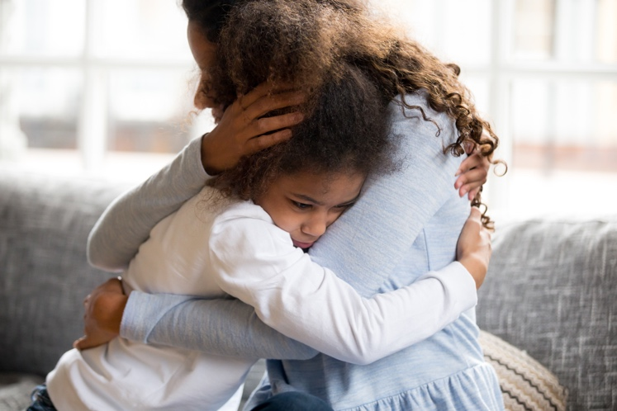
How could we support Sarah?
Now we have discussed this topic, what is the definition of grief?
Imagine your friend was experiencing a loss or grieving like Sarah. Would you know how to support them?
Notes:
Use national bereavement websites as sources of information. Some examples might include https://www.winstonswish.org/, https://www.childbereavementuk.org/, https://www.cruse.org.uk/get-help/for-parents/how-to-help-a-child-or-young-person

Slide 81
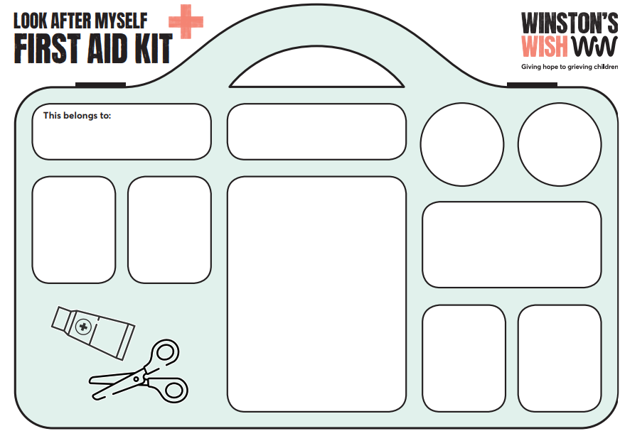
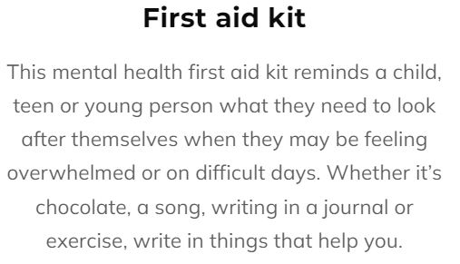
How could we support Sarah?
Ways to support people when they are grieving.
Notes:
Use national bereavement websites as sources of information. Some examples might include https://www.winstonswish.org/, https://www.childbereavementuk.org/, https://www.cruse.org.uk/get-help/for-parents/how-to-help-a-child-or-young-person

Slide 82
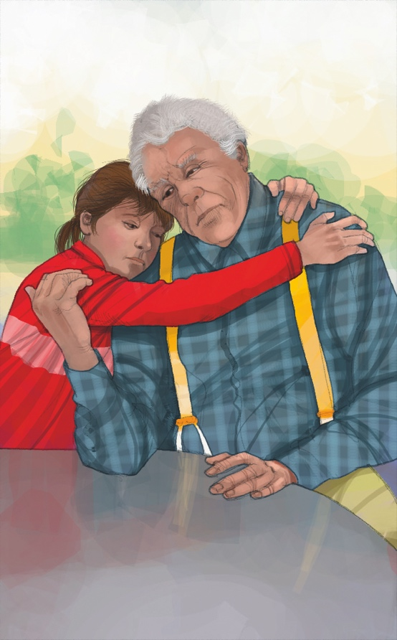
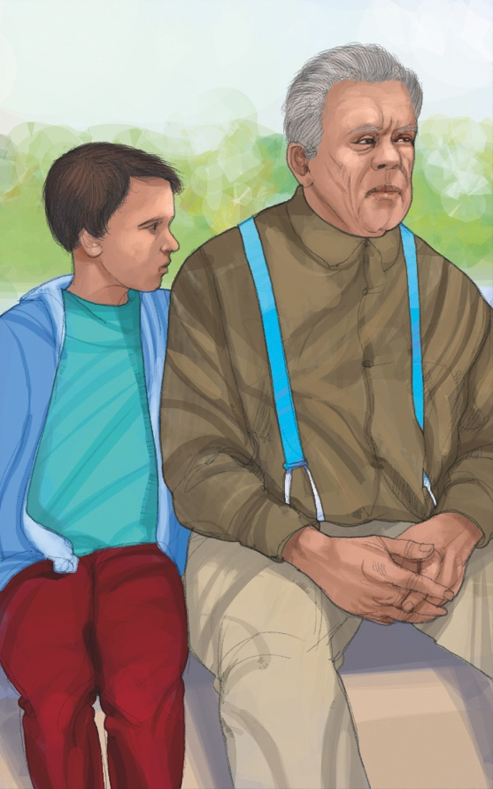
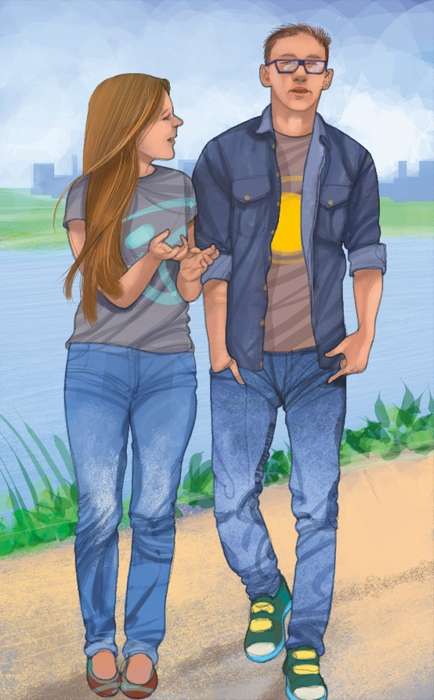
Supporting somebody that is grieving
What strategies did you find which could help to support a friend who is grieving?
Notes:
Ask pupils to share their leaflets and give their ideas on ways in which they could support someone who is grieving. These leaflets could be used in a wellbeing area in school so that other pupils could benefit from the information.

