Slide 1

Monday 2nd February
TBAT: Use joins consistently.
stationary
stationery
steal
steel
wary
weary
who’s
whose
fate
fete
Are there any words you are unsure of?
Use a dictionary to look them up and then use them in a sentence.

Slide 2
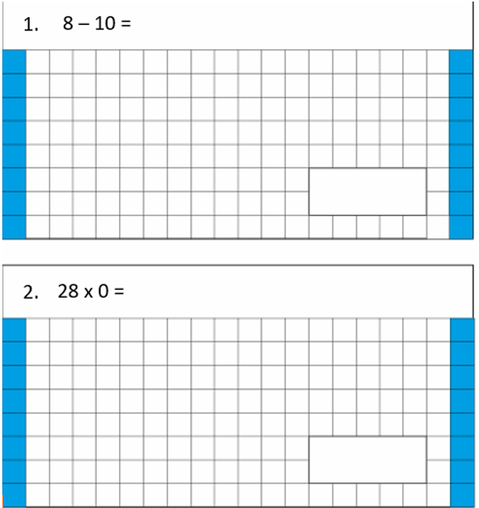
2.2.26
TBAT- use column method to add amounts of money.
3 in 3 3. 3001 – 245.7 = [ ]
Challenge: ½ + ¼ + 1/3 =
3. 3001 – 245.7 = [ ]

Slide 3
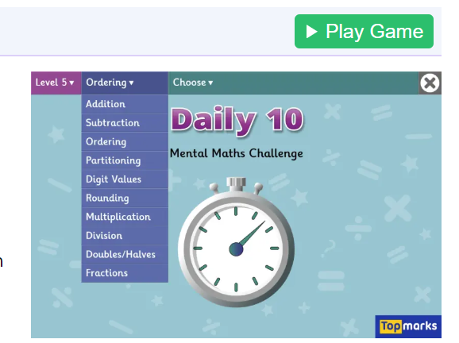
Daily 10 - Mental Maths Challenge - Topmarks x8

Slide 4
In books: Mental methods
Double 420 =
145 + _____= 200
£1.70 + 0.50 =
69+ ____ = 80
Double 210 =
£3.50 + 1.20 =
Challenge: £14.55 + _________ + £4.00 = £20.00

Slide 5
£45.50 + £111 = £5660
What mistake has been made when solving this problem?

Slide 6
Why is it a good idea to use the written column method to add amounts of money with pounds and pence?
Which number facts can we use to help us add?
Together:
What do we add first? Then what next?
Where do we write the extra pound? Have you remembered to add on the extra pound?

Slide 7

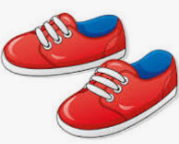
Class work:
In a shop a pair of shoes cost £35.69 and a hat cost £6.80. What is the total?

Slide 8
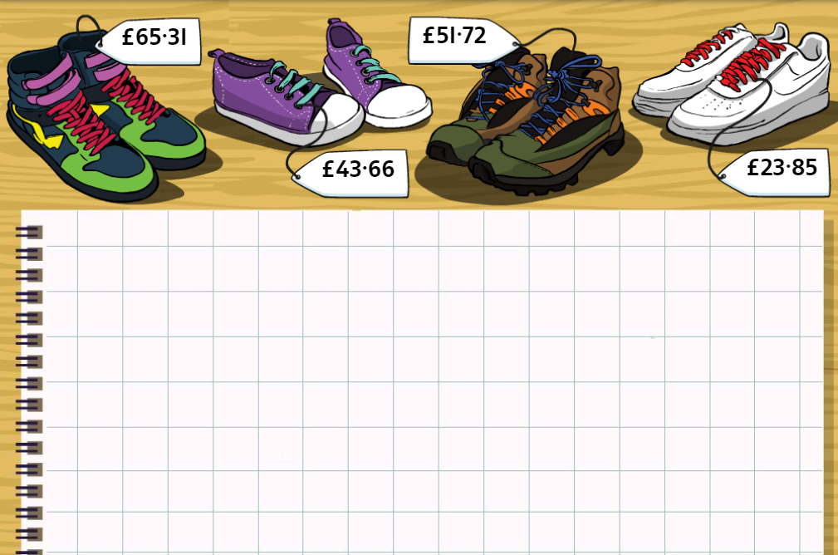
TBAT- Use column method to add amounts of money
Whiteboard work:
£51.72 +
£43.66

Slide 9
TBAT- Use column method to add amounts of money
£65.31 +
£23.85
Whiteboard work:

Slide 10
Select two amounts to add using the column method.
Whiteboard work:

Slide 11

Checkpoint question:
£3.71
+ £2.88
A) £6.59
B) £0.83
C) £5.59

Slide 12
In books:
£45.92 + £15.28=
I bought a pack of crisps for 0.86p, a drink for £1.20 and a bar for £0.45p. What is the total cost?
£17.55 + £23.70 =
An apple cost 0.48p, a drink cost £1.90 and some gum cost £0.79. What is the cost altogether?
Challenge: £1.78 + £213 + 75p =

Slide 13
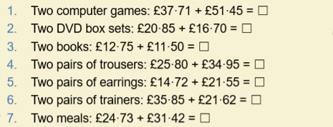
TBAT- Use column method to add amounts of money
Independent Work:

Slide 14
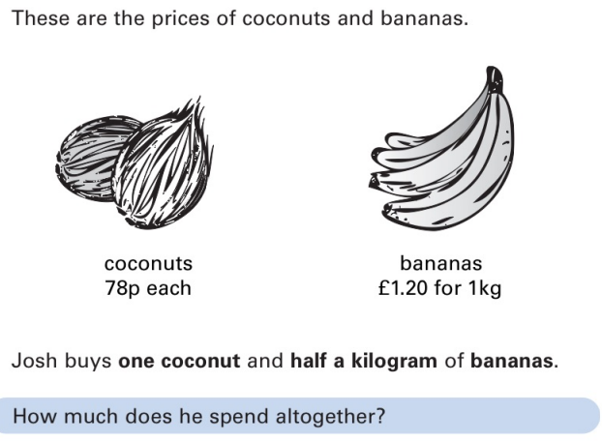
RP
a) Zoe says if you buy a pen for £5.89, and a book for £2.75, the total will be less than £8.50. Do you agree? Explain.
b) T/F If there is an 8 in the I’s column, there are only 2 numbers you can add to it before an exchange is required.
Challenge:
You have 2 prices to add together, the total will be £100. The total number of 1ps =10p and the total number of 10p’s = £1 What could the 2 prices be?
Mastery:

Slide 15
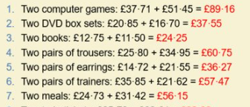

Slide 16
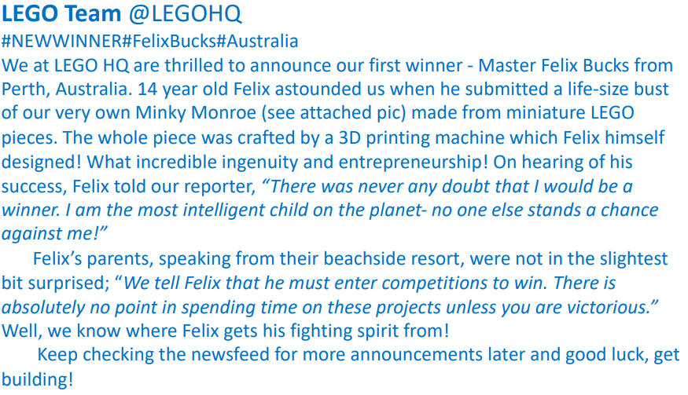
Monday 2nd February
TBAT- explore author's choice of language.
1)Where do you think this announcement was displayed?
Newspaper Twitter
2) How did he make his object?
3) Where is Felix from?
Challenge: Are his parents supportive and why do you think this?

Slide 17

Synonym Challenge:
Iconic
Honorary
Crucial
Determination
Admiration
Infamous
Legendary
Critical
Appreciation
Notorious
Persistence
Commemorative

Slide 18
Blue
What is a difference between a Youtube announcement and a Twitter announcement?
Green
What is a similarity between a Youtube announcement and a Twitter announcement?
Challenge: Which would you use more often and why?

Slide 19
Talk partners:
Compare the two author's: Frank Cottrell-Boyce and Roald Dahl.

Slide 20
Read the model text
Make a jotting next to each paragraph:
What is the purpose of the paragraph?
Feedback as a class and record the structure of this text.
P1-
P2-

Slide 21
Author's choice of words:
1. Find and copy one group of words from the first paragraph that makes the competition sound exciting and full of possibilities.
2. Why has the author chosen to use rhetorical questions in the competition announcement (e.g., "Are you bursting with creativity? Do you love building worlds with bricks of endless possibility?")? How do they affect the reader?
3. How does the phrase "determination sparking in her eyes" help the reader understand Ellie’s feelings about entering the competition?
4. The word "infamous" is used to describe Jeremy. What does this word suggest about his reputation? Tick one:
He is well-known for being talented
He is well-known for being kind
He is well-known for bad behaviour
He is unknown to most people
5. What is the effect of the phrase "Ellie’s heart thumped loudly in her chest as she waited for the final announcement"? How does it help build tension?
6. "...and a smug grin filled the screen." Why does the author describe Jeremy's grin as "smug"? What does this suggest about his character?

Slide 22
Order the events in the story:
Order | Event
 | The news reporter seems less keen on this character.
 | Ellie felt hopeful for children like herself.
 | Amira Patel was announced as a winner.
 | Ellie agrees that this character was a genius and truly deserves this chance.

Slide 23
Challenge:
How have Ellie's feelings changed across the text?
Use evidence from the text at each point.

Slide 24
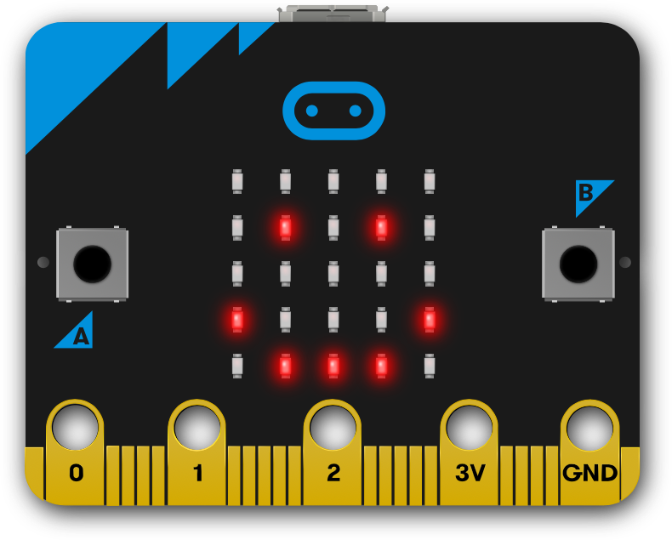

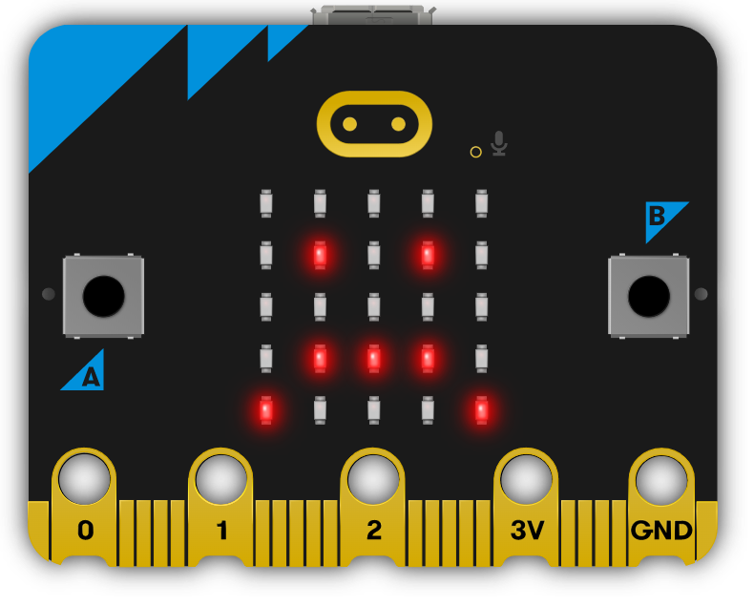
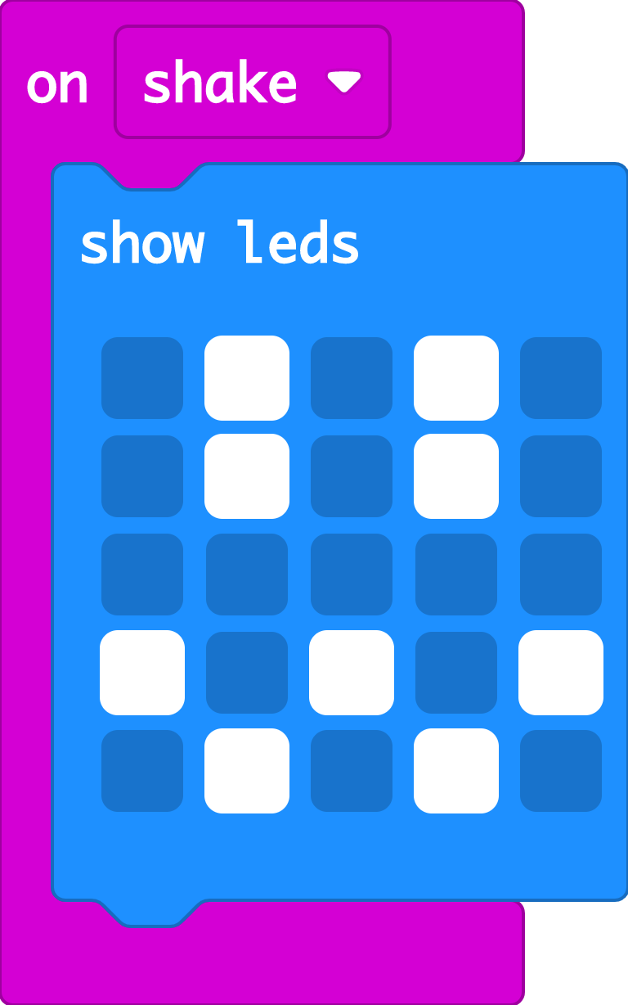


Recap: emotion badge
Last time we used different button inputs to show different emotions on the micro:bit’s LED display output.
You may also have used the ‘on shake’ block to show other emotion images when you shake your micro:bit.
The micro:bit’s accelerometer senses when it’s shaken. We’ll be using it today.

Slide 25






This is lesson 4, in lesson 6 you will be making a rock, paper, scissors game using accelerometer
Notes:
We’ll be making a Rock, paper, scissors game using the accelerometer in lesson six in this series.

Slide 26





TBAT: use the accelerometer and variables.
I can explain that the accelerometer is a sensor, an input that senses movement.
I can explain that variables are containers for storing data which can be accessed and updated.
Notes:
Explain that the accelerometer is a sensor input that senses when you shake your micro:bit.
Students may have already used accelerometers to count steps using phones, watches or fitness trackers.
The accelerometer is labelled on the back of the micro:bit, so you can see where it is – even though it’s tiny, it contains moving parts that react to movement.
Variables help us count how many steps we’ve taken. They are containers for storing data which can be accessed and updated while a program is running.

Slide 27
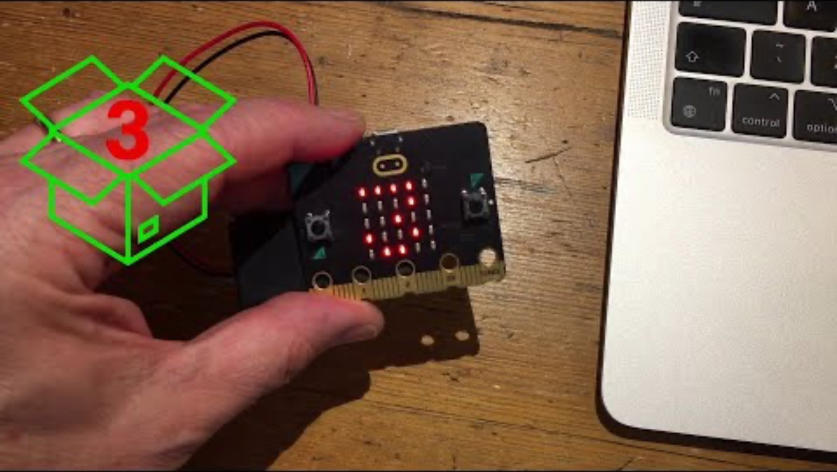


Think: step counter introduction video
Optionally play video: https://youtu.be/bSANf_njTSk

Slide 28

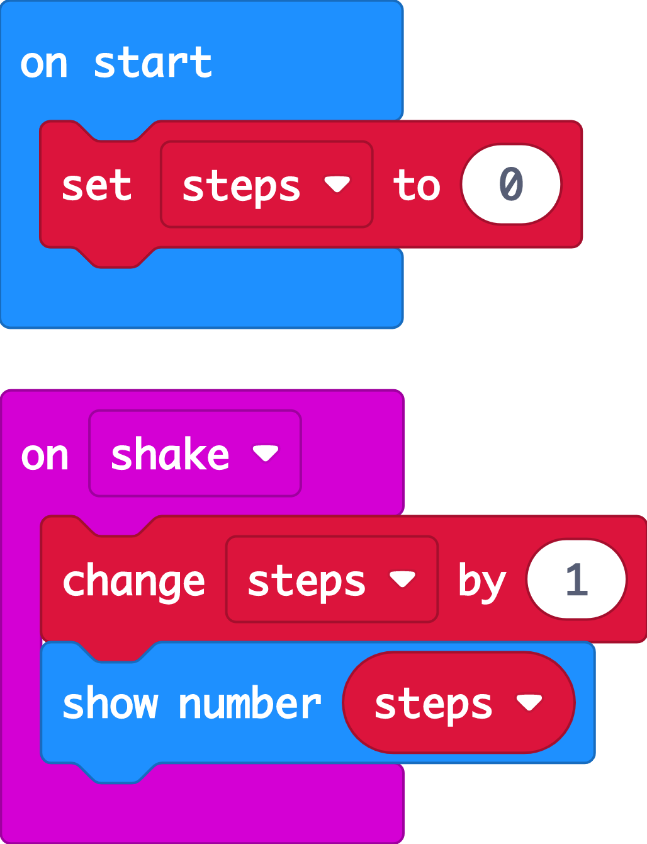

Create: examine the code
At the start the code sets a variable called ‘steps’ to 0.
The ‘steps’ variable keeps track of how many steps we’ve taken.
When the accelerometer input senses a shake, the ‘change’ block adds 1 to the number stored in the ‘steps’ variable.
After the ‘steps’ variable is updated, ‘show number’ displays the new count on the LED display output.
Teacher: open the completed code in the editor
Notes:
You can follow the link to open the completed code in the editor.
It’s a good idea to set variables to a known value at the start of a computer program.
The order of blocks is important – the code must show the ‘steps’ variable number on the LED display after it’s been updated, or the count will be out-of-date!

Slide 29


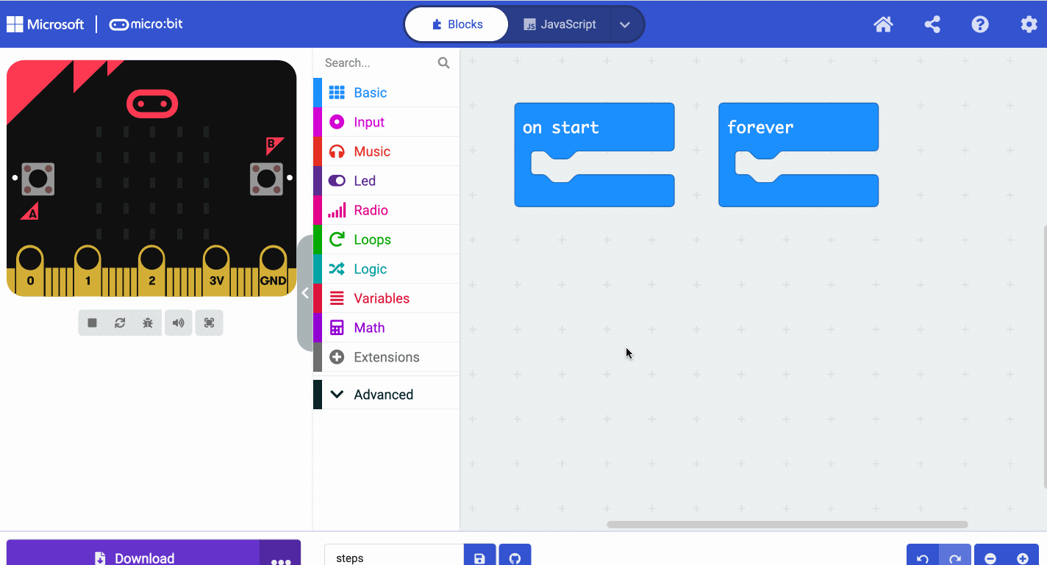
Create: coding animation
Notes:
Animated GIF of building the code you can share with your students, if YouTube is blocked in your school.

Slide 30
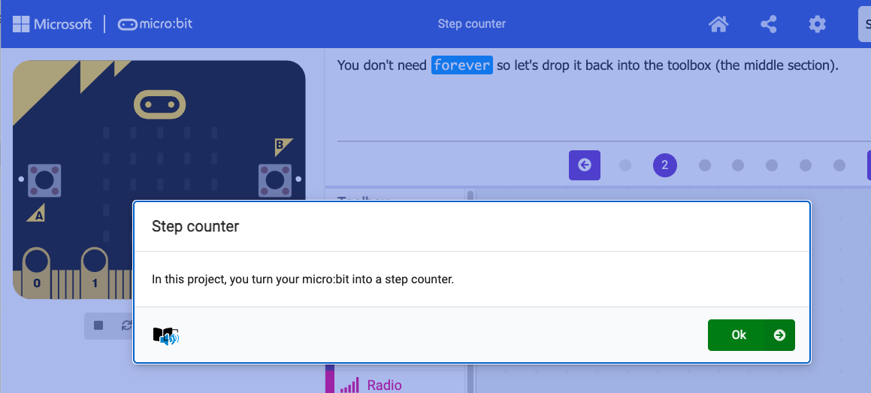
Create: step-by-step online tutorial
https://mbit.io/tutorial-step-counter
Notes:
You can optionally share this online step-by-step tutorial with your students to follow individually.

Slide 31


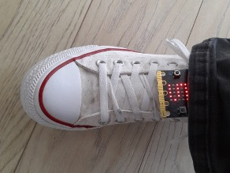

Evaluate
Download your code to a micro:bit
Does it work as you expect?
How good is the project?
Could it have other uses?
How does it work?
Notes:
Does it work as you expect?
If not, do you need to debug the code and download it again?
How good is the project?
Can you think of anyone who would like this project and find it useful of enjoyable?
How could you improve it?
Students may find the display hard to read, that they have to stamp their legs to record steps, or that it counts fewer steps than they expected. See ‘Extend’ below for some ideas for improving the project.
Could it have other uses?
How does it work?
Encourage students to think about how it works when using it.

Slide 32

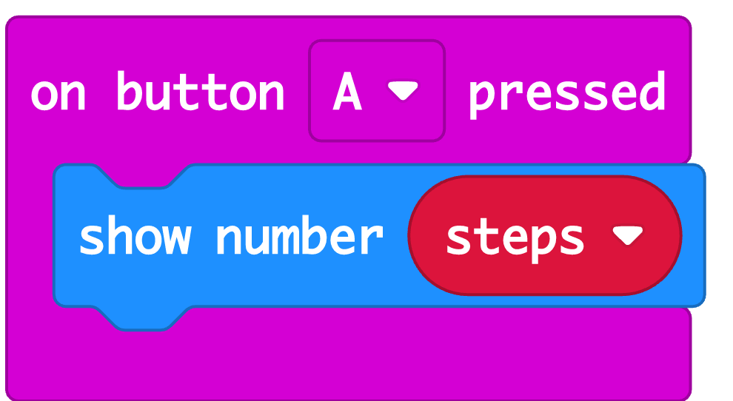

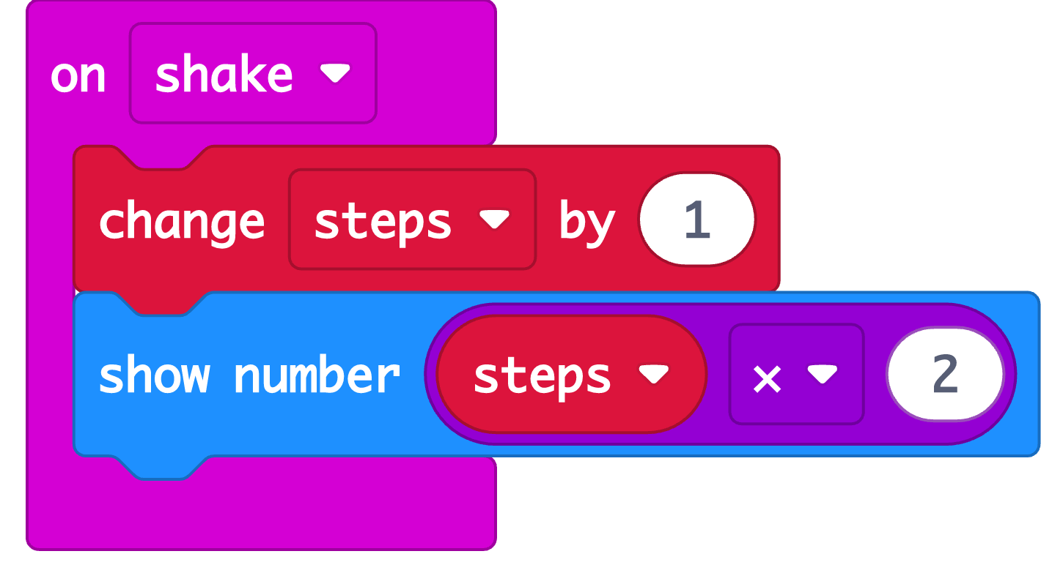

Extend
Add blocks to show the step count when you press button A.
If it’s counting too few steps, modify the code using Maths blocks to fix this.
Notes:
Add an ‘on button A pressed’ block to show the step count when you press button A – this means you can read the step count at any time without having to shake the micro:bit.
Assess how accurate your step counter is. If the step counter is attached to one leg, it may be counting strides rather than steps, counting every other step. Students could compensate for this by using Maths blocks to multiply the ‘step’ variable by 2 when it’s shown on the LED display.

Slide 33

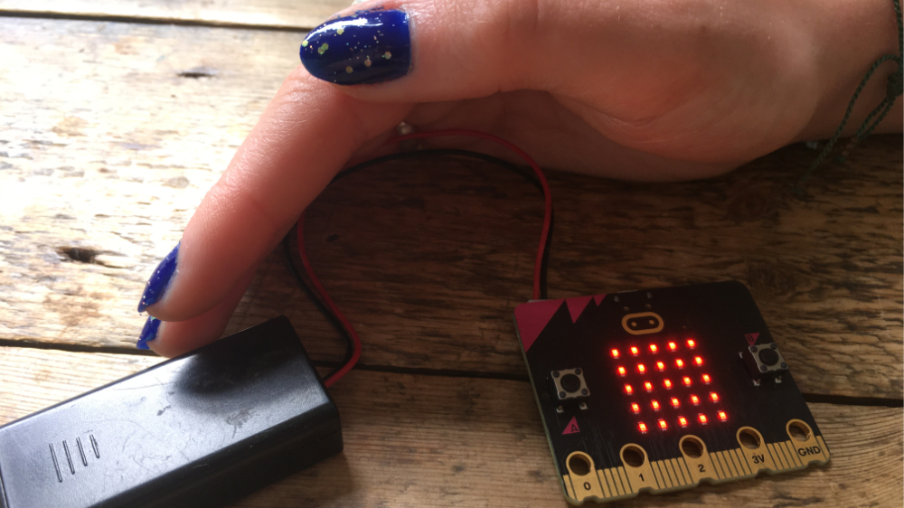
Next steps
Today we used the accelerometer sensor input that can sense when you shake your micro:bit to make a step counter.
Next time, we’re going to use another micro:bit sensor and logic to turn LED lights on automatically when it gets dark.

Slide 34
