Slide 1



Tuesday 10th February 2026
10.02.26
Morning Challenge
Task A: Rewrite the sentences, adding the correct punctuation.
quickly the cat ran across the playground to chase a falling leaf
we walked to the park after school and played on the swings the slide and the roundabout
my friends shiny pebble was sparkling in the sunlight
the teacher said please line up quickly for assembly
Task B: Write 3 sentences that contain fronted adverbials. Don't forget the comma.
Quiet reading when finished.

Slide 2
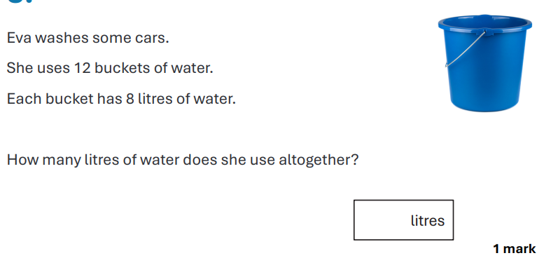
Whiteboards

Slide 3
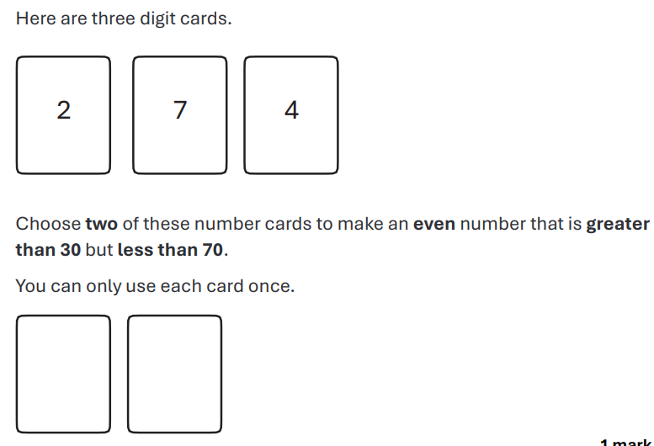
Whiteboards

Slide 4
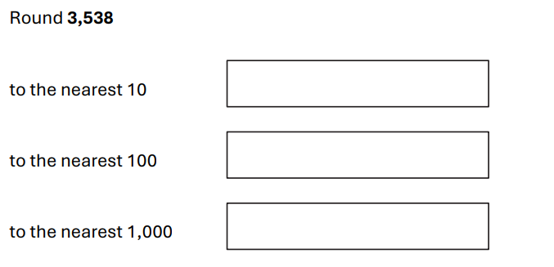
Whiteboards

Slide 5
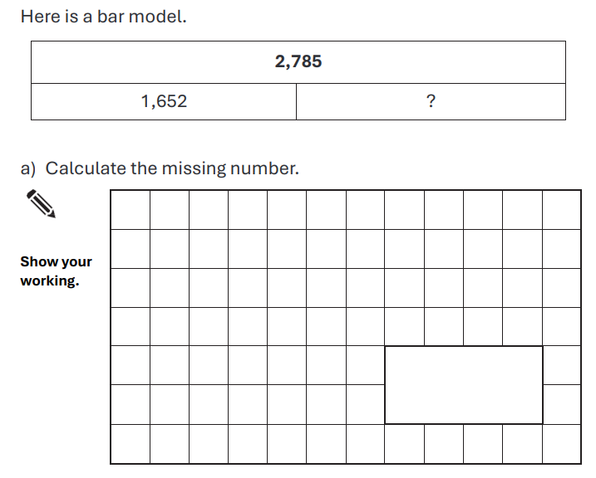
Whiteboards

Slide 6
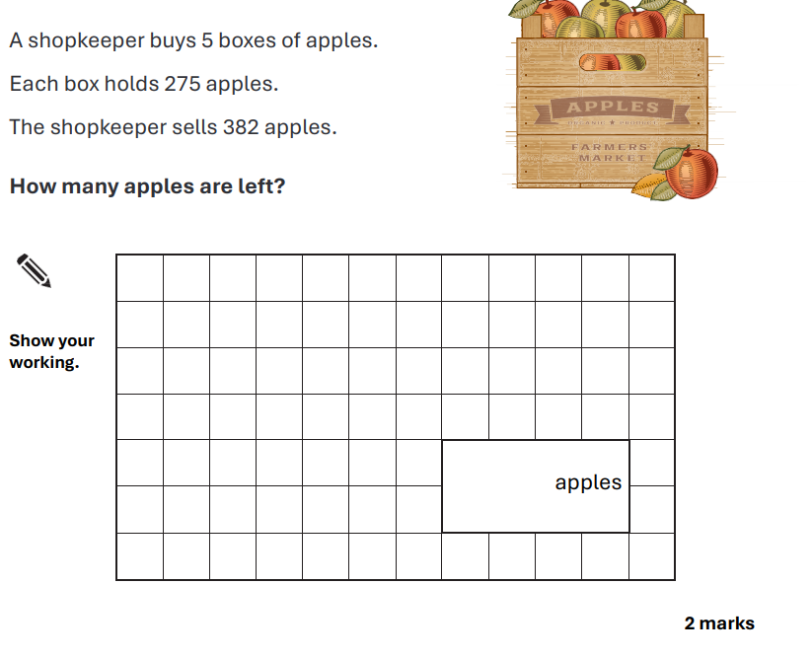
Whiteboards

Slide 7
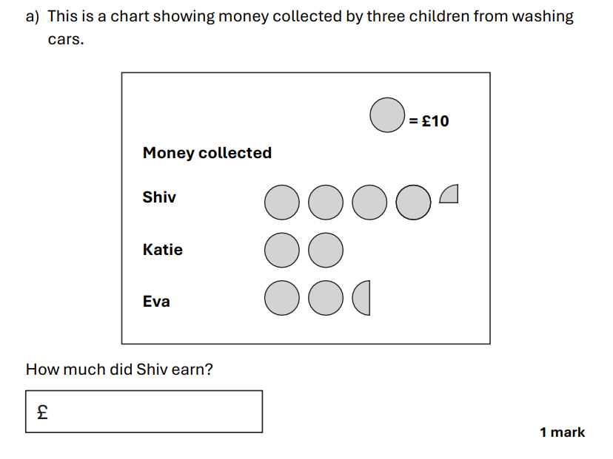
Whiteboards

Slide 8
Tuesday 10th February Maths Reasoning
1. Read your question carefully.
2. Find the numbers in the question, circle them.
3. Calculate what the question is asking you to do.
4. Answer the question.
If you have finished:
Read through each of your questions and check that you have answered them carefully. Have you used the correct method?

Slide 9
Tuesday 10th February GPS Paper
1. Read the instructions for each question carefully – this will show you what type of answer is required.
2. Write your answer in the space provided. If you are not sure what to do, ask the adult you are working with.

Slide 10
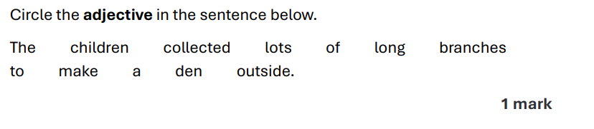
Whiteboards

Slide 11
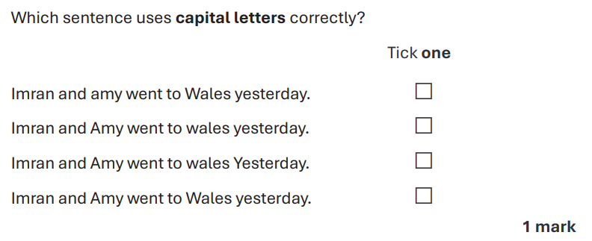
Whiteboards

Slide 12
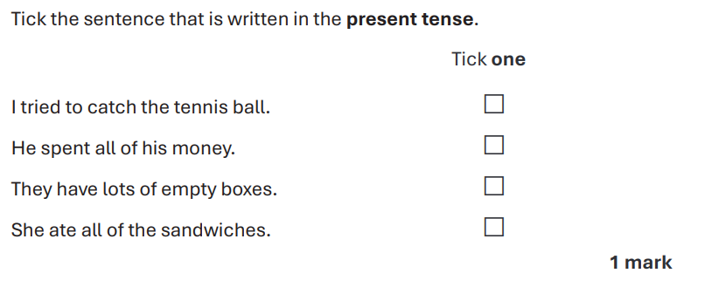
Whiteboards

Slide 13
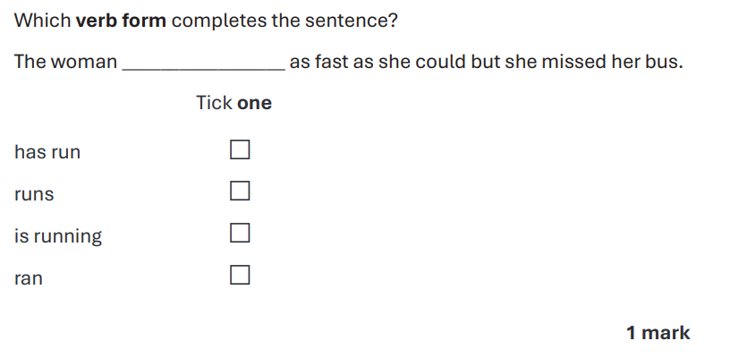
Whiteboards

Slide 14
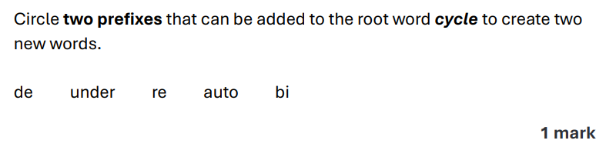
Whiteboards

Slide 15
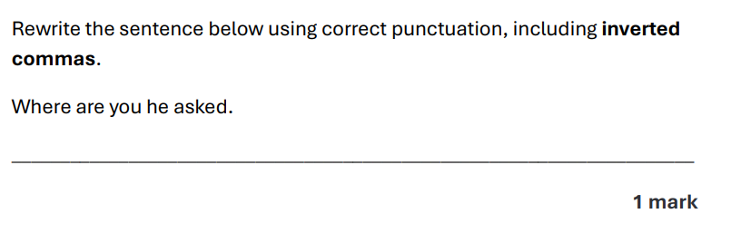
Whiteboards

Slide 16
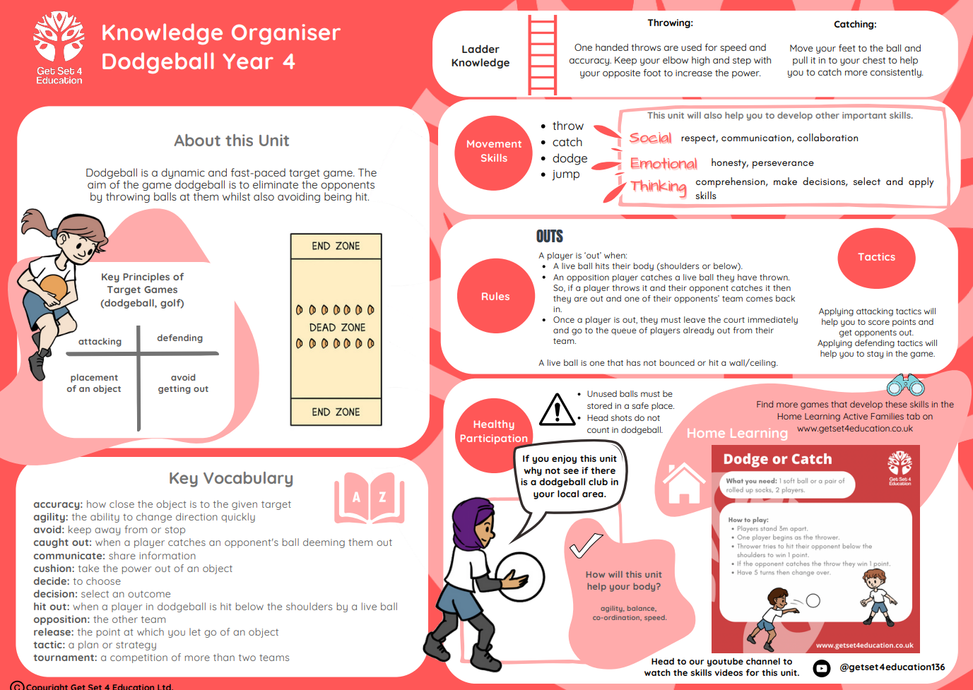
Tuesday 10th February 2026​
TBAT: further develop catching and use the rules of the skill within this game.
Dodgeball –Lesson 5
Success criteria:
Use 2 hands to catch a ball
Watch the ball as it comes towards you

Slide 17
Tuesday 10th February 2026
TBAT: further develop catching and use the rules of the skill within this game.
You have 4 MINUTES to get changed into your full PE kit – silently!
1st- receive 5 marbles
2nd- receive 4 marbles
3rd- receive 3 marbles
4th- receive 2 marbles
5th- receive 1 marble
Please collect the marbles from your own classroom.
4 min timer
https://youtu.be/uW7DCSR4h4E?si=8f8JhD8rlWDqTCF8

Slide 18
Tuesday 3rd February 2026
TBAT: create a repeated pattern using shapes.
Blue: Why do you think designers repeat shapes when making patterns? What effect does it create?
Green: What shapes or colours do you notice repeating in patterns around the classroom?
Challenge: How do artists make sure a repeated pattern stays balanced and pleasing to look at?

Slide 19
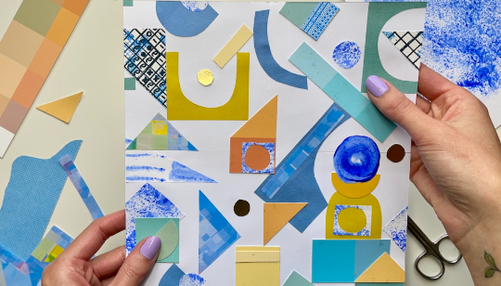
Tuesday 10th February 2026
TBAT: create a repeated pattern using shapes.
A repeated pattern is a design where shapes, colours or lines repeat again and again in the same order.
Designers use repeated patterns to make wallpapers, fabrics, wrapping paper and artwork.
Today, we are looking at how surface pattern designer Rachel Parker creates a “square tile repeat”, where one tile is designed and then repeated to make a seamless pattern. This helps artists think carefully about colour, shape, and balance in their designs.

Slide 20
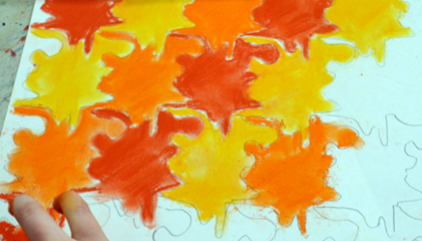
Tuesday 10th February 2026
TBAT: create a repeated pattern using shapes.
How do Tessellated Patterns and Repeated Patterns relate?
Tessellated patterns fit together without any gaps or overlaps, like tiles or honeycomb.
Repeated patterns repeat a design, shape, or motif again and again.
They are connected because tessellated shapes (like triangles, squares, hexagons) are often used as the base for repeated patterns.
Artists can design one tile, then repeat it to create a full artwork—just like Rachel Parker’s square tile repeat technique.
Both ideas help artists think about shape, space, colour, and symmetry.

Slide 21
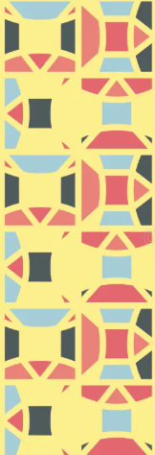

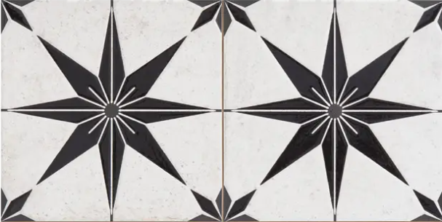


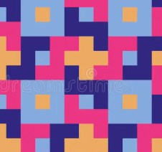
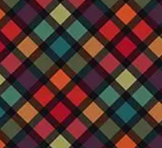
Here are some ideas of repeated patterns, using a variety of shapes.

Slide 22
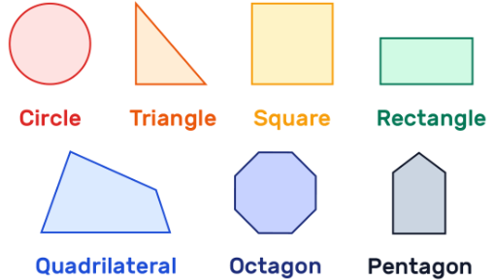
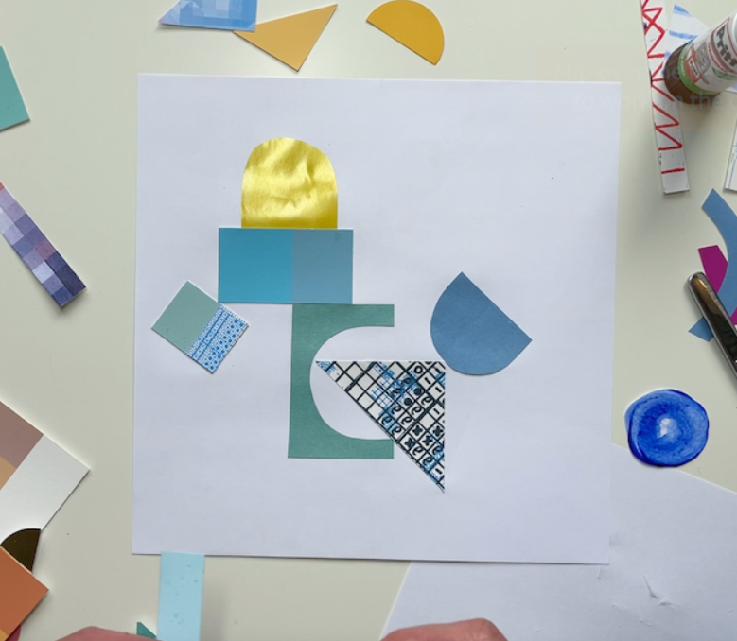
Pick the 2D shapes you want to use for your pattern.
You can mix different shapes or repeat one shape to make a neat tile pattern.
You could do either of the following:
Card Shapes
Place a 2D shape onto a piece of coloured card.
Hold it still with one hand.
Draw around it carefully.
Cut out the shape.
Outline on Paper
Place the shape directly onto your plain background paper.
Draw around it to make an outline.
Colour the inside later.

Slide 23
Arrange your shapes on the paper to make a repeating pattern.
Glue the shapes onto your paper neatly once you are happy with the pattern.
Equipment:
Pieces of coloured card
Plain paper (your background)
2D shape templates (squares, circles, triangles, rectangles, hexagons, etc.)
Scissors
Glue sticks
Colouring pencils or felt tips

