Slide 1
Wednesday 11th February 2026

Slide 2

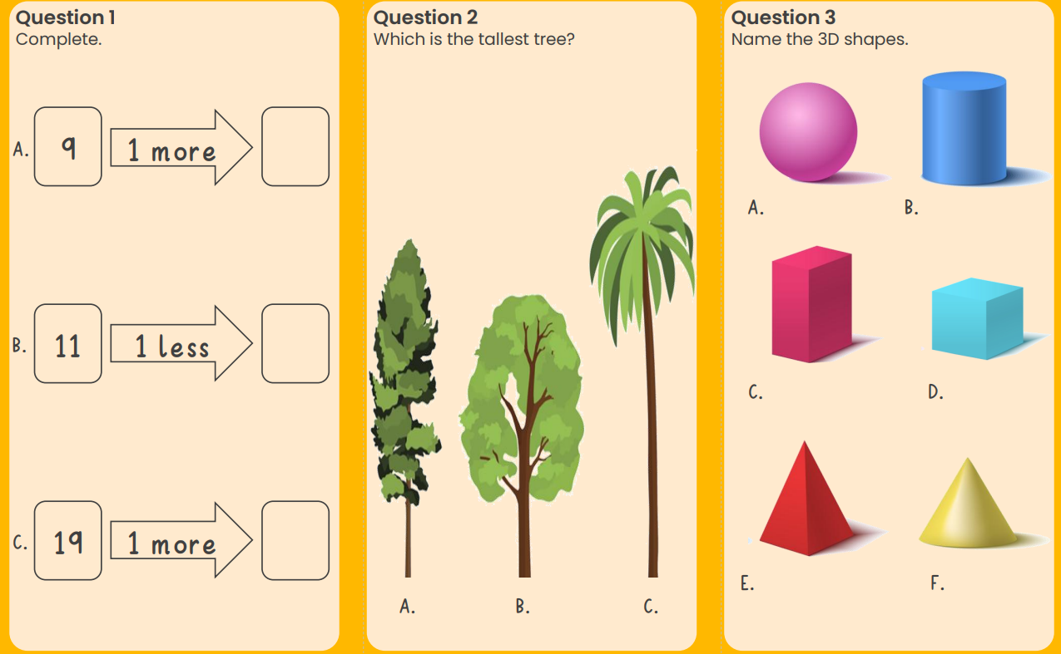
Morning Challenges:
Name writing

Slide 3
Phonics
Wednesday 11th February 2026
11/2/26
Revisit and review
Lesson focus:
Read words with the o-e/e-e/a-e/i-e/u-e

Slide 4

Revisit and review
Wednesday 11th February 2026
11/2/26
Today's Grapheme
a-e/e-e/i-e/o-e/u-e

Slide 5
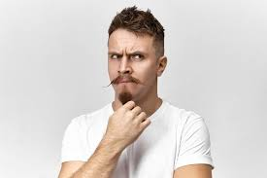
Mrs
Revisit and review
Wednesday 11th February 2026
11/2/26
would
should
people
tricky words
who
could
Read the tricky words?
Mr

Slide 6
Focus words
Wednesday 11th February 2026
11/2/26
choke
pike
brake
gnome
hikes
poke
What digraphs can you see?
Now read the word aloud

Slide 7
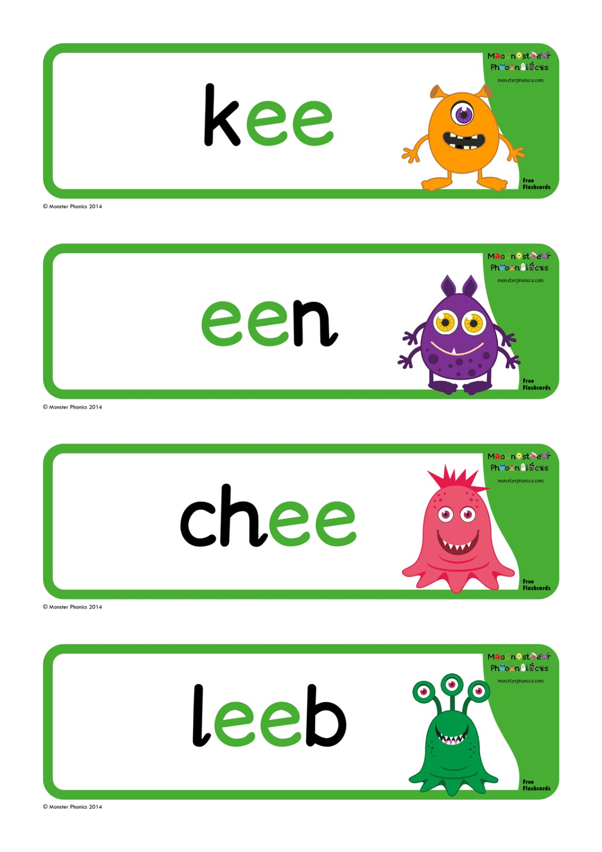
Focus words
Wednesday 11th February 2026
11/2/26
whobe
phobe
webe
lope
wabe
asabe
nubes
What digraphs can you see?
Now read the word aloud

Slide 8
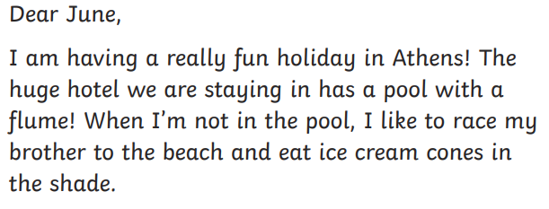
Focus words
Phoneme Spotting!
Wednesday 11th February 2026
11/2/26
CHALLENGE
Can you see anymore ai phonemes?

Slide 9
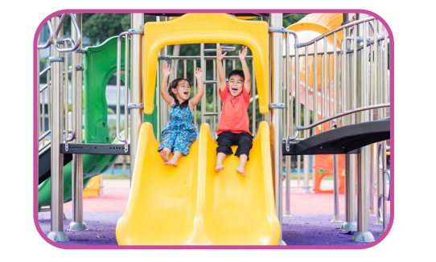
Wednesday 11th February 2026
11/2/26
Write a sentence about the picture. Remember to include one of today's sounds.
Extend using 'and'.

Slide 10
TBAT: identify alliteration.
Wednesday 11th February 2026
11/2/26
3 in 3- Can you think of 3 words that being with.....?
g
p
t
Challenge: Can you put these together in a sentence?

Slide 11

TBAT: identify alliteration.
Wednesday 11th February 2026
11/2/26
Blue/Green- Which words begin with the same sound?
Challenge:
Can you use these words to create a sentence?
big
rat
bat
bounce
bed
rug
rat
chair
ran
rapidly

Slide 12
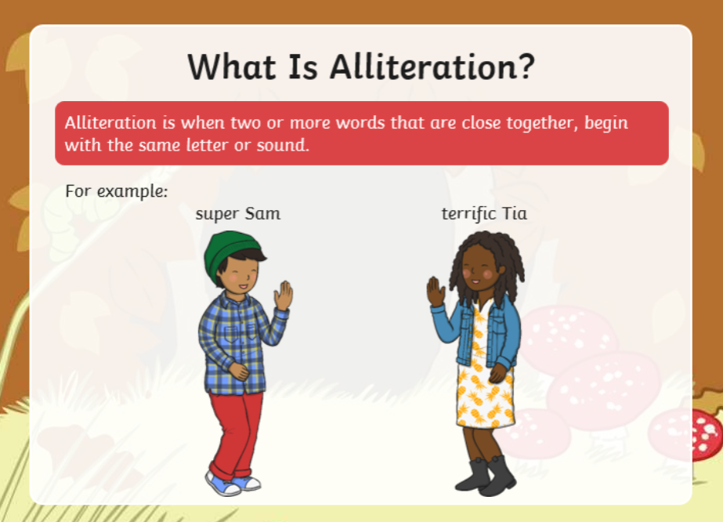
TBAT: identify alliteration.
Wednesday 11th February 2026
11/2/26

Slide 13
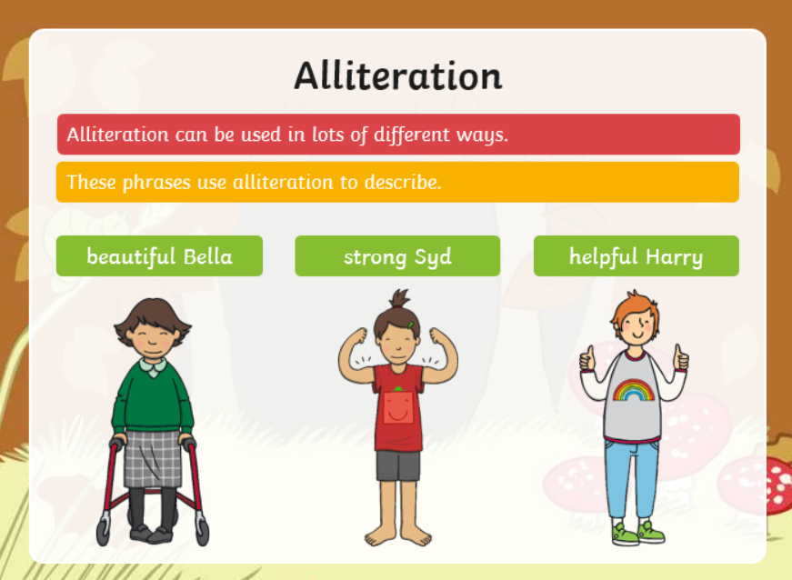
TBAT: identify alliteration.
Wednesday 11th February 2026
11/2/26
Use your name to create an alliteration phrase.

Slide 14
TBAT: identify alliteration.
Wednesday 11th February 2026
11/2/26
Can you spot the alliteration?
In space, shiny stars sparkle like special gems!

Slide 15
TBAT: identify alliteration.
Wednesday 11th February 2026
11/2/26
Can you spot the alliteration?
In space, playful planets dance around the peaceful, patient sun.

Slide 16
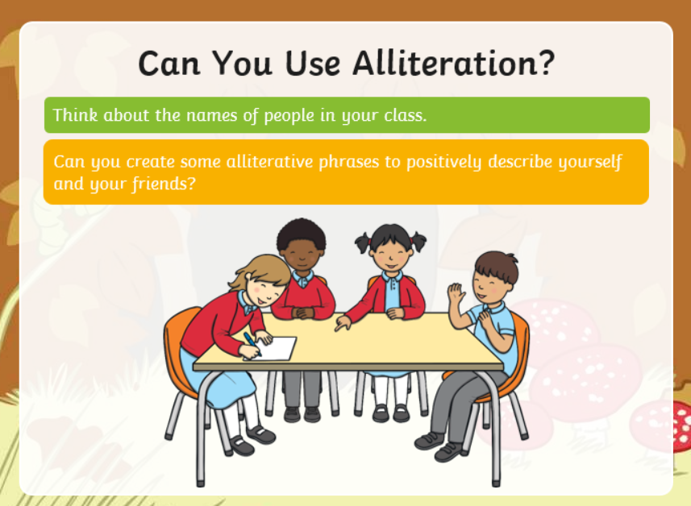
TBAT: identify alliteration.
Wednesday 11th February 2026
11/2/26

Slide 17

TBAT: identify alliteration.
Wednesday 11th February 2026
11/2/26
Knowledge check: Which of these sentences contains an example of alliteration?
The soaring stars ran across the sky.
The blue moon lit up the sky.
The racing rockets roared across the sky.

Slide 18
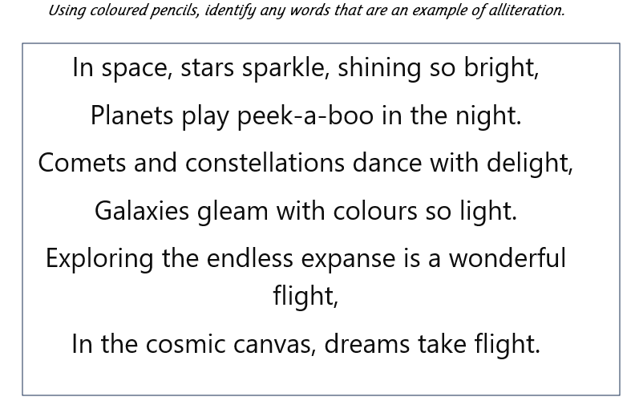
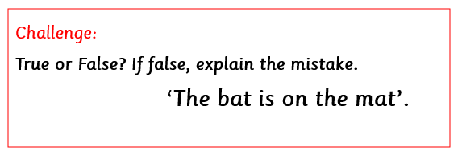
TBAT: identify alliteration.
Wednesday 11th February 2026
11/2/26
Challenge:
Independent:

Slide 19
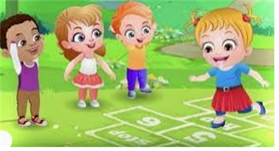
Break

Slide 20
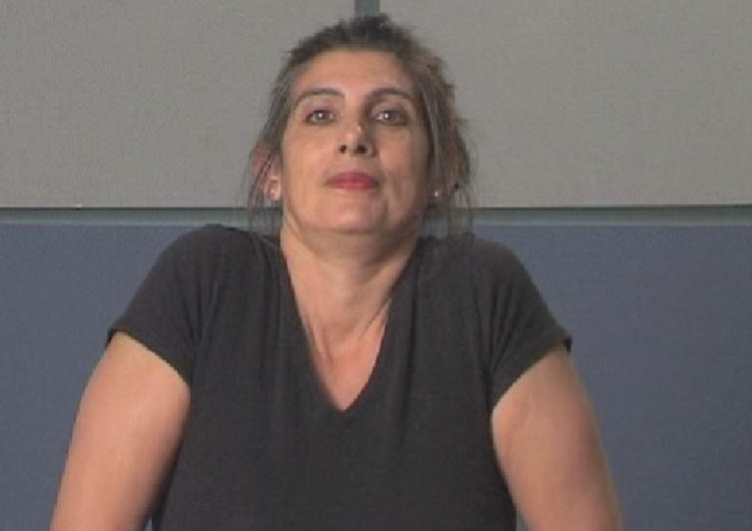
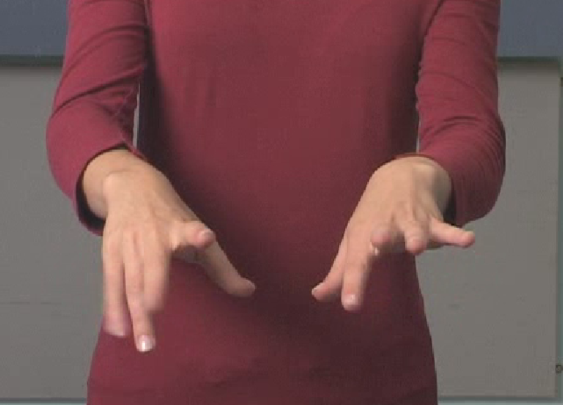
Handwriting- Warm Up's
Wednesday 11th February 2026
11/2/26
TBAT: correctly form /u/.
Gross motor- Shoulder roll
Fine motor- knuckles, wrists, palms

Slide 21
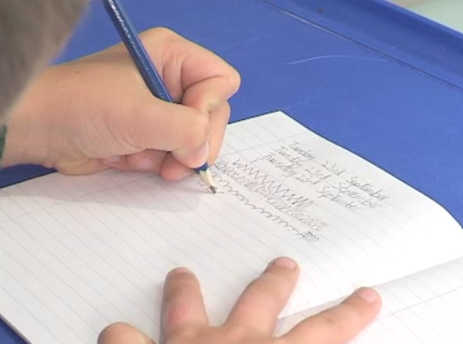
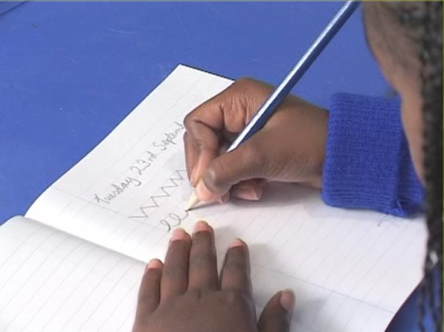
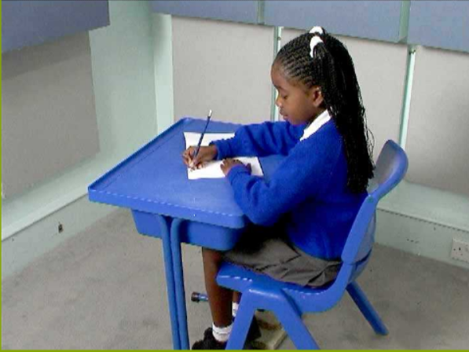
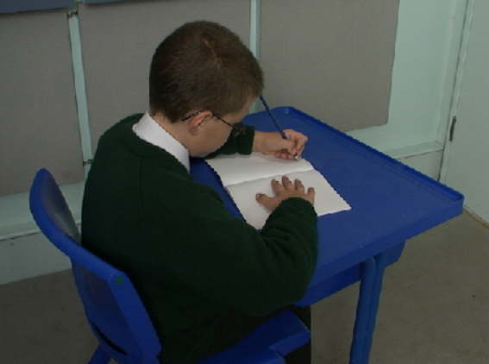
Wednesday 11th February 2026
11/2/26
TBAT: correctly form /u/.
Right handed
Left handed

Slide 22
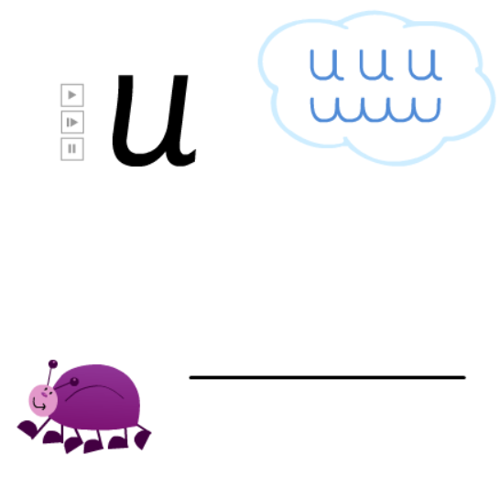
Wednesday 11th February 2026
11/2/26
TBAT: correctly form /u/.

Slide 23
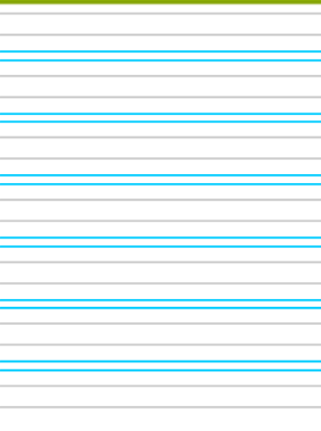
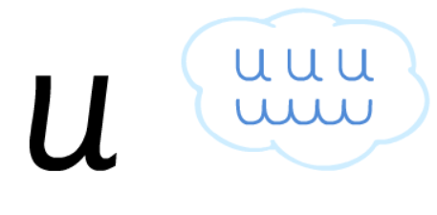
Wednesday 11th February 2026
11/2/26
TBAT: correctly form /u/.

Slide 24
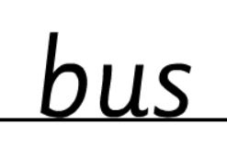
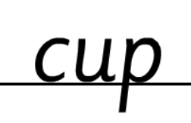
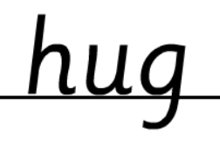
Wednesday 11th February 2026
11/2/26
TBAT: correctly form /u/.

Slide 25
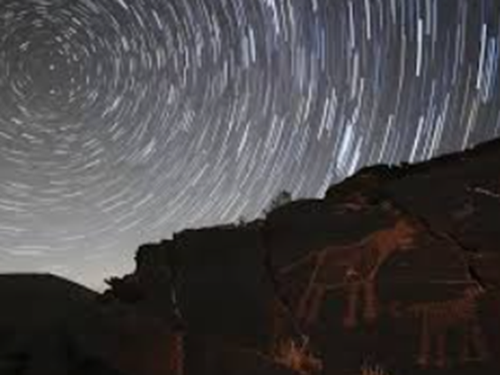
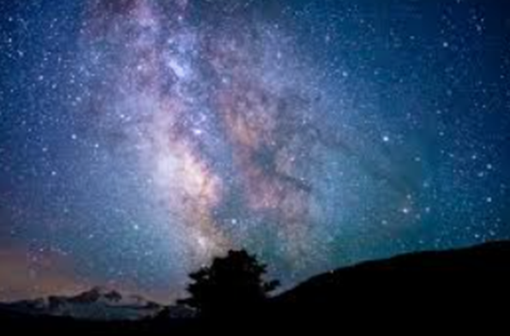
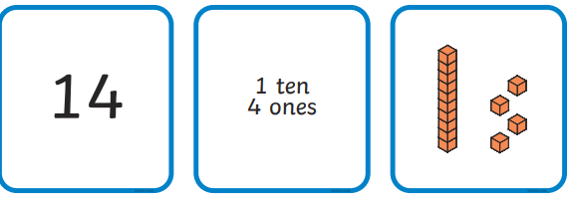
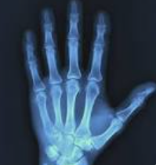
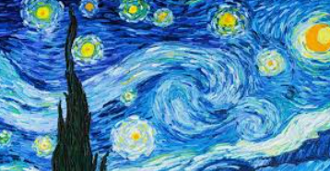
Independent Challenges:
Narrative Zone
Maths Zone
Describe the starry sky pictures.
Match the cards to show how many tens and ones the number has.
Can you use alliteration?
Enquiry Zone
Creative Zone
Create your own version of Van Gogh's 'Starry Night'.
Explore the pictures of the inside of the body.
What can you see?

Slide 26

Lunch

Slide 27

Wednesday 11th February 2026
11/2/26
KQ: How can I use AI responsibly?

Slide 28
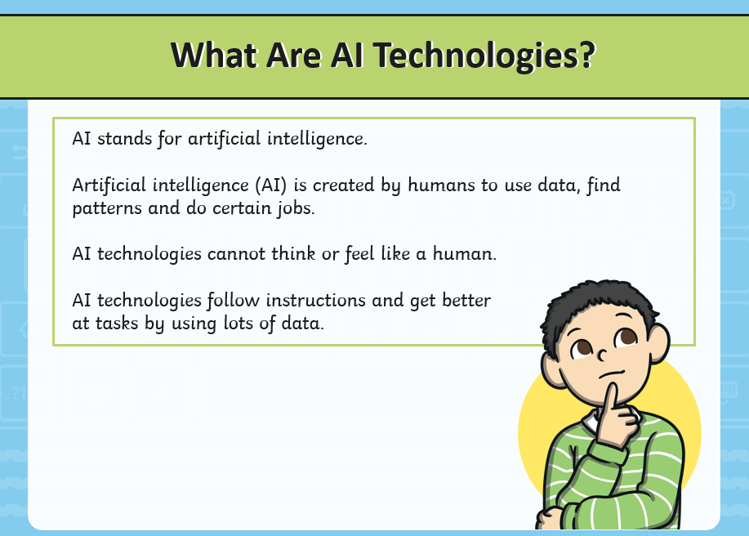
Wednesday 11th February 2026
11/2/26
KQ: How can I use AI responsibly?

Slide 29
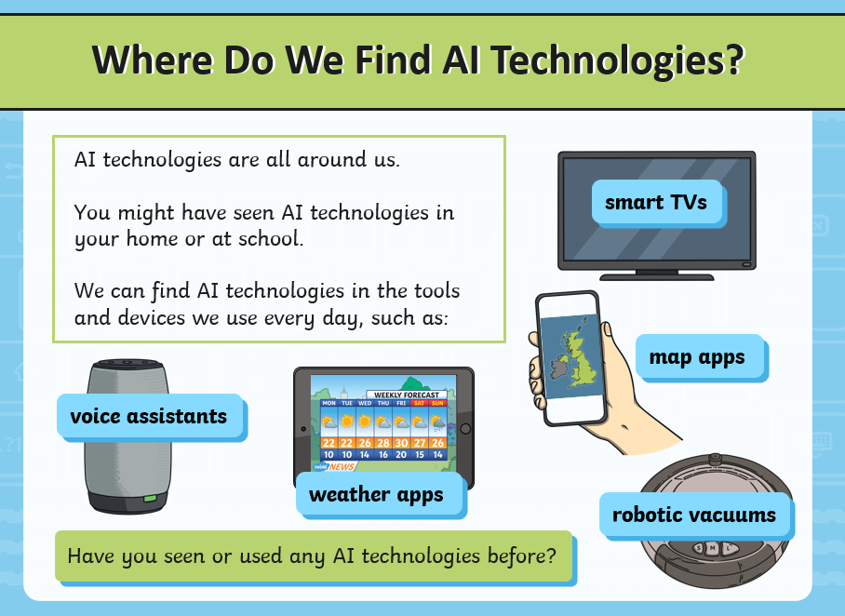
Wednesday 11th February 2026
11/2/26
KQ: How can I use AI responsibly?

Slide 30
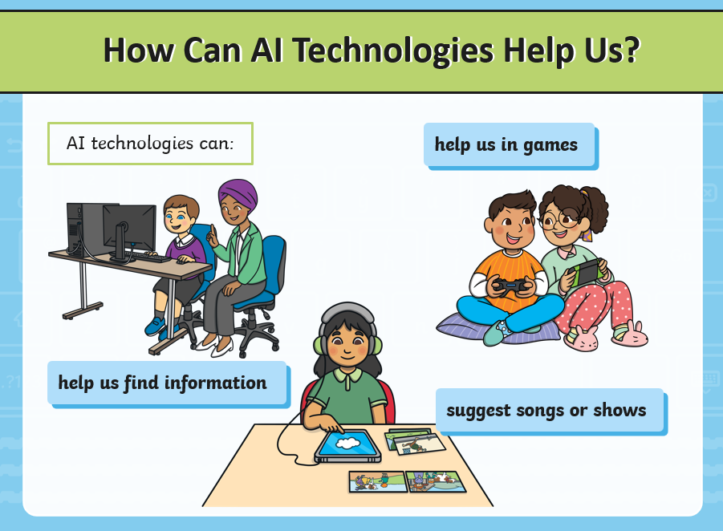
Wednesday 11th February 2026
11/2/26
KQ: How can I use AI responsibly?

Slide 31
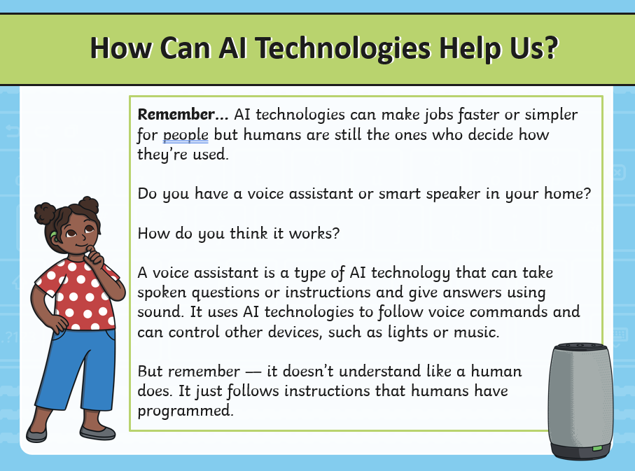
Wednesday 11th February 2026
11/2/26
KQ: How can I use AI responsibly?

Slide 32
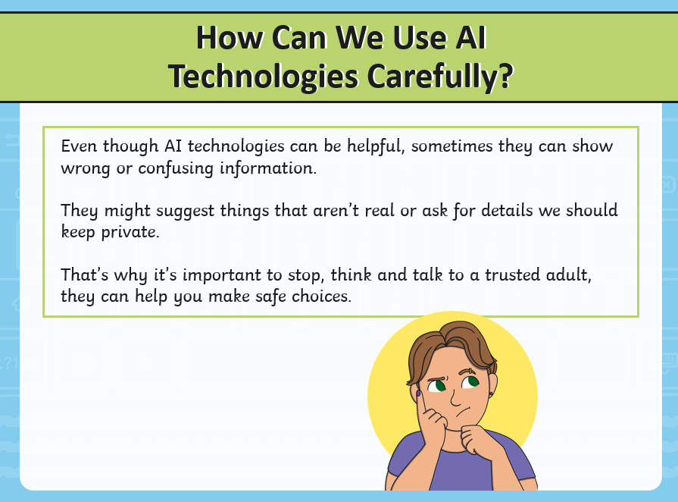
Wednesday 11th February 2026
11/2/26
KQ: How can I use AI responsibly?

Slide 33
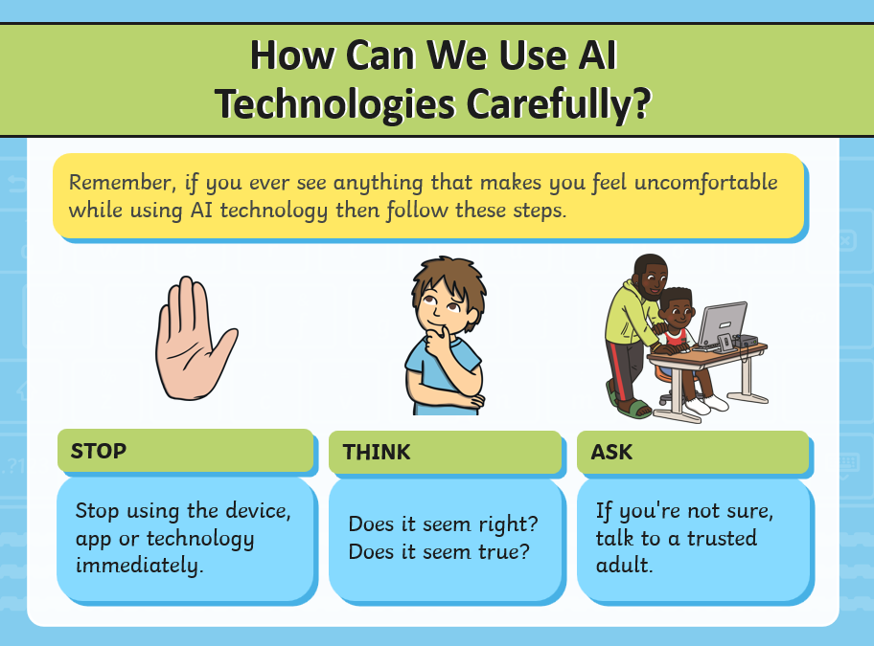
Wednesday 11th February 2026
11/2/26
KQ: How can I use AI responsibly?

Slide 34
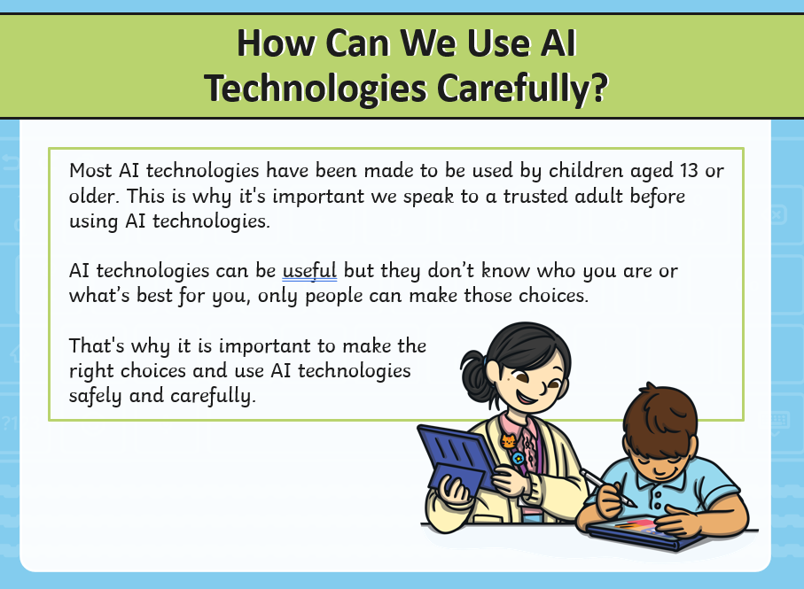
Wednesday 11th February 2026
11/2/26
KQ: How can I use AI responsibly?

Slide 35
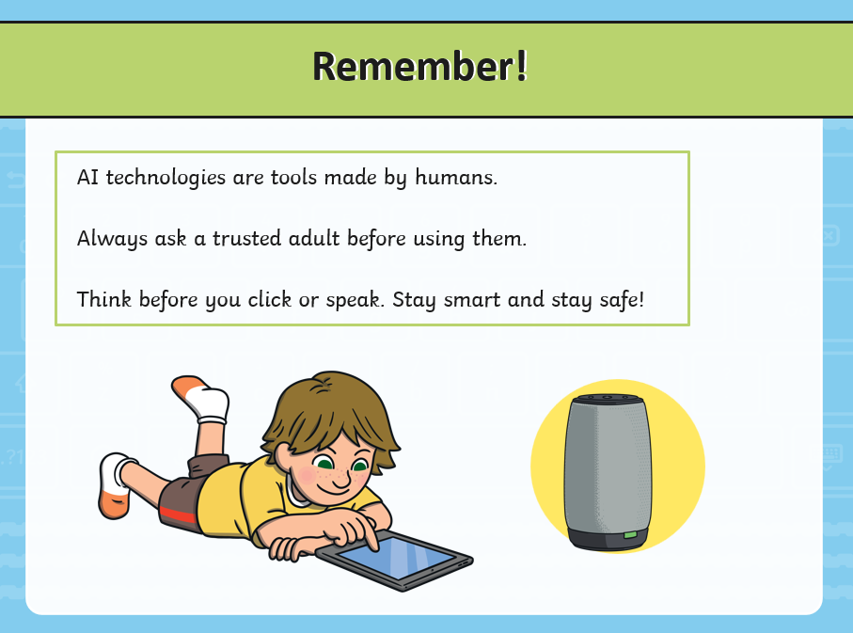
Wednesday 11th February 2026
11/2/26
KQ: How can I use AI responsibly?

Slide 36
TBAT: Review what we have learned about the human body
Entry question:
Can you name some of your body parts that are on the inside?

Slide 37
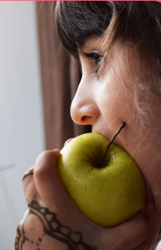
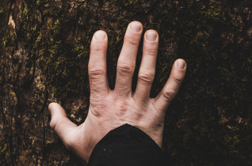
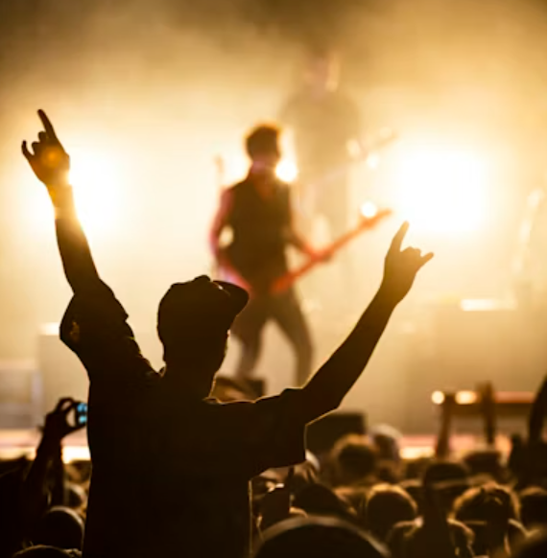
TBAT: Review what we have learned about the human body
3 in 3
What senses are being used in each picture?

Slide 38
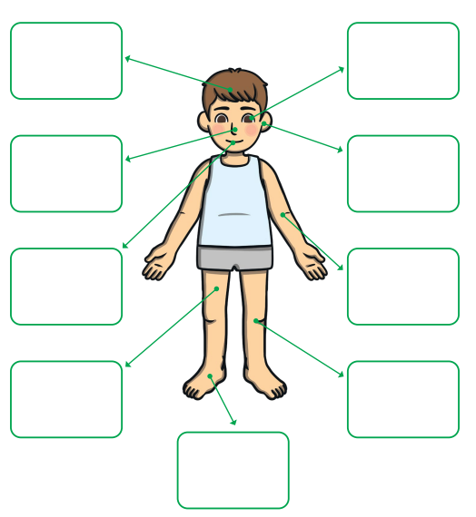
Blue / green Can you remember the body parts?
Wednesday 11th February 2026
11/2/26
TBAT: Review what we have learned about the human body

Slide 39
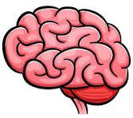
Wednesday 11th February 2026
11/2/26
TBAT: Review what we have learned about the human body
Can you identify this body part?
What job does it do?
Where will you find it in your body?
inside a human body

Slide 40
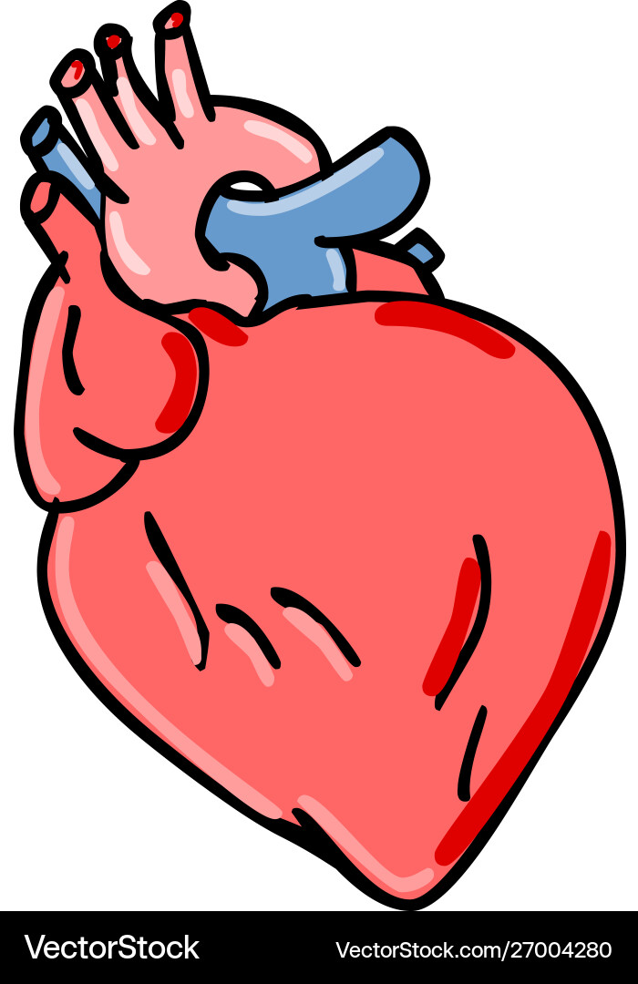
Wednesday 11th February 2026
11/2/26
TBAT: Review what we have learned about the human body
Can you identify this body part?
What job does it do?
Where will you find it in your body?
inside a human body

Slide 41
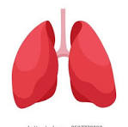
Wednesday 11th February 2026
11/2/26
TBAT: Review what we have learned about the human body
Can you identify these body parts?
What job does it do?
Where will you find it in your body?
inside a human body

Slide 42
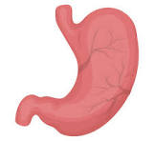
Wednesday 11th February 2026
11/2/26
TBAT: Review what we have learned about the human body
Can you identify this body part?
What job does it do?
Where will you find it in your body?
inside a human body

Slide 43
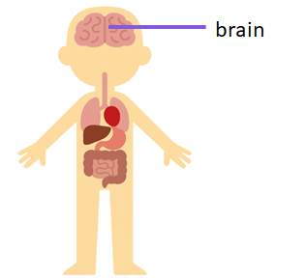
Wednesday 11th February 2026
11/2/26
TBAT: Review what we have learned about the human body
lungs
heart
stomach

Slide 44
Wednesday 11th February 2026
11/2/26
TBAT: Review what we have learned about the human body
How many senses are there?
What are they?
What body parts help you do each of these?
How do your senses keep you safe?

Slide 45
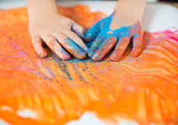
E
Wednesday 11th February 2026
11/2/26
TBAT: Review what we have learned about the human body
Exit question
What sense is being used in this picture?

