Slide 1
Tuesday 3rd February 2026

Slide 2


Morning Challenges:
Name writing
Find the letters the spelling thief has stolen-Can you write the words in a sentence?
ar* sa*d beca*se

Slide 3
Phonics
Revisit and review
Tuesday 3rd February 2026
3/2/26
TBAT
Read words with the /ee/ phoneme

Slide 4
Recap
Tuesday 3rd February 2026​
3/2/26
ea e e-e ie
ey y ee

Slide 5

Revisit and review
Tuesday 3rd February 2026
3/2/26
Today's Grapheme
ea/e/e-e
ie/ey/y/ee

Slide 6
happy
hairy
bodies
belief
monkey
honey
fever
secret
field
Where in the word?
Tuesday 3rd February 2026
3/2/26
What are the digraphs?
Segment these
words and read them
Blend and say words

Slide 7
Best Bets
sheet
teeth
steep
treat
eating
each
these
least
Tuesday 3rd February 2026
3/2/26
Sort the words under the correct grapheme

Slide 8

Revisit and review
where
would
Tuesday 4th February 2025
4/2/25
could
should
tricky words
whole
who
Read the tricky words
two

Slide 9
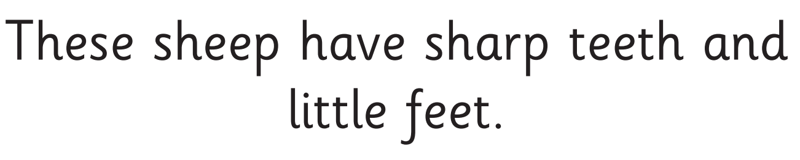
Tuesday 3rd February 2026
3/2/26
Now let's read this sentence!​
What digraphs can you see?
What tricky words can you see?

Slide 10
Let's spell!
How many sounds? Write it.
Tuesday 3rd February 2026
3/2/26
tricky words
happy secret want
Listen to the sentence, say it, write it and read it!
Challenge
Extend the sentence using 'and'

Slide 11
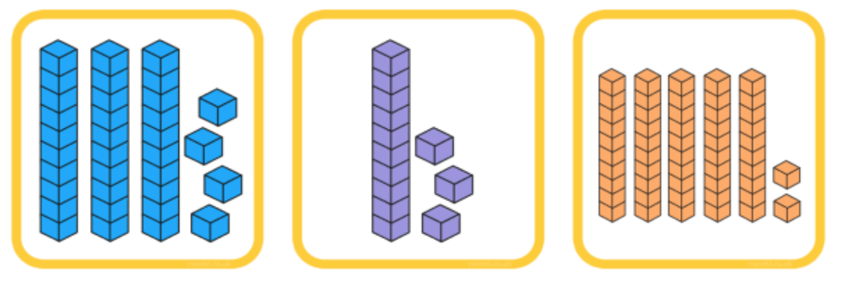
3 in 3
What numbers are shown here?
TBAT: compare and order numbers to 50
Tuesday 3rd February 2026
3/2/26
Challenge: find one more and one less
Notes:
Do Now: Reading and writing numbers to 20
On mini whiteboards, pupils write the numbers from zero to 20 in numerals and words. They could do this independently or use the printable resources ‘0–20 numerals and words’ as a prompt.

Slide 12
TBAT: compare and order numbers to 50
Tuesday 3rd February 2026
3/2/26
smaller
greater
greatest
smallest
less
order
least
ones
groups of ten

Slide 13


Represent these numbers on a place value chart
TBAT: compare and order numbers to 50
Tuesday 3rd February 2026
3/2/26
12
32
Which number has the greater value?
How do you know?
DYNAMIC REPRESENTATION
Build up your own representation, ‘live’ in the lesson
Notes:
New Learning: Representing and comparing two numbers
Pupils use interlocking cubes to represent the numbers 12 and 32 on a place value chart and discuss which has the greater value. Take feedback, listening particularly for whether pupils can explain that 32 has a greater value because it has three tens as opposed to one ten.
Share the pictorial representation on the next slide. Explain that when we compare 2-digit numbers we look at the ten first, because they have a greater value than the ones.
32 has more groups of ten than 12. It has three groups of ten and 12 has one group of ten. So 32 has a greater value than 12.
Ensure all pupils have a chance to repeat these key sentence structures.
Repeat for other pairs where the number of tens differ but the number of ones is the same.
Discuss an example where both numbers have the same number of tens, e.g. 29 and 25.
Which number has more groups of ten?
Neither of them. 29 and 25 both have two tens. They have an equal number of tens.
Discuss how in this case it is necessary to compare the ones.
29 has a greater number of ones. Nine is greater than five. So 29 has a greater value than 25.
Repeat for other pairs where the number of tens is the same and the number of ones differs.

Slide 14
Which number has the greater value?
TBAT: compare and order numbers to 50
Tuesday 3rd February 2026
3/2/26
Blue/Green
12
Tens | Ones
32
Tens | Ones
___ is the greater number. I know this because…
Notes:
New Learning: Representing and comparing two numbers
Pupils use interlocking cubes to represent the numbers 12 and 32 on a place value chart and discuss which has the greater value. Take feedback, listening particularly for whether pupils can explain that 32 has a greater value because it has three tens as opposed to one ten.
Share the pictorial representation on the next slide. Explain that when we compare 2-digit numbers we look at the ten first, because they have a greater value than the ones.
32 has more groups of ten than 12. It has three groups of ten and 12 has one group of ten. So 32 has a greater value than 12.
Ensure all pupils have a chance to repeat these key sentence structures.
Repeat for other pairs where the number of tens differ but the number of ones is the same.
Discuss an example where both numbers have the same number of tens, e.g. 29 and 25.
Which number has more groups of ten?
Neither of them. 29 and 25 both have two tens. They have an equal number of tens.
Discuss how in this case it is necessary to compare the ones.
29 has a greater number of ones. Nine is greater than five. So 29 has a greater value than 25.
Repeat for other pairs where the number of tens is the same and the number of ones differs.

Slide 15
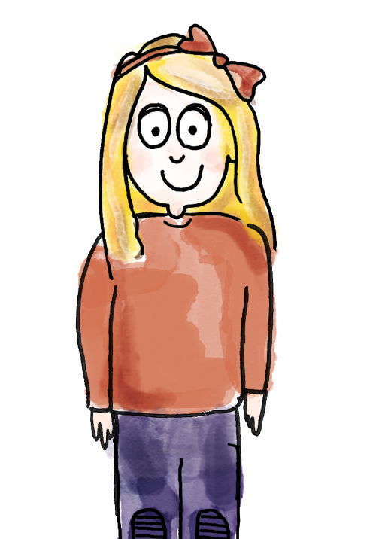
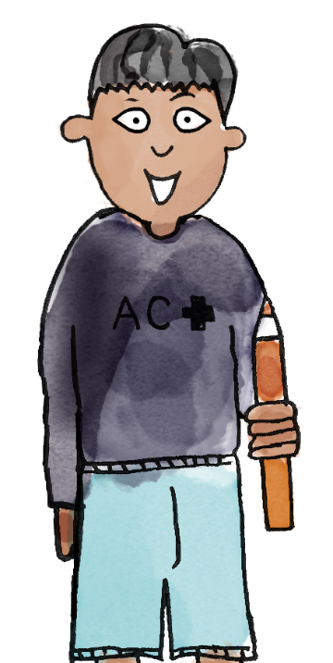
TBAT: compare and order numbers to 50
Tuesday 3rd February 2026
3/2/26
Which number has the greater value?
I have made 29.
It has two groups of ten and nine ones.
29
or
21
I have made 21.
It has two groups of ten and one one..
Tens | Ones
Tens | Ones
29 has a greater value than 21. They both have two groups of ten, but 29 has nine ones and 21 only has one one.
greater greatest smaller smallest less least order groups of ten ones
Notes:
Talk Task: Using comparative language
Pupils have concrete manipulatives of a type that can be grouped into tens and ones (not a fixed ten like Dienes), a large place value chart and the Task Sheet.
Pupil A represents the first number on their place value chart and says how many groups of ten and how many ones it has. Pupil B does the same for the second number. Pupil A says which number has a greater value and how they know. Pupils swap roles so that both have a chance to compare and explain.

Slide 16
Blue/ green
What’s the same? What’s different?
TBAT: compare and order numbers to 50
Tuesday 3rd February 2026
3/2/26
32
23
Challenge:
Which is the greatest? How do you know?
Use the words:
Tens
Ones
DYNAMIC REPRESENTATION
Build up your own representation, ‘live’ in the lesson
Notes:
Develop Learning: Ordering a set of numbers
Show the numbers 32 and 23 and ask pupils what’s the same and what’s different. Invite pupils to make concrete representations on place value charts to compare the tens and ones.
Then show three numbers: 37, 34 and 27. Invite pupils to create each number using concrete manipulatives on place value charts. Support pupils to order the numbers from least to greatest value, using the concrete representations to support their reasoning. Remind pupils to begin by comparing the tens, and if the number of tens is the same, compare the ones. Ensure pupils are practising key sentence structures, e.g.
34 has a greater value than 27 because 34 has three groups of ten and 27 has two groups of ten.

Slide 17
Which number has the least value?
TBAT: compare and order numbers to 50
Tuesday 3rd February 2026
3/2/26
Which has the greatest value?
How do you know?
37
34
27
least
greatest
DYNAMIC REPRESENTATION
Build up your own representation, ‘live’ in the lesson
Notes:
Develop Learning: Ordering a set of numbers
Show the numbers 32 and 23 and ask pupils what’s the same and what’s different. Invite pupils to make concrete representations on place value charts to compare the tens and ones.
Then show three numbers: 37, 34 and 27. Invite pupils to create each number using concrete manipulatives on place value charts. Support pupils to order the numbers from least to greatest value, using the concrete representations to support their reasoning. Remind pupils to begin by comparing the tens, and if the number of tens is the same, compare the ones. Ensure pupils are practising key sentence structures, e.g.
34 has a greater value than 27 because 34 has three groups of ten and 27 has two groups of ten.

Slide 18
TBAT: compare and order numbers to 50
Tuesday 3rd February 2026
3/2/26
Knowledge check
Which is the greatest number?
43 34
Which is the smallest number?
44 43 34

Slide 19
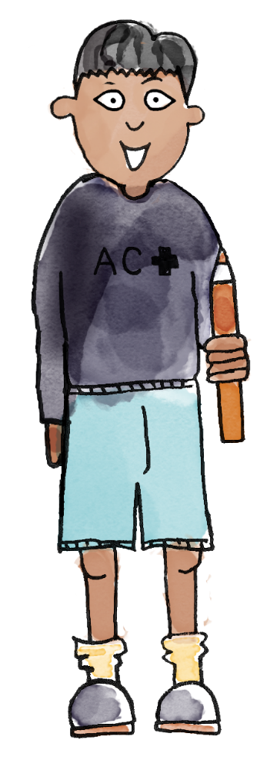
Do you agree with this child? Why/why not?
TBAT: compare and order numbers to 50
Tuesday 3rd February 2026
3/2/26
I think 16 is greater than 32 because it has six ones and 32 only has two ones.
Convince your partner that the child is correct/incorrect.
Notes:
Plenary: Addressing a misconception
Ask pupils to look at the statement: ‘I think 16 is greater than 32 because it has six ones and 32 only has two ones.’ Pupils discuss whether they agree or disagree, explaining their reasoning using manipulatives.

Slide 20
Compare the value of numbers using a number line
TBAT: compare and order numbers to 50
Tuesday 3rd February 2026
3/2/26
0
1
2
3
4
5
6
7
8
9
10
11
12
13
14
15
16
17
18
19
20
21
22
23
24
25
26
27
28
29
30
31
32
33
34
35
36
37
38
39
40
41
42
43
44
45
46
47
48
49
50
_____ has a greater value than _____.
_____ is further along the number line.
Notes:
New Learning: Identifying and comparing two numbers on the number line
This lesson builds on learning from Unit 4 Lesson 6, where pupils compared and ordered numbers up to 20 on a number line.
Show a 0–50 number line.
When we move to the right on the number line, what happens to the value of the numbers?
The numbers increase in value. Each number is one greater than the number next to it.
When we move to the left, what happens to the value of the numbers?
The numbers decrease in value. Each number is one less than the number next to it.
Explain that we can use this to compare the value of numbers.
Pick two numbers and circle them on the number line. Use this sentence structure:
48 has a greater value than 41. 48 is further along the number line.
Repeat for another pair, using the number line on the next slide and this sentence structure:
29 has a smaller value than 30. 29 is closer to zero on the number line.
Demonstrate the same comparison using two bead strings, holding them one on top of the other to see which has the greater value. The next slide can be used to support this.
(Note: when using bead strings, encourage pupils to move beads in blocks of ten and then ones to reinforce previous learning in this unit.)

Slide 21
TBAT: compare and order numbers to 50
Tuesday 3rd February 2026
3/2/26
0
1
2
3
4
5
6
7
8
9
10
11
12
13
14
15
16
17
18
19
20
21
22
23
24
25
26
27
28
29
30
31
32
33
34
35
36
37
38
39
40
41
42
43
44
45
46
47
48
49
50
_____ has a smaller value than _____.
_____ is closer to zero on the number line.
Notes:
New Learning: Identifying and comparing two numbers on the number line
This lesson builds on learning from Unit 4 Lesson 6, where pupils compared and ordered numbers up to 20 on a number line.
Show a 0–50 number line.
When we move to the right on the number line, what happens to the value of the numbers?
The numbers increase in value. Each number is one greater than the number next to it.
When we move to the left, what happens to the value of the numbers?
The numbers decrease in value. Each number is one less than the number next to it.
Explain that we can use this to compare the value of numbers.
Pick two numbers and circle them on the number line. Use this sentence structure:
48 has a greater value than 41. 48 is further along the number line.
Repeat for another pair, using the number line on the next slide and this sentence structure:
29 has a smaller value than 30. 29 is closer to zero on the number line.
Demonstrate the same comparison using two bead strings, holding them one on top of the other to see which has the greater value. The next slide can be used to support this.
(Note: when using bead strings, encourage pupils to move beads in blocks of ten and then ones to reinforce previous learning in this unit.)

Slide 22


Compare the value of numbers using bead strings
TBAT: compare and order numbers to 50
Tuesday 3rd February 2026
3/2/26
25
41
0
1
2
3
4
5
6
7
8
9
10
11
12
13
14
15
16
17
18
19
20
21
22
23
24
25
26
27
28
29
30
31
32
33
34
35
36
37
38
39
40
41
42
43
44
45
46
47
48
49
50
DYNAMIC REPRESENTATION
Build up your own representation, ‘live’ in the lesson
Notes:
New Learning: Identifying and comparing two numbers on the number line
This lesson builds on learning from Unit 4 Lesson 6, where pupils compared and ordered numbers up to 20 on a number line.
Show a 0–50 number line.
When we move to the right on the number line, what happens to the value of the numbers?
The numbers increase in value. Each number is one greater than the number next to it.
When we move to the left, what happens to the value of the numbers?
The numbers decrease in value. Each number is one less than the number next to it.
Explain that we can use this to compare the value of numbers.
Pick two numbers and circle them on the number line. Use this sentence structure:
48 has a greater value than 41. 48 is further along the number line.
Repeat for another pair, using the number line on the next slide and this sentence structure:
29 has a smaller value than 30. 29 is closer to zero on the number line.
Demonstrate the same comparison using two bead strings, holding them one on top of the other to see which has the greater value. The next slide can be used to support this.
(Note: when using bead strings, encourage pupils to move beads in blocks of ten and then ones to reinforce previous learning in this unit.)

Slide 23






TBAT: compare and order numbers to 50
Tuesday 3rd February 2026
3/2/26
0
1
2
3
4
5
6
7
8
9
10
11
12
13
14
15
16
17
18
19
20
21
22
23
24
25
26
27
28
29
30
31
32
33
34
35
36
37
38
39
40
41
42
43
44
45
46
47
48
49
50
I’ve circled 35 on the number line.
Now I’ll make 35 on my bead string: ten, twenty, thirty, 31, 32, 33, 34, 35.
The number 17 is here on the number line. And this is it on a bead string: ten, 11, 12, 13, 14, 15, 16, 17.
35 is greater than 17 because it is further away from zero on the number line.
17 is less than 35. It is further left on the number line.
greater than less than between value compare tens ones
Notes:
Talk Task: Using comparative language
Pupils have a copy of the Task Sheet between them and a bead string each.
Pupil A circles the first number on the number line and makes it on a bead string (moving blocks of ten first, then individual beads for the ones). Pupil B does the same for the second number. Pupil A says whether their number is greater or smaller and explains why. Pupil B does the same for their number.

Slide 24
TBAT: compare and order numbers to 50
Tuesday 3rd February 2026
3/2/26
Blue:
Show your partner a number greater than 26.
How do you know it is greater than 26?
Green:
Show your partner a number less than 26.
How do you know it is less than 26?
DYNAMIC REPRESENTATION
Build up your own representation, ‘live’ in the lesson
Notes:
Develop Learning: Identifying relative positions of numbers on a number line
Pupils work in pairs, with a bead string each. Give them a number and ask them to show numbers greater and less than it. For example:
Pupil A/B, show your partner a number greater/less than 26. How do you know it is greater/less?
I made 29. I know it is greater than 26 because I made 26 and added three more beads.
I have made 18. I know it is less than 26 because it has one ten and 26 has two tens
Take feedback from a pair of pupils, marking their numbers on the number line on the next slide. Model the following sentence and have pupils repeat:
26 is between __ and __.
Repeat with other examples.

Slide 25
Numbers in between
TBAT: compare and order numbers to 50
Tuesday 3rd February 2026
3/2/26
0
1
2
3
4
5
6
7
8
9
10
11
12
13
14
15
16
17
18
19
20
21
22
23
24
25
26
27
28
29
30
31
32
33
34
35
36
37
38
39
40
41
42
43
44
45
46
47
48
49
50
26 is between _____ and _____.
How many different ways can you complete this sentence?
DYNAMIC REPRESENTATION
Build up your own representation, ‘live’ in the lesson
Notes:
Develop Learning: Identifying relative positions of numbers on a number line
Pupils work in pairs, with a bead string each. Give them a number and ask them to show numbers greater and less than it. For example:
Pupil A/B, show your partner a number greater/less than 26. How do you know it is greater/less?
I made 29. I know it is greater than 26 because I made 26 and added three more beads.
I have made 18. I know it is less than 26 because it has one ten and 26 has two tens
Take feedback from a pair of pupils, marking their numbers on the number line on the next slide. Model the following sentence and have pupils repeat:
26 is between __ and __.
Repeat with other examples.

Slide 26
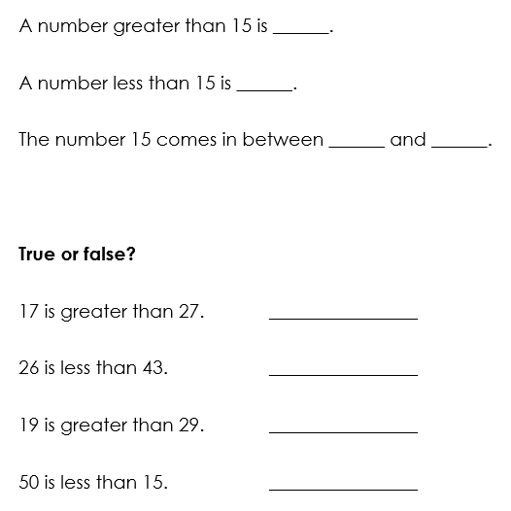
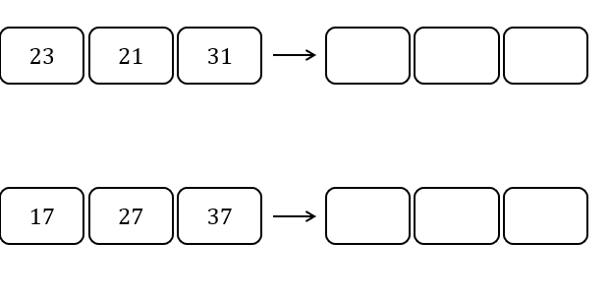
TBAT: compare and order numbers to 50
Represent each number on a place value chart.
Use this to compare the numbers using the star words.
Then write the numbers in order from least to greatest.
Notes:
Independent Task
Pupils have one copy of the Task Sheet between two. They also need a large place value chart and concrete manipulatives. They represent each number to compare and order and talk about how they know which number has the greatest/least value.
Possible adaptations:
The sets of numbers for pupils to order could be adapted, e.g. they could all have different tens values (8, 13 and 25).
Pupils could be provided with pictorial representations of the values, which they then ‘copy’ using manipulatives and then order.

Slide 27
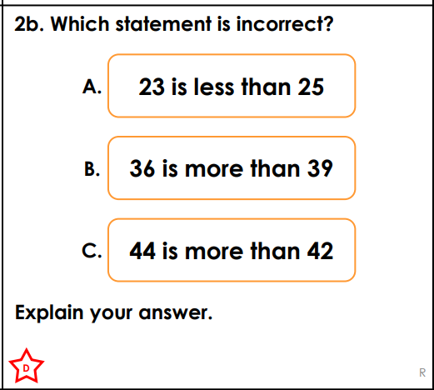
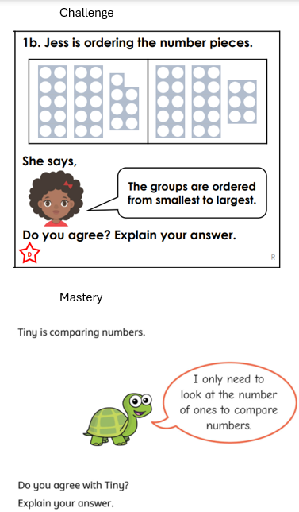
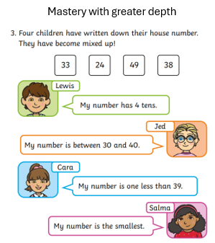

Slide 28
Guess my number
0
1
2
3
4
5
6
7
8
9
10
11
12
13
14
15
16
17
18
19
20
21
22
23
24
25
26
27
28
29
30
31
32
33
34
35
36
37
38
39
40
41
42
43
44
45
46
47
48
49
Notes:
Plenary: Guess my number
Play ‘guess my number’. Tell pupils you are thinking of a number and its value is greater than 20 but less than 40. Pupils must ask comparative questions (not just guess the number), e.g. Is it greater than 27? If the answer is yes, model crossing off all the numbers less than 27. If pupils do not offer questions using ‘between’, model this, e.g. Is it between 34 and 40?

Slide 29
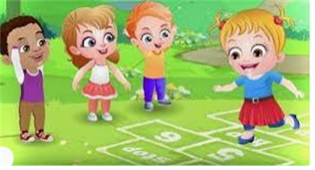
Break

Slide 30
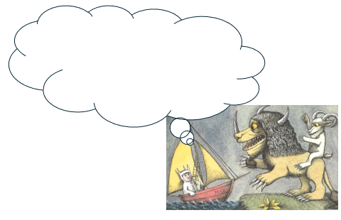
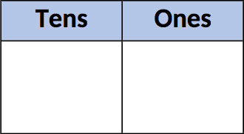
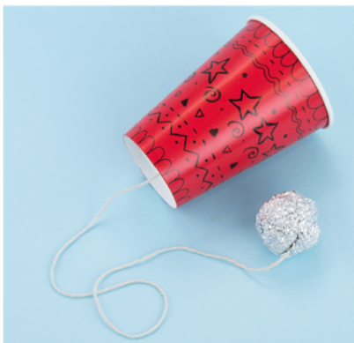
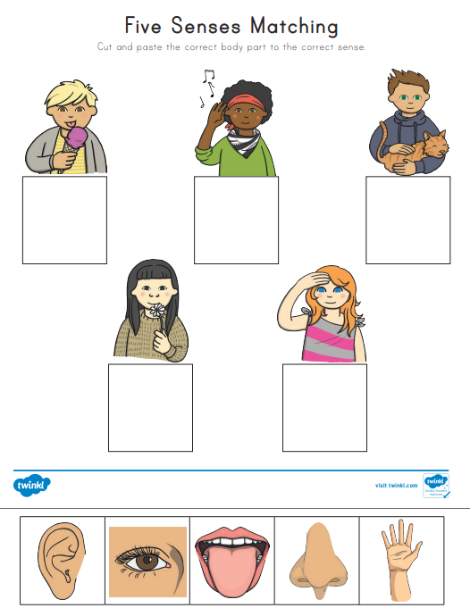
Independent Challenges:
Narrative Zone
Maths Zone
What do you think Max is thinking or feeling at this moment?
Create a number using the dienes in the place value chart.
Draw the dienes onto your chart and write the number underneath.
Enquiry Zone
Creative Zone
Match the body part to the senses.
Make a cup and ball toy

Slide 31

Lunch

Slide 32
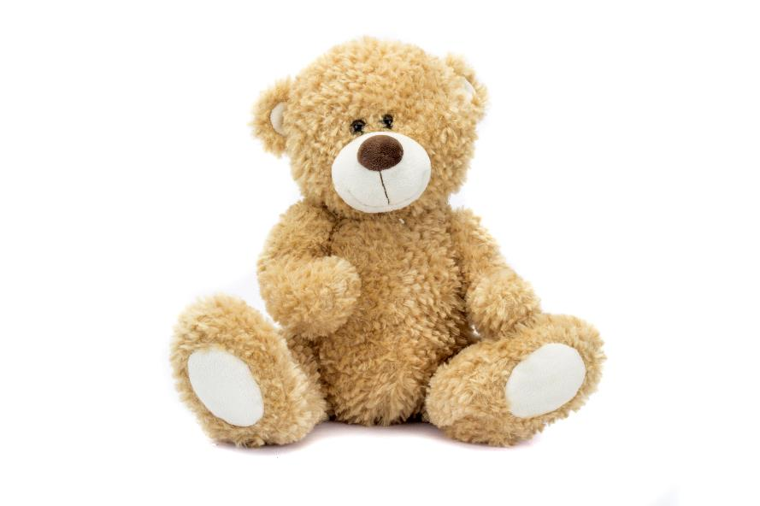
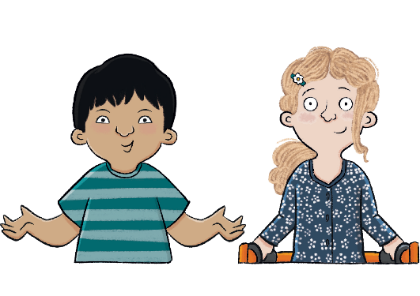
Unit 1: Toys Over Time
Tuesday 3rd February 2026​
3/2/26
KQ: How are toys today different from toys in the past?
Notes:
Note: If you are using Ark Curriculum+ Science, pupils will have looked at material names and their properties. You may wish to incorporate some of that key vocabulary here, e.g. material, wood, plastic, glass, paper, fabric, and metal.

Slide 33
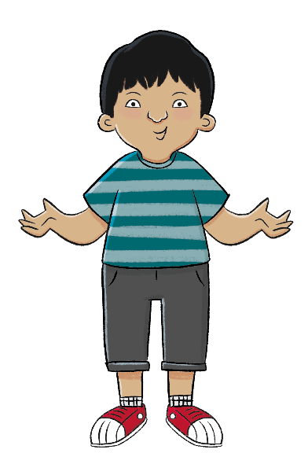
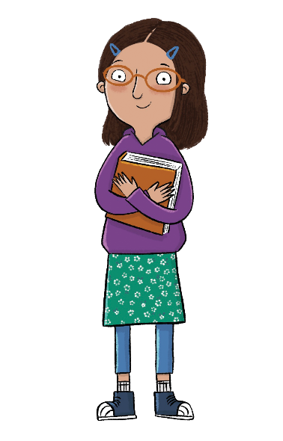
Entry question:
KQ: How are toys today different from toys in the past?
Tuesday 3rd February 2026
3/2/26
Lesson 4:
Which toys have changed the least?
Which toys have changed the most?
Notes:
Learning review: Using the teaching slides, talk partners tell each other a response to the questions. Add further review questions if you wish to.

Slide 34
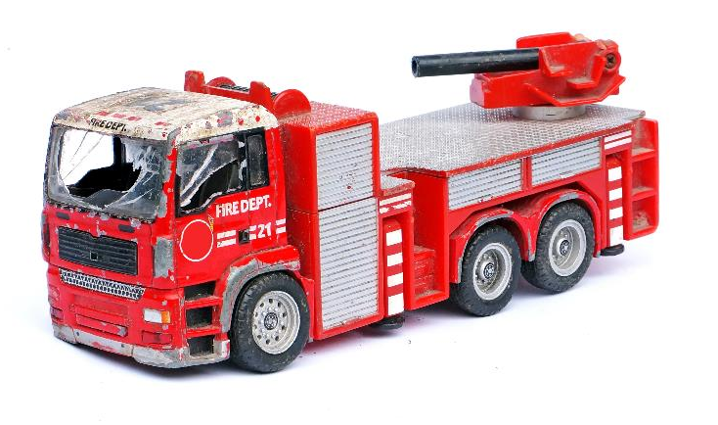
KQ: How are toys today different from toys in the past?
Tuesday 3rd February 2026​
3/2/26
Lesson 5:
4 in 4
Which one of these words would you use to describe a toy from the past?
modern old new
This toy is _______________ and _____________. (Pick two.)
from the past broken modern
Notes:
Knowledge quiz 1.4: Pupils complete this in the Additional resource: Knowledge quizzes booklet to assess their knowledge retention from the previous lesson. They write their score in the chart also provided in the additional resource.

Slide 35
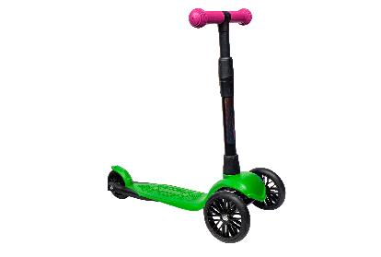
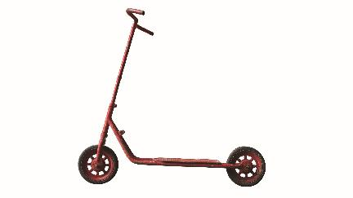
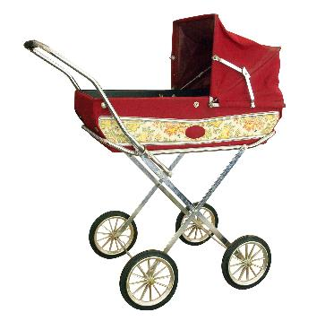
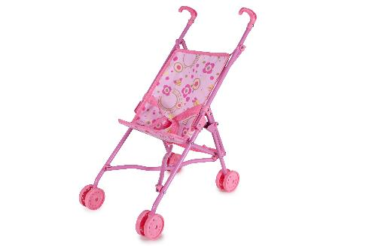
KQ: How are toys today different from toys in the past?
Tuesday 3rd February 2026​
3/2/26
Lesson 5:
4 in 4
Circle the oldest toy.
Circle the most modern toy.

Slide 36

KQ: How are toys today different from toys in the past?
Tuesday 3rd February 2026​
3/2/26
How are toys today similar to and different from toys in the past?
Notes:
Revisit the main enquiry question and the learning journey so far.

Slide 37
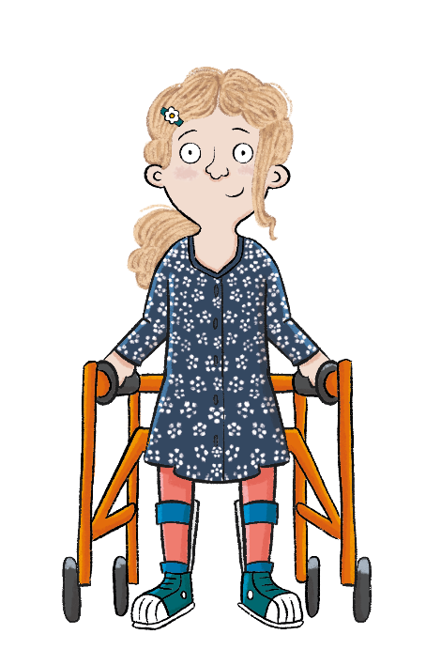
KQ: How are toys today different from toys in the past?
Tuesday 3rd February 2026​
3/2/26
Lesson 5:
In this lesson, we are designing a toy that is safe and strong.
Notes:
Introduction: Share the lesson statement, and key term. Then share key knowledge and other key vocabulary with pupils—you may want to add images to the teaching slides to support exemplification and understanding of these words.

Slide 38
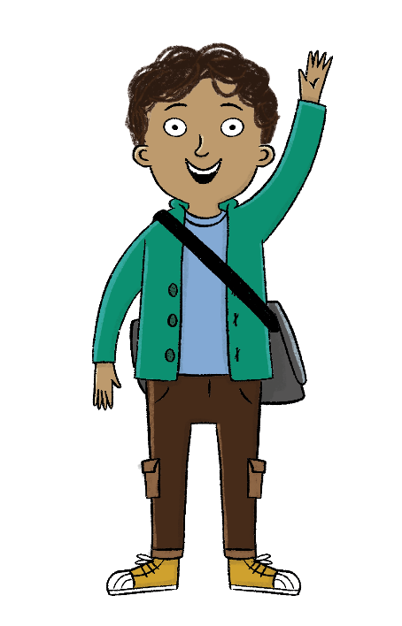
KQ: How are toys today different from toys in the past?
Tuesday 3rd February 2026​
3/2/26
Lesson 5:
The key term for this lesson is material.
A material is what something is made from.
Notes:
To reinforce the definition of the key term ‘material’, you could refer back to Science lessons from Unit 1 (if taught). Alternatively, you could describe some different materials in the classroom, e.g. a coat (made from woollen fabric), a book (paper and cardboard), a pencil (wood and carbon/graphite), a pot (plastic).

Slide 39
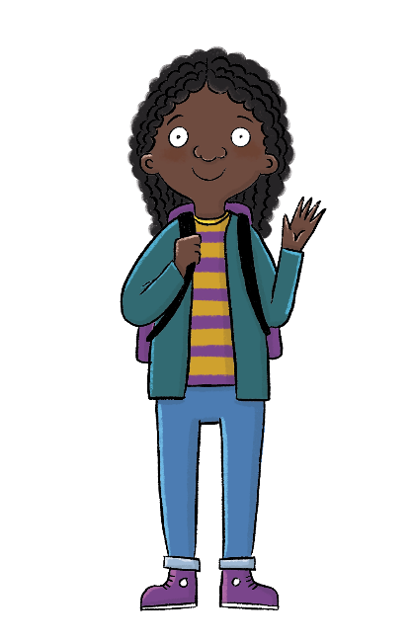
How are toys today different from toys in the past?
KQ: How are toys today different from toys in the past?
Tuesday 3rd February 2026​
3/2/26
Lesson 5:
The material toys are made from has changed over time.
Toys have become safer and stronger.
material
technology

Slide 40
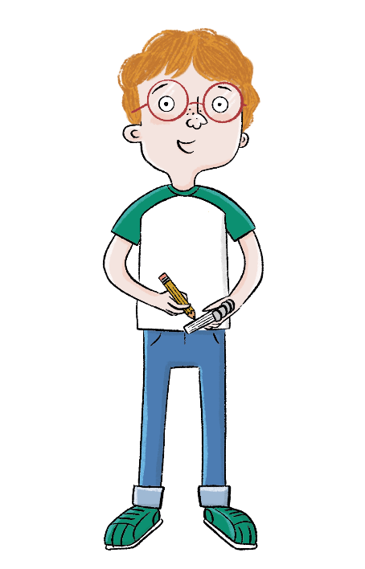
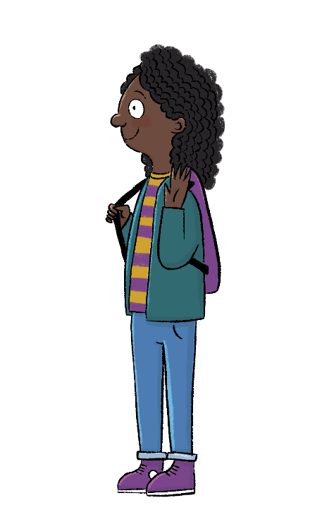
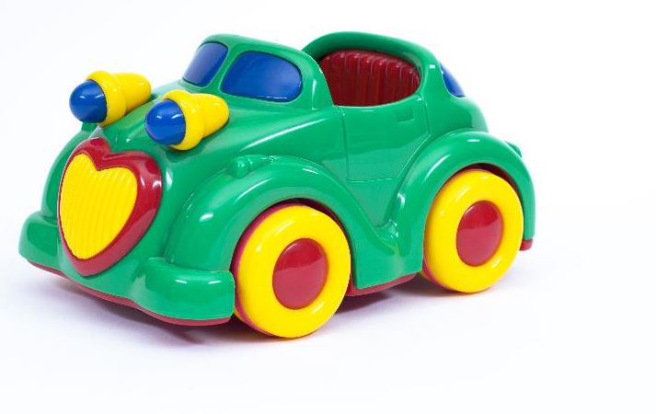

KQ: How are toys today different from toys in the past?
Tuesday 3rd February 2026​
3/2/26
Lesson 5:
Blue/Green
Can you see anything else in the classroom made from this material?
What material is this toy made from?
This toy is made from.....
I can also see....
material metal plastic paper strong
Notes:
Talk task: Ask pupils to look at the photo of a toy car and discuss these questions with their partner: ‘What material is this made from?’ and ‘Can you see anything else in the classroom made from this material?’. Pupils should be able to name it as plastic and spot other plastic classroom items. To support pupils if they are struggling to identify the material, give them a choice: plastic, wood, or glass. Recap plastic and its properties. Take feedback from the class on other plastic items in the classroom.

Slide 41
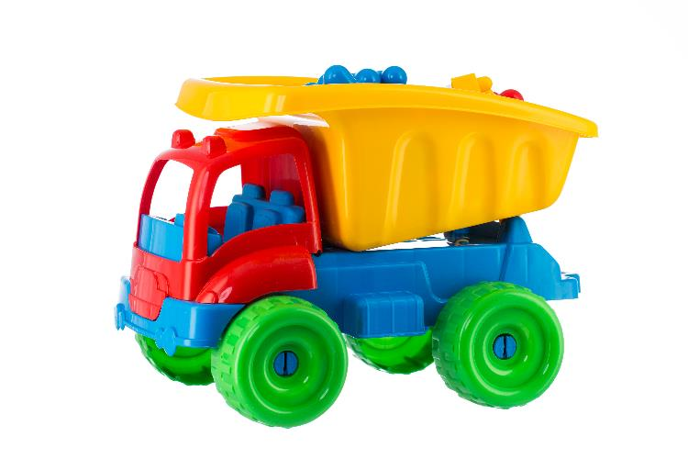
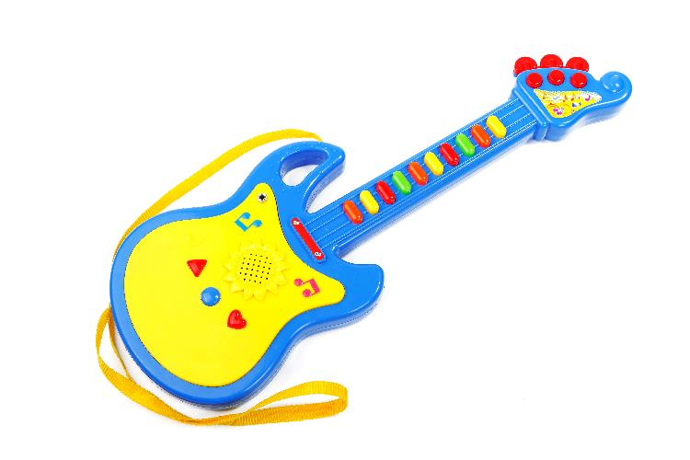
How have materials changed over time?
KQ: How are toys today different from toys in the past?
Tuesday 3rd February 2026​
3/2/26
Lesson 5:
Plastic is a new material. In the past, toys were not made from plastic because it hadn’t been invented yet. Plastic is very strong and can easily be made into different shapes. This has made toys safer for children to play with.
Notes:
Read: ‘How have materials changed over time?’. Use the items that pupils pointed out in the classroom as being made from plastic to demonstrate how plastic is strong and how it can be made into many different shapes, from a bottle lid to the chairs they may be sitting on.

Slide 42

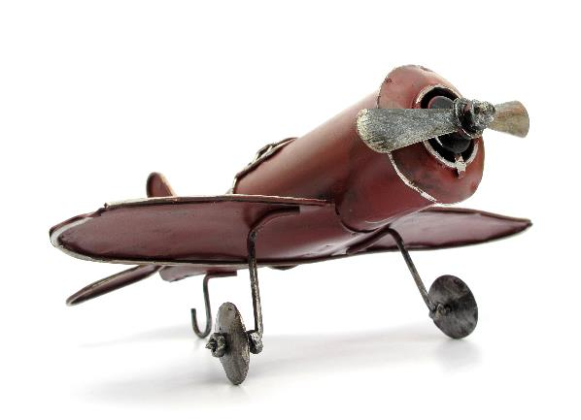
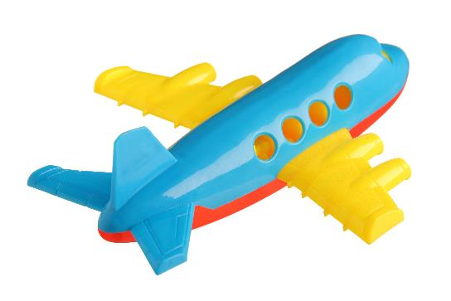
KQ: How are toys today different from toys in the past?
Tuesday 3rd February 2026​
3/2/26
Lesson 5:
Which toy do you think is stronger?
Which toy do you think is safer?
Notes:
Talk task: Ask pupils to discuss in partners the questions: ‘Which toy do you think is stronger?’ and ‘Which toy do you think is safer?’. Explain that the old toy is made from metal and the other plane from plastic. The metal toy will rust and break more easily than the plastic toy. Metal is sharp so is less safe than the plastic. Then ask pupils which toy they think is from the past and which is modern? How do they know? Remind pupils that as plastic is a modern material, the righthand image must be modern and the left must be old.

Slide 43

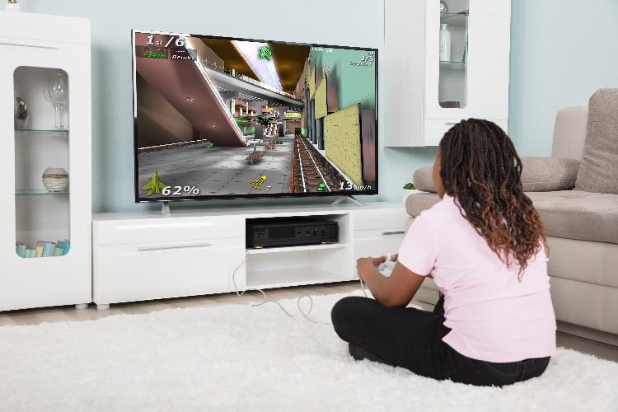
How has technology changed over time?
KQ: How are toys today different from toys in the past?
Tuesday 3rd February 2026​
3/2/26
Lesson 5:
Technology has changed over time. TVs, tablets, and games consoles have got better and better over the years. Here is a TV from the past and a TV today.
Notes:
Read: ‘How has technology changed over time?’ slides. Stop at each slide and ask pupils to compare the similarities and differences between the two images. Explain some of the ways toys have improved: televisions used to be black and white, now they are bigger with a clearer picture in colour. Televisions in the past could only be used to watch programmes being broadcast at that time. Today televisions can be used to watch and record programmes, to browse or watch videos from the internet or to play games online or using games consoles.

Slide 44

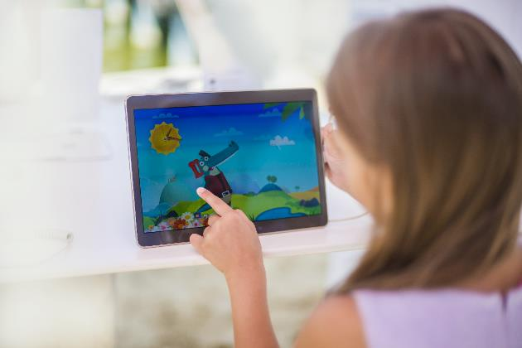
How has technology changed over time?
KQ: How are toys today different from toys in the past?
Tuesday 3rd February 2026​
3/2/26
Lesson 5:
Here is a tablet from the past and a tablet today.

Slide 45
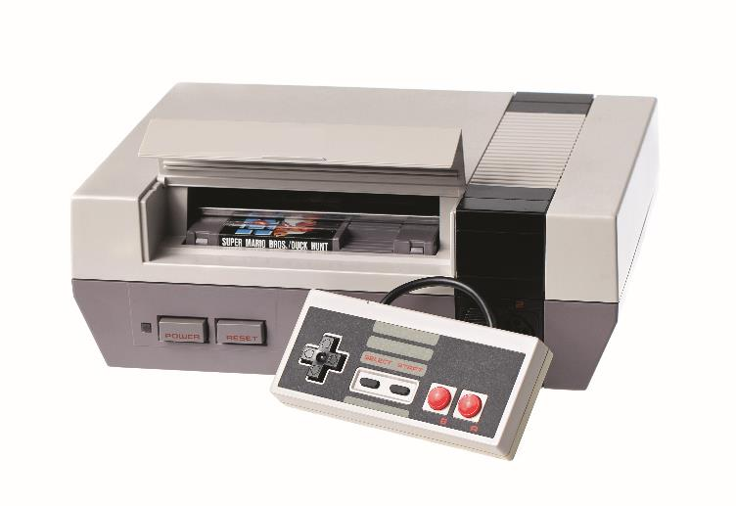
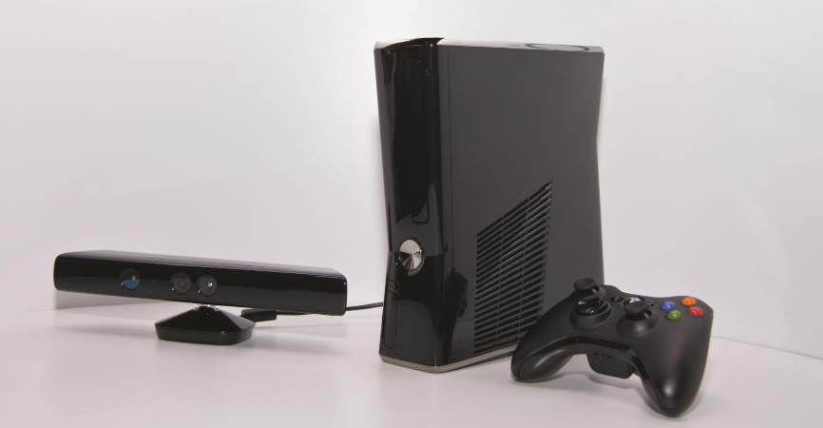
How has technology changed over time?
KQ: How are toys today different from toys in the past?
Tuesday 3rd February 2026​
3/2/26
Lesson 5:
Here is a games console from the past and a games console today.

Slide 46
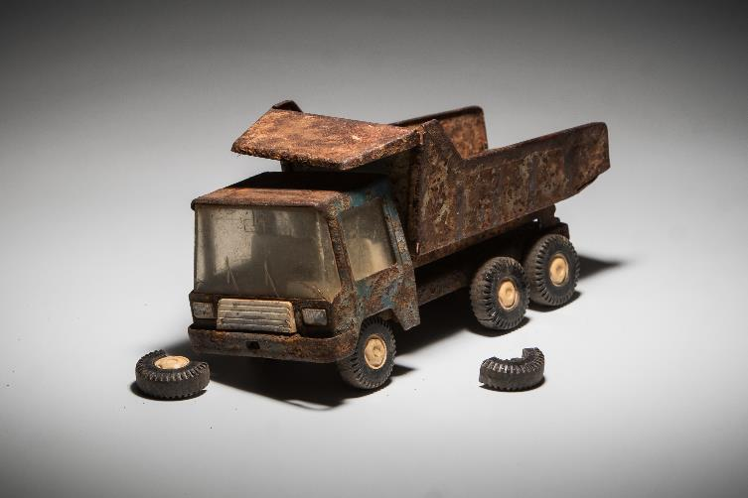
How have toys got safer?
KQ: How are toys today different from toys in the past?
Tuesday 3rd February 2026​
3/2/26
Lesson 5:
Some toys in the past were not made as well as some toys today. The materials toys were made from were not as strong so they could break and hurt children.
Notes:
Read: ‘How have toys got safer?’. Explain to pupils that some toys in the past were not made as well as the toys today. The materials were not as strong so they could break and hurt children.

Slide 47
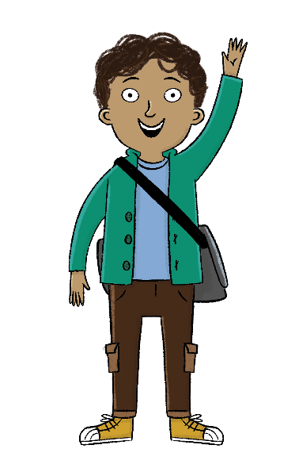

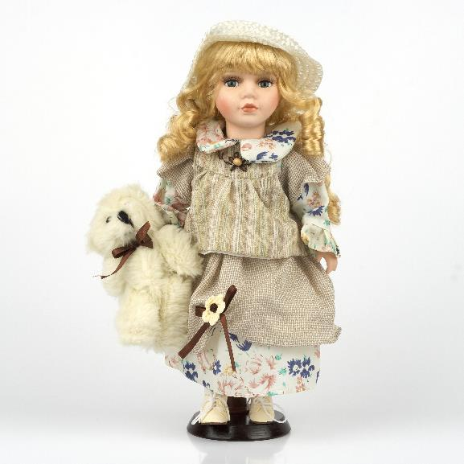
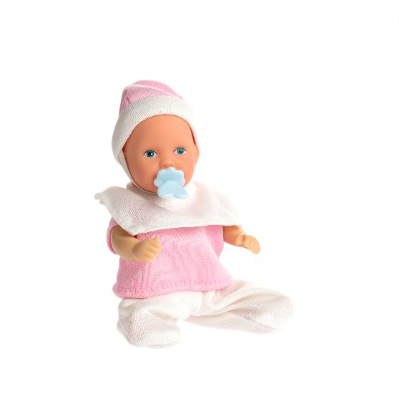
KQ: How are toys today different from toys in the past?
Lesson 5:
Tuesday 3rd February 2026​
3/2/26
Which doll is safer?
Why?
Notes:
Talk task: Ask pupils to discuss in partners the questions: ‘Which doll is safer?’, ‘Why?’. Explain to pupils that the first doll’s face and hands are made from porcelain which can break easily and the pieces would be sharp. The second doll is made from plastic and doesn’t break easily. She can also be washed and kept clean.

Slide 48
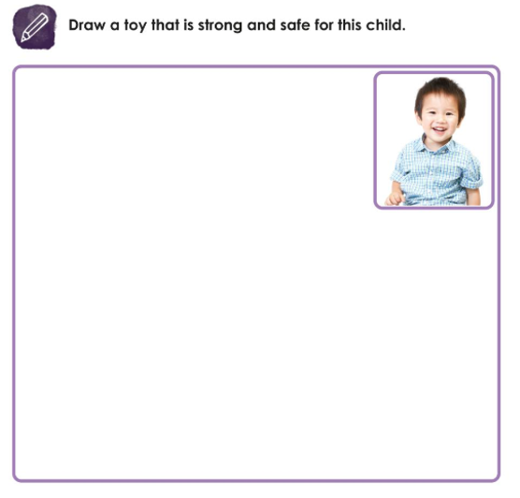
KQ: How are toys today different from toys in the past?
Tuesday 3rd February 2026​
3/2/26
Lesson 5:
Independent:
Challenge:
Explain why you have chosen to design a toy like this? What material have you used and why?
Notes:
Write: Pupils should design a toy in their Workbooks. Explain that they need to design a toy for the young child in the photo that is safe and strong. Model this for pupils by thinking aloud what toy you will select and why. Model writing up labels such as ‘plastic’, ‘strong’, and ‘safe’. Challenge pupils to add labels themselves when they’ve finished their drawing. Support pupils by helping them choose a plastic toy from the classroom to draw from.

Slide 49
Exit Question:
KQ: How are toys today different from toys in the past?
Tuesday 3rd February 2026​
3/2/26
Lesson 5:
What material is new?
Why has plastic made toys safer?
Notes:
Learning review: Using the teaching slides, talk partners tell each other a response to the questions. Add further review questions if you wish to.

Slide 50
How are toys today different from toys in the past?
Tuesday 3rd February 2026​
3/2/26
Lesson 5:
The material toys are made from has changed over time.
Toys have become safer and stronger.
material
technology

