Slide 1
Monday 9th February 2026

Slide 2

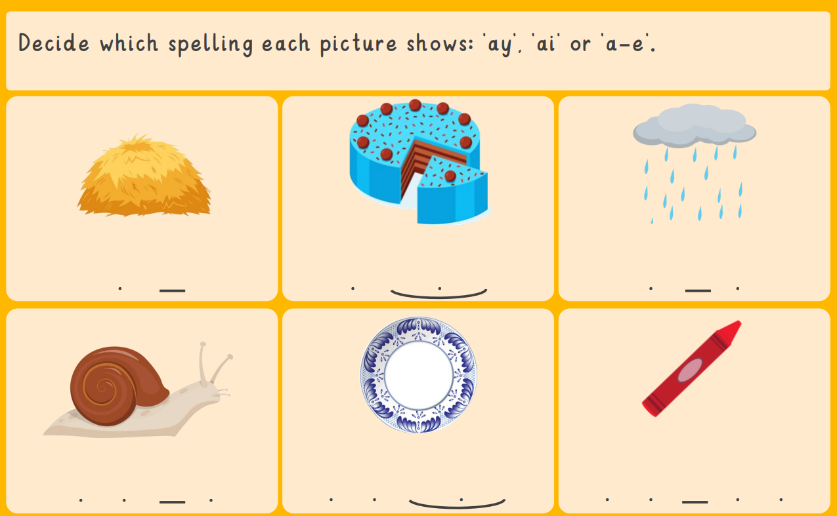
Morning Challenges:
Name writing

Slide 3
Phonics
Monday 9th February 2026
9/2/26
Revisit and review
Lesson focus:
Read words with the ew/oe/ue/ow

Slide 4

Revisit and review
Monday 9th February 2026
9/2/26
Today's Grapheme
ew/oe/ue/ow

Slide 5
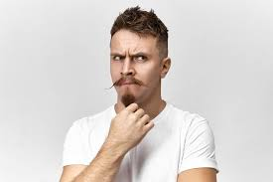
Mrs
Revisit and review
would
Monday 9th February 2026
9/2/26
should
people
tricky words
who
could
Read the tricky words?
Mr

Slide 6
Focus words
Monday 9th February 2026
9/2/26
flew
boat
toes
tow
blue
boe
stew
What digraphs can you see?
Now read the word aloud

Slide 7
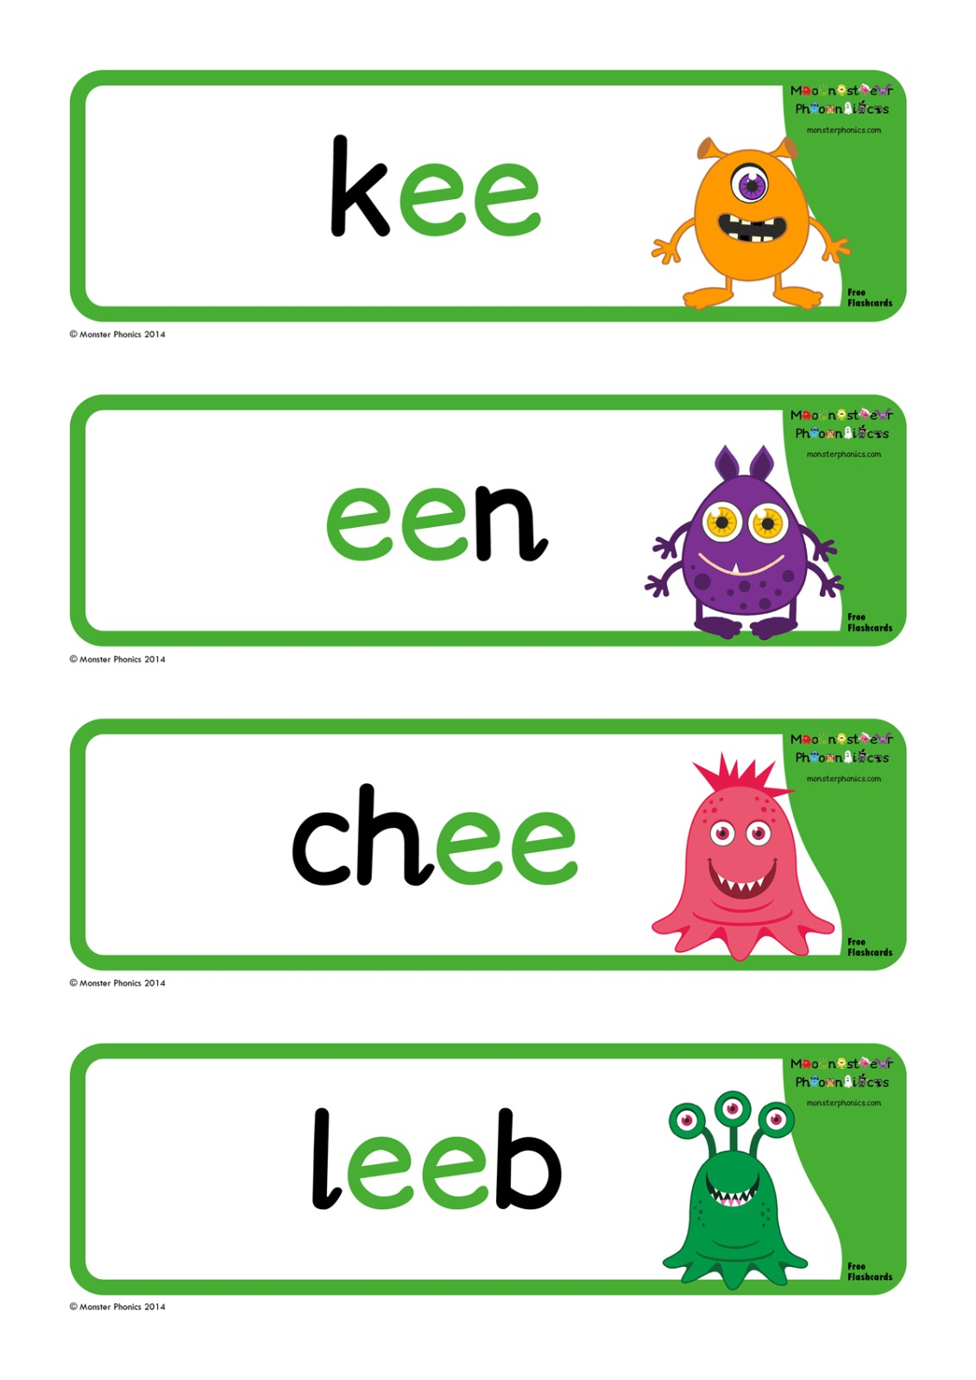
Focus words
Monday 9th February 2026
9/2/26
flewn
stroap
trown
bluep
boen
strown
What digraphs can you see?
Now read the word aloud

Slide 8
Focus words
Monday 9th February 2026
9/2/26
Can you sort the words into nonsense and real words
Real
Nonsense
CHALLENGE
Can you write a sentence using a real word?
drewn true mewp blue toes flewp flew strewd jueb

Slide 9

Monday 9th February 2026
9/2/26
Write a sentence about the picture. Remember to include one of today's sounds.
Extend using 'and'.

Slide 10
KQ: What is belonging and where do I feel I belong?
Monday 9th February 2026
9/2/26
3 in 3- Match the word to its definition.

Slide 11
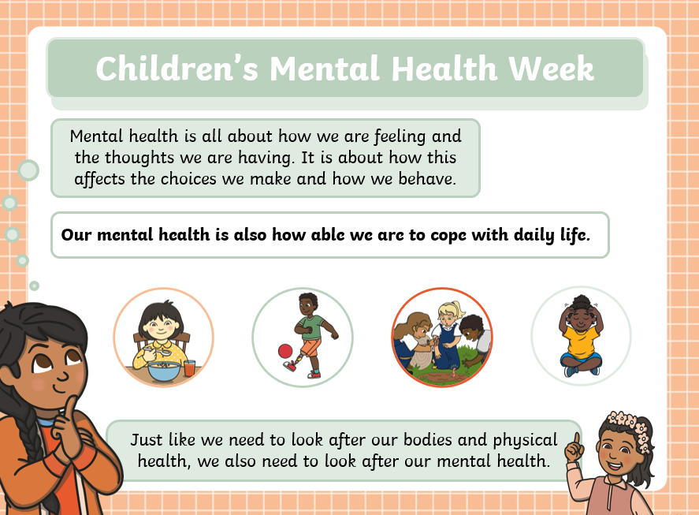
KQ: What is belonging and where do I feel I belong?
Monday 9th February 2026
9/2/26

Slide 12
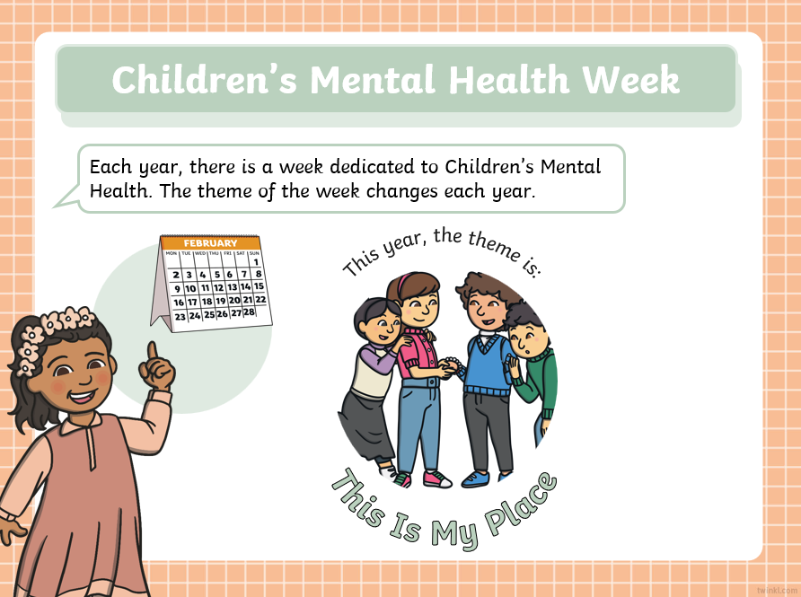
KQ: What is belonging and where do I feel I belong?
Monday 9th February 2026
9/2/26

Slide 13
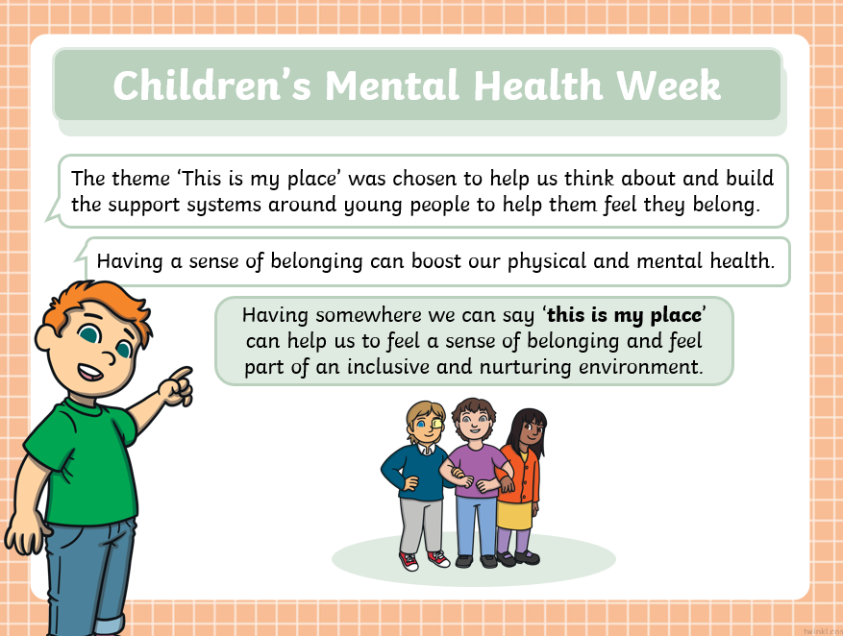
KQ: What is belonging and where do I feel I belong?
Monday 9th February 2026
9/2/26

Slide 14
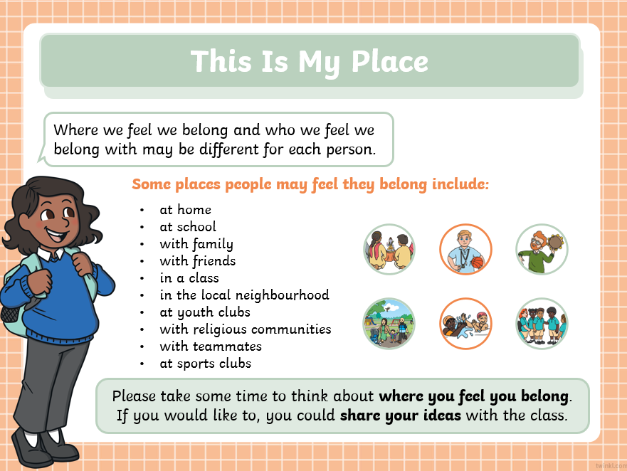
KQ: What is belonging and where do I feel I belong?
Monday 9th February 2026
9/2/26
Blue/ Green

Slide 15
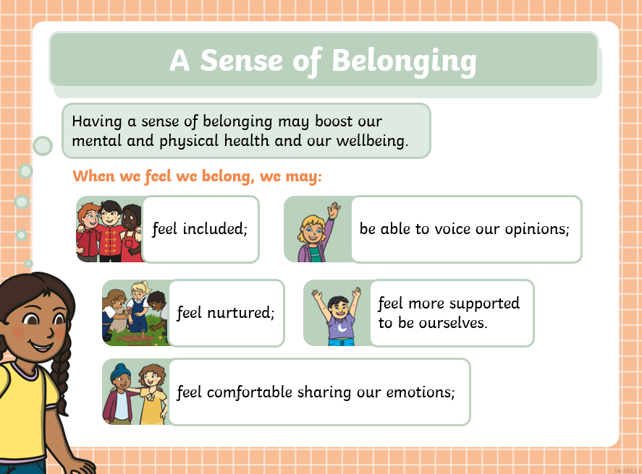
KQ: What is belonging and where do I feel I belong?
Monday 9th February 2026
9/2/26

Slide 16
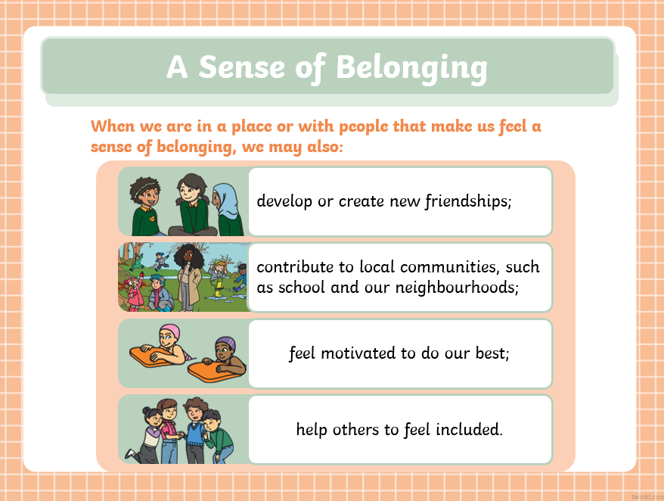
KQ: What is belonging and where do I feel I belong?
Monday 9th February 2026
9/2/26

Slide 17
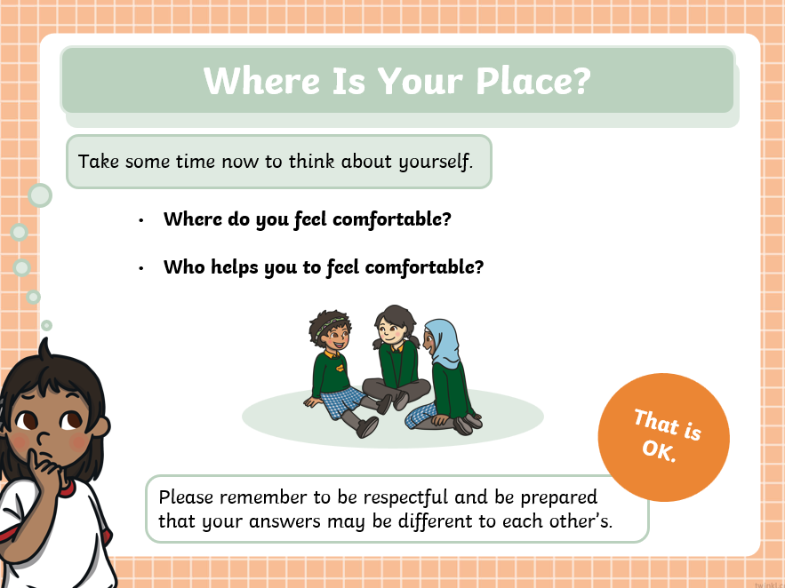
KQ: What is belonging and where do I feel I belong?
Monday 9th February 2026
9/2/26

Slide 18
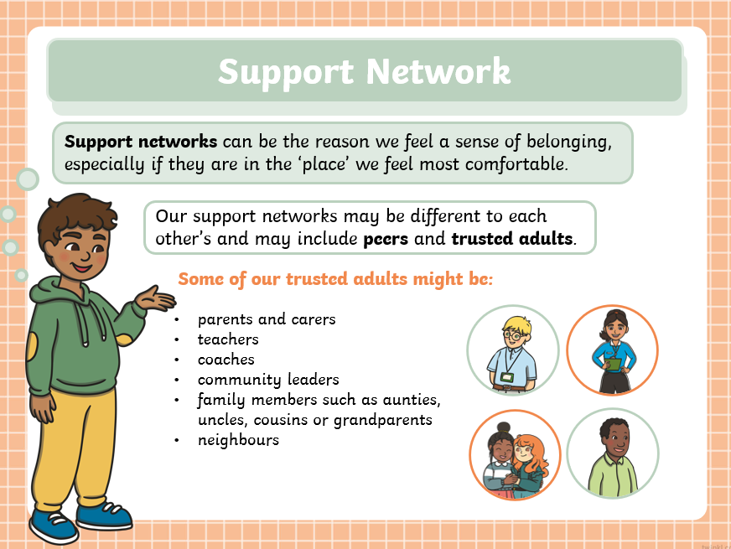
KQ: What is belonging and where do I feel I belong?
Monday 9th February 2026
9/2/26

Slide 19
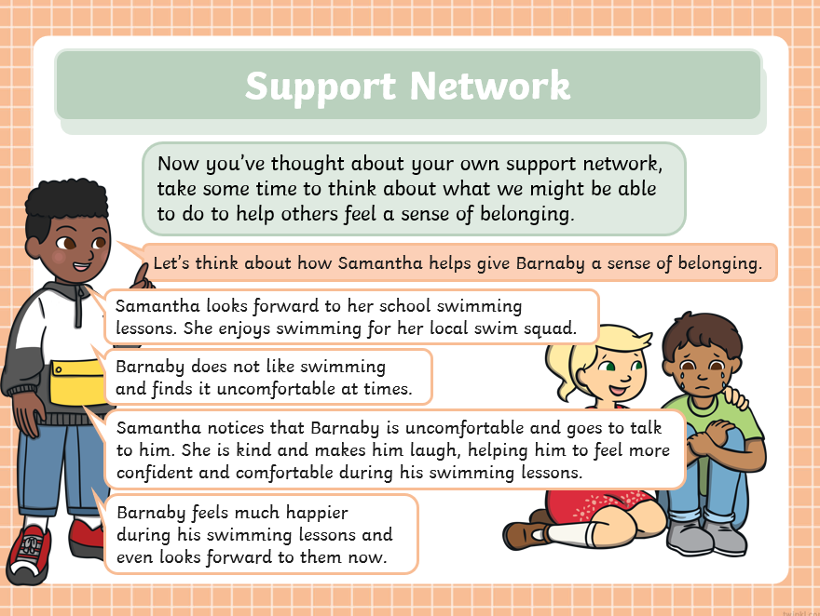
KQ: What is belonging and where do I feel I belong?
Monday 9th February 2026
9/2/26

Slide 20
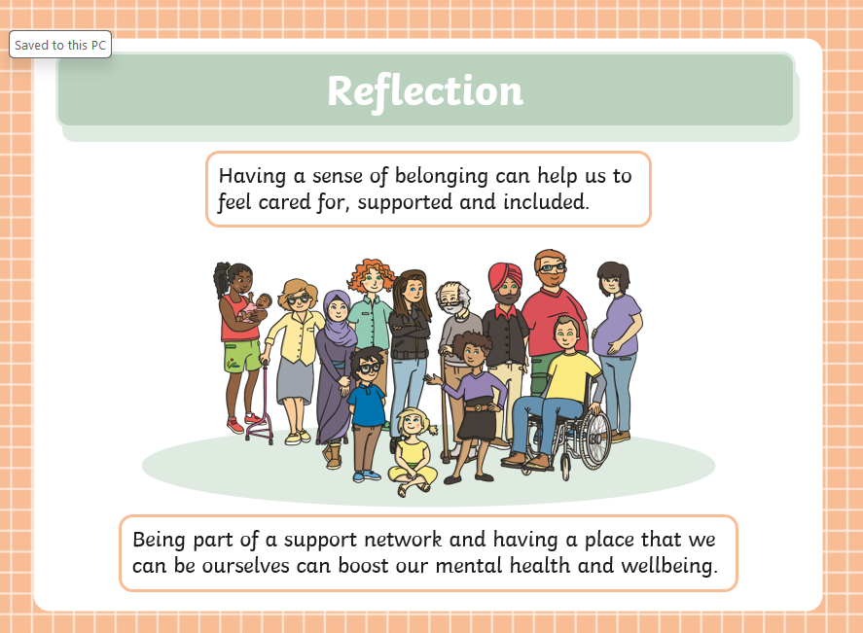
KQ: What is belonging and where do I feel I belong?
Monday 9th February 2026
9/2/26

Slide 21
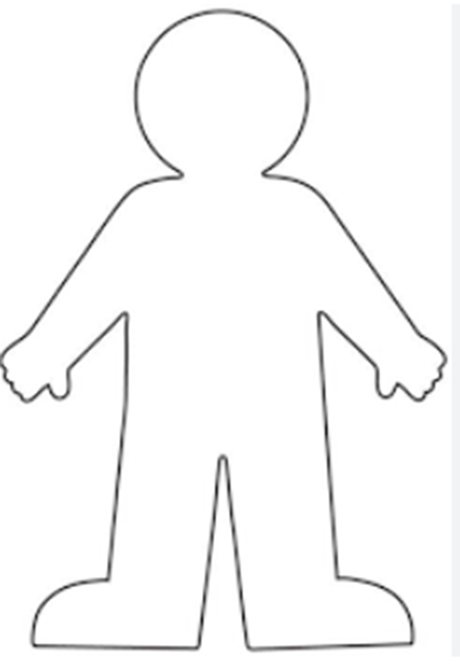
KQ: What is belonging and where do I feel I belong?
Monday 9th February 2026
9/2/26
Create a 'mini-me' to show where you feel like you belong.

Slide 22
KQ: What is belonging and where do I feel I belong?
Monday 9th February 2026
9/2/26

Slide 23
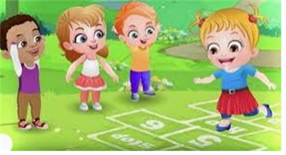
Break

Slide 24
PE- TBAT: explore speeds and actions.
Warm up - Sleeping Toys:
Shh… the toy shop is closed, and all the toys are fast asleep in their boxes. But when the music starts, something magical happens, the toys come to life.
Stand in a space. Begin walking gently around the toy shop. Progress to galloping. The toys are waking up. When you hear ‘sleeping toys’ lay on the floor asleep. When you hear ‘rise and shine’ jump up and gallop again.

Slide 25

Becoming magical toys
How might they move if they were magical moving toys?
robot: slow stiff body parts with jerky and robotic movements
An aeroplane: wide wings, soaring high and low
A ball: bouncing and rolling using different body parts A tambourine: bouncing action with quick shaking shoulders
Travel like each toy for 8 counts. Practice with and without the music, counting out loud then in our heads.

Slide 26
Magical toy box
Choose three toys to use in your dance.
Practise changing between them.
Add a starting and finishing pose to complete your dance.
Let’s see a few performances.

Slide 27

Lunch

Slide 28
TBAT: explain my thoughts about a text.
Monday 9th February 2026
9/2/26
3 in 3
What do you think you might see if you looked up at the sky today?
Have you ever been so excited about something that you wanted to tell everyone? What was it?
Why do you think someone might miss something amazing if they’re always looking down at a screen?

Slide 29

Blue/ Green
TBAT: explain my thoughts about a text.
Monday 9th February 2026
9/2/26
What do you think this story is about?
Who do you think is the main character?
Explain why you think this.

Slide 30

TBAT: explain my thoughts about a text.
Monday 9th February 2026
9/2/26
Words you will come across in the text:
Telescope
Gravity
myth: stories about how the world was created or why certain things happen
speechless: unable to speak due to a strong emotion.

Slide 31
TBAT: explain my thoughts about a text.
Monday 9th February 2026​
9/2/26
Rocket Says Look Up! Pages 1-17 - Flip PDF Download | FlipHTML5

Slide 32
Look Up!
TBAT: explain my thoughts about a text.
Monday 9th February 2026
9/2/26
What do we mean by explain?
What words to we use to explain ourselves?
I think that ….... because.......
I like ….... because.......
My favourite is ....... because........

Slide 33
Look Up!
TBAT: explain my thoughts about a text.
Monday 9th February 2026
9/2/26
Class Discussion
Who is your favourite character? Why?
Is there anything you would change about this story?
Do you like this text? What do you like about it?

Slide 34
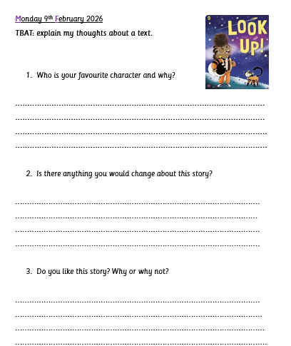
Independent:
TBAT: explain my thoughts about a text.
Monday 9th February 2026
9/2/26
Challenge:
Would you like to see a meteor shower? Why or why not?

Slide 35
Art
TBAT: use printing techniques to recreate art inspired by Yayoi Kusama.
Blue/ Green
How did your print go last week? Were you happy with it? What could have gone better?
The best thing about my print is…
Next time, I would …

Slide 36

TBAT: use printing techniques to recreate art inspired by Yayoi Kusama.
Today we are going to create artwork inspired by Yayoi Kusama.

Slide 37
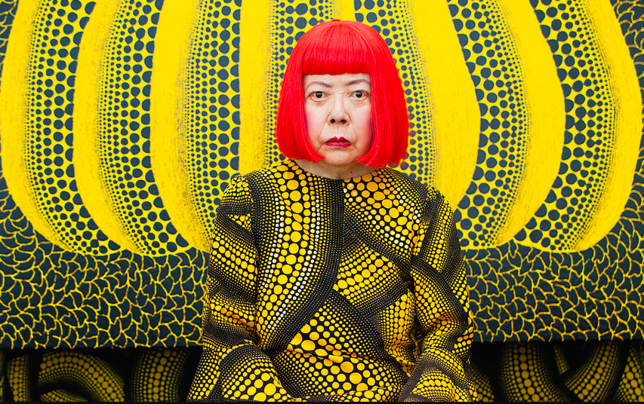
TBAT: use printing techniques to recreate art inspired by Yayoi Kusama.
Here she is with
one of her pieces
of art.
Yayoi Kusama is an
artist from Japan.

Slide 38
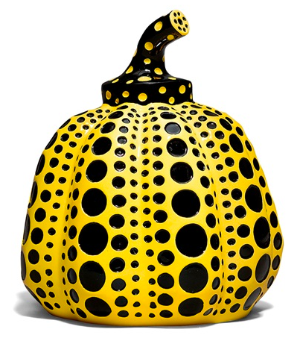
What shapes and colours can you see?
TBAT: use printing techniques to recreate art inspired by Yayoi Kusama.
[Yayoi Kusama]

Slide 39

What does this painting remind you of?
TBAT: use printing techniques to recreate art inspired by Yayoi Kusama.
[Yayoi Kusama]

Slide 40

How do you feel when you look at this painting?
TBAT: use printing techniques to recreate art inspired by Yayoi Kusama.
What does it remind you of?
[Yayoi Kusama]

Slide 41

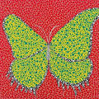

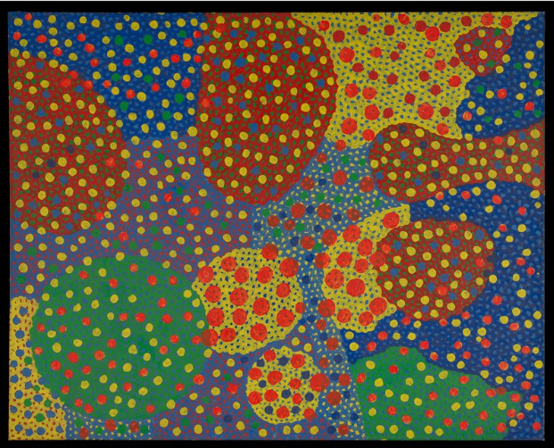
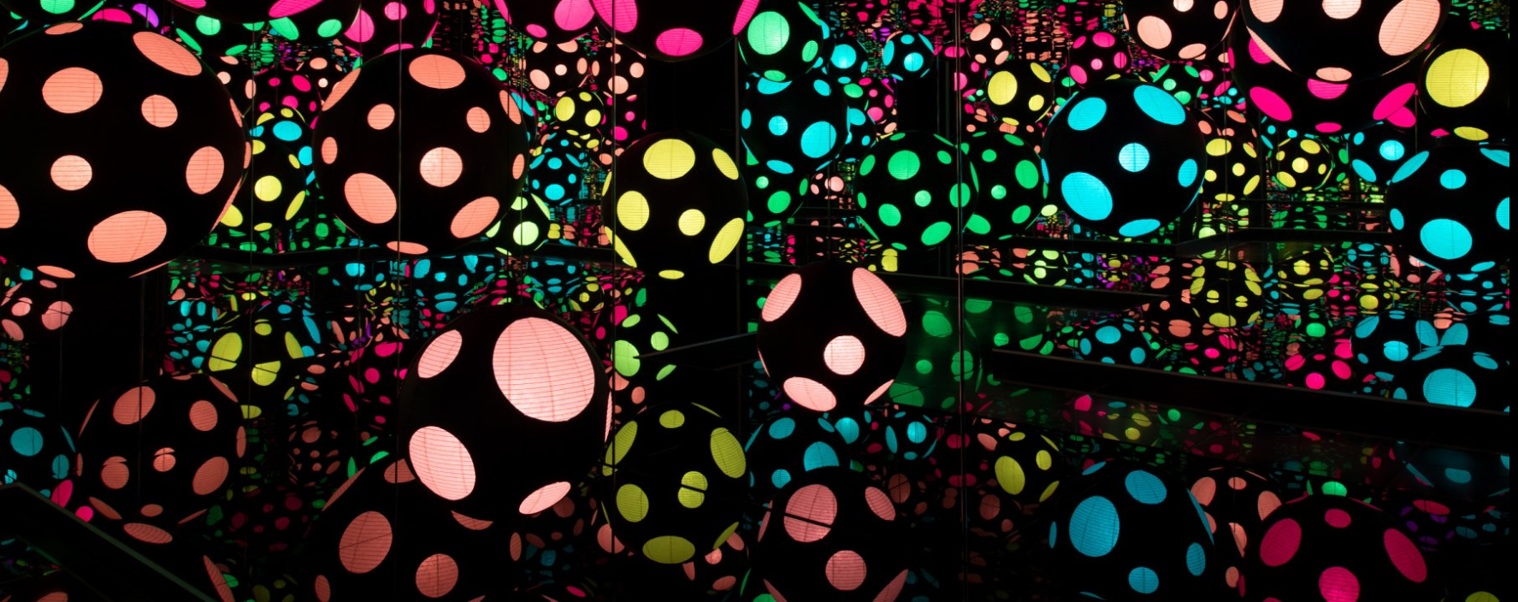
What do the pieces of art have in common?

Slide 42
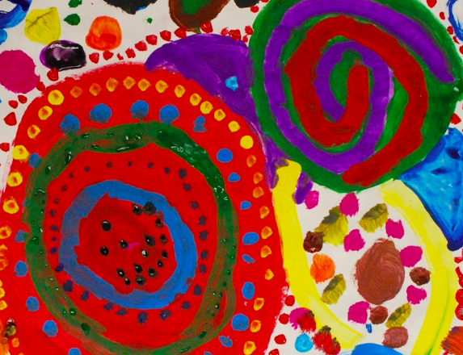
TBAT: use printing techniques to recreate art inspired by Yayoi Kusama.
What shape should we use to print our Yoyoi inspired art work?

Slide 43
Using your knowledge of printing techniques- create artwork inspired by Yayoi Kasuma.
TBAT: use printing techniques to recreate art inspired by Yayoi Kusama.

Slide 44

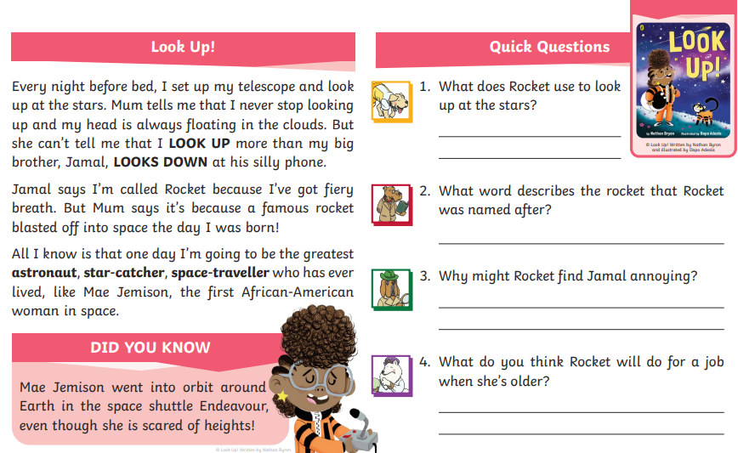


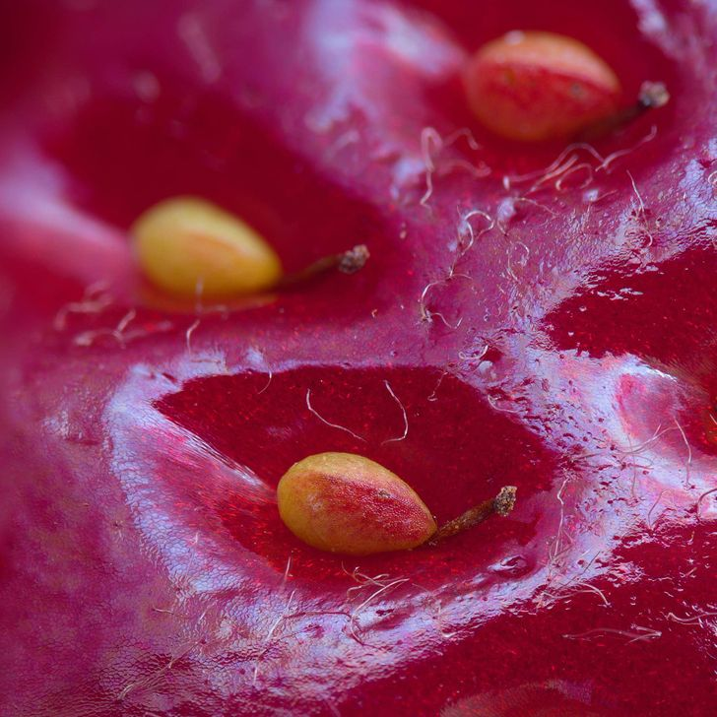
Independent Challenges:
Narrative Zone
Maths Zone
Look Up ! Reading comprehension.
Count along the number tracks
Enquiry Zone
Creative Zone
Create a 'mini-me' to show where you feel like you belong.
Look closely at the pictures. What do you think they are?

