Slide 1
Monday 2nd February 2026

Slide 2

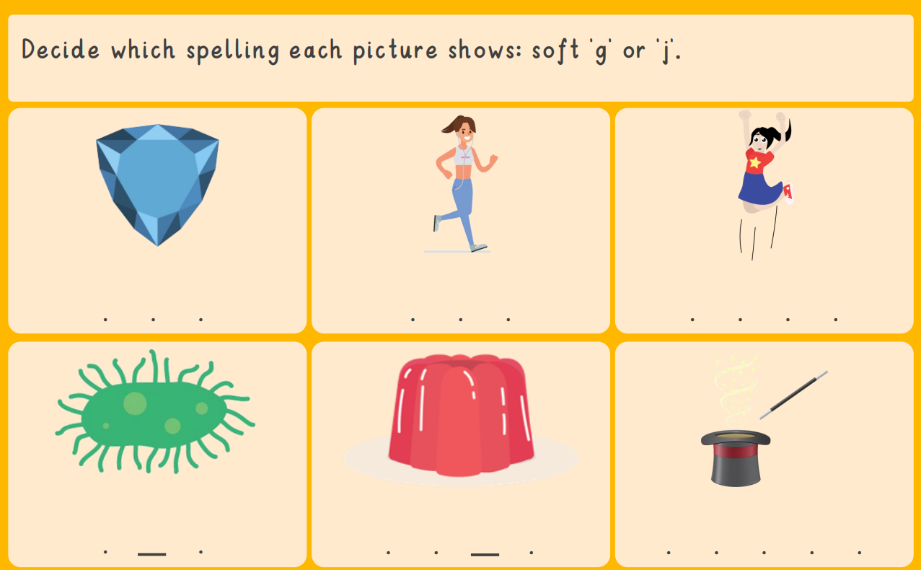
Morning Challenges:
Name writing

Slide 3
Phonics
Monday 2nd February 2026
2/2/26
Revisit and review
Lesson focus:
Read words with the /oo/yoo phonemes

Slide 4
Recap
Monday 2nd February 2026​
2/2/26
oo u ew
ue u-e ow

Slide 5

Revisit and review
Monday 2nd February 2026
2/2/26
Today's Graphemes
ou
ui

Slide 6
Where in the word?
Monday 2nd February 2026
2/2/26
What are the digraphs?
unicorn
blue
rule
chew
music
glue
Segment these
words and read them
Blend and say words

Slide 7
Focus words
Monday 2nd February 2026
2/2/26
y-ou-th
f-r-ui-t
b-r-ui-se
Sounds out these
words and read them

Slide 8
Focus words
Monday 2nd February 2026
2/2/26
youth
fruit
bruise
Sounds out these
words and read them

Slide 9
Focus words
Monday 2nd February 2026
2/2/26
youth
group
soup
fruit
juice
bruise
Read, sound talk and blend
And again... FASTER!

Slide 10
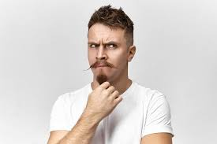
Revisit and review
any
Monday 2nd February 2026
2/2/26
many
water
again
tricky words
want
Read the tricky words?

Slide 11

Monday 2nd February 2026
2/2/26
Now let's read this sentence!​
What digraphs can you see?
What tricky words can you see?

Slide 12
Monday 2nd February 2026
2/2/26
Let's spell!
How many sounds? Write it.
tricky words
fruit group water
Listen to the sentence, say it, write it and read it!
Challenge
Extend the sentence using 'and'

Slide 13
Key Question: How can we keep safe in the sun?
Monday 2nd February 2026
2/2/26
3 in 3- True or false?
Children should have 2 hour of exercise every day.
You should never eat sugar.
Being online can make it difficult to fall asleep.

Slide 14
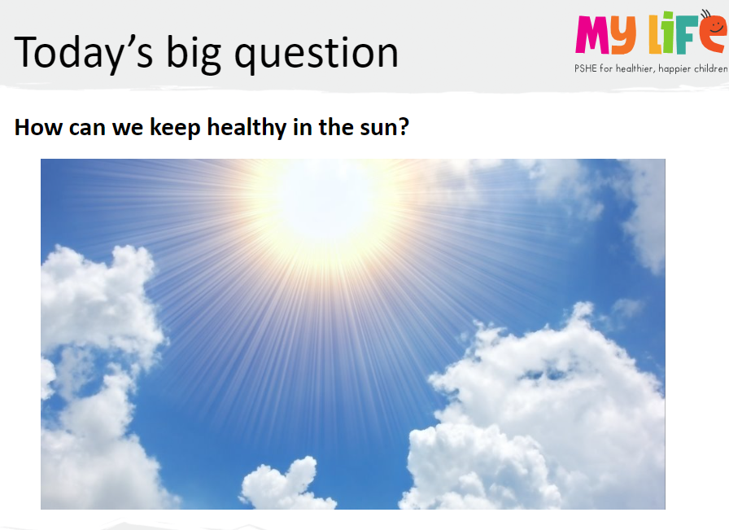
Key Question: How can we keep safe in the sun?
Monday 2nd February 2026
2/2/26

Slide 15
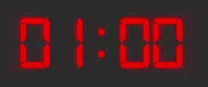
Key Question: How can we keep safe in the sun?
Monday 2nd February 2026
2/2/26
Blue/ Green
Explain to your partner things to enjoy outside.
Blue you have 30 seconds to explain, then green will have 30 seconds to explain.
Extend your sentence using 'because' eg
I like going to the beach because the air is really fresh.
Listen carefully because you will share what your partner said.

Slide 16
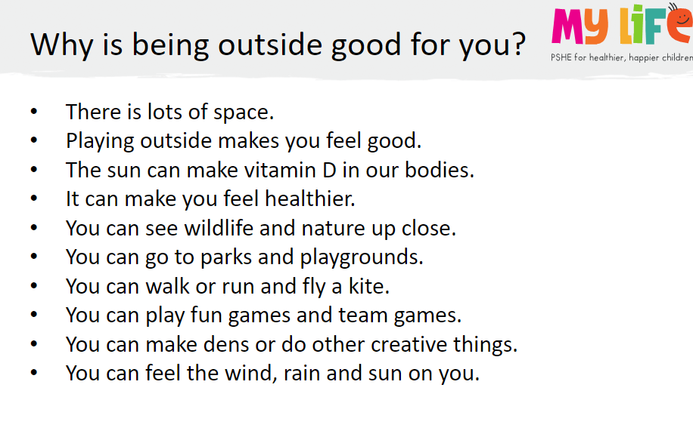
Key Question: How can we keep safe in the sun?
Monday 2nd February 2026
2/2/26

Slide 17
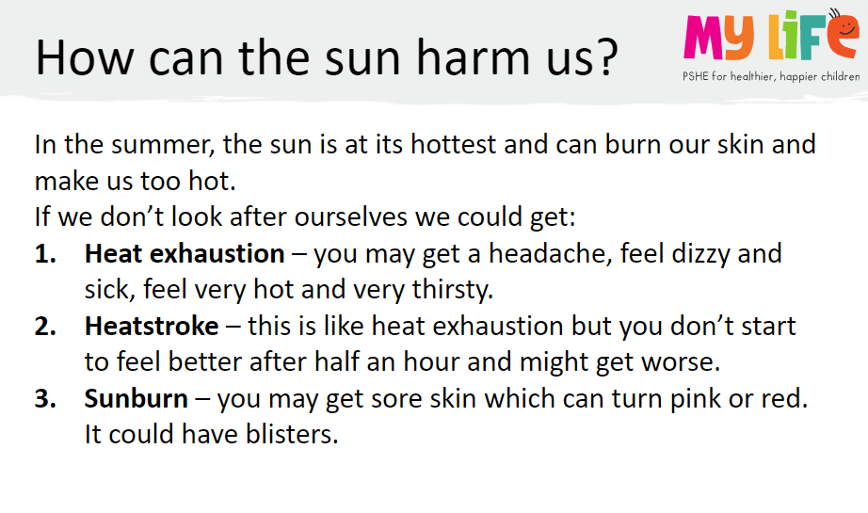
Key Question: How can we keep safe in the sun?
Monday 2nd February 2026
2/2/26

Slide 18
Key Question: How can we keep safe in the sun?
Monday 2nd February 2026
2/2/26
Blue/ Green
Green speak first, name 3 ways you can keep safe in the sun
Blue, can you add any other ways to keep safe in the sun ?
Add examples if you can think of any eg protective clothing like a sun hat.

Slide 19
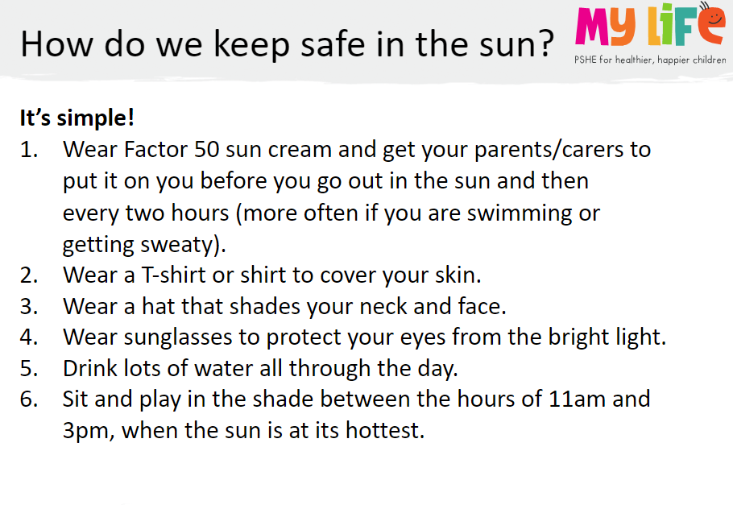
Key Question: How can we keep safe in the sun?
Monday 2nd February 2026
2/2/26

Slide 20
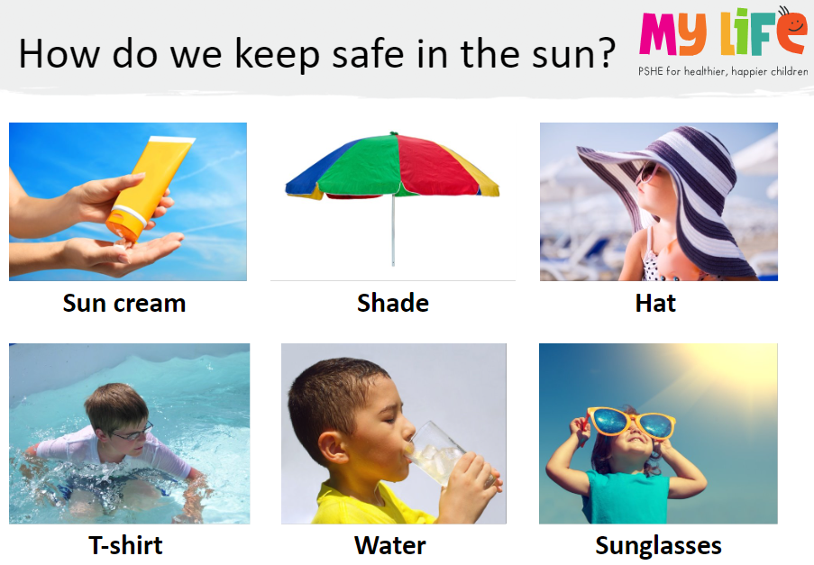
Key Question: How can we keep safe in the sun?
Monday 2nd February 2026
2/2/26

Slide 21
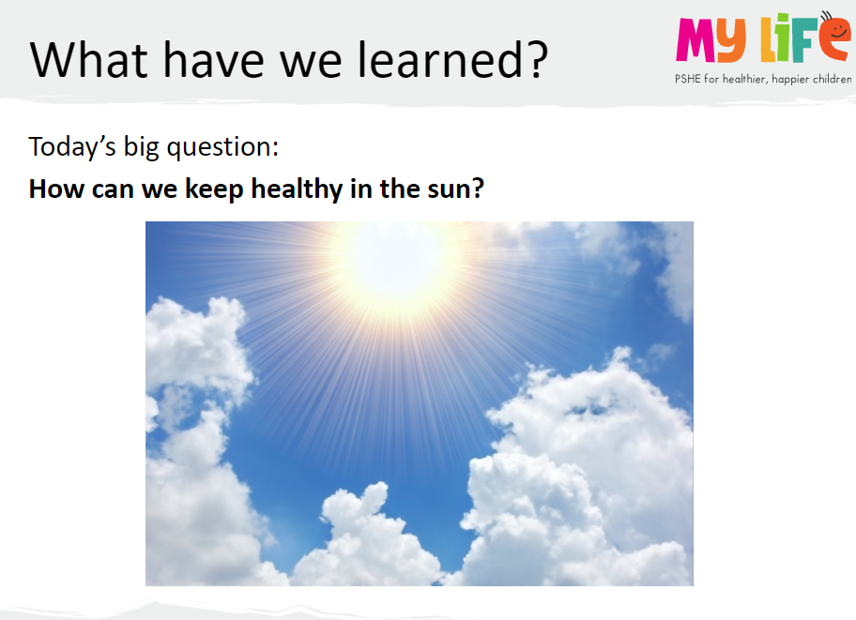
Key Question: How can we keep safe in the sun?
Monday 2nd February 2026
2/2/26

Slide 22
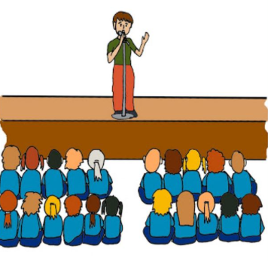
Assembly

Slide 23
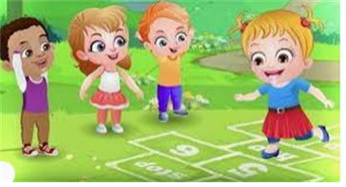
Break

Slide 24
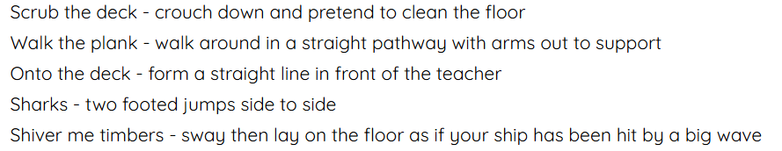
TBAT: copy, remember and repeat actions that represent the theme
Warm up

Slide 25
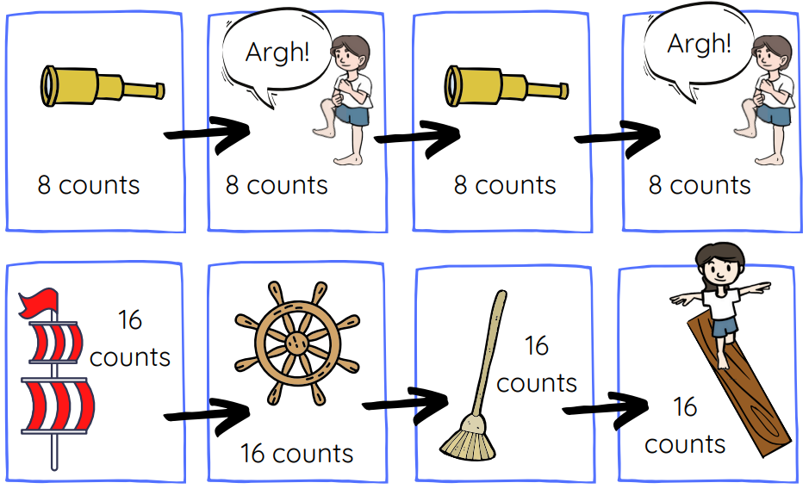
Learn each of the dance moves and practise them in a sequence.
Be a good audience as we see some children perform!

Slide 26
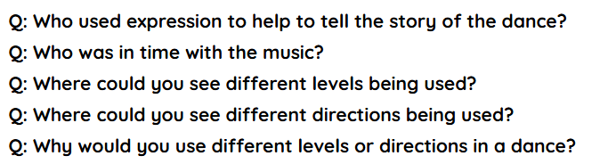
Plenary

Slide 27

Lunch

Slide 28
TBAT: recognise the features of a diary.
Monday 2nd February 2026
2/2/26
3 in 3- Think of words to complete these sentences.
Max was chasing a ….............. down the stairs and was being …..................
Max sailed across the …....... in a .................................... boat
The Wild Things ...................... Max and wanted him to ................... with them forever.

Slide 29

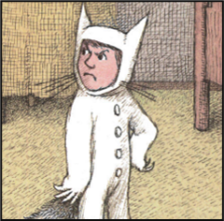
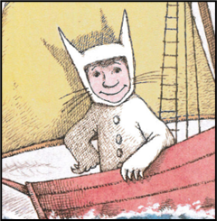
TBAT: recognise the features of a diary.
Monday 2nd February 2026
2/2/26
Blue/ Green
happy
sad
confused
angry
excited
annoyed
I think Max is feeling …........... I think this because...............................

Slide 30
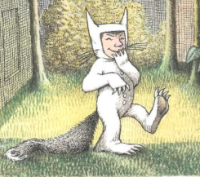
TBAT: recognise the features of a diary.
Monday 2nd February 2026
2/2/26
This week we are going to write a diary .
We will be pretending to be Max.
What is a diary?
Has anyone ever written a diary before?

Slide 31
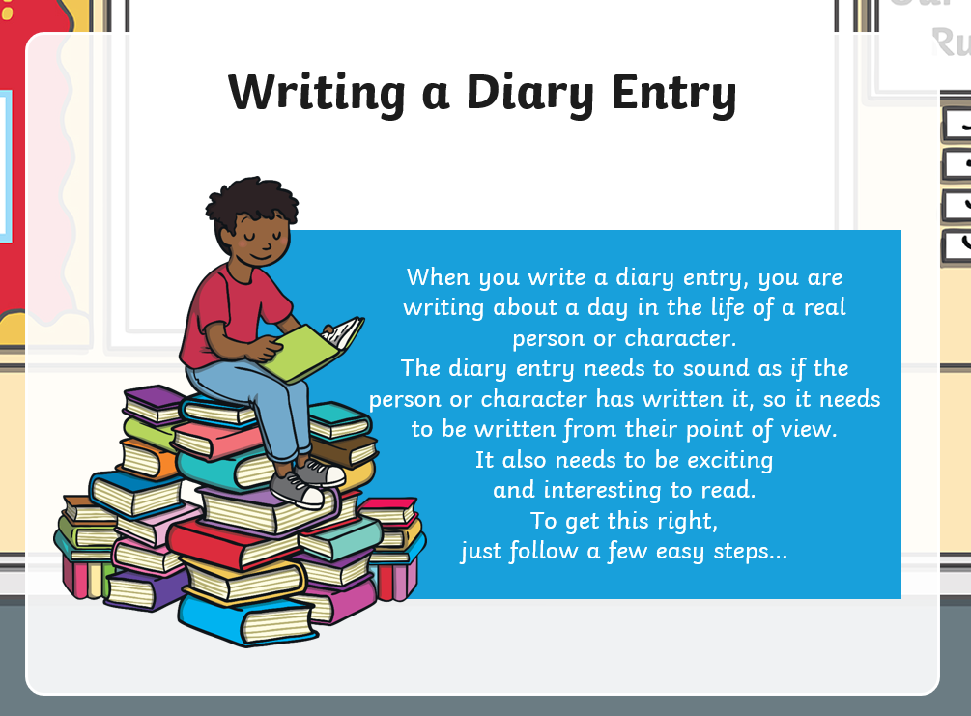
TBAT: recognise the features of a diary.
Monday 2nd February 2026
2/2/26

Slide 32
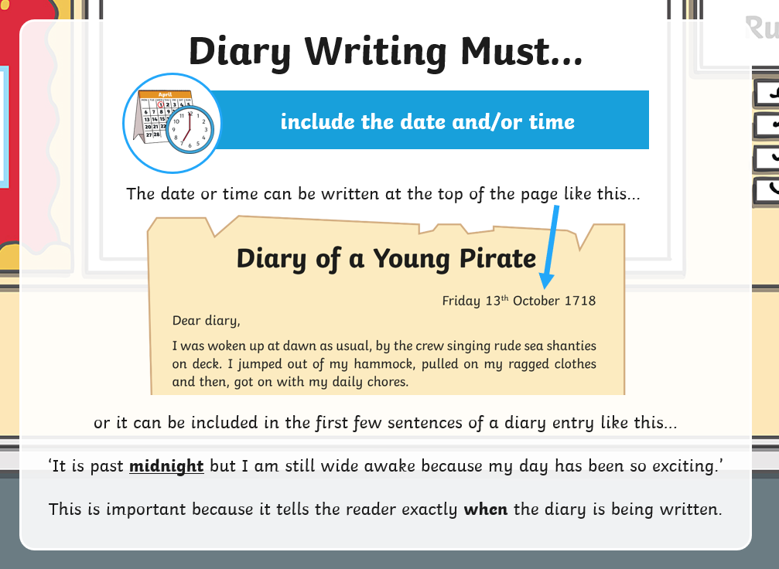
TBAT: recognise the features of a diary.
Monday 2nd February 2026
2/2/26

Slide 33
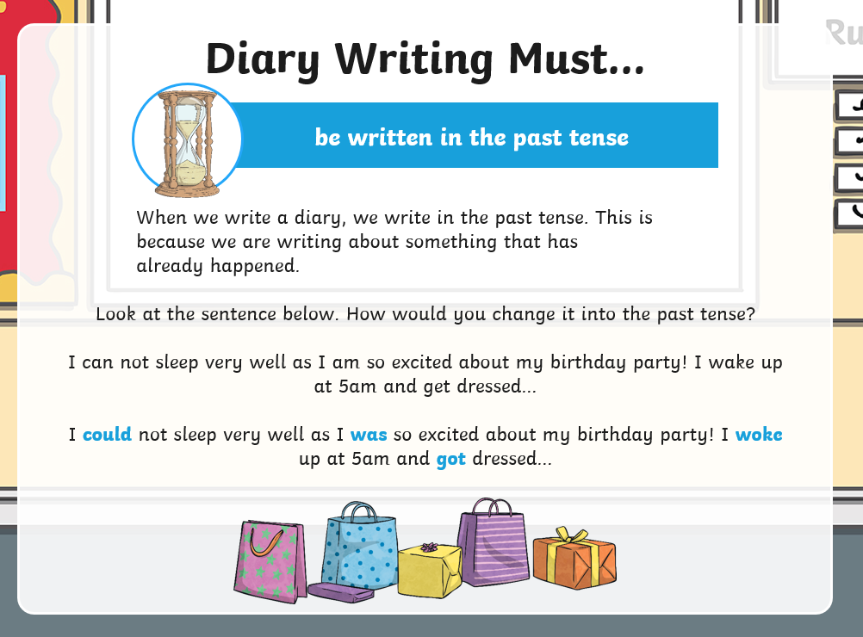
TBAT: recognise the features of a diary.
Monday 2nd February 2026
2/2/26

Slide 34
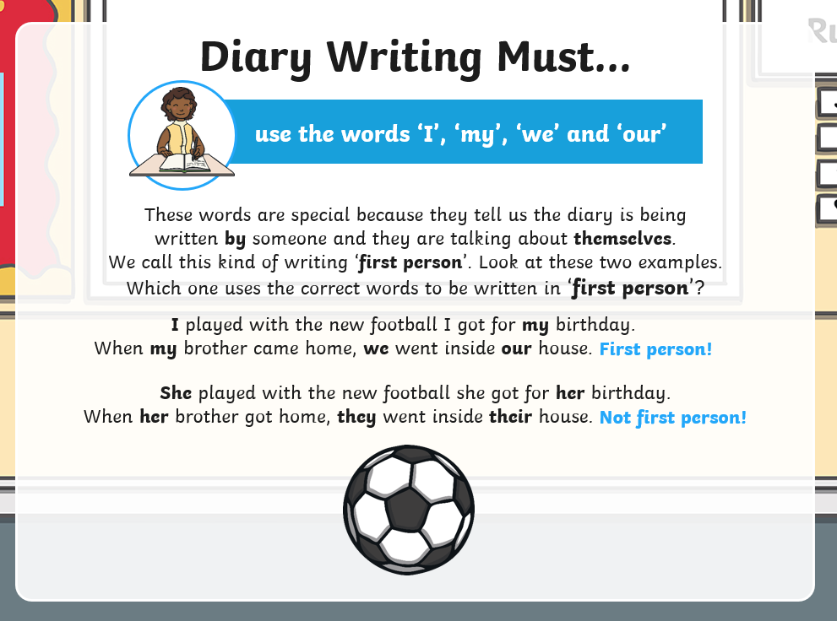
TBAT: recognise the features of a diary.
Monday 2nd February 2026
2/2/26

Slide 35
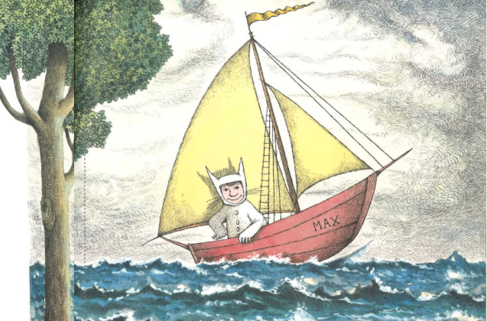
TBAT: recognise the features of a diary.
Monday 2nd February 2026
2/2/26
Which sentence would be correct in a diary?
Max sailed across the sea in a boat.
I sailed across the sea in a boat.

Slide 36
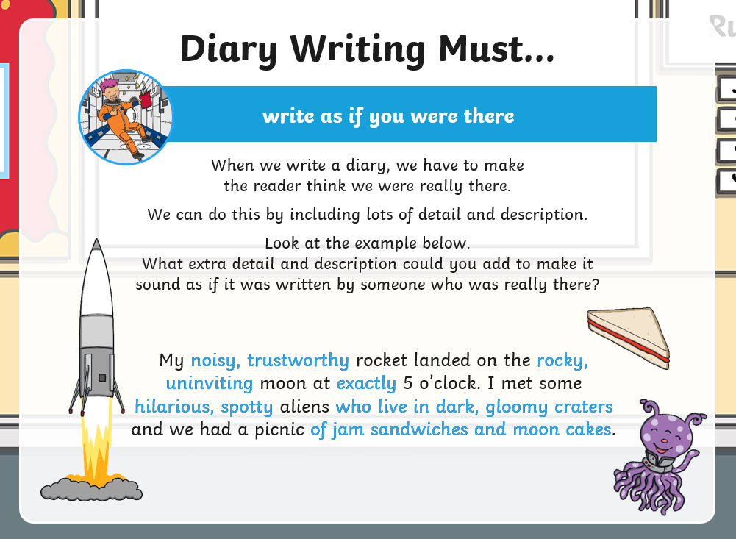
TBAT: recognise the features of a diary.
Monday 2nd February 2026
2/2/26

Slide 37
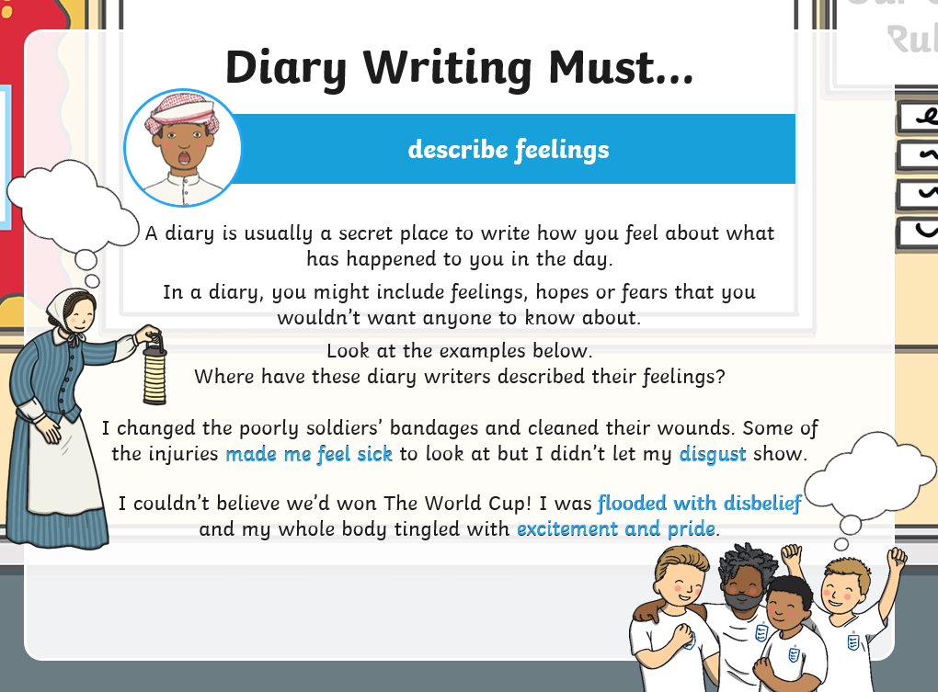
TBAT: recognise the features of a diary.
Monday 2nd February 2026
2/2/26

Slide 38
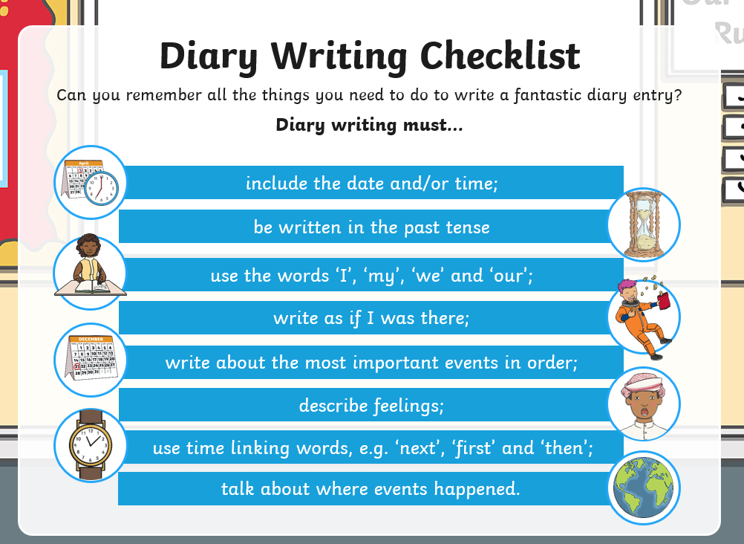
TBAT: recognise the features of a diary.
Monday 2nd February 2026
2/2/26

Slide 39
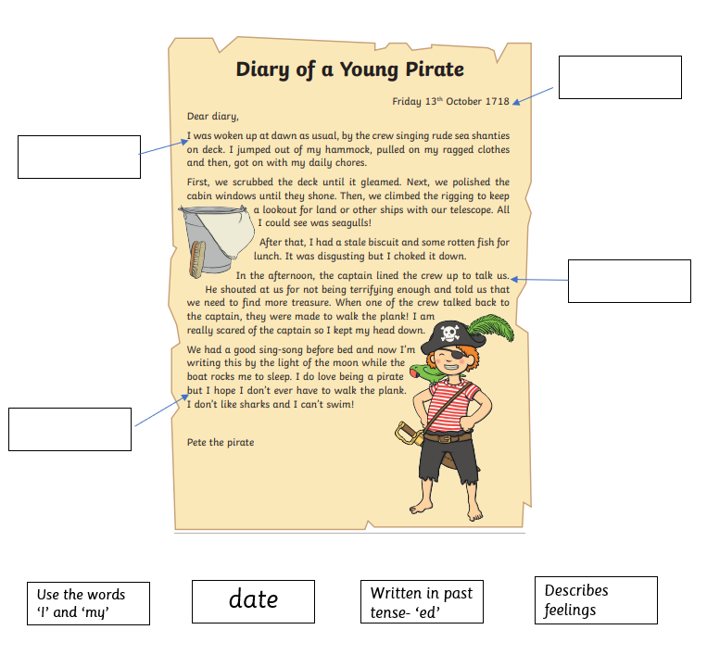
TBAT: recognise the features of a diary.
Monday 2nd February 2026
2/2/26
Independent:
Challenge:
Is this a part of a diary entry? Why/ why not?
Max went on his boat to the land of the Wild Things. As he arrived the monsters snarled and showed their teeth at him

Slide 40
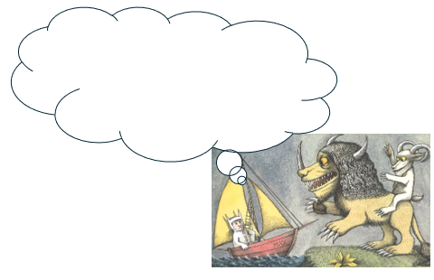
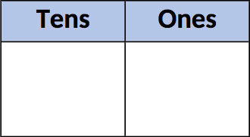
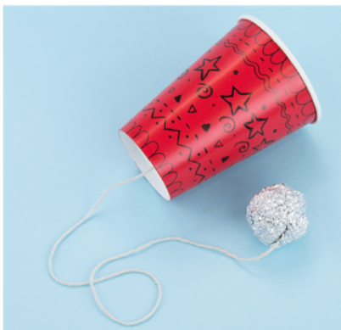
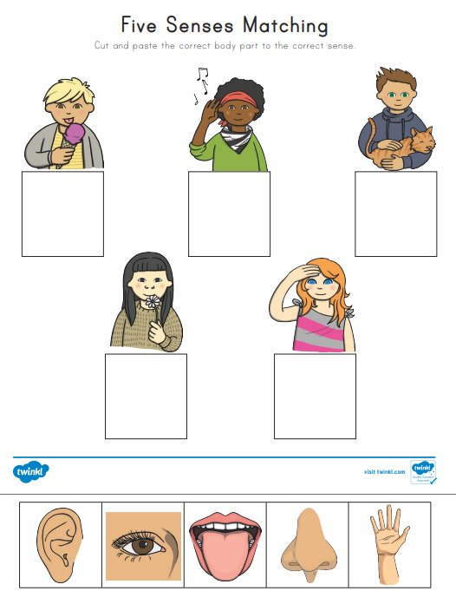
Independent Challenges:
Narrative Zone
Maths Zone
What do you think Max is thinking or feeling at this moment?
Create a number using the dienes in the place value chart.
Draw the dienes onto your chart and write the number underneath.
Enquiry Zone
Creative Zone
Match the body part to the sense.
Make a cup and ball toy

