Slide 1
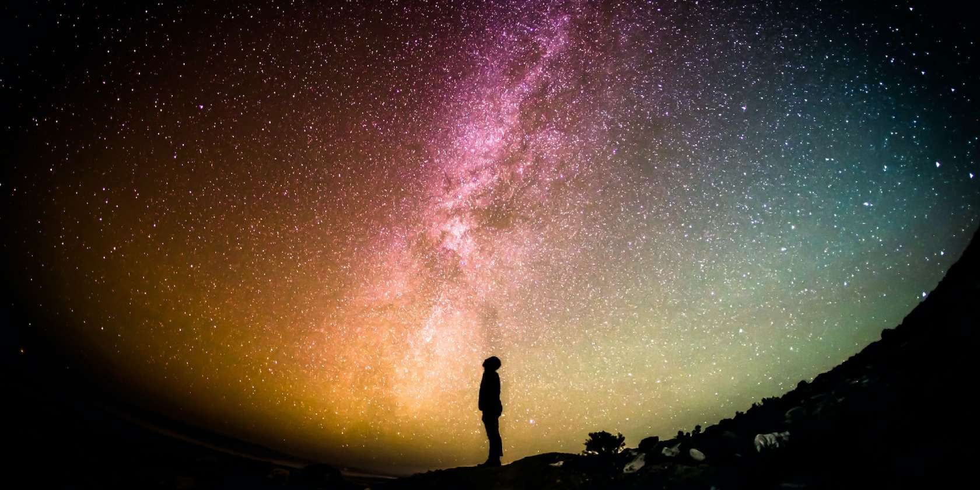
What can you infer from this image?
Who is looking at the sky? Why?
What's happening in the image?

Slide 2
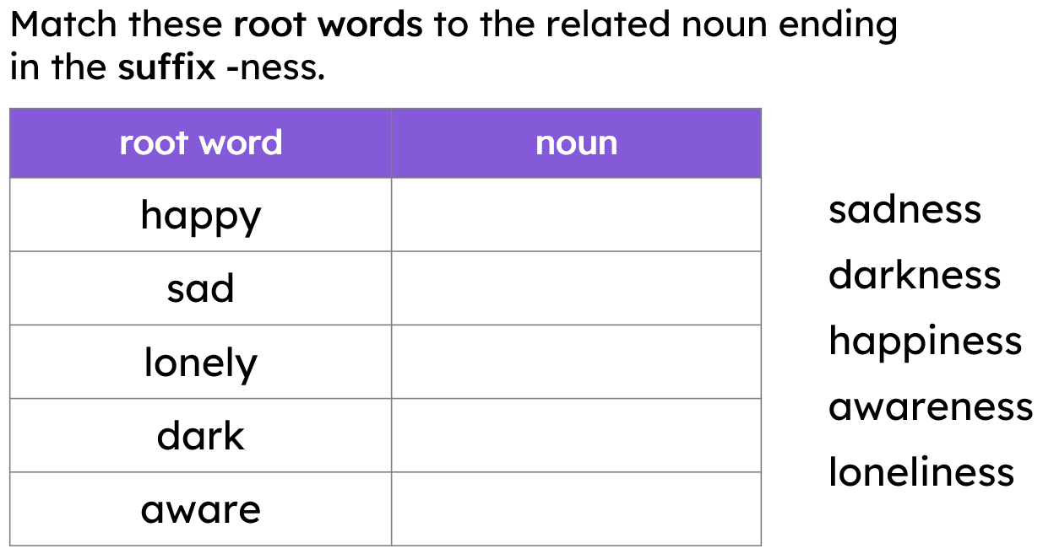
Thursday 22nd January
TBAT: understand the suffix -ness

Slide 3





Using the suffix -ness
Abstract nouns are a type of thing. They have no physical form. They can be created using the suffixes -ness, -ity and -tion.
tiredness
generosity
operation
brightness
They are the names of ideas, qualities or states that cannot be seen or touched.

Slide 4
Using the suffix -ness
The suffix -ness turns adjectives into abstract nouns.
I do not like cold showers!
The word ‘cold’ is describing showers. It is an adjective.
The coldness spread through her body on the snowy day.
The word ‘coldness’ is a thing.It is a noun, an abstract noun.

Slide 5
Using the suffix -ness
What word class are ‘kind’ and ‘kindness’?
The kind neighbour gave her a warm cup of tea.
The word ‘kind’ is describing the neighbour. It is an adjective.
I was so grateful for her kindness.
The word ‘kindness’ is a thing, a quality. It is a noun, an abstract noun.

Slide 6
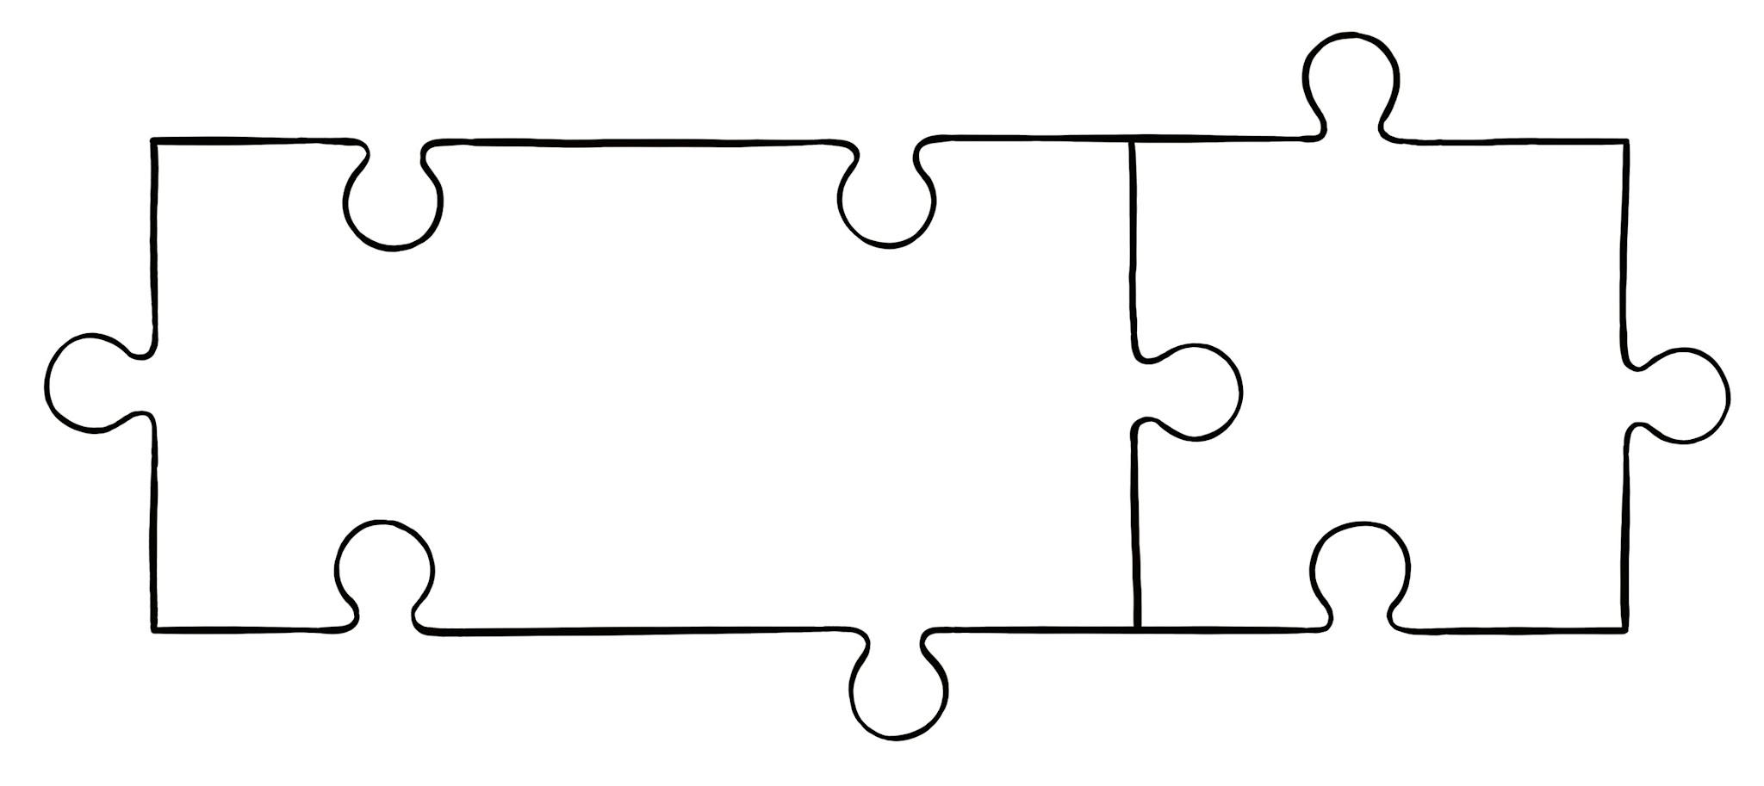
Spelling words using the suffix -ness
The -ness suffix starts with a consonant. This means the root word usually doesn’t change when the suffix is added.
ill +ness
illness
calm +ness
calmness
sad
ness
dark +ness
darkness
fit +ness
fitness

Slide 7
Spelling words using the suffix -ness
If the root word has more than one syllable and ends in a consonant + ‘y’, then the ‘y’ is replaced by ‘i’ before the suffix.
lazy +ness
happy +ness
laziness
happiness
This rule is similar to other suffixes, such as -ly, -ful and -less.

Slide 8
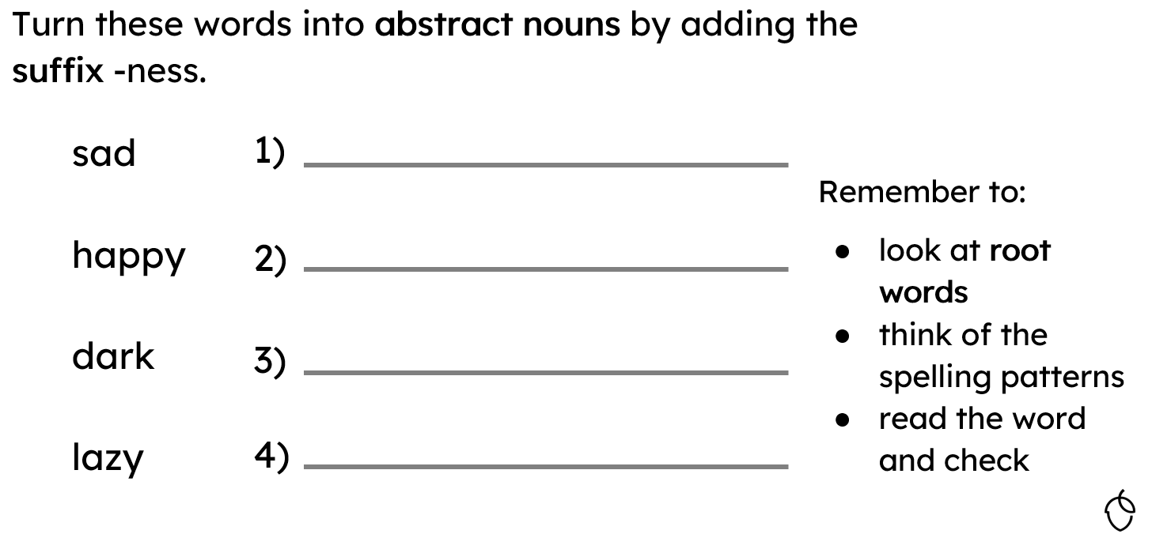
Thursday 22nd January
TBAT: understand the suffix -ness

Slide 9
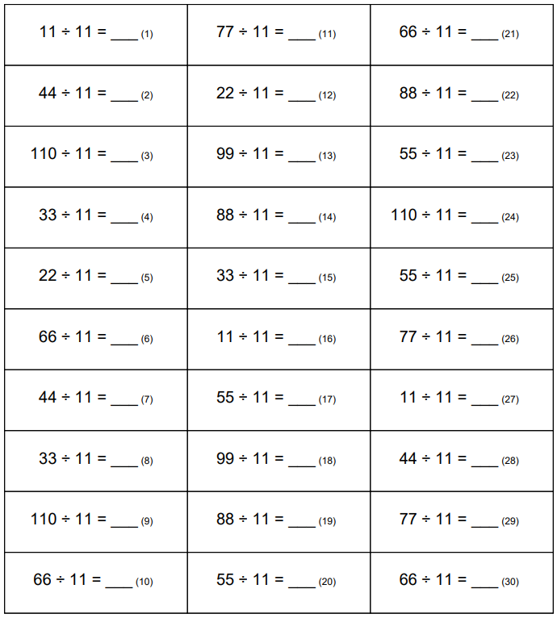
22.1.26
TBAT- Use mental strategies to solve multiplication .

Slide 10
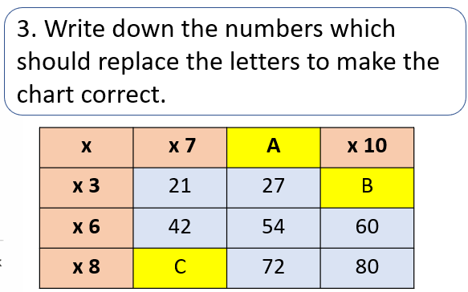
TBAT- Use mental strategies to solve multiplication
3 in 3 Challenge: [ ] x 10 = 2.7
1 . 4768 – 362.8 = [ ]
2. 389 divided by 6 =

Slide 11
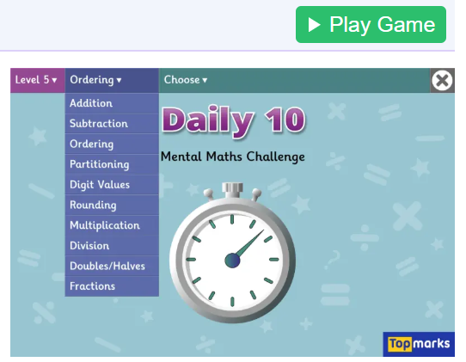
Daily 10 x 11
Daily 10 - Mental Maths Challenge - Topmarks

Slide 12
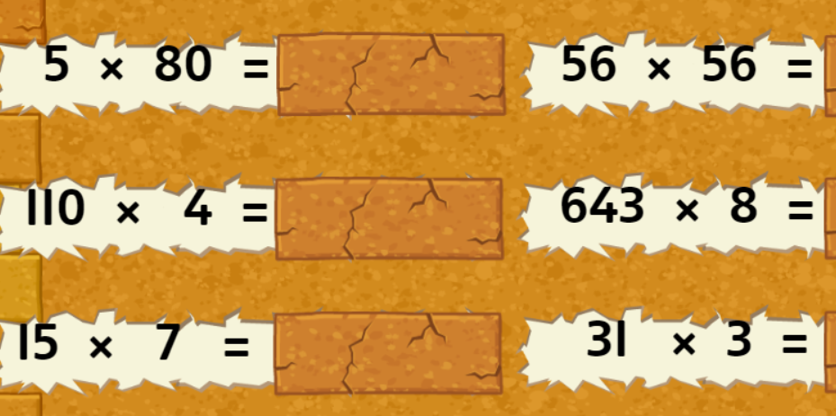
Talk partners:
Which calculations are better done using written method?

Slide 13
5 x 6 = 4 x 9 =
50 x 6 = 40 x 9 =
500 x 6 = 400 x 9 =
Challenge: 70 x ? = 5, 600

Slide 14
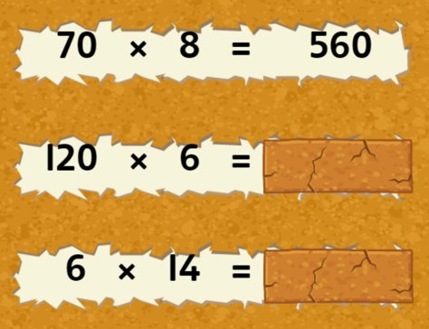
Whiteboard work:

Slide 15
Talk partners: How would we solve this problem using a mental method?
31 x 6 =

Slide 16
Paired work:
91 x 9 =

Slide 17
Talk partners: How would we solve this problem using a mental method?
29 x 6 =

Slide 18
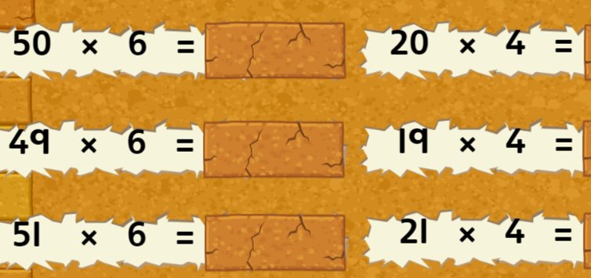
Whiteboard work:
Blue Green

Slide 19
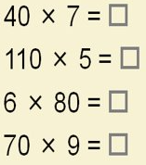
Independent:
RP
a) Explain how you can use
5 x 3 =15, to work out 5 x 29.
b) Lily says if 6 x 6 =36, then
60 x 60 = 360. What mistake
has she made?
19 x 5 =
22 x 8 =

Slide 20
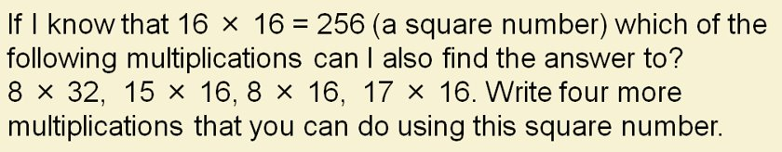
Challenge:
Explain how knowing that 60 x 7= 420 helps you work out 59 x 7.
Mastery:

Slide 21
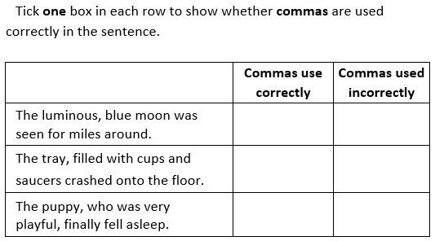
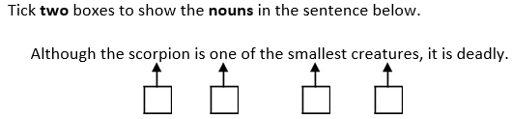
Thursday 22nd January
TBAT- write a narrative to entertain.
3 in 3
Write a question to the answer:
Liam was fearless; Florida was fearful.

Slide 22
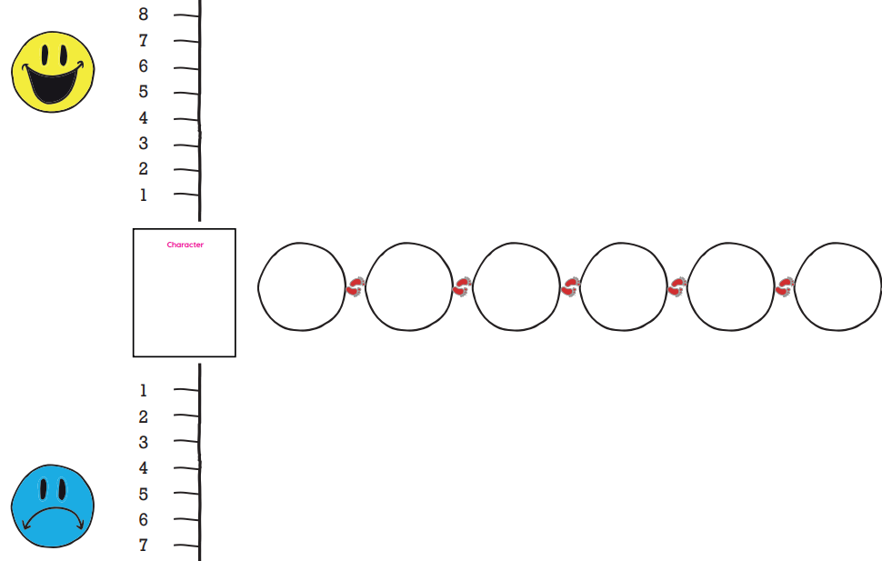

Partner Work: Use your plan from yesterday to tell your partner what happens at each point of your story. Use the plots below to help.
At each plot, was it a high or a low point for the character?

Slide 23
Infront of our eyes was the great Porshe showroom. There it was. 15 foot ahead of me was the engine: magnificent and great, calling my name.
What are your first thoughts on this paragraph?
Words from Monday's lesson:
amble
meander
manoeuvre
audacious
vast
deceive
Y5/6 words
achieve
immediately
lightning
opportunity
curiosity
privilege
vehicle

Slide 24
Infront of our eyes was the great Porshe showroom. There it was. 15 foot ahead of me was the engine: magnificent and great, calling my name.
This is what I wrote on my plan, do I need to write it word for word? Would I rewrite it completely?
How could we up-level this short paragraph?
Words from Monday's lesson:
amble
meander
manoeuvre
audacious
vast
deceive
Y5/6 words
achieve
immediately
lightning
opportunity
curiosity
privilege
vehicle

Slide 25
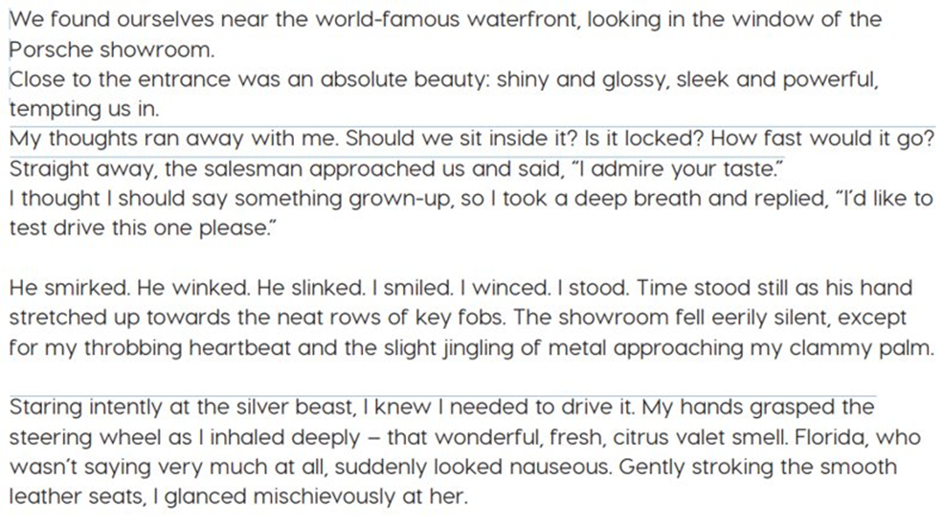
Use your plan to write your story.
NEATEST HANDWRITING!

Slide 26
Somehow, we found ourselves next to the window, curiously staring inside the Porsche showroom. Inside, near the posh entrance, was an absolute piece of heaven: vibrantly red and powerfully loud, beautiful and glistening in the sunlight. It was calling our names.
My thoughts ran away with me. Is it safe? Could I drive it? Should I drive it? The salesman approached us as I quickly thought of a grown-up thing to say, trying not to look nervous.
"She's a beauty, isn't she? he said confidently.
"She is, I would like to take her for a test drive," I said in a deep, manly voice.
He stared. He blinked. He winked. I winced. I coughed. I smiled awkwardly. Outside, the sun was shining and there wasn't a raindrop in sight, but inside, time froze like a blizzard came over and froze everything in sight. I froze as well. In my head, there was a slight sound of clinking keys. Suddenly, the salesman approached us. Florida anxiously tapped me on my hand as time unfroze. I let out my clammy hand towards him as a golden key entered my palm. I grabbed it with joy. Apparently, it didn’t show because Florida looked at me strangely as we walked towards the car. Staring intriguingly, at the ruby beast, I knew I needed to drive her.

Slide 27
Steps to success
- First person – writing as Liam
- Past tense
- Clear paragraphs
- Dialogue punctuated correctly, including use of a reporting clause
- Relative clause x 2
Words from Monday's lesson:
amble
meander
manoeuvre
audacious
vast
deceive
Y5/6 words
achieve
immediately
lightning
opportunity
curiosity
privilege
vehicle

Slide 28
Thursday 22nd January
TBAT- make visual notes and find marks made by different artists.
Blue- What is a monotype?
Green- How is a monotype made?

Slide 29
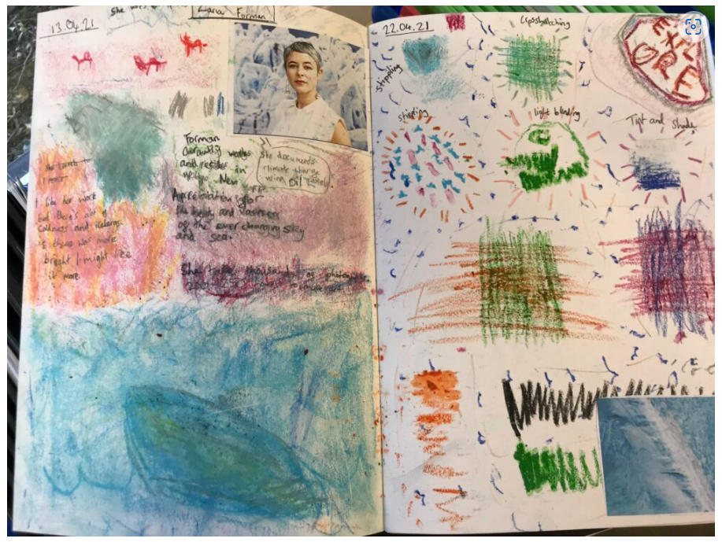
What is a sketchbook?
A sketchbook is a place to make visual notes.
You can explore a topic or theme.
It is your own and there is no correct way to do it.

Slide 30
Sketchbooks can focus on different things:
Colour
Lines, shapes and mark making
Words
Sequence and connections

Slide 31
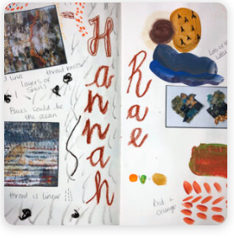
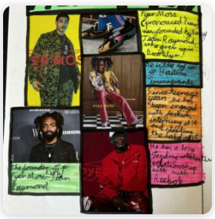
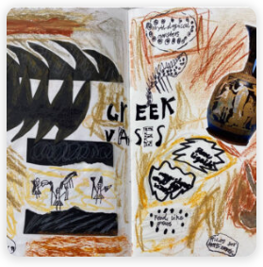
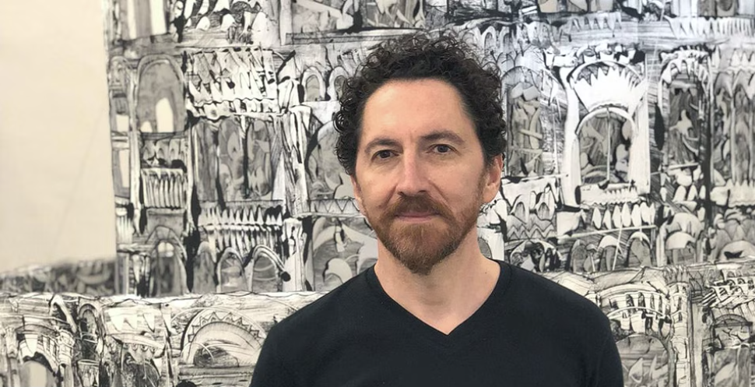
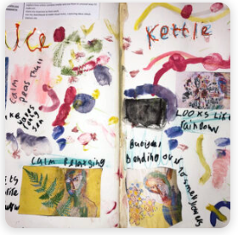
Look at these images, what do you think might have been to the focus?
Colour
Lines, shapes and mark making
Words
Sequence and connections
They might include more than 1 focus.

Slide 32
Watch the video about Kevork Mourad again
Talking Points: Kevork Mourad (accessart.org.uk)
In your sketchbook make visual notes from the video.

Slide 33
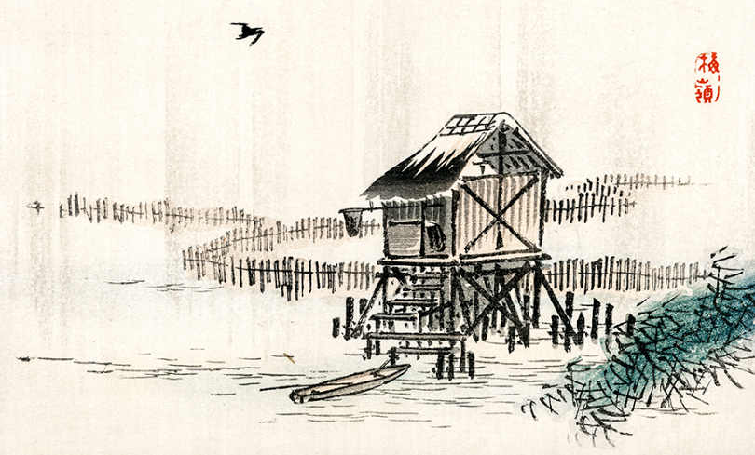
Look at these images, how do you think these marks were made on the page?
Think about:
How the artist might have made the marks?
What did they use?
How did they hold their pen?
How much pressure did they apply?
How quickly or slowly were the marks made?
Are the marks neat and precise or loose?

Slide 34
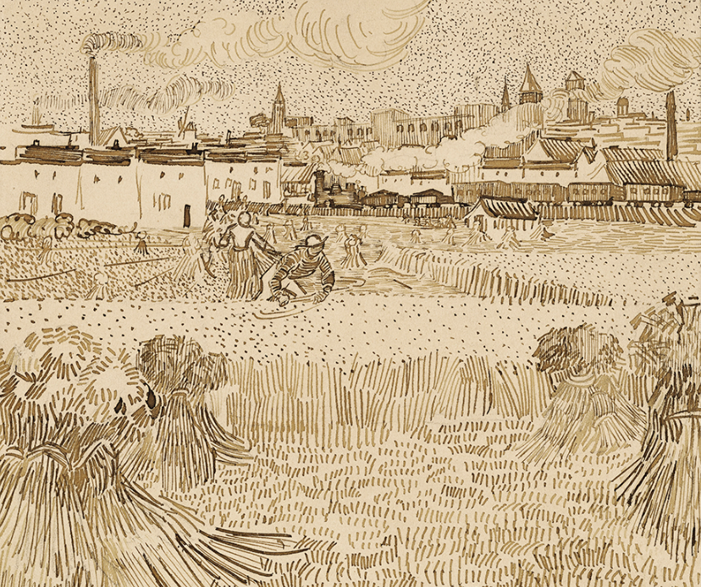
Look at these images, how do you think these marks were made on the page?
Think about:
How the artist might have made the marks.
What did they use?
How did they hold their pen?
How much pressure did they apply?
How quickly or slowly were the marks made?
Are the marks neat and precise or loose and expressive?

Slide 35
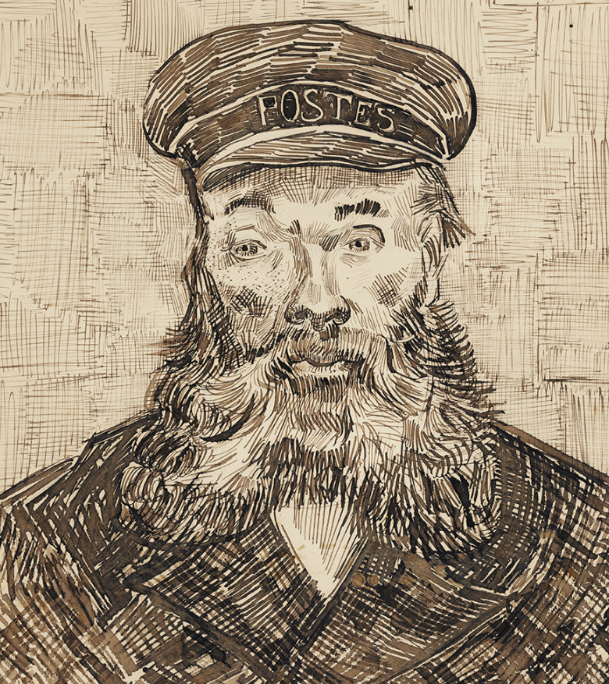
Look at these images, how do you think these marks were made on the page?
Think about:
How the artist might have made the marks.
What did they use?
How did they hold their pen?
How much pressure did they apply?
How quickly or slowly were the marks made?
Are the marks neat and precise or loose and expressive?

Slide 36
In your sketchbook, using just a pencil and 1 coloured pencil- make as many different marks as possible.
Think about:
Light and dark
Shade
Long and short marks
Different parts of the lead

Slide 38
