Slide 1
Morning Challenge – 21.01.26
Addition 4, 625 + 1077= 2.3 + 1.92 = | Subtraction 459 – 37 = 965 – 607=
Multiplication 234 x 5 = 5.14 x 100 = | Division 55 divided by 5 = 423 divided by 3 =
Fractions
Find equivalent fractions
4/5 2/3
Simply the following fractions
5/15 4/6

Slide 2

Spelling Bee
Whiteboards
happiness
hardness
madness
nastiness
silliness
tidiness
childishness
willingness
carelessness
foolishness

Slide 3
Word work
Correct the punctuation
"The car looks expensive" Florida said looking at me with concern in her eyes, maybe we should leave it!
We've come too far now," I replied.
The salesman returned, go on take her for a spin!"

Slide 4
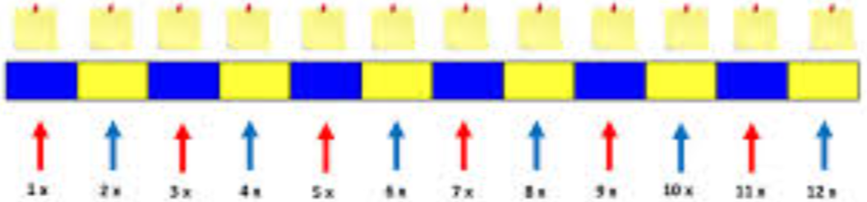
Class work: Counting stick Talk partners: Which multiple of 11 would we place first? Then.... after that...

Slide 5
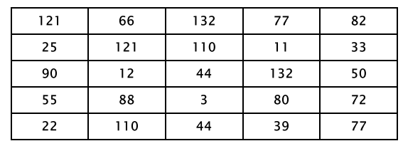
Circle the multiples of 11.
2) There are 11 rows of 6 bikes. How many bikes are there in total?
3) If there are 11 players in a football team. How many players would there be on a pitch in one game?
How many players are taking part in 7 matches?

Slide 6
21.1.26
TBAT: find square numbers and square roots.
3 in 3
[ ] = 50 divided by 100
1/5 of 30 = [ ]
124 x 7 =
Challenge; 2/3 + ¼ = [ ]

Slide 7
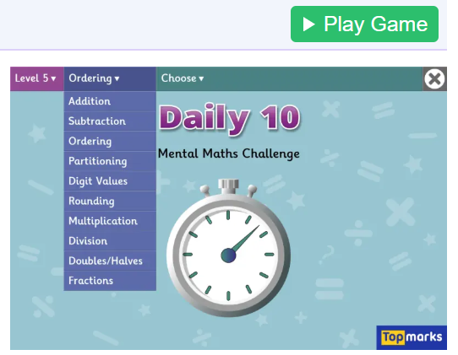
Daily 10 x 11 Daily 10 - Mental Maths Challenge - Topmarks

Slide 8
What are the factor pairs B- 21 and 36 G- 18 and 30 Challenge: What is the HCF and the LCF?

Slide 9
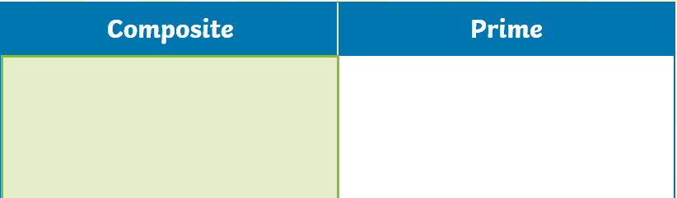
Whiteboard work: Draw the table and sort the numbers.
14 25 2 106 39 6
Challenge: How does this relate to divisibility rules?

Slide 10

TBAT: Find square numbers and square roots
What is the area of a 3 x 3 square?
Talk partners: Do we need to count the individual squares?

Slide 11
Talk partners:
How can we use this information to find the area of the other squares?
​

Slide 12
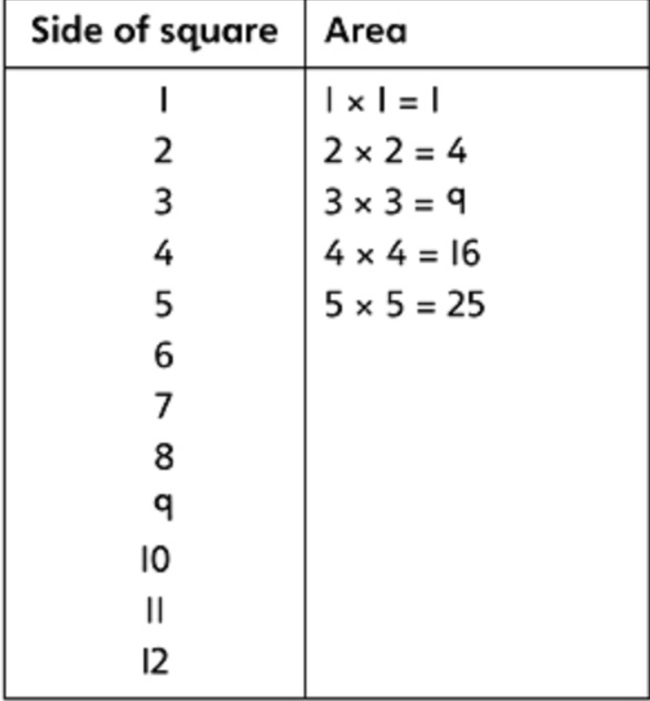
Complete
the table.
The numbers on
The right are
Square numbers

Slide 13
To find a square number you multiply a number by itself.
3 x 3 can be written as 3²
What is 10² ?

Slide 14
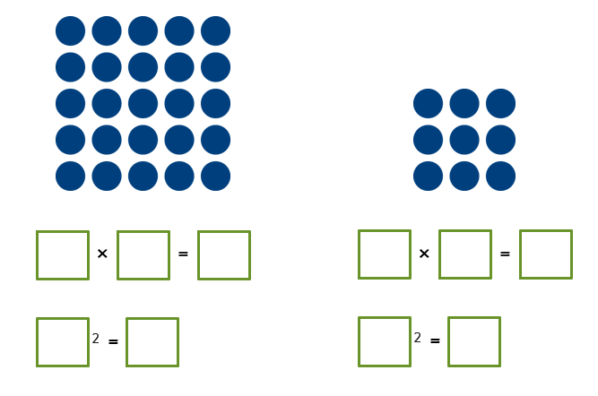
Blue
Green

Slide 15
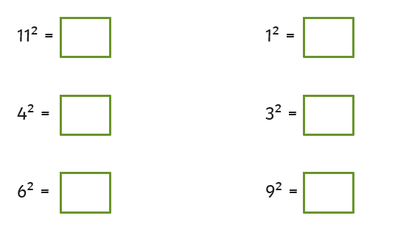
Whiteboard work:

Slide 16
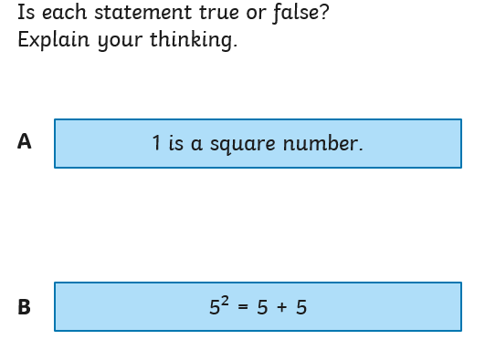
Class work:

Slide 17
Square root is the opposite ? X ? = 36 so the square root of 36 = ___
Blue Green

Slide 18
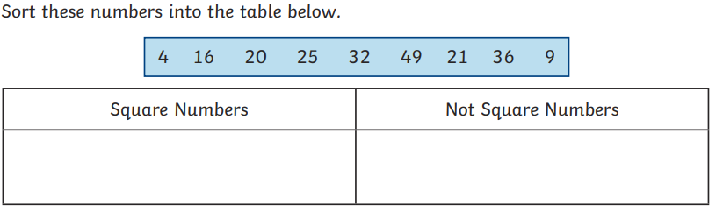

Slide 19

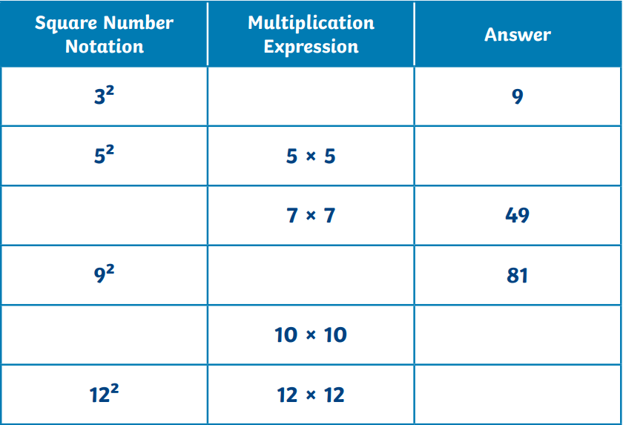
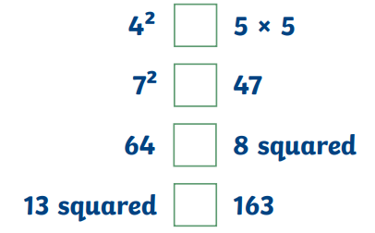
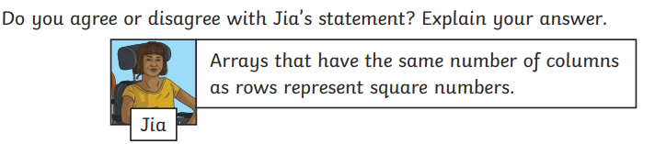
Independent:

Slide 20
Challenge:
The product of two square numbers always equals a square number. Is this correct?
Mastery
20² = 400. How can you use this to
Work out what 41² is?

Slide 21
Wednesday 21st January TBAT- plan a short narrative to entertain. 2 in 2
Insert the missing full stops and capital letters into the passage below to make two correct sentences.
everybody crowded around sarah and cheered she had finally
completed the london marathon
2) Expand this sentence to make it a compound sentence.
Liam walked towards the car.

Slide 22
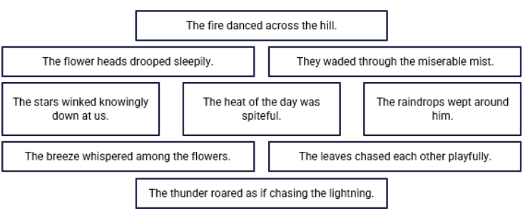
Paired work: Rank the pathetic fallacies in how effective you think they are from most (at the top), to the least (at the bottom)

Slide 23
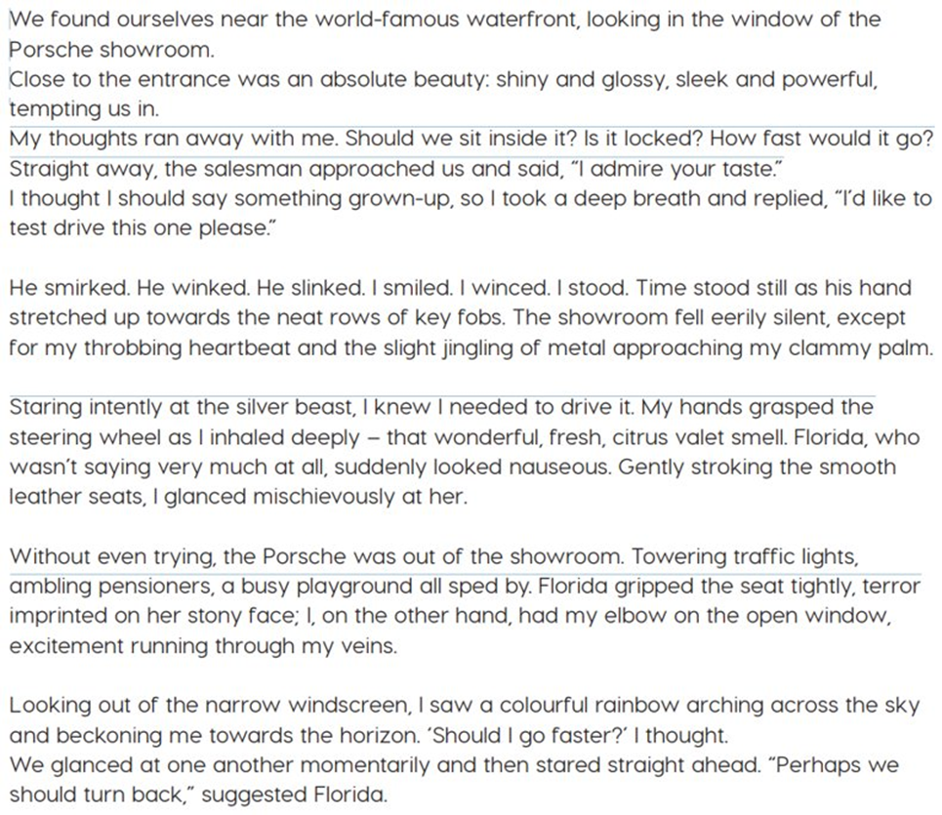

Slide 24
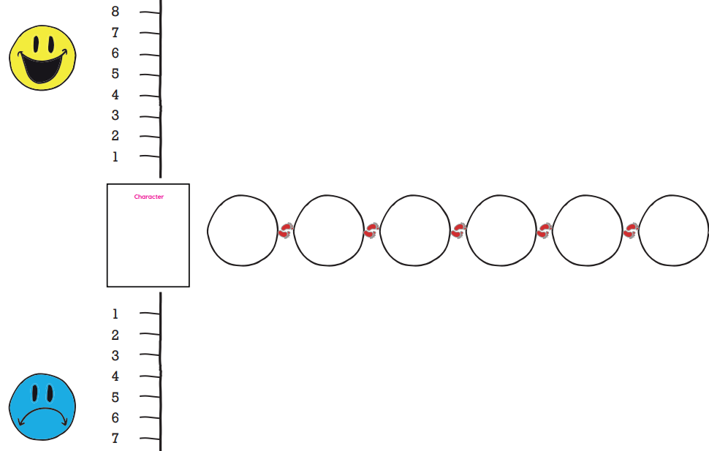

Task: Use the modelled text to decide on six plots that make this narrative.
Class Work: Complete the plot planning.
At each plot, was it a high or a low point for the character?

Slide 25
Stood outside the showroom –Box 1 prepositional phrase and including a colon, adjectives and a ‘tempting’ phrase 2) Inside the showroom- Box 2 internal thoughts x 2 Short dialogue with salesman- punctuate correctly. 3) Getting the keys - See yesterday's lesson X 3 short sentences for the both characters. Pathetic fallacy showing how Liam is feeling about driving the car. You have already written this: He grinned. He charmed etc.. I frowned...etc The sun shone cheerfully... Slow down time passing over the keys- jangling metal approaching my clammy hands-

Slide 26
4) Inside the car ​- Open with a looking phrase (staring intently, peering excitedly ) - verb + adverb .
Express desire to drive the car. ​ Relative clause for Florida's reaction. ​
5) The 'high-speed' drive- Use high-speed verbs. Class share write – what you can see.
Without even trying, the Porsche was out of the showroom. Towering traffic lights, ambling pensioners, a busy playground all sped by. Florida gripped the seat tightly, terror imprinted on her stony face; I, on the other hand, had my elbow on the open window, excitement running through my veins. Inform reader driving quickly- list three things drive past​- You have not written this sentence yet
Contrasting characters' feelings using a semi-colon​- you have already written this (Thursday)

Slide 27
6) Should we go faster?
You have not written this part yet Include pathetic fallacy – what is Liam drawn to? Liam notices the leaver- what question would he have in his mind?​​ Verb + adverb to capture Liam reaching for the button (verbs (stretching, reaching, leaning, bending); adverbs (boldly, cautiously, unashamedly, excitedly, hastily, casually, brazenly) ​
Florida says something to Liam. ​ Looking out of the narrow windscreen, I saw a colourful rainbow arching across the sky and beckoning me towards the horizon. ‘Should I go faster?’ I thought. We glanced at one another momentarily and then stared straight ahead. “Perhaps we should turn back,” suggested Florida.

Slide 28
Plot Point | Ideas | Additional Notes Conjunctions Adverbials Prepositional phrases
1
2
3
4
5
6
Use the planning guidance to record your ideas.
You can use your ideas from the build up lessons. You may wish to use some and then add further, and/or make changes.
Additional Notes- anything additional that you want to remember to include. For example: simile, or expanded noun phrase, dialogue etc...

Slide 29
Wednesday 21st January
TBAT: How does Coventry Cathedral foster peace in its local community and across the world?
What question did Peter ask Jesus?
What does seventy times seven mean in the context of forgiveness?

Slide 30
reconciliation
fixing a broken friendship or making peace after a disagreement
forgiveness
letting go of hurt and choosing kindness instead of anger
symbol
a symbol is a picture, object, or sign that stands for something else
peace
living happily with others, without fighting or hurting each other

Slide 31

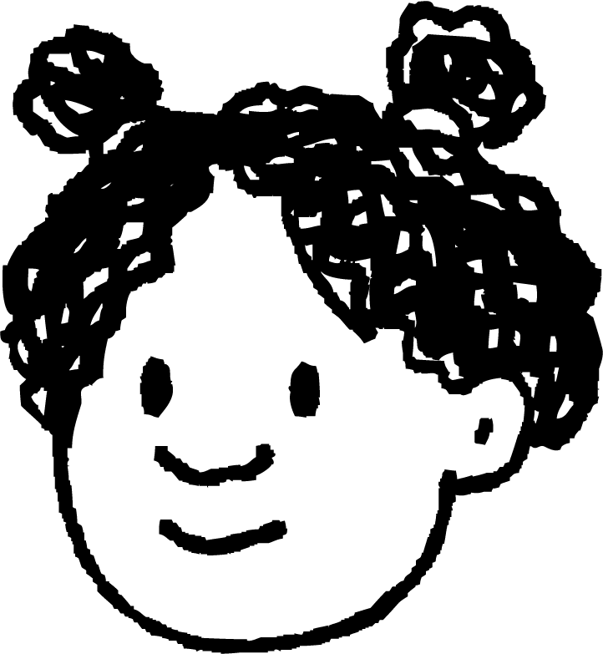

How is Coventry Cathedral a symbol of peace?
Izzy and Laura are discussing Coventry Cathedral.
The story of Coventry Cathedral is incredible. It is inspiring how it was rebuilt after the destruction of the bombing.
Izzy
I want to find out more about the new building and how it symbolises peace and reconciliation. Let’s look at the cathedral in more detail!
Laura

Slide 32

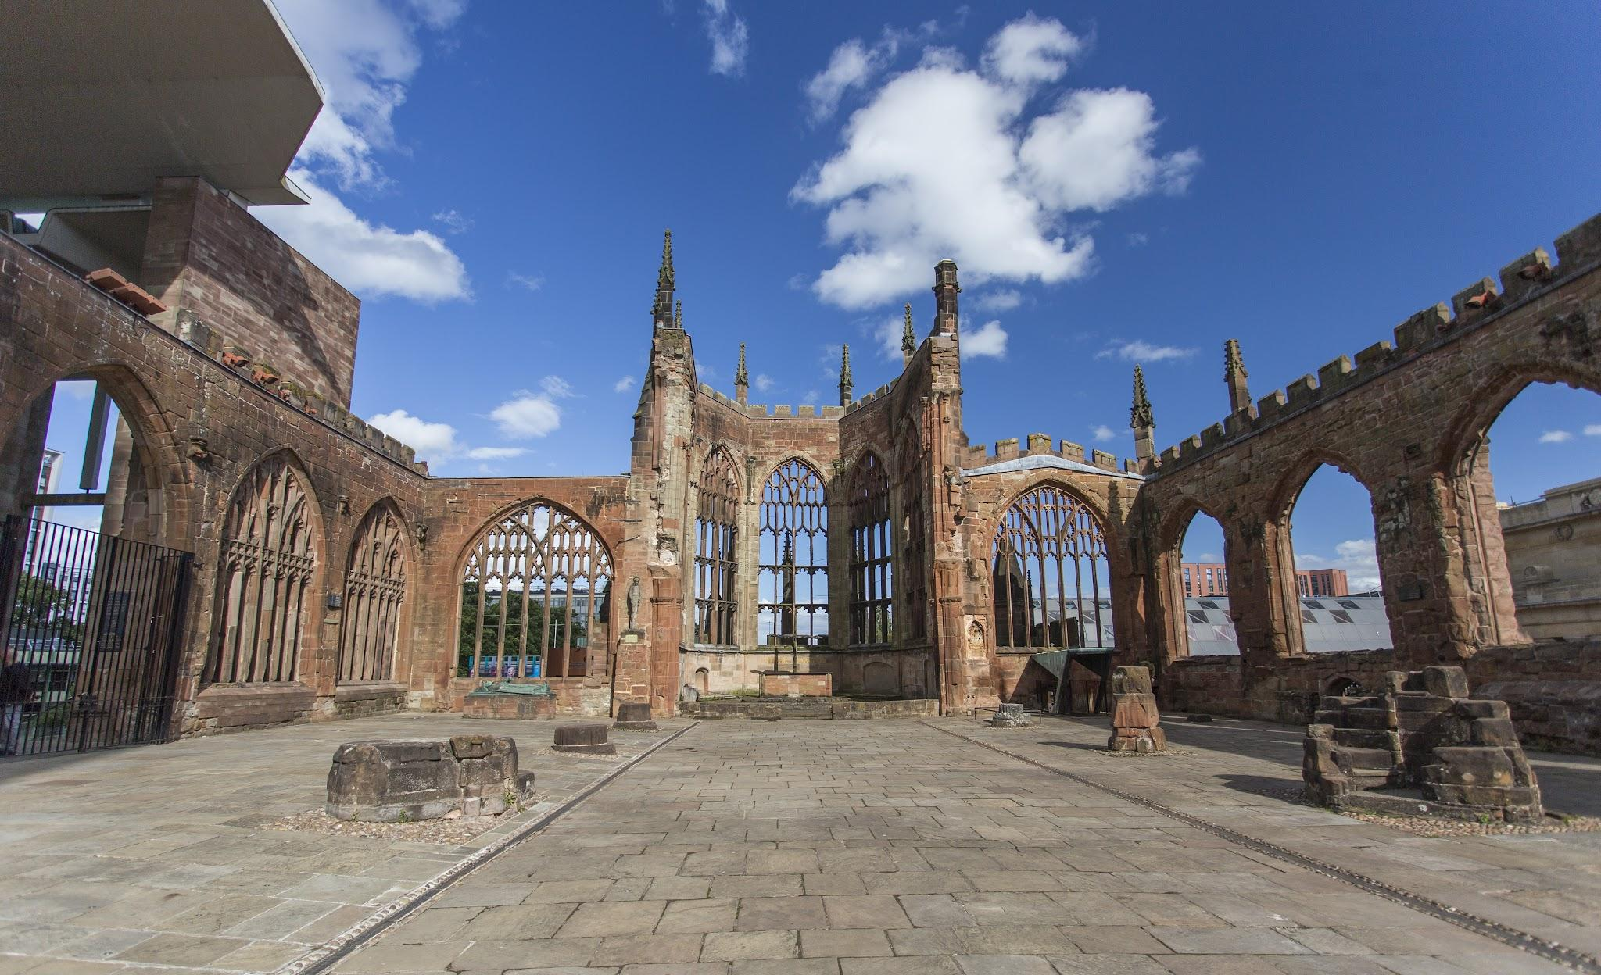
How is Coventry Cathedral a symbol of peace?
The ruins of the old cathedral have been left to remember it.
Photo: Joseph Witcombe

Slide 33

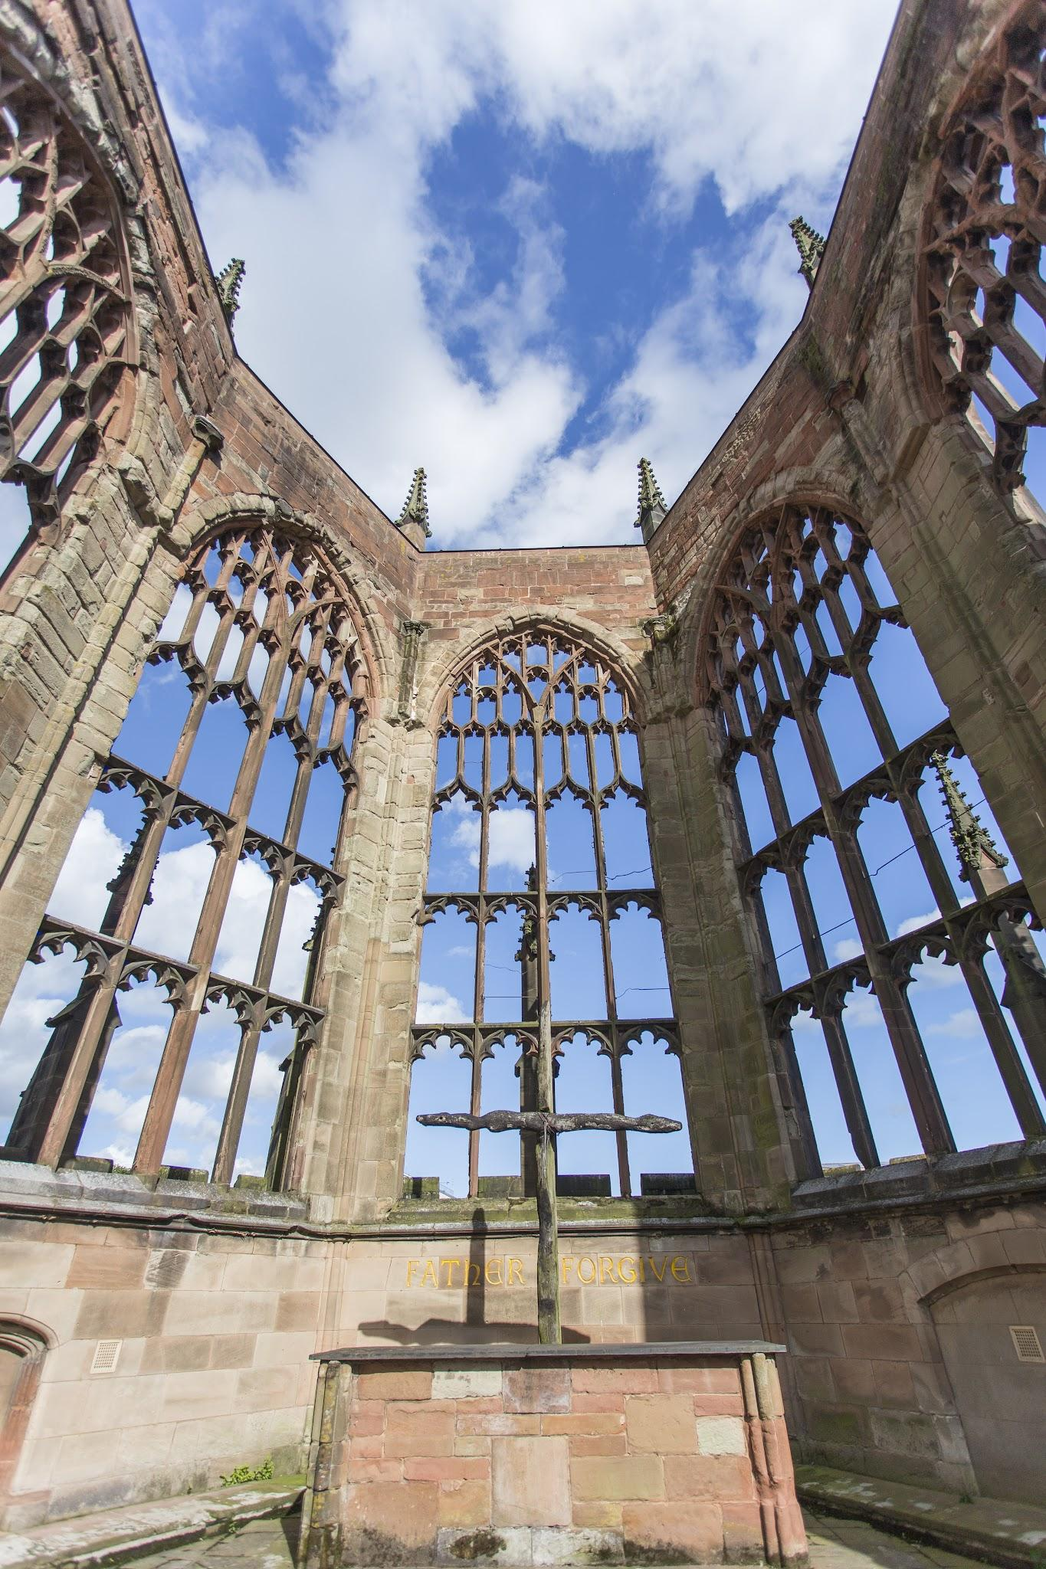
How is Coventry Cathedral a symbol of peace?
The charred cross was set up with the words ‘Father, Forgive’ behind it.
Photo: Joseph Witcombe

Slide 34
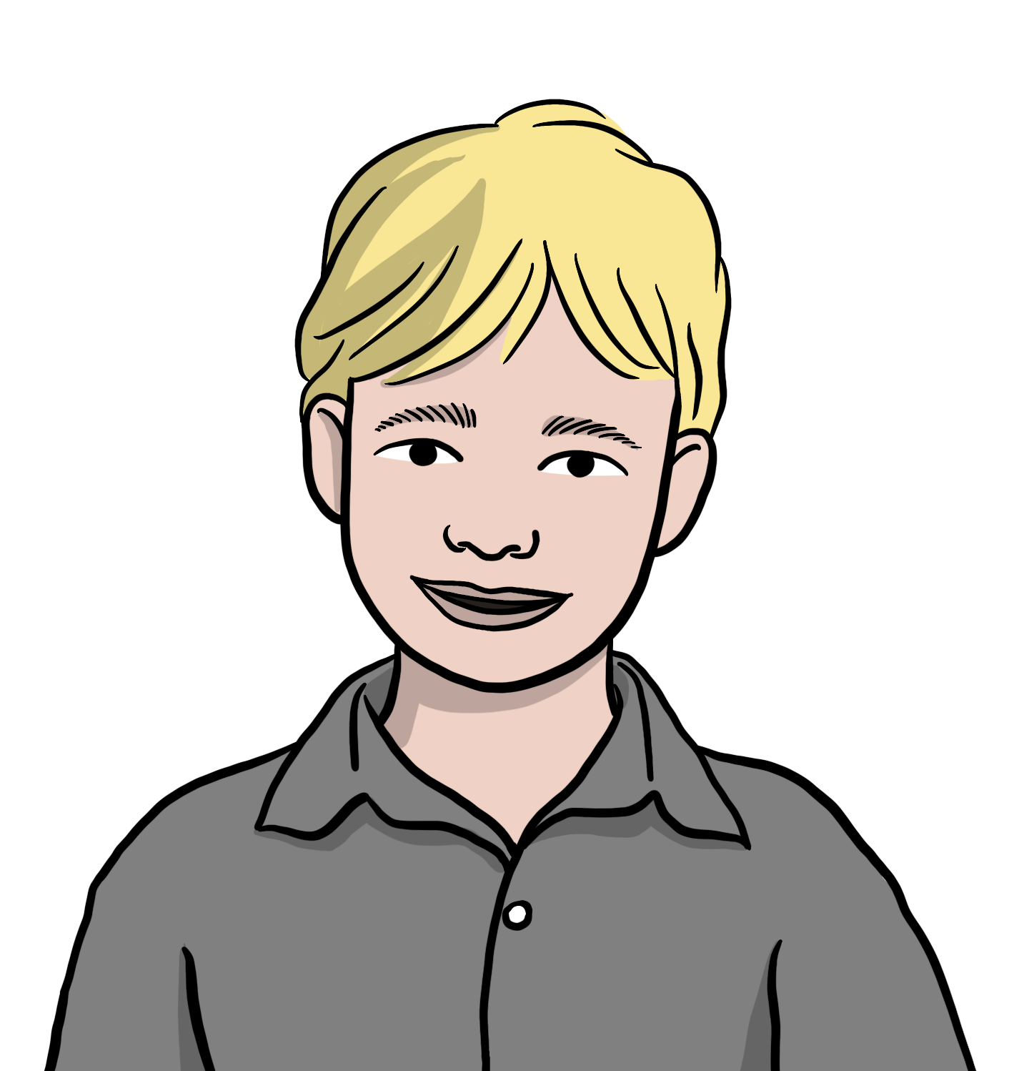
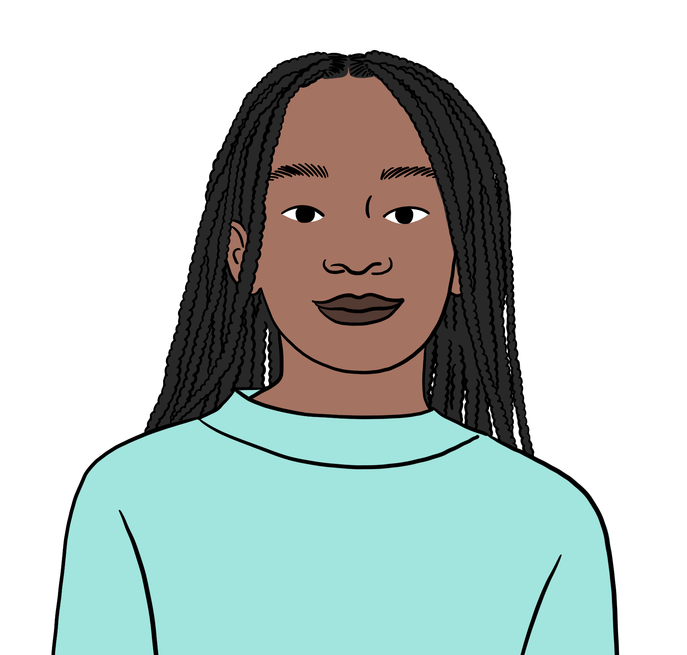
How is Coventry Cathedral a symbol of peace?
Grace and Andrew both have a Christian worldview. They are discussing the symbolism of the charred cross.
The words, ‘Father, Forgive’ remind me of the story of Jesus and Peter. Jesus tells Peter he must forgive ‘not just seven times, but seventy times seven!’.
Andrew
Yes. Those words were also some of the last words Jesus spoke on the cross. The charred cross shows Christians that everyone needs forgiveness, and Christians should never think someone is beyond forgiveness.
Grace

Slide 35
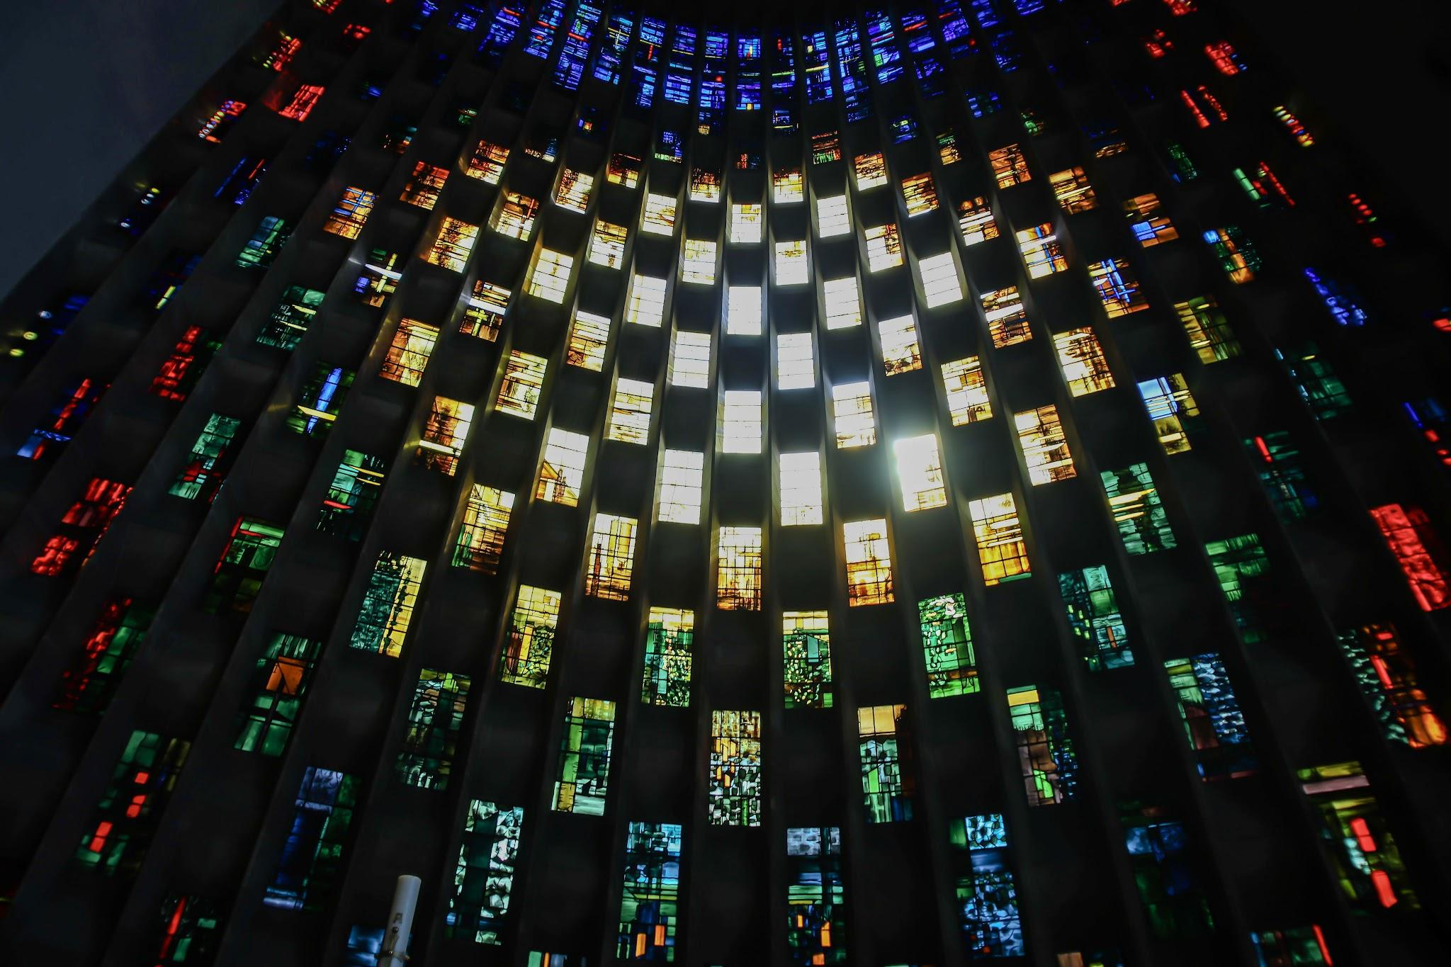
How is Coventry Cathedral a symbol of peace?
What can you see in this photograph?
How might it connect to the story of the cathedral?
How might it connect to peace?
Photo: Emilia Jayne Photography

Slide 36

How is Coventry Cathedral a symbol of peace?
The Baptistery window by John Piper is one of the stained glass windows in the new cathedral.
Photo: Emilia Jayne Photography

Slide 37
How is Coventry Cathedral a symbol of peace?
Grace and Andrew are discussing the symbolism of the Baptistery window.
I love the way the window looks like a sun is rising. It makes me think of hope and the beautiful cathedral coming from the ashes of the old one.
Andrew
I think about my belief that Jesus rose from the dead. I believe that Jesus taught forgiveness and peace. The window shows that peace is more powerful than war.
Grace

Slide 38
Wednesday 21st January
TBAT: How does Coventry Cathedral foster peace in its local community and across the world?
Why was the charred cross placed in the ruins of Coventry Cathedral?
What is the significance of the "Father, Forgive" inscription at Coventry Cathedral?

Slide 39
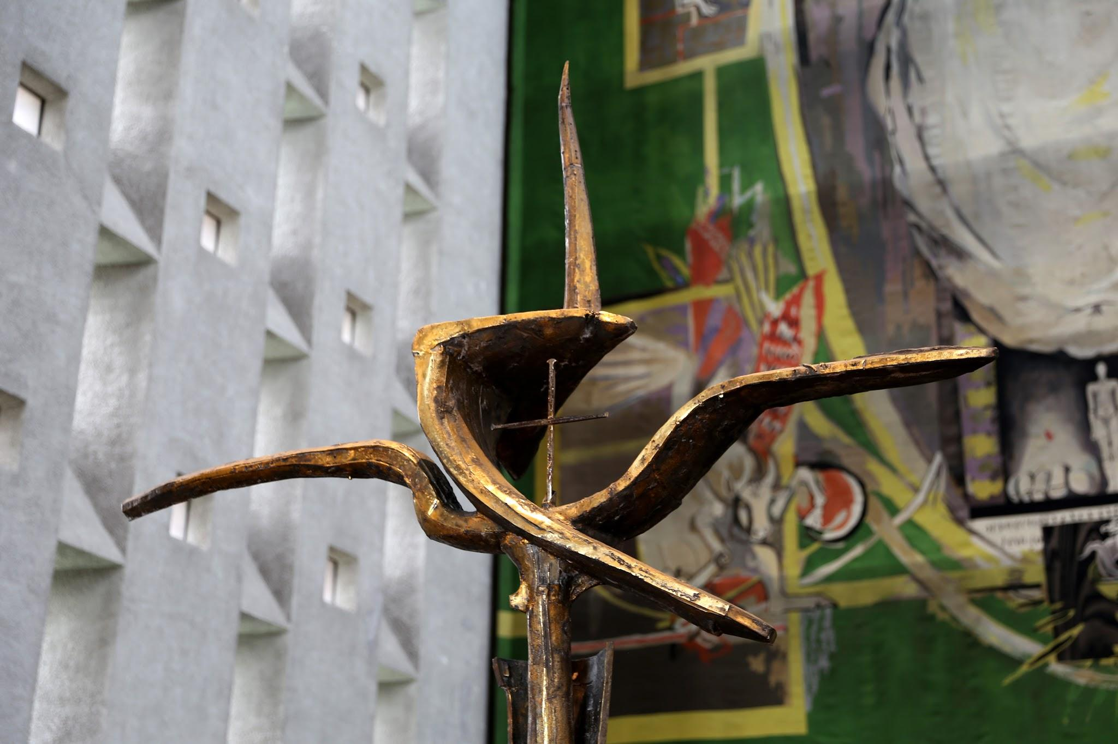
How does Coventry spread its message of peace?
This is another object in Coventry Cathedral.
What can you see?
What might its link be to peace and reconciliation?
Photo: Gerda Muldaryte

Slide 40

How does Coventry spread its message of peace?
The Cross of Nails is made from nails found after the bombing.
Photo: Gerda Muldaryte

Slide 41
How does Coventry spread its message of peace?
Grace and Andrew are discussing the connection between the Cross of Nails and reconciliation.
The word reconciliation means to bring together something that was broken. By giving the Cross of Nails to churches in Germany, Coventry Cathedral was trying to heal the memories of the war. It is not forgetting, but mending.
Andrew
I love the way that Coventry Cathedral has given Crosses of Nails to other countries that have faced war. Jesus asked his followers to ‘love your enemies’, and the Cross of Nails is a powerful symbol of reconciliation.
Grace

Slide 42

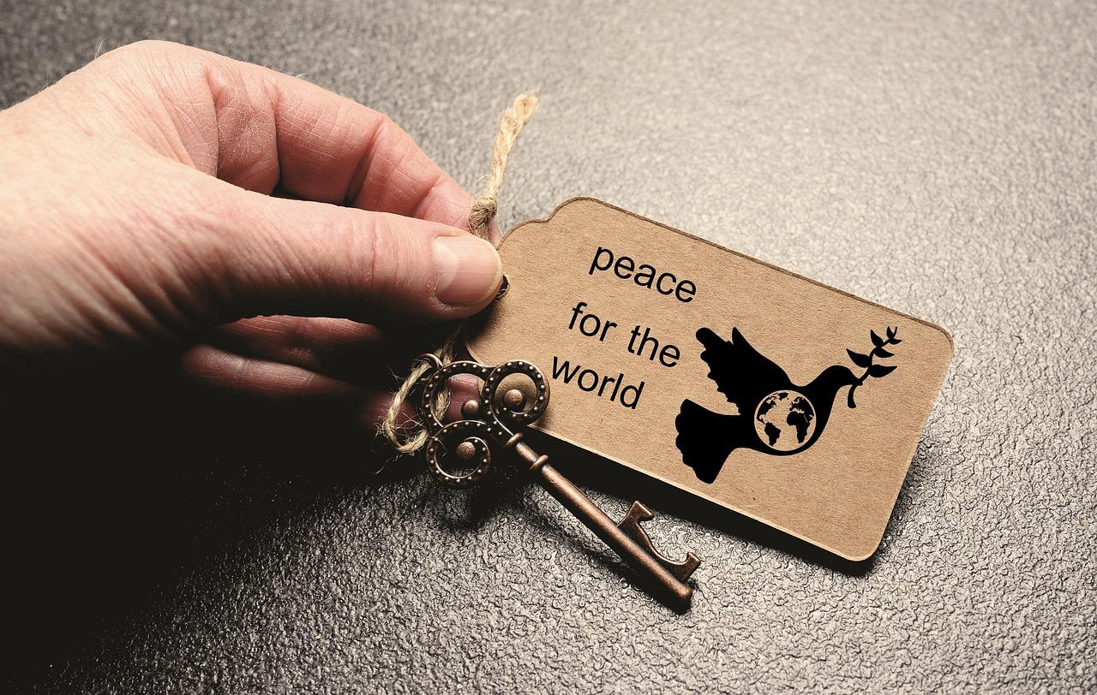
How does Coventry spread its message of peace?
Coventry Cathedral works for peace all over the world.

Slide 43
How does Coventry spread its message of peace?
Izzy and Laura are discussing peace, hope and reconciliation.
I think the most important thing that Coventry did was to build a new cathedral. It offered hope to the city and shows reconciliation is possible between enemies.
Izzy
I think the most important thing was the work around the world for peace and reconciliation. It means the message of Coventry can help others to reconcile as well.
Laura
What do you think about what Izzy and Laura are saying? Where do your ideas about reconciliation come from?

Slide 44
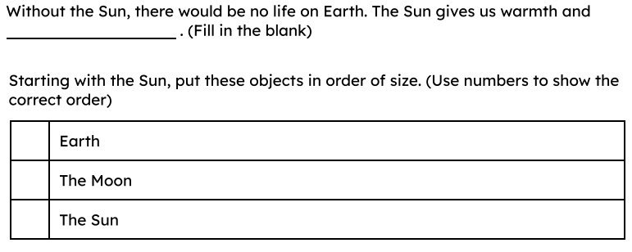
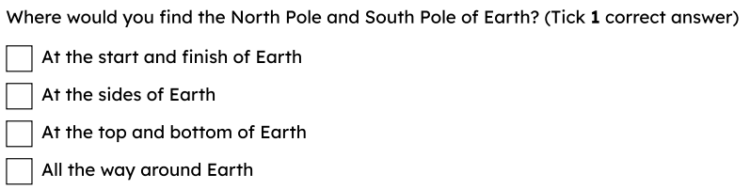
Wednesday 21st January
Q: Why do we have day and night?
Why is a doughnut not the right choice to represent the sun?

Slide 45
Earth is the planet on which we live.
The Sun is a star and the centre of our solar system.
To rotate is to turn or spin.
The Earth’s axis is the imaginary line through its centre, from North pole to South pole.
A model is used to describe something that can’t be experienced directly.

Slide 46
A spinning Earth
We live on planet Earth.
Earth is the shape of a sphere.
North pole
axis
Earth has an imaginary line that runs from the North pole, through its centre, to the South pole.
Earth
This line is called its axis.
South pole

Slide 47
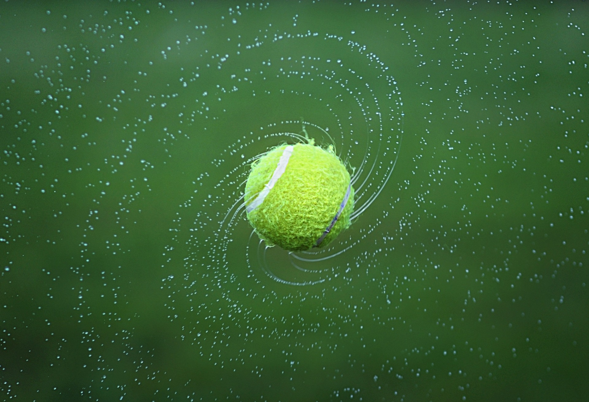
A spinning Earth
Earth spins round on its axis, like a spinning basketball.
It spins in an anti-clockwise direction.
Scientists use the word rotate to describe how Earth spins.
A tennis ball spinning

Slide 48
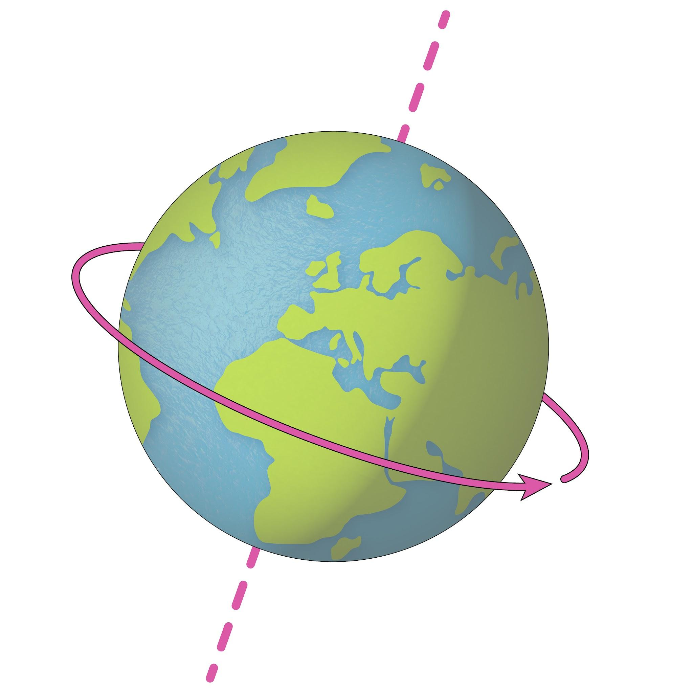
A spinning Earth
Earth is rotating at a constant speed of around 1000 miles per hour!
How long does it takes Earth to rotate once on its axis?
Because of its large size, it takes Earth 24 hours to complete one rotation.

Slide 49
Wednesday 21st January
Q: Why do we have day and night?
What is the name of the imaginary line that goes straight through the centre of the Earth?
How long does it take Earth to rotate once on its axis?
True or false?
Earth moves on its axis like a spinning basketball.

Slide 50
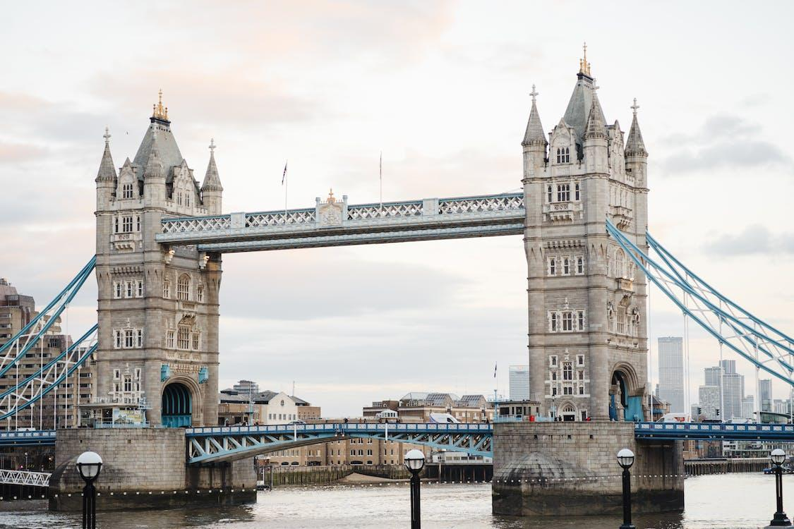
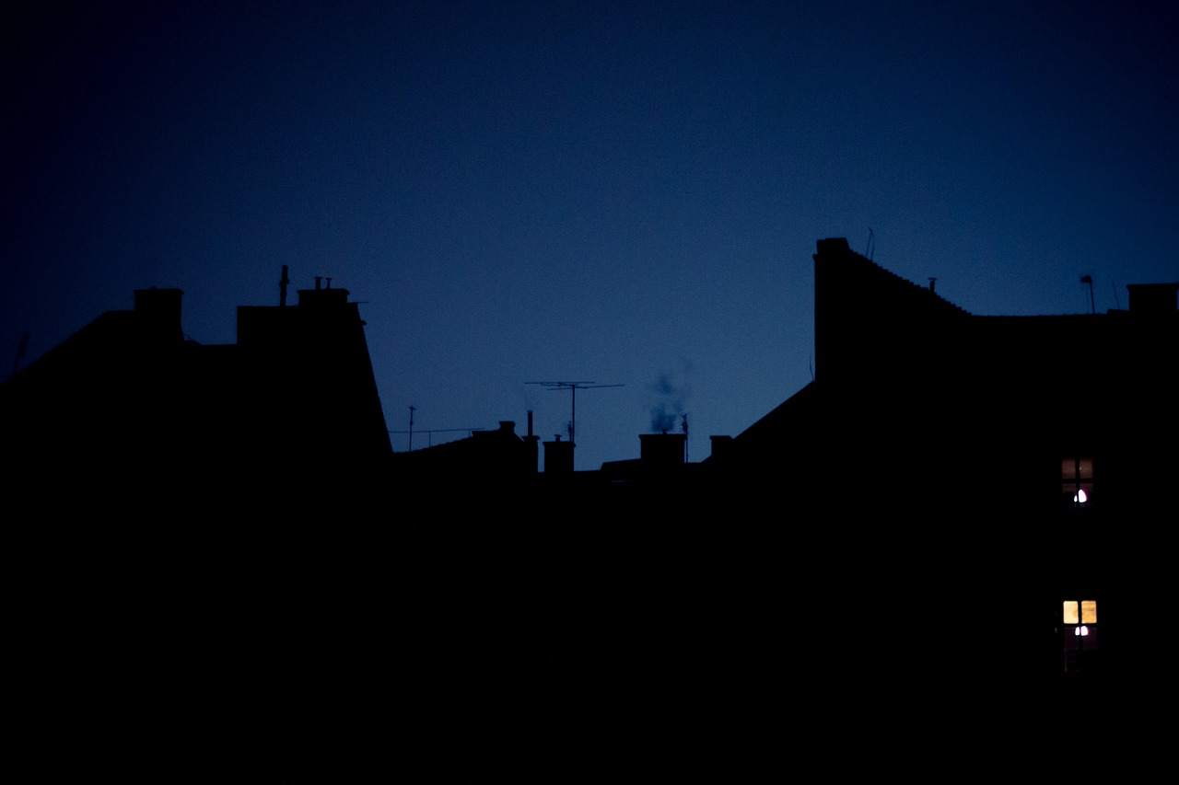
Day and night
The Sun gives us light during the day, but it is dark at night.
day time
night time
Why do you think it gets dark at night?

Slide 51
Day and night
The spinning Earth is what causes day and night.
As Earth rotates on its axis, the part where you live will face towards the Sun and then spin to face away from the Sun.
This is what is happening when it is getting lighter and darker on Earth.
A spinning sphere

Slide 52
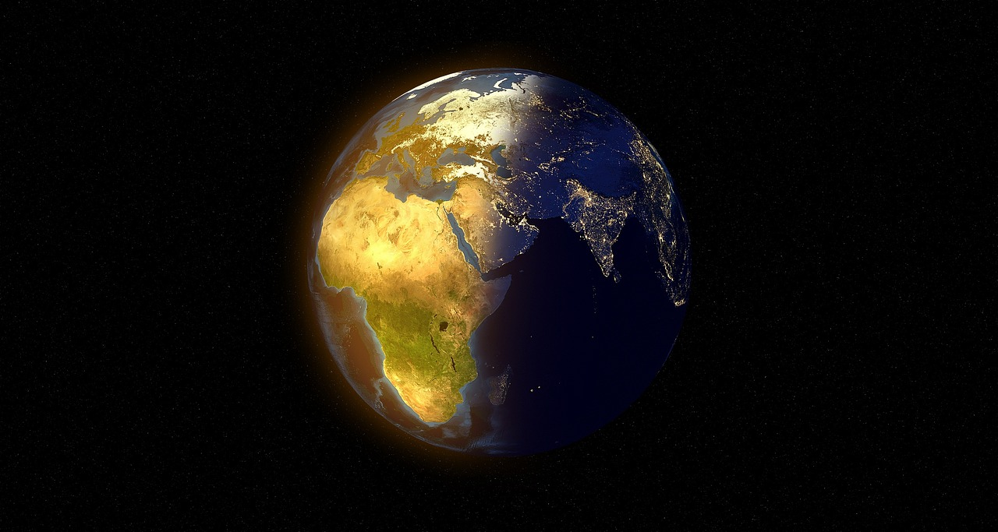
Day and night
The Sun is the centre of our solar system and gives all living things warmth and light.
As Earth rotates on its axis, the part of Earth facing the Sun has day time.
day time
Light from the the Sun
The Earth

Slide 53
Day and night
The part of Earth facing away from the Sun has night time.
night time
Light from the the Sun
The Earth

Slide 54

Day and night
People living in different parts of the world experience day and night at different times.
As your part of Earth rotates towards the Sun, it gradually becomes lighter. When you are directly facing the Sun, it is midday.
As your part of Earth rotates away from the Sun, it gradually becomes darker. When you are facing directly away the Sun, it is midnight.
When it is midnight for us, what time is it for someone living on the opposite side of the world?

Slide 55
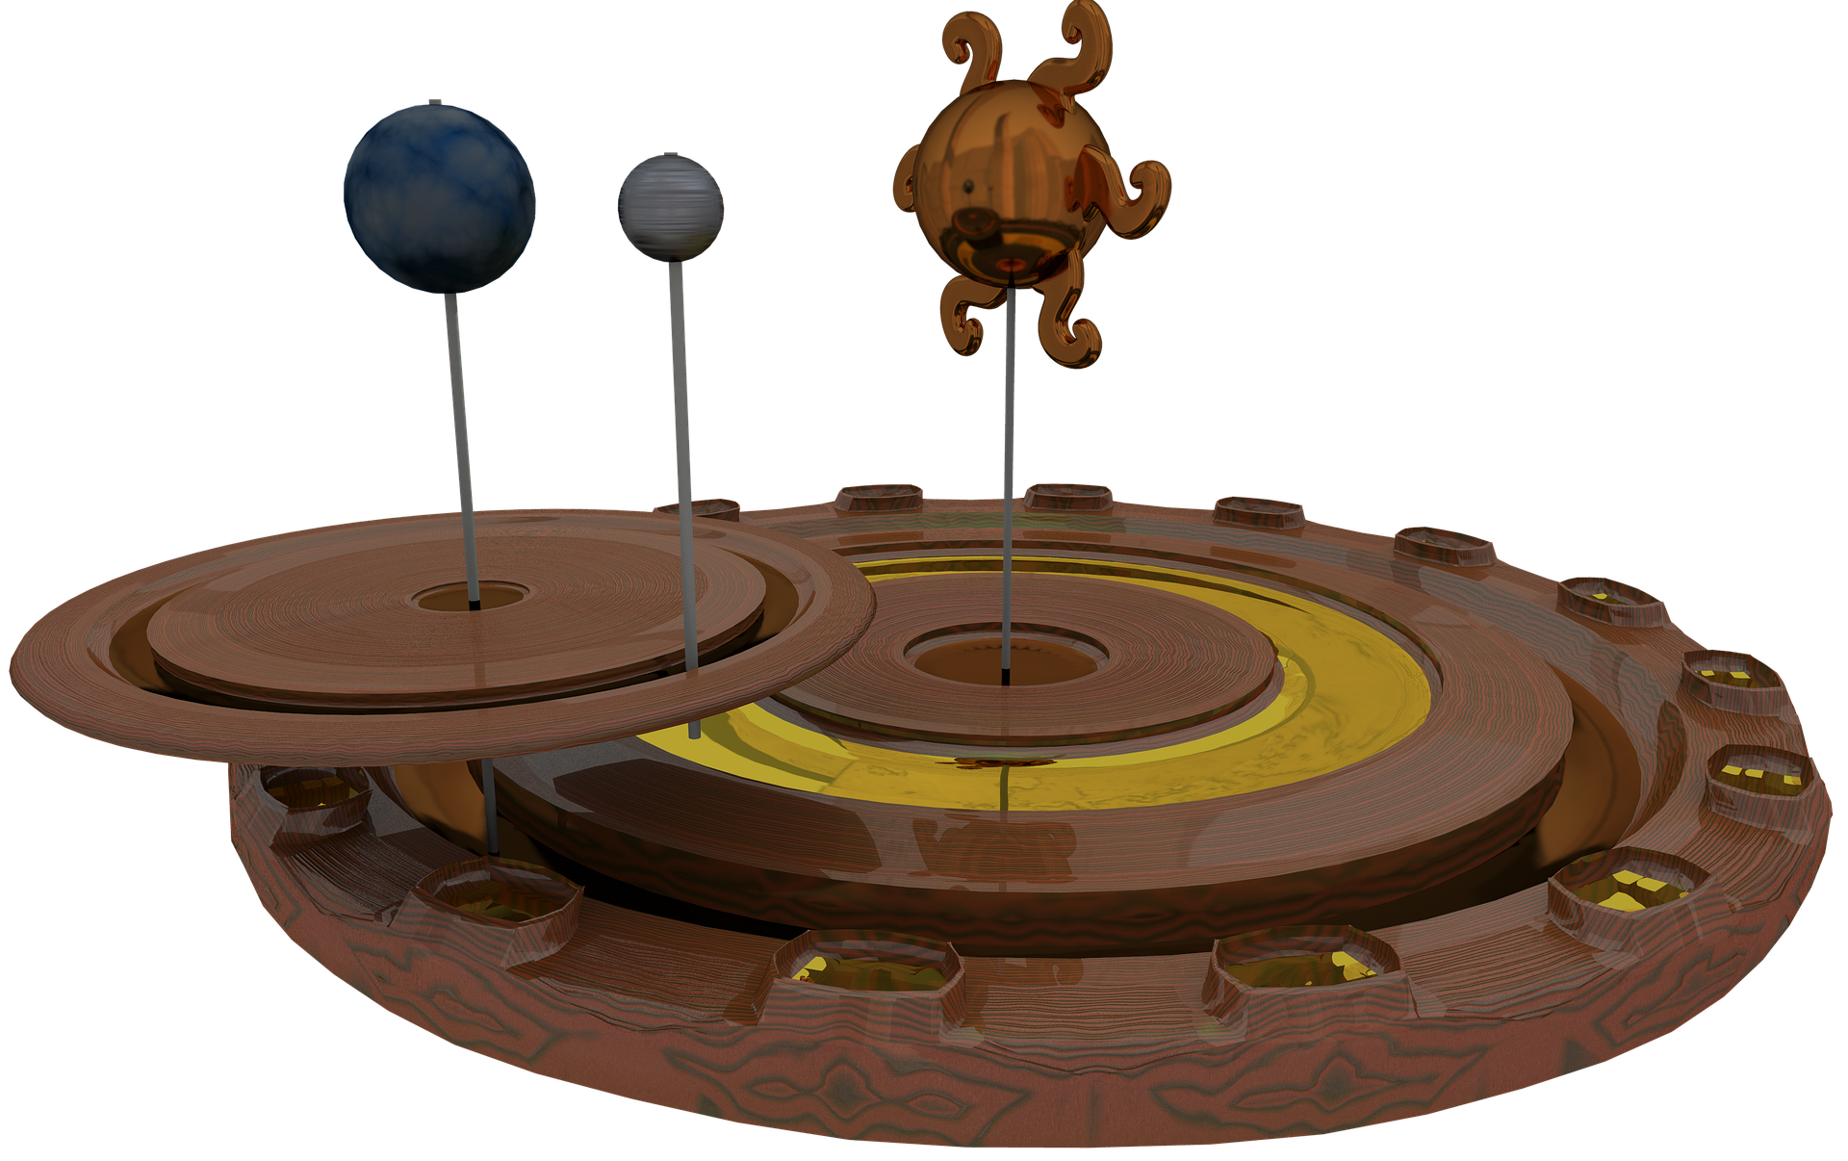
Day and night
People use models to help describe and explain things they can not experience themselves, such as what happens in space.
This model is called an orrery.
It spins to show how things move in space. Parts of an orrery can be used to explain why we have day and night.
orrery

Slide 56
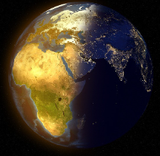




Day and night
Earth rotates in an anticlockwise direction. What will be happening at the cross on Earth below in the next few hours?
The Earth
Light from the the Sun
getting lighter
getting darker
staying the same

Slide 57
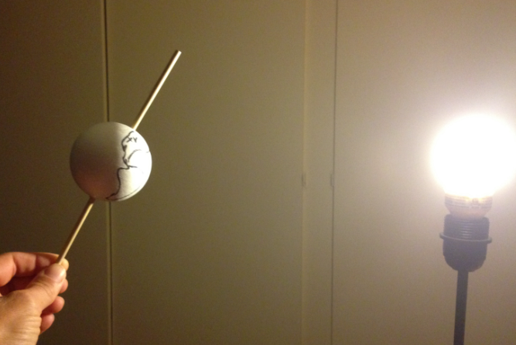
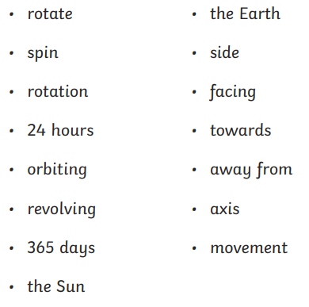
Wednesday 21st January
Q: Why do we have day and night?
Choose an object to represent Earth, and a bright torch for the Sun, to demonstrate why we have day and night.
Write a short commentary to explain why we have day and night.

Slide 58
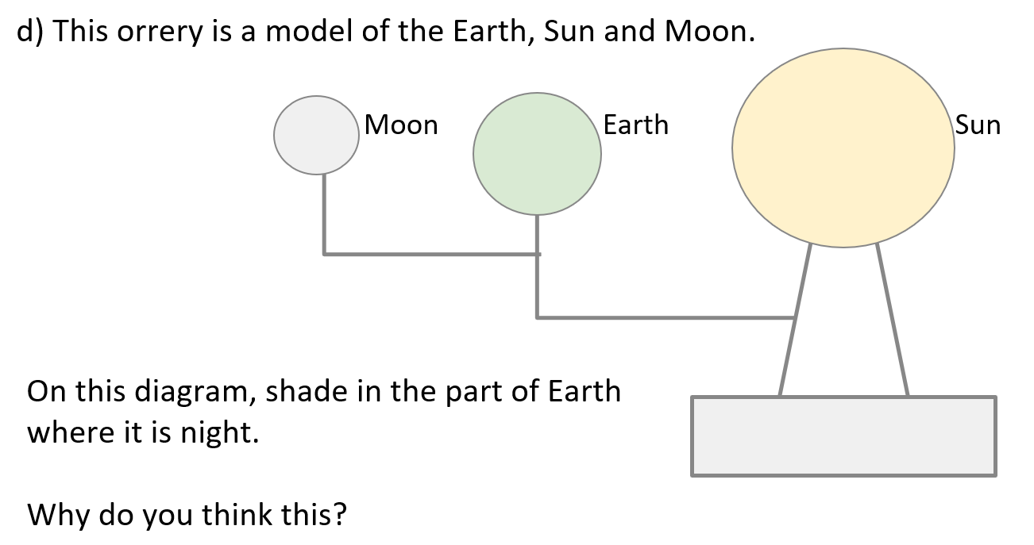
Wednesday 21st January
Q: Why do we have day and night?
Challenge

Slide 59
Wednesday 21st January
Q: Why do we have day and night?
Exit questions 1) How does Earth move to cause day and night?
2) Explain why we have nighttime on Earth.

Slide 60
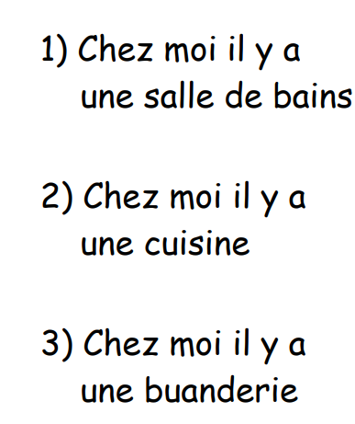
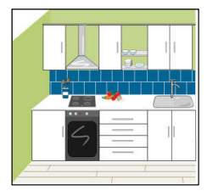
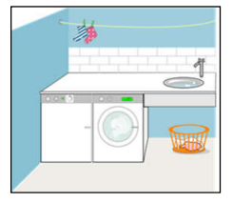
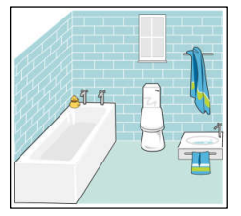
Frech mercredi 21 janvier TBAT: To learn another five nouns for rooms of the home. 3 in 3

Slide 61
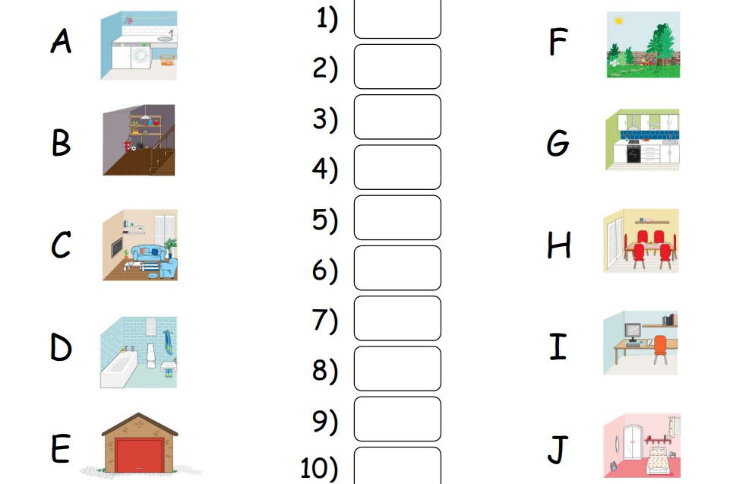
Dashboard Language angels – lesson 3

Slide 62
