Slide 1
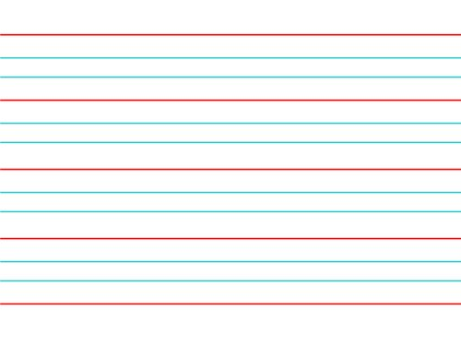
Morning Challenge – 19.1.26
happiness
hardness
madness
nastiness
silliness
tidiness
childishness
willingness
carelessness
foolishness Are there any words you are unsure of? Use a dictionary to look them up and then use them in a sentence.

Slide 2
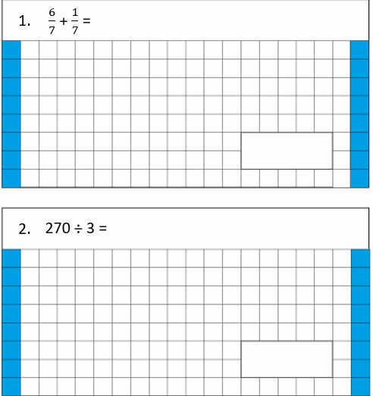
19.1.26 TBAT- apply divisibility tests for 2,3,4,5,6,9 and 10.
Challenge: Write 75% as a decimal.
3. 567.09 divided by 100 =[ ]

Slide 3
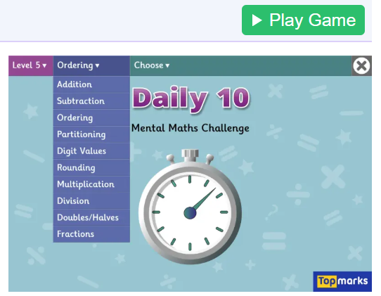
Daily 10 x 11 Daily 10 - Mental Maths Challenge - Topmarks

Slide 4
How do we know if a number is a multiple of 2? How do we know if a number is a multiple of 5? Challenge: How can we test if a number is divisible by 9?

Slide 5
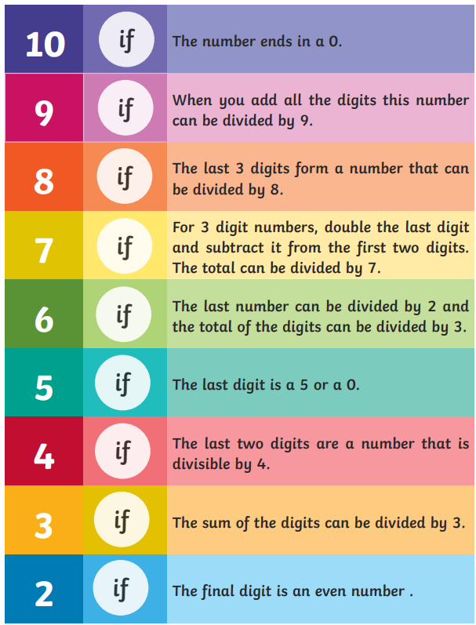

Slide 6
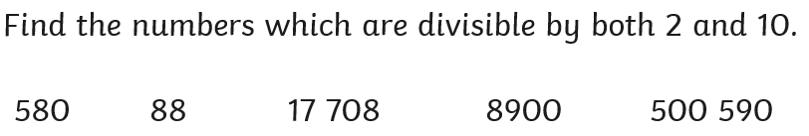
Whiteboard work:
Challenge: Select one of the numbers and explain why it is not divisible by 10.

Slide 7
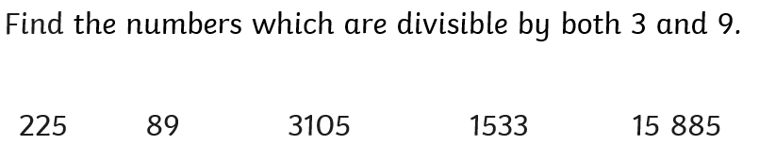
Whiteboard work:
Challenge: Select one of the numbers and explain why it is not divisible by 3.

Slide 8
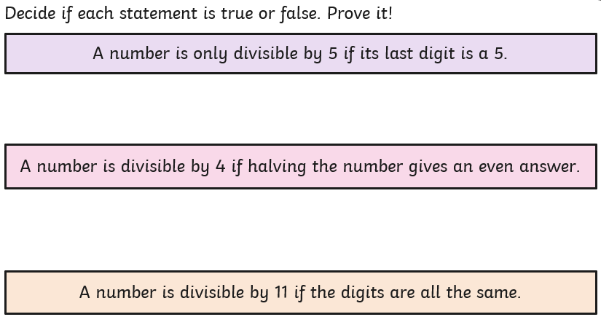
Whiteboard work:

Slide 9
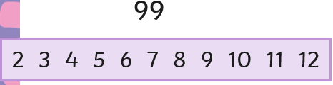
Class work: Use divisibility rules to find which numbers in the box are factors of the number.

Slide 10
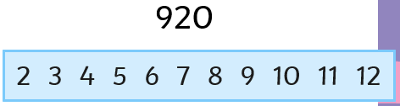
Paired work: Use divisibility rules to find which numbers in the box are factors of the number.

Slide 11
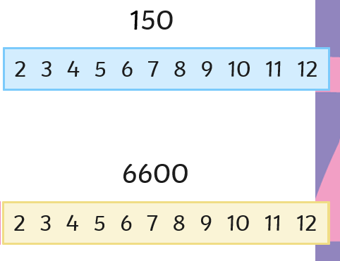
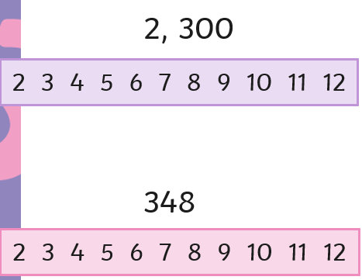
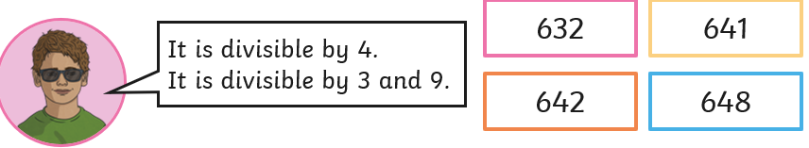
In books: Blue Green
Challenge:

Slide 12
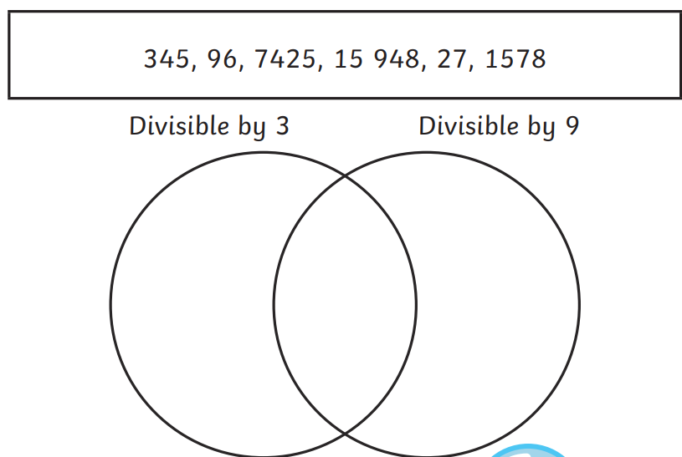
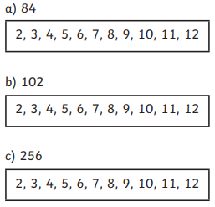
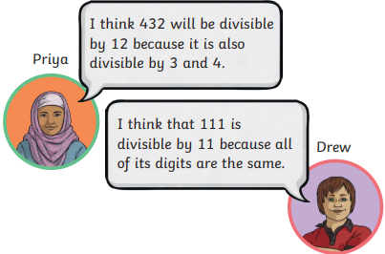
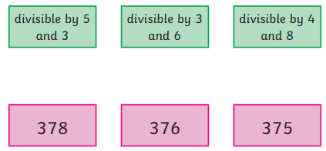

Independent:
Who is correct? Explain your answer:
Prove it!

Slide 13
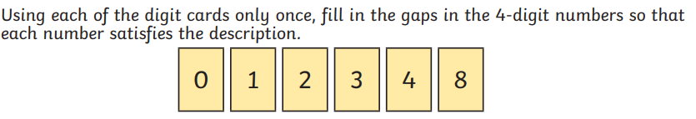
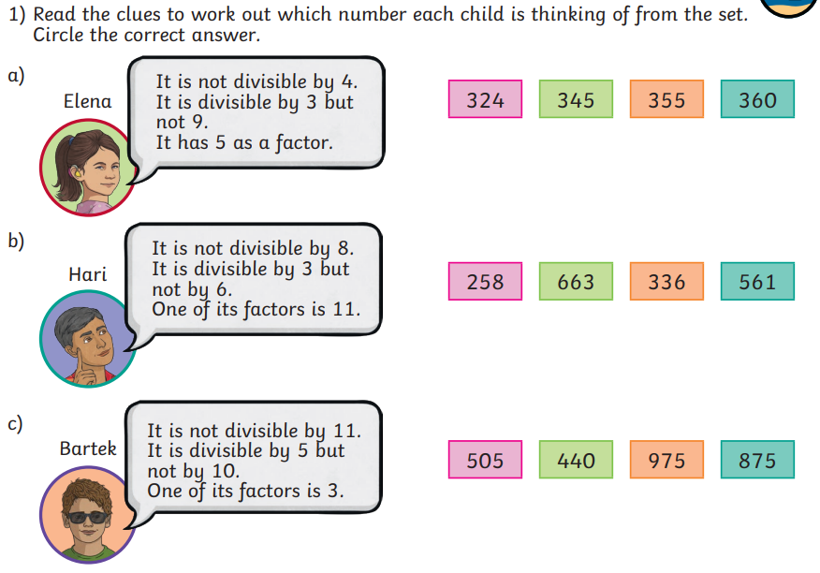
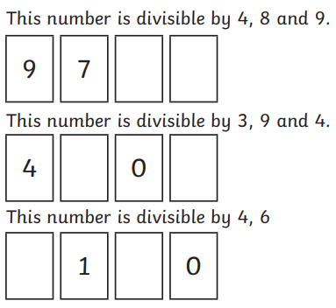
Challenge: Mastery:

Slide 14

Monday 19th January
TBAT- explore author's choice of language.
3 in 3
A rocket, launched yesterday from a private site in northern China, is missing. Yesterday the Internet was alive with rumours of a secret manned space mission. Today NASA and the Russian Federal Space Agency both confirmed that a rocket did take off but denied it was theirs. The rocket entered high orbit and then disappeared into “deep space”. No manned rocket has left earth’s orbit since Apollo 17 in 1972.
Find a word with a similar meaning to vanished.
2) Where did the rocket launch from?
3)What do you infer from 'deep space'?

Slide 15

Synonym Challenge:
anxious
manoeuvre
movement
mission
audacious
meander
deceive
adventurous
vast
big
amble
trick

Slide 16
Blue He smiled. He winked. He slinked. What sentence type has been used? Green My thoughts ran away with me. Should we sit inside? Why did the author follow the statement with a question?

Slide 17
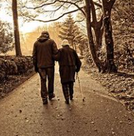
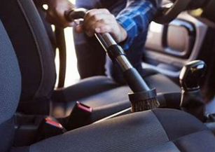
Key Vocabulary: ambling valet nauseous

Slide 18

In groups read the text, decide who will read what parts. Read the text as a class. Highlight three parts of the text that you find interesting.

Slide 19
Class Work: Close to the entry was an absolute beauty: shiny and glossy, sleek and powerful, tempting us in. What is the 'beauty'? Why do you think this word was selected?

Slide 20
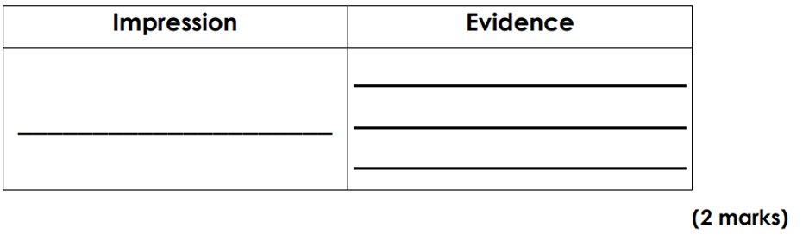
'My thoughts ran away with me.' What does this tell you about how the character is feeling at this time? 2) Find and copy a word with a similar meaning to 'love'. 3) 'Time stood still as his hand stretched up towards the neat row of key fobs.' Why has the author chosen the phrase; time stood still? 4) Find and copy a phrase that shows Liam felt anxious? 5) Find an example of a metaphor used to describe the car. 6) I saw a colourful rainbow arching across the sky and beckoning me towards the horizon. What do you think Liam wanted to do at this point and why? 7) What impression do you get of Liam? Use evidence from the text to support your answer.

Slide 21
Challenge: He smirked. He winked. He slinked. I smiled. I winced. I stood. Compare the two characters based on the sentences above. Salesman and Liam. What are the feelings and thoughts towards each other?

Slide 22
In box 5, write a sentence about how Liam was in the car. It will continue on from the semi-colon. I, on the other hand, had my elbow on the open window, excitement running through my veins

Slide 23
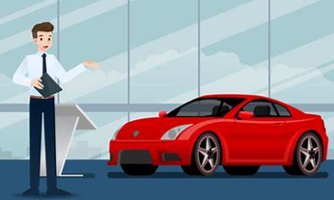
Word work: (continue planning sheet) Liam wants to say something grown up so that he isn't caught out, what may he say to the car salesman?

Slide 24
Word work: (continue planning sheet) Talk partners: What are the rules for using direct speech in our writing?

Slide 25
My thoughts ran away with me. Should we sit inside it? Is it locked? How fast would it go? Straight away, the salesman approached us and said, “I admire your taste.” I thought I should say something grown-up, so I took a deep breath and replied, “I’d like to test drive this one please.” (Box 2) Write a sentence that the car salesman might say to Liam and write Liam's response.

Slide 26





TBAT- create a micro:bit animation using a sequence of images in a loop.
I can explain that the order or sequence of instructions is important.
I can explain that loops can make code more compact and easier to read.
Notes:
Explain: animation is a sequence of still images shown one after the other to look like movement. Loops allow us to repeat sets of instructions without having to write them out multiple times. We used sequences of instructions in a loop last time to keep showing our names and pictures on the micro:bit’s display. Ask students: where else you have seen animations? E.g. cartoons, games.

Slide 27
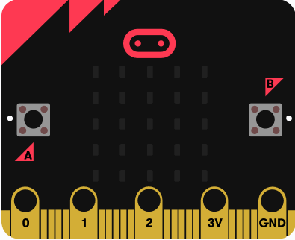
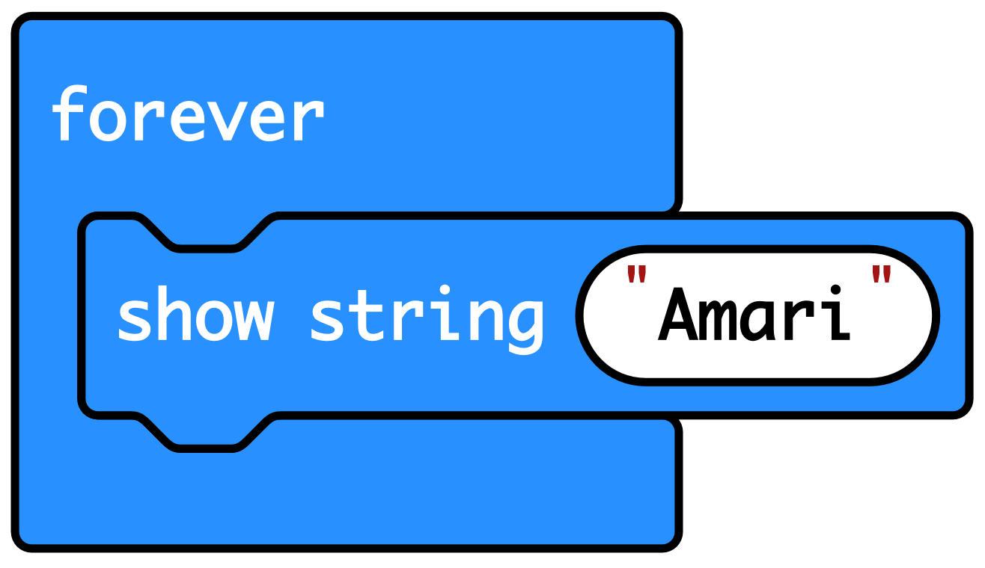
Recap: what did we discover about the micro:bit?
It’s a tiny computer.
You tell it what to do by creating code which you send to the micro:bit.
The code is an algorithm, a sequence of instructions.
The micro:bit has an LED display which it uses as an output to send out information such as our names.
The ‘forever’ loop kept the code running.

Slide 28
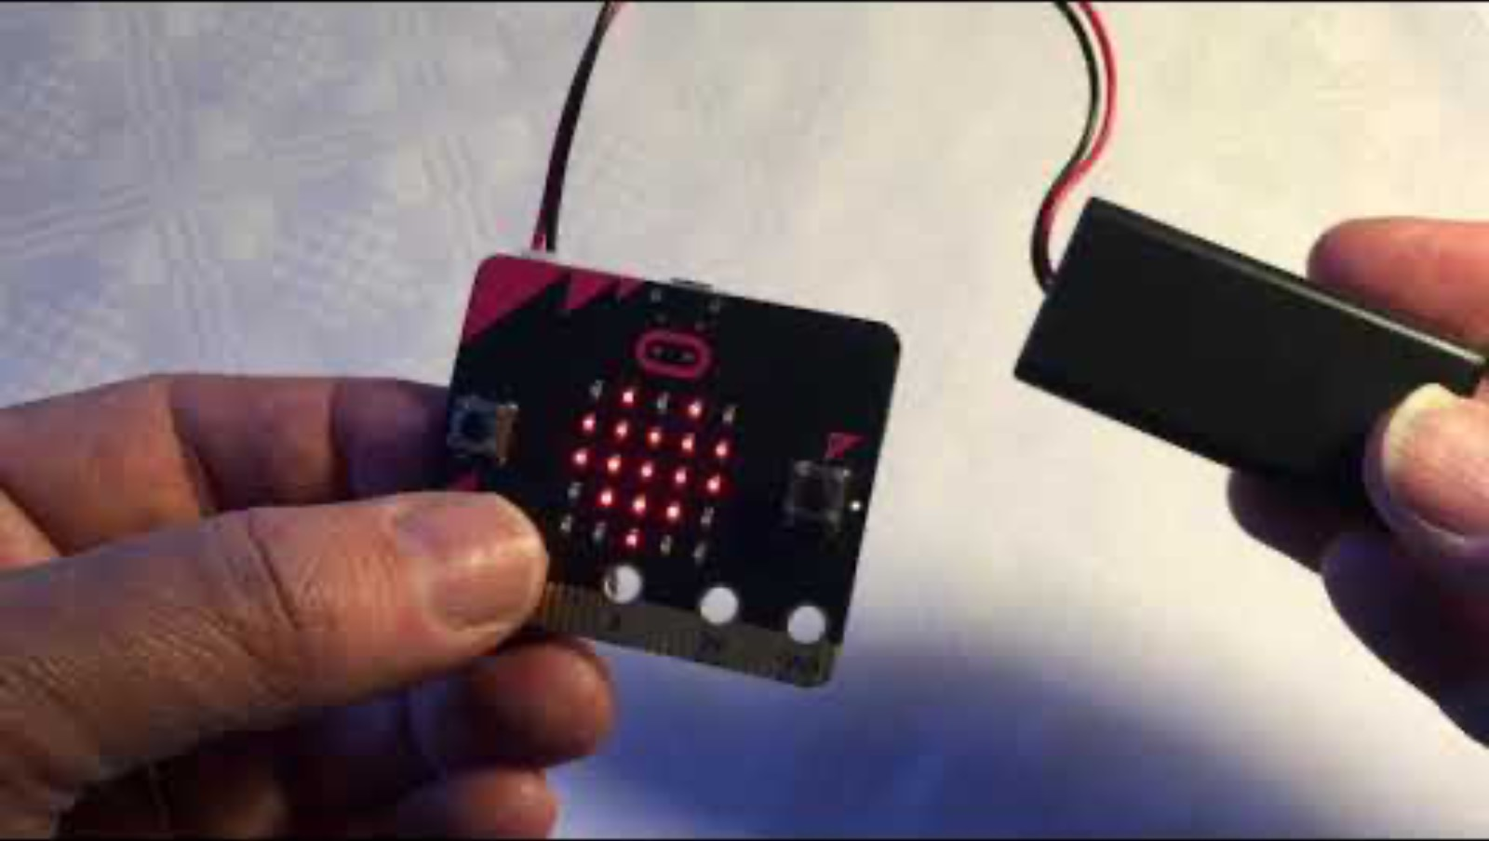



Think: beating heart introduction video
Optionally play video: https://youtu.be/8qzYWH10o6E

Slide 29

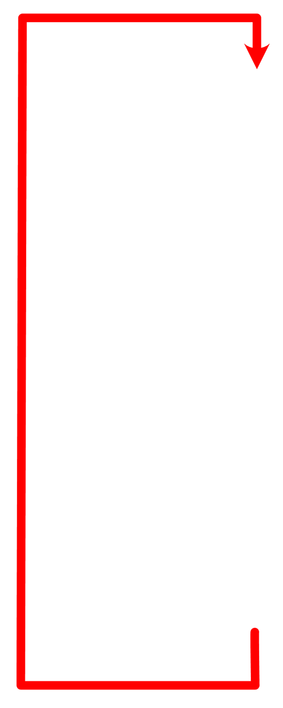
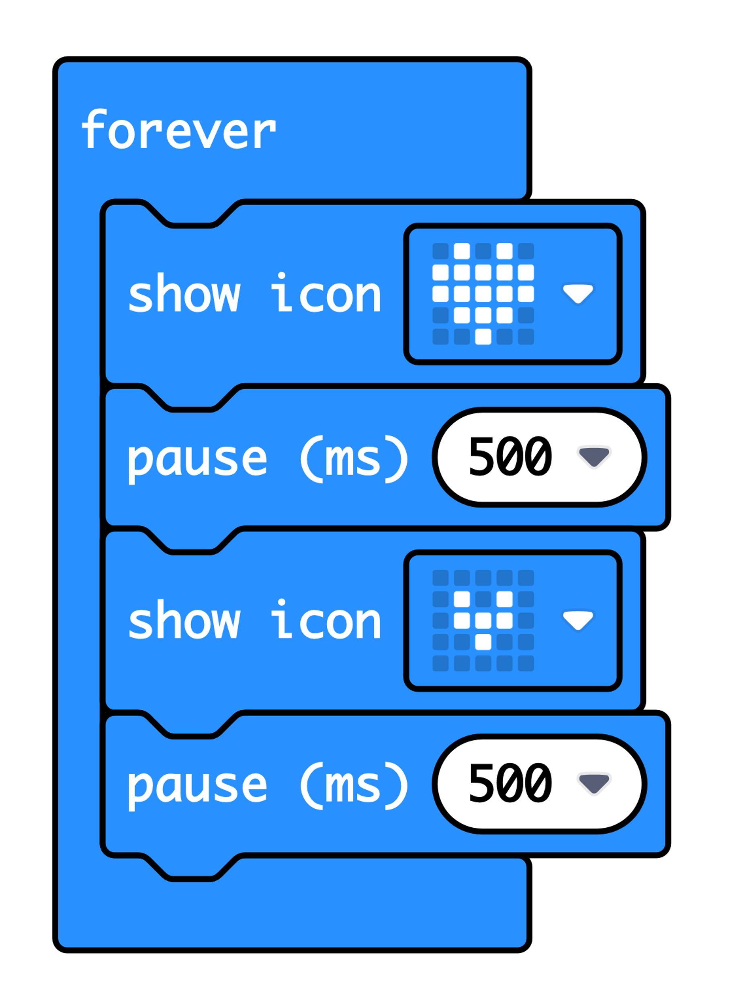

Create: examine the code
‘Forever’ is a loop that keeps the code running.
‘Show icon’ lights up the LED display output in a pattern.
‘Pause’ makes the micro:bit wait before carrying out the next instruction. 500 milliseconds is half a second.
After carrying out these four instructions, the loop goes back to the top and starts again.
Teacher: open completed code in editor
Notes:
The ‘forever’ block is a loop which keeps the sequence going. It’s an ‘infinite loop’ – a loop that keeps going as long as the micro:bit has power.
The ‘show icon’ and ‘pause’ blocks make up the sequence. Changing the pause time makes the animation faster or slower.
At the end of the sequence, the loop goes back to the top and starts again. Using a loop means we can use only 4 blocks to create an animation that runs forever.
You can follow the link to open the completed code in the editor. You can model changing the pause times and seeing what effect that has in the simulator.

Slide 30

Create: build the code
Open a new MakeCode project https://makecode.microbit.org/
Notes:
You can follow the link to open a new MakeCode project and model building the code yourself – or use slide 7 to show a YouTube coding video, or slide 8 to show an animated GIF of building the code if YouTube is blocked in your school.

Slide 31

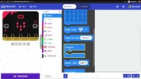
Create: coding video
YouTube coding video: https://mbit.io/lessons-heart-code-video
Notes:
Optionally share this YouTube coding video with your class: https://mbit.io/lessons-heart-code-video

Slide 32


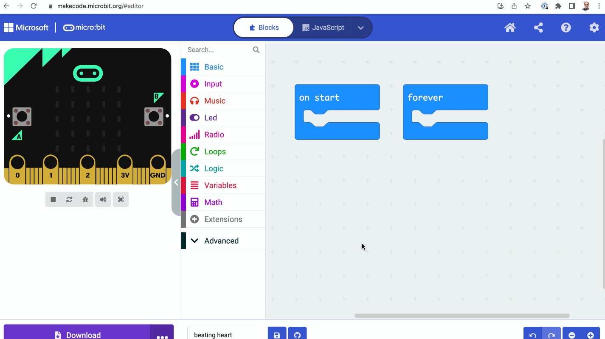
Create: coding animation
Notes:
Animated GIF of building the code you can share with your students, if YouTube is blocked in your school.

Slide 33
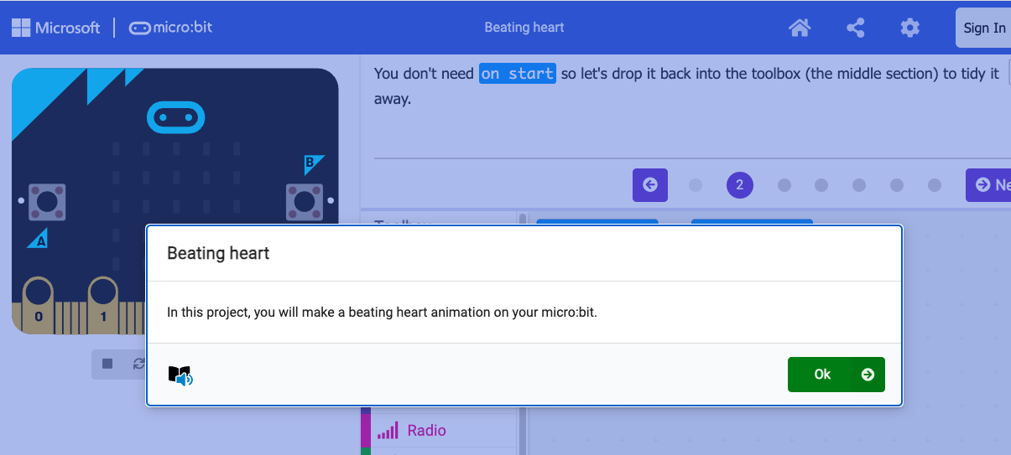

Create: step-by-step online tutorial
Use the link and follow the steps to create an animation.
Challenge:
Once you have evaluated your animation, then you can:
Create your own animations usingthe ‘show LEDs’ block.​
Make longer sequences with more images.​
https://mbit.io/tutorial-beating-heart
Notes:
You can optionally share this online step-by-step tutorial with your students to follow individually.

Slide 34

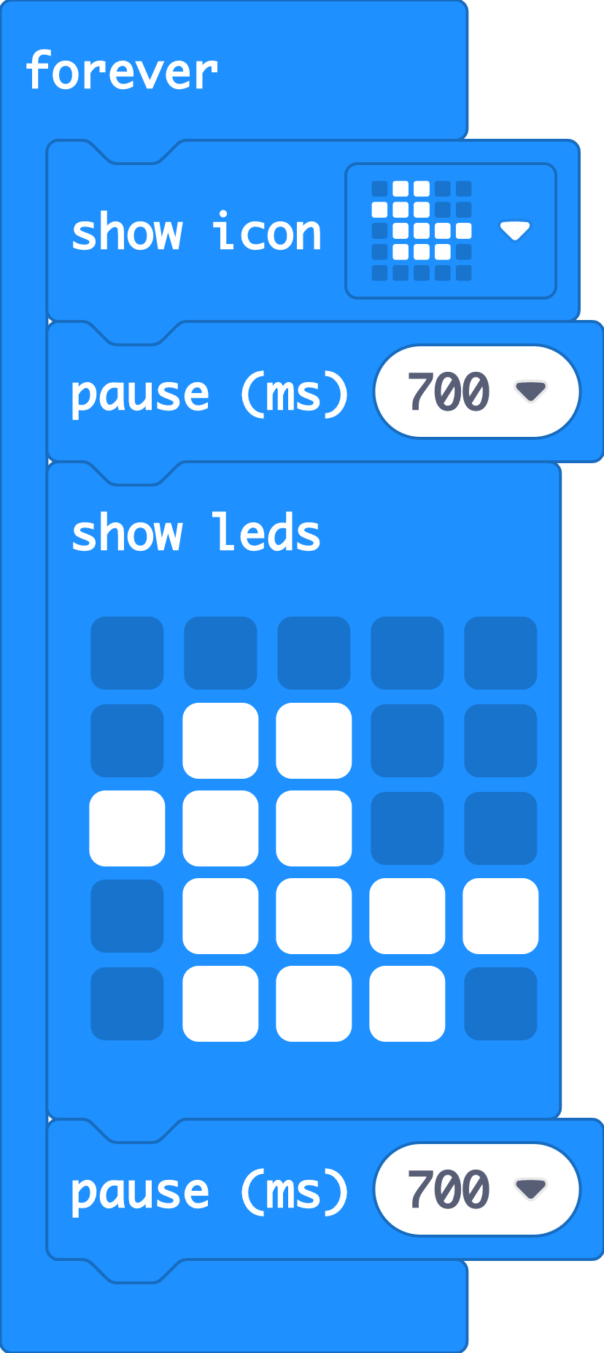

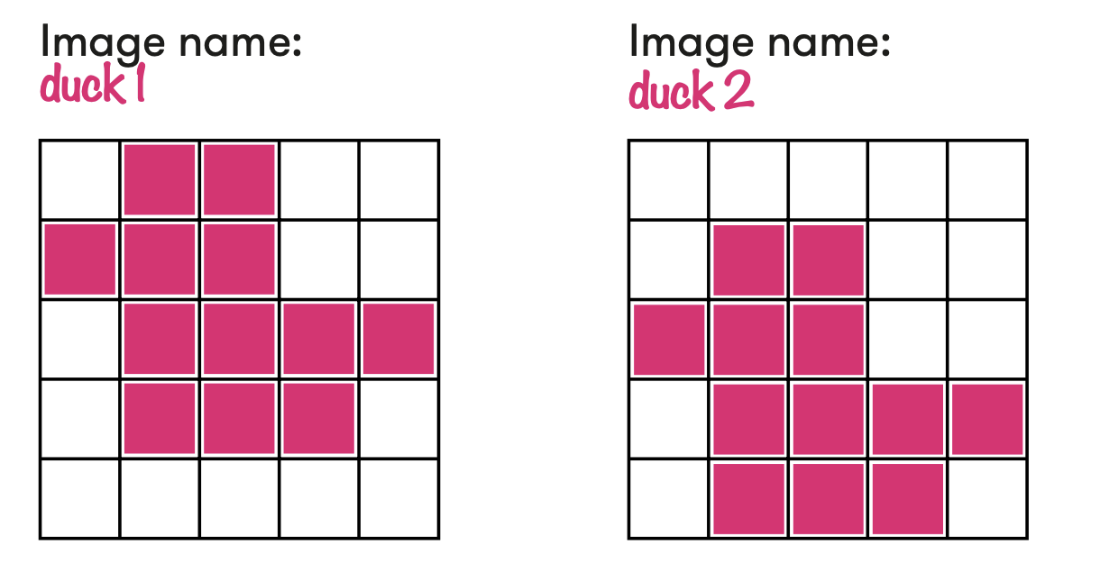

Extend
Change the pause times – what effects do shorter and longer pause times have on the animation?
Create your own animations using the ‘show LEDs’ block.
Make longer sequences with more images.

Slide 35


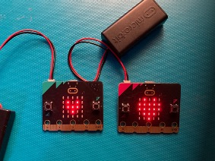

Evaluate
Download your code to a micro:bit
Does it work as you expect?
How good is the project?
Could it have other uses?
How does it work? (think about how it works whilst holding it in your hands)
Notes:
Students transfer code to their micro:bit and test.
If you have a battery packs, encourage students to unplug micro:bits from computers and attach batteries. Their code remains on the micro:bit and will still work
Does it work as you expect?
If not, do you need to debug the code and download it again?
How good is the project?
Can you think of anyone who would like this project and find it useful of enjoyable?
How could you improve it?
Could it have other uses?
How does it work?
Encourage students to think about how it works when holding it in their hands.

Slide 36

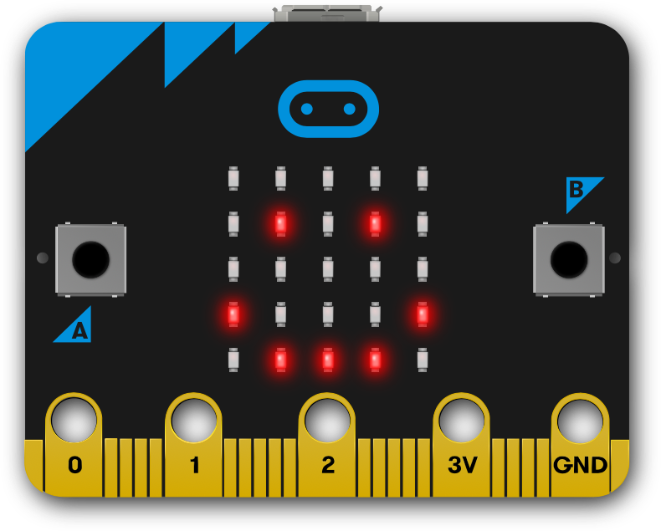

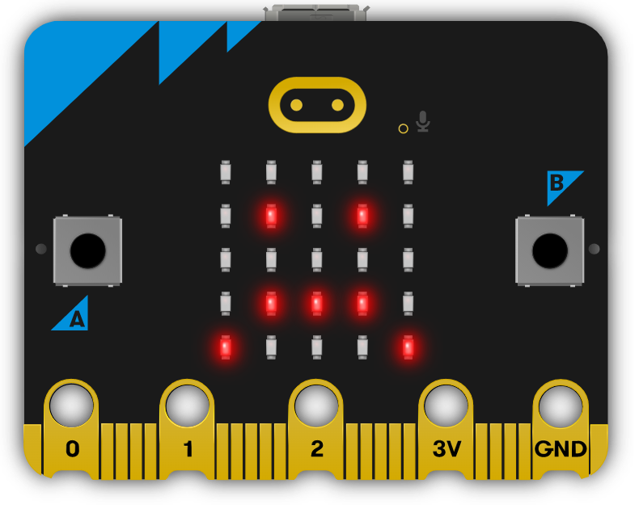
Next steps
Today we used the ‘forever’ loop block and sequences of instructions to make animations on the micro:bit’s LED display output.
Next time, we’ll use some of the micro:bit’s inputs, to make different pictures appear when we press different buttons.

Slide 37
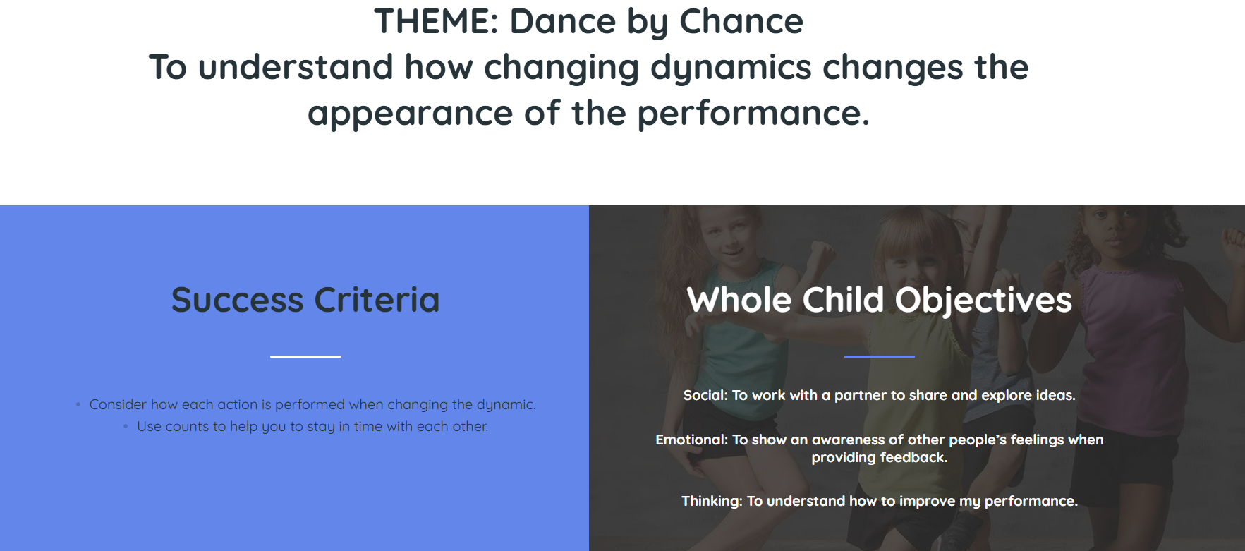
PE: Get Set 4 PE - Lesson Plan -2 for Year 5 Dance

