Slide 1
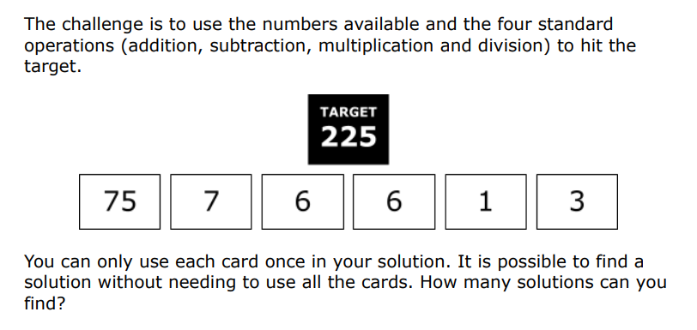
Friday 16th January Morning Challenge

Slide 2
Friday 16th January
Dictation
Our community worked together to clean the local park on Saturday morning.
Her curiosity led her to ask many questions about how the volcano was formed.
The bright costume improved the dancer’s visibility on the dark stage.
“I will remember this day forever,” he said, thinking about eternity.
There is a possibility that we will go on an excursion if the weather is good.

Slide 3
Friday 16th January
Dictation
Our community worked together to clean the local park on Saturday morning.
Her curiosity led her to ask many questions about how the volcano was formed.
The bright costume improved the dancer’s visibility on the dark stage.
“I will remember this day forever,” he said, thinking about eternity.
There is a possibility that we will go on an excursion if the weather is good.

Slide 4
16.01.26
TBAT- select an appropriate method for addition and subtraction.
1. 5.92 x 10 =
2. 0.00372 X 1000 =
3. 459.03 + 34.9 =
Challenge:
Write 0.8 as a fraction and a percentage

Slide 5
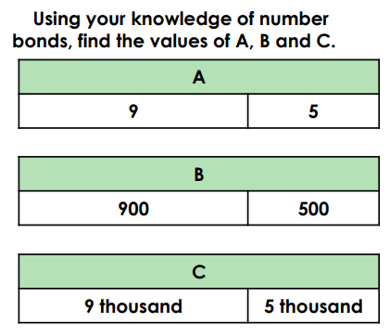
TBAT - choose to use a mental strategy or written method to solve addition and subtraction
Recap:

Slide 6
TBAT - choose to use a mental strategy or written method to solve addition and subtraction
Can you sort these calculations?
200,000 + 100,000 =
23,956 + 34,729 =
28,291 – 999 =
6020 + 2060 =
39,553 – 28,105 =
Mental strategy | Written strategy

Slide 7
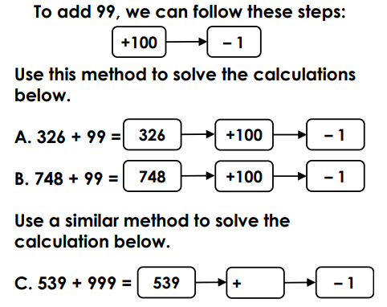
TBAT - choose to use a mental strategy or written method to solve addition and subtraction

Slide 8
Talk partners: Which method would you use to solve the following problem? 2, 637 – 1, 889

Slide 9
Mia says that the best method to use for 598 + 1, 023 is formal written. Do you agree? Convince me.

Slide 10
TBAT - choose to use a mental strategy or written method to solve addition and subtraction
200,000 + 100,000 =
23,956 + 34,729 =
28,291 – 999 =
6020 + 2060 =
31,553 – 28,195 =
999 + 1, 003 =
Challenge:
Explain why you chose to solve some using formal written method.

Slide 11
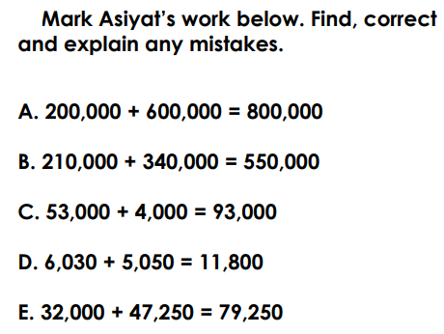
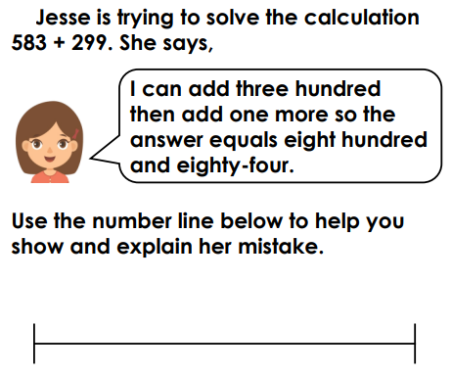
TBAT - choose to use a mental strategy or written method to solve addition and subtraction
RP:
Independent
Choose either to use a mental or written strategy.
1. 23,000 – 500 =
2. 86,472 – 35,291 =
3. 53,563 + 999 =
4. 26.55 + 111.2 =
5. 7, 020 – 5, 829=

Slide 12

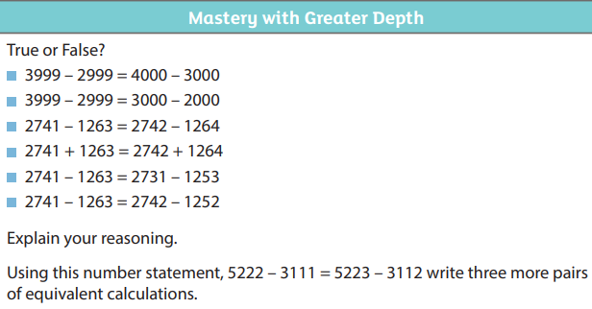

Slide 13
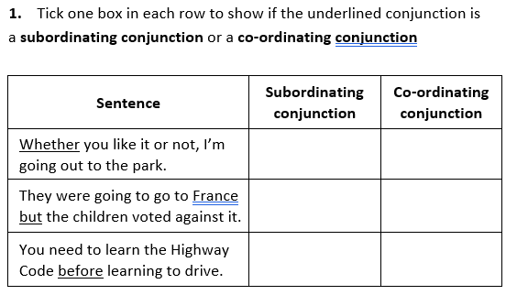
Friday 16th January TBAT- write effective sentences to entertain.
A subordinating clause needs a __________________ conjunction.
Connect the two sentences below.
Her name is Lilly. She attends Greenbank High School.

Slide 14
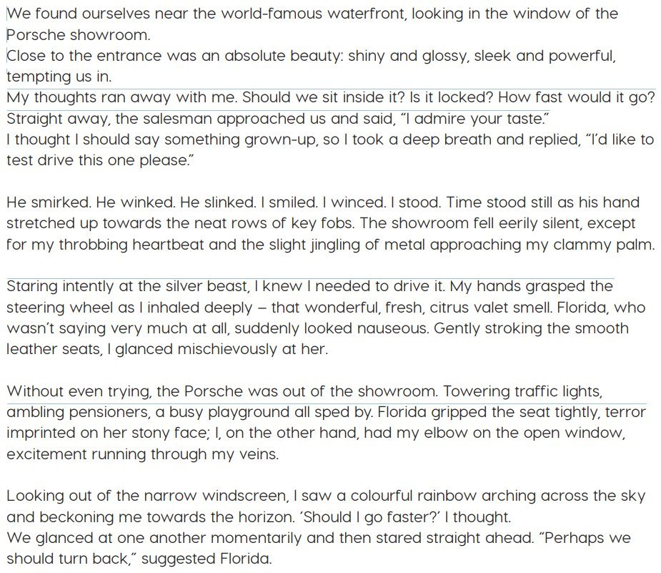
Class work: Read the text . What are the main ideas? Find a prepositional phrase.

Slide 15
We found ourselves near the world-famous waterfront, looking in the window of the Porsche showroom.
Activity:
Talk partners: Think of three prepositional phrases:
Right beside the window...
Task: In box 1, write an opening sentence about being outside the showroom.

Slide 16
Watch the advert and write adjectives. Mission X: The Call of Tomorrow The new 911 ST: 60 years of the Porsche 911 - YouTube

Slide 17
Close to the entrance was an absolute beauty: shiny and glossy, sleek and powerful, tempting us in.
Activity:
What is the expanded noun phrase to describe the Porsche?
What expanded noun phrase would you use?

Slide 18
Task- box 1 on planning sheet
We found ourselves near the world-famous waterfront, looking in the window of the Porsche showroom.
Close to the entrance was an absolute beauty: shiny and glossy, sleek and powerful, tempting us in.
You are outside the showroom- including prepositional phrase.
2) You go to the entrance and see the car.
What word could you use instead of car?
Describe what it looks like using expanded noun phrase. Ch: Could you include two pairs of expanded noun phrases?

Slide 19
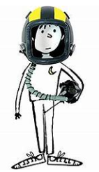
What questions might Liam ask himself in the car showroom? Write three questions that Liam may have thought in his head. Example: My thoughts ran away with me. Should we sit inside it? Is it locked? How fast would it go?

Slide 20
My thoughts ran away with me. Should we sit inside it? Is it locked? How fast would it go? Box 2: Write the opening statement, followed by the three questions Liam would ask himself. Do not take up the whole box as more will be going in there next week.

