Slide 1

Monday 12th January TBAT: practise joins consistently.
community
curiosity
ability
visibility
captivity
activity
eternity
flexibility
possibility
sensitivity

Slide 2
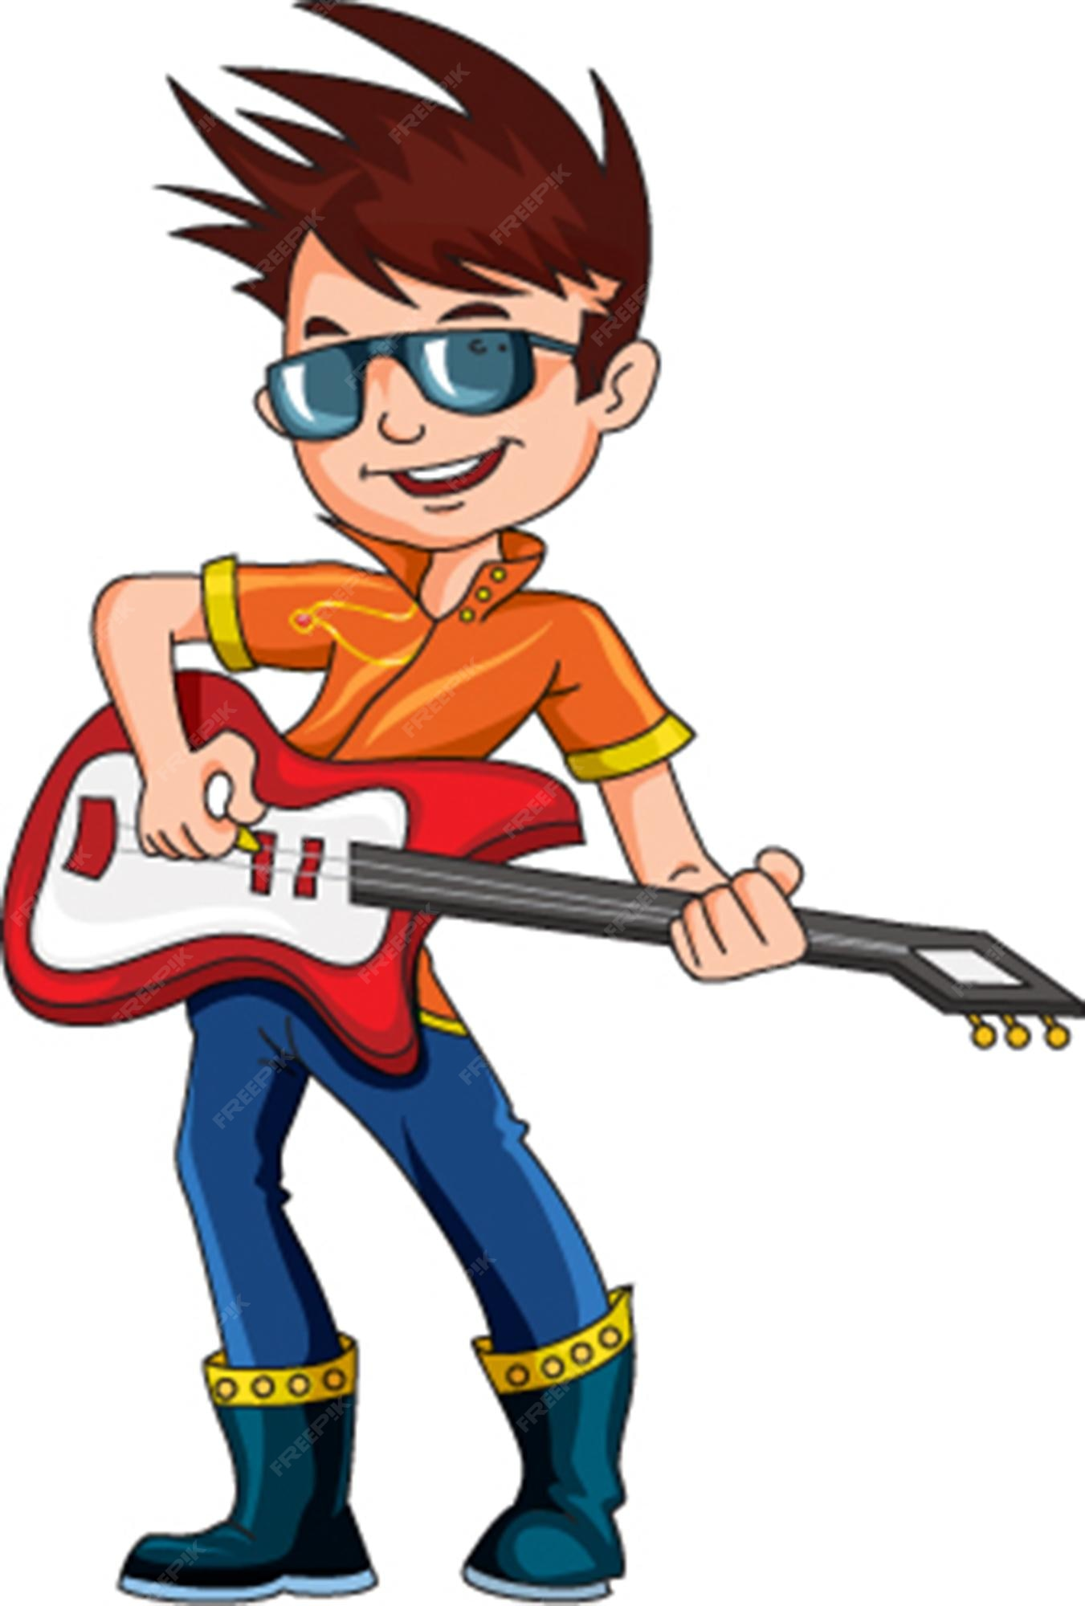
Rock Steady Workshop 9am

Slide 3
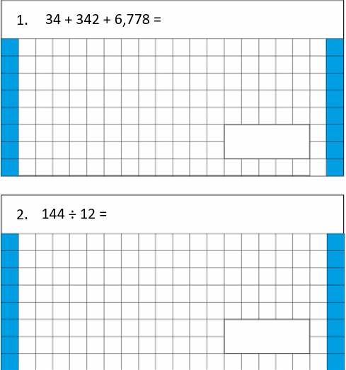
12.01.26 TBAT-use mental strategies for addition.
3. Simplify 16/48
Challenge; [ ] divided
by 10 = 24.7

Slide 4
Talk partners: What methods would be used to solve these problems?
5.6 + 3.9 =
3465 + 299 =
5.7 + 7.7 =

Slide 5
Rounding and adjusting Partitioning Number bonds Derived facts
Talk partners:
What would be the most suitable method to solve the problem below?
129 + 364 =

Slide 6
Rounding and adjusting Partitioning Number bonds Derived facts
Paired whiteboard work:
What would be the most suitable method to solve the problem below?
199 + 65 =

Slide 7
Whiteboard work:
55 + 128 =
999 + 25 =
57 + 107 =
32 + 39 =
155 + 202 =
68 + 25 =
Rounding and adjusting Partitioning Number bonds
Challenge: Think of a real-life scenario where you may need to solve this problem using a mental method.

Slide 8
Rounding and adjusting Partitioning Number bonds Derived facts
Talk partners:
What would be the most suitable method to solve the problem below?
45.9 + 11.1 =

Slide 9
Rounding and adjusting Partitioning Number bonds
Paired Whiteboard work:
What would be the most suitable method to solve the problem below?
22.23 + 100.18 =

Slide 10
12.2 + 1.28 =
22.7 + 12.5 =
57.1 + 20.88 =
32.2 + 1.39 =
15.56 + 20.24 =
68.34 + 25.5 =
Rounding and adjusting Partitioning Number bonds
Derived facts
Challenge: Think of a real-life scenario where you may need to solve this problem using a mental method.

Slide 11
TBAT- Use mental strategies to add decimals and whole numbers.
Independent Work:
29.9 + 8.2 =
163 + 29 =
7.5 + 5.2 =
4.14 + 12.5 =
John has two pipes. They are 2.1m and 4.7m. How long are they if he lays them end to end?
Billy is 1.43m tall and Bobby is 2.48m tall. How high would they be if Billy stood on Bobby’s head? (They are gymnasts; the dance hall ceiling is 3.8m high. Can they do the trick in there?)
220 adults attended a production. Half of them brought one child with them and 50 of them took two children. How many attendees were there altogether?
Dan has £2.23 in his pocket, £15.21 in his wallet and his gran gives him £10. How much money does he have altogether?

Slide 12
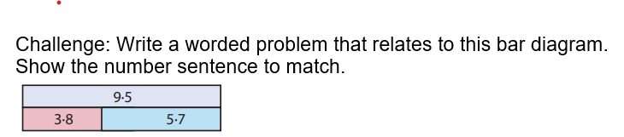
Mastery:
If you know 0.47 + 0.53 = 1.
Write two similar additions based on this fact. E.g. 4.7 + 5.3 = 10

Slide 13

Monday 12th January
TBAT- retrieve information from a text and explore author's choice of language.
What can we infer from the illustration about what might happen in the story?
Where do you think the story is set?

Slide 14
3 in 3
A rocket, launched yesterday from a private site in northern China, is missing. Yesterday the Internet was alive with rumours of a secret manned space mission. Today NASA and the Russian Federal Space Agency both confirmed that a rocket did take off but denied it was theirs. The rocket entered high orbit and then disappeared into “deep space”. No manned rocket has left earth’s orbit since Apollo 17 in 1972.
Find a word with a similar meaning to agreed.
2)When did the last manned rocket leave Earth?
3)What does 'no manned' rocket mean?
Challenge: Summarise this text in 10 words.

Slide 15

Synonym Challenge:
anxious
manoeuvre
movement
mission
encouragement
uncomfortable
ambition
aspiration
cheering
concerned
awkward
assignment

Slide 16
ANSWERS:
anxious
manoeuvre
movement
mission
encouragement
uncomfortable
ambition
aspiration
cheering
concerned
awkward
assignment

Slide 17
Chapter One and Two
Listen and reflect on Chapter 1 and 2. Think about the Tell me Grid. Highlight.
Likes
Dislikes
e.g.Likes – I like that the character is lost in space, it adds some mystery to the text and I want to find out more.
e.g. Dislikes - I dislike that his space rocket has lost control and he might be in danger. It makes me feel worried about the character.
Puzzles
Surprises

Slide 18

What is the chosen cause of action when they were spinning hopelessly out of control into forever?

Slide 19
Independent: Chapter 1 1) How far away is Liam’s rocket the ‘Infinite Possibility’ from Earth at the beginning of the chapter?
2) How does Liam feel about being extraordinarily tall for his age? Justify your impression using evidence from the text.
3)‘Anyway, a few hours back the Infinite Possibility was supposed to complete a routine manoeuvre and basically it didn’t.’ The word routine in this sentence is closest in meaning to: Tick one. unusual difficult standard basic
Chapter 2 4) Identify two things that Liam enjoys about being in space. 5)‘The multi-storey blots out most of the sky.’ The words ‘blots out’ in this sentence are closest in meaning to: illuminates reveals darkens hides
6) ‘Possibly. In some remote and noble corner of my heart, yes.’ The word ‘remote’ in this sentence is closest in meaning to: controlled small distant unlikely

Slide 20
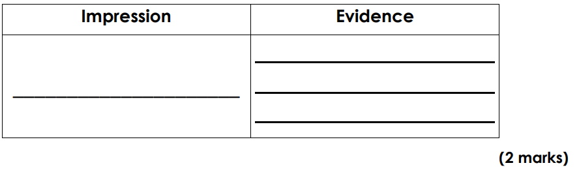
Challenge: What impression do you have of Liam from the two chapters? Identify evidence/events from the text to support your point.

Slide 21
Monday 12th January TBAT- input an algorithm to make a name badge on micro-bit. What is an algorithm? Name as many devices as you can.

Slide 22





TBAT- input an algorithm to make a name badge on micro-bit.
I can explain that the micro:bit is a tiny computer.
I can explain that computers need to be given sets of instructions (an algorithm) in code.
I can give the micro:bit instructions in code to make a name badge using the LED display output.
Notes:
Today we’re going to code our micro:bits to show our names. Our names are shown scrolling across the LED lights on the front of the micro:bit. We’ll create an algorithm – instructions in code, a language the micro:bit can understand.

Slide 23



Recap- talk partners: what is a computer?
What do computers do?
Where do we find them?
Is a phone a computer?
A game console?
What else do you think has a computer inside?
Notes:
Computers are not just laptops and desktops PCs, they all around us, inside phones, games consoles, TVs and even cars.

Slide 24
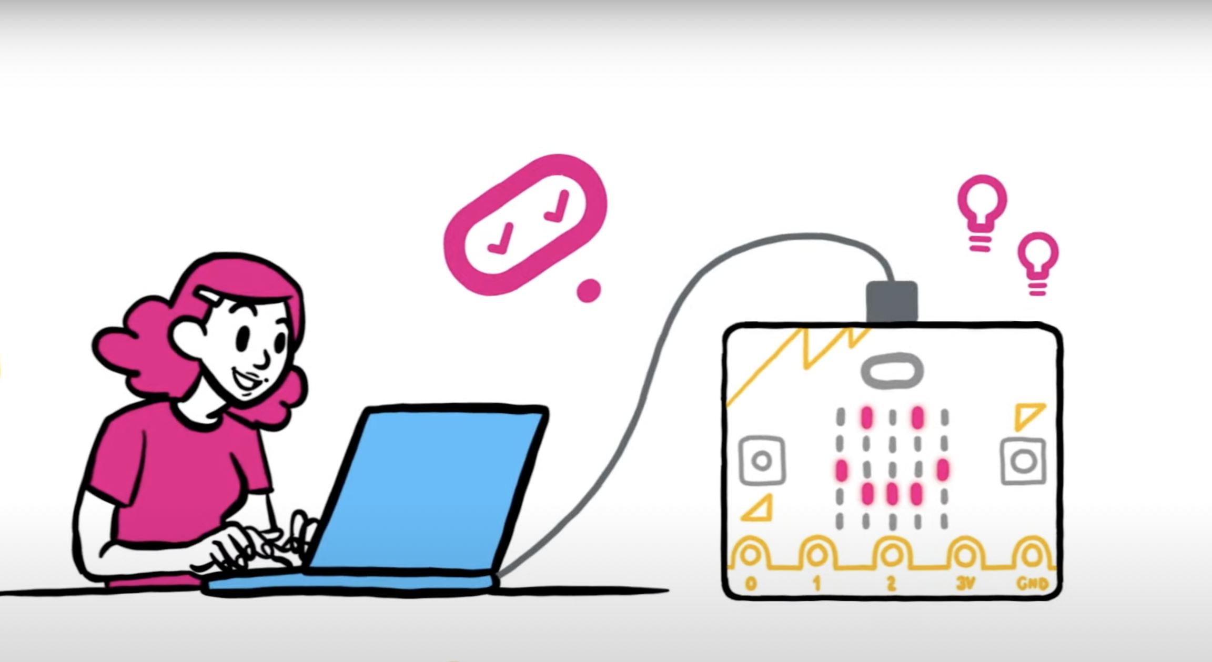
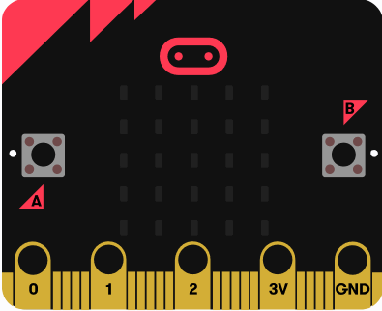

Think: what is a micro:bit?
A tiny computer
You tell it what to do by writing instructions in code
The code is an algorithm, a sequence of instructions.
The micro:bit can show words on its LED display output.
You can unplug your micro:bit, attach a battery pack and the code still works
Notes:
LEDs are light emitting diodes, the lights on the front of the micro:bit.
Information coming out of a computer is called an output.

Slide 25




Think: Introduction to the BBC micro:bit
Optionally play video: https://youtu.be/u2u7UJSRuko

Slide 26

Think: name badge introduction video
Optionally play video: https://youtu.be/teC0wzWF4tI

Slide 27
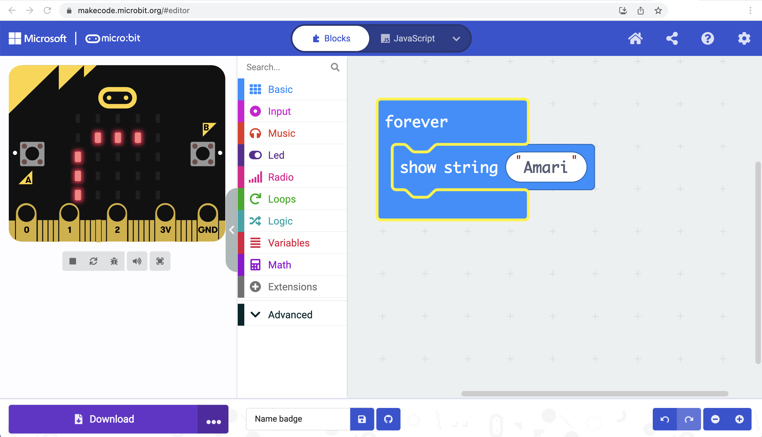
Introducing the MakeCode editor
1
Toolbox: find code blocks
Workspace: assemble your code
Simulator: test your code
Download code to your micro:bit
2
2
3
3
1
4
4
Notes:
If it’s your first lesson with the micro:bit, introduce the parts of the MakeCode editor. The MakeCode block editor works a lot like Scratch.

Slide 28


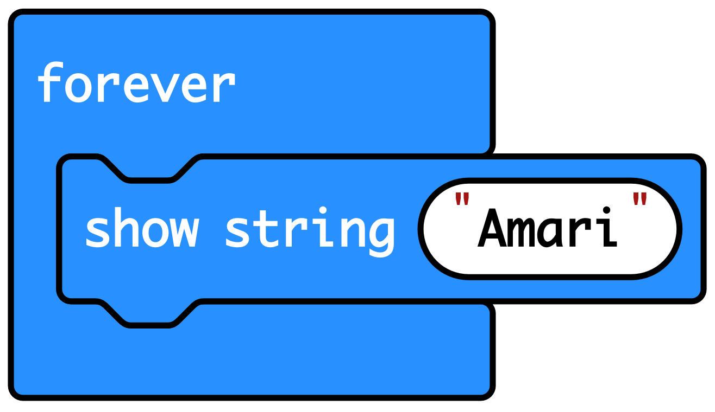

Create: examine the code
‘Forever’ is a loop that keeps the code running.
‘Show string’ scrolls the string of letters that make up your name across the LED display output.
The code then goes back to the top of the loop and runs again.
Teacher: open completed code in editor
Notes:
You can follow the link to open the completed code in the editor.
Model changing the name in the ‘show string’ block and seeing it change in the simulator.

Slide 29

Create: build the code
Open a new MakeCode project https://makecode.microbit.org/
Notes:
You can follow the link to open a new MakeCode project and model building the code yourself – or use slide 10 to show a YouTube coding video, or slide 11 to show an animated GIF of building the code if YouTube is blocked in your school.

Slide 30

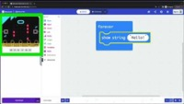
Create: coding video
YouTube coding video: https://mbit.io/lessons-name-code-video
Notes:
Optionally share this YouTube coding video with your students: https://mbit.io/lessons-name-code-video

Slide 31


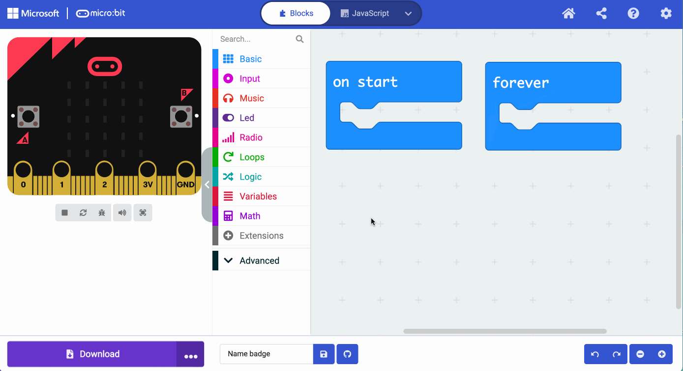
Create: coding animation
Notes:
Animated GIF of building the code you can share with your students, if YouTube is blocked in your school.

Slide 32
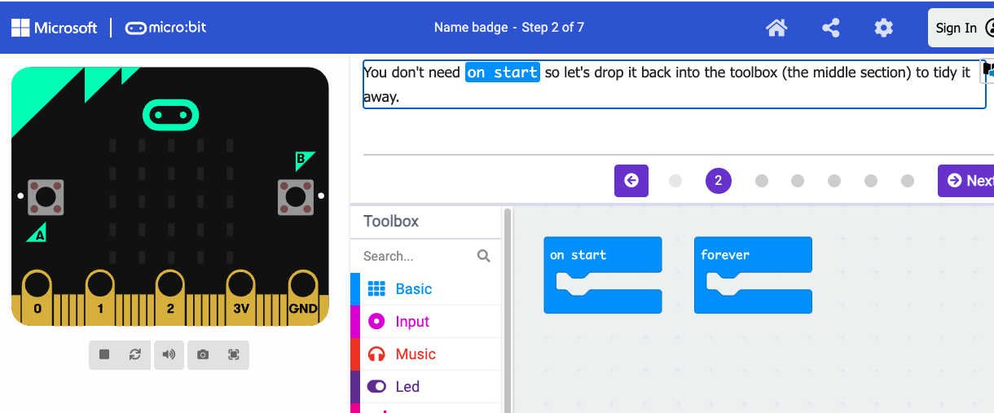
Create: step-by-step online tutorial
https://mbit.io/tutorial-name-badge
Notes:
You can optionally share this online step-by-step tutorial with your students to follow individually.

Slide 33


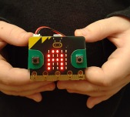

Evaluate
Download your code to a micro:bit
Does it work as you expect?
How good is the project?
Could it have other uses?
How does it work?
Notes:
Students transfer code to their micro:bit and test.
If you have a battery packs, encourage students to unplug micro:bits from computers and attach batteries. Their code remains on the micro:bit and will still work
Does it work as you expect?
If not, do you need to debug the code and download it again?
How good is the project?
Can you think of anyone who would like this project and find it useful of enjoyable?
How could you improve it?
Could it have other uses?
How does it work?
Encourage students to think about how it works when holding it in their hands.

Slide 34



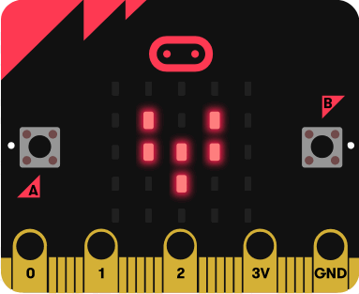
Next steps
Today we used the ‘forever’ loop block and instructions to make name badges.
Next time we’ll use the ‘forever’ loop block and sequences of instructions to make animations.

Slide 35
Monday 12th January TBAT: To create a dance using a random structure and perform the actions showing quality and control. Partner talk: Match the word to its definition: Actions Canon Choreograph Get Set 4 PE - Lesson Plan -1 for Year 5 Dance
when performers complete the same action one after the other. create a sequence of actions or movements.
the movement a performer uses e.g. travel, jump, kick.

