Slide 1
Wednesday 21st January 2026

Slide 2

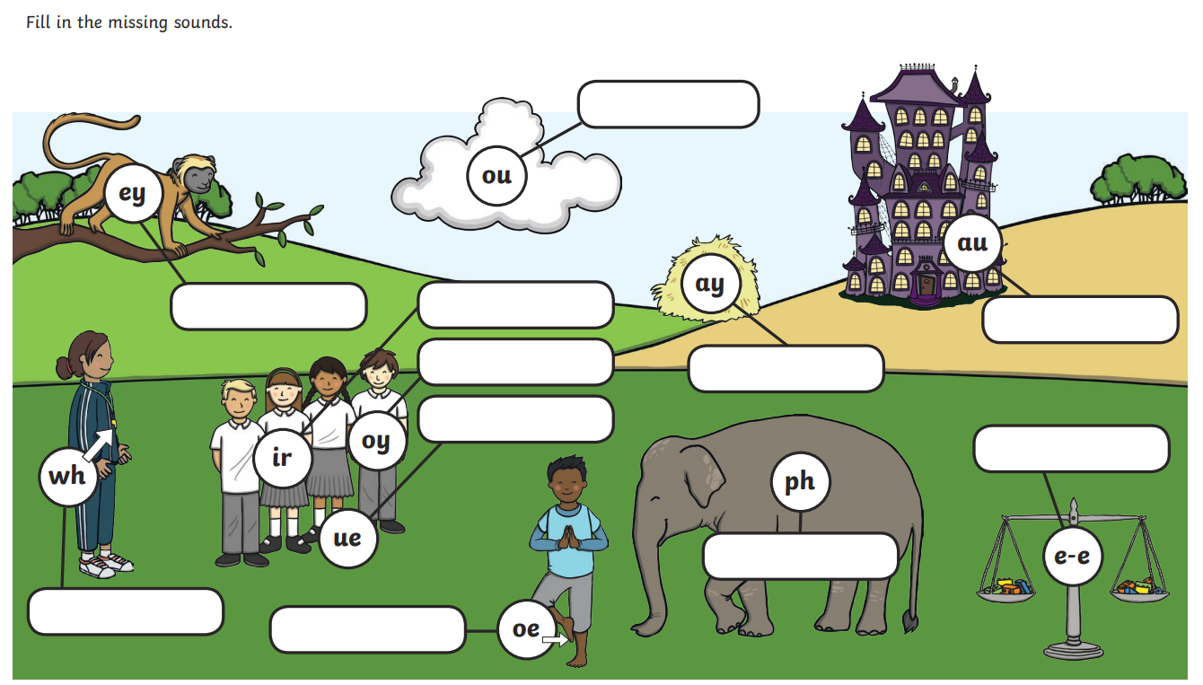
Morning Challenges:
Name writing

Slide 3
Phonics
Wednesday 21st January 2026
21/1/26
Revisit and review
Lesson focus:
Read words with the /s/c/ grapheme

Slide 4

Revisit and review
Wednesday 21st January 2026
21/1/26
Today's Grapheme
c

Slide 5
Recap
Wednesday 21st January 2026​
21/1/26
s c ph g
y ea wh
ow oe ou
le al

Slide 6
Revisit and review
Wednesday 21st January 2026
21/1/26
What are the digraphs?
final
equal
snow
spy
sparkle
apple
Segment these
words and read them
Blend and say words

Slide 7
Focus words
Wednesday 21st January 2026
21/1/26
f-a-c-e
s-p-a-c-e
l-a-c-e
Sounds out these
words and read them

Slide 8
Focus words
Wednesday 21st January 2026
21/1/26
face
space
lace
Read these words on sight

Slide 9
Focus words
Wednesday 21st January 2026
21/1/26
face
space
lace
mice
lice
Read, sound talk and blend
And again... FASTER!

Slide 10
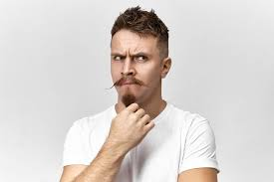
Revisit and review
Ms
Wednesday 21st January 2026
21/1/26
Mrs
Mr
school
tricky words
call
Read the tricky words

Slide 11
New tricky word
Wednesday 21st January 2026​
21/1/26
Different
Which part is tricky?

Slide 12

Wednesday 21st January 2026
21/1/26
Now let's read this sentence!​
What digraphs can you see?
What tricky words can you see?

Slide 13
Wednesday 21st January 2026
21/1/26
Let's spell!
How many sounds? Write it.
face mice different
tricky words
Listen to the sentence, say it, write it and read it!
Challenge
Extend the sentence using 'and'

Slide 14
TBAT: give clear instructions verbally.
Wednesday 21st January 2026
21/1/26
3 in 3- Circle the nouns, underline the verbs.
cat
run
kite
hat
fly
jump

Slide 15
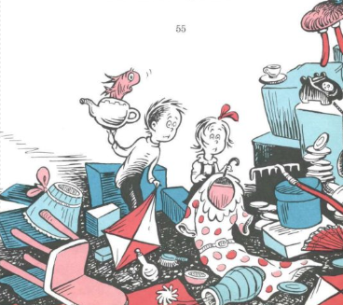
TBAT: give clear instructions verbally.
Wednesday 21st January 2026
21/1/26
Today we need to give instructions to Thing 1 and Thing 2, so they can clear up all the mess.

Slide 16

TBAT: give clear instructions verbally.
Wednesday 21st January 2026
21/1/26
What is an instruction?

Slide 17
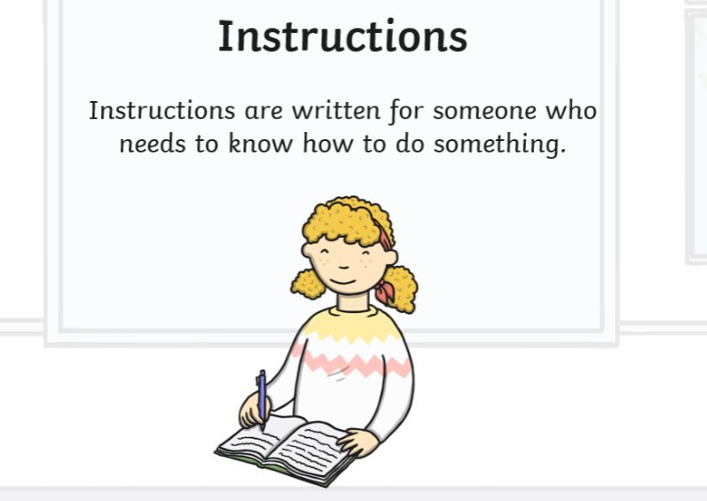
TBAT: give clear instructions verbally.
Wednesday 21st January 2026
21/1/26

Slide 18
TBAT: give clear instructions verbally.
Wednesday 21st January 2026
21/1/26
Instructions need to be clear. They need to tell the reader/ listener exactly what to do.
Why do you think that is?

Slide 19

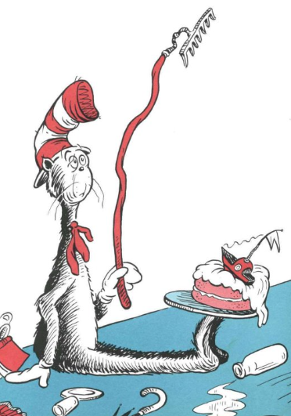
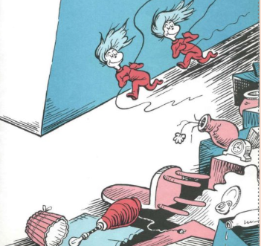
TBAT: give clear instructions verbally.
Wednesday 21st January 2026
21/1/26
Blue/ Green- Give your partner an instruction on how to clean up the mess.
clear
mess
spill
sweep
pick

Slide 20
TBAT: give clear instructions verbally.
Wednesday 21st January 2026
21/1/26
What needs to happen to clear up all the mess?

Slide 21
TBAT: give clear instructions verbally.
Wednesday 21st January 2026
21/1/26
​Pick up the chair.
Sweep up the floor.
Brush up the dust.
Gather the plates.

Slide 22
TBAT: give clear instructions verbally.
Wednesday 21st January 2026
21/1/26
Other imperative verbs you could use:
Gather Collect Wipe Scrub Mop Rinse
Sort Empty Shake off Fold Tidy Clear
Rinse Dry Replace Disinfect

Slide 23
TBAT: give clear instructions verbally.
Wednesday 21st January 2026
21/1/26
Independent:
Give clear instructions to Thing 1 and Thing 2 to tidy up the mess.
Challenge:
"Pick up that thing over there"
Is this a good instruction?
Why/ why not?

Slide 24
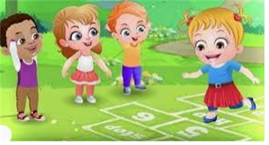
Break

Slide 25
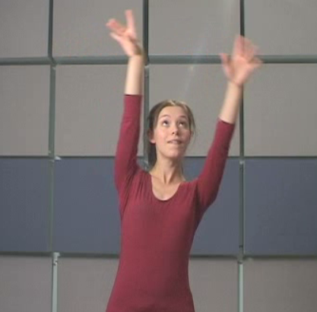
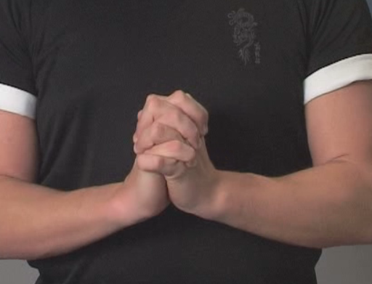
Handwriting- Warm Up's
Wednesday 21st January 2026
21/1/26
TBAT: correctly form curly caterpillar letters.
Gross motor- Mexican wave
Fine motor- finger interlock

Slide 26
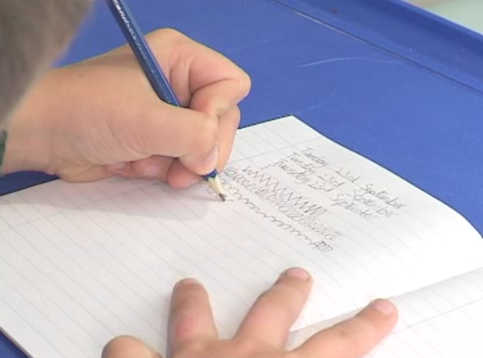
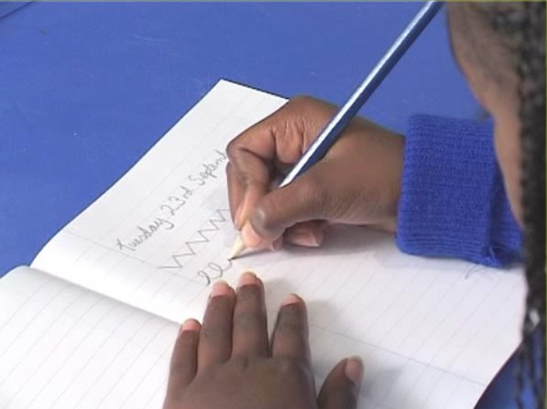
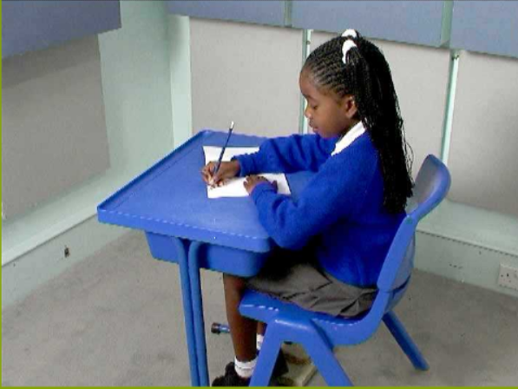
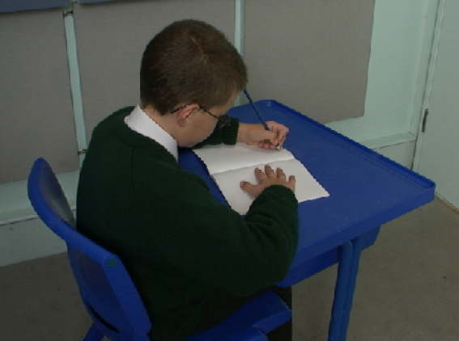
Wednesday 21st January 2026
21/1/26
TBAT: correctly form curly caterpillar letters.
Right handed
Left handed

Slide 27

Wednesday 21st January 2026
21/1/26
TBAT: correctly form curly caterpillar letters.

Slide 28


Wednesday 21st January 2026
21/1/26
TBAT: correctly form curly caterpillar letters.

Slide 29

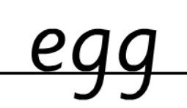

Wednesday 21st January 2026
21/1/26
TBAT: correctly form curly caterpillar letters.

Slide 30
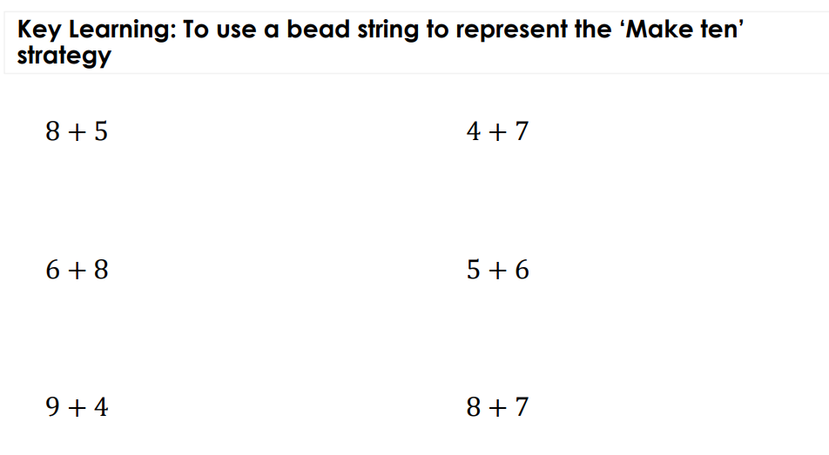
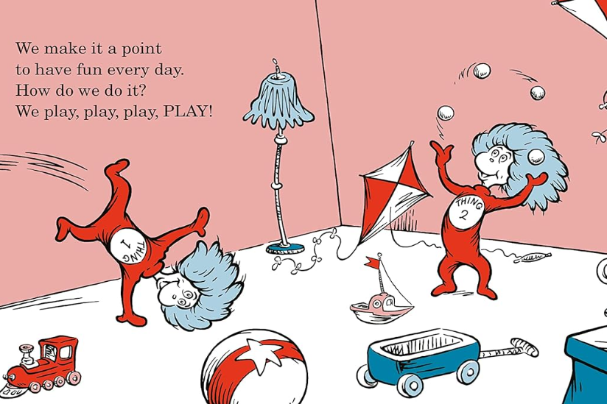
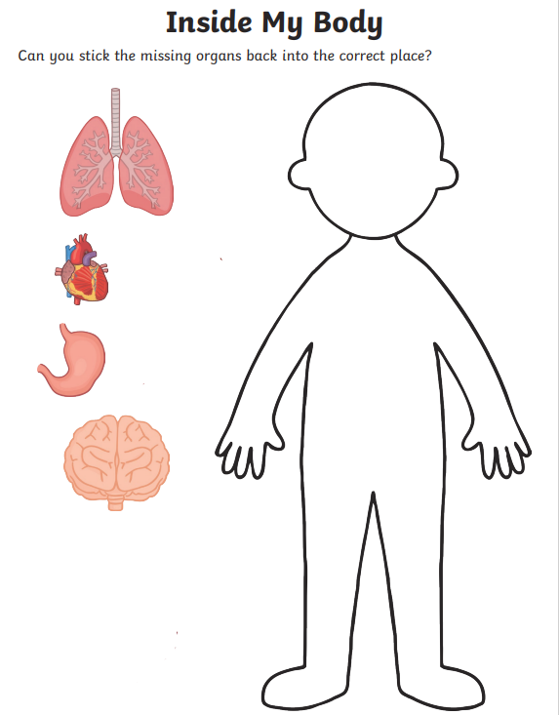
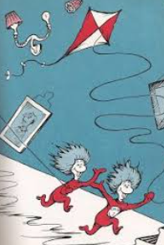
Independent Challenges:
Narrative Zone
Maths Zone
What game would you want to play if Thing 1 and Thing 2 came to visit you?
Solve the calculations using a bead string
Enquiry Zone
Creative Zone
Stick the organs in the correct place.
Make a kite for Thing 1 and 2.

Slide 31

Lunch

Slide 32


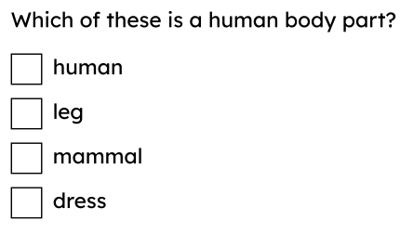
Entry question

Slide 33
3 in 3
What type of animal is a human?
What body parts help us to walk?
What is the job of the fingers?
Challenge: What body parts would you use to run?

Slide 34
Keywords
human body
draw
label
name
identify

Slide 35



Body parts on the inside
Sam adds some labels to give information about the human body.
head
I know that this is a head, and this is an arm. I think a human’s body is made up of lots of different parts.
arm
Sam
Blue / Green
What do you think? Can you name any different body parts?

Slide 36





Body parts on the inside
Who do you think is correct?
I think the human body is one big part.
I think the human body is made up of two parts called a body and a head.
I think the human body is made up of lots of different parts.
Jun
Sofia
Alex

Slide 37

Body parts on the inside
Blue / Green
Do you agree with Andeep?
There are no body parts on the inside of a human, our body is everything that is on the outside.
Andeep
body outline

Slide 38

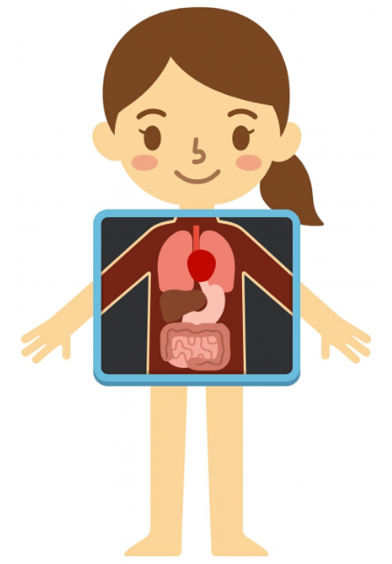
Body parts on the inside
Some human body parts are on the inside. We can’t see them unless we have an X-ray or a scan.
Can you name any body parts on the inside?
an X-ray and a scan

Slide 39
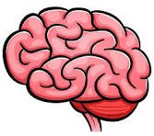
Body parts on the inside
Can you identify this body part?
This is a brain. Do you know what its job is?
Different body parts do different jobs. A brain lets humans think and control how their body moves.
inside a human body

Slide 40

Body parts on the inside
Can you identify this body part? Do you know what its job is?
This is a heart. A heart pumps blood around a human’s body.
inside a human body

Slide 41


Body parts on the inside
True or false?
All of a human’s body parts are on the outside of their bodies.
T
True
F
False
This is because …
a
a human’s heart and brain are inside their bodies.
different body parts do different jobs.
b

Slide 42

Body parts on the inside
Can you identify these body parts? Do you know what their job is?
These are lungs. Lungs are for breathing and bringing air into a human’s body.
inside a human body

Slide 43
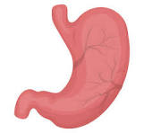
Body parts on the inside
Can you identify this body part? Do you know what its job is?
This is a stomach. A stomach is where food goes once a human has eaten it.
Do you know any other body parts on the inside?
inside a human body

Slide 44
Where do you think each of the organs are in your body?
Place the pictures where you think they are inside your body.

Slide 45
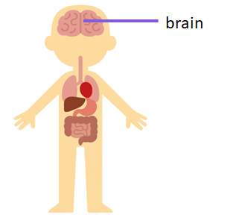
lungs
heart
stomach

Slide 46


Body parts on the inside
In which diagram is the heart being pointed to?

Slide 47
Body parts on the inside
True or false?
Different body parts do different jobs.
T
True
F
False
This is because …
humans are mammals.
a
the brain lets a human think and controls how their body moves.
b

Slide 48

Body parts on the inside
Match each body part to its name and job.
This is where food goes once a human has eaten it.
This organ pumps blood around a human’s body.
heart
lungs
Lets a human think and controls how their body moves.
stomach
Used for breathing and bringing air into a human’s body.
brain
All images: Sudowoodo/Shutterstock.com

Slide 49
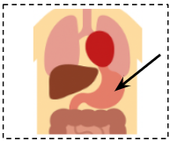
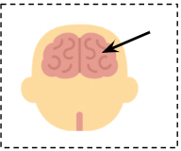
Body parts on the inside
Match each body part to its name and job.
stomach
brain
This is where food goes once a human has eaten it.
Lets a human think and controls how their body moves.

Slide 50
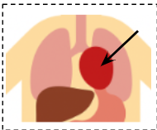
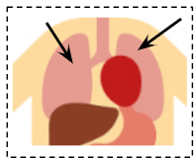
Body parts on the inside
Match each body part to its name and job.
heart
lungs
This organ pumps blood around a human’s body.
Used for breathing and bringing air into a human’s body.

Slide 51
Recording different body parts
Tell a partner what job each body part does.
Humans use lungs to breathe and bring air into their bodies. A human’s brain lets them think and control how their body moves.
The stomach is where food goes once it has been eaten. A heart pumps blood around a human’s body.
Sam
Alex

Slide 52
Now go and check your organs are in the right place. If not, move them to the right place!

Slide 53
Body parts on the inside
The human body is made up of lots of different parts which do different jobs.
There are body parts on the inside of your body as well as on the outside.
Body parts on the inside can include the heart, the lungs, the stomach and the brain.
Body parts can be recorded using drawing and labelling skills.
human body

Slide 54
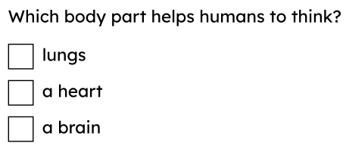
Exit question

