Slide 1
Wednesday 14th January 2026

Slide 2

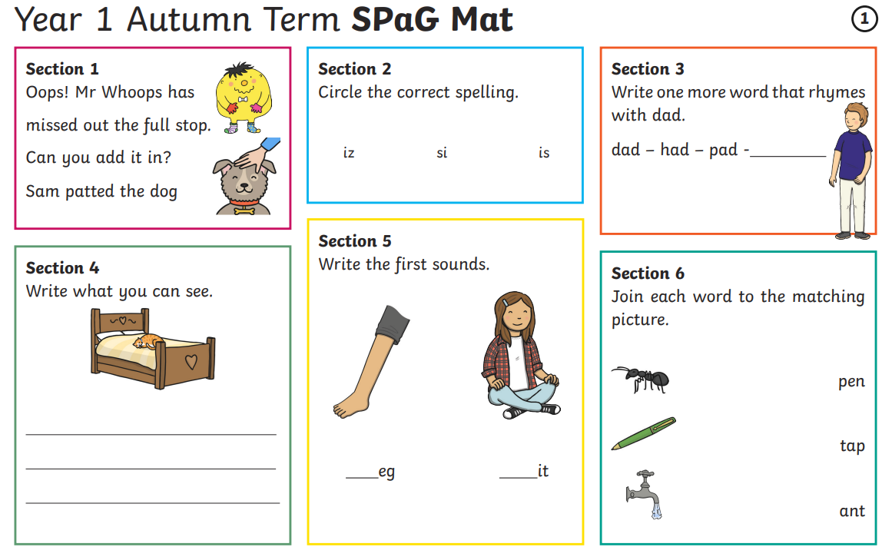
Morning Challenges:
Name writing

Slide 3
Phonics
Wednesday 14th January 2026
15/1/26
Revisit and review
Lesson focus:
Read words with the /j/g grapheme

Slide 4

Revisit and review
Wednesday 14th January 2026
15/1/26
Today's Grapheme
g

Slide 5
Revisit and review
Wednesday 14th January 2026
15/1/26
What are the digraphs?
carry
dry
snow
show
shaking
amaze
Segment these
words and read them
Blend and say words

Slide 6
Focus words
Wednesday 14th January 2026
15/1/26
g-e-m
g-i-a-n-t
m-a-g-i-c
Sounds out these
words and read them

Slide 7
Focus words
Wednesday 14th January 2026
15/1/26
gem
giant
magic
Read these words on sight

Slide 8
Focus words
Wednesday 14th January 2026
15/1/26
gem
giant
magic
danger
huge
Read, sound talk and blend
And again... FASTER!

Slide 9
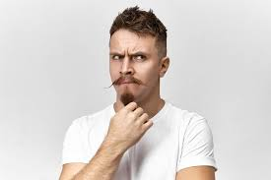
Revisit and review
would
Wednesday 14th January 2026
15/1/26
could
should
who
tricky words
whole
Read the tricky words

Slide 10
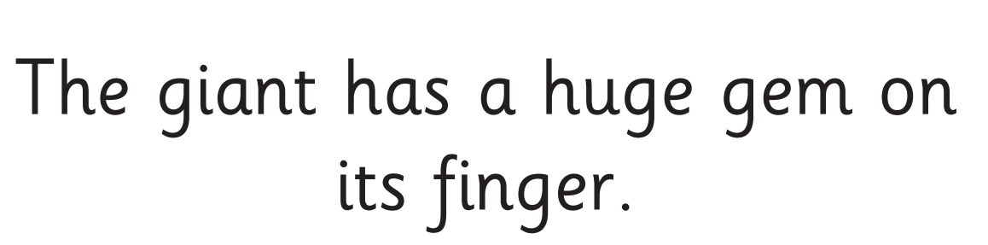
Wednesday 14th January 2026
15/1/26
Now let's read this sentence!​
What digraphs can you see?
What tricky words can you see?

Slide 11
Wednesday 14th January 2026
15/1/26
Let's spell!
How many sounds? Write it.
tricky words
huge magic where
Listen to the sentence, say it, write it and read it!
Challenge
Extend the sentence using 'and'

Slide 12
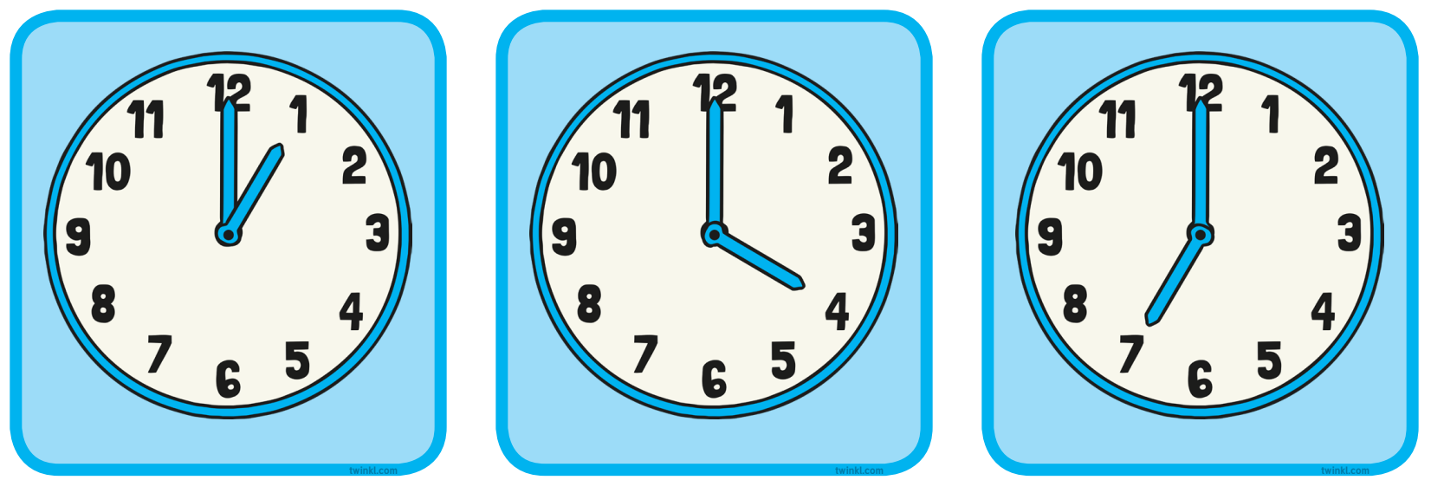
3 in 3 – what time do these show? How do you know?
TBAT: read and write the time to half past on an analogue clock
Wednesday 14th January 2026
15/1/26
Challenge: Which is the earliest time if they are all after midday?
Notes:
Do Now: December duel!
In pairs, pupils repeat the game from the Lesson 1 Talk Task. Pupil A and Pupil B take it in turns to say either one or two months of the year in order. The winner is the person who says December.

Slide 13
TBAT: read and write the time to half past on an analogue clock
Wednesday 14th January 2026
15/1/26
minute hand
hour
hour hand
clock
time
half past
half way between

Slide 14
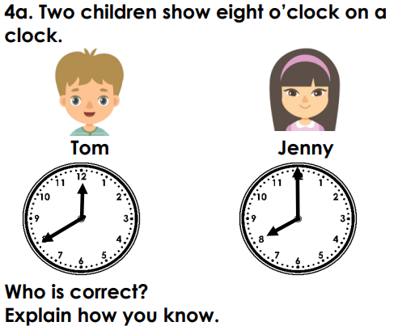
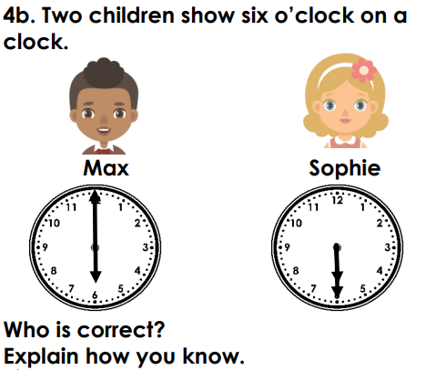
Blue / Green
TBAT: read and write the time to half past on an analogue clock
Wednesday 14th January 2026
15/1/26
Minute hand
Hour hand
pointing
It is ____. I know because…

Slide 15
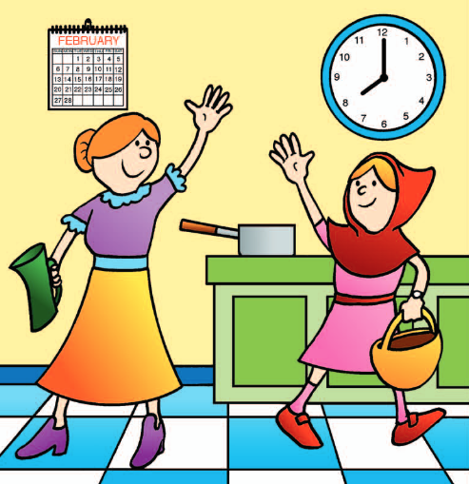
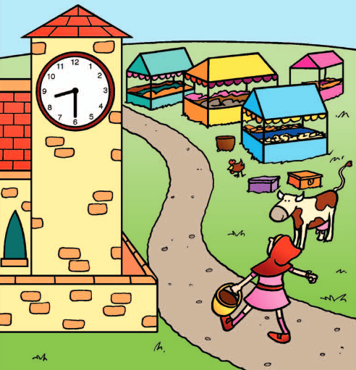
Blue / Green
Look at the clock
What’s the same? What’s different?
TBAT: read and write the time to half past on an analogue clock
Wednesday 14th January 2026
15/1/26
Notes:
New Learning: Introducing half past
Show pupils the first and second sections of the Big Picture.
What’s the same and what’s different?
If necessary, ask:
What’s the same and what’s different about the hour and minute hands on the clocks?
In the first picture, the hour hand is pointing to the eight and the minute hand is pointing straight up. In the second picture, the hour hand is pointing halfway between eight and nine, and the minute hand is pointing straight down.
Use a large demonstration clock to make seven o’clock and then move the minute hand to half past seven. As you do so, discuss the movements of each hand using the sentence structures introduced in this unit. (Remember to describe the minute hand as pointing down, rather than pointing to the six, as the minute hand is pointing to the minute scale.)
Repeat this process for other half past times. Each time, ask:
What time have I made? How do you know?
Pupils explain their answer to a partner and decide whether they agree with each other.

Slide 16
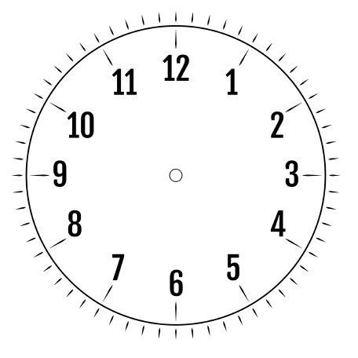
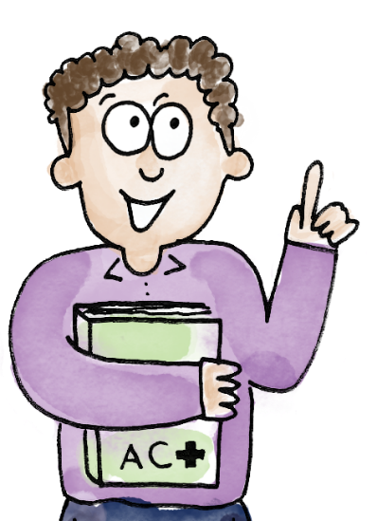
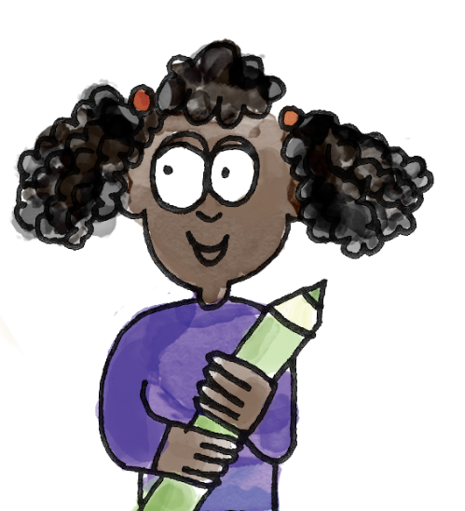
TBAT: read and write the time to half past on an analogue clock
Wednesday 14th January 2026
15/1/26
Challenge:
How many minutes past the hour is it?
I know that it is half past ten because the minute hand is pointing straight down and the hour hand is halfway between the ten and the eleven.
I agree that this clock shows half past ten.
time hour clock hour hand minute hand half past halfway between
Notes:
Talk Task: What’s the time?
Pupils have the Task Sheet. Pupil A picks a clock and says what the time is, explaining how they know. Pupil B says whether they agree or disagree and explains why. Pupils swap roles and repeat.
This could be done with geared clocks instead; however, the sheet ensures pupils are definitely using accurate representations of half past and allows their attention to be focused on describing the position of the hands.

Slide 17
TBAT: read and write the time to half past on an analogue clock
Wednesday 14th January 2026
15/1/26
I know that it is half past ____ because the minute hand is pointing __________ and the hour hand is halfway between the ______ and the _______.
I agree that this clock shows half past ten.
time hour clock hour hand minute hand half past halfway between
Notes:
Talk Task: What’s the time?
Pupils have the Task Sheet. Pupil A picks a clock and says what the time is, explaining how they know. Pupil B says whether they agree or disagree and explains why. Pupils swap roles and repeat.
This could be done with geared clocks instead; however, the sheet ensures pupils are definitely using accurate representations of half past and allows their attention to be focused on describing the position of the hands.

Slide 18
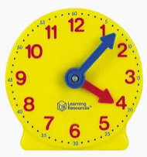
TBAT: read and write the time to half past on an analogue clock
Wednesday 14th January 2026
15/1/26
On your clock, make the time half past 6
Make half past 12
Make half past 7

Slide 19
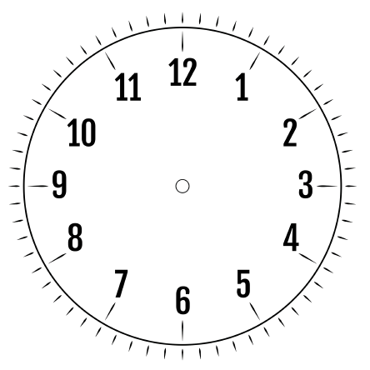
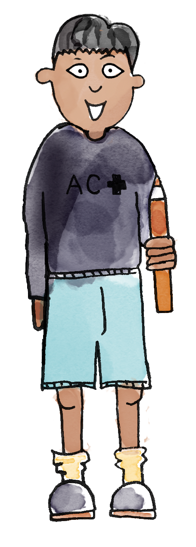
Do you agree or disagree? Why?
TBAT: read and write the time to half past on an analogue clock
Wednesday 14th January 2026
15/1/26
This clock shows half past ten.
Notes:
Develop Learning: Addressing misconceptions about hands
On a large demonstration clock, position the hour hand so it points to the six, and position the minute hand to point halfway between ten and eleven (or show the slide).
This clock shows half past ten. Do you agree or disagree? Discuss.
Take feedback, requiring pupils to explain their ideas. Establish that the hour hand is pointing straight down and the minute hand is pointing to halfway between the ten and the eleven, and if it were half past ten, they would be the other way around. Use this as an opportunity to reinforce the concept of the short hand being called the hour hand and the long hand being called the minute hand.
Repeat for other ‘hand swapping’ examples and try to catch pupils out.

Slide 20
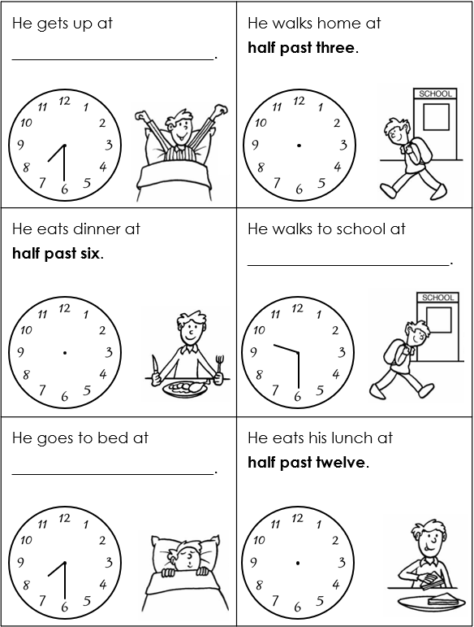
TBAT: read and write the time to half past on an analogue clock
Wednesday 14th January 2026
15/1/26
For each event:
  draw hands on the clock to show the time
  or write the time in words.
Notes:
Independent Task: Reading the time to half past
Pupils have a copy of the Task Sheet. They complete the missing information, either by writing the times in words, or drawing the hands on the clocks.
Possible adaptations:
The task could be presented as a card sort, with pupils matching written and clock times.
Pupils could be given some half past times written in words for them to make on a geared clock.

Slide 21
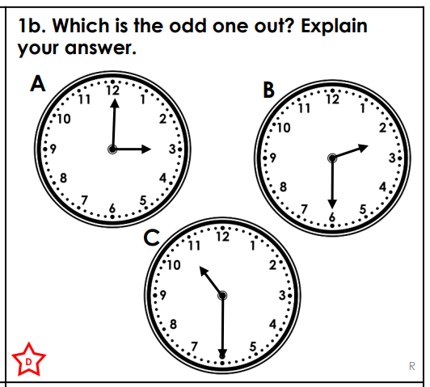
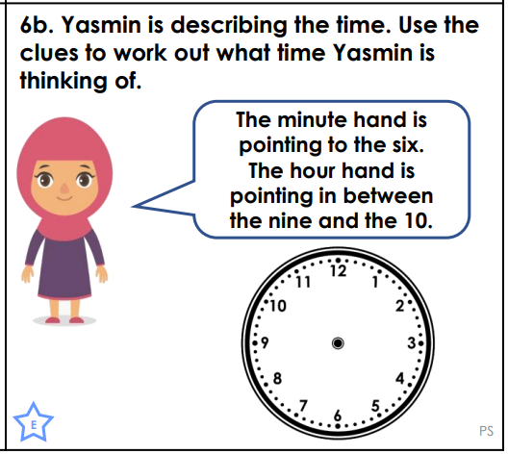
Challenge Mastery

Slide 22
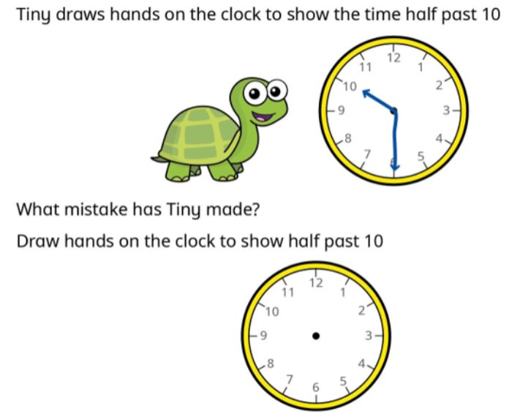
Mastery with greater depth

Slide 23
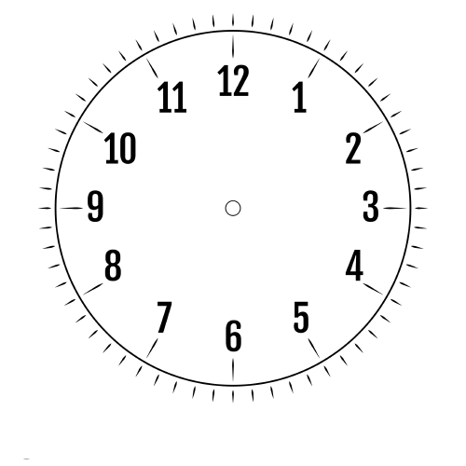
Match the written times to the clocks
half past twelve
seven o’clock
half past eight
two o’clock
Notes:
Plenary: Matching the words to the time
Pupils match a mixture of o’clock and half past written times to the clocks.
How do you know this clock shows half past twelve?
I know this clock shows half past twelve because the minute hand is pointing straight down and the hour hand is between the twelve and the one.

Slide 24
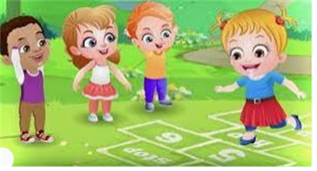
Break

Slide 25
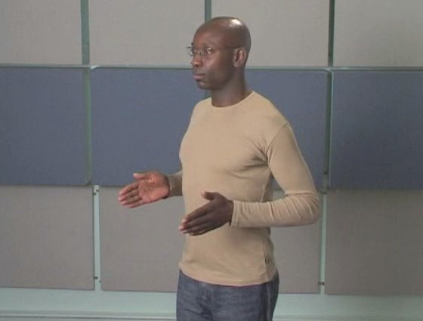
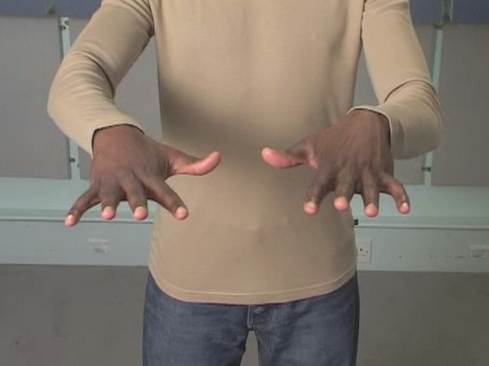
Handwriting- Warm Up's
Wednesday 14th January 2026
15/1/26
TBAT: correctly form one arm robot letters.
Gross motor- Be a train
Fine motor- finger stretch

Slide 26
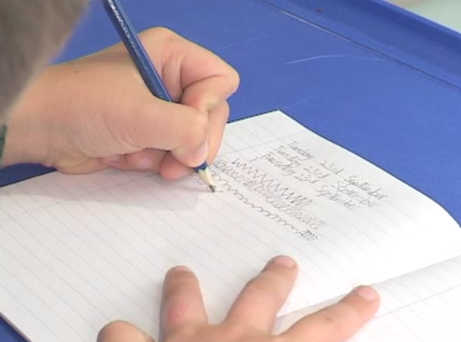
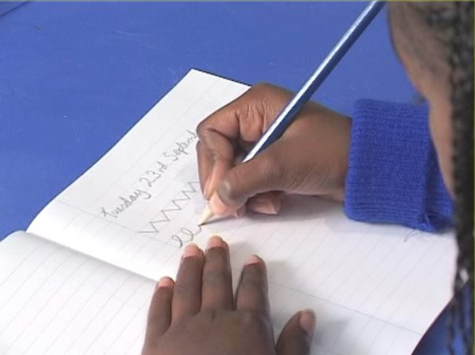
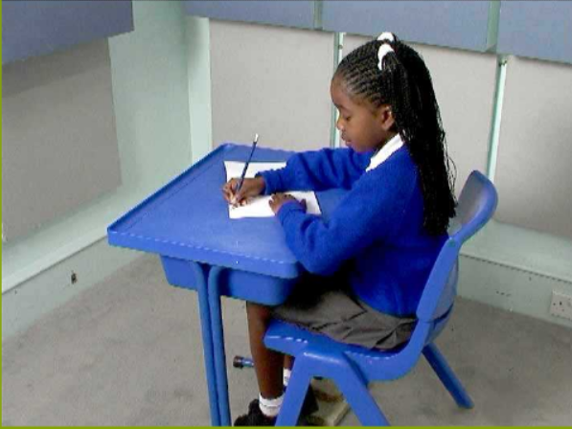
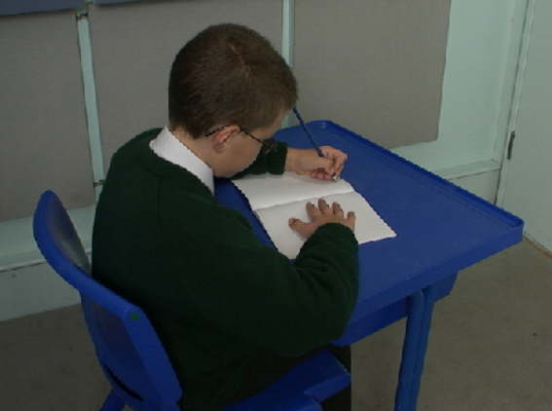
Wednesday 14th January 2026
15/1/26
TBAT: correctly form one arm robot letters.
Right handed
Left handed

Slide 27
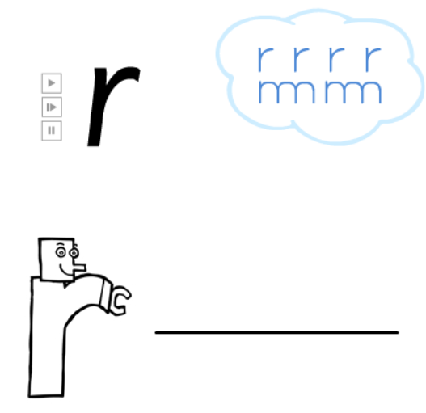
Wednesday 14th January 2026
15/1/26
TBAT: correctly form one arm robot letters.

Slide 28
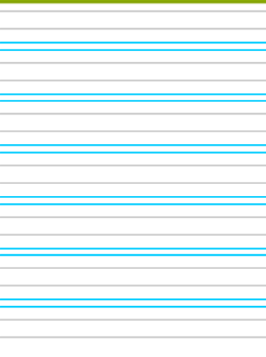

Wednesday 14th January 2026
15/1/26
TBAT: correctly form one arm robot letters.

Slide 29

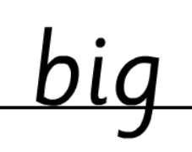

Wednesday 14th January 2026
15/1/26
TBAT: correctly form one arm robot letters.

Slide 30
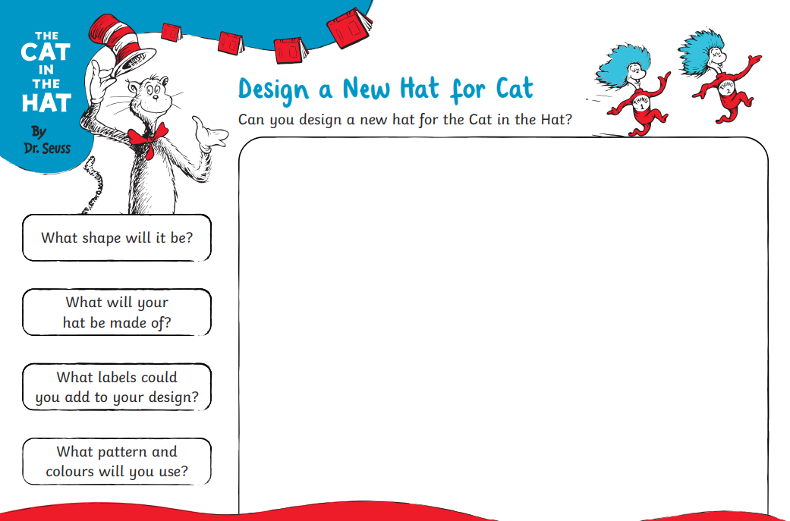
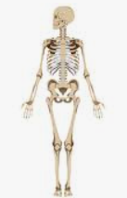
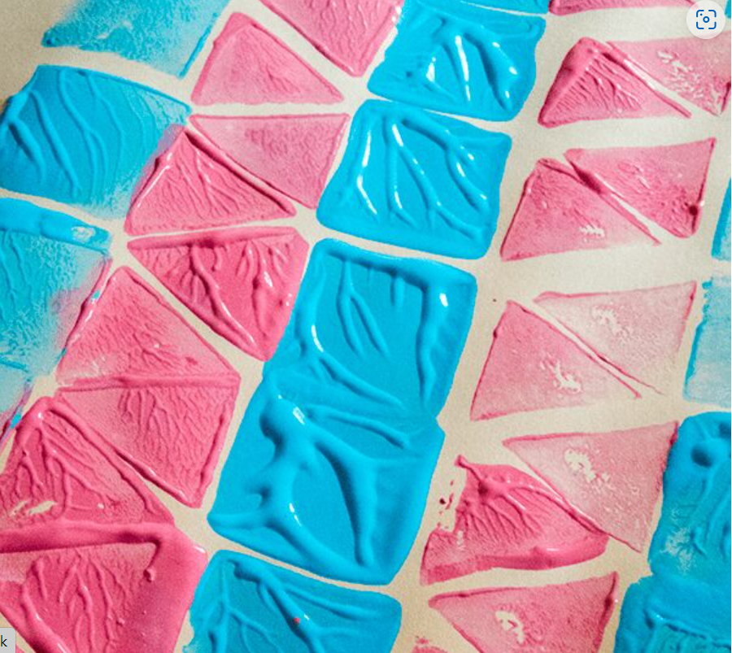
Independent Challenges:
Narrative Zone
Maths Zone
Match the written times to the clocks
Design a new hat for the Cat in the Hat and write a sentence about it.
Enquiry Zone
Creative Zone
Use the sticky notes to write labels to label the different parts of the skeleton.
Use the 2D shapes to print a repeating pattern

Slide 31

Lunch

Slide 32


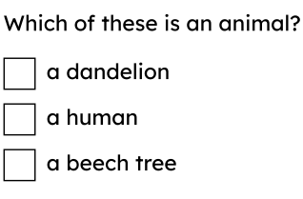
Entry Question:

Slide 33
3 in 3
What three things do all animals need to stay alive?
True or false? We are humans.
What kind of animal group do we belong to?

Slide 34
Key Vocabulary
human body
identify
name
draw
label

Slide 35
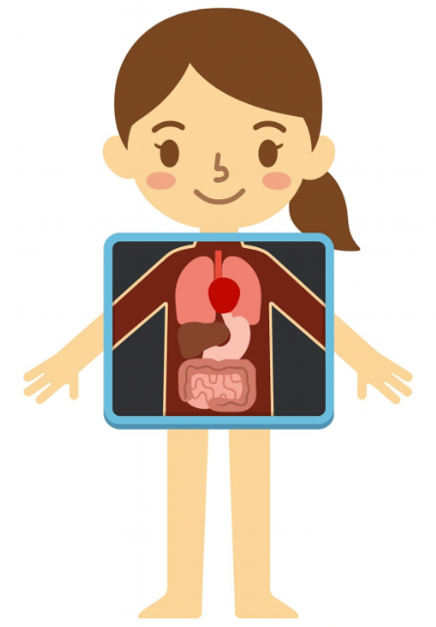


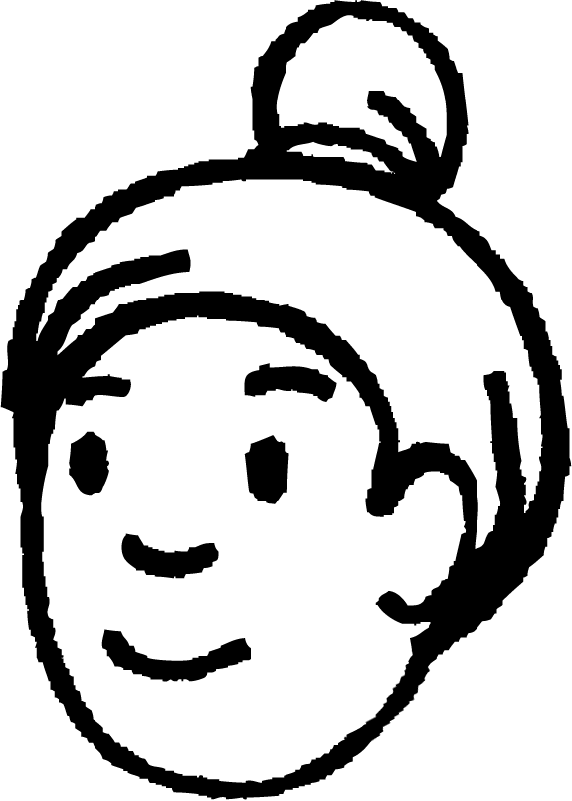
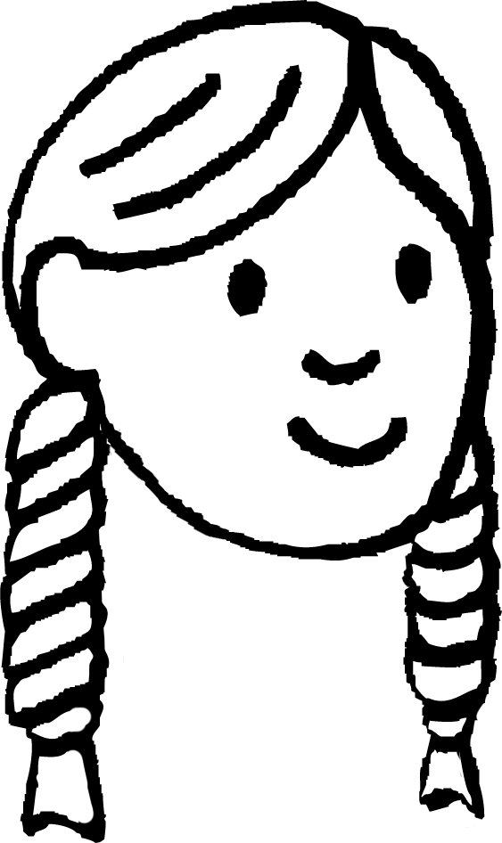
Body parts on the outside
Blue / Green
The children are finding out about the human body.
I think it is called the body because it is one big body part.
I think the human body is made up of lots of different parts.
Who is correct?
Andeep
human body
Laura
I think ______ is correct because

Slide 36
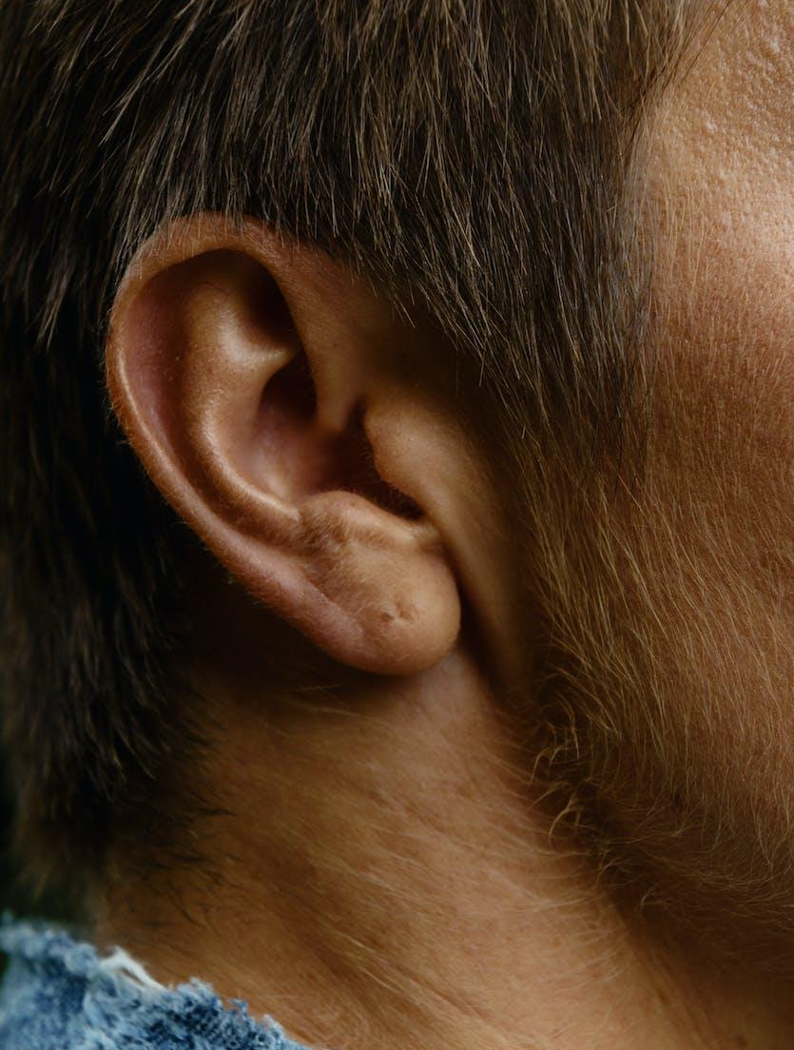
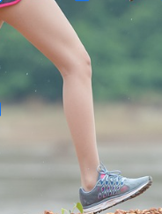
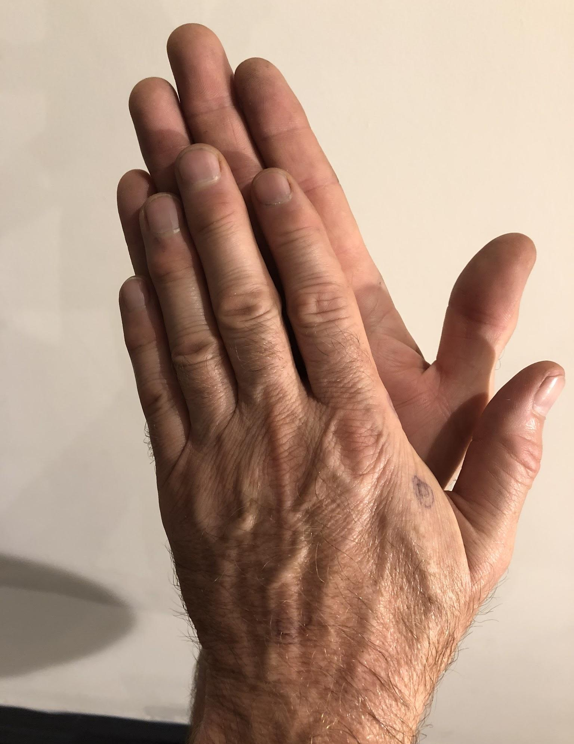
Body parts on the outside
The human body is made up of lots of different parts.
When we identify something, we can name it correctly.
ear
hands
leg
Can you identify these body parts? Point to them on yourself.
Laura

Slide 37
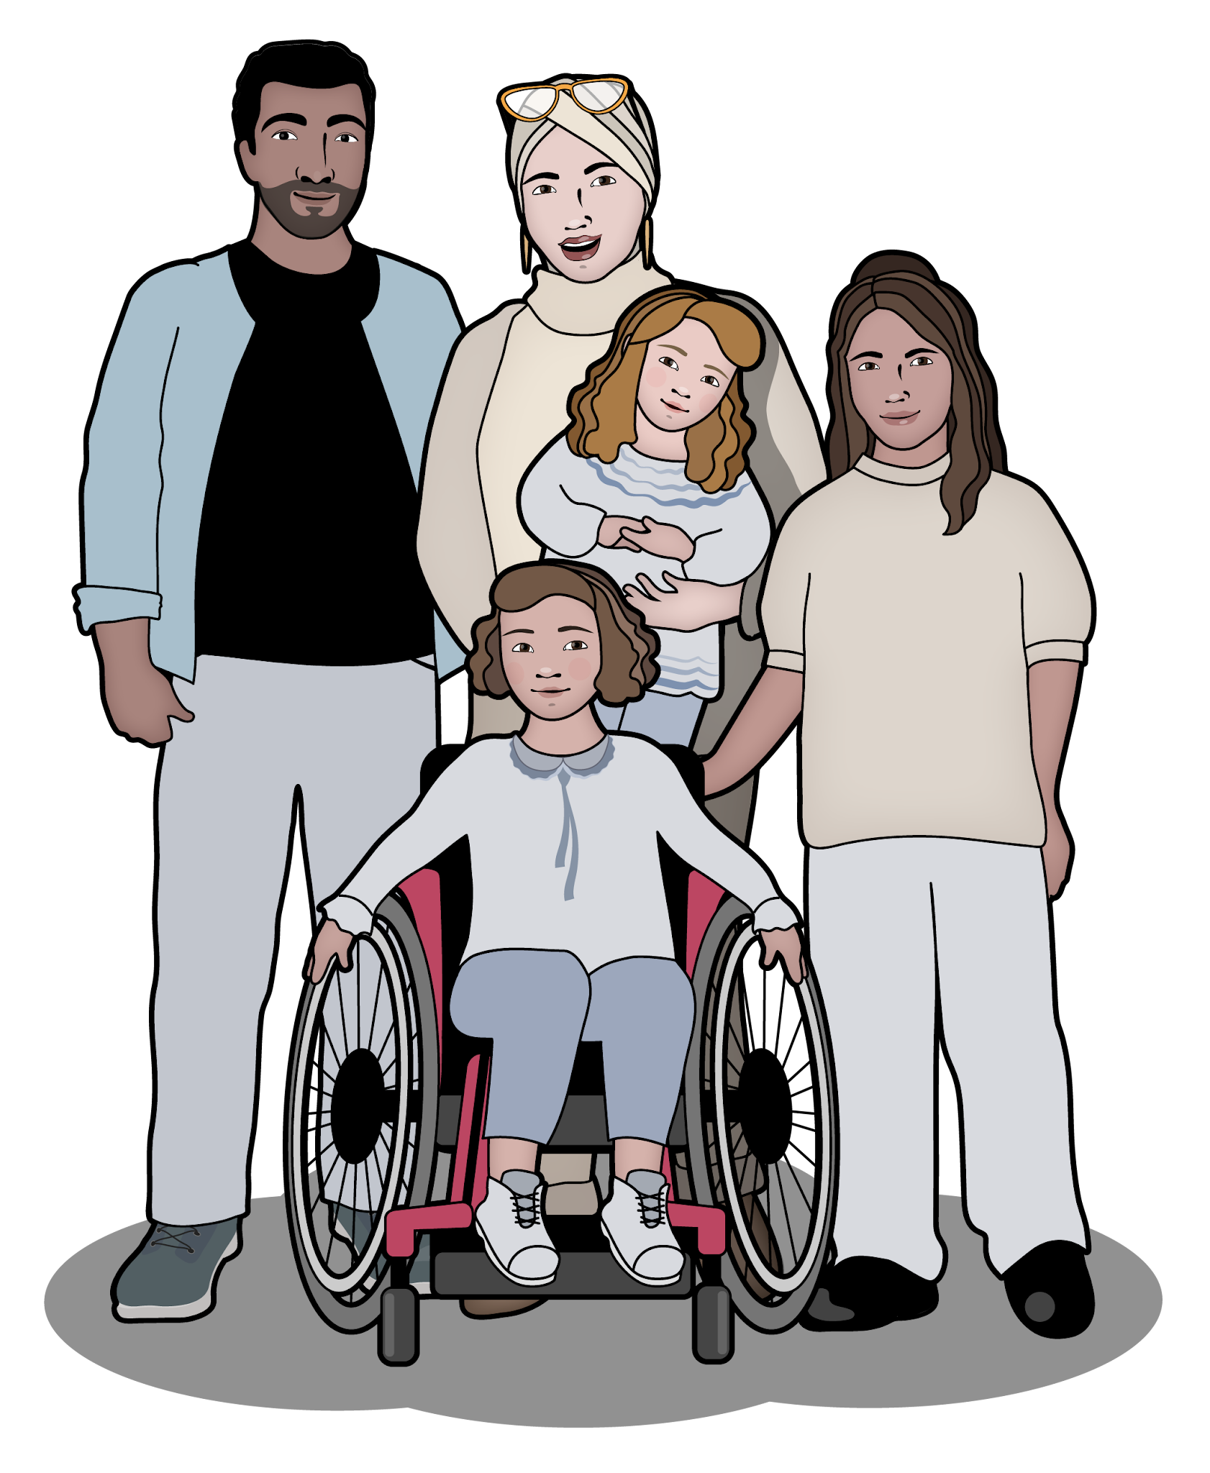
Body parts on the outside
Some of these body parts are on the outside of our bodies.
Do you know the names of any parts of your body that you can see?
humans
True or false?
The human body is made up of lots of different parts.

Slide 38
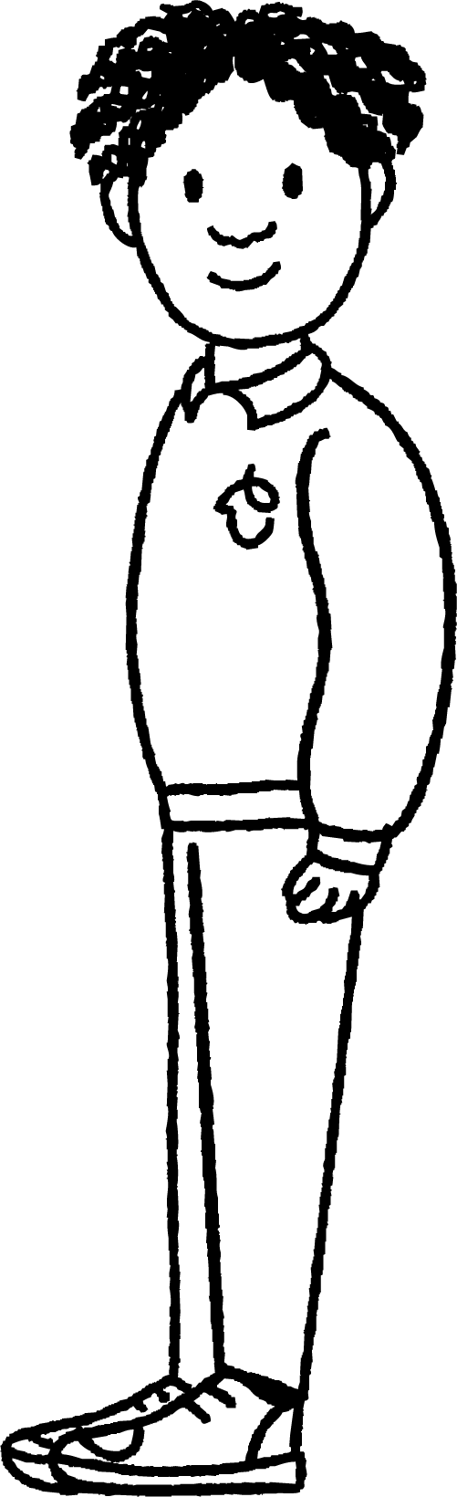

Body parts on the outside
Jacob is shocked to see an alien from the planet Asteroak.
I am here to find out all about the animals known as humans. Why do you all look so strange?
We don’t look strange! Our bodies are just different to yours. My friends and I can explain why.
alien
Jacob

Slide 39

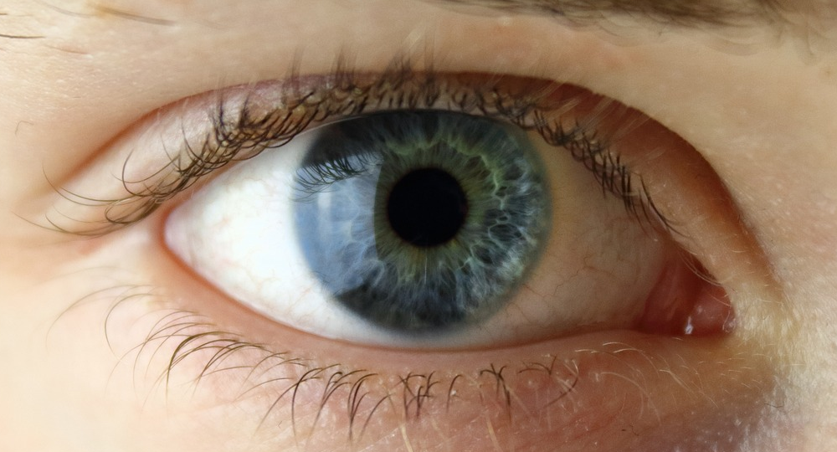
Body parts on the outside
Can you help Jacob to answer the alien’s questions?
This is an eye. Humans have two eyes in their head. We use our eyes to see.
What is the name of this body part? What does it do?
Jacob
eye
alien

Slide 40
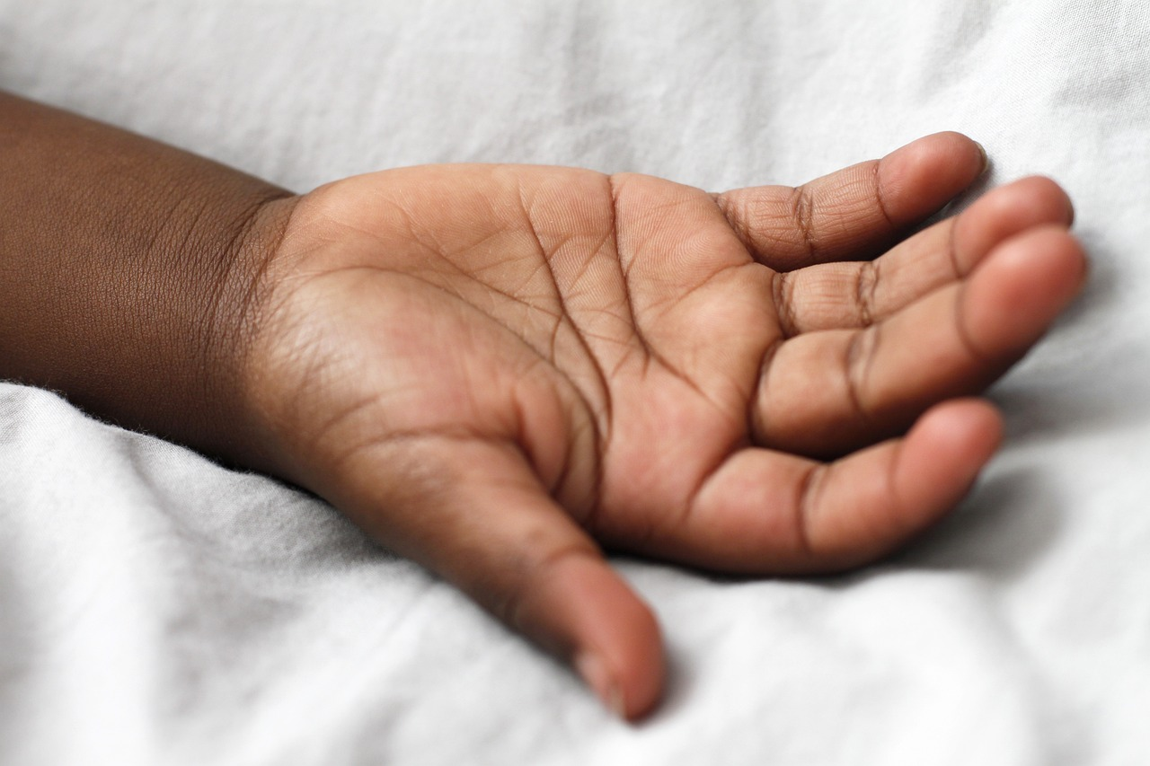
Body parts on the outside
This is a hand. It doesn’t help us to see. Different body parts have different jobs. Hands help us to pick things up or hold things.
What is the name of this body part? Does it also help you to see?
Jacob
alien
hand

Slide 41
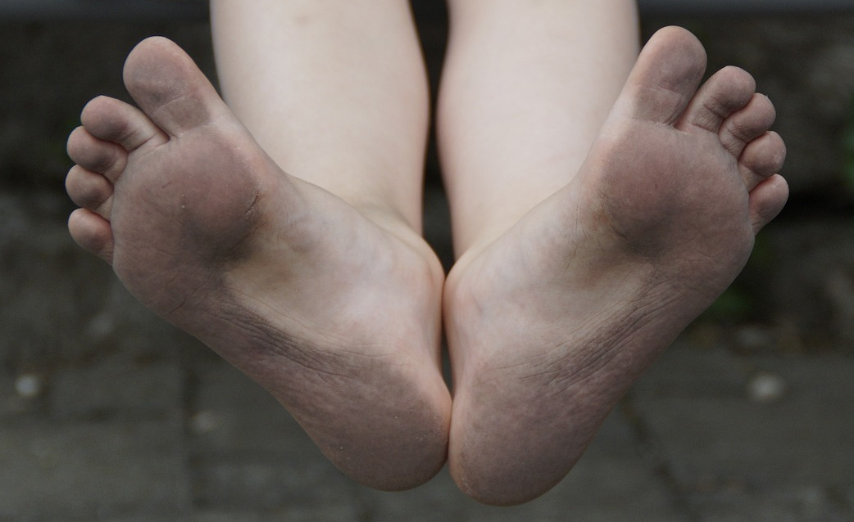
Body parts on the outside
I think I can identify these body parts. They’re at the end of the legs and they look a bit like a hand. Are they called leg-hands?
feet
These body parts are at the end of the legs, but they are not called leg-hands. They are called feet. They help us to stand up and to walk.
Jacob
alien

Slide 42
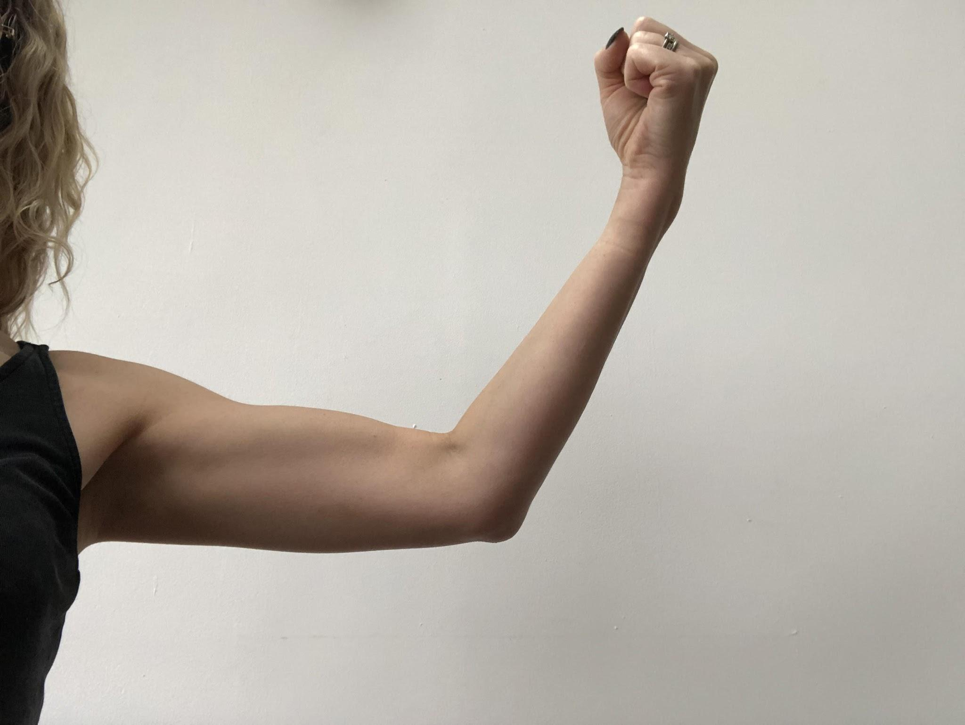
Body parts on the outside
I’ve spotted a strange pointy bit in the middle of your arms? What is that called and what job does it do?
This body part is called an elbow. This helps us to bend and to straighten our arms. We have an elbow on each of our arms.
Jacob
alien
elbow

Slide 43


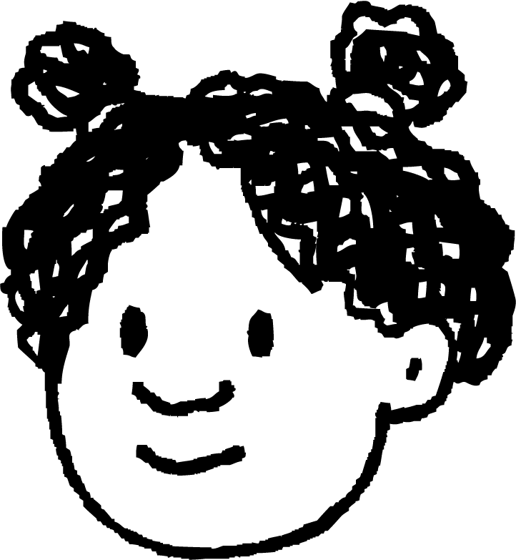
Body parts on the outside
Who do you agree with?
My body is made up of one big part.
We have different body parts, and they all do the same job.
We have different body parts, and they do different jobs.
Lucas
Jun
Izzy

Slide 44
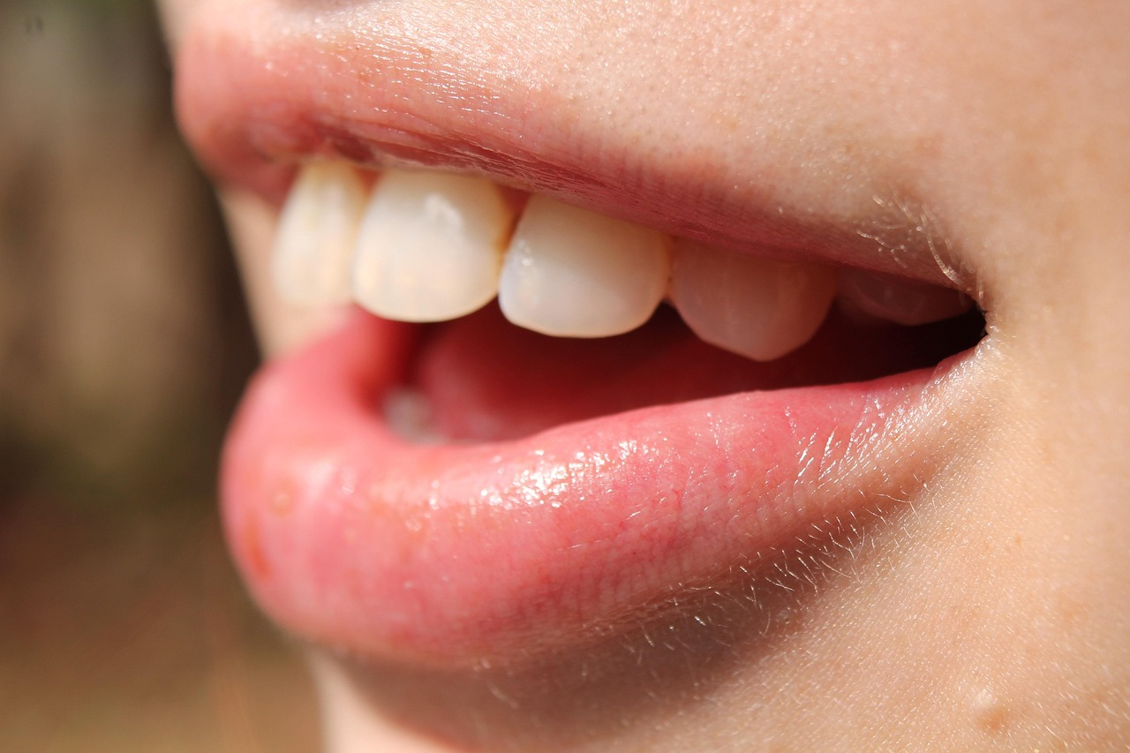
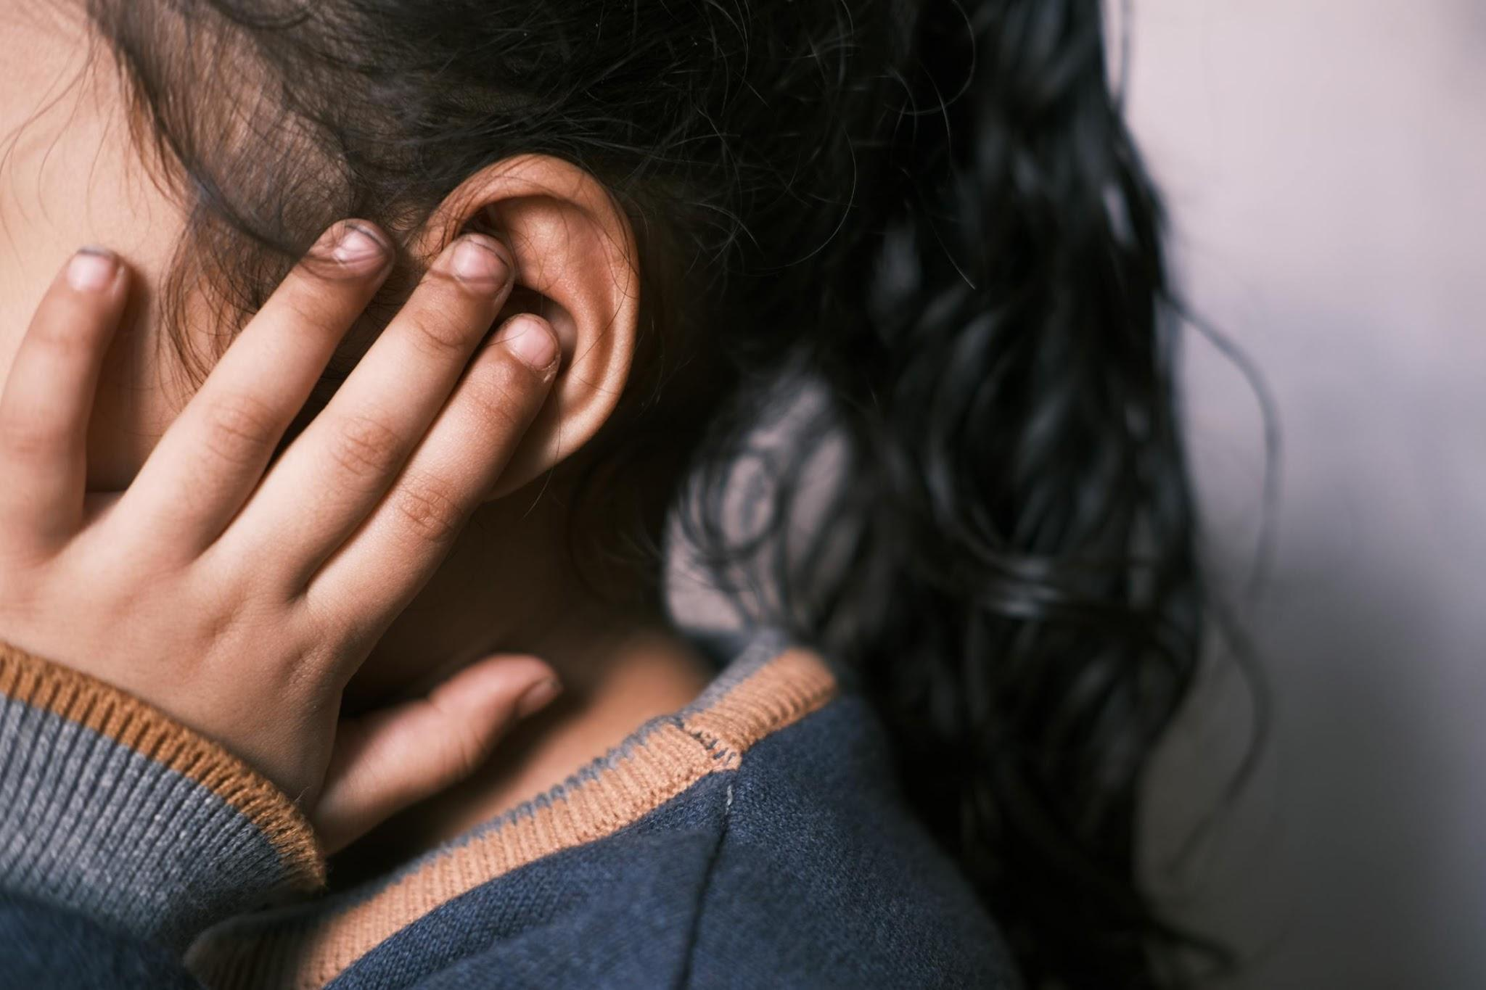
Body parts on the outside
Play 'Simon Says' by following instructions to identify different body parts.
ear
mouth

Slide 45
Recording different body parts
Thank you for all of your help. I will take this information back to the planet Asteroak. You have so many different body parts. How am I going to remember them all?
We can help you. There are lots of different ways of recording this information.
alien
Jacob

Slide 46

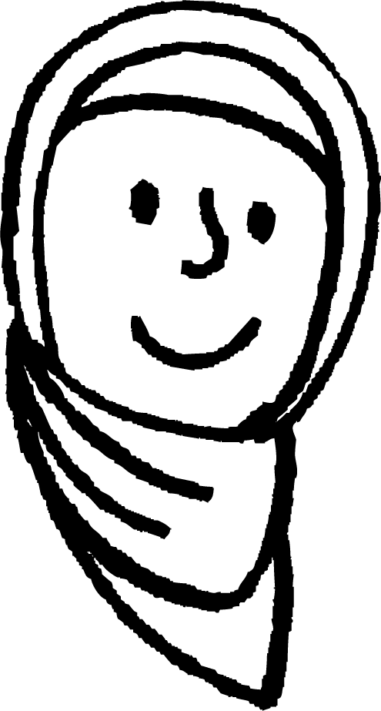

Recording different body parts
How could Jacob record all of the different human body parts?
We can make a model.
We can take photographs.
Can you think of any other ways?
Sam
Aisha
Alex

Slide 47
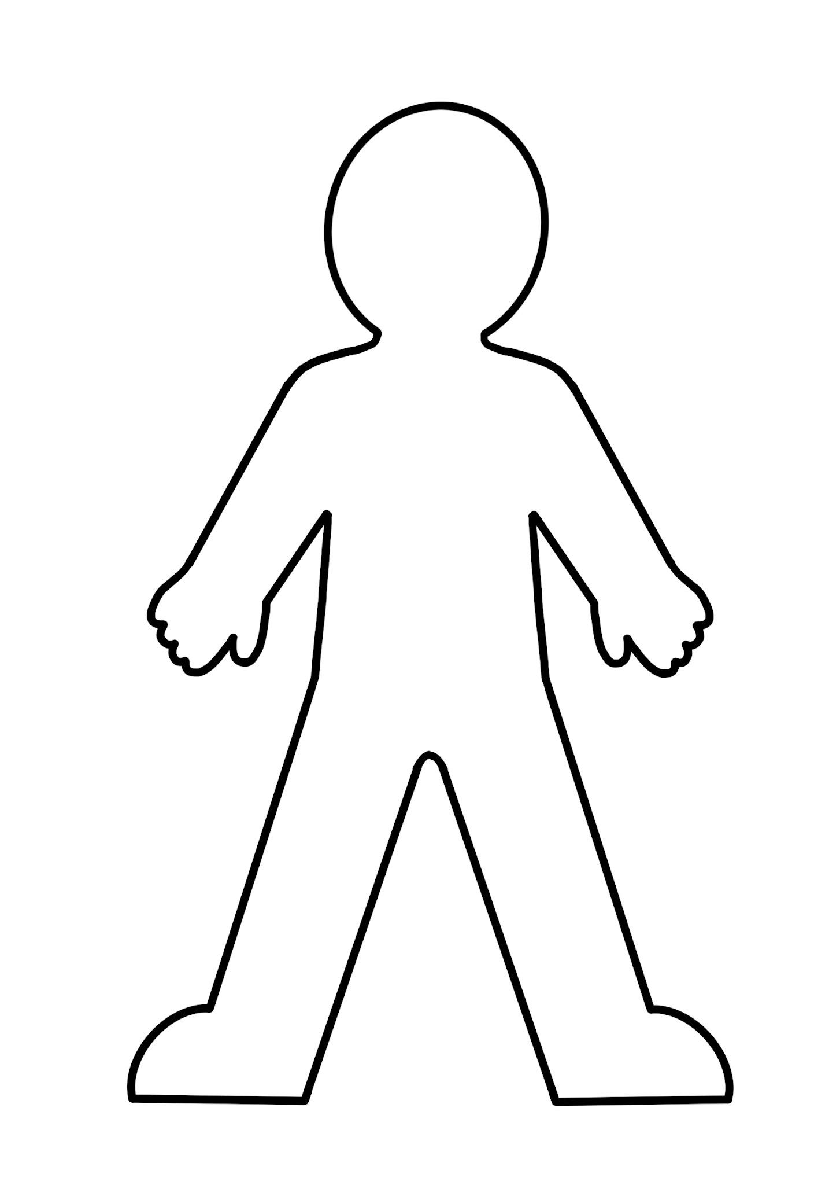
Recording different body parts
The children decide to draw around Aisha and add labels to each of her body parts.
They add labels for her head, arm, stomach, leg and foot. What other labels could they add?
head
arm
stomach
leg
foot
body outline

Slide 48
Recording different body parts
The children decide to add more body parts to their drawing.
They add labels for Aisha’s shoulder, elbow, wrist, knee and ankle.
Where should they put these labels?
shoulder
elbow
wrist
knee
ankle
body outline

Slide 49

Recording different body parts
Which skills do we use to record different body parts?
counting and researching
measuring and sorting
drawing and labelling

Slide 50
Recording different body parts
In groups, draw an outline of a body and add labels for different body parts. What does each body part do?
body outline

Slide 51

Body parts on the outside
The human body is made up of lots of different parts.
Different body parts do different jobs.
Body parts can be recorded using drawing and labelling skills.
children walking

Slide 52

Exit Question

