Slide 1
Tuesday 13th January 2026

Slide 2

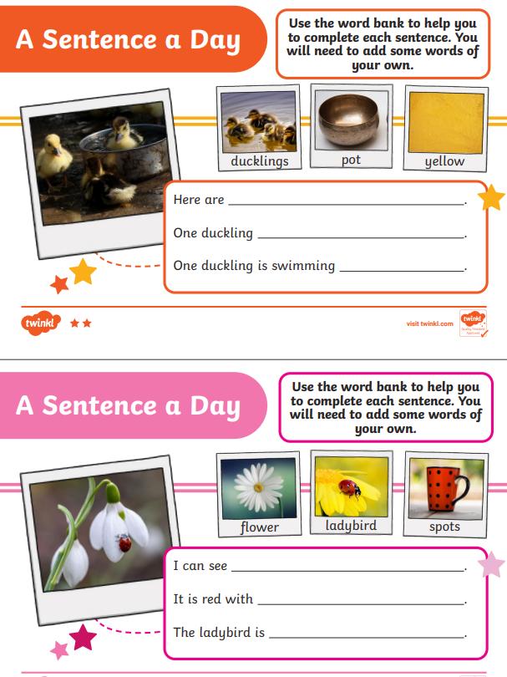
Morning Challenges:
Name writing

Slide 3
Revisit and review
Tuesday 13th January 2026
13/1/26
What are the digraphs?
world
work
valley
dance
done
nothing
Segment these
words and read them
Blend and say words

Slide 4
Focus words
Tuesday 13th January 2026
13/1/26
aw-f-ul
p-l-ay-f-ul
c-oul-d
Sounds out these
words and read them

Slide 5
Focus words
Tuesday 13th January 2026
13/1/26
awful
playful
could
Read these words on sight

Slide 6
Focus words
Tuesday 13th January 2026
13/1/26
playful
pudding
awful
octopus
Read, sound talk and blend
And again... FASTER!

Slide 7
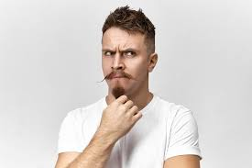

Revisit and review
Tuesday 13th January 2026
13/1/26
once
oh
tricky words
their
Read the tricky words

Slide 8
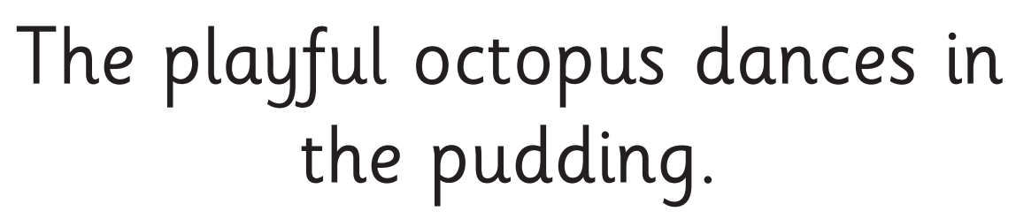
Tuesday 13th January 2026
13/1/26
Now let's read this sentence!​
What digraphs can you see?
What tricky words can you see?

Slide 9
Tuesday 13th January 2026
13/1/26
Let's spell!
How many sounds? Write it.
tricky words
awful playful our
Listen to the sentence, say it, write it and read it!
Challenge
Extend the sentence using 'and'

Slide 10
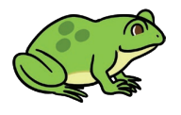
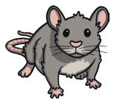

TBAT: make inferences about a character's feelings and actions.
Tuesday 13th January 2026
13/1/26
3 in 3- Match the word to a picture that rhymes.
house
Challenge:
How many other words can you think of to complete these rhyming strings?
star
dog

Slide 11


TBAT: make inferences about a character's feelings and actions.
Tuesday 13th January 2026
13/1/26
Blue/ Green- Explain what you think this story will be about. Why do you think that?
I think the story will be about.........
I think this because..............
I think the main character will be …......

Slide 12
TBAT: make inferences about a character's feelings and actions.
Tuesday 13th January 2026
13/1/26
Words you might come across in the text:
mischief – playful trouble or naughty behaviour
spotless – completely clean
whirl – a fast spinning movement
tilt – to lean to one side

Slide 13
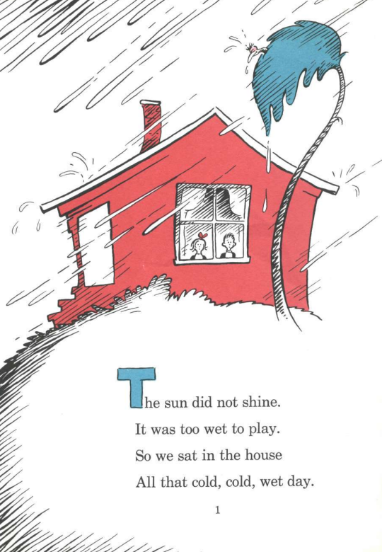
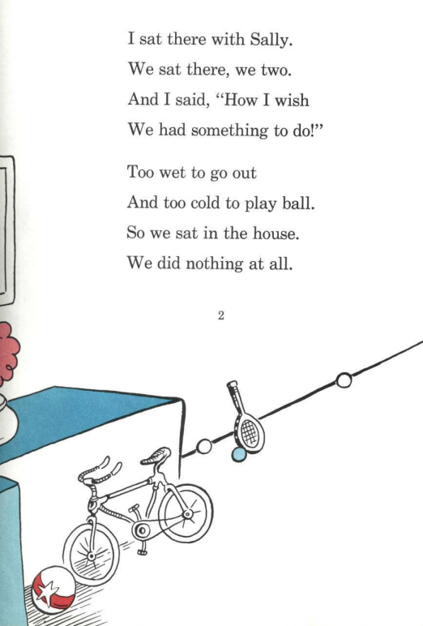
TBAT: make inferences about a character's feelings and actions.
Tuesday 13th January 2026
13/1/26

Slide 14
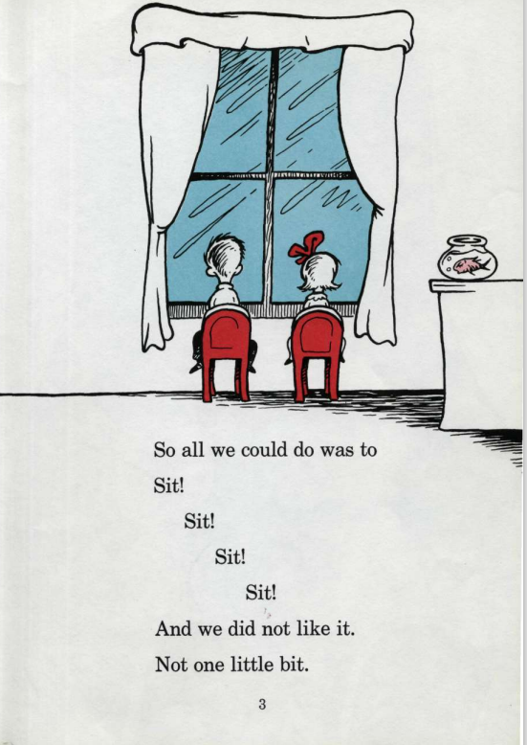
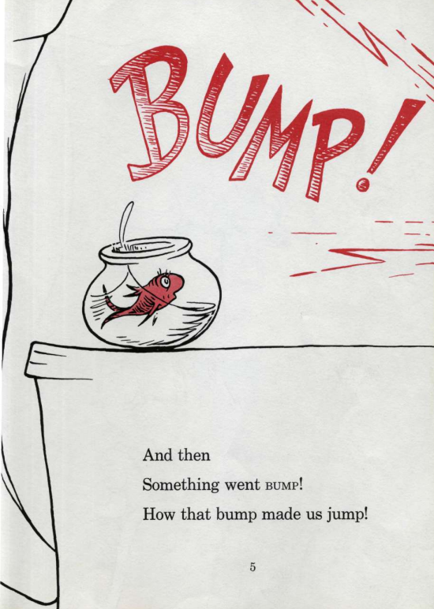
TBAT: make inferences about a character's feelings and actions.
Tuesday 13th January 2026
13/1/26

Slide 15
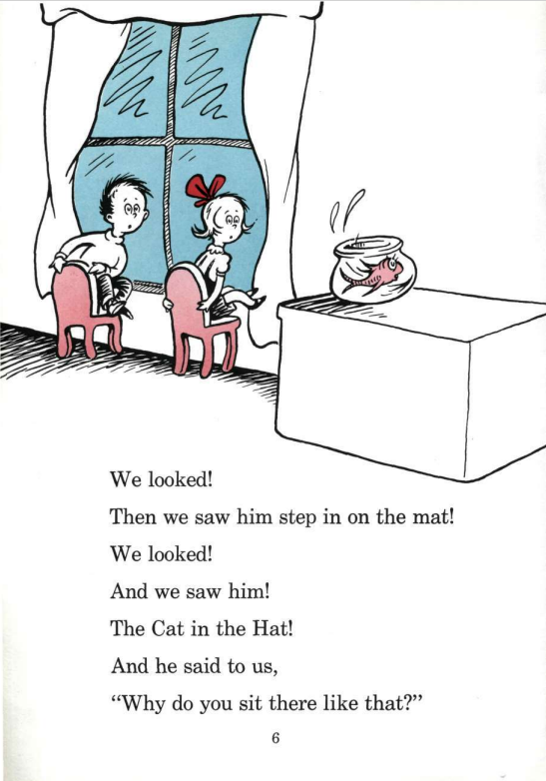
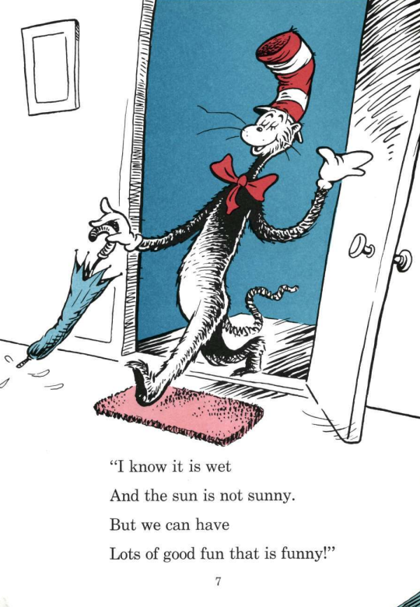
TBAT: make inferences about a character's feelings and actions.
Tuesday 13th January 2026
13/1/26

Slide 16
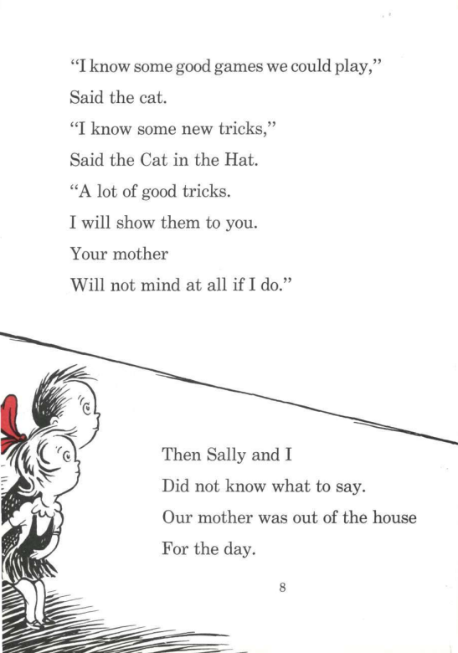
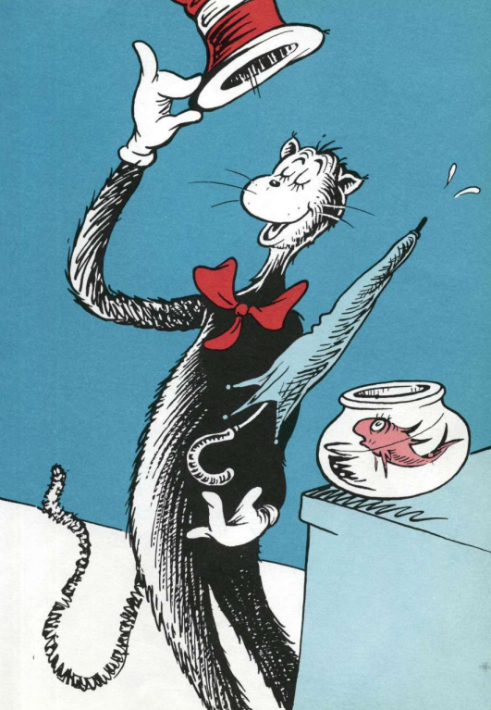
TBAT: make inferences about a character's feelings and actions.
Tuesday 13th January 2026
13/1/26

Slide 17
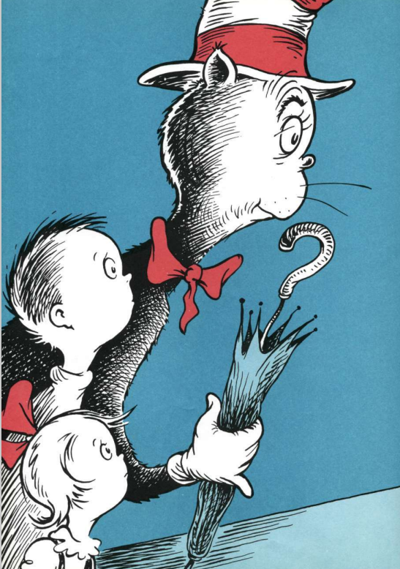
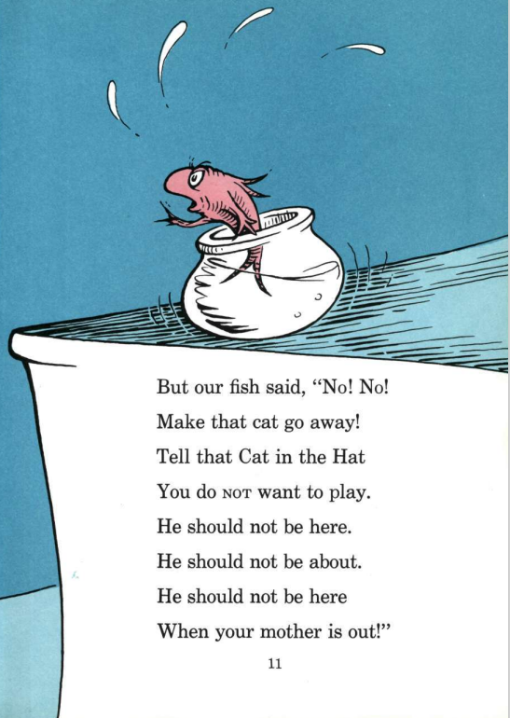
TBAT: make inferences about a character's feelings and actions.
Tuesday 13th January 2026
13/1/26

Slide 18
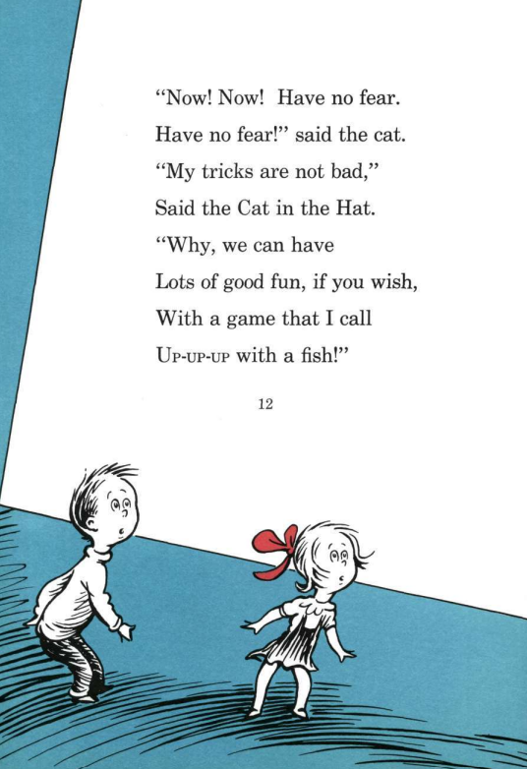
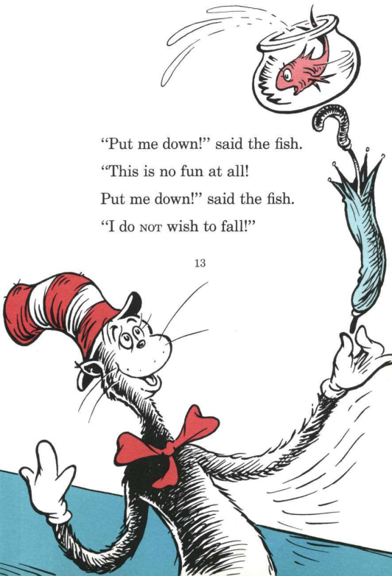
TBAT: make inferences about a character's feelings and actions.
Tuesday 13th January 2026
13/1/26

Slide 19
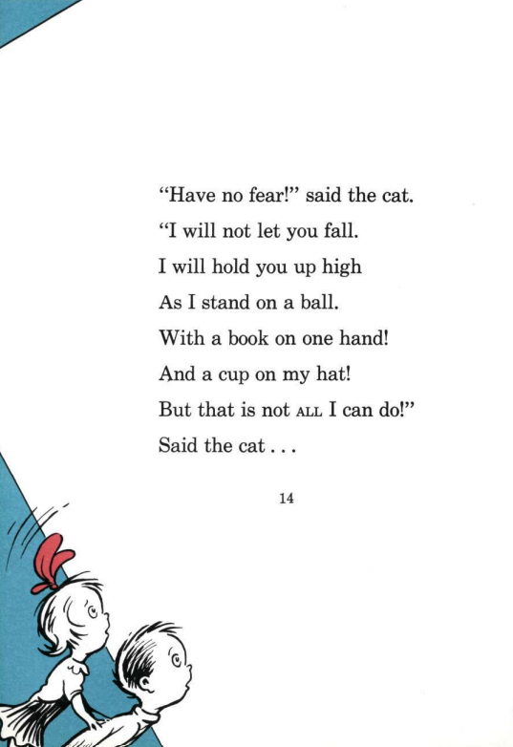
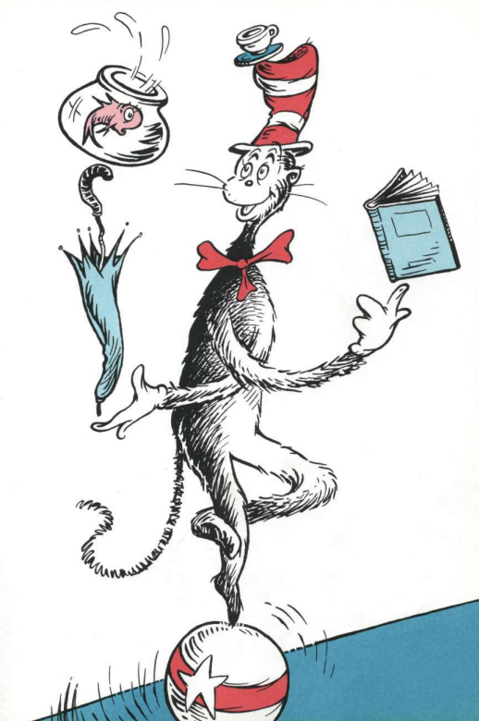
TBAT: make inferences about a character's feelings and actions.
Tuesday 13th January 2026
13/1/26

Slide 20
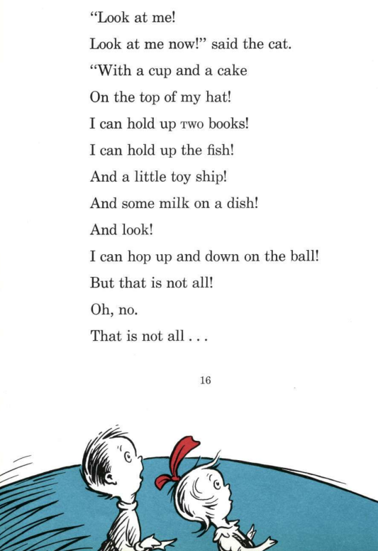
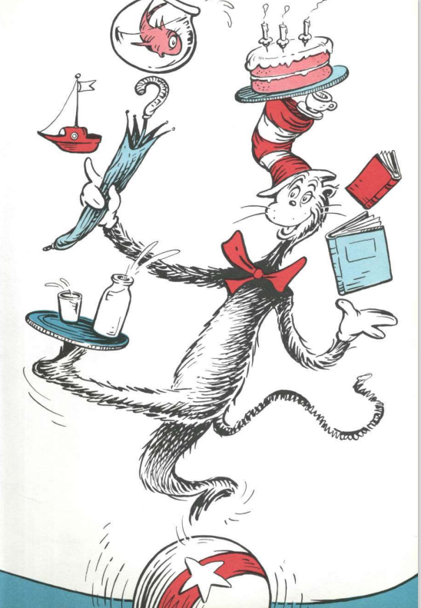
TBAT: make inferences about a character's feelings and actions.
Tuesday 13th January 2026
13/1/26

Slide 21
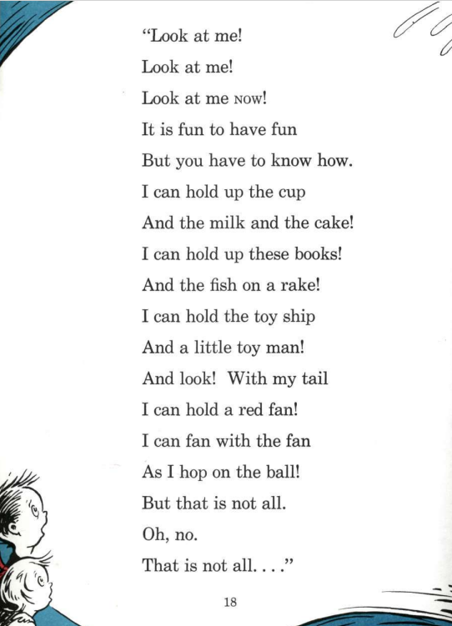
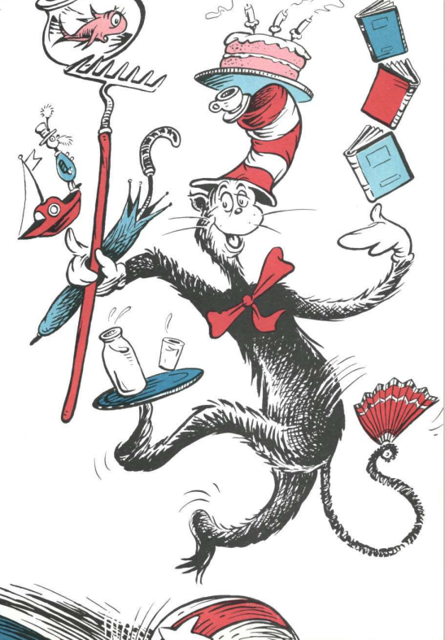
TBAT: make inferences about a character's feelings and actions.
Tuesday 13th January 2026
13/1/26

Slide 22
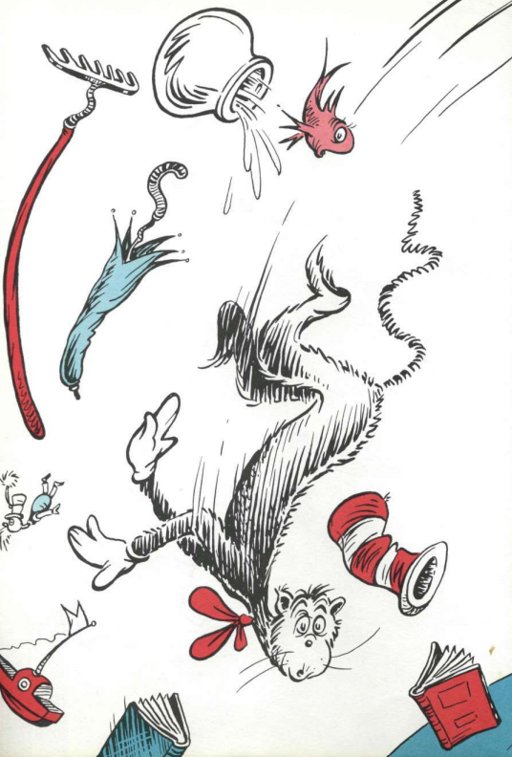
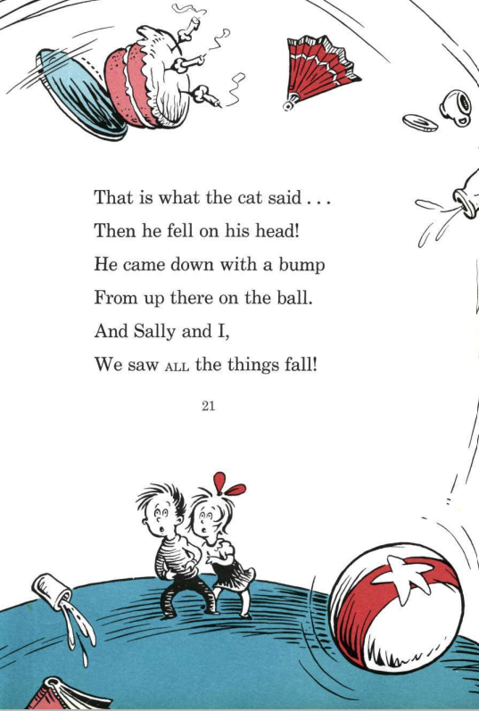
TBAT: make inferences about a character's feelings and actions.
Tuesday 13th January 2026
13/1/26

Slide 23
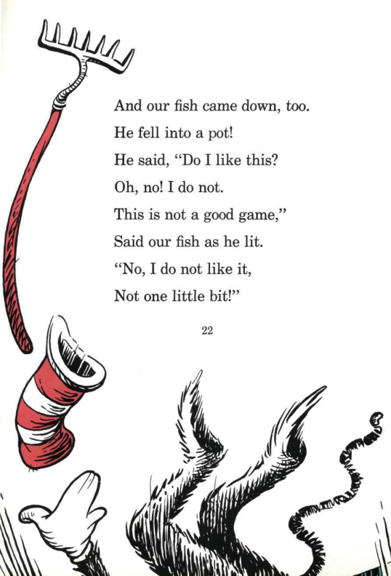
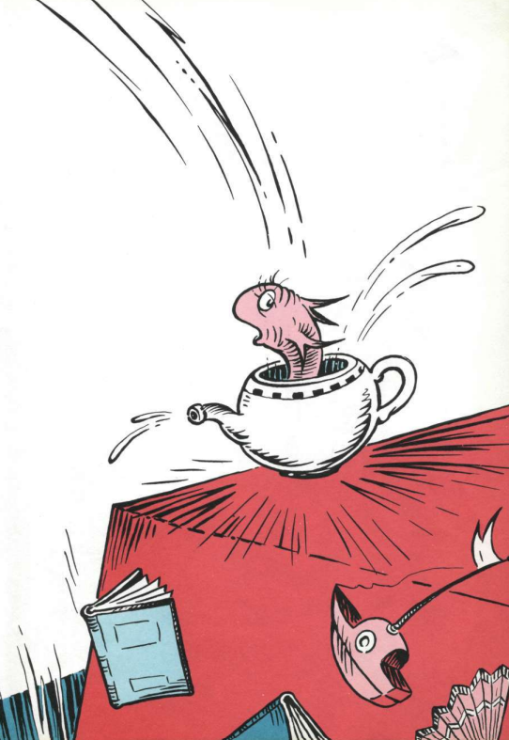
TBAT: make inferences about a character's feelings and actions.
Tuesday 13th January 2026
13/1/26

Slide 24
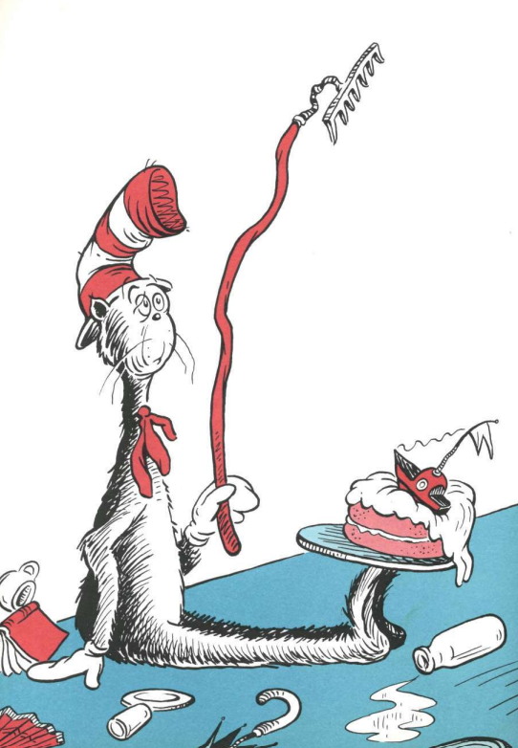
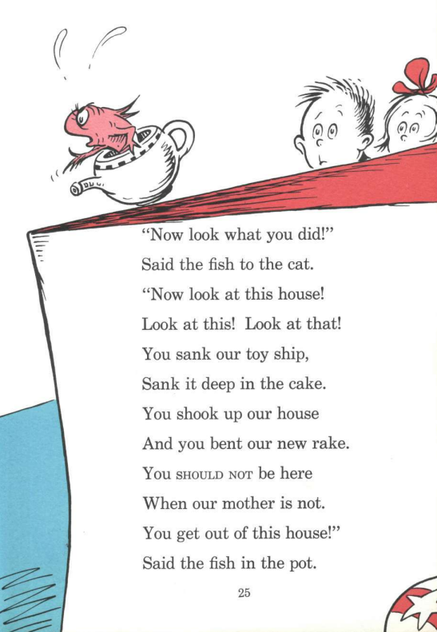
TBAT: make inferences about a character's feelings and actions.
Tuesday 13th January 2026
13/1/26

Slide 25
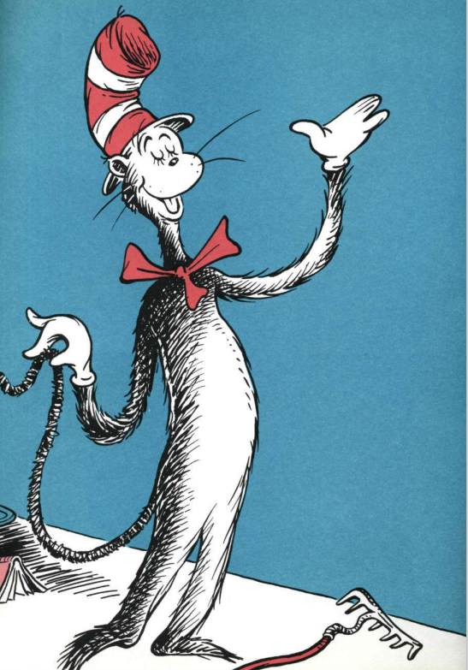
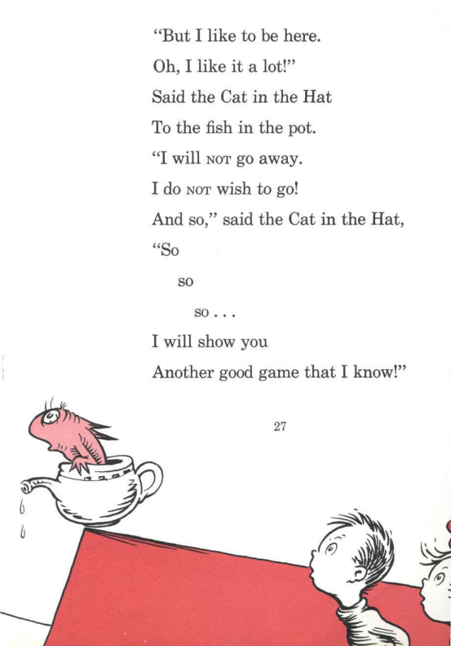
TBAT: make inferences about a character's feelings and actions.
Tuesday 13th January 2026
13/1/26

Slide 26
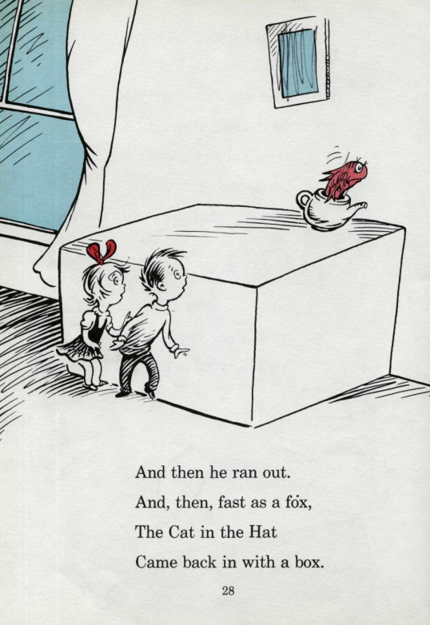
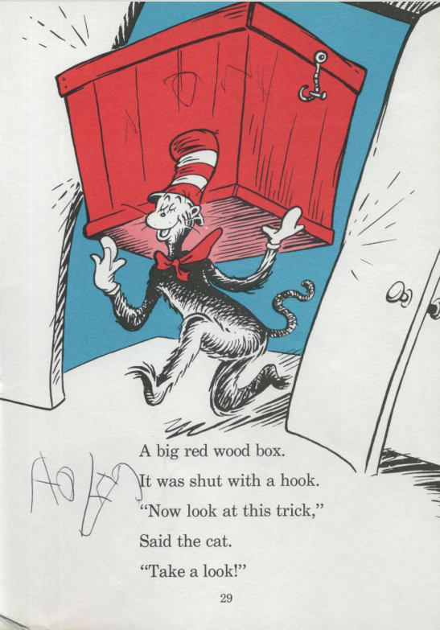
TBAT: make inferences about a character's feelings and actions.
Tuesday 13th January 2026
13/1/26

Slide 27
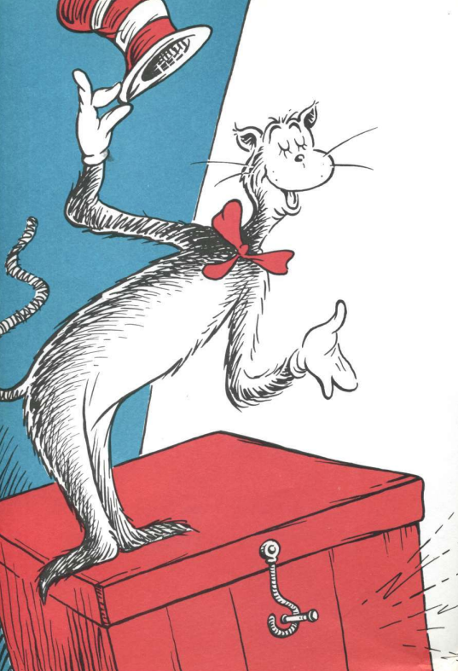
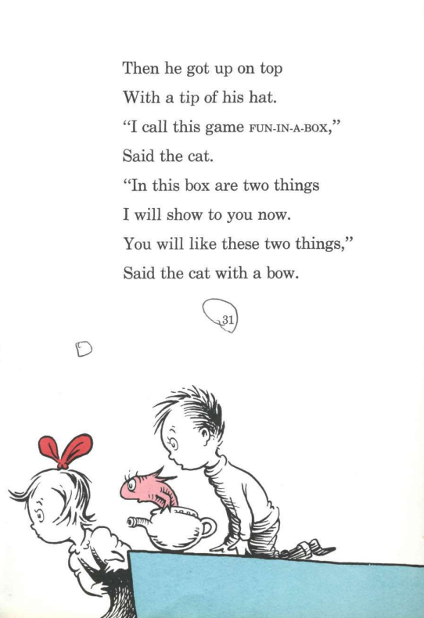
TBAT: make inferences about a character's feelings and actions.
Tuesday 13th January 2026
13/1/26

Slide 28
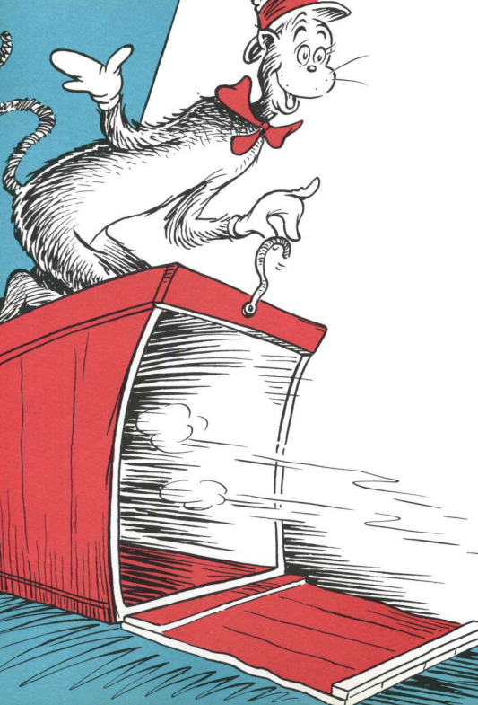
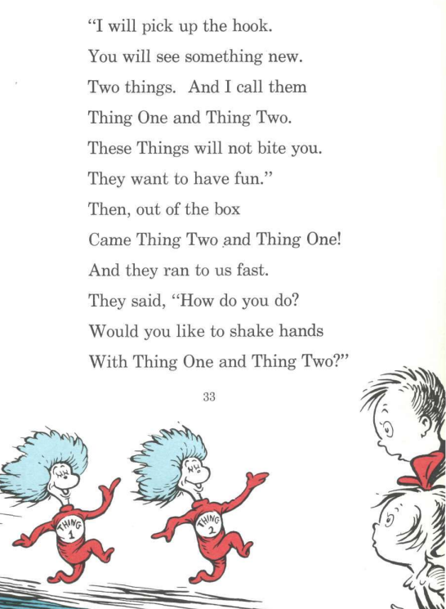
TBAT: make inferences about a character's feelings and actions.
Tuesday 13th January 2026
13/1/26

Slide 29
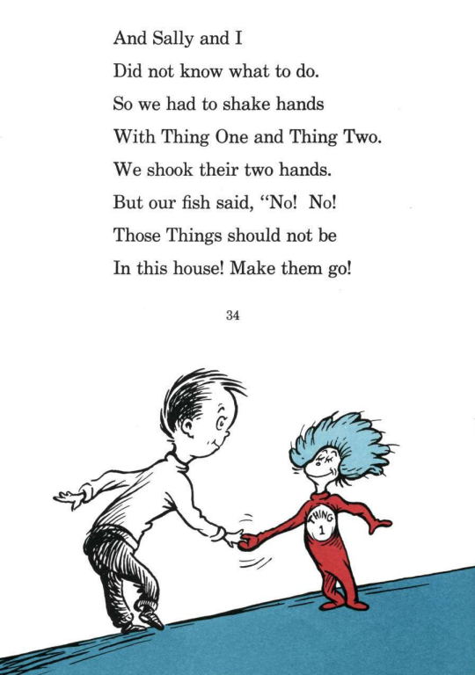
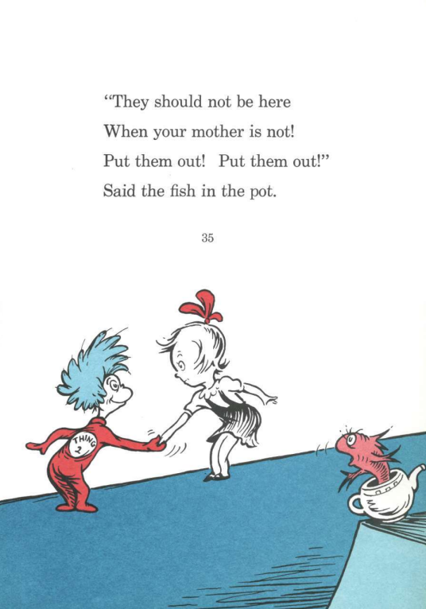
TBAT: make inferences about a character's feelings and actions.
Tuesday 13th January 2026
13/1/26

Slide 30
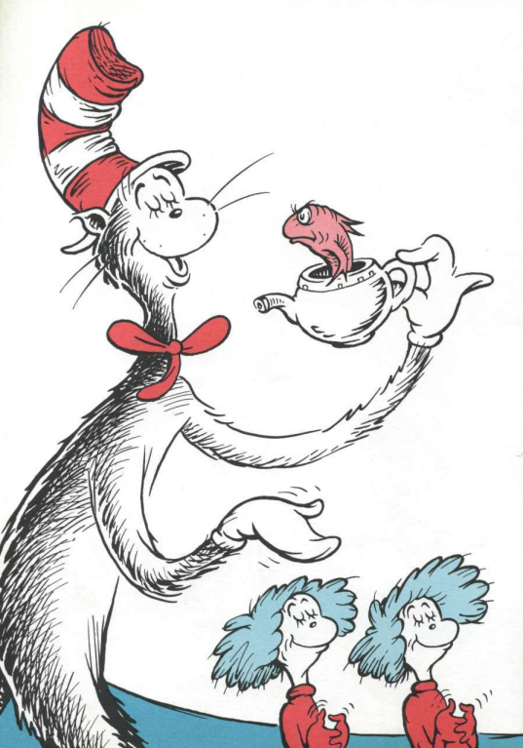
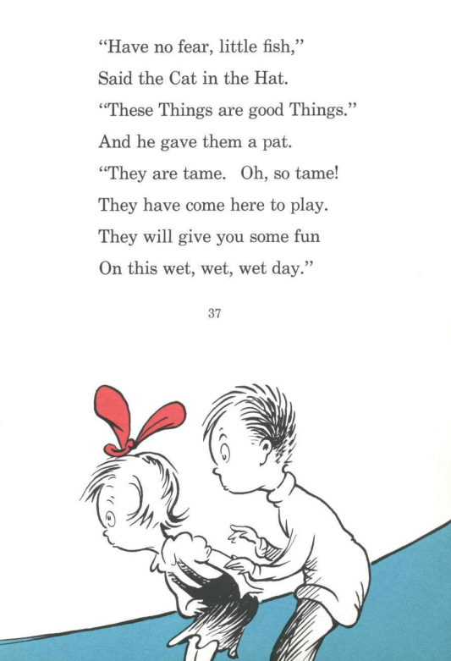
TBAT: make inferences about a character's feelings and actions.
Tuesday 13th January 2026
13/1/26

Slide 31
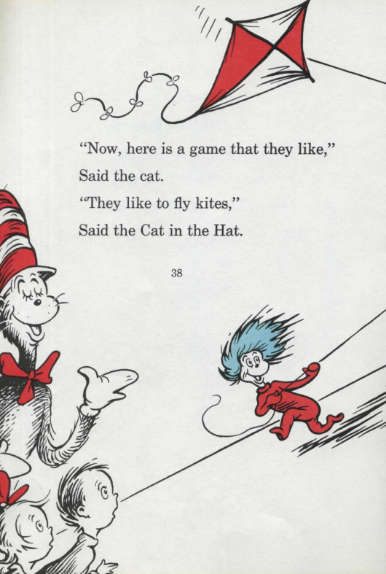
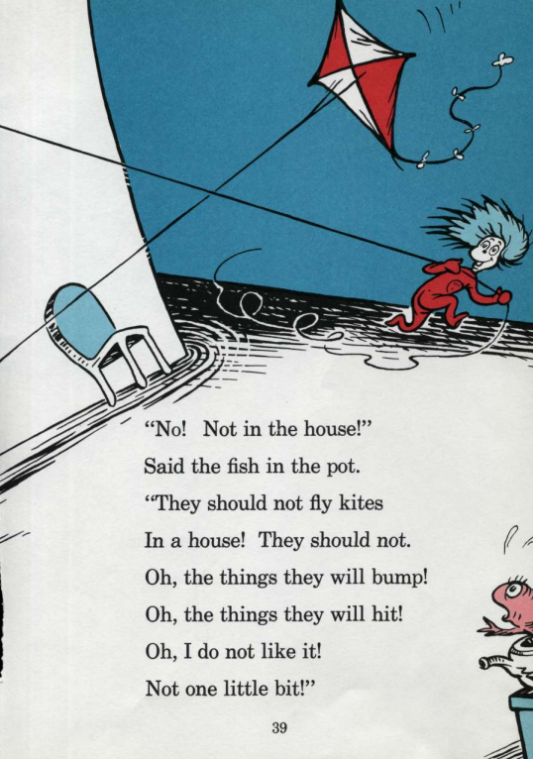
TBAT: make inferences about a character's feelings and actions.
Tuesday 13th January 2026
13/1/26

Slide 32
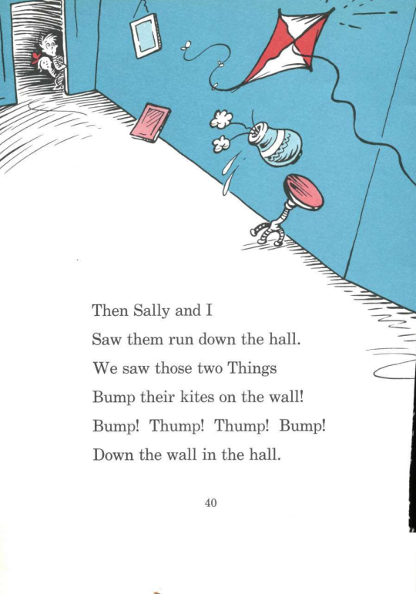
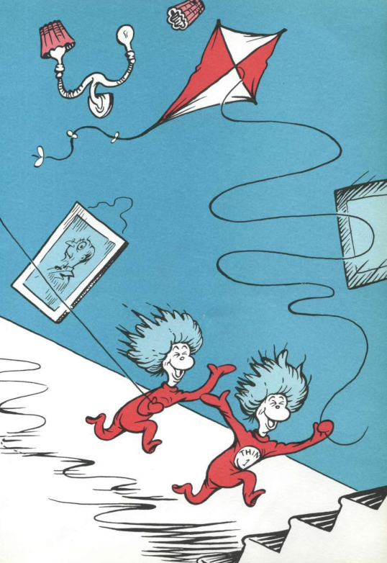
TBAT: make inferences about a character's feelings and actions.
Tuesday 13th January 2026
13/1/26

Slide 33
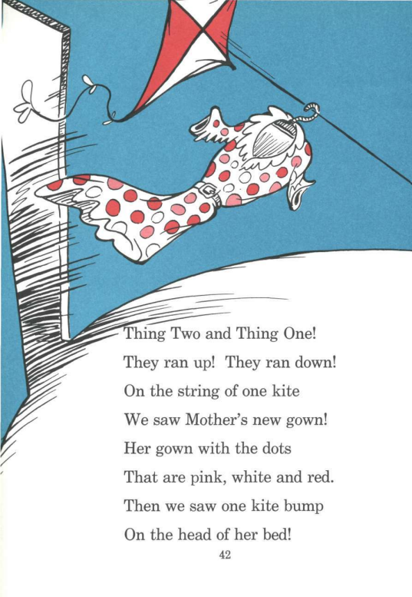
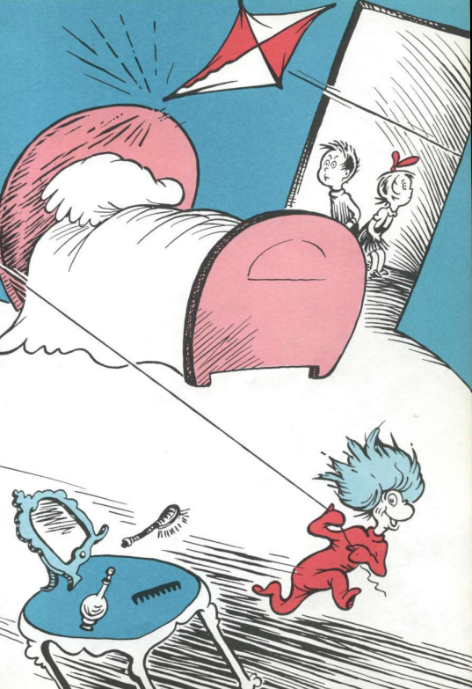
TBAT: make inferences about a character's feelings and actions.
Tuesday 13th January 2026
13/1/26

Slide 34
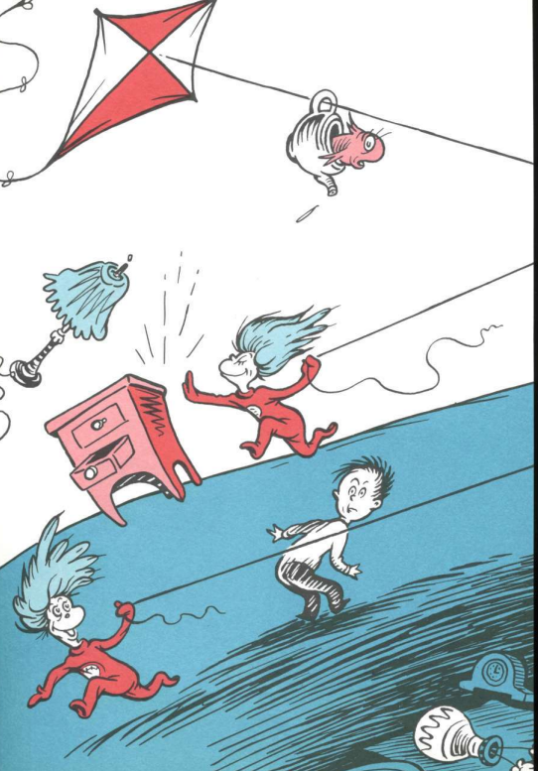
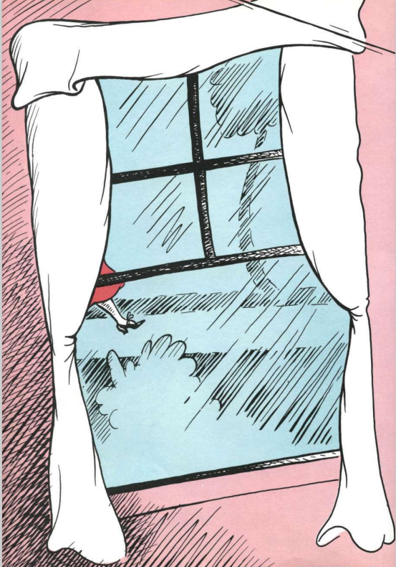
TBAT: make inferences about a character's feelings and actions.
Tuesday 13th January 2026
13/1/26

Slide 35
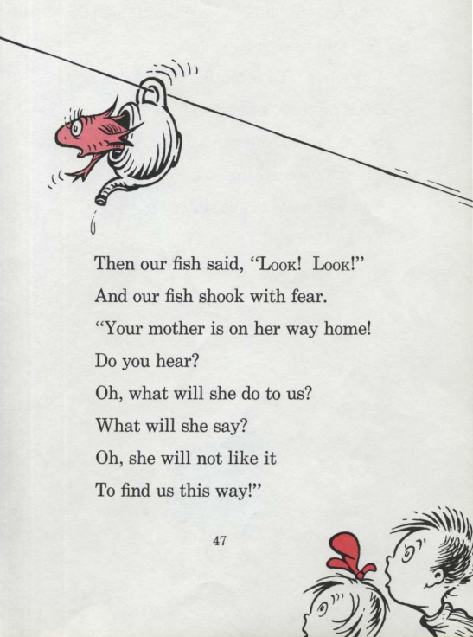

TBAT: make inferences about a character's feelings and actions.
Tuesday 13th January 2026
13/1/26

Slide 36


TBAT: make inferences about a character's feelings and actions.
Tuesday 13th January 2026
13/1/26

Slide 37


TBAT: make inferences about a character's feelings and actions.
Tuesday 13th January 2026
13/1/26

Slide 38


TBAT: make inferences about a character's feelings and actions.
Tuesday 13th January 2026
13/1/26

Slide 39


TBAT: make inferences about a character's feelings and actions.
Tuesday 13th January 2026
13/1/26

Slide 40


TBAT: make inferences about a character's feelings and actions.
Tuesday 13th January 2026
13/1/26

Slide 41


TBAT: make inferences about a character's feelings and actions.
Tuesday 13th January 2026
13/1/26

Slide 42


TBAT: make inferences about a character's feelings and actions.
Tuesday 13th January 2026
13/1/26

Slide 43
TBAT: make inferences about a character's feelings and actions.
Tuesday 13th January 2026
13/1/26
Multiple choice questions:
1. Why do you think the children look worried when the Cat arrives?
Because they don’t like fun
Because they know they shouldn’t have visitors when Mum is out
Because they are tired
Because they want to go outside
Notes:
B

Slide 44
TBAT: make inferences about a character's feelings and actions.
Tuesday 13th January 2026
13/1/26
Multiple choice questions:
2. Why do you think the Fish keeps telling the Cat to stop?
Because the Fish wants to play instead
Because the Fish likes being bossy
Because the Fish knows the Cat is making trouble
Because the Fish wants to take a nap
Notes:
C

Slide 45
TBAT: make inferences about a character's feelings and actions.
Tuesday 13th January 2026
13/1/26
Multiple choice questions:
3. Why do you think the Cat brings out more and more tricks?
Because he wants to impress the children
Because he is hungry
Because he wants to clean the house
Because he is looking for his hat
Notes:
A

Slide 46

TBAT: make inferences about a character's feelings and actions.
Tuesday 13th January 2026
13/1/26
Independent:
Challenge:
Do you think the Cat is being helpful or unhelpful overall? Use clues from the story to explain your thinking.

Slide 47

Break

Slide 48





Independent Challenges:
Narrative Zone
Maths Zone
Cat in the Hat reading comprehension
Use clocks to create the times.
Match the clock to the time it is showing
Enquiry Zone
Creative Zone
Sort the toys into groups
Hand printing

Slide 49

Lunch

Slide 50


Entry Question:
KQ: Can I describe my favourite toy?
Tuesday 13th January 2026
Lesson 1:
Can you remember the six different types of toys?
Can you describe the different types of toys to your partner?
Notes:
Learning review: Using the teaching slides, talk partners tell each other a response to the questions. Add further review questions if you wish to.

Slide 51





KQ: Can I describe my favourite toy?
Tuesday 13th January 2026​
Lesson 2:
3 in 3
1. Circle the two outdoor toys.
2. Draw lines to match the toys to the correct group.
Building and making toys
Musical toys
Notes:
Knowledge quiz 1.1: Pupils complete this in the Additional resource: Knowledge quizzes booklet to assess their knowledge retention from the previous lesson. They write their score in the chart also provided in the additional resource.

Slide 52


KQ: Can I describe my favourite toy?
Tuesday 13th January 2026​
Lesson 2:
3 in 3
3. Draw lines to match the toys to the correct group.
4. Which one describes soft toys?
cuddly problems to solve use lots of energy
Puzzles and games
Moving toys

Slide 53

KQ: Can I describe my favourite toy?
Tuesday 13th January 2026​
How are toys today similar to and different from toys in the past?
Notes:
Revisit the main enquiry question and the learning journey so far.

Slide 54

KQ: Can I describe my favourite toy?
Tuesday 13th January 2026​
Lesson 2:
In this lesson, we are describing our favourite toys.
Notes:
Introduction: Share the lesson statement and key term. Then share key knowledge and other key vocabulary with pupils—you may want to add images to the teaching slides to support exemplification and understanding of these words.

Slide 55

KQ: Can I describe my favourite toy?
Tuesday 13th January 2026​
Lesson 2:
The key term for this lesson is describe.
When we describe something, we say what it is like.
Notes:
You could support understanding of the key term ‘describe’ by selecting items in the classroom and listing adjectives to describe it using the five senses. You could select multiple items to use and ask pupils to help you list words to describe each.

Slide 56

Can I describe my favourite toy?
Tuesday 13th January 2026​
Lesson 2:
Toys look and feel different.
Toys are special for different reasons.
describe
labels

Slide 57



KQ: Can I describe my favourite toy?
Tuesday 13th January 2026​
Blue / green
Lesson 2:
What is your favourite toy?
My favourite toy is ___________________.
It is special because ___________________.
Notes:
Talk task: Ask pupils the question ‘What is your favourite toy?’ Model showing the class your favourite toy using the sentences ‘My favourite toy is _______. It is special because _______.’ Ask pupils to ask and answer the same question using the sentence supports to help. You could ask some pupils to come to the front to present their toy to the class using the sentence stems.

Slide 58


KQ: Can I describe my favourite toy?
Tuesday 13th January 2026​
Which words could you use to describe these toys?
football
modelling clay
hard
squishy
soft
colourful
round
black and white
bouncy
squeezy
Notes:
Talk task: Ask ‘Which words could you use to describe these toys?’. Ask pupils to discuss with their partner what adjectives (describing words) they would use. Challenge pupils to think of more adjectives that aren’t on the board/haven’t been discussed so far this lesson.

Slide 59

Let’s label one of your toys.
KQ: Can I describe my favourite toy?
Tuesday 13th January 2026​
Lesson 2:
What does it look like?
What does it feel like?
?
What does it do?
Notes:
Group task: Show ‘Let’s label one of your toys’. Model answering the questions: ’What does it do?, ‘What does it look like?’, ‘What does it feel like?’ using your own favourite toy. Ask pupils to help you come up with labels to describe your toy. Ask them to answer the questions about their own toy, with a partner. You could ask sets of partners who demonstrate good partner talk to present their discussions to the class.

Slide 60

Can you guess the toy in the feely bag?
KQ: Can I describe my favourite toy?
Tuesday 13th January 2026​
Lesson 2:
What does it feel like?
What does it look like?
hard
soft
bouncy
square
round
moveable
squishy
squeezy
colourful
black and white
plain
patterned
Notes:
Group task: Show ‘Can you guess the toy in the feely bag?’ slide. Ask ‘What does it feel like?’. Introduce the adjectives illustrated on the slide. Define, model, and add actions to each word to support comprehension. Using a feely bag with a range of toys, ask pupils to take it in turns to feel a toy and come up with adjectives to describe it. If pupils come up with any adjectives in addition to those on the slide, write them up on sticky notes/card/white board to use throughout the lesson. Then, ask if pupils can guess what toy they are describing. Pupils can then pull the toy out of the bag to see if they are correct. Ask pupils ‘What does it look like?’ and introduce the adjectives on the slide. Then ask them to think of more words to describe the toy now they can see it.

Slide 61
Exit question
KQ: Can I describe my favourite toy?
Tuesday 13th January 2026​
Lesson 2:
Why is it your favourite toy?
What does it look like?
What does it feel like?
Notes:
Learning review: Using the teaching slides, talk partners tell each other a response to the questions. Add further review questions if you wish to.

Slide 62

Can I describe my favourite toy?
KQ: Can I describe my favourite toy?
Lesson 2:
Toys look and feel different.
Toys are special for different reasons.
describe
labels
Notes:
Pupil home learning task: Before the next lesson, pupils should ask an older person (e.g. parent, grandparent, aunt, or teacher) what their favourite toy was when they were young and why.
Note: Teacher needs to arrange for older visitors to come in next lesson to share their favourite toys with pupils.

Slide 63
Independent Challenges:
Narrative Zone
Maths Zone
Cat in the Hat reading comprehension
Use clocks to create the times.
Match the clock to the time it is showing
Enquiry Zone
Creative Zone
Sort the toys into groups
Hand printing

