Slide 1
Thursday 22nd January 2026

Slide 2

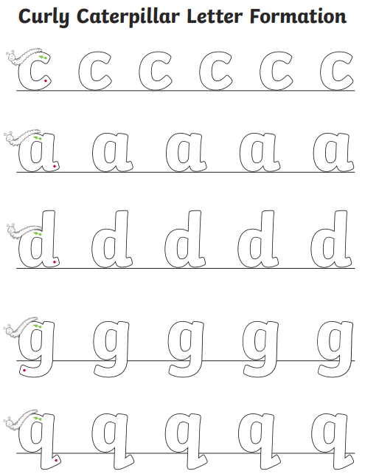
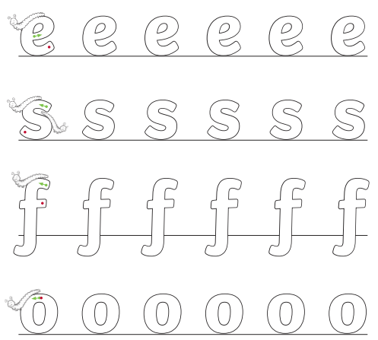
Morning Challenges:
Name writing

Slide 3
Phonics
Thursday 22nd January 2026
22/1/26
Revisit and review
Lesson focus:
Read words with the /v/ve/ grapheme

Slide 4

Revisit and review
Thursday 22nd January 2026
22/1/26
Today's Grapheme
ve

Slide 5
Recap
Thursday 22nd January 2026​
22/1/26
v c ph g
y ea wh
ow oe ou
le al

Slide 6
Revisit and review
Thursday 22nd January 2026
22/1/26
What are the digraphs?
face
space
whisper
bubble
pedal
petal
Segment these
words and read them
Blend and say words

Slide 7
Focus words
Thursday 22nd January 2026
22/1/26
g-i-ve
s-o-l-ve
l-ea-ve
Sounds out these
words and read them

Slide 8
Focus words
Thursday 22nd January 2026
22/1/26
give
solve
leave
Read, sound talk and blend
And again... FASTER!

Slide 9
Revisit and review
Thursday 22nd January 2026
22/1/26
What are the digraphs?
give
have
live
solve
leave
Segment these
words and read them
Blend and say words

Slide 10

Revisit and review
Ms
Thursday 22nd January 2026
22/1/26
Mrs
Mr
school
tricky words
different
call
Read the tricky words

Slide 11
New tricky word
Thursday 22nd January 2026
22/1/26
ask
Which part is tricky?

Slide 12
Thursday 22nd January 2026
22/1/26
Now let's read this sentence!​
This space puzzle is hard to solve.
What digraphs can you see?
What tricky words can you see?

Slide 13
Thursday 22nd January 2026
22/1/26
Let's spell!
How many sounds? Write it.
tricky words
give leave ask
Listen to the sentence, say it, write it and read it!
Challenge
Extend the sentence using 'and'

Slide 14

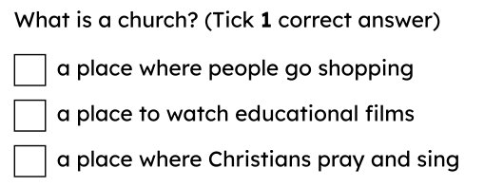
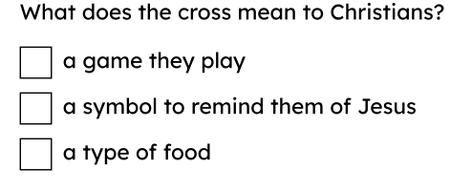
3 in 3
What does it mean to belong?

Slide 15
Key words
faith
believing in something that you cannot see; Christians have faith in God and Jesus
family
the people who love and care for you; not all families look the same
Christian
a person who believes in God and follows Jesus
belong
being part or a member of a group

Slide 16

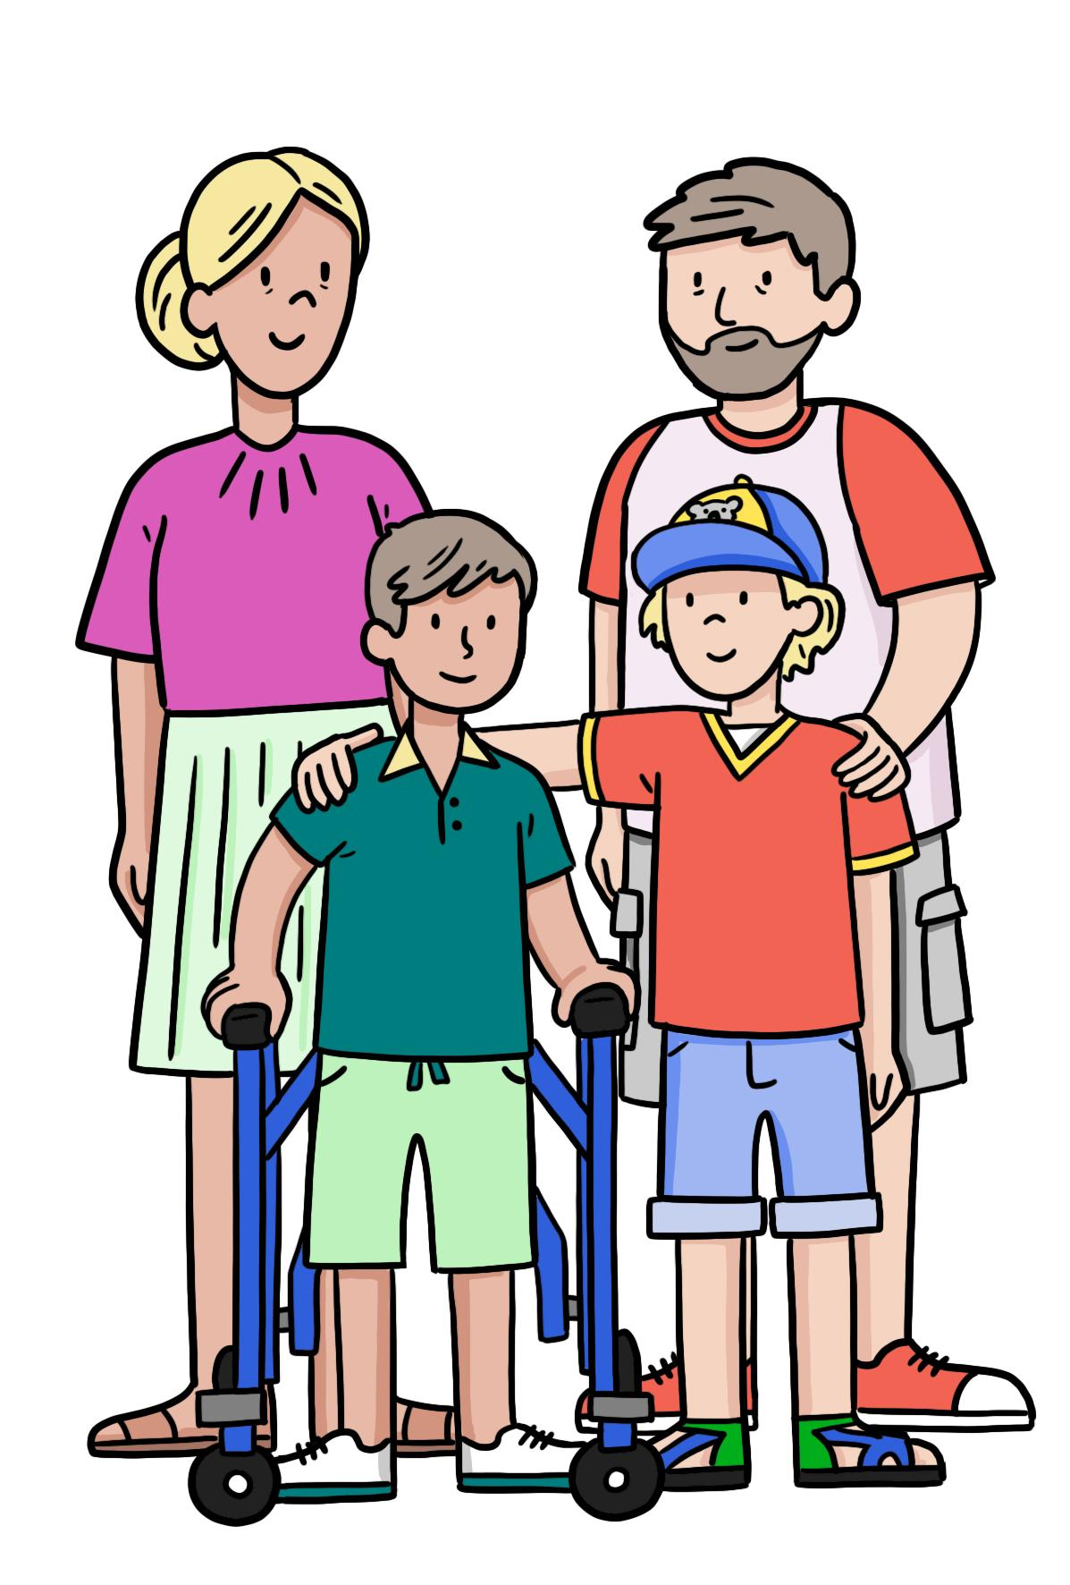
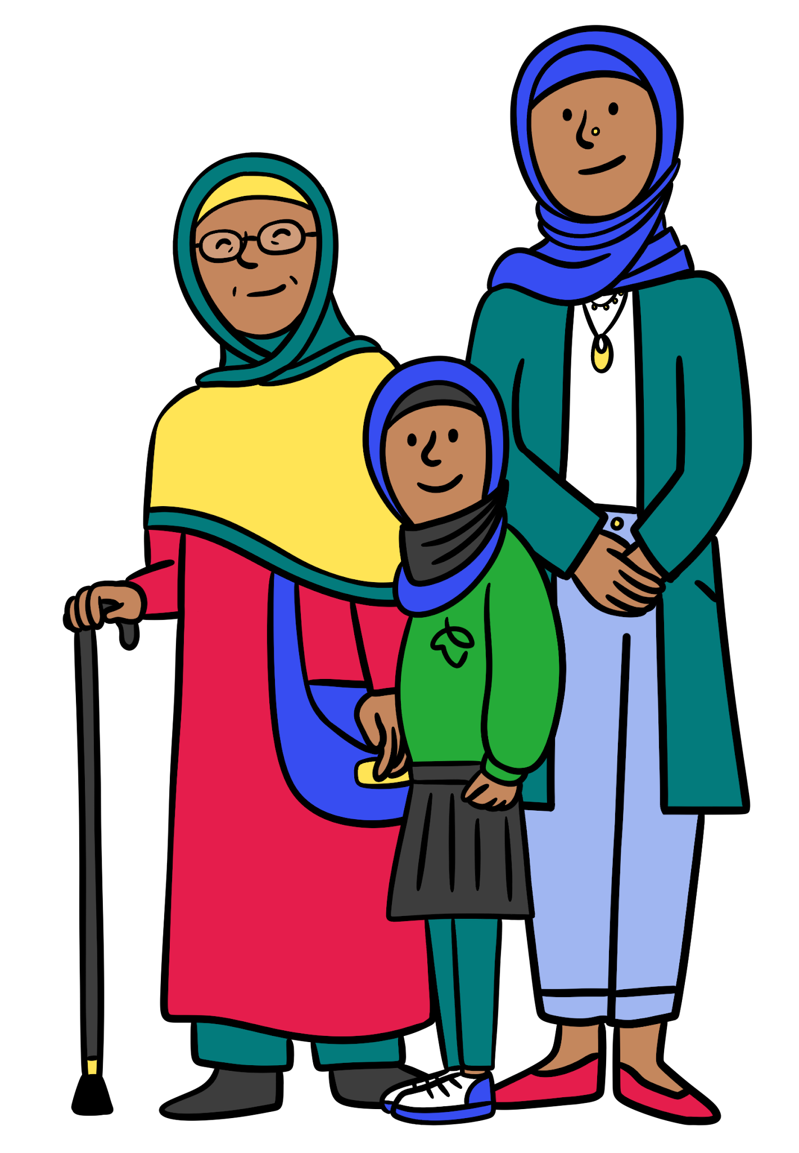
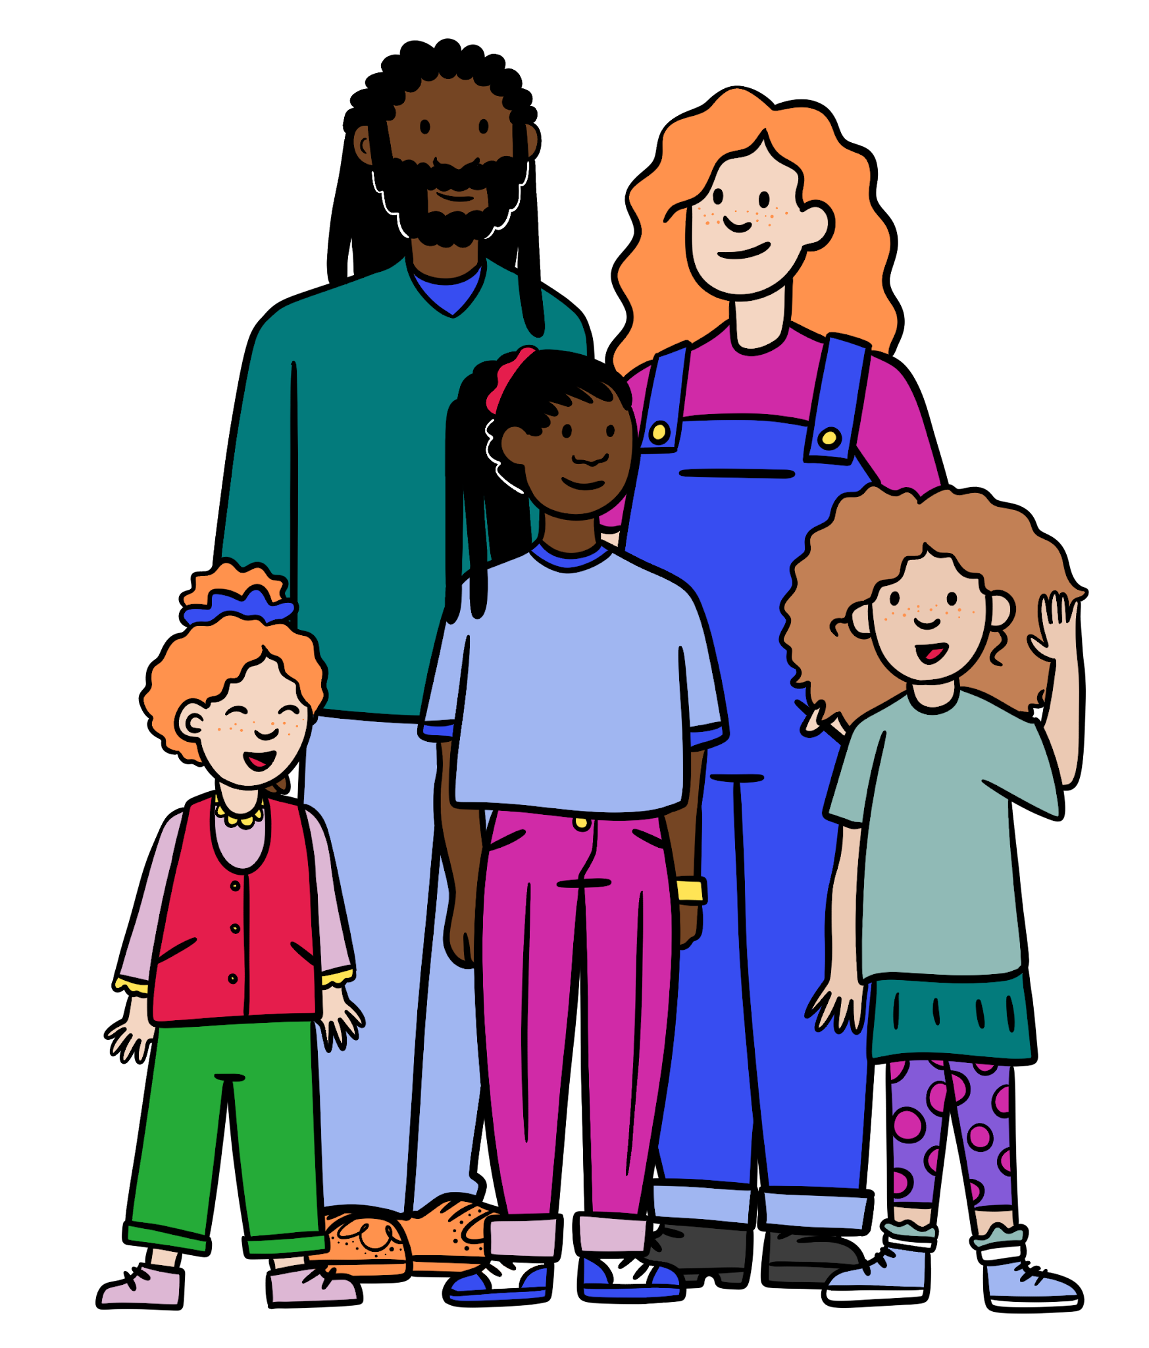
What is a Christian faith family?
In this lesson, we will look at examples of different Christians and how their beliefs about how to belong to a faith family have impacted the way they live.
There are lots of different types of families.
Who is in your family?

Slide 17






What is a Christian faith family?
Everyone’s family is different.
A family may live in the same house as each other or perhaps far away.
A family might share meals together.
Izzy
Aisha
A family might meet up on special occasions such as birthdays or festivals.
People in a family could be related to each other.
Alex
Lucas

Slide 18
What is a Christian faith family?
A family might help each other if someone has a difficult time or is feeling sad.
A family might play games together.
Izzy
Aisha
People in a family may go on holiday together.
A family is a group of people who belong together and help one another feel safe and loved.
Alex
What does your family do?
Lucas

Slide 19
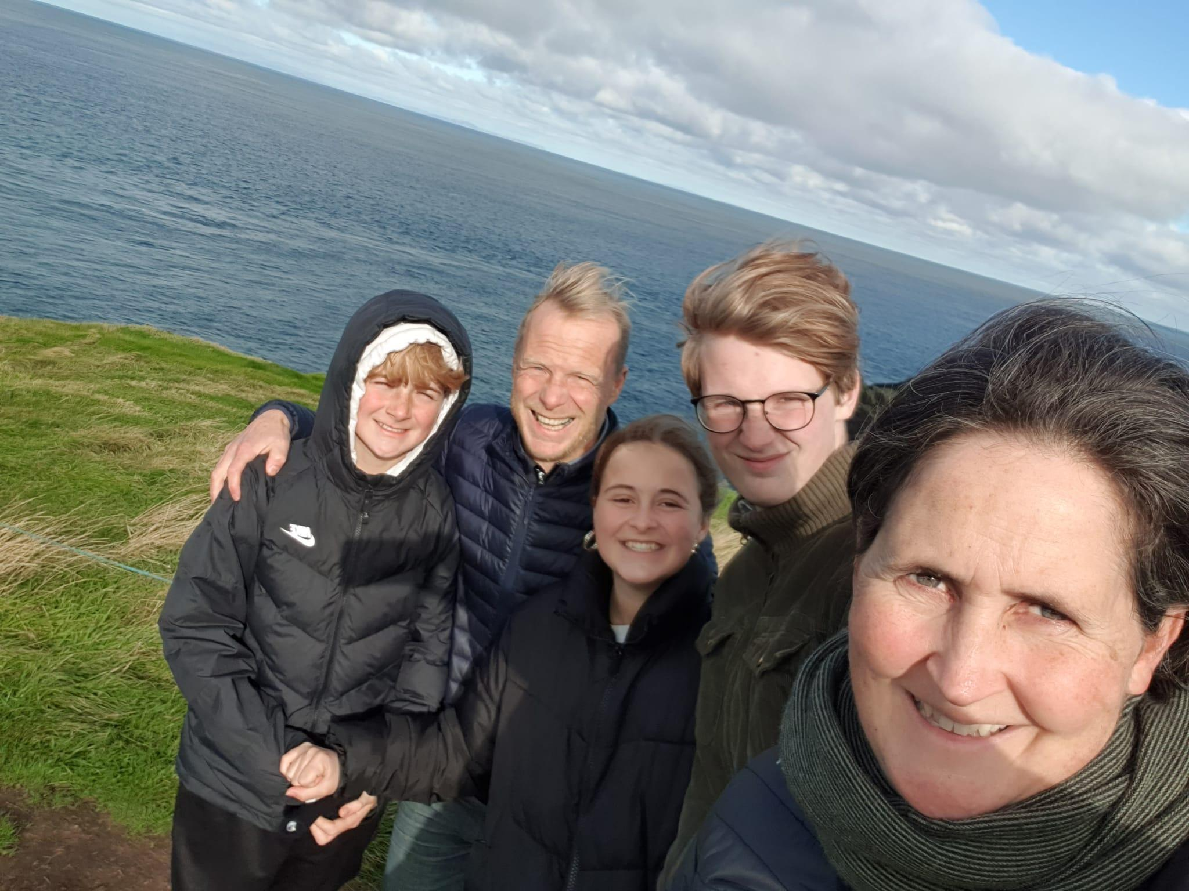

What is a Christian faith family?
This is Wayne and his family.
Wayne is a Christian, he believes in God.
Wayne and his family follow the teachings of Jesus.
Wayne is also part of a faith family.

Slide 20
What is a Christian faith family?
A faith family is a group of people who believe in the same things and have the same traditions.
Wayne and his Christian faith family all have faith in God and Jesus.
They come together to care for each other, just like other families.

Slide 21
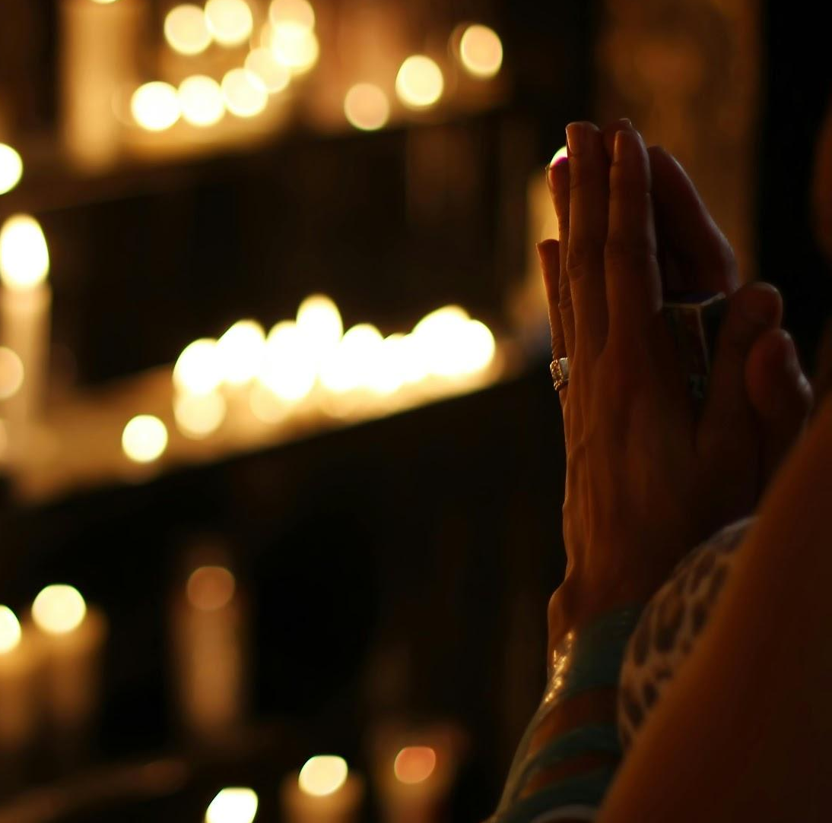
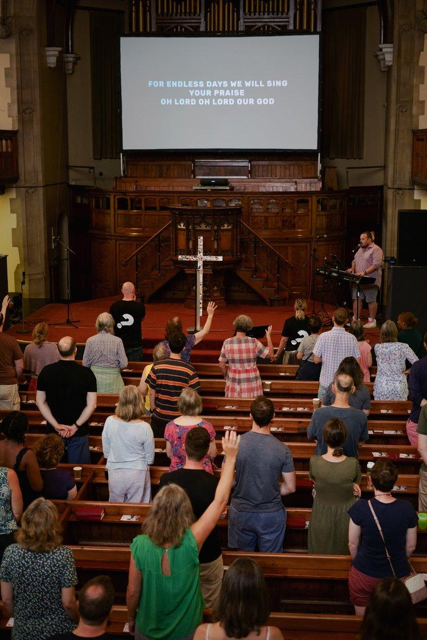
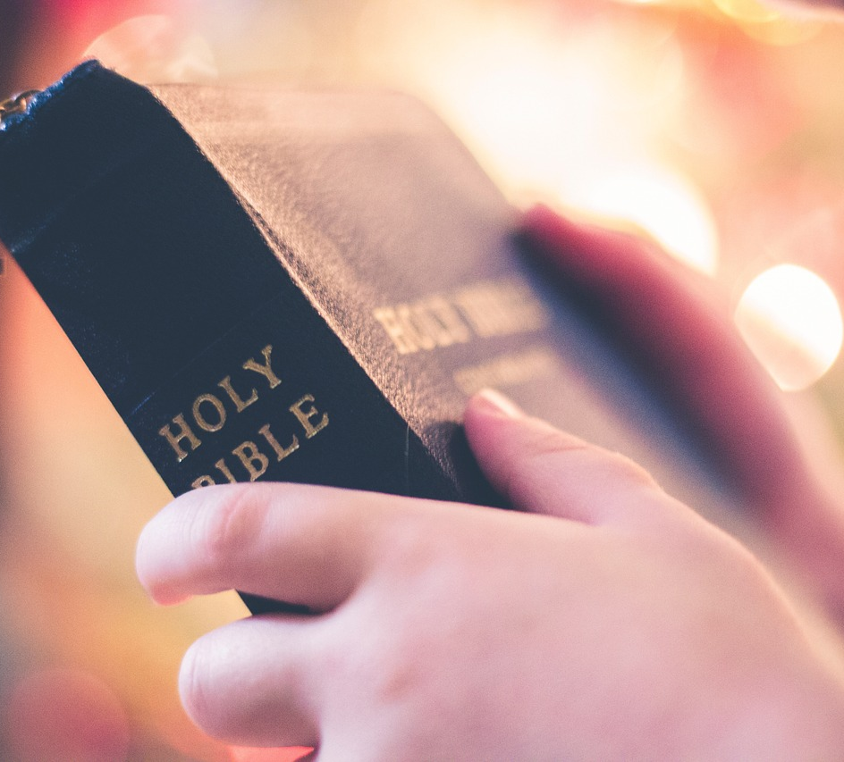
What is a Christian faith family?
What are some things a Christian faith family may do?
they may meet to pray together
they may meet in church to sing and worship God
they may show they belong by reading the Bible together

Slide 22

What is a Christian faith family?
A faith family is exactly the same as a family.
Why?
In families, the members of that family do not always share the same beliefs. A faith family is a group of people who are connected because they share the same beliefs, not because they are related.

Slide 23


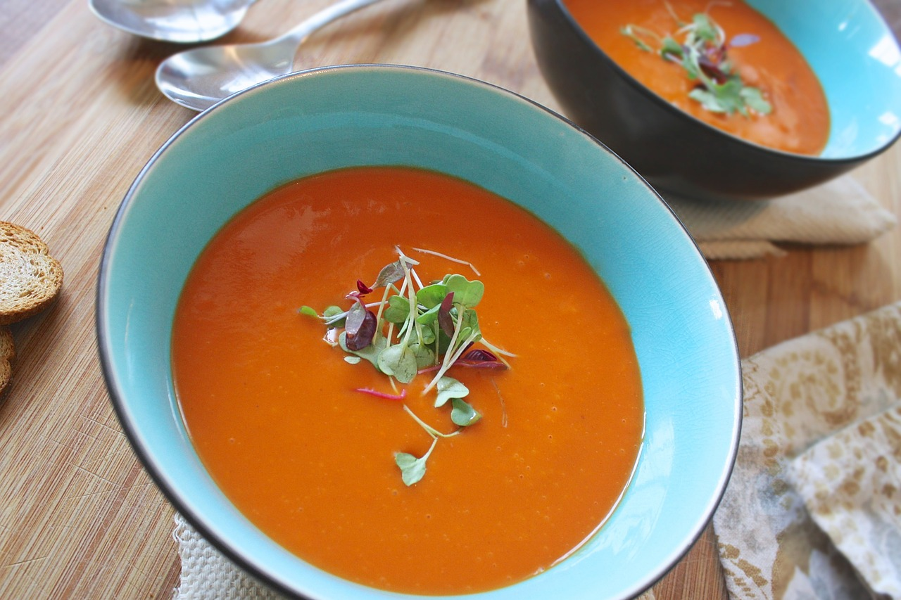
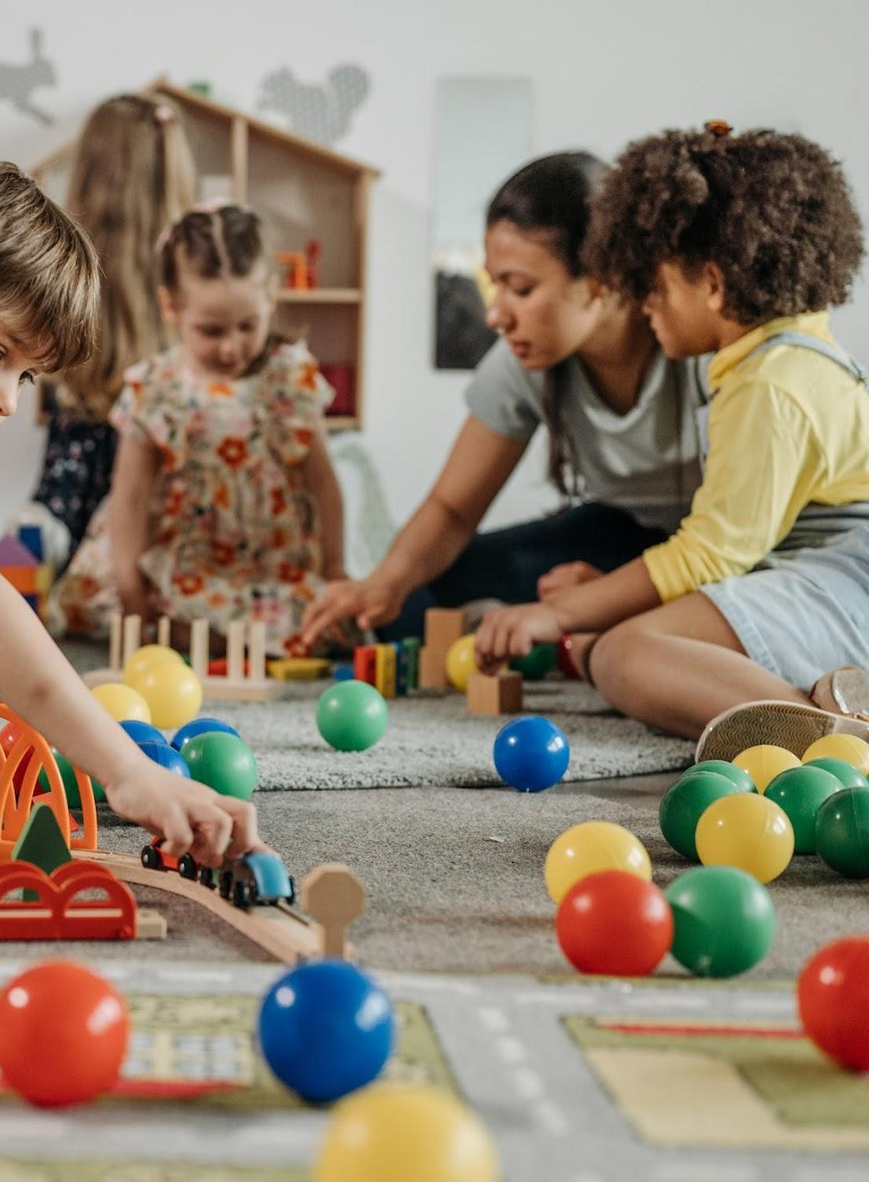
How do Christian faith families show they belong?
Wayne’s faith family meets together at church on different days of the week.
Sunday worship
hot meals
toddler group

Slide 24
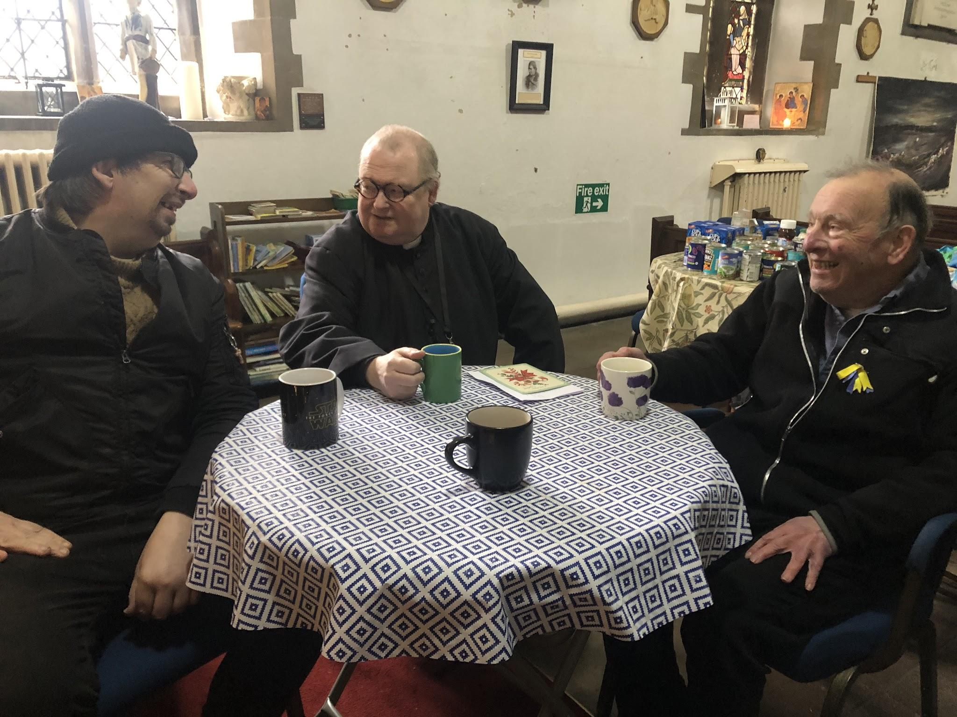
How do Christian faith families show they belong?
This is Father David.
Father David is a vicar at a different church in Bristol.
Father David is also part of a Christian faith family.

Slide 25
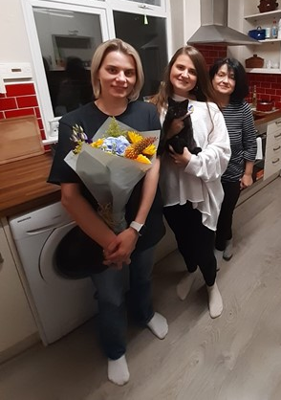
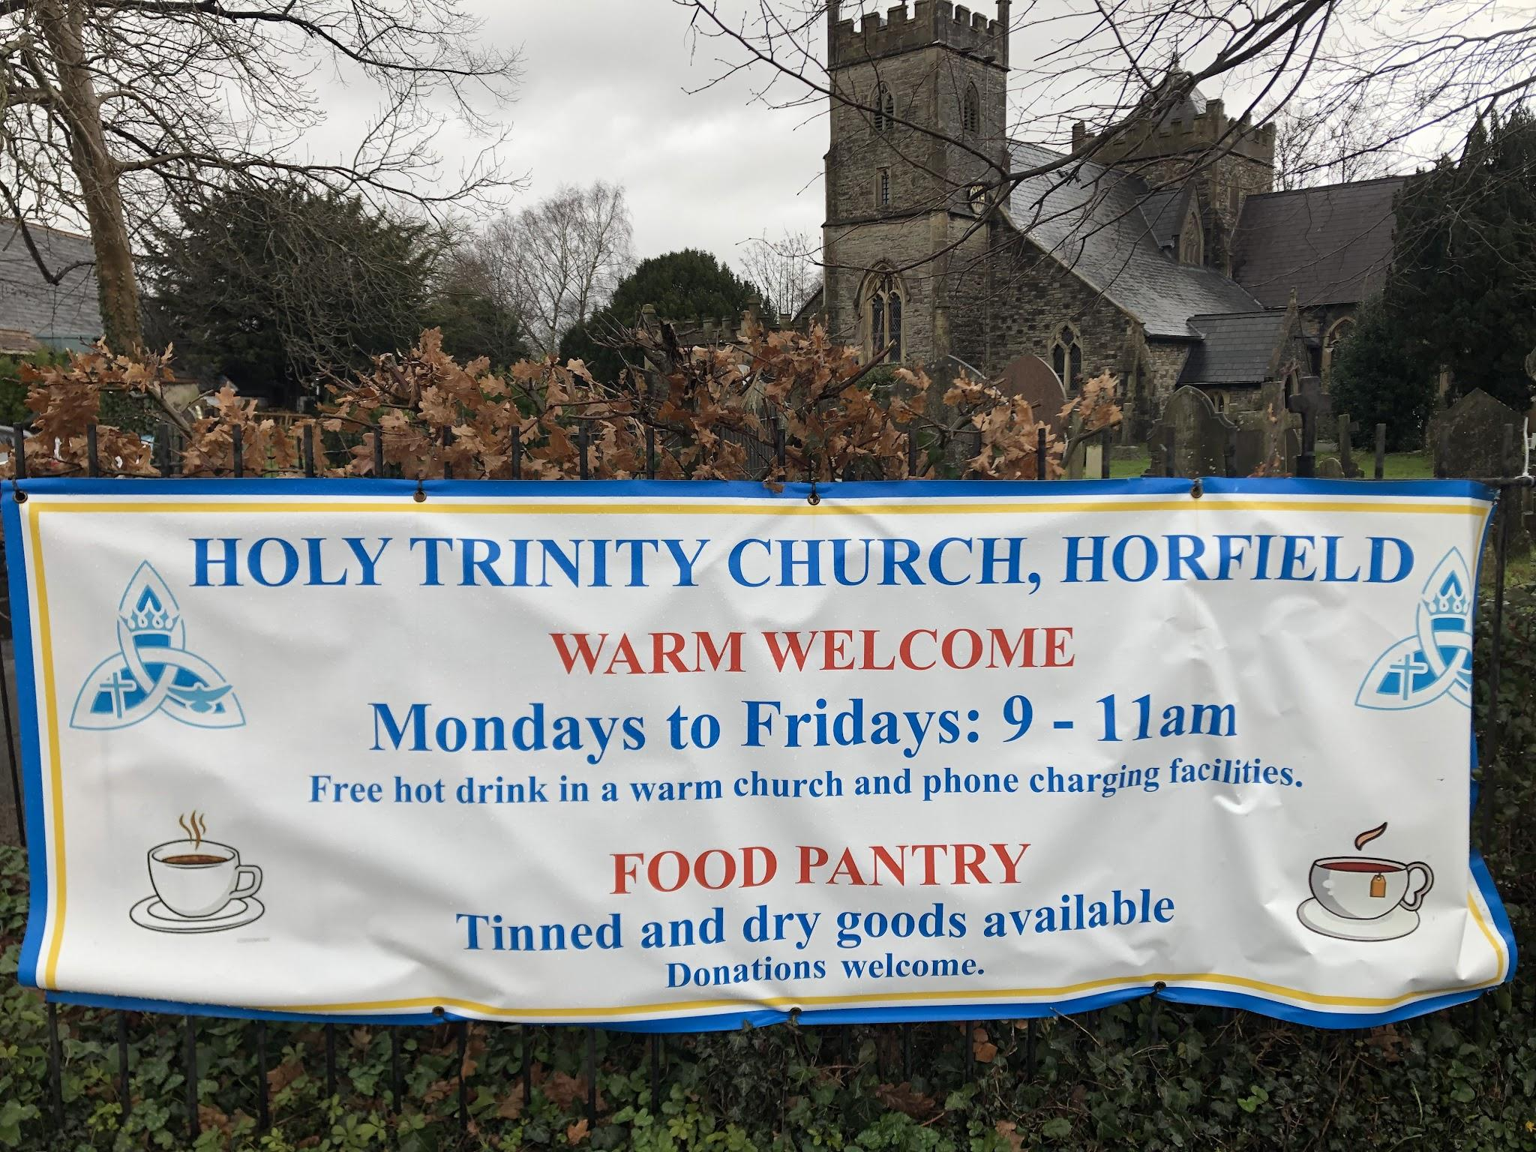
How do Christian faith families show they belong?
At Father David’s church, the members show that they are part of a wider Christian faith family by helping others.
They provide a place to rest and talk for homeless people.
They help to make new people feel welcome.
They provide food for people who cannot afford to buy it.

Slide 26
How do Christian faith families show they belong?
Which statement is not an example of how members of a Christian faith family help others?
give food to people who are hungry
provide homes for refugees
attend church each week

Slide 27
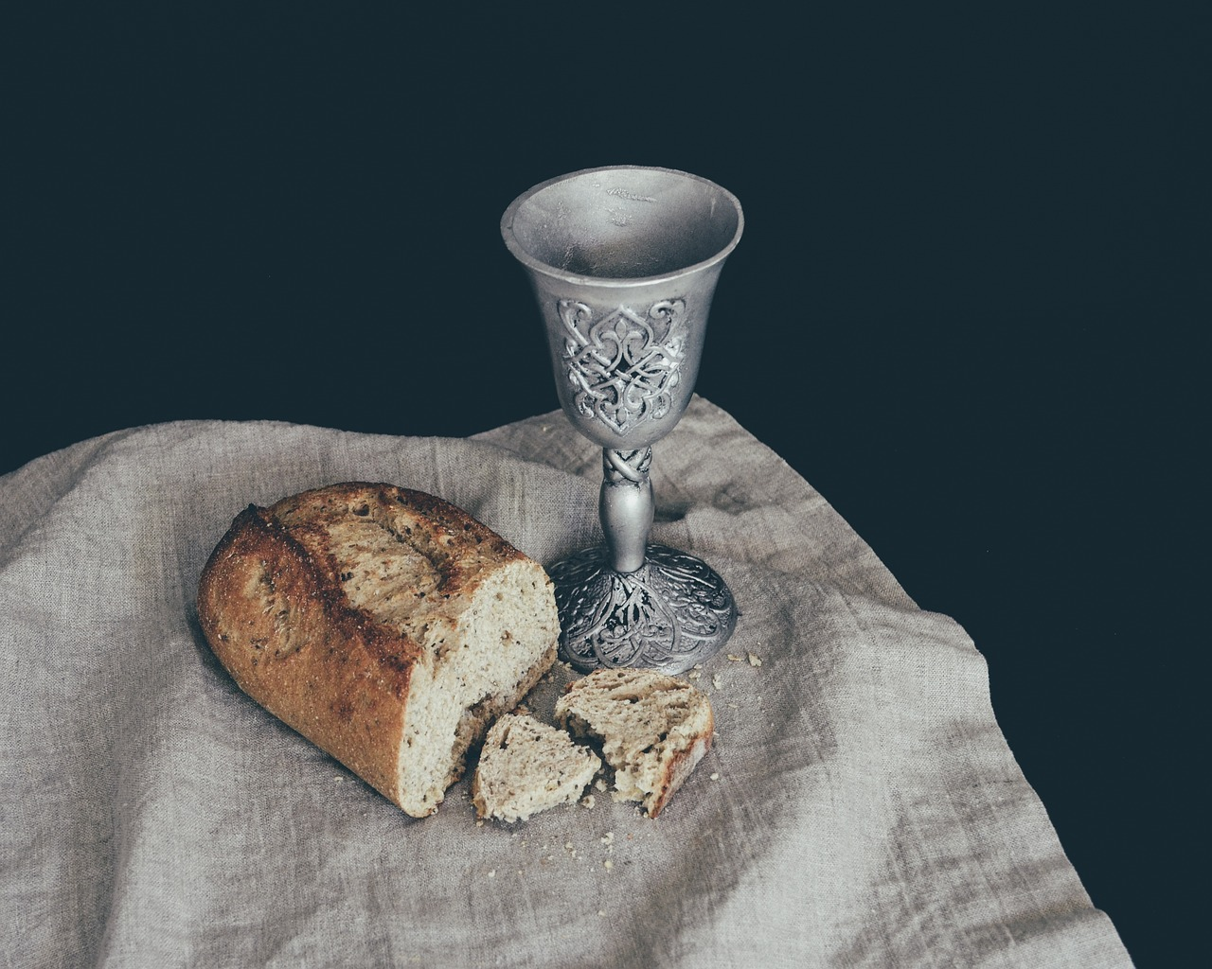
How do Christian faith families show they belong?
Father David’s faith family come together in church on a Sunday to worship Jesus.
They have Holy Communion together.
They do this to remember Jesus.
communion bread and wine
Wayne’s faith family come together in church on a Sunday to worship Jesus.
They sing about Jesus together.
They do this to remember Jesus.

Slide 28
How do Christian faith families show they belong?
Father David and Wayne do different things with their different Christian faith families.
What do they have in common?
Father David and Wayne’s Christian faith families both:
include people they are not related to
welcome people so that they feel that they belong
are connected by following Jesus

Slide 29
How do Christian faith families show they belong?
Worshipping together is the only way a person can be a part of a Christian faith family.
Why?
Worshipping together is one way to belong to a faith family, but there are also many other ways.

Slide 30

How do Christian faith families show they belong?
Wayne and Father David are talking about what makes their faith families similar. Can you complete their sentences?
I think our faith families are similar because …
I think what connects all the things we do is …

Slide 31

How do Christian faith families show they belong?
Wayne and Father David are talking about what makes their faith families similar. Your sentences might be similar to these:
I think our faith families are similar because we both love Jesus and want to show God’s love by helping people.
I think what connects all the things we do is being kind and treating others as Jesus would want them to be treated.
What other examples did you have?

Slide 32
Christians and their faith family
People who share the same belief in God, and have similar traditions for worshipping him, are called a faith family.
Anyone who shares the same Christian beliefs in God can belong to the faith family.
Christians can meet up with their faith family in their houses or at church.
People in a Christian faith family love God and Jesus and want to show God’s love to other people.

Slide 33
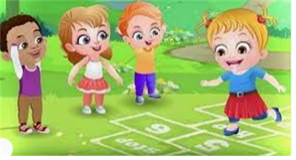
Break

Slide 34

Yoga – TBAT: develop flexibility when holding poses.
Success Criteria:
Stretch a little further each breath.

Slide 35
Wild West
Begin jogging around the space.
Rodeo: gallop around.
Rocky road: jump around. Bend your knees on take off and landing.
There's a snake in my boots: hop around.

Slide 36
Skill development
Wild west poses,
Try to stretch a little further every few breaths when holding your pose. Practise each pose for three breaths in and three breaths out. Try to make each breath last for a count of three.
Cow: Place your hands and knees on the floor, hands underneath shoulders. Arch your back, tilt hips and keep your neck long, looking up.
Cactus: Try to lift your non-standing foot high into your inner thigh of your standing foot. Open your hips by your non-standing knee facing sideways. Feel the stretch in your glutes (bottom) and hips.
Dog: Keep both hands and feet on the floor. Look back between your legs. Hips up and back, with a flat back
Cowgirl: Front foot facing forwards, back foot diagonal. Back leg stays straight and front knee bends.
Tumbleweed: Knees apart, heels together, stretch arms as far forwards as possible, sink your bottom backwards. Snake As you push up, feel the stretch across your chest and stomach

Slide 37
Plenary
How do you feel after your yoga lesson, both in your body and in your mind?
How well did you work as a group?
Were you able to listen to each other and make decisions together?
Which pose did you find most challenging?

Slide 38

Lunch

Slide 39
Blue / Green
Come up with sentences about the part, part, whole models.
If I know … then I know … because …
TBAT: To use doubles to calculate near doubles
9
19
Challenge:
Think of your own example that is not shown here.
2
7
12
7
8
18
5
3
5
13
Notes:
Do Now: If I know … then I know …
Pairs each have a set of 20 cubes and a large part-whole model. They rehearse their learning from Lesson 1, placing and moving cubes on the part-whole model to show related facts. You may wish to encourage pupils to make a train of ten cubes, to make the structure of the teens numbers easier to see. Encourage use of the sentence structure:
If I know two plus seven is equal to nine, then I know 12 plus seven is equal to 19.

Slide 40
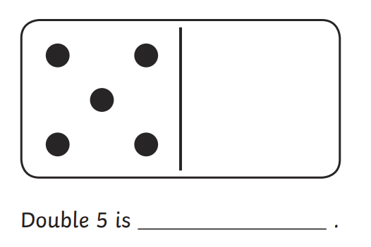
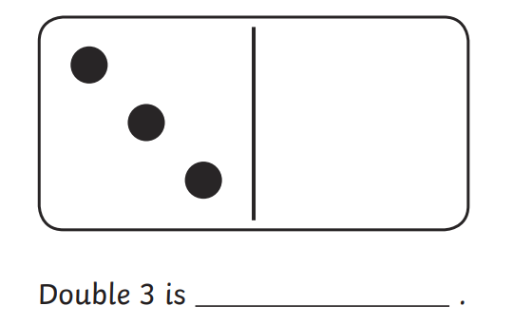
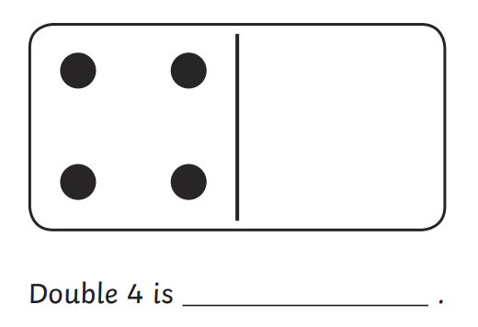
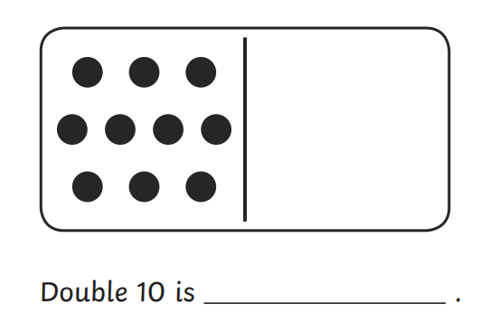
3 in 3
Find the doubles
TBAT: To use doubles to calculate near doubles
Challenge:
Notes:
Do Now: If I know … then I know …
Pairs each have a set of 20 cubes and a large part-whole model. They rehearse their learning from Lesson 1, placing and moving cubes on the part-whole model to show related facts. You may wish to encourage pupils to make a train of ten cubes, to make the structure of the teens numbers easier to see. Encourage use of the sentence structure:
If I know two plus seven is equal to nine, then I know 12 plus seven is equal to 19.

Slide 41
TBAT: use doubles to calculate near doubles
double
known fact
near double
number bond

Slide 42
Blue / Green
What does double mean?
What methods could you use to double?
TBAT: To use doubles to calculate near doubles

Slide 43
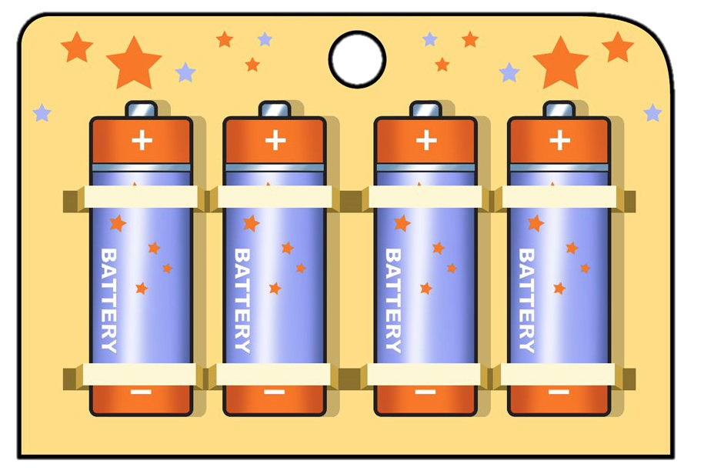
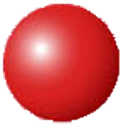
Buy one get one free
TBAT: To use doubles to calculate near doubles
I pay for four batteries.
I get ________ batteries.
Double four is ________.
Four plus four is equal to ________.
4
4
Notes:
New Learning: Rehearsing doubles
Use this part of the lesson to help pupils revise and become more fluent in doubles to ten. Set a context: explain that you went to a shop and there was a special offer on batteries: buy one get one free. So however many batteries you pay for, you get double that number.
What does the word ‘double’ mean?
I paid for four batteries. How many did I get?
Show how this could be modelled on a bead string and using equal stacks of cubes.
Repeat for other examples.
Discuss with pupils which doubles facts they already know. Explain that doubles facts are useful as they can help us to calculate other facts. Pupils will be at different stages of knowing doubles facts, so discuss different strategies for calculation if these facts have not yet been memorised (counting on, ‘Make ten’, pupils’ own strategies). Model using a bead string/cubes.

Slide 44
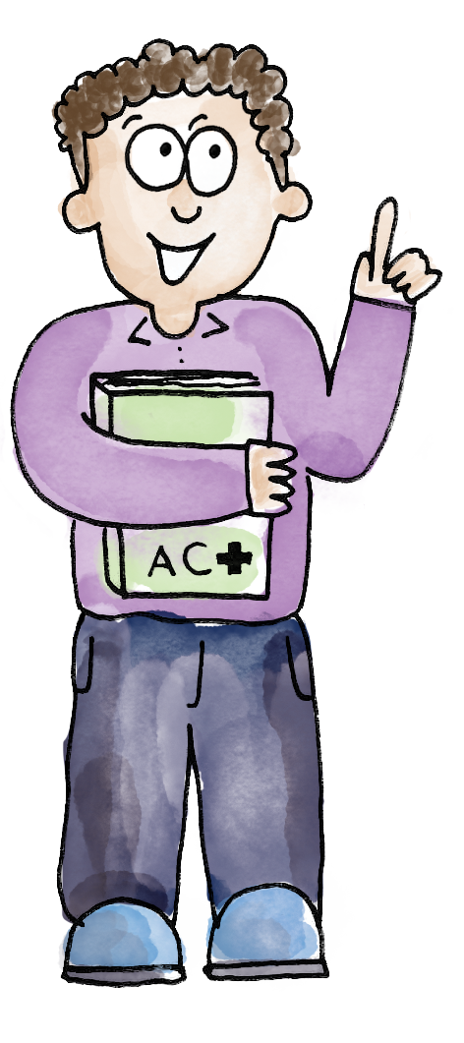
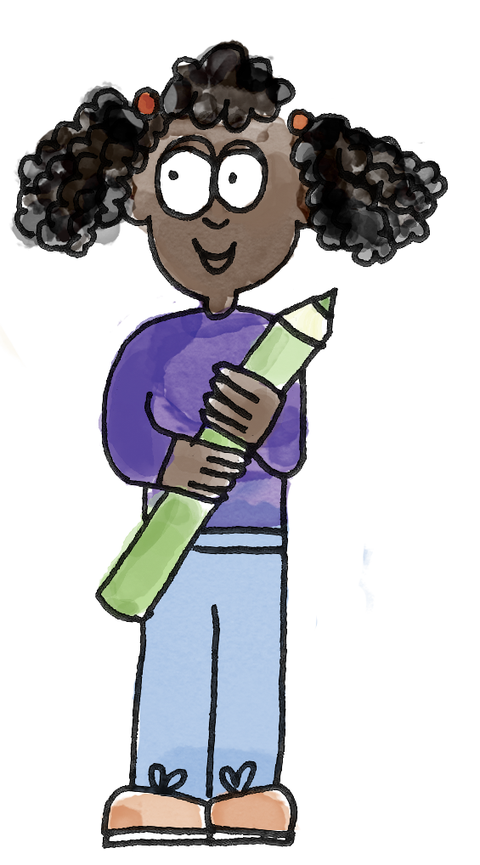

TBAT: To use doubles to calculate near doubles
I’ve chosen seven.
I’ll use ‘Make ten’. I need to add three to seven to make ten. Then there’s another four left to add. That’s fourteen altogether.
Double seven is fourteen.
7
I can see a group of ten beads and four more beads.
Double seven is fourteen.
double known fact near double number bond
Notes:
Talk Task: Rehearsing doubles
Pupils have a bead string and a set of number cards 0–10.
Pupil A selects a card. Pupil B identifies double that number, either using a known fact or calculating. Pupil A models the same fact on a bead string and says the double fact.
Encourage pupils to reflect on which facts they know and which they still need to calculate.

Slide 45
TBAT: To use doubles to calculate near doubles
I’ll use ‘Make ten’. I need to add two to eight to make ten. Then there’s another six left to add. That’s sixteen altogether.
Double eight is…
8
I’ve chosen 8.
I can see a group of ten beads and … more beads.
Double eight is…
double known fact near double number bond
Notes:
Talk Task: Rehearsing doubles
Pupils have a bead string and a set of number cards 0–10.
Pupil A selects a card. Pupil B identifies double that number, either using a known fact or calculating. Pupil A models the same fact on a bead string and says the double fact.
Encourage pupils to reflect on which facts they know and which they still need to calculate.

Slide 46
What is the missing number?
TBAT: To use doubles to calculate near doubles
= 4 + 5
What do you already know that will help you?
How did you calculate the missing number?
Notes:
Develop Learning: Using doubles to derive near doubles
This part of the lesson establishes how it is useful to know doubles facts because they can help us to find other facts (just like knowing addition facts helps us to derive subtraction facts). Show __ = 4 + 5, and ask pupils to calculate the missing value. Then ask them to share their strategies. Acknowledge different strategies then focus pupils’ attention on how if we know double four, we can add one because five is one more than four. Show this using concrete representations (e.g. cubes or a bead string). Get pupils to build their own models. (A pictorial representation can be found on the next slide.) The written equation 4 + 5 = 4 + 4 + 1 is another way of expressing the mathematical structure.
If pupils are confident, you could also discuss and represent how 4 + 5 can be calculated using double five then subtracting one.
Model further examples, chosen based on pupils’ familiarity with doubles facts. If they are only confident in facts to double five, stick with these for now as understanding the ‘double plus one’ structure is the focus.
Show the next slide, and ask pupils to say who they agree with and why.

Slide 47
Double plus one
TBAT: To use doubles to calculate near doubles
= 4 + 5
4 + 5 = 4 + 4 + 1
Notes:
Develop Learning: Using doubles to derive near doubles
This part of the lesson establishes how it is useful to know doubles facts because they can help us to find other facts (just like knowing addition facts helps us to derive subtraction facts). Show __ = 4 + 5, and ask pupils to calculate the missing value. Then ask them to share their strategies. Acknowledge different strategies then focus pupils’ attention on how if we know double four, we can add one because five is one more than four. Show this using concrete representations (e.g. cubes or a bead string). Get pupils to build their own models. (A pictorial representation can be found on the next slide.) The written equation 4 + 5 = 4 + 4 + 1 is another way of expressing the mathematical structure.
If pupils are confident, you could also discuss and represent how 4 + 5 can be calculated using double five then subtracting one.
Model further examples, chosen based on pupils’ familiarity with doubles facts. If they are only confident in facts to double five, stick with these for now as understanding the ‘double plus one’ structure is the focus.
Show the next slide, and ask pupils to say who they agree with and why.

Slide 48
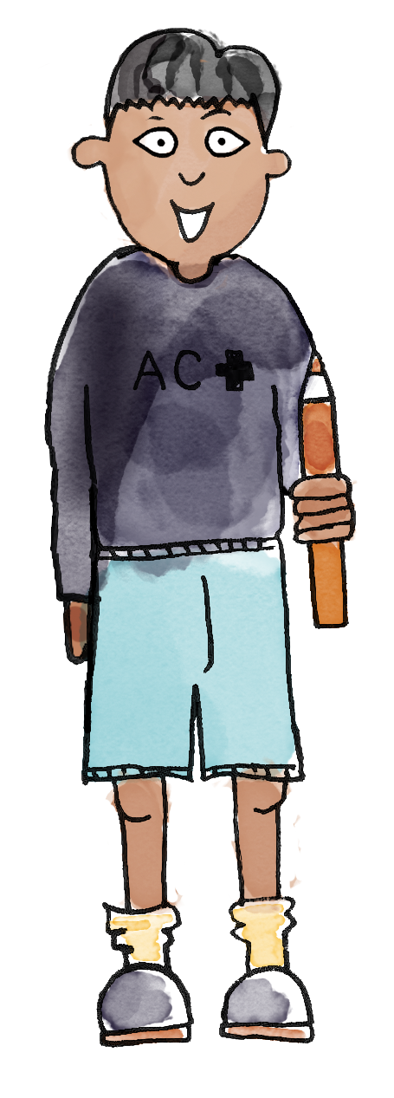
Who do you agree with? Why?
TBAT: To use doubles to calculate near doubles
To calculate 3 + 4, I can double four and then add one.
To calculate 3 + 4, I can double three and then add one.
Notes:
Develop Learning: Using doubles to derive near doubles
This part of the lesson establishes how it is useful to know doubles facts because they can help us to find other facts (just like knowing addition facts helps us to derive subtraction facts). Show __ = 4 + 5, and ask pupils to calculate the missing value. Then ask them to share their strategies. Acknowledge different strategies then focus pupils’ attention on how if we know double four, we can add one because five is one more than four. Show this using concrete representations (e.g. cubes or a bead string). Get pupils to build their own models. (A pictorial representation can be found on the next slide.) The written equation 4 + 5 = 4 + 4 + 1 is another way of expressing the mathematical structure.
If pupils are confident, you could also discuss and represent how 4 + 5 can be calculated using double five then subtracting one.
Model further examples, chosen based on pupils’ familiarity with doubles facts. If they are only confident in facts to double five, stick with these for now as understanding the ‘double plus one’ structure is the focus.
Show the next slide, and ask pupils to say who they agree with and why.

Slide 49
TBAT: To use doubles to calculate near doubles
If I know 2 + 2 = 4, then I know ...
Notes:
Independent Task
Pupils represent doubles facts from double one to double five (using cubes or bead strings) and then identify at least one fact they can derive from this, e.g. 5 + 6. No sheet is provided, so consider whether/how pupils record this work. They could use the sentence structure:
If I know [double three is six], then I know [three plus four is seven].
They could also write equations, e.g. 3 + 4 = 3 + 3 + 1. The focus should be on explaining how the near doubles strategy works, rather than ‘getting the answer’.
Possible adaptations:
Pupils could be challenged to write at least two derived facts for each double, e.g. double 4 to derive 4 + 5, 5 + 4, 3 + 4 and 4 + 3.
Pupils could be provided with pictorial representations of doubles for them to draw on an extra ‘one’ (or cross out ‘one’) and write related equations.

Slide 50
Do you agree or disagree? Why?
TBAT: To use doubles to calculate near doubles
I can use the fact that double five is ten to help me calculate 6 + 7.
Notes:
Plenary: Using doubles to derive near doubles
Get pupils to discuss the statement on the slide. Some pupils might say that it is better to use double six and add one, or double seven and subtract one. Some pupils might see that 6 + 7 can be seen as double five add three. The purpose is to share ideas and establish that we can think about calculations in flexible ways. You might like to use manipulatives or pictures to represent what pupils are saying to ensure the whole class can follow.

Slide 51
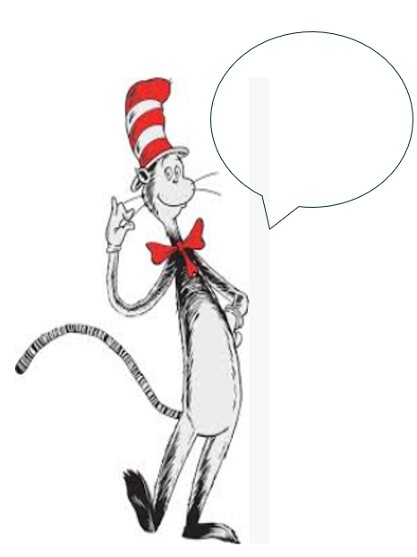
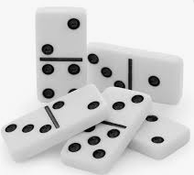
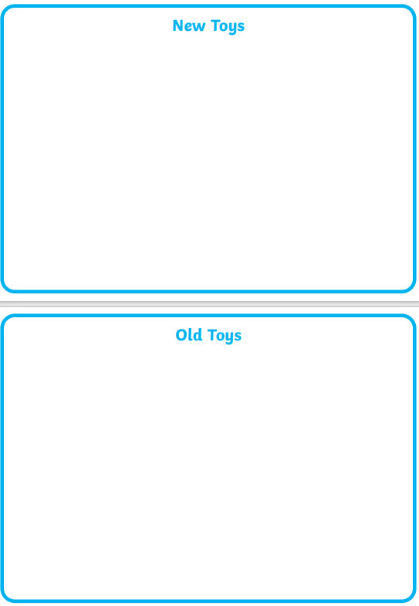
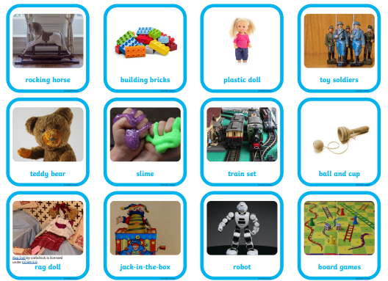




Independent Challenges:
Narrative Zone
Maths Zone
Write an instruction that the Cat in the Hat is giving to Thing 1 and Thing 2 to clear up the mess.
Use the dominoes to calculate doubles and near doubles.
Enquiry Zone
Creative Zone
Sort the old and new toys.
Use the stamps to print your name

