Slide 1
Thursday 15th January 2026

Slide 2

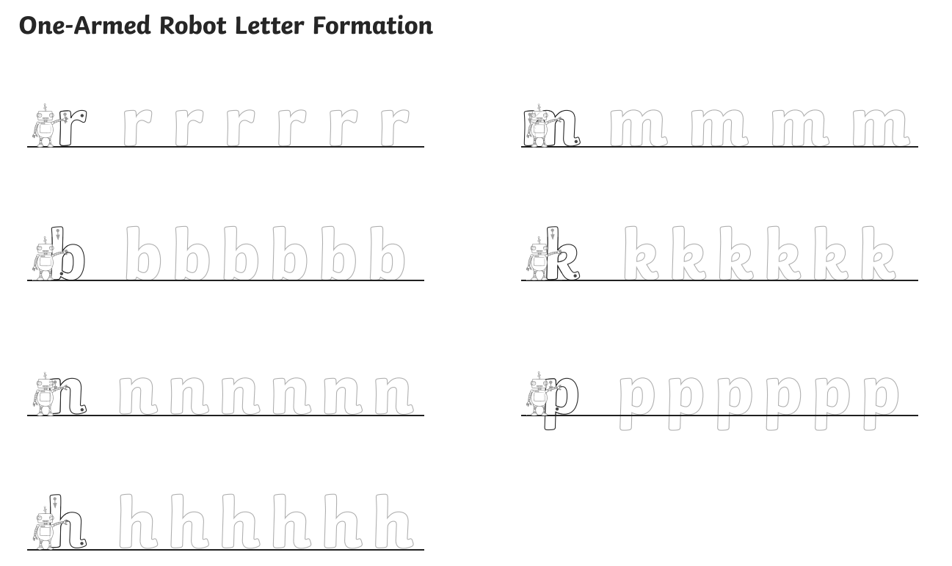
Morning Challenges:
Name writing

Slide 3

Revisit and review
Thursday 15th January 2026​
15/1/26
Today's Grapheme
ph

Slide 4
Phonics
Thursday 15th January 2026
15/1/26
Revisit and review
Lesson focus:
Read words with the f/ph/ grapheme

Slide 5
Revisit and review
Thursday 15th January 2026
15/1/26
What are the digraphs?
yellow
follow
energy
brownie
shower
danger
Segment these
words and read them
Blend and say words

Slide 6
Focus words
Thursday 15th January 2026
15/1/26
ph-a-s-e
ph-o-t-o
d-o-l-ph-i-n
Sounds out these
words and read them

Slide 7
Focus words
Thursday 15th January 2026
15/1/26
phase
photo
dolphin
Read, sound talk and blend
And again... FASTER!

Slide 8
Revisit and review
Thursday 15th January 2026
15/1/26
What are the digraphs?
phone
photo
dolphin
elephant
alphabet
Segment these
words and read them
Blend and say words

Slide 9
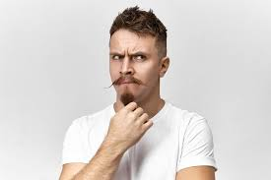
Revisit and review
whole
Thursday 15th January 2026
15/1/26
would
should
who
tricky words
could
were
Read the tricky words

Slide 10
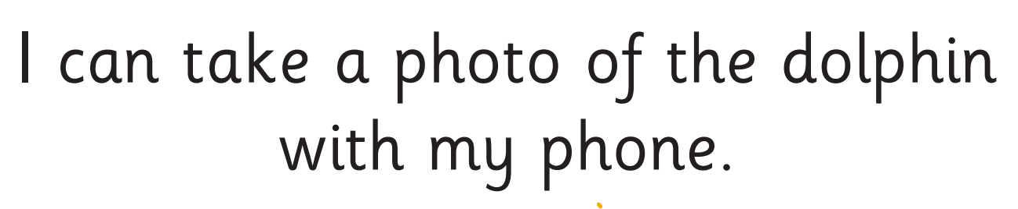
Thursday 15th January 2026
15/1/26
Now let's read this sentence!​
What digraphs can you see?
What tricky words can you see?

Slide 11
Thursday 15th January 2026
15/1/26
Let's spell!
How many sounds? Write it.
tricky words
photo dolphin
Listen to the sentence, say it, write it and read it!
Challenge
Extend the sentence using 'and'

Slide 12

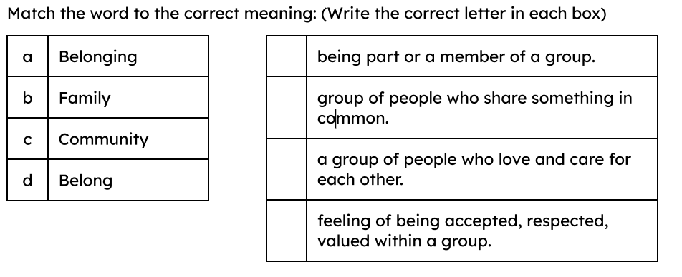
4 in 4

Slide 13
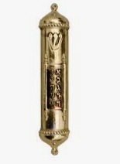
Key Vocabulary
symbol
a picture, sign, or object that helps us to understand what someone believes or where they belong
belong
to be accepted, respected, and valued within a group
mezuzah
a tiny scroll with special words from the Torah, contained in a small case on the door of a Jewish home

Slide 14

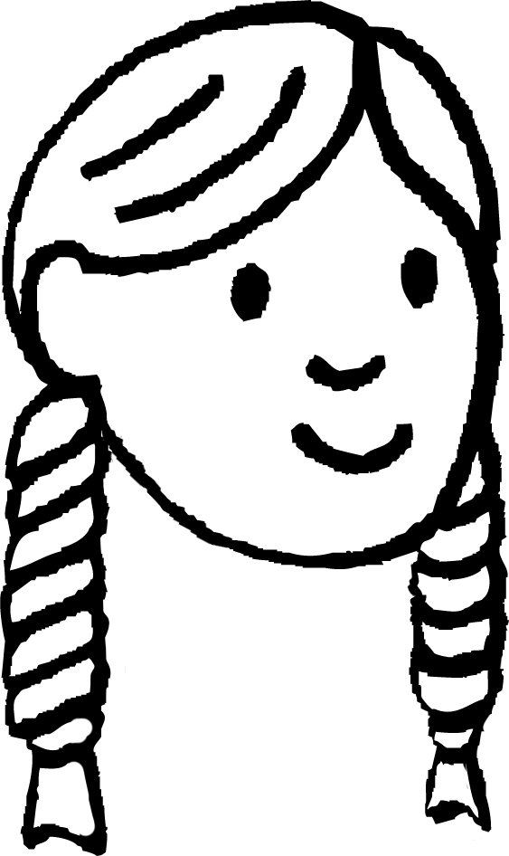
What are symbols and why do people use them?
Laura explains why it is useful to learn about a range of people in religious education.
We can better understand people’s beliefs and worldviews, and how they make a difference to their daily lives, if we find out what is important to them and talk to them about the way they live.
Laura
Today, we will look at the symbols and objects people use in their everyday lives to show they belong.

Slide 15



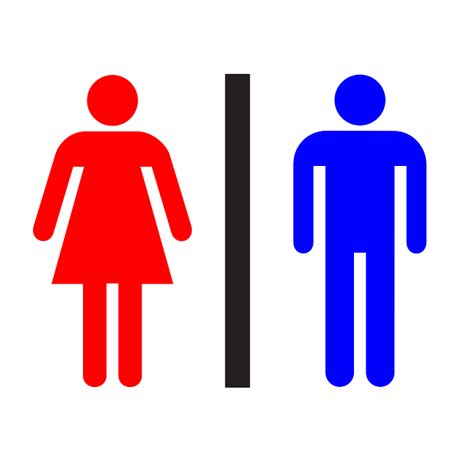

What are symbols and why do people use them?
What are these?
What do we use them for?
heart
warning sign
toilet door sign
Blue / Green - What other symbols have you seen?

Slide 16

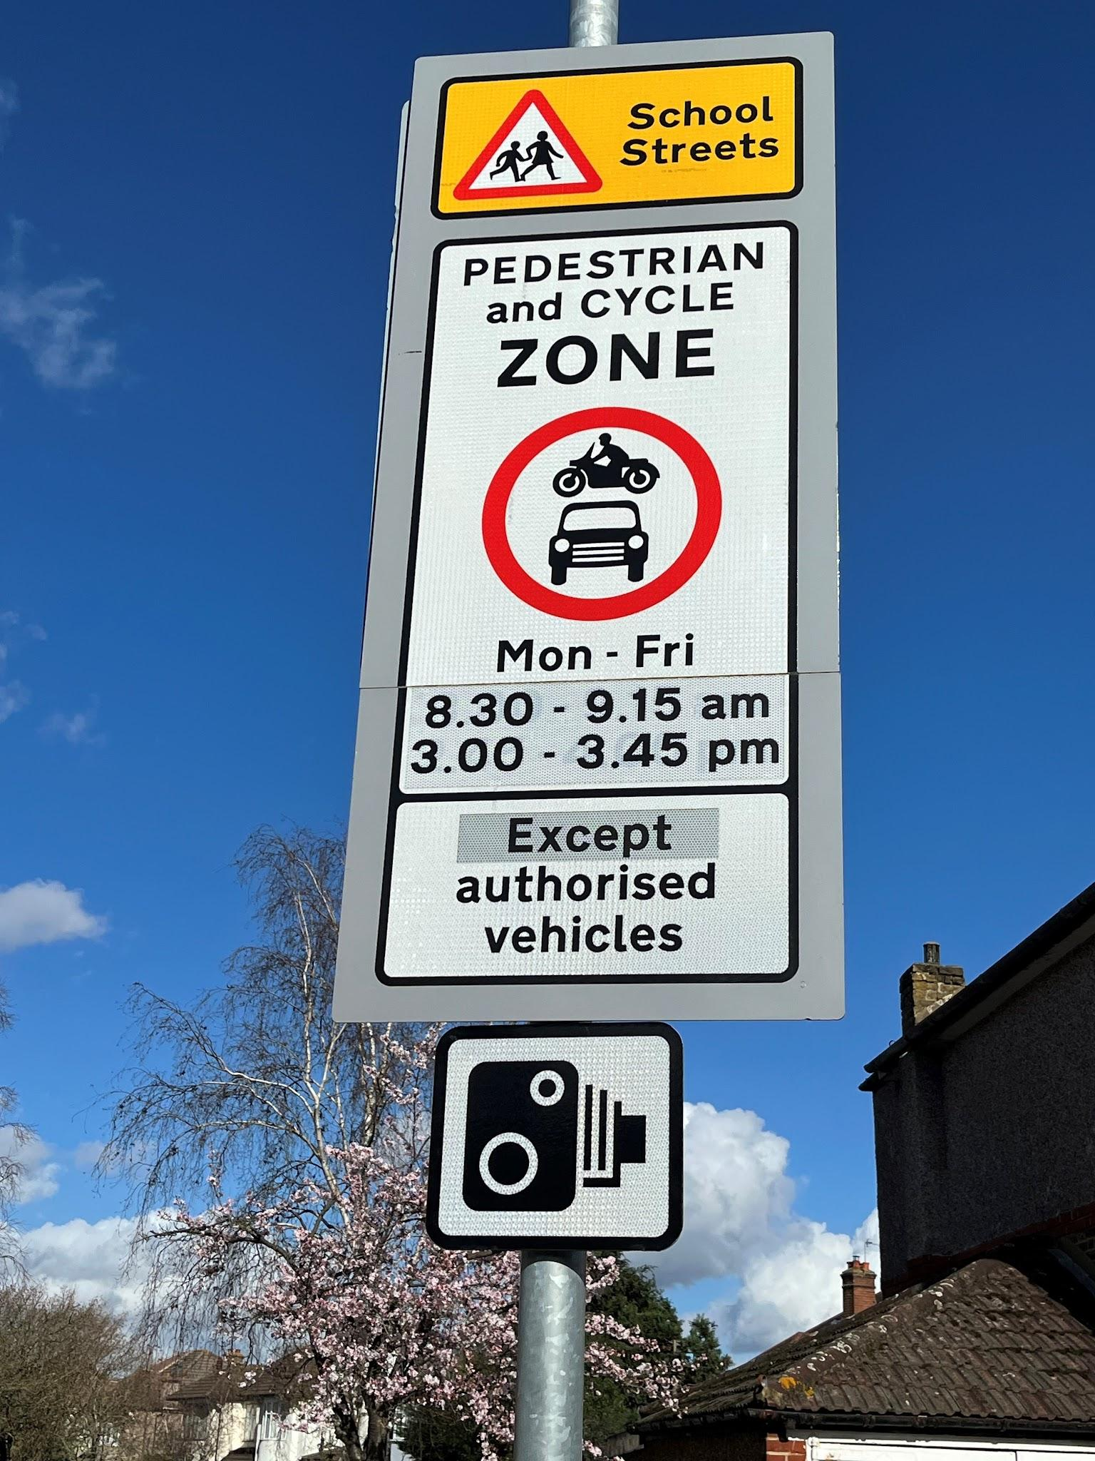

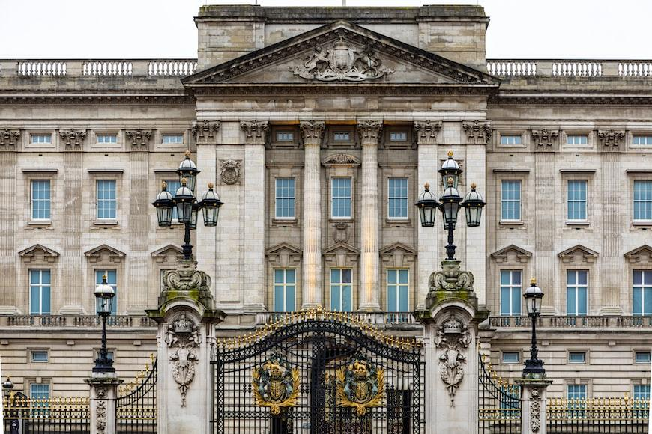
What are symbols and why do people use them?
Where do we see symbols?
We see symbols all around us.
royal crest
street signs
Buckingham Palace
Right photo: © Ken Welsh. All rights reserved 2024 / Bridgeman Images

Slide 17
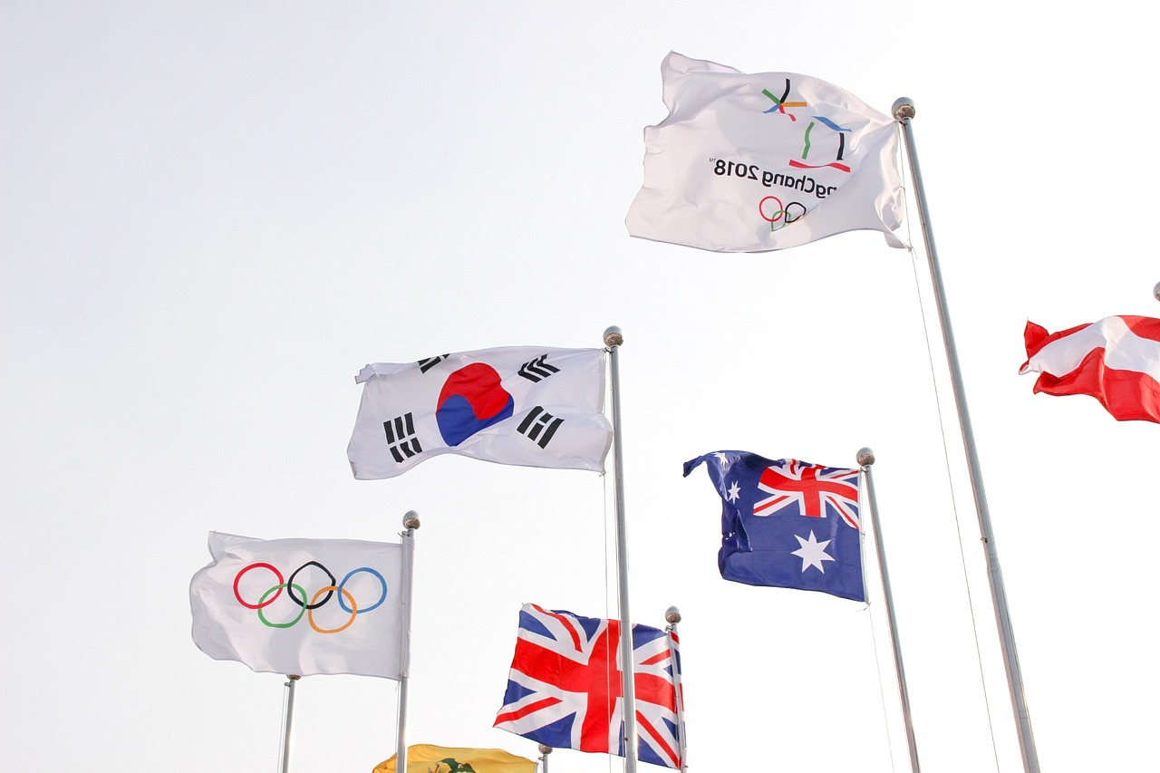
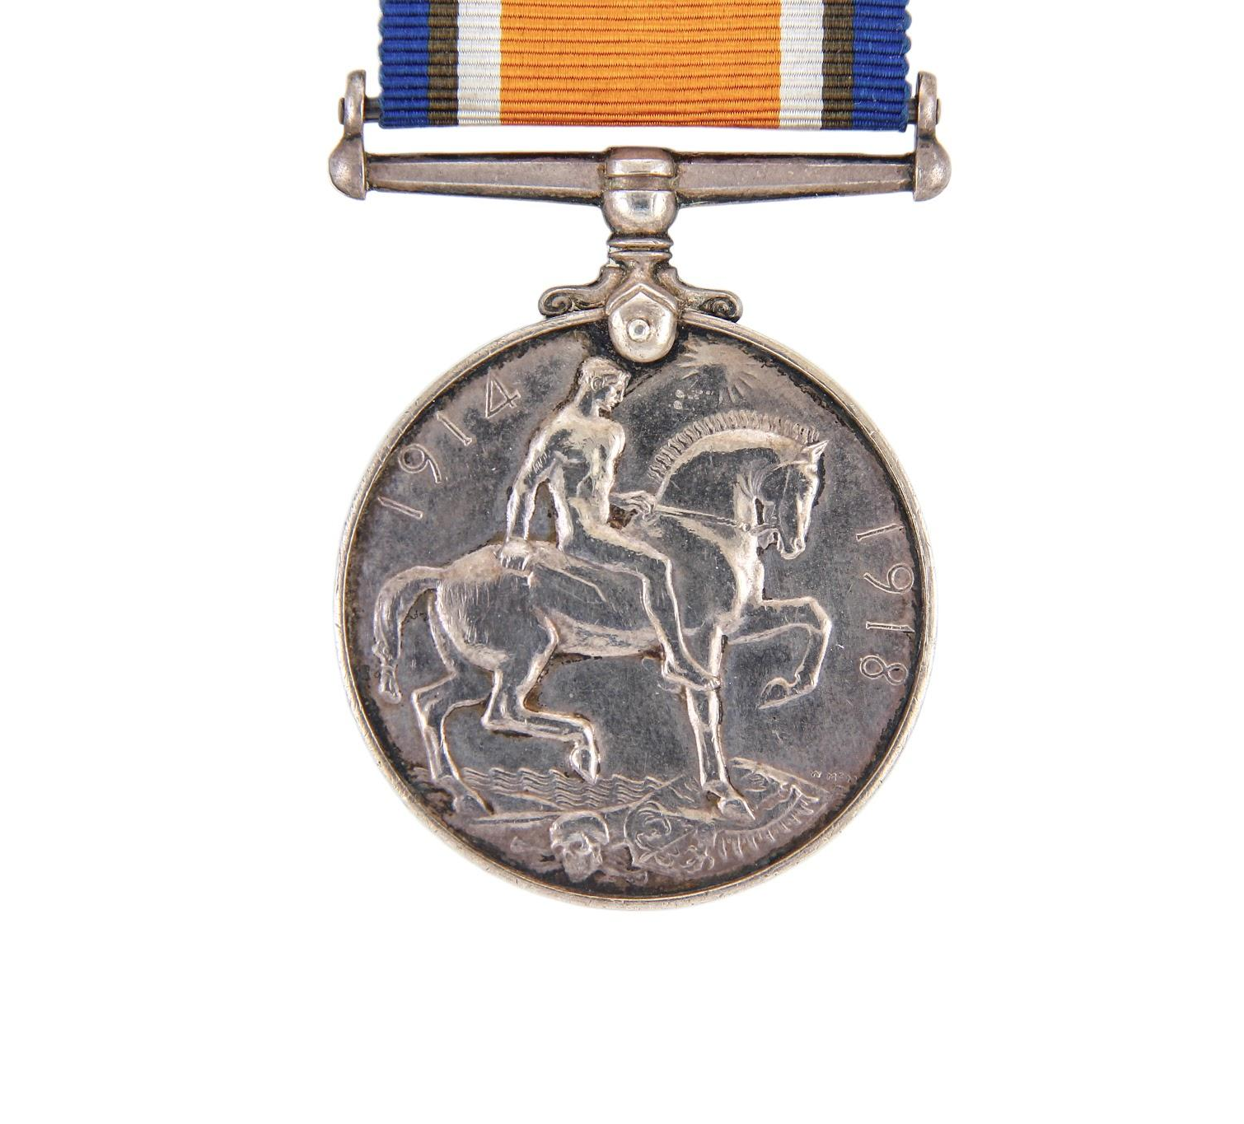
What are symbols and why do people use them?
Symbols help people show what is important to them.
a symbol can show a special event
a symbol can show pride
a symbol can show identity
Middle photo: Massimo Vernicesole/Shutterstock.com Right photo: © Ken Welsh. All rights reserved 2024 / Bridgeman Images

Slide 18


What are symbols and why do people use them?
Symbols can help a person feel that they belong.
They can show others that a person belongs to a particular group.
example of a symbol

Slide 19
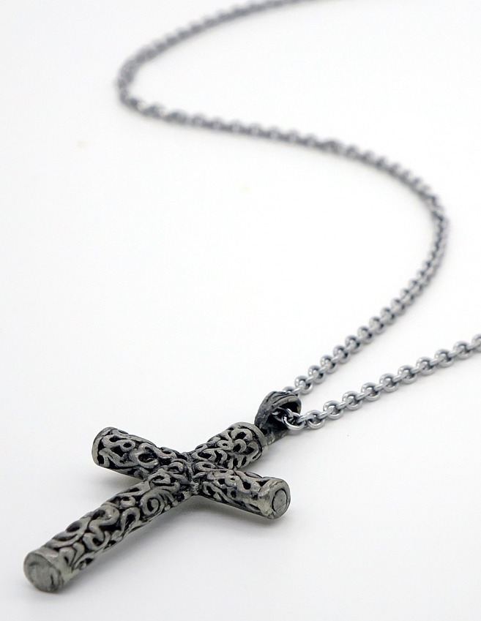
What are symbols and why do people use them?
Some religious people also use symbols.
These special symbols can help them feel they belong to a religion.
These special symbols can show others that they belong to a religion.
The symbols might be worn or kept at home or used in a place of worship.

Slide 20

What are symbols and why do people use them?
This is our school logo, the symbol that shows our school. We wear this on our uniforms to show that we belong here.
Blue / Green
Can you think of any other places where people where a symbol on their clothes to show they belong?

Slide 21

What are symbols and why do people use them?
All symbols are religious.
Why?
Symbols can be used to represent information about lots of different ideas, not just religious ideas.

Slide 22
What are symbols and why do people use them?
Can you match these symbols to what they represent?
a coat of arms representing the Royal Family
belonging to a special group that helps to look after the environment
a special sporting event called the Olympics
Middle photo: Photo © Ken Welsh. All rights reserved 2024 / Bridgeman Images

Slide 23
How do symbols show belonging?
Belonging is important because it helps us to feel connected to other people.
Belonging means you are part of a group.
When we belong, we feel safe, happy and cared for.
Belonging can help us understand who we are.
Symbols can be helpful in identifying where we belong.

Slide 24
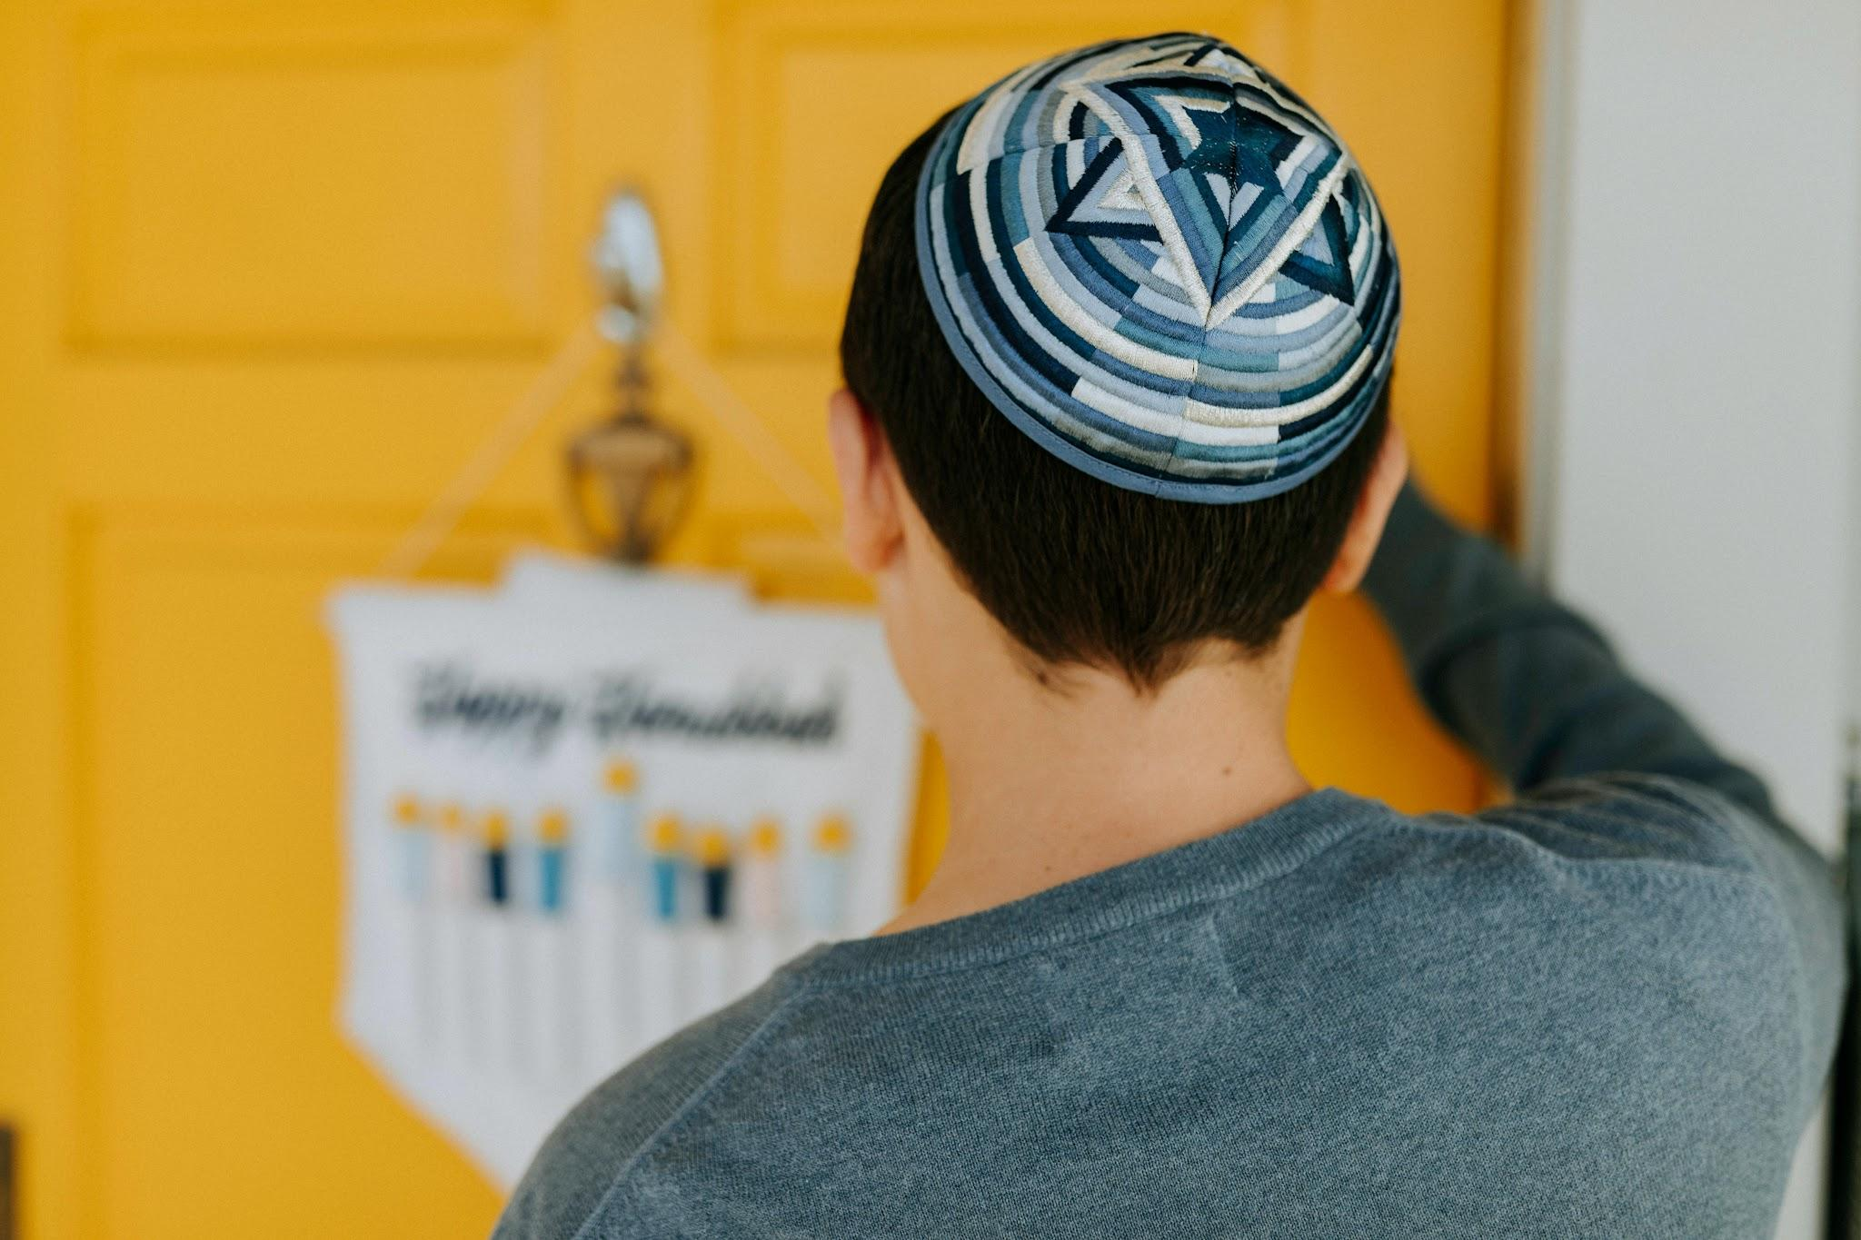
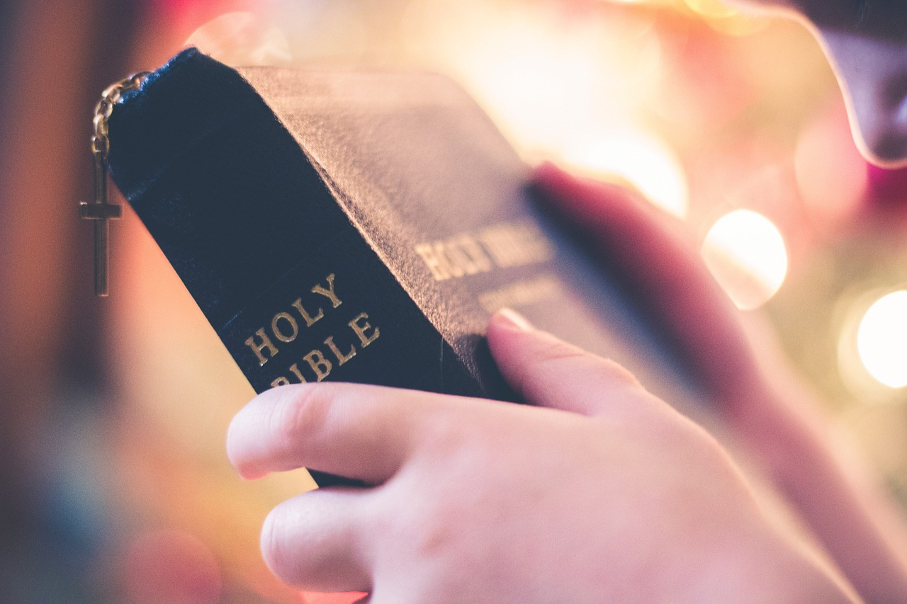
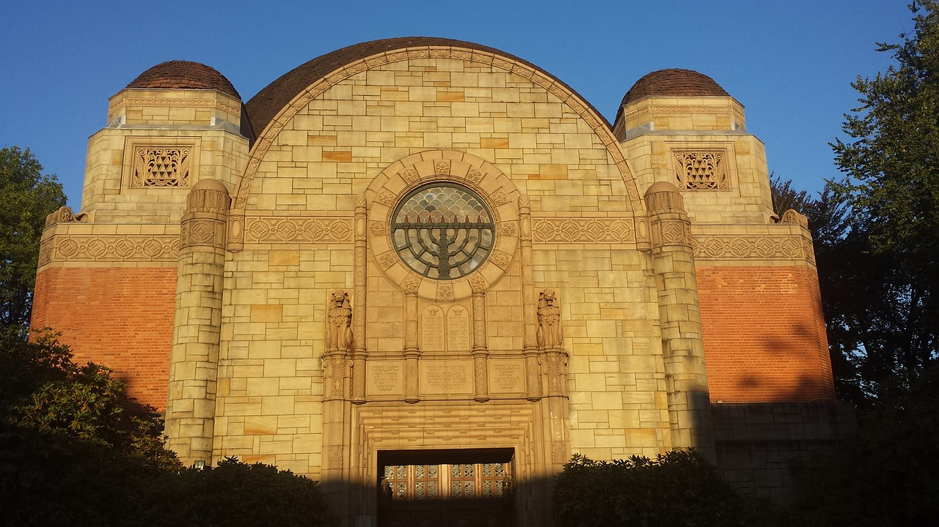
How do symbols show belonging?
Some people may use symbols or objects to show they belong to a religion or have a religious worldview.
These may be worn, used in the home or be placed on a building.
Jewish boy wearing a kippah
Christian Bible
Jewish symbol on a synagogue

Slide 25



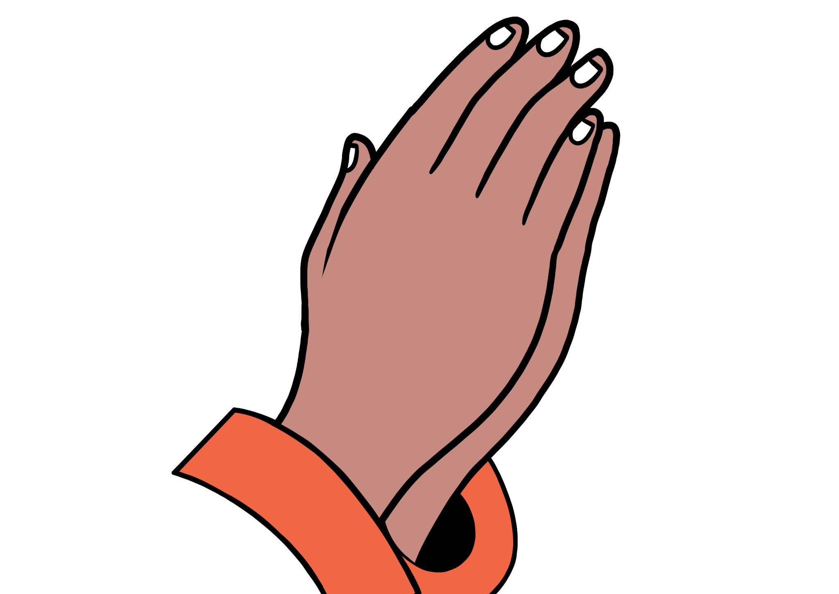
How do symbols show belonging?
What are symbols of Christianity?
cross
fish
Christian Bible
praying hands
These symbols can be a sign that a person is a Christian.

Slide 26

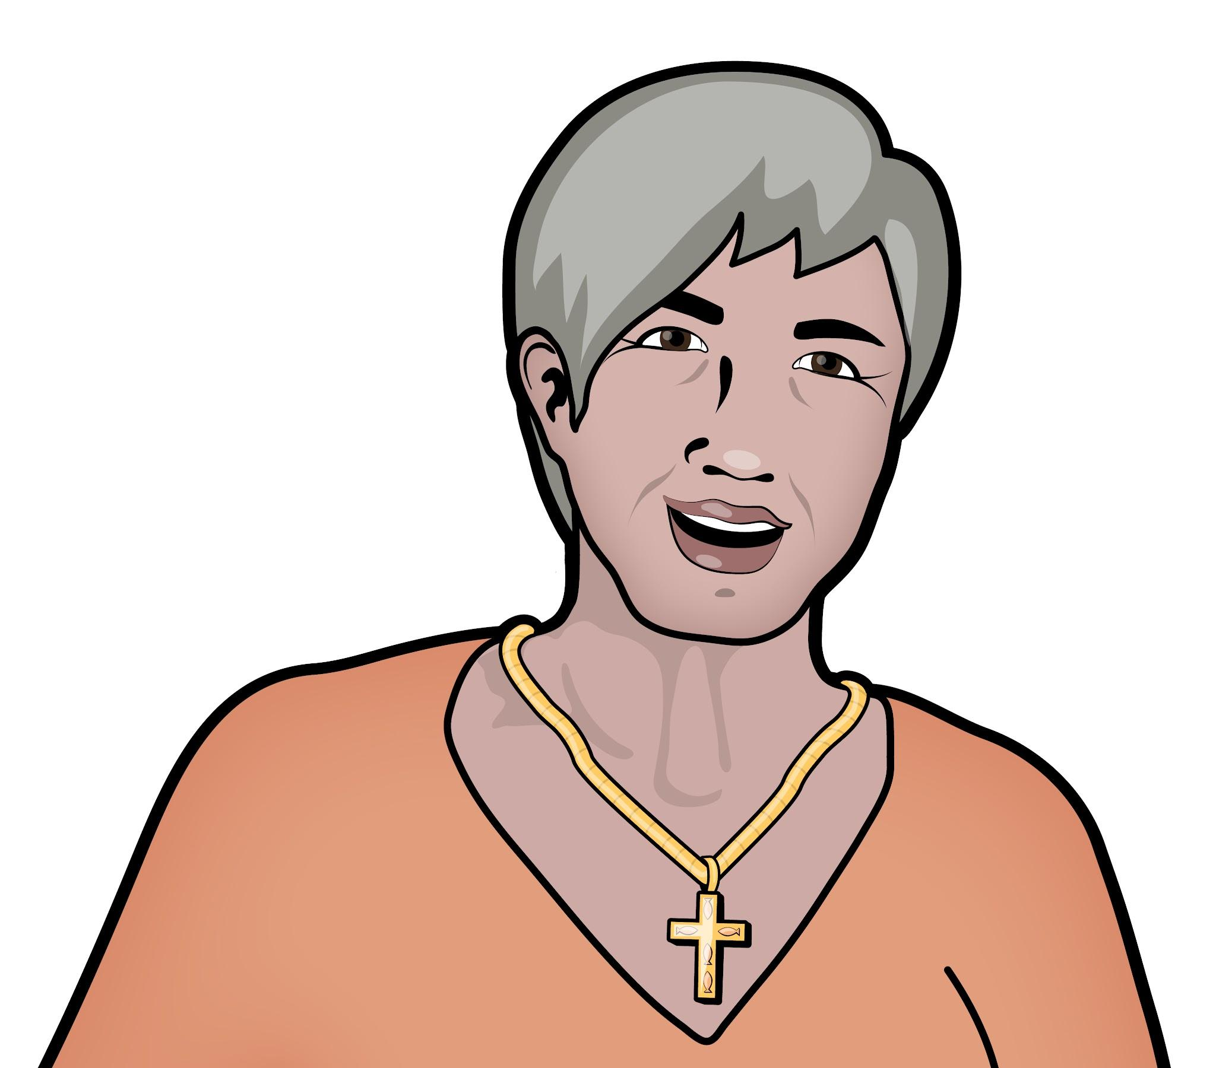
How do symbols show belonging?
Fiona is a Christian and she wears a necklace with the symbol of a cross.
I wear this cross because it reminds me I belong to my religion and my church. It’s a special symbol that reminds me of the story of Jesus and helps others know more about me.
Fiona
The necklace shows other people that Fiona belongs to her religion.

Slide 27

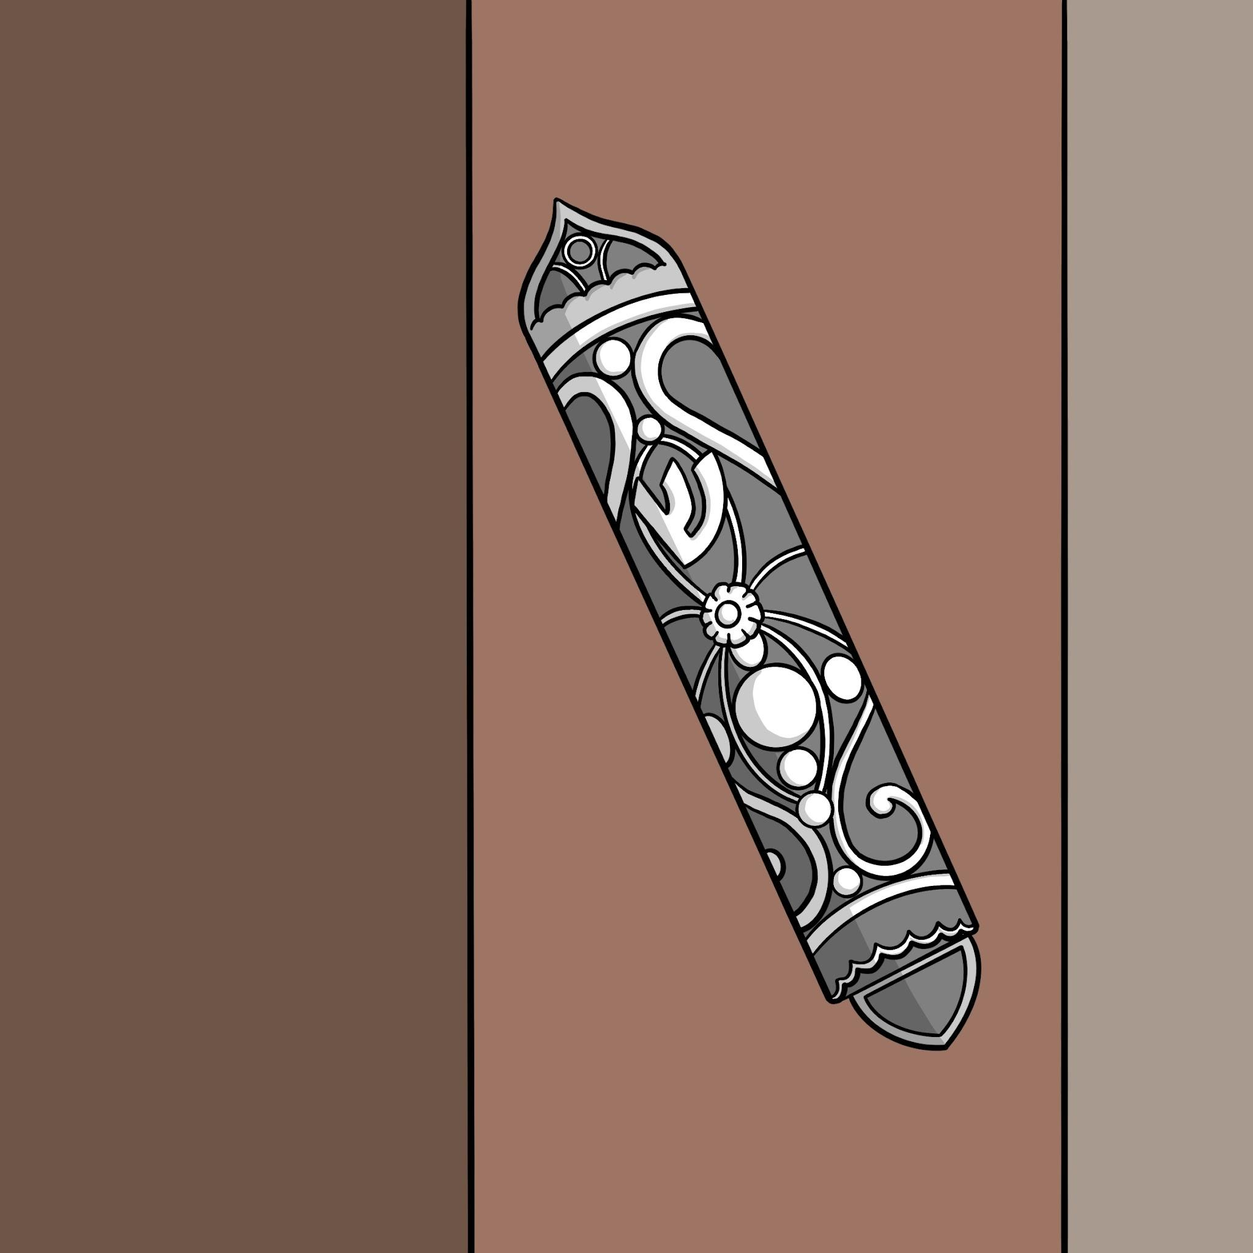
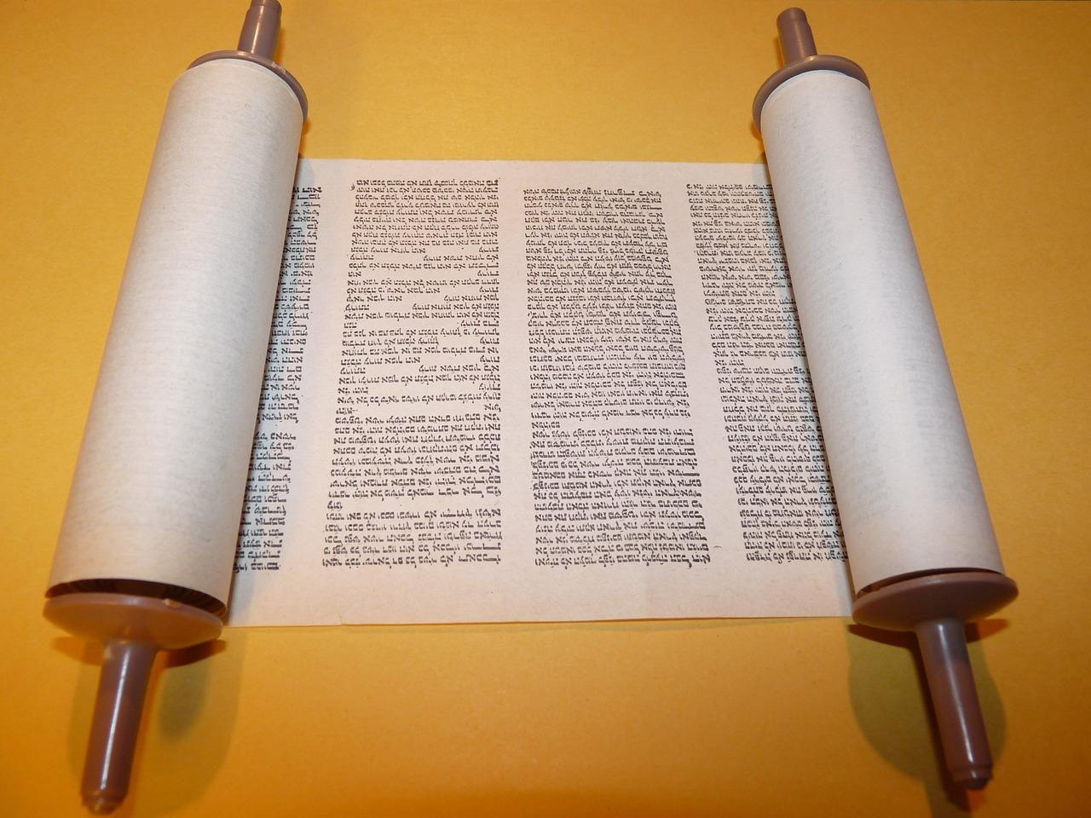
How do symbols show belonging?
What are symbols of Judaism?
mezuzah case
Torah - Jewish scriptures

Slide 28
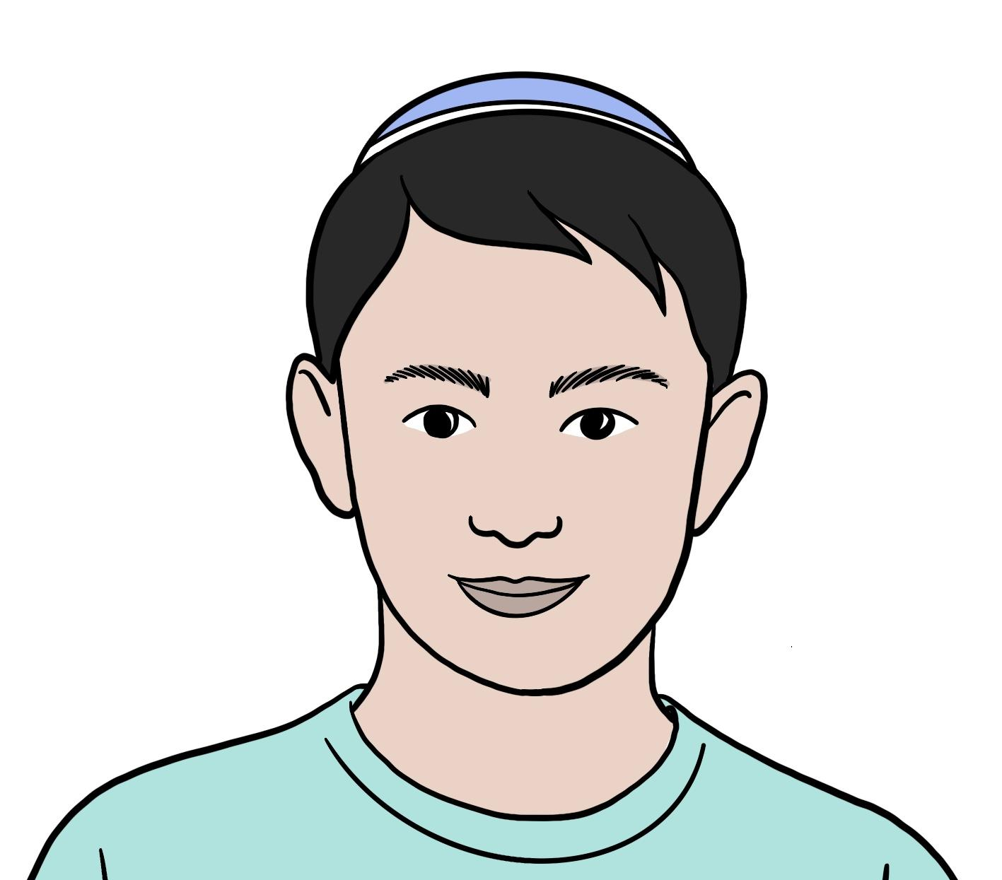
How do symbols show belonging?
Rafi is a Jew and has a mezuzah case on the doorpost of his front door.
The mezuzah case on our family’s door is a symbol that we belong to the Jewish faith. When I see it or touch it, it reminds me that God is with us in our home.
Rafi
The mezuzah case shows other people that Rafi’s family belongs to Judaism.

Slide 29

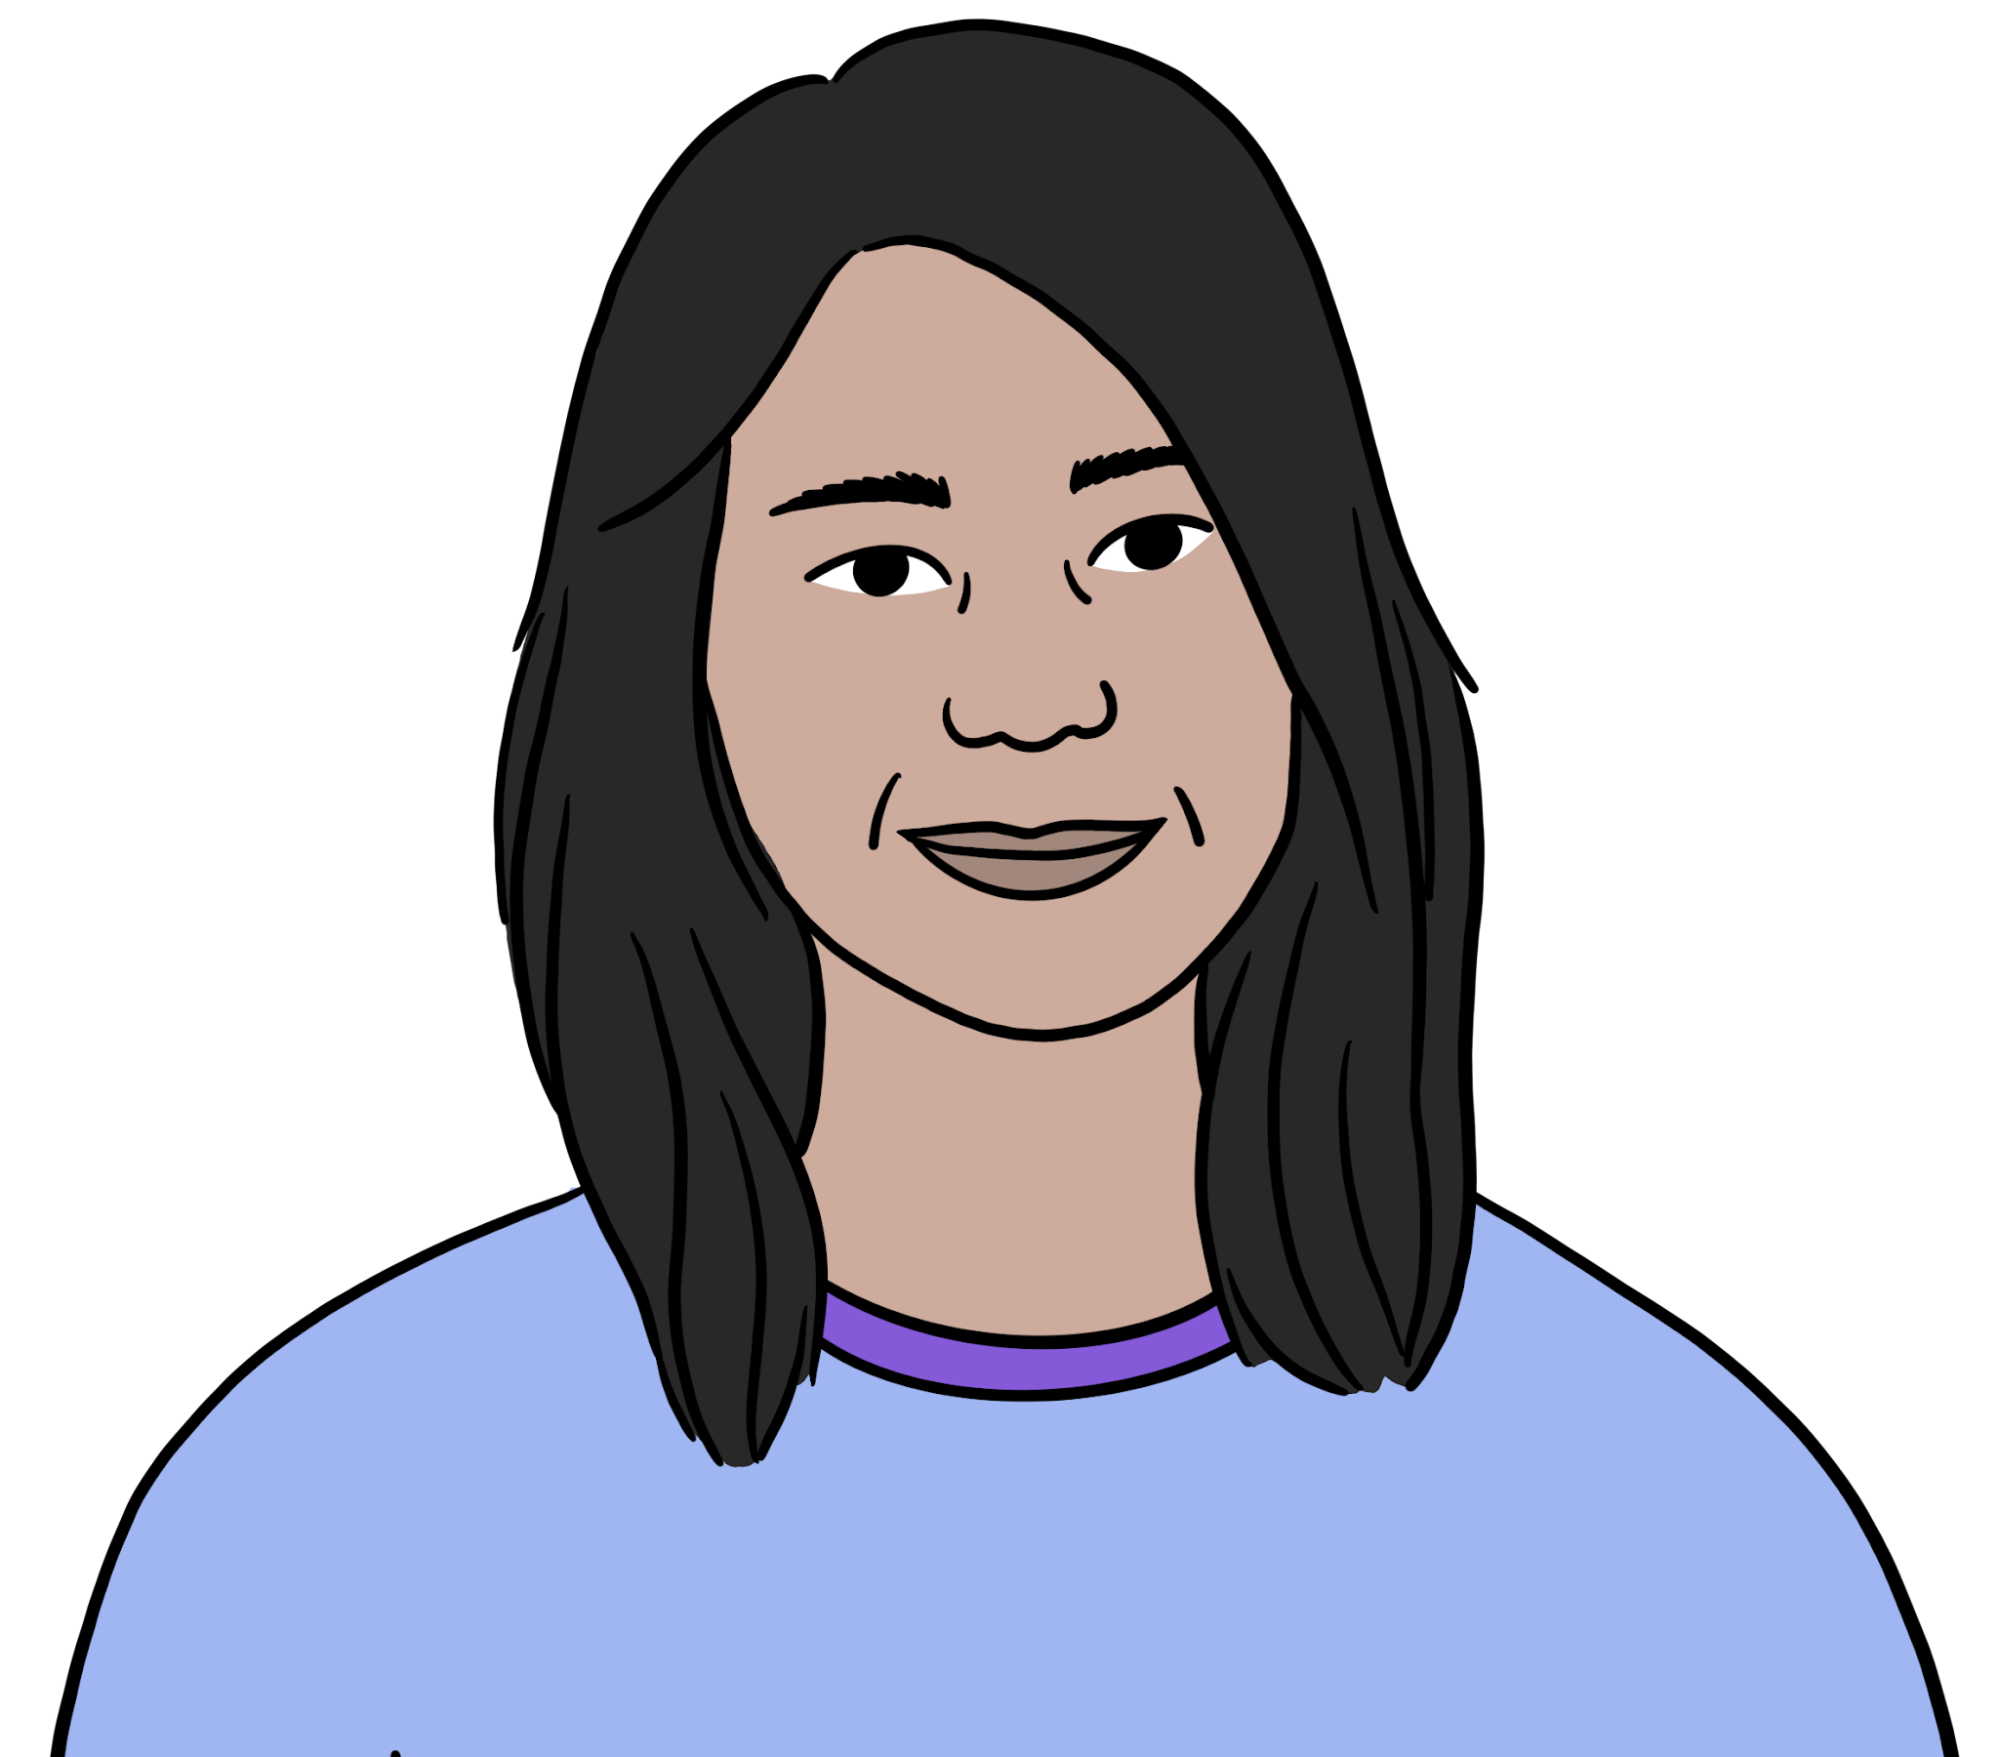
How do symbols show belonging?
Can a non-religious worldview use symbols to show belonging?
Yes! I belong to a group called Humanists. Some of us wear a badge with a symbol on it known as the happy human. It shows that a person belongs to the Humanist community. It reminds me to be kind, help others and enjoy life by making good choices.
Diane
The badge with the happy human symbol shows other people that Diane is a Humanist.

Slide 30
How do symbols show belonging?
Blue/ Green
Fiona, Rafi, and Diane all have a symbol they use. Each symbol represents their worldview.
What is similar and different about them?
cross
Mezuzah case
happy human
Fiona
Rafi
Diane
Notes:
You might have said:
Each person has a symbol to show what they believe and to show that they belong to their group. The symbols show something important to that person.
Fiona’s symbol is a cross. She wears it on a necklace. It reminds her of Jesus.
Rafi has a mezuzah case on his door. He touches it to remind him to love God.
Diane wears the happy human badge. It reminds her to be kind and make good choices.

Slide 31
Symbols of belonging
We use symbols every day.
Symbols give important information quickly.
Some religious and non-religious people may use symbols to show they belong to a particular group.
The cross is an important symbol for most Christians.
Some Jews have a mezuzah case on their door post to remind them of God.
Some Humanists wear a happy human badge.

Slide 32
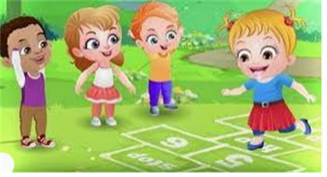
Break

Slide 33
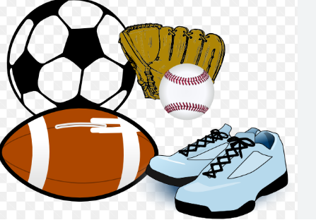
PE

Slide 34

Lunch

Slide 35

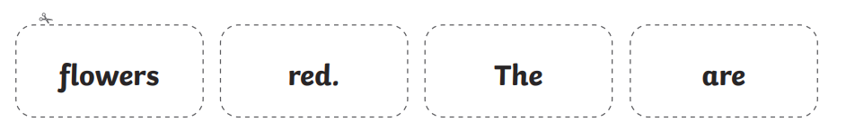
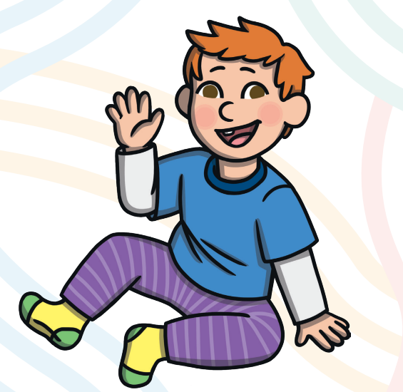
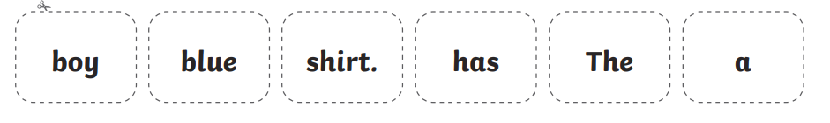
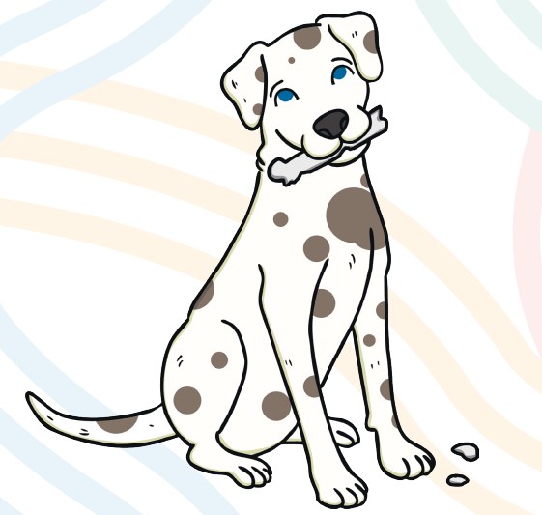
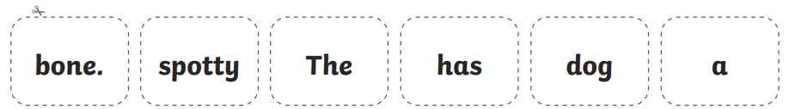
TBAT: able to say, write and check a full sentence that makes sense.
Thursday 15th January 2026
15/1/26
3 in 3
Challenge: How could each of these sentences be extended?

Slide 36
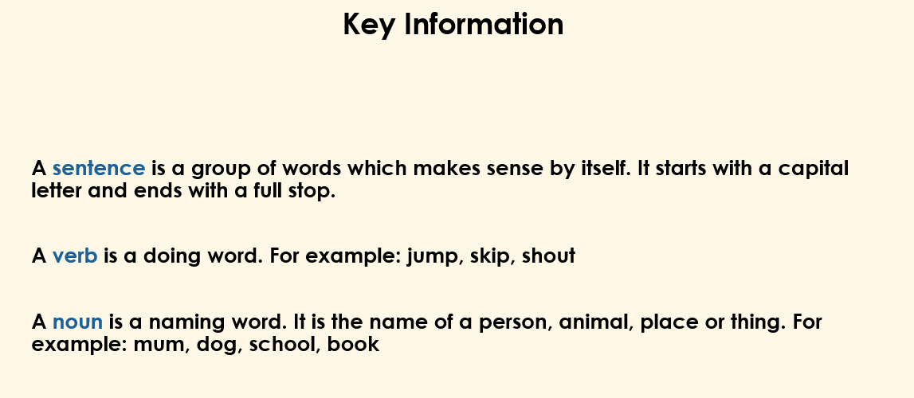
TBAT: able to say, write and check a full sentence that makes sense.
Thursday 15th January 2026
15/1/26

Slide 37
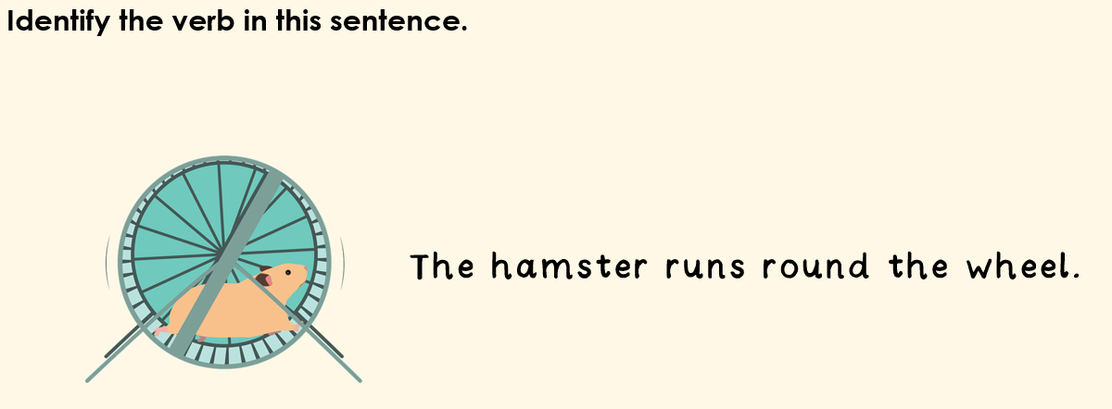
TBAT: able to say, write and check a full sentence that makes sense.
Thursday 15th January 2026
15/1/26

Slide 38
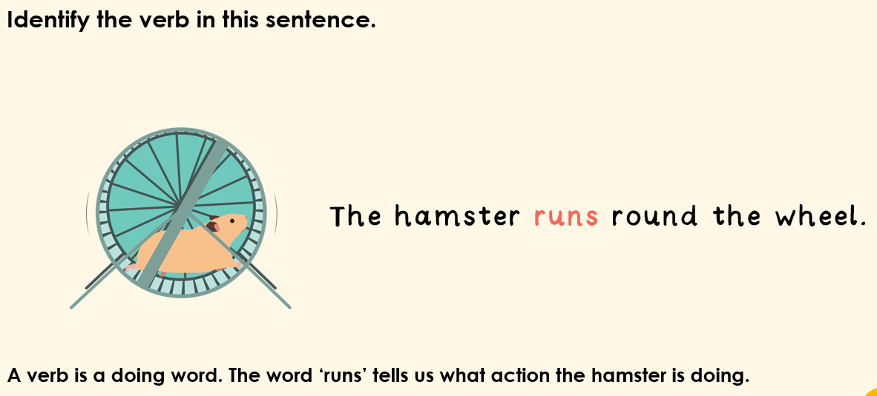
TBAT: able to say, write and check a full sentence that makes sense.
Thursday 15th January 2026
15/1/26

Slide 39

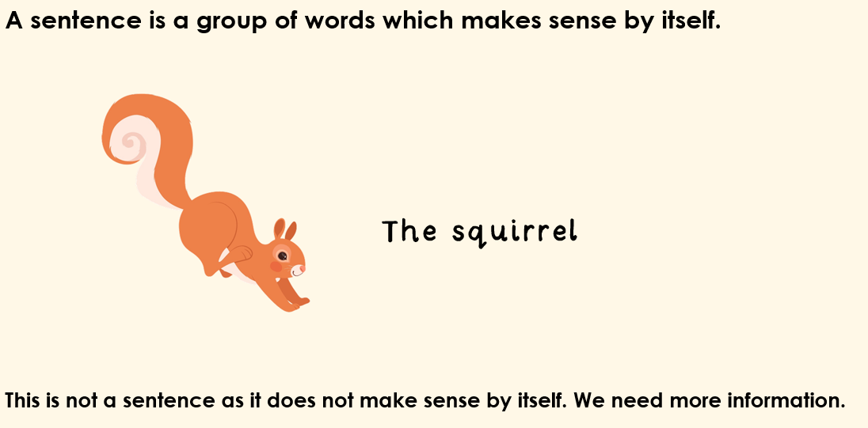
TBAT: able to say, write and check a full sentence that makes sense.
Thursday 15th January 2026
15/1/26
Blue/Green
What words could be added to the end to make this a full sentence?
Challenge: What type of words make sense here?

Slide 40
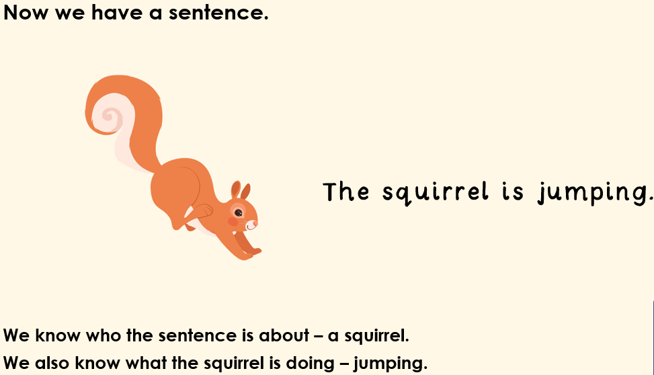
TBAT: able to say, write and check a full sentence that makes sense.
Thursday 15th January 2026
15/1/26

Slide 41
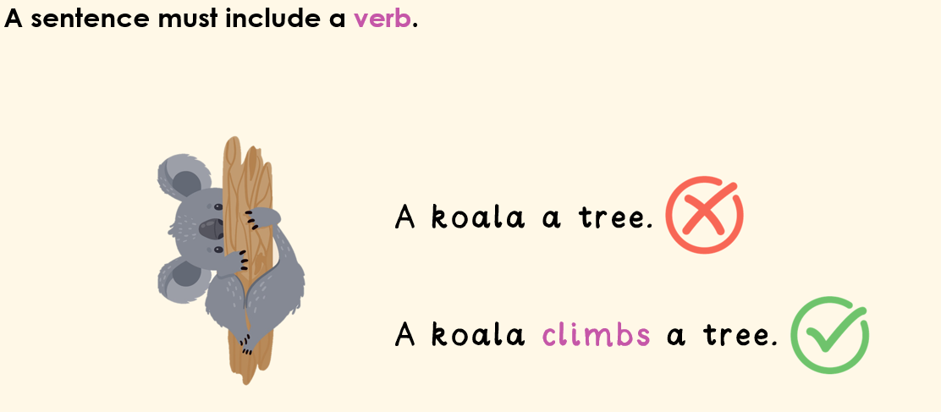
TBAT: able to say, write and check a full sentence that makes sense.
Thursday 15th January 2026
15/1/26

Slide 42
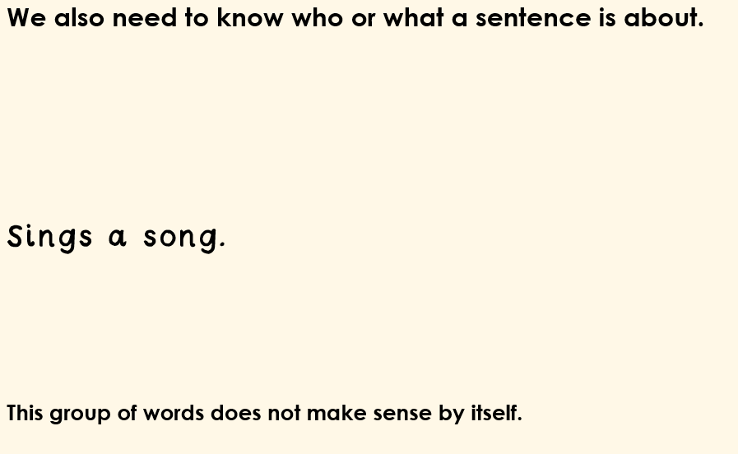
TBAT: able to say, write and check a full sentence that makes sense.
Thursday 15th January 2026
15/1/26

Slide 43
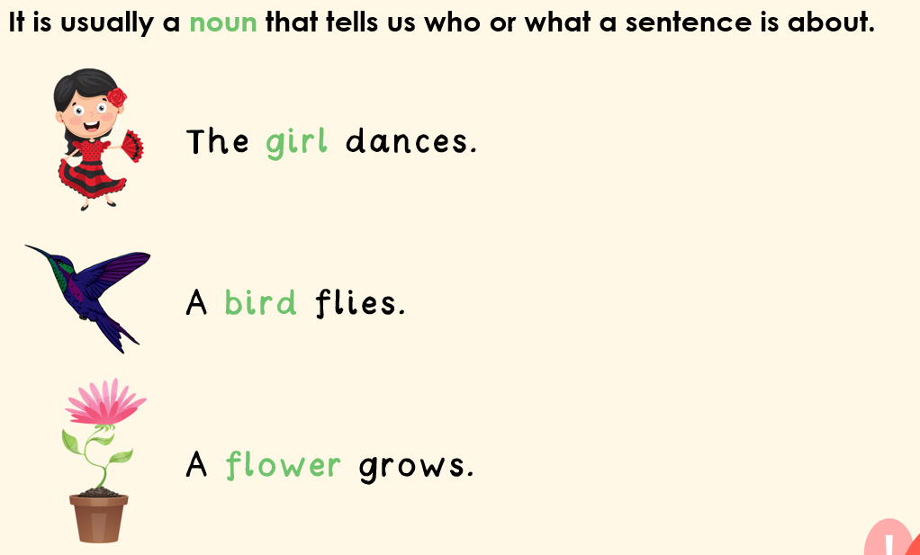
TBAT: able to say, write and check a full sentence that makes sense.
Thursday 15th January 2026
15/1/26

Slide 44
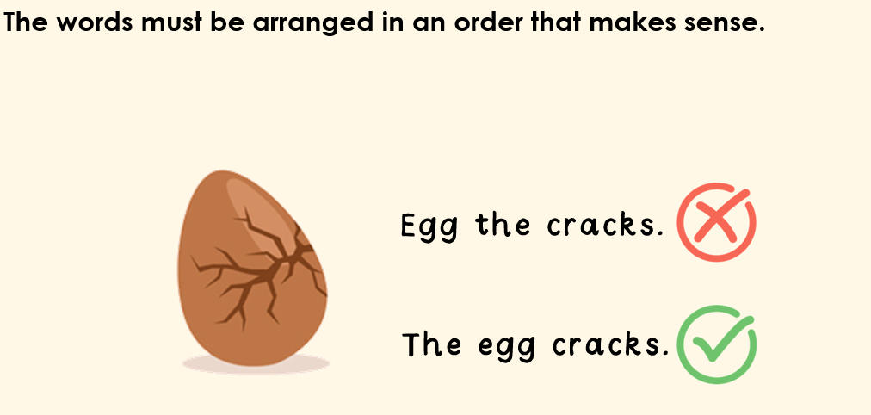
TBAT: able to say, write and check a full sentence that makes sense.
Thursday 15th January 2026
15/1/26

Slide 45
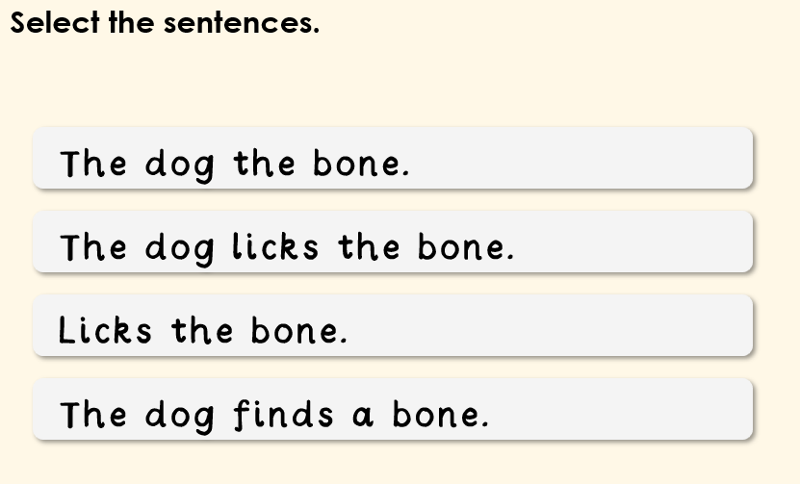
TBAT: able to say, write and check a full sentence that makes sense.
Thursday 15th January 2026
15/1/26

Slide 46
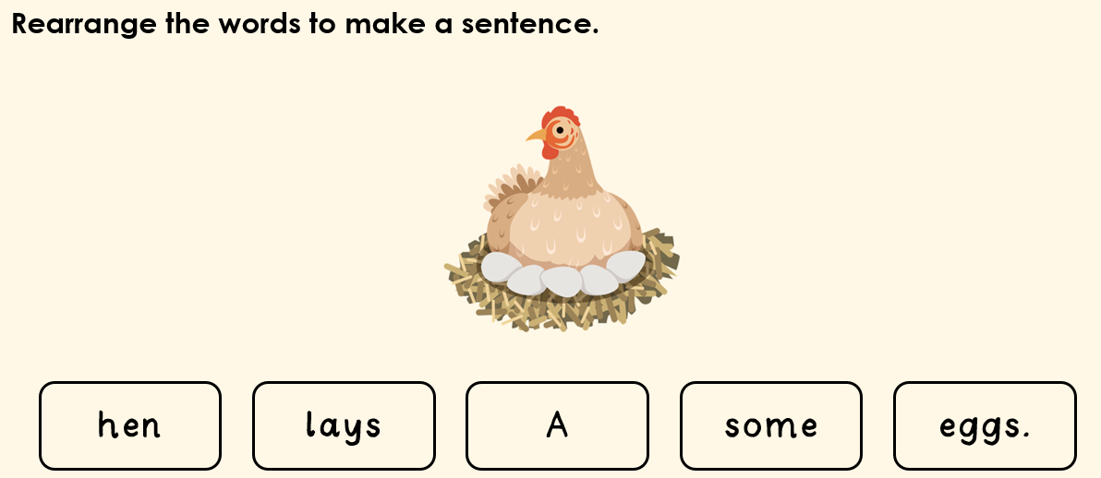
TBAT: able to say, write and check a full sentence that makes sense.
Thursday 15th January 2026
15/1/26

Slide 47
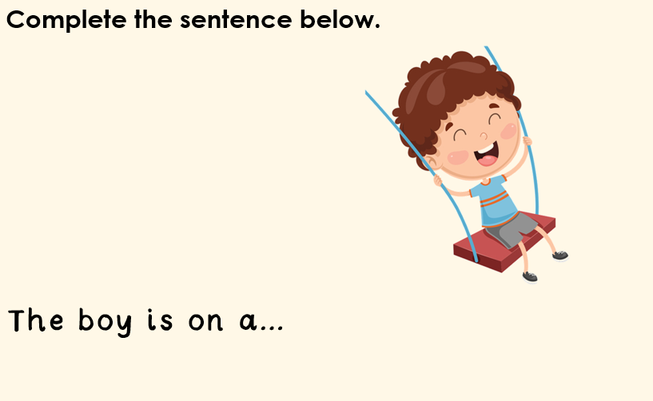
TBAT: able to say, write and check a full sentence that makes sense.
Thursday 15th January 2026
15/1/26

Slide 48
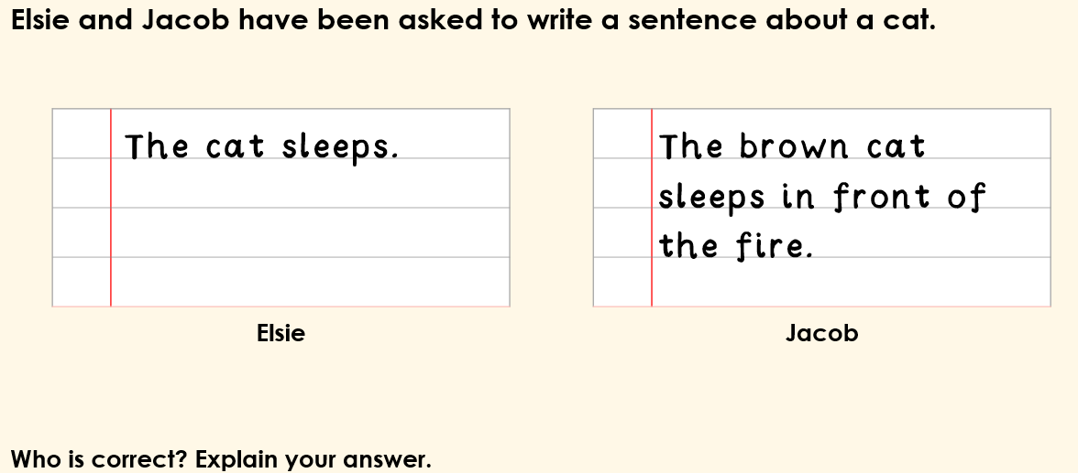
TBAT: able to say, write and check a full sentence that makes sense.
Thursday 15th January 2026
15/1/26

Slide 49
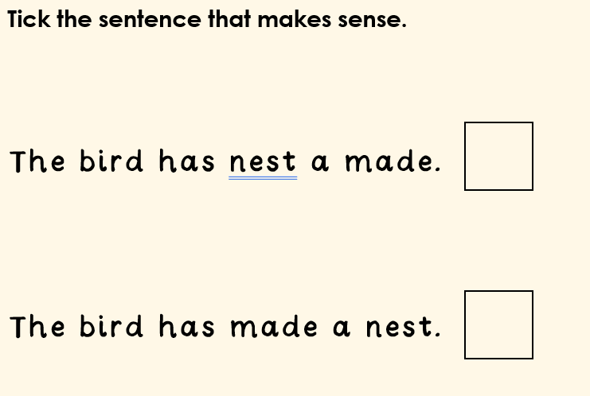
TBAT: able to say, write and check a full sentence that makes sense.
Thursday 15th January 2026
15/1/26

Slide 50
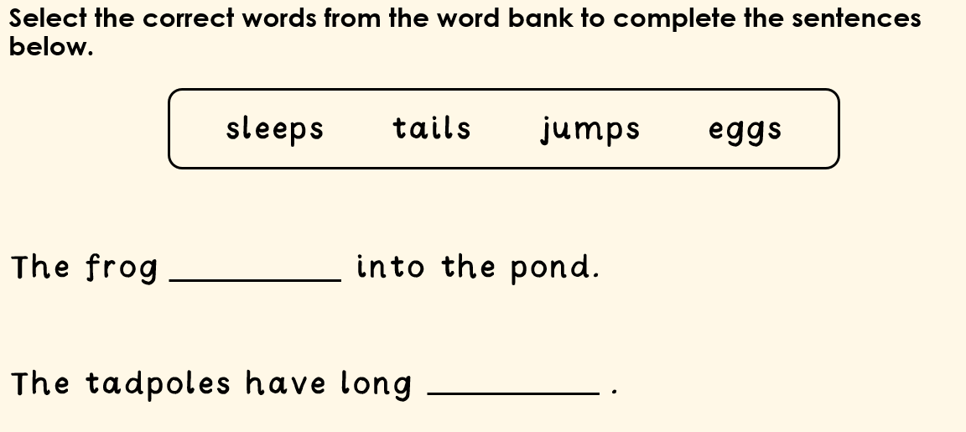
TBAT: able to say, write and check a full sentence that makes sense.
Thursday 15th January 2026
15/1/26

Slide 51
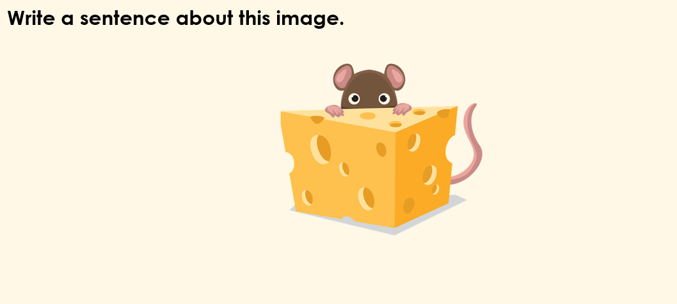
TBAT: able to say, write and check a full sentence that makes sense.
Thursday 15th January 2026
15/1/26

Slide 52
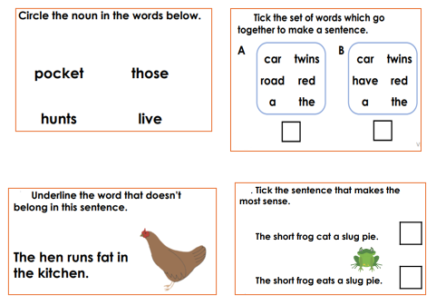
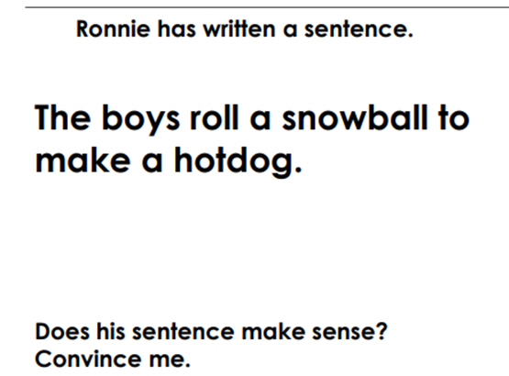
TBAT: able to say, write and check a full sentence that makes sense.
Thursday 15th January 2026
15/1/26
Independent:
Challenge:

Slide 53
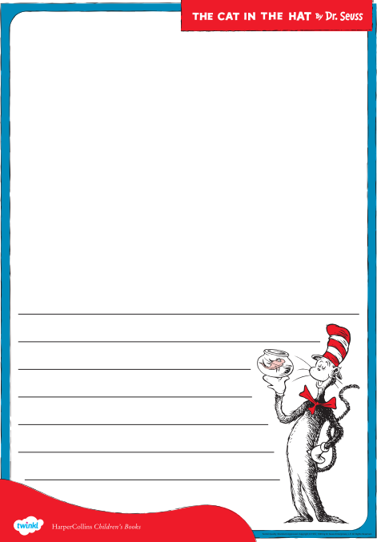

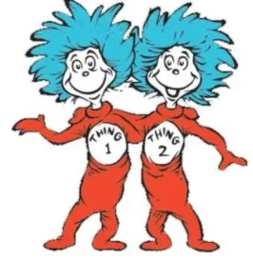
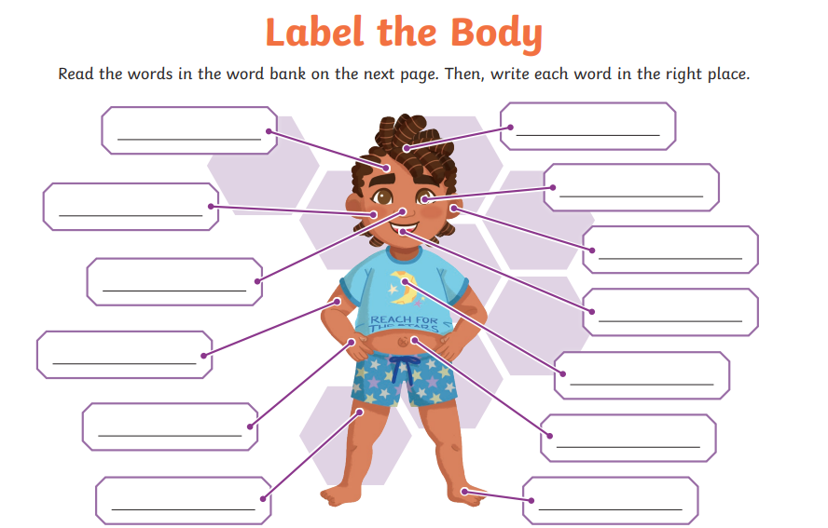
Independent Challenges:
Narrative Zone
Maths Zone
Draw and write about your favourite part of The Cat in the Hat
Draw the hands on the clocks to show the times
Enquiry Zone
Creative Zone
Design your own ‘Thing 1’ and ‘Thing 2’

Slide 54
TBAT – identify and perform a change in tempo
Thursday 15th January 2026
15/1/26
Key vocabulary
Beat – the regular heartbeat of the music – the 'steady beat'
Tempo - the speed at which music is performed, usually described in terms of fast/slow
Dynamics - The loudness of the music - loud or quiet
2 in 2
What does steady beat mean?
What does body percussion mean? Give an example

Slide 55
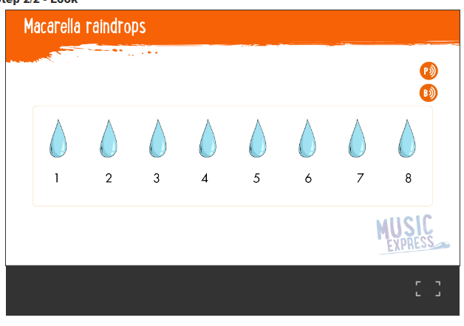

Number – Mt Macarella –
TBAT – identify and perform a change in tempo
Thursday 15th January 2026
15/1/26
Listen to the first line of 'Marcello Copycats'
March on the spot and repeat the words.
What do you notice about the speed of movements?
TALK PARTNERS
Body percussion – add movements to each verse – different tempo each time
PARTNER WORK
CHALLENGE – Can you find three different movements – one for each speed?
Collins Connect

Slide 56


Mr Marcella's percussion
TBAT – identify and perform a change in tempo
Thursday 15th January 2026
15/1/26
Use claves, drums or shakers
Tap to the 8 beats (follow on the screen)
CHALLENGE
Can you do a crescendo (gradually tap louder or quieter)
Collins Connect

Slide 57

Mr Marcella's percussion
TBAT – identify and perform a change in tempo
Thursday 15th January 2026
15/1/26
Choose one of these characters and play their instrument
Choose body percussion movements for each character as a class.
Collins Connect

Slide 58
Mr Marcella's percussion
TBAT – identify and perform a change in tempo
Thursday 15th January 2026
15/1/26
Practise tapping to the 8 beats using your instrument.
And again with the music!
Collins Connect

Slide 59
In the hall of the mountain king.
TBAT – identify and perform a change in tempo
Thursday 15th January 2026
15/1/26
Listen and tap your knees in a steady beat.
What do you notice about the beat of the song?
Is it the same at the beginning and the end?

