Slide 1
Monday 19th January 2026

Slide 2

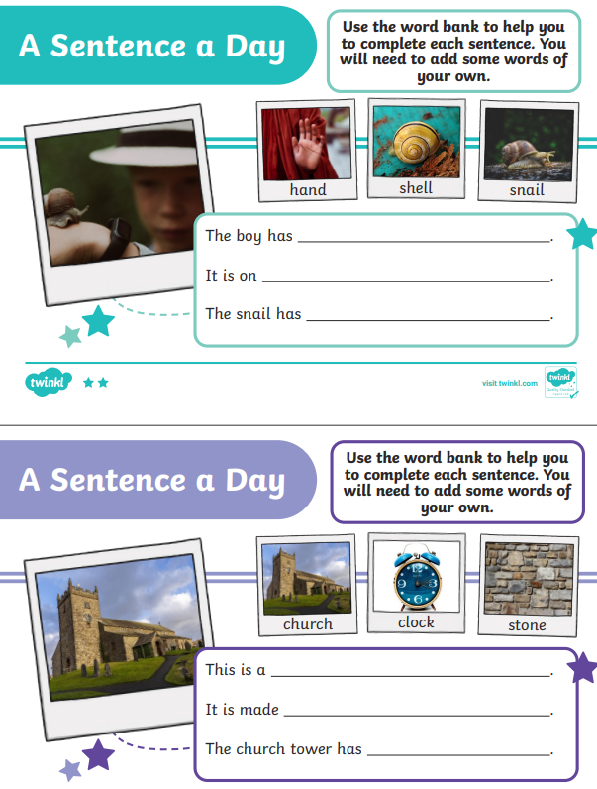
Morning Challenges:
Name writing

Slide 3

Revisit and review
Monday 19th January 2026
19/1/26
Today's Grapheme
le

Slide 4
Phonics
Monday 19th January 2026
19/1/26
Revisit and review
Lesson focus:
Read words with the /l/le/ grapheme

Slide 5
Revisit and review
Monday 19th January 2026
19/1/26
What are the digraphs?
alphabet
elephant
giant
follow
reply
white
Segment these
words and read them
Blend and say words

Slide 6
Focus words
Monday 19th January 2026
19/1/26
a-pp-le
s-p-ar-k-le
b-ee-t-le
Sounds out these
words and read them

Slide 7
Focus words
Monday 19th January 2026
19/1/26
apple
sparkle
beetle
Sounds out these
words and read them

Slide 8
Focus words
Monday 19th January 2026
19/1/26
apple
gentle
beetle
sparkle
bubble
Read, sound talk and blend
And again... FASTER!

Slide 9
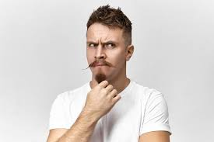
Revisit and review
Mrs
Monday 19th January 2026
19/1/26
Mr
tricky words
Ms
Read the tricky words?

Slide 10
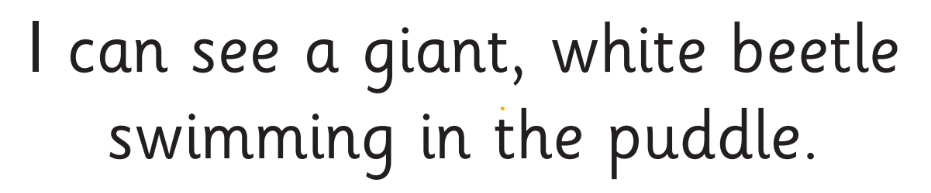
Monday 19th January 2026
19/1/26
Now let's read this sentence!​
What digraphs can you see?
What tricky words can you see?

Slide 11
Monday 19th January 2026
19/1/26
Let's spell!
How many sounds? Write it.
tricky words
bubble gentle school
Listen to the sentence, say it, write it and read it!
Challenge
Extend the sentence using 'and'

Slide 12
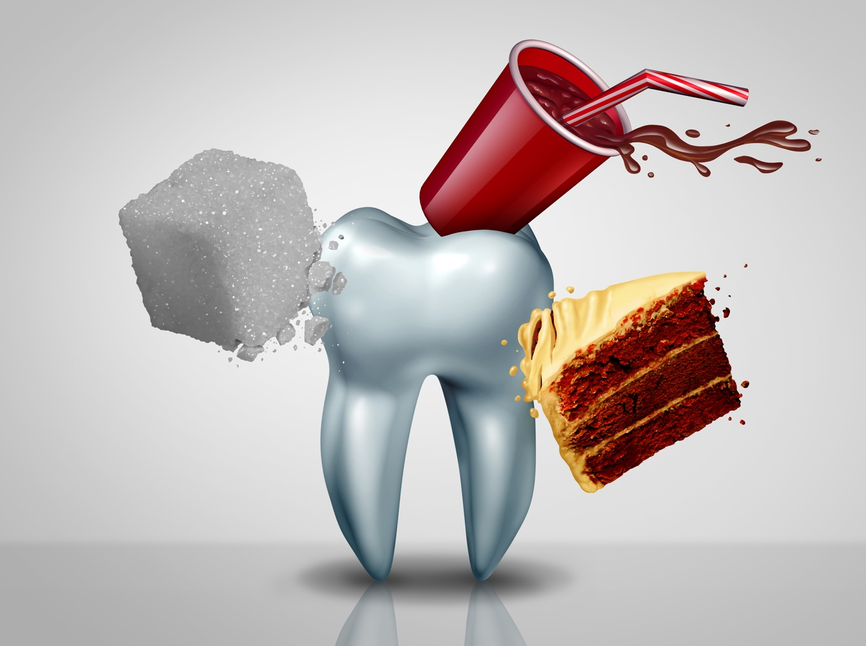
Monday 19th January 2026
19/1/26
Today’s big question
KQ: Why is sugar bad for my teeth?
Notes:
This offers another chance for assessment. Allow the class to call out and, as they do, write their ideas on the board; you could use these notes to reassess at the end of the lesson.

Slide 13
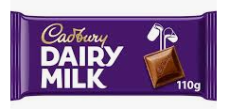
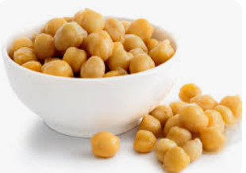
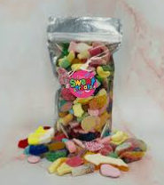
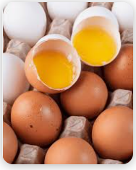
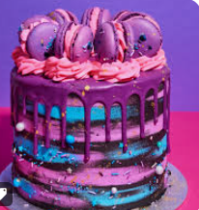
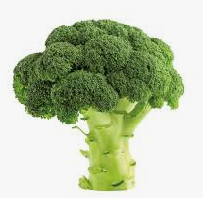
KQ: Why is sugar bad for my teeth?
Monday 19th January 2026
19/1/26
3 in 3- Which of these food do you think are high in sugar?
Notes:
Read through the text and talk about fillings, too. Some children in the class may already have had fillings – explain that this this is when the dentist fills a hole in a tooth. The next slide goes through the things that help keep teeth healthy; see if pupils can work out the three ways to do this before you move on.

Slide 14
KQ: Why is sugar bad for my teeth?
Monday 19th January 2026
19/1/26
Sugar
Our bodies need food but there are some foods we eat just because they taste good! One of these foods is sugar.
It is OK to eat sugar in small amounts but many of us eat far too much each day. This can make us unhealthy and cause us to put on weight.
One of the other problems with sugar is that it is very bad for our teeth.
Notes:
Think about your cohort here and be aware and compassionate if any children have poor dental hygiene or dental health, or are overweight. If this is the case, be sure to create a working agreement before the lesson reminding all pupils to be kind and respectful.

Slide 15
KQ: Why is sugar bad for my teeth?
Monday 19th January 2026
19/1/26
Sugar and our teeth
Teeth help us to chew and make our food smaller so that we can swallow it more easily.
Teeth are very strong, but when we eat sugar it attacks the outside of our teeth and damages it. This can cause something called tooth decay. (The tooth can break down and form small holes called cavities.)
There are three simple things we can do to keep our teeth healthy. What do you think these are?
Notes:
Read through the text and talk about fillings, too. Some children in the class may already have had fillings – explain that this this is when the dentist fills a hole in a tooth. The next slide goes through the things that help keep teeth healthy; see if pupils can work out the three ways to do this before you move on.

Slide 16
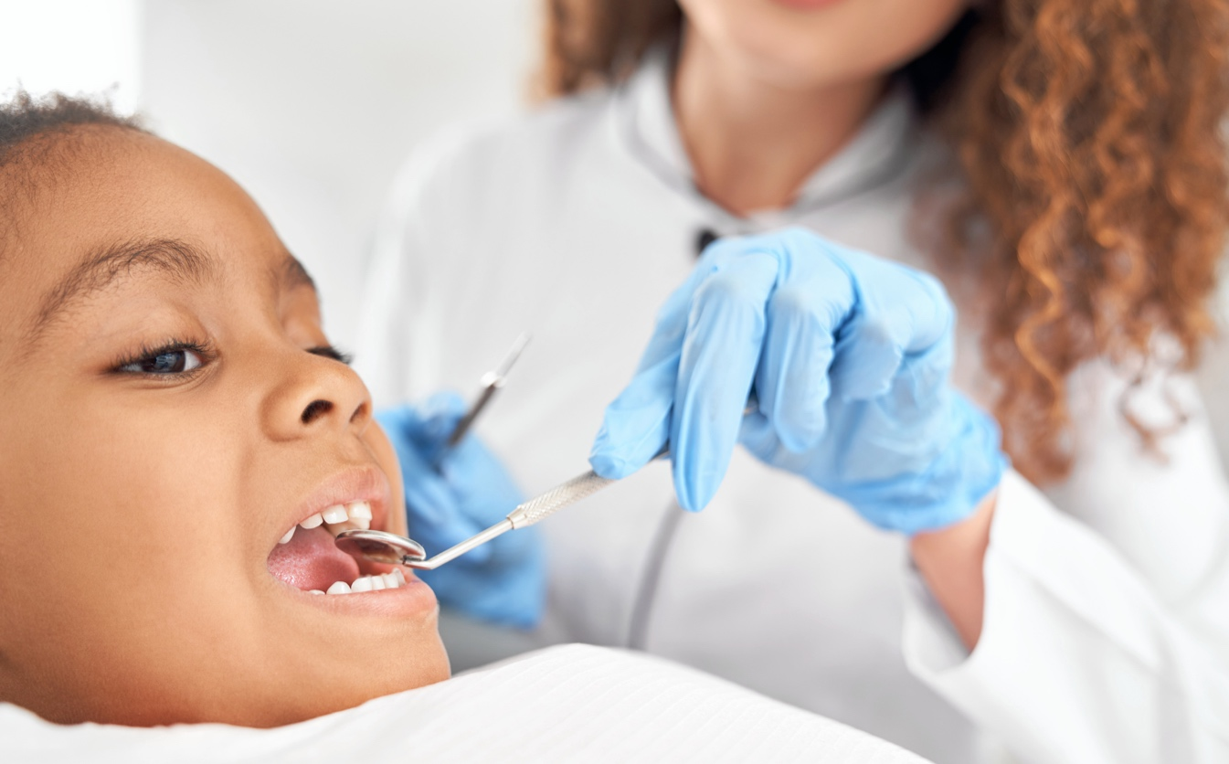
KQ: Why is sugar bad for my teeth?
Monday 19th January 2026
19/1/26
Looking after our teeth
Eat less sugar.
Brush them morning and evening for 2‒3 minutes every day.
Visit the dentist two times a year.
Notes:
Write these up so pupils can still see them when you click off the slide.

Slide 17
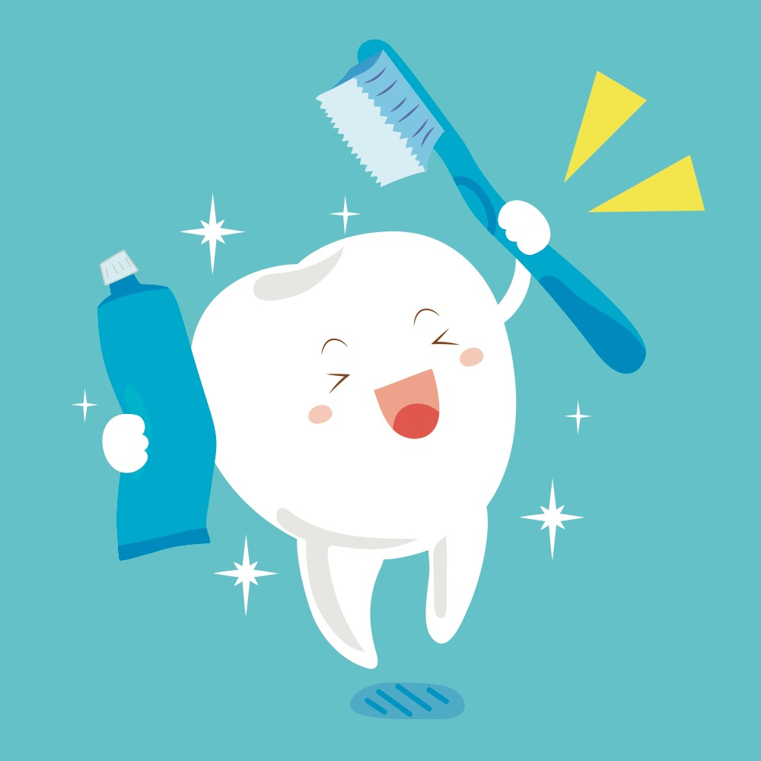
KQ: Why is sugar bad for my teeth?
Monday 19th January 2026
19/1/26
Let’s learn a song so we know how to clean our teeth!
https://www.bbc.co.uk/programmes/p0389wb3
Notes:
This rhyme teaches children how to clean their teeth. Note that it only shows the front teeth being cleaned, so make it clear that all teeth need cleaning. It would be helpful to add actions to show how you clean the front, both sides and behind teeth too. Tell them if they learn this and sing it twice through in their heads when they are cleaning their teeth every morning and night, that will be almost two minutes of brushing. Singing it three times would give them super sparkly clean teeth!

Slide 18
KQ: Why is sugar bad for my teeth?
Monday 19th January 2026
19/1/26
What have we learned?
Why is sugar bad for my teeth?
Notes:
Use this to evaluate their understanding and, if necessary, spend time clarifying any misconceptions or answering any questions.

Slide 19
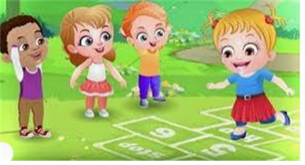
Break

Slide 20

PE

Slide 21
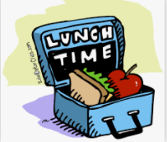
Lunch

Slide 22
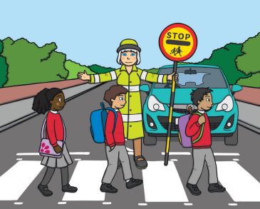
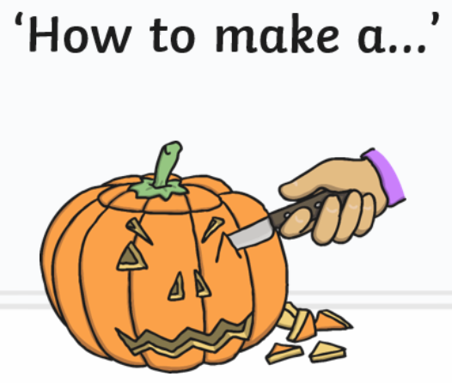
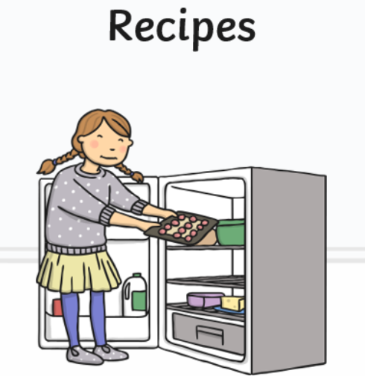
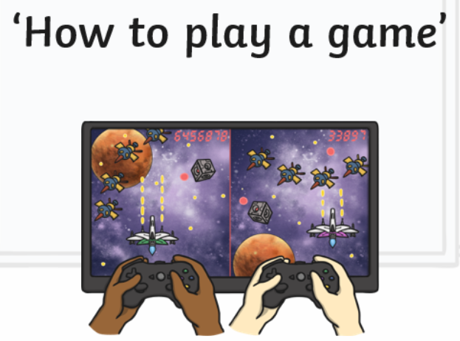
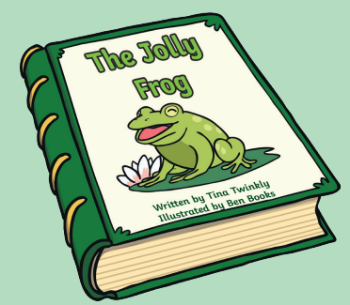
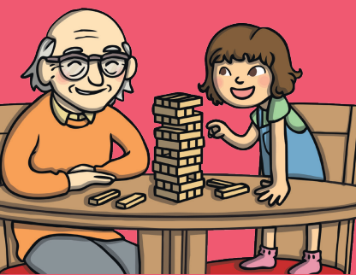
Monday 19th January 2026
19/1/26
TBAT: identify features of a set of instructions.
3 in 3- Which of these are an example of instructions?
Crossing the road
Reading a book
Playing a game.

Slide 23

TBAT: identify the features of a set of instructions.
Monday 19th January 2026
19/1/26
Blue/ Green- Put these instructions in order.
Finally, rinse with water
First, first on the tap.
Next, add soap and rub into hands.
After that, add a tea bag to the cup.
First, boil the kettle.
Lastly, pour the water into the cup and stir.
How could you tell the correct order?
What was the main clue?

Slide 24
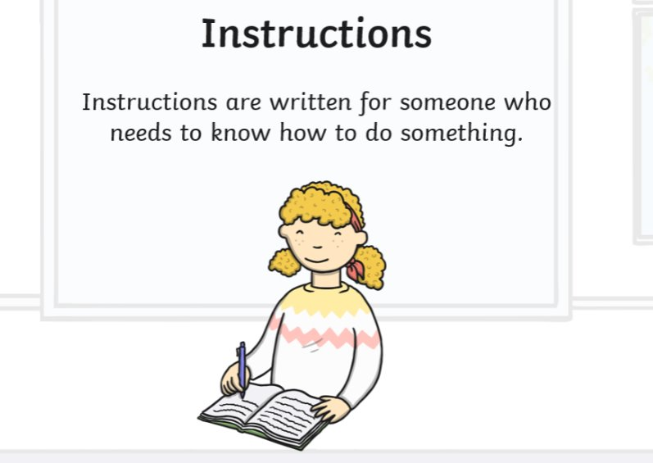
TBAT: identify the features of a set of instructions.
Monday 19th January 2026
19/1/26

Slide 25
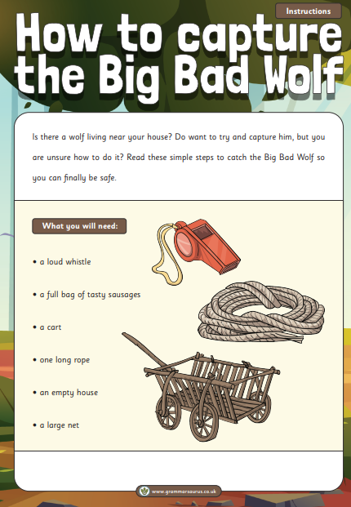


TBAT: identify the features of a set of instructions.
Monday 19th January 2026
19/1/26
Instructions are written in the present tense.

Slide 26
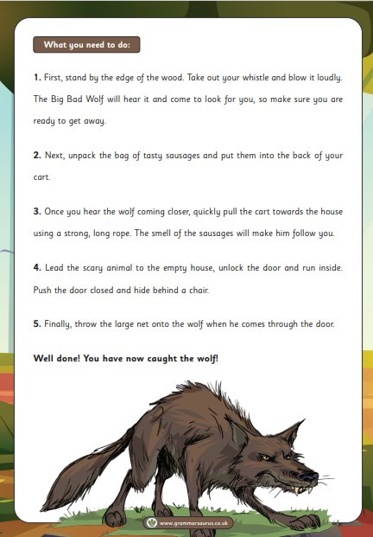


TBAT: identify the features of a set of instructions.
Monday 19th January 2026
19/1/26

Slide 27
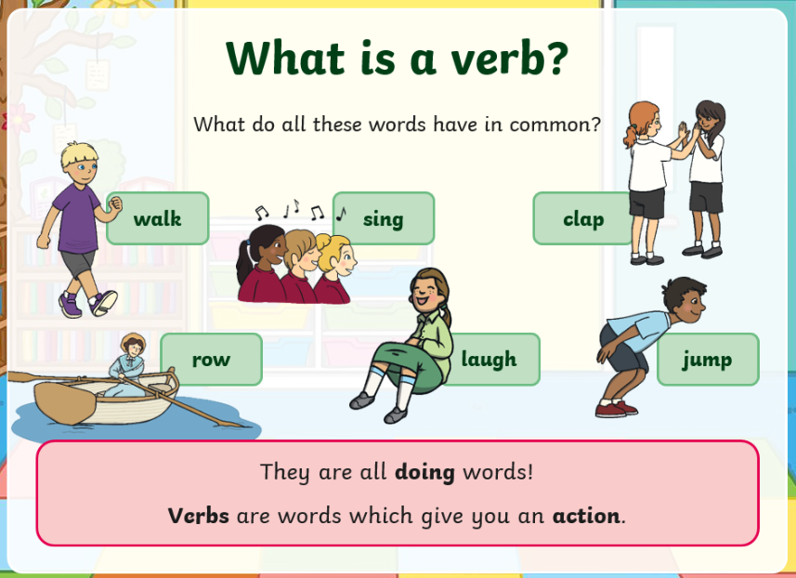
TBAT: identify the features of a set of instructions.
Monday 19th January 2026
19/1/26
An imperative verb tells someone what to do.

Slide 28
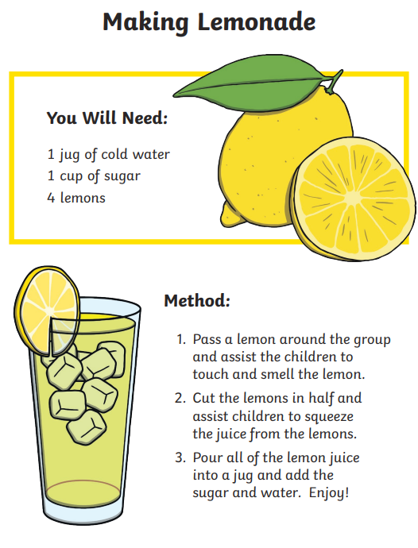

TBAT: identify the features of a set of instructions.
Monday 19th January 2026
19/1/26
numbered list

Slide 29
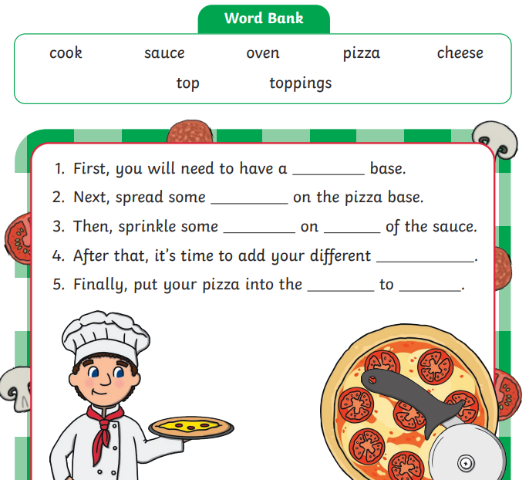
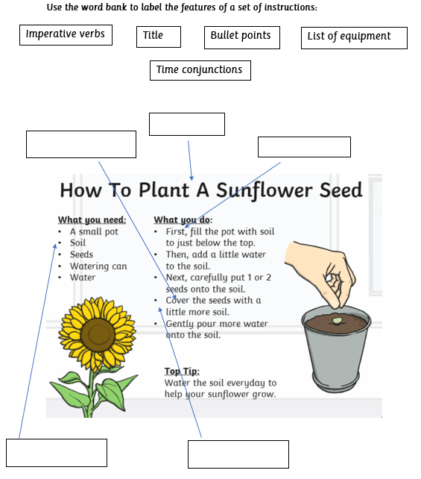
TBAT: identify the features of a set of instructions.
Monday 19th January 2026
19/1/26
Independent:
Challenge:

Slide 30
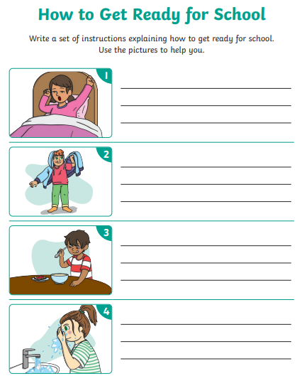
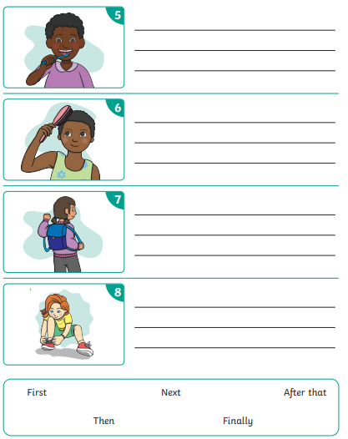
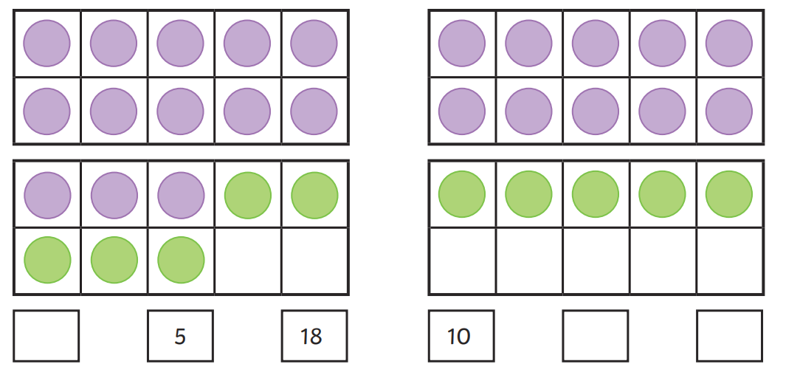
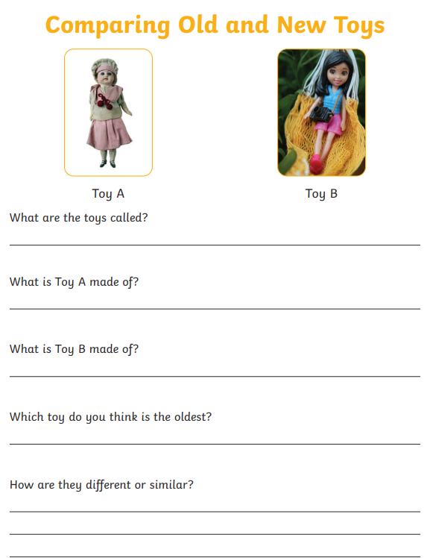
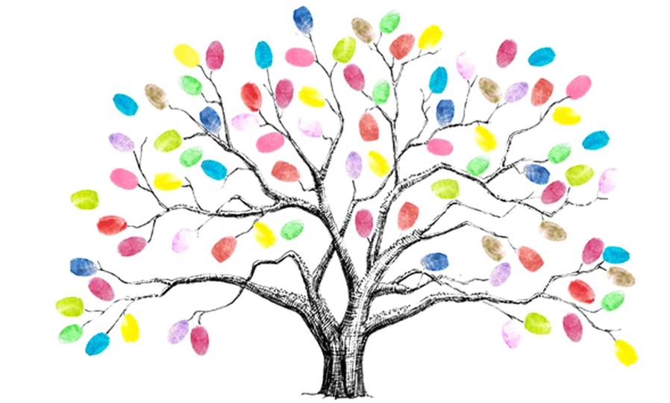
Independent Challenges:
Narrative Zone
Maths Zone
Write a set of simple instructions.
Work out the additions to 20
Enquiry Zone
Creative Zone
Compare the old and new toys.
Use your finger print to create a tree

Slide 31
TBAT: take rubbings and make compositions.
Monday 19th January 2026
19/1/26
2 in 2
What is printing?
What did we use to print with last week?

Slide 32
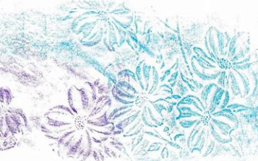
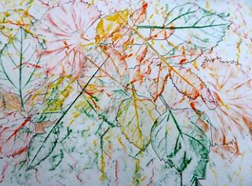
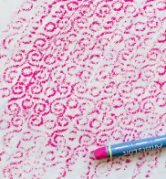
Last week, we printed using our hands
TBAT: take rubbings and make compositions.
Monday 19th January 2026
19/1/26
This week, we are going to take rubbings.
We need to think like an explorer and find things with different textures.

Slide 33
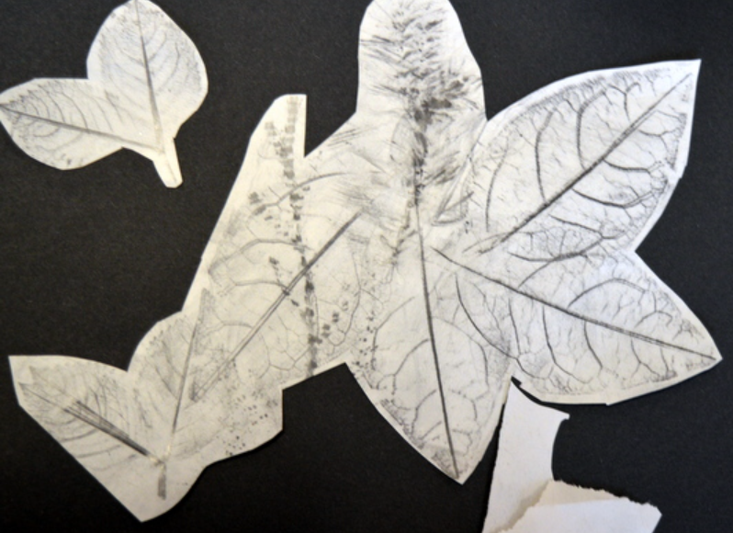
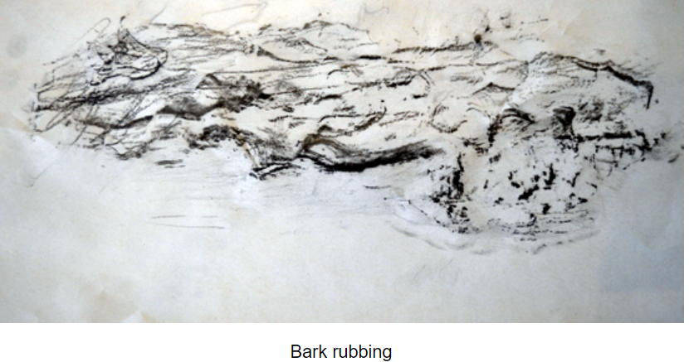
You can take rubbings outside or collect items to bring inside.
TBAT: take rubbings and make compositions.
Monday 19th January 2026
19/1/26

Slide 34
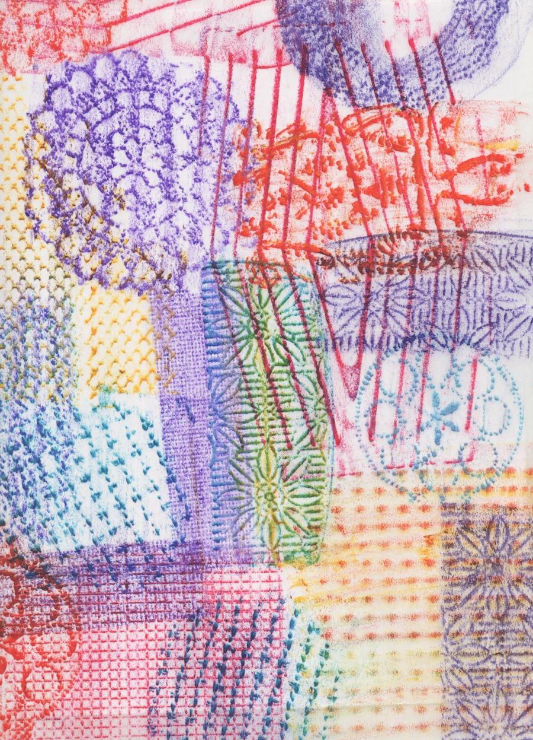
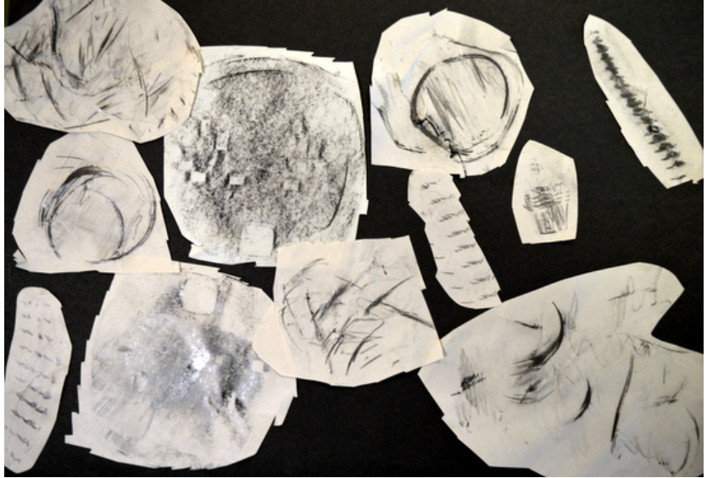
Once you have a selection of rubbings, cut them out and arrange them on your page.
TBAT: take rubbings and make compositions.
Monday 19th January 2026
19/1/26

