Slide 1
Monday 12th January 2026

Slide 2

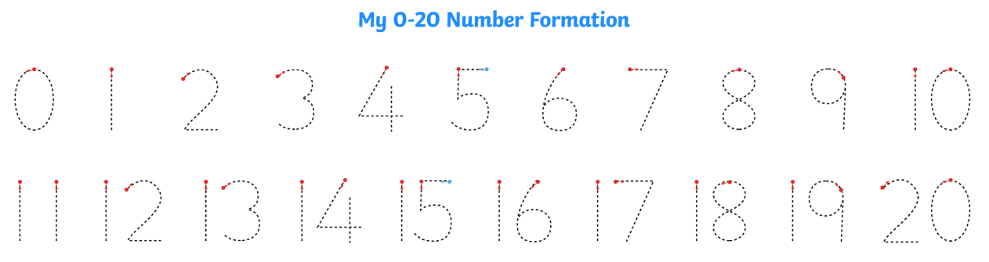
Morning Challenges:
Name writing

Slide 3
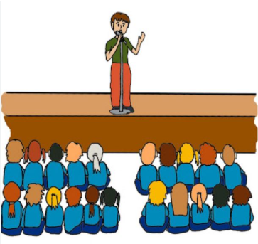
Assembly

Slide 4
Phonics
Monday 12th January 2026
12/1/26
Revisit and review
Lesson focus:
Read words with the /igh/y grapheme

Slide 5

Revisit and review
Monday 12th January 2026
12/1/26
Today's Grapheme
y

Slide 6
Revisit and review
Monday 12th January 2026
12/1/26
What are the digraphs?
hairy
boulder
grew
spread
breakfast
goes
Segment these
words and read them
Blend and say words

Slide 7
Focus words
Monday 12th January 2026
12/1/26
s-p-y
d-r-y
wh-y
Sounds out these
words and read them

Slide 8
Focus words
Monday 12th January 2026
12/1/26
spy
fly
dry
reply
why
Read, sound talk and blend
And again... FASTER!

Slide 9
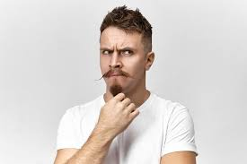
Revisit and review
would
Monday 12th January 2026
12/1/26
could
tricky words
should
Read the tricky words?

Slide 10
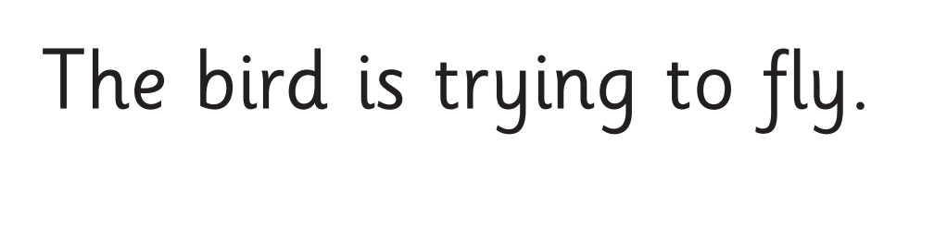
Monday 12th January 2026
12/1/26
Now let's read this sentence!​
What digraphs can you see?
What tricky words can you see?

Slide 11
Monday 12th January 2026
12/1/26
Let's spell!
How many sounds? Write it.
tricky words
fly dry who
Listen to the sentence, say it, write it and read it!
Challenge
Extend the sentence using 'and'

Slide 12
KQ: How does exercise keep me healthy?
Monday 12th January 2026​
12/1/26
3 in 3- Match the word to its definition.
exercise
you feel good, have energy, and can play and learn.
healthy
your body is strong and able to move easily, so you can play, run, and have fun without getting too tired.
fit
when you move your body to make it strong and happy, like running, jumping, dancing, or playing.
Notes:
Use this as an initial assessment of understanding. Allow the class to call out and, as they do, write their ideas on the board.

Slide 13

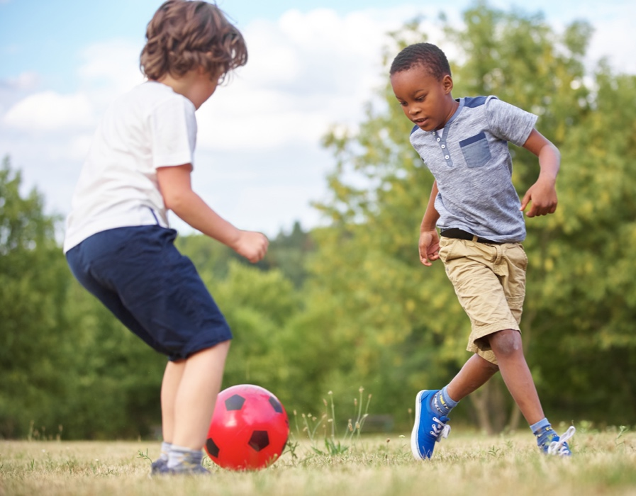
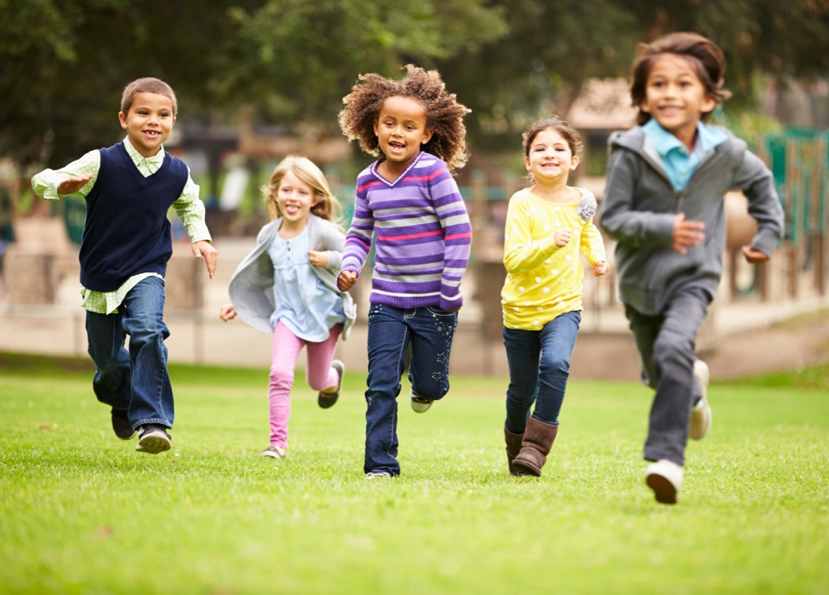
KQ: How does exercise keep me healthy?
Monday 12th January 2026​
12/1/26
Blue/ Green- How many different types of exercise can you think of?
Notes:
Use this as an initial assessment of understanding. Allow the class to call out and, as they do, write their ideas on the board.

Slide 14
KQ: How does exercise keep me healthy?
Monday 12th January 2026​
12/1/26
Our heart
Our heart is a very important part of the body because it pumps blood, which carries food and oxygen, all around it.
… The harder it pumps, the more goodness our body gets!
We can help our heart by eating lots of healthy food like fruit and vegetables, for example, but we can also look after it by exercising.

Slide 15
KQ: How does exercise keep me healthy?
Monday 12th January 2026​
12/1/26
Our heart and veins
Notes:
For more information about this illustration, see teacher notes. You could find out if they know anything else about the heart. Do they know where their heart is in their bodies? Do they think it really looks like a ‘heart’ (i.e. the common shape people use to refer to love)?

Slide 16
KQ: How does exercise keep me healthy?
Monday 12th January 2026​
12/1/26
Can you feel it?
At the moment our bodies are relaxed, so our heart is pumping slowly.
Let’s see if we can feel our heartbeat …
Notes:
Model how to feel your heartbeat by putting two fingers on a vein on your wrist then lightly pushing down. Help the children to follow your instruction – an additional adult would be very helpful.

Slide 17

KQ: How does exercise keep me healthy?
How much exercise each day is good for us?
Monday 12th January 2026​
12/1/26
It is recommended that children do one hour of exercise every day to keep themselves fit.
What can we do to exercise?
Notes:
Ask for ideas and, if they don’t mention the following, remind them that cycling, dancing, skipping, football, running around, playing games like ‘tag’, etc. are all great ways of exercising and staying healthy. It’s easy to have lots of fun keeping fit every day!
Ideas include:
Relay races
Tag: Choose one person to be the tagger, giving them a bib or band so the class can see them. When they touch someone, that person becomes ‘it’.
Stuck in the mud: You can choose 1–3 taggers for this game. When they touch someone, that person becomes ‘stuck in the mud’ – they must stand in a star position and the other free players can release them from being stuck by crawling under their legs.

Slide 18
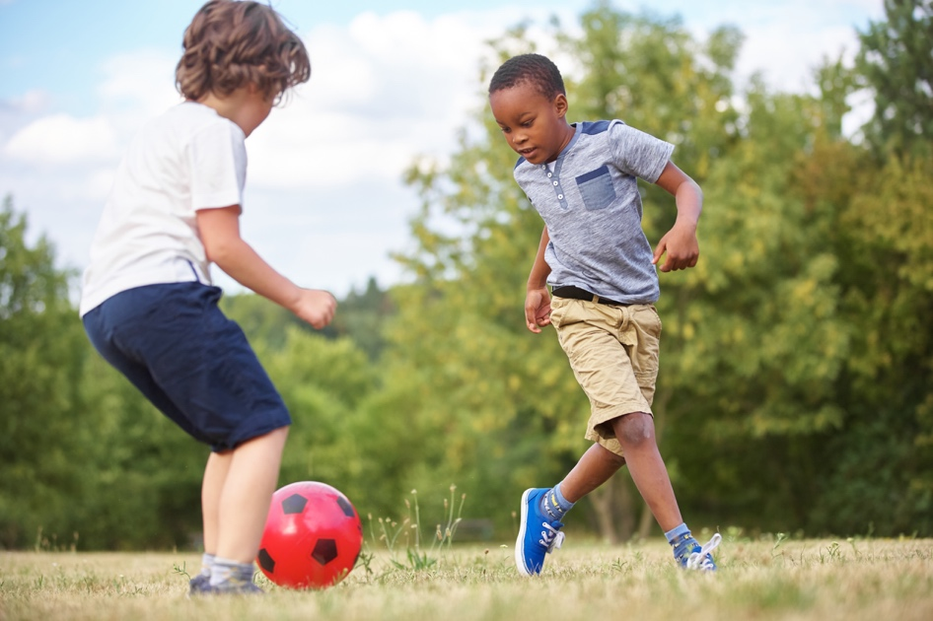
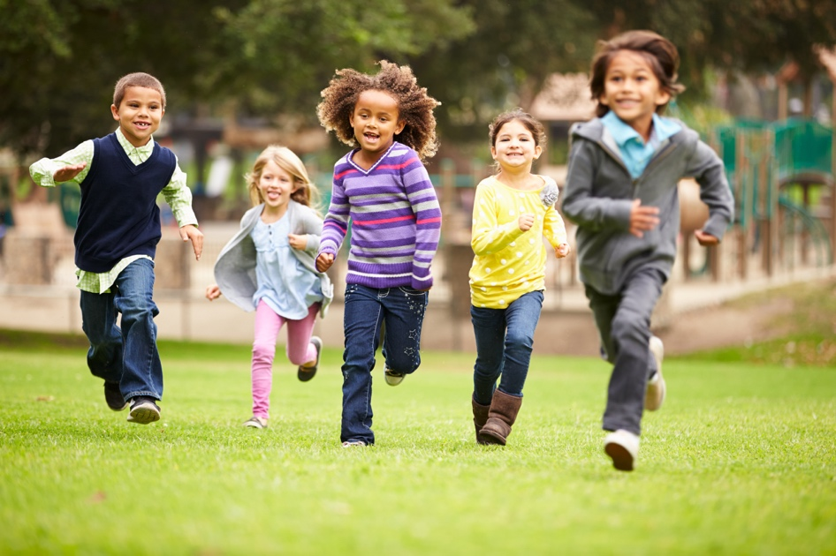
KQ: How does exercise keep me healthy?
Monday 12th January 2026​
12/1/26
What have we learned?
Today’s big question:
How does exercise keep me healthy?
Notes:
Use this to evaluate their understanding and, if necessary, spend time clarifying any misconceptions or answering any questions.

Slide 19
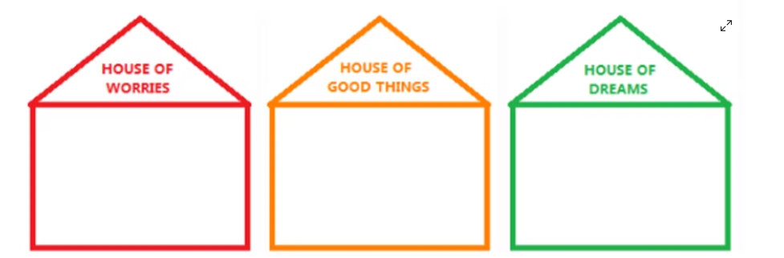

Slide 20
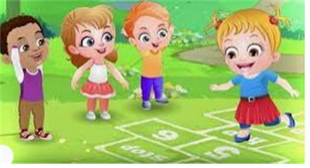
Break

Slide 21
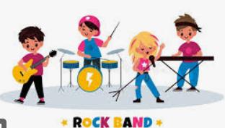
Rock steady workshop

Slide 22
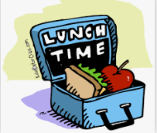
Lunch

Slide 23
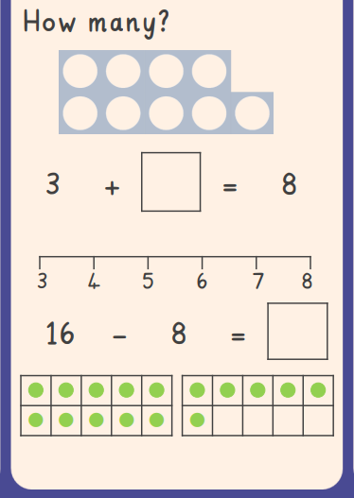

3 in 3
TBAT: read and write the time to o’clock on an analogue clock
Monday 12th January 2026
12/01/2026
Challenge:

Slide 24
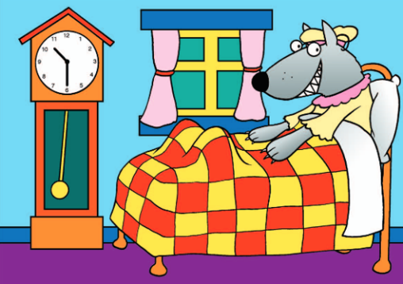
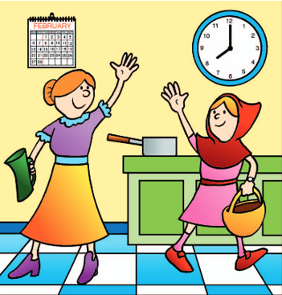
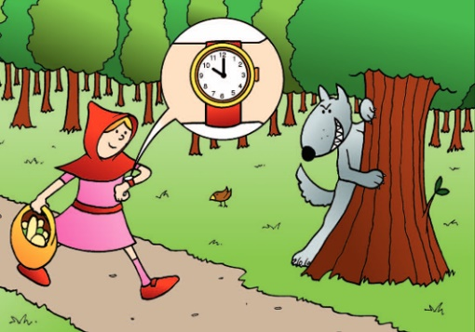
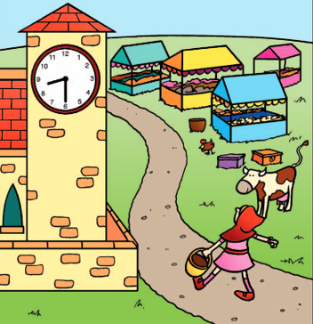
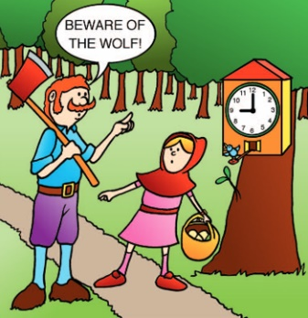
Blue / Green Use these words to put the parts of the story in order
TBAT: read and write the time to o’clock on an analogue clock
Monday 12th January 2026
12/01/2026
before
after
next
then
Challenge: did each thing take seconds or minutes?
Notes:
Do Now: Order of events
Each table has a copy of the Big Picture cut into parts (from the Lesson 2 Talk Task). They order the story of Little Red Riding Hood, using the language on the slide.

Slide 25
TBAT: read and write the time to o’clock on an analogue clock
Monday 12th January 2026
12/01/2026
o’clock
long
hour
short
hand
minute
clock
time

Slide 26
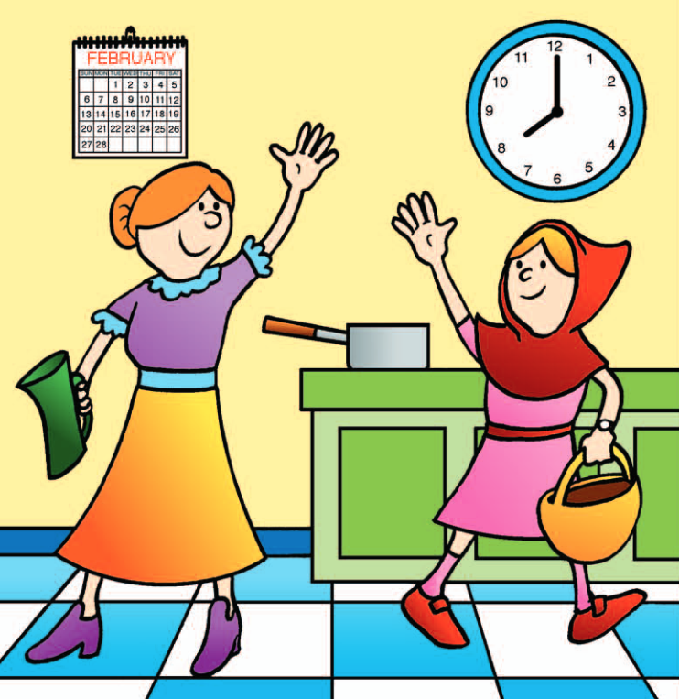
What can you see on the wall?
TBAT: read and write the time to o’clock on an analogue clock
Monday 12th January 2026
12/01/2026
Which is longer, a second or a minute?
The short hand is the hour hand and it points to the ‘hour numbers’ written around the clock to tell us what hour it is.
The long hand is the minute hand. It moves faster than the hour hand and tells us how many minutes into each hour we are. When the minute hand is pointing straight up, it is o’clock.
Notes:
New Learning: Introducing o’clock
Show pupils the first section of the Big Picture.
What can you see hanging on the wall?
I can see a calendar. I can see the month February. I can see a clock.
Point out the clock and remind pupils that clocks measure seconds, minutes and hours.
Which is longer, a second or a minute? How do you know?
A minute is longer because I can clap my hands three times in a second and I can clap lots and lots of times in a minute.
Explain that today we will learn about hours and how to read the hours on a clock, which are longer than minutes or seconds. Using a large demonstration clock, show pupils eight o’clock. Explain that the short hand is the hour hand and it points to the ‘hour numbers’ written around the clock to tell us what hour it is. Explain that the long hand is the minute hand. It moves faster than the hour hand and tells us how many minutes into each hour we are. When the minute hand is pointing straight up, it is o’clock.
(Note: avoid saying ‘when the minute hand is pointing to the 12’. The minute hand actually points to the minute scale, which is often unnumbered, though may be numbered 1–60 on a demonstration clock. Confusion often arises from pupils thinking the minute hand is pointing to the hour scale.)
Show other o’clock times and discuss what time the clock shows. Model the following sentence structure (shown on the next slide) and get pupils to repeat:
I know that it is six o’clock because the hour hand is pointing to the six and the minute hand is pointing straight up.

Slide 27
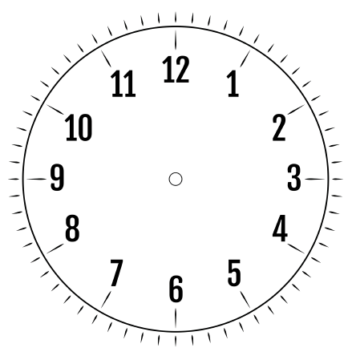
Introducing o’clock
TBAT: read and write the time to o’clock on an analogue clock
Monday 12th January 2026
12/01/2026
I know that it is ____ o’clock because the hour hand is pointing to the ____ and the minute hand is pointing straight up.
Notes:
New Learning: Introducing o’clock
Show pupils the first section of the Big Picture.
What can you see hanging on the wall?
I can see a calendar. I can see the month February. I can see a clock.
Point out the clock and remind pupils that clocks measure seconds, minutes and hours.
Which is longer, a second or a minute? How do you know?
A minute is longer because I can clap my hands three times in a second and I can clap lots and lots of times in a minute.
Explain that today we will learn about hours and how to read the hours on a clock, which are longer than minutes or seconds. Using a large demonstration clock, show pupils eight o’clock. Explain that the short hand is the hour hand and it points to the ‘hour numbers’ written around the clock to tell us what hour it is. Explain that the long hand is the minute hand. It moves faster than the hour hand and tells us how many minutes into each hour we are. When the minute hand is pointing straight up, it is o’clock.
(Note: avoid saying ‘when the minute hand is pointing to the 12’. The minute hand actually points to the minute scale, which is often unnumbered, though may be numbered 1–60 on a demonstration clock. Confusion often arises from pupils thinking the minute hand is pointing to the hour scale.)
Show other o’clock times and discuss what time the clock shows. Model the following sentence structure (shown on the next slide) and get pupils to repeat:
I know that it is six o’clock because the hour hand is pointing to the six and the minute hand is pointing straight up.

Slide 28
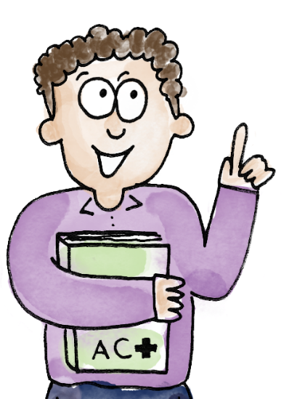
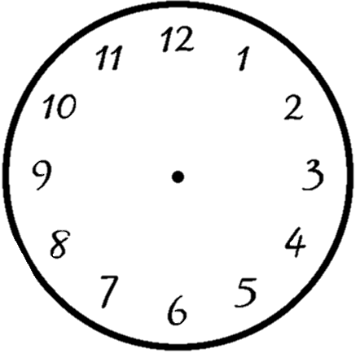
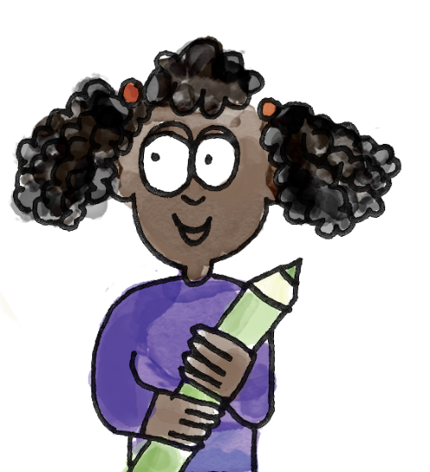
What’s the o’clock time?
TBAT: read and write the time to o’clock on an analogue clock
Monday 12th January 2026
12/01/2026
o’clock time hour minute clock hand long short
I know it is three o’clock because the hour hand is pointing at the three and the minute hand is pointing straight up.
What time have I made?
Notes:
Talk Task: What’s the o’clock time?
Each pair of pupils will need a small geared clock.
Pupil A makes an o’clock time on the clock. Pupil B says what the time is and explains how they know. Pupils swap roles and repeat.

Slide 29

What time is it? How do you know?
TBAT: read and write the time to o’clock on an analogue clock
Monday 12th January 2026
12/01/2026
Blue
Green
I know that it is ____ o’clock because the hour hand is pointing to the ____ and the minute hand is pointing straight up.
Notes:
New Learning: Introducing o’clock
Show pupils the first section of the Big Picture.
What can you see hanging on the wall?
I can see a calendar. I can see the month February. I can see a clock.
Point out the clock and remind pupils that clocks measure seconds, minutes and hours.
Which is longer, a second or a minute? How do you know?
A minute is longer because I can clap my hands three times in a second and I can clap lots and lots of times in a minute.
Explain that today we will learn about hours and how to read the hours on a clock, which are longer than minutes or seconds. Using a large demonstration clock, show pupils eight o’clock. Explain that the short hand is the hour hand and it points to the ‘hour numbers’ written around the clock to tell us what hour it is. Explain that the long hand is the minute hand. It moves faster than the hour hand and tells us how many minutes into each hour we are. When the minute hand is pointing straight up, it is o’clock.
(Note: avoid saying ‘when the minute hand is pointing to the 12’. The minute hand actually points to the minute scale, which is often unnumbered, though may be numbered 1–60 on a demonstration clock. Confusion often arises from pupils thinking the minute hand is pointing to the hour scale.)
Show other o’clock times and discuss what time the clock shows. Model the following sentence structure (shown on the next slide) and get pupils to repeat:
I know that it is six o’clock because the hour hand is pointing to the six and the minute hand is pointing straight up.

Slide 30
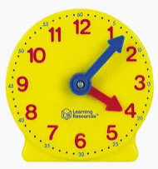
TBAT: read and write the time to o’clock on an analogue clock
Monday 12th January 2026
12/01/2026
On your clock make the time 5 o’clock
Make the time 12 o’clock
Make the time 4 o’clock

Slide 31
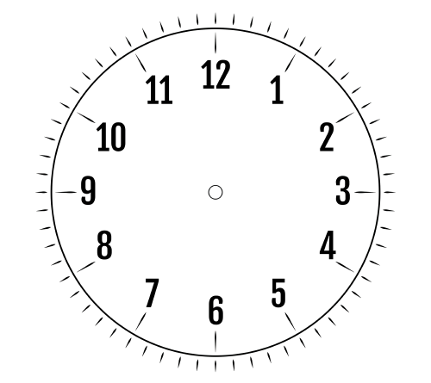
Drawing hands on a clock
TBAT: read and write the time to o’clock on an analogue clock
Monday 12th January 2026
12/01/2026
The time is nine o’clock.
Notes:
Develop Learning: Drawing hands on a clock
Pupils have their individual clocks on the carpet. Based on your assessment during the Talk Task, practise more reading of o’clock times, always requiring pupils to explain how they know what the time is.
Then show pupils a time written in words with a blank clock face.
How would we show this time on the clock?
Model drawing the hands on the clock face, using the sentence structure from the Talk Task to explain. Draw attention to the minute hand being quite a lot longer than the hour hand.

Slide 32
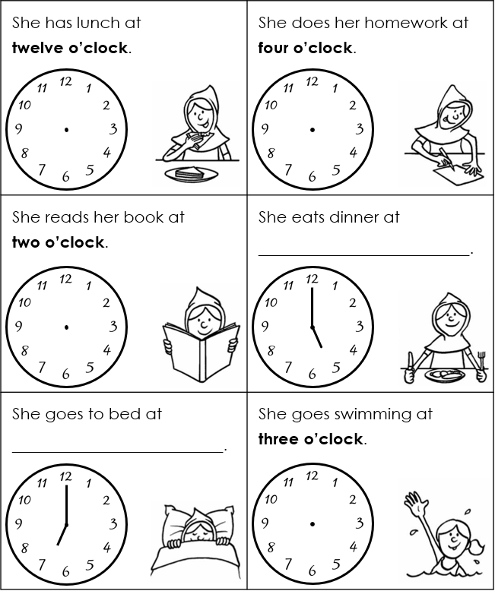
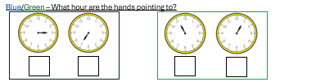
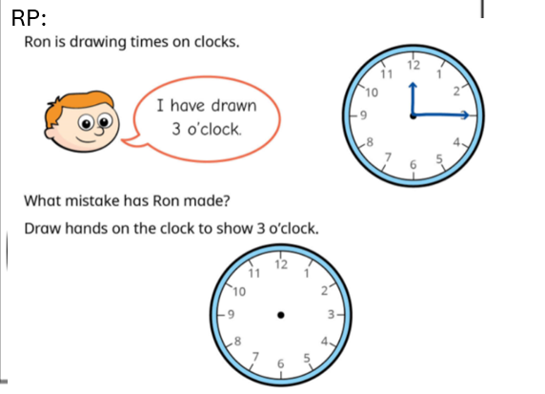
TBAT: read and write the time to o’clock on an analogue clock
Monday 12th January 2026
12/01/2026
For each event in Little Red Riding Hood’s day:
draw hands on the clock to show the time
or write the time in words.
Notes:
Independent Task: Telling time to o’clock
Pupils have a copy of the Task Sheet. They complete the missing information, either by writing the times in words, or drawing the hands on the clocks.
Possible adaptations:
The task could be presented as a card sort, with pupils matching written and clock times.
Pupils could be given some times written in words for them to make on a geared clock.

Slide 33
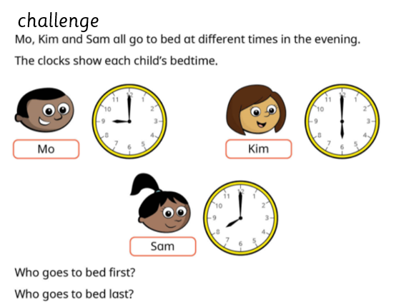
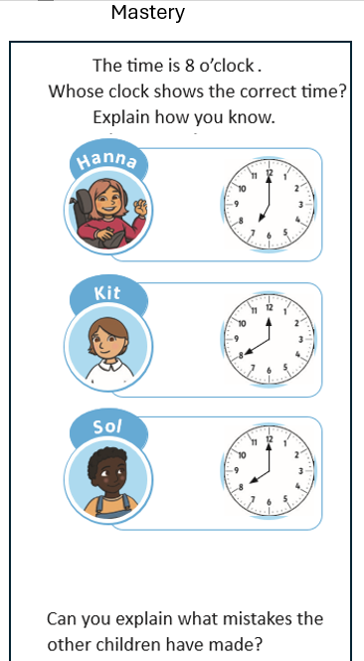
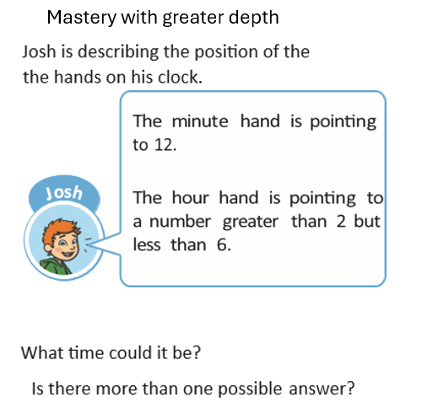

Slide 34
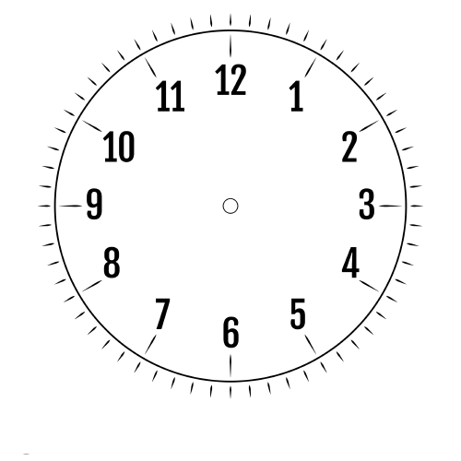
Match the written times to the clocks
TBAT: read and write the time to o’clock on an analogue clock
Monday 12th January 2026
12/01/2026
eleven o’clock
four o’clock
nine o’clock
three o’clock
Notes:
Plenary: Matching the o’clock time to the clock
Pupils match the written times to the clocks.
How do you know this clock shows eleven o’clock?
I know the clock shows eleven o’clock because the hour hand is pointing to eleven and the minute hand is pointing straight up.

Slide 35

Art
Monday 12th January 2026
12/01/2026
TBAT: make simple prints with my hands.
This half term in art we will be looking at simple print making.
Today we will be printing with
our hands.

Slide 36
Blue/ green What does printing mean?
TBAT: make simple prints with my hands.
Monday 12th January 2026
12/01/2026
Have you printed before?
What did you use?

Slide 37
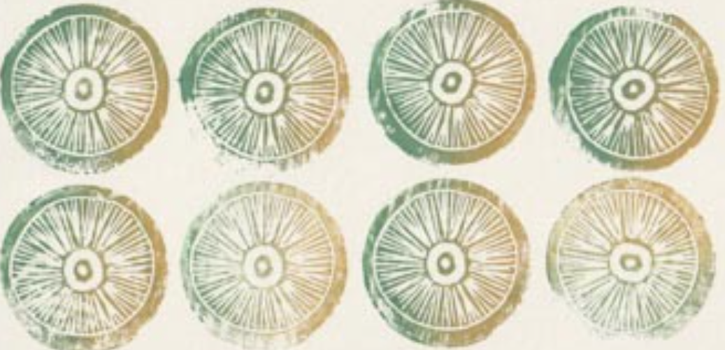
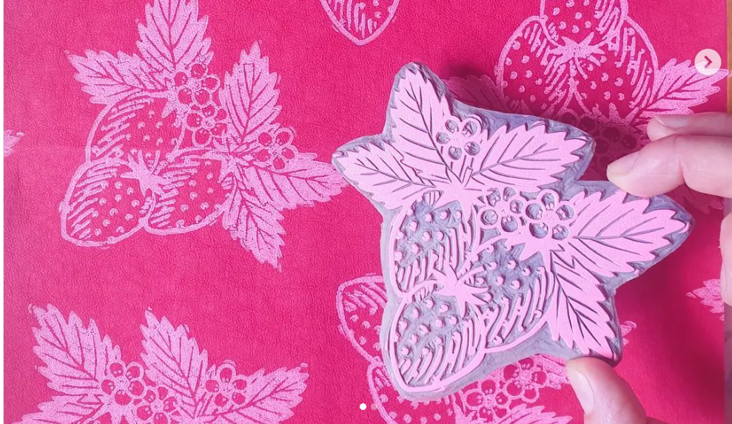

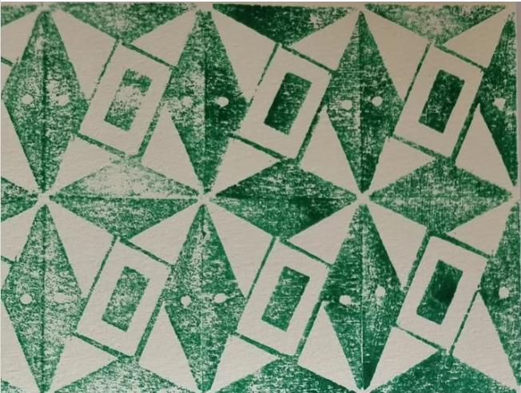
Monday 12th January 2026
12/01/2026
What do you notice?

Slide 38
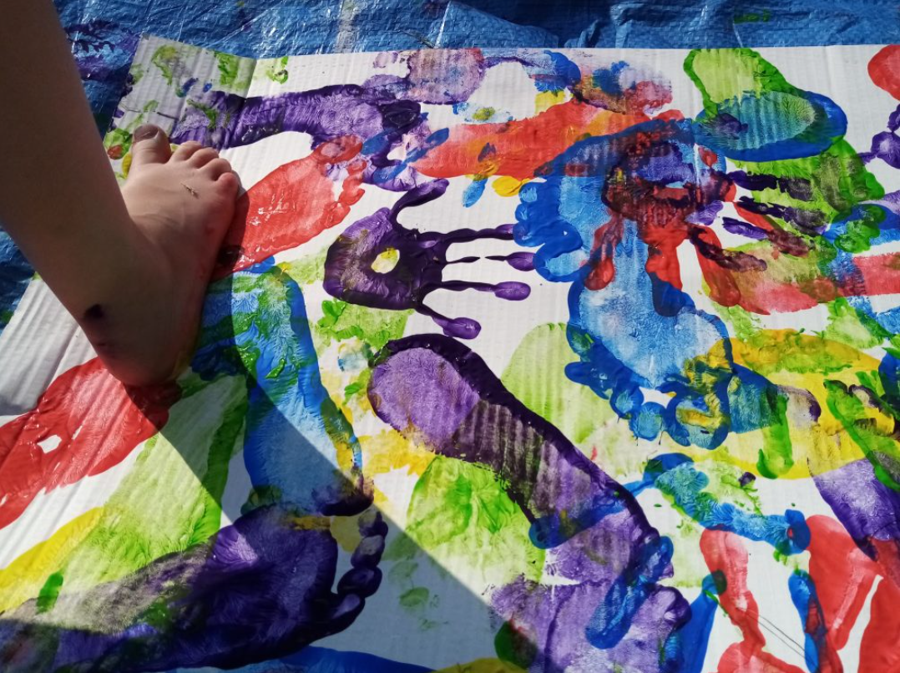
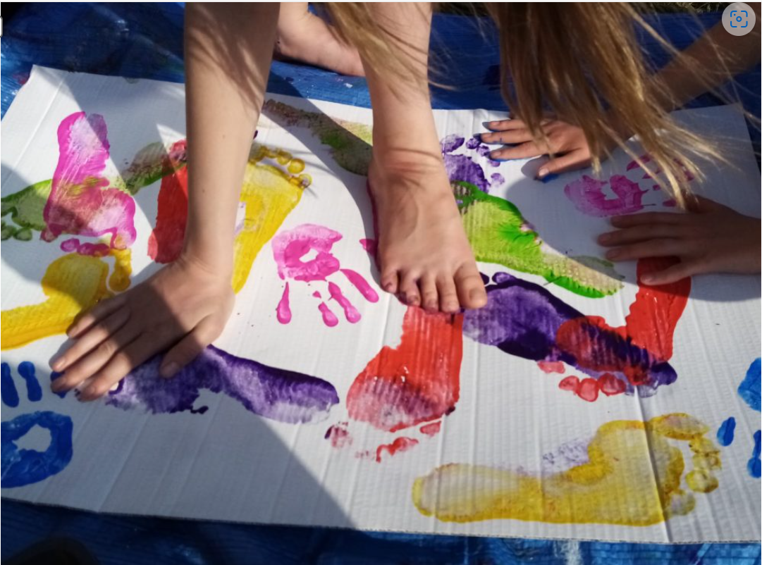
Art
TBAT: make simple prints with my hands.
Monday 12th January 2026
12/01/2026
Let's spend some time exploring printing with our hands.
Cover your page with prints of different colours.

Slide 39
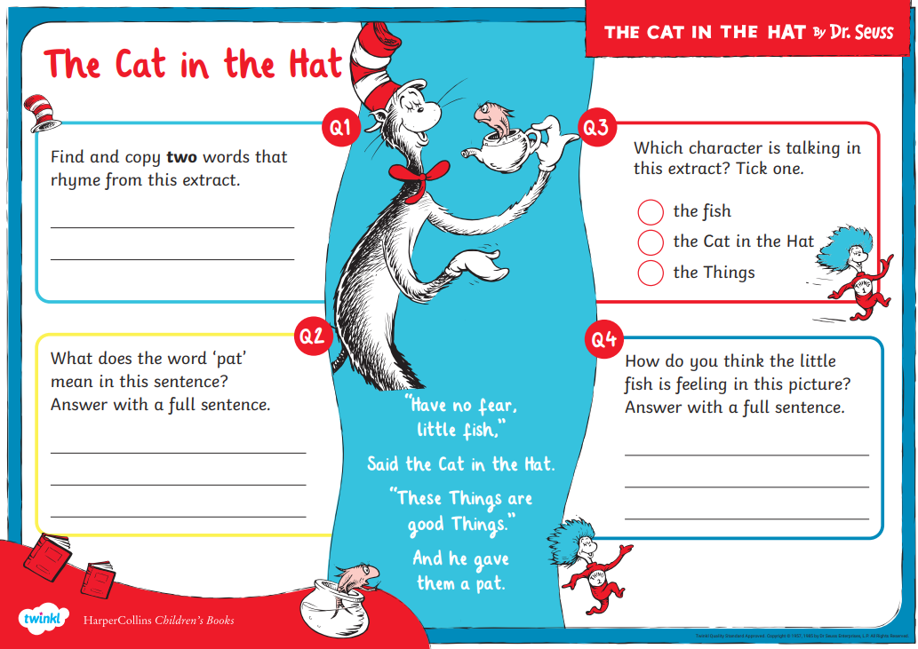
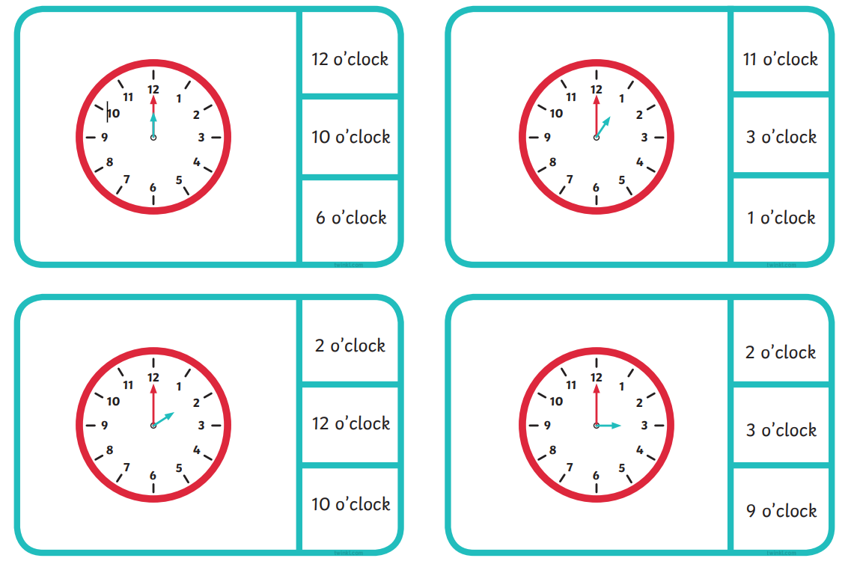
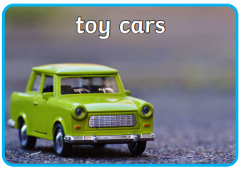
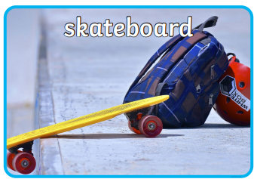
Independent Challenges:
Narrative Zone
Maths Zone
Cat in the Hat reading comprehension
Use clocks to create the times.
Match the clock to the time it is showing
Enquiry Zone
Creative Zone
Sort the toys into groups
Hand printing

