Slide 1
Friday 16th January 2026

Slide 2

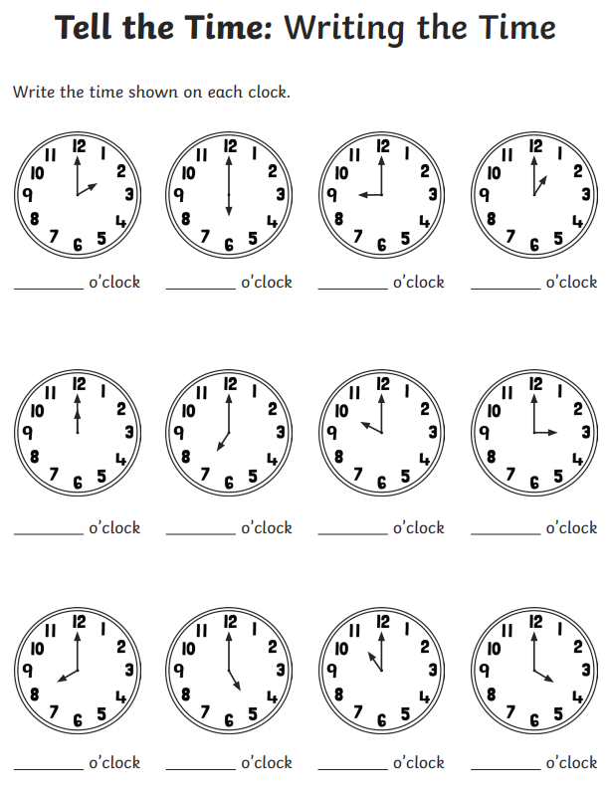
Morning Challenges:
Name writing

Slide 3

Revisit and review
Friday 16th January 2026
16/1/26
Sort the ow words
follow yellow snow crown howl crowd

Slide 4


Revisit and review
who
whole
Friday 16th January 2026
16/1/26
would
where
tricky words
could
two
should

Slide 5
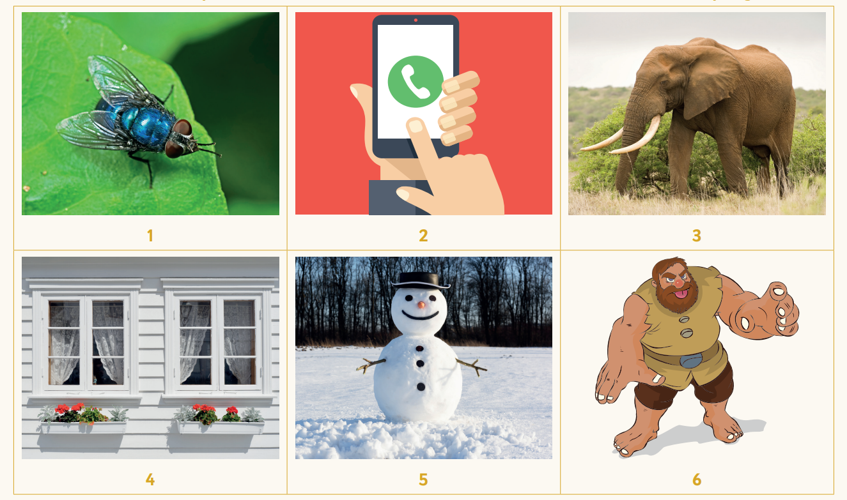
Focus words
Friday 16th January 2026
16/1/26
Match the words to the pictures
elephant
giant
fly
snow
phone
window

Slide 6
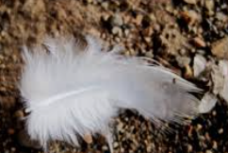
Write a sentence to match this picture.
Friday 16th January 2026​
16/1/26​
Notes:
A feather from a white bird fell on the ground

Slide 7
3 in 3 Make these times on your clock
TBAT: read the time to o’clock and half past on an analogue clock
Friday 16th January 2026
16/1/26
five o’clock
nine o’clock
seven o’clock
four o’clock
eleven o’clock
eight o’clock
three o’clock
ten o’clock
Notes:
Do Now: Showing o’clock times on clocks
Pupils have individual geared clocks. In pairs, they choose a time from the slide and make it on their clock. They explain to each other how they know they are correct.
I know it is ten o’clock because the hour hand is pointing to the ten and the minute hand is pointing straight up.

Slide 8
TBAT: read the time to o’clock and half past on an analogue clock
Friday 16th January 2026
16/1/26
hour
minute hand
hour hand
afternoon
half past
morning
halfway between

Slide 9
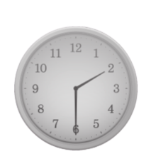
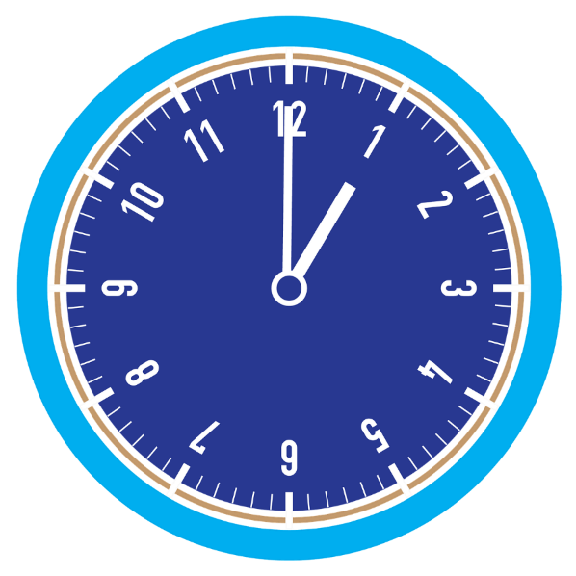
Blue / Green What can you remember about telling the time?
TBAT: read the time to o’clock and half past on an analogue clock
Friday 16th January 2026
16/1/26
How do we know when it is o’clock?
How do we know when it is half past?
Challenge: What is the difference between the hour hands at o'clock and half past?
Notes:
New Learning: Recapping how to tell the time
Have the large demonstration clock and give each pupil a small geared clock.
What can you remember about telling the time?
The hour hand is the short hand, and the long hand is the minute hand. When the minute hand is pointing straight up it is o’clock. When the minute hand is pointing straight down it is half past. When it is o’clock the hour hand will be pointing to a number. When it is half past the hour hand will be pointing to halfway between two numbers.
Play a game of ‘What’s the time, Mr Wolf?’ (next slide). Give pupils clues, for example:
The minute hand is pointing straight down. The hour hand is pointing between the one and the two.
Pupils guess the time, using their individual clocks for support. This can be used as an opportunity to address any misconceptions, e.g. confusion between the minute and hour hands.

Slide 10

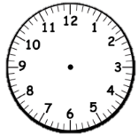
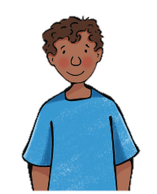
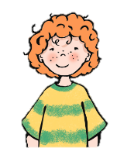
What’s the time, Mr Wolf?
TBAT: read the time to o’clock and half past on an analogue clock
Friday 16th January 2026
16/1/26
?
The minute hand is …
The hour hand is …
Your time is …
Notes:
New Learning: Recapping how to tell the time
Have the large demonstration clock and give each pupil a small geared clock.
What can you remember about telling the time?
The hour hand is the short hand, and the long hand is the minute hand. When the minute hand is pointing straight up it is o’clock. When the minute hand is pointing straight down it is half past. When it is o’clock the hour hand will be pointing to a number. When it is half past the hour hand will be pointing to halfway between two numbers.
Play a game of ‘What’s the time, Mr Wolf?’ (next slide). Give pupils clues, for example:
The minute hand is pointing straight down. The hour hand is pointing between the one and the two.
Pupils guess the time, using their individual clocks for support. This can be used as an opportunity to address any misconceptions, e.g. confusion between the minute and hour hands.

Slide 11
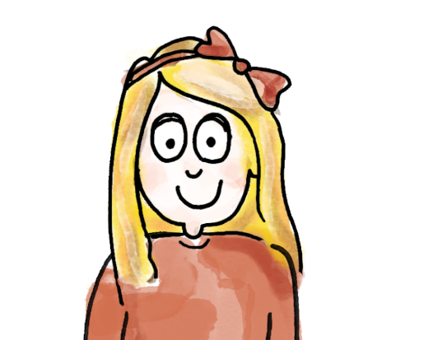
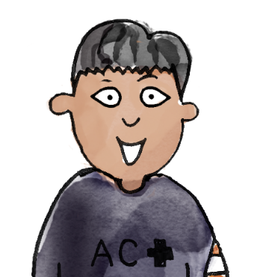
TBAT: read the time to o’clock and half past on an analogue clock
Friday 16th January 2026
16/1/26
I know this is a half past time because the minute hand is pointing straight down.
The time is half past ____ because the hour hand is halfway between the _____ and the _____.
I know this is an o’clock time because the hour hand is pointing straight up.
The time is _____ o’clock because the hour hand is pointing at the _____.
hour hour hand minute hand half past halfway between morning afternoon
Notes:
Talk Task: O’clock and half past
Pupils have a copy of the Task Sheet and individual geared clocks.
Pupil A picks a clock from the sheet and makes the same time on their personal clock. Pupil B reads the time from the clock, explaining how they know. They cross that clock off on their sheet. Pupils then swap roles and repeat.

Slide 12
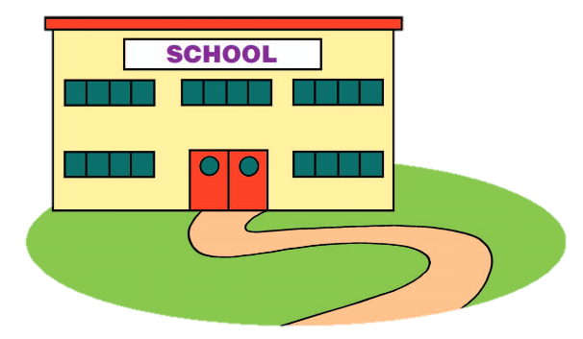
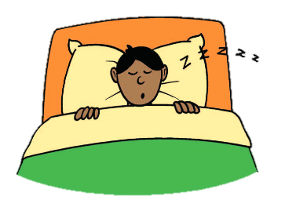
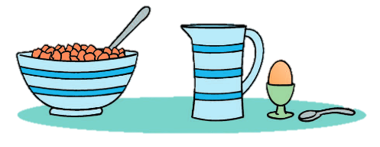
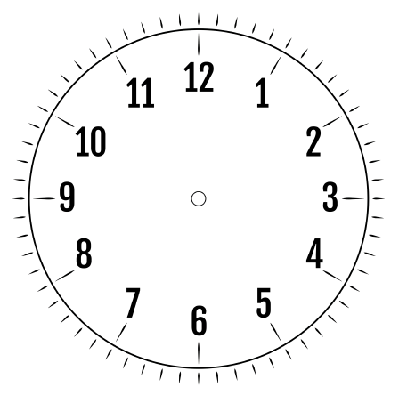
What time of day do we do these activities?
TBAT: read the time to o’clock and half past on an analogue clock
Friday 16th January 2026
16/1/26
Eating breakfast
Going home
Going to bed
When does the morning become afternoon?
Notes:
Develop Learning: Morning, afternoon and evening activities
Discuss some activities that we do in the morning, afternoon and evening.
Do we eat breakfast in the afternoon?
When do we have dinner? Do we have dinner in the morning?
Take feedback.
When does the morning become afternoon?
Discuss the meaning of the word ‘noon’ and establish that 12 o’clock is called noon or midday, and the afternoon comes after it. Establish that morning is until 12 o’clock noon and afternoon is after 12 o’clock noon. You might want to also discuss that there are two 12 o’clocks each day, midday and midnight, and that pupils will be asleep at midnight.
What do we do in the morning? What do we do in the afternoon?
Agree on four activities. (If you want to link this directly into the Independent Task, steer pupils towards breakfast, playtime, home time and dinner time). Discuss what time of day each activity might happen, e.g. eating breakfast at seven o’clock in the morning. Emphasise morning, afternoon and evening, and o’clock and half past times.

Slide 13
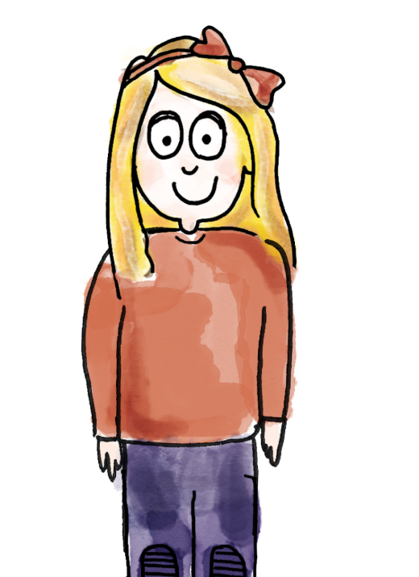
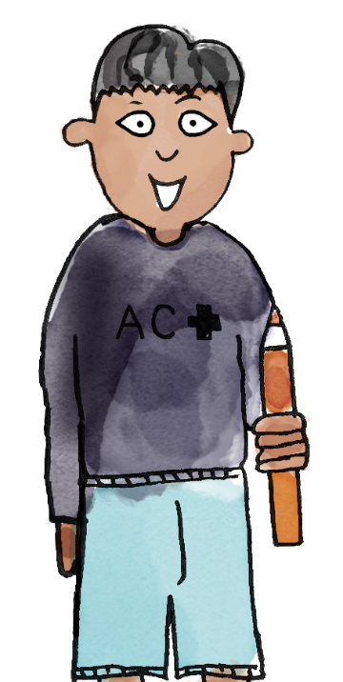
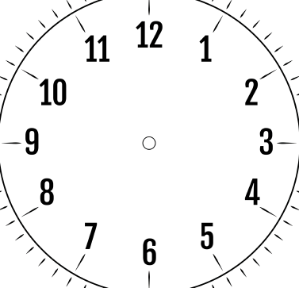
TBAT: read the time to o’clock and half past on an analogue clock
Friday 16th January 2026
16/1/26
I have made half past ten. At half past ten in the morning I go out to play with my friends.
I have made four o'clock. At four o'clock in the afternoon I go swimming.
time o’clock half past minute hand hour hand
Notes:
Talk Task: Times and activities
Pupils need one copy of the Task Sheet and an individual geared clock.
Pupils take it in turns to pick a time from the sheet, make it on their individual clock and say something they might do at that time.

Slide 14
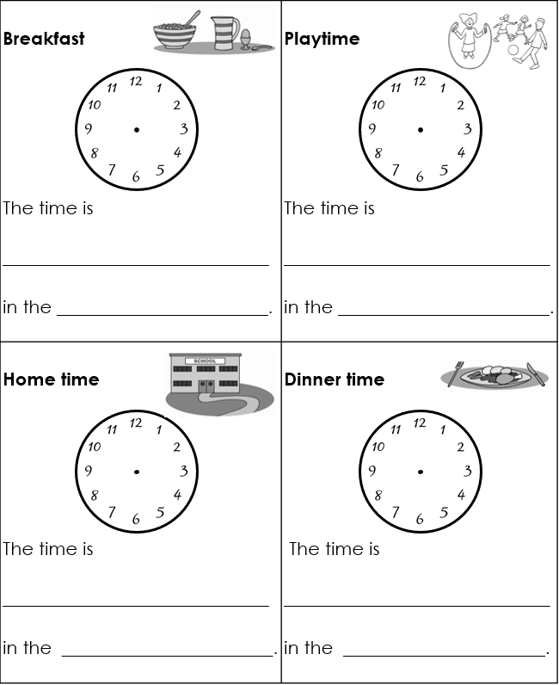
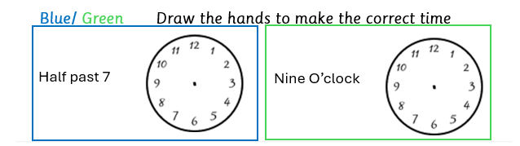
TBAT: read the time to o’clock and half past on an analogue clock
Friday 16th January 2026
16/1/26
For each activity:
draw the hands on the clock to show the time
complete the sentence.
Notes:
Independent Task: Morning, afternoon and evening times
Pupils have a copy of the Task Sheet. They suggest times when each activity might occur and draw the hands on the clock. They then complete the sentence, writing the time in words and whether it happens in the morning, afternoon or evening.
Possible adaptations:
Pupils could have the times and words completed for them to match to the activities.
Pupils could think of their own daily activities and write their o’clock or half past times.

Slide 15
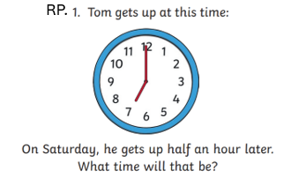
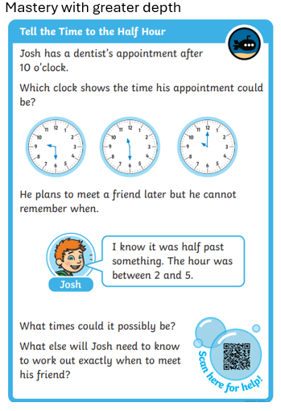
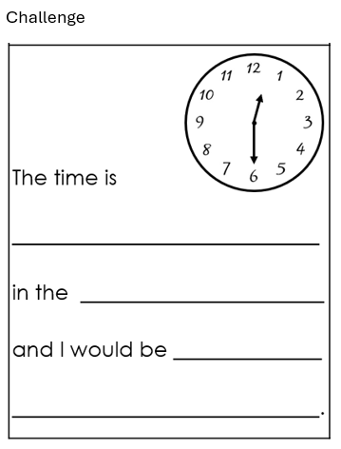
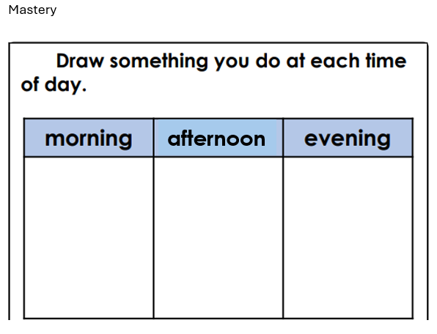

Slide 16
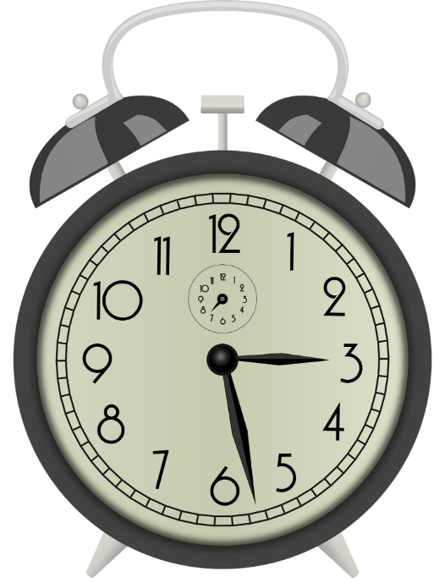

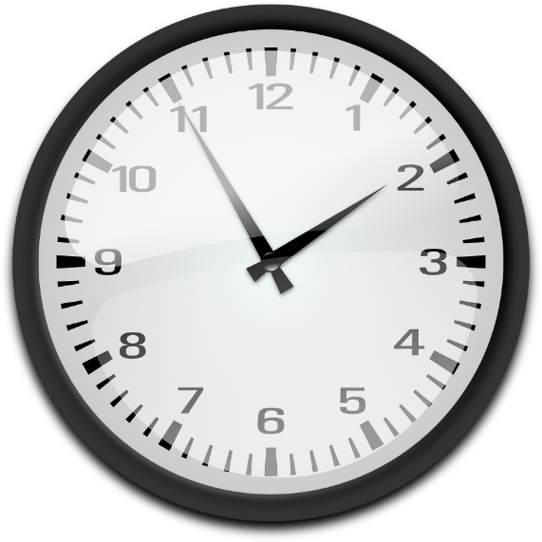

What do you notice?
What time do you think each clock says?
How can you tell?
Notes:
Plenary: Missing minute hand
Display the four clocks, which are all missing their minute hands. Use the questions below to stimulate a discussion about how we can use the hour hand to give us an approximate time. Encourage pupils to explain their ideas.
What do you notice?
What time do you think each clock says? How do you know?

Slide 17
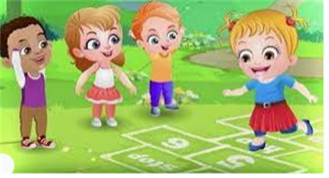
Break

Slide 18
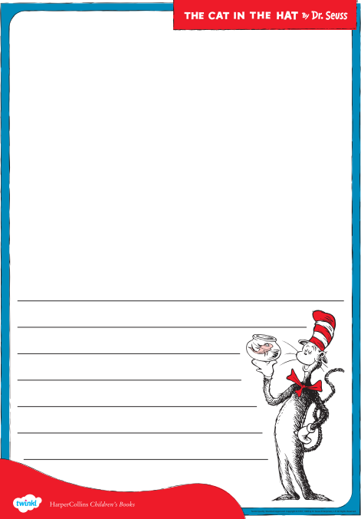
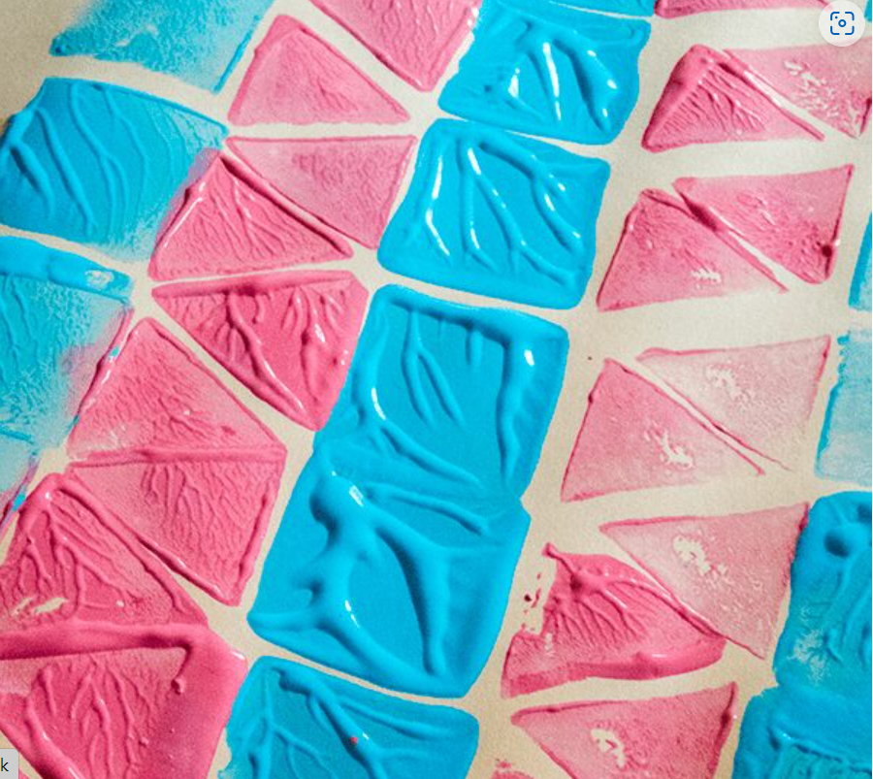
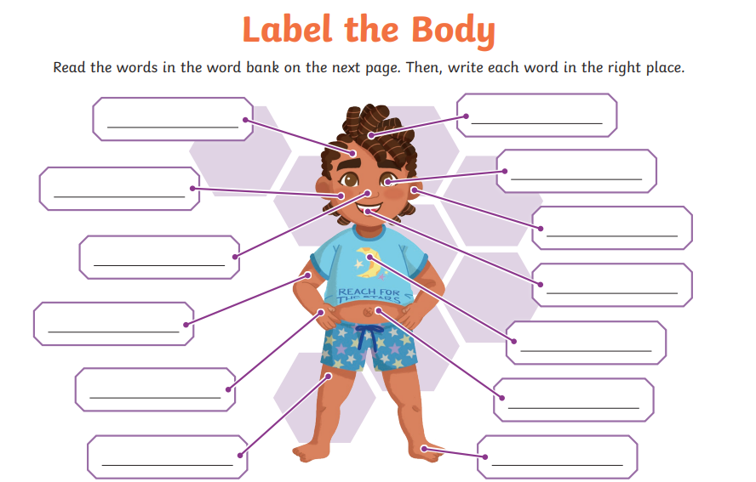
Independent Challenges:
Narrative Zone
Maths Zone
Draw and write about your favourite part of The Cat in the Hat
Draw the hands on the clocks to show the times
Enquiry Zone
Creative Zone
Use the 2D shapes to print a repeating pattern

Slide 19

Lunch

Slide 20

Golden Book Assembly

Slide 21

Enrichment

