Slide 1
MONDAY

Slide 2
MORNING CHALLENGE

Slide 3
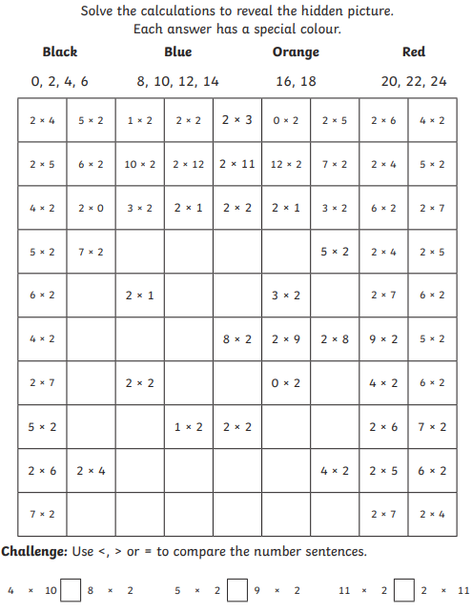



Slide 4
9-1030

Slide 5

T.B.A.T. identify and explain the purpose and layout of instructions
3 in 3
Name two items you will need to make the card Christmas tree.
------------------------------------------------
----------------------------------------------
Write one imperative ('bossy') verb to tell people what they need to do with the card.
----------------------------------------------------
Write one time conjunction you could use when writing instructions.
----------------------------------------------------

Slide 6


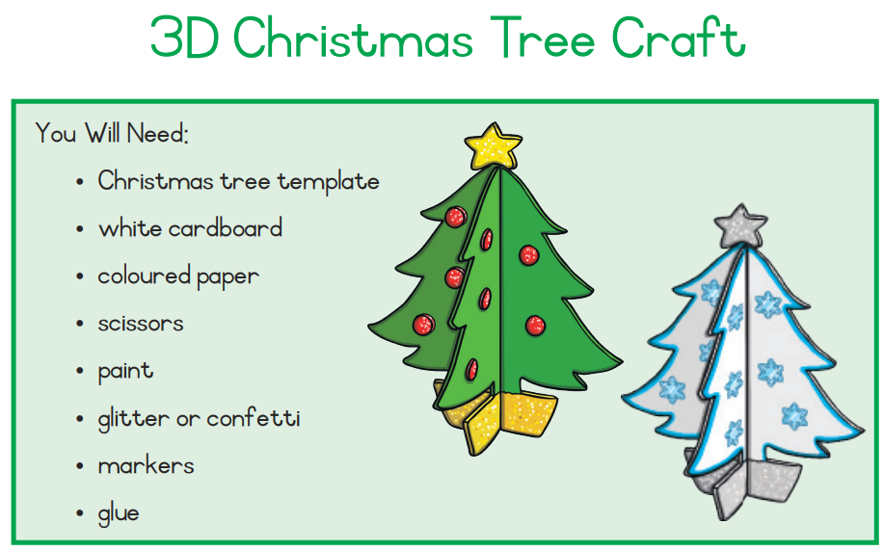
T.B.A.T. identify and explain the purpose and layout of instructions
When we write instructions it is important to put in a 'what you will need' section. Why?

Slide 7

TITLE
Why do you need a title for instructions?
----------------------------------------------------------------------------------------------------------
2. How can you make the title stand out?
----------------------------------------------------------------------------------------------------------

Slide 8
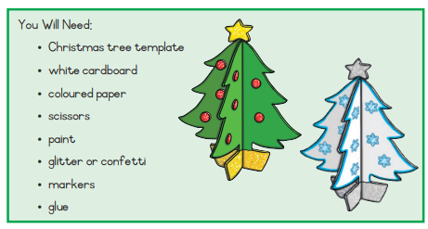
YOU WILL NEED:
3. Why do we use bullet points for the equipment?
----------------------------------------------------------------------------------------------------------
4. Why do you think the pictures are included?
----------------------------------------------------------------------------------------------------------

Slide 9
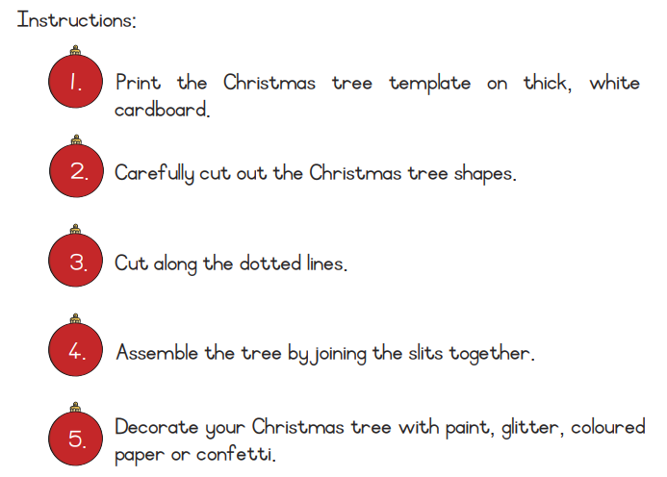
INSTRUCTIONS:
5. How to numbers help the reader?
----------------------------------------------------------------------------------------------------------
6. Write down 4 imperative ('bossy') verbs.
-------------- -------------- -------------- ---------------

Slide 10
INSTRUCTIONS:
CHALLENGE:
What could you use instead of numbers? Give an example.
----------------------------------------------------------------------------------------------------------
GREATER DEPTH:
How might a labelled diagram help the reader even more?
----------------------------------------------------------------------------------------------------------

Slide 11
BREAK

Slide 12
10.50 - 11.50

Slide 13
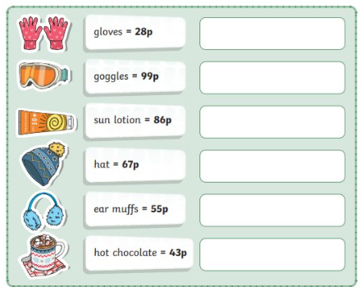
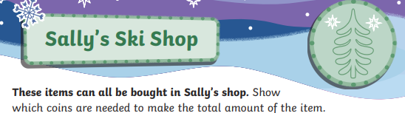
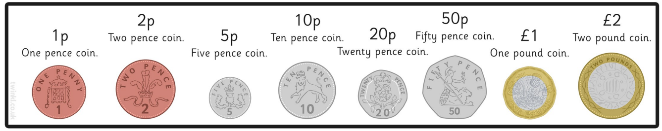
What you can do:
Use a 100 square to help.
You can use each coin more than once.
You can only use the coins on the list.
Work with a buddy.

Slide 14
LUNCH

Slide 15
P.S.H.E

Slide 16
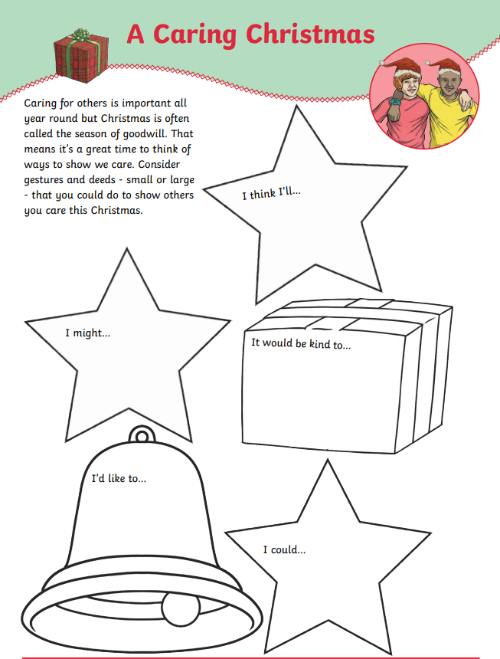
T.B.A.T. think about ways in which we care for others at Christmas

Slide 17
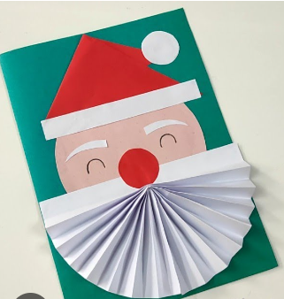

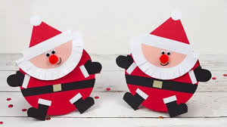
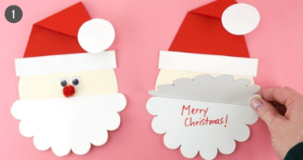
Art p.m.
Christmas Cards / Christmas Trees

Slide 19
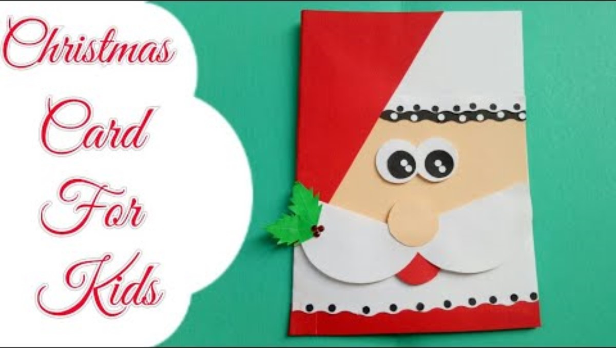

Slide 20
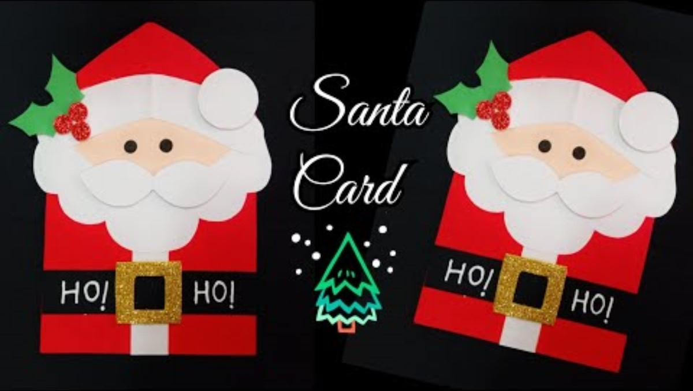

Slide 21
You will need:
Red paper
Face coloured paper
White paper
Pom Pom

