Slide 1
Wednesday 17th December 2025

Slide 2
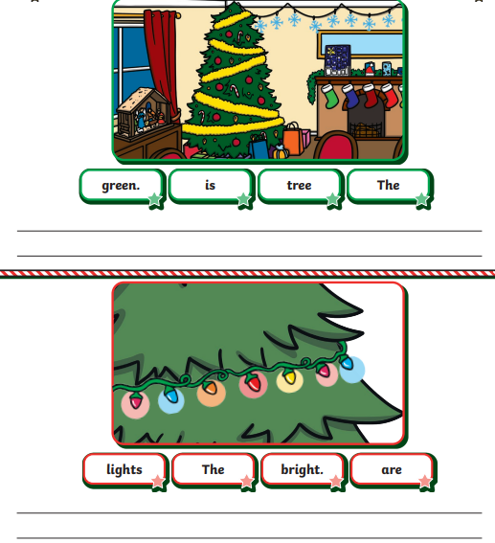
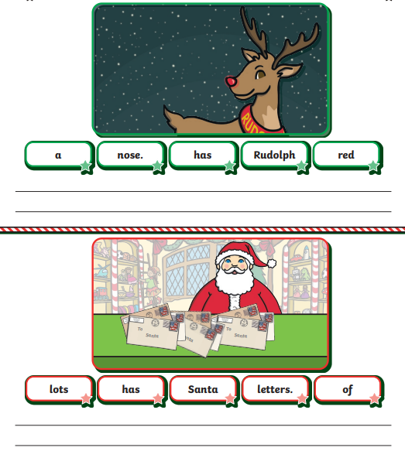
Morning Challenges:

Slide 3
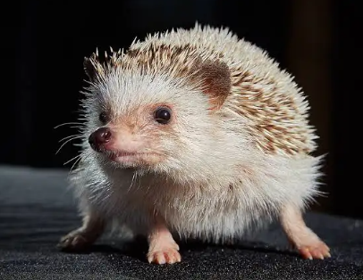
Hedgehog assembly: 9am

Slide 4
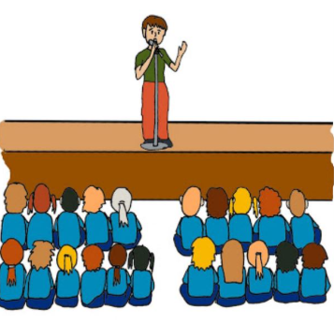
Attendance Assembly- 10:00 am

Slide 5
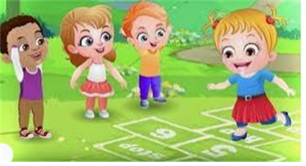
Break

Slide 6
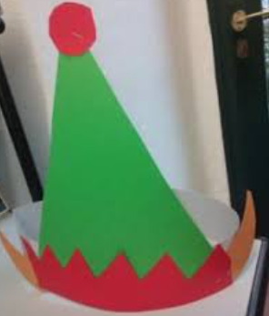
Christmas elf hat

Slide 7

Lunch

Slide 8
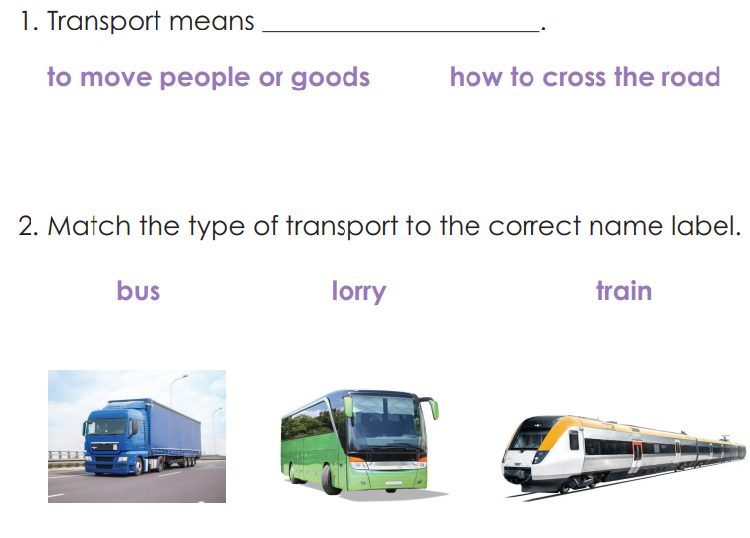
History- End of Unit assessment

Slide 9
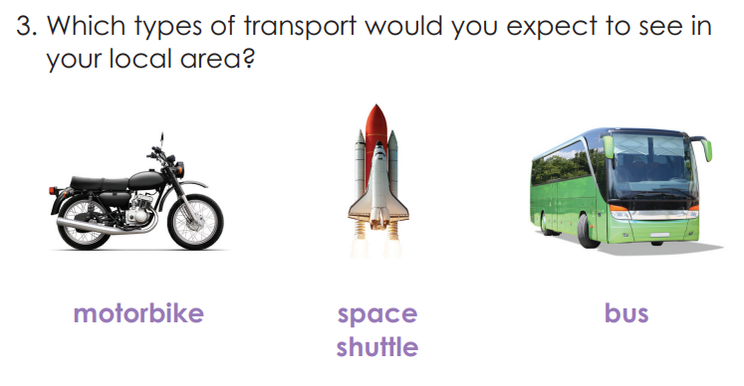

Slide 10
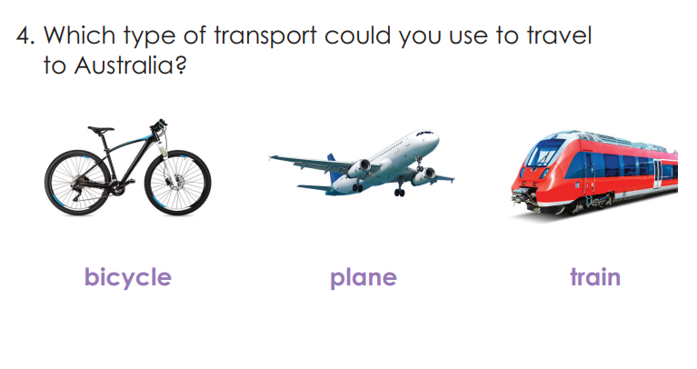

Slide 11
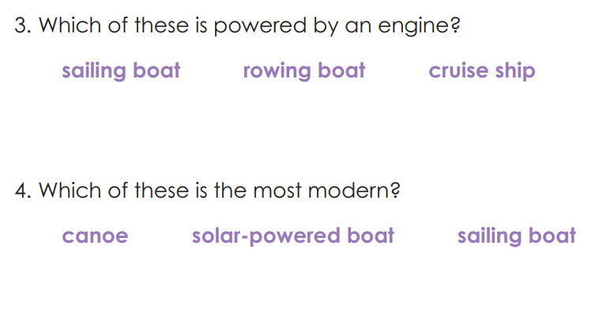

Slide 12
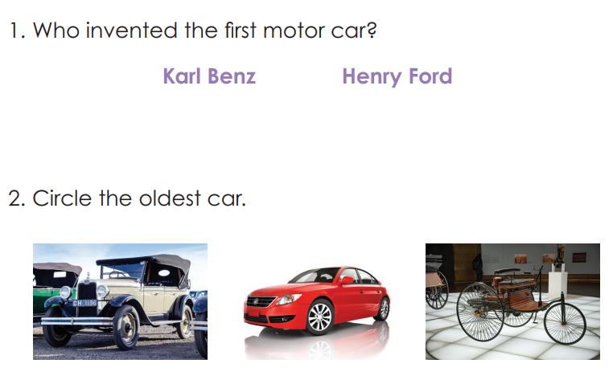

Slide 13
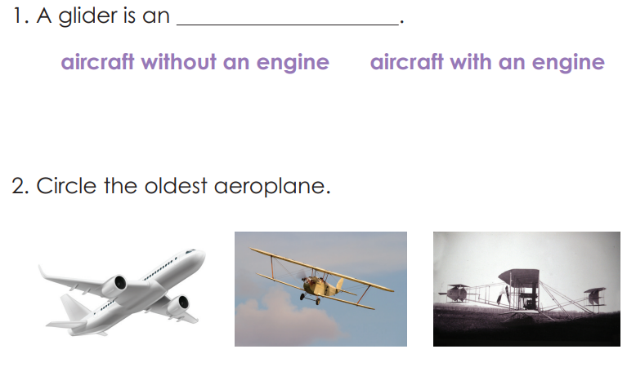

Slide 14
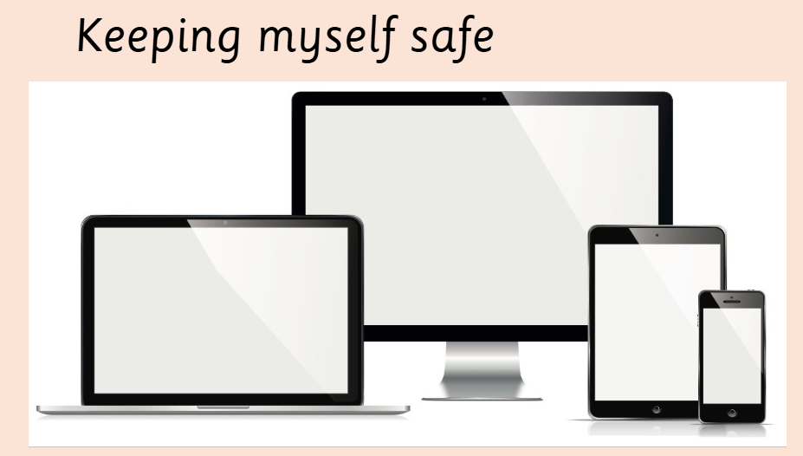
KQ: How can I keep myself safe online?
Wednesday 12th December 2025

Slide 15
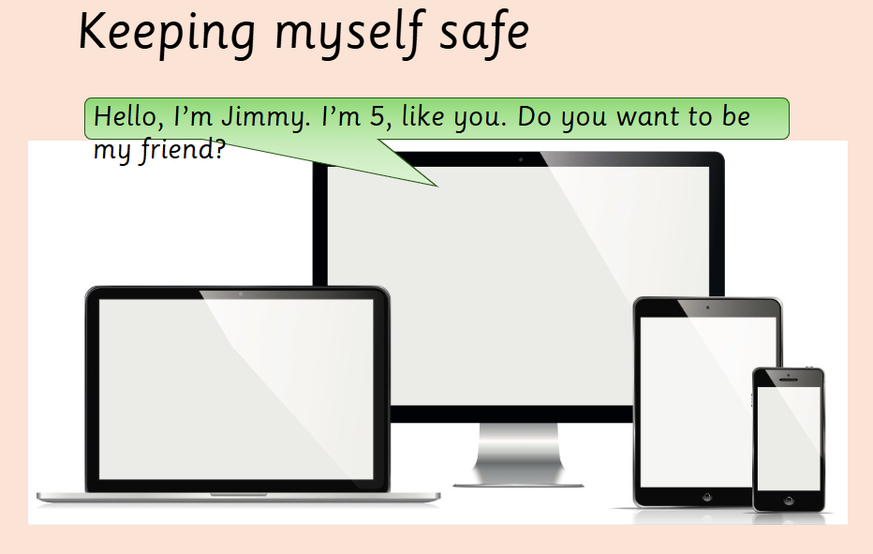
KQ: How can I keep myself safe online?
Wednesday 12th December 2025

Slide 16
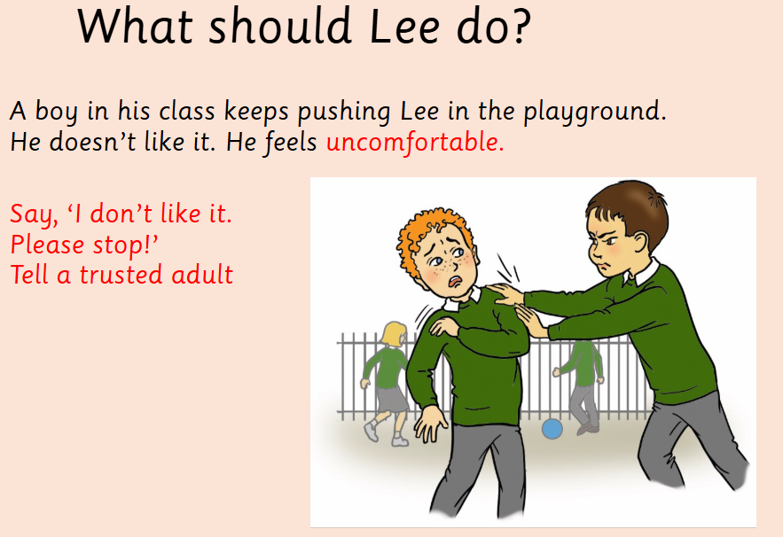
KQ: How can I keep myself safe online?
Wednesday 12th December 2025

Slide 17
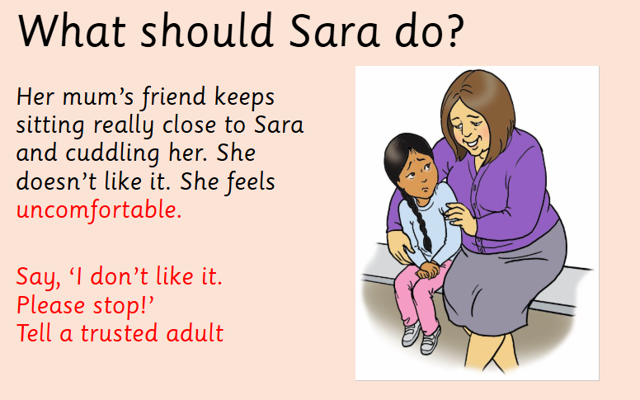
KQ: How can I keep myself safe online?
Wednesday 12th December 2025

Slide 18
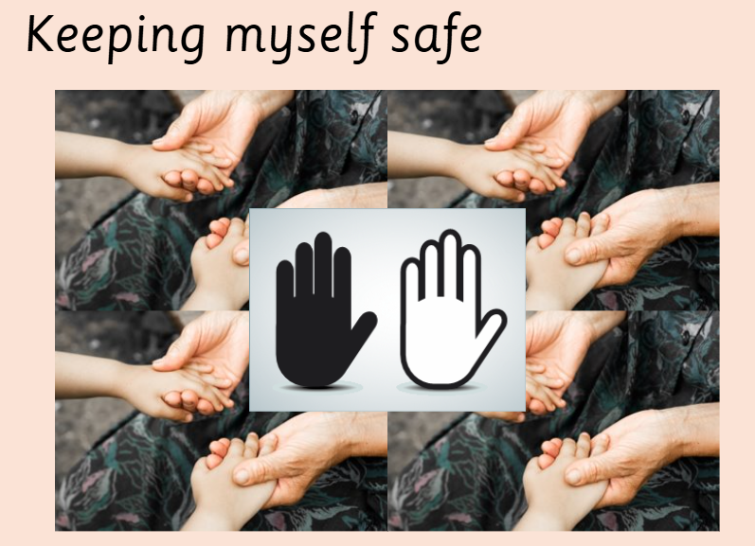
KQ: How can I keep myself safe online?
Wednesday 12th December 2025

Slide 19
Christmas cards

