Slide 1
Wednesday 10th December 2025

Slide 2


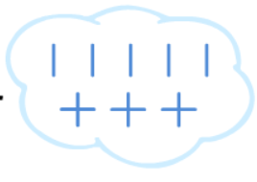

Morning Challenges:
Name writing
N O P Q R S T UV W X Y Z

Slide 3
TBAT: review phase 3 and phase 5 sounds
Wednesday 10th December 2025
Digital Flashcards - Teach Your Monster to Read

Slide 4
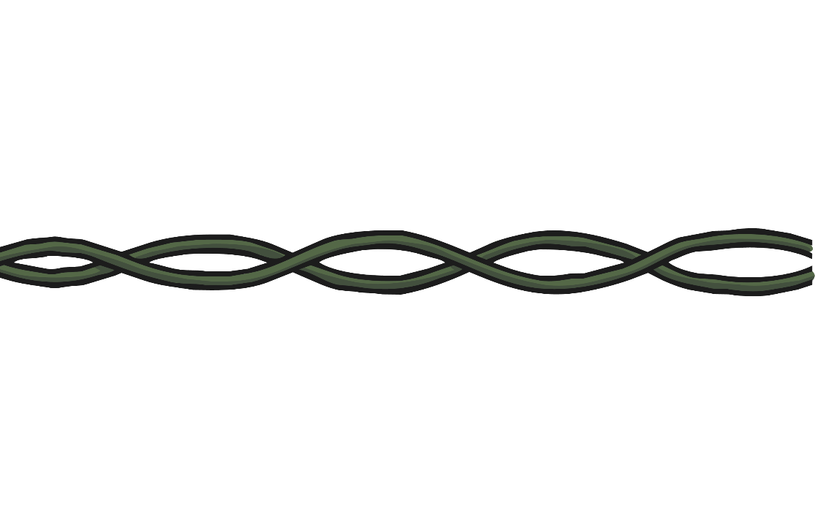






Switching on the Christmas Lights
TBAT: review phase 3 and phase 5 sounds
Wednesday 10th December 2025
he
that
will
see
you
for
When you have read each word, you can click the light to switch it on.
Click once for red or twice for green.

Slide 5
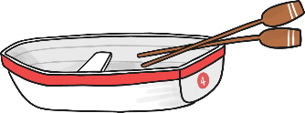



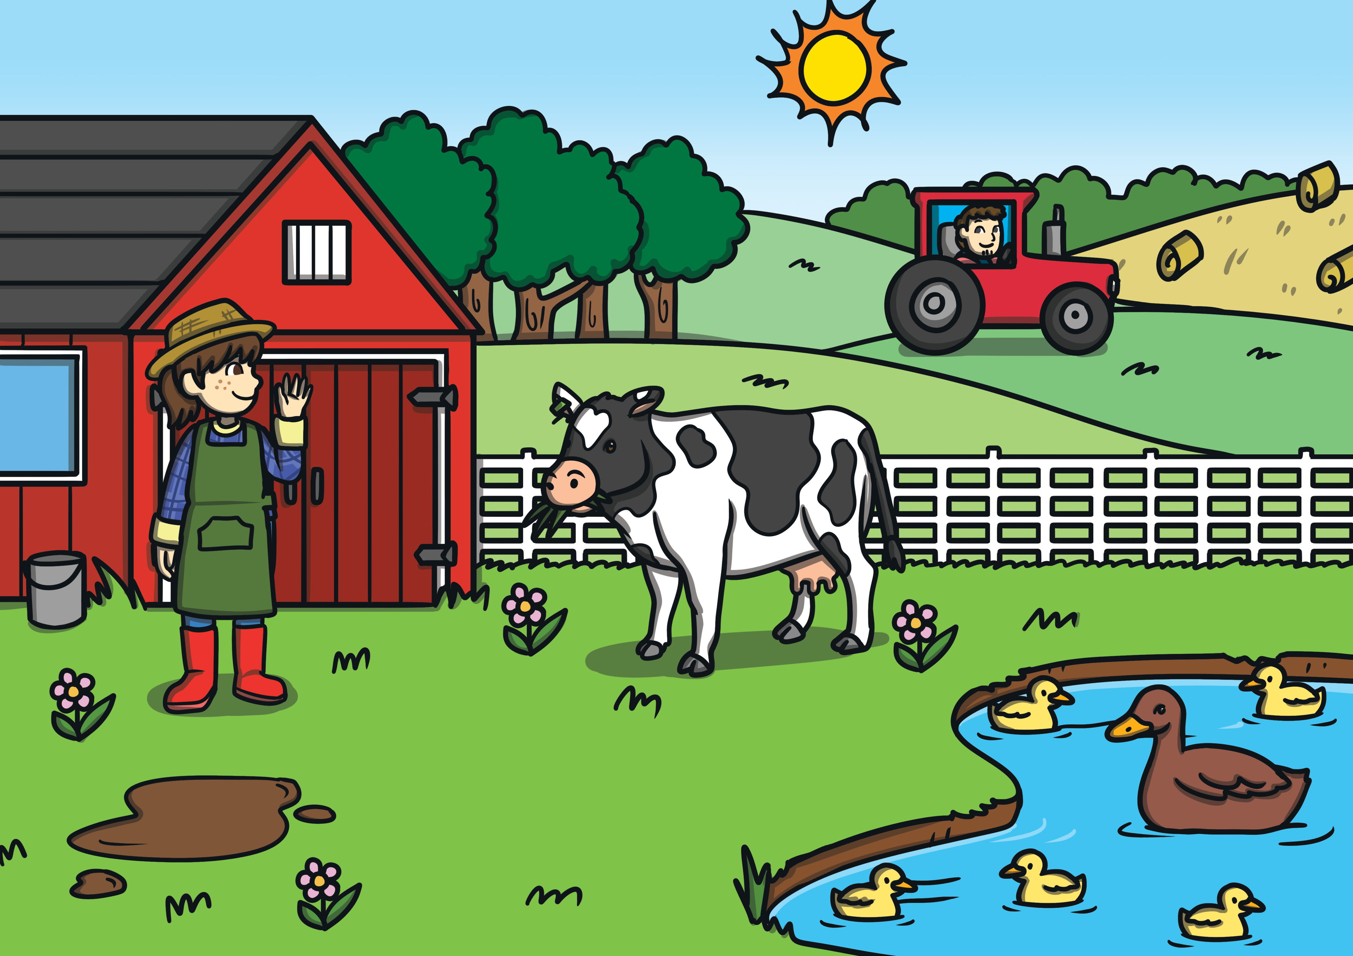

Elena’s Christmas List
TBAT: review phase 3 and phase 5 sounds
Wednesday 10th December 2025
Can you help Elena to write her Christmas list?
Dear Santa,
I would like a
b ____ t
b ____ k
c ____
ri ____
f ____ m
Lots of love from
Elena
oa
oo
ar
ng
Click here for answers
ar

Slide 6
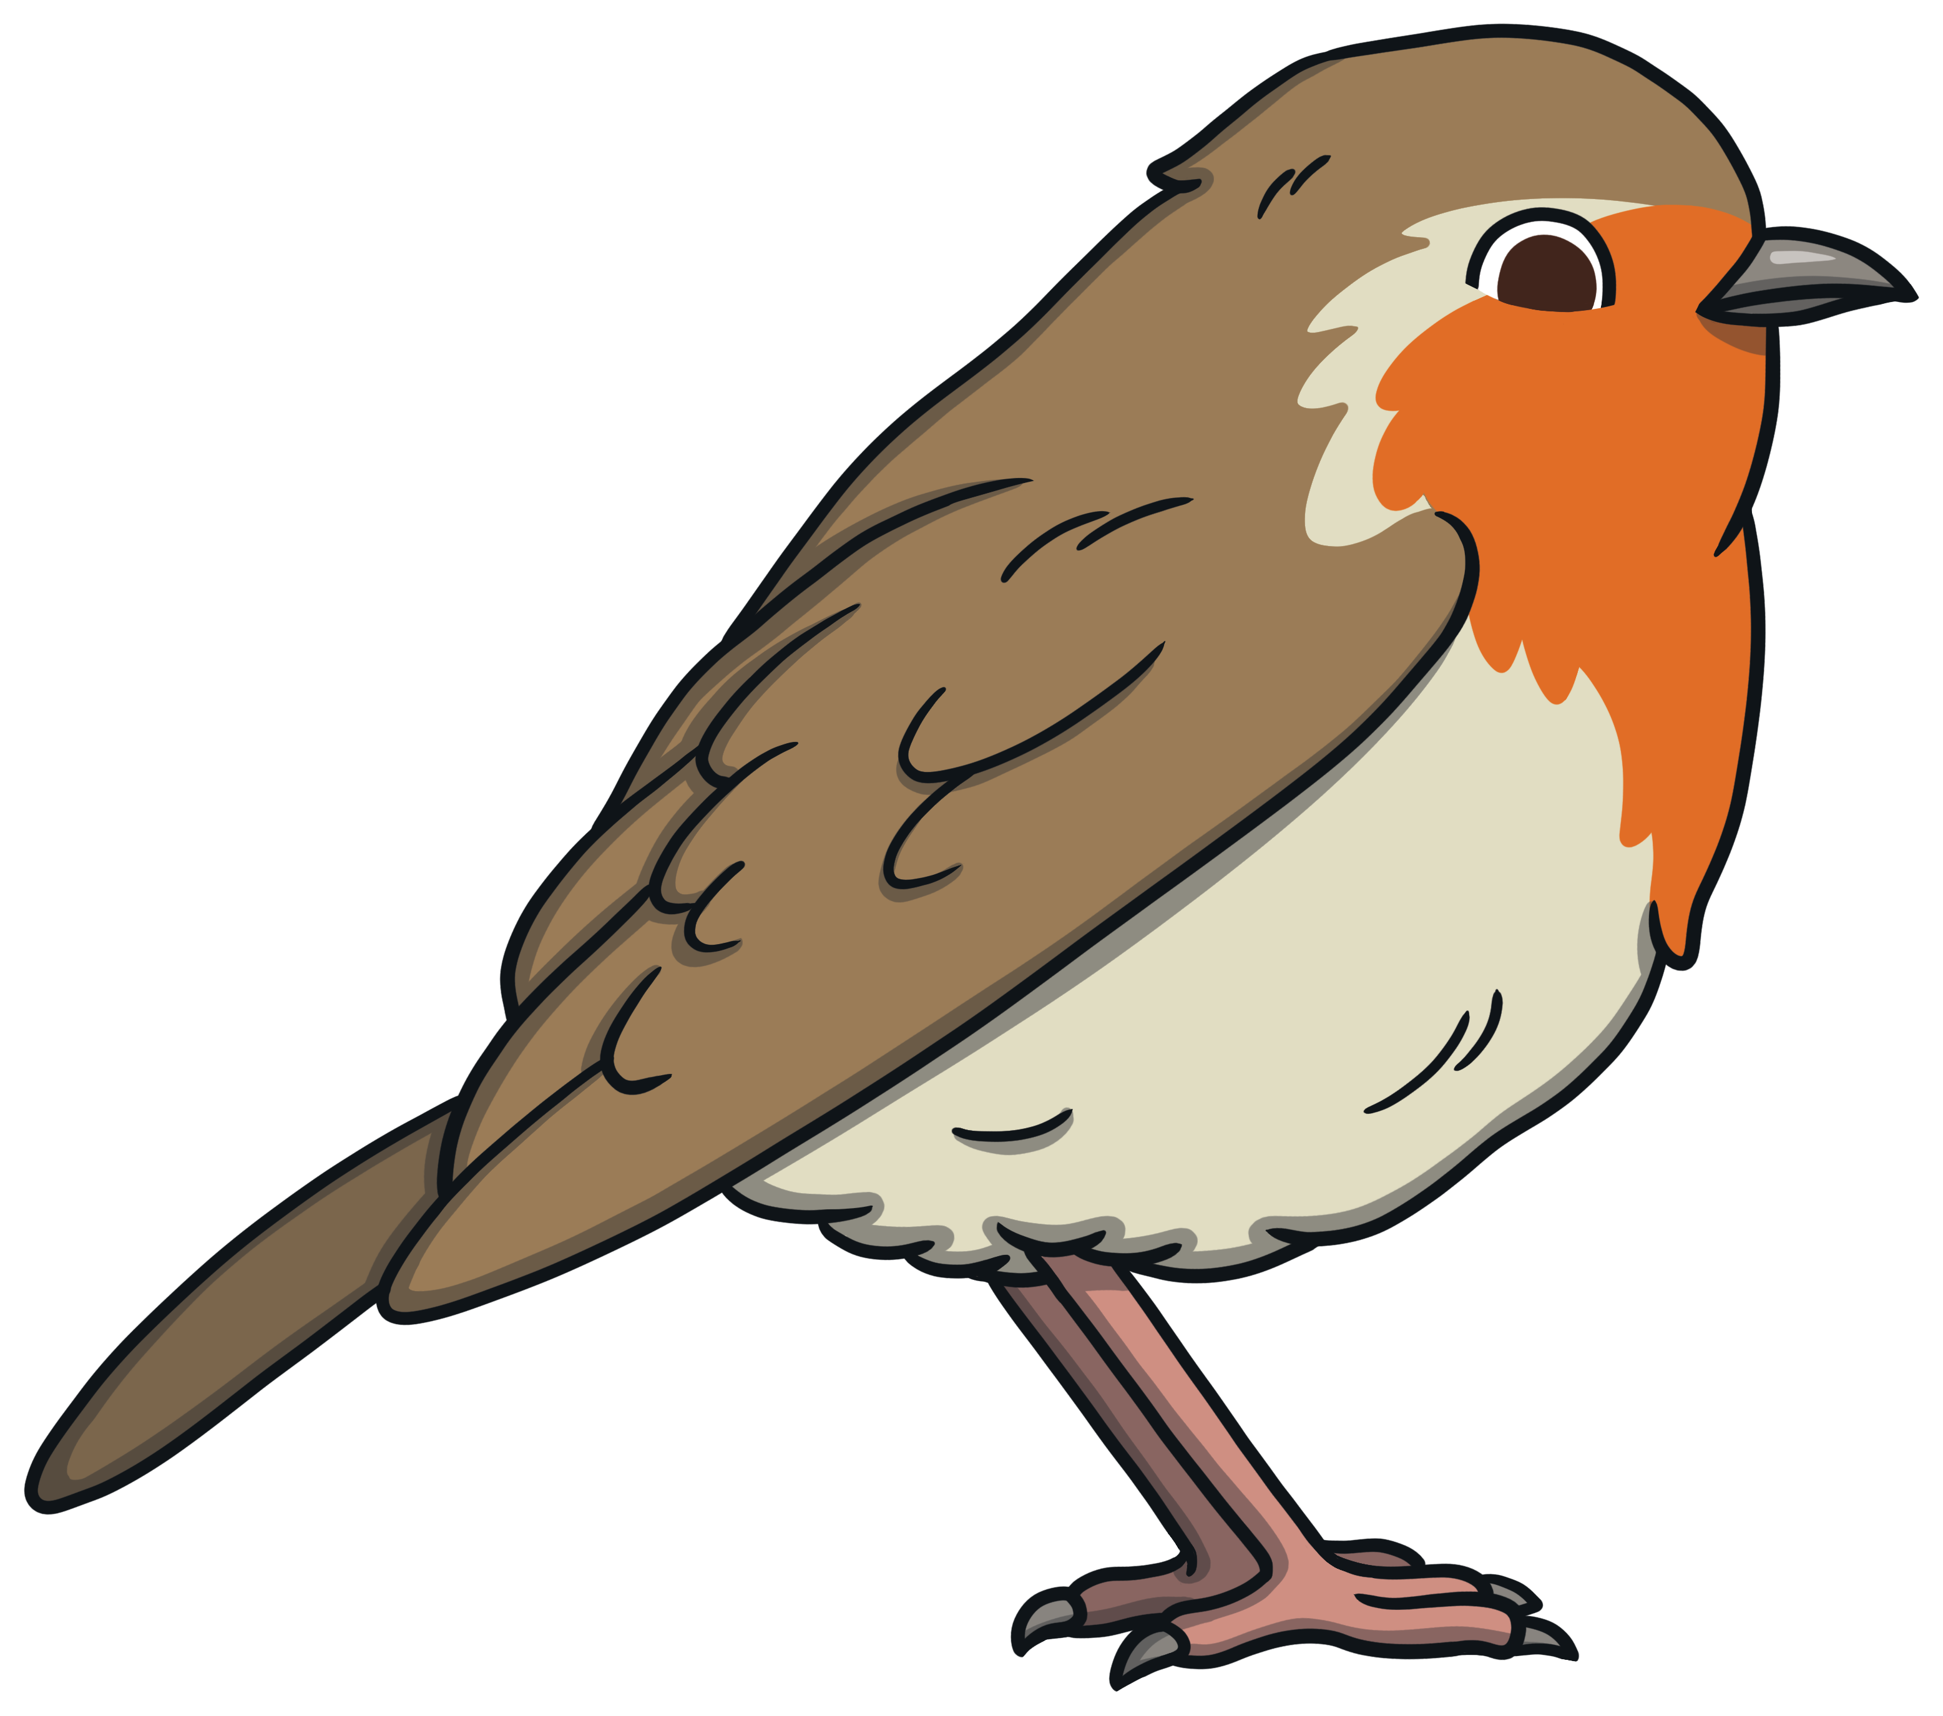
Phoneme Robins
TBAT: review phase 3 and phase 5 sounds
Wednesday 10th December 2025
Click on the pictures to make a word.
v
ow
v
n
c
h
n
ow
c
ow
h
ow

Slide 7
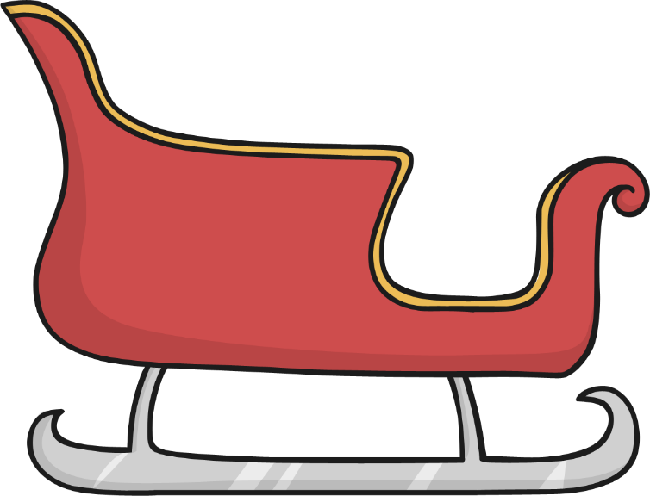
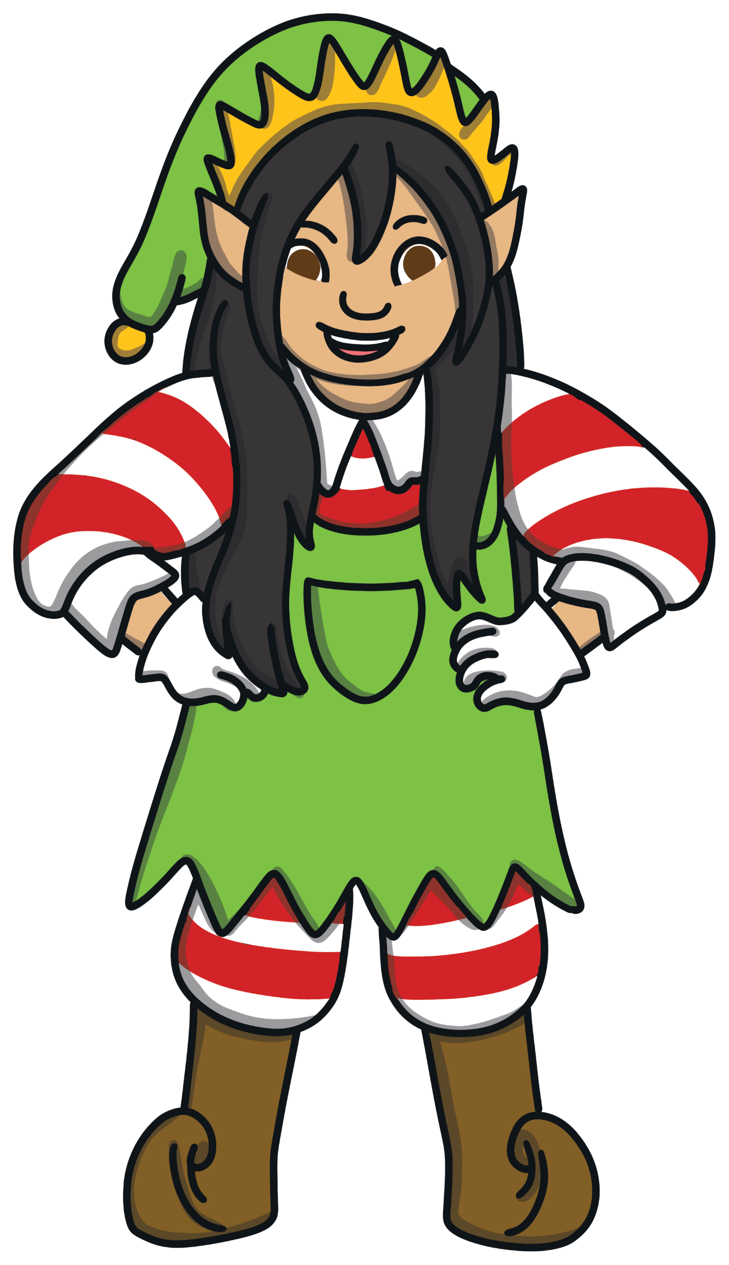







Load the Sleigh
TBAT: review phase 3 and phase 5 sounds
Wednesday 10th December 2025
Help Ella the Elf to load the sleigh.
Read a word, then click the gift to put it on the sleigh.
tight
pair
cork
year
soil
took
pure

Slide 8






A Mighty Mix-Up
TBAT: review phase 3 and phase 5 sounds
Wednesday 10th December 2025
Oh no! The elves have muddled up all of the presents and labels.
Can you help them to sort them out?
sheep
hammer
coat
rocket
jeep

Slide 9
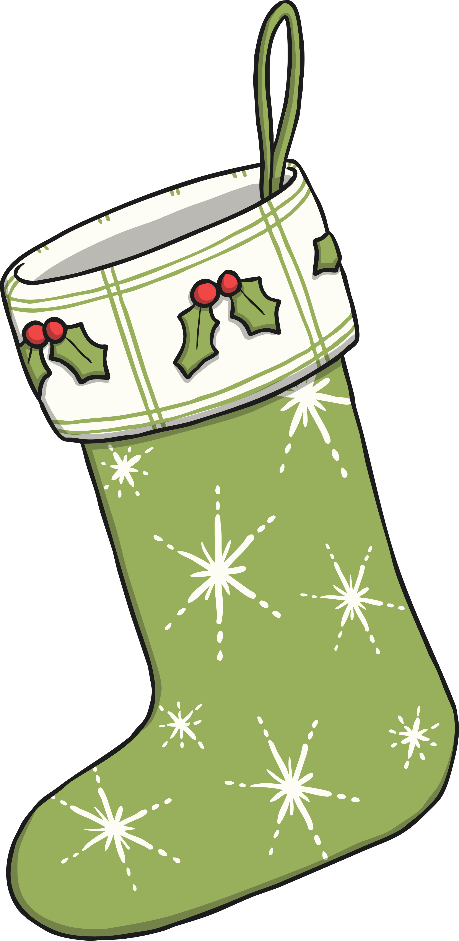

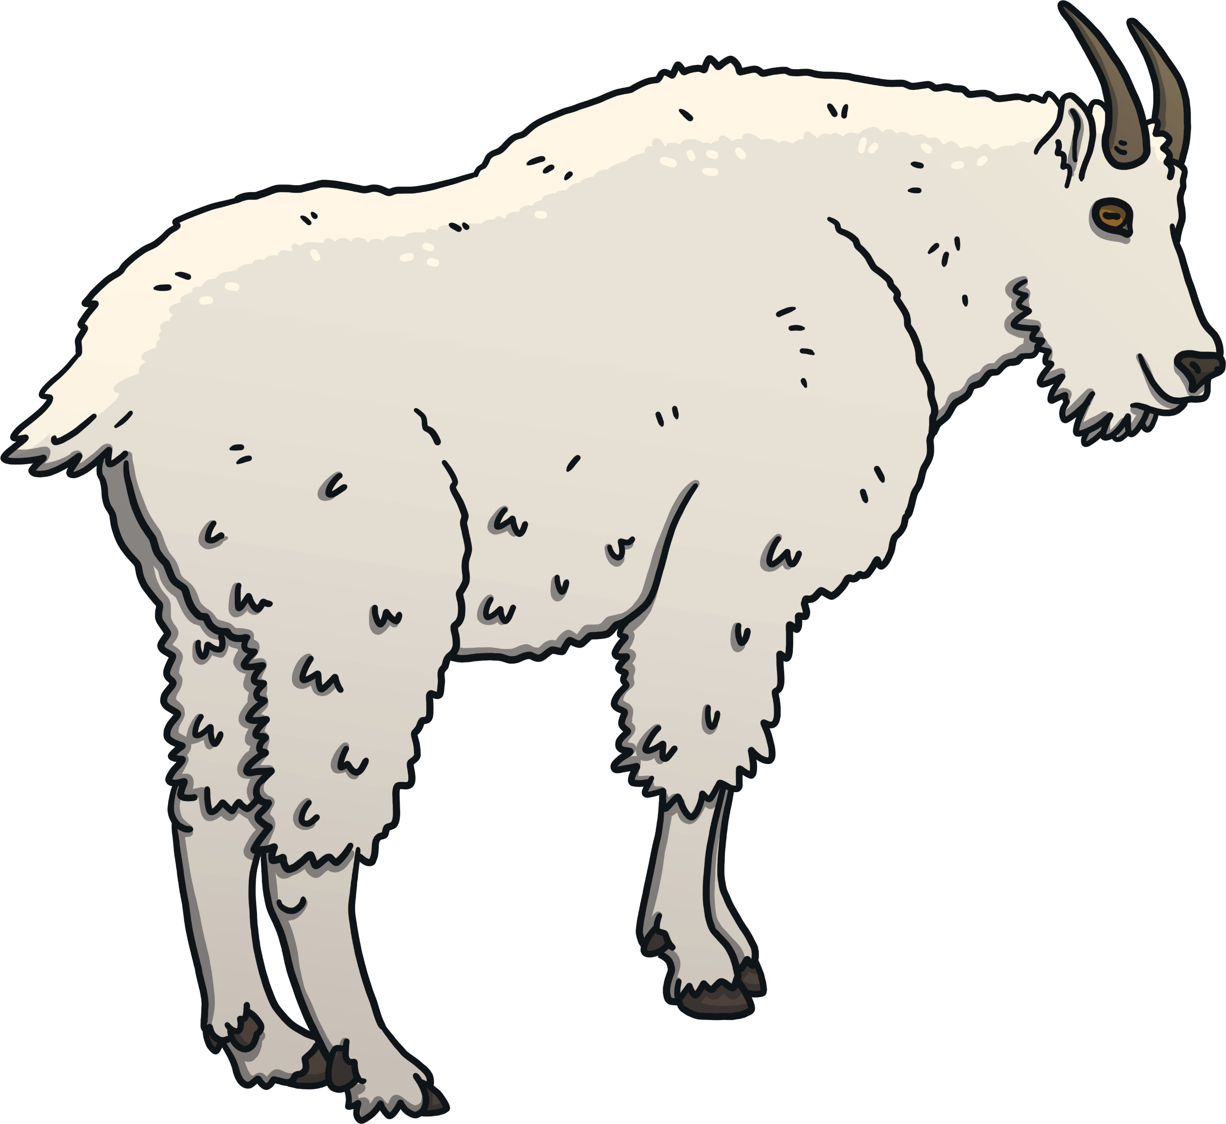
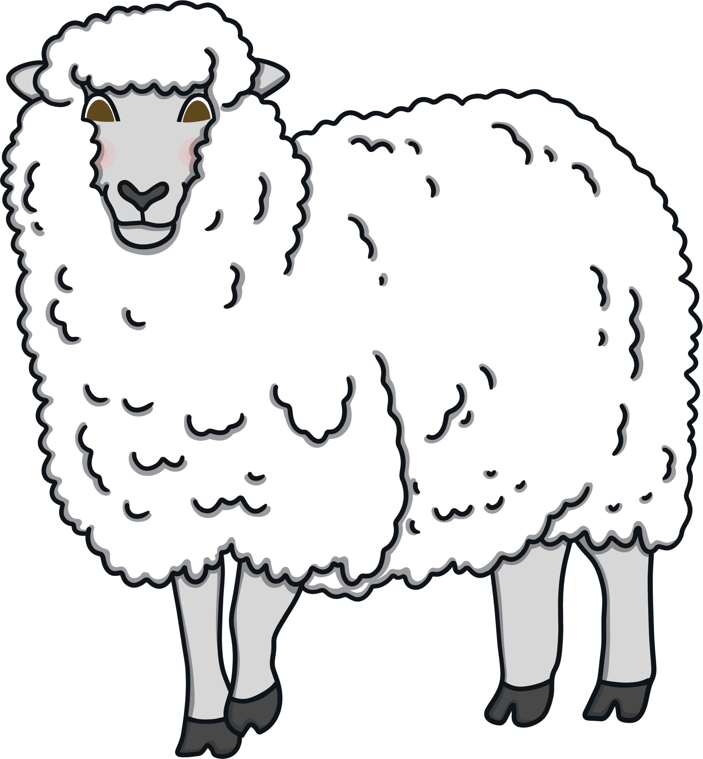



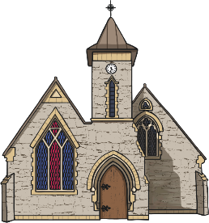

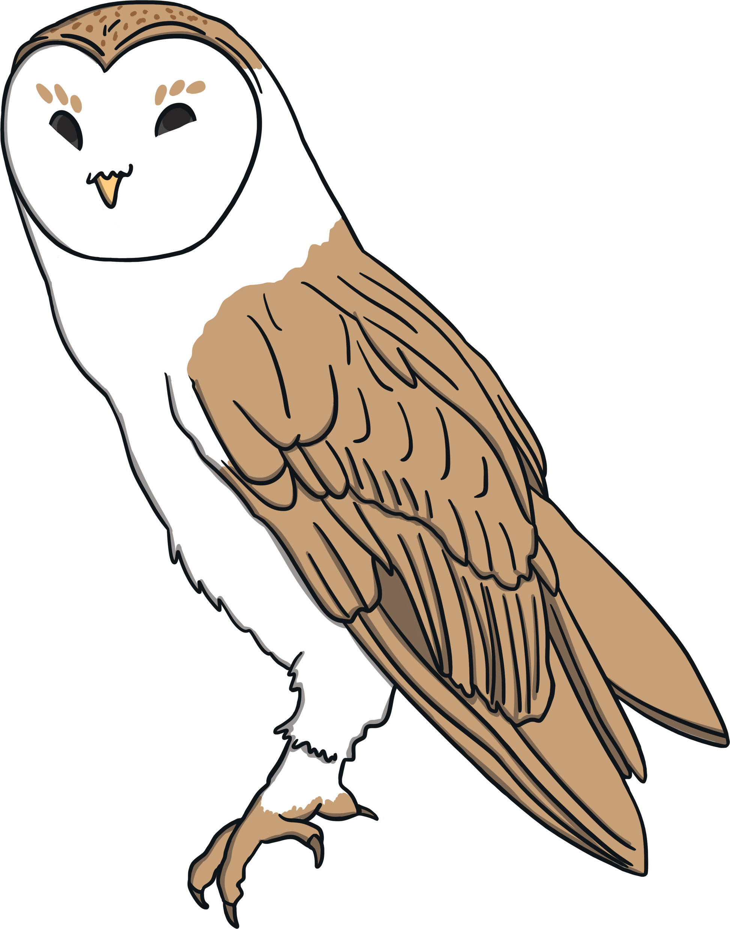
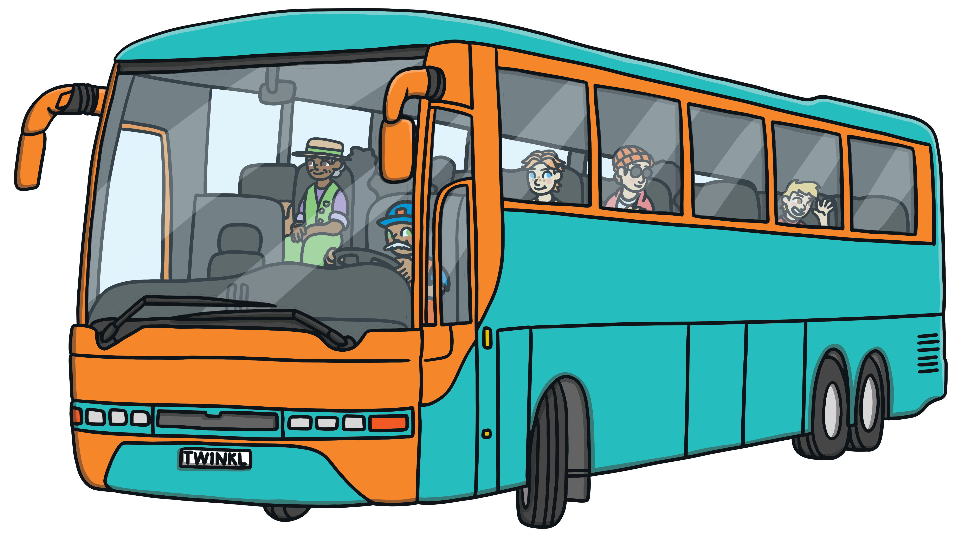
Which stocking?
TBAT: review phase 3 and phase 5 sounds
Wednesday 10th December 2025
Santa needs some help putting the presents into the correct stockings.
Listen carefully to the phonemes in the words, to help you find the correct present for each stocking.
Click the presents to check if you are right.
ar
oa
or
ur
ow
ee

Slide 10
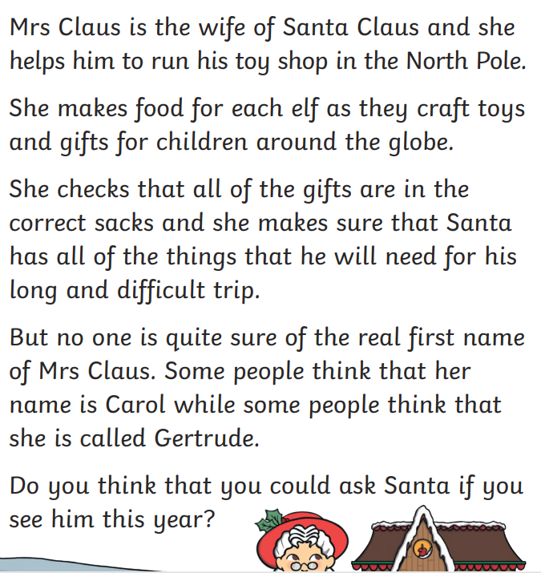
Wednesday 10th December 2025
TBAT: review phase 3 and phase 5 sounds
Can you find all of the split digraphs?

Slide 11
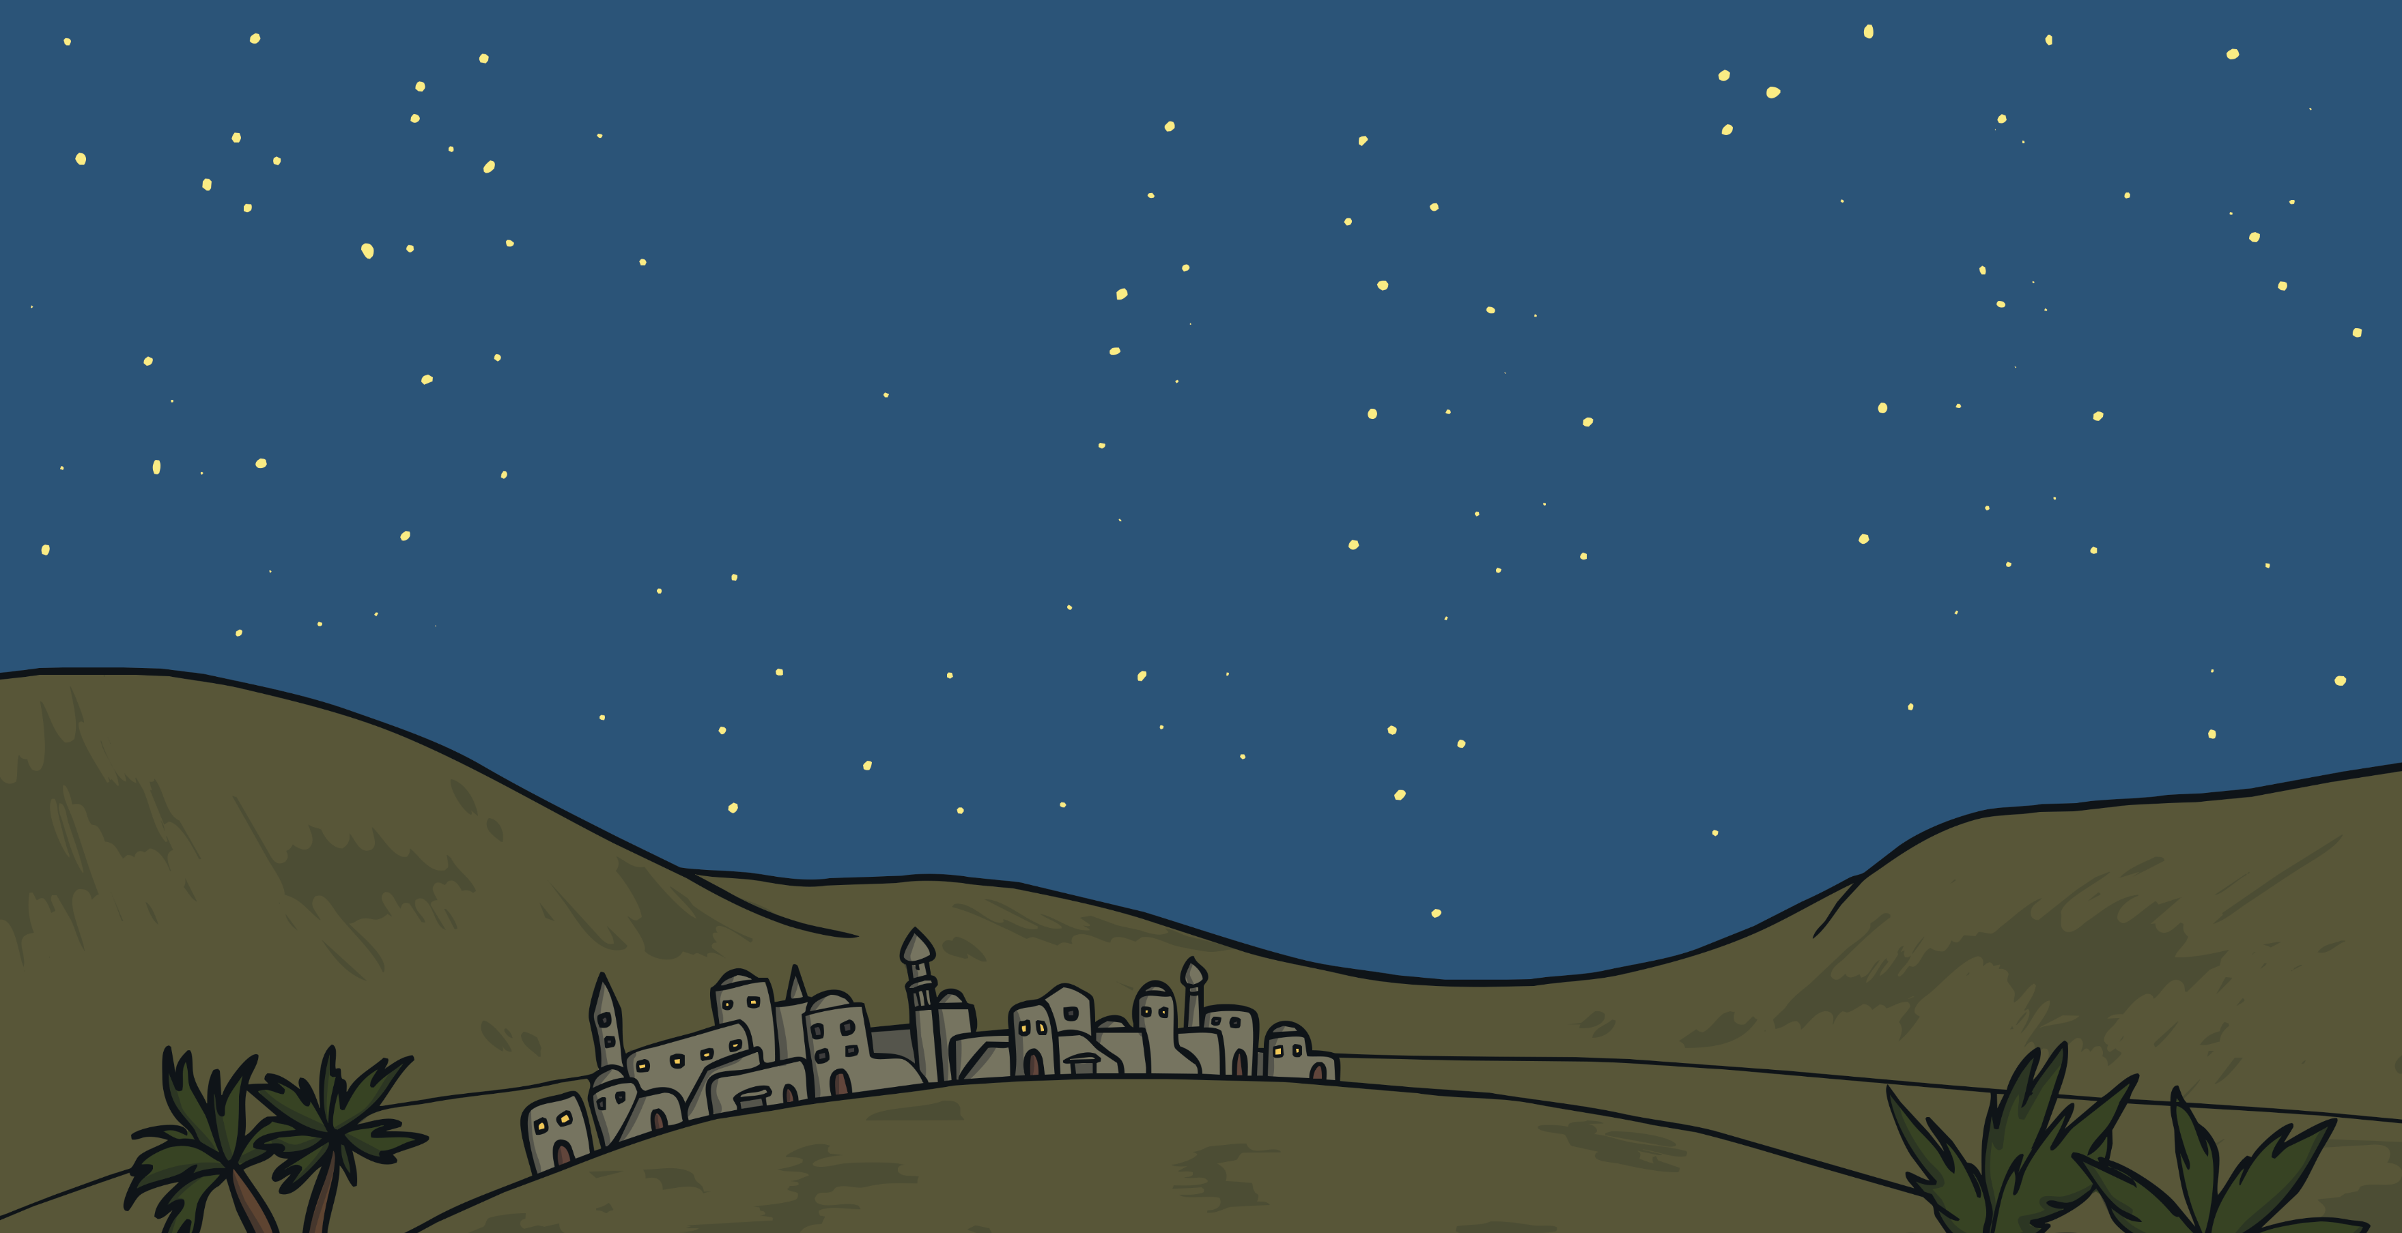

Follow the Star…
TBAT: review phase 3 and phase 5 sounds
Wednesday 10th December 2025
Can you use the phonemes in the star to make some words?
t
b
ar
c
j
f
Now choose a word and put it into a sentence. Write it on your white board.

Slide 12
TBAT: explore new vocabulary
Wednesday 10th December 2025
3 in 3
Who is St Nicholas another name for?
Which of these words mean quick?
rapid rose stirring
What flew into the sky like the down of a thistle?

Slide 13
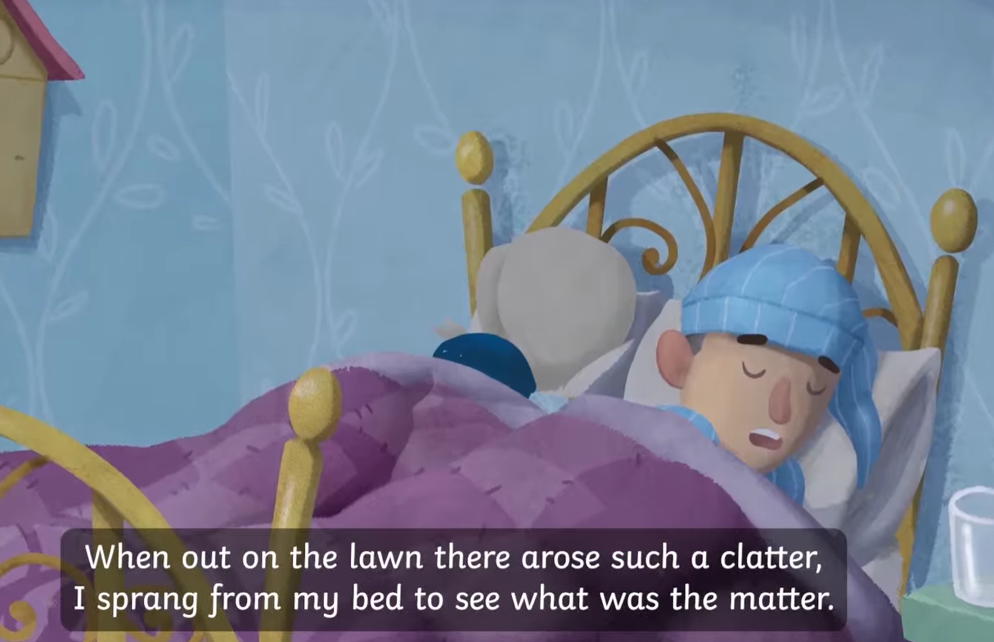
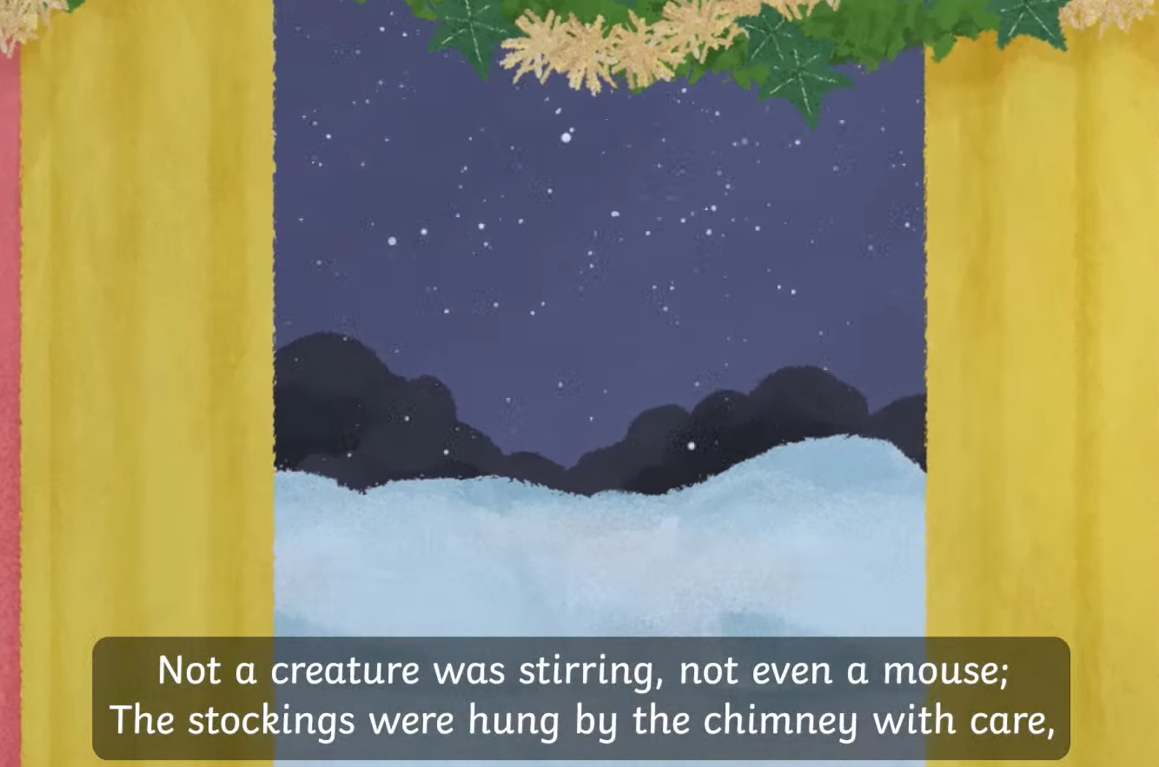
Blue / Green
TBAT: explore new vocabulary
Wednesday 10th December 2025
Put these sentences into your own words to explain what they mean. What is happening?

Slide 14
What word could replace clatter in this sentence?
TBAT: explore new vocabulary
Wednesday 10th December 2025

Slide 15
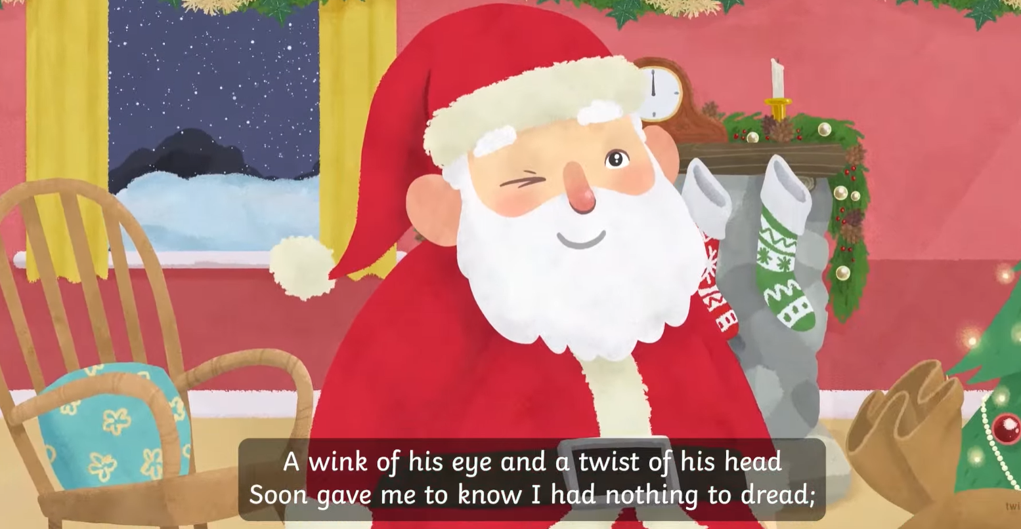
Dread: to worry about or dislike something
TBAT: explore new vocabulary
Wednesday 10th December 2025
Put this into your own words. What does ‘soon gave me to know I had nothing to dread’ mean?

Slide 16

What do you dread doing?
What do you really not look forward to or worry about?

Slide 17
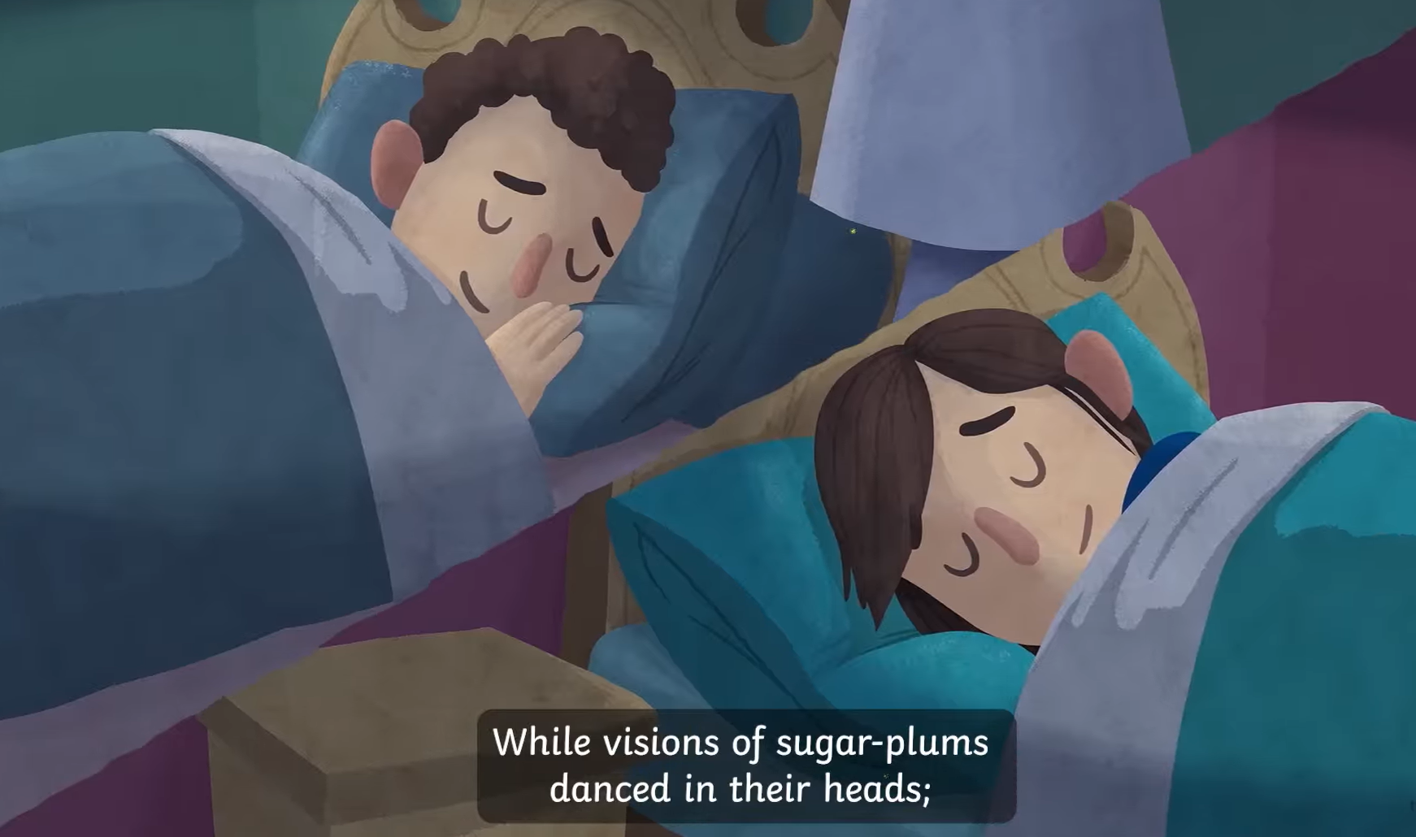
Visions – seeing something
Sugar plums – a type of sweet
TBAT: explore new vocabulary
Wednesday 10th December 2025
What could this mean?

Slide 18
What word could replace ‘visions’ in this sentence?
TBAT: explore new vocabulary
Wednesday 10th December 2025

Slide 19
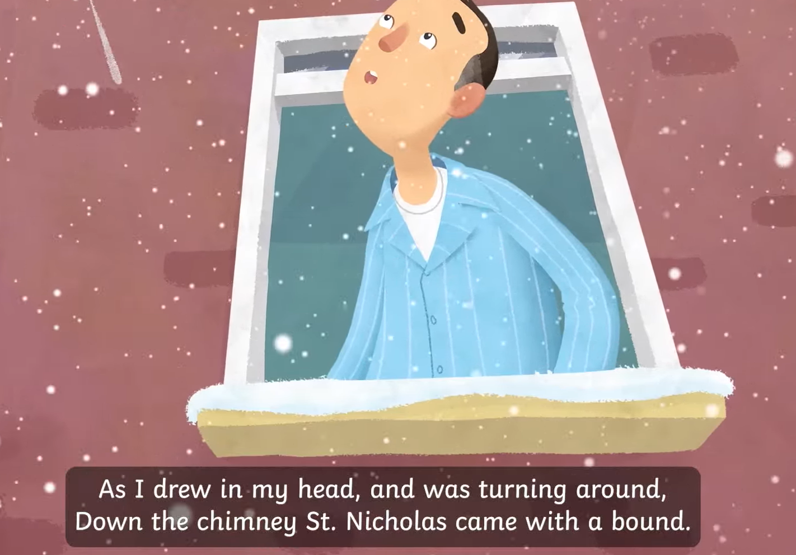
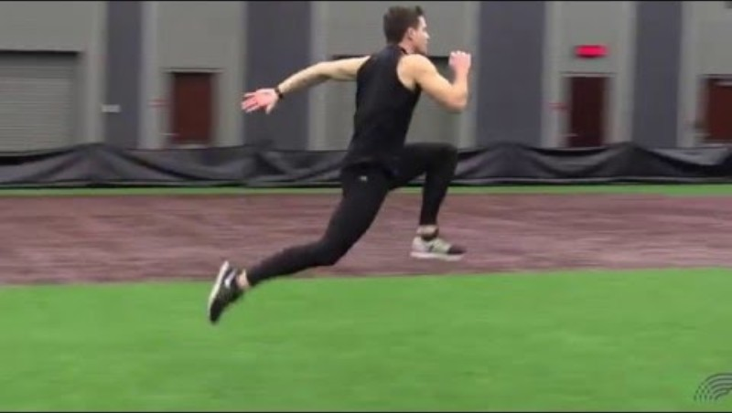
Bound – jump or hop as you run
TBAT: explore new vocabulary
Wednesday 10th December 2025
What word could replace bound in this sentence?

Slide 20
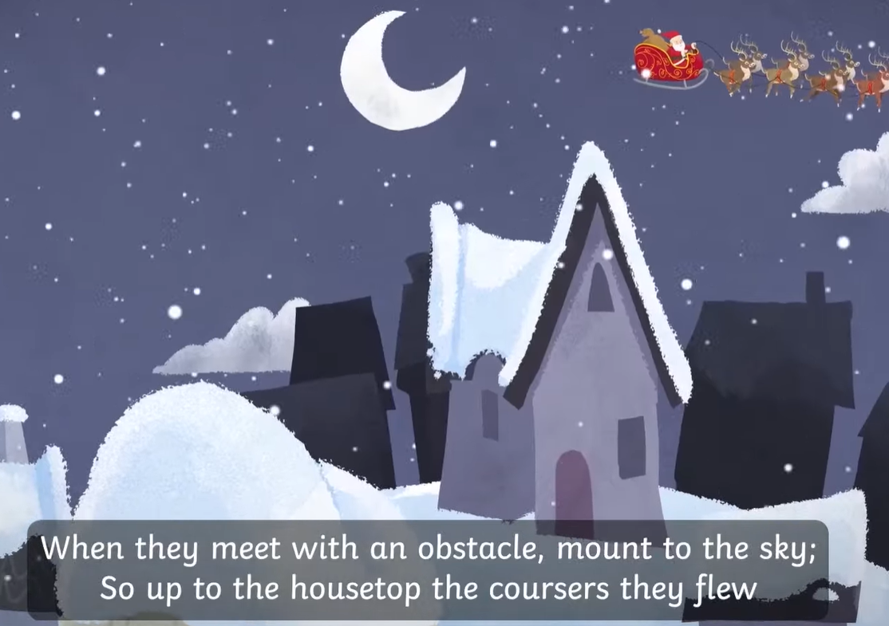

Obstacle: something in the way
TBAT: explore new vocabulary
Wednesday 10th December 2025

Slide 21
What does clatter mean?
TBAT: explore new vocabulary
Wednesday 10th December 2025
A type of cup
A load noise
clapping

Slide 22
Which sentence uses dread correctly?
TBAT: explore new vocabulary
Wednesday 10th December 2025
I dread enjoying myself at the park.
I thought about going into the haunted house and I was filled with dread.
I like jam on my dread.

Slide 23
What is an obstacle?
TBAT: explore new vocabulary
Wednesday 10th December 2025
A) An ice lolly
B) Something nearby
C) Something in the way

Slide 24
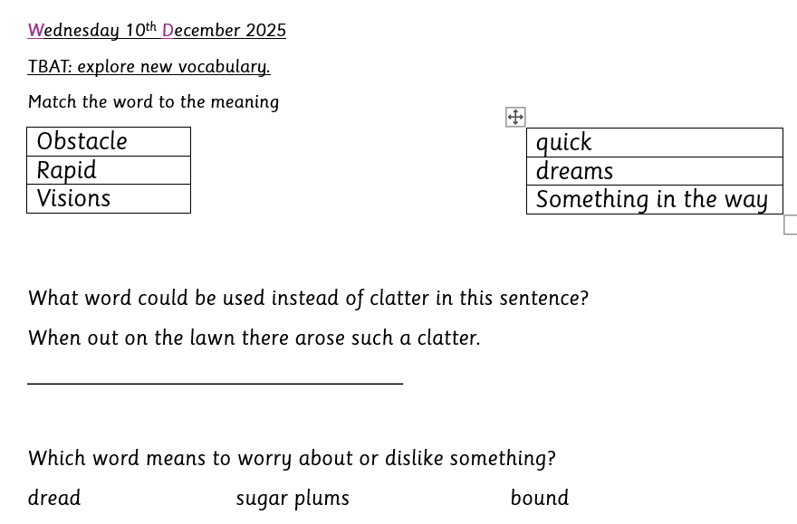
Challenge:
Use the word clatter in a sentence. What could make a clatter?

Slide 25
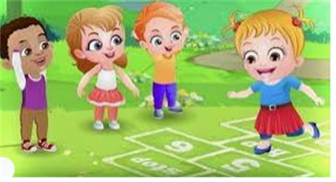
Break

Slide 26
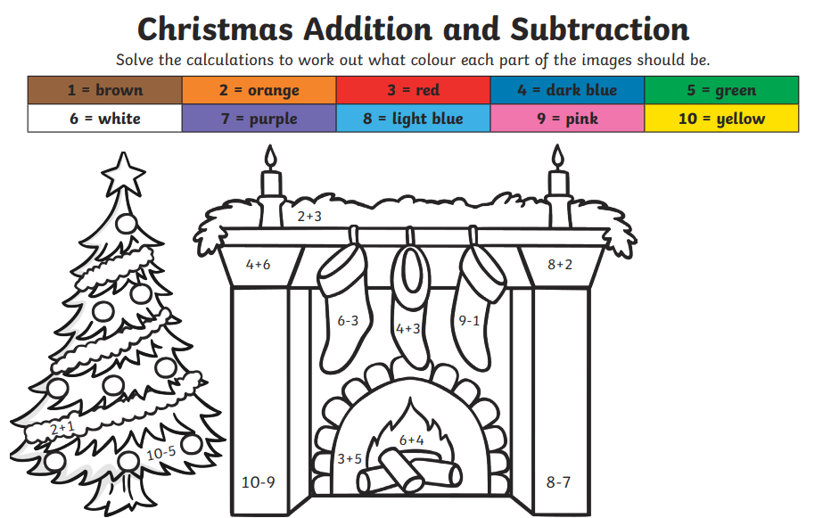
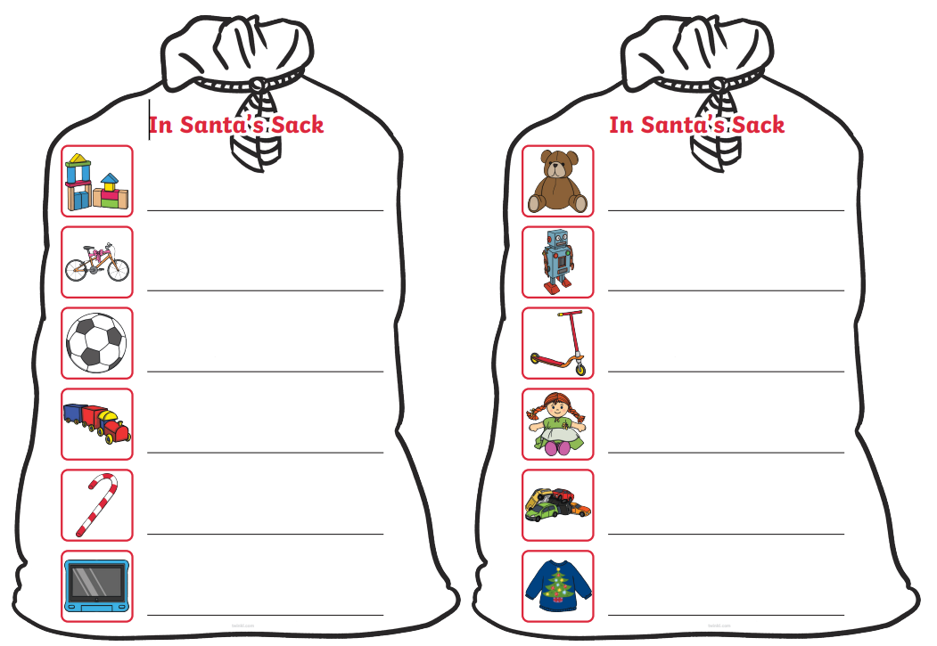
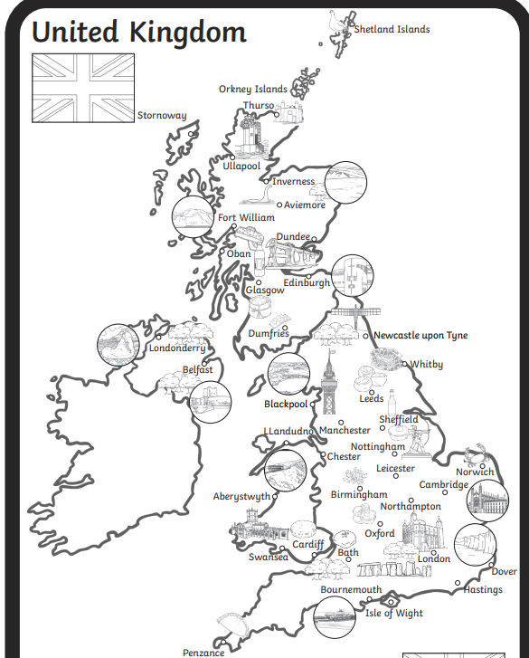
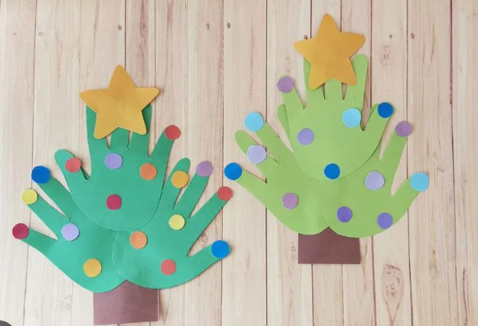
Independent Challenges:
Narrative Zone
Maths Zone
Write the items that are in Father Christmas’ sack
Addition and subtraction colour by numbers
Enquiry Zone
Creative Zone
Make a handprint tree.
Draw a route for Father Christmas to take around the UK.
Where might he start and end?

Slide 27

Lunch

Slide 28
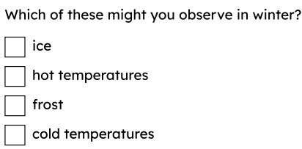
KQ: What happens to day length in Winter?
Wednesday 10th December 2025
Entry Question:

Slide 29
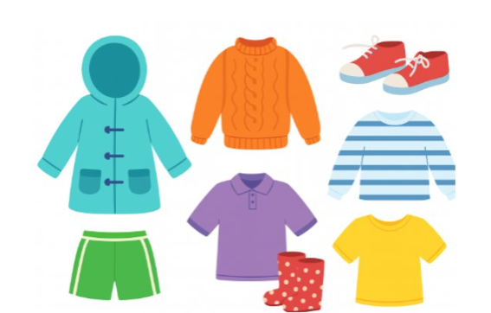
KQ: What happens to day length in Winter?
Wednesday 10th December 2025
3 in 3: Pick three types of clothes you would wear in Winter.

Slide 30
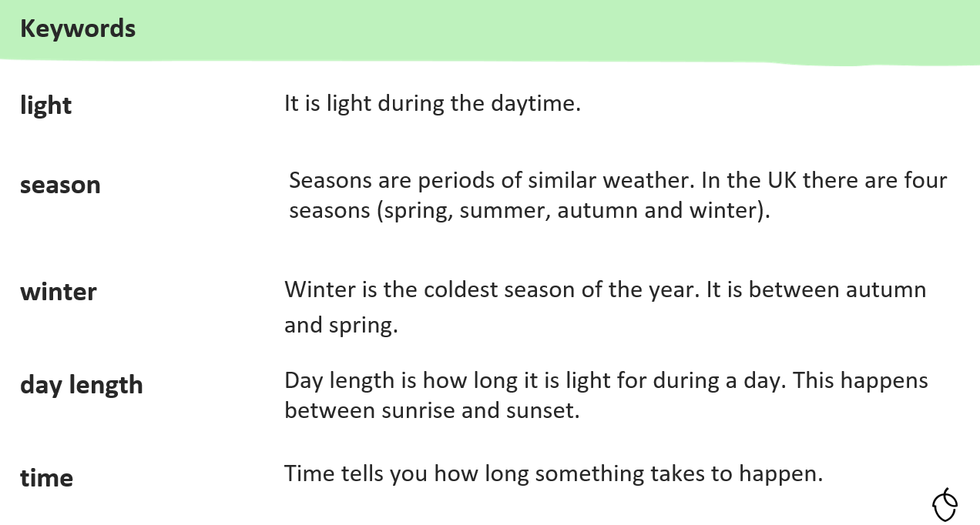
KQ: What happens to day length in Winter?
Wednesday 10th December 2025

Slide 31
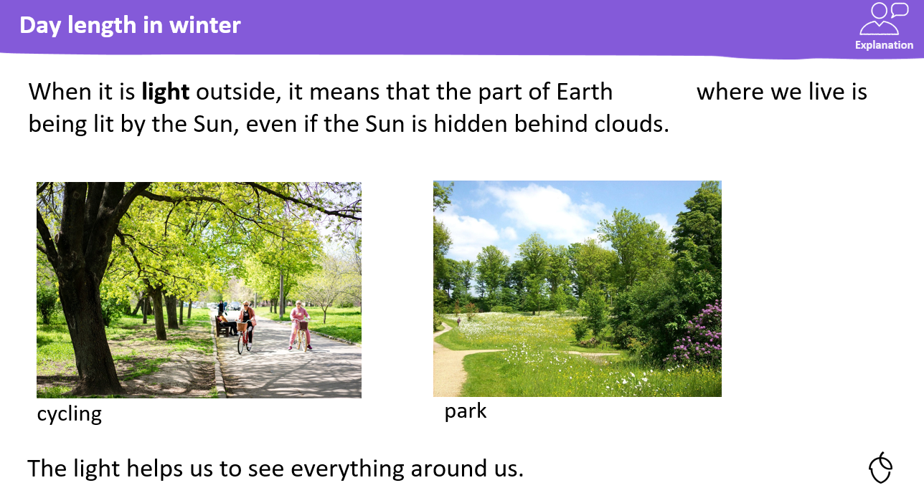
KQ: What happens to day length in Winter?
Wednesday 10th December 2025

Slide 32
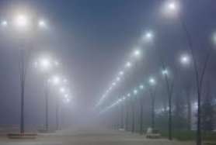

KQ: What happens to day length in Winter?
Wednesday 10th December 2025
Blue/ Green- What time of day do you think it is in this picture?
evening
night
morning
dark
I think it is …....... I think this because...........

Slide 33
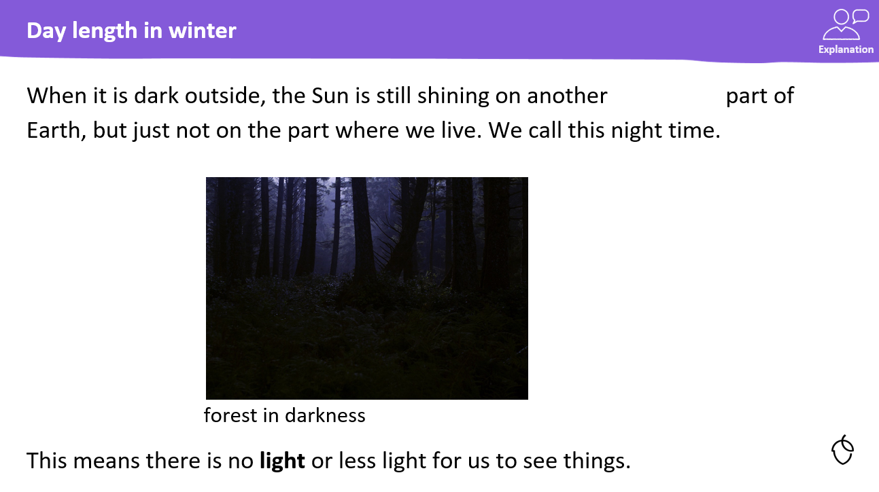
KQ: What happens to day length in Winter?
Wednesday 10th December 2025

Slide 34
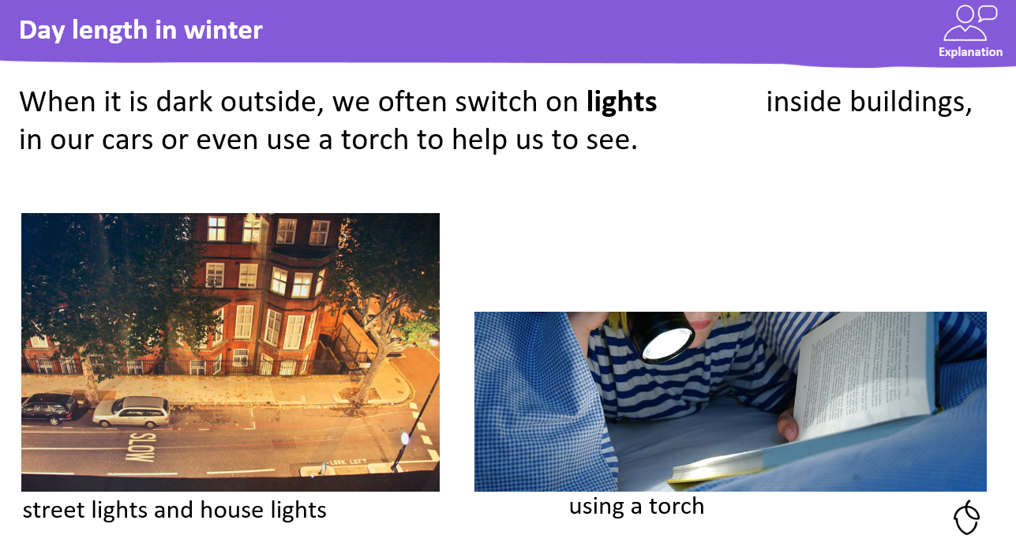
KQ: What happens to day length in Winter?
Wednesday 10th December 2025

Slide 35
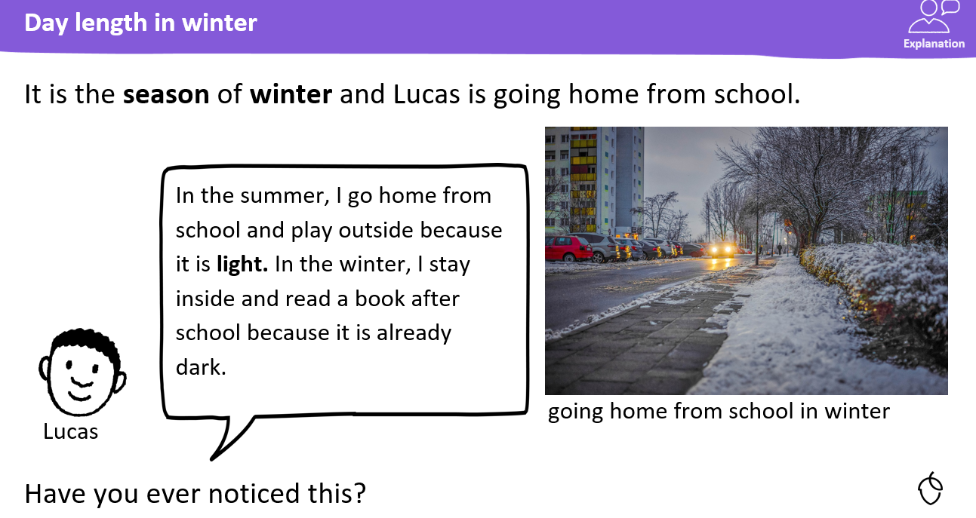
KQ: What happens to day length in Winter?
Wednesday 10th December 2025

Slide 36
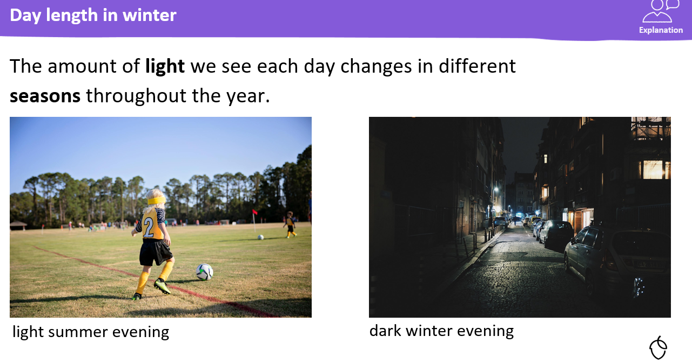
KQ: What happens to day length in Winter?
Wednesday 10th December 2025

Slide 37
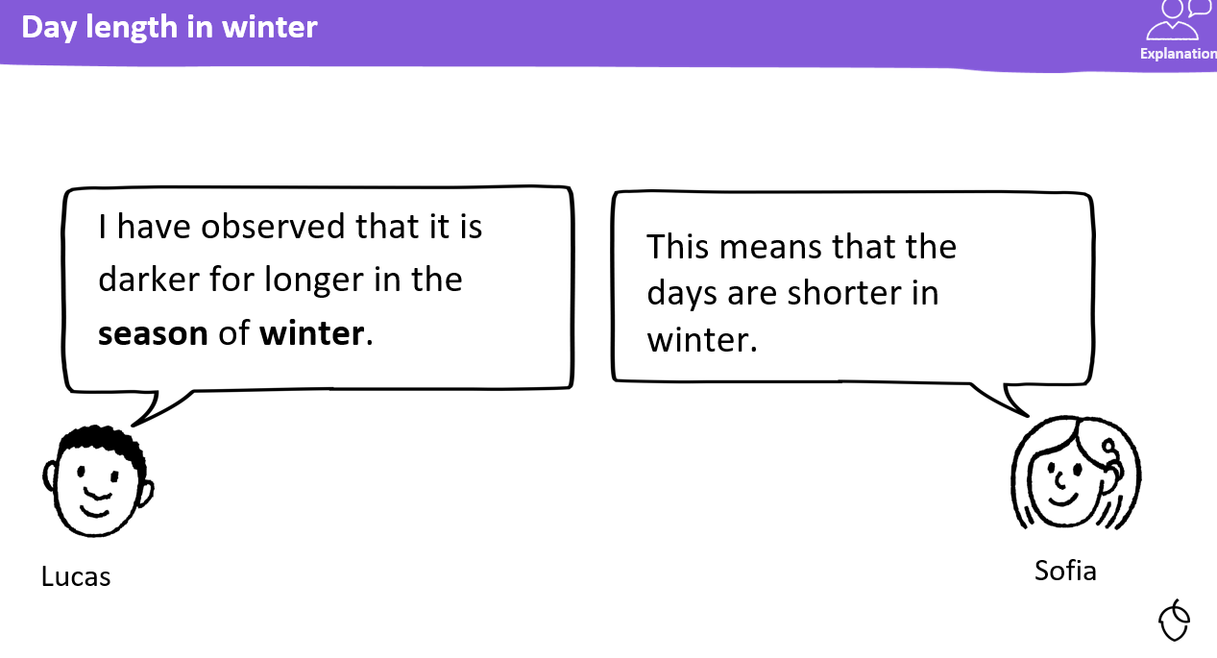
KQ: What happens to day length in Winter?
Wednesday 10th December 2025

Slide 38
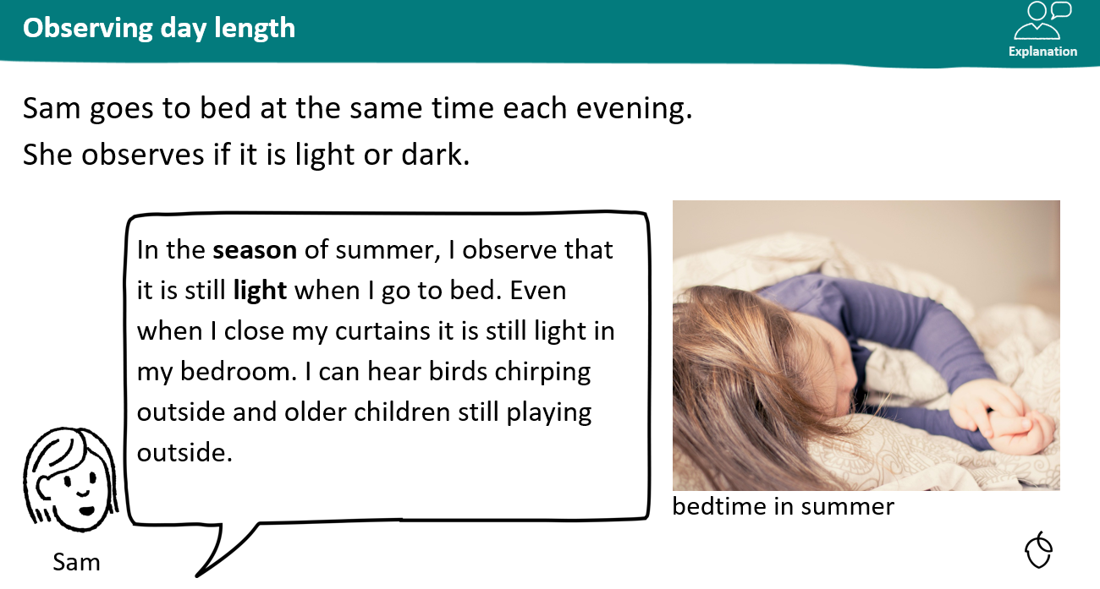
KQ: What happens to day length in Winter?
Wednesday 10th December 2025

Slide 39
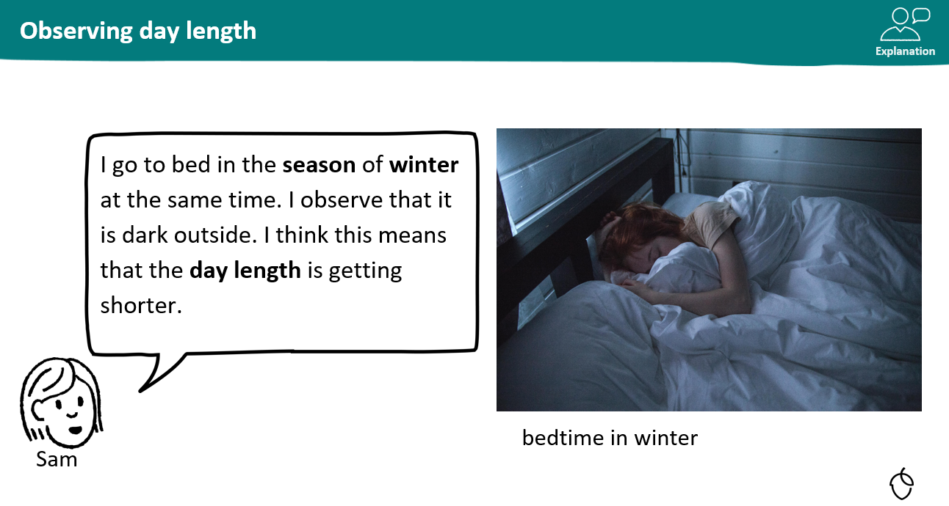
KQ: What happens to day length in Winter?
Wednesday 10th December 2025

Slide 40
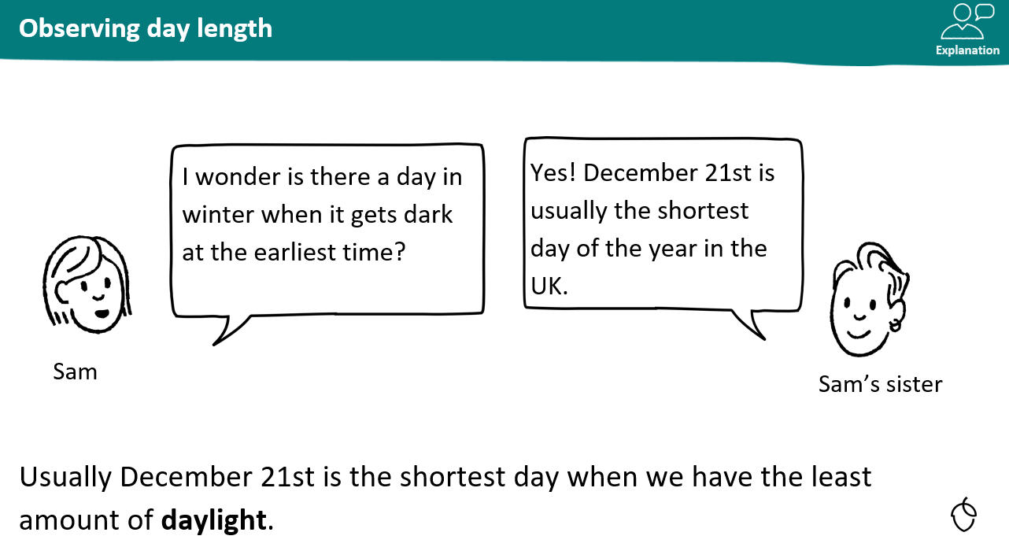
KQ: What happens to day length in Winter?
Wednesday 10th December 2025

Slide 41
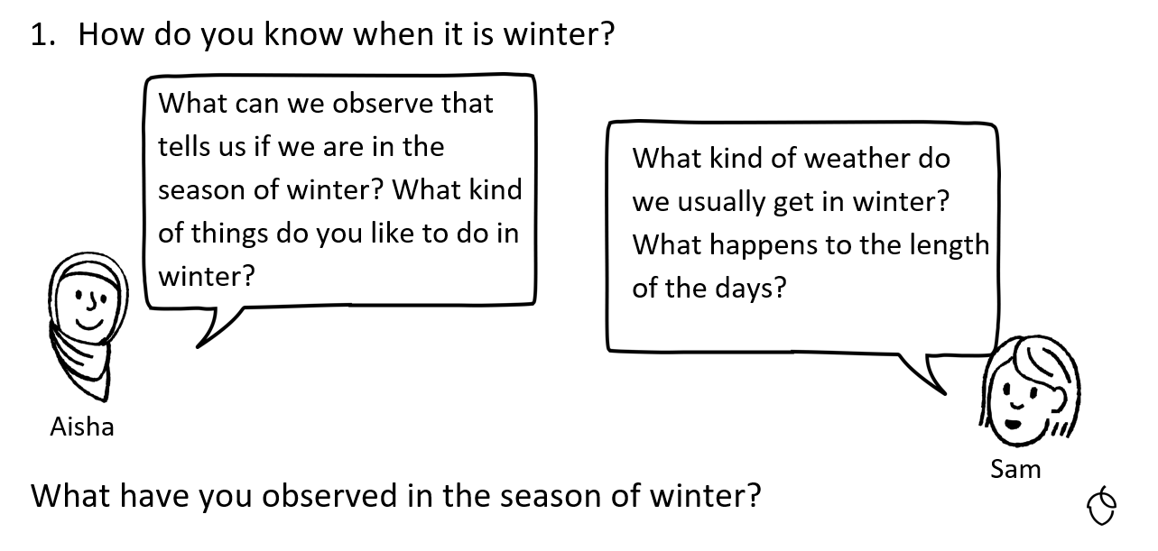
KQ: What happens to day length in Winter?
Wednesday 10th December 2025

Slide 42
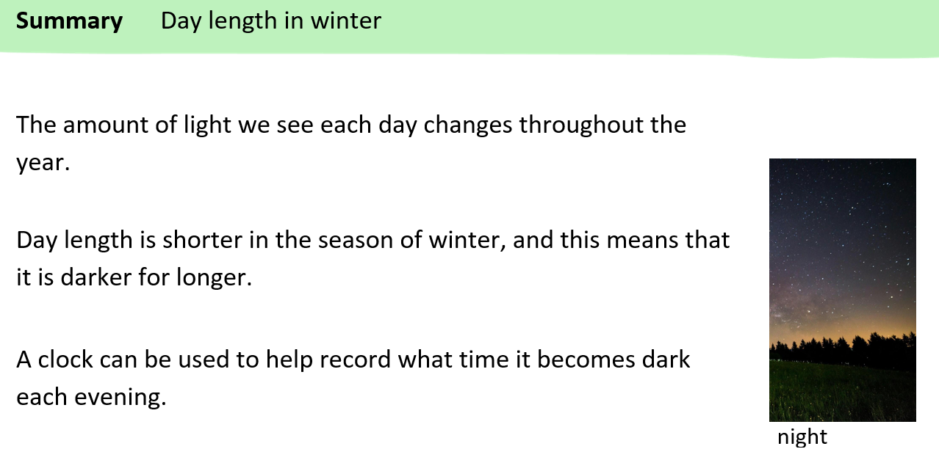
KQ: What happens to day length in Winter?
Wednesday 10th December 2025

Slide 43
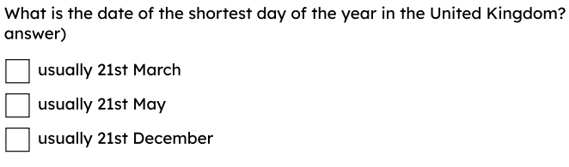
KQ: What happens to day length in Winter?
Wednesday 10th December 2025
Exit Question:

Slide 44
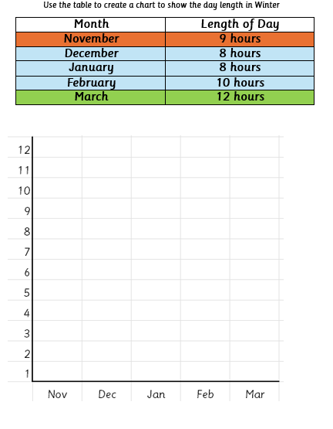
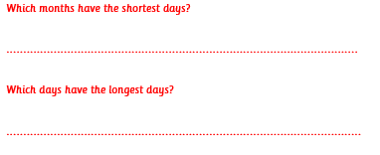
KQ: What happens to day length in Winter?
Wednesday 10th December 2025
Independent:
Challenge:

